Slide 1
CMAQ Simulations using Fire Inventory of NCAR (FINN) Emissions
Cesunica Ivey, David Lavoué, Aika Davis, Yongtao Hu, Armistead Russell
Georgia Institute of Technology, Atlanta, GA
CMAS Meeting
Chapel Hill, NC
Wednesday October 29th, 2014

Slide 2
Motivation
Poster: Spatiotemporal Error Assessment for Ambient Air Pollution Estimates obtained using an Observation-CMAQ Data Fusion Technique
(Xinxin Zhai, Georgia Tech)
CDC PHASE CMAQ runs show plumes over GA
National Emissions Inventory (NEI) represents 3 years of emissions
Vertical distribution of emissions oftentimes misrepresented
Human exposure to biomass burning may have strong correlations with adverse health impacts
Notes:
This is work in progress. Goal here was to develop the code and the method to integrate FINN emissions in CMAQ model. And interface between the 2 modeling programs.
For experiments, go to: http://www-air.larc.nasa.gov
- DC3: exp ended 30 June 2012
- SEAC4RS (NCAR) : Mary said they encountered plumes
Define field experiment domains and superimpose (MODIS, GOES) smoke plumes of active fires in 2012 during experiments

Slide 3
Modeling Smoke in N. America
Fire emissions from satellite retrieval: GFED (van der Werf et al. 2010), FINN (Wiedinmyer et al. 2011), GBBEP-Geo (Zhang et al. 2012).
Smoke plume modeling: CALPUFF, HYSPLIT (NOAA), Daysmoke (Goodrick et al. 2012), ATHAM (Trentmann et al. 2002)
Smoke forecasting: BlueSky (Larkin et al. 2009), FLAMBE (Reid et al. 2009), NOAA Smoke Forecasting System (READY)
Notes:
This is work in progress. Goal here was to develop the code and the method to integrate FINN emissions in CMAQ model. And interface between the 2 programs.
For experiments, go to: http://www-air.larc.nasa.gov
- DC3: exp ended 30 June 2012
- SEAC4RS (NCAR) : Mary said they encountered plumes
Define field experiment domains and superimpose (MODIS, GOES) smoke plumes of active fires in 2012 during experiments

Slide 4
Research Goals
Example of wildfire plume detected
by MODIS overlaid with hotspots (red)
Improve simulated concentrations and model sensitivities from fires
Evaluate model outputs using available field experiments and satellite imagery
Investigate the impact of changing climate on fires, which in turn affects AQ
NASA image courtesy of MODIS Rapid Response Team
Notes:
This is work in progress. Goal here was to develop the code and the method to integrate FINN emissions in CMAQ model. And interface between the 2 modeling programs.
For experiments, go to: http://www-air.larc.nasa.gov
- DC3: exp ended 30 June 2012
- SEAC4RS (NCAR) : Mary said they encountered plumes
Define field experiment domains and superimpose (MODIS, GOES) smoke plumes of active fires in 2012 during experiments

Slide 5
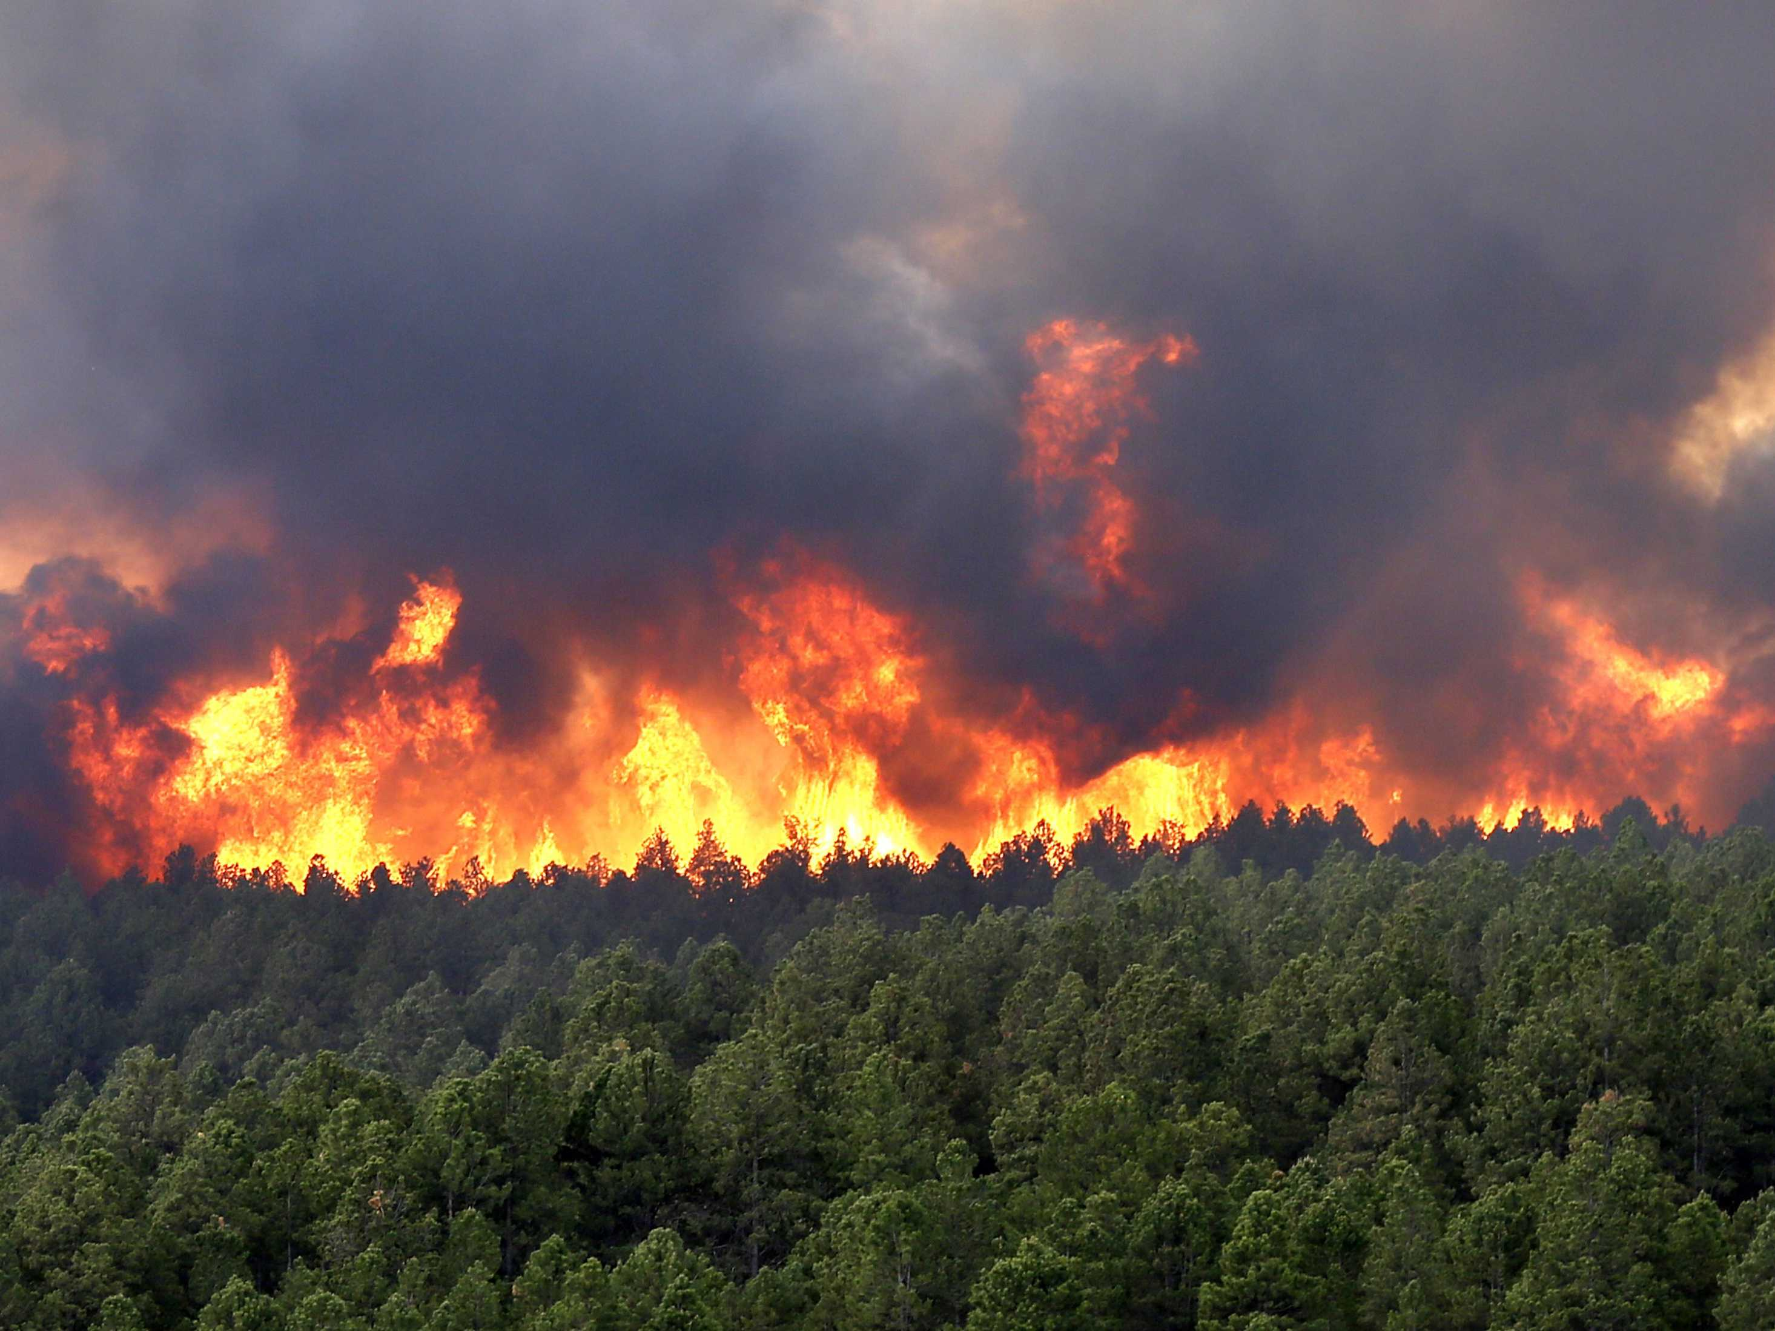
Primary Approach
Obtain annual FINN emissions and integrate with the WRAP plume profile
Replace NFEI fire emissions with FINN emissions
Simulate episode with both emissions using CMAQ
Image Credit: calaveraswines.org
Notes:
This is work in progress. Goal here was to develop the code and the method to integrate FINN emissions in CMAQ model. And interface between the 2 modeling programs.
For experiments, go to: http://www-air.larc.nasa.gov
- DC3: exp ended 30 June 2012
- SEAC4RS (NCAR) : Mary said they encountered plumes
Define field experiment domains and superimpose (MODIS, GOES) smoke plumes of active fires in 2012 during experiments

Slide 6
NFEI 2011
BlueSky framework: fuel load, fuel consumed, emission factors
SF2 software for area burned
FEPS model for emissions estimates
Source: 2011 National Emissions Inventory, version 1, Technical Support Document
Emissions = Area burned * Fuel Load Available * Fuel Consumed (Burn Efficiency) * Emission Factors
Notes:
I have information from the NEI technical document to put here
http://www.epa.gov/ttn/chief/net/2011nei/2011_nei_tsdv1_draft2_june2014.pdf

Slide 7
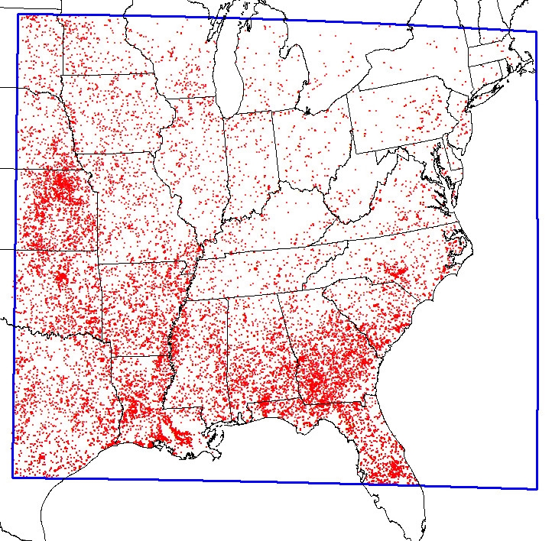
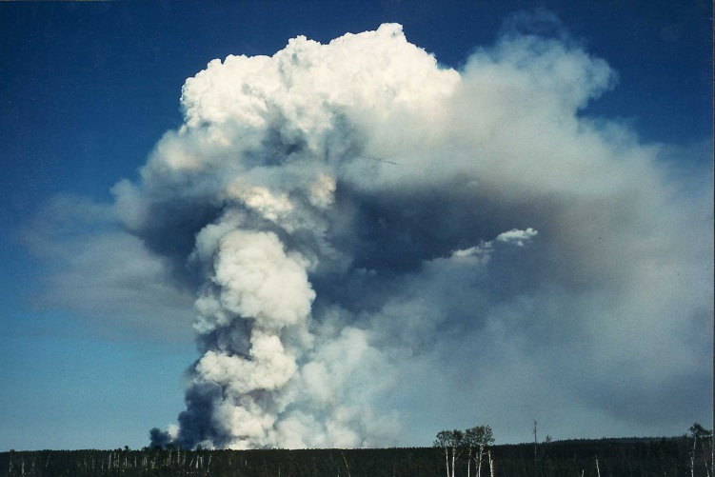
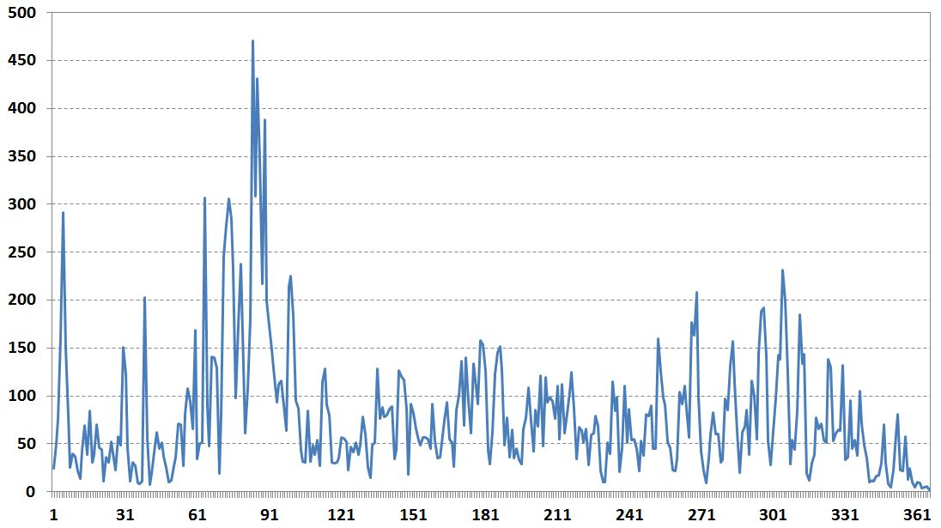
Fire INventory of NCAR (FINN)
Available http://bai.acd.ucar.edu/Data/fire/
Daily emissions based on satellite from 2002-2014
The 2012 fire season was the 3rd worst in US history
Cluster hotspots to get areas burned (Kerry Anderson, Canadian Forest Service)
Plume rise calculated from fire size (WRAP 2005)
June
Example of fire smoke plume
(Courtesy of Brian J. Stocks)
Notes:
- Why do we use FINN: daily (NOT a monthly average) emissions, and this is based on satellite, available for many years (2002-2014)
- All hotspots for 2012 plotted in 12-km eastern US domain
- Daily no. hotspots for 2012 show that June was a month with moderate fire activity (June is usually a month with low fire activity in Georgia)

Slide 8
Fire INventory of NCAR (FINN)
Emissions,i = Area Burned(x,t) × Biomass Loading(x) × Burn Fraction × Emission Factor
Notes:
Why do we use FINN: daily (NOT a monthly average) and based on satellite, available 2002-2014
All hotspots for 2012 in domain eastern US at 12 km
No. hotspots per day -> June is a month with moderate fire activity
CAUTION: June is usually a month with low fire activity in Georgia (see pdf from DI Tian)

Slide 9
Preparing FINN Emissions
Acres Burned (acres/day)
Heat Flux (BTU/hr/m2)
Emissions (mole/s or g/s)
GIS
SMOKE manual
SAPRC99 to CB05 equivalents
Daily to hourly temporal scale using WRAP
Python
Daily ptfire
Stack File
Python
Daily ptfire
Inline File
NETCDF4 Module
Notes:
Why do we use FINN: daily (NOT a monthly average) and based on satellite, available 2002-2014
All hotspots for 2012 in domain eastern US at 12 km
No. hotspots per day -> June is a month with moderate fire activity
CAUTION: June is usually a month with low fire activity in Georgia (see pdf from DI Tian)

Slide 10
CMAQ Modeling
Temporal and Spatial Metadata
1-22 June 2012
12 km horizontal resolution
13 vertical layers
Models
WRF meteorological inputs
SMOKE v3.5 emissions, NEI 2011 (excluding FINN substitutions)
CMAQ v5.0.2
Chemical Mechanism: CB05
Aerosol Module 6
Notes:
Ptfire: new fire file inside SMOKE (still uses the structure of ptipm files (power plants)) : emissions, heat flux (?)
Stackfile for ptfire : height, location/Col,Row, area
Creating new fire location for each smoke layer
CMAQ directly reads the two files above
FINN(saprc99) vs SMOKE(cb05) forced into cb05 by taking average MW for saprc99 species

Slide 11
Results
CO Mixing Ratio
NEI Surface Layer
FINN Surface Layer

Slide 12
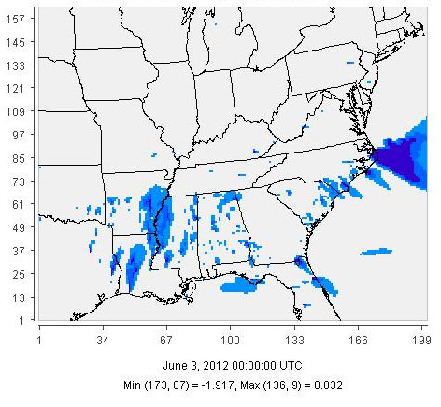
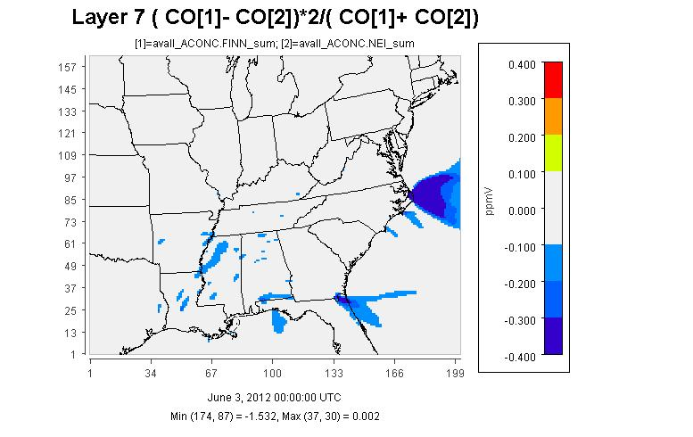
Results
$$\frac{{[CO]}_{FINN}−{[CO]}_{NEI}}{{[CO]}_{AVG}}$$
Surface Layer
1-km

Slide 13
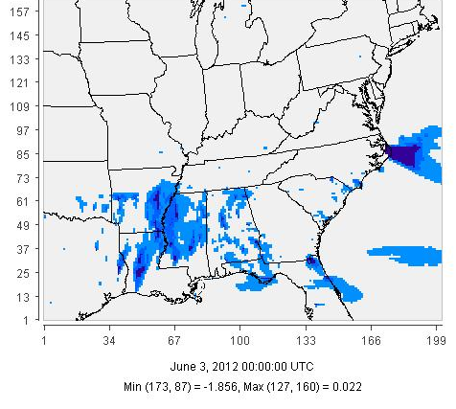
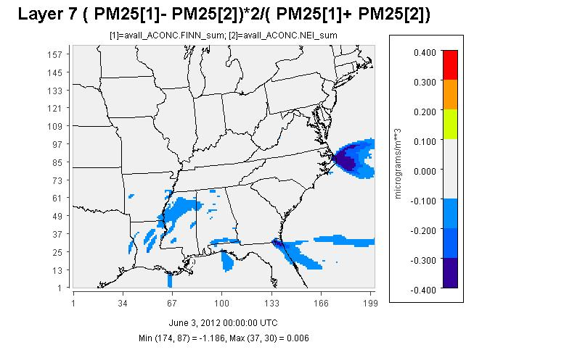
Results
$$\frac{{[PM2.5]}_{FINN}−{[PM2.5]}_{NEI}}{{[PM2.5]}_{AVG}}$$
Surface Layer
1-km

Slide 14
Summary
Most current NEI emissions capture spatial and temporal variability in fire activity
FINN provides added information for off-years and historical simulations
Updated historical fire emissions will improve simulations for exposure estimates in health studies

Slide 15
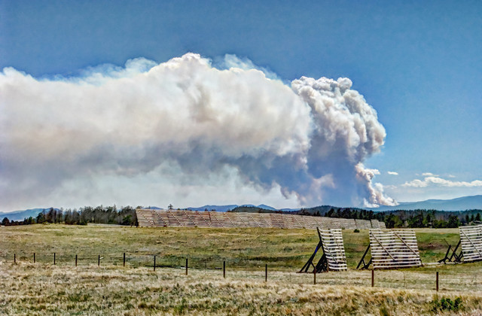
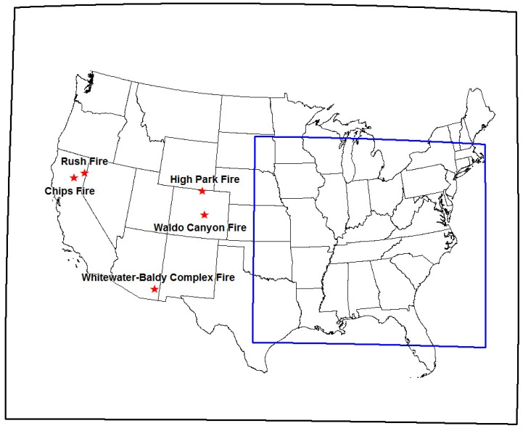
Future Work
Apply methods over CONUS at 36 km to study transport of smoke plumes from western US wildland fires
Integrate all hotspots detected by MODIS when building daily burned areas
Integrate a sub-plume model (i.e., Daysmoke) to calculate injection heights of fire emissions
Top 5 US wildfires of 2012:
about 800,000 acres burned
High Park Fire (CO) smoke plume (http://www.wunderground.com)
AGU Fall Meeting: Abstract ID 30977, “Modeling of Biomass Burning Aerosols over Southeastern United States”
Notes:
An updated version of the emissions and concentrations will be presented at the 2014 AGU Fall Meeting.

Slide 16
Acknowledgements
EPA STAR Graduate Fellowship Program
Alfred P. Sloan Foundation
Air & Waste Management Association
National Center for Atmospheric Research: Christine Wiedinmeyer
Georgia Tech: Cong Liu, Lucas Henneman
FP-91761401-0
This presentation was made possible in part by STAR Fellowship Assistance Agreement no. FP-91761401-0. It has not been formally reviewed by EPA. Its contents are solely the responsibility of the grantee and do not necessarily represent the official views of the funding sources and those sources do not endorse the purchase of any commercial products or services mentioned in the publication.
Notes:
Thanks to Lucas and Cong for WRF and 2011 NEI

