Slide 1
Car Time: Updating onroad temporal profiles
Alexis Zubrow¹, Chris Allen², and James Beidler²
1. EPA OAQPS and Region 1; 2. CSC

Slide 2
Temporal profile overview
What do temporal profiles do?
Generally:
distribute emissions annual -> month, month -> day, day -> hour
the “when” of emissions
Onroad (i.e. SMOKE-MOVES):
distribute vehicle miles traveled (VMT) from month-> day, day->hour
impacts rate-per-distance (RPD) processes, i.e. emissions from on-network
impacts total emissions: how much VMT vs what is the temperature at a specific hour
Problem: previous onroad diurnal profiles vary by road only

Slide 3
2011NEI and MOVES
2011NEI: first time EIS accepted MOVES inputs
32 S/L/T provided MOVES inputs for 2011NEI v1
Individual submissions consisted of series of county databases (CDBs)
Each CDB consisted of set of tables
e.g. VMT, VPOP, speed distributions, age distributions, I/M programs, etc.
dayvmtfraction – distribution VMT within week
hourvmtfraction – distribution VMT within day
Not all tables were updated by S/L/T

Slide 4
2011NEI and MOVES (cont)
Data mining opportunity
1,363 CDBs
1,839,097 hrvmtfraction records (non default)
1,013,853 dayvmtfraction records (non default)
Flagged “bad” profiles
Consolidated duplicate profiles
627,550 day profiles
89,304 hour profiles
Developed scripts to average across various dimensions and to create LOTS of plots
Focused on diurnal profiles
Day of week profiles were unchanged

Slide 5
Road type and SCC
MOVES
SMOKE
SCC_road | scc_tier4
110 | Rural Interstate: Total
130 | Rural Other Principal Arterial: Total
150 | Rural Minor Arterial: Total
170 | Rural Major Collector: Total
190 | Rural Minor Collector: Total
210 | Rural Local: Total
230 | Urban Interstate: Total
250 | Urban Other Freeways and Expressways: Total
270 | Urban Other Principal Arterial: Total
290 | Urban Minor Arterial: Total
310 | Urban Collector: Total
330 | Urban Local: Total
roadTypeID | roadDesc
2 | Rural Restricted Access
3 | Rural Unrestricted Access
4 | Urban Restricted Access
5 | Urban Unrestricted Access
1-to-many mapping
SCCs have more road types, but may not be useful to differentiate to this level
Notes:
Note that roadtype 1 (off-network) is mapped to SCC_road 390. This is used for RPV and RPP and doesn’t use SMOKE temporalization

Slide 6
Source type and SCC
MOVES
SMOKE
sourceTypeID | sourceTypeName
11 | Motorcycle
21 | Passenger Car
31 | Passenger Truck
32 | Light Commercial Truck
41 | Intercity Bus
42 | Transit Bus
43 | School Bus
51 | Refuse Truck
52 | Single Unit Short-haul Truck
53 | Single Unit Long-haul Truck
54 | Motor Home
61 | Combination Short-haul Truck
62 | Combination Long-haul Truck
SCC7 | Description
2201001 | Light Duty Gasoline Vehicles (LDGV)
2201020 | Light Duty Gasoline Trucks 1 & 2 (M6) = LDGT1 (M5)
2201040 | Light Duty Gasoline Trucks 3 & 4 (M6) = LDGT2 (M5)
2201070 | Heavy Duty Gasoline Vehicles 2B thru 8B & Buses (HDGV)
2201080 | Motorcycles (MC)
2230001 | Light Duty Diesel Vehicles (LDDV)
2230060 | Light Duty Diesel Trucks 1 thru 4 (M6) (LDDT)
2230071 | Heavy Duty Diesel Vehicles (HDDV) Class 2B
2230072 | Heavy Duty Diesel Vehicles (HDDV) Class 3, 4, & 5
2230073 | Heavy Duty Diesel Vehicles (HDDV) Class 6 & 7
2230074 | Heavy Duty Diesel Vehicles (HDDV) Class 8A & 8B
2230075 | Heavy Duty Diesel Buses (School & Transit)
many-to-many mapping
Overlapping definitions source type (MOVES sourceTypeID) and vehicle type (SMOKE SCC7)
Complicates comparison of MOVES and SMOKE temporal profiles
Plan to revise SCCs for MOVES2013 to make mapping 1-to-1

Slide 7
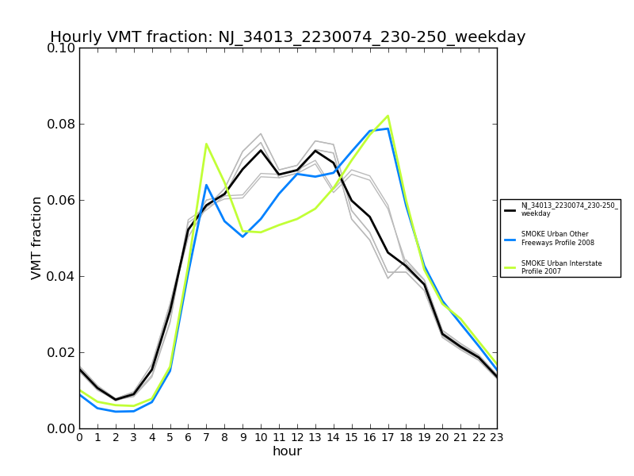
Essex NJ, example
LDGV urban restricted, weekday
HHDDV urban restricted, weekday
Notes:
Newark, NJ

Slide 8
Dimensions of variation
Previous diurnal profiles varied across road type and day only
MOVES based profiles could vary across:
Vehicle type
Road type
Day (weekday vs weekend)
County

Slide 9
Variation in MOVES Inputs
Notes:
Shows non-default MOVES inputs to 2011 NEI. Variation across vehicle, road, and day. Doesn’t show variation across county.

Slide 10
Using S/L/T profiles
When should we use submitted profiles for “self”?
Criteria:
At least as much variability as the previous SMOKE profiles
Vary by road type and/or vehicle type
Minor transformation from MOVES
Averaging over source type to get SCC7 (SMOKE vehicle type)
NJ example:
Varies by county, road, and vehicle (for most counties)
Doesn’t vary by weekday/weekend
Used county specific profiles for all weekday profiles

Slide 11
Profiles for “the rest”
What should we do for states that didn’t submit or for S/L/T that didn’t satisfy our criteria?
Options:
Use historic SMOKE profiles
Map counties to similar counties
Develop national profiles from subset of S/L/T profiles
Notes:
Option 1: conservative and doesn’t provide variation by vehicle type. Option 2: difficult to develop mapping of representative counties. Option 3: clean criteria

Slide 12
National profiles: overview
Using S/L/T profiles to create national profiles
Criteria:
Varies by road
Varies by vehicle
May or may not vary by county
Treat weekday and weekend separately
Process:
Develop state average profile by vehicle/road/weekday or weekend
Average state profiles to develop national profiles

Slide 13
National profiles: overview
It’s like cooking…

Slide 14
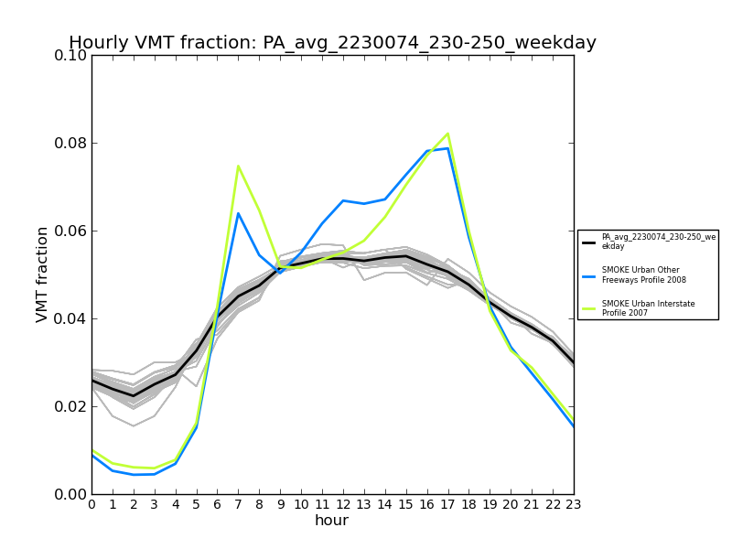
National profiles: state averages
NJ, average HHDDV urban restricted, weekday
PA, average HHDDV urban restricted, weekday
Notes:
Note how there is greater variability across MOVES source types and counties in NJ than in PA. Weekday profiles

Slide 15
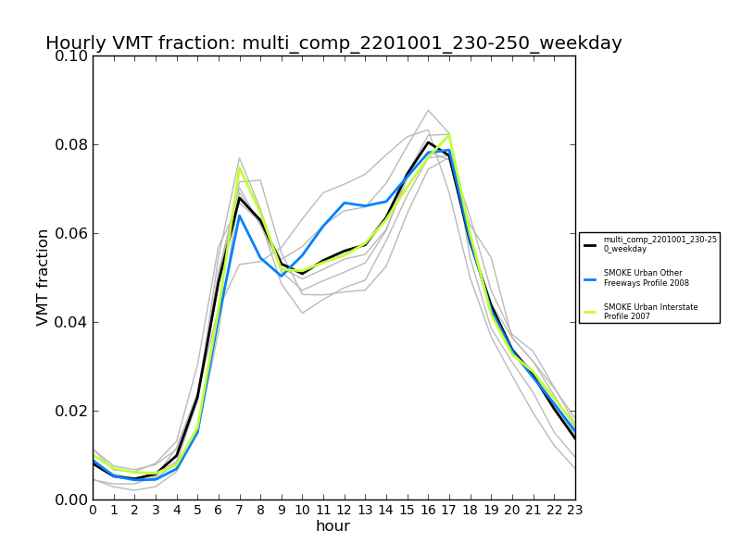
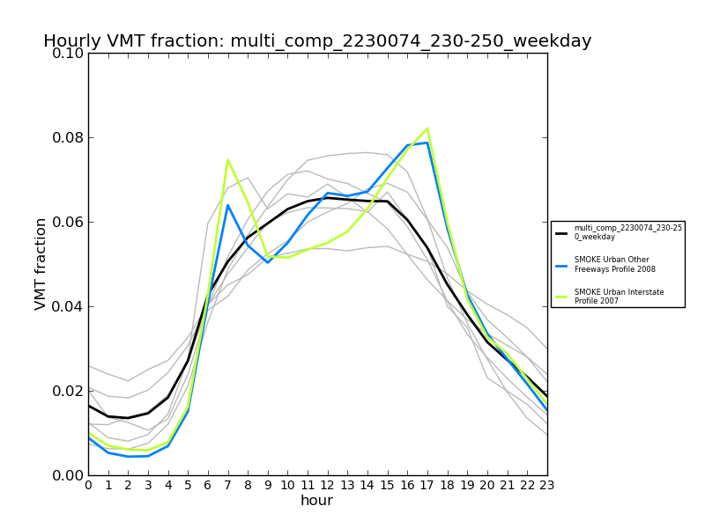
National profiles: weekday example
National LDGV urban restricted, weekday
National HHDDV urban restricted, weekday
Notes:
Weekday profiles composed of: ID, ME, MI, NJ, OH, PA. Weekend profiles composed of: ID, ME, MI

Slide 16
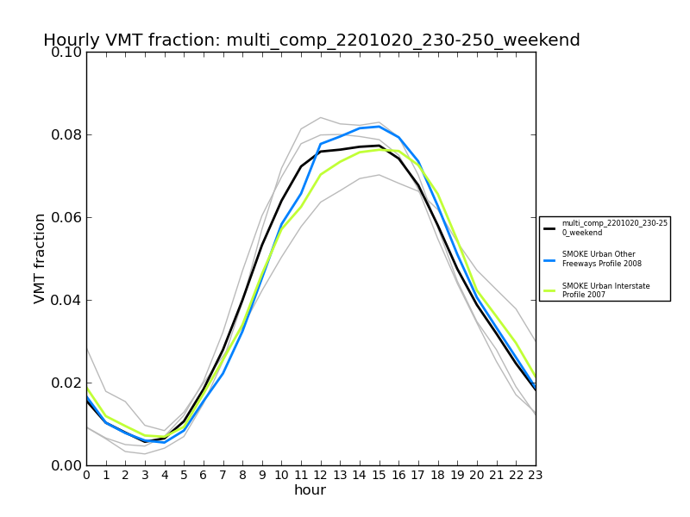
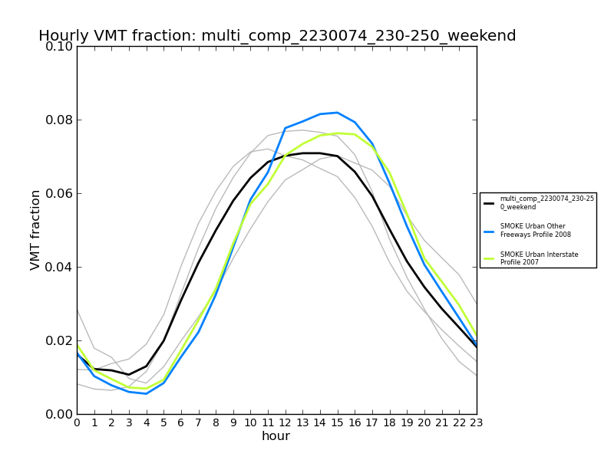
National profiles: weekend example
National LDGV urban restricted, weekend
National HHDDV urban restricted, weekend
Notes:
Weekday profiles composed of: ID, ME, MI, NJ, OH, PA. Weekend profiles composed of: ID, ME, MI

Slide 17
2011 platform profiles
Notes:
CA using ARB profiles. Note: some states we are not using their profiles for “self”

Slide 18
Future work
AQ sensitivities
For later versions of 2011 platform
Outreach to S/L/T on specific questions about submissions
2011 NEI v2:
Outreach to S/L/T on potential uses of MOVES inputs
Specific outreach to update temporal related tables
Incorporate temporal profiles from specific studies
For 2014 platform
New SCCs simplify process (MOVES 2013)
Continue with outreach to S/L/T on need for this data

Slide 19
Acknowledgments
Dave Brzezinski and Harvey Michaels (OTAQ)
Alison Eyth, Marc Houyoux, Rich Mason, Norm Possiel, and Brian Timin (OAQPS)
Vernon Hughes (ARB)
Click and Clack

Slide 20
Extra Slides

Slide 21
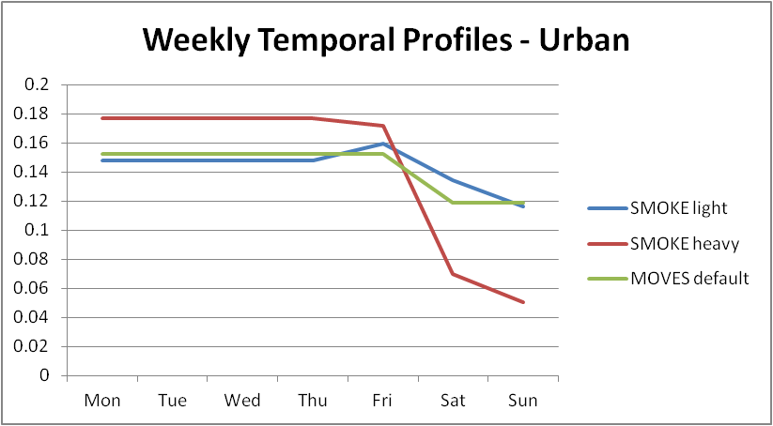
SMOKE weekly profiles

Slide 22
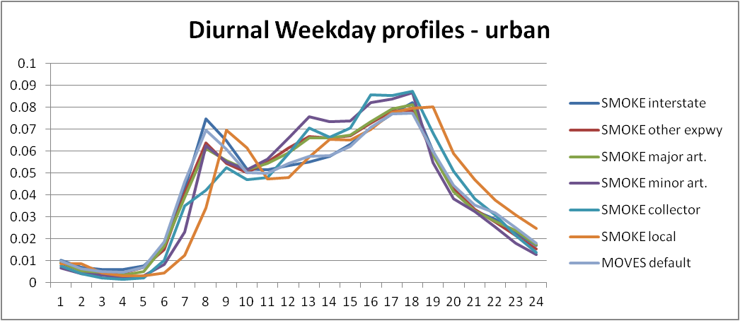
SMOKE diurnal profiles weekday

Slide 23
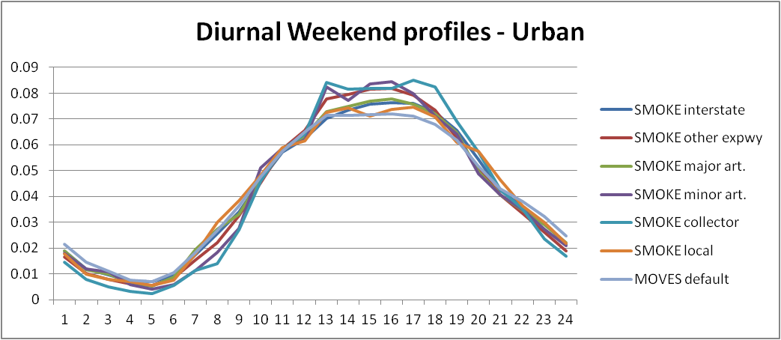
SMOKE diurnal profiles weekend

Slide 24
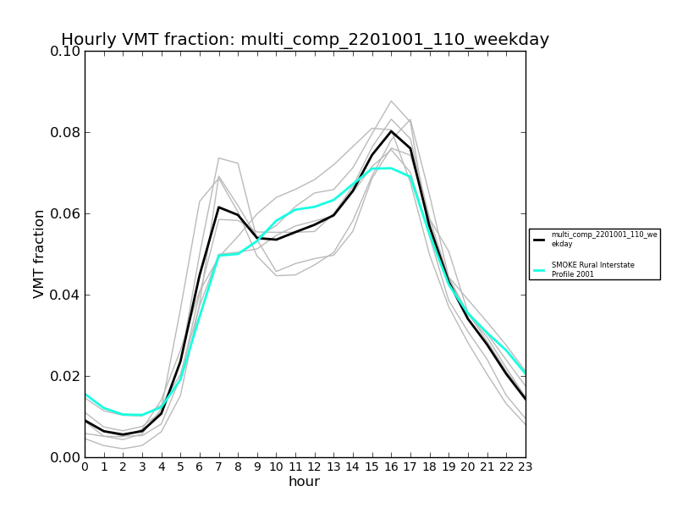
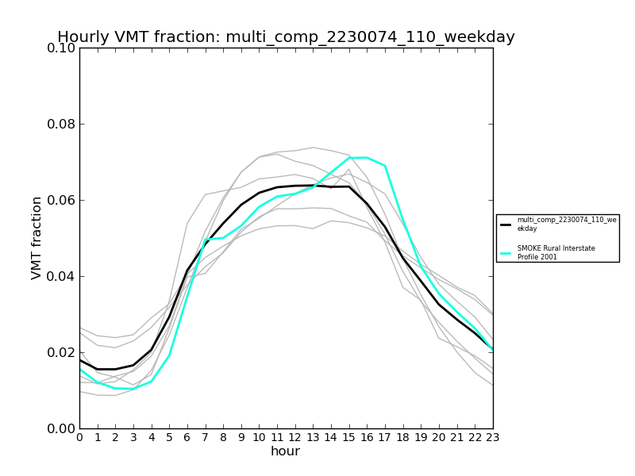
National profiles
National LDGV rural restricted, weekday
National HHDDV rural restricted, weekday
Notes:
Weekday profiles composed of: ID, ME, MI, NJ, OH, PA. Weekend profiles composed of: ID, ME, MI

Slide 25
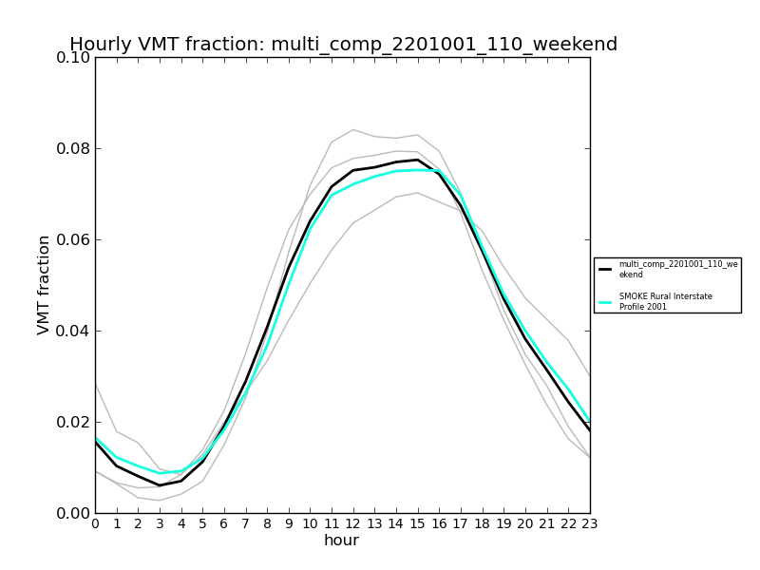
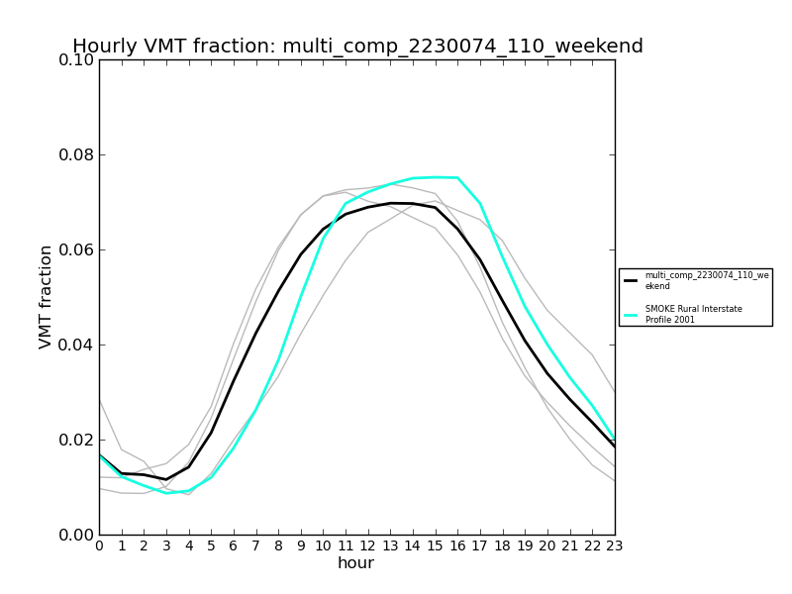
National profiles
National LDGV rural restricted, weekend
National HHDDV rural restricted, weekend
Notes:
Weekday profiles composed of: ID, ME, MI, NJ, OH, PA. Weekend profiles composed of: ID, ME, MI

Slide 26
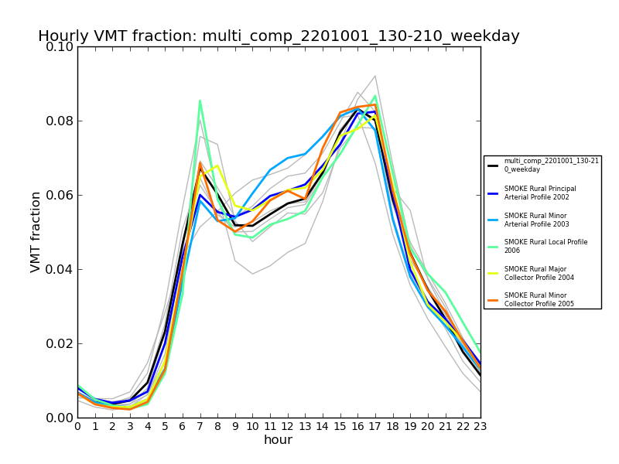
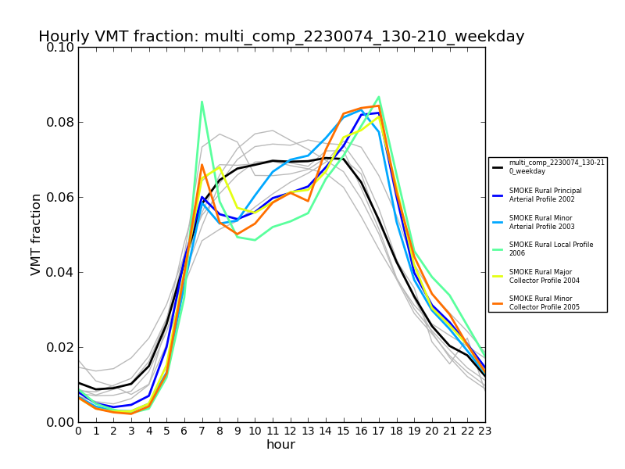
National profiles
National LDGV rural unrestricted, weekday
National HHDDV rural unrestricted, weekday
Notes:
Weekday profiles composed of: ID, ME, MI, NJ, OH, PA. Weekend profiles composed of: ID, ME, MI

Slide 27
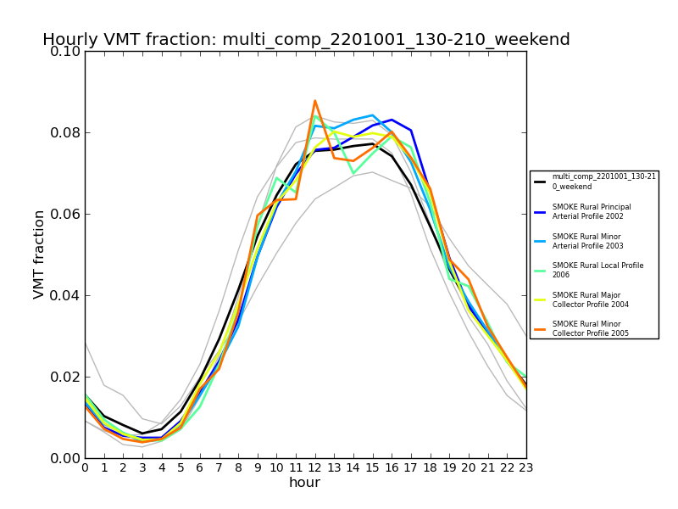
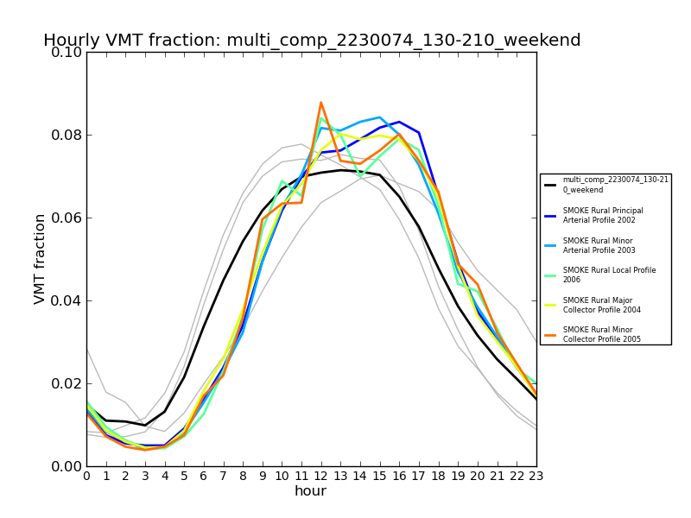
National profiles
National LDGV rural unrestricted, weekend
National HHDDV rural unrestricted, weekend
Notes:
Weekday profiles composed of: ID, ME, MI, NJ, OH, PA. Weekend profiles composed of: ID, ME, MI

Slide 28
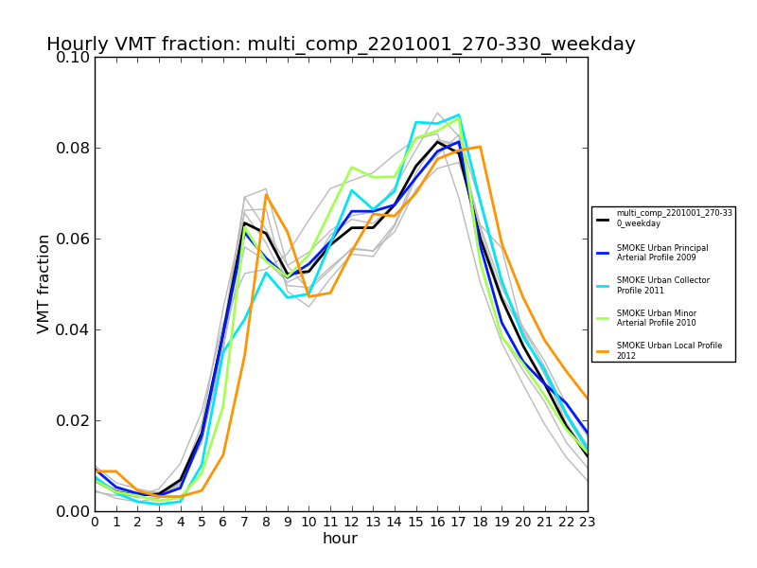
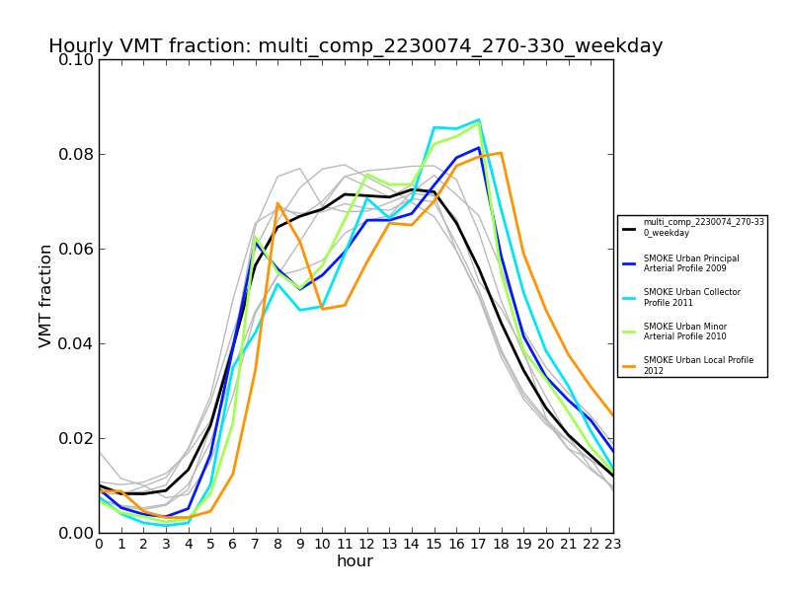
National profiles
National LDGV urban unrestricted, weekday
National HHDDV urban unrestricted, weekday
Notes:
Weekday profiles composed of: ID, ME, MI, NJ, OH, PA. Weekend profiles composed of: ID, ME, MI

Slide 29
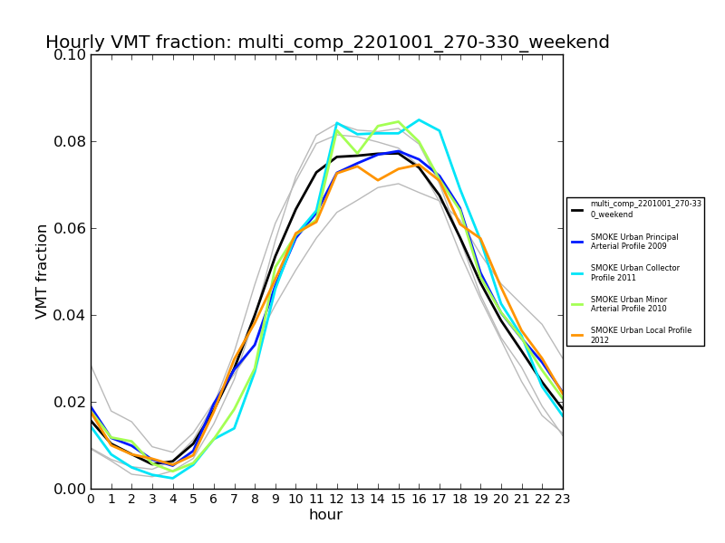
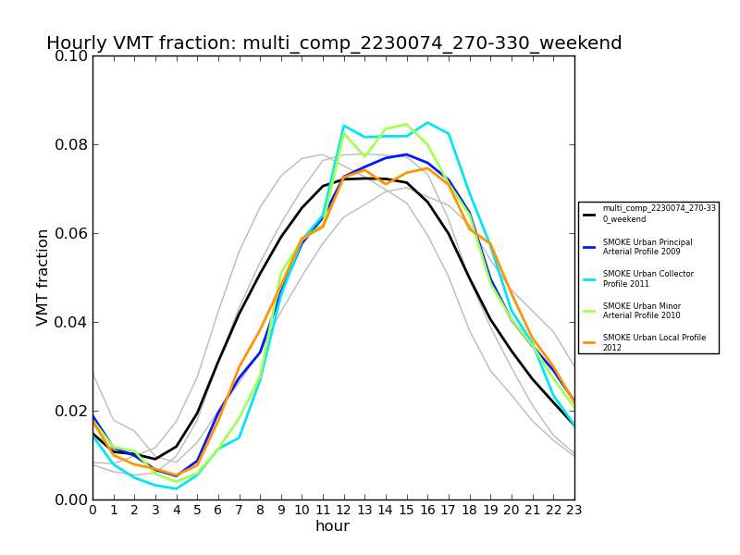
National profiles
National LDGV urban unrestricted, weekend
National HHDDV urban unrestricted, weekend
Notes:
Weekday profiles composed of: ID, ME, MI, NJ, OH, PA. Weekend profiles composed of: ID, ME, MI

Slide 30
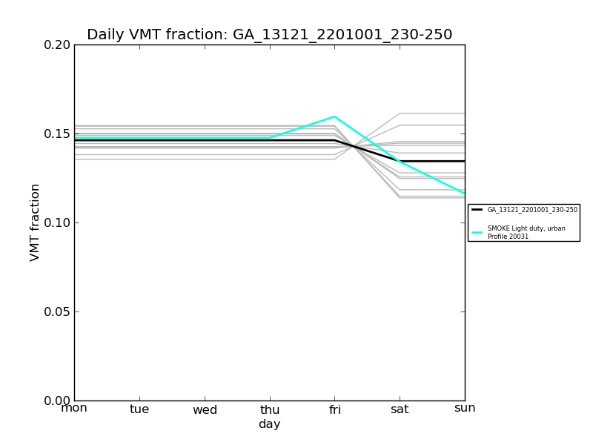
Fulton, GA weekly profile
Notes:
MOVES has only weekday vs weekend. SMOKE has 7 days possible, though in reality they are (M-Th,Fri, Sat,Sun). Currently using 4 profiles: light/rural, heavy/rural, light/urban, and heavy/urban

