Slide 1
Sensitivity of Simulated Cloud Properties to Meteorological Model Configurations
Junhua Zhang and Wanmin Gong
Air Quality Research Division, Environment Canada, Toronto, Ontario, Canada
Acknowledgement:
Dr. Jason Milbrandt and Manon Faucher (EC) for GEM v4 model setup
12th Annual CMAS Conference, Chapel Hill, NC, Oct. 28-30, 2013

Slide 2
Overview:
Introduction
Study Case and Meteorological Model Setup
Sensitivity of Cloud Properties to Model Configurations
Sensitivity to Cloud Microphysics Scheme
Sensitivity to Initialization and Forecast Lead Time
Sensitivity to the Location of the Upstream Boundaries of the Domain
Sensitivity to Land Surface Processes
Conclusions

Slide 3
Introduction:
Clouds play an important role in the processing and cycling of atmospheric gaseous and aerosol tracers, which impacts aerosol mass, size distribution, and chemical composition
It is important to adequately predict clouds by meteorological model for air quality modelling.
Canadian off-line air quality model AURAMS (A Unified Regional Air-quality Modelling System) is driven by the Canadian meteorological model GEM (Global Environmental Multiscale model)
GEM (v3.2.2) was previously evaluated for its ability to predict cloud microphysical properties against aircraft observations conducted during the 2004 ICARTT (International Consortium for Atmospheric Research on Transport and Transformation ) field study for 5 stratocumulus (SCu) and 5 towering cumulus (TCu) cases. (Zhang et al., 2007)

Slide 4
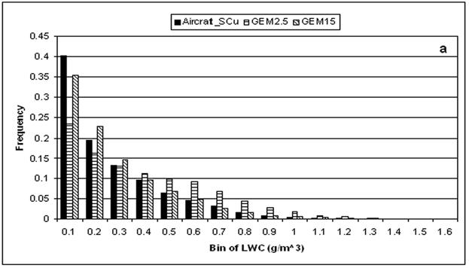
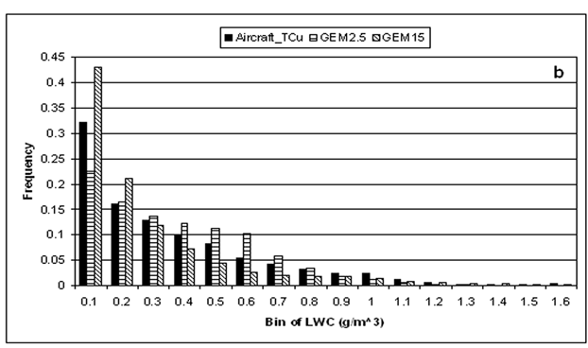
Introduction:
Since the previous evaluation, GEM has undergone many updates. In particular, a new generation of GEM (version 4 vs. version 3) has been developed.
Amongst various important changes, the single-moment explicit bulk cloud microphysical scheme (Kong & Yau, 1997) is being replaced by a double-moment scheme (Milbrandt & Yau, 2005) for high-resolution simulations.
Performance of GEM4 in predicting cloud fields will be examined.

Slide 5
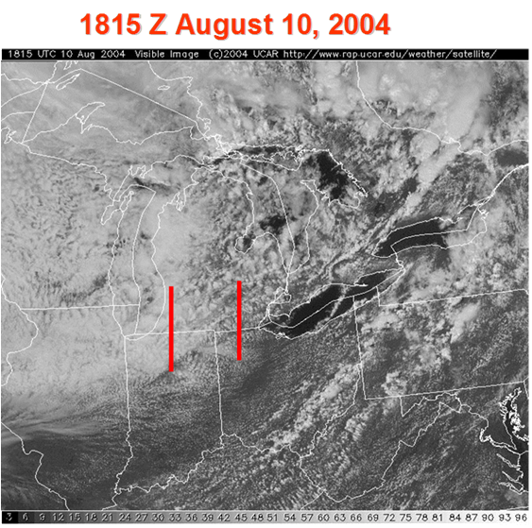
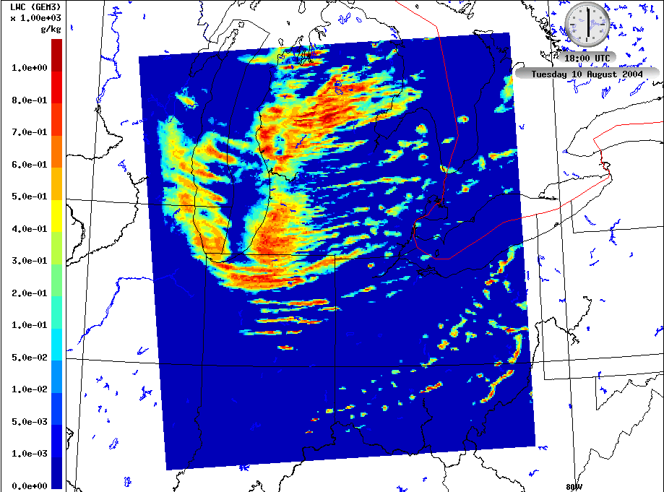
Study Case:
ICARTT-CTC Convair 580 FLT 16 & 17 (16 Z, 2004-08-10 – 00 Z, 2004-08-11) studying chemical processing by clouds (Gong et al., 2013)
Trace gases, aerosol physics & chemistry, and cloud microphysics & chemistry were sampled along two north-south lines (~ 86W and 84W) in and below clouds. Multiple plumes from the Chicago area were encountered across the aircraft sampling lines
GOES Image, 18:15Z August 10, 2004
LWC – GEM3, 18:00Z August 10, 2004

Slide 6
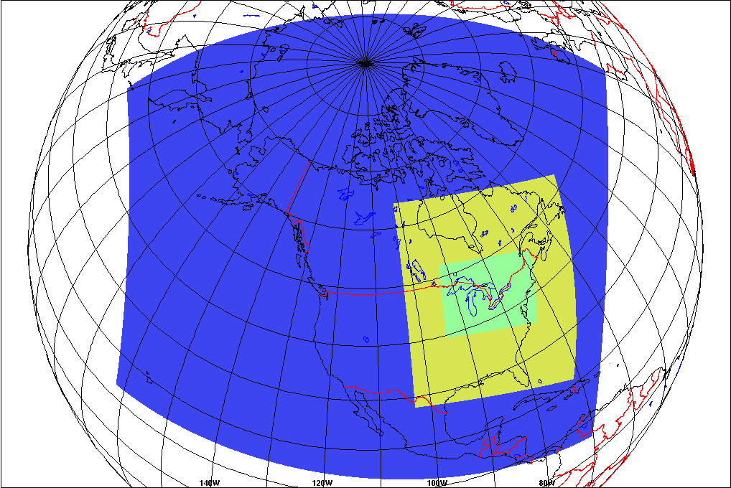
GEM4 Model Setup:
Objective reanalysis
@ 00, 06, 12, and 18 UTC
Continental 15-km (blue)
Cloud microphysical scheme:
Sundqvist + Kain Fritsch convection
Regional 15-km (yellow)
Milbrandt & Yau double-moment scheme + Kain Fritsch convection
2.5-km (light green)
Milbrandt & Yau double-moment microphysical scheme

Slide 7
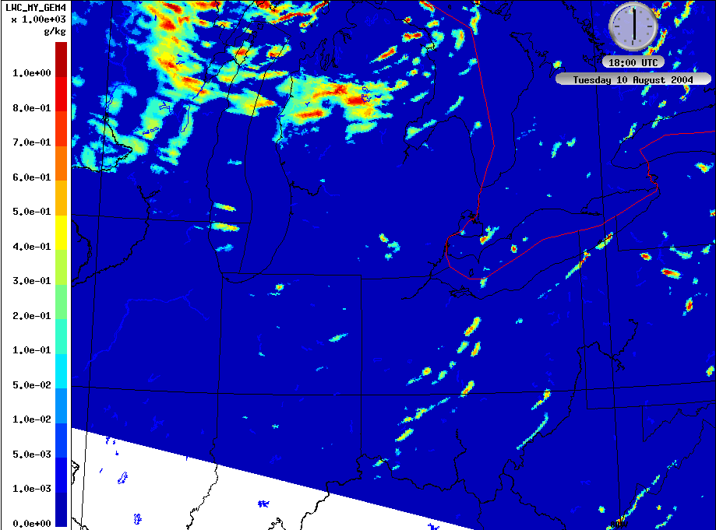
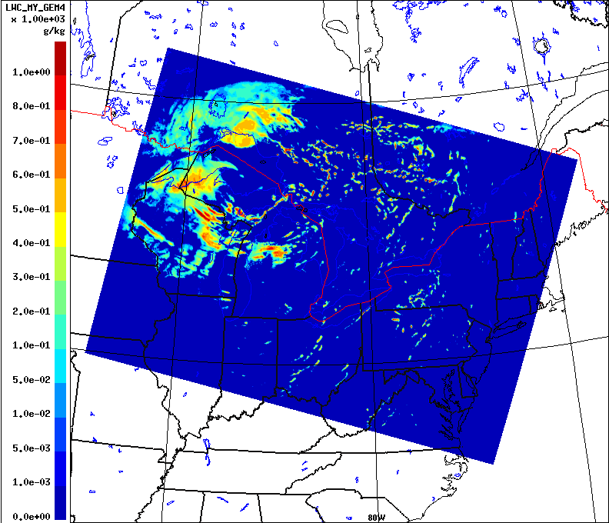
Initial 2.5km Model Results:
Comparison of simulated Liquid Water Content (LWC) between GEM4 and the previous version, GEM3
LWC – GEM3 @18Z
LWC – GEM4 @18Z
At 18:00Z on August 10, 2004
About 1400m above surface, the level where most of the clouds were encountered and sampled by the aircraft
The new version, GEM4, predicted much less LWC than the previous version, GEM3, especially in the area where clouds were sampled by aircraft

Slide 8
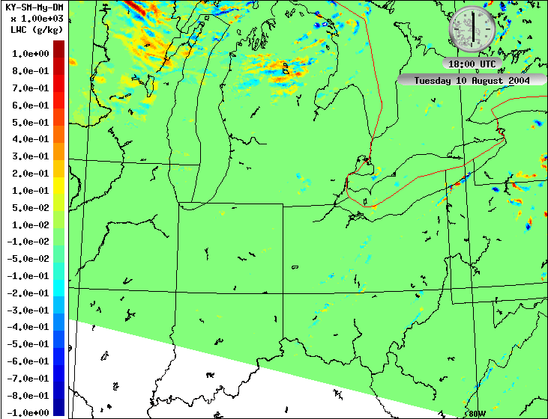
1. Sensitivity to cloud microphysical scheme
Double-moment scheme (MY-DM) vs. Single-moment scheme (KY-SM)
LWC – GEM4 MY-DM
LWC – GEM4 KY-SM
Microphysical scheme in GEM4 is switched from the double-moment (MY-DM) scheme back to the single-moment scheme (KY-SM)
Very little difference of LWC simulated by the two schemes
KY-SM seems to have predicted slightly more LWC in the cloudy area
KY-SM will be used for the following 3 sensitivity runs to be consistent with the previous GEM3 run
KY-SM - MY-DM

Slide 9
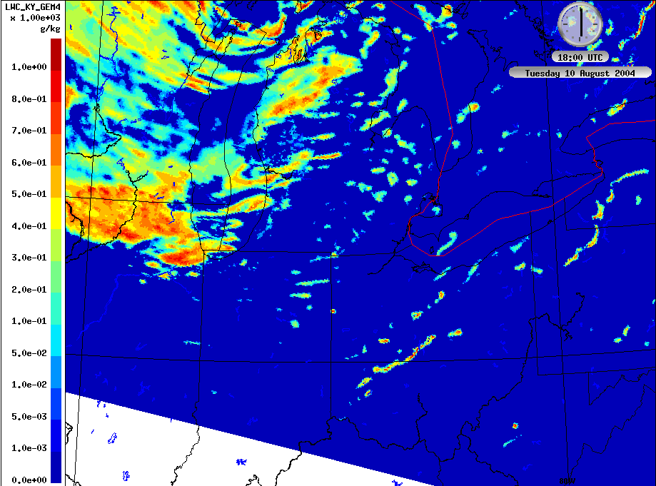
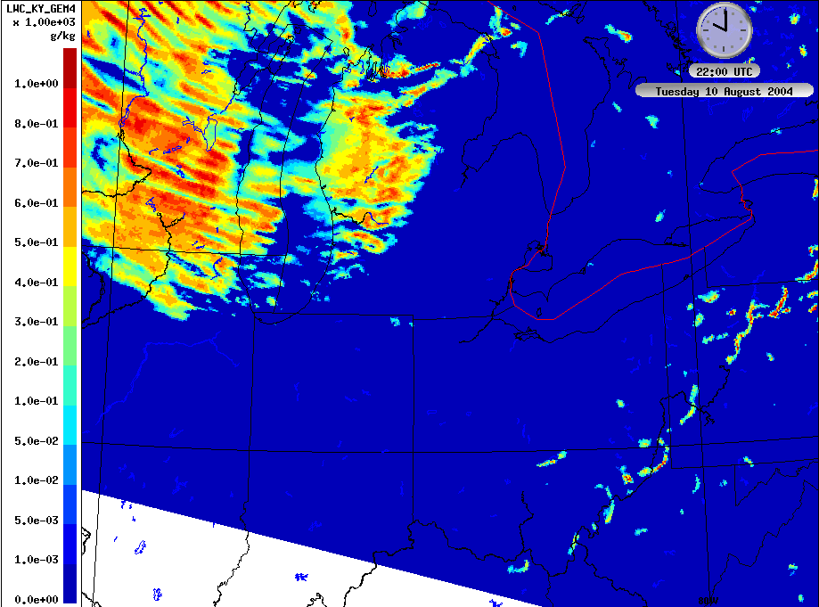
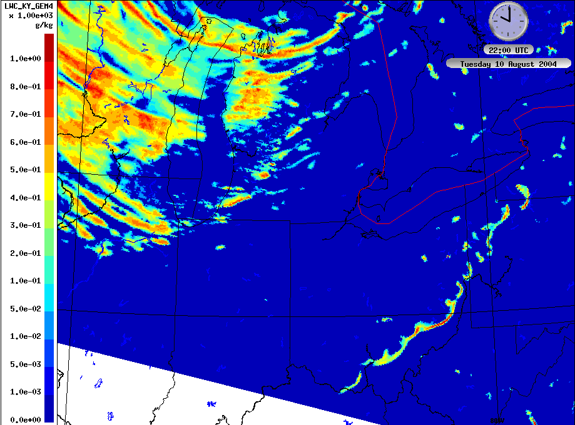
2. Sensitivity to initialization and forecast lead time
GEM3 Initialized at 00Z, 18h forecast valid at 18Z
GEM4 Initialized at 12Z, 6h forecast valid at 18Z
GEM4 18Z, Ini@12Z
GEM4 18Z, Ini@00Z
GEM4 was initialized at 00Z, Aug.20, the same as previously done for GEM3.
Initialization of GEM4 at 00Z dramatically increased the LWC predicted at 18Z after 18 hours of simulation.
The amount of LWC are comparable at 22Z after 10 and 22 hours of simulation for the model initialized at 12Z and 00Z, respectively.
However, the spatial distribution of clouds are different due to different initial conditions and forecast hours
GEM4 22Z, Ini@12Z
GEM4 22Z, Ini@00Z

Slide 10
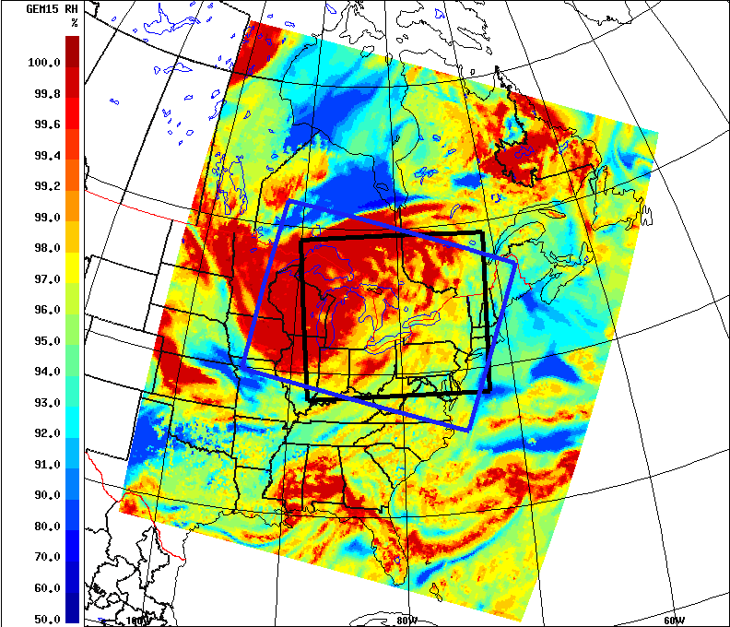
3. Sensitivity to the location of the upstream boundaries
New 2.5km model domain (blue) vs. Old 2.5km model domain (black)
Relative Humidity (RH) - GEM4 15km Domain
New GEM4 Grid
upstream boundaries, i.e., the upper western and northern boundaries, of the new GEM4 2.5-km domain are located somewhat at the edge of the system
Old GEM3 Grid
upstream boundaries, i.e., the upper western and northern boundaries, of the old GEM3 2.5-km domain are located in the middle of the cloud system

Slide 11
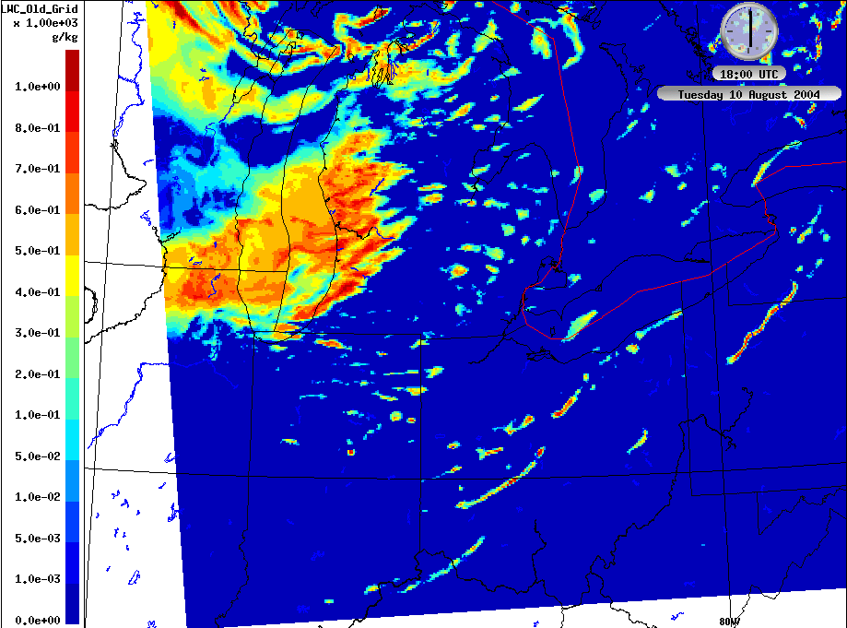
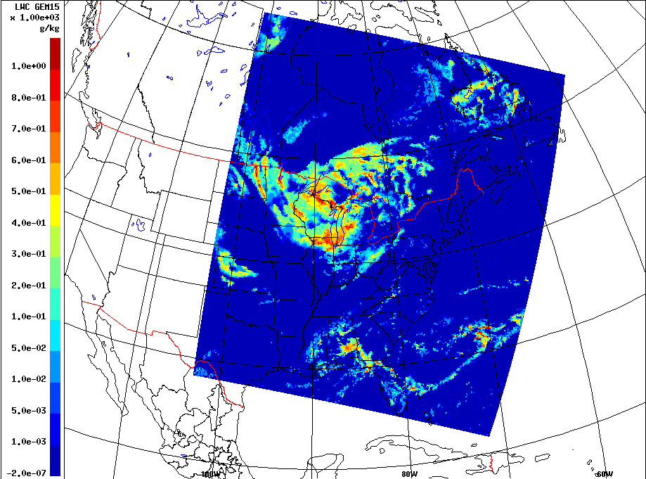
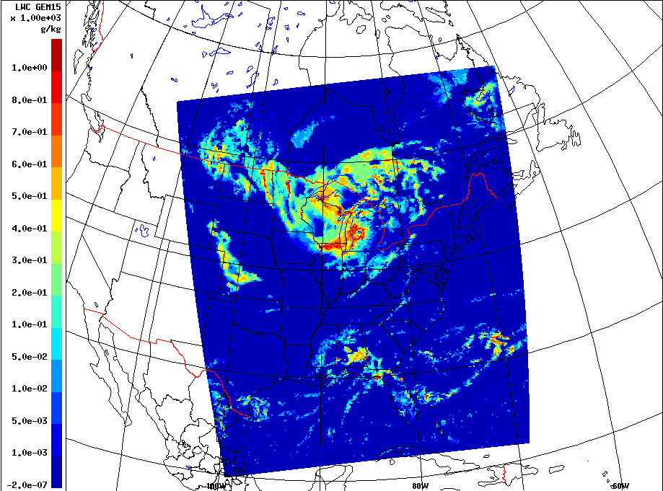
3. Sensitivity to the location of the upstream boundaries
New 2.5km model domain vs. Old 2.5km model domain
GEM4 - New 2.5km domain
GEM4 - Old 2.5km domain
With the old 2.5km domain, more LWC is predicted in the area east of Lake Michigan at 18Z after 18 hours of simulation.
The piloting regional 15-km model grid has the same rotation as the 2.5-km domain
LWC predicted by the two piloting 15-km runs have very little difference
The difference seen in the 2.5km runs seems to be due to the differences in upstream boundary placement rather than differences in piloting fields
GEM4 - New 15km domain
GEM4 - Old 15km domain

Slide 12
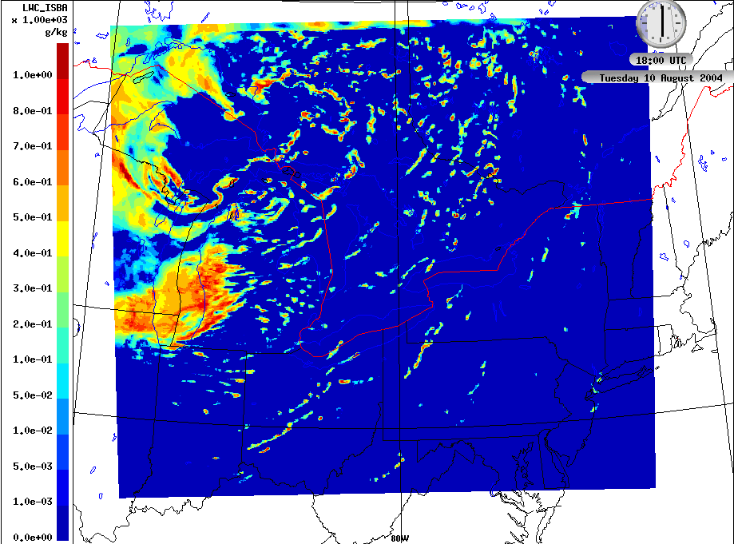
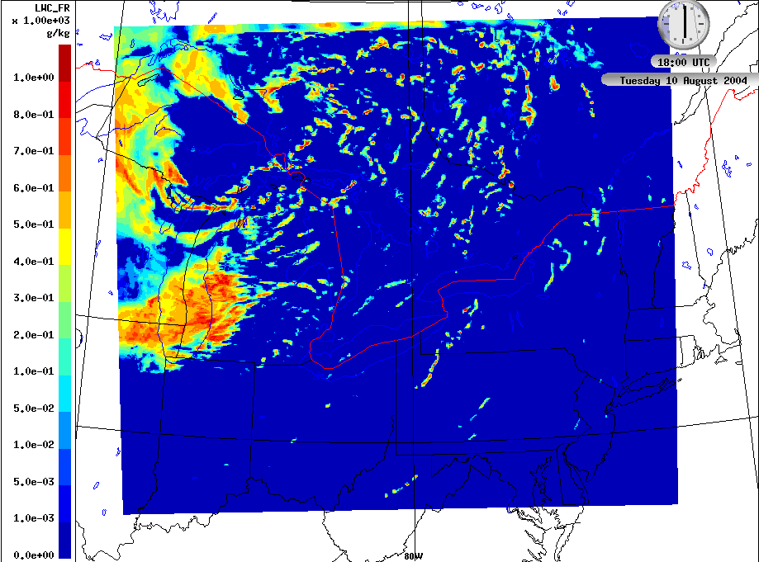
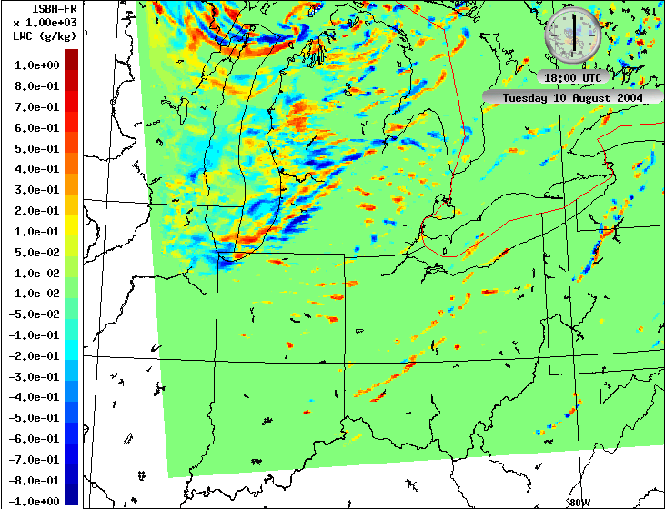
4. Sensitivity to the land surface parameterization
Interaction Soil Biosphere Atmosphere (ISBA) vs. Force-Restore (FR)
ISBA
Force Restore
Interaction Soil Biosphere Atmosphere (ISBA) land surface system is currently being used in the GEM model
ISBA was replaced by the Force-Restore land surface system for sensitivity testing purposes
Model with Force-Restore scheme predicted slightly less LWC over the area south- east of Lake Michigan
ISBA – Force Restore

Slide 13
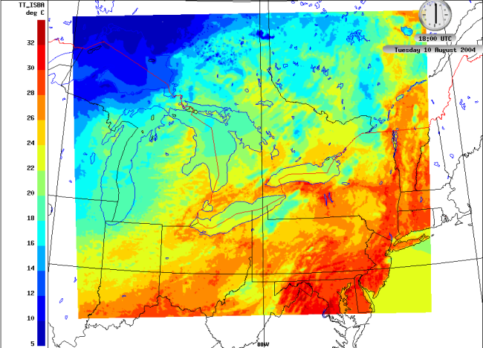
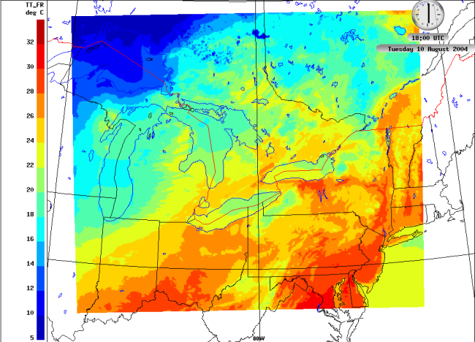
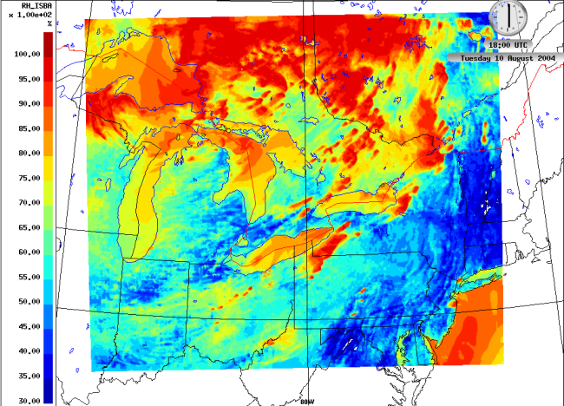
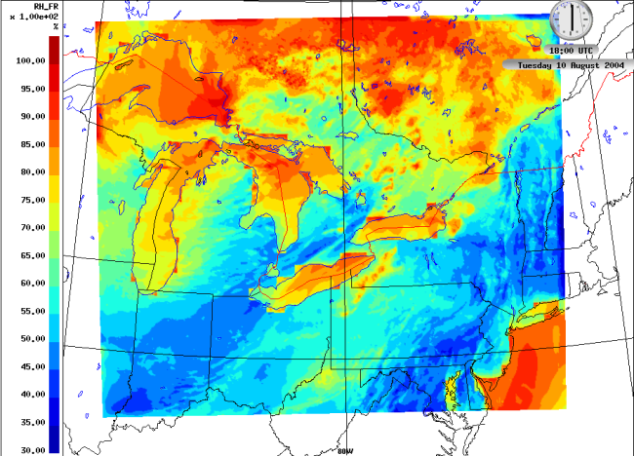
4. Sensitivity to the land surface parameterization
Interaction Soil Biosphere Atmosphere (ISBA) vs. Force-Restore (FR)
ISBA, surface temperature
FR, surface temperature
Model with Force-Restore land surface system predicted slightly higher surface temperatures and lower relative humidity over the area where clouds were sampled by the aircraft
ISBA, surface RH
FR, surface RH

Slide 14
Conclusions:
The ability of meteorological models to adequately predict cloud fields is critical for accurate representation of cloud processing in air quality modelling
Changing from the double-moment cloud scheme to the single-moment cloud scheme has little impact on simulated LWC for the case studied here
To allow clouds to develop, enough spin-up time is needed. The often used 6-hour spin up does not seem to be long enough for cloud simulation, a 10- to 12-hour spin-up may be sufficient
The selection of the location of model domain, i.e., the locations of the upstream boundaries, can be important for simulation of clouds over a small model domain
The land surface scheme also impacts cloud formation due to its role in determining the moisture and heat balance at the surface
Notes:
FEVER traffic count: Aug. 17 – Sep. 17, 2010

Slide 15
Thank You

