Slide 1
Estimating Regional Background Air Quality using Space/Time Ordinary Kriging to Support Exposure Studies
Alejandro Valencia, Saravanan Arunachalam
Institute for the Environment, UNC Chapel Hill
Yasuyuki Akita, Marc Serre
Department of Environmental Sciences and Engineering, UNC Chapel Hill
Valerie Garcia, Vlad Isakov
Office of Research and Development, U.S. EPA
Presented at the Annual CMAS Conference, Chapel Hill
October 28 – 30, 2013

Slide 2
BACKGROUND
Motivation
  Exposure studies rely on detailed spatio-temporal characterization of air quality fields
  While this is potentially easily done for targeted emissions sources, characterization of regional background is a challenging task at the scales of the study
What is Regional Background ?
  Concentrations that would occur in the absence of local source emissions in our exposure domain
Previous work
  Ambient-based method
    Percentile of observed concentration
  Emissions-based method
    Emission inventory data
  Chemistry transport model based method
    Run Model (i.e. CMAQ) without local sources
Notes:
Backround is the regional background without for the domain
Previous work estimating background
Prefered method - Highly dependent of quality and availability of sites
Spatially coarse, and potentially resource-intensive

Slide 3
OBJECTIVE
To develop a method to estimate background concentration for the Near-Roadways Exposure to Urban Air Pollutants (NEXUS) Study in Detroit
    At very fine spatial scales at numerous cohort locations, as well as receptors near roadways
    29-month period from January 2010 – May 2012
Analyses presented today will focus only on 2010
Notes:
Air quality Support exposure study.
CMAQ coarse
Devloped what stok

Slide 4
Methodology

Slide 5
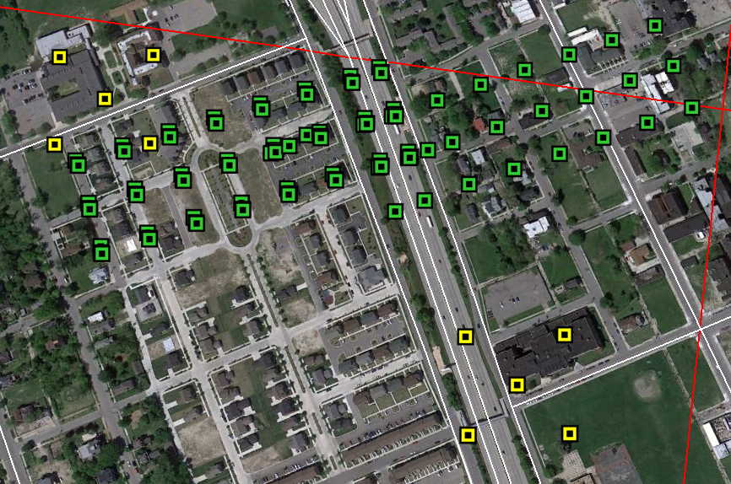
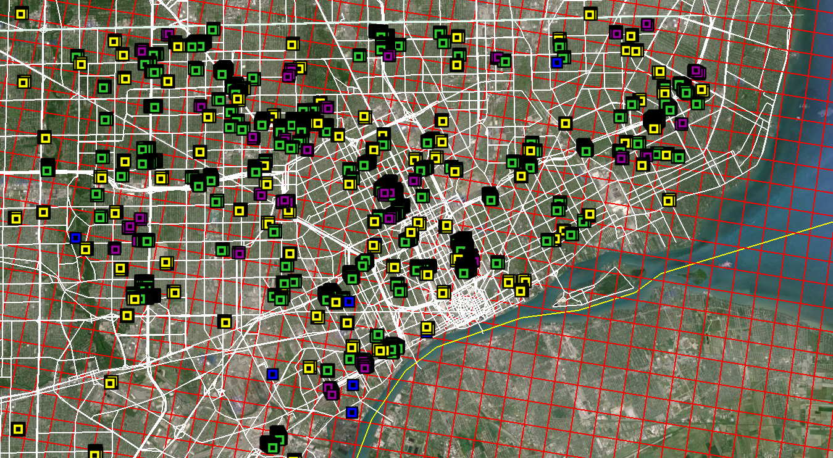
Detroit Study Domain
4122 Receptors
Notes:
Glimpse of the study domain
1km grid
# of estimation locations were we want to estimate background concentrations
50m green

Slide 6
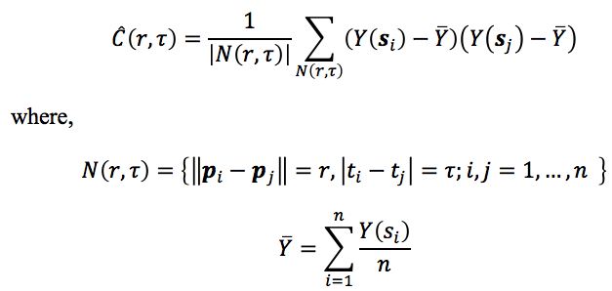
Space/Time Variability Modeling
The spatial and temporal dependency is characterized by the means of its covariance function.
The sample covariance function is dependent on the residual concentration Y
  Y(s_{i}) = Z(s_{i}) - m
Z(s_{i}) observation at (p_{i,}t_{i})
m global mean
Residuals concentrations - isotropic and homogeneous-stationary
The sample covariance function is modeled by the method-of-moments estimator Ĉ at various spatial (ϒ) and temporal (τ) lag.
Notes:
Constant global mean = average of all the observations
This implies that the space/time covariance function of the residuals is dependent on the spatial and temporal distance between two space/time points

Slide 7
Space/Time Variability Modeling
The sample covariance function is then used to fit a positive definite covariance model.
In this work, we use the space/time separable two component exponential covariance model defined as
    where,
    C₁ and C₂ are sill parameter quantifying the variability of observations
    a_{ϒ1} and a_{ϒ2} are spatial range
    a_{τ1} and a_{τ2} are temporal range
Covariance model parameters are estimated by an automated weighted least square procedure
Notes:
The range parameter characterizes the extent of the influence of spatial and temporal autocorrelation and is given by the separation distance at which the covariance decreases to 5% of the sill. First we obtained the spatial component of the sample covariance function at temporal lag τ=0 and the temporal component at spatial lag r=0. Then, these sample covariance functions were used to fit the model.

Slide 8
Space/Time Ordinary Kriging (STOK)
STOK estimate is given by the linear combination of nearby samples
The kriging weights are obtained by minimizing the estimation mean square error subject to the unbiasedness constraint
In this study, we used 50 nearby samples which were observed within five temporal units (days or hours) from the estimation time
Nearby samples were selected based on the space/time distance defined below where (space/time metric) is the ratio of the spatial covariance range and temporal covariance range
Notes:
STOK Matlab

Slide 9
Input Data for STOK
Hard Data
  AQS sites with “Background” Monitoring Objective
Soft Data
  Estimate of background data at monitoring sites that are not deemed as Background
    AQS sites that are not background ( Z_{i} )
    2 previously run CMAQ simulations
      R₂₀₀₅ = CMAQ_{Background}/CMAQ_{Total}
      Removed R₂₀₀₅ below 1% and above 99%
    Paired R₂₀₀₅ and Z_{i} in space
    Soft data mean = Z_{i} * mean(R₂₀₀₅)
    Soft data variance = Z_{i}² * variance(R₂₀₀₅)
Notes:
There are two types of a priori data
CONFIDENCE
Conveniently for detroit domain
Removed extreme outliers
Mean in time
Variance in time

Slide 10
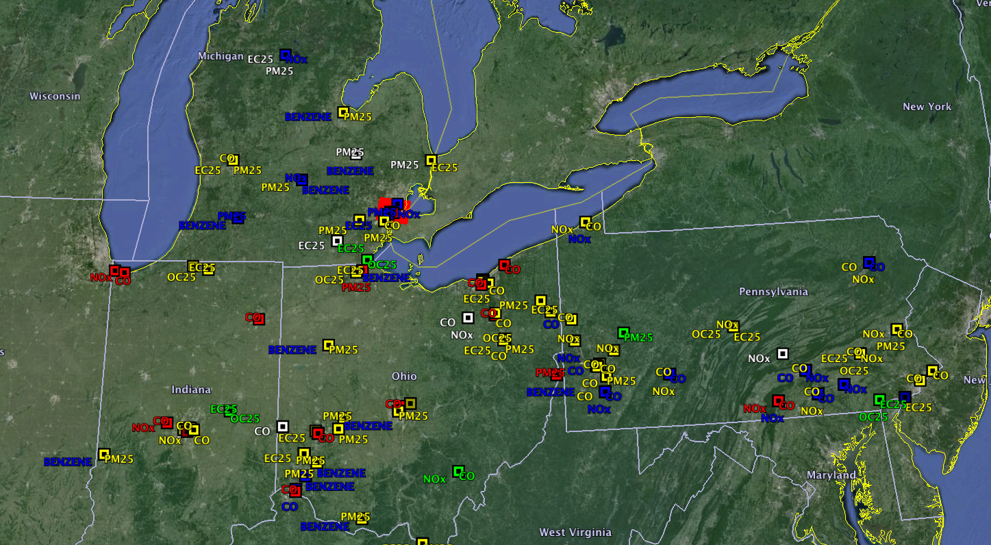
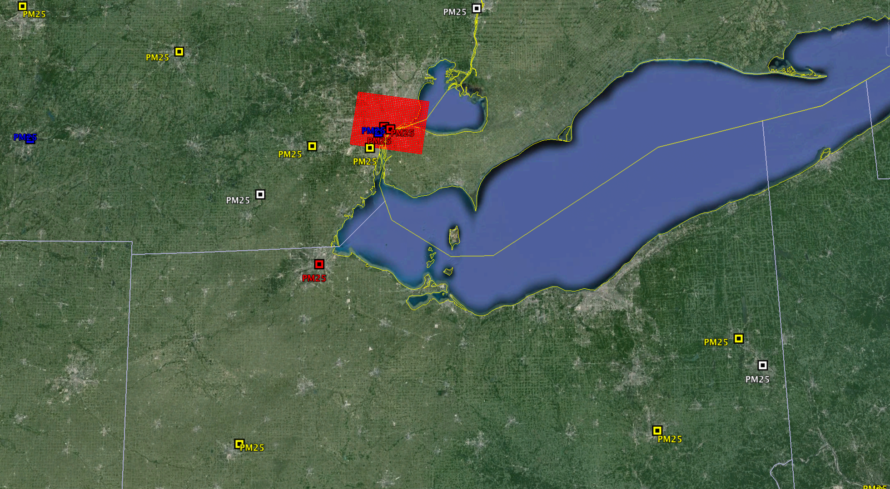
AQS Sites by Monitor Objective
Background
Regional Transport
Population Exposure
Highest Concentration
Other
Background
Regional Transport
Population Exposure
Highest Concentration
Other
Collected data from 2009 – 2011 for 4 States
Only 2 – 6 “Background” AQS per pollutant
Notes:
40 to 50 sites per pollutant
Colored by monitor objective

Slide 11
CMAQ Model Application
CMAQ Simulations for annual 2005
  Using CMAQ v4.7.1
  12km x 12 km
  PM_{2.5}, CO, NOx, Benzene, EC and OC
  2 CMAQ Simulations
    CMAQ_{Total}
      Base Case
    CMAQ_{Background}
      Local Sources in Detroit have been zeroed out
Notes:
This evaluation utilized two 2005 full year simulations using CMAQ v4.7.1. The modeling domain covered the eastern half of the contiguous US using a 12km x 12km horizontal grid resolution. One simulation, provided by EPA, modeled all emission source (CMAQ Total) for the entire domain. The other simulation ,run by IE, modeled the same domain removing local emission sources in 16 grid cells covering the Detroit Metropolitan area (CMAQ Background).

Slide 12
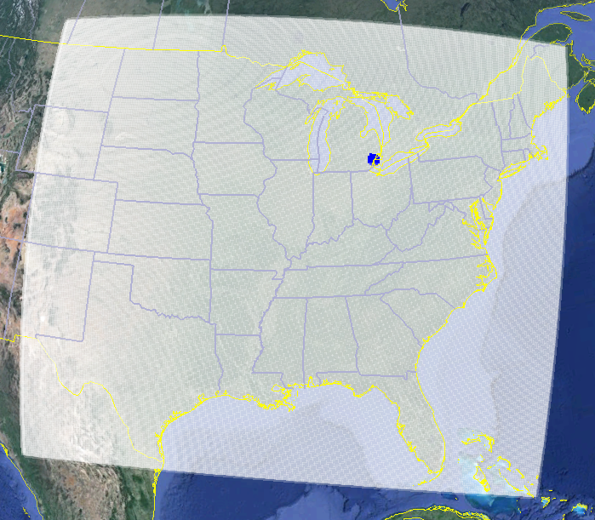
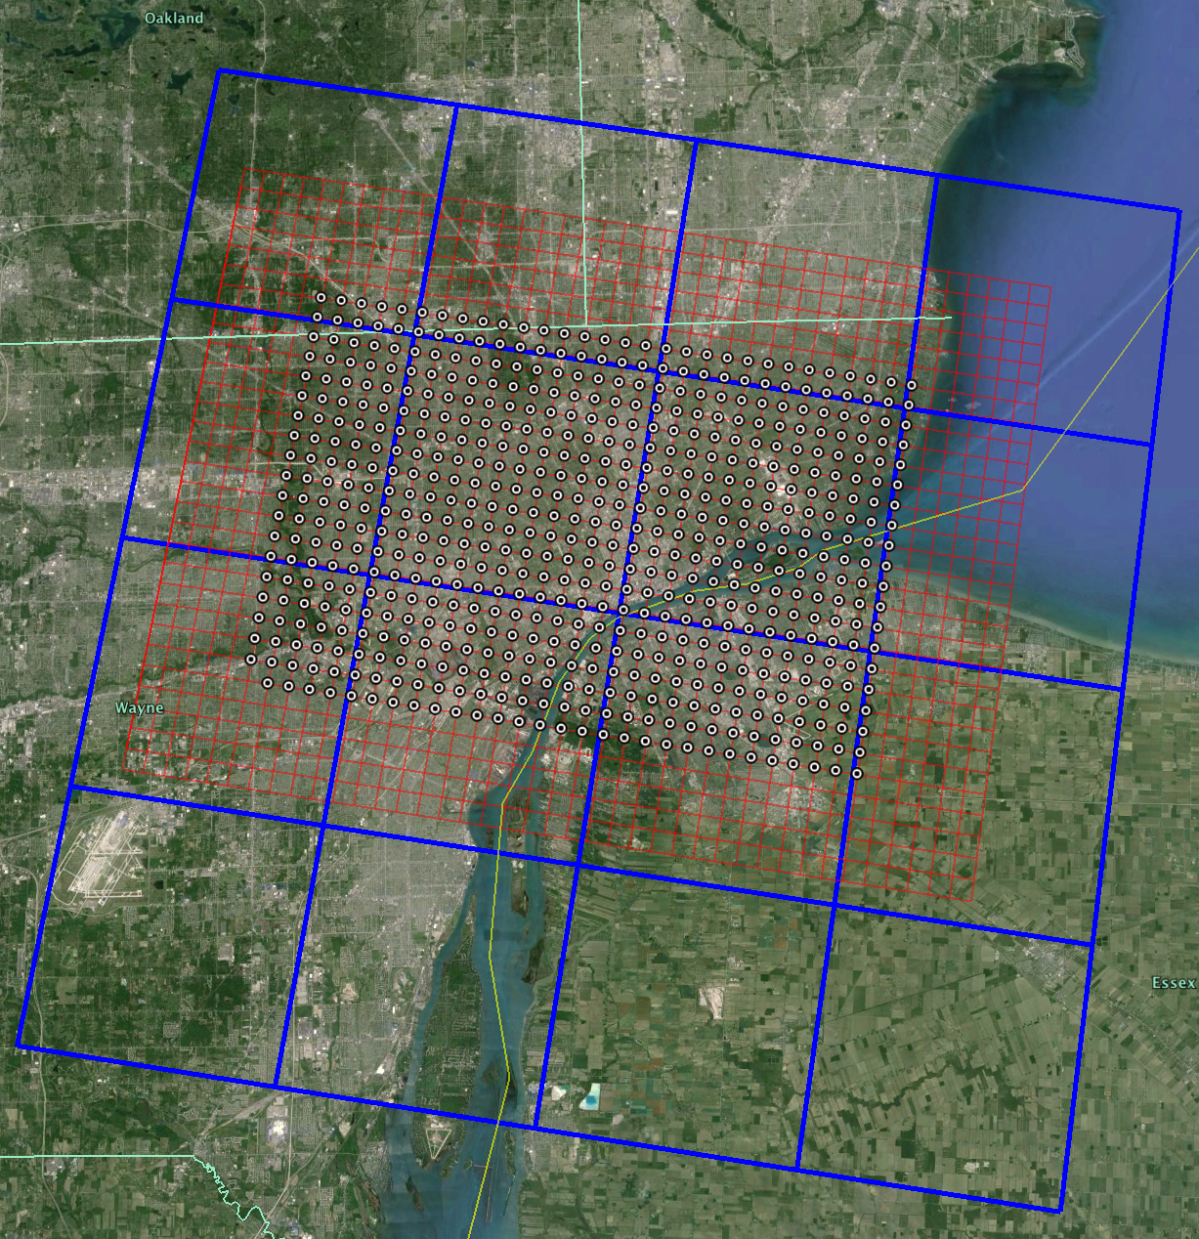
CMAQ Modeling Domain
Study location for NEXUS
Estimation locations for demonstration purposes
Notes:
Kept biogenics

Slide 13
Results
Focus on PM25 and NOx
Notes:
PM25 and NOx

Slide 14
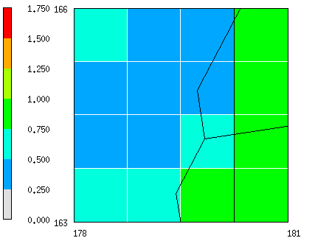
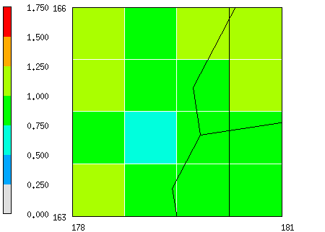
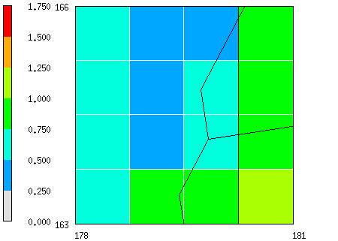
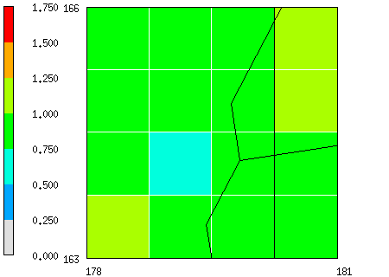
Monthly Average R_{Background/Total}
4x4 Domain
Summer NOX
Summer PM_{2.5}
Winter NOX
Winter PM_{2.5}
R_{Background/Total} < 1 due to removal of local sources
PM_{2.5} background concentration accounts for more of total concentration
Notes:
2 Annual CMAQ divided
Ratio shows decrease due to removla of local source
Shows temporal variability of R
PM2.5 shows less reduction

Slide 15
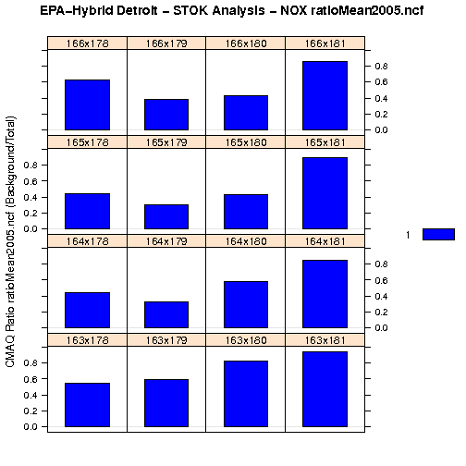
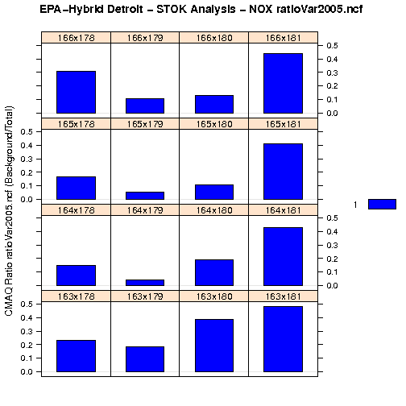
NOx R_{Background/Total}
4x4 Domain
Mean(R_{Background/Total})
Variance(R_{Background/Total})
R_{Background/Total} mean shows most reduction at Detroit metro area
R_{Background/Total} shows least variance at Detroit metro area
Notes:
Actual values that are paired with Observations that are not background

Slide 16
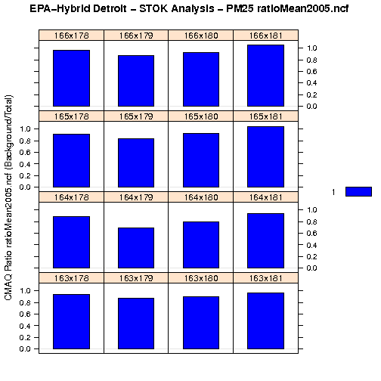
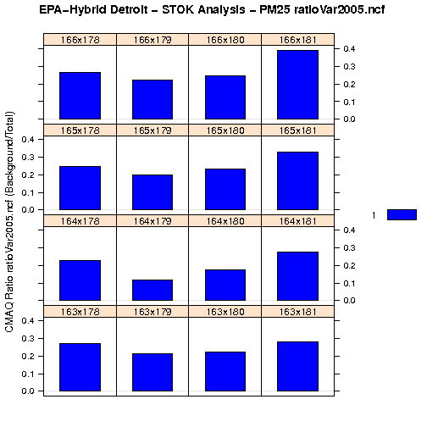
PM_{2.5} R_{Background/Total}
4x4 Domain
Mean(R_{Background/Total})
Variance(R_{Background/Total})
R_{Background/Total} mean higher than NOx
R_{Background/Total} variance is also higher than NOx

Slide 17
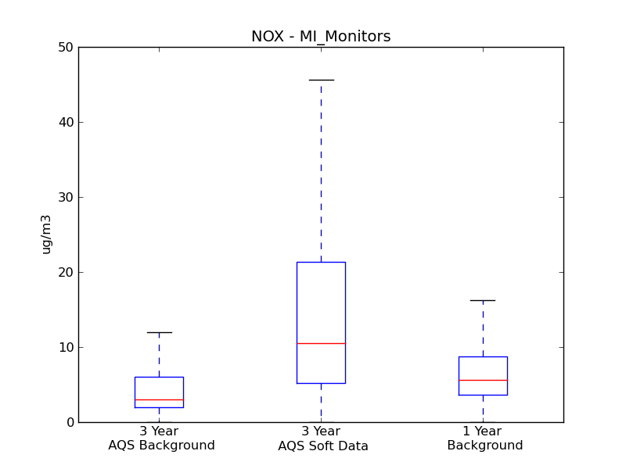
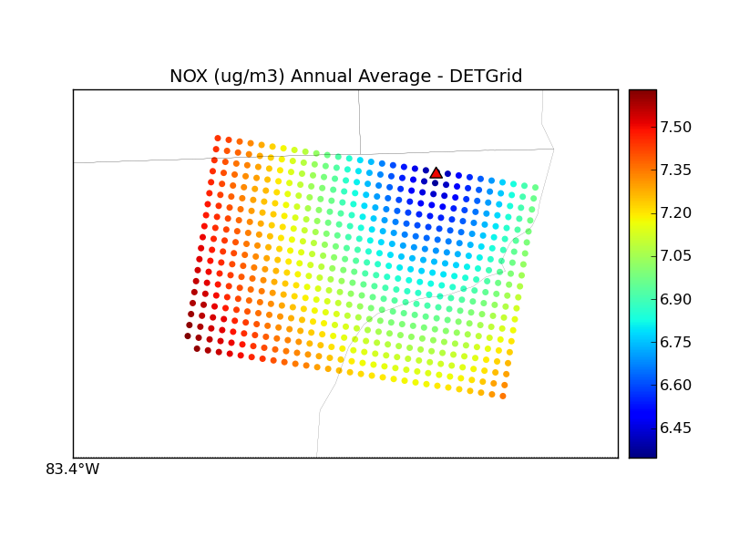
STOK Background – NOx
NOX (ppb) Annual Average - DetGrid
ppb
STOK Background distribution is comparable to monitors classified as background
Spatial concentration gradient influenced by non-background monitors
Notes:
Soft mean
Spatial variation

Slide 18
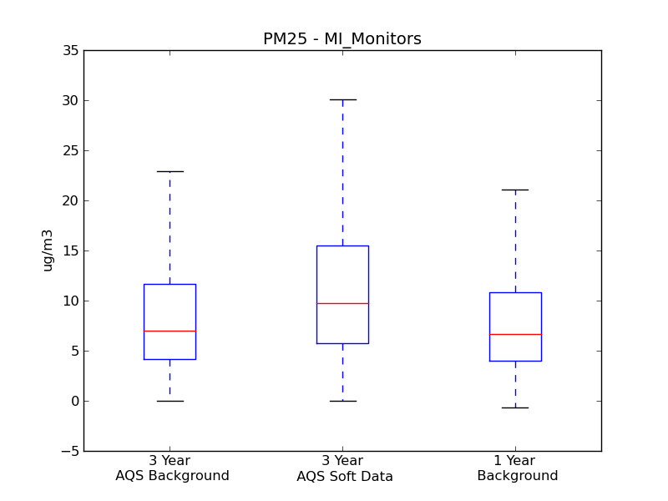
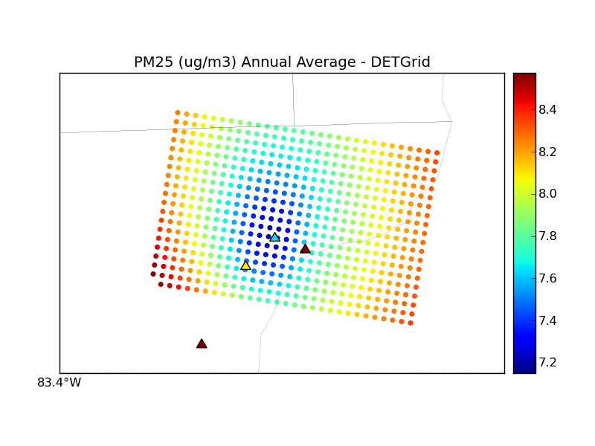
STOK Background – PM_{2.5}
Lower background concentrations closer to Detroit center
Monitors with less variability highly influence background estimation

Slide 19
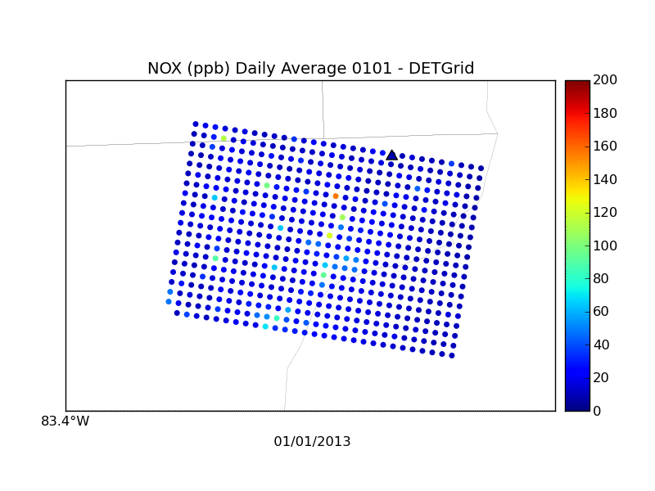
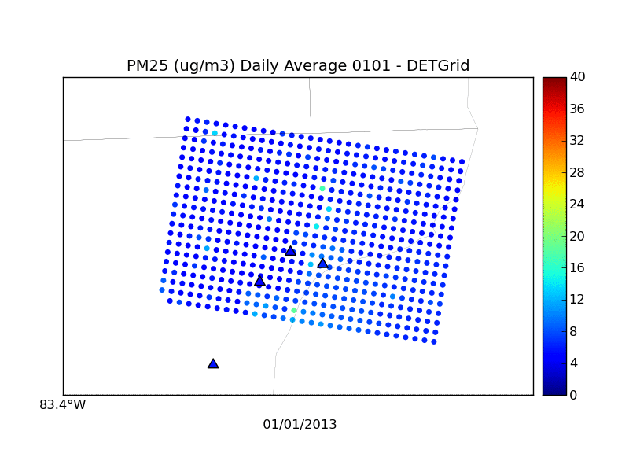
Total Concentration
Local Sources + Background
Total concentration are comparable to AQS sites
Model is capturing higher concentration but overestimating some days

Slide 20
CONCLUSIONS
Developed a new approach that relies on both observations and model to estimate fine-scale background concentrations
Successfully applied for ongoing exposure study in Detroit for a 29-month period for multiple pollutants
STOK provides spatially resolved field of background concentrations at study locations, and these estimates are comparable to AQS sites in the region, classified as background
Notes:
Fast
In an ideal world AQS sites everywhere

Slide 21
ACKNOWLEDGEMENTS
U.S. EPA Contracts EPW09023 and EPD12044
David Heist, U.S. EPA
UNC-IE Colleagues
  Mohammad Omary
  Kevin Talgo
  Brian Naess

Slide 22
Backup Slides

Slide 23
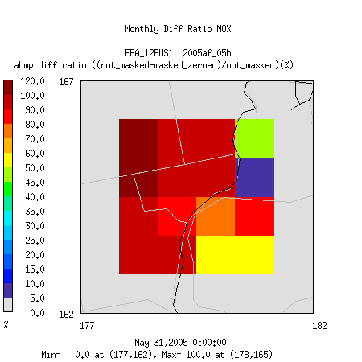
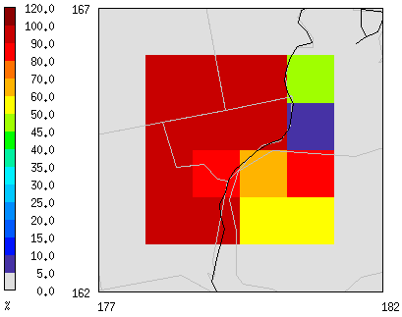
Monthly Average R_{Background/Total}
4x4 CMAQ Domain
Summer NOX
Summer NOx
Winter NOX
Winter NOx
Background/Total ratio shows decrease due to zero out of emission
Notes:
2 Annual CMAQ divided
Shows temporal variability of R
PM2.5 shows less reduction

Slide 24
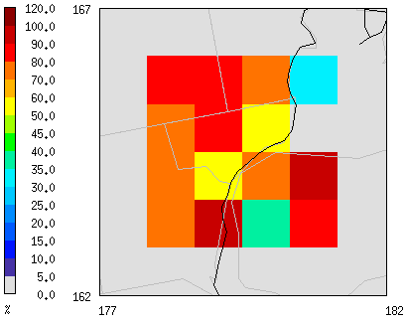
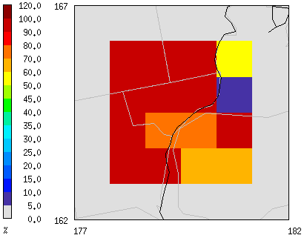
Monthly Average R_{Background/Total}
4x4 CMAQ Domain
Summer NOX
Summer PM_{2.5}
Winter NOX
Winter PM_{2.5}
Background/Total ratio shows decrease due to zero out of emission
Notes:
2 Annual CMAQ divided
Shows temporal variability of R
PM2.5 shows less reduction

Slide 25
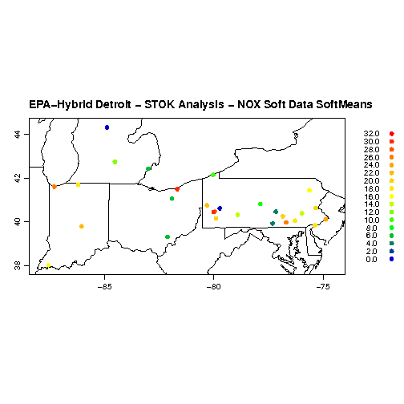
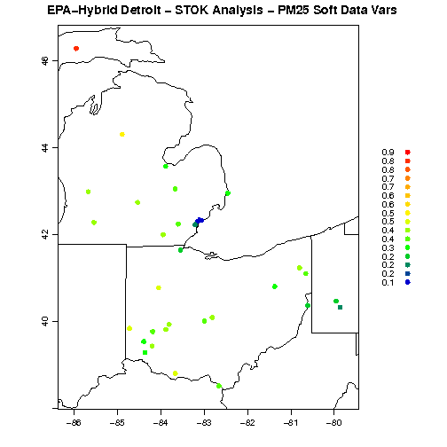
Spatial Variability of Soft Data
PM25(ug/m3) Annual Soft Mean
NOx (ppb) Annual Soft Mean
NOx
PM_{2.5}
Both NOx and PM2.5 have high variance as you move away from Detroit area

Slide 26
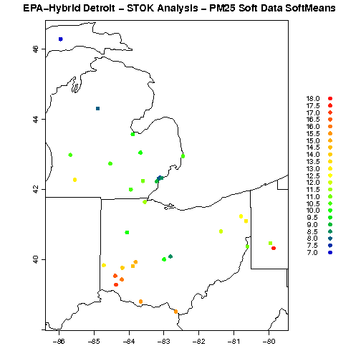
Spatial Variability of Soft Data Mean
PM25(ug/m3) Annual Soft Mean
NOx (ppb) Annual Soft Mean
NOx
PM_{2.5}
Soft Data Mean = Z_{i} * mean(R₂₀₀₅)
NOx Soft mean range wider than PM25
Notes:
Range of soft mean NOx vs PM25

Slide 27
AQS Monitor Count
Not Background
Pollutant | Collection Frequency | Background | Regional Transport | Population Exposure | Highest Concentration | Other Objective
NOx | Hourly | 2 | 1 | 19 | 4 | 16
CO | Hourly | 2 | 1 | 23 | 13 | 10
PM_{2.5} | Hourly | 6 | 3 | 23 | 5 | 8
BENZENE | Every 6th day | 1 | 0 | 5 | 0 | 40
EC | Every 6th day | 2 | 4 | 22 | 0 | 7
OC | Every 6th day | 2 | 4 | 22 | 0 | 7
AQS Data 2009, 2010 and 2011
Notes:
Hourly and Daily Pollutants. Label table better
Not background curly brace other

Slide 28
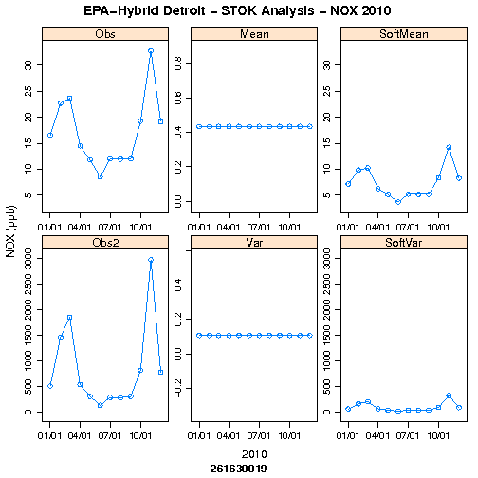
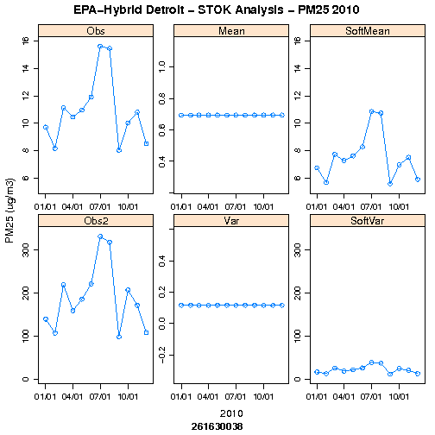
Illustration of Background at AQS Site
NOX
PM_{2.5}
Shows soft Mean and Variance for NOx and PM_{2.5} for a Monitor in Detroit.

