Slide 1

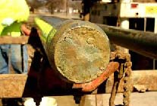
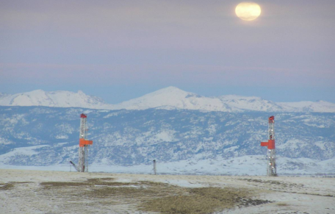
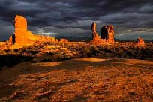



Development of a Uinta Basin Oil and Gas Emissions Inventory Suitable for a Model Performance Evaluation
Courtney Taylor¹, Caitlin Shaw¹, Chao-Jung Chien¹, Tiffany Samuelson¹, Erin Pollard², Stephen Reid², Leonard Herr³
¹AECOM Inc.
²Sonoma Technology, Inc.
³Bureau of Land Management, Utah State Office

Slide 2
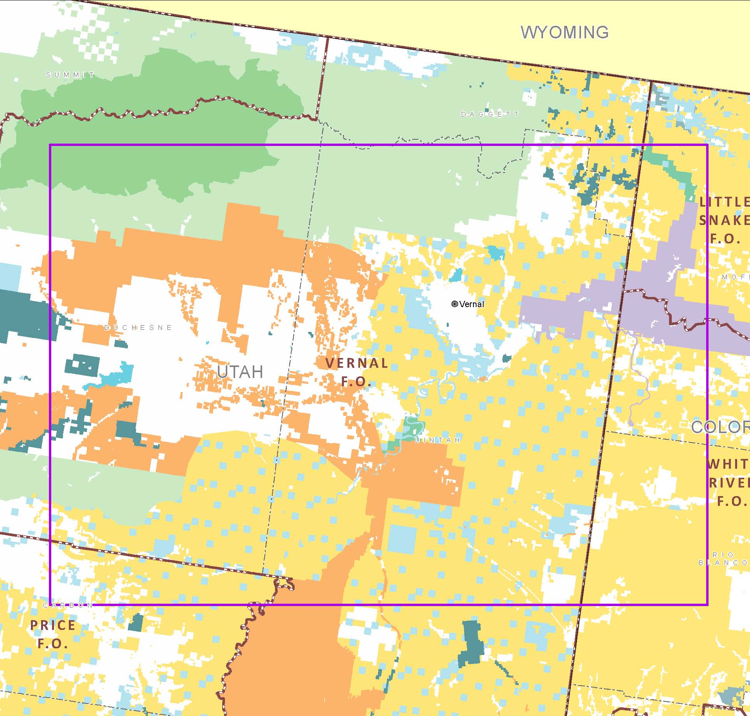
Road Map
Why the Uinta Basin?
Uinta Basin Oil and Gas (O&G) Emissions Inventory
  Methodology
  Survey Results
Emissions Results
  By Equipment Type
  Spatial\Temporal Variability
Conclusions and Next Steps
2

Slide 3
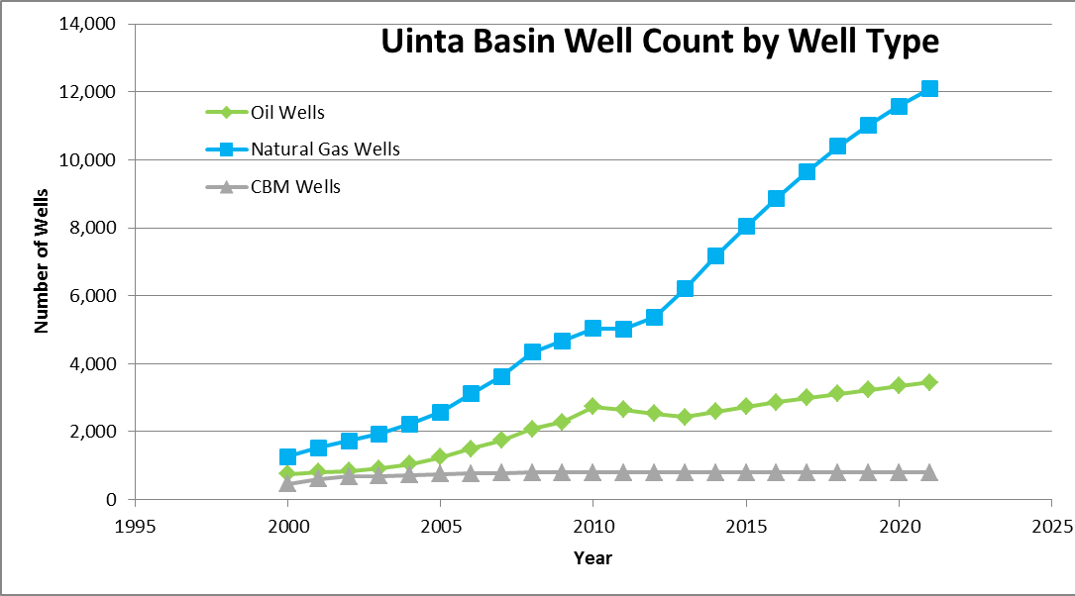
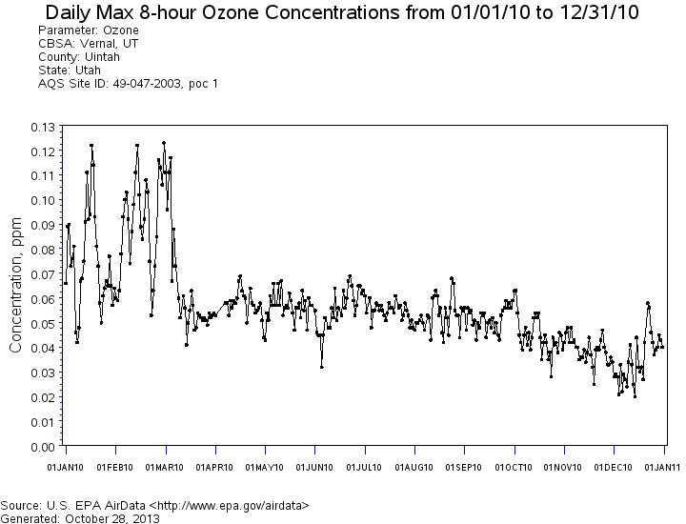
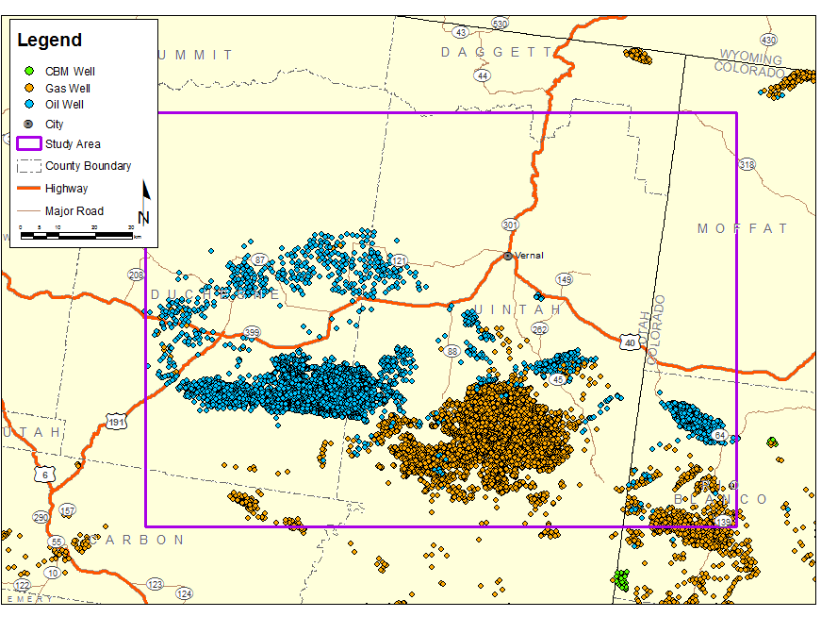
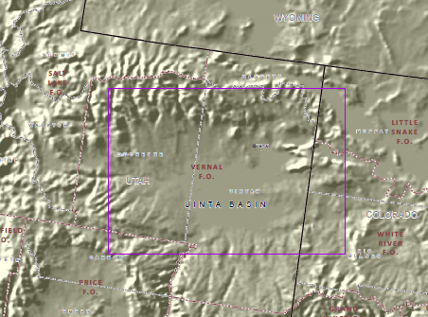
Why the Uinta Basin?
Emission Composition:
  Rural area in NE Utah
  Extensive oil and gas activity
Winter Ozone Events:
  Topographical and Climatological Conditions are conducive to winter ozone formation
O&G Activity Projected to Continue
3

Slide 4
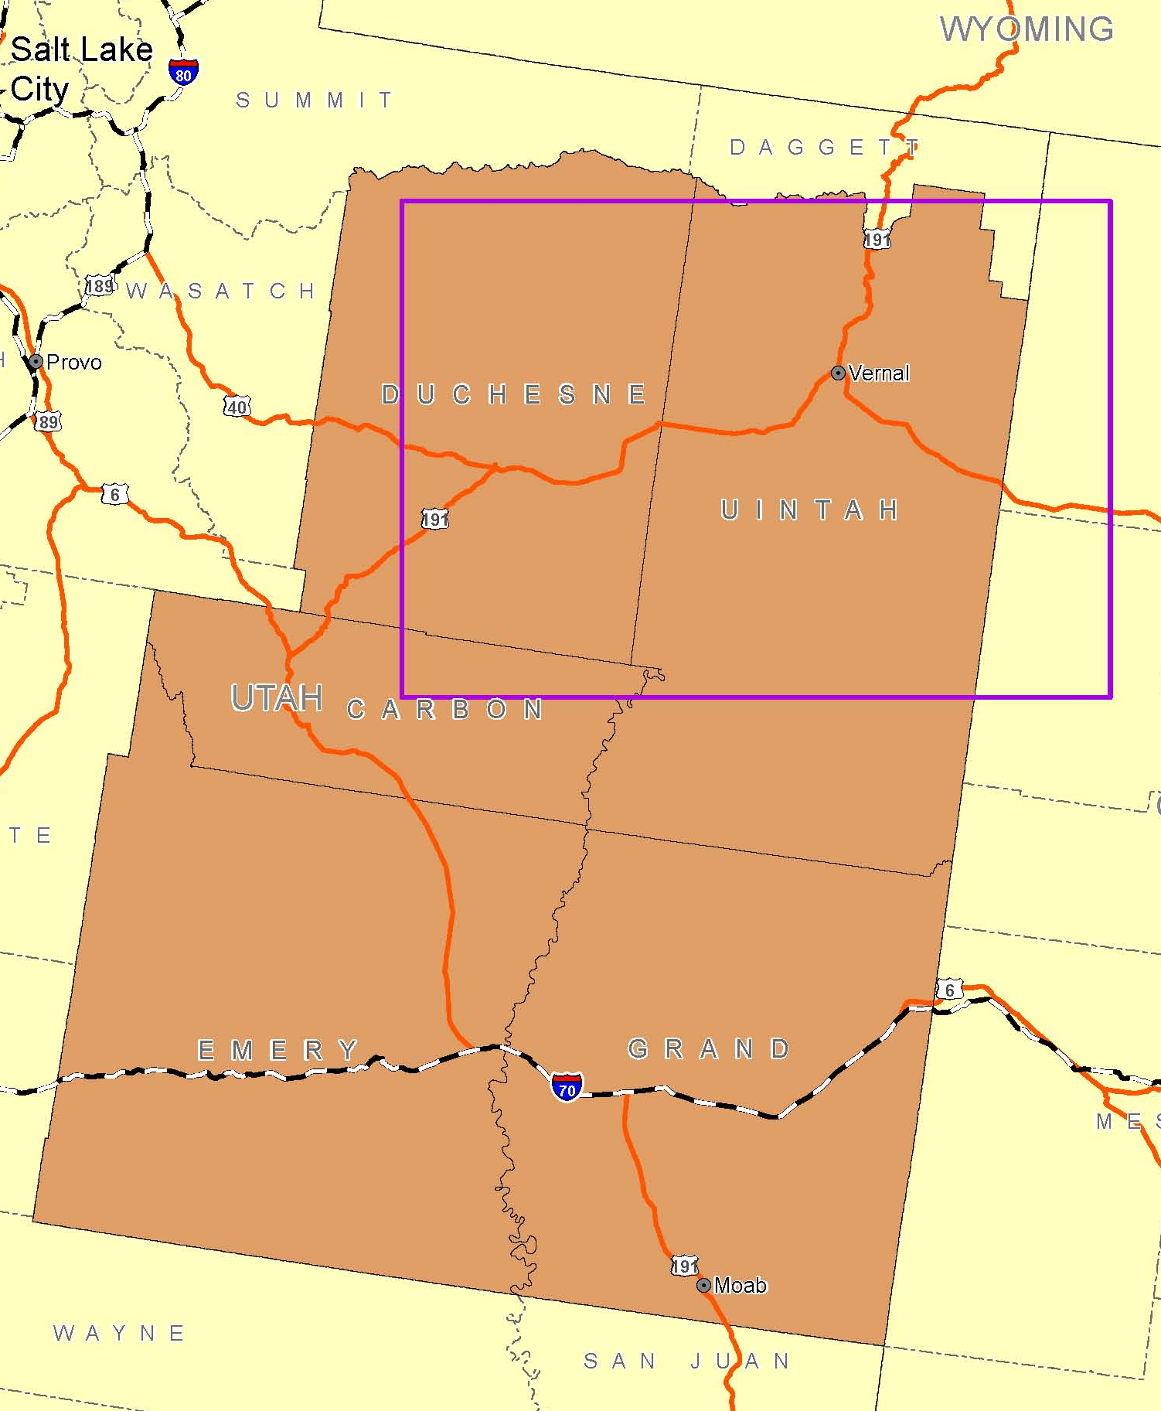
Emissions Inventory Method – Overview
A 2010 O&G EI was developed for 5-counties comprising the Uinta Basin using several methods:
Develop bottom-up emissions estimates for select sources, resolve spatially and temporally
Develop top-down emissions estimates for several other source types
Estimate emissions for remaining equipment based on existing basin-wide EI for 2006 by applying 2010 activity data and controls.
Combine and process with SMOKE model
4
Notes:
4

Slide 5
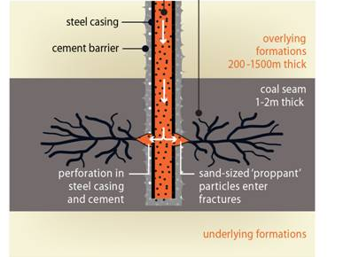
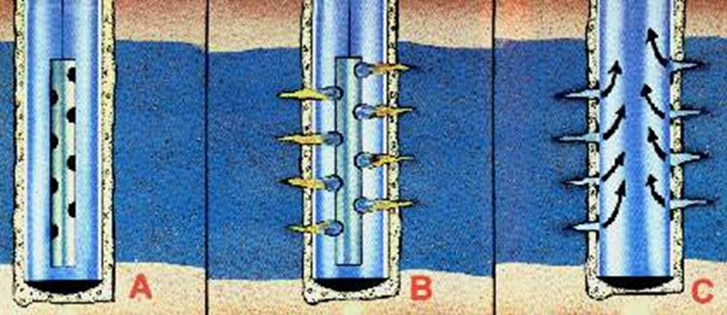
Oil and Gas Development Processes
Production
5
Notes:
5

Slide 6
Survey Design
In order to temporalize actual 2010 Uinta Basin oil and gas emissions, a survey was developed to target information related to:
Drilling\Workovers:
  engine and boiler size,
  emissions control technology,
  daylight rig,
  period\duration, continuous\non-continuous, hydraulic fracturing.
Completion\Re-completions:
  volume of flowback gas,
  control technology,
  period\duration, continuous\non-continuous, hydraulic fracturing.
6
Notes:
6

Slide 7
Survey Results
The survey response rate was considered to be an adequate sample size based on percent of oil and gas activities.
Operator | Percent of 2010 Active Wells (%) | Percent of 2010 New Wells (%) | Percent of 2010 Oil Production (%) | Percent of 2010 Gas Production (%)
Survey Respondents | 60 | 77 | 55 | 67
All Other Operators | 40 | 23 | 45 | 33
Total | 100 | 100 | 100 | 100
7
Notes:
7

Slide 8
Drilling Duration
The drilling duration distribution is very similar regardless of continuous vs. non-continuous operations.
The drilling duration for oil wells is frequently characterized as continuous.
Gas wells tend to have a longer drilling duration than oil wells, even when both are drilled continuously.
The maximum drilling duration for a gas well is significantly longer than for an oil well (90 days vs. 16 days).
Drilling Technology (vertical, horizontal, directional) did not have notably different drilling duration distributions.
8
Notes:
8

Slide 9
Well Completion Duration
Statistics | All Wells | Continuous versus Non-continuous |  | Well Type
 |  | Continuous | Non-continuous | Gas Wells | Oil Wells
Mean (days) | 9 | 5 | 17 | 14 | 4
Median (days) | 4 | 4 | 14 | 11 | 4
Mode (days) | 4 | 4 | 11 | 2 | 4
Maximum (days) | 86 | 55 | 86 | 86 | 4
Minimum (days) | 1 | 1 | 1 | 1 | 4
Standard Deviation (days) | 10 | 5 | 13 | 12 | 0
Number of wells with temporal information (wells) | 716 | 496 | 220 | 342 | 374
Oil wells tend to have a uniform completion duration and are more likely to be completed continuously than gas wells.
Gas wells tend to have a longer completion duration than oil wells.
9
Notes:
9

Slide 10
Treatment of Flow back Gas (Completions)
Well Type (Units) | Captured and Sold | Flared | Vented | Total
All Wells (Mscf) | 1,274,550 | 15,500 | 2,485 | 1,292,535
All Wells (Percent) | 98.61% | 1.20% | 0.19% | 100%
Gas Wells (Mscf) | 1,274,550 | 15,500 | 500 | 1,290,550
Gas Wells (Percent) | 98.76% | 1.20% | 0.04% | 100%
Oil Wells (Mscf) | 0 | 0 | 1,965 | 1,965
Oil Wells (Percent) | 0% | 0% | 100% | 100%
Other Wells (Mscf) | 0 | 0 | 20 | 20
Other Wells (percent) | 0% | 0% | 100% | 100%
Over 98% of the total flow back gas (i.e. completion gas) by volume is captured and sold. This is largely dependent on the treatment of gas well flow back gas.
100% of the flow back gas is vented from oil wells and wells drilled for enhanced oil recovery.
On average, 5 Mscf is vented from oil wells per completion event, while ~3,000 Mscf is captured from gas wells per completion event.
10
Notes:
10

Slide 11
Bottom-up Emissions Estimates
Source Category | NO_{X} (tpy) | VOC (tpy) | CO (tpy) | SO₂ (tpy) | PM_{2.5} (tpy) | PM₁₀ (tpy)
Drill Rig | 4,037 | 395 | 2,951 | 5 | 168 | 168
Workover | 268 | 22 | 181 | 0 | 10 | 10
Completion-flaring | 2 | 0 | 12 | 0 | 1 | 1
Completion-venting | 0 | 14 | 0 | 0 | 0 | 0
Recompletion-flaring | 1 | 0 | 8 | 0 | 0 | 0
Recompletion-venting | 0 | 18 | 0 | 0 | 0 | 0
Hydraulic fracturing pump engines | 1,652 | 165 | 895 | 2 | 52 | 52
Total Bottom-up | 5,960 | 615 | 4,047 | 7 | 231 | 231
Percent of Basin | 36.1% | 0.6% | 8.3% | 21.9% | 38.4% | 38.4%
11
Notes:
11

Slide 12
Uinta Basin Emissions
12

Slide 13
Temporal Information
On any given hour, the difference from the annual average emissions rate can vary substantially for NOx, both in an absolute sense (±0.2 tph) and relative sense (±25%)
Temporal variability for VOC is negligible for the analyzed sources since completion venting is insignificant
While PM_{2.5} emissions have a similar temporal variability as NOx, the quantity of emissions is significantly less
13
Notes:
13

Slide 14
Temporal Information
On any given hour, the difference from the annual average emissions rate can vary substantially for NOx, both in an absolute sense (±0.15 tph) and relative sense (±30%)
14
Notes:
14

Slide 15
Conclusions and Next Steps
O&G Emissions:
Drilling duration in the Uinta Basin is generally shorter for oil wells than gas wells.
Over 98% of the total flow back gas (i.e. completion gas) by volume is captured and sold. This is largely due to the treatment of gas well flow back gas.
Approximately 85% of produced water is re-injected. Emissions from produced water ponds are an insignificant source of VOCs in the basin.
Temporalization:
Information related to temporally and spatially varying NOx emissions sources can potentially be important within the Uinta Basin.
Does it Matter? Next Steps:
Conduct an Air Quality Model Performance Evaluation (Rodriguez, et al. 2013)
Compare model performance between this temporalized inventory to a typical year emissions inventory (which is temporally uniform).
15
Notes:
15

Slide 16
Acknowledgements
Funding for this project is from the Bureau of Land Management, Utah State Office.
Accurate data would not be possible with out support from the oil and gas Operators that participated in the data request
Participation by review agencies included representatives of the USEPA, FS, NPS, FWS, and Utah State Division of Air Quality
Disclaimer: Information in this presentation not represent the opinion of these agencies.
16

Slide 17
Contact:
Courtney Taylor
Air Quality Scientist
AECOM Environment
970-493-8878
courtney.taylor@aecom.com
www.AECOM.com
17

Slide 18
Model Performance Evaluation Overview
A Model Performance Evaluation (MPE) is necessary to assess the model capabilities and limitations for a specific period and geographic location.
The following types of data are needed for an MPE:
  Gridded four-dimensional meteorological fields (Craig, et al. 2013).
  Spatially-resolved (horizontally and vertically) and temporally-varying emissions inventory concurrent with the meteorological data.
  Initial Concentrations and Boundary Condition datasets.
  Monitored data for the pollutants of interest for comparison to the results of the air quality model.
Obtaining accurate estimates of oil and gas (O&G) emissions resolved in both time and space can be challenging.
18

