Slide 1
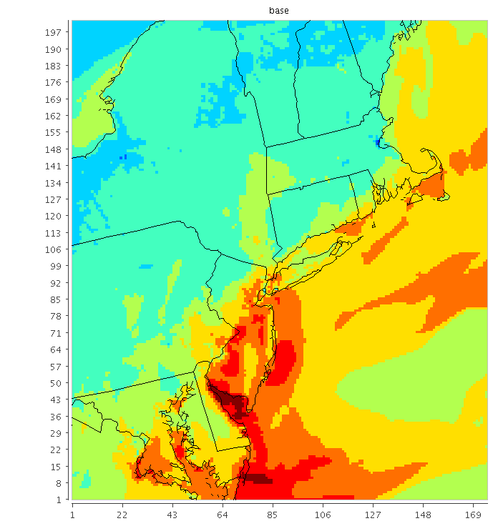
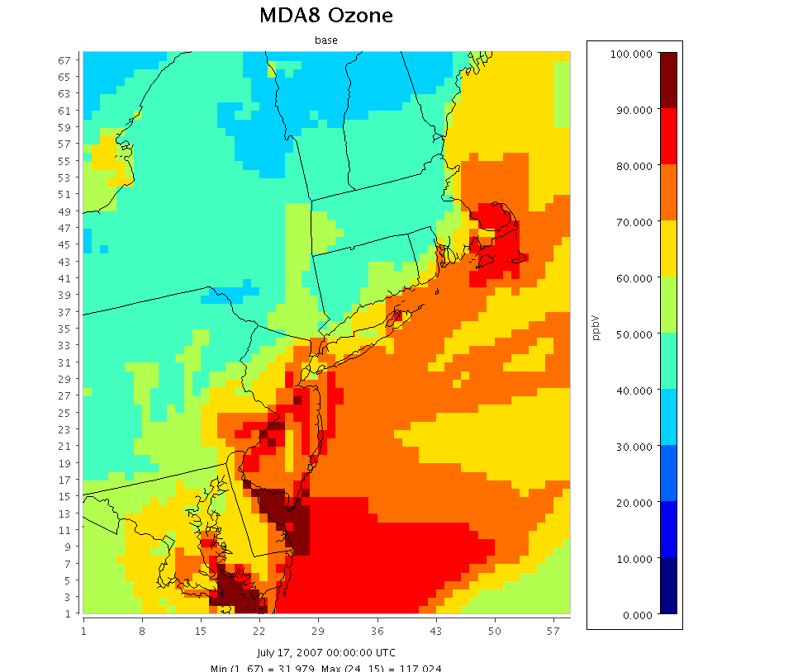
Model Resolution and Ozone Sensitivity to NOx Emissions Changes in in the Northeastern US
Heather Simon, Kirk Baker, Norm Possiel, Pat Dolwick, Brian Timin
Office of Air Quality Planning and Standards, US EPA
Acknowledgements: Nancy Hwang, Chris Allen, Darrell Ensley, Cliff Stanley, Chris Misenis

Slide 2
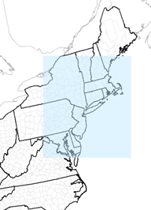
Look at case study of the Northeastern US at 12 and 4km resolutions
Model Set-up
  CMAQv5.0.1 (AER06)
  WRFv3.3, MCIPv4.1.2, USGS land use
    Meteorology run separately at 12km and 4 km resolutions
  25 layers
  April-October 2007
  IC/BC from 12US2 CONUS CMAQ simulation
4 model simulations
  12NE base
    12km resolution
    2007 emissions developed for the PM NAAQS RIA
  12NE 50NOx
    12km resolution
    2007 with 50% cut in NE anthropogenic NOx emissions
  4NE base
    4km resolution
    2007 emissions
  4NE 50NOx
    4km resolution
    2007 with 50% cut in NE anthropogenic NOx emissions
NE domain

Slide 3
Analyses
4km vs 12km changes in monthly mean MDA8 ozone
Ozone changes on example days
Examine ozone response at specific monitoring locations

Slide 4
4km vs 12km changes in monthly mean MDA8 ozone

Slide 5
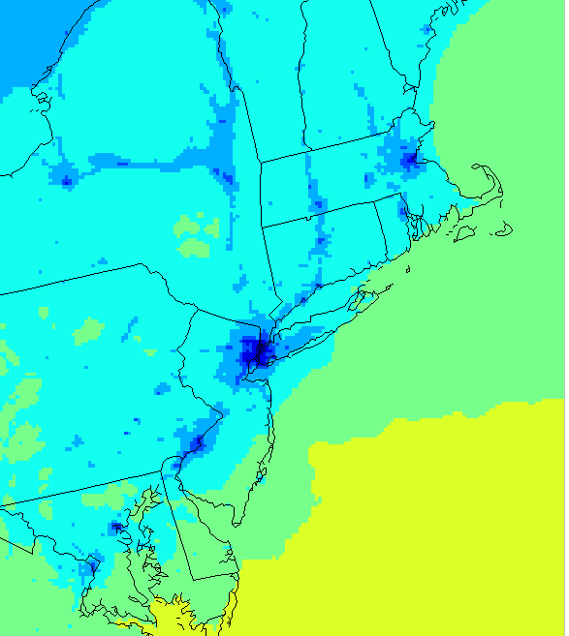
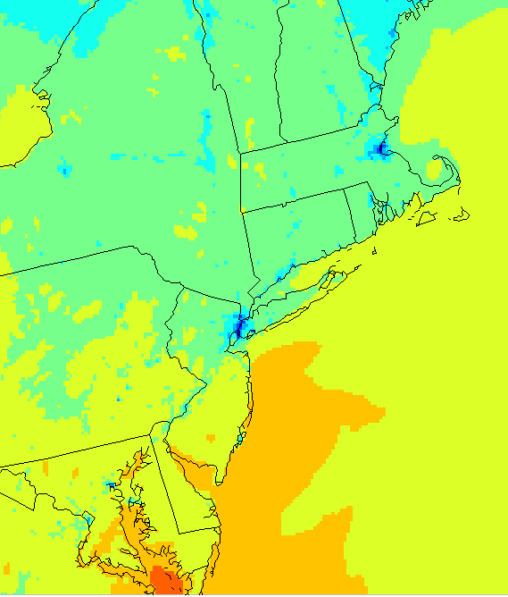
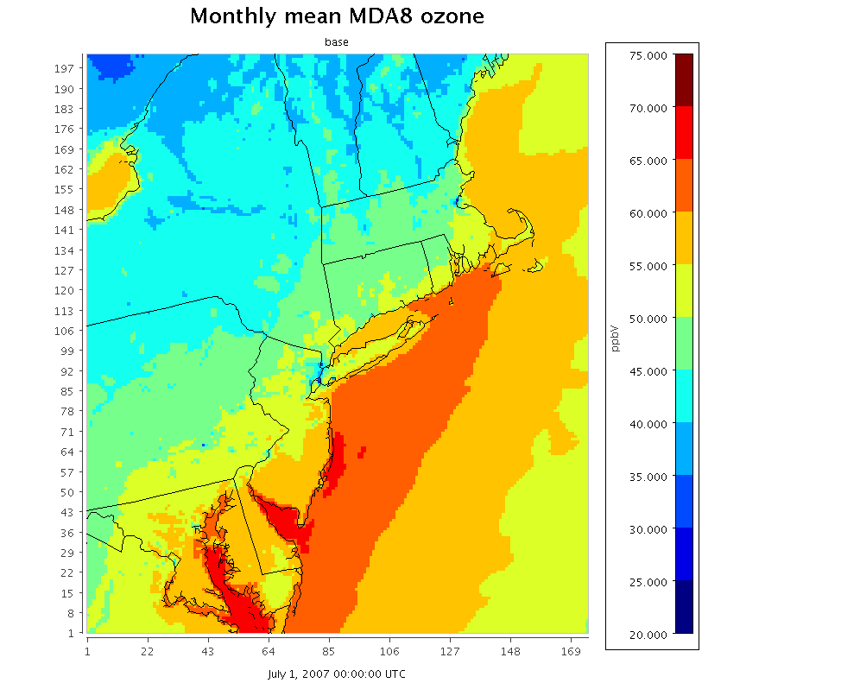
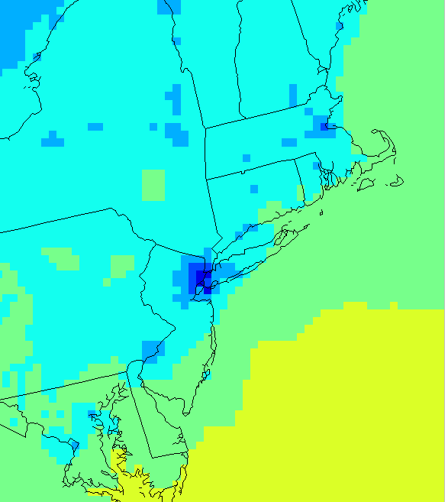
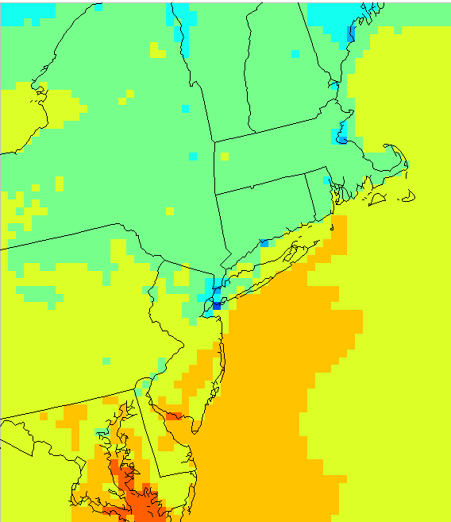
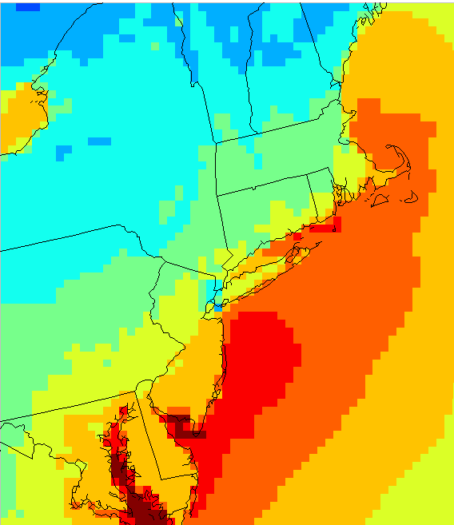
Seasonal Variation in Monthly Mean MDA8 O3
April
May
July
4 km
12 km

Slide 6
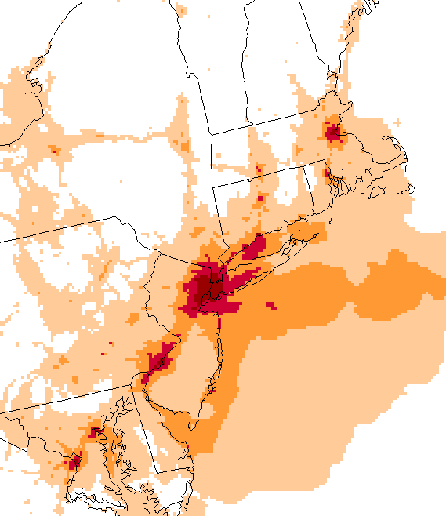
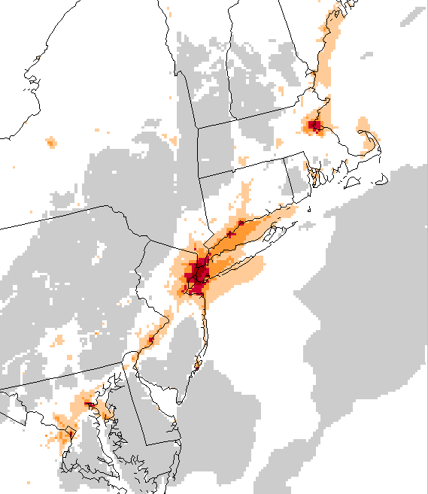
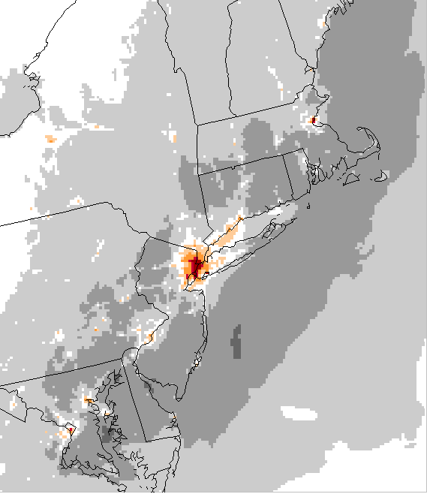
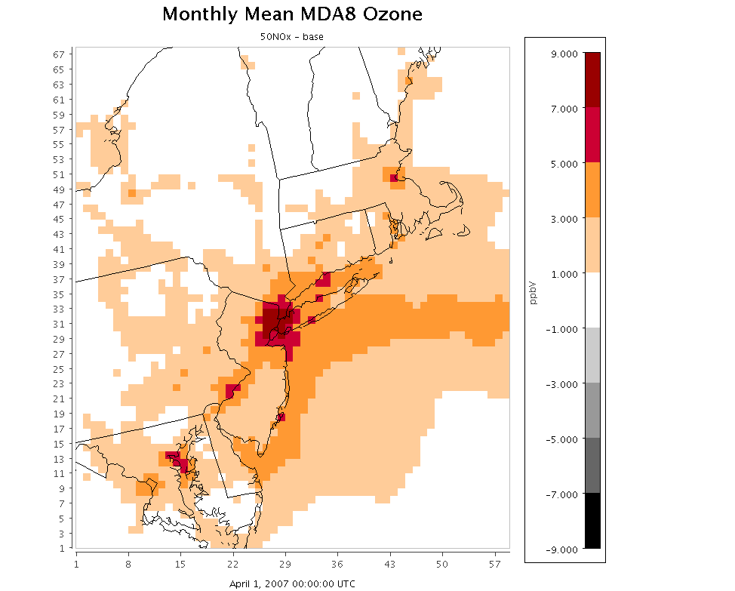
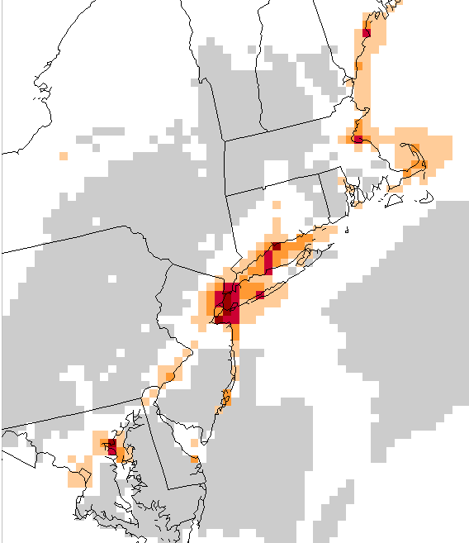
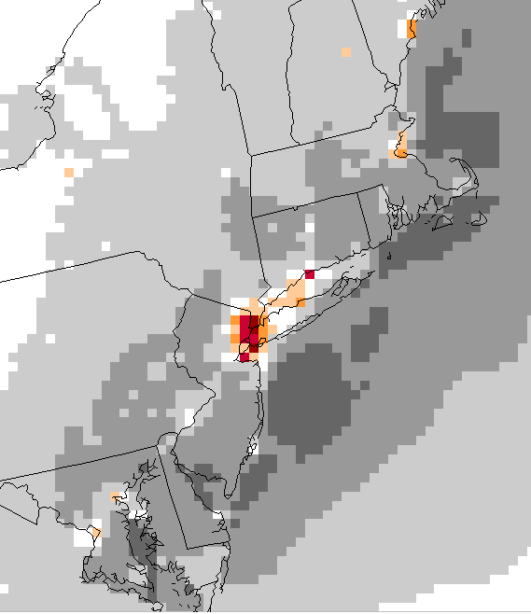
Seasonal Variation in Change in Monthly Mean MDA8 O3
50NOx - base
April
May
July
4 km
12 km

Slide 7
Daily 8-h maximum Ozone changes on example days

Slide 8
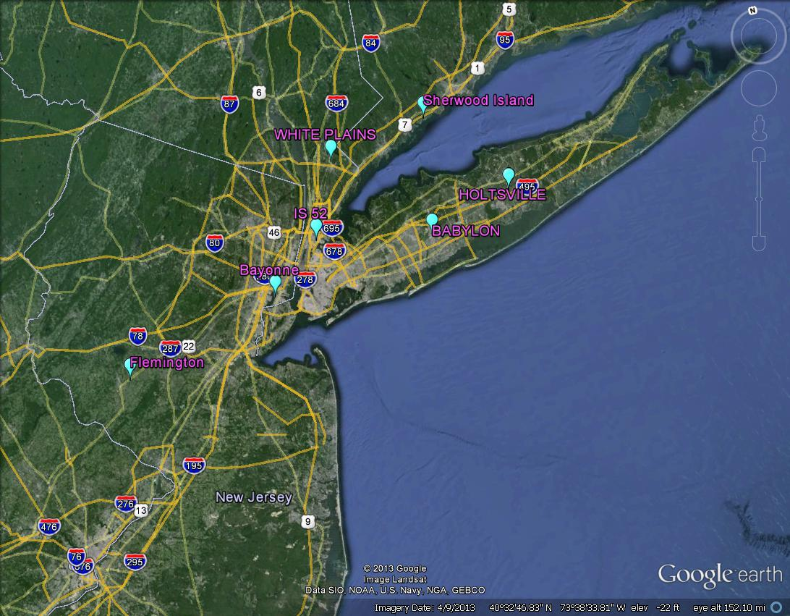
O3 changes and indicator ratios on example days
Selection of Example Days
Two summer season days were chosen during the summer of 2007 based on moderate to high regional ozone concentrations and relatively good model performance at 7 NY area sites: May 31 and August 25
(other days shown in “extra slides”)

Slide 9
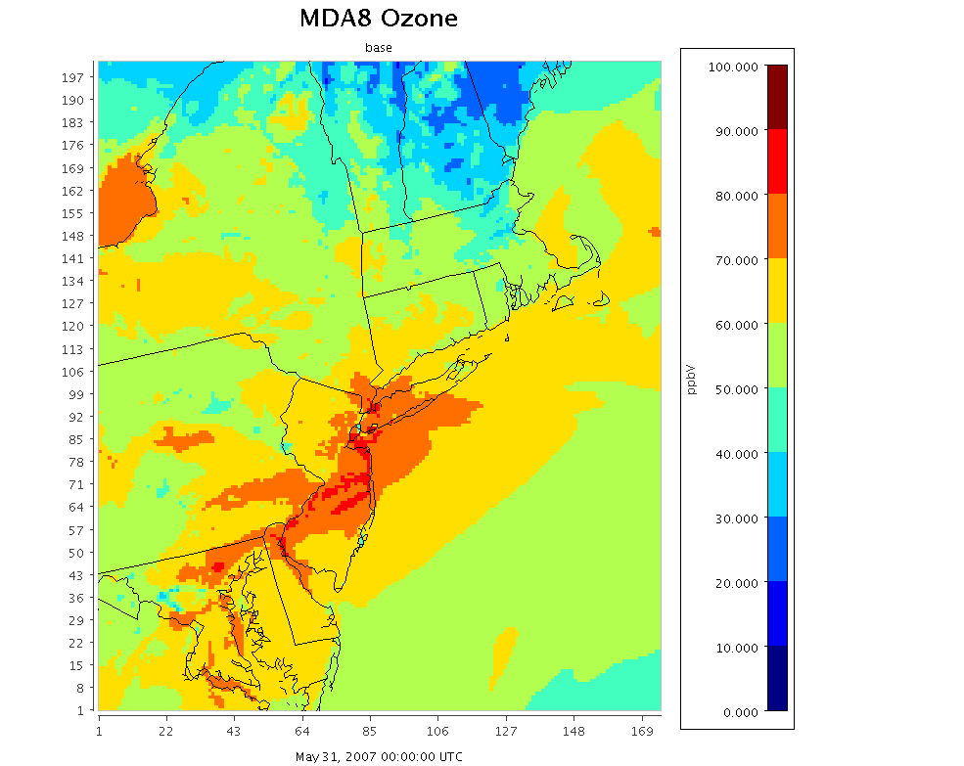
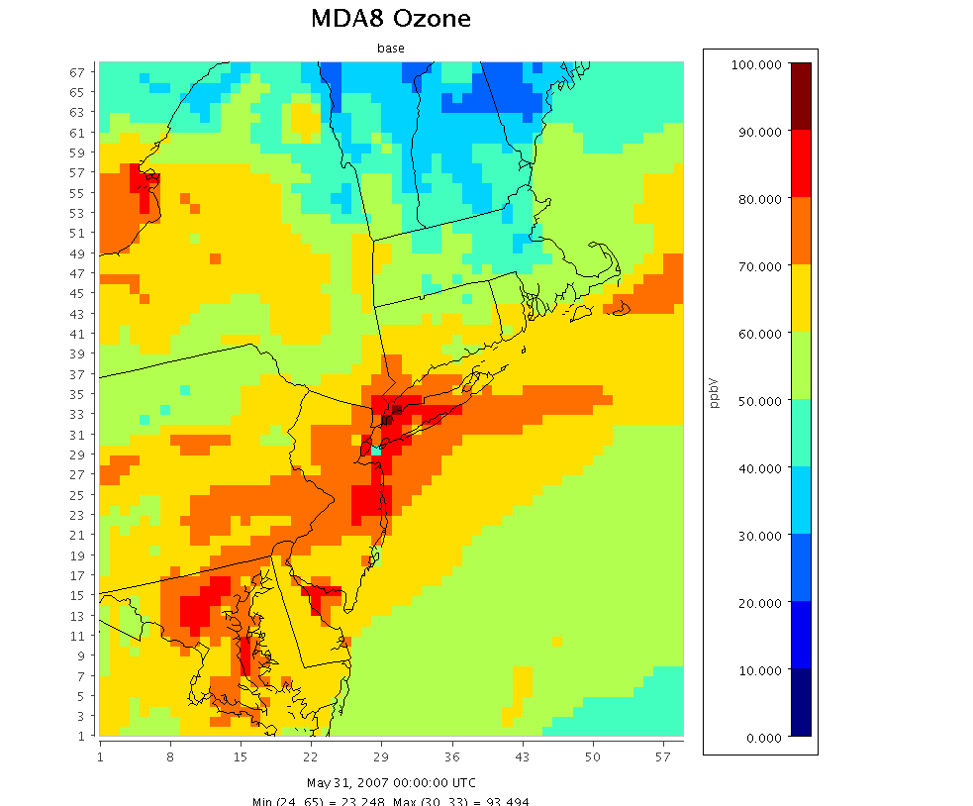
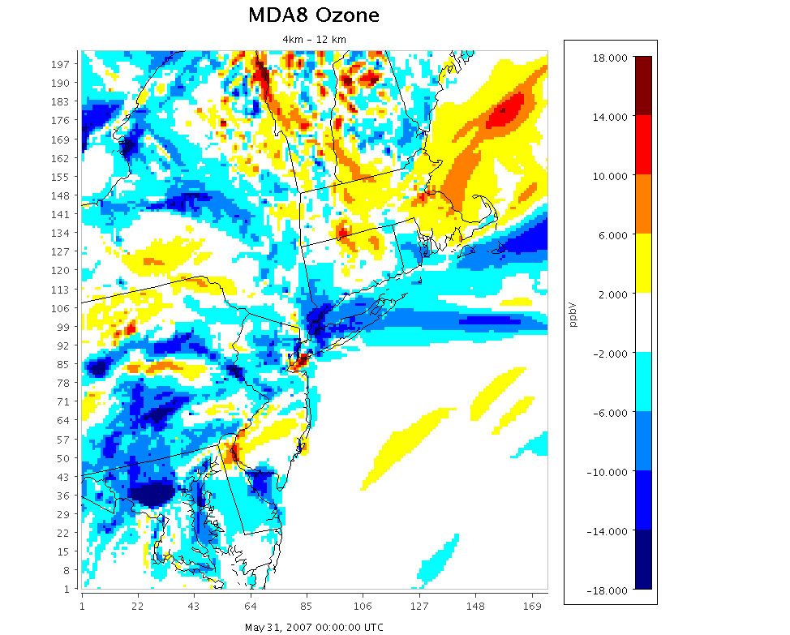
May 31, 2007
8-hr daily maximum O₃
4km base
12km base
4km – 12km

Slide 10
May 31, 2007
8-hr daily maximum O₃
4km base
12km base
4km – 12km

Slide 11
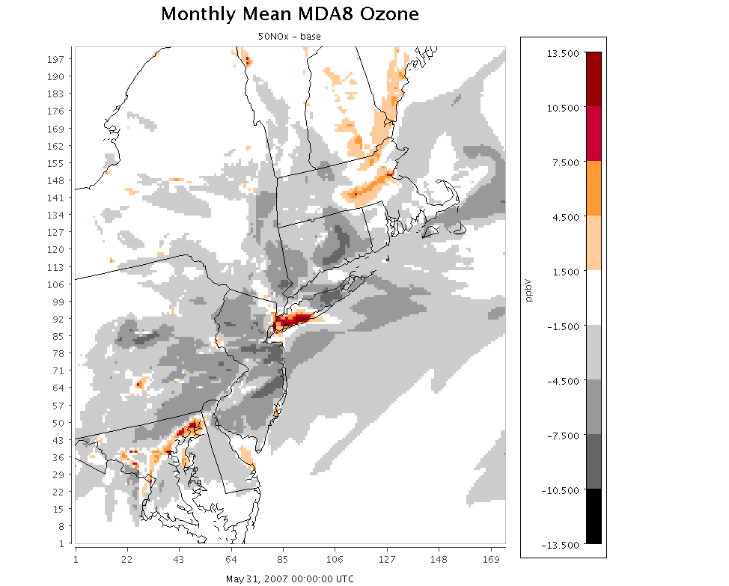
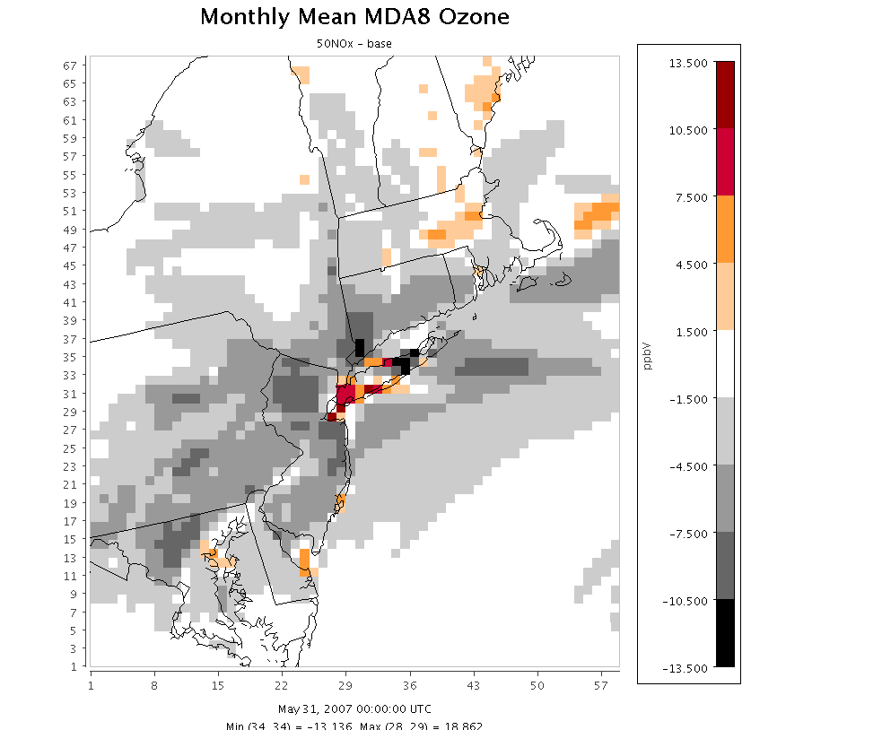
May 31, 2007
8-hr daily maximum O₃
4km base
12km base
4km
50NOx -base
12km
50NOx -base

Slide 12
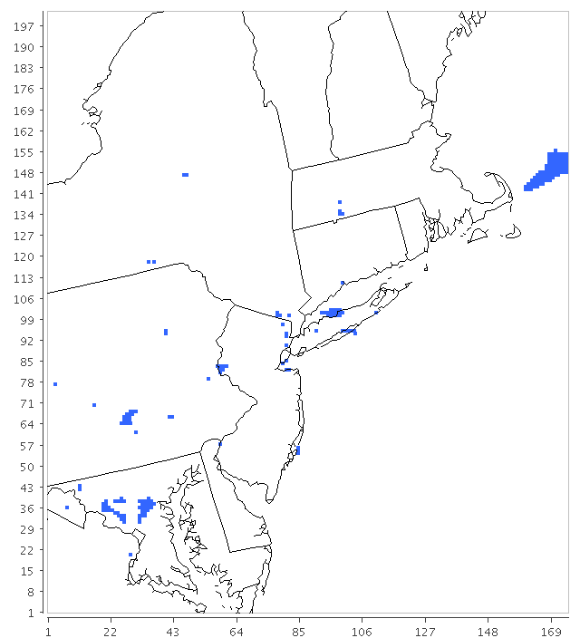
May 31, 2007
Locations with absolute changes > 2ppb in opposite directions
4km
50NOx -base
12km
50NOx -base

Slide 13
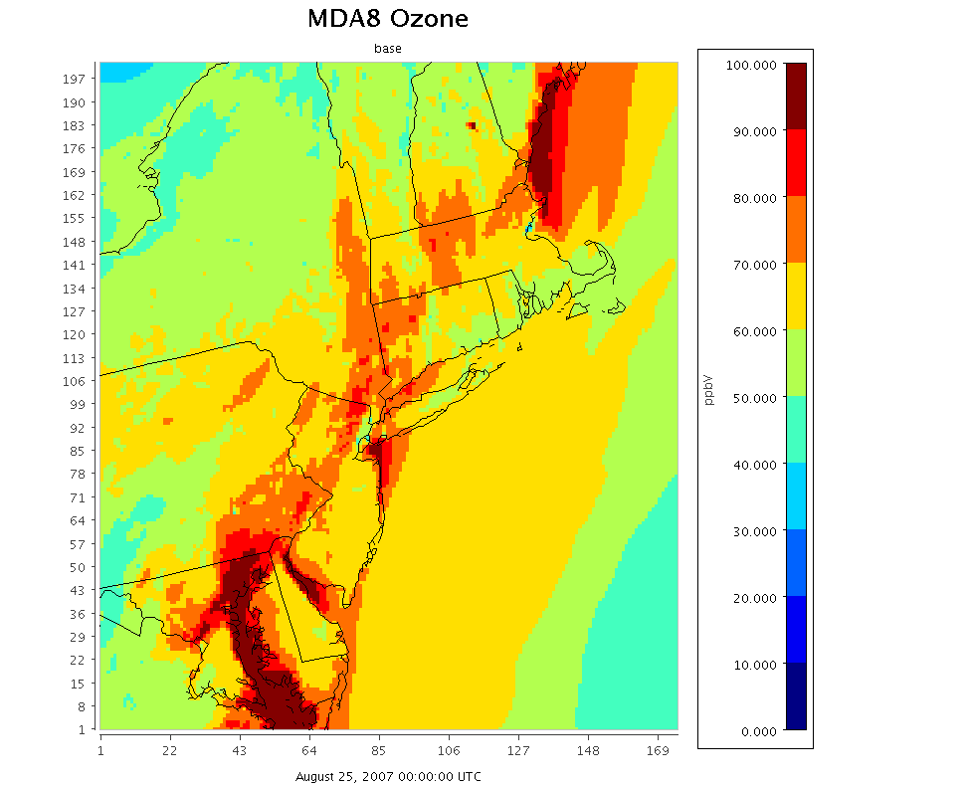
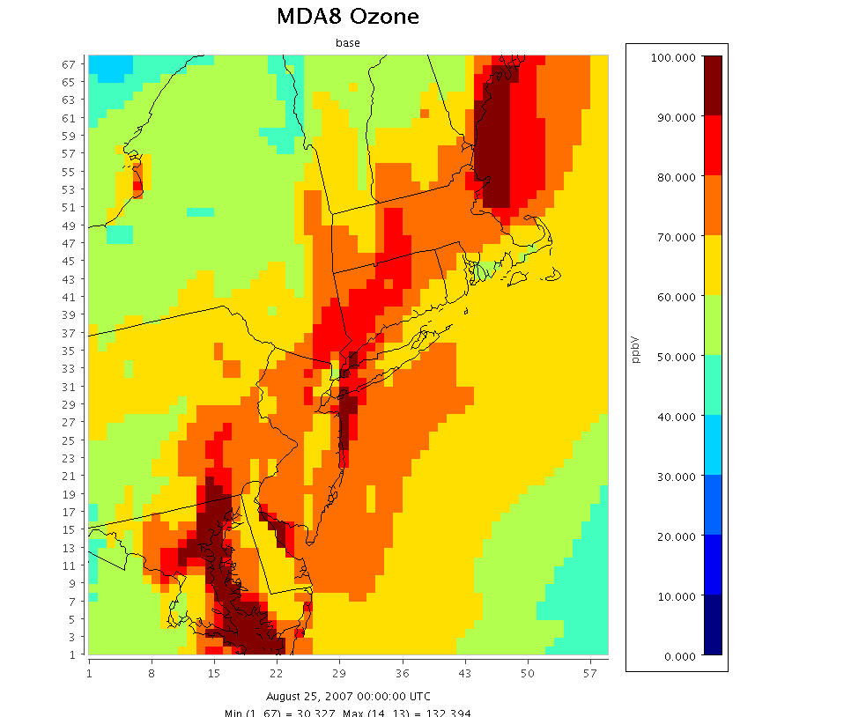
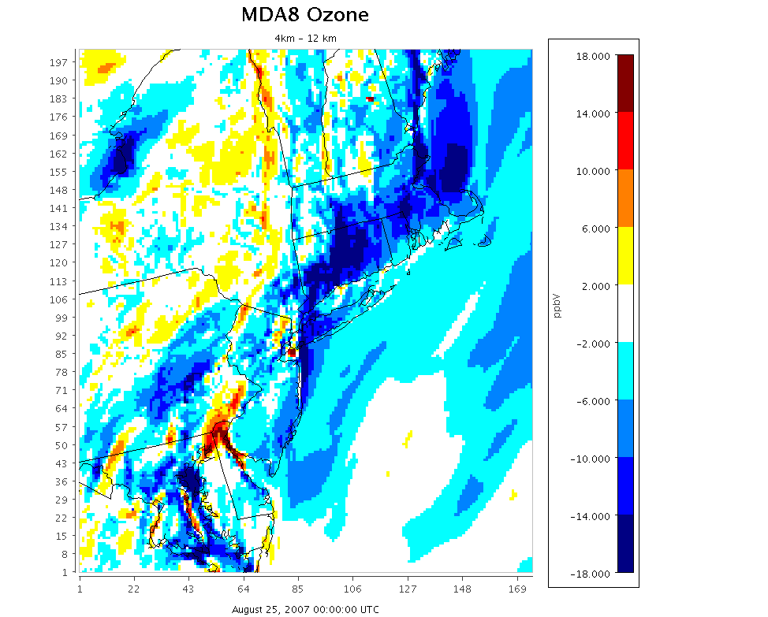
8-hr daily maximum O₃
4km base
12km base
Aug 25, 2007
4km – 12km

Slide 14
8-hr daily maximum O₃
4km base
12km base
Aug 25, 2007
4km – 12km

Slide 15
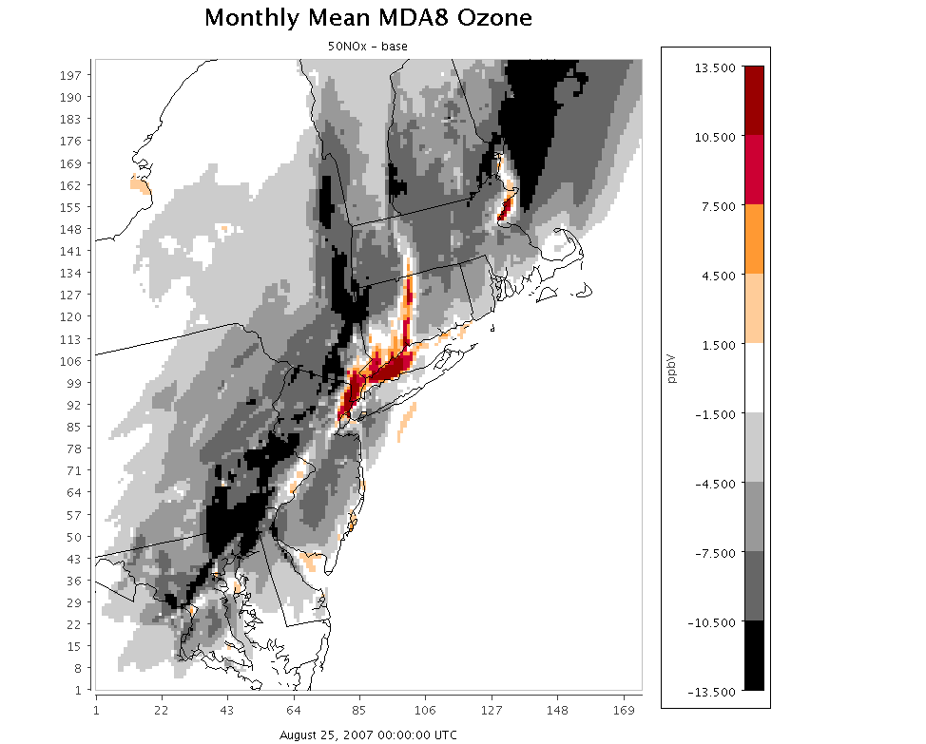
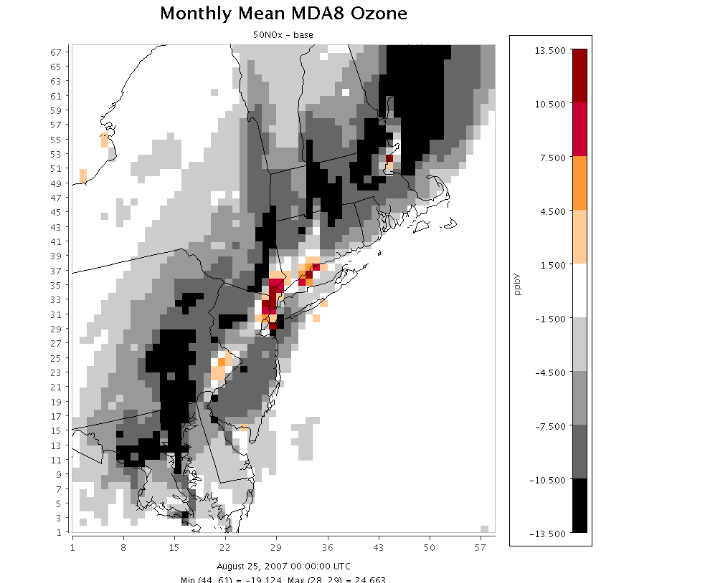
8-hr daily maximum O₃
4km base
12km base
Aug 25, 2007
4km
50NOx -base
12km
50NOx -base

Slide 16
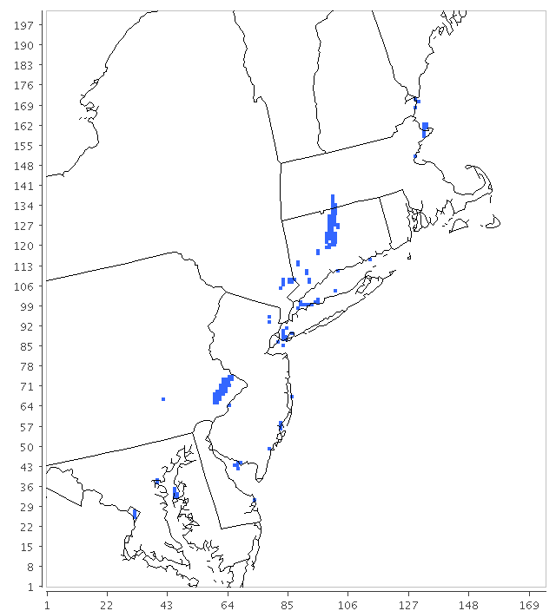
Locations with absolute changes > 2ppb in opposite directions
Aug 25, 2007
4km
50NOx -base
12km
50NOx -base

Slide 17
Examine ozone response at specific monitoring locations

Slide 18
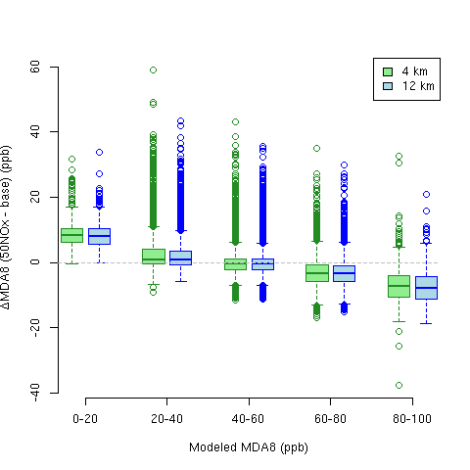
Aggregated across all days and all sites in the NE domain, 12km and 4km responses look similar

Slide 19
Examine ozone response at specific monitoring locations in the NY area
Upwind site:
  Flemington, NJ
NOx titration zone:
  Bayonne, NJ
  IS 52 (Bronx), NY
  Babylon, NY (sometimes)
Downwind sites:
  Babylon, NY (sometimes)
  Holtsville, NY
  White Plains, NY
  Sherwood Island, CT

Slide 20
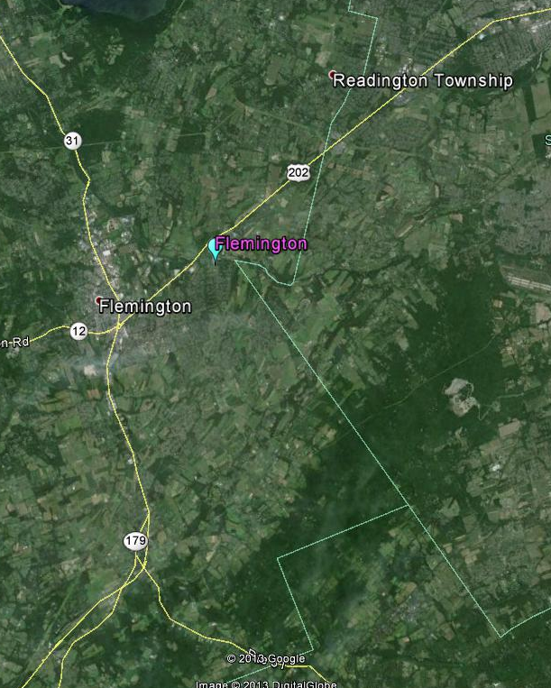
Flemington, NJ

Slide 21
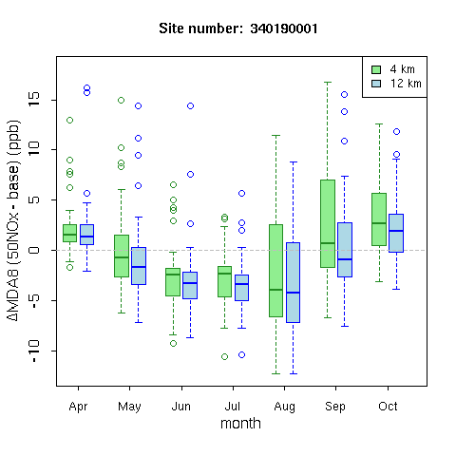
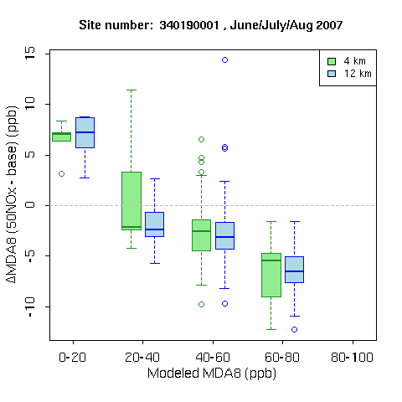
Flemington NJ:
Response in 8-h Daily Max Ozone to 50% NOx cut
By Month
By Ozone Conc

Slide 22
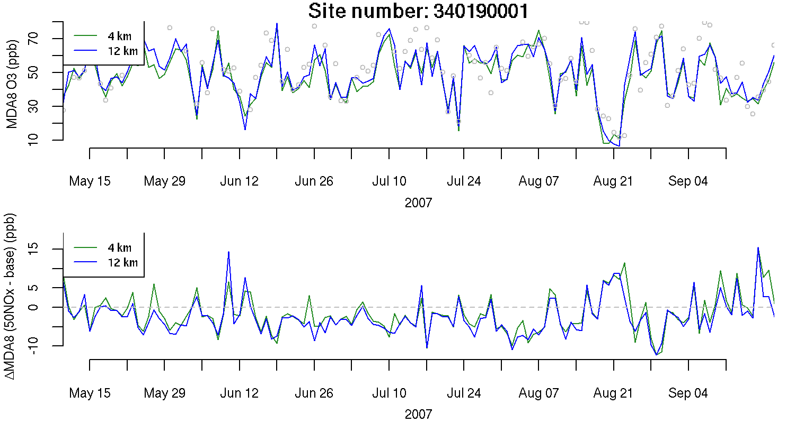
Flemington NJ: Time Series

Slide 23
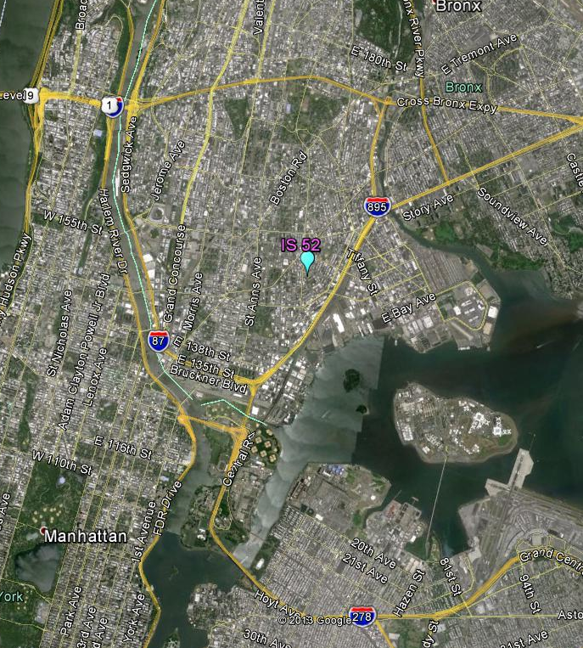
IS 52 (Bronx), NY

Slide 24
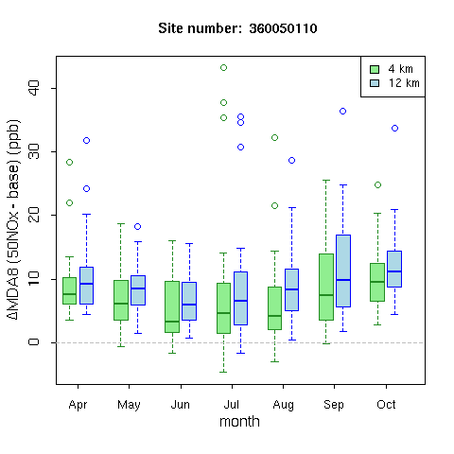
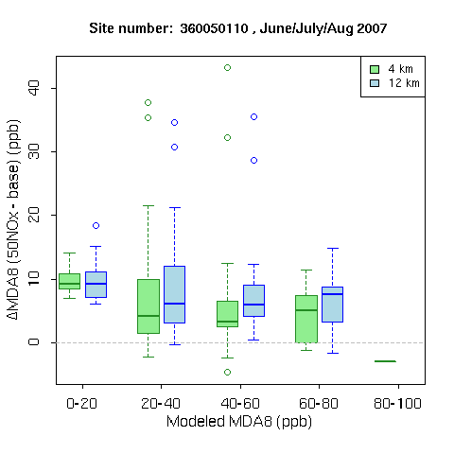
Bronx NY:
Response in 8-h Daily Max Ozone to 50% NOx cut
By Month
By Ozone Conc

Slide 25
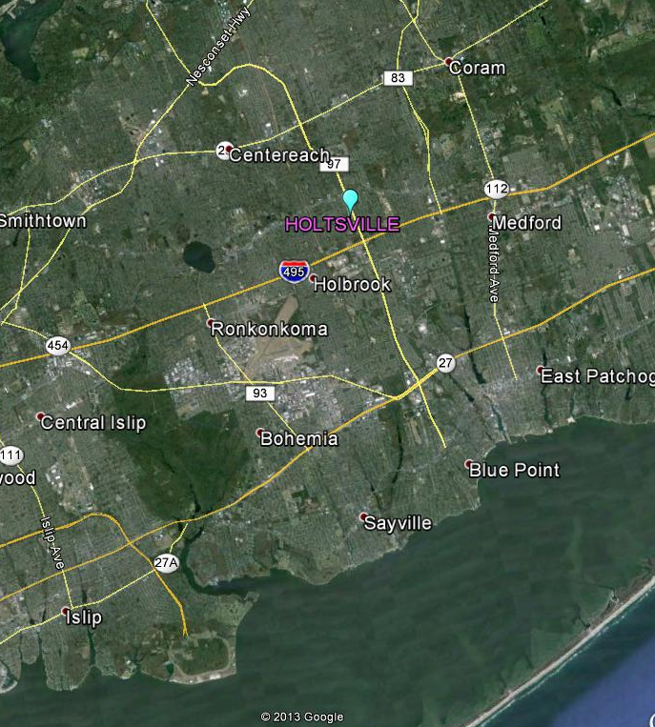
Holtsville, NY

Slide 26
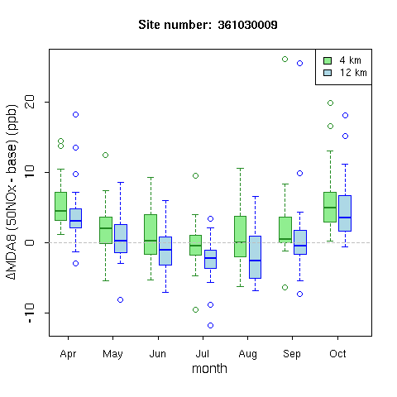
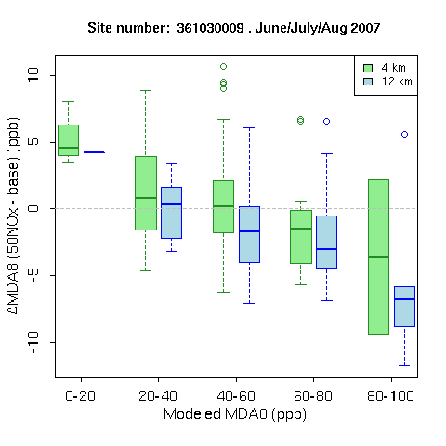
Holtsville NY:
Response in 8-h Daily Max Ozone to 50% NOx cut
By Month
By Ozone Conc

Slide 27
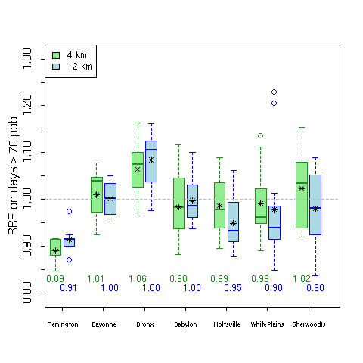
Small Differences in Absolute Response (ppb) may be important for design values
Holtsville:
  Difference of 0.04 in 12km vs 4km RRF
  2006-2008 DV = 86
  Leads to > 3ppb difference in projected DV
Sherwood Island:
  Difference of 0.04 in 12km vs 4km RRF
  2006-2008 DV = 87
  Leads to > 3ppb difference in projected DV

Slide 28
Summary
4km and 12km resolution simulation show similar spatial and temporal patterns for ozone and ozone response
  Lower ozone and more disbenefits in cooler months
  More disbenefits over highly urbanized areas of NYC, Boston, and Baltimre/D.C.
At specific times and locations, response can vary substantially between the two simulations
Larger ozone disbenefits in response to 50% NOx cuts can be seen in either the 4km or 1k2m simulation at specific times and locations
Differences between 4km and 12km resolution simulations could lead to differences in projected design values by over 3 ppb

Slide 29
Extra Plots

Slide 30
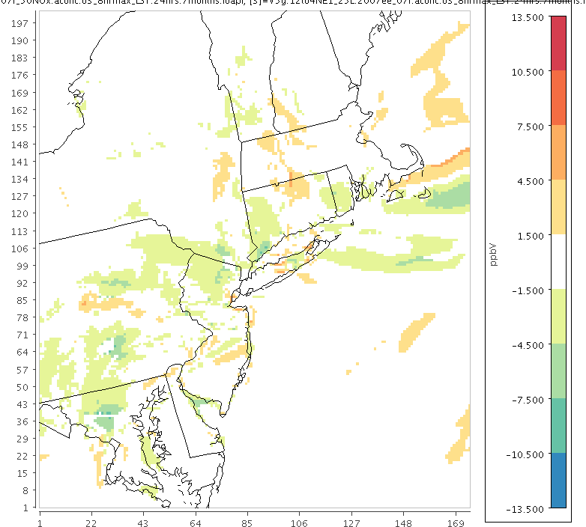
May 31, 2007
Difference in absolute MDA8 ozone benefits: 4km-12km
Orange = larger benefits in 4km sim
Green = smaller benefits in 4km sim
4km
50NOx -base
12km
50NOx -base

Slide 31
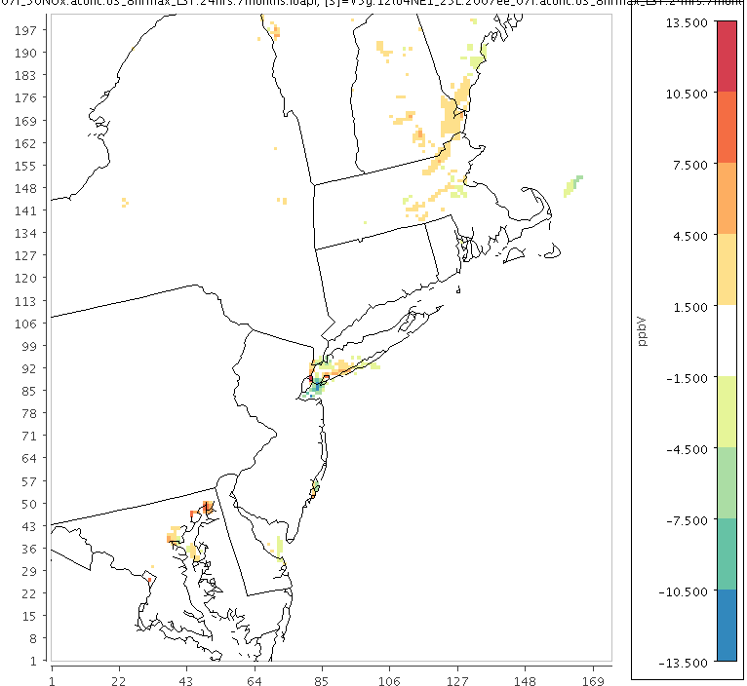
May 31, 2007
Difference in absolute MDA8 ozone dibenefits: 4km-12km
Orange = larger disbenefits in 4km sim
Green = smaller disbenefits in 4km sim
4km
50NOx -base
12km
50NOx -base

Slide 32
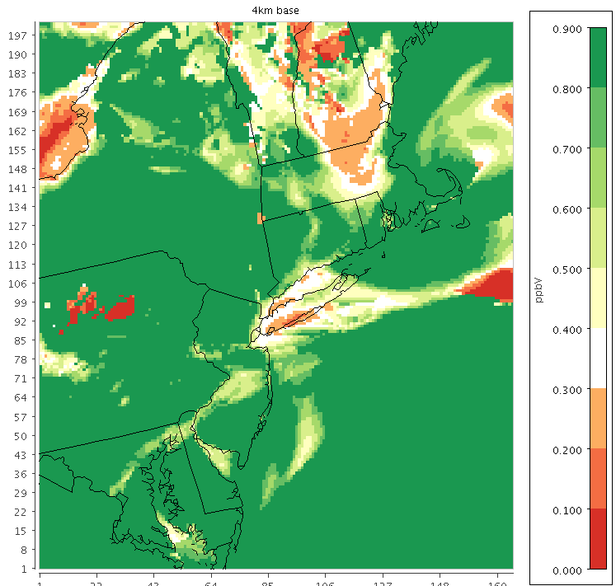
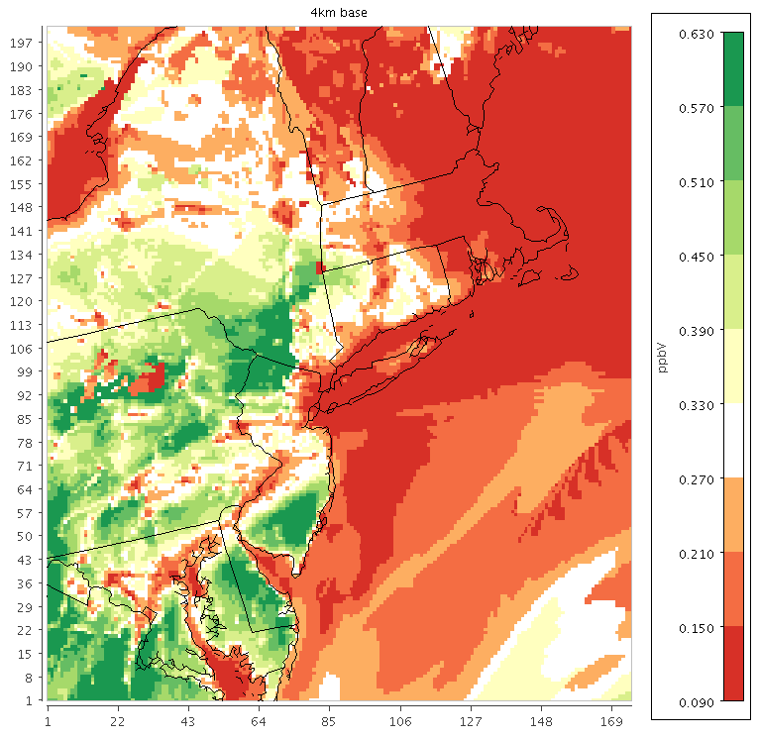
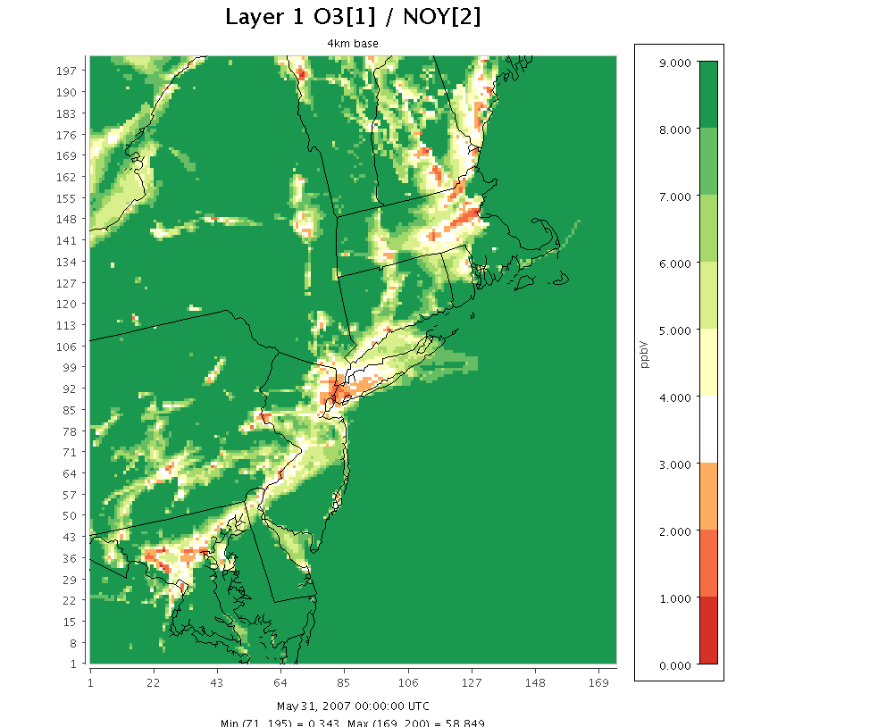
May 31, 2007
4km
50NOx -base
4km
H2O2/HNO3
H2O2/HNO3
Transition point = 0.035
(Sillman, 1995)
FORM/NOY
Transition point = 0.28
(Zhang et al, 2009)
O3/NOy
Transition point = 3.5
Zhang et al, 2009 recommend 7-15
4km
FORM/NOY
4km
O3/NOY

Slide 33
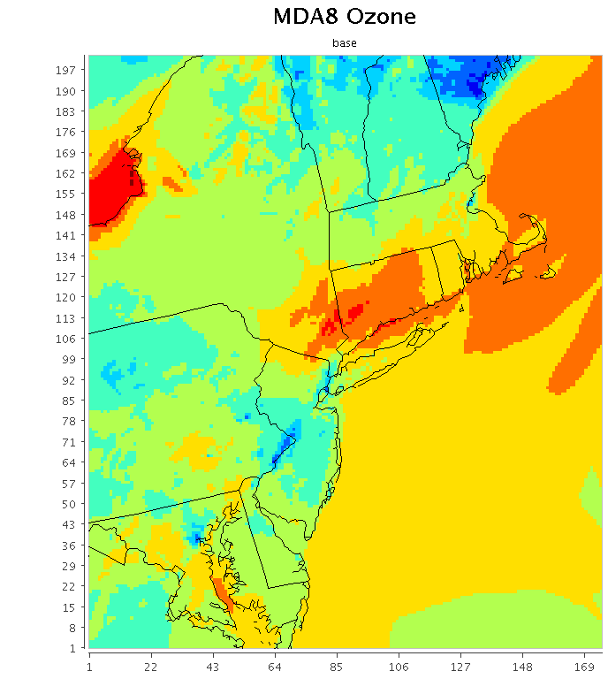
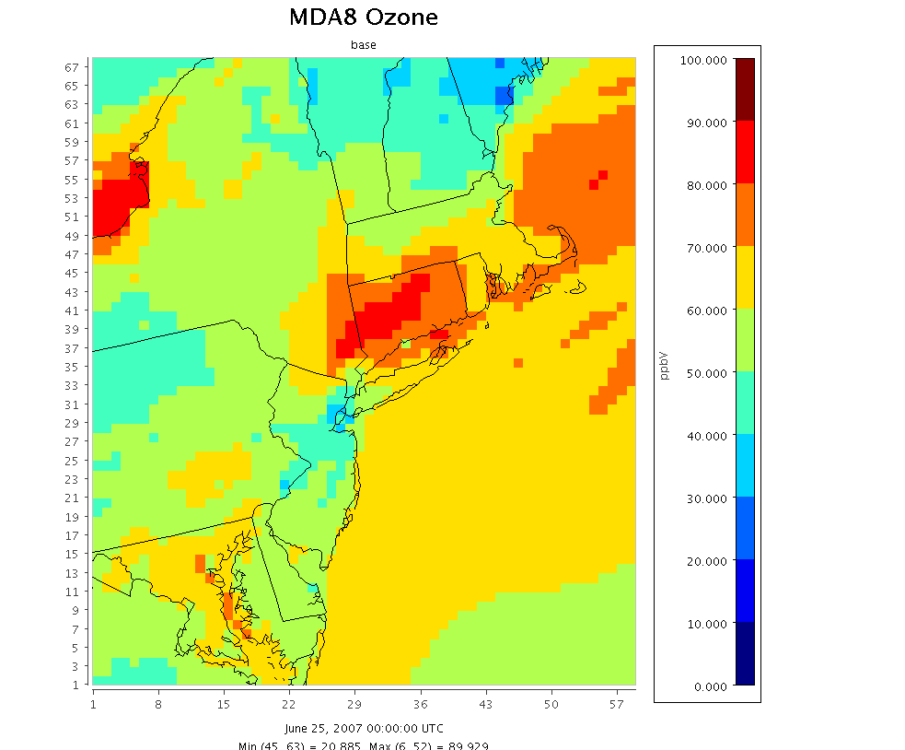
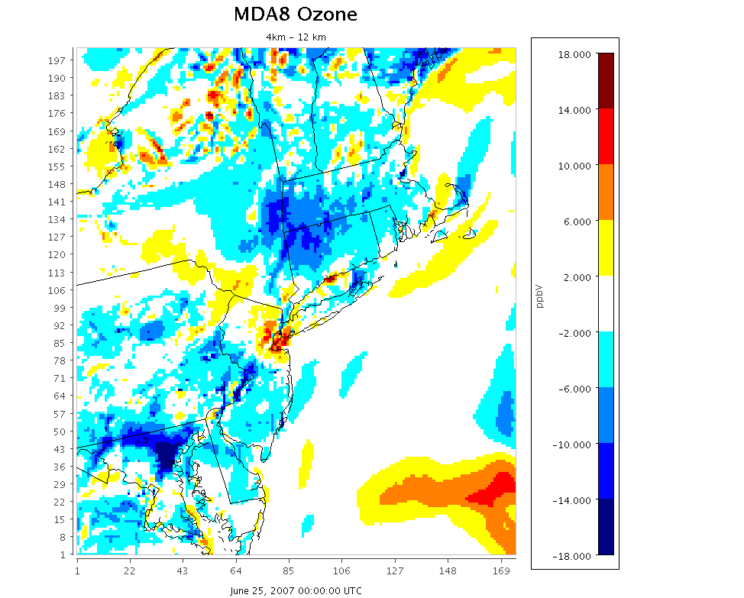
4km base
12km base
June 25, 2007
4km – 12km

Slide 34
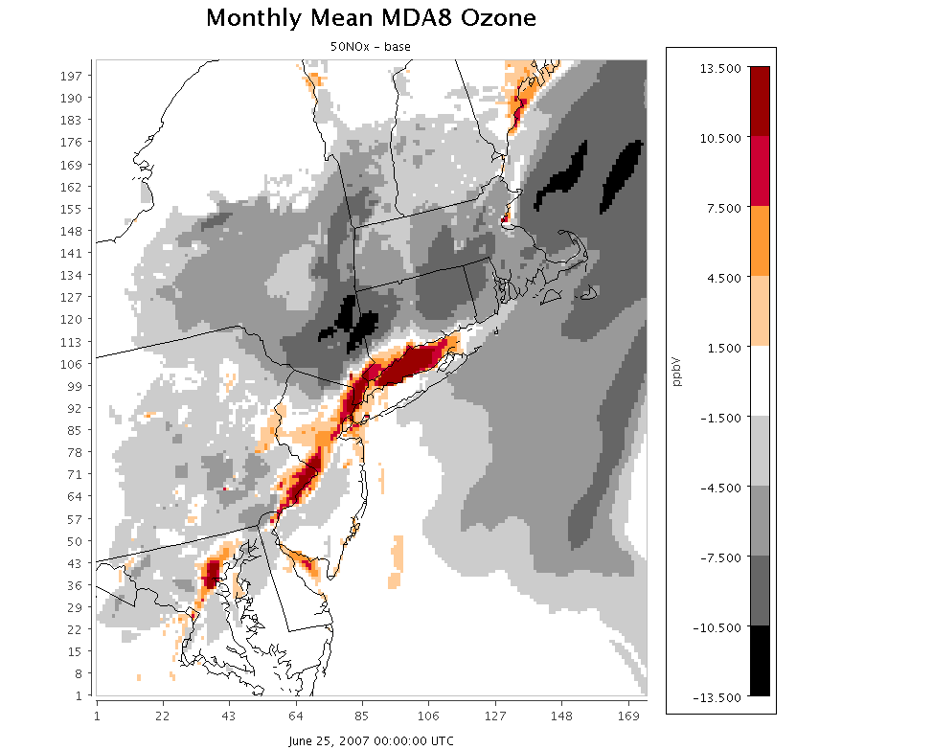
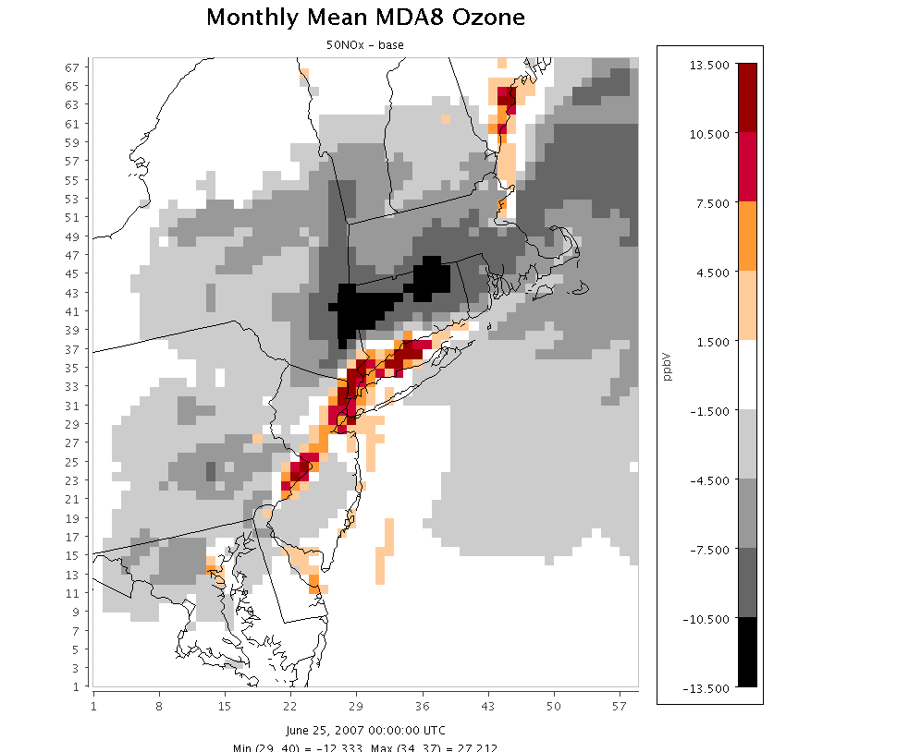
4km base
12km base
June 25, 2007
4km
50NOx -base
12km
50NOx -base

Slide 35



June 25, 2007
4km
50NOx -base
4km
H2O2/HNO3
H2O2/HNO3
Transition point = 0.035
(Sillman, 1995)
FORM/NOY
Transition point = 0.28
(Zhang et al, 2009)
O3/NOy
Transition point = 7
(Zhang et al, 2009)
O3/NOy
Transition point = 3.5
Zhang et al, 2009 recommend 7-15
4km
FORM/NOY
4km
O3/NOY

Slide 36

Locations with absolute changes > 2ppb in opposite directions
June 25, 2007
4km
50NOx -base
12km
50NOx -base

Slide 37

Difference in absolute MDA8 ozone benefits: 4km-12km
Orange = larger benefits in 4km sim
Green = smaller benefits in 4km sim
June 25, 2007
4km
50NOx -base
12km
50NOx -base

Slide 38

Difference in absolute MDA8 ozone disbenefits: 4km-12km
Orange = larger disbenefits in 4km sim
Green = smaller disbenefits in 4km sim
June 25, 2007
4km
50NOx -base
12km
50NOx -base

Slide 39

4km base
12km base
July 17, 2007
4km – 12km

Slide 40


4km base
12km base
July 17, 2007
4km
50NOx -base
12km
50NOx -base

Slide 41


July 17, 2007
4km
50NOx -base
4km
H2O2/HNO3
H2O2/HNO3
Transition point = 0.035
(Sillman, 1995)
FORM/NOY
Transition point = 0.28
(Zhang et al, 2009)
O3/NOy
Transition point = 7
(Zhang et al, 2009)
O3/NOy
Transition point = 3.5
Zhang et al, 2009 recommend 7-15
4km
FORM/NOY
4km
O3/NOY

Slide 42

Locations with absolute changes > 2ppb in opposite directions
July 17, 2007
4km
50NOx -base
12km
50NOx -base

Slide 43

Difference in absolute MDA8 ozone benefits: 4km-12km
Orange = larger benefits in 4km sim
Green = smaller benefits in 4km sim
July 17, 2007
4km
50NOx -base
12km
50NOx -base

Slide 44

Difference in absolute MDA8 ozone disbenefits: 4km-12km
Orange = larger disbenefits in 4km sim
Green = smaller disbenefits in 4km sim
July 17, 2007
4km
50NOx -base
12km
50NOx -base

Slide 45




4km base
12km base
Aug 8, 2007
4km
50NOx -base
12km
50NOx -base

Slide 46



Aug 8, 2007
4km
50NOx -base
4km
H2O2/HNO3
H2O2/HNO3
Transition point = 0.035
(Sillman, 1995)
FORM/NOY
Transition point = 0.28
(Zhang et al, 2009)
O3/NOy
Transition point = 7
(Zhang et al, 2009)
O3/NOy
Transition point = 3.5
Zhang et al, 2009 recommend 7-15
4km
FORM/NOY
4km
O3/NOY

Slide 47

4km base
12km base
Aug 8, 2007
4km – 12km

Slide 48

Locations with absolute changes > 2ppb in opposite directions
Aug 8, 2007
4km
50NOx -base
12km
50NOx -base

Slide 49

Difference in absolute MDA8 ozone benefits: 4km-12km
Orange = larger benefits in 4km sim
Green = smaller benefits in 4km sim
Aug 8, 2007
4km
50NOx -base
12km
50NOx -base

Slide 50

Difference in absolute MDA8 ozone disbenefits: 4km-12km
Orange = larger disbenefits in 4km sim
Green = smaller disbenefits in 4km sim
Aug 8, 2007
4km
50NOx -base
12km
50NOx -base

Slide 51

Difference in absolute MDA8 ozone benefits: 4km-12km
Orange = larger benefits in 4km sim
Green = smaller benefits in 4km sim
Aug 25, 2007
4km
50NOx -base
12km
50NOx -base

Slide 52

Difference in absolute MDA8 ozone disbenefits: 4km-12km
Orange = larger disbenefits in 4km sim
Green = smaller disbenefits in 4km sim
Aug 25, 2007
4km
50NOx -base
12km
50NOx -base

Slide 53


Aug 25, 2007
4km
50NOx -base
4km
H2O2/HNO3
H2O2/HNO3
Transition point = 0.035
(Sillman, 1995)
FORM/NOY
Transition point = 0.28
(Zhang et al, 2009)
O3/NOy
Transition point = 7
(Zhang et al, 2009)
O3/NOy
Transition point = 3.5
Zhang et al, 2009 recommend 7-15
4km
FORM/NOY
4km
O3/NOY

Slide 54
IS 52 (Bronx), NY

Slide 55

Bronx NY: Time Series

Slide 56

Bayonne, NJ

Slide 57


Bayonne, NJ:
Response in 8-h Daily Max Ozone to 50% NOx cut
By Month
By Ozone Conc

Slide 58

Bayonne NJ: Time Series

Slide 59

Babylon, NY

Slide 60


Babylon NY:
Response in 8-h Daily Max Ozone to 50% NOx cut
By Month
By Ozone Conc

Slide 61

Babylon NY: Time Series

Slide 62
Holtsville, NY

Slide 63

Holtsville NY: Time Series

Slide 64

White Plains, NY

Slide 65


White Plains NY:
Response in 8-h Daily Max Ozone to 50% NOx cut
By Month
By Ozone Conc

Slide 66

White Plains NY: Time Series

Slide 67

Sherwood Island, CT

Slide 68


Sherwood Island CT:
Response in 8-h Daily Max Ozone to 50% NOx cut
By Month
By Ozone Conc

Slide 69

Sherwood Island CT: Time Series

