Slide 1
Summary of the Emission Inventories compiled for the AQMEII Phase 2 Simulations
George Pouliot, Christian Hogrefe, Ryan Cleary,
Junhua Zhang, Mike Moran,Paul Makar, Shawn Roselle, Rohit Mathur
12th Annual CMAS Conference, Chapel Hill NC
October 29, 2013
Office of Research and Development
National Exposure Research Laboratory Atmospheric Modeling and Analysis Division
October 29 2013

Slide 2
What is AQMEII?
AQMEII – Air Quality Modeling Evaluation International Initiative
Promote research on regional air quality model evaluation across the European and North American atmospheric modeling communities
Exchange of information on practices
Realization of inter-community activities
Identification of research priorities
First Workshop was held in April 2009; most recent was the 5th workshop in August 2013

Slide 3
What is AQMEII Phase 2?
Build credibility for coupled models and provide a better representation of feedback processes,
aerosol, radiation, and cloud interactions and changes in air quality-climate interactions
Large reduction in the emissions of SO₂ and NO_{x} from both electric power and motor vehicle sectors in the United States and Europe during the past 20 years.
Examine coupled regional-scale models’ ability to properly simulate the changes observed in surface radiation, temperature, and concentrations from emission reductions from regulatory programs implemented in North America and Europe over the past few decades

Slide 4
Purpose of this presentation
Analysis of emissions used in modeling exercise to help the understanding of the model results (dynamic evaluation)
Provide an idea of what types of analysis we are doing in conjunction with the rest of the AQMEII phase 2 project
Focus on US (and NA) in the presentation, but hope to do joint analysis with EU
Extend what was done in phase 1 emissions paper:
“Comparing emission inventories and model-ready emission datasets between Europe and North America for the AQMEII project” (Pouliot et al, 2012)

Slide 5
Emission Inventories
Emission Inventories prepared for 2006 and 2010 for the modeling simulations will be compared
Some of the Comparisons:
Changes in Criteria pollutants between 2006 and 2010
Compare with EPA Trends data (Caution!)
Compare 2006 AQMEII phase 2 with AQMEII phase 1
Focus on NO_{x} and SO₂ emissions for this presentation but will include some of the other criteria pollutants.

Slide 6
US Sectors Used for NA Emissions in Phase 2
Emissions supplied for 12 US sectors typically used by U.S. EPA for regulatory modeling
Source Type | Description
afdust | Area source fugitive dust from anthropogenic sources, PM10 & PM_{2.5} only
ag | Area source emissions from agricultural operations, NH₃ only
agfire | Area source emissions from crop residue burning
c1c2rail | Area source emissions from aircraft, locomotive, and marine (except class 3 vessels) (Aircraft includes only takeoff, landing, and ground operations.)
c3marine | Commercial marine port and inter-port Class 3 (C3) vessels defined as having displacement greater than 30 liters per cylinder.
nonpt | Area source emissions not included in other sectors (e.g., residential wood combustion)
nonroad | Off-road mobile source emissions from EPA’s National Mobile Inventory Model (NMIM)
onroad | On-road mobile source emissions using SMOKE/MOVES system
ptipm | Electric generating unit (EGU) point source emissions, includes Continuous Emission Monitoring (CEM) hourly data
ptnonipm | Non-EGU point source emissions (industrial source and no power generation)
ptfire | Wildland fires and prescribed burning fire emissions modeled as point sources
rwc | Residential Wood Combustion

Slide 7
Canada/Mexico Sectors Used for NA Emissions in Phase 2
Emissions supplied for 8 sectors typically used by U.S. EPA for regulatory modeling
Source Type | Description
canafdust | 2006 Canada Area source fugitive dust from anthropogenic sources, PM10 & PM_{2.5} only
canag | 2006 Canada Area source emissions from agricultural operations, NH₃ only
canar | 2006 Area source emissions not included in other sectors including nonroad from Canada excluding c3marine emissions (included in US inventory); also included are c1c2 marine emissions, rail emissions, and aircraft emissions
canon | 2006 Canada On-road mobile source emissions
canpt | 2006 Canada point source emissions
Mexar | 1999 Mexico area sources
mexon | 1999 Mexico onroad sources
mexpt | 1999 Mexico point sources

Slide 8
2006 North American Emissions
Comprised of data from the United States, Canada, and Mexico
Primary basis: U.S. EPA’s 2008 National Emission Inventory, version 2 (NEIv3), translated onto the 2007/2008 modeling platform described in EPA’s Technology Transfer Network Clearinghouse for Inventories and Emissions Factors (TTN/CHIEF)
2006-Specific Updates for AQMEII:
2006 Continuous Emission Monitoring (CEM) data of SO₂ and NO_{x} from major point sources
2006 wildfires (US only), daily with hourly plume rise
2006 Canadian emissions and spatial surrogates
2005 MOVES emission factors with 2006 VMT (US only)
Pollutants: NO_{x}, VOC, CO, SO₂, NH₃, PM_{2.5}, and PM₁₀

Slide 9
2010 North American Emissions
Comprised of data from the United States, Canada, and Mexico
Primary basis: U.S. EPA’s 2008 National Emission Inventory, version 2 (NEIv3), translated onto the 2007/2008 modeling platform described in EPA’s Technology Transfer Network Clearinghouse for Inventories and Emissions Factors (TTN/CHIEF)
2010-Specific Updates for AQMEII:
2010 Continuous Emission Monitoring (CEM) data of SO₂ and NO_{x} from major point sources
2010 wildfires (US only), daily with hourly plume rise
2009 MOVES emission factors with 2010 VMT (US only)
Pollutants: NO_{x}, VOC, CO, SO₂, NH₃, PM_{2.5}, and PM₁₀

Slide 10
Processing of NA Emissions for Phase 2 (EPA)
Emission Processing
Performed using SMOKE system version 3.0
Temporal allocation:
Hour-specific for major point sources equipped with Continuous Emission Monitors (CEM), wildfire emissions, and biogenic emissions
Annual emissions allocated to individual hours based on source-specific monthly, weekly, and diurnal factors
Speciation:
VOC speciated both for the CB-05 and SAPRC07 mechanism based on source-specific profiles
Primary PM_{2.5} emissions split into sulfate, nitrate, EC, OC, and other primary PM_{2.5}
Spatial allocation:
12km by 12km modeling grid using a Lambert Conformal projection
Used 60+ spatial surrogates (population, roadways, railroads, ports, etc.) to perform source-specific spatial allocation of county-based emissions to the modeling grid
No spatial allocation was performed for point sources because the exact latitude and longitude are known

Slide 11
Source: Derived from US EPA Trends Data: http://www.epa.gov/ttn/chief/trends/
(1970 - 2012 Average annual emissions, all criteria pollutants in MS Excel - June 2013

Slide 12
Source: Derived from US EPA Trends Data: http://www.epa.gov/ttn/chief/trends/
(1970 - 2012 Average annual emissions, all criteria pollutants in MS Excel - June 2013

Slide 13
2006 Emission Estimates across all sectors in thousands of short tons
Pollutant | AQMEII Phase 1 (Full Domain) | AQMEII Phase 2 (Full Domain) | EPA Trends estimate (US only*)
SO2 | 16,839 | 15,477 | 13,320
NOx | 20,863 | 23,165 | 18,286
PM2.5 | 4,047 | 5,316 | 5,636
NH3 | 4,698 | 5,087 | 4,714
CO | 90,064 | 98,339 | 88,077
*includes wildfires from 2005NEI

Slide 14
2010 Emission Estimates across all sectors in thousands of short tons
Pollutant | AQMEII Phase 2 (Full Domain) | EPA Trends estimate (US only)
SO2 | 11,032 | 7,557
NOx | 19,060 | 14,310
PM2.5 | 4,663 | 5,636
NH3 | 4,963 | 4,714
CO | 75,797 | 88,077

Slide 15
2010 - 2006 Changes in emission Estimates across all sectors in thousands of short tons
Delta Emissions with % change in ()
Pollutant | 2010-2006 AQMEII Phase 2 (Full Domain) | 2010-2006 EPA Trends estimate (US only*)
SO2 | -4,445 (-29%) | -5,762 (-43%)
NOx | -4,105 (-18%) | -3,976 (-22%)
PM2.5 | -653 (-12%) | -309 (-5%)
NH3 | -124 (-2%) | +162 (+4%)
CO | -22,542 (-23%) | +14,403 (+20%)
*includes wildfires from 2005NEI and 2008 NEI

Slide 16
Basic Demographics and Related Statistics for US 2006 & 2010 (excluding AK,HI)
Year | Area(mi2) | Pop (millions) | Number of Vehicles (millions) | Electric Generating Capacity Millions GWHr
2006 | 2.95 | 296 | 243 | 4.06
2010 | 2.95 | 307 | 240 | 4.13
Sources:
http://quickfacts.census.gov/qfd/states/00000.html
http://www.fhwa.dot.gov/policy/ohim/hs06/htm/mv1.htm
http://www.fhwa.dot.gov/policyinformation/statistics/2010/mv1.cfm
http://www.eia.gov/electricity

Slide 17
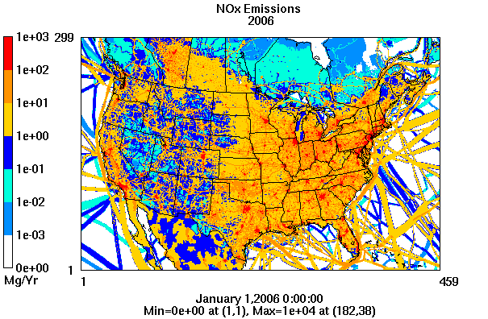
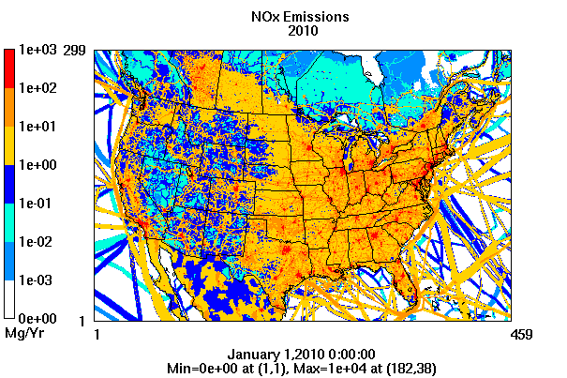
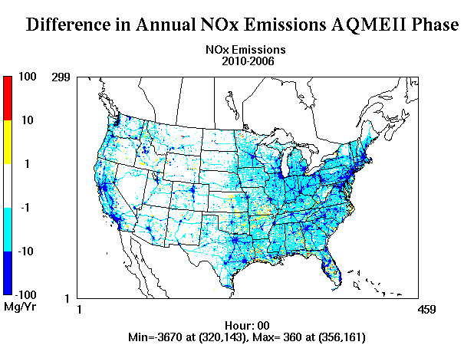
NOX Emissions Difference

Slide 18
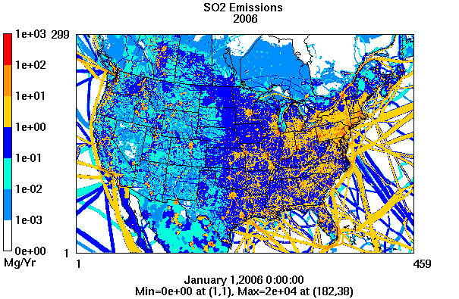
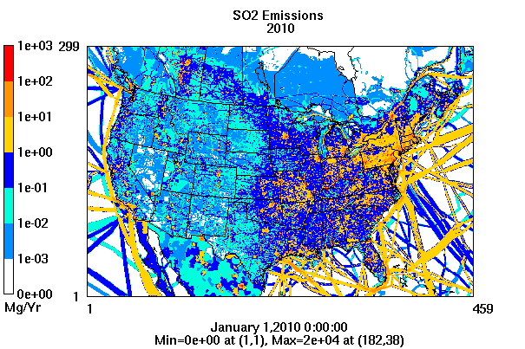
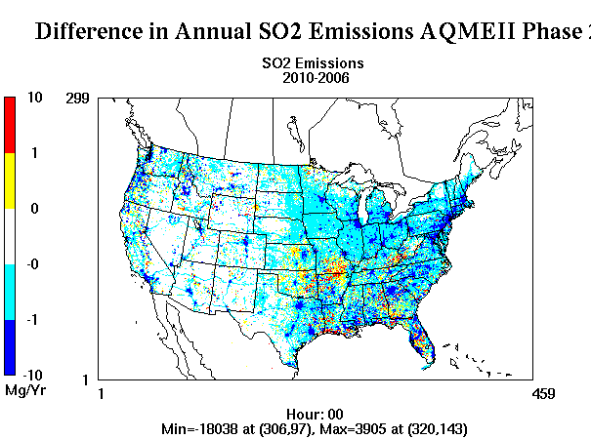
SO2 Emissions Difference

Slide 19
Further Steps
Do analysis for all Pollutants
Temporal Analysis
Biogenic/Natural Emissions Comparisons especially iosprene and monoterpenes
Include EU data and analysis?
Other?

Slide 20
For an overview and evaluation of the WRF/CMAQ model results, Christian Hogrefe’s Presentation
Overview and Evaluation of AQMEII Phase 2 Coupled Simulations over North America
Model Evaluation Session, Dogwood Room
Wednesday October 30, 2013 3:30 PM

