Slide 1
Evaluating the impact of increasing horizontal resolution on AIR QUALIY MODELLING SYSTEMS over big metropolitan areas in Spain
M.T. Pay¹, G. Arévalo¹, J. M. Baldasano^{1,2}
¹Earth Science Department, Barcelona Supercomputing Center, Spain
²Environmental Modelling Laboratory, Technical University of Catalonia, Spain
12th Annual CMAS Conference, Chapel Hill, NC, October 28-30, 2013

Slide 2
Introduction
Beside the challenges in understanding and representing physical and chemical processes, the most common limitation in geophysical modelling studies regards spatial resolution.
Disadvantages of increasing model horizontal resolution:
High resolution input data: meteorology, emission, land use, etc.
Increasing the computational costs
The selected grid resolution for a specific application should be an optimum which maximizes the model performance with the available computational and input data resources.

Slide 3
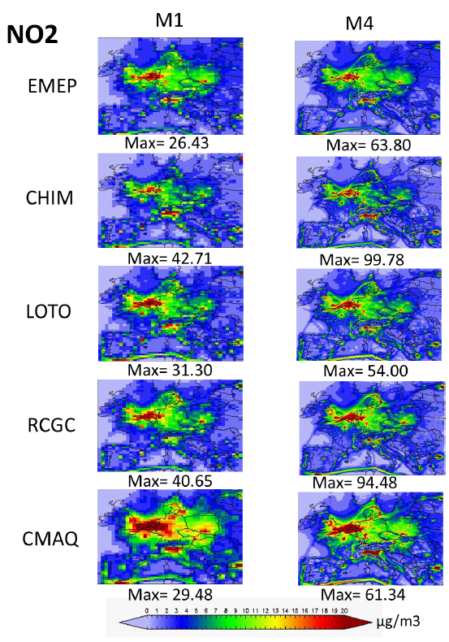
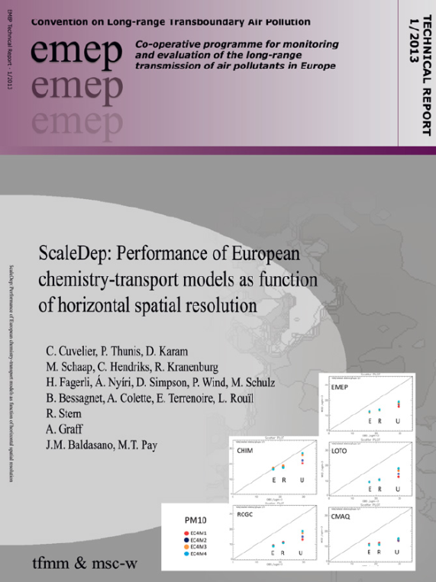
Introduction
The EMEP MSC-W models instrumental to the development of AQ policies in Europe since the late 1970s.
Since 1999, the EMEP model runs on a 50 km. Last years, modification of the EMEP grid has been discussed → grid resolution.
56 km
7 km
Test 4 horizontal resolutions:
56, 28, 14, and 7 km
Run at the BSC

Slide 4
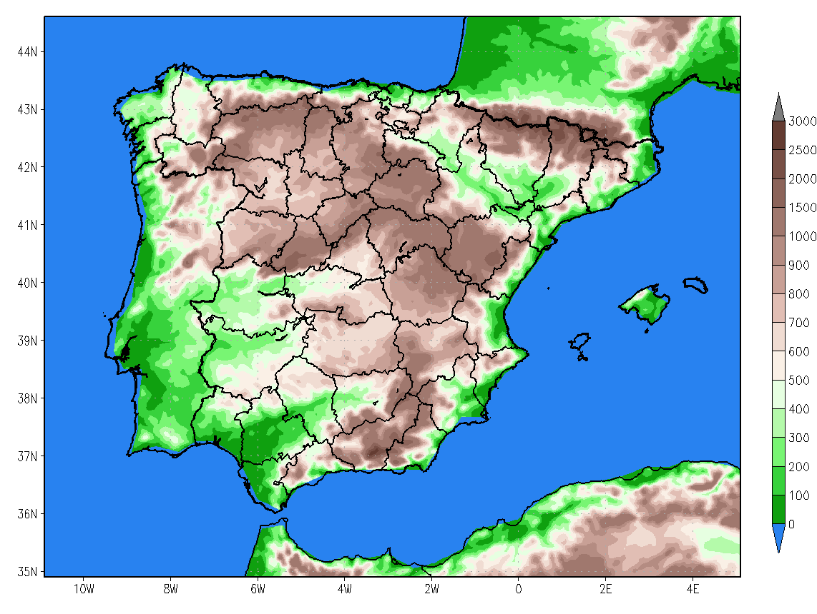
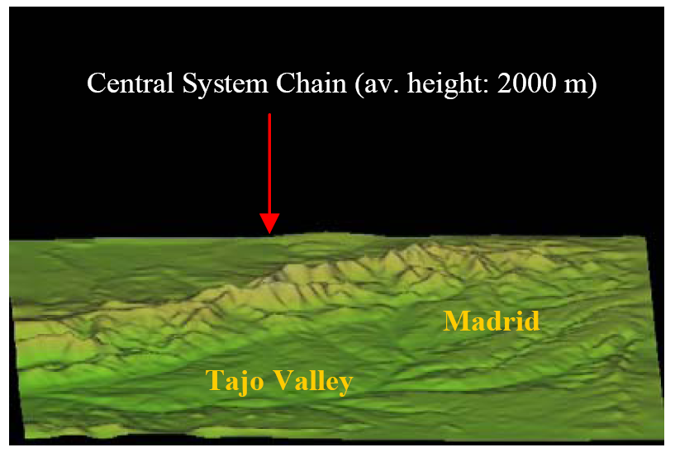
Objective
To analyse the effect of increasing horizontal resolution on model performance over three complex areas in Spain
BCN
Domains: Andalucía (AND), Barcelona (BCN), and Madrid (MAD)
Two hor. resolutions: 4 km and 1 km
CALIOPE AQFS
AQ pollutants:O₃, NO₂, SO₂, and PM10.
Study period: April 2013
MAD
AND
Iberian Massif (av. 2000 m)
AND
MAD
BCN
Guadalquivir Basin
Betic Range (av. 2500 m)

Slide 5
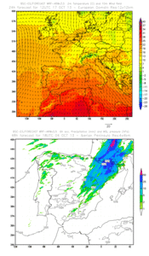
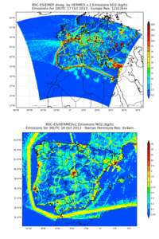
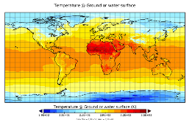
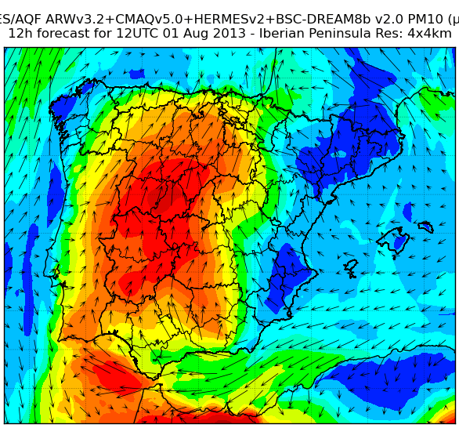
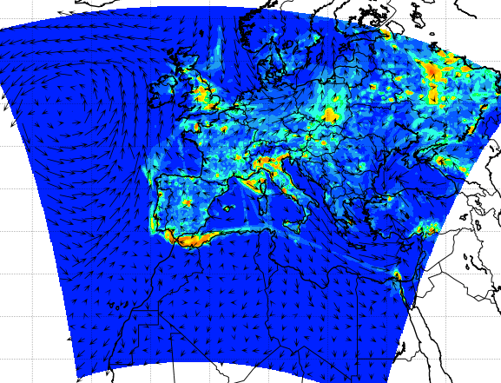
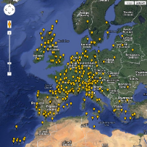
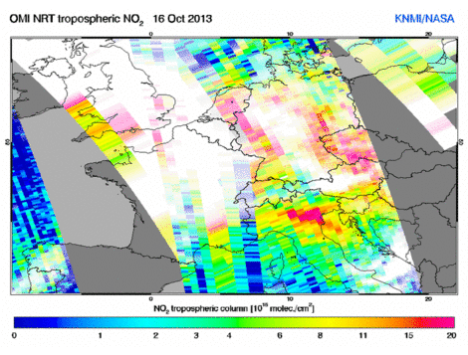
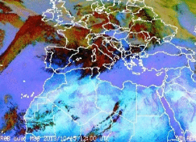
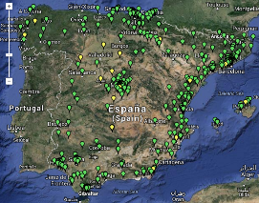
CALIOPE Air Quality Forecasting System (www.bsc.es/caliope)
Domains: Europe (12 km, 480x400 cells) and Spain (4 km, 399x399 cells)
Modules
Meteorology: WRF-ARW
Version 3.5
IBC: GFS (NCEP)
SST: SST MODEL (NCEP)
38 sigma levels (top 50 hPa)
Emissions: HERMES
Version 2
EU: HERMES-DIS (EMEP data)
Spain: HERMES-BOUP
Chemistry: CMAQ
Version 5.0.1
CB05
Aerosol module (AERO5)
BC: NCAR MOZART4 model
15 sigma levels (top 50 hPa)
Mineral dust: BSC-DREAM8b v2
Post-process by Kalman filter
Evaluation:
NRT-ground level observations
Satellite
Ozone soundings
METEOROLOGICAL
FORECAST
WRF-ARW
EMISSION FORECAST
HERMES v2
(12 km x 12 km)
(12 km x 12 km)
NCEP GLOBAL SIMULATIONS
Initial and boundary conditions
(4 km x 4 km)
(4 km x 4 km)
AIR QUALITY FORECAST CMAQ
NCAR MOZART4
Boundary Conditions
SAHARAN DUST OUTBREAKS
BSC-DREAM8b v2
(12 km x 12 km)
(4 km x 4 km)
(50 km x 50 km)
AIR QUALITY FORECAST EVALUATION
METEO. OBSERVATIONS
SATELLITE OBSERVATIONS
AQ POLLUTANT OBSERVATIONS
Notes:
5
30/10/2013

Slide 6
CALIOPE AQFS: domains, resolution and emission approach
HERMES - DIS
HERMES - BOUP
12 km x 12 km
4 km x 4 km
aggregation
1 km x 1 km
D6
146x158 cells
399x399 cells
D5
480x400 cells
146x146 cells
→ This study
D4
666x358 cells
Adapted from: Guevara et al., AE 2013

Slide 7
Evaluation method
 | AND |  | BCN |  | MAD |  | Total
 | 80 |  | 46 |  | 45 |  | 171
Pollutant
O₃ | 49 |  | 30 |  | 36 |  | 115
NO₂ | 73 |  | 34 |  | 45 |  | 152
SO₂ | 63 |  | 31 |  | 19 |  | 113
PM10 | 54 |  | 15 |  | 33 |  | 102
Area |  | % |  | % |  |  |  | %
Urb | 37 | 46 | 21 | 46 | 32 | 71 | 90 | 53
Subur | 28 | 35 | 18 | 39 | 7 | 16 | 53 | 31
Rur | 15 | 19 | 7 | 15 | 6 | 13 | 28 | 16
BCN
MAD
AND
Urban
Suburban
Rural
→ Data has not been validated
Modelled concentrations are compared against observations from the Spanish monitoring network providing Near Real Time (NRT) measurements on an hourly basis.
The evaluation is based on the annual analysis of classical statistics such as correlation coefficient (r), Mean Bias (MB), and Root Mean Square Error (RMSE) performed on an hourly basis.

Slide 8
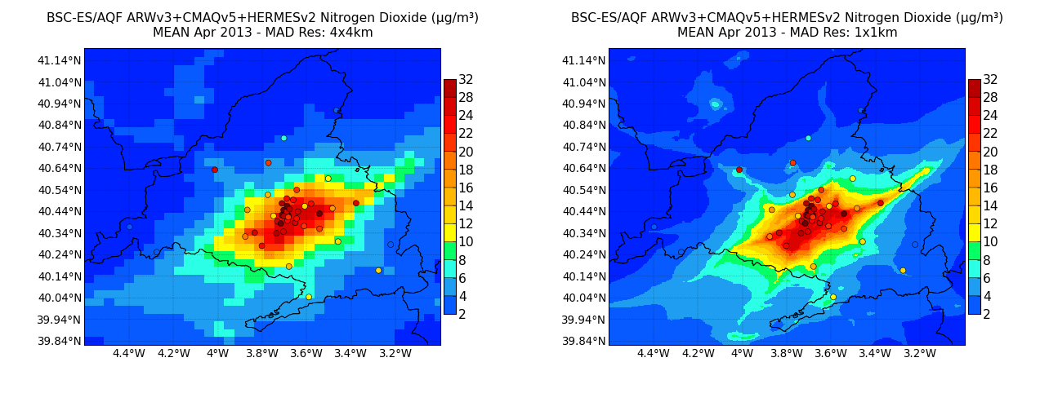
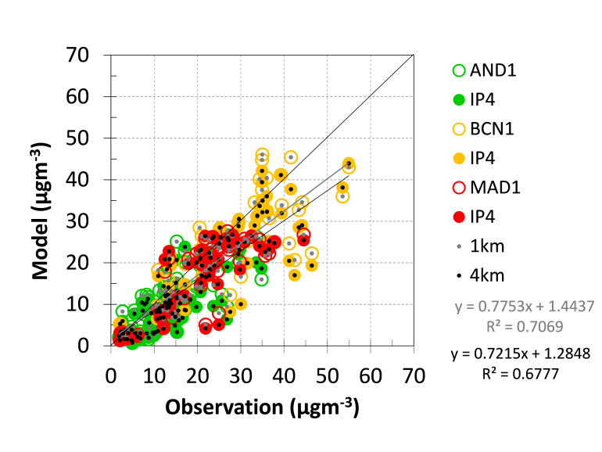
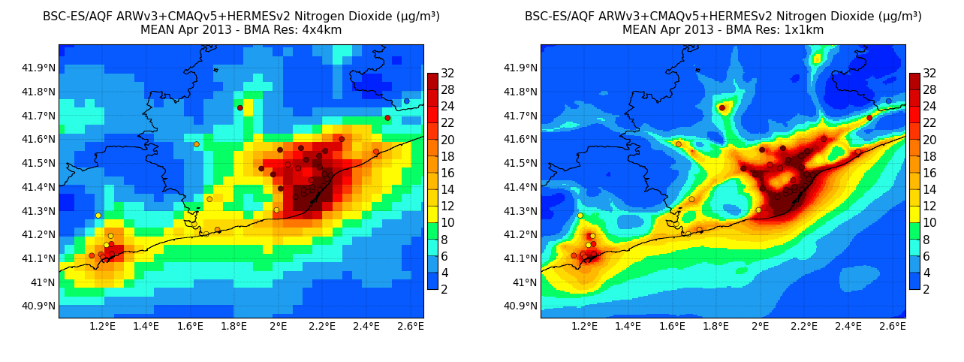
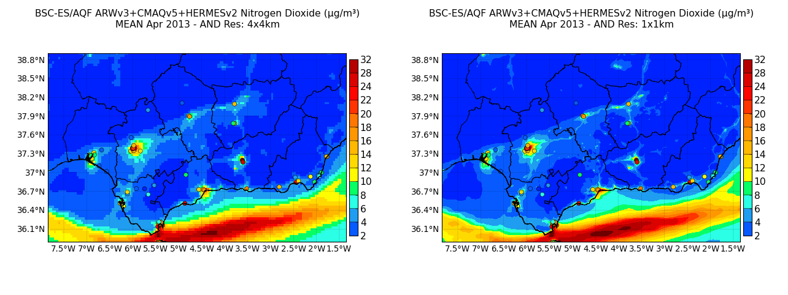
Forecasted NO₂: mean concentration April 2013
Spatial correlation by domain
 | IP4 | IP1
All | 0.82 | 0.84
AND | 0.71 | 0.74
BCN | 0.72 | 0.73
MAD | 0.77 | 0.80

Slide 9
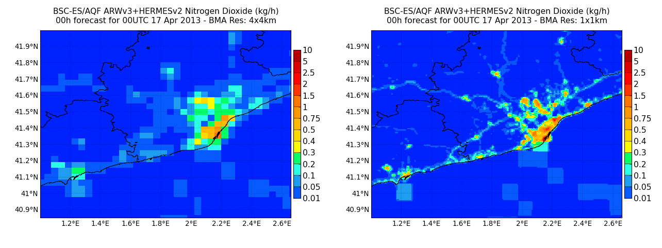
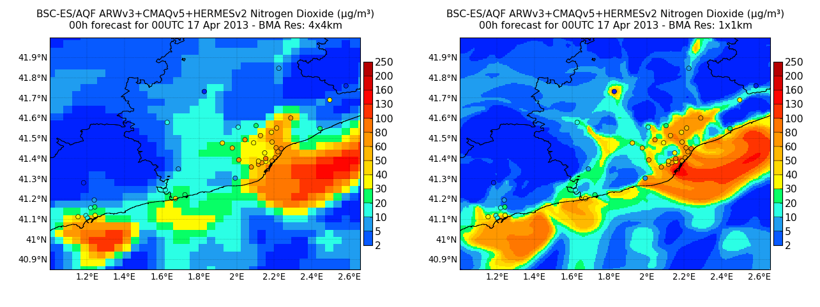
NO₂ dynamic: emissions vs. concentrations
BCN

Slide 10
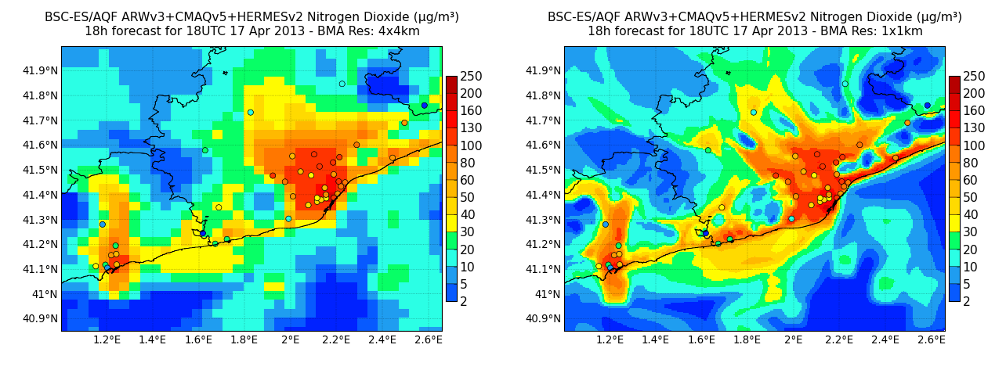
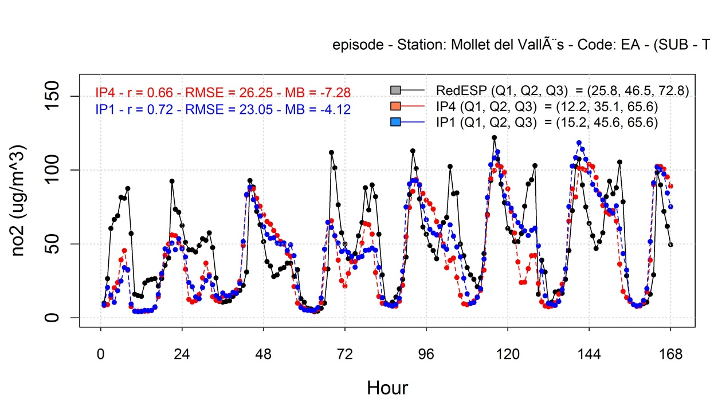
Traffic station
Mollet
Mollet
Period: from 12-April to 18 April, station: Mollet (traffic)
NO₂ (µg/m³)

Slide 11
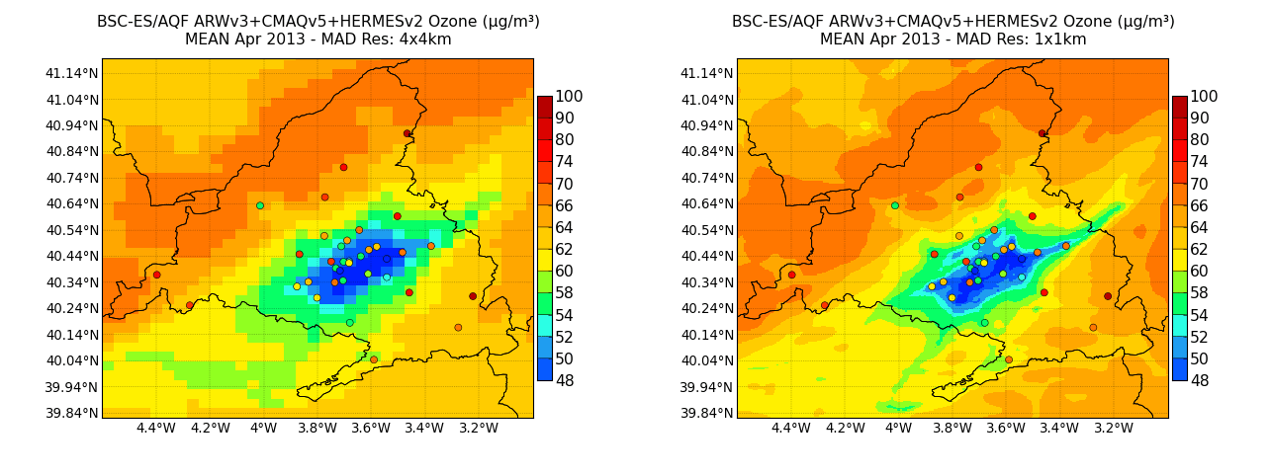
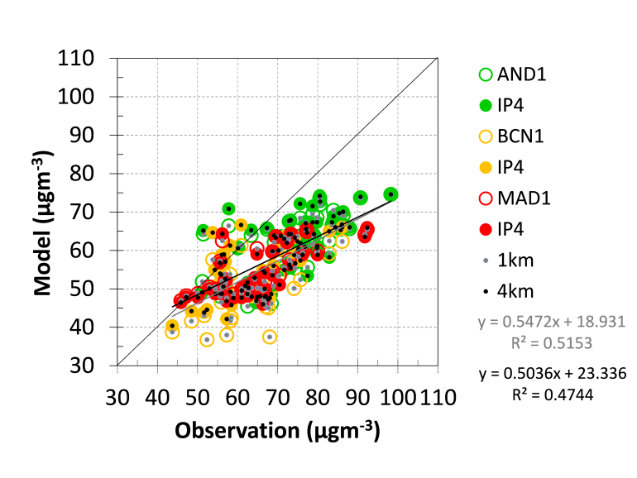
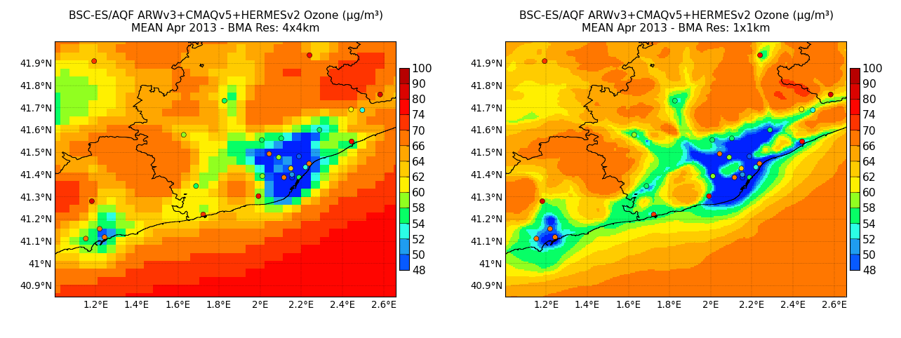
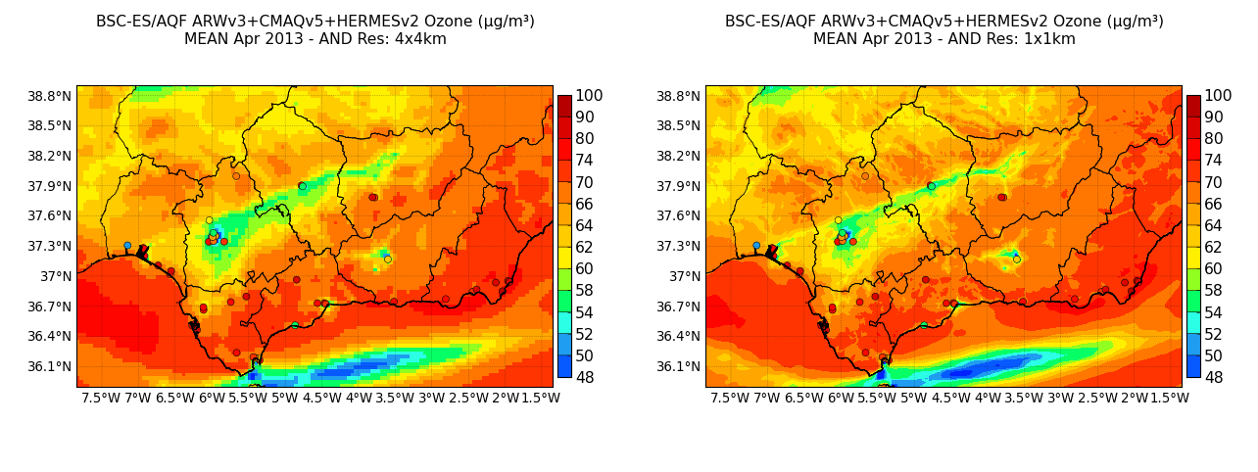
Forecasted O₃: mean concentration April 2013
Spatial correlation by domain
 | IP4 | IP1
all | 0.69 | 0.72
AND | 0.57 | 0.64
BCN | 0.54 | 0.55
MAD | 0.71 | 0.73

Slide 12
Statistics by pollutant & station type
Negative effect of resolution increase
Positive effect of resolution increase
NO₂
O₃
SO₂
PM10
~
~
~
~
161 25 50 86 67 57 37
115 21 37 57 66 28 21
113 17 35 61 38 53 22
102 15 31 56 43 39 20
Enviro.
Source
→ Improvements for NO₂ (lesser extend SO₂) and near large sources

Slide 13
Statistics by domain
Negative effect of resolution increase
Positive effect of resolution increase
NO₂
O₃
SO₂
PM10
≈
≈
161 45 73 43
115 36 49 30
113 19 63 31
102 33 54 15
→ Improvements at MAD for all the pollutant

Slide 14
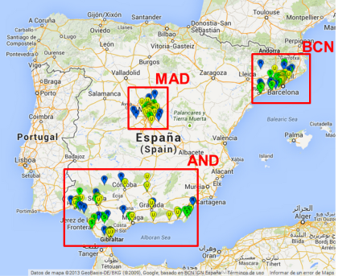
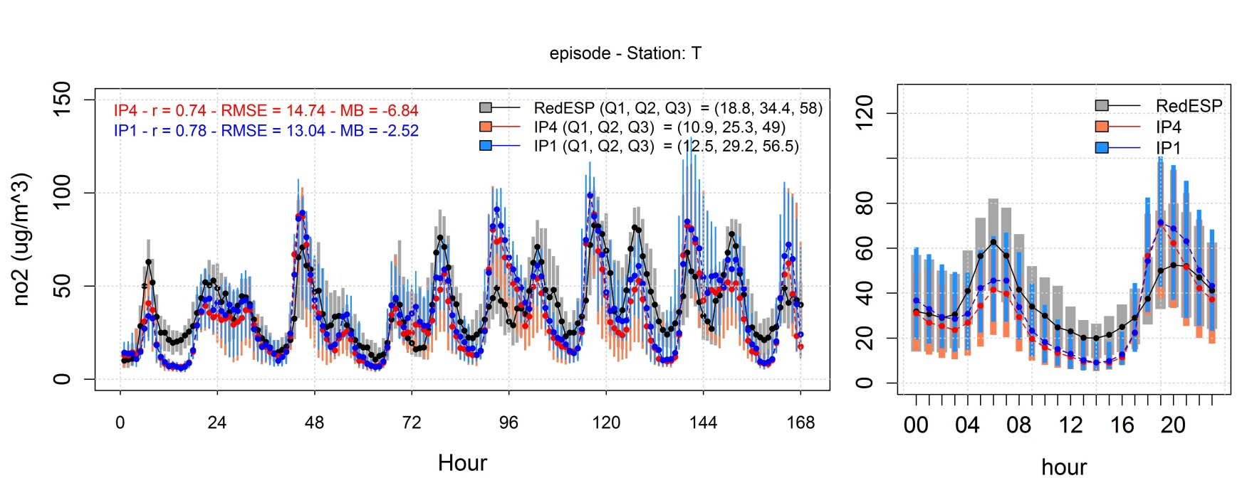
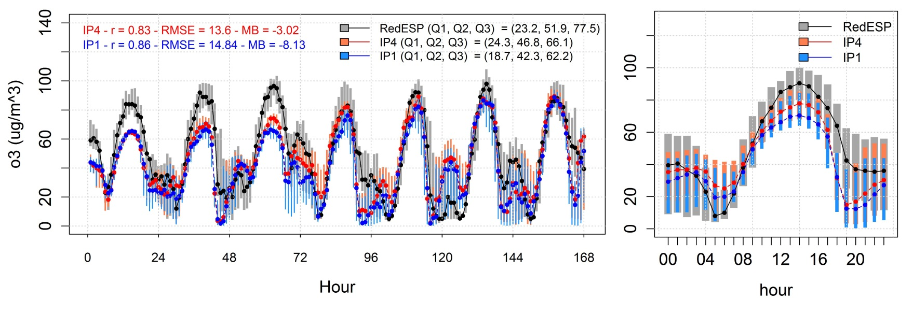
Daily cycles NO₂/O₃: Traffic stations
Episode: 12th April – 18th April 2013 (n = 37)
NO₂ (µg/m³)
Episode: 12th April – 18th April 2013 (n = 21)
O₃ (µg/m³)

Slide 15
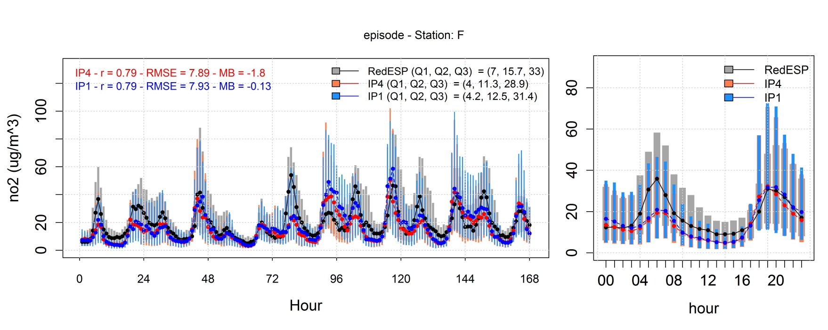
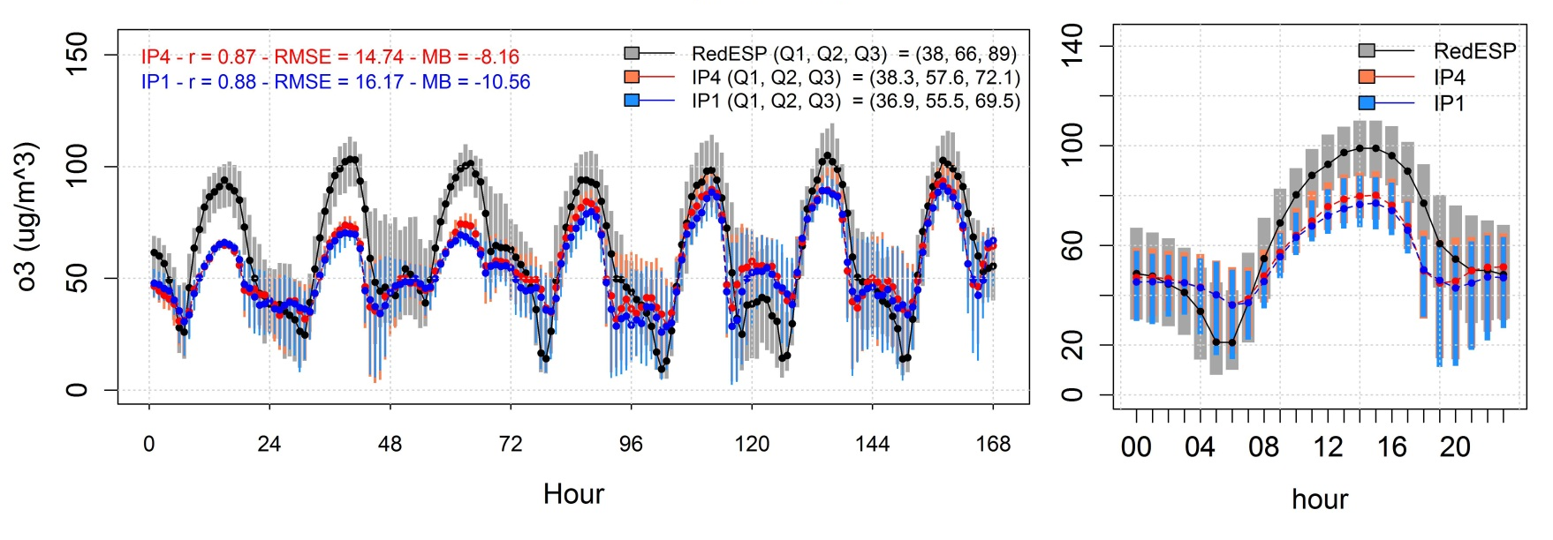
Daily cycles NO₂/O₃: Background stations
Episode: 12th April – 18th April 2013 (n = 67)
NO₂ (µg/m³)
Episode: 12th April – 18th April 2013 (n = 66)
O₃ (µg/m³)

Slide 16
Conclusions
Differences between resolution increase (4 km → 1 km) in terms of statistical is relatively low (MB and RMSE less than 5 and 2 µg m⁻³, respectively, and r less than 0.3).
Concentration maps at 1 km are better spatial allocated, more realistic patterns.
The horizontal grid influence highly depends on the study pollutant (NO₂, O₃, SO₂, PM10), the environment (from urban to rural) and the study domain (AND, BCN and MAD).
Pollutants:
The resolution increase is positive for NO₂, and lesser extend to SO₂
The grid effect is less pronounced for PM10 than for O₃.
Environment:
The resolution increase improves CALIOPE’s performance at stations near large emission sources as traffic and industrial stations.
Domain:
MAD > AND > BCN: more complex topography and meteorological pattern
The resolution increase also increases uncertainty in meteorological data over complex terrains (the case of Barcelona)

Slide 17
Future work
Sensitivity of Air Quality Models to Meteorological Inputs (12th CMAS, October 29)
Mesoscale meteorological modeling at kilometer scale grid meshes for air quality simulations, Jason Ching et al.
Fine-scale Meteorological Simulation of Cold Pools in Salt Lake City, Chris Misenis et al.
Recent Advances in High-Resolution Lagrangian Transport Modeling, Jennifer Hegarty et al.

Slide 18
Thank you for your attention
Webs:
Air Quality Forecasts Europe / Spain: http://www.bsc.es/caliope
BSC-DREAM8b mineral dust model forecasts North Africa/Europe/East-Asia: http://www.bsc.es/projects/earthscience/DREAM/
Acknowledgments:
Beatriu Pinós (2011 BP-A 427)
Severo Ochoa (SEV-2011 00067)
CALIOPE team (especially, F. Martinez and M. Guevara)

