Slide 1
Going the Extra Mile in Downscaling: Why Downscaling Is Not Just “Plug-and-Play”
Tanya L. Otte and Christopher G. Nolte
U.S. EPA, Research Triangle Park, NC
12th Annual CMAS Conference
30 October 2013
Acknowledgments:
Jared H. Bowden (UNC)
Lara J. Reynolds (CSC)
Kathy Brehme (CSC)
Kiran Alapaty (U.S. EPA)
O. Russell Bullock (U.S. EPA)
Jerold A. Herwehe (U.S. EPA)
Megan S. Mallard (U.S. EPA)

Slide 2
Motivation for Regional Climate Modeling Research
We will respond to the threat of climate change, knowing that failure to do so would betray our children and future generations. – President Obama (21 Jan 2013)
If we embrace this [climate change] challenge, … we will save lives, protect and preserve our treasured natural resources, cites, and coastlines for future generations. – President Obama’s Climate Action Plan (June 2013)
We have a clear responsibility to act now on climate change. This Agency has the courage to act. – EPA Admin. McCarthy (22 Jul 2013)
Global Climate
- Comprehensive science
- Emissions scenarios
- Multi-century data
- Coarse resolution
Regional Impacts of Climate Change
- Effects on air quality, ecosystems, and human health
- Frequency and intensity of extreme events
Regional Climate Modeling
using Downscaling
Large, well-established programs
EPA’s interests

Slide 3
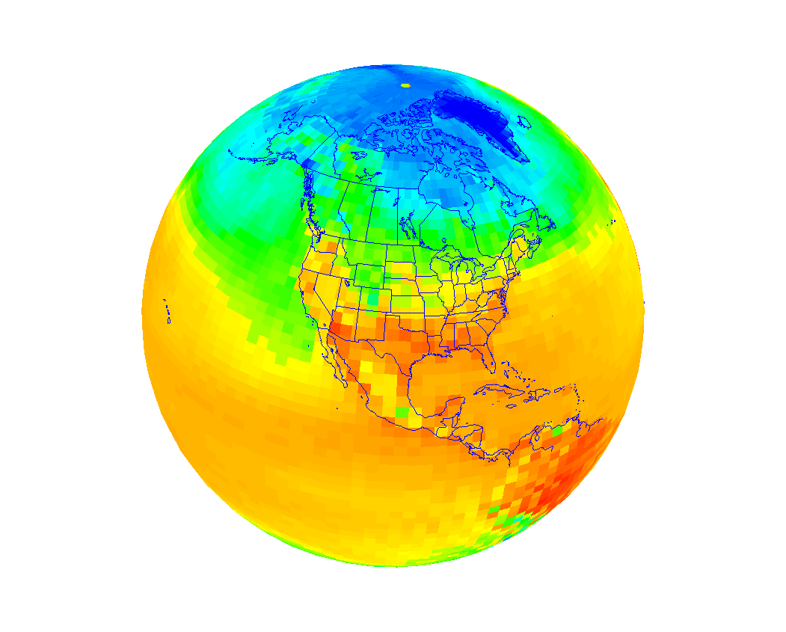
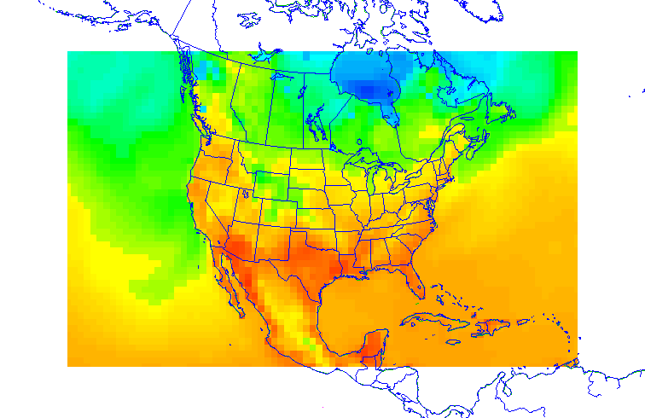
What is “dynamical downscaling”?
Atmospheric-oceanic global climate model (AOGCM) creates coarse gridded future climate with world-wide coverage by modeling the whole earth system.
AOGCM
RCM
Regional climate model (RCM) generates gridded higher-resolution climate over focal area using a dynamical, physics-based atmospheric model.
More detail in local effects from:
scale-appropriate physics
topography & land/water interfaces
urban areas (population centers)

Slide 4
Developing Downscaling Methodology for Environmental Applications
Use historical data sets to develop downscaling methodology
20-year runs driven by historical data at comparable size to AOGCM
Evaluate RCM results against observation-based data sets
See Bowden et al. (J. Climate, 2012), Otte et al. (J. Climate, 2012), Bowden et al. (Clim. Dyn., 2013), Bullock et al. (JAMC, in press)
Apply downscaling methodology to AOGCM simulations
AR5 Ensemble: time slices, RCPs, AOGCMs
NASA GISS ModelE2, NCAR CESM 1.0, NOAA GFDL CM3, …
Examine air quality-climate change interactions, as well as impacts on human exposure, energy demands, ecosystems, etc.

Slide 5
Downscaling CESM Using WRF
Community Earth System Model (CESM)
Participating in IPCC AR5
Data are ~1.0 deg, 6-h
Weather Research and Forecasting (WRF) Model v3.4.1
36-km North America domain with 34 layers up to 50 hPa
Continuous 11-year simulation plus 3-month spin-up
RRTMG longwave and shortwave radiation
WSM6 microphysics
G3 and Kain-Fritsch plus subgrid feedback on radiation (Alapaty et al., GRL, 2012; Herwehe et al., in preparation)
YSU PBL scheme
NOAH land-surface model
Spectral nudging on wavelengths >1500 km (only above PBL)

Slide 6
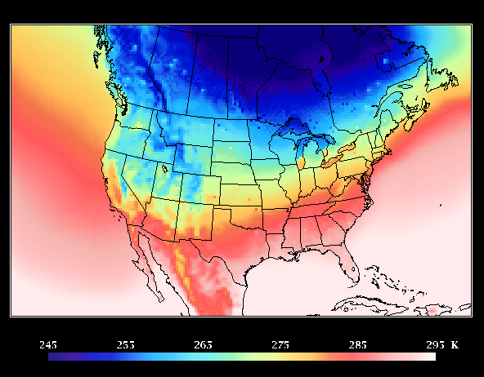
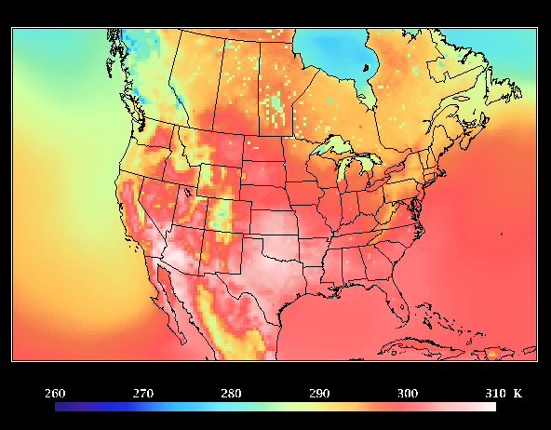
A First Look at the Downscaled Output…
Monthly Average 2-m Temperature (K)
245
255
265
275
285
295
260
270
280
290
300
310
January “1995”
July “1995”
OK at first glance, but large temperature gradients over Great Lakes. Why?

Slide 7
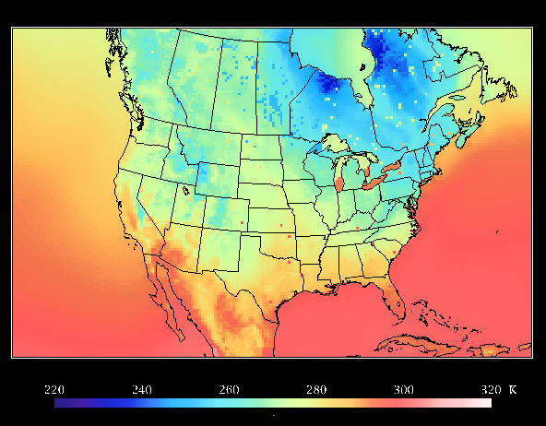
Time to Double-Check the Input Data…
Skin Temperature (K) – 00 UTC 01 Dec “1995”
Inland lakes easy to identify throughout domain.
251.7 K
293.3 K
220
240
260
280
300
320
Unrealistic lake temperatures are part of input.
How did this happen?

Slide 8
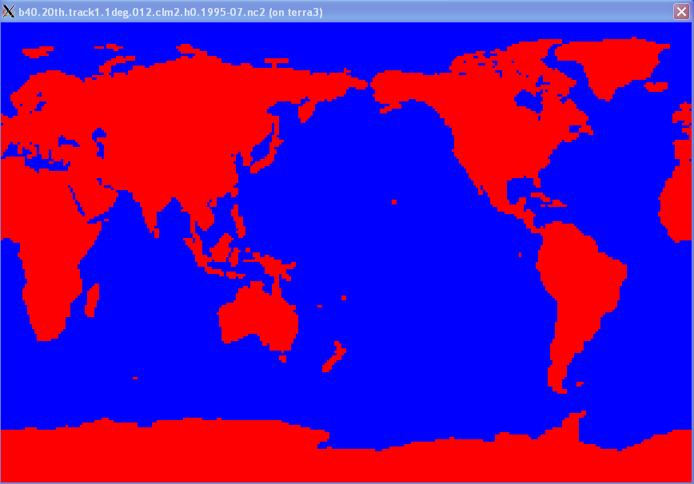
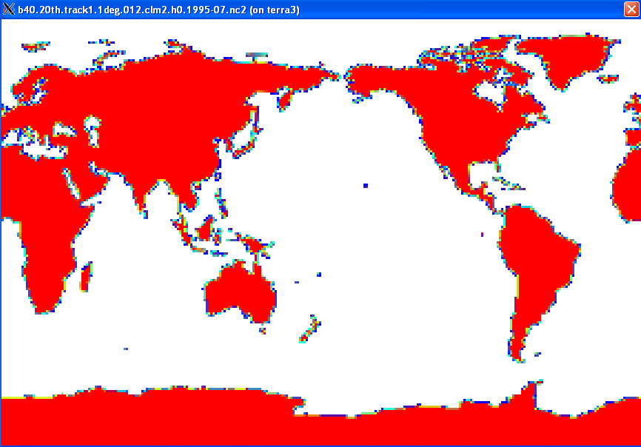
CESM Fields (part of standard downscaling suite)
landmask: 0 for ocean, 1 for land
landfrac: missing over ocean,
fractional along coastlines
Note that Great Lakes are not apparent in either CESM field. WRF uses nearest water point to set inland lake temperatures!

Slide 9
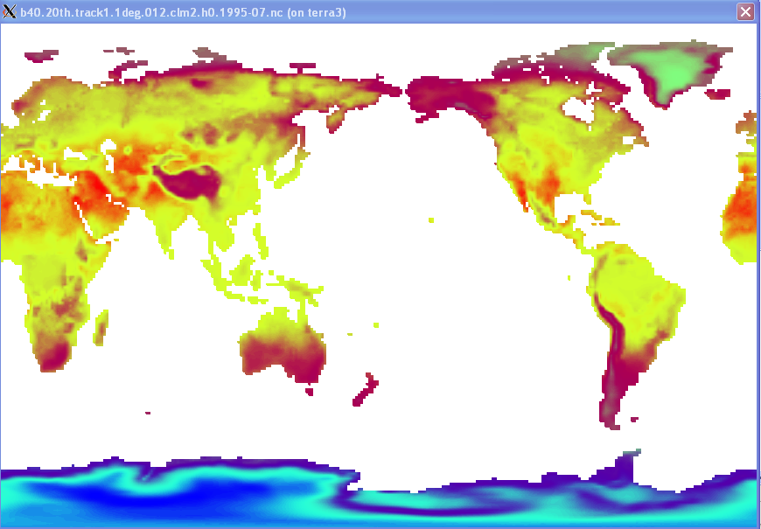
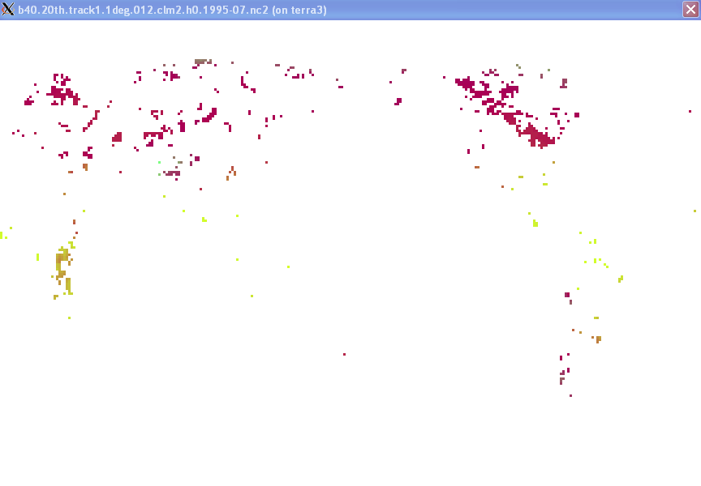
Getting Resourceful…
CESM Ground Temperature (TG)
CLM Lake Temperature (TLAKE)
(not part of CMIP5 downscaling suite)
Note: TG is not equal to TLAKE, even where TLAKE is valid.

Slide 10
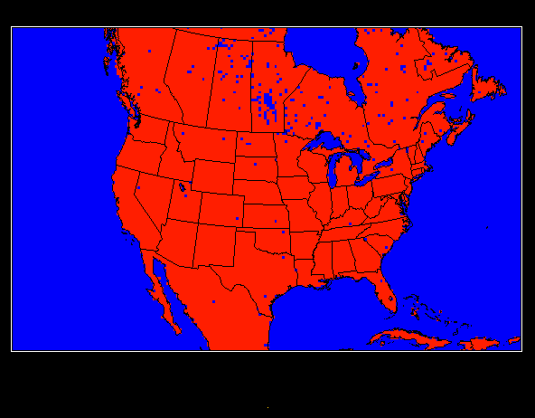
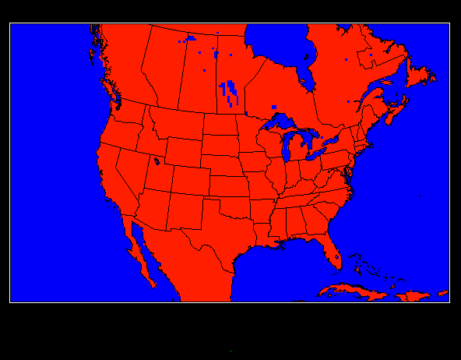
Can we find a way to blend TLAKE with TG in WRF???
This is NOT straightforward…otherwise everyone would do it.
Modifications needed in:
Acquiring monthly CLM fields with 6-h and monthly CESM fields
Not necessarily available on Earth System Grid
WRF “geogrid” … need to add lake classification in land use
Option is fairly new in WRF to add supplemental category
WRF pseudo- “ungrib” … collect TLAKE
WRF “metgrid” … process TLAKE field onto WRF domain
After WRF “metgrid” … blend TLAKE with TG using land use
Land Mask:
USGS 2-min
Land Mask:
USGS 2-min
+ Lakes

Slide 11
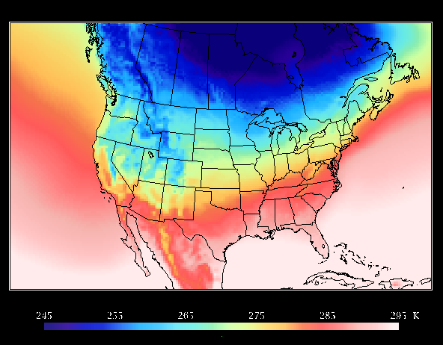
January “1995” 2-m Temperature (K)
245
255
265
275
285
295
245
255
265
275
285
295
default method
updated method

Slide 12
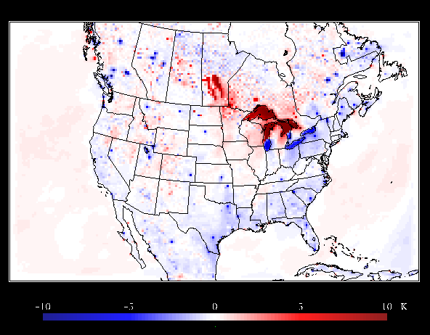
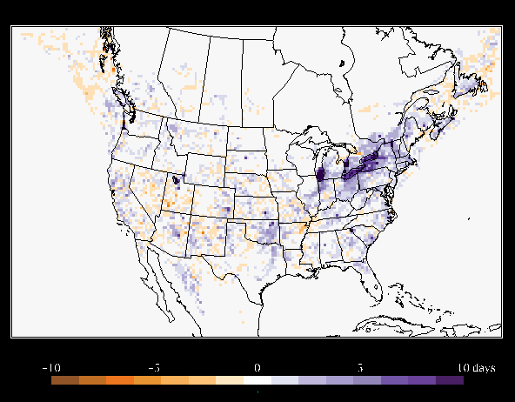
January “1995” 2-m Temperature
-10
-5
0
5
10
-10
-5
0
5
10
change in average daily min temperature (K)
change in number of days of T < 32°F

Slide 13
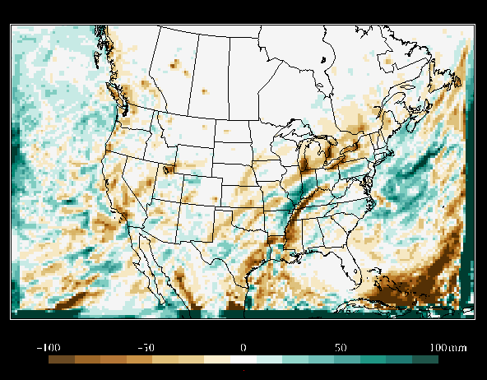
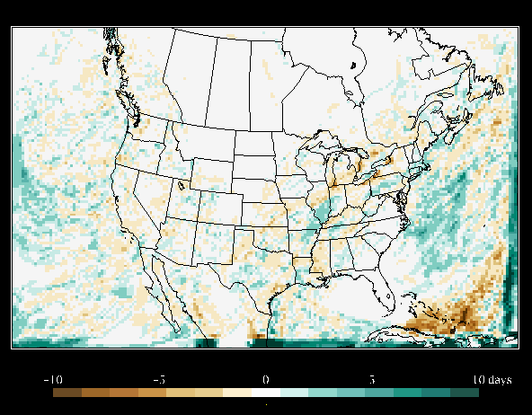
January “1995” Precipitation
-100
-50
0
50
100
-10
-5
0
5
10
change in average total precipitation (mm)
change in number of days of P > 0.5 in

Slide 14
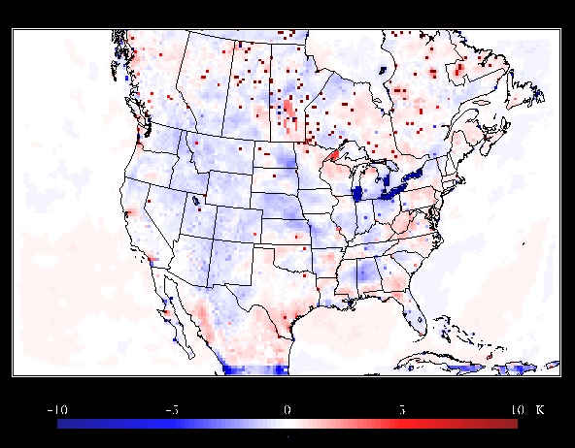
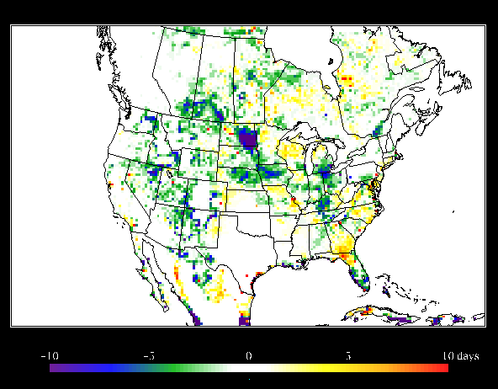
July “1995” 2-m Temperature
-10
-5
0
5
10
-10
-5
0
5
10
change in average daily max temperature (K)
change in number of days of T > 90°F

Slide 15
Closing Thoughts
Downscaling is not just a “plug-and-play”, one-size fits all procedure
Going the extra mile can make a BIG difference
Quality of the downscaled fields
Conclusions drawn from downscaled fields
Effects on extremes
Need to inform archivers of AOGCM data of more specific data needs for downscaling
Blending TLAKE and TG (as shown here) may not be a substitute for a more advanced lake model in WRF (e.g., Mallard et al. poster)
Major caveat: Change to convective scheme needs to be removed to isolate effects if changing lake temperature. Qualitative differences in winter are likely to hold.

