Slide 1


Particle-phase liquid water
measurements during the Southern
Oxidant and Aerosol Study
Thien Khoi V. Nguyen
Markus Petters, Annmarie Carlton, Sarah Suda, Rob Pinder, Havala Pye

Slide 2
Introduction
Dry constituent: low-volatility species that remain predominantly in the particle phase (e.g. sulfates, elemental carbon, organic compounds)
Semi-volatile compounds (SV): partition between the condensed and gaseous phases (e.g. glutaric acid, pyruvic acid, oxalic acid)
Water: condenses onto existing aerosol particles as f(RH, T, aerosol and gas phase chemical composition)
V_{amb} = V_{dry} + V_{sv}+ V_{w}
Sample atmospheric aerosol particle
SV
Dry
Water
Notes:
Water is predicted to represent a substantial fraction of total tropospheric ambient aerosol volume, but it not routinely measured and actual mass concentrations are not well-known

Slide 3
Particle-phase liquid water
What are the trends in particle-phase liquid water content?
Why is aerosol water important?
Atmospheric aqueous chemistry: medium for partitioning of polar, water-soluble-gas phase species
Visibility impairment: affects aerosol light scattering, extinction coefficients, and aerosol optical depths
Influences climate: affects cloud forming properties and acid deposition
Improve atmospheric photochemical models (e.g., CMAQ)

Slide 4
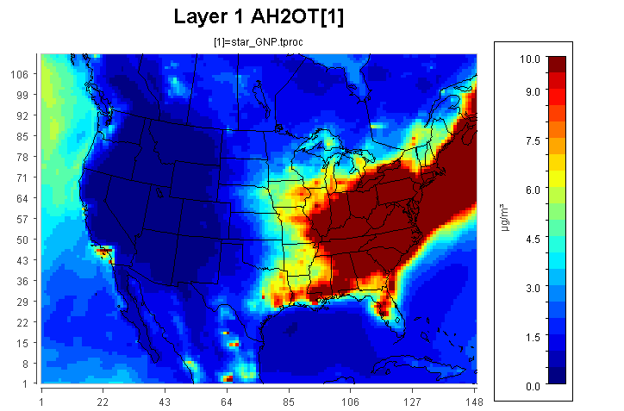
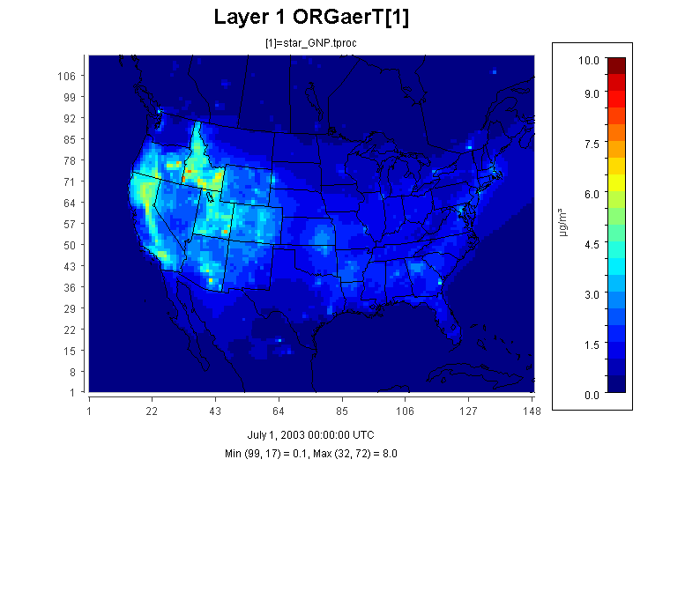
Why SOAS?
Southern Oxidant and Aerosol Study (SOAS)
June 1 to July 15, 2013
Talladega National Forest in Brent, AL
Liquid water is predicted to be the dominant aerosol constituent in the Eastern US (Carlton and Turpin, 2013)
Particle Phase Liquid Water
Particle Phase Organic Mass
10
5
µg m⁻³
0
H₂O_{ptcl} calculated in CMAQ using ISORROPIA
July 2003 average, CMAQv4.7
Adapted from Carlton and Turpin, 2013; simulation details in Carlton et al., 2010
Notes:
Anthropogenic aerosol water can provide partitioning medium and potentially drive biogenic SOA formation in high RH locations
Observational evidence of enhanced biogenic SOA mass in eastern US (Chan et al., 2010; Hatch et al., 2011)

Slide 5
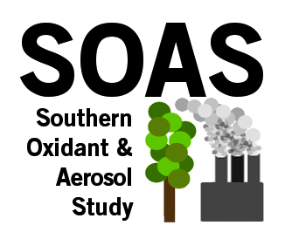
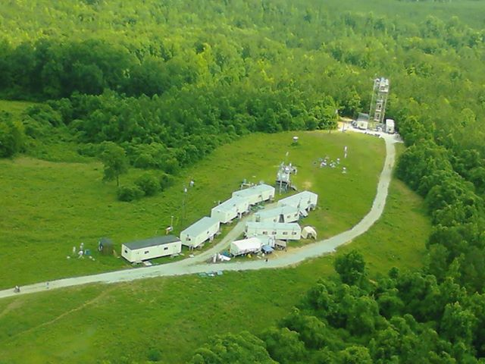
Study Goals
Semi-volatile Differential Mobility Analyzer (SVDMA): Test the hypothesis that water is the dominant aerosol constituent in the SE U.S.
Instrument deployed during SOAS campaign
  Collect 6 weeks of continuous in situ data
  Identify chemical and thermodynamic controls on particle phase liquid water content
  Validate model predictions of particle phase liquid water content
Aerial view of SOAS
AL ground site

Slide 6
SVDMA
1. Ambient
T_{inlet} = T_{ambient}
T_{ambient}
To SMPS
RH sheath = RH ambient
V_{dry}
V_{sv}
V_{w}
2. Dry
T_{inlet} = T_{ambient} – 30°C
T_{ambient}
To SMPS
RH sheath ~ 10%
V_{dry}
3. Dry-humidified
T_{inlet} = T_{ambient} – 30°C
T_{ambient}
sample
re-humidification
V_{dry}
V_{w}
To SMPS
RH sheath = RH ambient
V_{w} = V_{dryhumidifed} – V_{dry}
V_{sv} = V_{ambient} – V_{dryhumidifed}
Size range: ~10-1000 nm

Slide 7
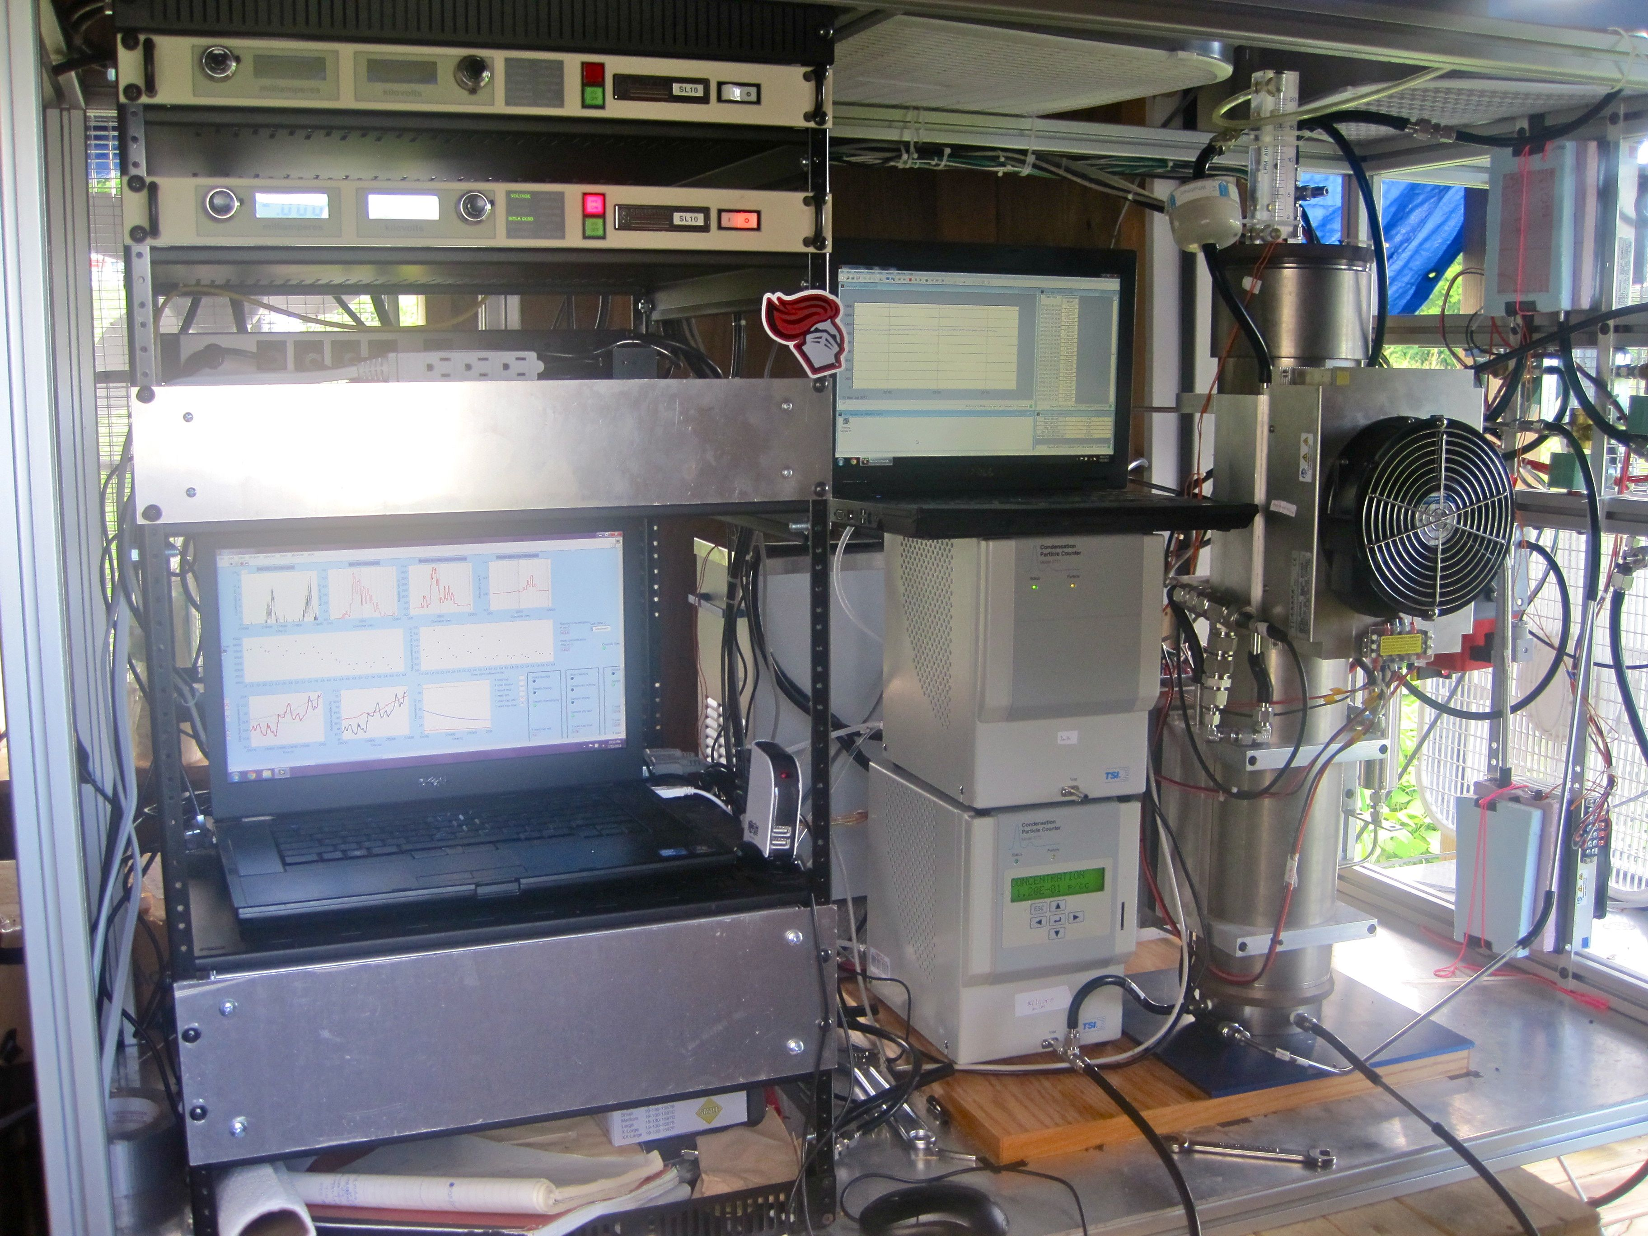
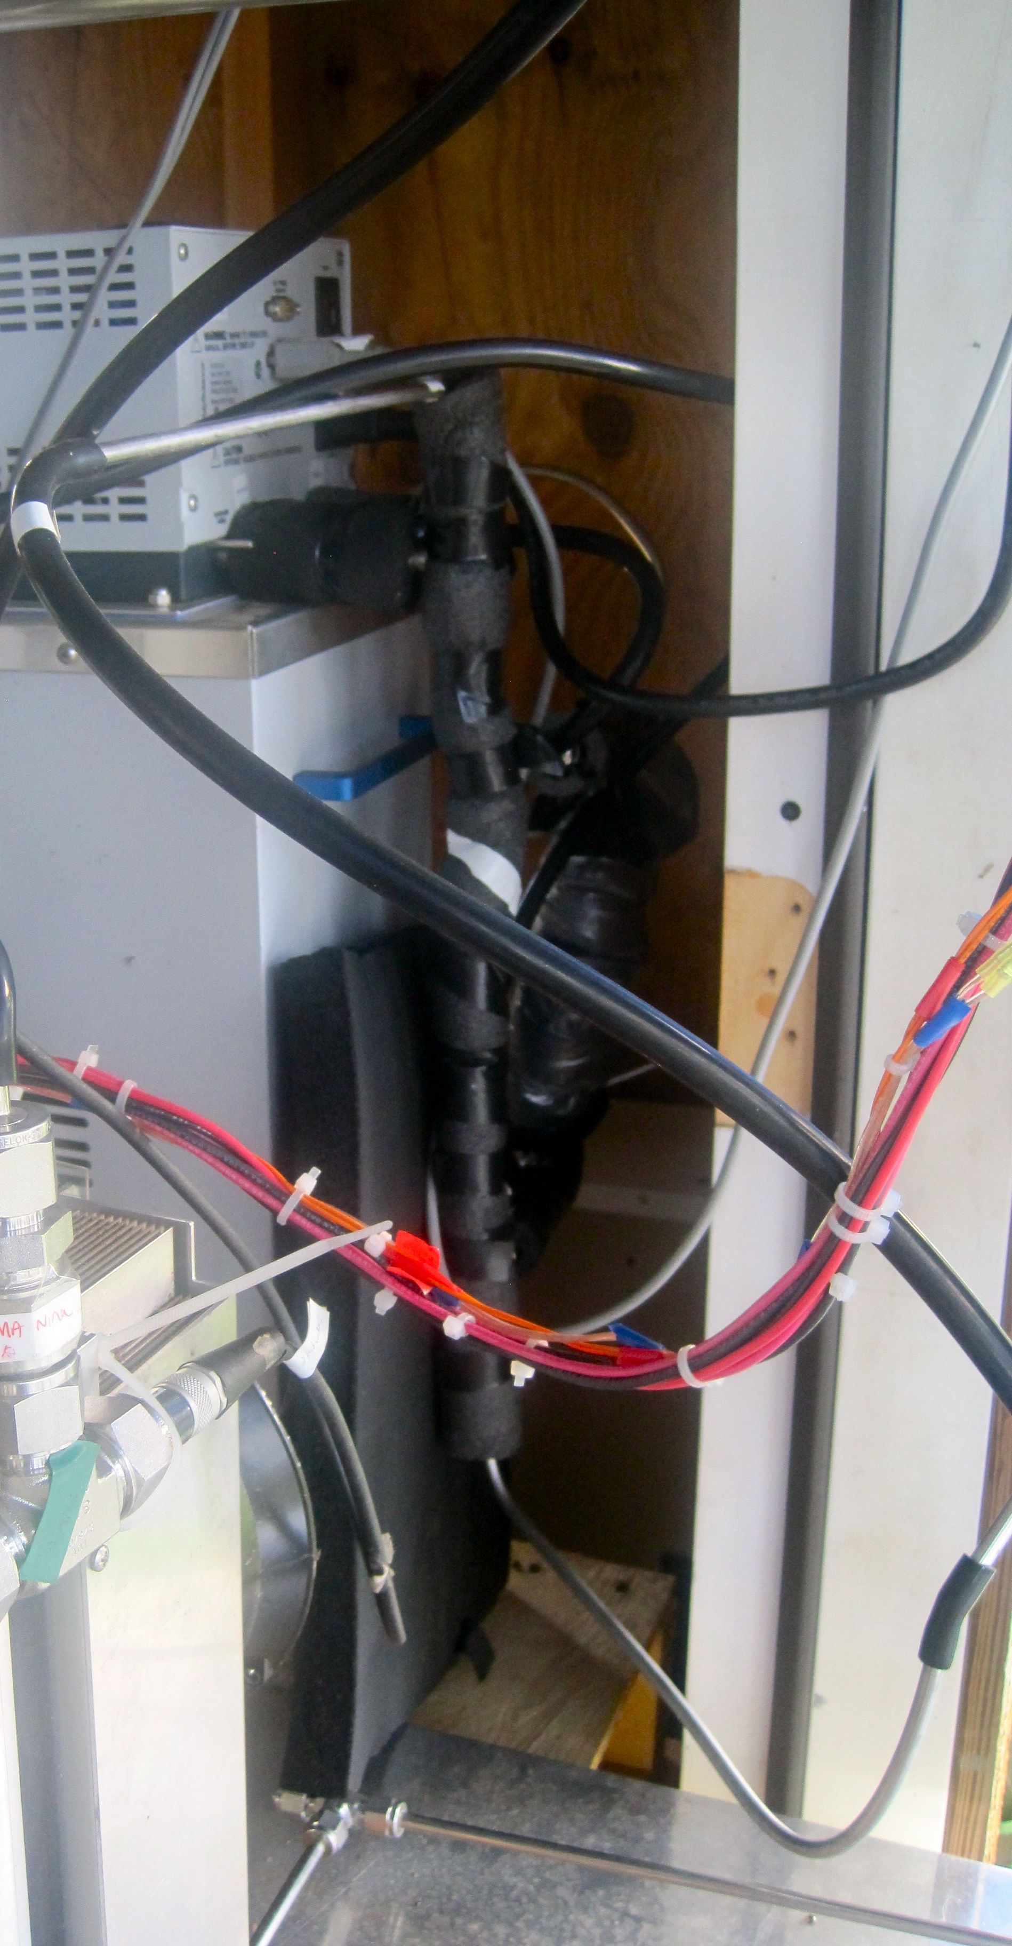

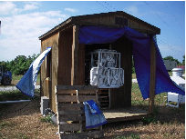
SVDMA during SOAS
Nafion tubes
HVPS
Thermoelectric cooler
T bath
CPC 2
DMA
Inlet
LabView
CPC 1
Dryer

Slide 8
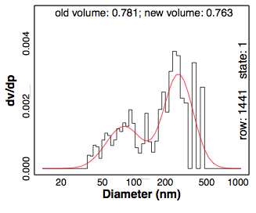
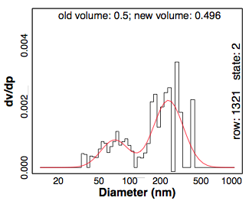
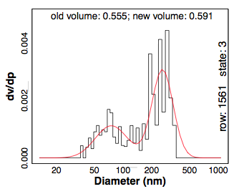
Bimodal distribution
Two modes in volume distribution: lower diameter mode (D1) and higher diameter mode (D2)
Lognormal fittings: Fit volume data to lognormal distribution to obtain mean diameter for each mode to use later on for analysis
Ambient
Dry-humidified
Dry
D2
D2
D2
D1
D1
D1

Slide 9
SOAS RH and water diurnal trends

Slide 10
Hygroscopicity Parameter, κ
κ: hygroscopicity parameter that describes water uptake
κ = 0 means no water uptake (nonhygroscopic compounds)
κ ~ 0.01 to 0.5 for slightly to very hygroscopic species
κ ~ 0.5 to 1.4 for highly hygroscopic compounds
κ = ∑E_{i}κ_{i}
κ_{org} ~ 0.1
κ_{SO4} ~ 0.5
κ_{NO3} ~ 0.7
2 Diameter Modes
a_{w}: water activity
D_{dh}: mode diameter, dry-humidified state
D_{dry}: mode diameter, dry state
V_{w}: particle phase liquid water
V_{dry}: dry aerosol volume
Volume-based κ
Diameter-based κ
Equations adapted from Petters and Kreidenweis, 2007

Slide 11
κ Diurnal Trend
Lower diameter mode
κ ~ 0.1 to 0.2
Smaller diameter mode may be more organic dominated (lower κ). ﻿
Higher diameter mode
κ ~ 0.2 to 0.3
Higher diameter mode may contain more sulfates (higher κ) & comprises most of the volume
Volume
κ ~ 0.2 to 0.3
Consistent with a mix of organic and inorganic compounds
Notes:
Typical ranges for these modes

Slide 12
Growth factor (volume-based)
gf_{vol} = 1 (no volume change when water condenses onto particle)
gf_{vol} = 2 (volume doubles when water condenses onto particle)

Slide 13
Semi-volatiles
95% Confidence Interval: Detection of SV material is not
statistically discernible
Water-mediated partitioning of SV
Reversible process on short time scales
OR
Effect is smaller than our measurement uncertainty

Slide 14
CMAQ comparison
CMAQ
SVDMA
Base comparison: SVDMA parameters (V_{dry} and RH) adjusted to CMAQ’s parameters
Liquid water (µg m⁻³)
Hours past midnight (local time)
  CMAQv5.0.1

Slide 15
CMAQ comparison

Slide 16
Conclusions
Diurnal cycle in water content
  Liquid water is the dominant aerosol constituent (GF_{vol} > 2) during morning hours (7-9 AM) when RH is decreasing
    Changes in aerosol composition in terms of water uptake and loss occur on short time scales
κ ~ 0.1 to 0.2 for lower diameter mode, suggesting the presence of more organics than sulfates. κ ~ 0.2 to 0.3 for higher diameter mode (more sulfates) and volume-based calculations.
Detection of SV material is not statistically discernible
Base comparison shows similar trends between CMAQ and SVDMA water data, but there are offsets in κ comparison

Slide 17






Acknowledgements
National Science Foundation
EPA, NOAA, ARA, NCAR, EPRI
U.S. Department of Education
Lab group at Rutgers
All of the SOAS participants
CMAQ developers
Everyone here for attending

Slide 18
EXTRA SLIDES

Slide 19
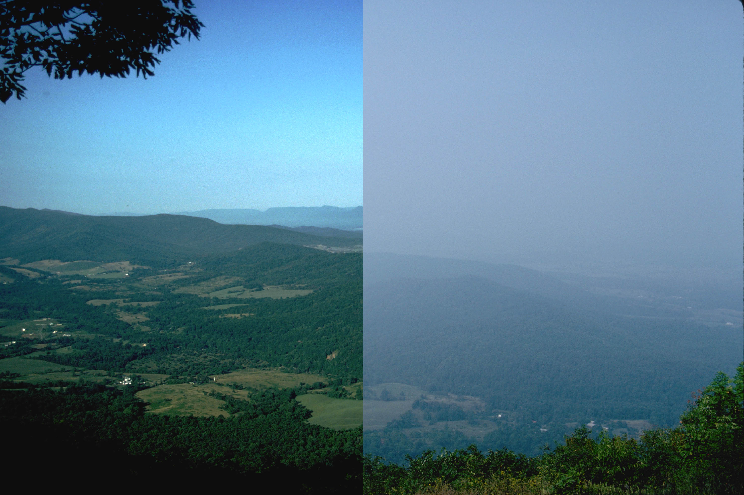
Particle-phase liquid water
How do anthropogenic influences on particle water affect partitioning of organic gases to the condensed phase and biogenic SOA formation?
Shenandoah National Park, img: NPS
Visibility impairment: affects aerosol light scattering, extinction coefficients, and aerosol optical depths
  Poor summertime visibility in eastern U.S. primarily due to high [SO₄] exposed to high RH. (Malm et al., 1994; Park et al., 2004; Pitchford et al., 2007)
Influences climate: affects cloud forming properties and acid deposition
Improve atmospheric photochemical models (e.g., CMAQ) to enable more effective strategies of air quality management and climate mitigation.

Slide 20
Most places liquid water is more accessible than OM
dry aerosol mass
sulfate/nitrate/ammonium/
organic+elemental carbon
water aerosol mass associated sulfate/nitrate/ammonium/
organic+elemental carbon
mg m⁻²
Aerosol water is 2-3 times dry aerosol mass.
Liao and Seinfeld JGR (2005)

Slide 21
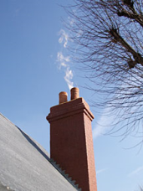
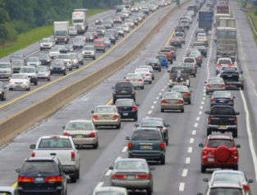

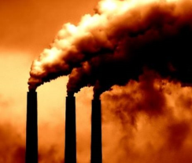
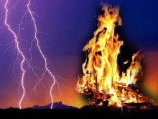
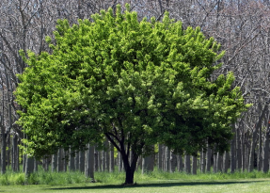
Introduction
Anthropogenic pollution enhances
biogenic secondary organic aerosol (SOA) formation.
SVOC₁
SVOC₂
SVOC_{n}
VOC
Condensation
Oxidant
(O₃, OH, NO₃,…)
+
→
→
→
SOA
(isoprene,
monoterpenes, SESQ)
(equilibrium
partitioning)
…
“Like” dissolves into “like”: non polar semi-volatile compounds will partition to OA (e.g. dry) matrix, polar organic gases will partition to polar solvents (e.g. water)
Absorptive partitioning framework (Pankow, 1994; Odum et al., 1996; Donahue et al., 2006)

Slide 22
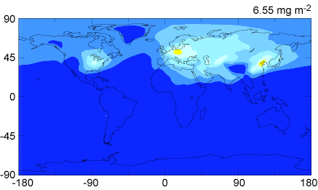
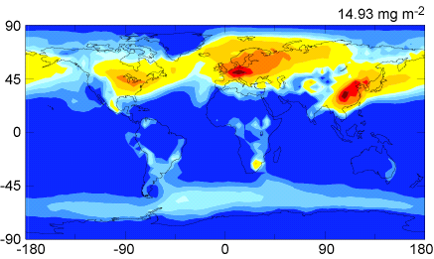
NOx, primary OA emissions are anthropogenic influences on BSOA formation (Carlton et al., 2010; Hoyle et al., 2010; Shilling et al., 2013). SO₂ pollution, through contributions to aerosol water likely influences BSOA as well.
Average SOA in SE U.S. 2-3 µg m⁻³ (Carlton et al., 2010b)
Dry mass
mg m⁻²
Water mass
Liao and Seinfeld (2005)
Amazon OA < 1µg m⁻³ (Pöschl et al., 2010; Martin et al, 2010)
Note: wet scavenging unconstrained
Notes:
Water everywhere - poor access to OM - only very close to sources, as ptcls become hygroscopic and take up water (thorugh addition of sulfate, more polar organics) – much better access to water than to OM

Slide 23
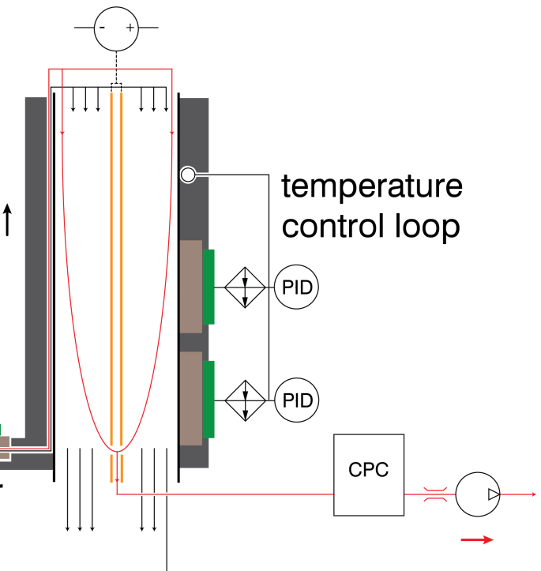
Semi-volatile Differential Mobility Analyzer (SVDMA)
  Use T and RH controlled DMA
  Scanning mobility particle sizing (SMPS) mode with CPC →13 to 1067 nm
  0.5 hr time resolution
  Operates/traces ambient conditions (5°C < T < 40°C)
  Temperature-controlled cooled inlet freezes out water and semi-volatile organic compounds
  3 inlet states
temperature control loop
Notes:
Operates with single DMA column and particle counter
Construct an inlet to dry particles and devise a strategy to capture semi-volatile organic compounds
Place instrument outside to measure particles in unperturbed state
Resolves particle phase liquid water content and contributions of semi-volatile OC at ~ 0.5 hr time resolution

Slide 24
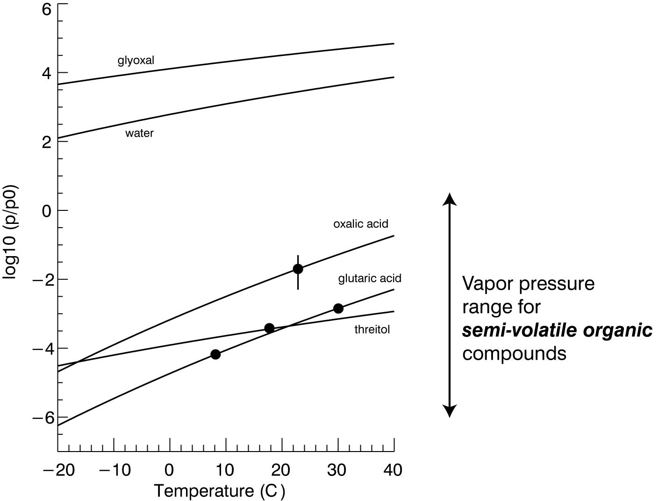
Loss of semi-volatiles
T_{inlet} = T_{ambient} – 30°C
Cooling reduces saturation vapor pressure by ~ 2 orders of magnitude
Reduced vapor pressures lead to condensation of vapor onto the inlet surface
Reheating the sample reduces the relative saturation ratio, driving off water and semi-volatile organic compounds from the aerosol
Water fully equilibrates as expected by thermodynamics
T_{ambient} – 30°C

Slide 25
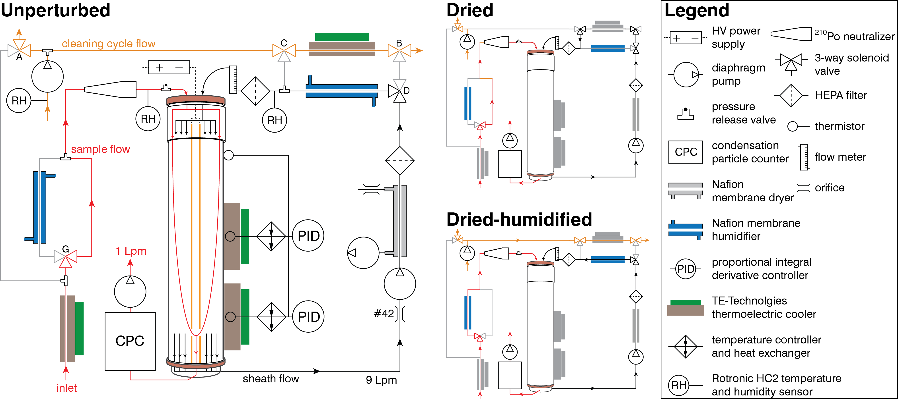
V_{w} = V_{dry-humidified} – V_{dry}
V_{sv} = V_{ambient} – V_{dry-humidified}
Semi-volatile Differential
Mobility Analyzer (SVDMA)
V_{dry}
Ambient
Dry
Dry-humidified
Figure by S.R. Suda
V_{dry}
V_{dry}
Diameter range:
~10 to 1000 nm
V_{sv}
V_{w}
V_{w}

Slide 26
Example snapshot of data
Total particle volume (µm³ cm⁻³)
80
60
40
20
0
0
5
hour (local)
10
15
Total particle concentration measured by CPC (# cm⁻³)
Unperturbed
QA check
CPC
Dry
QC check flagged
Dry-Wet
6e3
4e3
2e3
0
0
5
hour (local)
10
15

Slide 27
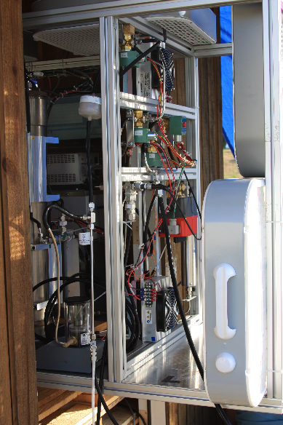
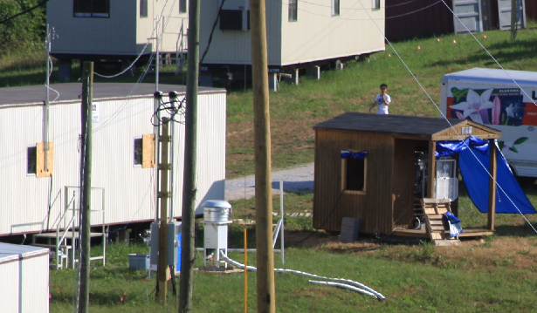
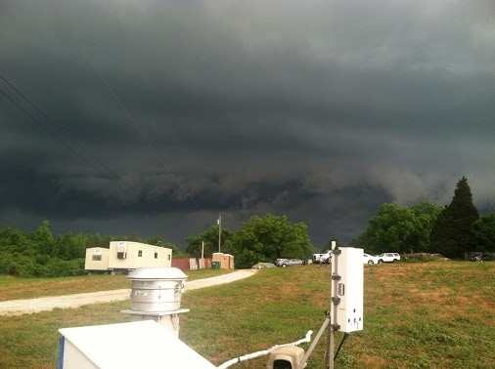
SVDMA during SOAS
Isothermal Instrument
Tornado Shelter
Trace ambient temperature: “outdoor inlet”
T, RH-controlled DMA column

Slide 28
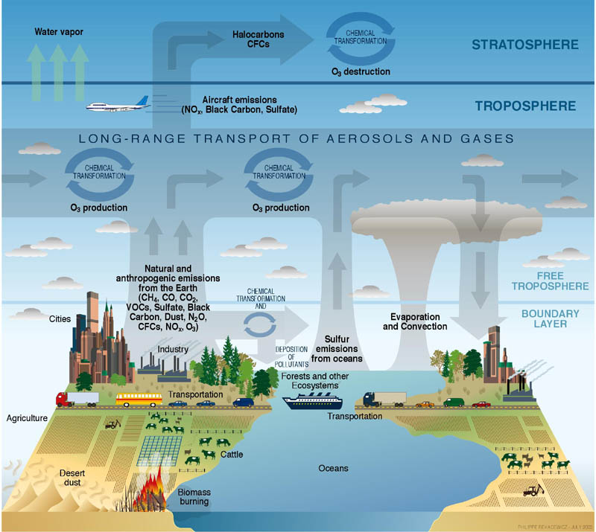
CMAQ
Community Multiscale Air Quality (CMAQ) Model
  3-dimensional photochemical air quality model
  U.S. EPA uses CMAQ for regulatory applications
  NOAA uses CMAQ for air quality forecasts
  Tropospheric O₃, particles, toxics, acid deposition
  One atmosphere and multi-scale urban, regional, hemispheric
  Well-vetted: open source, user community is large and dispersed
img: climatescience.gov

Slide 29
CMAQ
CMAQ Details
  CMAQ version 5.0.1
  Expanded SAPRC07 gas-phase isoprene chemistry (Xie et al. 2013 ACP, Lin et al. 2013 PNAS) and updated isoprene aerosol (Pye et al. 2013 ES&T)
  Anthropogenic emissions: NEI 2008 adjusted to 2013 levels
  Biogenic emissions: calculated inline using BEIS
  Met data from WRF version 3.4 converted to CMAQ inputs using MCIP version 4.1.3

Slide 30
CMAQ
CMAQ Details
  CUMULUS PARAMETERIZATION: Kain-Fritsch (new Eta)
  SHALLOW CONVECTION: No shallow convection
  MICROPHYSICS: Morrison 2-moment
  LONGWAVE RADIATION: RRTMg
  SHORTWAVE RADIATION: RRTMg
  PBL SCHEME: ACM2 (Pleim)
  SURFACE LAYER SCHEME: Pleim
  LAND-SURFACE SCHEME: Pleim-Xiu
  Land-Surface Model
  URBAN MODEL: No urban physics
  LAND USE CLASSIFICATION: NLCD50
  3D ANALYSIS NUDGING: GRID

Slide 31
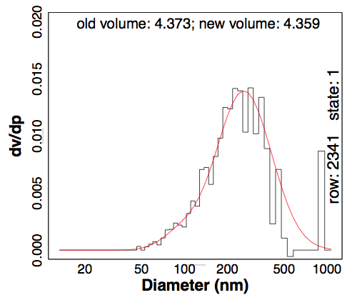
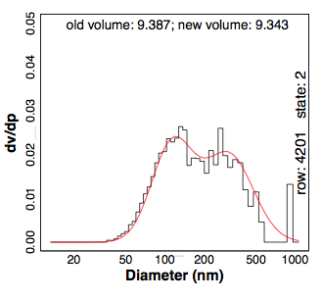
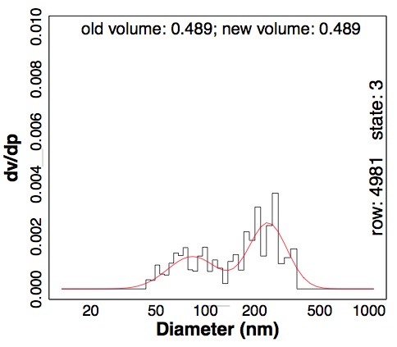
Lognormal Distribution Fitting
Bimodal fitting:
based on Seinfeld & Pandis, 2006, equation 8.34
Non-linear least squares model fitting in R to optimize:
  V_{t}, D_{pg1}, D_{pg2}, σ_{g1}, σ_{g2}

Slide 32
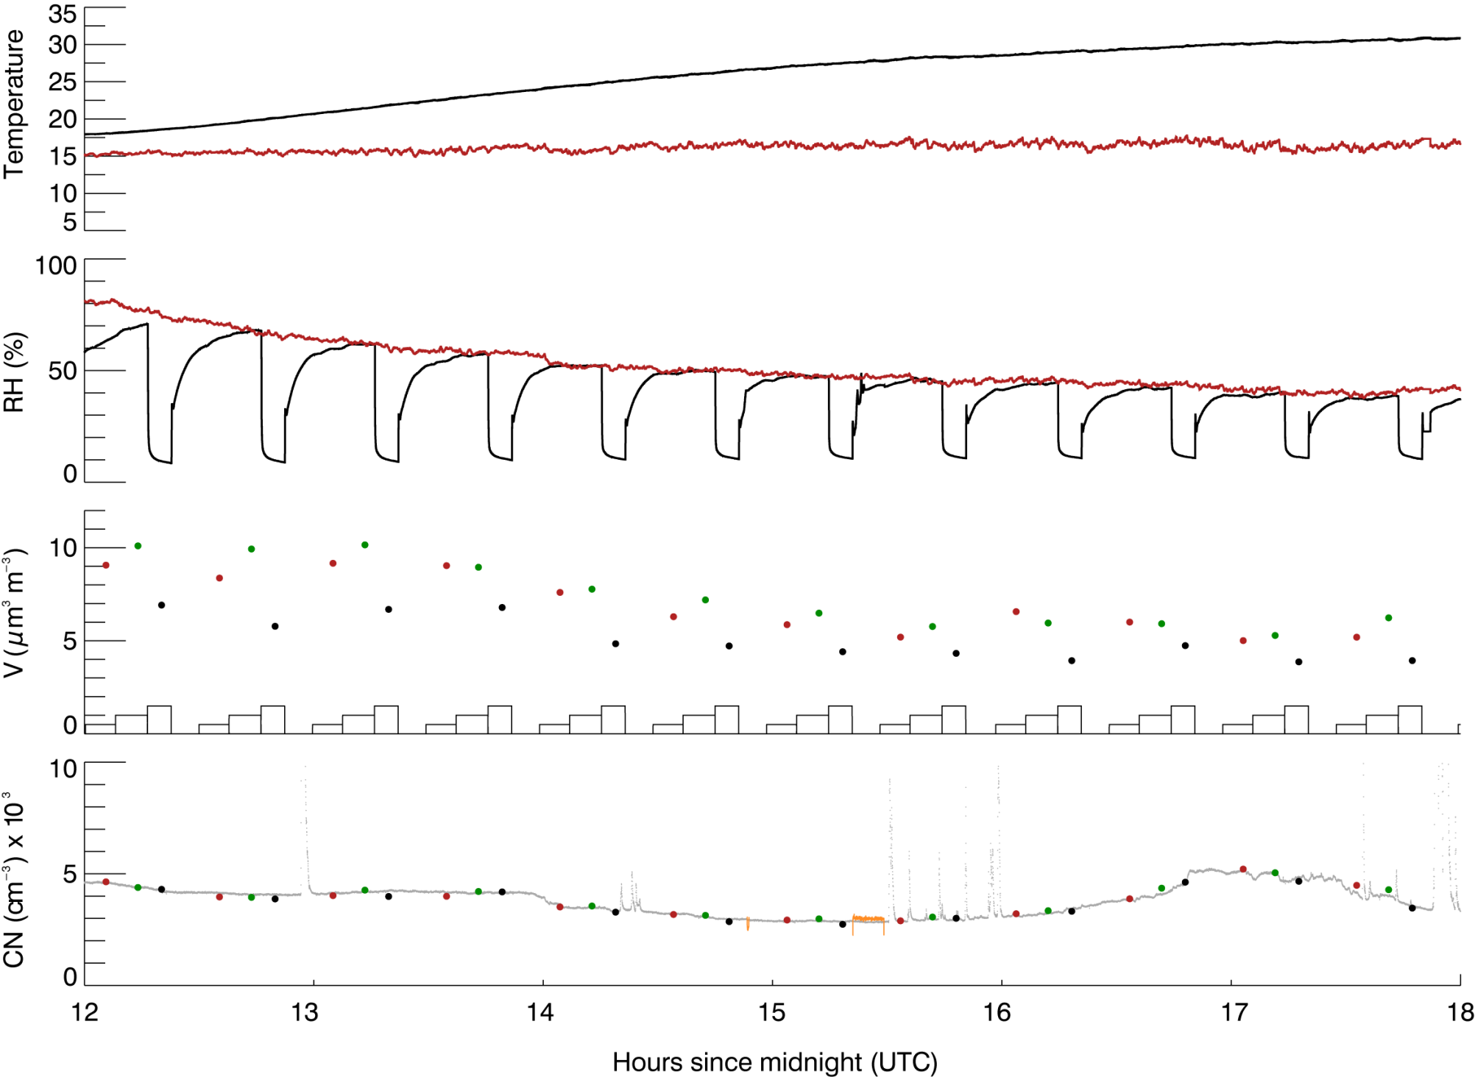
Quicklook sample
Dry Volume (~5 μm³ cm⁻³)
Dry-Wet (~7.5 m³ cm⁻³)
(~7.5 μm³ m⁻³)
Do Nothing (~7.5 μm³ cm⁻³)
V(µm³cm⁻³)
Total particle concentration
measured by CPC
Dry Mass: dry
Wet Mass: dry-wet – dry
Semi-volatile Mass: do
nothing – dry-wet
Dry-Wet
Do Nothing
Dry
Notes:
This slide shows how we would use the data that we collect for the three different states.
The bottom plot depicts integrated number concentration on the y-axis versus hours since midnight UTC on the x-axis. The integrated particle concentration as measured by the CPC should be relatively similar for the three different states, and that’s how we judge whether or not the instrument is working.
For the top plot, the y-axis is volume, again assuming unit density. The black dots represent volume for the dry state, the green dots represent volume for the dry-wet state, and the red dots represent volume for the ambient state. The difference between the dry-wet and dry volume for this the triplet pointed out on our plot is 2.5 cubic micrometers per cubic meters, and that represents our water mass. There is not much difference between our do nothing and our dry-wet state, so the semi-volatile mass in this case is below our detection limit.

Slide 33
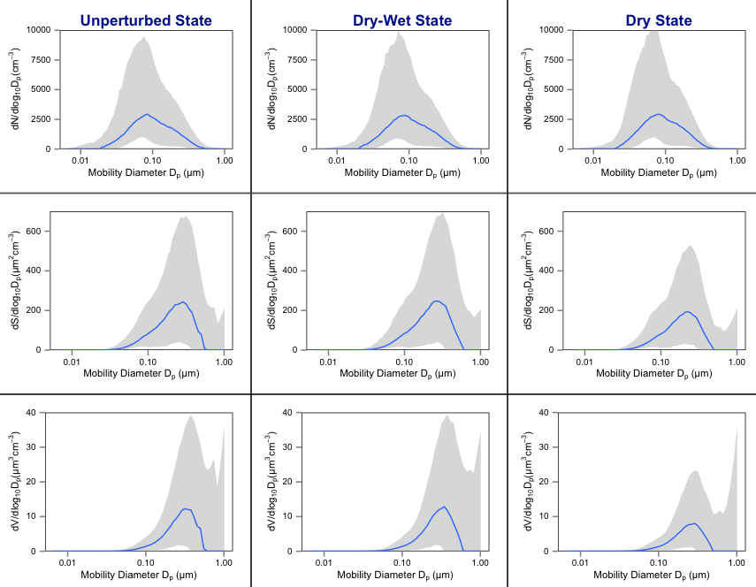
Summary Plot
For dry spectra, 18% of the volume is found in the smaller D_{p} mode. For dry-wet spectra, 13% of the volume is found in the smaller D_{p} mode → water uptake increases D_{p}

Slide 34
95% confidence interval for water

Slide 35
CMAQ comparison
y=x
CMAQ
SVDMA

Slide 36
