Slide 1
On using process-based statistical models of air pollutants to meet regulatory and research needs
Amy Nail, Ph.D.
Honestat, LLC
Statistics & Analytics
CMAS Conference
Chapel Hill, NC
October 28, 2013

Slide 2
Objective
Use two process-based statistical models (PBSMs) of 8-hour ozone to show that PBSMs of air pollutants
1. Can meet regulatory and research needs
2. Have a high return on investment

Slide 3
Return on investment: time and expertise
Jan 2001: started internship at EPA
Jan 2005: started first PBSM of ozone as dissertation research
Aug 2007: first PBSMO, dissertation, Nail 2007
Aug 2007 – 2008: My own simple modifications to model
2009: Help from George Pouliot and Joe Pinto

Slide 4
What is a process-based model?
Input variables have a cause-effect relationship with output, or are surrogates for variables that do
Mathematical representations are verifiably consistent with atmospheric chemistry results from chamber experiments and field studies
Model can be broken into interpretable components

Slide 5
Original goal
8-hour ozone
Daily
2001 (whole year)
Lat, lon resolution
Northeast US
NOx emissions
VOC emissions
Meteorology
PBSM

Slide 6
Needs met by original goal
Retrospective space-time prediction for exposure quantification
Decomposition
Assessment of past and future emission controls
Exceptional event analyses
Mutual evaluation/validation with other models
Learning about process
Quantification of uncertainty
(automatic with a statistical model)
Notes:
The retrospective prediction would have universal space-time coverage, because all of the inputs do.

Slide 7
Revised goal
8-hour ozone
Daily
2001 (whole year)
Lat, lon resolution
Northeast US
NOx observations
PBSM
VOC emissions
Meteorology
Notes:
Revised because at first modeling dispersion of Nox from point sources was a challenge I did not want to undertake along with all the rest of the challenges I was undertaking.

Slide 8
Changes to needs met
Exposure quantification → Can’t do yet
(No universal coverage for NOx)
Emission control assessment → VOCs only
Process learning → Better for VOCs
(Observed NOx more accurate than modeled NOx.)

Slide 9
The data
NOx and Ozone observations
SLAMS/NAMS/PAMS & CastNET
2001

Slide 10
Notes:
This is 2001 data from SLAMS/NAMS/PAMS.
There are roughly 11K observations in this dataset.
There is more data in the ozone season than in the winter.

Slide 11
PB SMO VOC
O3 = Created + Transported + Error_{O3}
f₁ ( ws, wd, O3 yesterday)
Random parts
Normally distributed
Mean zero
Variance & spatial correlation parameters depend on temp and ws
f₂ ( NOx, temp, sinusoid,
reactive VOC field )
f₃ ( VOC emissions, temp,
sinusoid ) + Error_{VOC}
Notes:
8-hour ozone at a point in space (lat, lon)
For one day
I’ll explain about background ozone toward the end.

Slide 12
Run time PB SMO VOC
9 hours on average

Slide 13
PB SMO: 36 & 12
O3 = Created + Transported + Error
f₁ ( ws, wd, O3 yesterday )
Random parts
Normally distributed
Mean zero
Variance & spatial correlation parameters depend on temp and ws
f₂ ( NOx, temp, sinusoid,
VOC emissions )
Notes:
8-hour ozone at a point in space (lat, lon)
For one day
I’ll explain about background ozone toward the end.

Slide 14
Run time PB SMO
6 – 19 minutes

Slide 15
VOC emission progression
Model | PB SMO VOC metcov | PB SMO Chemmech 36 & 12
Source | NEI, BEIS | SMOKE, CB-IV
Space | County | 36 & 12 km
Time | Bio Monthly Anthro Annual | Hourly
Species | Onroad Non-road Storage & Transport Biogenic Other area | Ald2 Ole CO Non-react Eth Par Form Tol Isop Xyl
Notes:
For the original and metcov models:
1) I got the NEI anthropogenic emissions data a looooong time ago from Rhonda Thompson, along with a couple of hours of consultation about what it meant and how it was derived.
2) I got the Biogenic emissions data a looooong time ago from Mark Pouliot.

Slide 16
How is transported process-based?
Transported ozone (here, today) =
Yesterday’s ozone 24 hours upwind
Is a weighted average of yesterday’s ozone in the whole region.
Weights
  depend on wind speed and direction
  are appropriately distributed over redundant information

Slide 17
How is created ozone process-based?

Slide 18
Three atmospheric regimes
Low VOC/NOx ratios
Changes in VOCs have no effect
Ozone increases when NOx increases
Created ozone can be negative
Mid-level VOC/NOx ratios
Ozone increases when NOx increases for fixed VOCs
Ozone increases when VOCs increase at fixed NOx
Ozone increases when both VOCs and NOx increase
High VOC/NOx ratios
Ozone increases when NOx increases
Ozone does not change when VOCs increase.

Slide 19
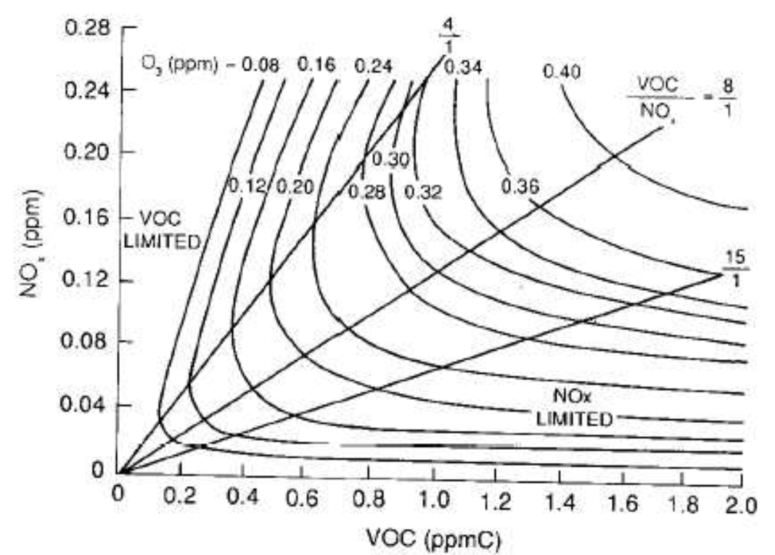
SMOG chamber contour plot
NRC (1991), p. 165

Slide 20
Contour plot at 95th percentile temperature
Notes:
At 95th percentile of temperature in the data.

Slide 21
Two predictors for two purposes
Process prediction
Created + transported
Process plus interpolated error
For exposure quantification, we can interpolate the error field to get better predictions.

Slide 22
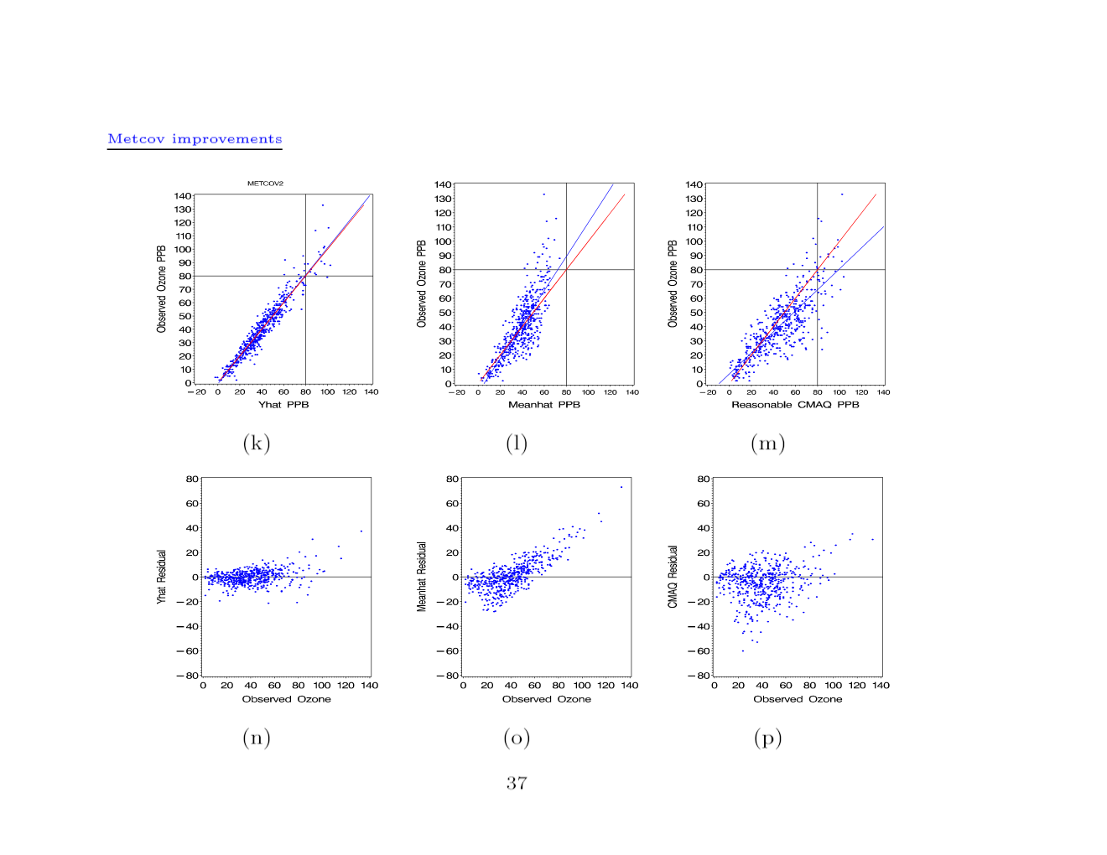
PB SMO VOC: metcov

Slide 23
PB SMO VOC (metcov)
 | R² | RMSE | Slope | Intercept | Val above
Process + interpolated error | .92 | 5.8 | 1.0 | -.75 | -
Process | .65 | 12.2 | 1.1 | -4.6 | 59
CMAQ | .64 | 12.0 | .74 | 6.8 | 97

Slide 24
Decomposition of ozone (ppb)
Date | Jan 2 | Jun 17 | Mar 26 | Sept 11 | Aug 10 | June 19 | Aug 2
Created | -4.3 | 31.6 | 8.3 | 27.8 | 28.5 | 27.2 | 24.0
Transported | 6.1 | 13.8 | 11.2 | 11.2 | 26.1 | 20.0 | 21.8
Deviation from obs | .2 | -28.4 | 6.5 | -4.0 | 5.4 | 32.8 | 47.2
Obs | 2 | 17 | 26 | 35 | 60 | 80 | 93
Oz %-ile | 0 | 25 | 50 | 75 | 94 | 99 | 100

Slide 25
How is background process-based?
Functional forms have these properties
If Nox = 0 and VOC emiss = 0 , then
created = 0
If created = 0 and transport = 0, then
Ozone = intercept = background
Revised metcov model
Background estimate:
39ppb

Slide 26
Metcov vs. chemmech 36
 |  | R² | RMSE | Slope | Intercept | Val above
PPIE | Metcov Chmech 36 | .92 .93 | 5.8 5.5 | 1.0 1.0 | -.75 -1.1 | -
Process | Metcov Chmech 36 | .65 .64 | 12.2 12.3 | 1.1 1.1 | -4.6 -3.9 | 59 70
 | CMAQ | .64 | 12.0 | .74 | 6.8 | 97

Slide 27
Metcov vs. chemmech 36, 12
 |  | R² | RMSE | Slope | Intercept | Val above
PPIE | Metcov Chmech 36 Chmech 12 | .92 .93 .93 | 5.8 5.5 5.6 | 1.0 1.0 1.0 | -.75 -1.1 -1.0 | -
Process | Metcov Chmech 36 Chmech 12 | .65 .64 .68 | 12.2 12.3 11.7 | 1.1 1.1 1.1 | -4.6 -3.9 -4.0 | 59 70 84
 | CMAQ | .64 | 12.0 | .74 | 6.8 | 97

Slide 28
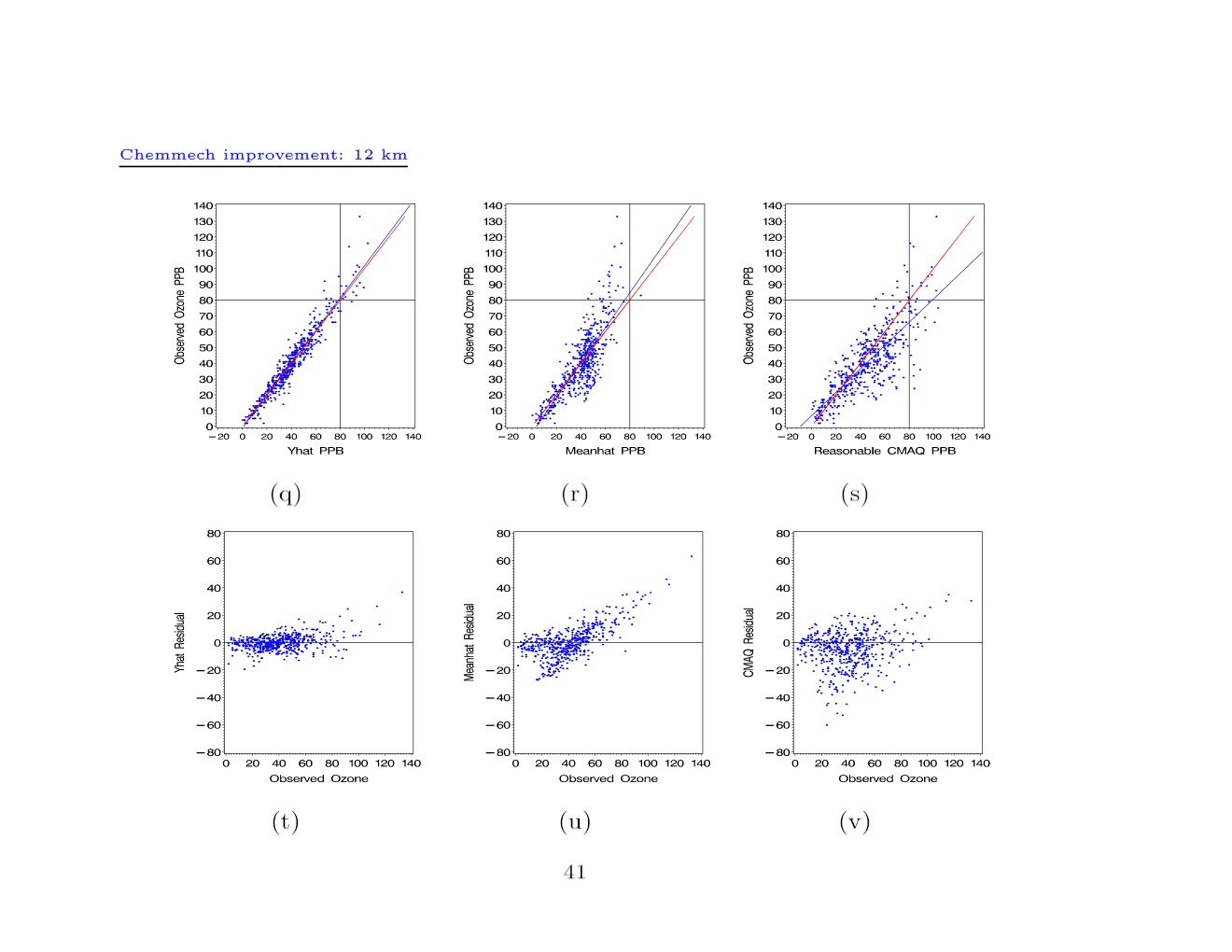
PB SMO: chemmech 12

Slide 29
From 2011 CMAQ Peer review
They [ the CMAQ team] have led the way by demonstrating, in retrospective studies, that simple models constrained by observations are preferable to more complex models that contain many uncertain and unknown parameter values.

Slide 30
While these are data driven adjustments, they are based upon a thorough understanding of the physics of the lower atmosphere.
Context:
Lauding improvements to the quality of science in meteorological models
Notes:
Page 9, Second full paragraph.
The “while these….” clause at the beginning of this sentence is a manifestation that a paradigm is shifting, at least when it comes to meteorological modeling.
I was never part of that paradigm. It is not a shift for me, which is probably why I was able to conceive of this idea. My paradigm is statistical models, aka probability models.
So I’m not so much thinking outside the box. I’m thinking outside of one box, inside another.

Slide 31
Thank you!

