Slide 1

ERTAC Electric Generation Unit Emission Projection Tool
Methodology and Results
CMAS
October 29, 2013
Julie McDill, P.E.
MARAMA
Mid-Atlantic Regional Air Management Association, Inc.

Slide 2
Eastern Regional Technical Advisory Committee (ERTAC)
ERTAC convenes ad-hoc groups to solve specific inventory problems
Collaboration:
  States - NE, Mid-Atlantic, Southern, and Lake Michigan
  Multi-jurisdictional organizations
  Industry
ERTAC EGU growth convened 3 years ago
  Goal: Build a low cost, stable/stiff, fast, and transparent model to project future EGU emissions
  Utility representatives provided guidance on model design and inputs
    AEP – Dave Long
    AMEREN - Ken Anderson
    RRI – John Shimshock
    NY Energy – Roger Caiz

Slide 3
ERTAC EGU Subcommittees
& Co-Chairs
Committee Co-chairs
  Laura Mae Crowder, WV DEP
  Bob Lopez, WI DE
  Danny Wong, NJ DEP
Subcommittees and Leads
  Implementation/Doris McLeod VA, Mark Janssen, LADCO
    Create logic for software
  Growth/Bob Lopez, WI & Laura Mae Crowder, WV
    Regional specific growth rates for peak and off peak
  Data Tracking/Wendy Jacobs, CT
    Improve default data to reflect state specific information
  Renewables & Conservation Programs/Danny Wong, NJ
    Characterize programs not already included in growth factors

Slide 4
How does it work?
Starting point: Hourly Clean Air Markets Division (CAMD) Continuous Emission Monitor (CEM) data
  2007 and 2011 CEM data developed as base years by ERTAC team
States provide info: new units, controls & other changes
Regional growth rates
  Base – Department of Energy (EIA) Annual Energy Outlook (AEO)
  Peak – North American Electric Reliability Corporation (NERC)
Growth rates for 5 fuel/unit bins
  coal, oil, simple cycle gas, boiler gas, combined cycle gas
Future hourly estimates based on base year activity
  Temporal profile of unit utilization matches meteorology
  Unit emission factors match their performance in the base year
Notes:
No growth rates for TDF, or wood, or other types of fuels.
Those should be identified in the UAF as “non-EGUs”.

Slide 5
Benefits of ERTAC EGU Growth Tool
Conservative predictions
  No big swings in generation
  No unexpected unit shutdowns that leave a “hole” in ambient concentrations
Inputs completely transparent
Hourly emissions reflect base year unit activity & meteorology
  Can be used to evaluate High Electricity Demand (HEDD)
Software not proprietary
Quickly evaluates various scenarios
  Regional and fuel modularity
  Can test retirements, growth, and controls

Slide 6
ERTAC Region Map
Notes:
Rely on growth factors to transition power between regions.

Slide 7
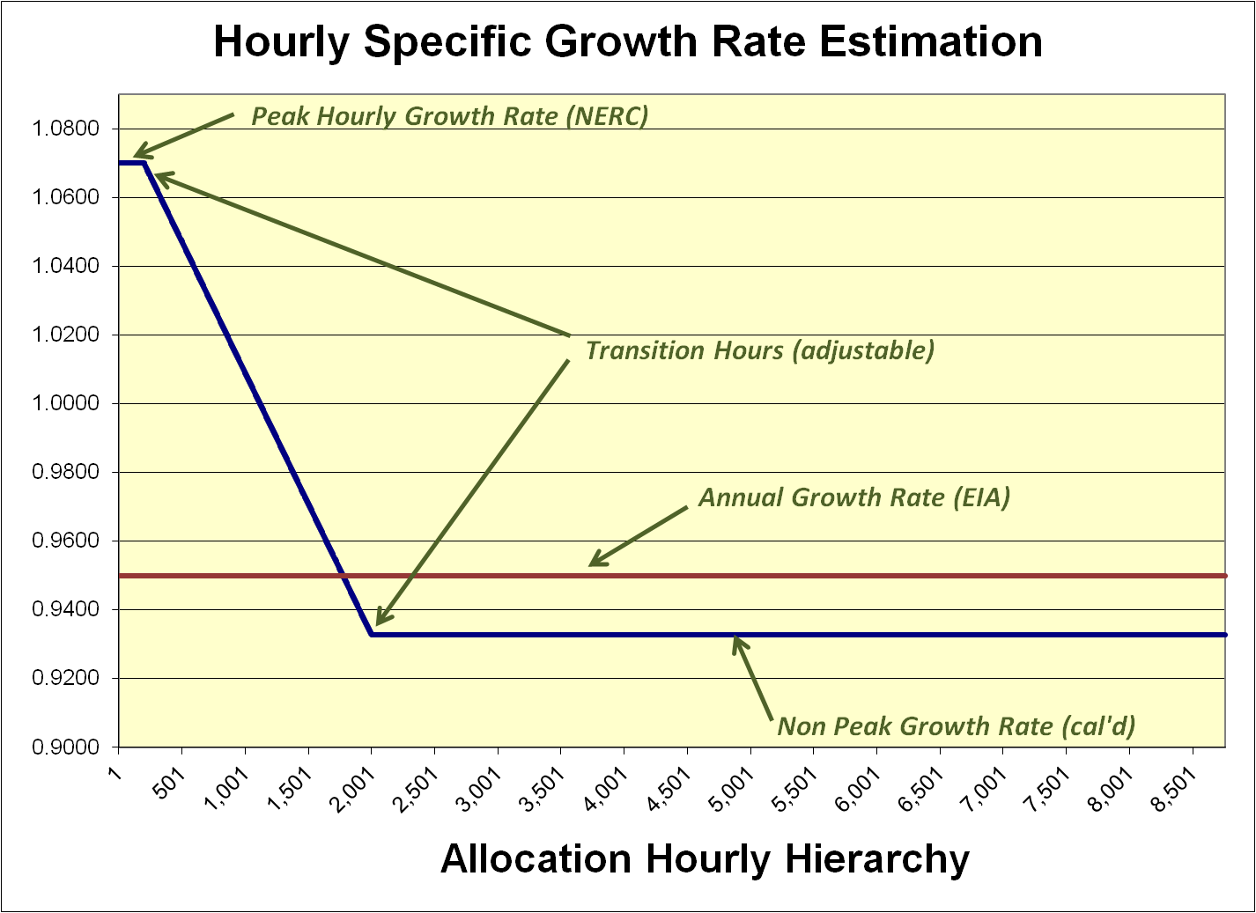
Example Growth Rate Curve
Peak GR = 1.07
Annual GR = 0.95
Transition hours of 200 & 2,000
Non Peak GR = 0.9328 (calculated)
Notes:
Calendar hours ordered by demand within each region & fuel – first hour in hierarchy has the maximum generation.
Hourly growth rate developed for every hour of the year and every fuel and region.
Hourly growth rates modified by the processor to account for new units added in future to meet demand.
AEO and NERC. Make the assumption that these sources are pretty accurately depicting the future year energy needs and economics.

Slide 8
Model components: Preprocessor
  Examines input files
  Unit Availability File (UAF)
  Controls
  Defaults data set
  Hourly CAMD data for outliers
  Removes non-EGUs
  Sets up hierarchies
    Orders hourly demand and unit utilization
  Sets up hourly growth files
  Generates a log file
Notes:
Preprocessor
Need:
*large database
*assistance in ID’s problem data and problem units
Data outliers: substituted data, incorrect units. Also checks Gross load, steam load, heat input, emissions
BY structure:
*unit utilization hierarchy by fuel/unit type
*hourly BY generation hierarchies by fuel/unit type
*BY partial year reporters – fills in
UAF calculations:
*3500+ units
*necessary data available
*unit level calculations like BY heat rates, maximum sizes, etc
Controls/Input Variables/etc:
*Basic structure and supplied data are as required by the program.

Slide 9
Model components: Processor
  Processor calculates future generation
  Growth modular by region
    and fuel/unit type
  Existing units grown using
    hourly growth rates
    New units – activity & emissions either provided by states or modeled on “high performing” existing units
  Flags & re-distributes generation beyond unit capacity
  Checks for capacity deficit
    May generate Generation Deficit Units (GDU)
    GDUs handled like a new unit
  Calculates spinning reserve – warning if inadequate
  Emission calculations and cap checks
Notes:
Activity for a unit depends on
Growth rates,
New units,
Retired units,
Capacity constraints on other existing units
States may limit the capacity of a unit on an annual basis in the UAF, if they want to.
Otherwise, the program assumes that units are limited annually by the utilization fraction assigned in the input_variables file.
Units may be run up to their maximum capacity, in the UAF. That value may be adjusted by state staff on a unit-by-unit basis. May not go over, however.
SPINNING RESERVE
Industry partners on implementation group also helped a great deal with this.
After all fuel/unit types in a region have completed processing, test to see if reserve requirements are met.
Spinning reserve capacity may be met by ANY fuel/unit type, regardless of what is fuel/unit type of the largest operating unit.
Will NOT add GDUs if enough available capacity across the fuels exists.
Will report this information to user.
Performed for a region after all fuel/unit types have been processed
Spinning reserve based on 100% of capacity of largest unit operating
Is there enough unused available capacity to cover?
GDU: stop-gap, fill-in measures. Program creates these units when generation demand outstrips capacity in any hour of the year. The much preferable situation is when existing and new, state-supplied units can meet all power demands.
CAP COMPARISONS
Provides comparisons of FY emissions and various types of caps
Tabular format
SO2, NOx and CO₂
State caps examples: NC Clean Smokestacks Act, CSAPR Assurance Levels
Regional caps examples: CAIR Budgets, Midwestern Greenhouse Gas Initiative, RGGI
Takes 13-16 hours for projection processor to run on Virginia Linux system.
About 16 hours or so on the system John uses that is Windows based.
Probably quicker on the new GT system that GA is using.
A lot of knobs and buttons on the tool. I’ve described just a few here in this discussion. Even stuff that the tool doesn’t use as of yet (minimum load threshold).
NonCAMD units can be included, but it is labor intensive AND the BY hourly data must exist in a format that is similar to CAMD’s hourly format.
**Can also manually adjust unit data if there is an unusual shutdown during the BY. Labor intensive, but can do it.
The processor log file is very helpful in determining issues regarding unit and hourly information as well as general processor run information.
Warning: output files are quite large. About 16 GB needed for inputs and outputs

Slide 10
What Does the Tool’s Main Output Look Like?
Hourly data for every unit
  Heat input (mmbtu)
  Gross load (MW-hrs)
  NOx emissions (lbs/hr)
  SO2 emissions (lbs/hr)
  Eventually other pollutants
New units
no Base Year data, but 8,760 hrs of Future data
Retired units
Base Year data, but 8,760 hrs of blank Future data
Notes:
Size of the output file for hourly data cumbersome to manipulate!

Slide 11
What Does the Tool’s Main Output Look Like?
Summary and informational files
  What hours hit max capacity?
  What regions got GDUs?
  What regions had spinning reserve concerns?
  Cap comparisons
  Unit level summaries
  Log file
  Updated UAF and growth files
Input and output files: about 16 GB
  3,000-4,500 units in Continental United States run
  8,760 hrs of data for most of them
Tool may be run regionally, which can decrease file sizes!
Post-processors available to summarize data
Notes:
The program spits out a LARGE volume of really good information.
You can drill down as far as you want to. Down to hourly levels, looking at specific BY and FY hourly data to determine what happened in a particular hour.
We’ve discovered all sorts of ways of analyzing this data. As more people look at it, I’m sure other interesting analyses will be developed as I think we’ve really just scratched the surface.
Size of the output file for hourly data quite cumbersome to manipulate!

Slide 12
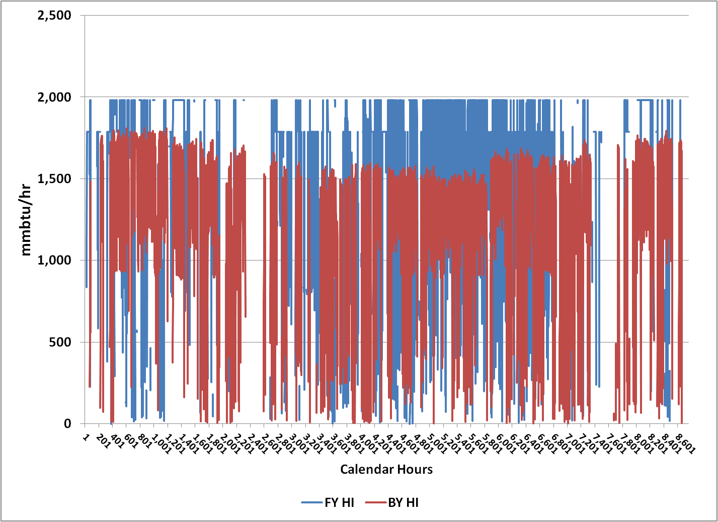
Existing Unit Level Hypothetical Example
Hours at Maximum Threshold
Hours at Optimal Threshold
Notes:
Here’s an example of some output for a VA unit, combined cycle, that had a really high growth rate (around 3).
Blue is future year heat input.
Red is base year heat input.
Can see where the hours are run up in the future year to the optimal threshold (first click) and in other hours to the maximum threshold (second click).
While the FY profile differs from the BY profile, still grounded in BY meteorology.

Slide 13
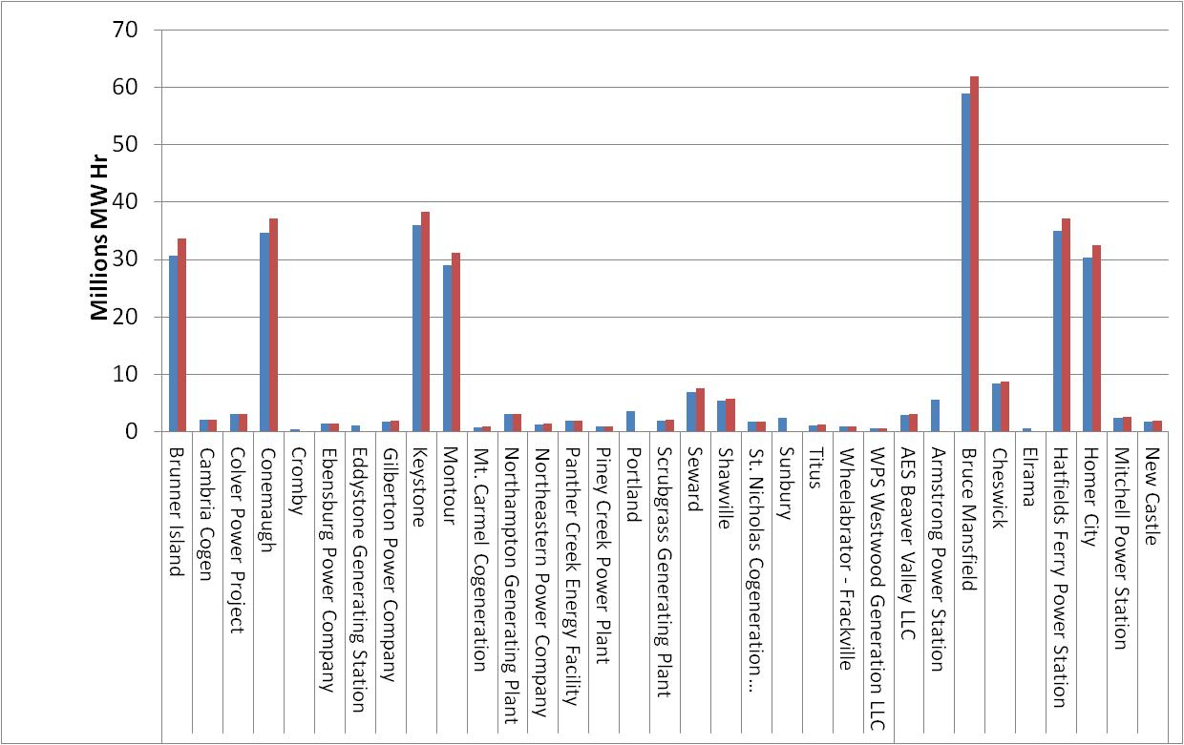
Post-Processed Results
Pivot Tables - Facility Level
Base Year vs Future
Annual Generation
Notes:
Enhanced Activity File
ORIS/Unit ID
Facility Name, State, Region
Fuel/Unit Type
Activity Data
Annually and OS
Emissions Data
NOx, SO2, rates
Annually and OS
Other data
Lat/longs
Retirement dates
May be used for input and output QA
Can be manipulated into charts and spreadsheets
Compared with inventory estimates
Pull into EXCEL and use pivot tables to drill down and examine individual activity: Example facility generation in PA.
Shutdowns - State supplied
Cromby
Eddystone
Portland
Sunbury
Armstrong
Elrama
This post process Requires less than 1 hour of computer time on the Virginia computer system for CONUS runs.
Includes summation data on BY and FY for every unit in the input files.
Handy for finding data anomalies, making comparisons to other inventories (NEI, SIP etc).

Slide 14
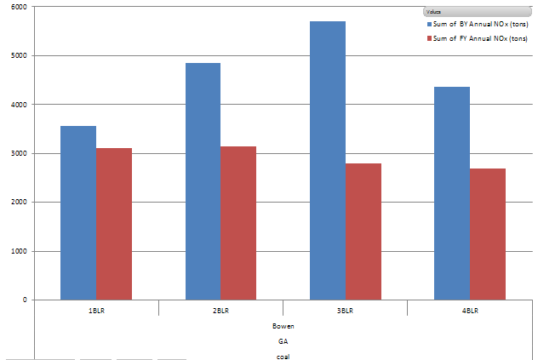
Pivot Table - Unit Level Example
Base Year vs Future Annual NOx Emissions
30
Notes:
drill down to unit level at a particular facility. Very useful for important emitters, those that are large or near sensitive air quality areas or both.

Slide 15
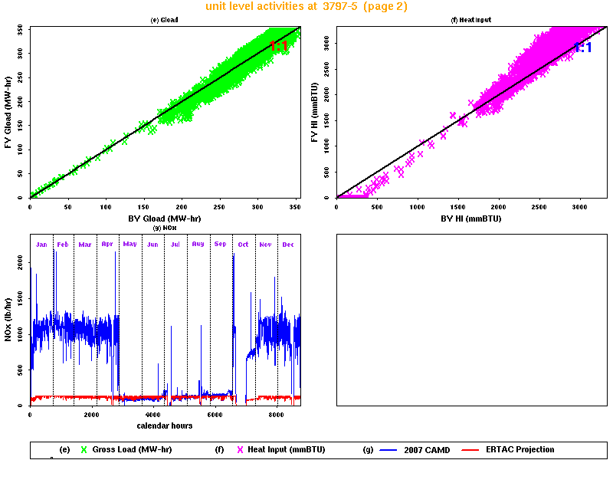
Graphical Post Processor
Notes:
Second page of graphical post processor

Slide 16
ERTAC EGU Growth Tool - Summary
Conservative hourly estimate of future EGU Emissions
  Hourly emissions reflect base year meteorology
  No unexpected shutdowns
Inputs transparent
Software not proprietary
Uses readily available and trusted databases
  CAMD CEM data, state staff knowledge, EIA-AEO, NERC,
Three parts
  Preprocessor
  Processor
  Postprocessors

Slide 17
Julie McDill, P.E.
Mid-Atlantic Regional Air Management Association
8600 Lasalle Road, Suite 636
Baltimore, MD 21281 jmcdill@marama.org
443-901-1882
Contact Information

