Slide 1
Improving Estimates of Soil NO Emissions
Ben Lash
PhD Student, CEVE, Rice U.

Slide 2
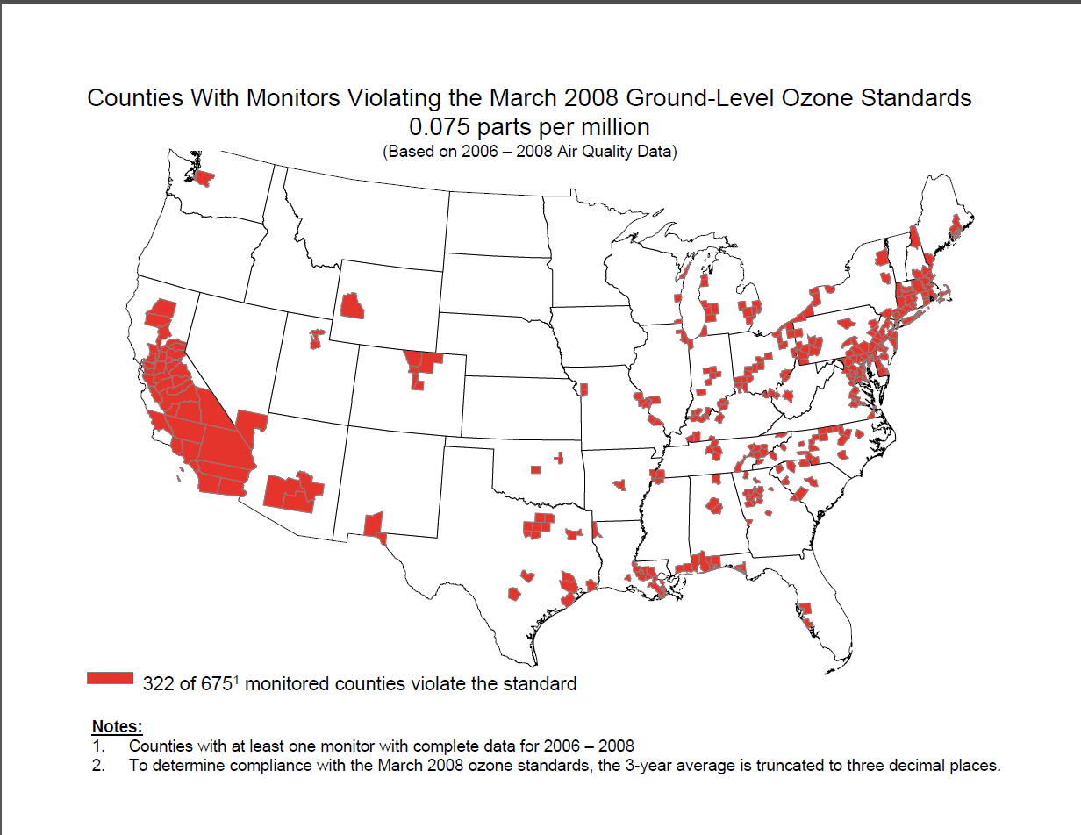

Slide 3
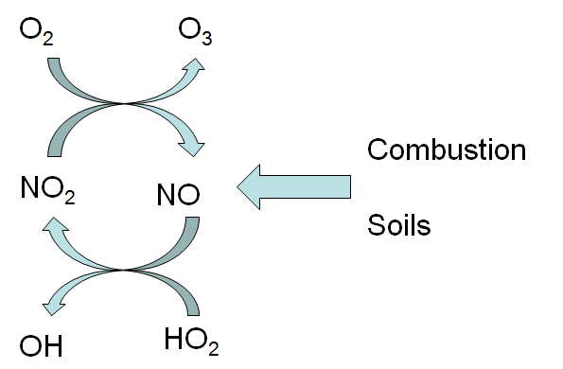

Slide 4
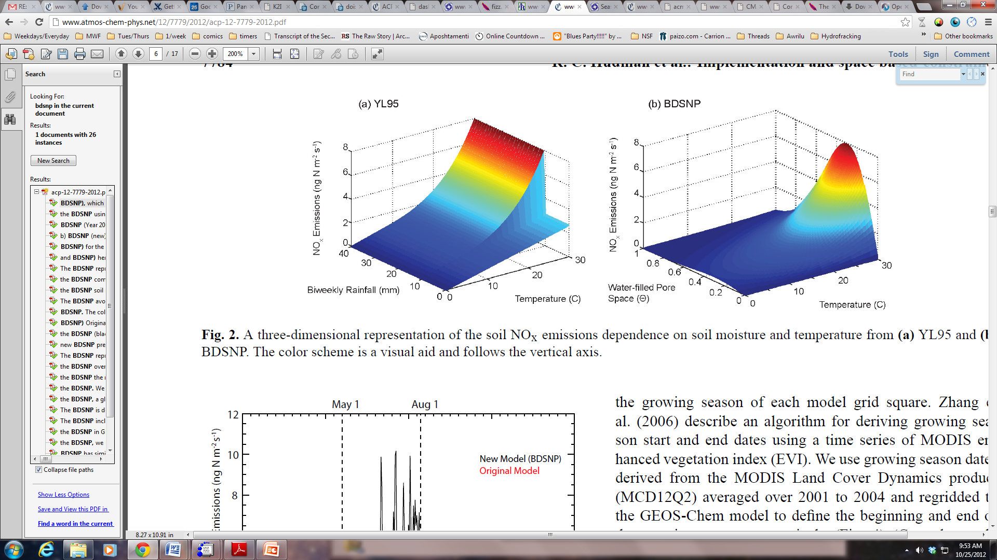
YL95: Current CMAQ
NO Emissions =
  F_{wet or dry}(Soil Temp, A_{wet or dry}(Biome)) x
  Pulse(Rainfall) x Canopy Reduction
Hudman, 2012

Slide 5
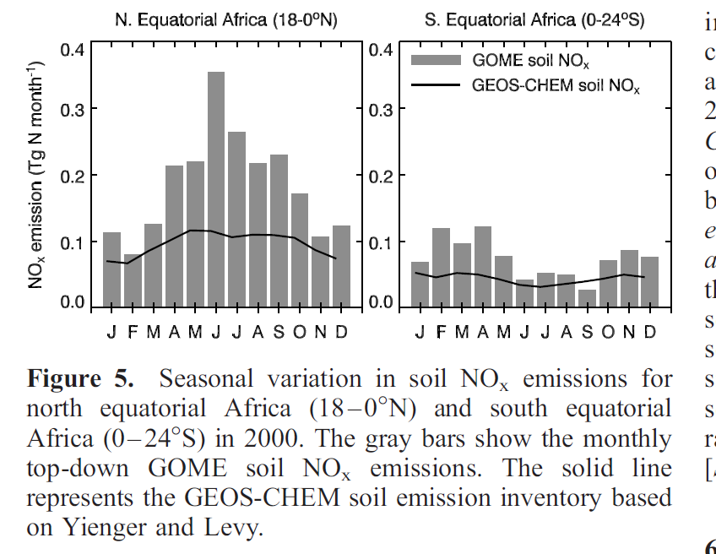
Jaegle 2004

Slide 6
BDSNP
Berkeley-Dalhousie Soil Nox Parameterization
NO Emissions =
  A(Biome, Soil Nitrogen) x f(T) x g(θ)
  Pulse(Dry Period) x Canopy Reduction
Hudman, 2012

Slide 7
BSNP vs YL95
Hudman et al. 2012

Slide 8
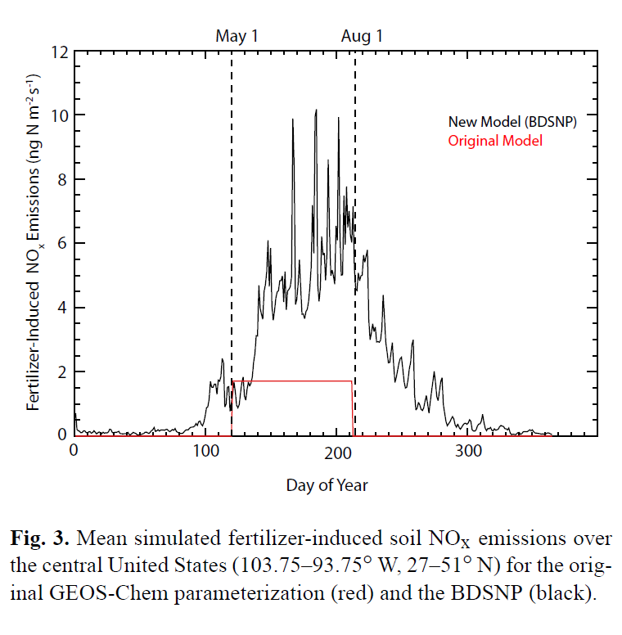
Fertilizer differences
Hudman et al. 2012

Slide 9
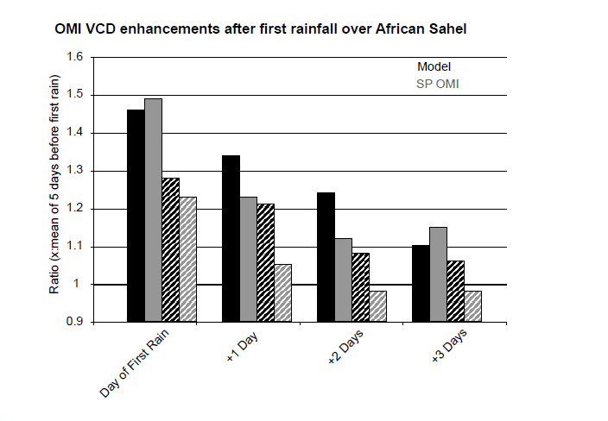
Pulsing
Hudman et al. 2012

Slide 10
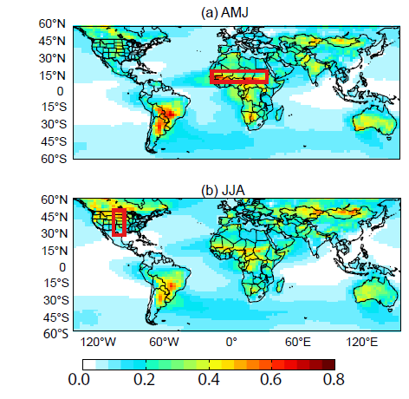
Soil NO2 vs All
Fraction NO₂ from Soil
  April-June
  June-August
Hudman et al. 2012

Slide 11
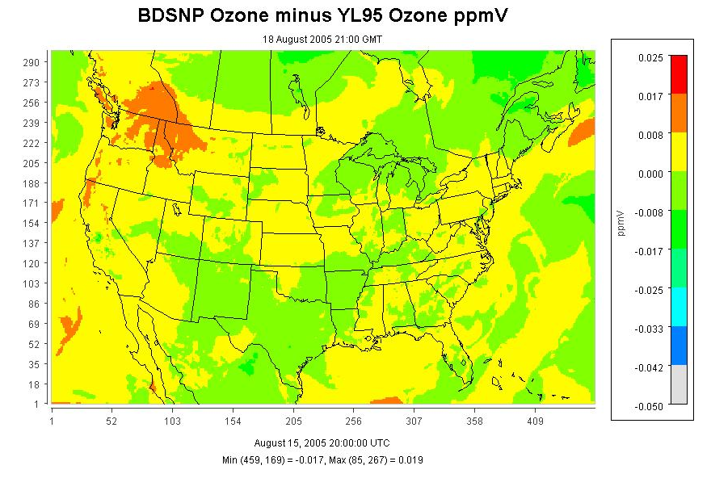

Slide 12
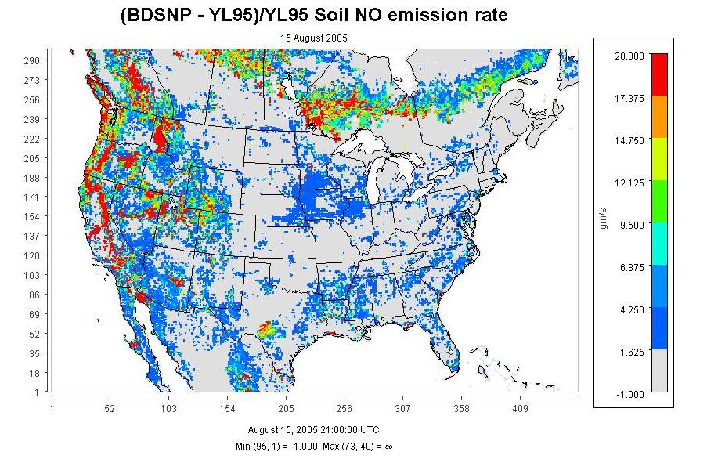

Slide 13
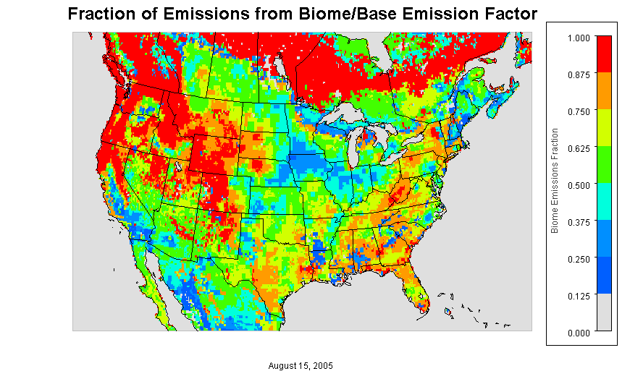

Slide 14
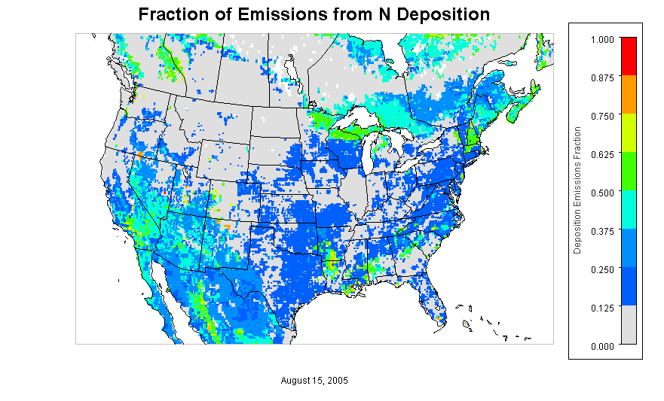

Slide 15
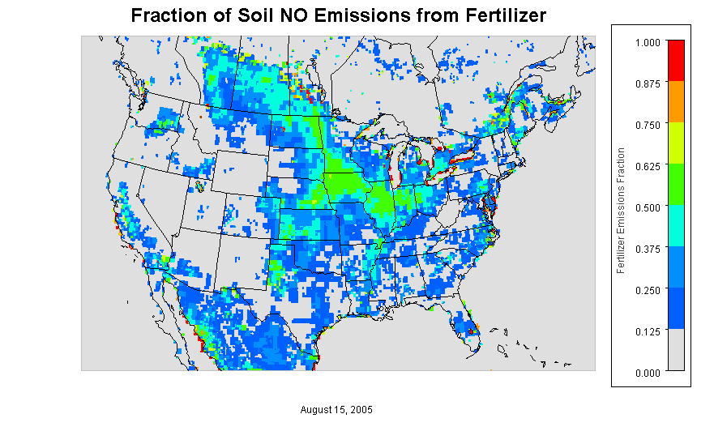

Slide 16
Mol/cm²

Slide 18
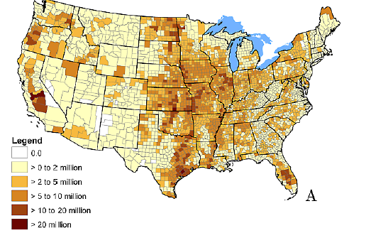
EPIC Fertilizer
Annual kg/county

Slide 19
Special Thanks
Dan Cohan
Jesse Bash
Allen Li

Slide 20
References
Hudman, R. C., Moore, N. E., Mebust, A. K., Martin, R. V., Russell, A. R., Valin, L. C., and Cohen, R. C. (2012). Steps towards a mechanistic model of global soil nitric oxide emissions: implementation and space based-constraints, Atmos. Chem. Phys., 12, 7779-7795, doi:10.5194/acp-12-7779-2012
Jaegle, L., Steinberger, L., Martin, R. V., & Chance, K. (2005). Global partitioning of NOx sources using satellite observations: Relative roles of fossil fuel combustion, biomass burning and soil emissions. Faraday Discussions, 130, 407-423. doi: 10.1039/b502128f
Yienger, J. J., & Levy, H. (1995). EMPIRICAL-MODEL OF GLOBAL SOIL- BIOGENIC NOX EMISSIONS. Journal of Geophysical Research-Atmospheres, 100(D6), 11447-11464. doi: 10.1029/95jd00370

