Slide 1
Evaluation of NO_{x} emission inventories in California using multi-satellite data sets, AMAX-DOAS, in-situ airborne measurements, and regional model simulations during the CalNex 2010
WRF-Chem Model Simulations, Inverse Model
NOAA Earth System Research Laboratory, U. of Colorado CIRES
Si-Wan Kim, Jerome Brioude, Sang-Hyun Lee, Ravan Ahmadov, Wayne Angevine, Gregory Frost, Stuart McKeen, Michael Trainer
CMAQ Model Simulations
EPA OAQPS
James Kelly, Kirk Baker
California Emission Inventory
EPA NEI05
CARB 2010 (released in 2013 for CalNex modeling or other research purposes)
UC Berkeley Brian McDonald, Robert Harley (Fuel-use base method)

Slide 2
NOAA WP-3D NO₂
NOAA Earth System Research Laboratory, U. of Colorado CIRES
Ilana Pollack, Thomas Ryerson
CU-AMAX-DOAS NO₂
U. of Colorado
Hilke Oetjen*, Sunil Baidar, Rainer Volkamer
*Now at Jet Propulsion Laboratory
Satellite NO₂ columns
Dalhousie U. Randall Martin
KNMI K. Folkard Boersma
NASA Lok Lamsal, Eric Bucsela, Edward Celarier,
Nickolay Krotkov
UC Berkeley Ashley Russell, Lukas Valin, Ronald Cohen
U. Bremen Andreas Richter, John Burrows
BEHR

Slide 3
Outline
Background
- CalNex 2010
- Trend in NOx emission
Motivation and goal
3. Results
- Emission inventories
- Comparisons of model and observations
In-situ aircraft obs.
AMAX-DOAS obs.
Satellite obs. (WRF-Chem and CMAQ)
All days, Weekday and Weekend
4. Summary and conclusions

Slide 4
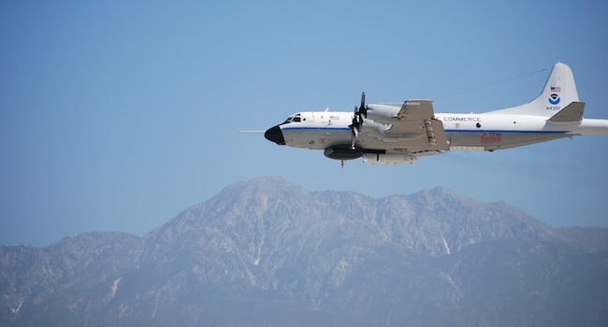
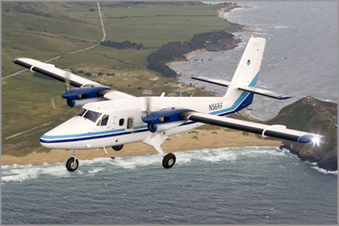
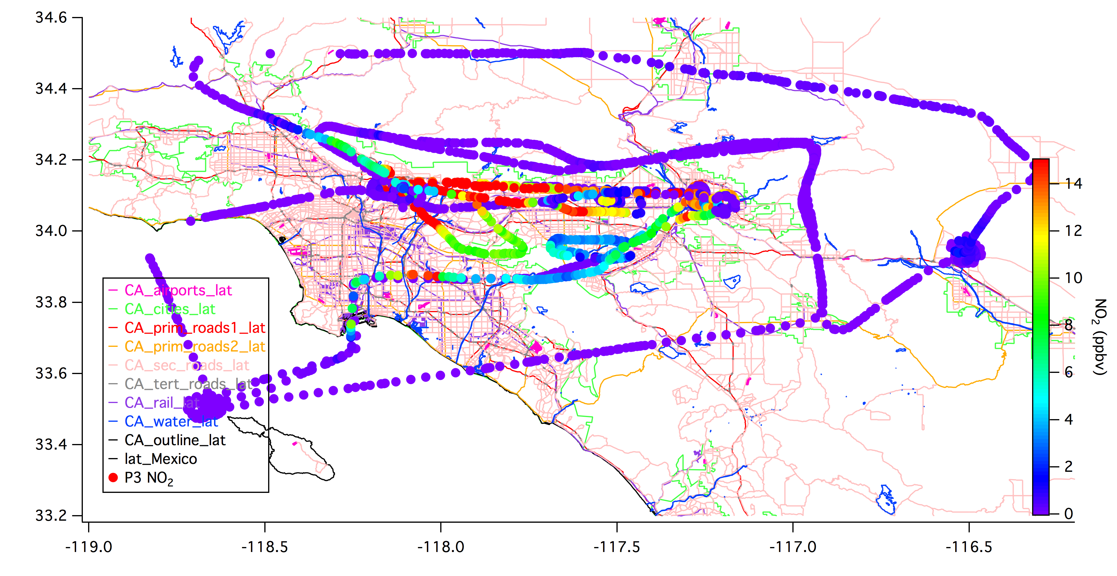
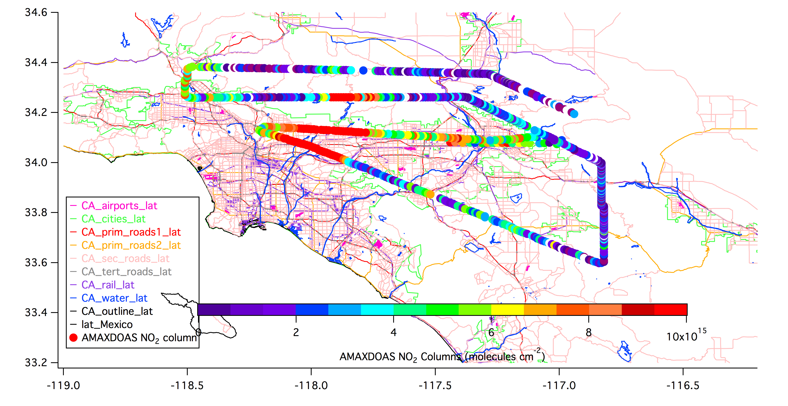
California case: CalNex 2010
(California Research at the Nexus of Air Quality and Climate Change) http://www.esrl.noaa.gov/csd/calnex
NOAA WP-3D (May-June 2010)
NOAA Twin-Otter (May-July 2010)
In-Situ NO₂
CU-AMAX-DOAS NO₂ columns
Los Angeles
Notes:
Houston = Urban + Industry

Slide 5
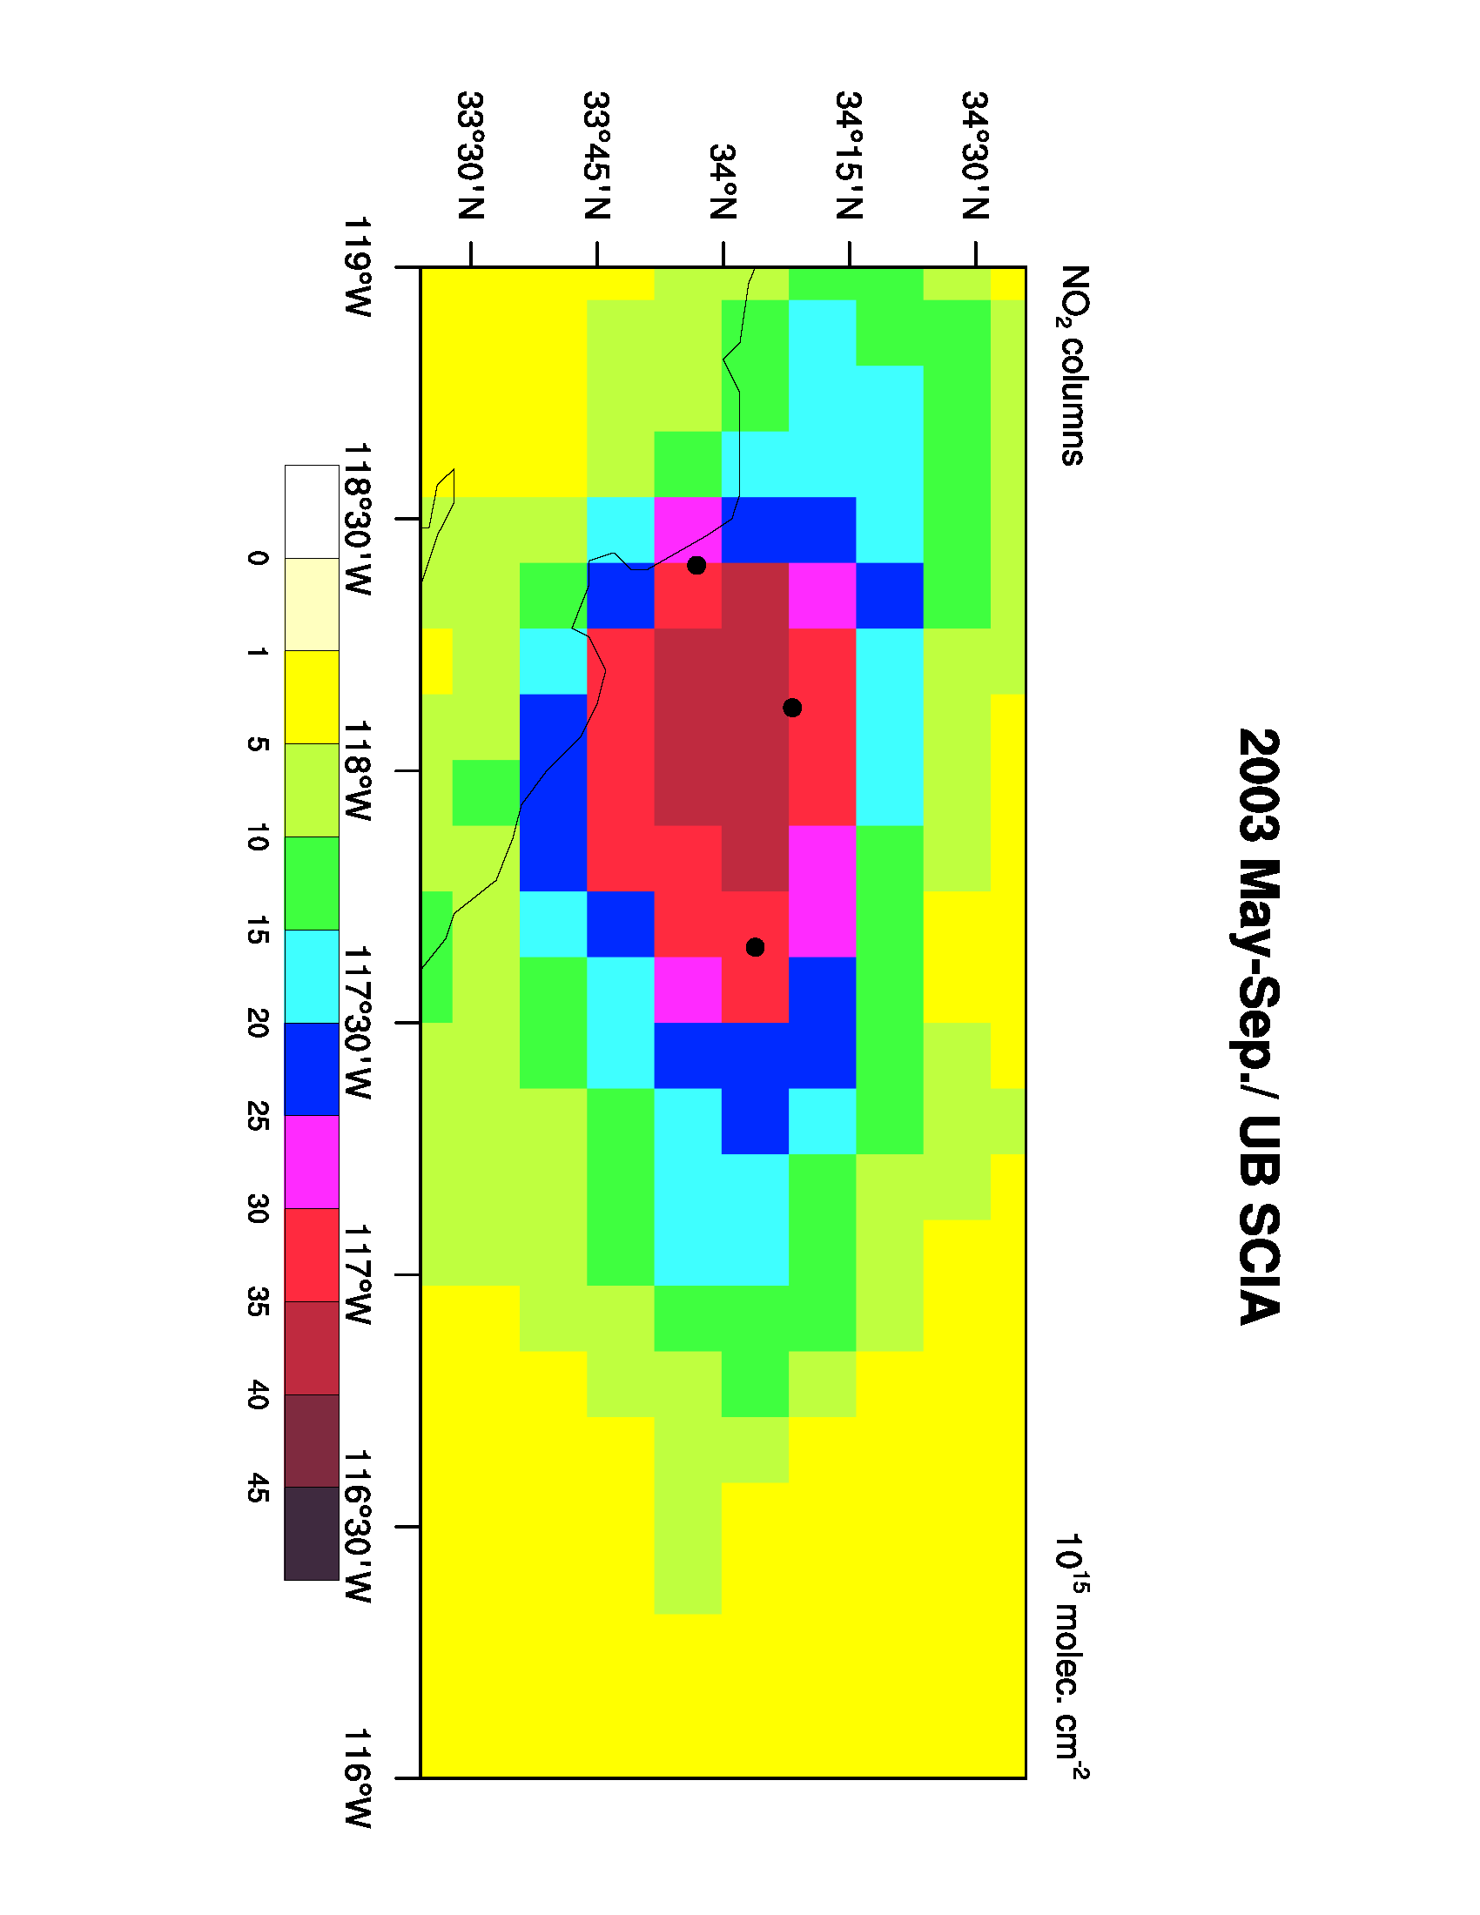
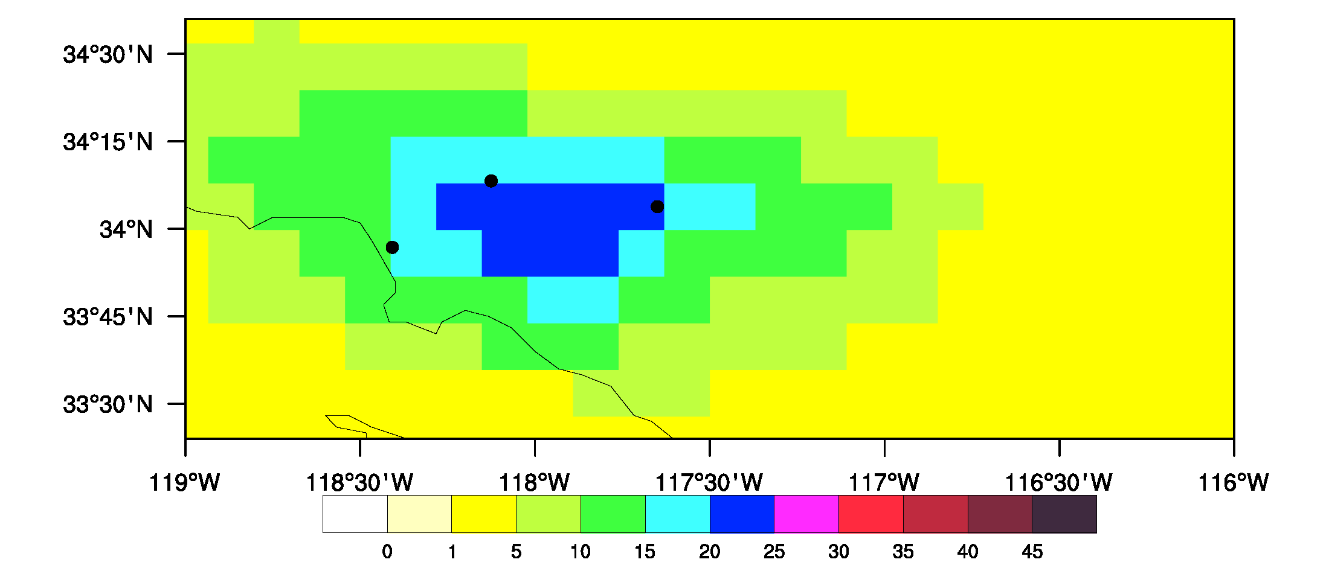
Satellite tropospheric NO₂ columns and trend: the LA basin
SCIAMACHY (University of Bremen)
May-September
2003
2003
Pasadena
Ontario
LAX
2010
2010
Pasadena
Ontario
LAX

Slide 6
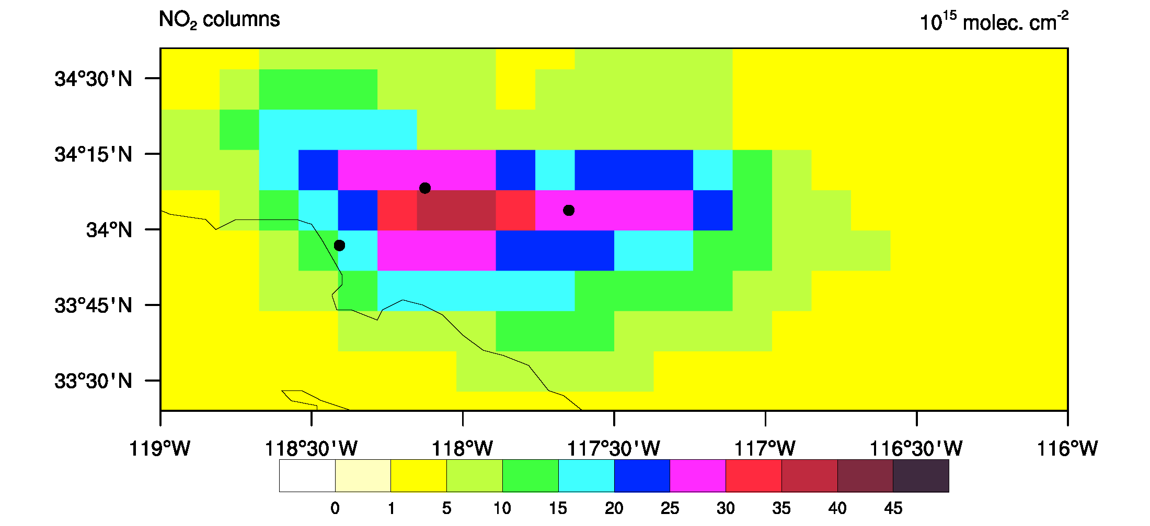
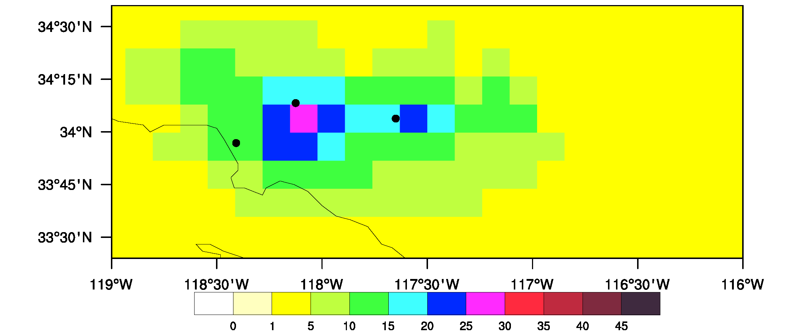
Satellite tropospheric NO₂ columns and trend: the LA basin
OMI (University of Bremen)
May-September
surface monitor
2005
Pasadena
Ontario
LAX
OMI
2010
Temporal change
~30% reduction of ambient NO₂
between 2005 and 2010
← Mobile emission control and
recession
(McDonald et al., JGR, 2012)
Model(NEI05)/Obs. ≈ 1.4
Pasadena
Ontario
LAX

Slide 7
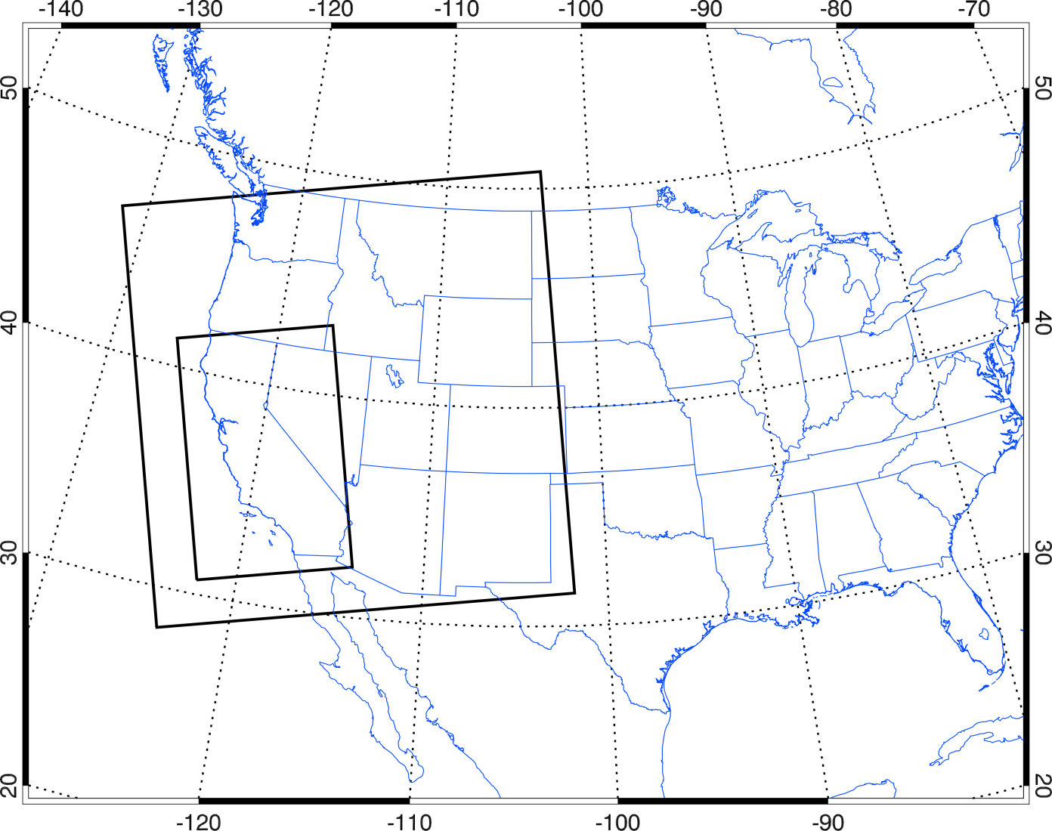
Using model for evaluation of NO_{X} emission inventory
WRF-Chem model version 3.4.1
Domains: Western US & CA
Number of vertical levels: 60
Simulation period: Apr/26-Jul/17 2010
Meteorological I.C. and B.C.: NCEP GFS
Idealized Chemical I.C. and B.C. for U.S. 12km resolution domain (D1): clean maritime condition
Anthropogenic emissions: EPA NEI-2005 , Inverse models, and CARB10
Biogenic emissions: BEIS3.13+Urban isoprene
Chemical mechanisms: RACM (Stockwell et al., 1997) → ~30 reactions updated following JPL 2006 report
Cumulus parameterization for D1 only
Lin microphysics scheme
YSU Planetary Boundary Layer model
Noah Land surface model
WRF-Chem Model Domains
D1: Western US (12 x 12 km² resolution)
D2: California (4 x 4 km² resolution)
- Satellite, Aircraft observations and Model comparison
D1 12 x 12 km²
D1
D2 4 x 4 km²
D2
Notes:
Model resolution – match with satellite resolutions

Slide 8
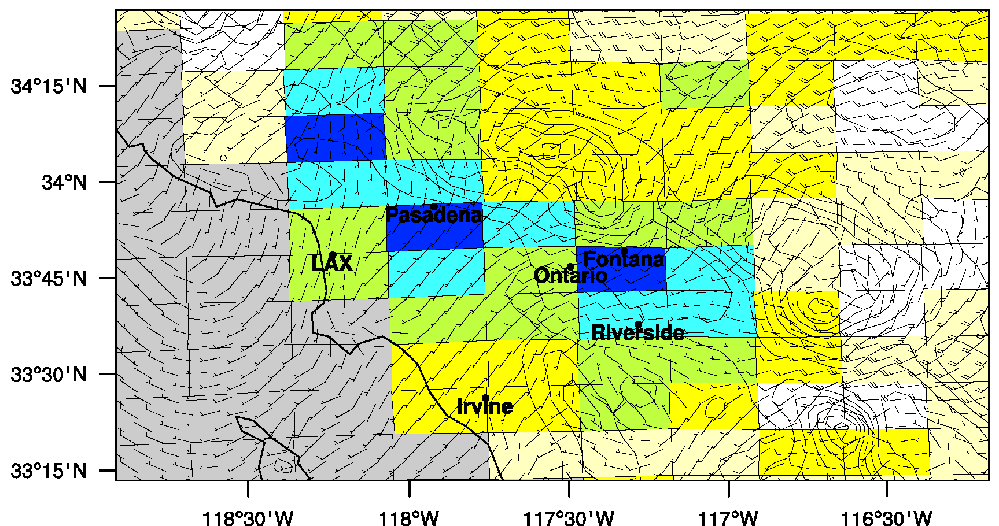
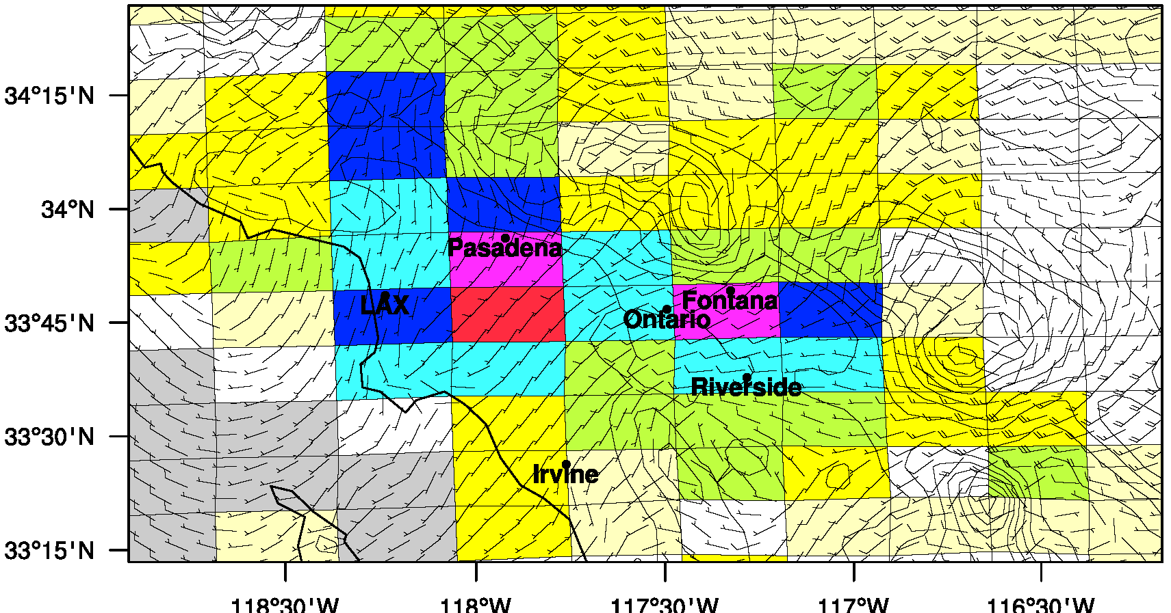
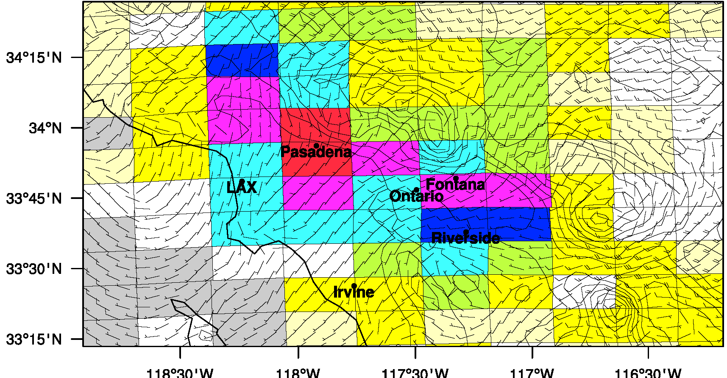
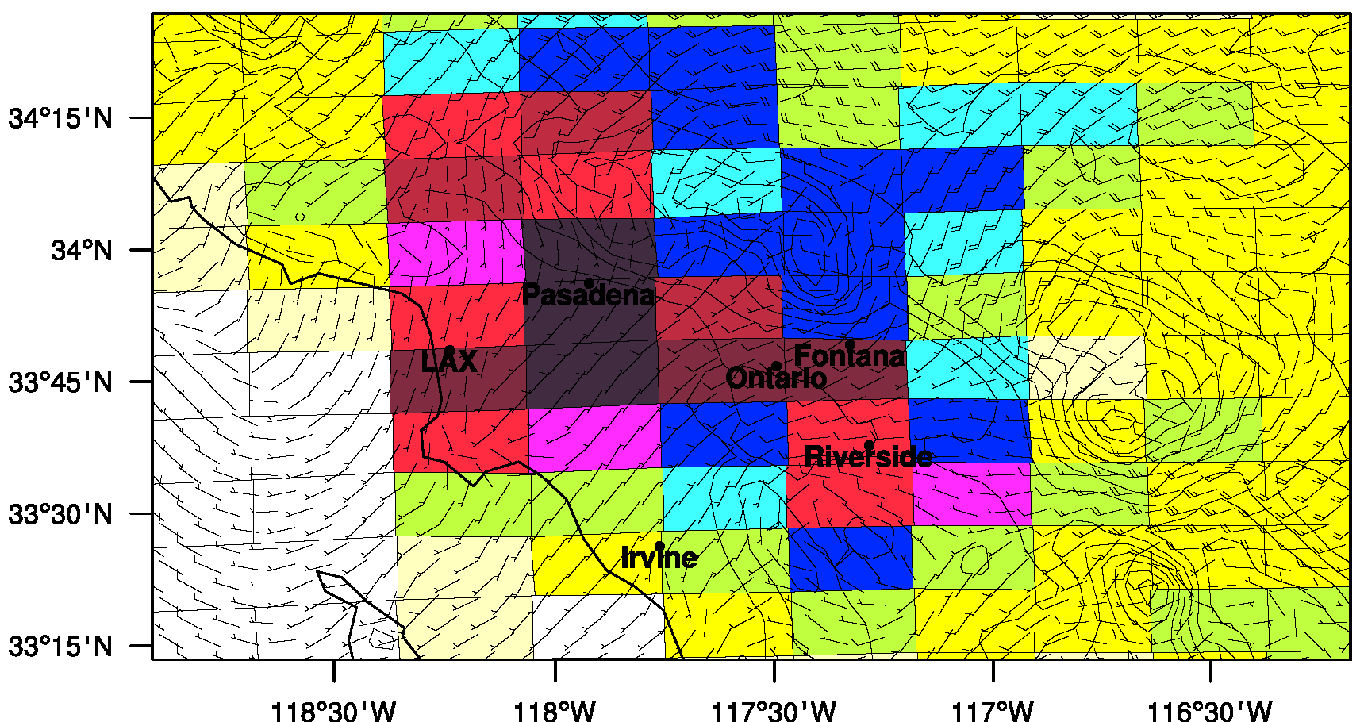
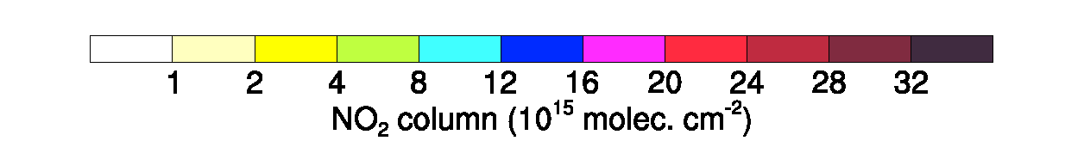
Satellite v. Model (projected to pixels): 6/1/2010 over the LA basin
NASA OMI NO₂
KNMI OMI NO₂
OMI albedo
GMI NO₂
OMI albedo
TM4 NO₂
BEHR OMI NO₂
WRF-Chem NEI05
MODIS albedo
WRF-Chem NO₂
Excellent spatial coverage of satellite data
Large difference among the retrievals
Model (NEI05) >> OMI columns ➔ Satellite problem? or Emission problem?

Slide 9
Consistent large biases → issues in emission inventory
Emission year
→ 2005
CalNex
(simulation period)
→ 2010
In-situ Aircraft Obs.
WRF(Model)/Obs. > 1.4
LA
CU-AMAX-DOAS
Satellite (OMI)
LA
LA

Slide 10
Motivation and Goal
California emission inventories need to include recent reductions in NO_{X} emissions (e.g., McDonald et al., 2012) and reduce uncertainties in emission factors/activities
Evaluate up-to-date California NO_{X} and VOC emission inventories
with model simulations and observations during CalNex 2010 and
find solutions for better emission inventories.
* NOAA-P3 in-situ NO₂ aircraft observation
5/4, 5/14, 5/19, 5/8, 5/16, 6/20
* NOAA Twin Otter CU-AMAX-DOAS NO₂ column
6/1, 6/4, 6/7, 6/24, 7/12, 7/16, 6/5, 6/26, 7/5, 7/17
* Multiple satellite tropospheric NO₂ columns
5/7, 5/14, 6/1, 6/3, 6/17, 6/24, 7/12, 5/16, 6/26, 7/3, 7/5
Weekday
Weekend

Slide 11
Emission inventories
NEI05
EPA NEI 2005 (MOBILE6, NONROAD)
JB_NOx (NOx inverse model results + NEI05_VOC)
Inverse model results using aircraft obs. during CalNex 2010
(Jerome Brioude et al., ACP, 2013)
AB_VOC (NOx inverse model results + Borbon VOC)
The same as JB_NOx except for VOC updates based on
Agnes Borbon et al. (JGR, 2012) observations at the CalTech site
CARB10
Released in 2013 for research purpose (e.g., CalNex modeling)

Slide 12
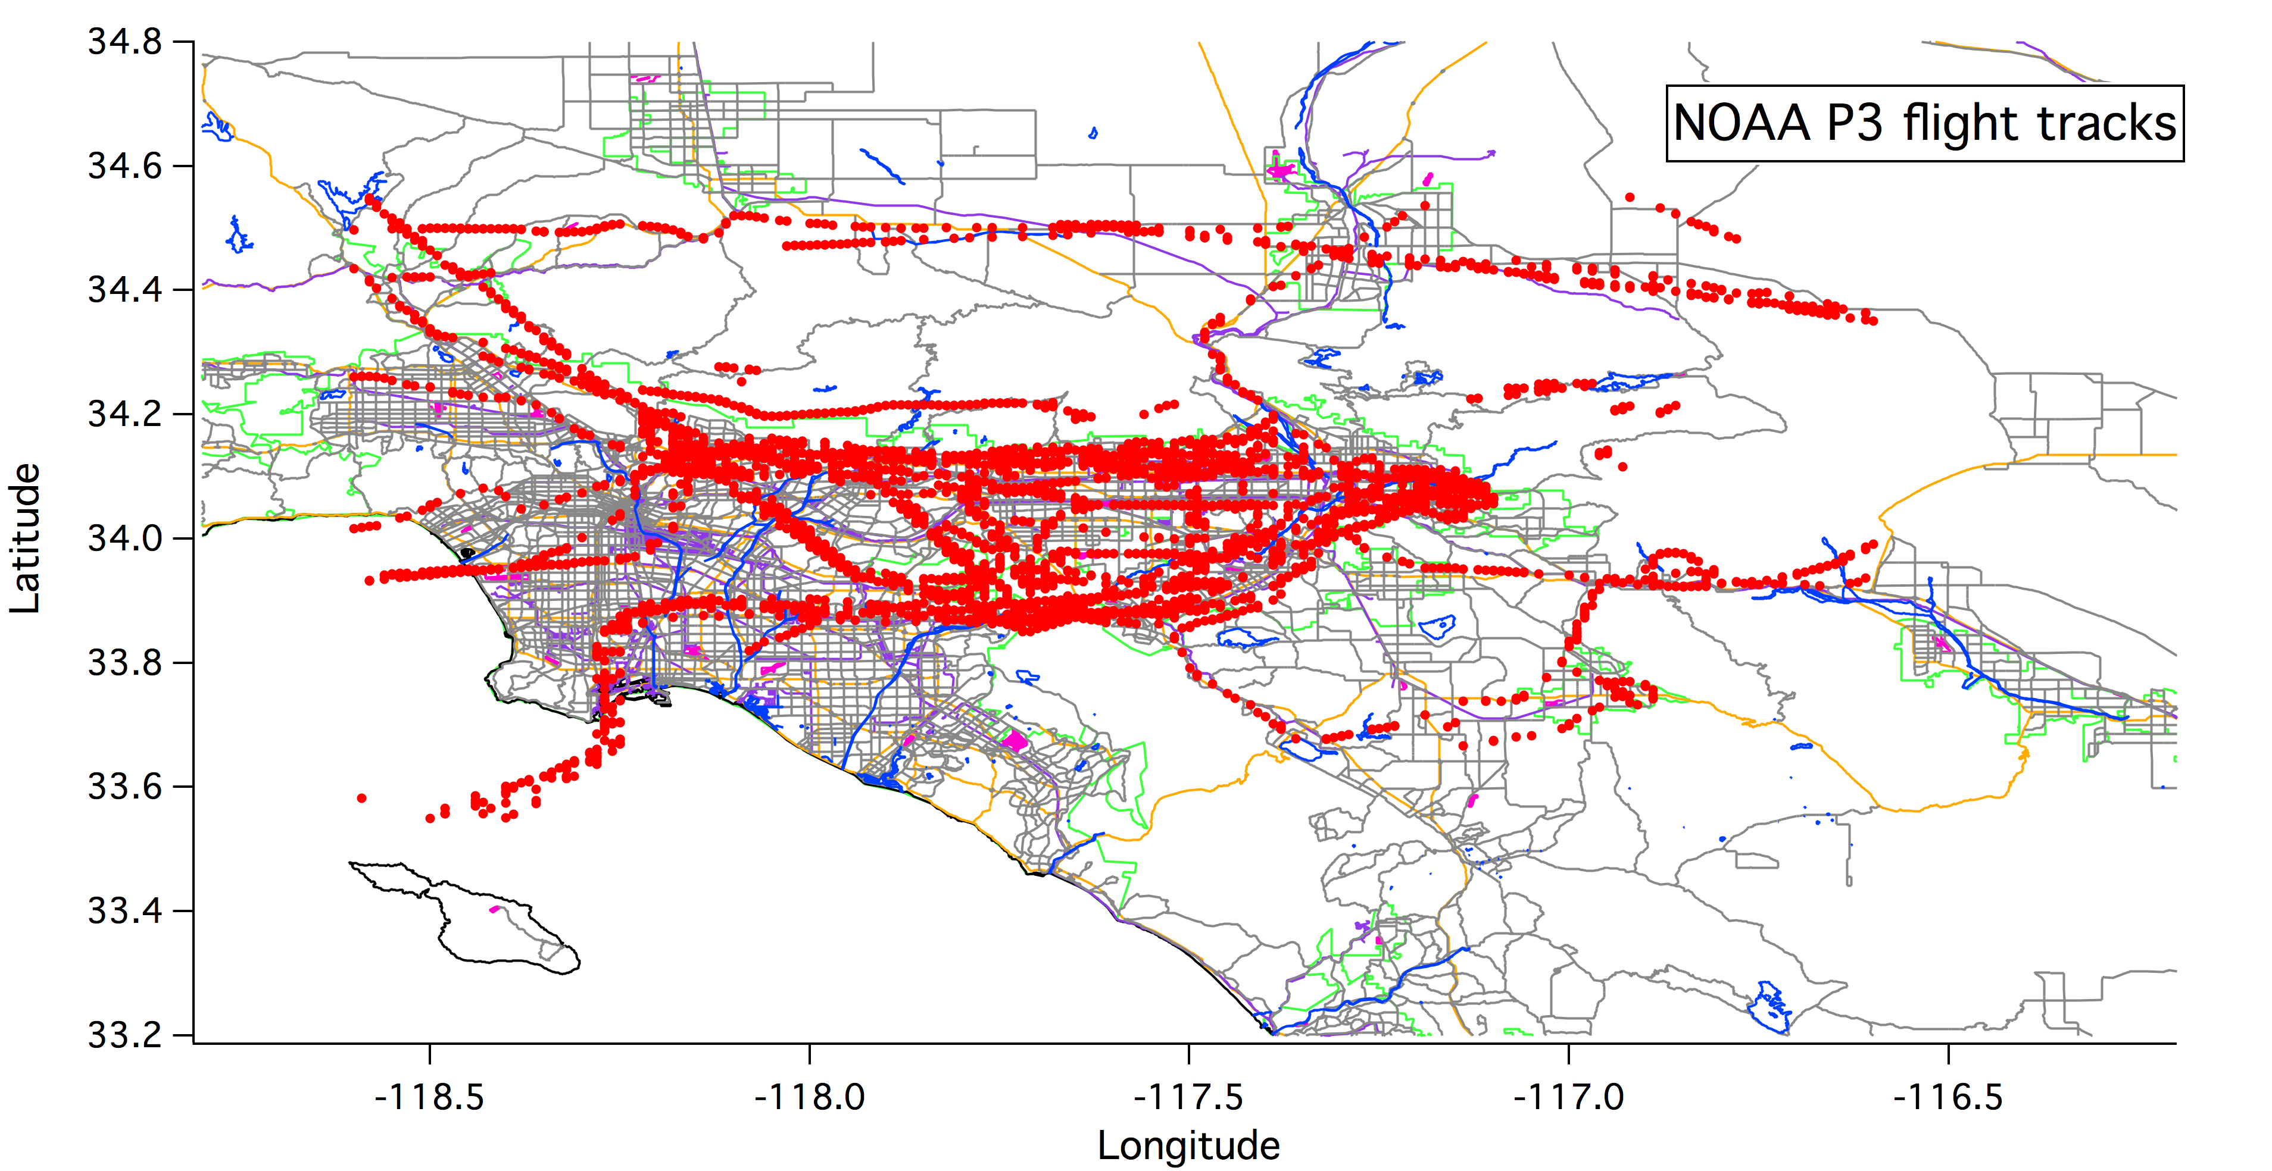
NOAA-P3 (in-situ) v. Model using different EIs: LA
Altitude above ground level < 1km
Inverse model emissions and CARB10 are much improved compared to NEI05
Inverse model results (JB_NOx and AB_VOC) have the best correlation with obs.

Slide 13
Diurnal variations of NOx emissions
Offroad+Area source
Offroad + Stationary Area Sources in the NEI2005 may explain large discrepancies between the model and the obs during CalNex 2010.
➔ large nighttime emissions
Improved in NEI2008 and NEI2011?

Slide 14
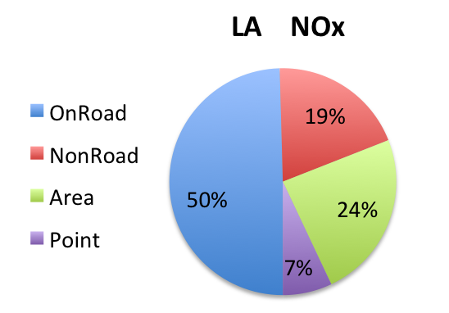
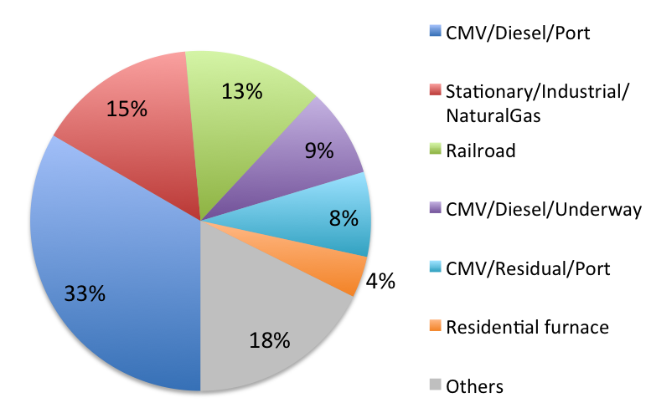
NEI-2005 NO_{x} partition in Los Angeles
NEI05_Gas > CARB10*_Gas
(70% higher)
NEI05_Diesel ≈ CARB10*_Diesel
NEI05_Onroad is 33% higher than CARB10*_Onroad.
*CARB10
CEPAM: 2009 Almanac-Standard Emission Tool
http://www.arb.ca.gov/app/emsinv/fcemssumcat2009.php
Potentially large uncertainties in:
NonRoad
Construction & Lawn Mowing
2. Area source (based on year 2002)
Commercial Marine Vessels (CMVs)
Kim et al., 2011, ACP
3. Point source (based on year 2002)
LA NOx Area Source
75% reduction in Nonroad
40% reduction in Area to be consistent with McDonald et al. (2012)

Slide 15
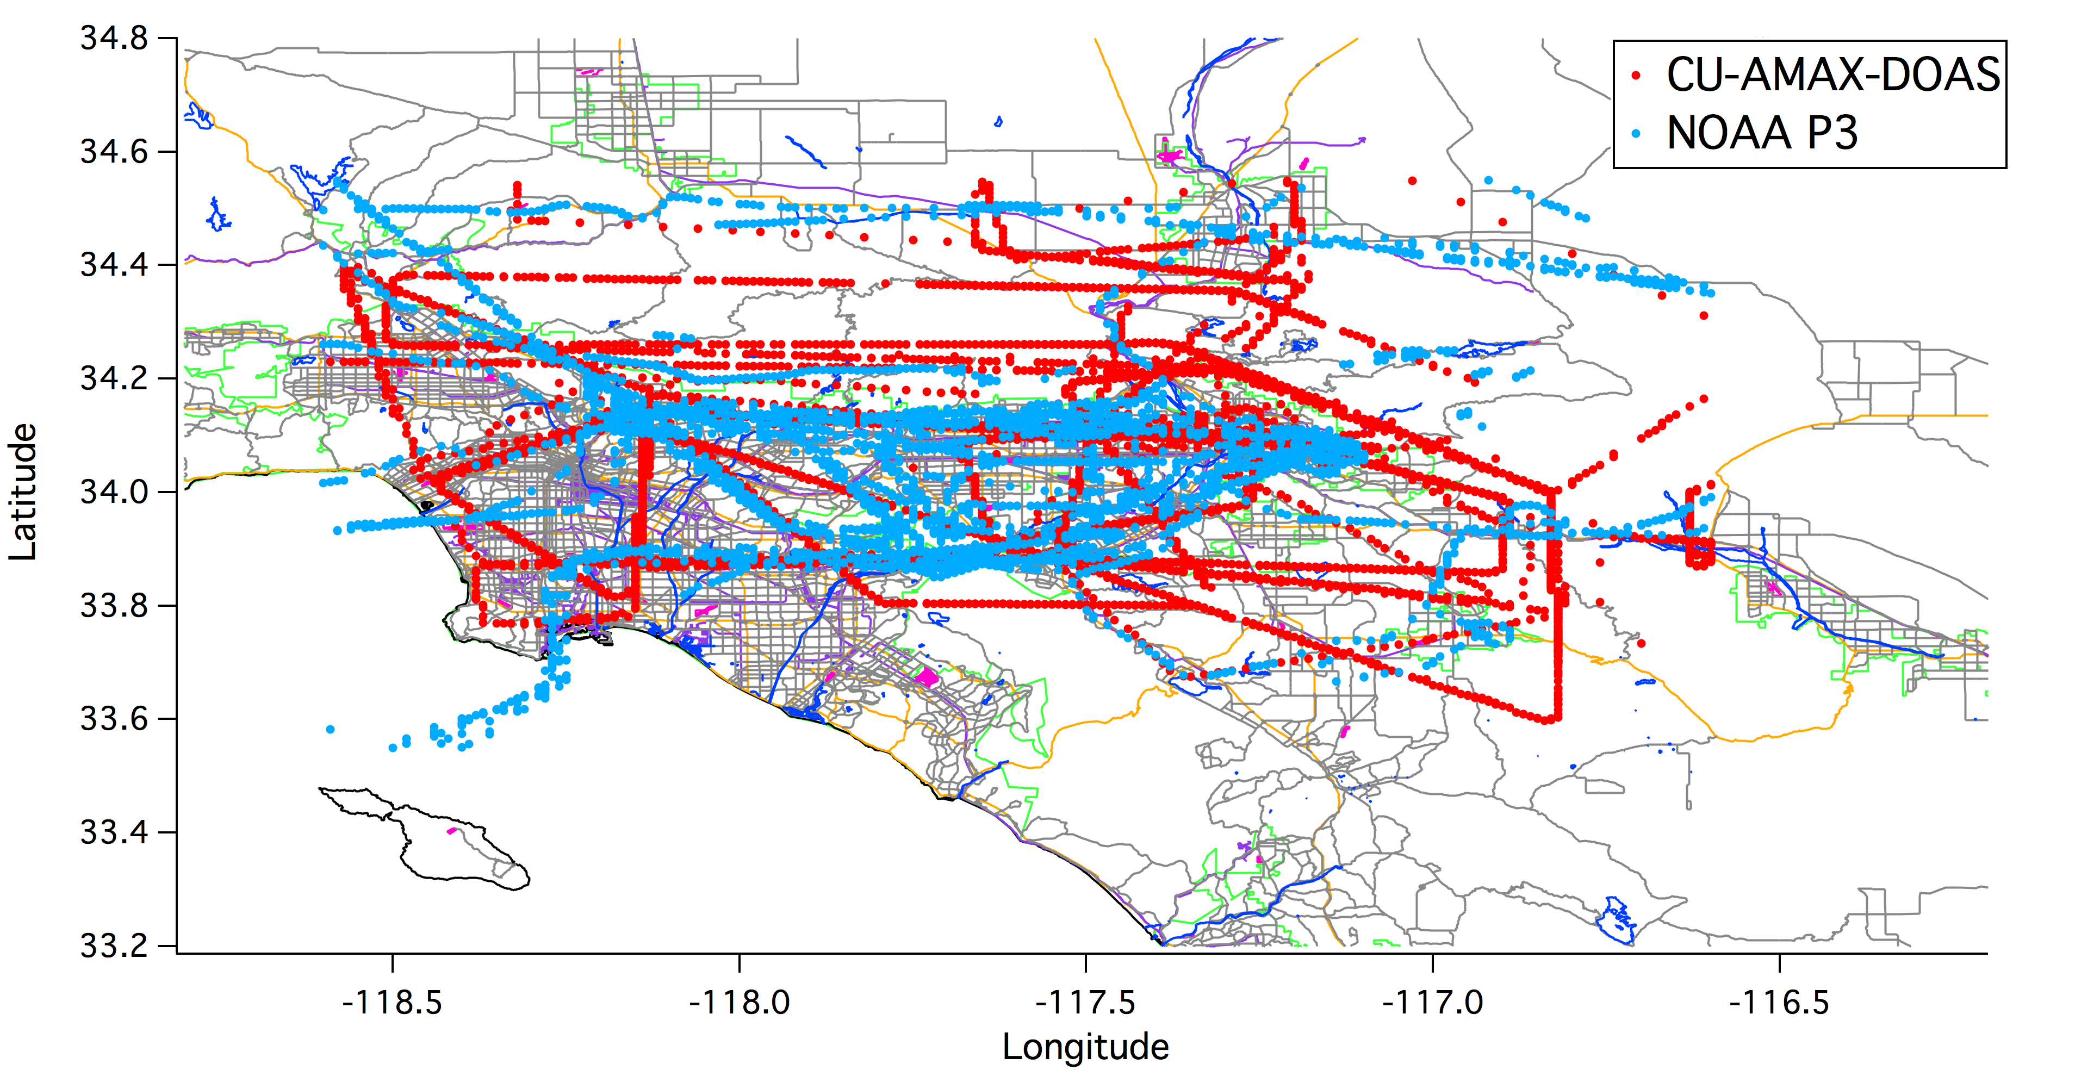
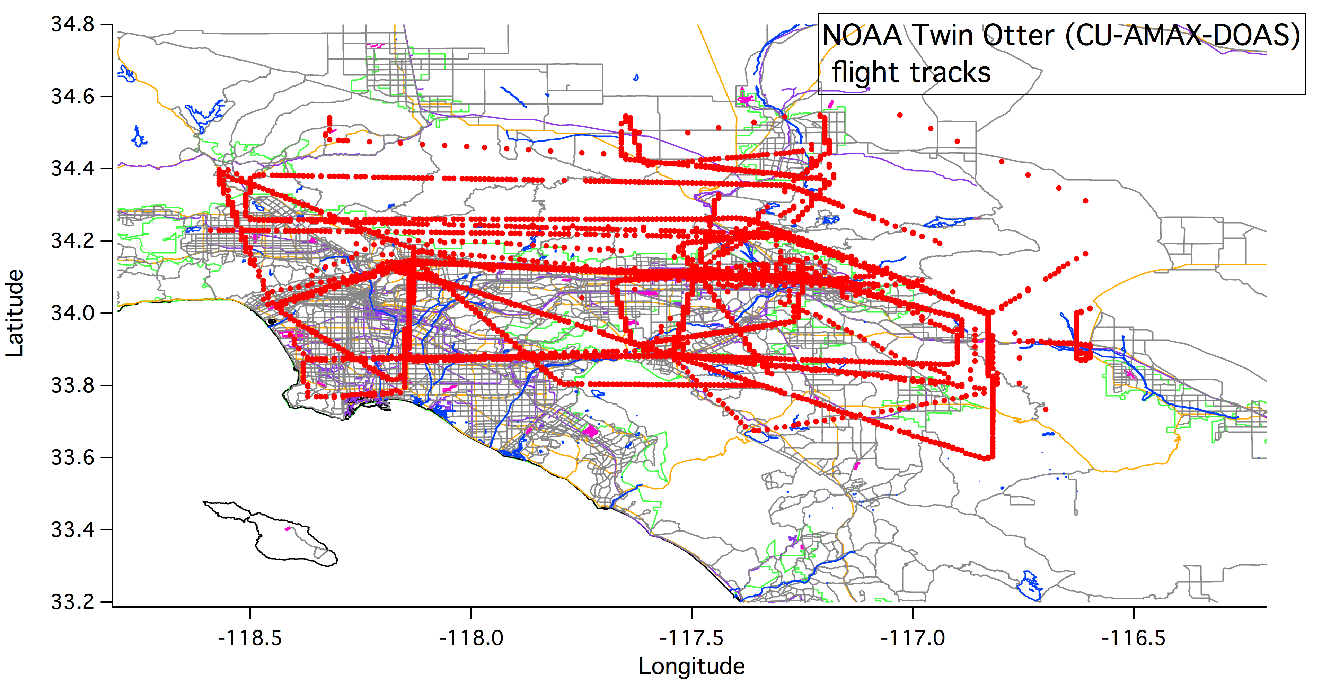
NOAA Twin Otter CU-AMAX-DOAS column NO₂
v. Model using different EIs over LA
Model > AMAX-DOAS obs.
Inverse model emissions and CARB10 are improved compared to NEI05
CARB10 has the best correlation with obs.
*Morning observations (influence of nighttime emission and previous day’s condition)
*Warm July episodes (sensitive to local circulation: seabreeze onset, nighttime drainage)

Slide 16
OMI tropospheric NO₂ columns
v. Model using different EIs over LA
Average of 3 OMI retrievals
Correlation between the model and OMI columns is high (0.8-0.9).
OMI retrievals are variable (UCB/NASA=1.6).
CARB10 and inverse model results are improved compared to NEI05.
NASA retrieval is being recalculated with the WRF-Chem 4km x 4km NO₂ profile.

Slide 17
Weekday v. Weekend over LA: NOAA P3 (in-situ data)
Ratio of Weekend to Weekday Observation (NOAA P3) = 0.37 (63% reduction)
WRF-Chem NO₂ NEI05 = 0.51 (NOx emission ratio = 0.71)
JB_NOx = 0.37 (emission ratio = 0.62)
AB_VOC = 0.37
CARB10 = 0.49 (emission ratio= 0.76)

Slide 18
CA urban and agricultural areas
OMI agrees better with CARB10 across CA urban areas.
Model columns over central valley are lower than the obs.

Slide 19
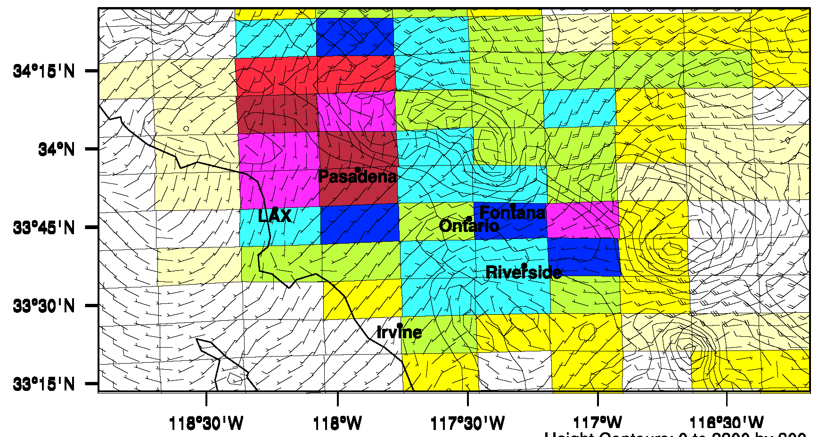
Satellite v. CMAQ: 6/1/2010 over the LA basin
NASA OMI NO₂
KNMI OMI NO₂
OMI albedo
GMI NO₂
OMI albedo
TM4 NO₂
BEHR OMI NO₂
CMAQ
MODIS albedo
WRF-Chem NO₂
NEI0₅
CMAQ columns were projected to OMI pixels.

Slide 20
NOx emission used for CMAQ simulations
Purple line: CMAQ
NOx emission in CMAQ is much reduced compared to NEI05.
But it is slighter larger than CARB10 and inversion.
NO_{X} emission in CMAQ:
On-road emission was interpolated from CARB07 and CARB11.
Spatial distribution using SMOKE-MOVE
CEMS 2010 for point source

Slide 21
CMAQ v. WRF-Chem
NO₂ columns
Los Angeles
No substantial biases between two model simulations
Preliminary results!

Slide 22
CMAQ v. OMI (NASA, KNMI, BEHR)
Average bias
= 65%
Average bias
= 24%
Los Angeles
Average bias
= 3%
CMAQ NO₂ columns agree better with KNMI and BEHR columns in terms of biases
Preliminary results!

Slide 23
Impact of A Priori NO₂ profiles on NASA OMI retrieval
NEI05
CARB10
Los Angeles
Inversion
Satellite NO₂ columns increased when WRF-Chem NO₂ profiles were used as a priori profile for retrieval.

Slide 24
Summary and Conclusions
Uncertainties in California NO_{X} emission inventories
- NOx (and CO) in CARB10 is improved compared to NEI05 (correlation ⬆, bias ⬇).
- Inversion results are promising (correlation ⬆, bias ⬇).
→ Large uncertainties in area and offroad source in EPA NEI
NOx emission biases in the NEI05 were identified with satellite retrievals of tropospheric NO₂ as well as AMAX-DOAS and in-situ aircraft observations.
Biases of CMAQ NO₂ columns relative to different retrievals were consistent with
those of WRF-Chem columns.
To understand variability among the satellite retrievals, impact of a priori profile on NASA standard retrieval was examined.
Using WRF-Chem NO₂ profile as a priori for retrieval increase satellite columns.
Emission inventory also affects the satellite retrieval.

