Slide 1
HCHO and NO₂ column comparisons between OMI, GOME-2 and CMAQ
during 2013 SENEX campaign
Hyun Cheol Kim ^{1,2}, Li Pan ^{1,2}, Pius Lee ¹, Rick Saylor ³, and Daniel Tong ^{1,2}
¹ NOAA/Air Resources Laboratory, College Park, MD
² UMD/Cooperative Institute for Climate and Satellites, College Park, MD
³ NOAA/ARL/Atmospheric Turbulence and Diffusion Division, Oak Ridge, TN

Slide 2
Background
Monitoring NO₂ is important to investigate locations of natural and anthropogenic NO_{x} emission sources, and chemical regimes according to Ozone-NO_{x}-VOC chemistry.
HCHO is a common intermediate product from the degradation of volatile organic compounds (VOCs), it can be used as a proxy to monitor emissions of VOCs from biogenic, biomass burning, and anthropogenic sources.
Monitoring the spatial and temporal variability of VOC emissions in the southeast US region is crucial to understanding control processes in this region’s air quality, especially for ozone and secondary organic aerosols productions.

Slide 3
The Goal of this presentation
How to compare space-born satellite measurements to fine scale regional chemistry model simulations
How to resolve variable resolution issues
Characteristics of different species
Retrieval uncertainties
To discuss the Impact by different footprint pixel sizes for different satellite instruments and even within the same instrument.
NO2 and HCHO column comparisons during SENEX compaign (preliminary)

Slide 4
NO₂ & HCHO observations from space
Instrument | Satellite | Local pass | Resolution | Data
GOME | ERS | 10:30 LT | 320x40 km | 1996-2003
SCIAMACHY | ENVISAT | 10:00 LT | 30x60 km | 2002-2012
OMI | Aura | 13:30 LT | 13x24 km | 2004-
GOME-2 | MetOp-A MetOp-B | 09:30 LT | 40x80 km | 2007- 2013-

Slide 5
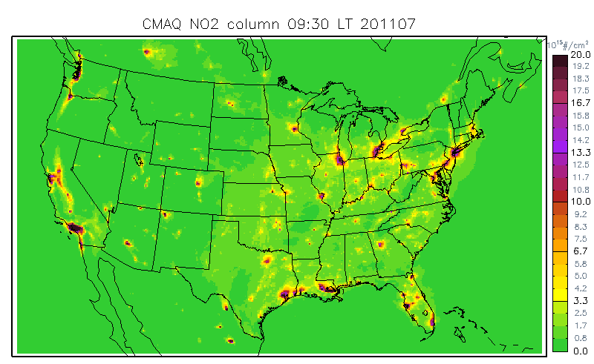
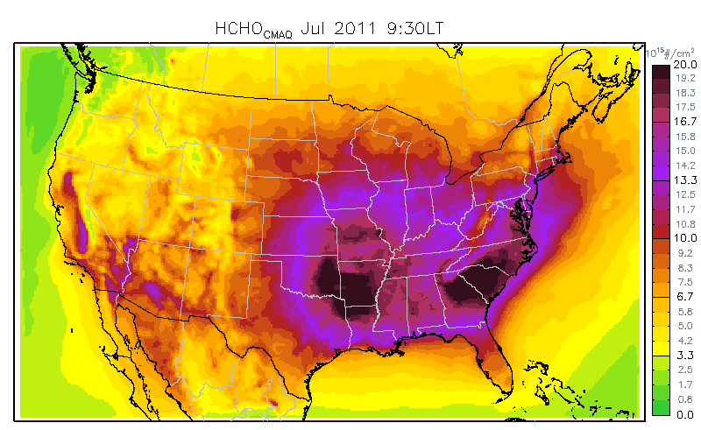
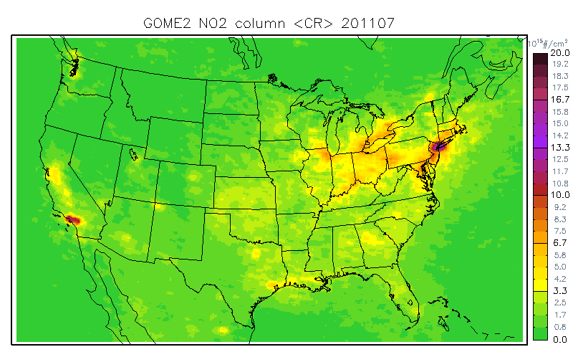
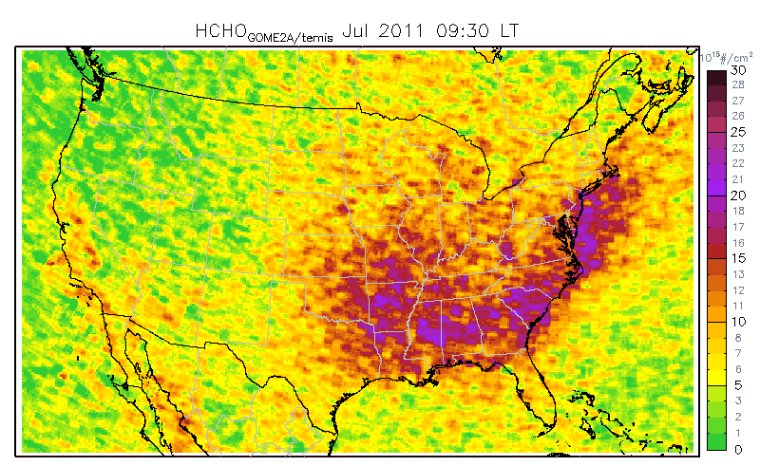
NO₂ and HCHO columns (CMAQ & Satellite)
CMAQ NO2
CMAQ HCHO
GOME-2 NO2
GOME-2 HCHO
Problems: Cannot capture fine-scale details (NO2), Retrieval is very noisy (HCHO)

Slide 6
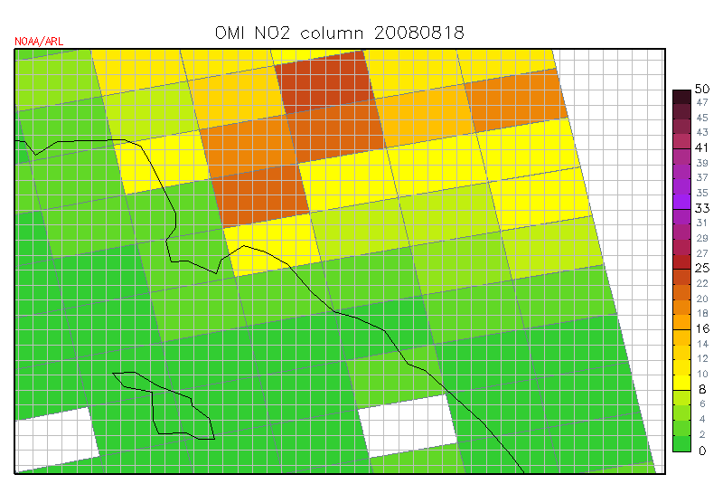
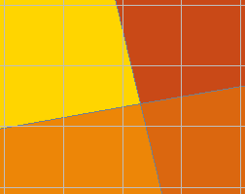
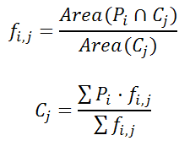
Method 1: Conservative remapping
P₂
P₁
f₁
f₂
C_{j}
f₃
f₄
P₃
P₄
Cj = (P1·f1+P2·f2+P3·3+P4·f4)/(f1+f2+f3+f4)
Overlapping fractions (f_{i,j}) are calculated using IDL-based Geospatial Data Processor (IGDP)

Slide 7
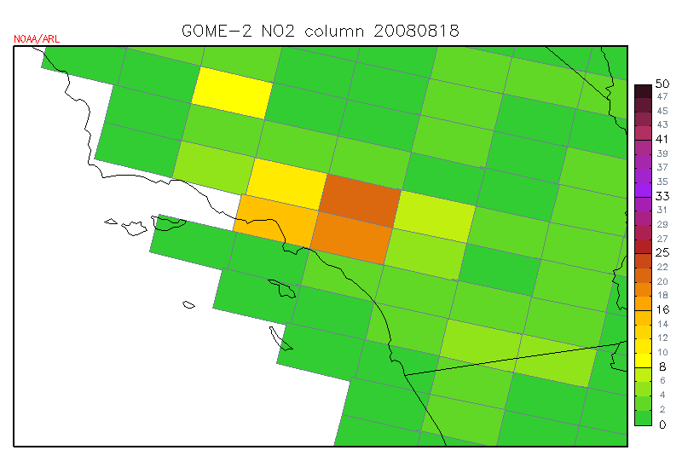
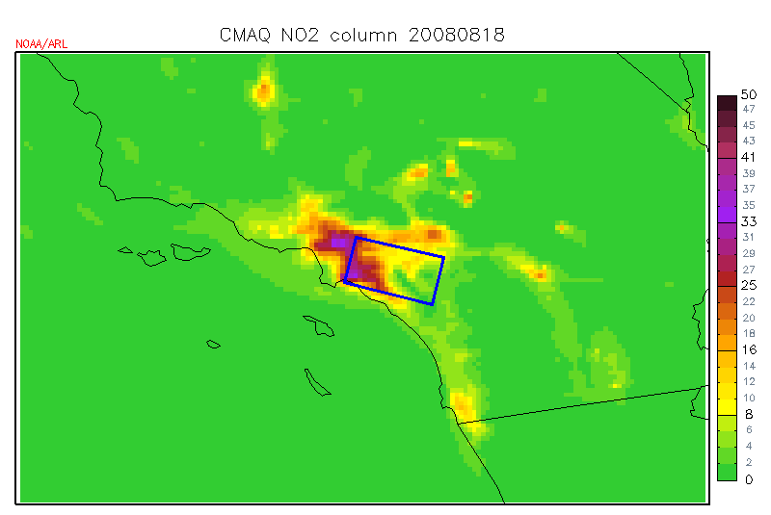
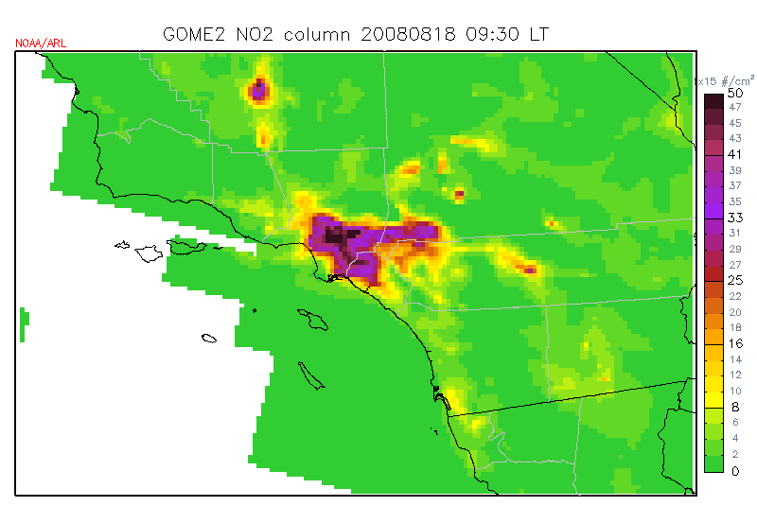
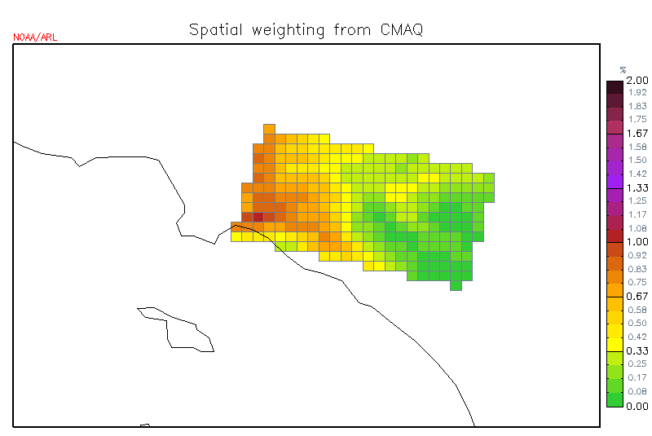
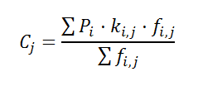
Method 2: Downscaling (DS)
GOME-2 NO2 raw pixels
CMAQ NO2 column
Downscaled GOME-2 NO2 column
Spatial weighting kernel
where k_{i,j} is the spatial weighting kernel of P_{i} in the position of C_{j}
Each spatial weighting kernel is satellite pixel-specific, so the quantity in the original pixel never propagates out of original data pixel’s coverage

Slide 8
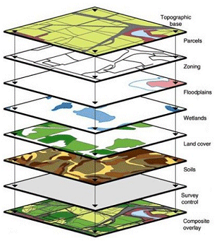
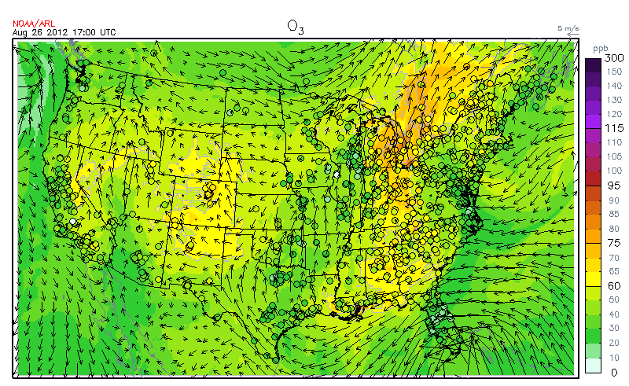
Powered by IDL-based Geospatial Data Processor (IGDP)
Developed by NOAA/ARL funded by TCEQ/AQRP.
Fast and accurate polygon, polyline, and pixel data processing capability
Conservative conversion (e.g. regridding) between different map projections and domain settings.
GIS, model comparison
Emission processing (e.g. surrogate files)
IGDP
Gridded world (Model)
Polygon, polyline, and pixels (GIS, Satellites, Emission)

Slide 9
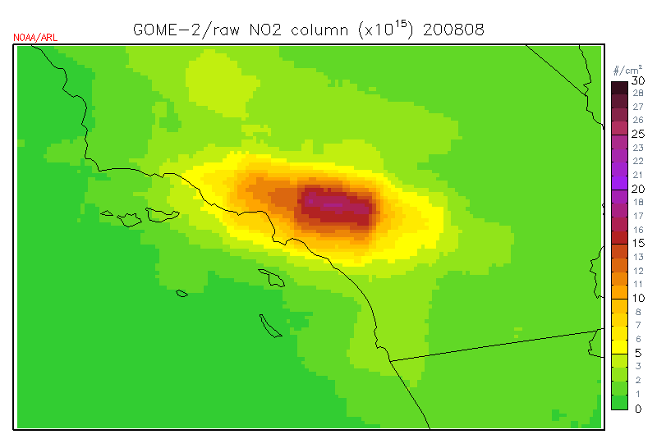
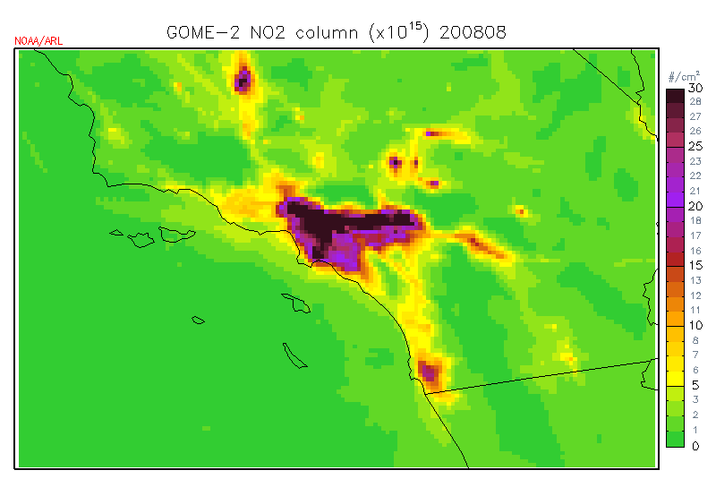
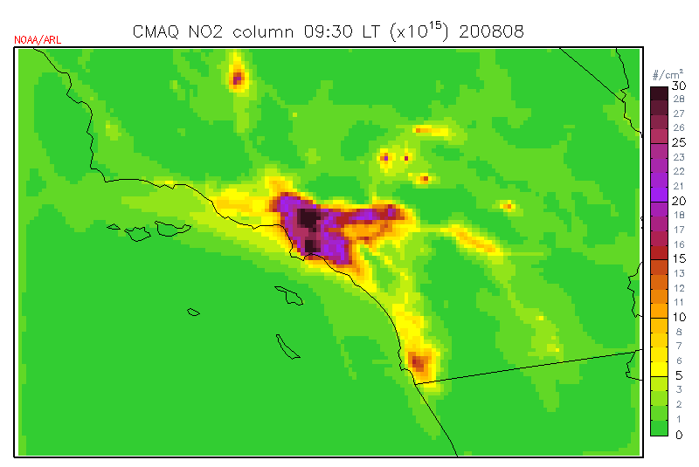
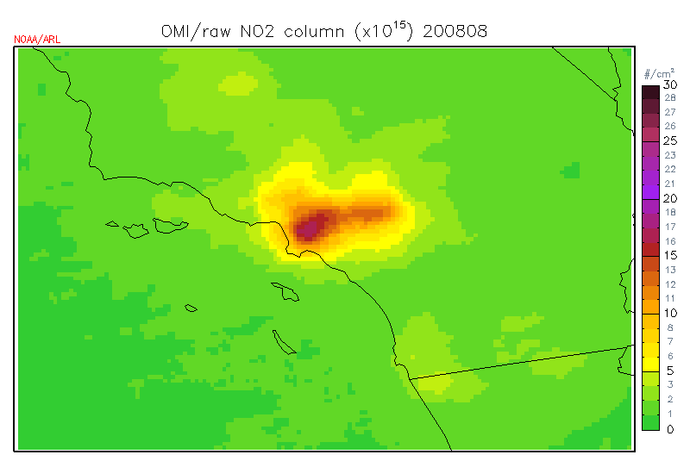
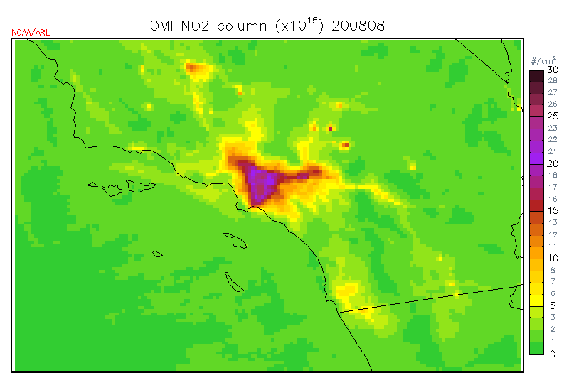
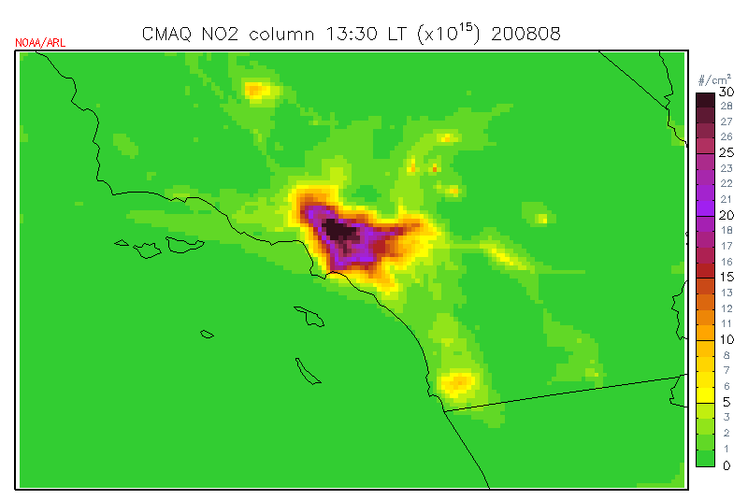
Monthly averaged NO2 column S. California Aug. 2008
GOME-2
GOME-2/ds
CMAQ (09:30LT)
OMI
OMI/ds
CMAQ (13:30LT)

Slide 10
How downscaling method works
Satellite measurement is strictly preserved within each footprint. Strength of model does not affect satellite measurement’s strength at all.
The only information that passed from model to satellite is relative spatial information within each satellite footprint.
Eventually, this method converts systematic negative bias due to coarse resolution to random errors, which can be cancelled out by temporal averaging.

Slide 11
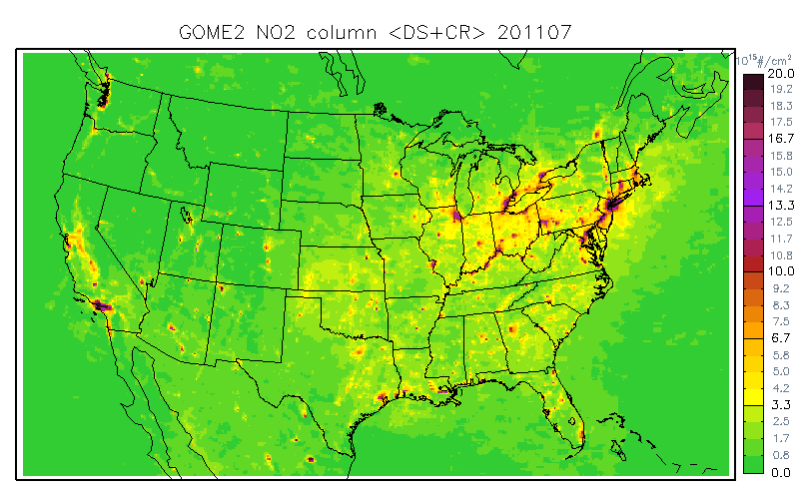
Monthly mean NO2 columns (Jul 2011)
CMAQ, GOME-2, Adjusted GOME-2
CMAQ
GOME-2
Small-scale features are well reconstructed by downscaling method
GOME-2/ds

Slide 12
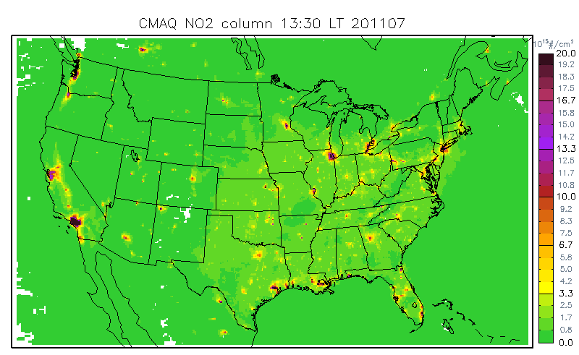
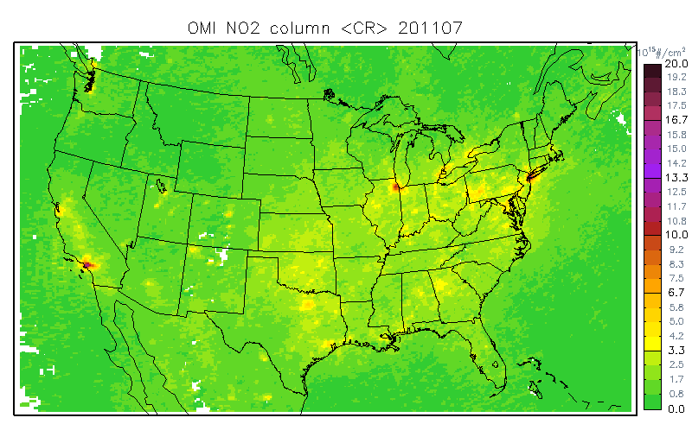
Monthly mean NO2 columns (Jul 2011)
CMAQ, OMI, Adjusted OMI
CMAQ
OMI
Since OMI has better resolution than GOME-2, the adjustment effect in small that GOME-2 case, but it still shows clear improvement in urban cities.
OMI/ds

Slide 13
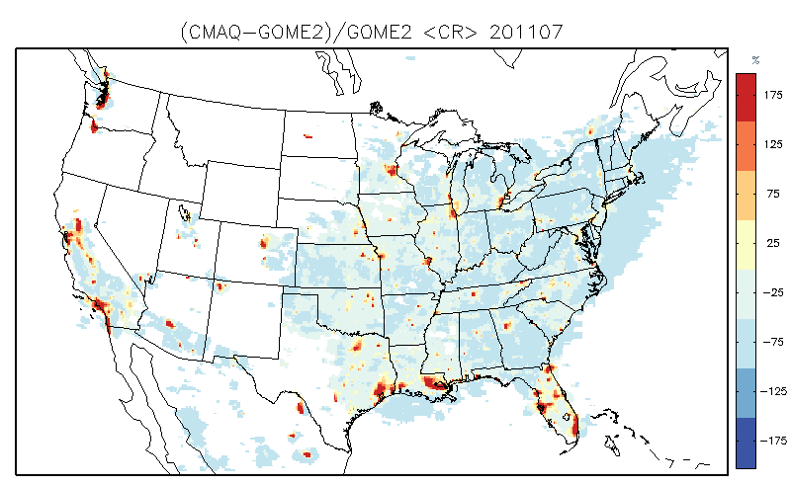
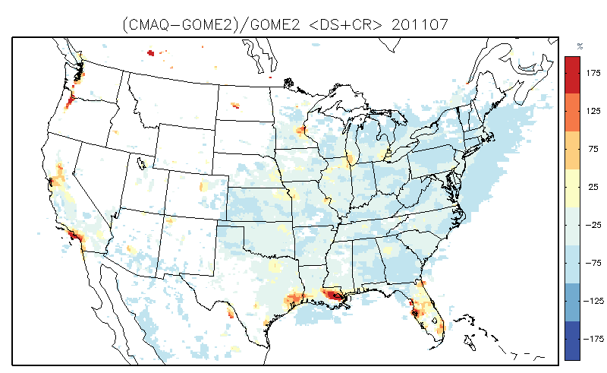
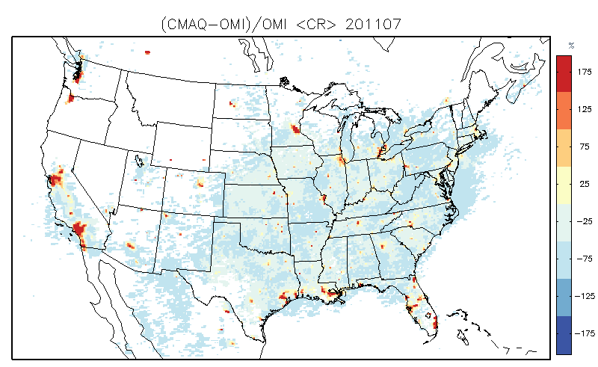
Difference (CMAQ-Sat)/Sat [%]
(CMAQ-GOME2)/GOME2
Resolution Adjusted
(CMAQ-OMI)/OMI
Resolution Adjusted

Slide 14
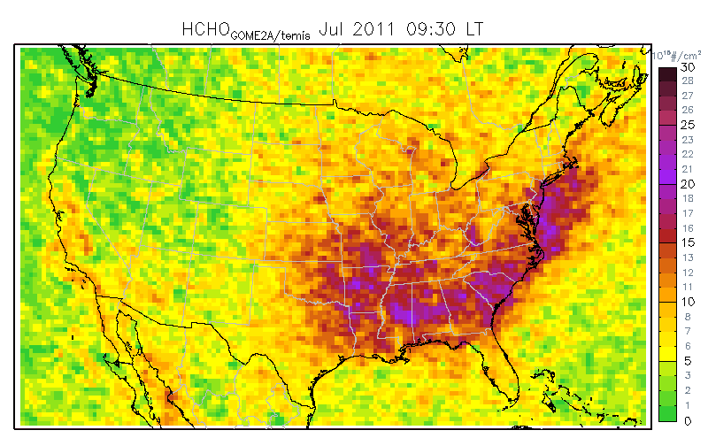
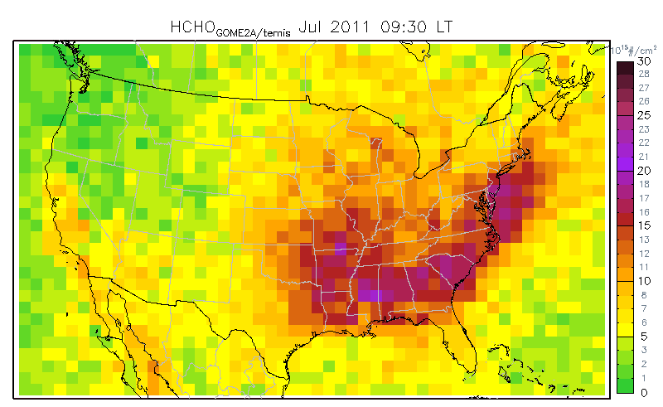
HCHO column CMAQ & GOME-2 (Jul 2011)

Slide 15
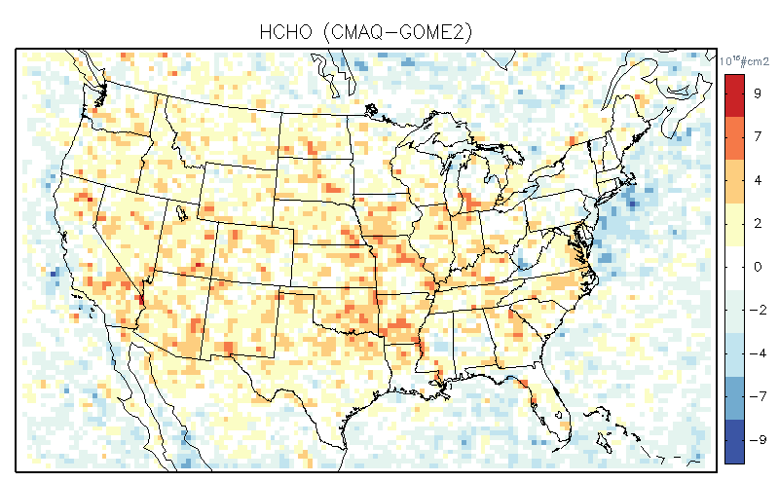
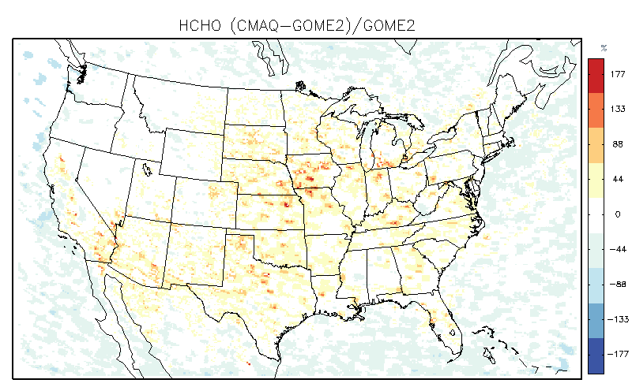
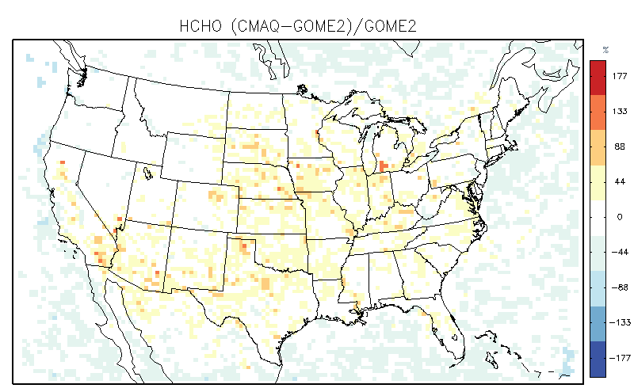
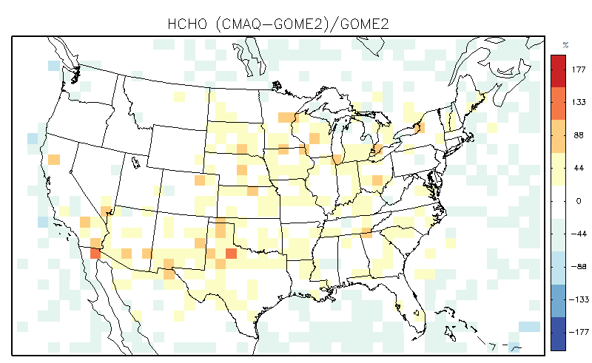
HCHO column comparison (CMAQ & GOME-2)
Difference (CMAS-GOME2)
% Difference (12km)
% Difference (36km)
% Difference (108km)

Slide 16
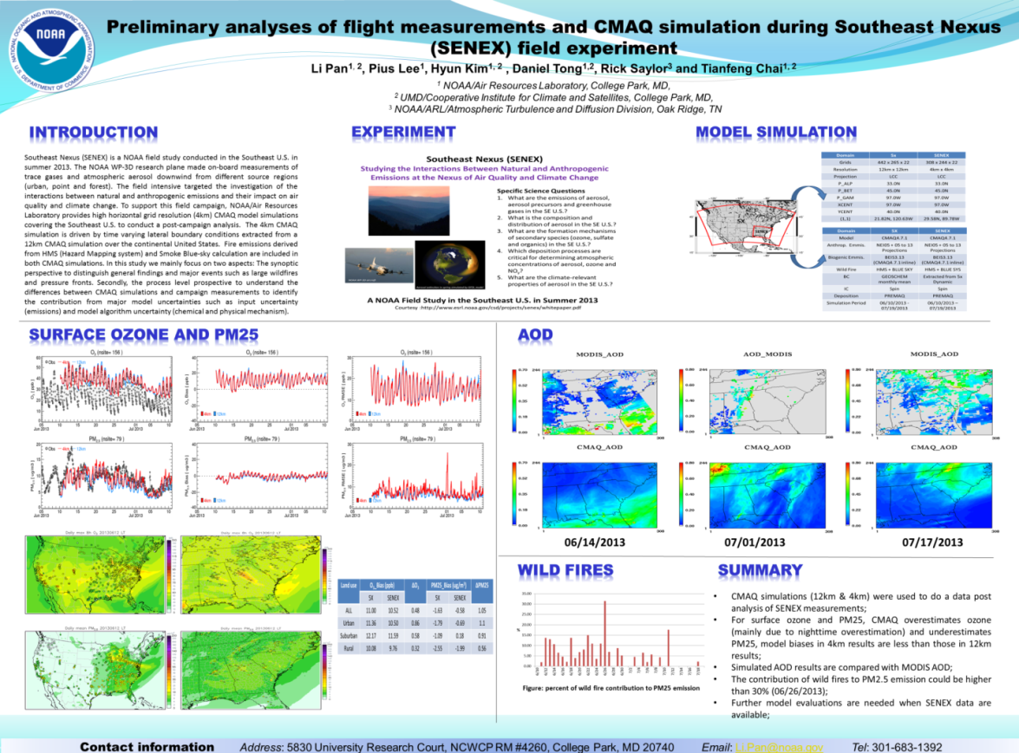
Preliminary comparison with SENEX
The SENEX campaign targets the investigation of the interactions between natural and anthropogenic emissions and their impact on air quality and climate change.
To support this field campaign, NOAA/Air Resources Laboratory provides high horizontal grid resolution (4km) CMAQ model simulations covering the Southeast U.S. to conduct a post-campaign analysis.
Poster by Pan et al.

Slide 17
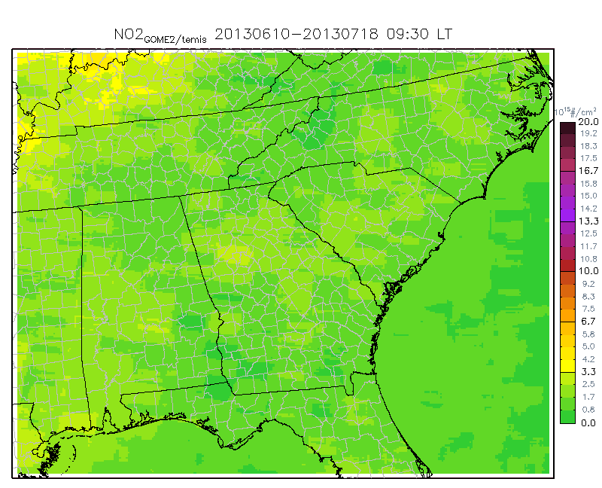
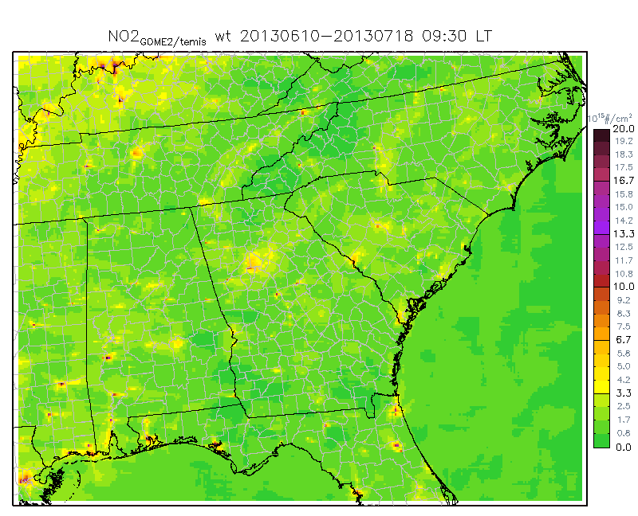
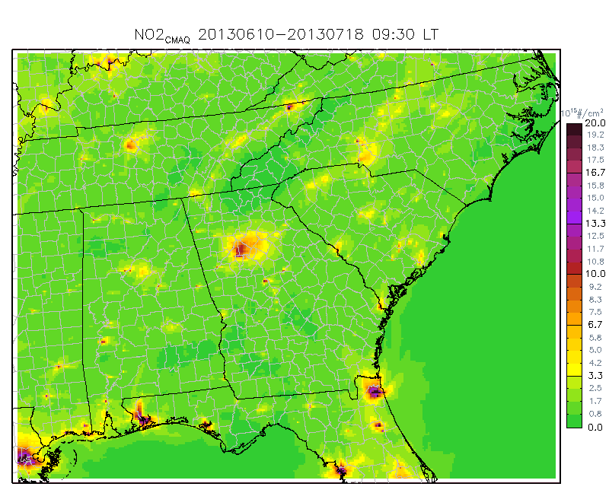
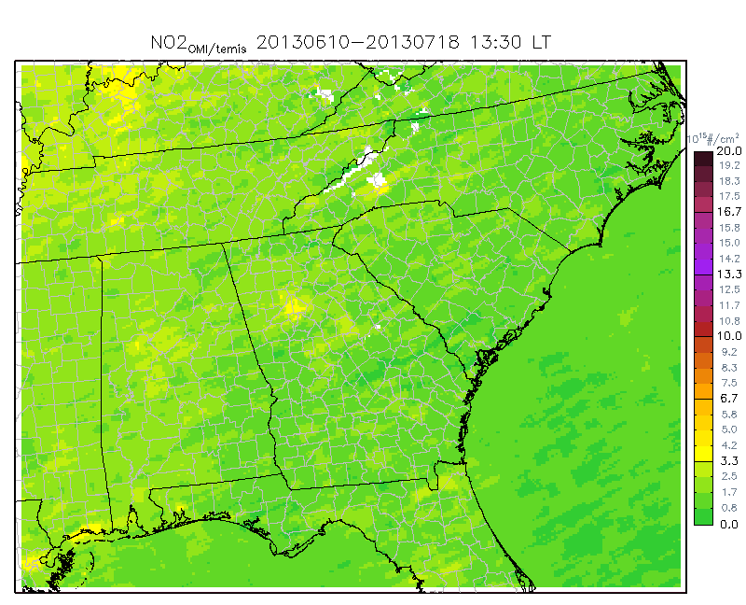
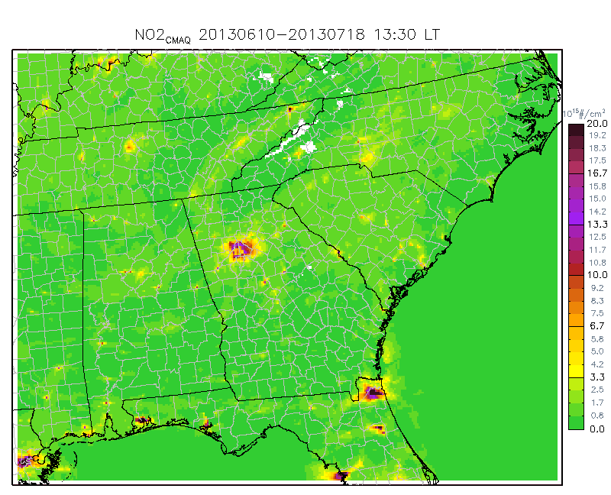
NO₂ column comparison (06/10~07/18 average)
CMAQ
GOME-2
GOME-2/ds
CMAQ (09:30LT)
OMI
OMI/ds
CMAQ (13:30LT)

Slide 18
Time series comparison (domain average)
CMAQ NO2 column is mostly underestimated

Slide 19
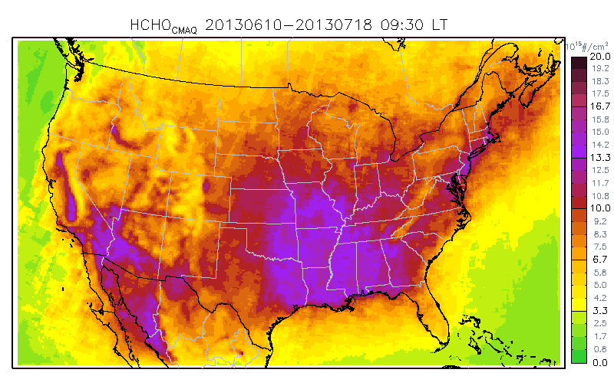
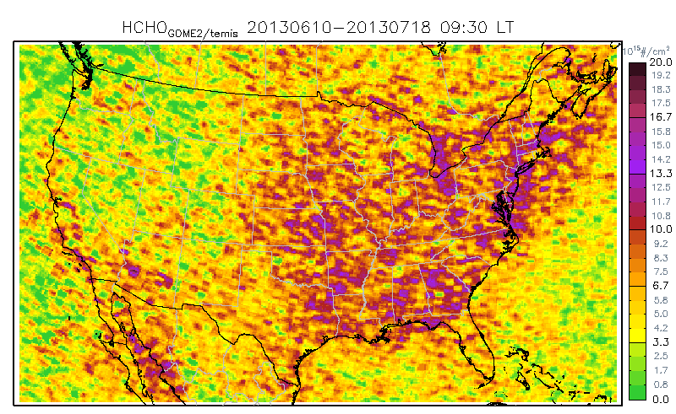
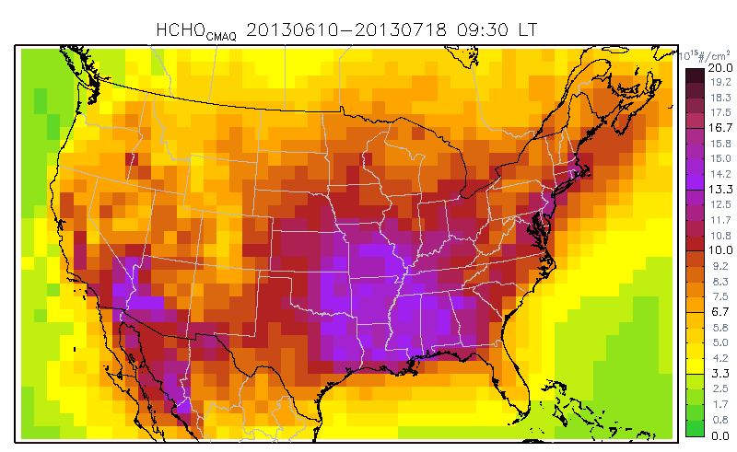
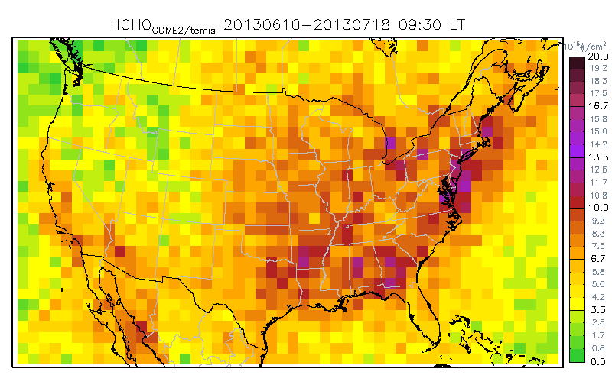
HCHO column comparison (06/10~07/18 average)
CMAQ 12km
GOME-2 (12km)
CMAQ 108km (upscaled)
GOME-2 (108km)

Slide 20
Time series comparison (domain average)
CMAQ HCHO column is mostly overestimated

Slide 21
Summary
We introduce conservative reconstruction method to compare coarse resolution satellite observation to fine-scale regional chemistry model simulations
For NO2 column and surface concentration, the downscaling method provides better agreement with fine scale regional simulation
Upscaling works better for HCHO due to its smoother spatial distribution and noises in satellite retrieval
SENEX aircraft comparison will be followed

Slide 22
End

Slide 23
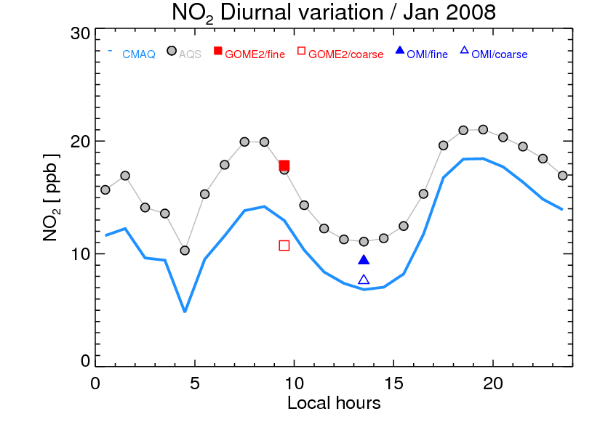
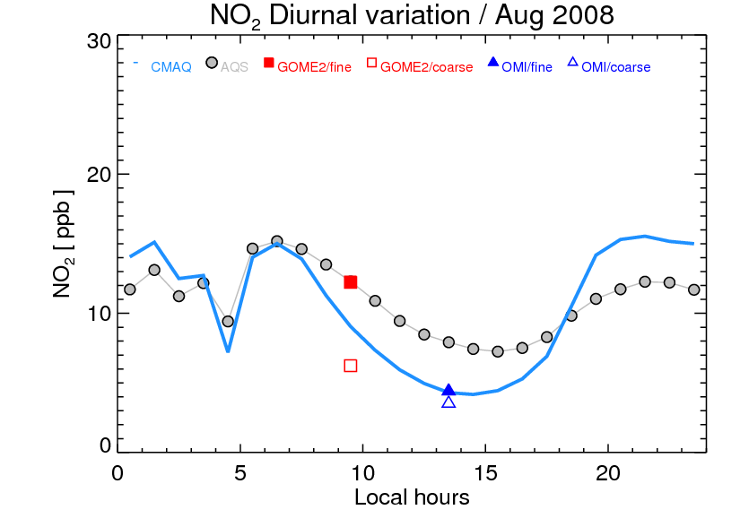
Diurnal variation
(a)
(b)
Figure 7. Surface NO2 concentration diurnal variation over 70 AQS sites, (a) for Jan. 2008, and (b) for Aug. 2008. Blue line indicate CMAQ NO2 concentration in the 1st layer, gray dots represent AQS surface NO2 observations. GOME-2-inferred surface NO2 concentrations are shown in red rectangles (closed: DS+CR method, open: CR method), and OMI-inferred surface NO2 concentrations are shown in blue triangles (closed: DS+CR method, open: CR method).

Slide 24
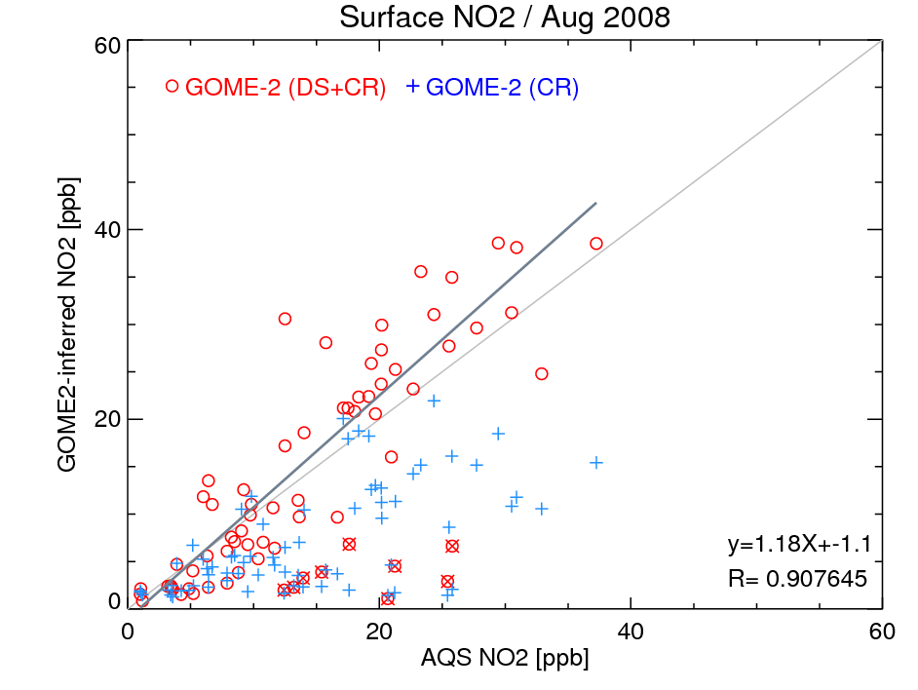
Surface NO₂ comparison
GOME-2 inferred surface NO2 = (GOME-2 column / CMAQ column ) * CMAQ surface NO2

