Slide 1



Study of REGIONAL extreme climate and ITS impact on air quality in U.S.
Joshua S. Fu, Ph.D.
Department of Civil and Environmental Engineering
University of Tennessee, Knoxville
International Center for Air Pollution and Energy Study
Institute for Security and Sustainable Environment
Bredesen Center for Interdisciplinary Research and Graduate Study-
Energy Science and Engineering
Joint Institute for Computational Sciences
Institute for Biomedical Engineering
Computer Science and Mathematics Division
Oak Ridge National Laboratory
October 30, 2013
Presented at
12th Annual CAMS Conference

Slide 2
Outline
Study of Regional extreme climate and Its impact on air quality in U.S.
Yang Gao, Joshua S. Fu, John D. Drake, The University of Tennessee
Jean-Francois Lamarque, National Center for Atmospheric Research

Slide 3
Objective of the study
Assessing the Cumulative Climate-Related Health Risks in the Eastern US
Funded by Center for Disease Control and Prevention
The results presented here are the views of the authors and
not the official views of the CDC
Identify locations and population groups at risk for specific climate related health threats, such as heat waves.
High resolution regional climate modeling
Identify environmental conditions, disease risks, and disease occurrences related to climate and air quality change, and assess their public health impact.
High resolution regional air quality modeling

Slide 4


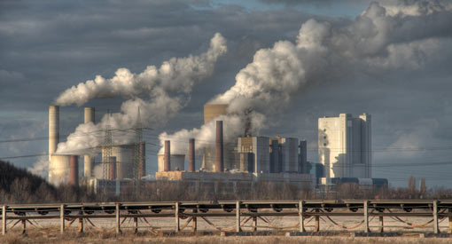
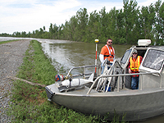

Impacts of Climate Change
Climate Change
(Extreme events)
Energy
Air Quality
Public Health
Ecosystem, Water Resources and Water Quality
Agriculture and Food

Slide 5
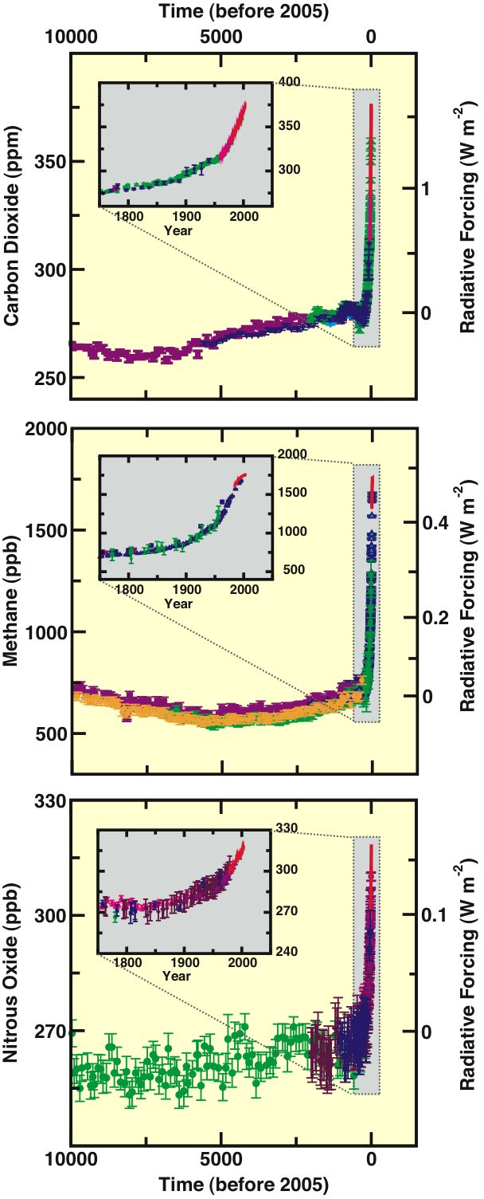
Human and Natural Drivers of Climate Change
CO₂, CH₄ and N₂O
Concentrations
Far exceed
pre-industrial values
Increased markedly
since 1750 due to
human activities
Show Relatively little
variation before
the industrial era
IPCC AR 4, 2007

Slide 6
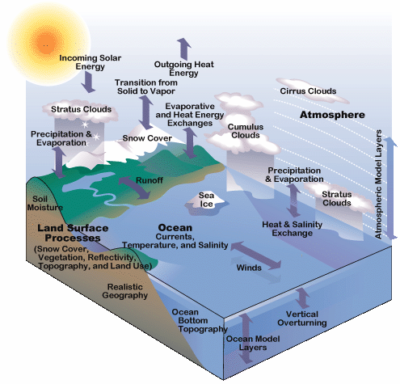
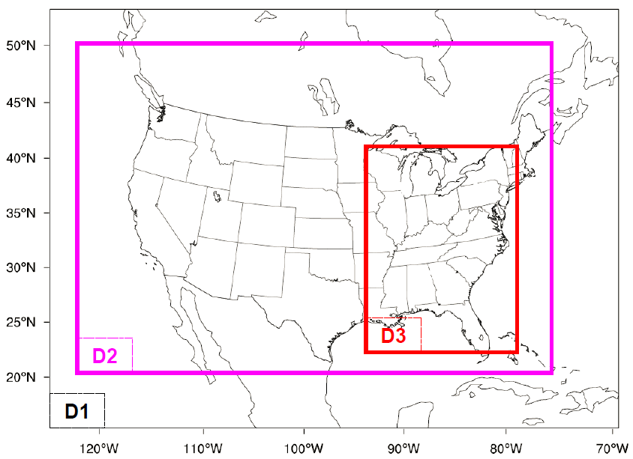
Overview of the study
Community Earth System Model
CESM 1.0
Regional Climate/Chem Model
WRF 3.2.1/CMAQ 5.0
Community Atmosphere Model (CAM)
Community Land Model
(CLM)
Community Sea Ice Model
(CSIM)
Ocean component
(POP)
D1/D2/D3: 36-12-4 km
0.9×1.25 deg (~100 × 140km lat/lon)--------> 36 km, 12 km, 4 km

Slide 7
The importance of the climate downscaling
The methodology developed in this study can be easily applied to other models/regions but this is a temporary strategy
Provide important information for policy makers when taking
actions on climate mitigation and adaptation
A large amount of data (~700 T) has been produced from this
study, and the data can be used in a variety of studies:
The data is currently being investigated at Harvard University, Emory University and University of Michigan for predictions of Lyme disease and lung cancer.
The data can be used as input to the biogeochemical or hydrologic model, to further investigate hydrology and water quality response to changes of climate in US.

Slide 8
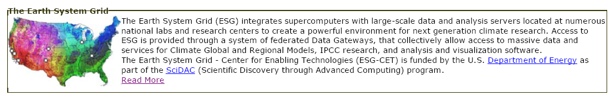
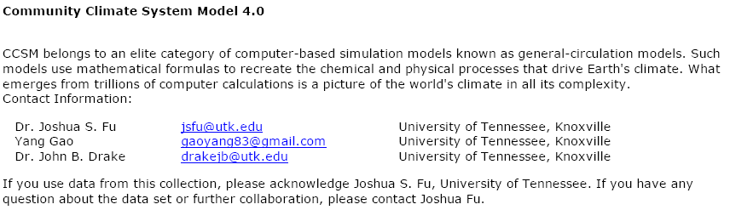
Global climate simulations with CESM
8
Three hourly 0.9×1.25 degree resolution
2005---->2100

Slide 9
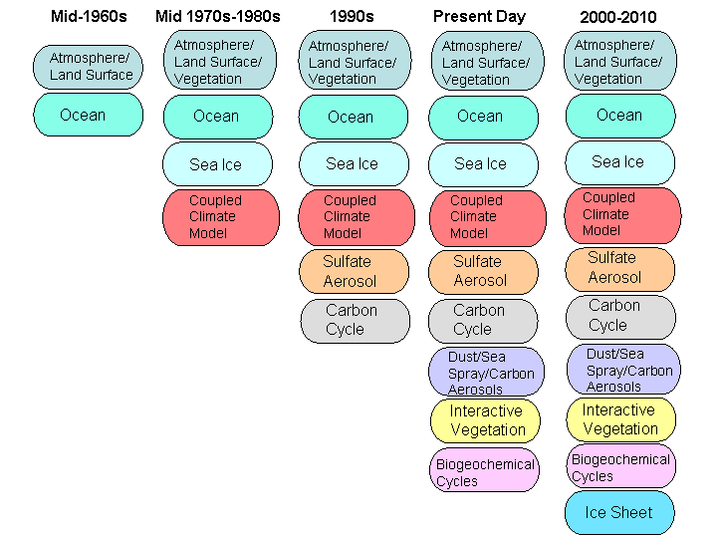
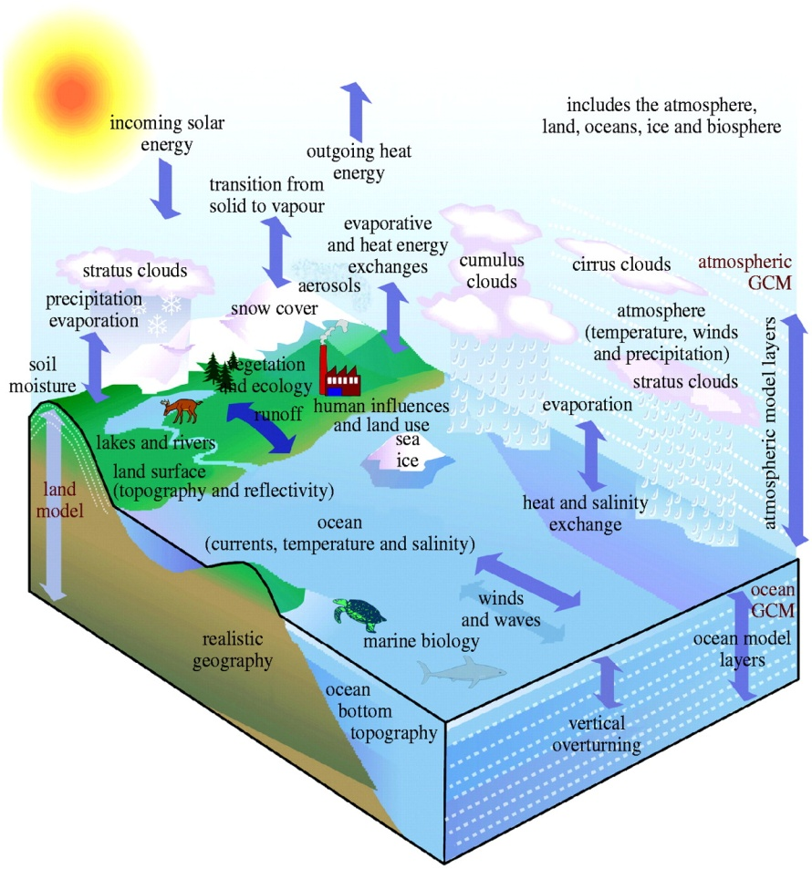
Timeline of the Evolution of Climate Modeling
Washington, W., L. Buja and A. Craig. The computational future for climate and Earth system models: on the path to petaflop and beyond, Philosophical Transactions of the Royal Society A 2009 367: 833-846.

Slide 10
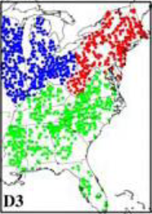
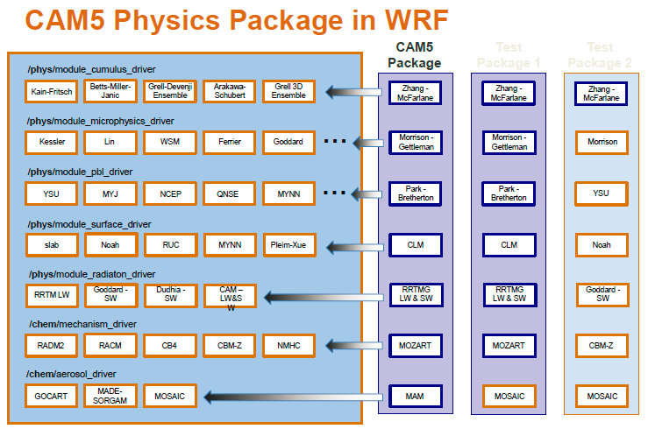
Major focus study area
The points represent National Climatic Data Center (NCDC) U.S. the Cooperative Observer Network (COOP) stations in the Eastern US
Issues in dynamical downscaling
Selection of physics options
Constraint from the boundary conditions, i.e., nudging techniques
Evaluation of global and regional modeling
Northeast (red color), Midwest (blue color) and Southeast (green color)
Present: 2001-2004 RCP 8.5: 2057-2059
Under working: 2054-2056 + RCP 4.5
Gustafson et al. 2010

Slide 11
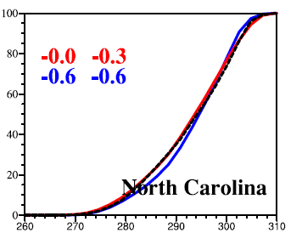
Evaluation of daily maximum temperature (T1/T2)
11
19 states in WRF and 17 states in CESM have bias less than 2 ºC.
In WRF, more than half of the states (13 out of 23) shows bias less than 1 ºC
97.5% 81%
WRF-NCDC
CESM-NCDC

Slide 12
More intense and frequent heat waves in future climate
Present (2001-2004)
RCP 8.5 (2057-2059) - P
Heat wave intensity
(ºC)
Heat wave duration
(days/event)
Heat wave frequency
(events/year)
Notes:
CESM: Community Earth System Model
RCP: Representative Concentration Pathways

Slide 13
Published paper
13
This paper has been featured in Environmental Research Web and more than 30 public media
One of top 5 downloads in the last 30 days in the Environmental Research Letters (more than 1000 downloads within 3 months)

Slide 14
Dynamical chemistry downscaling
14
Community Atmosphere Model (CAM-Chem)
Community Land Model
(CLM)
Community Sea Ice Model
(CSIM)
Ocean component
(POP)
Projection of future emissions
Evaluation methods
Climate impact on O₃ and PM_{2.5}

Slide 15
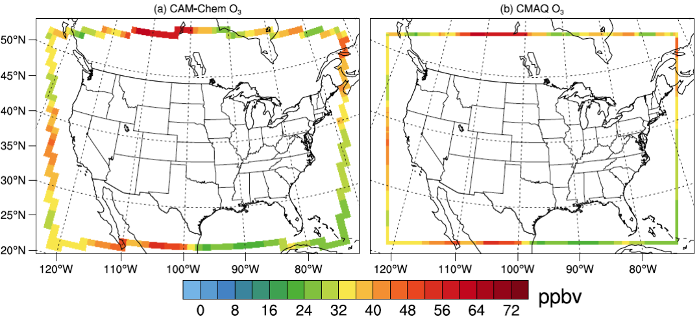
CAM-Chem VS. CMAQ for O3 concentrations
15

Slide 16
Projection of emissions
16
2060 - 2005
(a) RCP8.5: NMVOC
(b) RCP8.5: NOx
(c) RCP4.5: NMVOC
(d) RCP4.5: NOx
(kton/year)

Slide 17
Projection of emissions
more than 35% in VOC and 65% in NOx reduction in RCP 4.5, about 70% in VOC and 50% in NOx in RCP 8.5
About 25% (RCP 4.5) and 60% (RCP 8.5) reduction in PM2.5
10% reduction in RCP 4.5 but 60% increase in methane in RCP 8.5

Slide 18
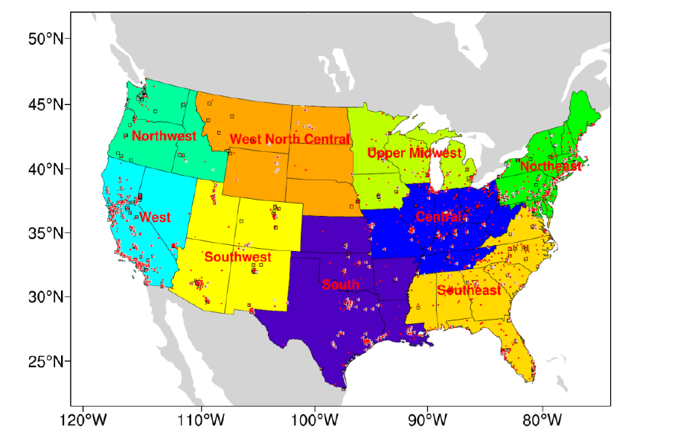
12 km by 12 km simulation domain with nine climate regions
The red points (~1200), the gray triangles (~450) and black squares (~450) represent the observational sites of O₃, NO₂ and CO, respectively, obtained from Air Quality System (AQS, http://www.epa.gov/ttn/airs/airsaqs/detaildata/downloadaqsdata.htm)
Gao et al., ACP, 2013

Slide 19
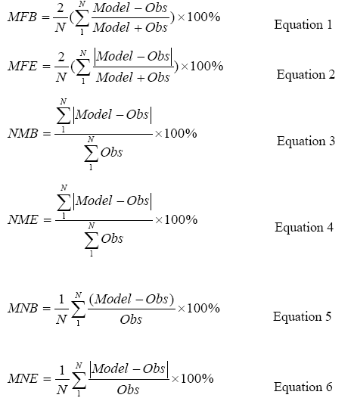
Statistical evaluation
MFB/MFE and NMB/NME is within (circled) or quite close to benchmark.
With improved climate and accurate regional emission inventory, paired statistical evaluation is possible for climate studies
Gao et al., ACP, 2013

Slide 20
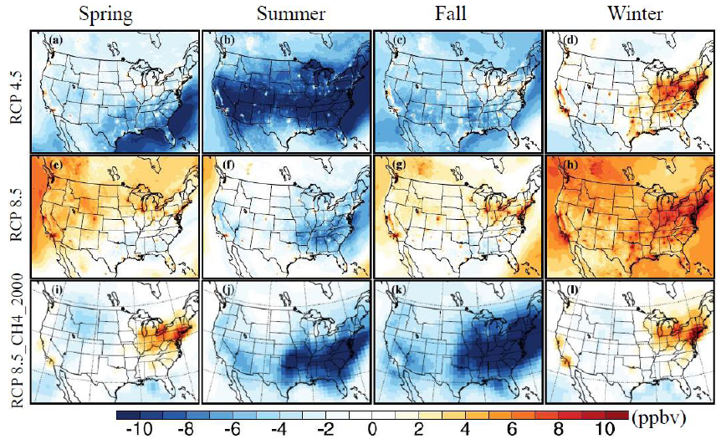
Seasonal variations of ozone changes in future
Seasonal mean surface O₃ (2057~2059) – (2001~2004)
Gao et al., ACP, 2013
Notes:
Seasonal mean surface ozone changes from CMAQ outputs under future climate (2057-2059 minus 2001-2004) for RCP 4.5 (a-d), RCP 8.5(e-h), and the bottom panel (i-l) shows ozone changes by the end of 2050s without methane increases in RCP 8.5 (ozone in 2050s with 2000s methane concentrations – ozone in 2000s).

Slide 21
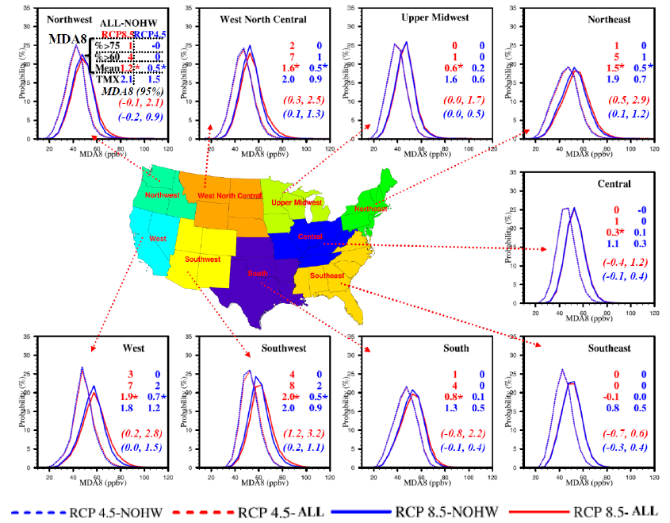
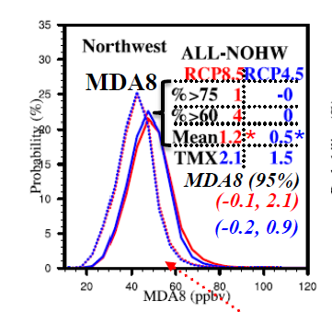
Impact of heat waves on MDA8 ozone
Gao et al., ACP, 2013
Notes:
Distributions of MDA8 during the entire period (referred to as ALL) and non-heat wave period (referred to as NOHW) for RCP 4.5 and RCP 8.5 from June to October. There are two columns of numbers (top four rows), and they represent percentage of MDA8 ozone exceeding 70 ppbv (top row) and 60 ppbv (second row), mean MDA8 ozone (third row, with unit of ppbv) and mean daily maximum temperature (TMX, fourth row, with unit of °C) for both scenarios. The bottom two rows numbers in italic in parenthesis represent the 95% confidence interval of MDA8 differences (ppbv) between entire period and non-heat wave period under RCP 8.5 (red numbers) and RCP 4.5 (blue numbers). Statistical significance was tested for the mean MDA8 differences and marked with star to indicate statistical significant at the level of 0.05. All TMX mean differences are statistically significant.

Slide 22
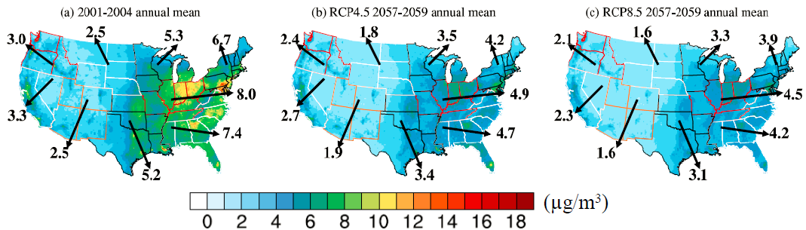
Decreasing trends of PM_{2.5} in future
Compared to O₃, PM_{2.5} is more related to emission reductions:
close to 30% reduction in RCP 4.5 and 60% reduction in RCP 8.5
By the end of 2050s, the PM_{2.5} in the nine regions is less than 5 ug/m³, with 16% to 39% reduction in RCP 4.5 and 28% to 44% reduction in RCP 8.5.

Slide 23
Implications
Downscaled climate results show significant improvement over global outputs, primarily due to the incorporation of local detailed topography and land use information (it is a temporary step, challenging down the way)
In future climate, more intense and frequency heat waves and extreme precipitation were projected
In RCP 4.5, ozone concentrations show significant decrease by the end of 2050s; In RCP 8.5, ozone concentration could increase from combined climate and emission effects

Slide 24
What’s next steps
Sensitivity studies of physics selections and nudging techniques, in particular, comparison of downscaling include HOMME (first order, second order is ongoing)
Impact of resolution scales: 1degree – 36 km - 12 km – 4 km
Sensitivity studies by comparing present climate/emissions and future climate/emissions as well as the discussion of biogenic emissions, lightning NOx
Extending the three year future simulations to 6 (finished) and even 10 years to investigate inter-annual variability

Slide 25
Acknowledgement
This research was supported in part by the National Science Foundation through TeraGrid resources provided by National Institute for Computational Sciences (NICS) under grant number [TG-ATM110009].
This research also used resources of the Oak Ridge Leadership Computing Facility at the Oak Ridge National Laboratory, which is supported by the Office of Science of the U.S. Department of Energy under Contract No. DE-AC05-00OR22725.
This work was partially sponsored by the Centers for Disease Control and Prevention (CDC) under a research project cooperative agreement (5 U01 EH000405).

Slide 26
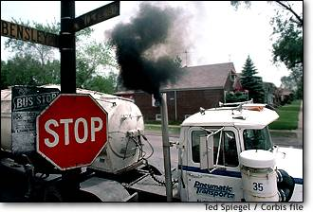
Thank you for your attention!

