Slide 1
Trends in background ozone in Houston-Galveston, 1998-2012
Mark Estesª, Shaena Berlin^{b}, Andrew Langford^{c}, Melody Dong^{d}, and David Parrish^{c}
Presented to Annual CMAS Meeting
October 29, 2013
Texas Commission on Environmental Quality, Austin, TX
Massachusetts Institute of Technology, Cambridge, MA
NOAA ESRL Chemical Sciences Division, Boulder, CO
Dept. of Bioengineering, University of California, San Diego
Air Quality Division

Slide 2
Outline
Two methods for estimating background ozone in Houston
Seasonal and interannual variations in background ozone
Transport and its effects upon background ozone
Contributions of background and locally-formed ozone to overall trend

Slide 3
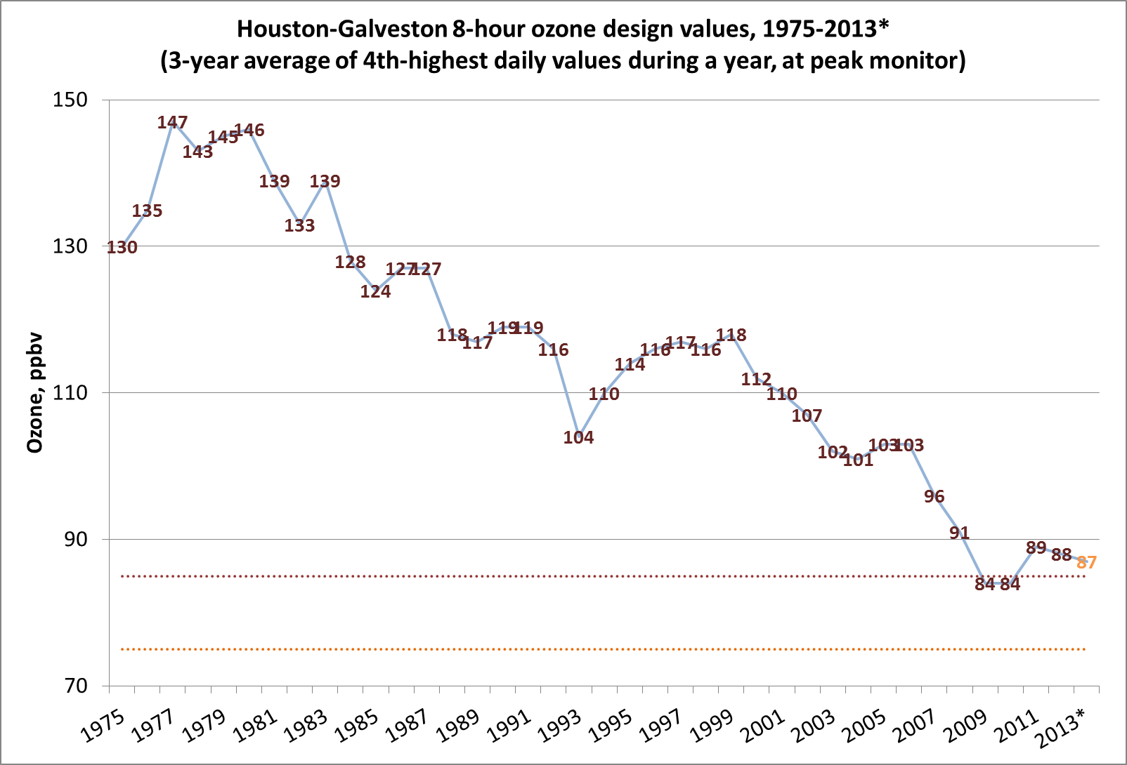
85 ppbv NAAQS
75 ppbv NAAQS
*2013 DV as of Oct 25, 2013.
Notes:
1975: one site; 1977: 4 sites; 1993: 12 sites; 2012: 42 sites.

Slide 4
Definition of regional background ozone
For these analyses, regional background ozone is the ozone transported into the area by synoptic scale winds. Local emissions have little influence upon regional background ozone concentrations.
Generally not equivalent to “natural background” or “policy-relevant background.”
Sometimes equivalent to “baseline ozone”, as defined by Parrish et al. (2009) or Cooper et al. (2012). Equivalent to baseline ozone when synoptic winds bring undisturbed marine air into the Houston area.

Slide 5
Method 1: Background ozone estimation at upwind sites
Select sites in the Houston area that are capable of measuring background ozone, given the proper conditions. These sites are not located near large emission sources
Calculate peak daily 8-hour ozone for each site.
Select the minimum peak daily 8-hour ozone from the subset of background sites.
Ozone season defined as April 1 – Oct 31.
Number of sites selected varied from 6 to 19, greatly increasing after 2002.

Slide 6
Method 2: Background ozone as a principal component
Langford et al. (2009) presented a principal components analysis of Houston’s maximum daily average eight-hour ozone (MDA8) monitoring site data in order to identify patterns of ozone variation.
They found the largest component increased ozone concentrations at all sites simultaneously, and inferred that background ozone concentrations were the cause.
Analysis was repeated for May-Oct 1998-2011, using data from 6 sites (results equivalent to 30 site analysis).

Slide 7
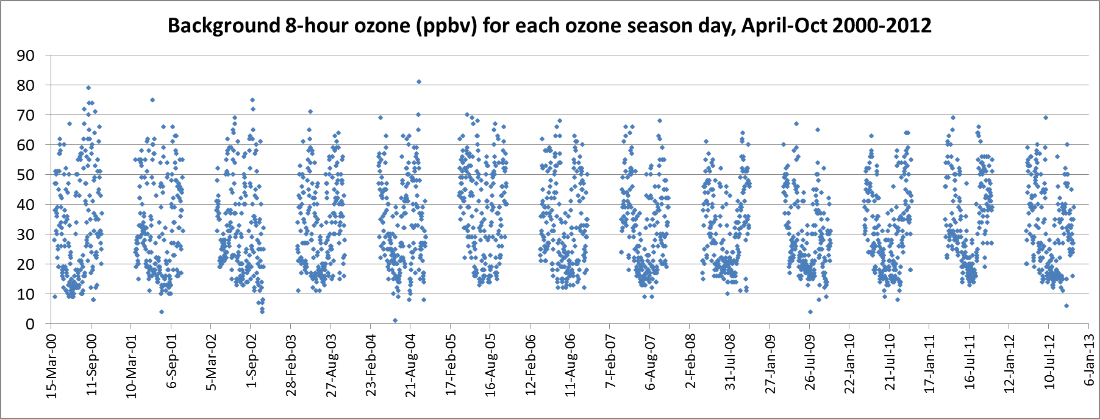
TCEQ-estimated Houston background ozone for every day
from April 1, 2000 to October 31, 2012
Median background ozone: 30 ppbv
Mean: 32.6 ppbv
95th percentile: 58 ppbv
Clearly, there are systematic variations in background ozone during the ozone season.

Slide 8
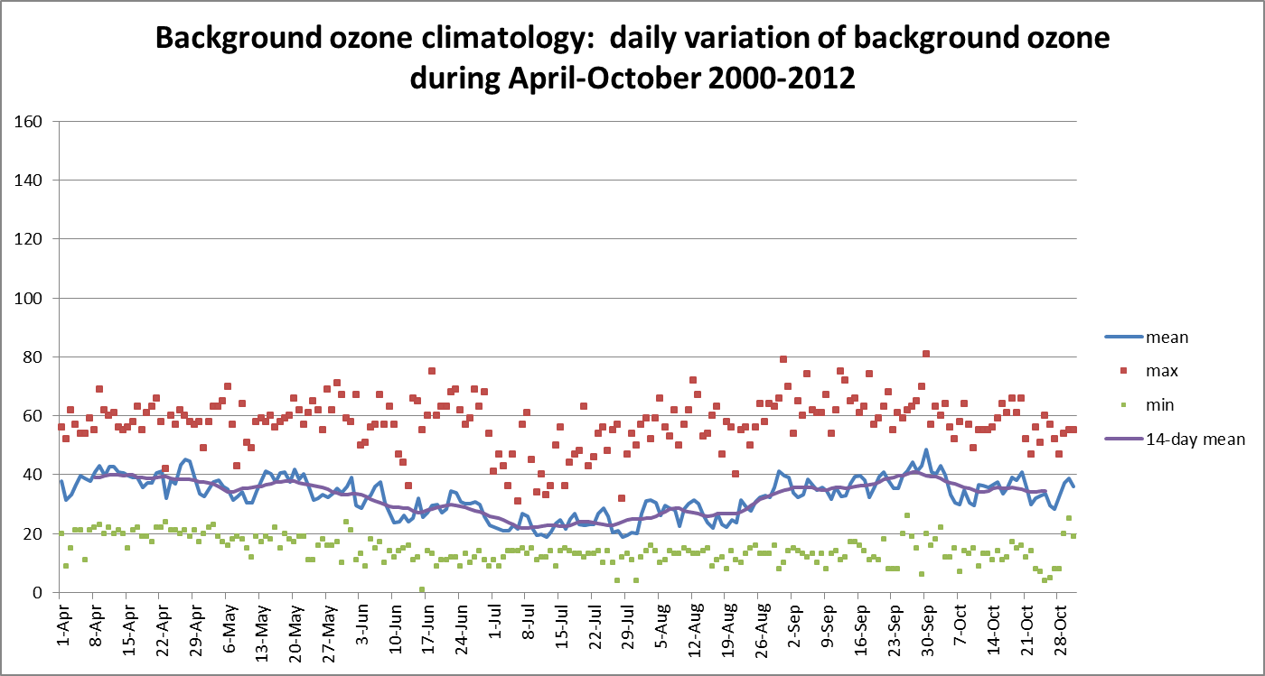
Lowest background ozone is seen during mid-summer, from June 10 to August 20. During this period, Bermuda High dominates the synoptic weather patterns in Houston, bringing relatively clean air onshore from the Gulf of Mexico (Davis et al., 1998.)
April and late September are strongly influenced by frontal passages (Davis 1998; Rappenglueck 2009). In addition, continental background is higher in spring due to transport from Asia, stratospheric intrusions (Cooper 2010; Lin 2012a,b; Brownsteiner 2011).

Slide 9
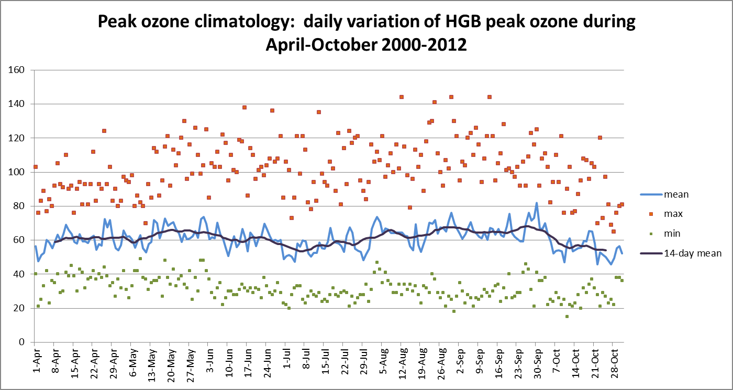

Slide 10
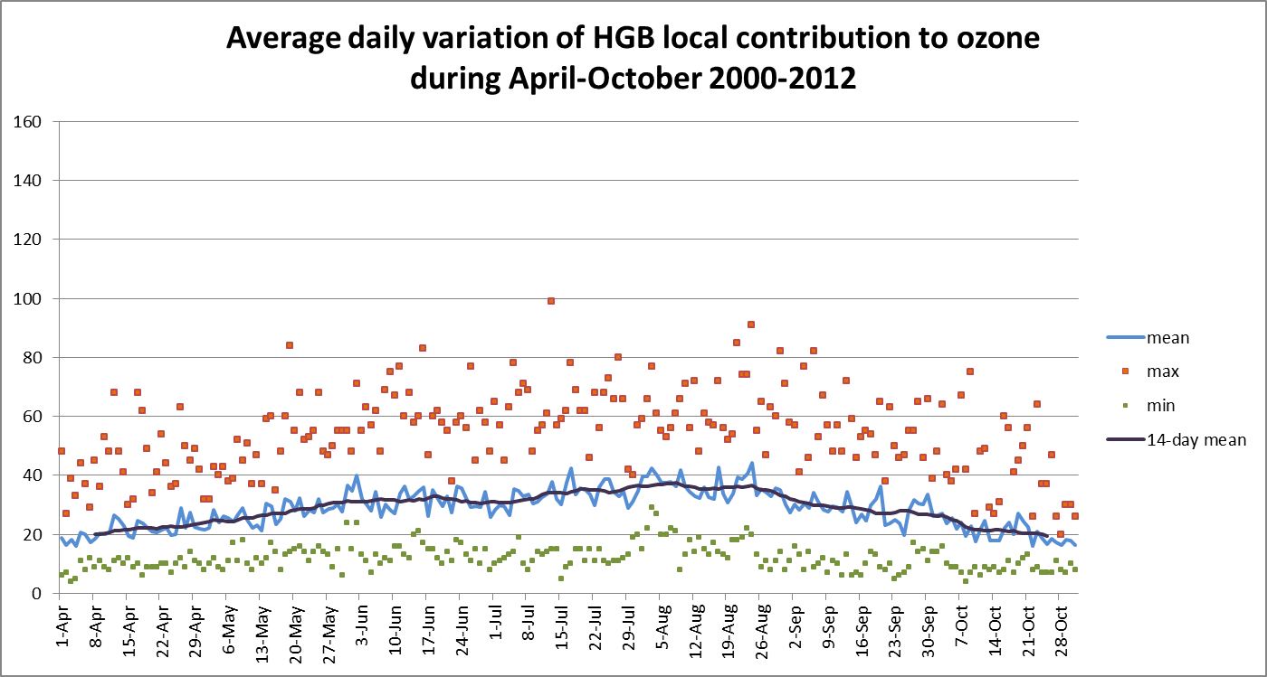
Local contribution is estimated by taking the difference between daily MDA8 ozone and daily regional background ozone

Slide 11
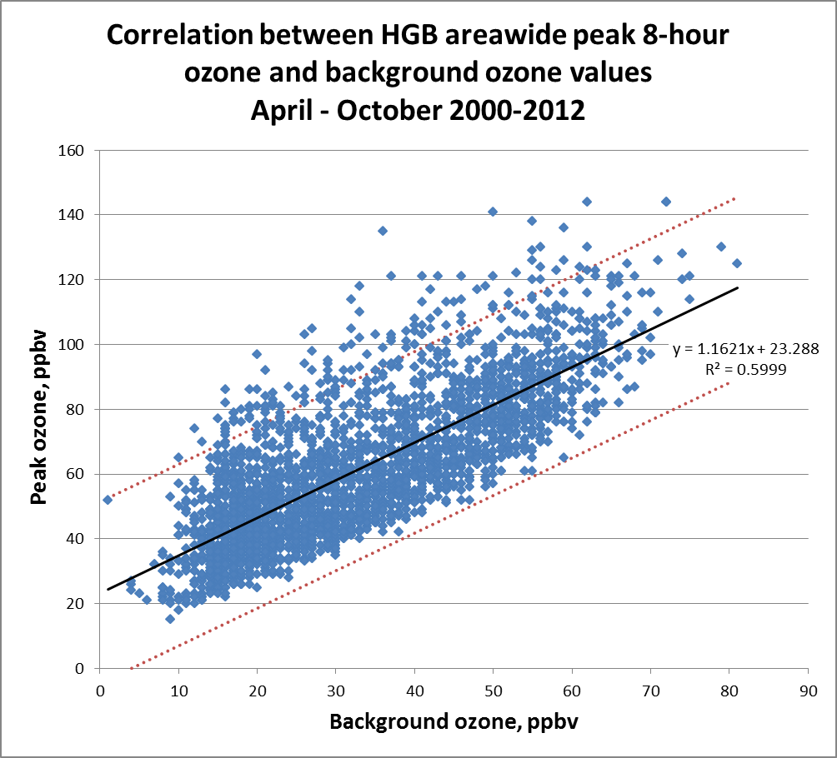
The relationship between background and peak ozone in HGB may help identify days with unusually large local ozone formation.

Slide 12
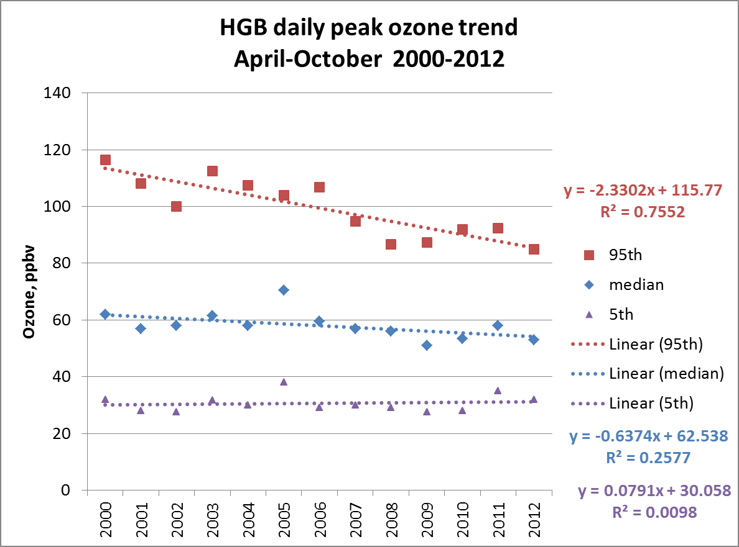
95th MDA8: -2.33 ± 0.40 ppbv/yr, p = 0.00012
50th MDA8: -0.64 ± 0.33 ppbv/yr, p = 0.077

Slide 13
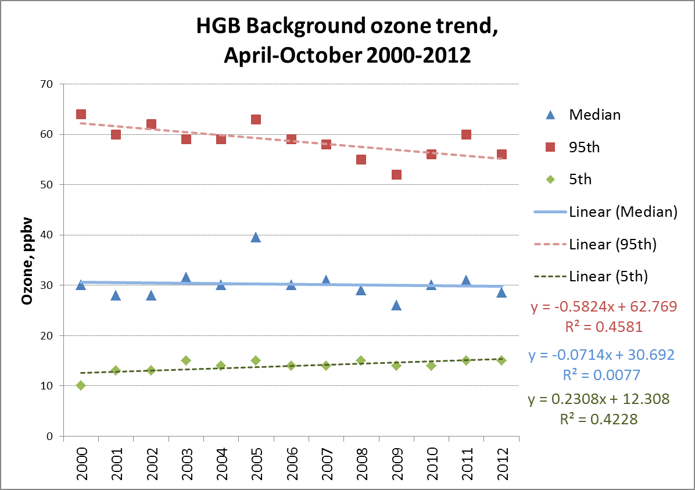
95th background: -0.58 ± 0.19 ppbv/yr (p = 0.011)
50th background: -0.071 ± 0.25 ppbv/yr (p = 0.78)
5th background: +0.23 ± 0.08 ppbv/yr (p = 0.016)

Slide 14
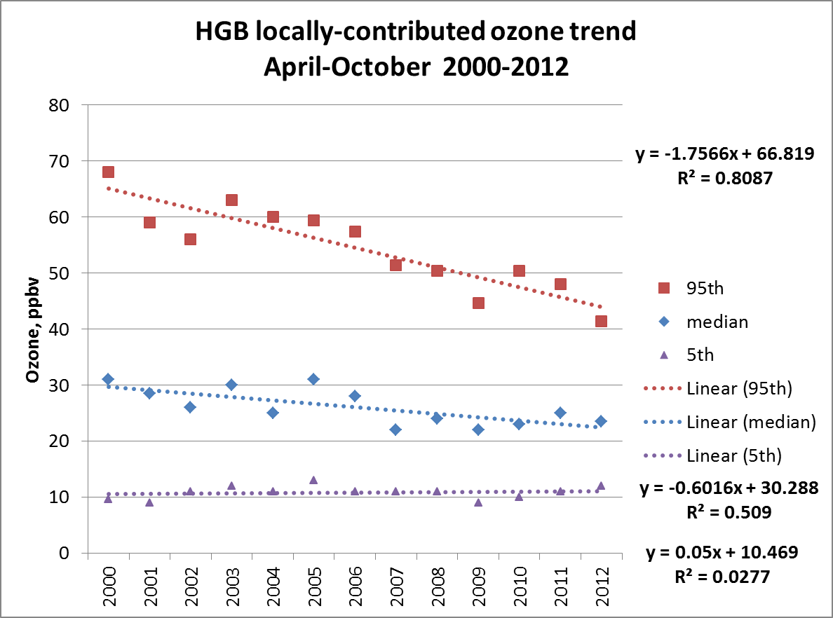
95th local: -1.76 ± 0.26 ppbv/yr, p = 0.000029
50th local: -0.60 ± 0.18 ppbv/yr, p = 0.0062

Slide 15
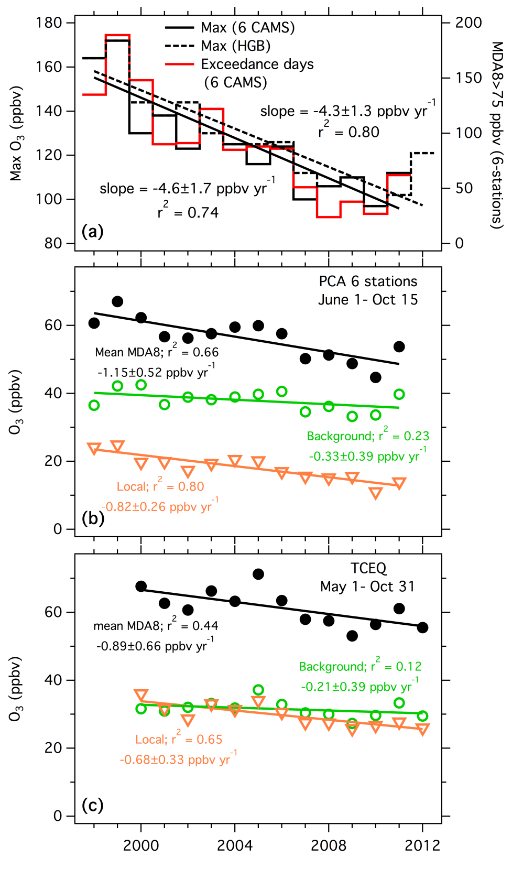
(a) Trends in the highest MDA8 O₃ reported by one of the 6 CAMS stations used in the PCA analysis (Max 6 CAMS) and by all HGB CAMS (Max HGB). The number of ozone exceedance days (2008 NAAQS) at the 6 CAMS stations is also shown.
(b) and (c) Trends in mean MDA8 ozone and background and local contributions from the 6-station PCA and the TCEQ methods, respectively. The solid lines indicate the linear least-squares fits; the parameters of the fits with 95% confidence intervals are annotated.

Slide 16
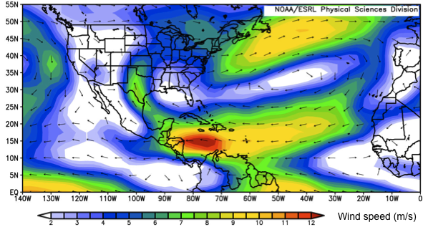
Mean wind vectors for July 1981-2010 at 850 mb based upon NCEP/NCAR reanalysis winds. (Figure courtesy of Owen Cooper.).

Slide 17
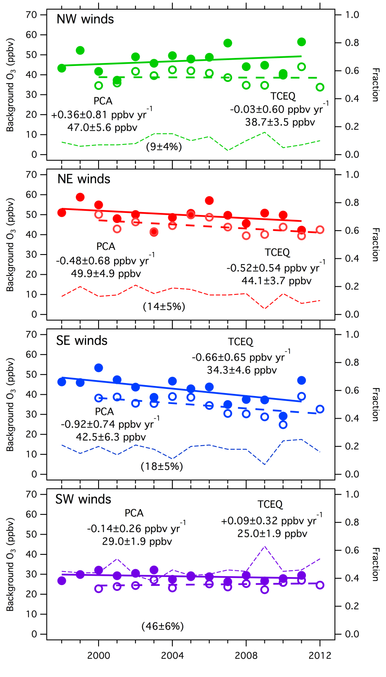
Temporal trends of background O₃ during periods with prevailing winds originating from the indicated wind quadrants.
The closed and open symbols give the results from the PCA and TCEQ analyses, respectively. The solid and dashed straight lines indicate the linear least-squares fits to the respective points; the slopes with 95% confidence intervals are annotated. Also annotated are the averages and standard deviations of the backgrounds.
The thin dashed lines show the fraction of days the wind was from each quadrant during the ozone season, and the average fraction of days with standard deviation is annotated for each wind sector within the parentheses

Slide 18
Average 72-hour HYSPLIT back trajectory for the six transport patterns detected by Sullivan (2009) and the respective average background ozone concentrations associated with each pattern.

Slide 19
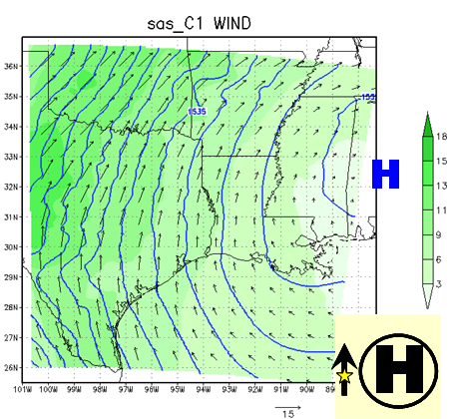
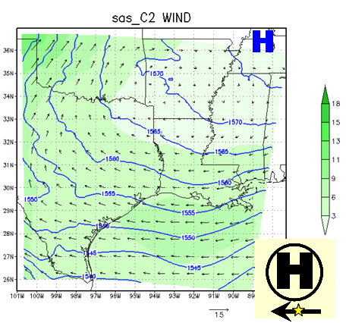
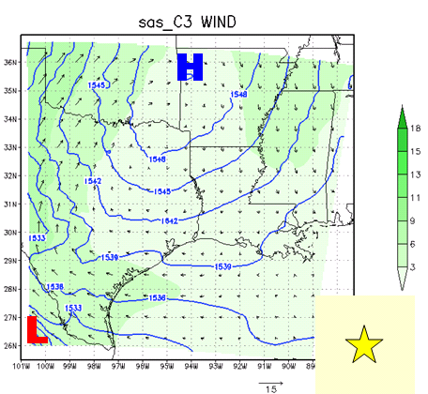
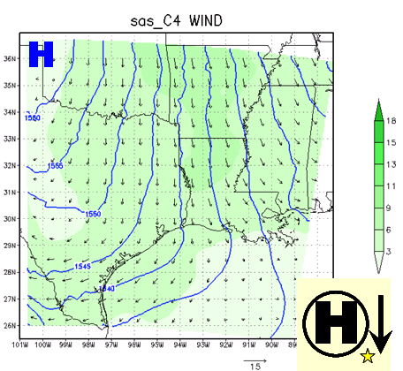
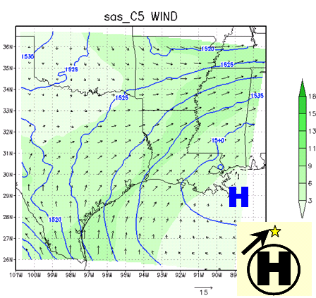
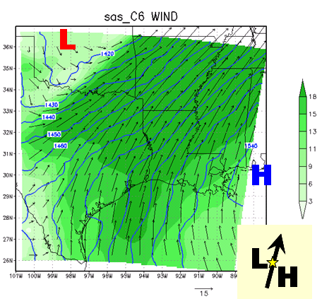
C1: SE/S, 35 ppb
C2: E, 65 ppb
C3: calm, 61 ppb
C4: N, 56 ppb
C5: SW, 40 ppb
C6: strong SW, 20 ppb
Meteorological regimes during May-September 2005-2006 as determined by Ngan and Byun (2008) using multivariate statistical analysis of met modeling and analysis. Icons in the lower right corner indicate the relative position of Houston (denoted by star), high or low pressure centers, and regional-scale wind flow affecting Houston (denoted by the arrow). The ozone concentration at the top of each map refers to mean hourly ozone concentrations during each regime.

Slide 20
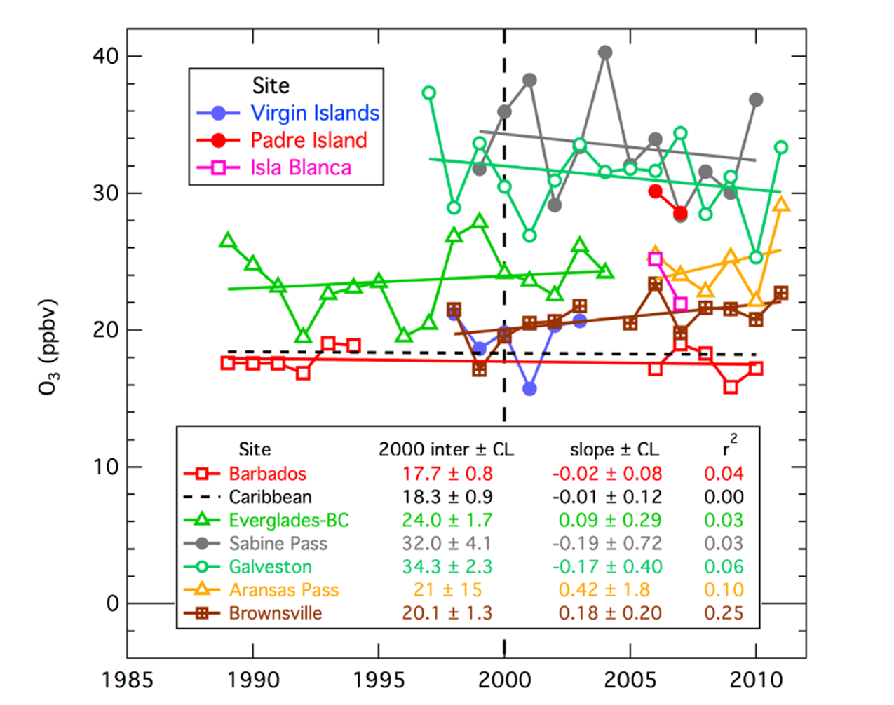
Background ozone for Gulf of Mexico and Caribbean sites. Trends are essentially flat for most locations.
Notes:
Temporal evolution of baseline ozone estimated for the Gulf of Mexico. Data
are selected to most nearly represent baseline conditions (see discussion in text)
averaged over the five-month (May-Sept.) ozone season. Linear least squares fits are
given for data sets with substantial temporal coverage. Only the most appropriate near
coastal and marine sites in the Caribbean and on the Gulf of Mexico coast are included.

Slide 21
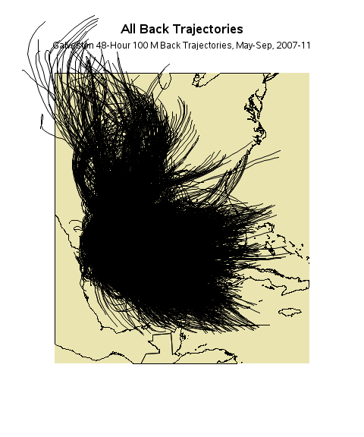
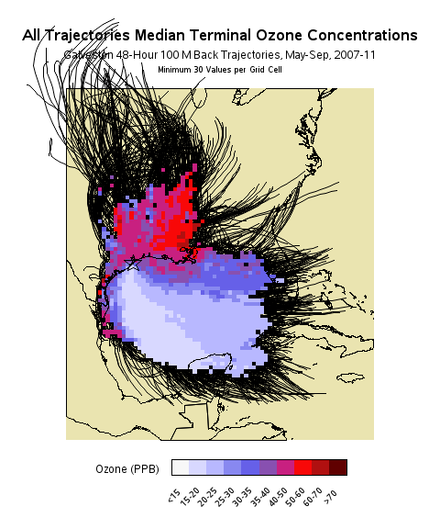
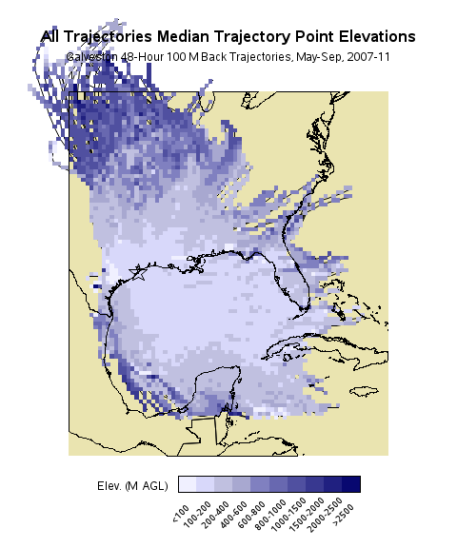
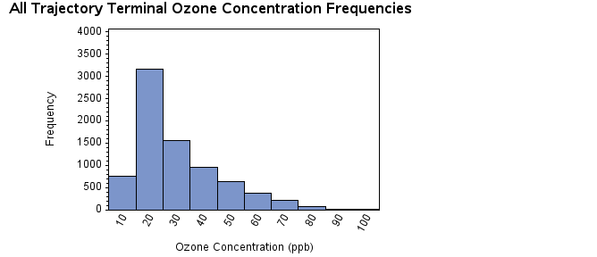
Galveston Trajectories
(7788 Trajectories)
Galveston back trajectories most frequently cross the Gulf of Mexico, but many traverse the Midwest and Louisiana. Trajectories originating in the western Gulf are characterized by very low (<25 ppb) ozone concentrations, while those crossing the central Gulf have higher concentrations (25-35 ppb). Trajectories skimming the Gulf Coast have higher concentrations still. The highest concentrations are associated with trajectories arriving from Louisiana and Midwest, but many are heavily influenced by local (Houston) sources.

Slide 22
Conclusions
Median background ozone is 30 ppbv in Houston, and is not changing significantly, though when dry and humid days are considered separately, a significant downward trend (-1.05 ppbv/yr) can be observed in dry days only.
95th percentile background ozone is decreasing significantly (-0.58 ppbv/yr) overall and for dry days (-0.71 ppbv/yr).
Background ozone is highest in spring and fall, and lowest in mid-summer.
These results are consistent with other analyses of ozone trends (Cooper et al. 2012, Lefohn et al. 2012, Parrish et al. 2012).

Slide 23
Spatial Synoptic Classifications
Spatial Synoptic Classification scheme (Sheridan, 2002, 2003; Davis et al. 2010: http://sheridan.geog.kent.edu/ssc.html ) subdivides the ozone season into dry and humid days.
Using TCEQ background data, recalculated trends for dry and humid classes and found that the trend in background ozone for dry days was significantly downward, whereas the humid days’ trend was not significantly different from zero.
The dry days are more likely to represent continental transport, whereas the humid days represent Gulf-influenced air.

Slide 24
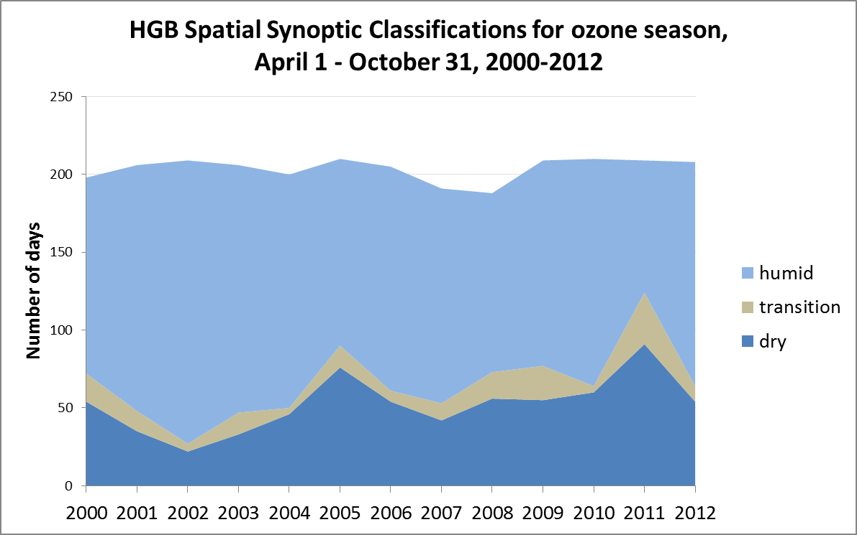

Slide 25
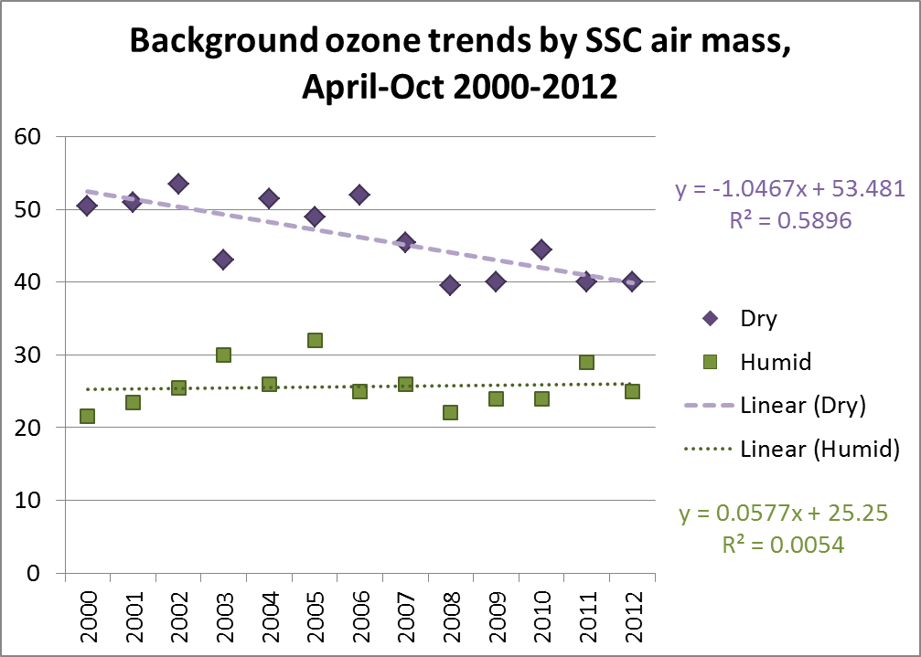
For all days April 1 – Oct 31 2000-2012
Median concentration trend: rate of change is over 1 ppbv/yr for days dominated by dry air masses (p=0.002), but is essentially zero for humid air masses. 95th percentile for dry days (not shown): -0.71 ppbv/yr (p=0.01).

Slide 26
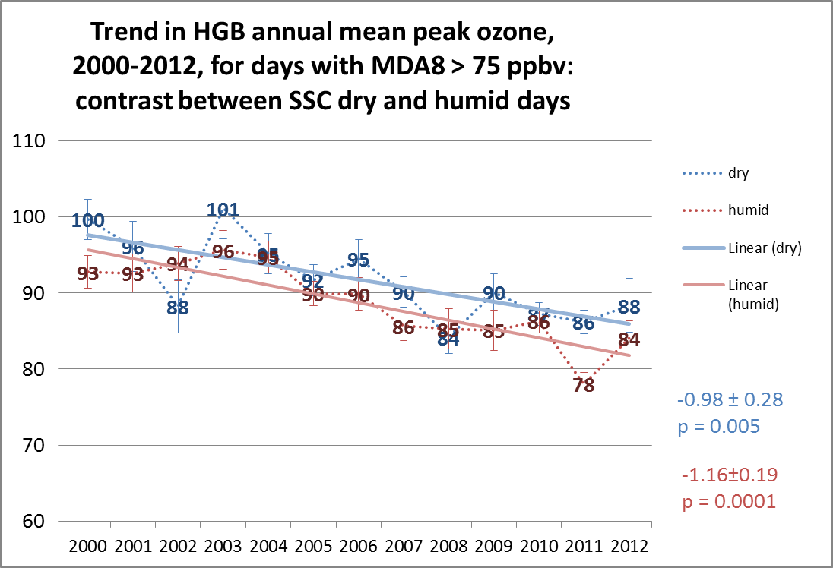
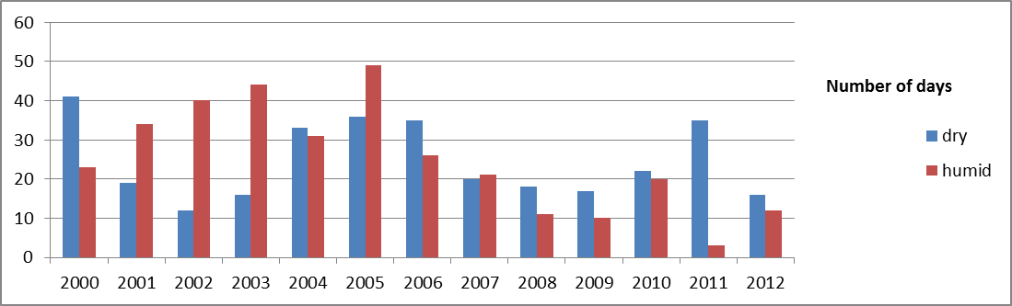

Slide 27
 | Observed Trend for days with MDA8 > 75 ppbv | P value
Dry Peak | -0.98 ± 0.28 ppbv/yr | 0.005
Dry Background | -0.35 ± 0.21 ppbv/yr | 0.12
Dry Local | -0.62 ± 0.40 ppbv/yr | 0.14
Humid Peak | -1.16 ± 0.19 ppbv/yr | 0.0001
Humid Background | -0.077 ± 0.21 ppbv/yr | 0.71
Humid Local | -1.08 ± 0.21 ppbv/yr | 0.0004
Peak ozone trend apparently dominated by decreases in local ozone (though background probably plays an important role in dry conditions).

Slide 28
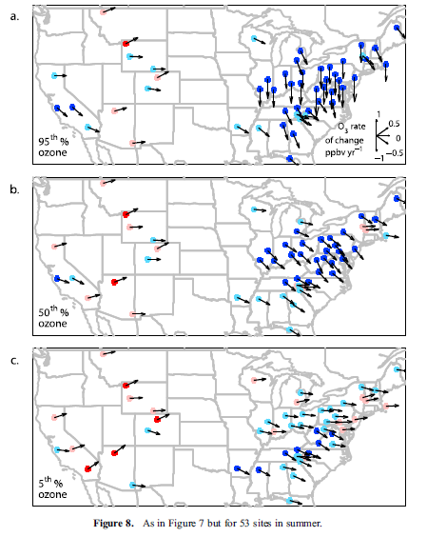
Observed ozone trends at CASTNET sites.
Summer daytime ozone trends (1990–2010) at 52 rural sites for the (a) 95th, (b) 50th and (c) 5th percentiles. Indicated are sites with statistically significant (red dots) and insignificant (pink dots) positive trends, and sites with statistically significant (dark blue dots) and insignificant (light blue) negative trends. Vectors indicate the ozone rate of change in ppbv/yr.
Eastern US shows downward trend in ozone at rural sites, but western US shows mix of upward and downward trends.
From Cooper et al. 2012

Slide 29
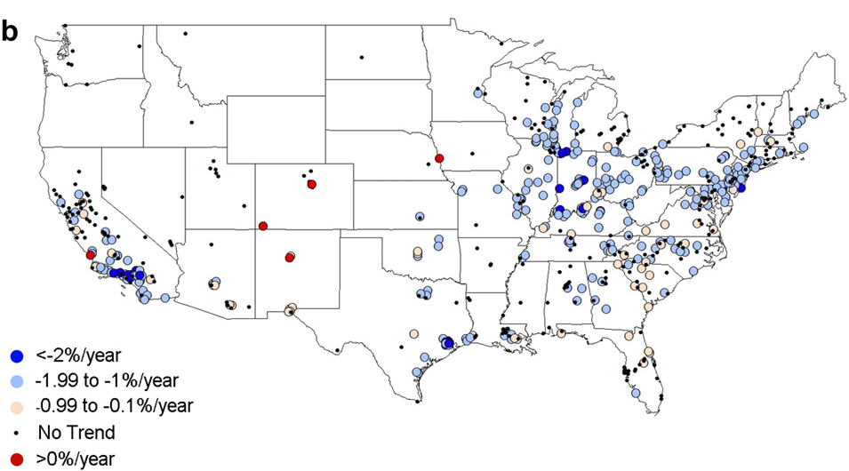
Lefohn et al. Trend in 8-hr ozone from 1994-2008. Mixture of urban and rural sites.

