Slide 1
Sensitivity to changes in HONO emissions from mobile sources simulated for Houston area
Beata Czader, Yunsoo Choi, Lijun Diao
University of Houston Department of Earth and Atmospheric Sciences

Slide 2
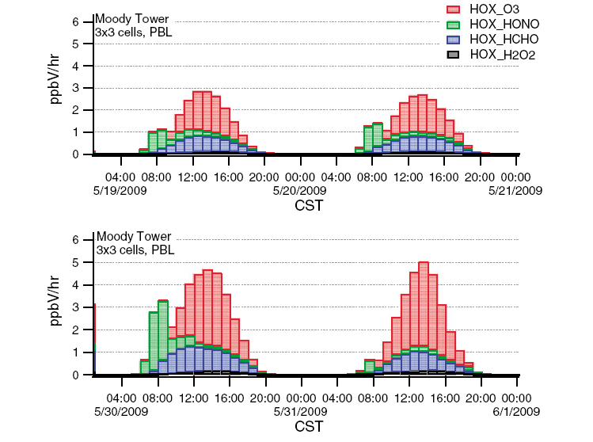
Background
Nitrous acid (HONO) is an important source of hydroxyl radical (OH), which plays a crucial role in oxidation of volatile organic compounds (VOCs) leading to the formation of ozone.
CMAQ results
for SHARP, 2009
Czader et al., JGR, 2013
University of Houston

Slide 3
Background
Accurate estimation of HONO in air quality modeling is important as it affects predictions of HO_{x} (OH + HO₂) as well as ozone concentrations.
SMOKE estimates HONO emissions based on the HONO/NOx ratio derived from the tunnel studies done in 2001.
University of Houston

Slide 4
HONO sources
Direct emissions
Chemical formation
Emissions from combustion processes
1. Gas phase formation OH + NO → HONO
2. Heterogeneous formation
2 NO₂ + H₂O → HONO + HNO₃
can be parameterized as NO₂ → HONO with reaction rate coefficient
3. Photolytic sources
Experiments show enhanced HONO formation when the sunlight is available, suggested uptake coefficient
r = 2∙10⁻⁵ with dependence on light intensity
Based on Kurtenbach et al.,2001.
r = 1 – 5 ∙10⁻⁶
r = 1∙10⁻⁶ used in CMAQ
University of Houston

Slide 5
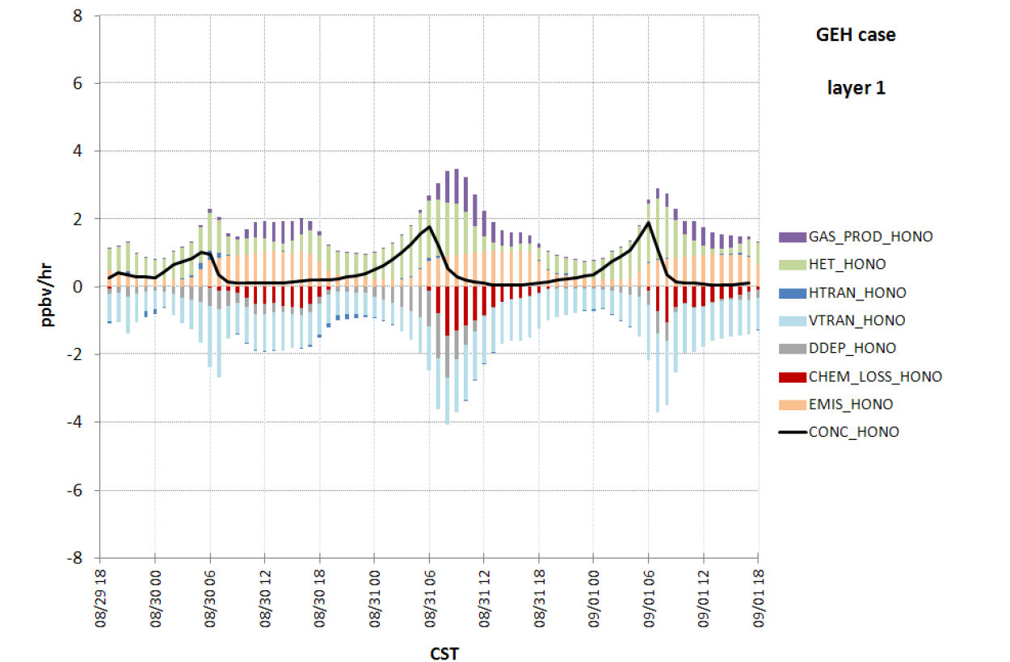
HONO partitioning in CMAQ
heterogeneous formation
is the main nighttime source (green)
gas phase formation is a midday source of HONO (purple)
Emissions:
27% - morning
50% - around noontime
emissions are mostly daytime source of HONO (orange)
CMAQ results
TexAQS 2006
Czader et al., ACP, 2012
University of Houston

Slide 6
CMAQ modeling of HONO for Houston
TexAQS 2006
red – gas phase HONO source (CMAQ 4.6 and earlier versions)
blue – gas phase, emissions, and heterogeneous formation (CMAQ 4.7 and later versions) Sarwar et al., AE, 2008; Foley et al., GMD, 2010
yellow – gas phase, emissions, and heterogeneous formation + photolytic source
Czader et al., ACP, 2012
University of Houston

Slide 7
CMAQ modeling of HONO for Houston
Czader et al., ACP, 2012
University of Houston

Slide 8
CMAQ modeling of HONO for Houston
TexAQS 2006
Czader et al., ACP, 2012
University of Houston

Slide 9
CMAQ modeling of HONO for Houston
TexAQS 2006
Czader et al., ACP, 2012
University of Houston

Slide 10
CMAQ modeling of HONO for Houston
TexAQS 2006
Uncertainties still exist in HONO modeling
Czader et al., ACP, 2012
University of Houston

Slide 11
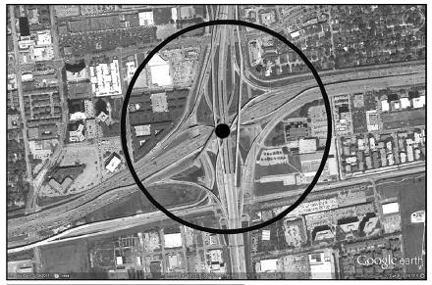
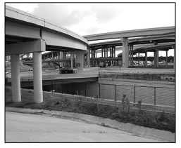
HONO measurements in Houston
Rappenglueck et al., JAWMA, 2013 reports HONO measurement in Houston. and suggest much higher HONO/NO_{x} emissions ratio than Kurtenbach et al. 2001.
Highway Junction I-59 South/610 in Houston
Partial view of where the measurements were taken
University of Houston

Slide 12
HONO measurements in Houston
In order to determine traffic related emissions only a subset of 10-min averaged data was used which met the following conditions:
1) weekdays
2) rush hour time 4:00-8:00 a.m. CST
3) global radiation < 10 Wm-2
4) PAN < 50 pptv
5) no precipitation
6) RH > 80%
1.7*10⁻³ (±0.9*10⁻³) r²=0.75 based on all data, July 15 – Oct. 15, 2009
1.6*10⁻³ r²=0.88 for Sep. 28, 2009
Rappenglueck et al., JAWMA, 2013
University of Houston

Slide 13
Goals
Apply the latest HONO/NO_{x} ratio in estimating emissions of HONO from mobile sources;
Perform air quality simulations with the CMAQ model;
Evaluate the effect of changing mobile emissions on HONO predictions as well as on O₃ and HO_{x} mixing ratios.
University of Houston

Slide 14
Methodology
Time period: September 2013, same as DISCOVER AQ in Houston
Emissions: 2008 NEI processed with SMOKE v. 3.1
Meteorological parameters: WRF v. 3.5 driven by NAM for AQF and re-simulated with NARR data
AQM: CMAQ v. 5.0.1, cb05tucl_ae5_aq chemical mechanism
Poster:
THE EVALUATION OF AIR QUALITY FORECASTING SYSTEMS BASED ON WRF-CMAQ AND WRF-CHEM OVER HOUSTON DURING THE DISCOVER-AQ HOUSTON: SURFACE O3 AND PM2.5
by Lijun Diao, Yunsoo Choi, Beata Czader, Sunyeon Choi, Joanna Joiner, Hyuncheol Kim
University of Houston

Slide 15
HONO emissions
Speciation profiles for mobile sources (gspro file):
NO_{X} → NO₂ → 9.2% → 8.4%
NO_{X} → NO → 90.0% → 90.0%
NO_{X} → HONO → 0.8% → 1.6%
HONO/NO_{x} = 8*10⁻³
base case
HONO/NO_{x} =1.6*10⁻³
sensitivity case
University of Houston

Slide 16
Evaluation of modeling results: CO
sub-urban site
urban/industrial site
University of Houston

Slide 17
Evaluation of modeling results: NOx
sub-urban site
urban site
University of Houston

Slide 18
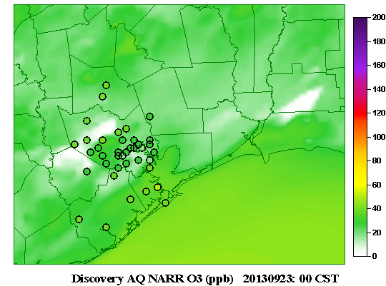
Evaluation of ozone predictions
September 23 – 27, 2013 (25-26 are high ozone days)
Background: CMAQ values
Dots: CAMS measurements (not validated)
provided by M. Estes, TCEQ
Due to too high NOx morning time ozone is underpredited in the morning
Afternoon values well captured by the model
University of Houston

Slide 19
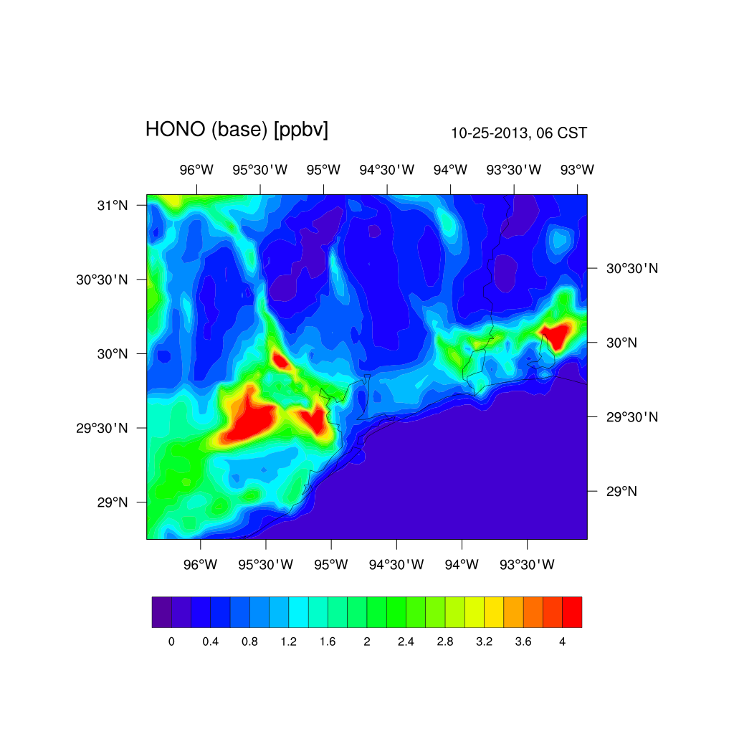
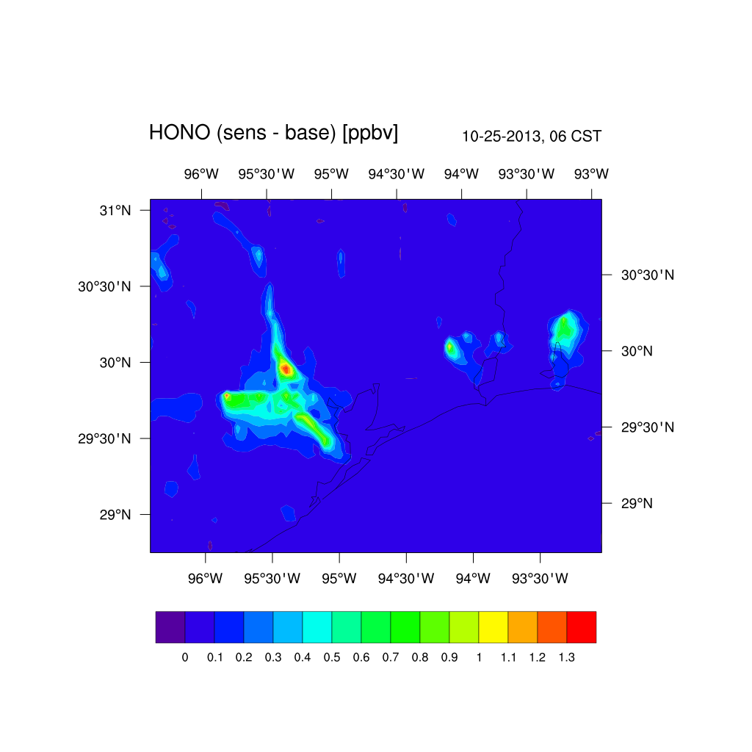
HONO mixing ratios
Base case
Differences in HONO
University of Houston

Slide 20
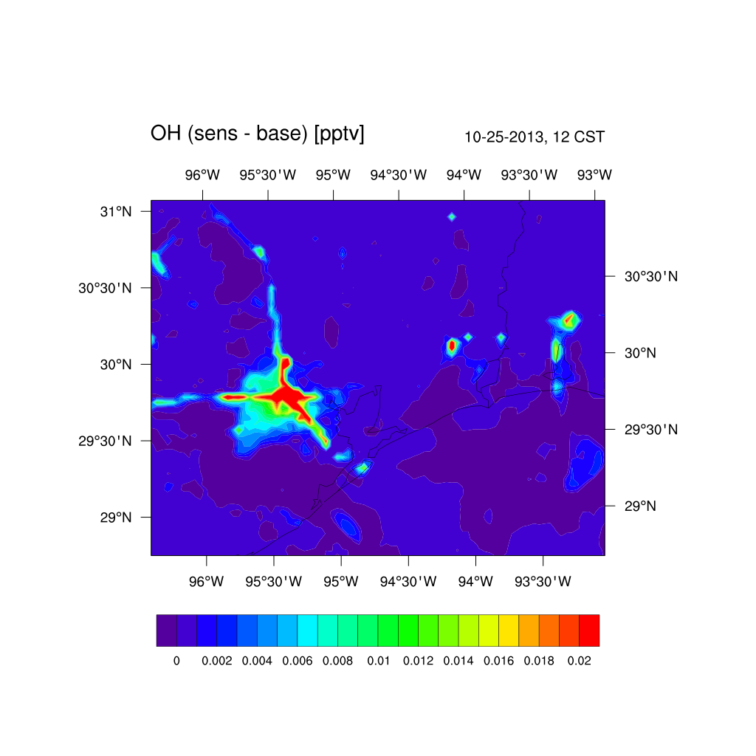
Effect of increased HONO on OH radical
Higher daytime OH from additional HONO case
University of Houston

Slide 21
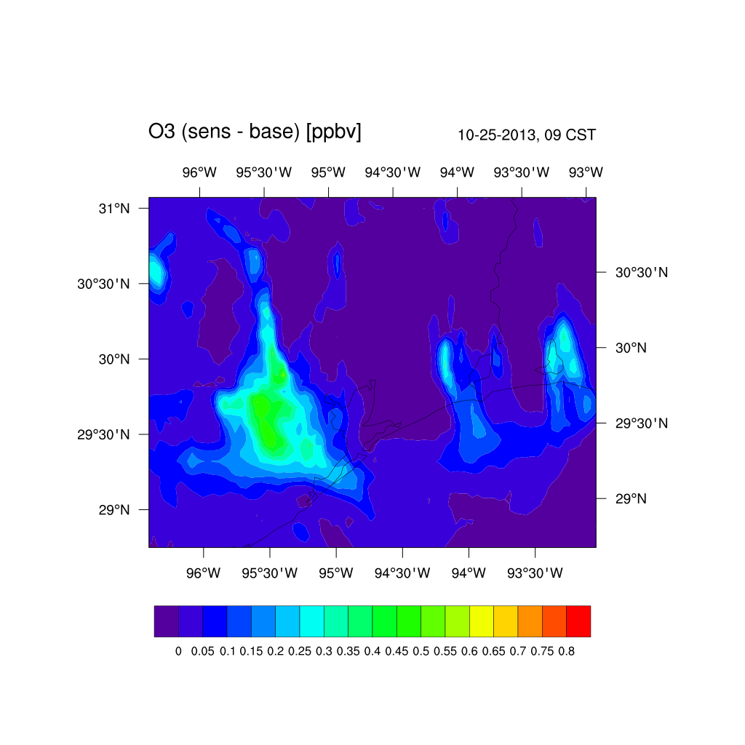
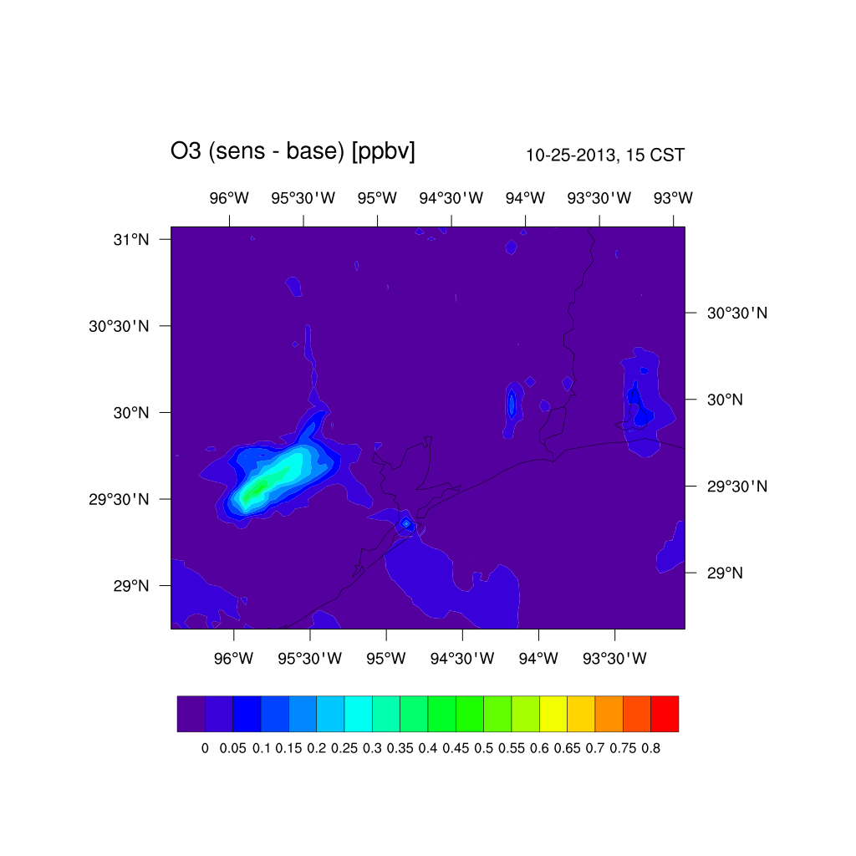
Effect of increased HONO on O₃
Difference occurs in the morning ~3%, changes to the afternoon peak are marginal
University of Houston

Slide 22
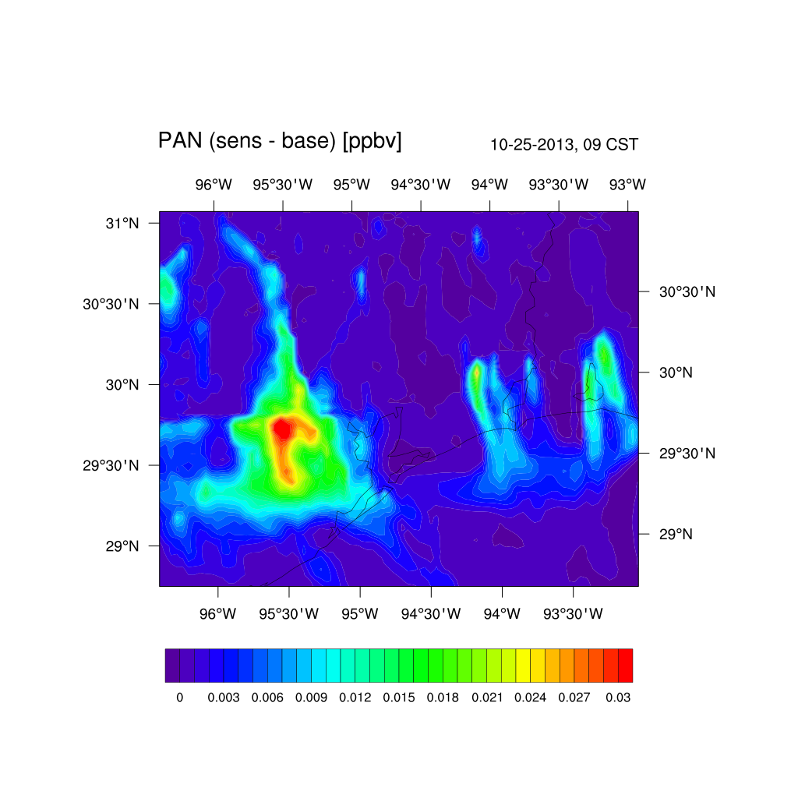
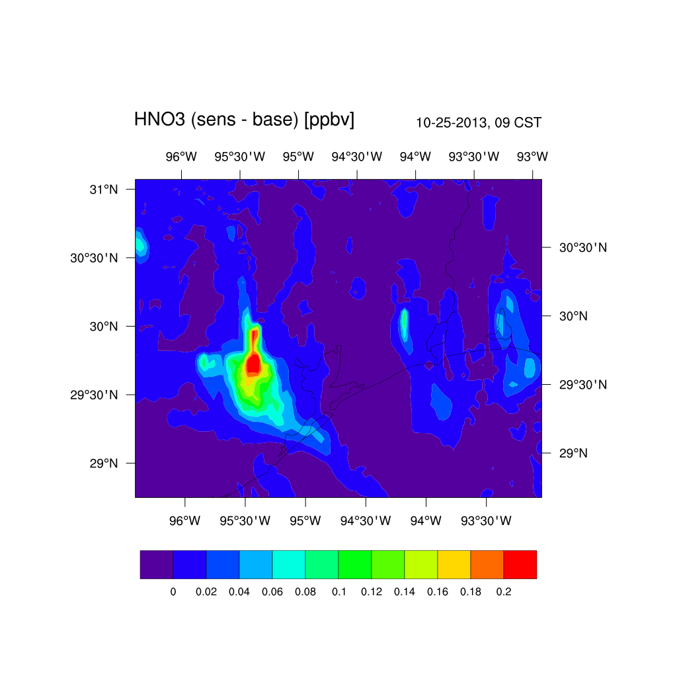
Effect on other pollutants
Higher daytime mixing ratios of PAN and HNO3 from additional HONO
The maximum difference occurs in the morning and reaches ~5% of PAN value, and ~2% for HNO3
University of Houston

Slide 23
Summary
Recent measurement studies in Houston suggest that HONO mobile emissions are higher than currently implemented in AQM.
Increasing (doubling) HONO emissions resulted in up too 1 ppb higher HONO mixing ratios.
Additional HONO emissions from mobile sources resulted in slightly higher daytime values of hydroxyl radical and consequently other pollutants, such as ozone, PAN, and HNO3, especially during morning times.
NEI2008 overpredicts NO_{x} emissions and is being adjusted based on CAMS and remote sensing data.
University of Houston

