Slide 1
Development of an Ozone Screening Tool for the Midwest
Alexander Cohan¹, Scott Leopold², Greg Yarwood³, Kirk Baker⁴
¹LADCO
²Illinois EPA
³ENVIRON
⁴U.S. EPA
10/30/13

Slide 2
Motivation
July 2010 - Sierra Club petitions EPA to designate air quality models for PSD permitting
January 2012 – EPA grants Sierra Club’s petition and commits to updating the Guideline on Air Quality Models (Appendix W)
Regional photochemical modeling is best science for addressing ozone impacts, but computational intensive and impractical for routine permitting
Regulators would like an easy to use screening tool to assess the ozone impact of stationary sources for PSD permitting applications

Slide 3
Reduced Form Models
Use regional photochemical model results to develop a simplified localized framework
Equivalency Ratio (Margaret McCourtney, MPCA)
Interpollutant Trading Ratios (James Boylan, Georgia EPD)
Response Surface Model (Carey Jang, EPA)
Parametric Model (Greg Yarwood, ENVIRON)

Slide 4
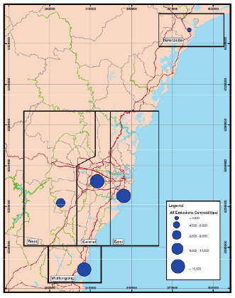
Background
Parametric Model (Yarwood, 2011)
Screening tool developed for Sydney
3 Km CAMx higher-order direct decoupled method (HDDM) simulations of the summer
Assumptions:
Ground source
Located at center of
emissions by mass
Yarwood, G., Scorgie, Y., Agapides, N., Tai, E., Karamchandani, P., Bawden, K., Spencer, J., Trieu, T, 2011. A screening method for ozone impacts of new sources based on high-order sensitivity analysis of CAMx simulations for Sydney. Proceedings, 10th Annual CMAS Conference, Chapel Hill, NC.

Slide 5
Background
CAMx
Base Ozone
Base Emission Inventory
Base Met
–
BF Ozone Impact
Ozone W/ Point Source
HDDM Ozone Impact
+
CAMx
Single Point Emissions
HDDM Ozone Sensitivities
2nd Order Taylor Series
2nd order Taylor series

Slide 6
Problem Statement
Question: How do ozone sensitivities to emission rates vary with emission rate and stack characteristics?
Approach: Use multiple CAMx HDDM simulations of individual point sources to train a statistical model to empirically relate

Slide 7
Statistical Models
Potential statistical models
CART
Neural network
Kriging
Fixed-Effects
Response Surface Model
Fixed-Effects (FE)
Represents observed quantities in terms of explanatory variables that are treated as if the quantities were non-random
Transparent and easy to implement

Slide 8
Methodology
A linear parametric fit will not work!
Sensitivities behave like Gaussian plume
Seinfield & Pandis (1998)

Slide 9
Methodology
Sources to the left or right might behave differently…
Use binomial expansion for α
Fit parametric equation at each grid cell
Solve for P₁…P₁₁ using R to minimize mean square error

Slide 10
Methodology
Proof of concept conducted for test case in Illinois
Based on LADCO 2007 Modeling platform
4 km CAMx HDDM modeling of summer 2007

Slide 11
Methodology
20 hypothetical point sources modeled with HDDM
Stack diameter is linearly related to stack height (SH)
Exit velocity of 44 ft/s
Exit temperature 70 °f

Slide 12
Methodology
HDDM Ozone Sensitivities PT01
FE Approach
FE Ozone Impact
R
Model Fit
P₁ … P₁₁
2nd Order Taylor Series
HDDM Ozone Sensitivities PT20
E_{NOx} , E_{VOC} , x , y, SH
FE Model
FE Ozone Sensitivities
HDDM Approach
HDDM Ozone Sensitivities PTXX
E_{NOx} , E_{VOC}
2nd Order Taylor Series
HDDM Ozone Impact

Slide 13
Methodology
HDDM Ozone Sensitivities PT01
FE Approach
FE Ozone Impact
Screening Tool
R
Model Fit
P₁ … P₁₁
2nd Order Taylor Series
HDDM Ozone Sensitivities PT20
E_{NOx} , E_{VOC} , x , y, SH
FE Model
FE Ozone Sensitivities
HDDM Approach
HDDM Ozone Sensitivities PTXX
E_{NOx} , E_{VOC}
2nd Order Taylor Series
HDDM Ozone Impact

Slide 14
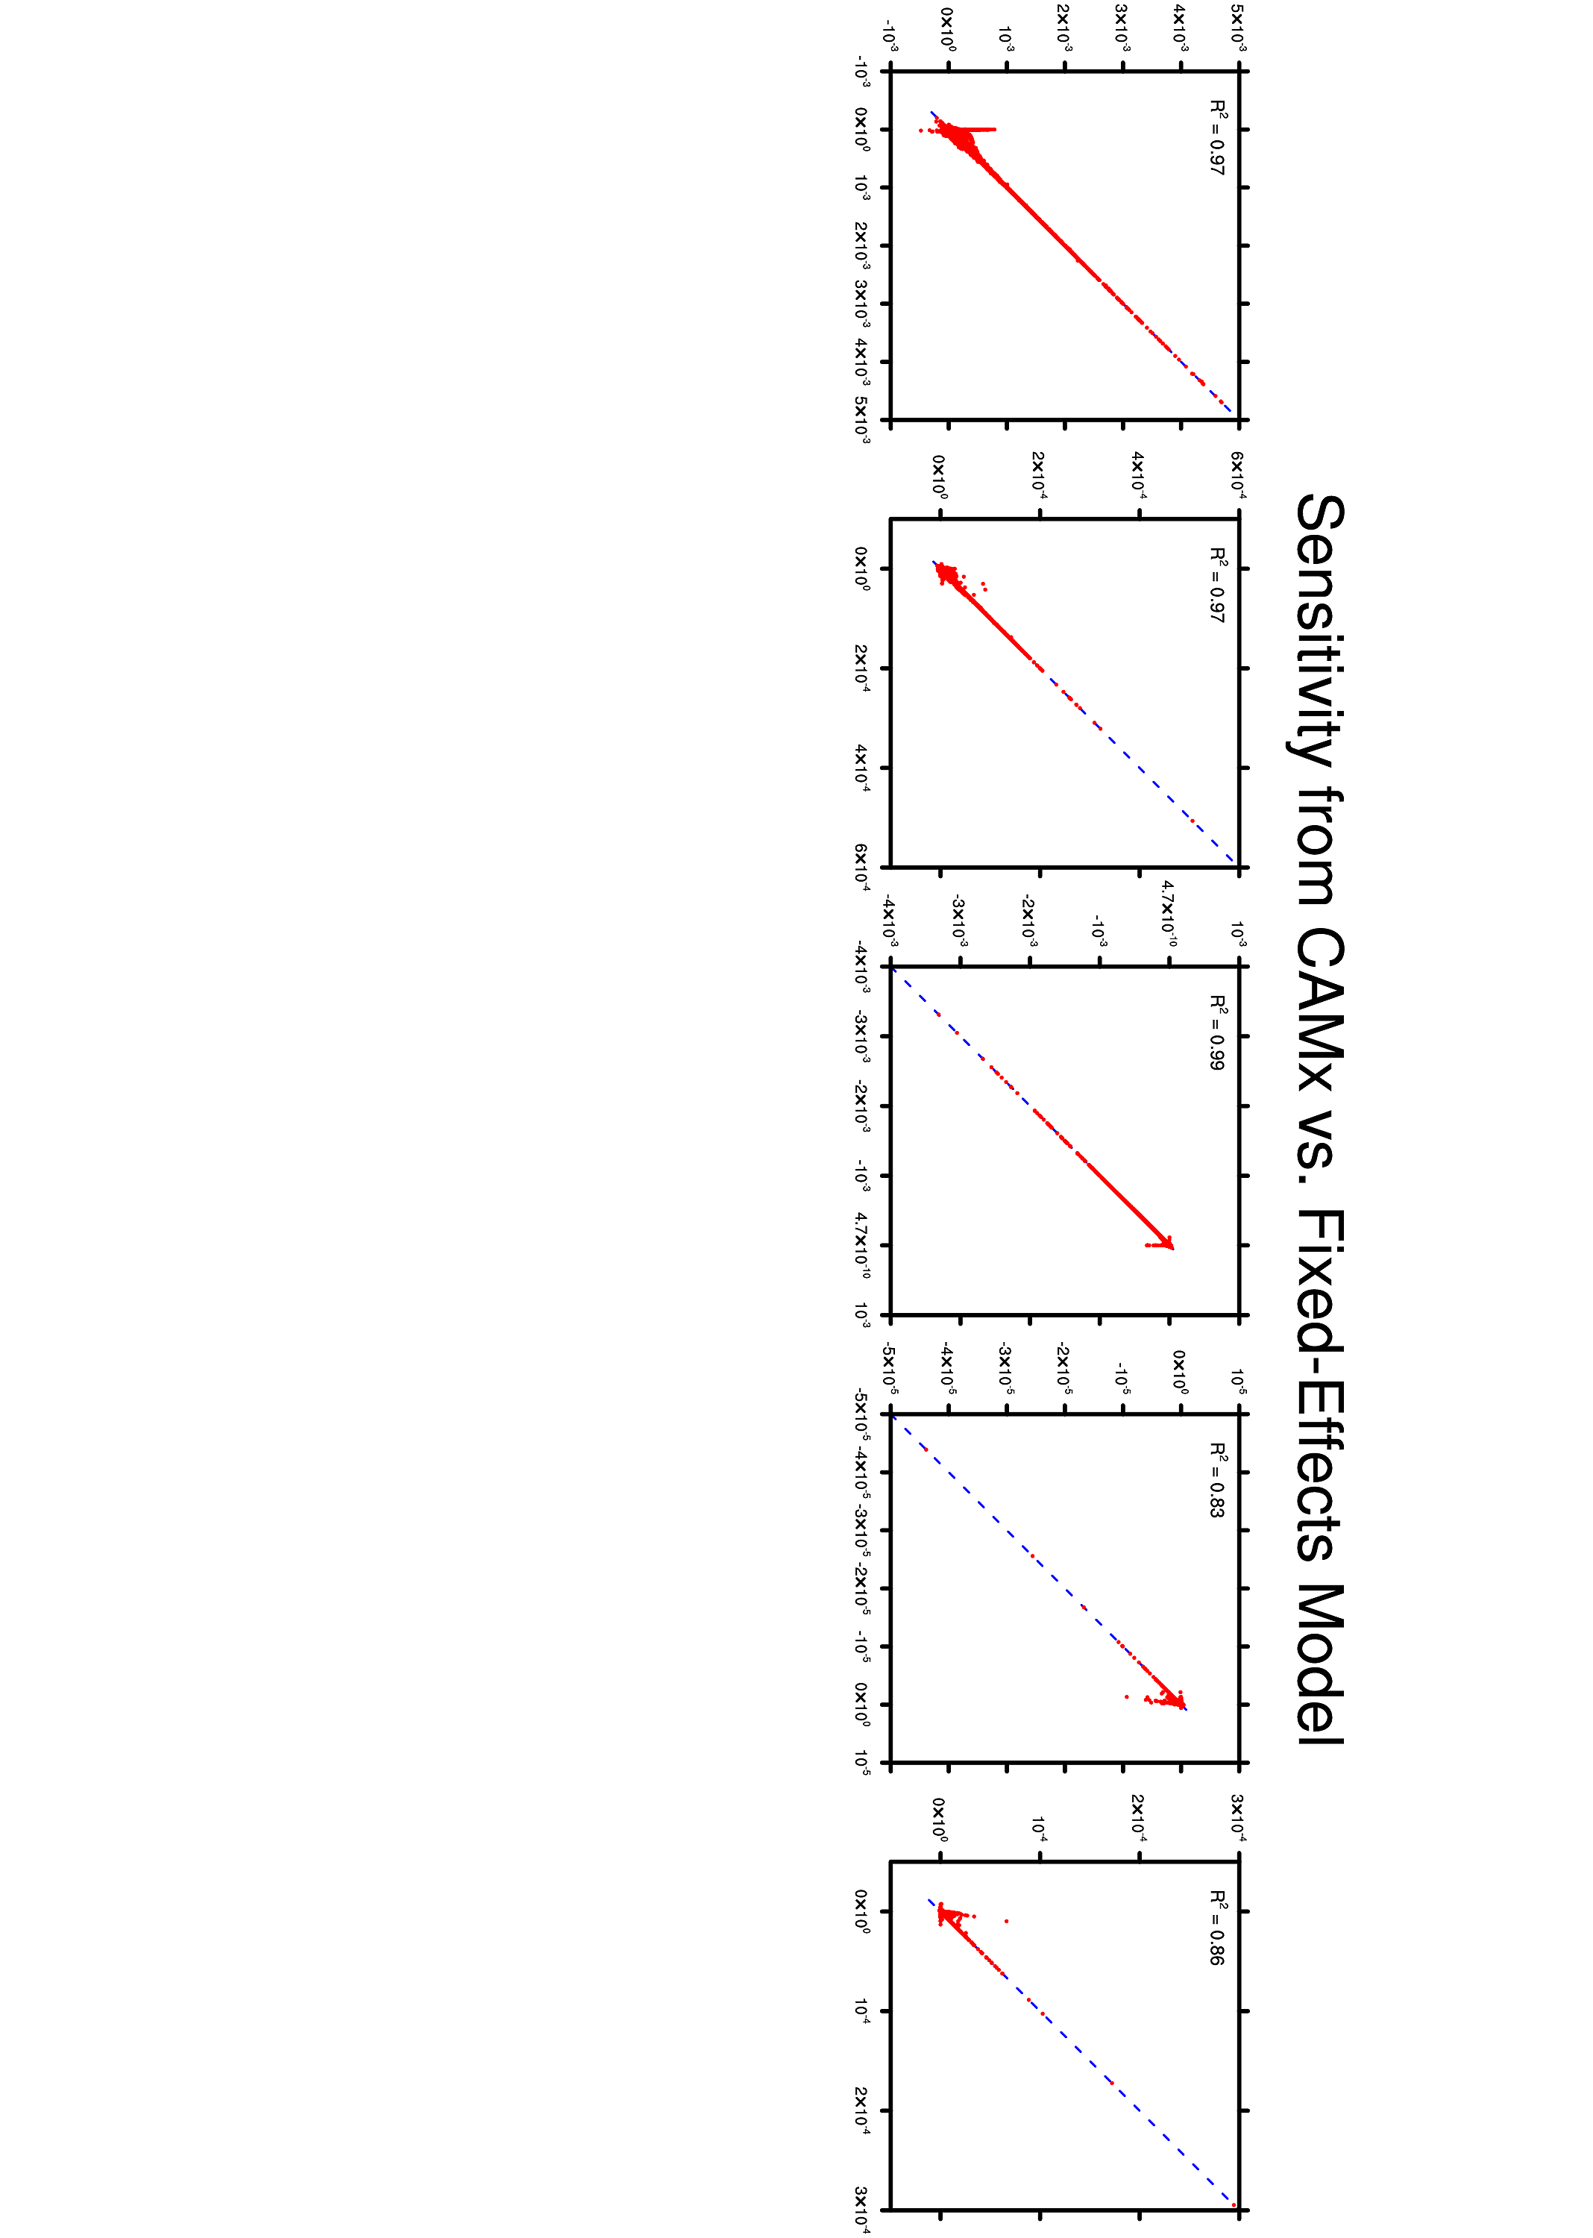
Sensitivities from CAMx HDDM vs. FE
FE Model
CAMx HDDM

Slide 15
Training Data Point 2
E_{NOx} = 718 tpy, E_{VOC} = 61 tpy, SH = 120 ft

Slide 16
Training Data Point 5
E_{NOx} = 80 tpy, E_{VOC} = 197 tpy, SH = 48 ft

Slide 17
Training Data Point 6
E_{NOx} = 943 tpy, E_{VOC} = 70 tpy, SH = 454 ft

Slide 18
Training Data Point 9
E_{NOx} = 610 tpy, E_{VOC} = 25 tpy, SH = 194 ft

Slide 19
Training Data Point 18
E_{NOx} = 380 tpy, E_{VOC} = 51 tpy, SH = 268 ft

Slide 20
Testing Point 1
E_{NOx} = 143 tpy, E_{VOC} = 143 tpy, SH = 71 ft
Notes:
24

Slide 21
Testing Point 2
E_{NOx} = 6 tpy, E_{VOC} = 292 tpy, SH = 177 ft
Notes:
21

Slide 22
Testing Point 3
E_{NOx} = 165 tpy, E_{VOC} = 192 tpy, SH = 83 ft
Notes:
23

Slide 23
Summary
FE matches HDDM training data well
FE/HDDM matches BF in magnitude and extent of impact, however BF produces a higher peak impact
FE Model would benefit from additional training data

Slide 24
Future Work
Investigate differences in peak impact predicted from BF and HDDM
Examine different VOC profiles
Explore other statistical models
Apply methodology to develop PM screening tool

Slide 25
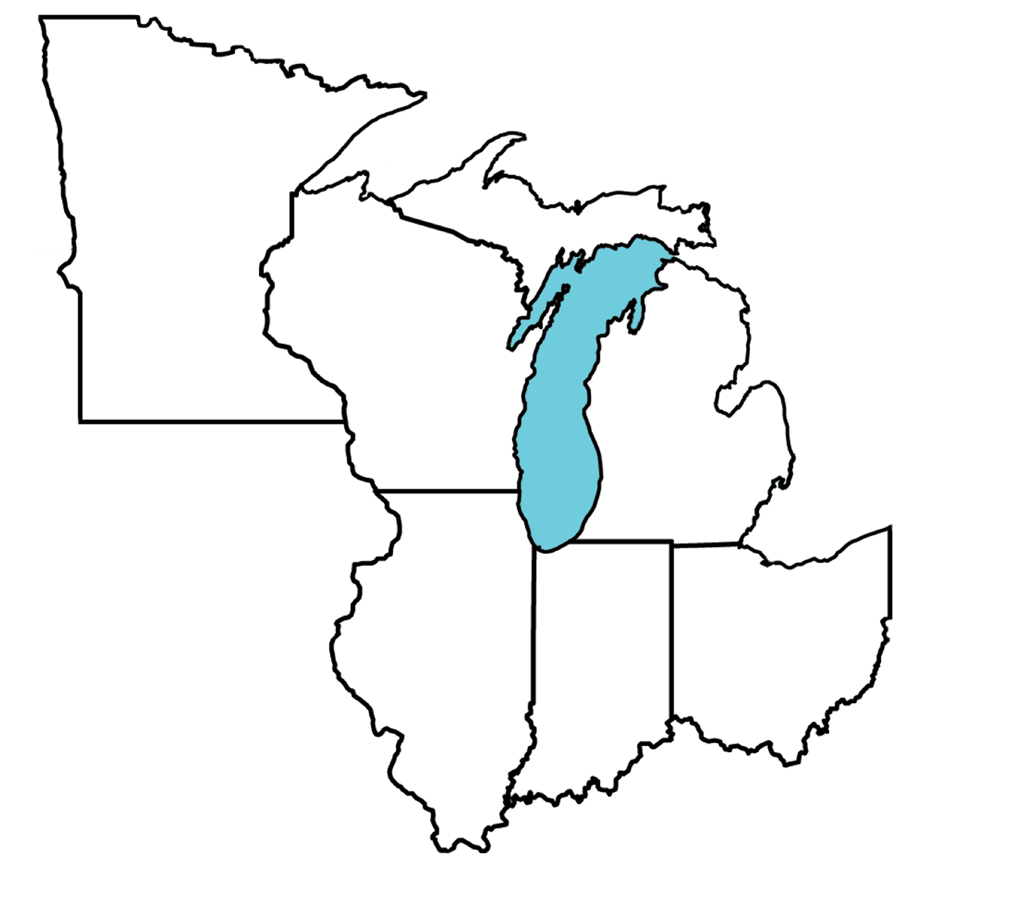
Acknowledgments
Scott Leopold – IL EPA
Greg Yarwood – ENVIRON
Kirk Baker – OAQPS
Margaret McCourtney – MN PCA
Randall Robinson – EPA Region 5
Mark Derf – IN DEM

Slide 26
20 HDDM Modeled Point Sources

Slide 27
LADCO 2007 Modeling Platform
Ozone Performance

