Slide 1
2013 CMAS user’s workshop
Study uncertainty of simulated O₃ in Taiwan
using CMAQ-HDDM: preliminary result
Fang-Yi Cheng¹, Meng-Ching Wu¹, Ka-Wa Chan¹ and Soontae Kim²
¹Dept. of Atmospheric Sciences, National Central University, Taiwan
²Dept. of Env. Engineering, Ajou University, Korea

Slide 2
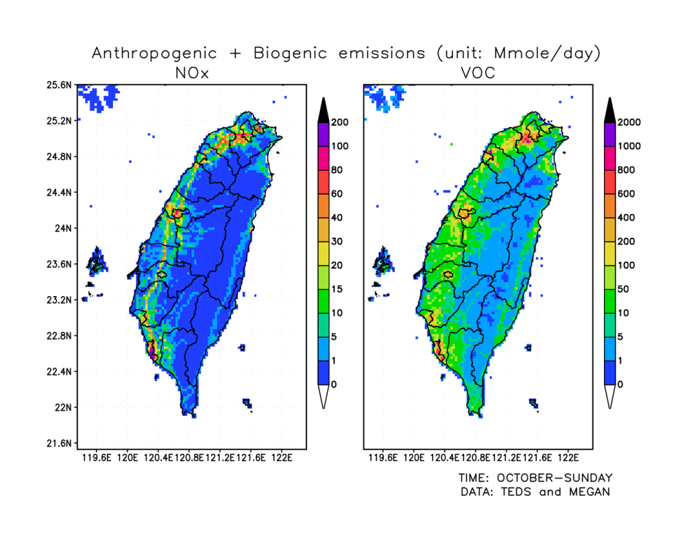
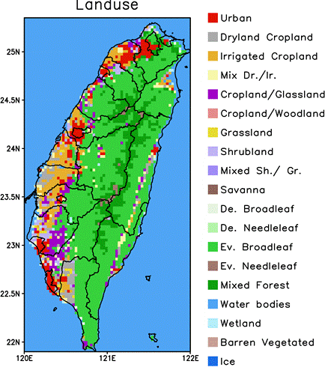
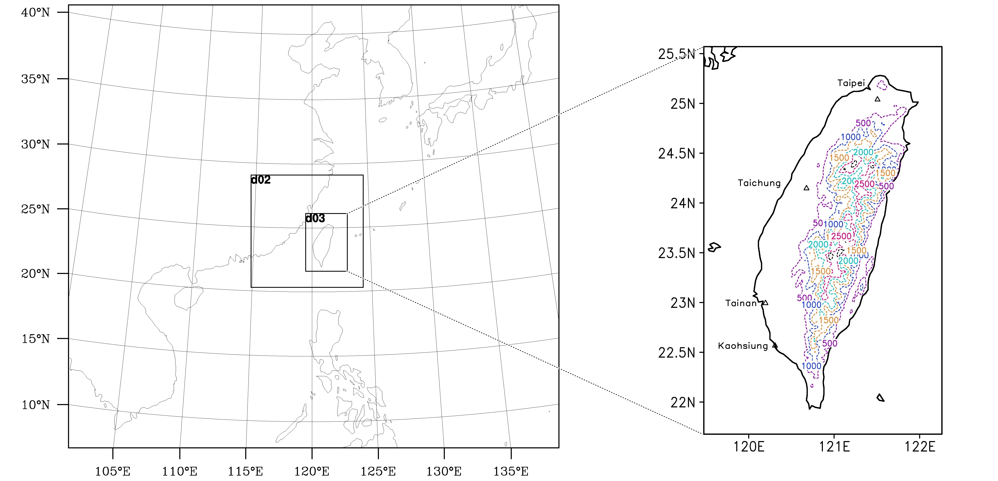
Taiwan’s O₃ problem
Taipei
Taichung
Tainan
Kaohsiung
(Biggest harbor)

Slide 3
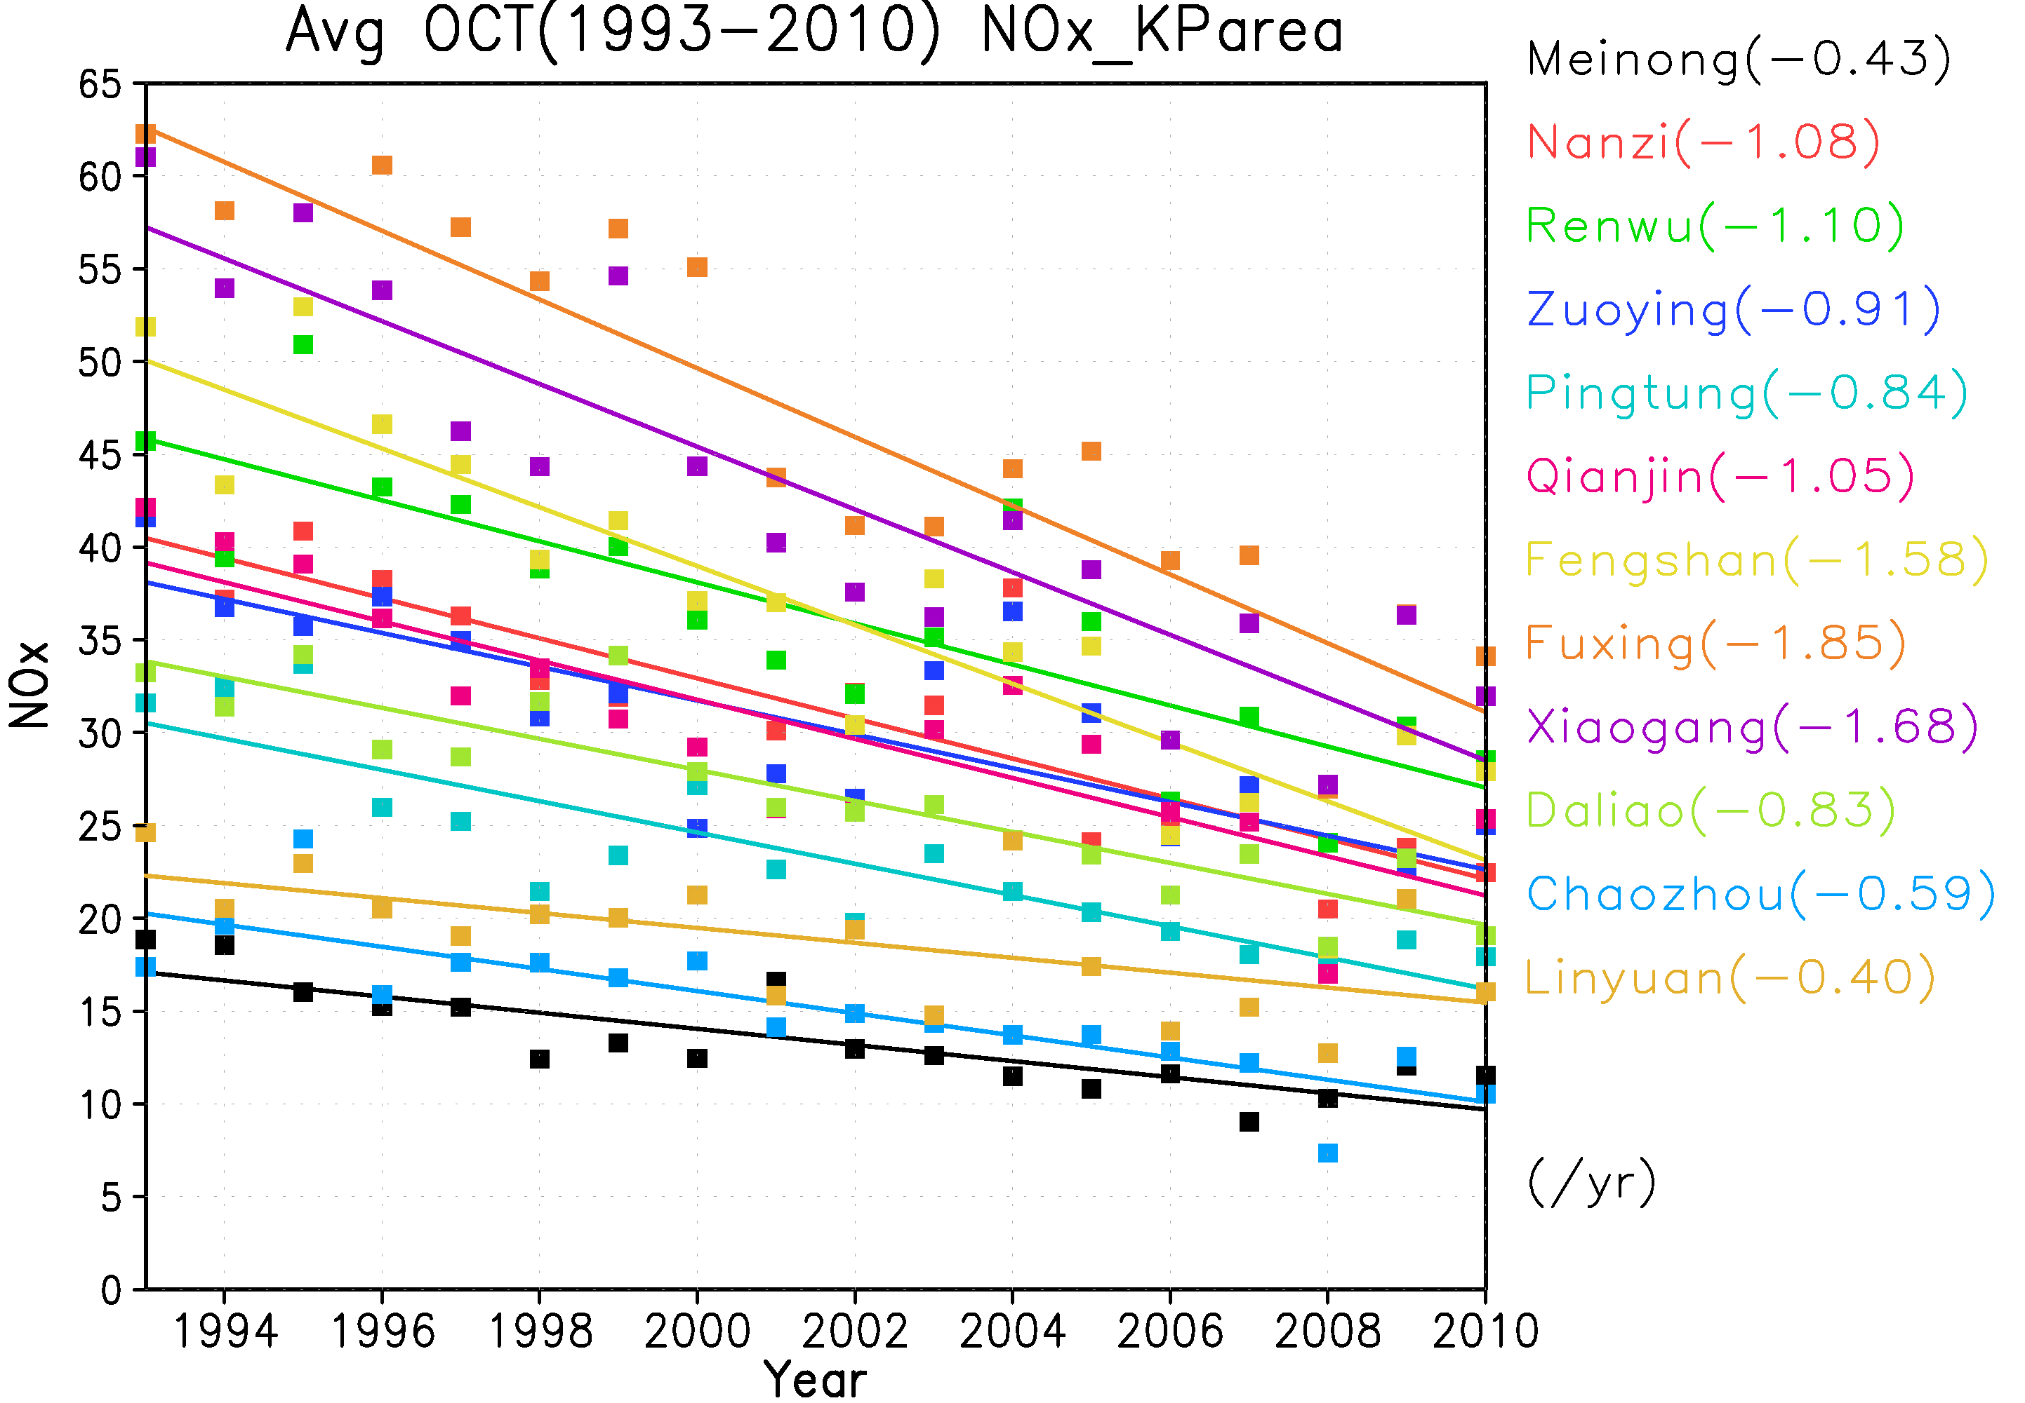
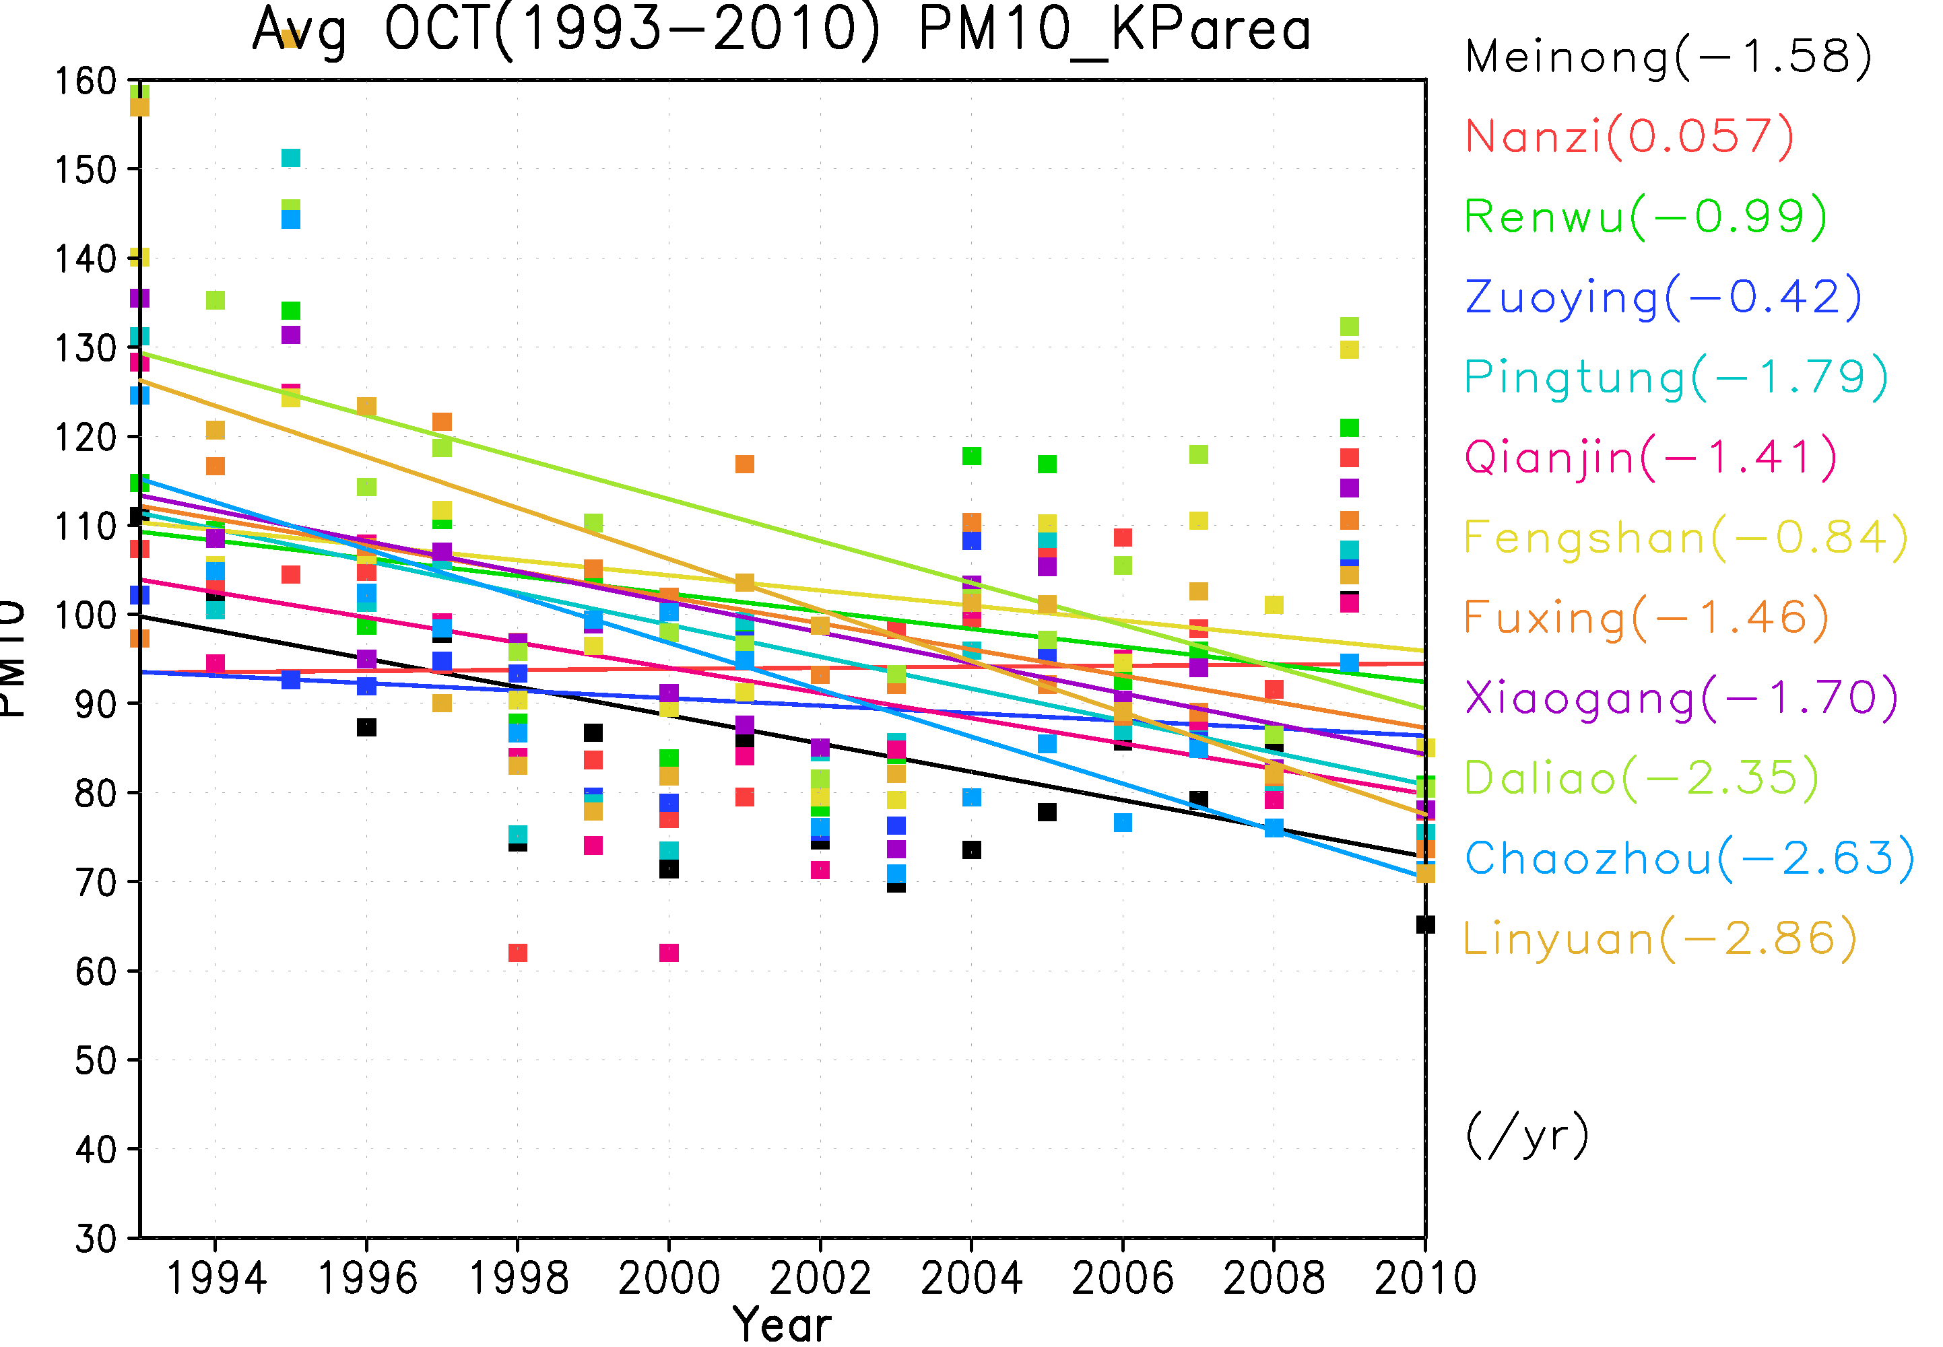
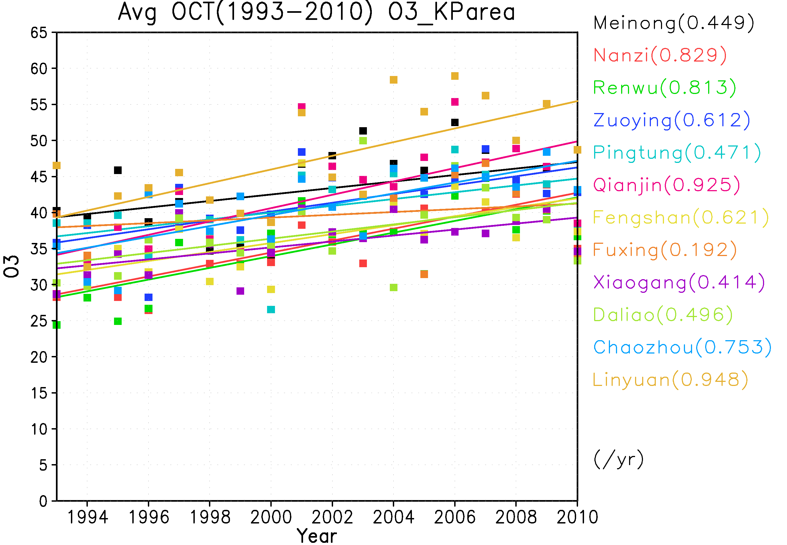
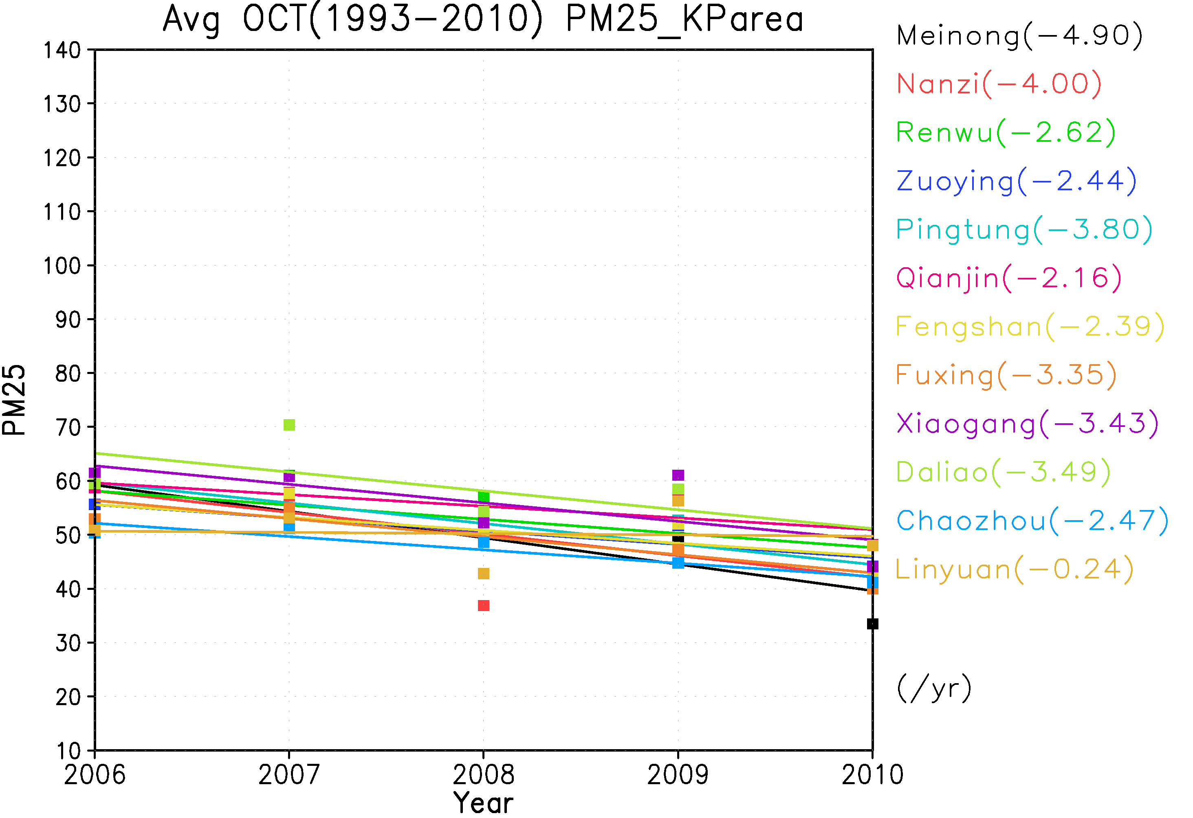
Annual averaged concentrations from 1993 to 2010
NOx
PM₁₀
O₃
PM₂₅
Cheng et al. 2013. Variations of meteorology and air quality in Taiwan due to regional climate changes . To be submitted to Journal of Climatic Changes.

Slide 4
Sensitivity Analysis
In this study, we focus on uncertainties of emissions to understand Taiwan’s O₃ problem through sensitivity analysis.
Traditional brute force method (BFM) has been used to perform sensitivity analysis
High-order decoupled direct method (HDDM) provides an alternative to perform sensitivity analysis by deriving sensitivity coefficient directly from governing equations
Tell how much concentration changes after a emission reduction plan

Slide 5
Sensitivity coefficient (BFM)
C_{base}
Concentration
△C
C_{P}
*Brute Force Method (BFM):
--- C(base), C(perturbation)
△E
E_{P}
E_{base}
Emission

Slide 6
Sensitivity Coefficients (DDM)
explains local sensitivity
C_{base}
Concentration
S⁽¹⁾ > 0
S⁽¹⁾ < 0
S⁽¹⁾ = 0
Emission
E_{base}

Slide 7
Direct Decoupled Method (DDM) 1st-order sensitivity coefficients
CMAQ-DDM
(Hakami et al., 2003)
C_{(+10%)}
△C
C_{(base)}
Concentration
C_{(-10%)}
-△εE_{(base)}
△εE_{(base)}
△E
Emission
E_{(-10%)}
E_{(base)}
E_{(+10%)}

Slide 8
CMAQ-HDDM 2nd-order sensitivity coefficients
C_{(+10%)}
△C
C_{(base)}
Concentration
C_{(-10%)}
-△εE_{(base)}
△εE_{(base)}
△E
Emission
E_{(-10%)}
E_{(base)}
E_{(+10%)}

Slide 9
Objective
Investigate O₃ sensitivities with respect to its emissions
Understand source contribution to Taiwan’s O₃ concentration
Identify source-receptor relationships to explain high O₃ concentration in Taiwan
Build an effective emission control strategy to reduce Taiwan’s high O₃ concentrations
Methodology
Apply CMAQ-HDDM for two high O₃ episode
--- a. 2011 Oct 23 (strong northeasterly monsoonal flow)
--- b. 2012 Sep 12 (strong land-sea breeze day)

Slide 10
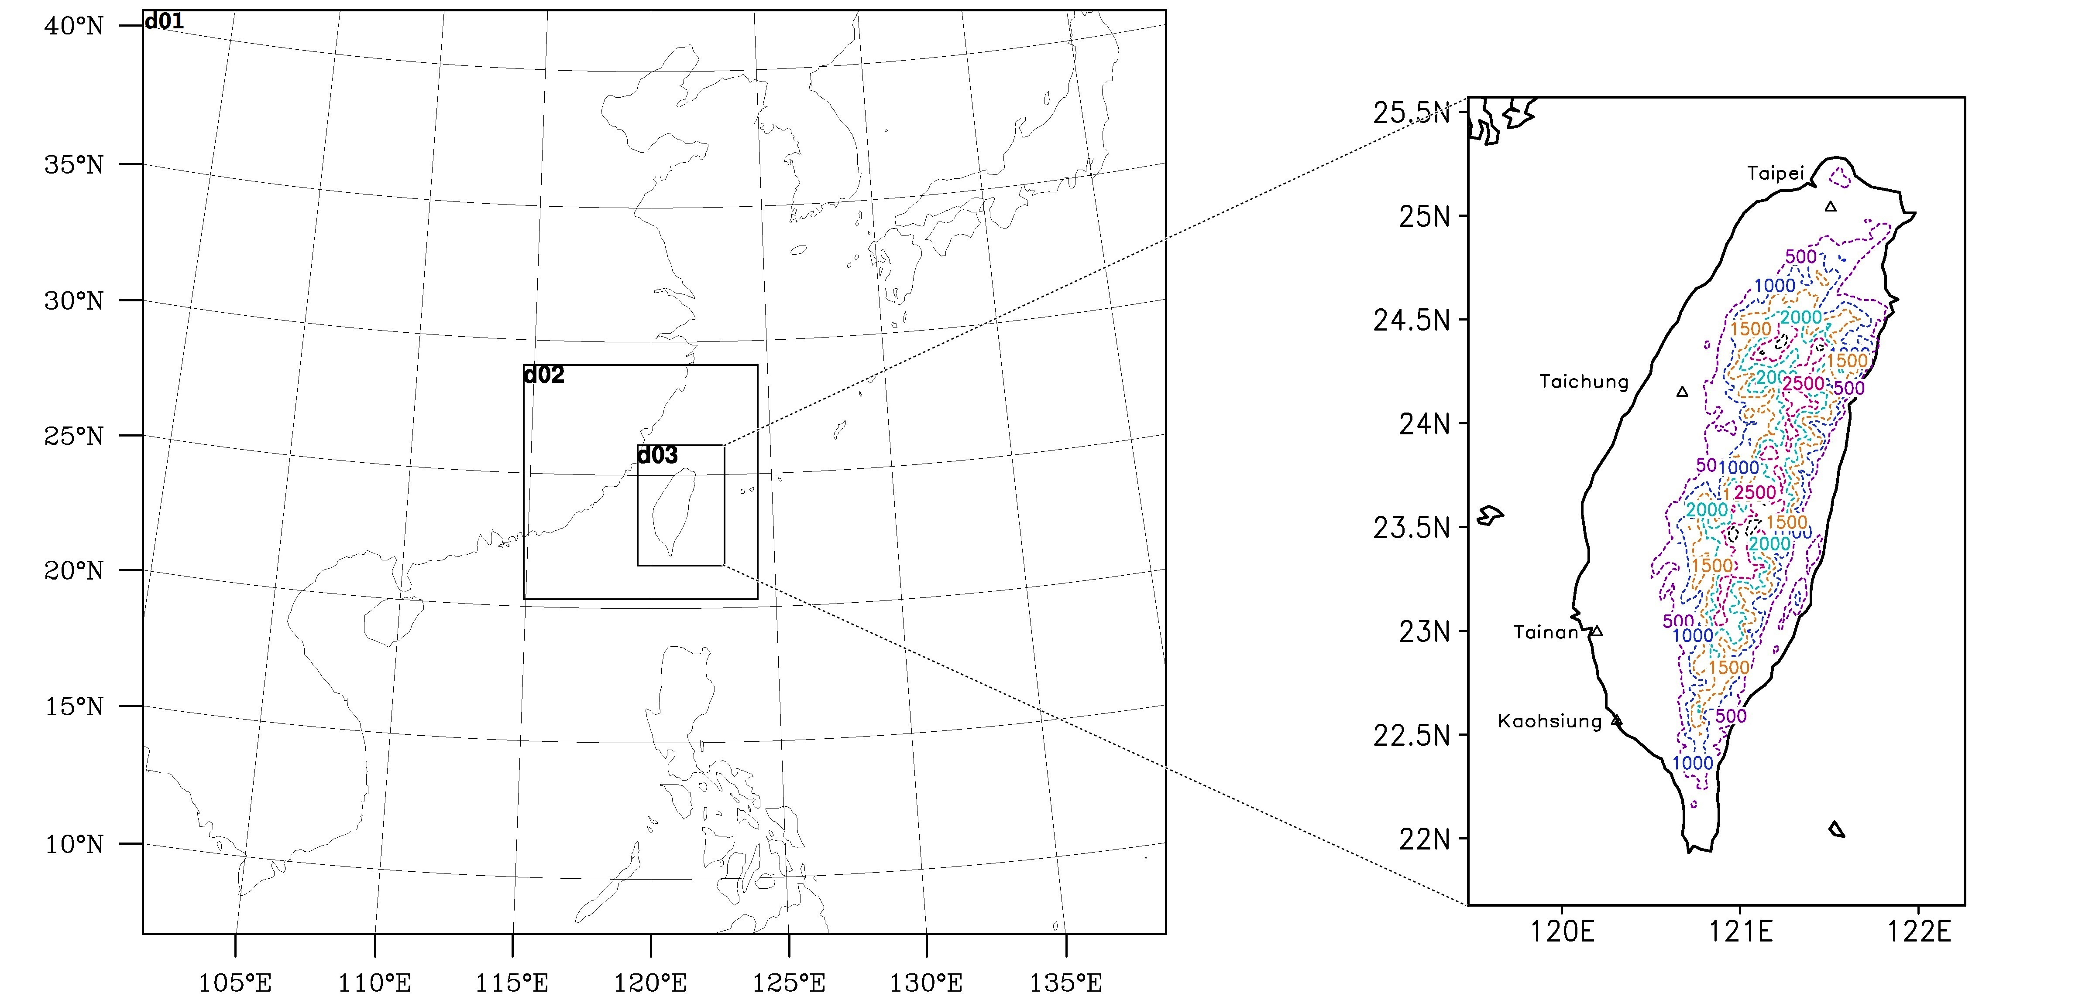
Model Configuration
WRFv3.5 with spatial resolution 27, 9, 3-km
Anthropogenic emission were prepared using 2007 Taiwan Emission Data System version 7.0
Biogenic emissions were prepared using MEGAN model system
CB05 chemical mechanism/AERO5 aerosol module
CMAQ-HDDM v4.7.1 (focus on 3-km domain)
Notes:
that includes point, line and area emission sources.
Gas-phase chemistry utilizes CB05 chemical mechanism.

Slide 11
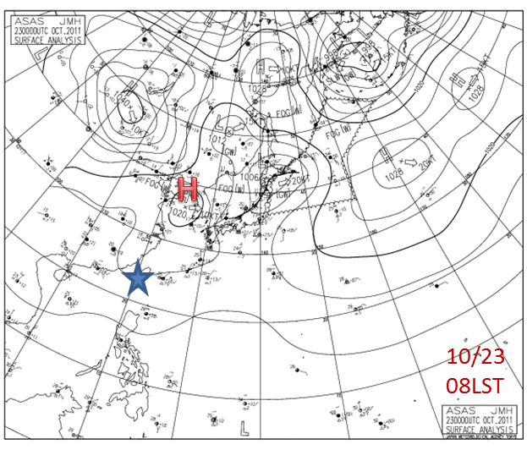
2011 Oct 23 0800 LST

Slide 12
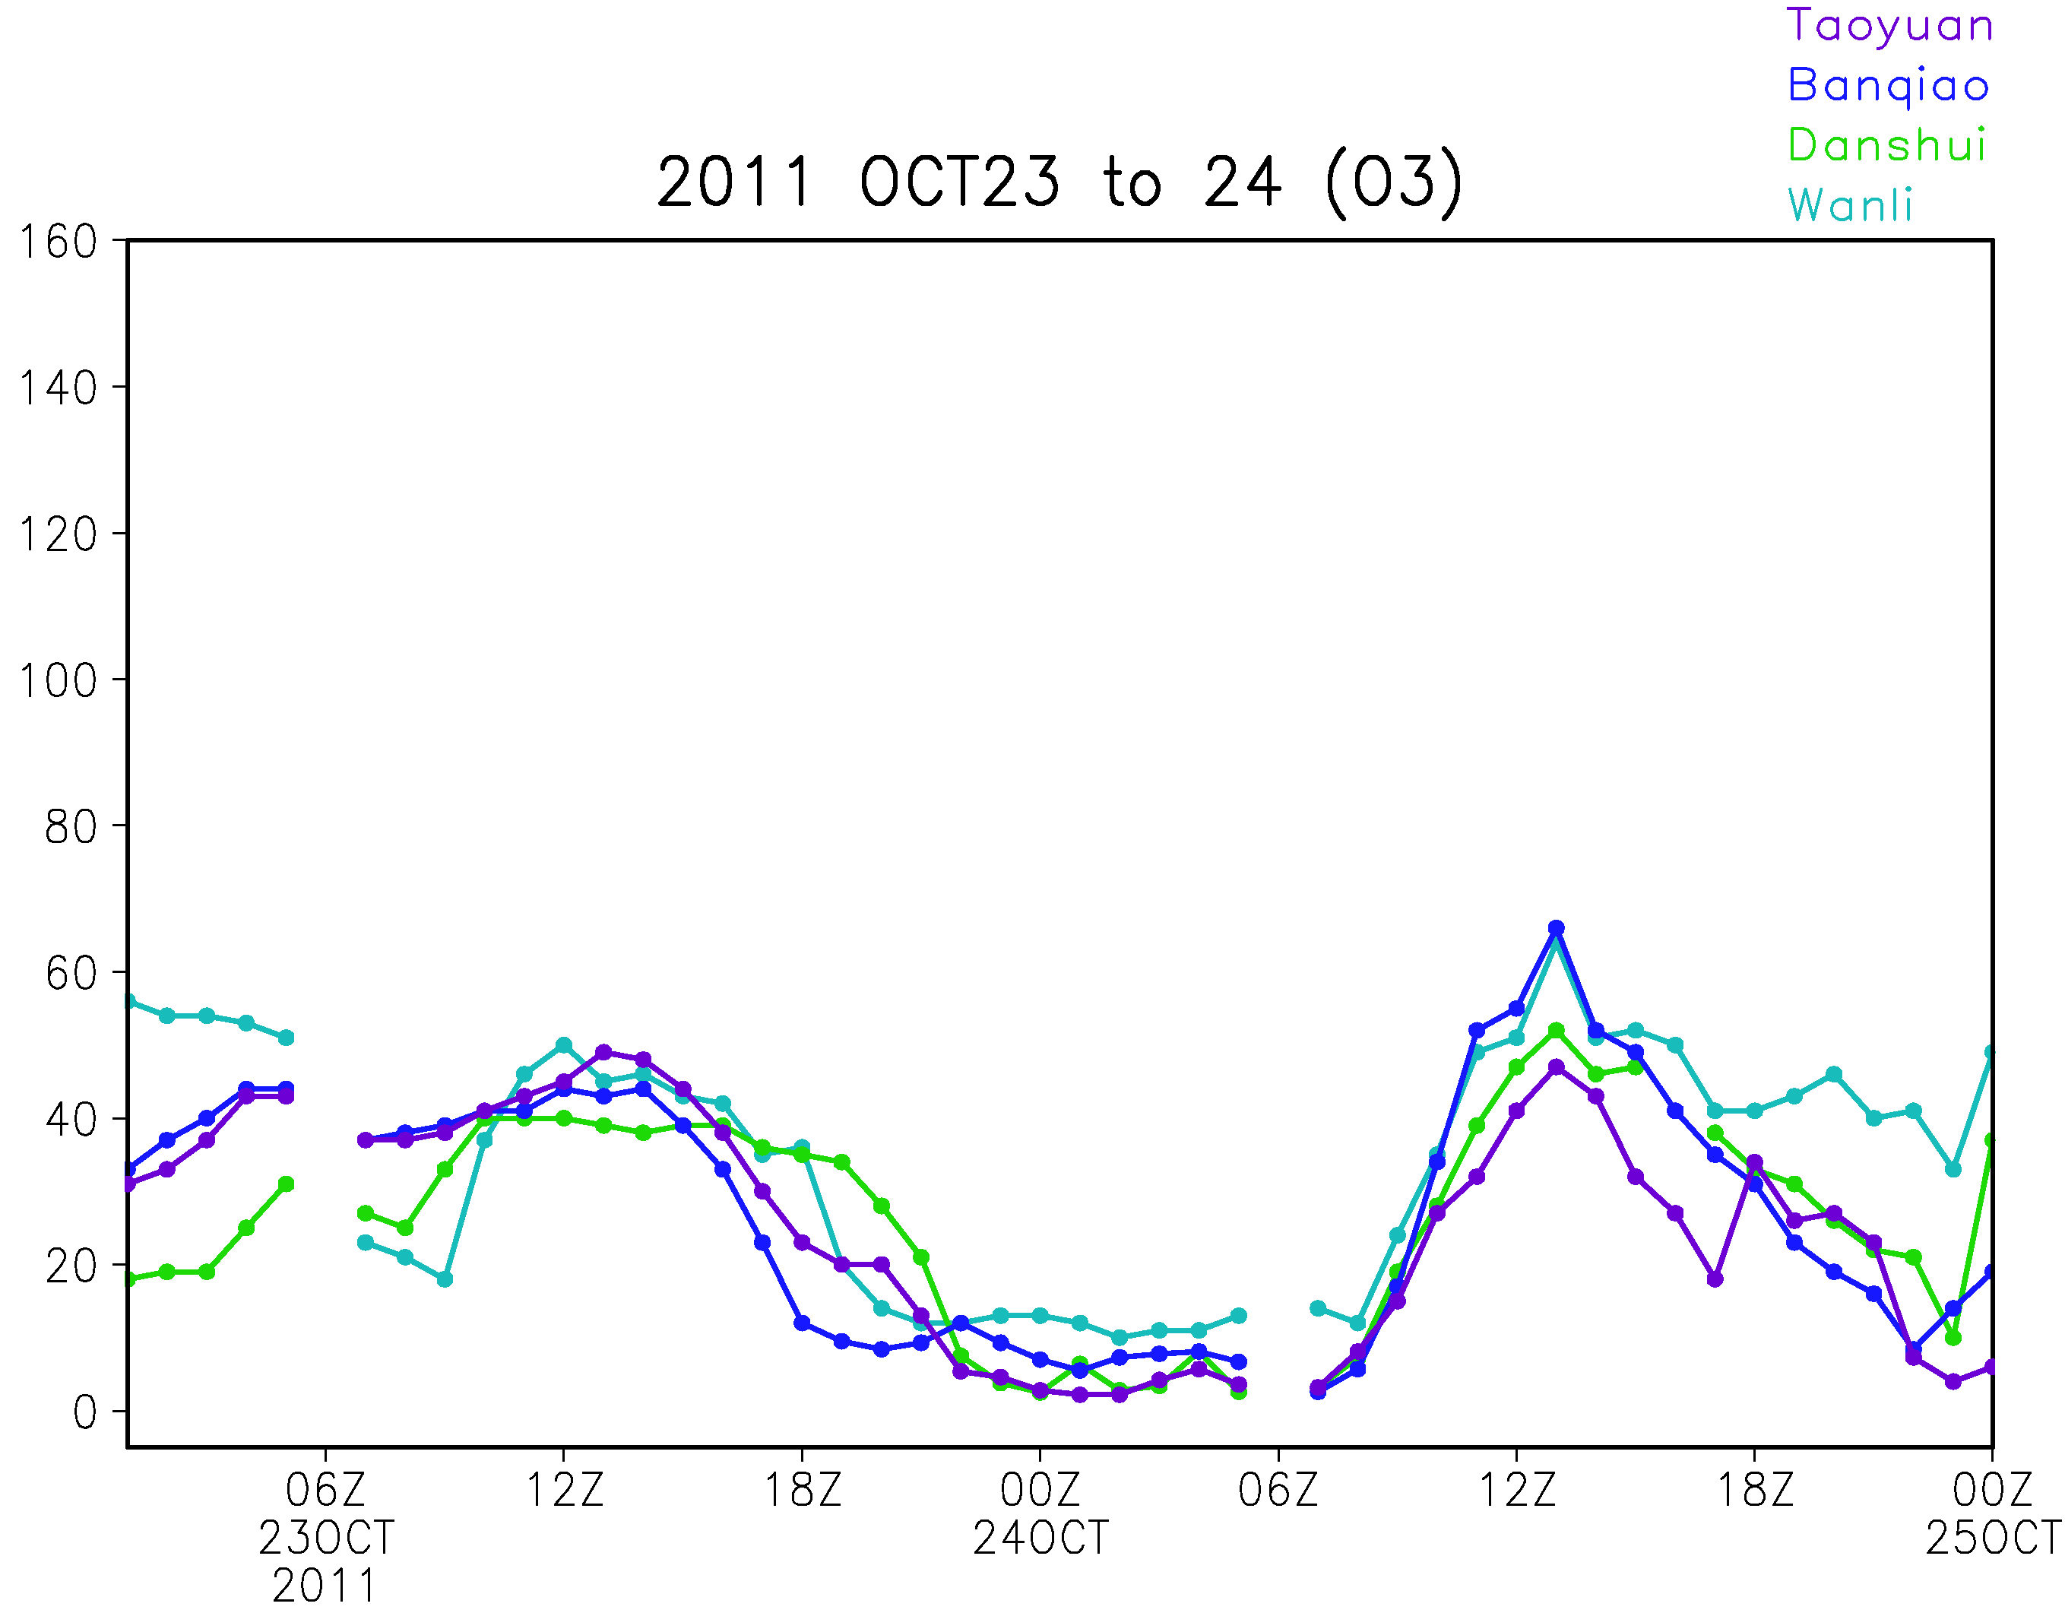
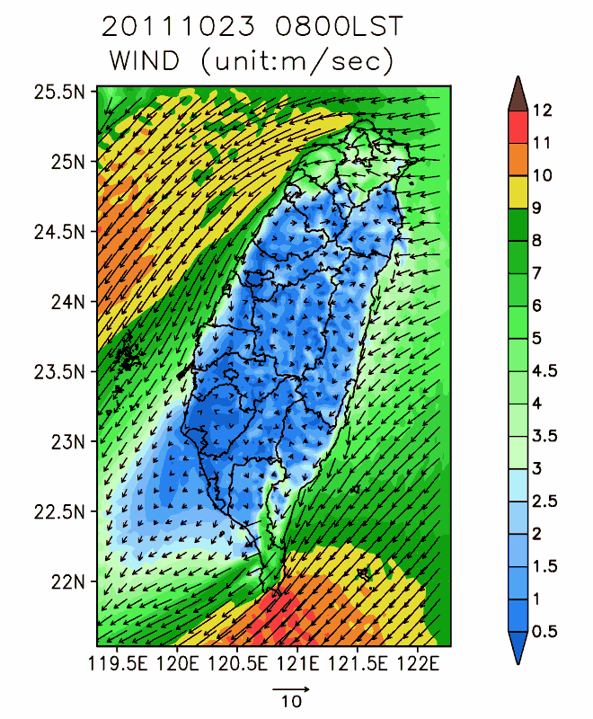
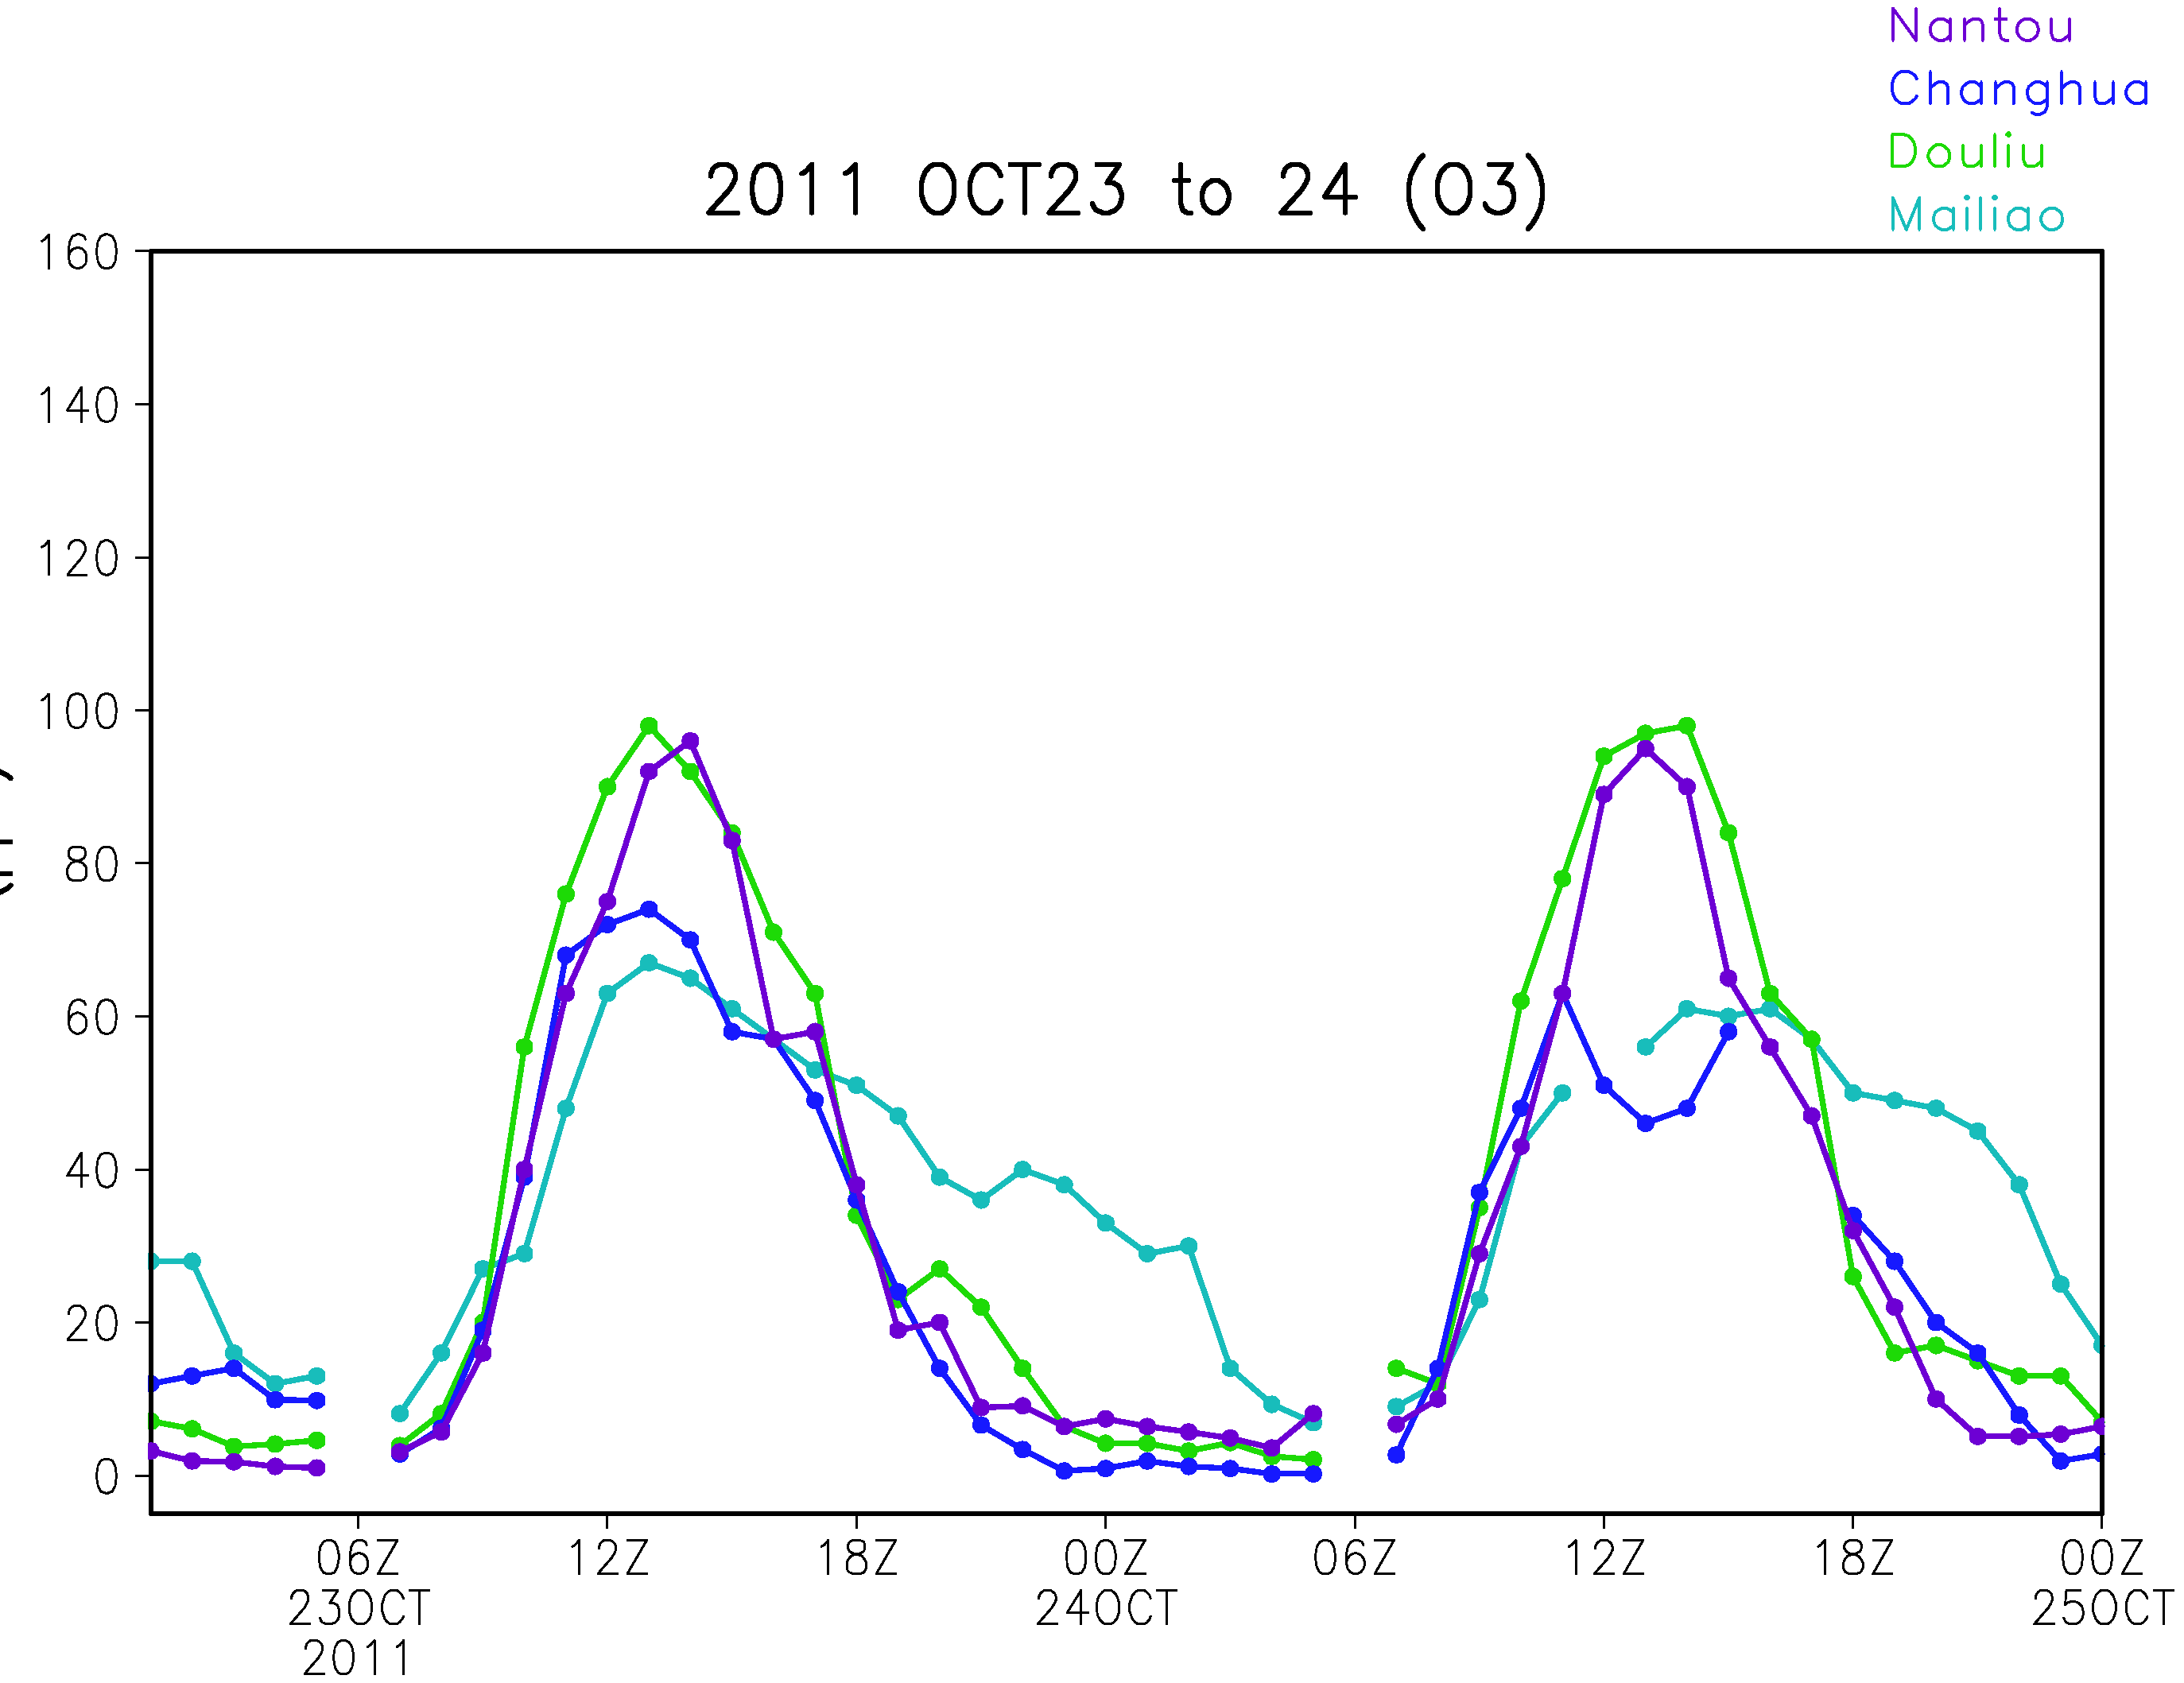
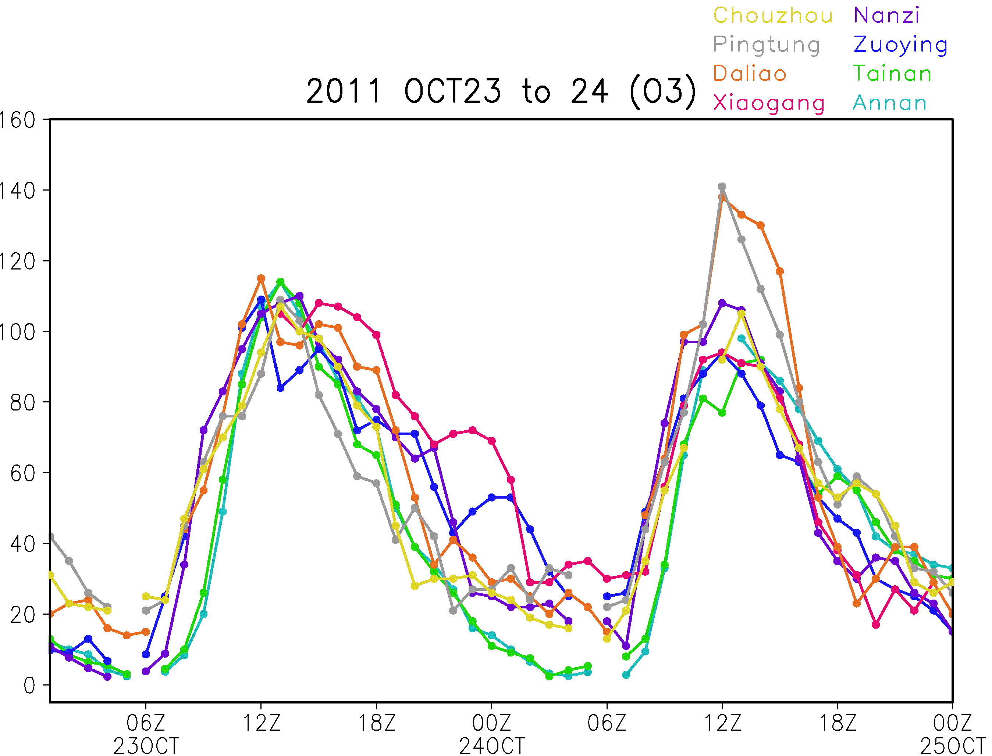
Observed O₃
North
Wind field
Oct 23
Central
South

Slide 13
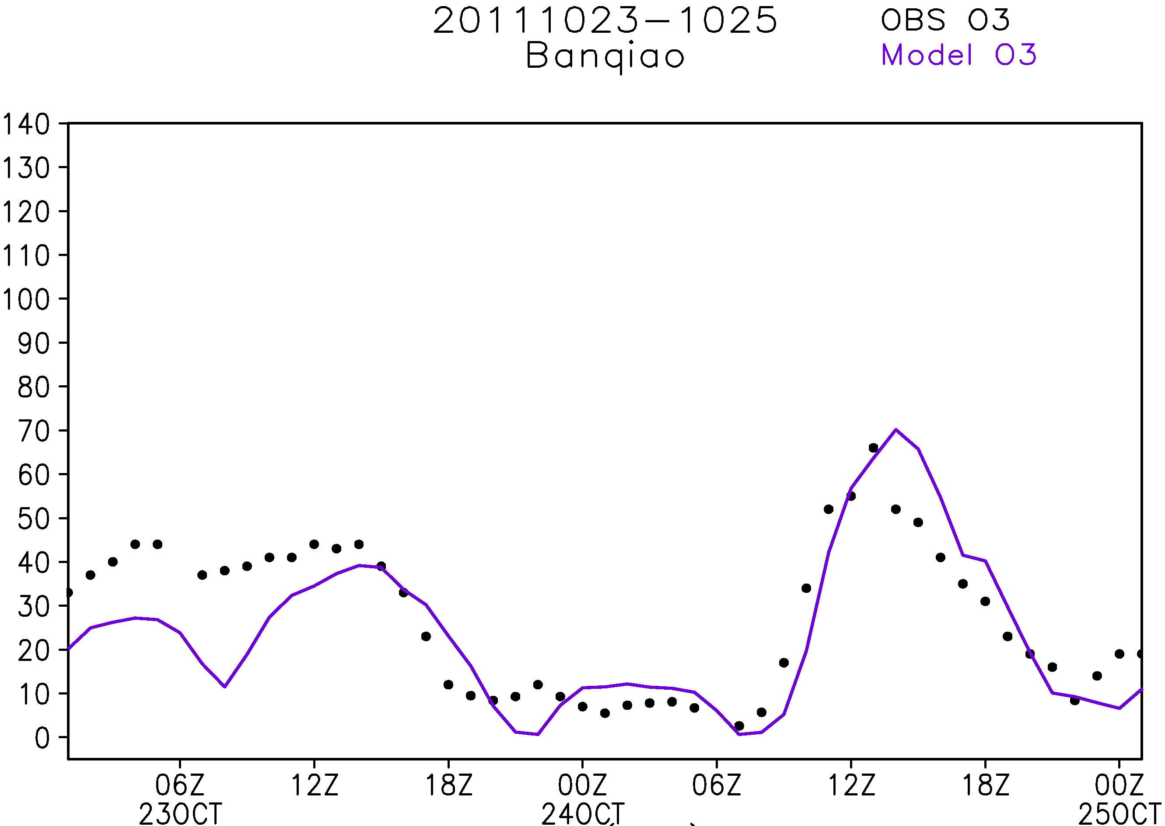
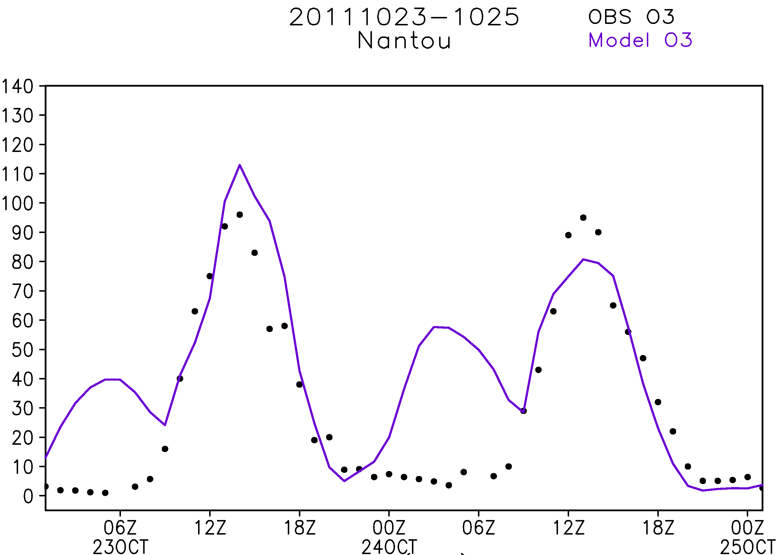
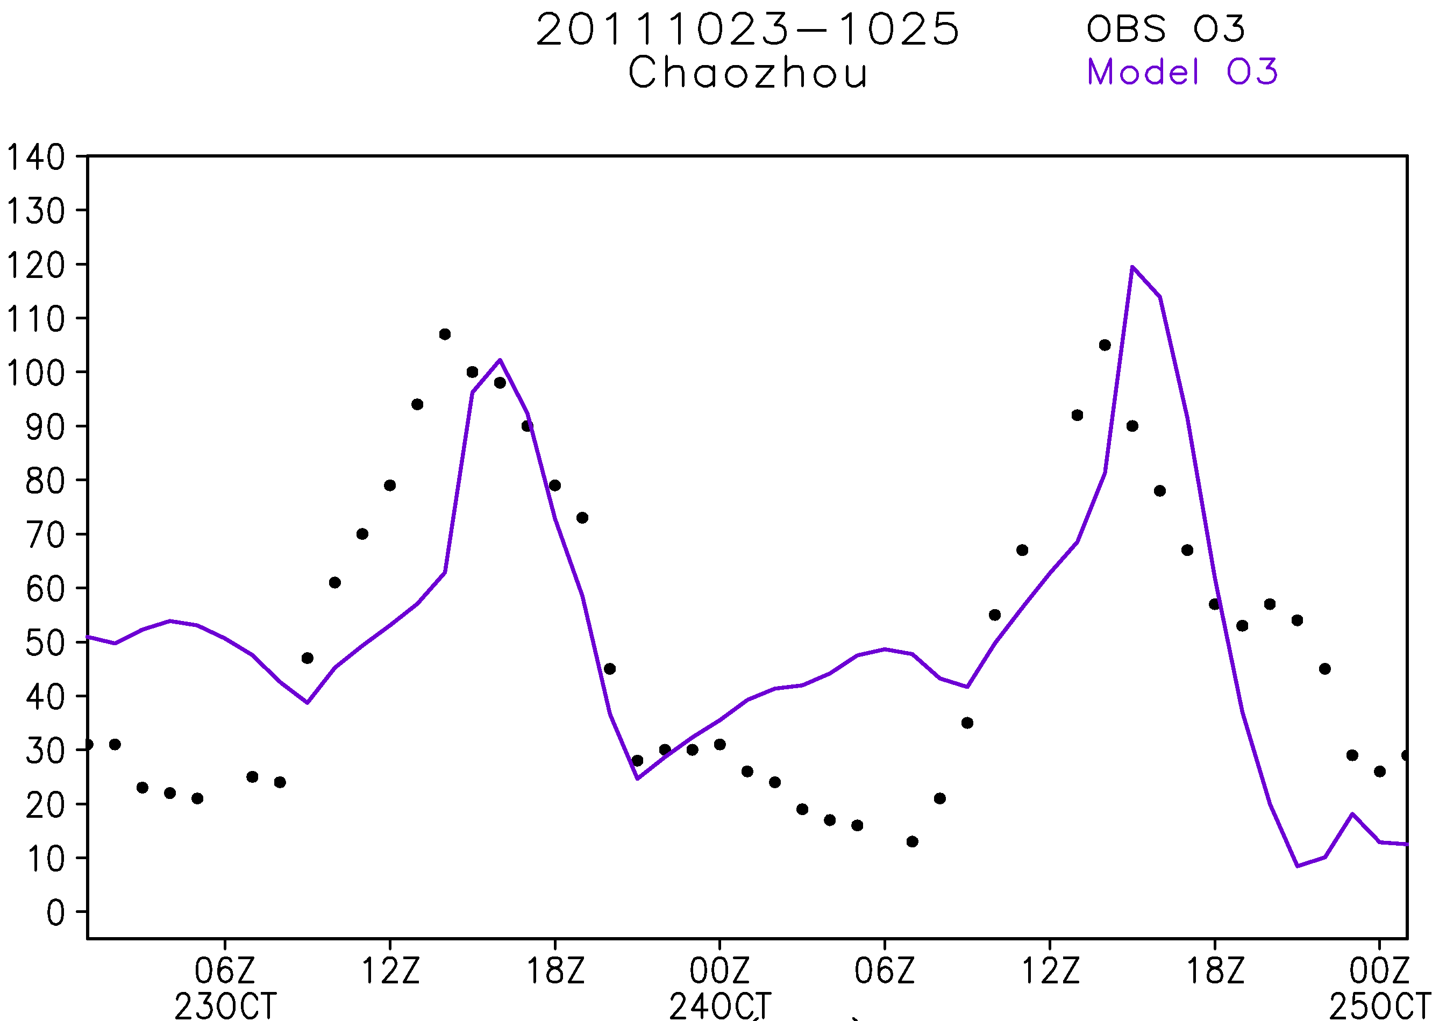
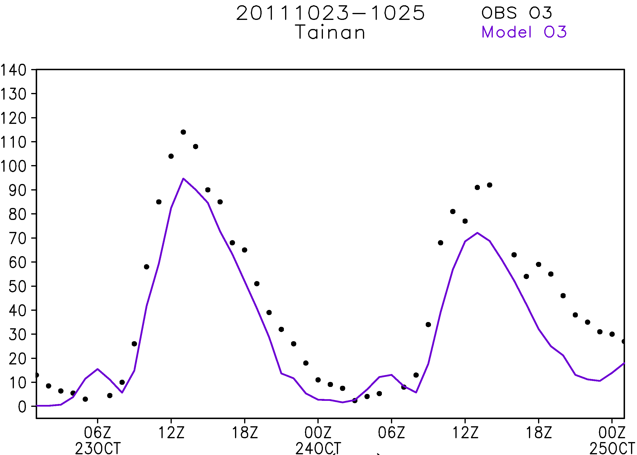
O₃ comparison with observed data

Slide 14
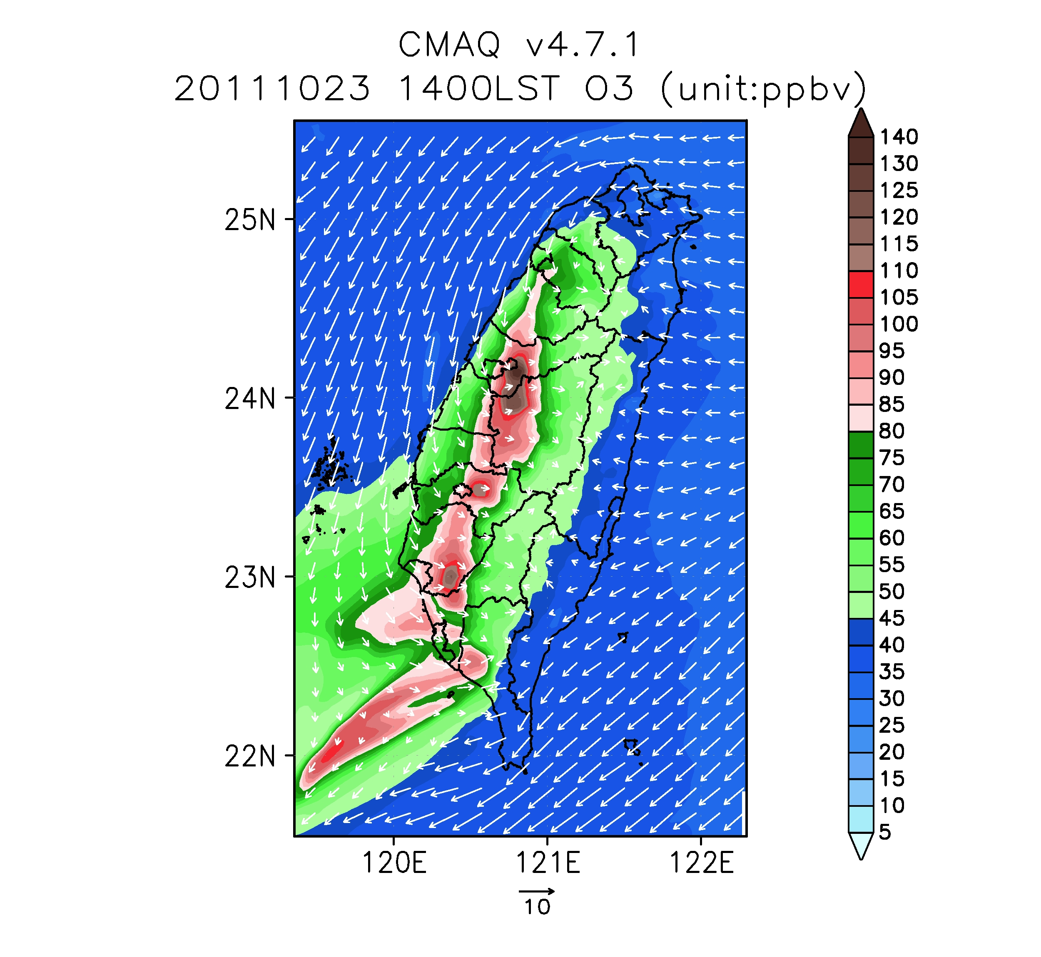
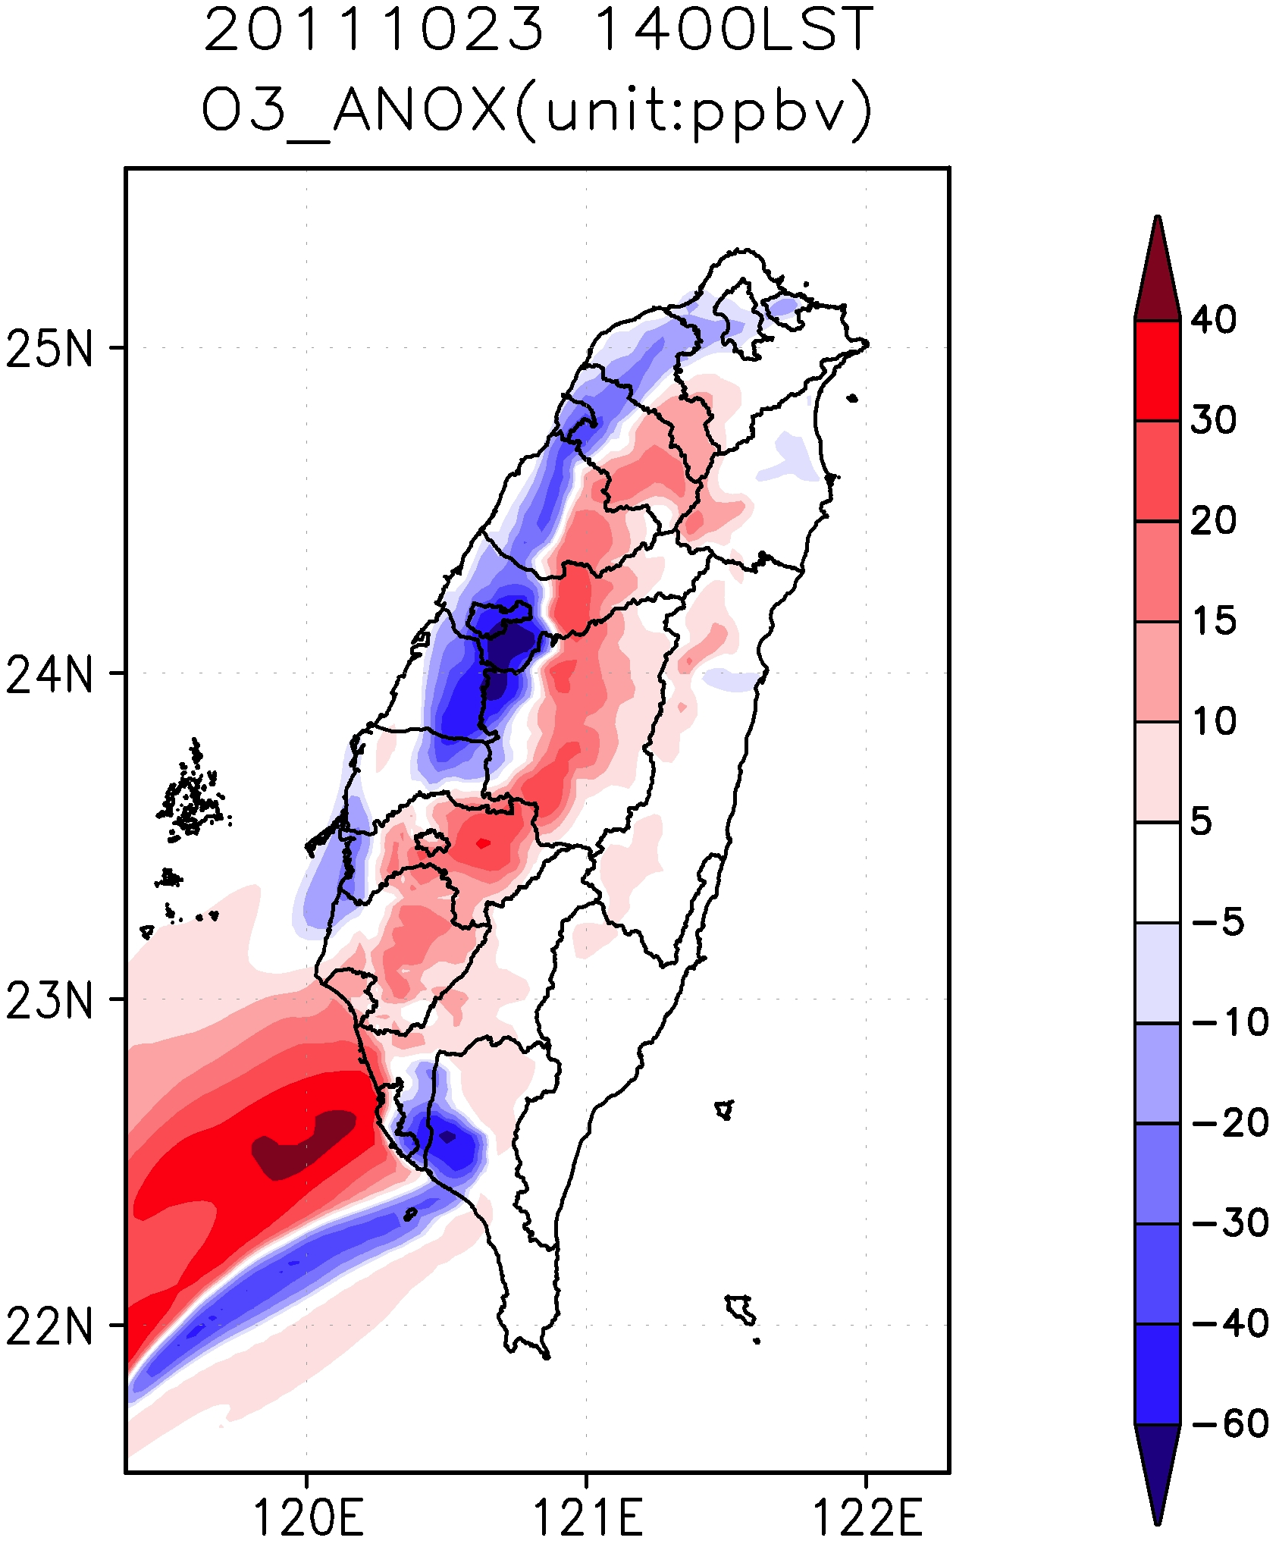
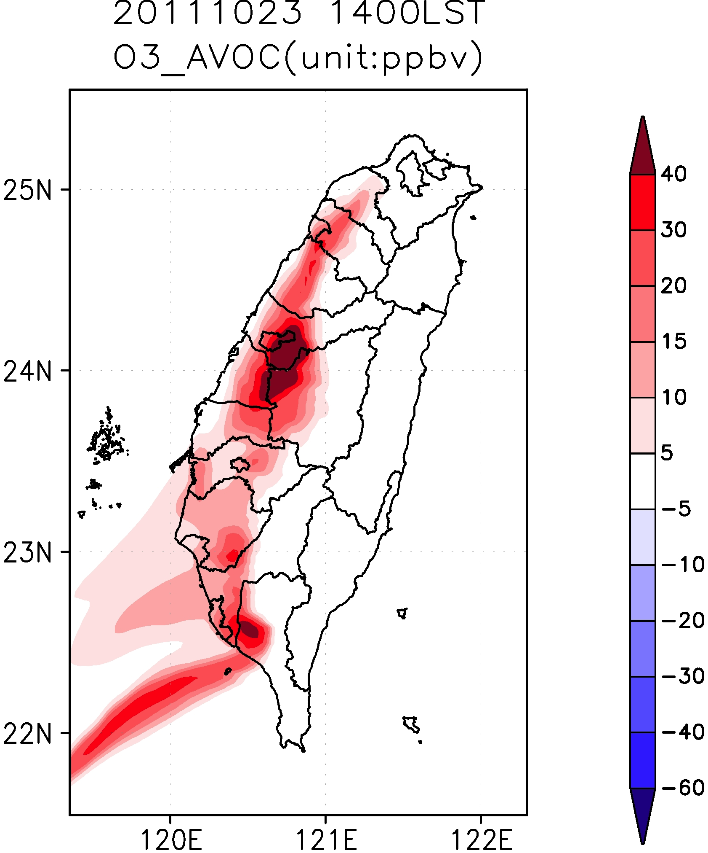
O₃
O₃
Emissions
NOx VOC
aNOx
aVOC
1st order O₃ sensitivity
Notes:
Color scale of red and above indicate o3 exceedance.
For high Nox areas, Nox disbenefit occurs for most of urban areas.
A positive Nox sensitivity in downwind areas indicating control nox is efficient.
For sensitivity to VOC, it is always positive.

Slide 15
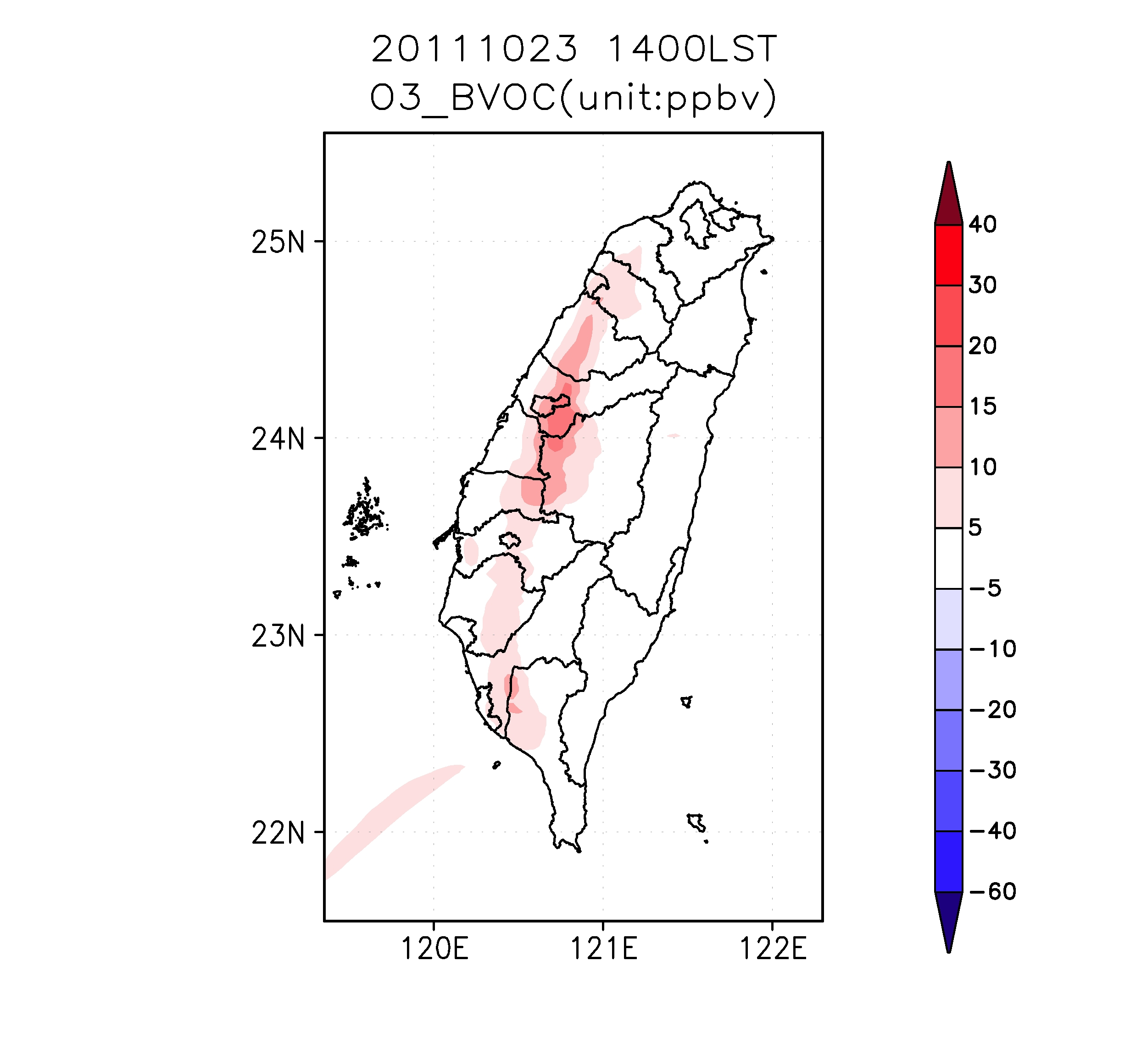
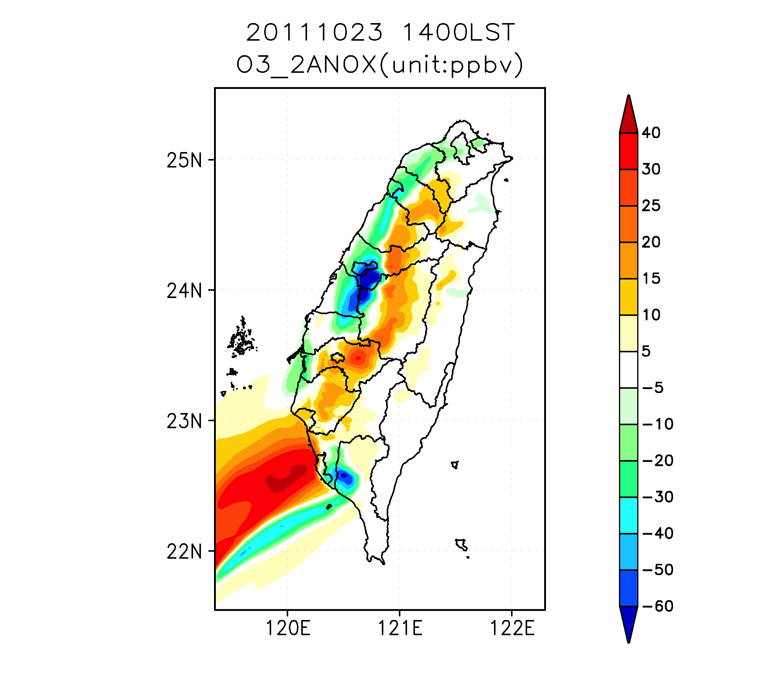
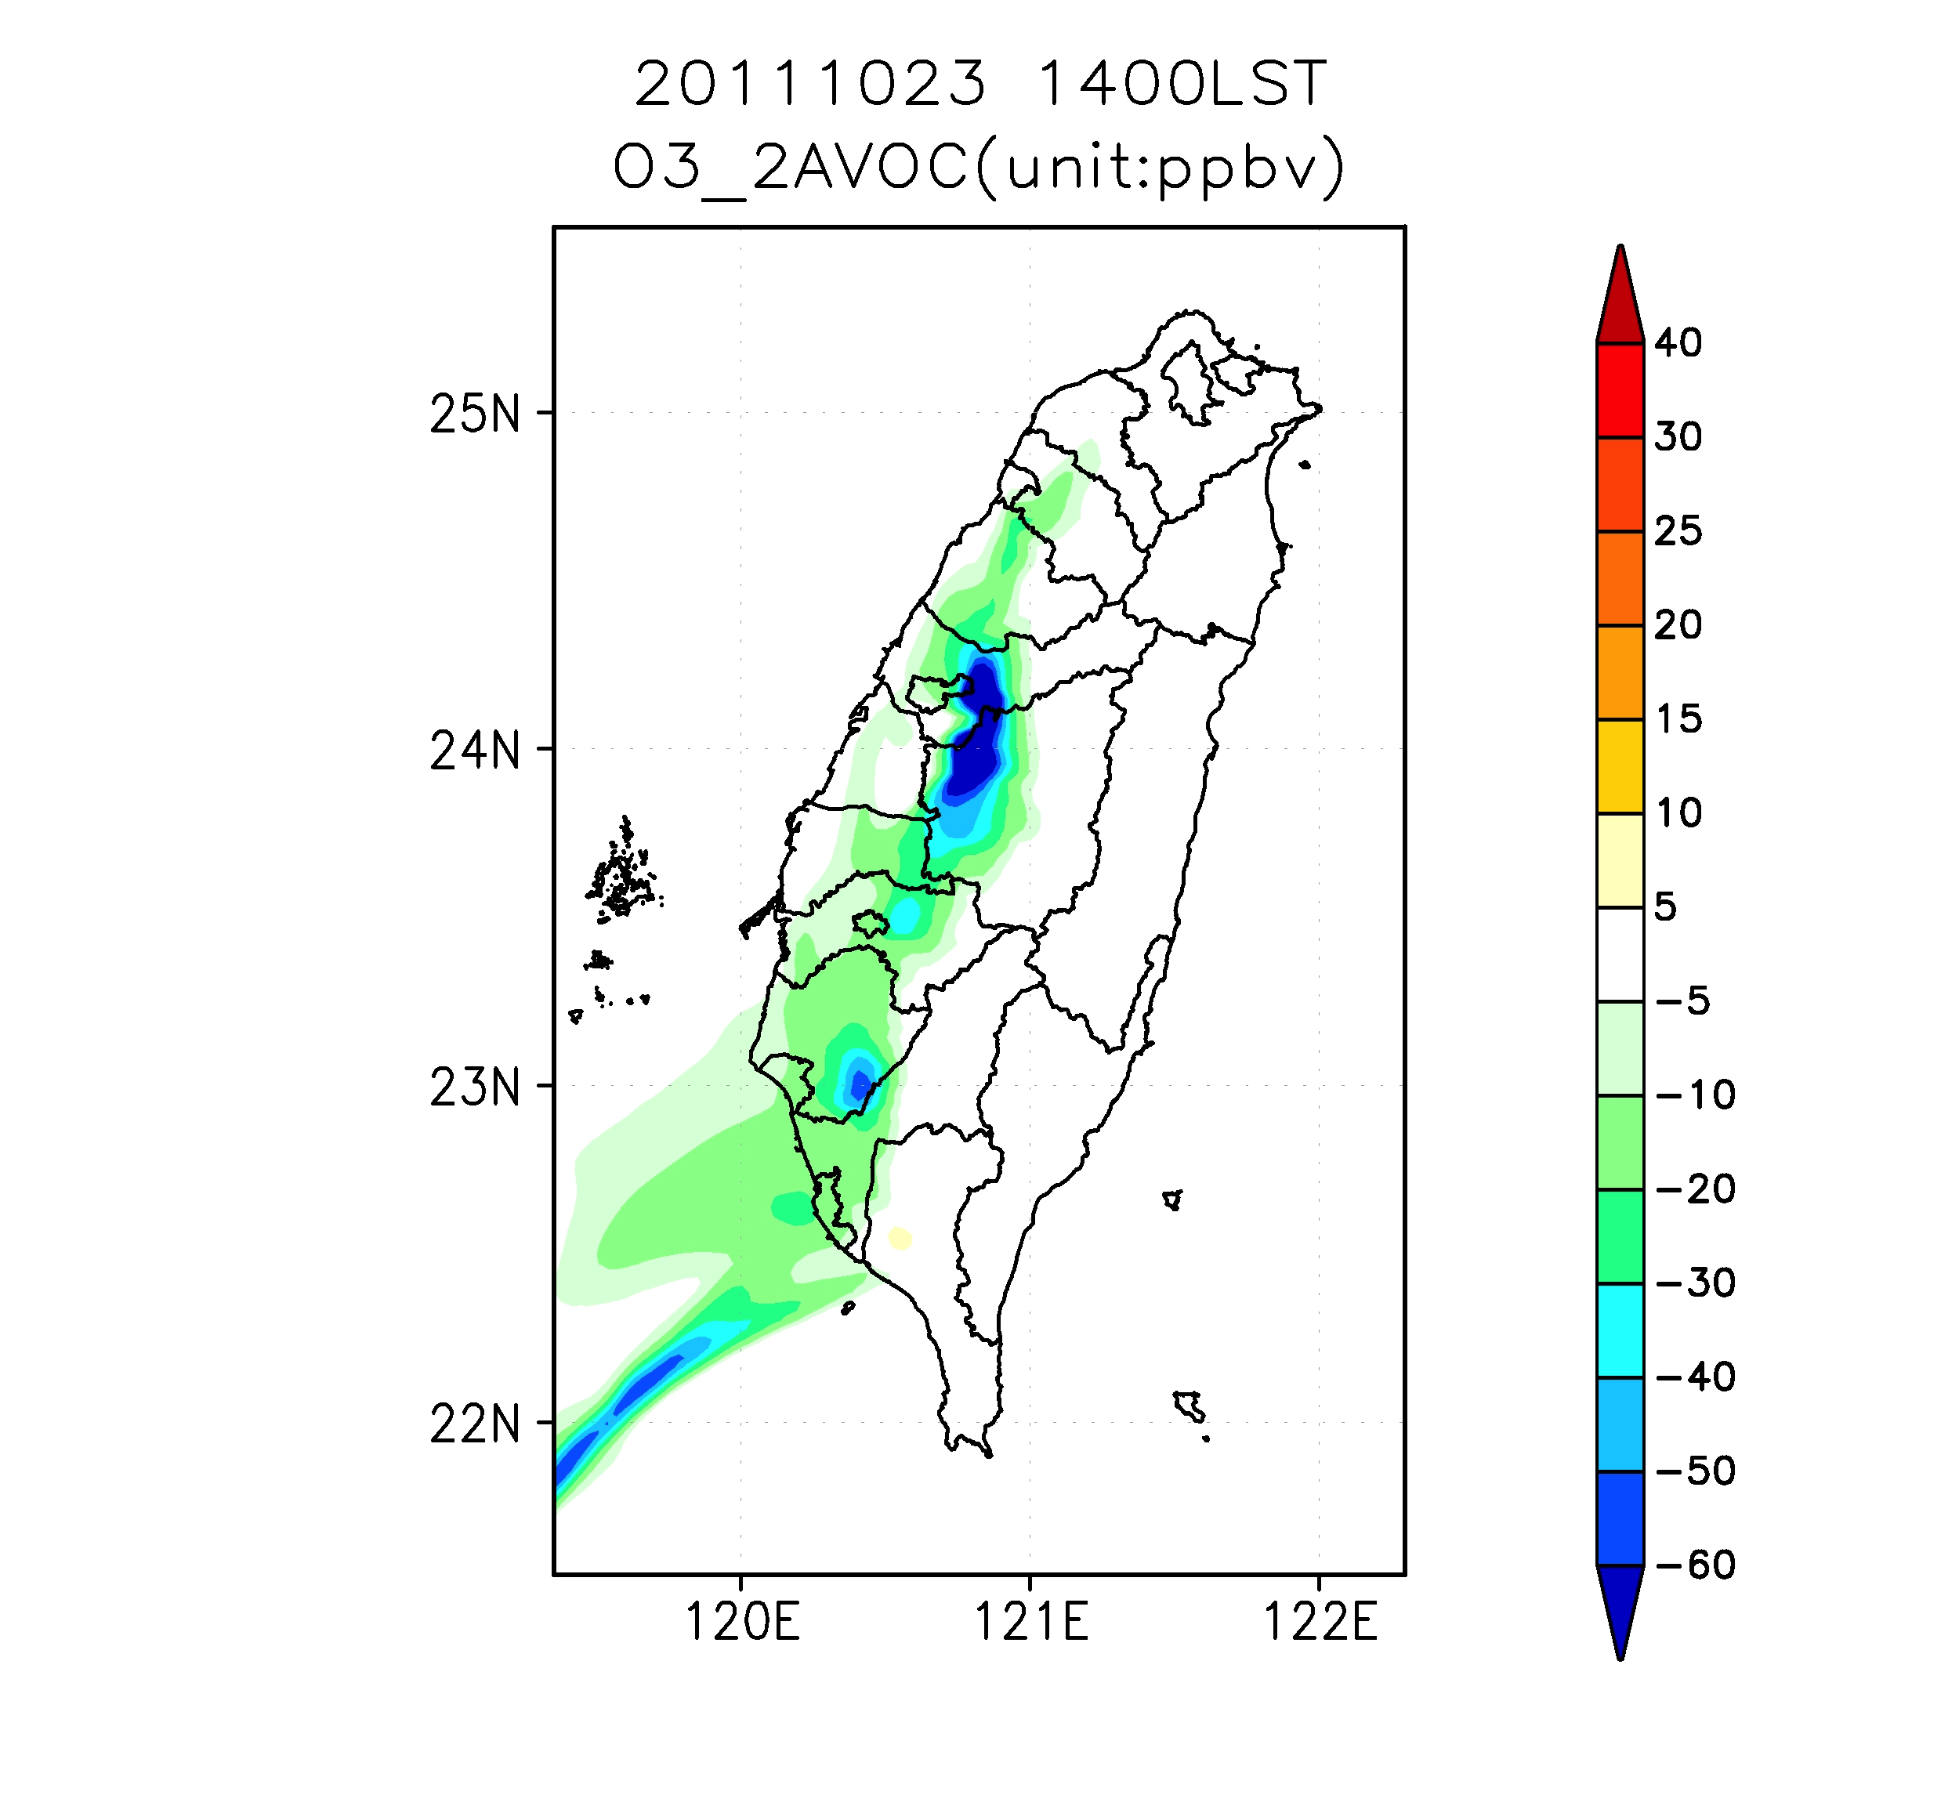
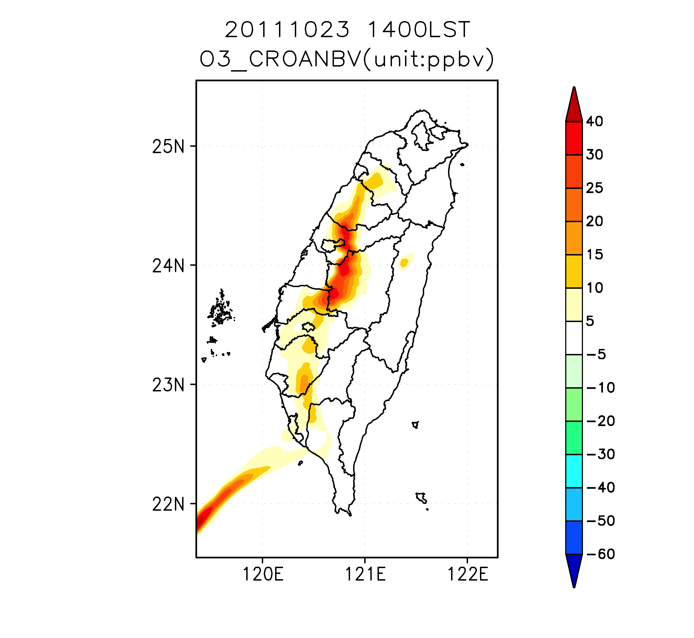
1st & 2nd order O₃ sensitivity
aNOx
aVOC
bVOC
Landuse
aNbV

Slide 16
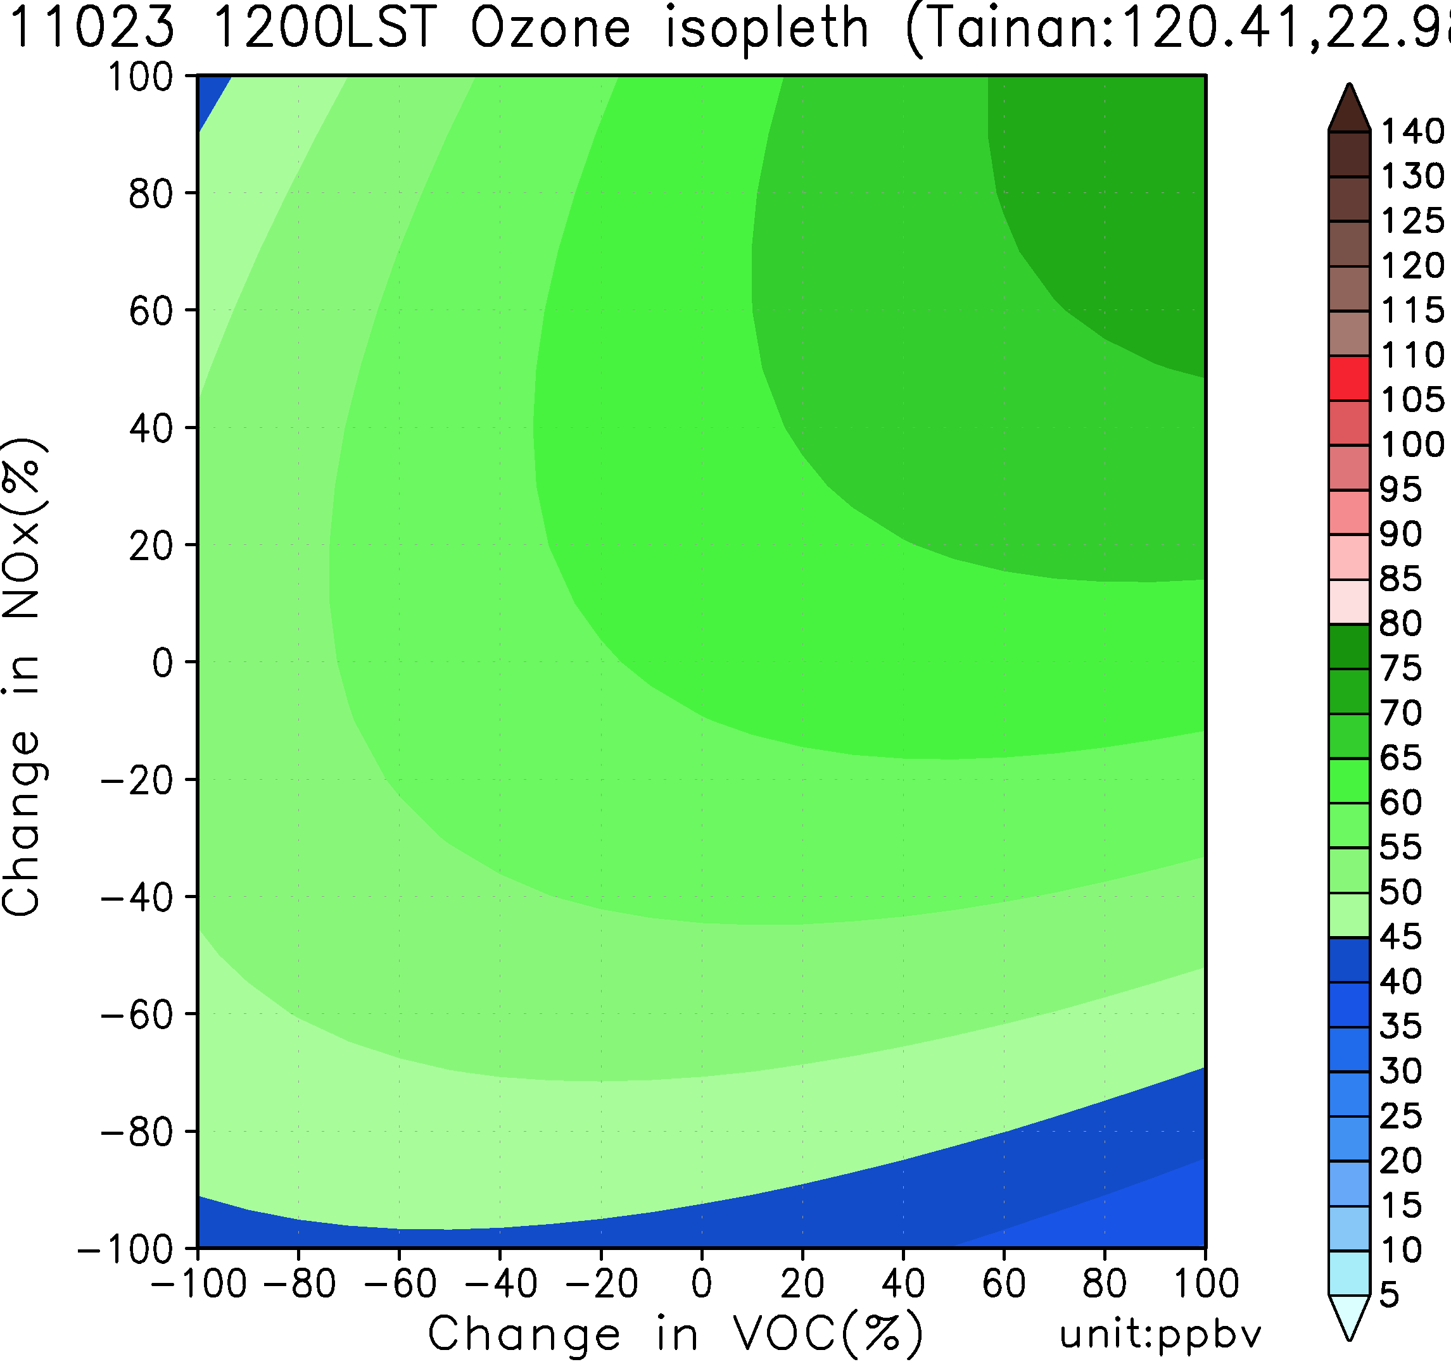
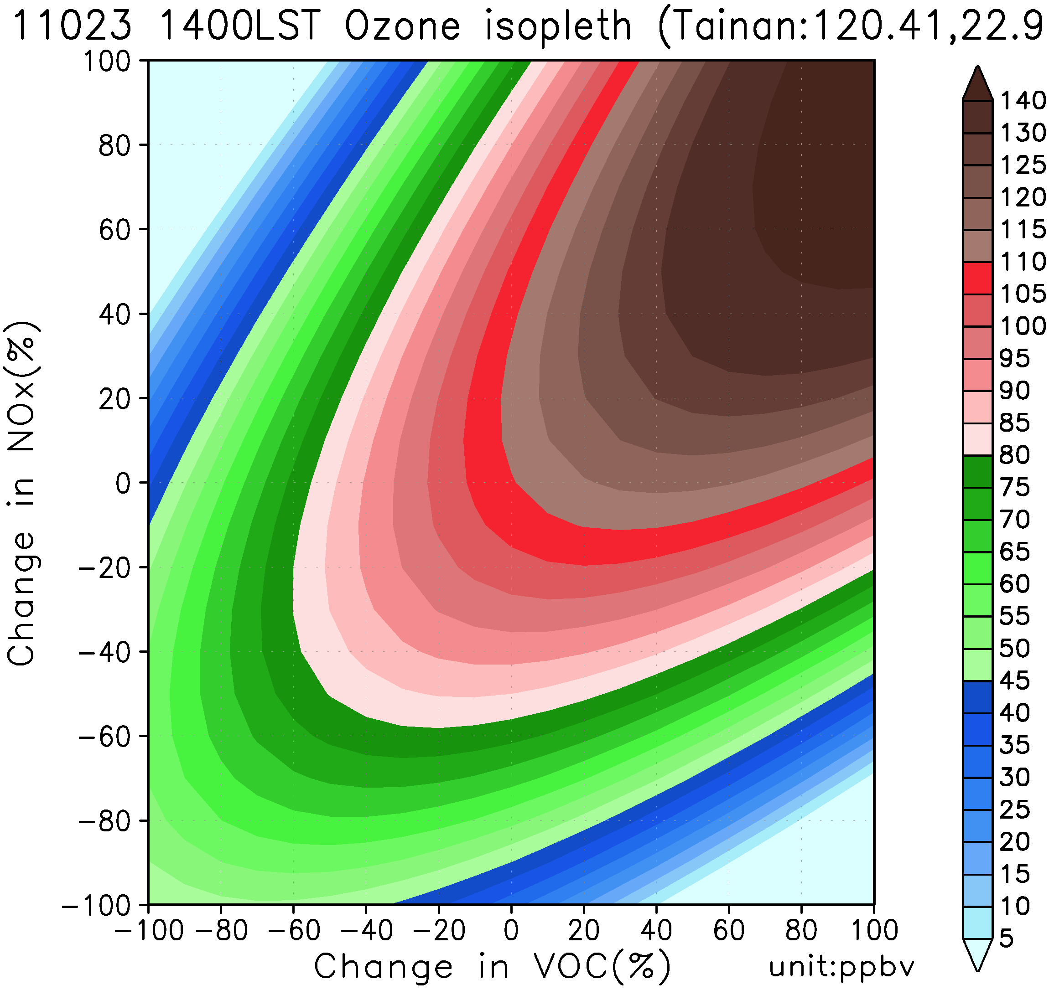
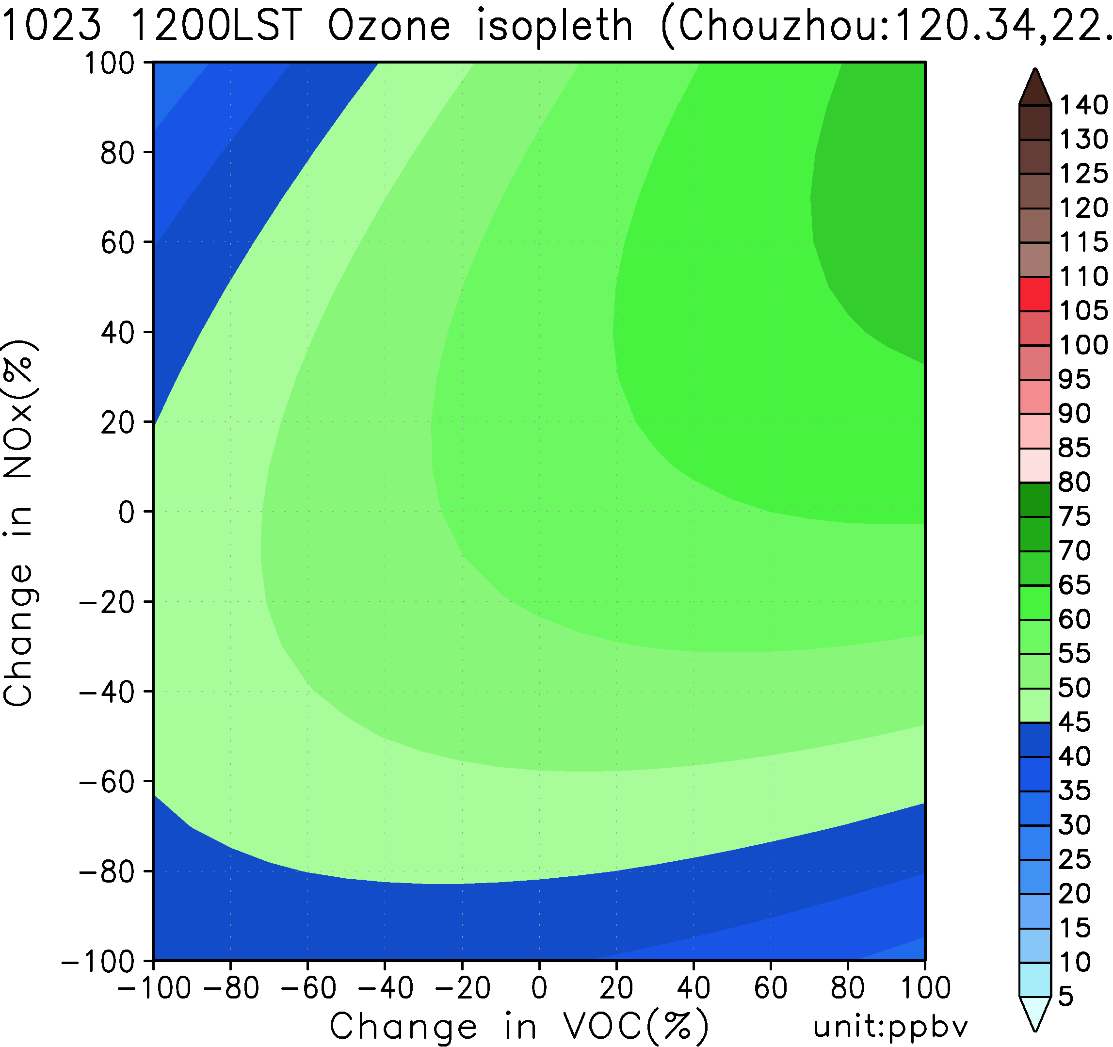
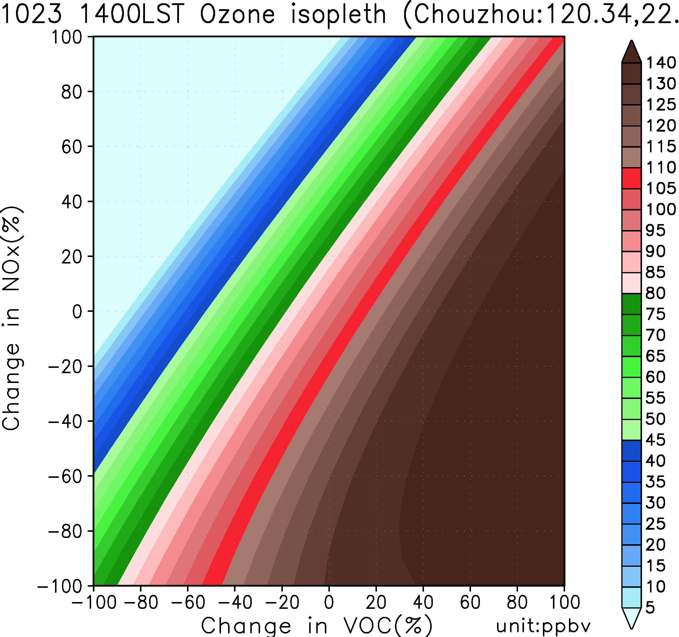
O₃ isopleth

Slide 17
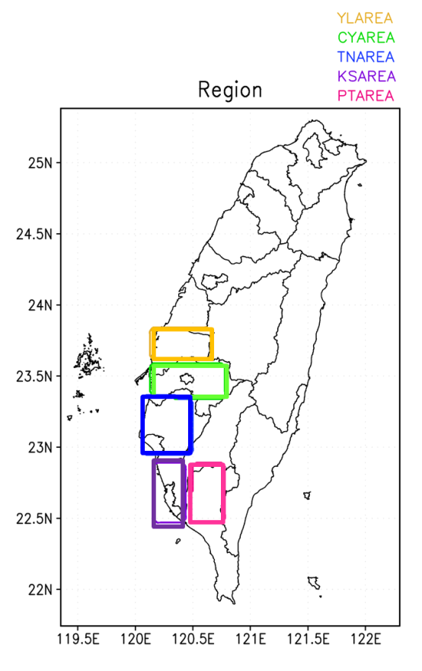
Source Contributions (zero out concentration)
Sensitivity
S¹ YFNOX S² TTSNOX
CFNOX KKSNOX
TFNOX PPSNOX
KFNOX
PFNOX S^{2CROSS} YKCRONOX
YPCRONOX
* same as VOC

Slide 18
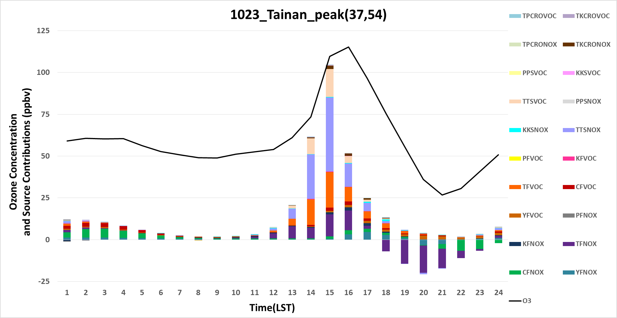
Oct 23 peak O₃ ZOC time series
2nd order NOx
1st order VOC
1st order NOx
Notes:
Ozone Background Value: 35ppb
The cross effect is more pronounced during the daytime (No.1: TKCRONOX)

Slide 19
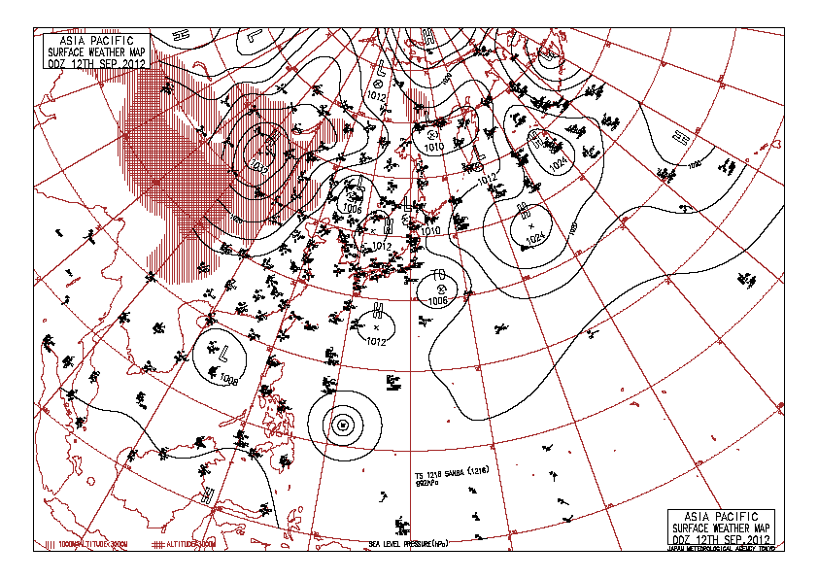
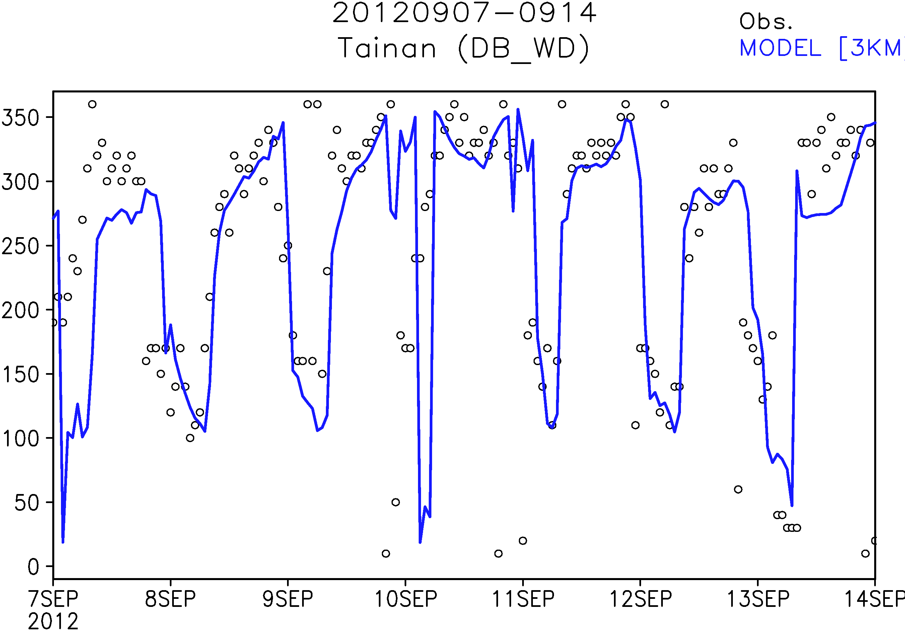
2012 Sep 12 0800 LST
0912 00UTC

Slide 20
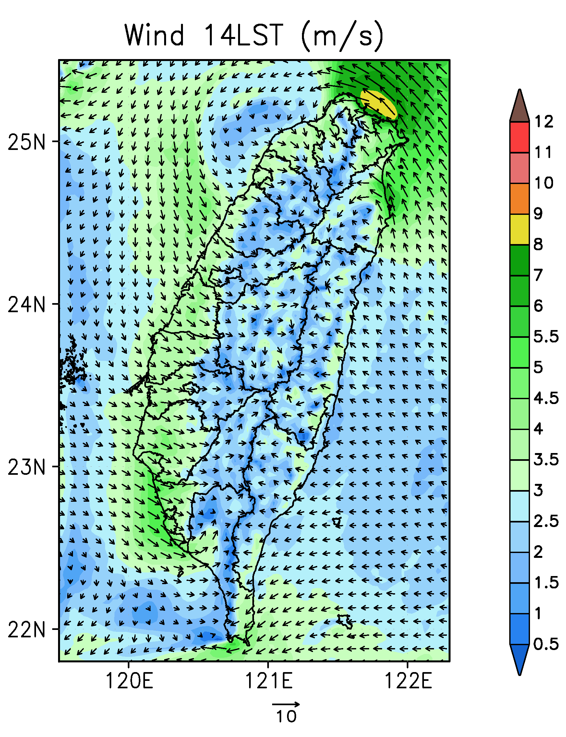
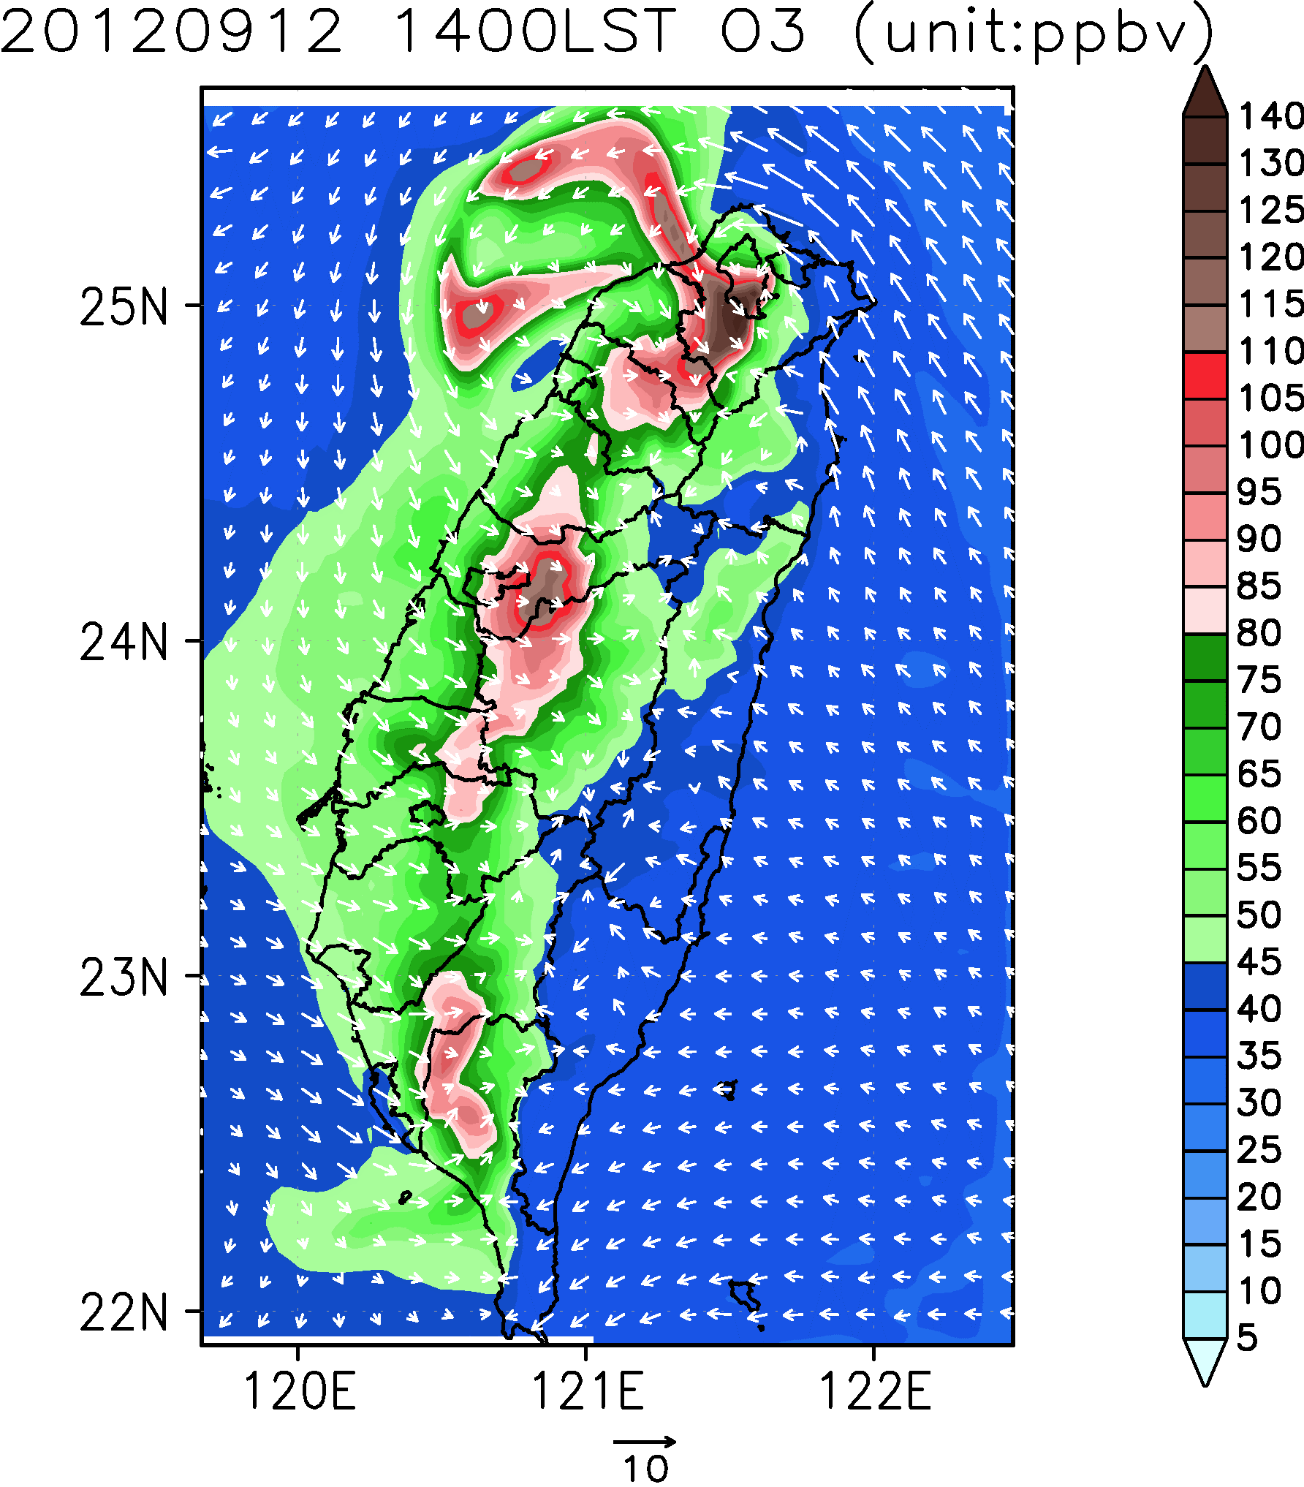
Wind
O₃

Slide 21
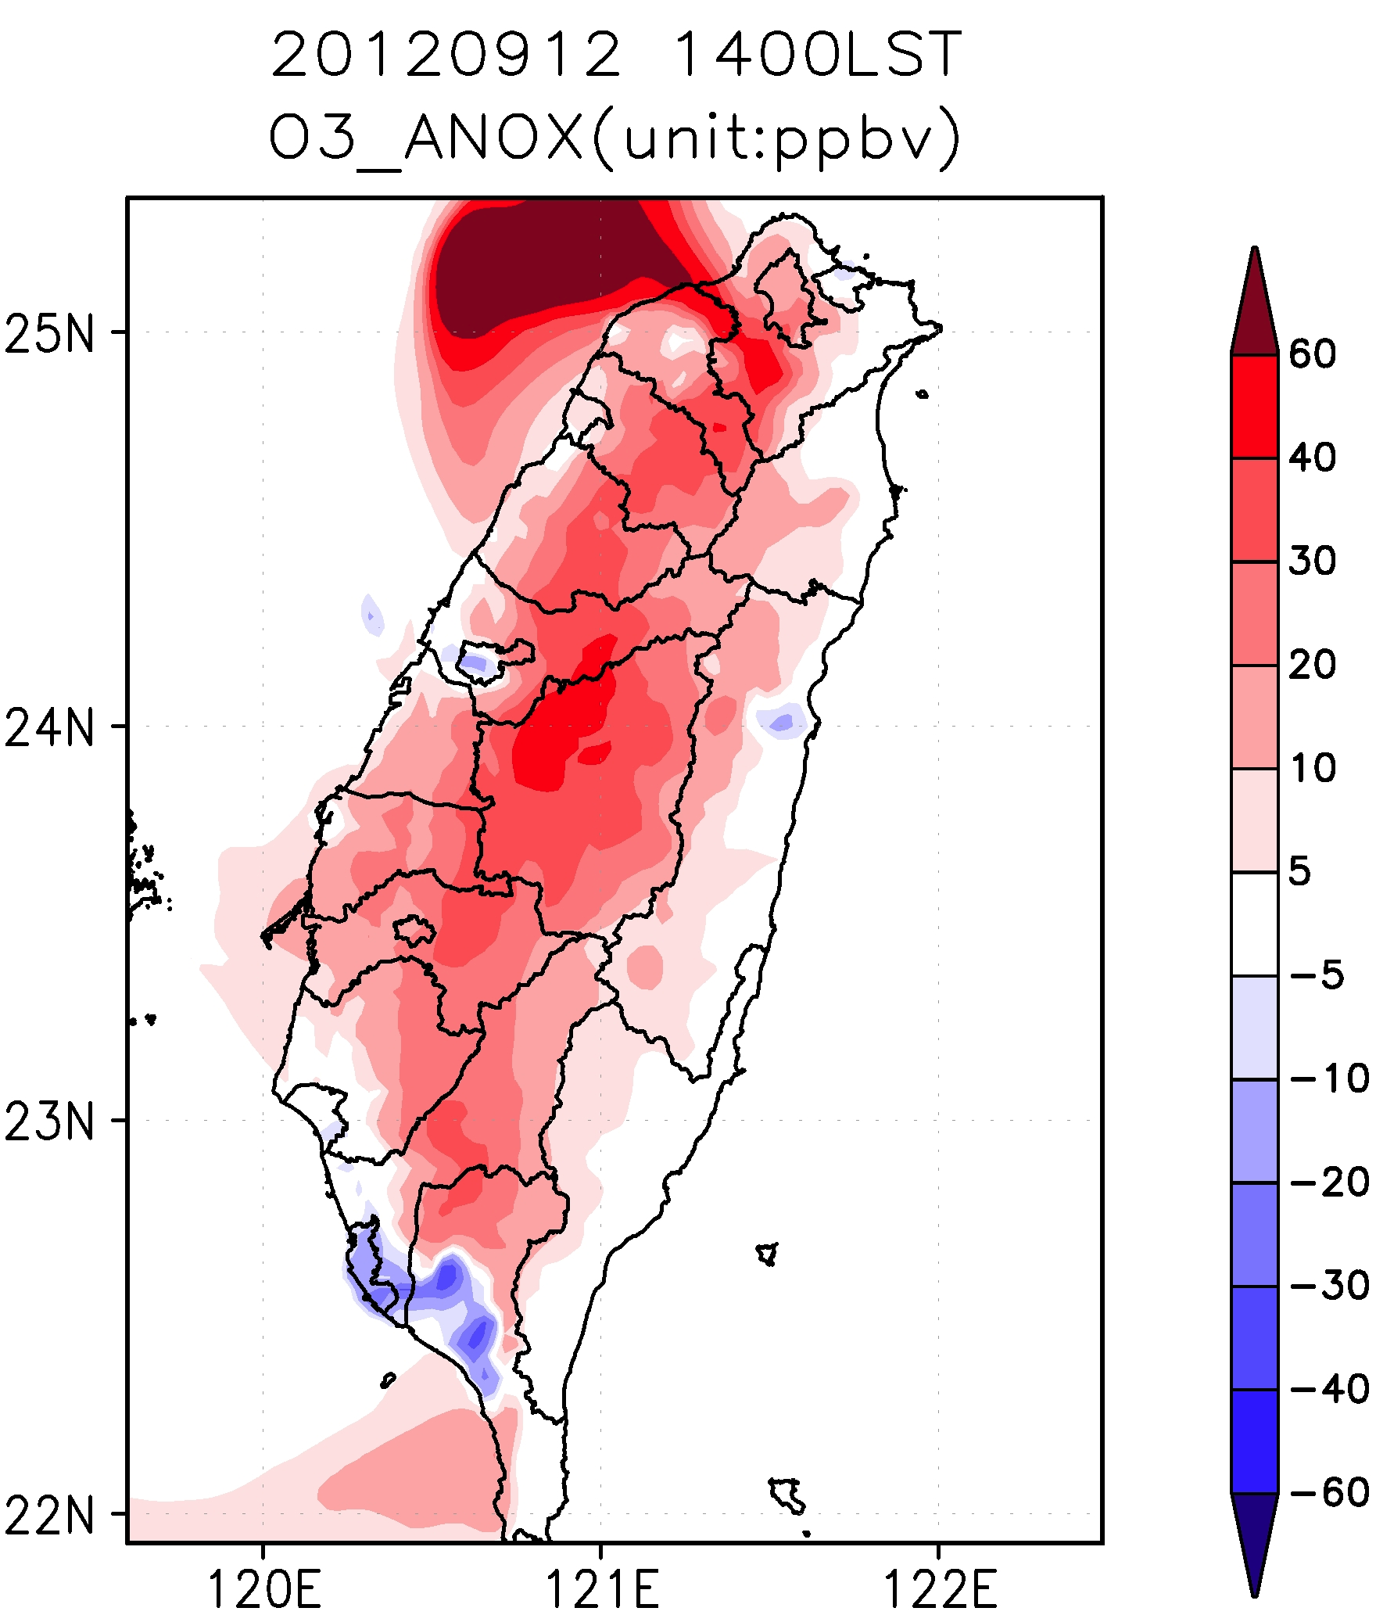
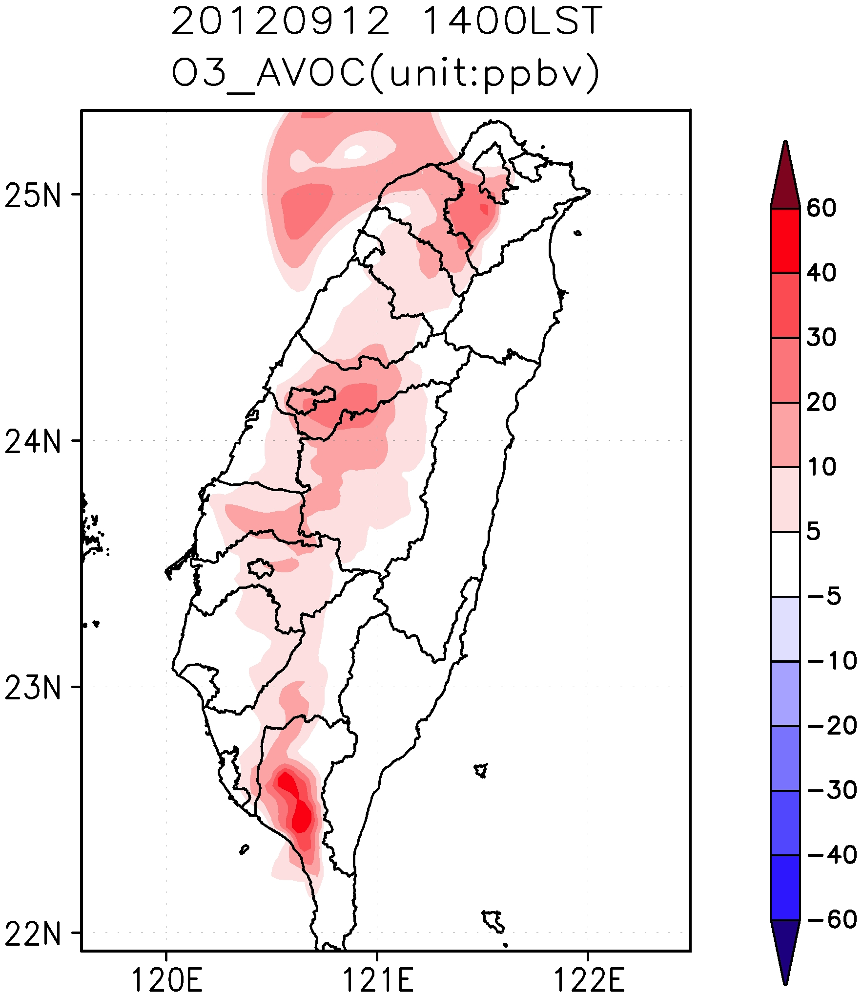
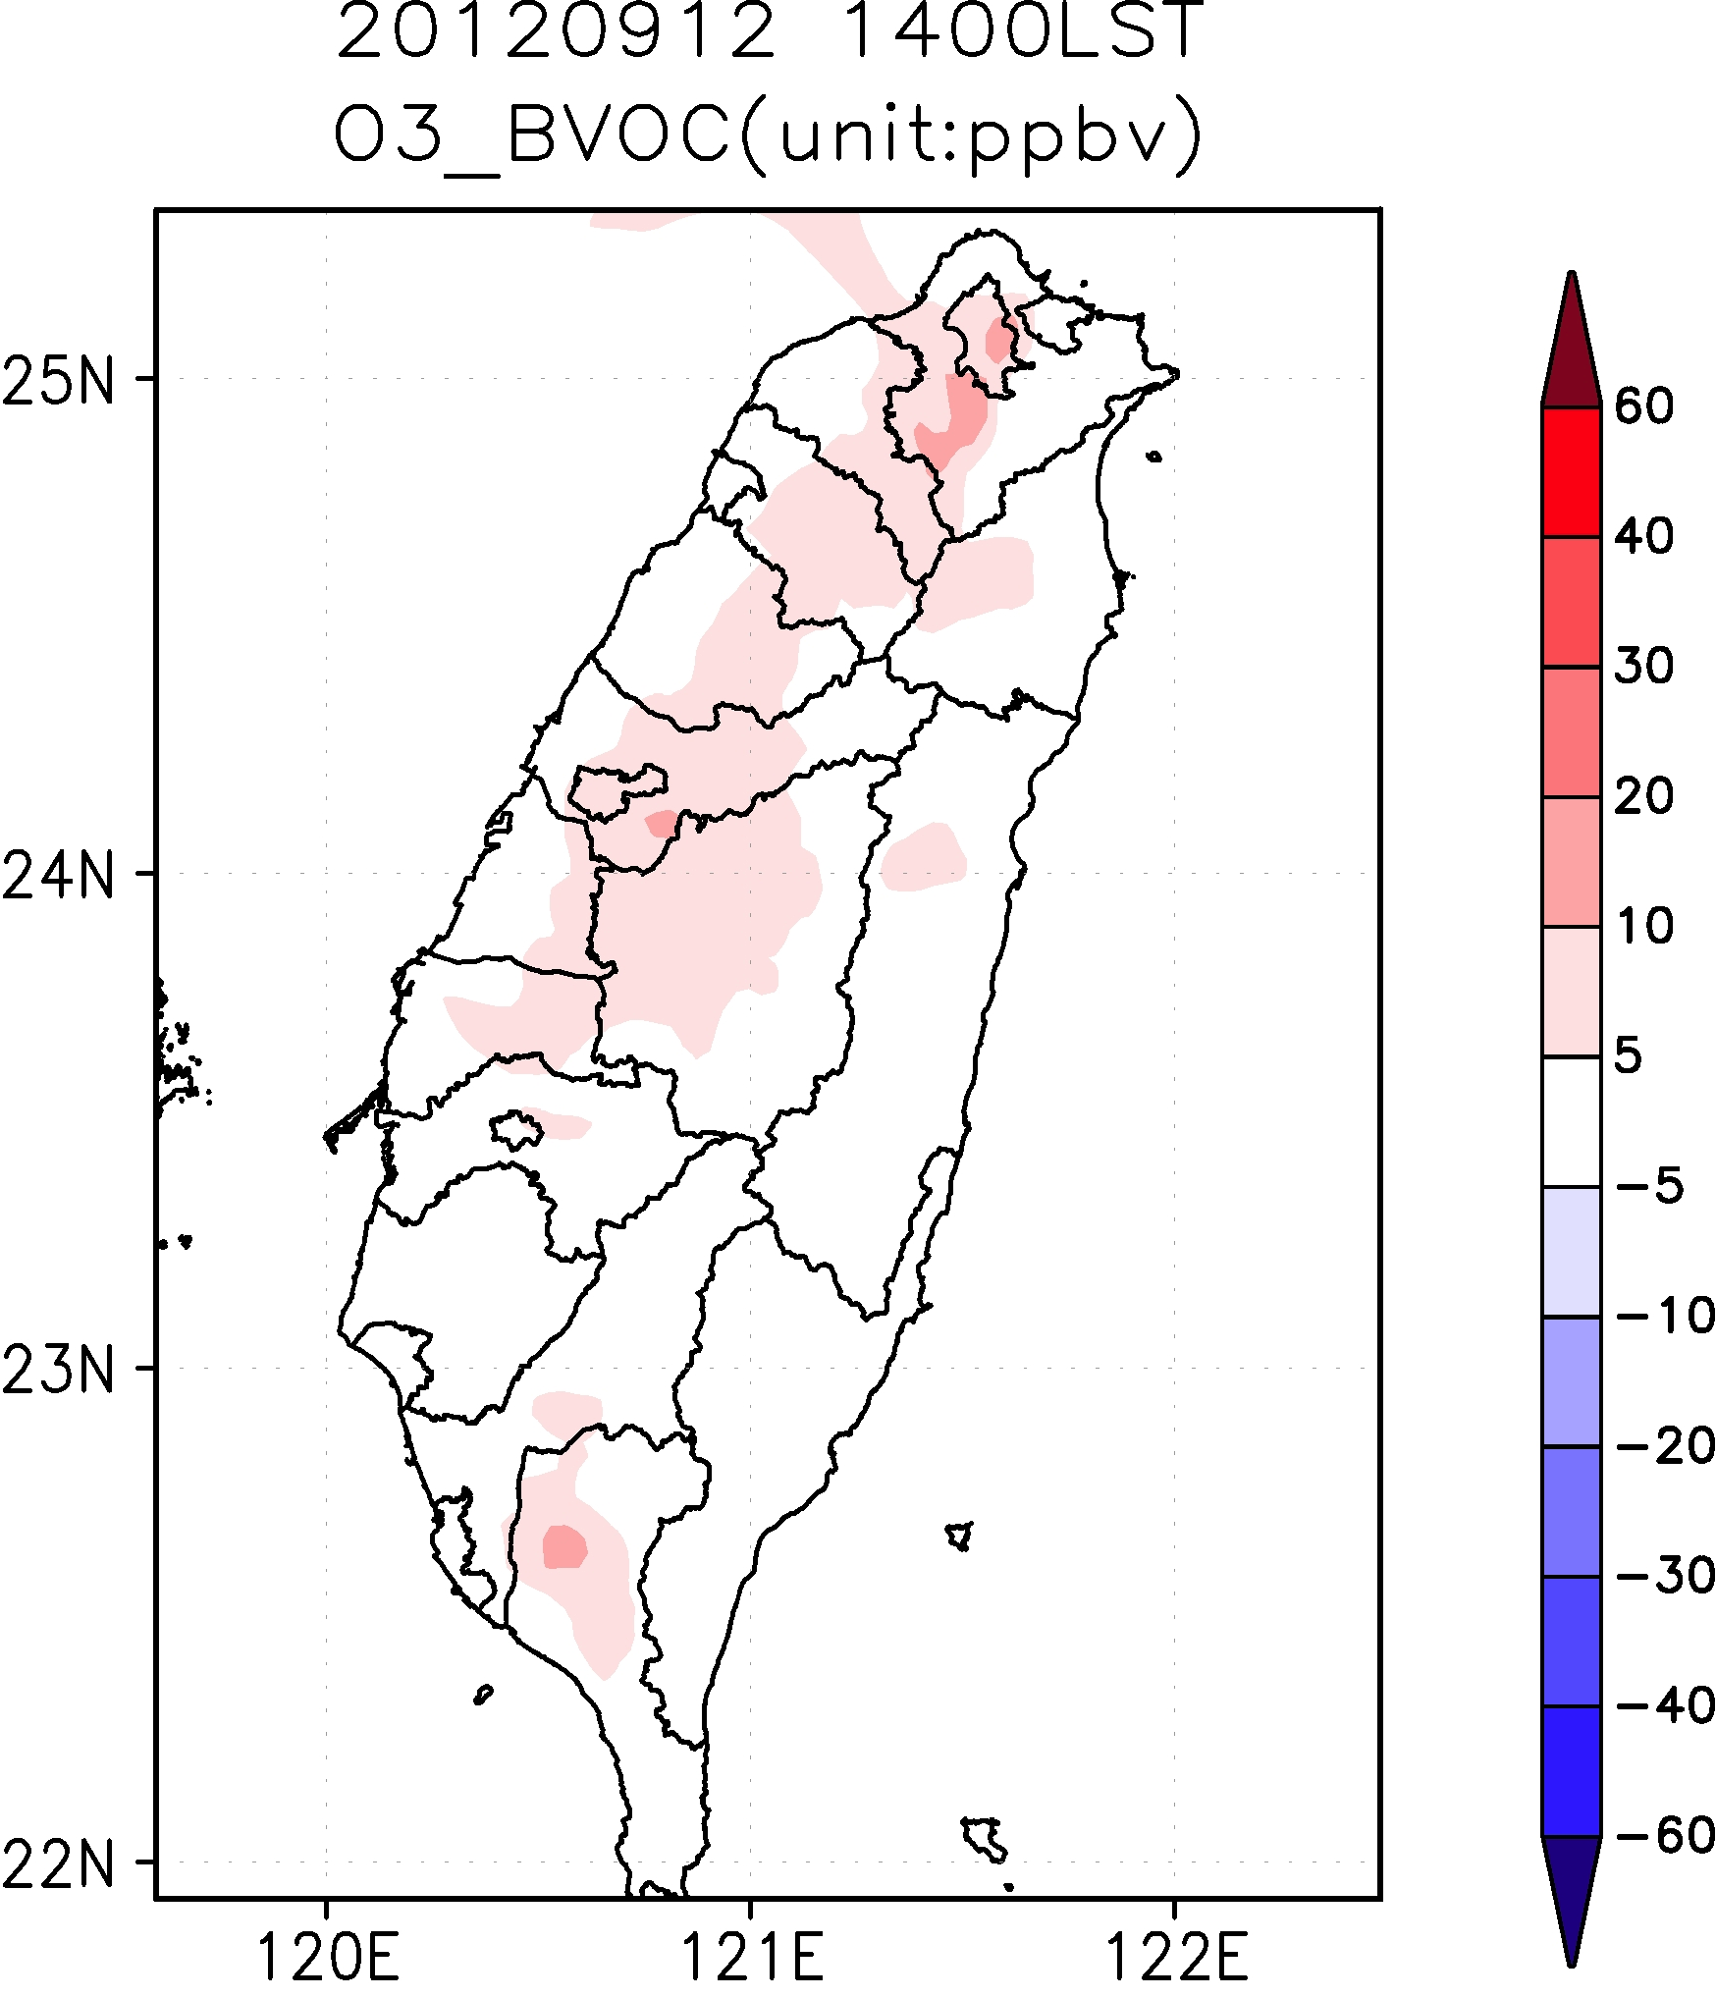
Land sea breeze
aNOx
aVOC
bVOC
Strong NE wind
aNOx
aVOC
bVOC

Slide 22
Land sea breeze
NO
NOx
PBL
Strong NE wind

Slide 23
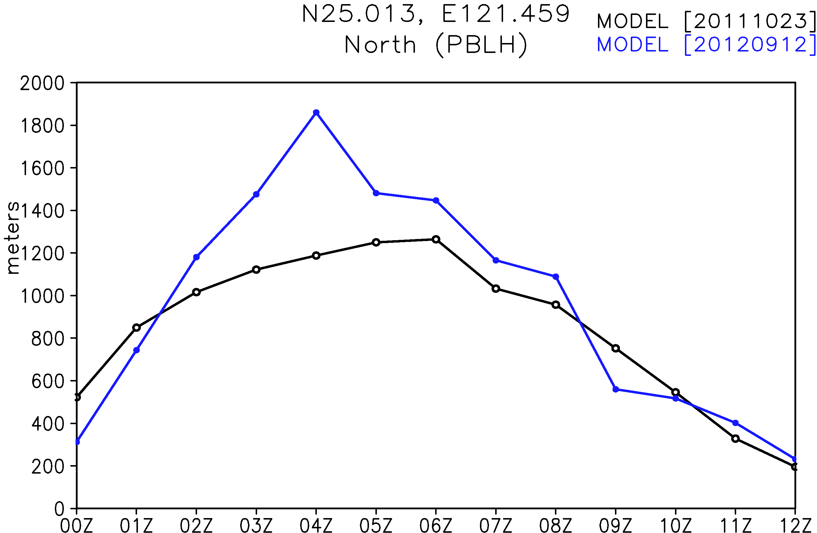
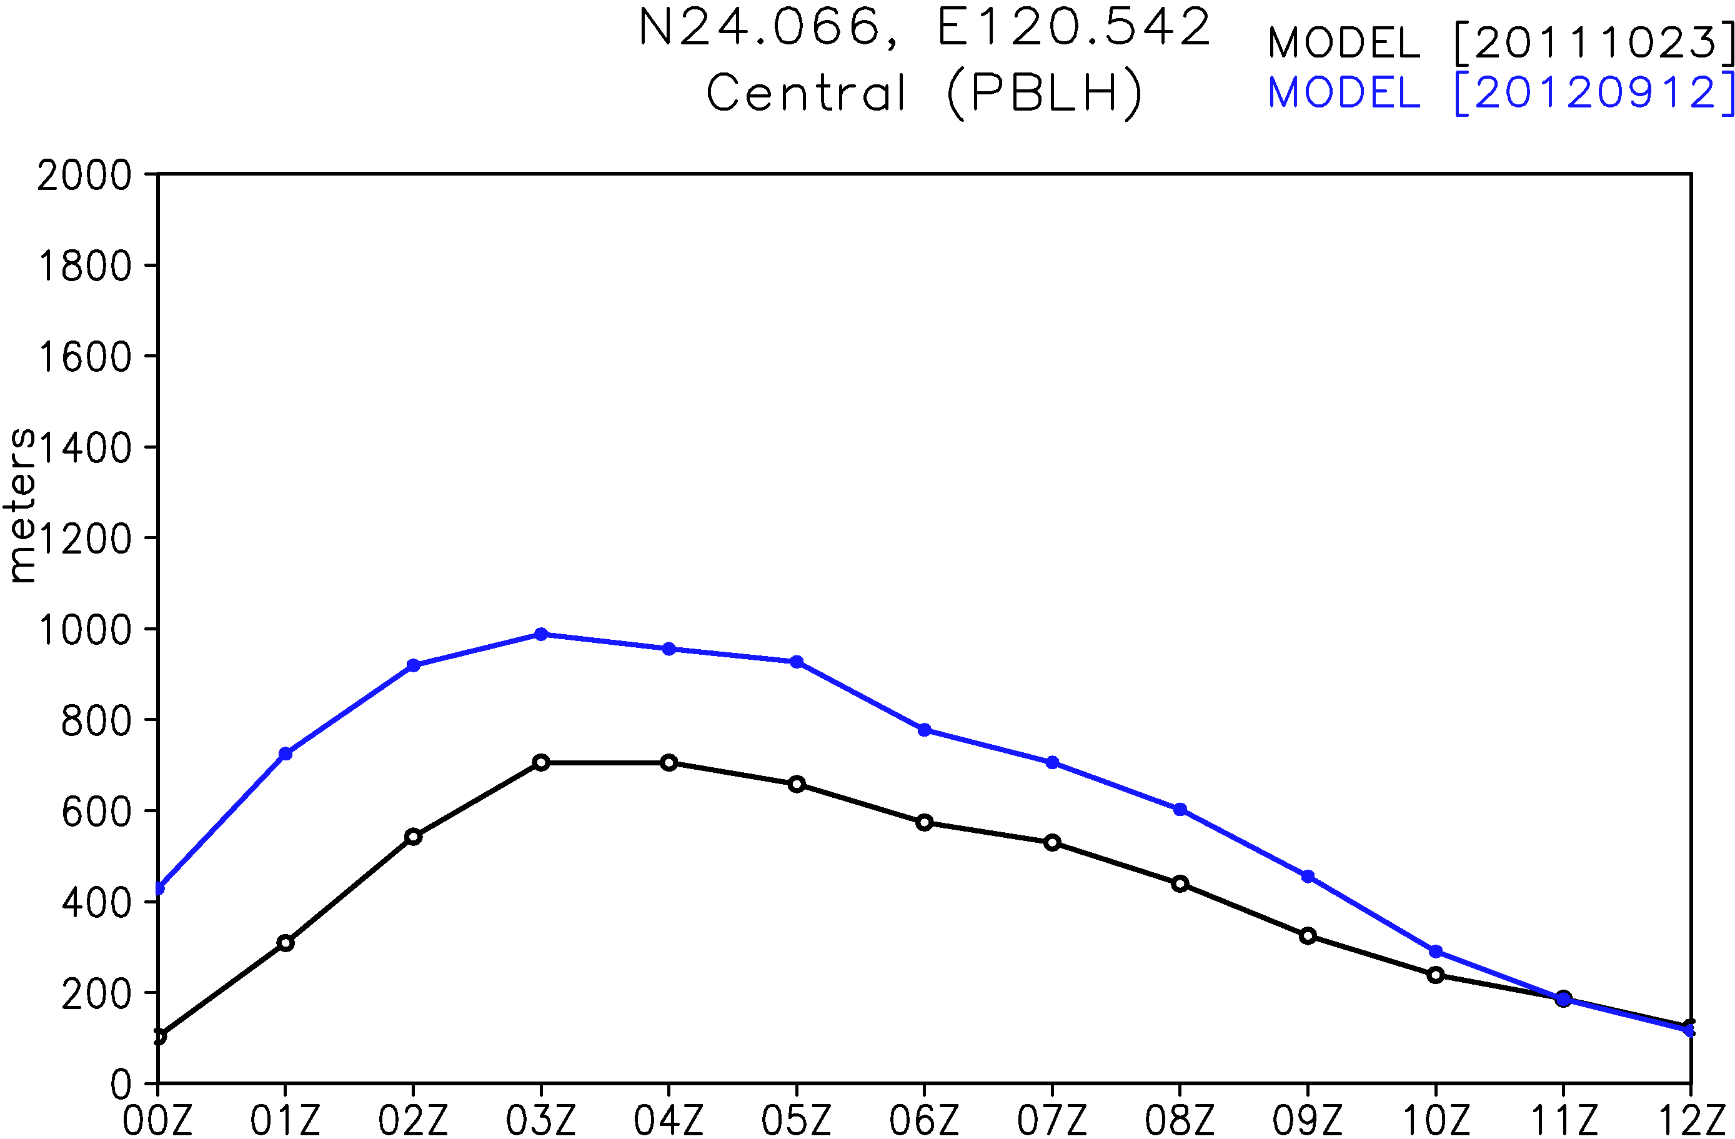
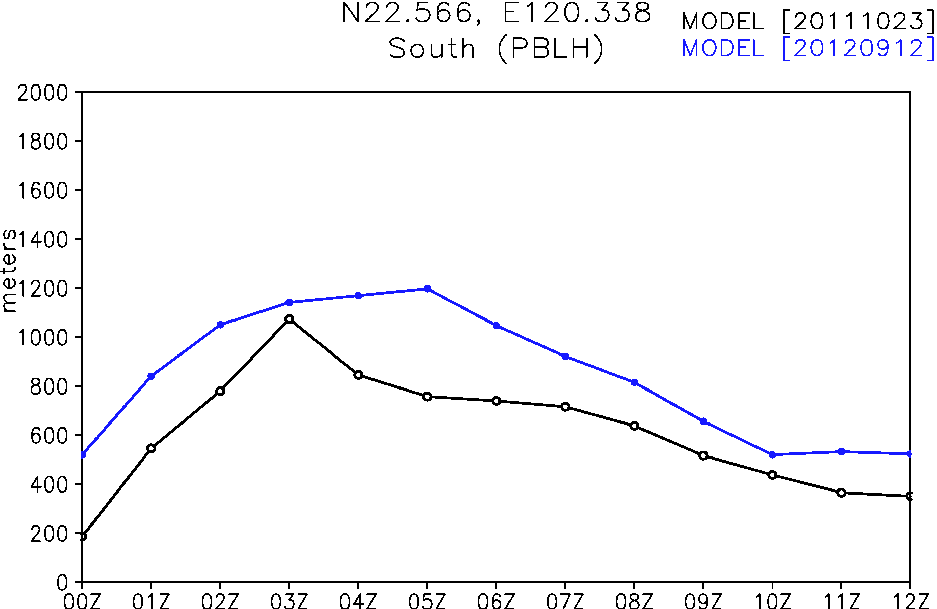
PBL ht development Blue: LSB Black: strong NE wind

Slide 24
Preliminary result
Sensitivity analysis using CMAQ-HDDM is applied to estimate 1st, 2nd and cross sensitivity coefficients for two high O₃ episode, one is with strong northeasterly monsoonal flow the other is typical LSB day.
O₃ control regimes change not only due to changes of emission but changes of meteorological condition also contributes.
--- For strong NE monsoonal flow, VOC control is beneficial in urban cities while NOx control is beneficial in downwind areas
--- For LSB case, reduction of NOx and VOC all reduce O₃ but more efficient with NOx reduction
Uncertainties in BVOC emission have modest effect because they are not collocated with anthropogenic source

Slide 25
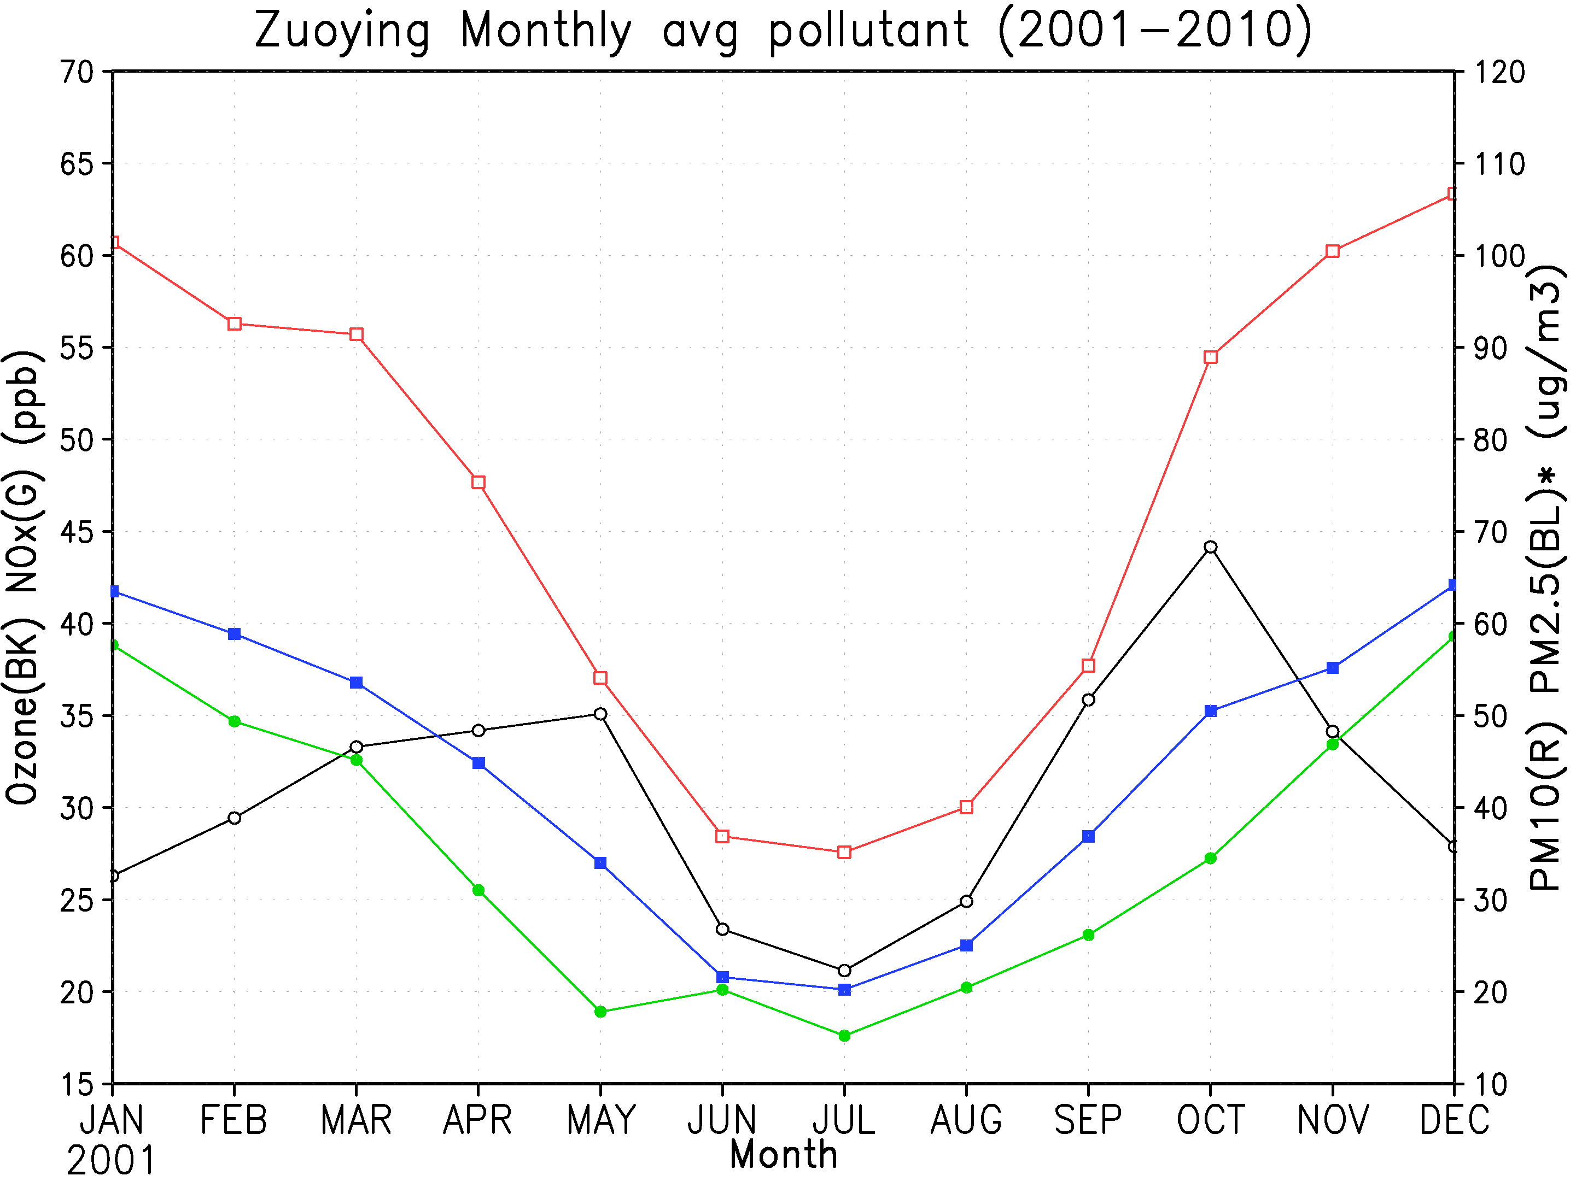
Monthly averaged concentration (2001-2010)
O₃ NOx PM₁₀ PM_{2.5}

Slide 26
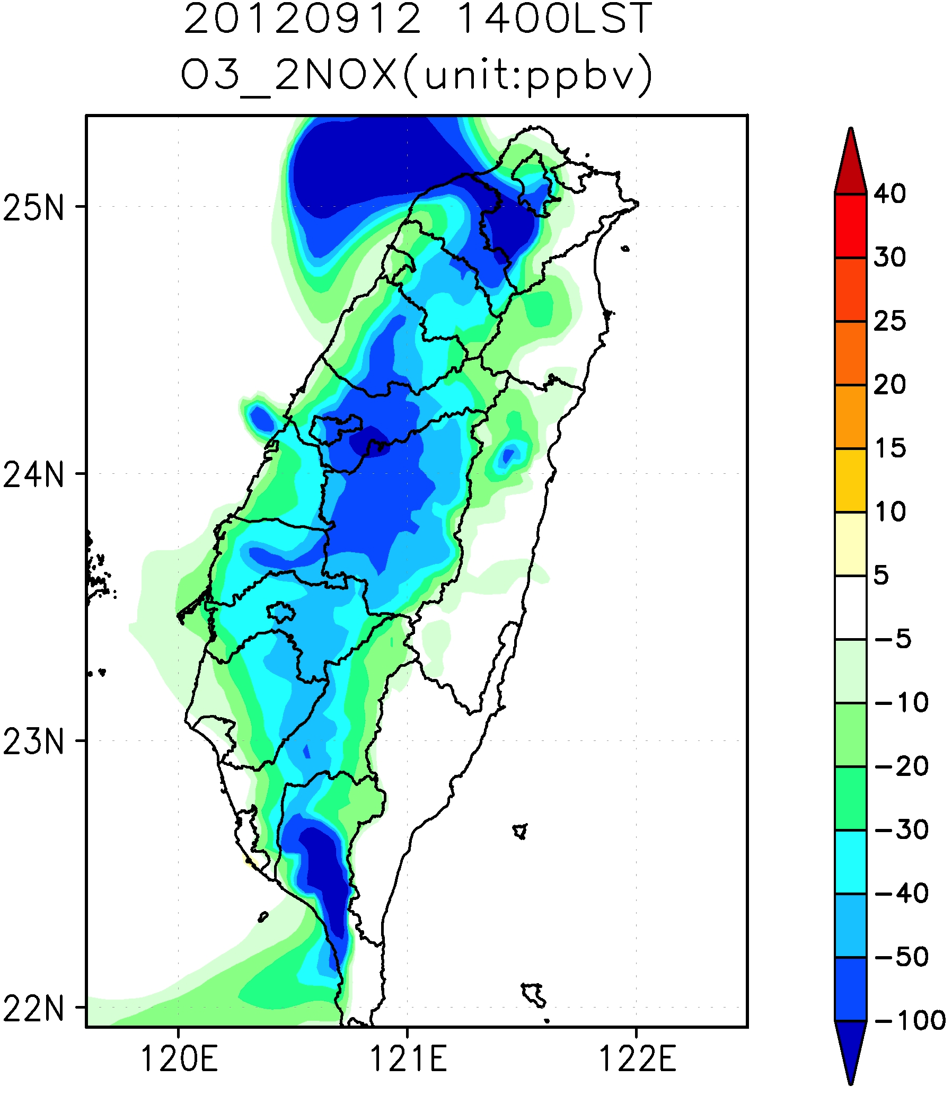
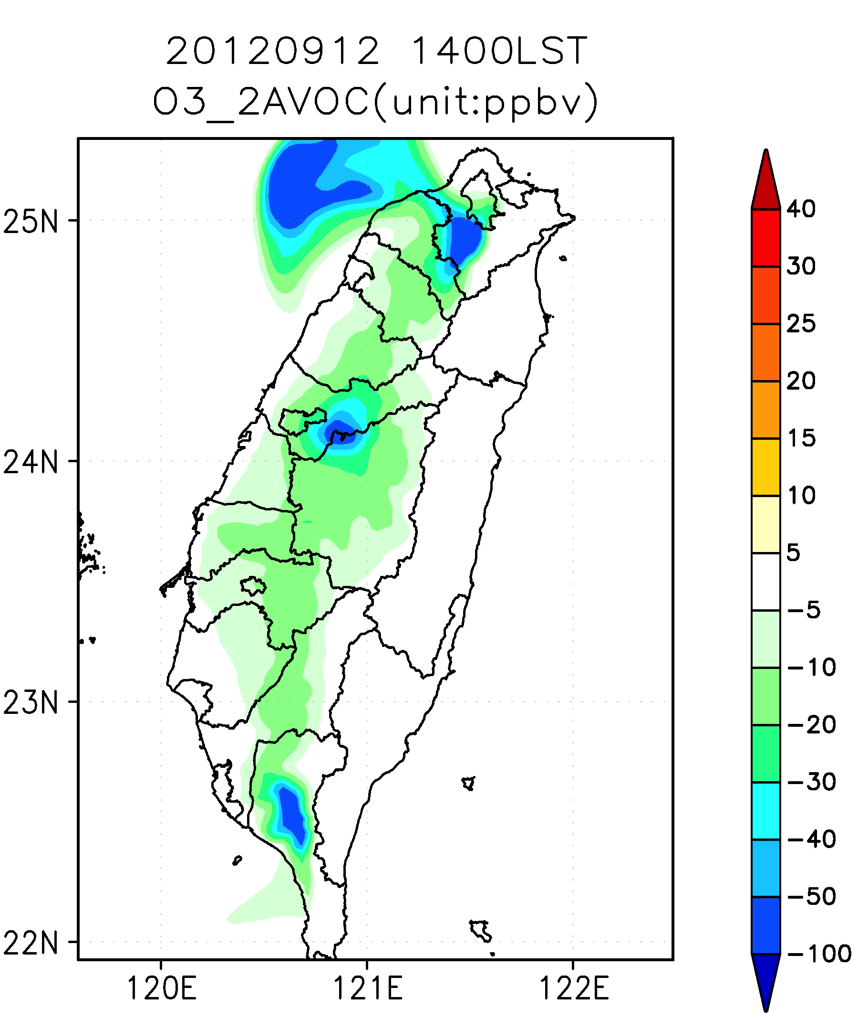
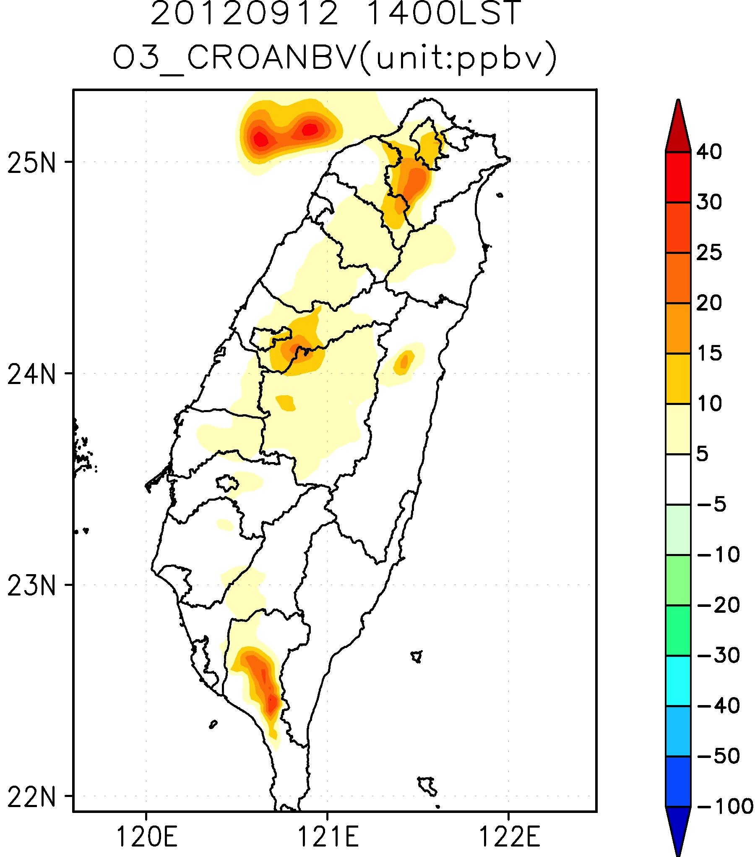
ANOx
AVOC
BVOC

