Slide 1
A Modeling Framework for Improved Characterization of Near-Road Air Quality at Fine Scales for Nationwide Exposure Assessment
Shih Ying Chang¹ (Changsy, Presenter)
Sarav Arunachalam¹, Brian Naess¹, Kevin Talgo¹, Alejandro Valencia¹,
Vlad Isakov², Brad Schultz² , and Ted Palma³
Institute for the Environment, University of North Carolina
Office of Research and Development, U.S. Environmental Protection Agency
Office of Air Quality Planning & Standards, U.S. Environmental Protection Agency
Notes:
Good morning everybody. Thanks for coming to my talk. I am Changsy from UNC. My topic today is A modeling Frame work for improved characterization of near road air quality at fine scales for nationwide exposure assessment.

Slide 2
Introduction
The importance of on-road emission source
11%
22%
15%
Source: EPA National-Scale Air Toxicity Assessment (NATA) 2005
Source: Rowangould, Transport Research Part D, 2013
Source: EPA National Emission Inventory
Notes:
Why do we care about near-road air quality? On average, 19% of the population in US lives close to the roads. However, if we look at the distribution map, some counties have up to 79% of population living close to the roads. But why is that important? It turns out that onroad traffic is a big pollution source. For example, onroad traffic accounts for more than 50% of NOx emission and ~39% of Benzene emission nationwide. As for PM2.5, although onroad source accounts for only 5% of emission, it is currently the most harmful pollutant that can affect human health. That is to say, the population living close to the roads is living close to a major pollution source. And from NATA 2005, we see that onroad emission is responsible for 15% of cancer risk, 22% of respiratory risk, and 11% of neurological risk.

Slide 3
Scientists want to
Characterize the relationship between on-road air pollutant and health
Ozkaynak et. al. JESEE 2013
Notes:
One important thing to understand the relationship between the on-road air pollution and health is to characterize the exposure. I borrowed this figure from EPA, which summarizes the methods that can be used to characterize the exposure. So, as a modeler, this is what we can do. We can use air quality models to provide useful information for exposure studies.

Slide 4
Objective
Provide fine-scale on-road traffic-related air quality fields to support exposure assessment study nationwide (8.2 million census blocks)
  A concentration map with detailed spatio-temporal characterization.
Develop approach to speed up the modeling process without sacrificing too much accuracy
Evaluate the approach at Cumberland County, Maine in 2010 and the North Carolina Piedmont from 2009 to 2011
Notes:
And that leads to the objective of this study. First of all, we want to provide fine-scale on-road traffic-related air quality fields to support exposure assessment study nationwide. That is, to provide a concentration map with detailed spatio-temporal characterization at census block level. We want to do this because people move. If we have a concentration map with coarse resolution, say 36 km, a person might be exposed to the same concentration level because that person can rarely escapes from that 36*36 grid. By doing this, we are looking at 8.2 million census blocks, which is computationally extensive so we need to develop an approach to speed up the modeling process without sacrificing too much accuracy. And in today’s talk we will show the evaluation of this approach at Cumberland County, Maine (a small region) in 2010 and the North Carolina Piedmont (a larger region) which is the central north Carolina from 2009 to 2011.

Slide 5
Methodology
on-road
Step 1: RLINE with Annual Average Daily Traffic (AADT) and STability ARray (RLINE-AADT-STAR)
Step 2: Spatio-Temporal Ordinary Kriging (STOK)
Step 3: Hybrid for total concentration
background
Notes:
Here comes the methodology. We have a three-step approach in this study. The first step is to use RLINE with Annual Average Daily traffic combining with stability array method to provide on-road concentration. The second step is to use the Spatio-Temporal Kriging to provide a background concentration. And the last step is to simply combine these two to provide a total concentration.

Slide 6
RLINE
Step 1: RLINE-AADT-STAR Step 2: STOK Step 3: Hybrid
RLINE (Research LINE source model)
  Dispersion model for treating on-road emissions as line sources
  Source-receptor model
Snyder et. al., AE 2013
Notes:
So what is RLINE. RLINE is Research Line source model which treats on-road emission as line sources. For example, if we have a road with length from Y1 to Y2, the RLINE treats it as multiple small point sources each produces a plume that is described by Gaussian distributions. The concentration at any location of the downwind site of that small point can be described by this equation, where the plume consists of two parts, vertical and horizontal. Vertically, the plume is described by two Gaussian distributions and horizontally, the plume is described by a Gaussian distribution. The model then integrateㄋ the concentration brought by these multiple point sources and gives the concentration estimate. RLINE is a source-receptor model so we can know the concentration at any given point in the domain of interest. And in this study, we set the receptors at the census block centroid.

Slide 7
Develop emission inputs
Step 1: RLINE-AADT-STAR Step 2: STOK Step 3: Hybrid
MOVES emission factor
Speed
  MOVES input data
Vehicle Type
  8 types:
    LDGV, LDGT 1, LDGT 2, HDGV, LDDV, LDDT, HDDV, MC
    Table VM-4 from the FHWA Statistics Series convert with EPA Emission Inventory Improvement Program
*Road Type
  12 national function class (NFC) types:
    Rural Interstate, Rural Principal Arterial, Rural Minor Arterial, Rural Major Collector, Rural Minor Collector, Rural Local, Urban Interstate, Urban Freeway, Urban Principal Arterial, Urban Minor Arterial, Urban Collector, Urban Local
*Traffic Count
  Annual Average Daily Traffic (AADT)
Temperature
  Temperature bins in Summer and Winter
  Map with AERMET output from 824 National Weather Service (NWS) sites in the U.S.
Vehicle type
Speed
Temperature
NFC
  * from Freight Analysis Framework (FAF3), Federal HighWay Administration (FHWA)
Notes:
To run RLINE, one important thing is to get the emission right. Luckily, EPA provides emission factors from MOVES. MOVES categorizes the emission factor based on Vehicle type, Speed, Temperature, and road type at county level. It does not provide the emission for a specific road. Instead, it tells you that at a specific county, if you have a vehicle, for example, a heavy duty diesel truck, running at 70 m/h on an interstate freeway when the temperature is 100 degree, the emission factor of that vehicle would be a specific value. So, to use this MOVES output, we need to have the information about the actual roads. So here I show the data source in this study, for vehicle speed, I took the MOVES input data, and for vehicle type, I use Table VM-4 from the federal highway administration statistics series and convert that with EPA Emission inventory improvement program. For road type and traffic count, we gather the information from Freight Analysis framework provided by federal highway administration and we get the temperature from AERMET output from 824 NWS sites in the U.S.

Slide 8
Run RLINE with AADT as inputs
Step 1: RLINE-AADT-STAR Step 2: STOK Step 3: Hybrid
AADT data
Link data NFC=N
N=1, 2, 6, 7, …19
AADT as emission rate
receptor file
AERMET output
RLINE
AADT contribution
Output
NFC=1,…19
8
Notes:
So now we have everything we need, and we can run the model. And because we are dealing with multiple pollutants from the same source, we try to use the AADT, which represents the traffic count, as the emission input to RLINE and scale up the output later based on the emission factor for each pollutant to get the concentration for each pollutant. So basically, we categorize the emission based on road type and we create an emission input file with AADT as emission rate and run the model. So the output we have is not actual concentration, but AADT contribution from each source at each receptor.

Slide 9
Step 1: RLINE-AADT-STAR Step 2: STOK Step 3: Hybrid
RLINE-AADT
Traffic inputs
MOVES EF Jan
Fleet data
summed
refueling
AADT contribution
Output
NFC=1,…19
MOVES speed data
EF winter combined
AERMET output
MATLAB preprocessor
EF summer combined
summed
refueling
MATLAB Post Processor
MOVES EF Jul
Emission factor input
Hourly concentration outputs
NFC=1, …19
SUM over NFC type
Hourly concentration outputs
Notes:
And then we take these AADT contribution output, combine them with the emission factor from MOVES, and the traffic information previously mentioned, to scale up these AADT contribution to actual concentration. And we simply sum up over NFC type to get hourly concentration. This equation here describes how we obtain the concentration. Traditionally, we use emission rate, which is traffic count multiplied by emission factor, as model input. With this method, we put AADT in the model first, and then multiplied this AADT contribution with emission factor to get concentration. This process took about 1 hour of computational time to model one county for one month. However, since we are dealing with more than 3000 counties, we have to further simplify this process.

Slide 10
STability ARray (STAR)
Step 1: RLINE-AADT-STAR Step 2: STOK Step 3: Hybrid
RLINE—meteorology
  STability ARray (STAR) Approach
    Use representative hours instead of actual hourly meteorological data
    Scale model output to annual average concentration using weights
1 year: 8760 hours
Monin-Obukhov length: 5 categories
Unstable, Slightly Unstable, Neutral, Slightly Stable, Stable
Wind Direction: 4 categories
North, East, South, West
Wind Speed: 5 categories
0~1, 1~2, 2~4, 4~7, >7
1 year: 100 hours
Notes:
That is where the stability array comes into play. In an explicit model run, we have to run the model with 8760 hours of meteorological data to obtain hourly concentration for a whole year. With the STAR approach, we use representative hours instead of actual hourly meteorological data. So how does this work. Basically we group the met data based on 3 parameters, Monin-Obukhov length 5 categories, wind direction 4 categories, and wind speed 5 categories so that’s a total of 100 groups. Within each group, we use one hour of met data to present all the others that fall in that group. Also, we calculate the hour count for each group. For example, how many hours fall in the first group, and so on. Then we calculate the weight, which is the hour count in each group divided by 8760.

Slide 11
RLINE-STAR
Step 1: RLINE-AADT-STAR Step 2: STOK Step 3: Hybrid
Source
Receptor
RLINE
Concentration output
STAR 100 hour
Annual average conc.
Post process
Scale up using weights
Notes:
So now, instead of 8760 hours, we run the RLINE with the 100 hours of representative met data and use another post processor to scale up the concentration output with the weights and obtain the annual average concentration. This process can reduce the computational time from 1 hour to 4 minutes to model one county for a month. However, remember the purpose of this method is to provide a concentration map with detailed spatio-temporal resolution. Using this RLINE-AADT-STAR approach gives annual average concentration which has no temporal resolution.

Slide 12
Step 2 & 3
Step 1: RLINE-AADT-STAR Step 2: STOK Step 3: Hybrid
Step 2: Estimate Background concentrations from other sources
  Spatio-Temporal Ordinary Kriging (STOK)
  Use AQS observations as inputs to estimate field of background concentrations at census block resolution
  If AQS observations available, use STOK
    Hourly: PM_{2.5}, NOx, CO
    Daily: Acetaldehyde, Benzene, Formaldehyde, PM_{2.5} OC, PM_{2.5} EC, PM_{2.5} SO4
  Else, use estimates from NATA-2008
    Annual: 1,3-Butadiene, Acrolein
Step 3: Estimate total concentrations (Hybrid)
  Add onroad estimates to background concentrations at each census block centroid
  Spatio-Temporal variability provided in background concentration
  Spatial variability provided in onroad estimates
Notes:
That is where the STOK comes into play. Basically we use the kriging to interpolate the concentration at census block level with AQS observational data. In this study, if AQS observations are available, we use STOK. And that will give us Hourly variation for PM2.5, Nox, and CO and Daily variation for Acetaldehyde, Benzene, Formaldehyde, PM2.5 OC, EC, and SO4. if observational data are not available, we use the estimates from NATA-2008 which gives the annual background concentration at county level. And in the last step, we combine the output from step 1 and step 2 to obtain total concentration. Note that with this approach, we obtian spatio-Temporal variability in background concentration but the spatial variability specific to on-road emission comes from RLINE.

Slide 13

Road networks in Portland, Maine
Census blocks in Portland, Maine
Road networks in the NC Piedmont
Census blocks in the NC Piedmont
Notes:
Before I go to the result section, let’s take a look at the domain of the two examples that I am presenting today. The whole U.S. is our target domain, and the first example is here in Cumberland county, Maine. This is the county boundary with roads, and here are the census blocks that I am going to model the concentration at. Another domain is at the North Carolina Piedmont. Again, this shows the county boundaries and roads and this shows the census blocks. As you can see, a lot.

Slide 14
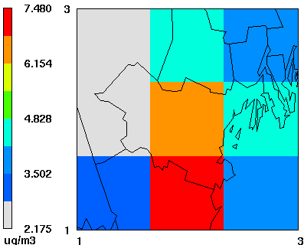
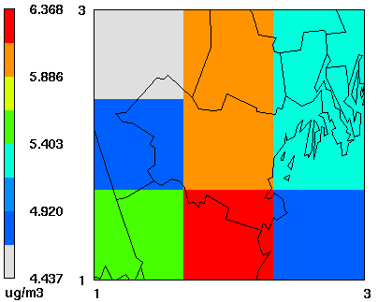
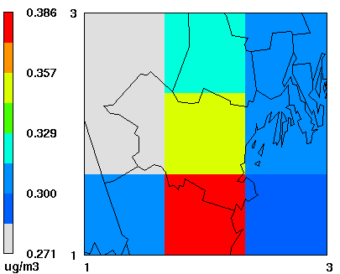
Results (Portland)
NOx
PM_{2.5}
BENZENE
CMAQ Annual Average Concentration (μg/m³)
Hybrid Annual Average Concentration (μg/m³)
The hybrid method shows much more detailed spatial variability
14
Notes:
Here I show three concentration maps provided by CMAQ at 36km times 36 km resolution. As you can see, we can only use 9 concentration values to estimate the exposure for everyone living in this county. However, with our approach, you can see a really detailed spatial resolution and the texture brought by on-road emission. Our method, in general, shows higher concentration than CMAQ output because the dispersion model does not have chemistry in it. For example, NOx is high in our result because there’s no chemistry to allow it to react.

Slide 15
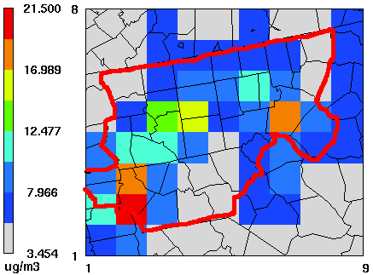
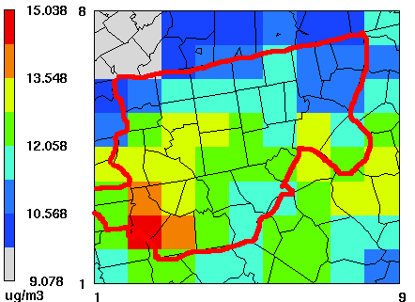
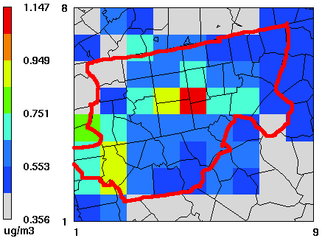
Results (NC)
NOx
PM_{2.5}
BENZENE
CMAQ Annual Average Concentration (ppbV)
Hybrid Annual Average Concentration (μg/m³)
The hybrid method shows much more detailed spatial variability
15
Notes:
The 3 figures show the CMAQ output for NC Piedmont area. Again, we can probably tell that these two are the cities but nothing related to on-road emission. However, with our method, you can clearly see the texture brought by the roads. These concentration maps allow us to do a lot of things. For example,

Slide 16
Near-road analysis: by Distance
Portland
NC
The concentrations drop dramatically after 100 meters from the road
Notes:
I try to quantify the concentration change with respect to distance from the road. In this figure, the x-axis represents the distance from the road with interval of 20 meters. For example, 200 represents the distance between 180 to 200 meters to the road. The y-axis represents the percentage to the maximum annual concentration. You can see that the concentrations drop dramatically after 100 meters from the road. In Portland, the concentration drops by 40 to 60% after 100 meters from the road. And in NC Piedmont, the concentration drop is 20 to 40%. This tells us that it is dangerous to live close to the roads.

Slide 17
Near road analysis: by AADT
Portland
NC
Concentrations could be very high near roads with heavy traffic
Notes:
With these concentration maps, I can do another analysis that is to look at the worst scenario. This figure shows the concentration change with AADT. The x-axis here represents AADT and the y-axis represents the concentration. Again, when the receptor is close to the road, the concentration is high, and furthermore, when the road is with heavy traffic, ie. High AADT, the concentration level could be extremely high.

Slide 18
Summary
Developed a modeling framework using state-of-the-art tools and databases to characterize on-road source contribution to air quality at census block resolution to support population exposure studies
Using STAR approach greatly reduces computational burden, while estimating annual averages without losing accuracy
Concentrations drop off rapidly after 100m from the roads
  By 40-60% in Portland
  By 20-50% in NC Piedmont
Concentration could be high near traffic-intense roads
Notes:
To summarize our work, We have

Slide 19
Future work
Continue QA’ing the result
  Evaluate model predictions at AQS sites
Assess relative contribution from different vehicles and road types
Extend methodology to apply to the whole nation
Perform health-based risk assessment using these fine-scale outputs

Slide 20
Acknowledge
Funding
EPA Contract EPD 12044 WA 1-02
EPA
Michelle Snyder
David Heist
Alexis Zubrow
Alison Eyth
UNC-IE
B. H. Baek
Lab mates
Matt Woody
Pradeepa Vennam
Scott Boone

Slide 21
references
H. Ozkaynak, L. L. Baxter, K. L. Dionisio, J. Burke, Air Pollution Exposure Prediction Approaches Used in Air Pollution Epidemiology Studies, (2013) J Expos Sci Environ Epidemiol (2013) 1-7.
W. J. Gauderman, H. Vora, R. McConnell, K. Berhane, F. Gilliland, D. Thomas, F. Lurmann, E. Avol, N. Kunzli, M. Jerrett, J. Peters, Effect of exposure to traffic on lung development from 10 to 18 years of age: a cohort study, (2007), Lancet(369), 571-577
M. G. Snyder a, A. Venkatram, D. K. Heist, S. G. Perry, W. B. Petersen, V. Isakov, RLINE: A line source dispersion model for near-surface releases, (2013) Atmospheric Environment(77), 748-756
2005 National-Scale Air Toxics Assessment (http://www.epa.gov/airtoxics/nata2005/tables.html)
G. M. Rowangould, A census of the US near-roadway population: Public health and environmental justice considerations, Transportation Research Part D: Transport and Environment(2013), 59-67
V. Singh, R. S. Sokhi, J. Kukkonen, PM_{2.5} concentrations in London for 2008 – A modeling analysis of contributions from road traffic, Journal of the Air & Waste Management Association(in Press).

Slide 22
Extra slides

Slide 23
Summary statistics at Portland (μg/m³)
 | RfC | Spatial |  | % to RfC
 |  | mean±std | max | mean±std | max
1,3-Butadiene | 2 | 0.04±0.06 | 1.38 | 2±3 | 69
ACETALDEHYDE | 9 | 1.29±0.4 | 7.63 | 14.33±4.44 | 84.78
Acrolein | 0.02 | 0.03±0.03 | 0.89 | 150±150 | 4450.00
BENZENE | 30 | 0.97±0.39 | 7.83 | 3.23±1.3 | 26.10
FORMALDEHYDE | 9.8 | 2.48±0.91 | 13.7 | 25.31±9.29 | 139.80
 | NAAQS | Spatial |  | % to NAAQS
 | annual | mean±std | max | mean±std | max
NOx | 100 | 100.2±116 | 3673.5 | 100.2±116 | 3673.50
CO | *10307 | 534.7±324.7 | 8006.7 | 5.19±3.15 | 77.68
PM_{2.5} | 12 | 8.83±7.96 | 170.48 | 73.58±66.33 | 1420.67
Acrolein, Formaldehyde, NOx, and PM_{2.5} could exceed health based thresholds

Slide 24
QA of results against Emissions Inventories
Onroad contribution for PM_{2.5} and BENZENE are comparable
24

Slide 25
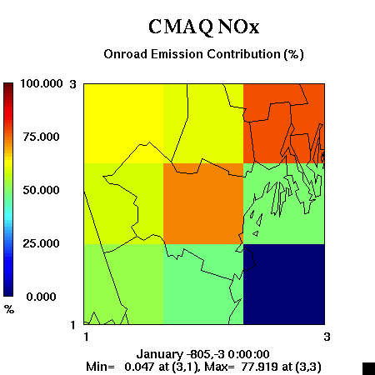
Results (Portland)
(% distribution with CMAQ)
Hybrid NOx
Onroad Concentration Contribution (%)
On-Road contribution is characterized with much more finer spatial detail

Slide 26
Summary statistics at the NC Piedmont 2010 (μg/m³)
 | RfC | Piedmont concentration |  | % to RfC
 |  | Spatial mean±std | max | mean±std | max
1,3-Butadiene | 2 | 0.04±0.04 | 0.81 | 2±2 | 40.5
ACETALDEHYDE | 9 | 1.99±1.28 | 5.4 | 22.11±14.22 | 60.00
ACROLEIN | 0.02 | 0.07±0.01 | 0.54 | 350±50 | 2700.00
BENZENE | 30 | 0.93±0.55 | 5.35 | 3.1±1.83 | 17.83
FORMALDEHYDE | 9.8 | 4.11±2.33 | 10.3 | 41.94±23.78 | 105.10
 | NAAQS | Piedmont concentration |  | % to RfC
 | annual | Spatial mean±std | max | mean±std | max
NOx | 100 | 62.1±56.6 | 203.06 | 62.1±56.6 | 203.06
CO | *10307 | 531.9±247.3 | 4722.4 | 5.16±2.4 | 45.82
PM_{2.5} | 12 | 13.38±6.17 | 92.89 | 111.5±51.42 | 774.08
Formaldehyde, Acrolein, NOx, and PM_{2.5} could exceed health based thresholds.

Slide 27
QA of results against Emissions Inventories
Onroad contribution for PM_{2.5} and NOx are comparable

Slide 28
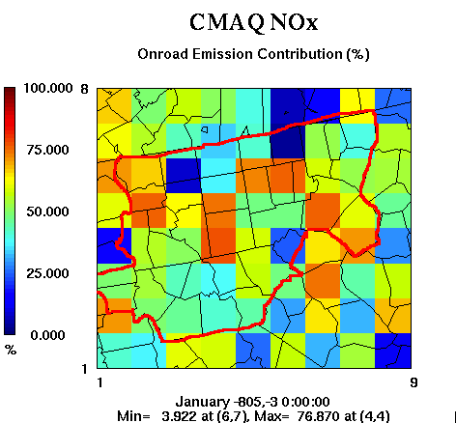
Results (NC)
(% distribution with CMAQ)
Hybrid NOx
Onroad concentration contribution (%)
On-Road contribution is characterized with much more finer spatial detail

Slide 29
Summary
Developed a modeling framework using state-of-the-art tools and databases to characterize on-road source contribution to air quality at census block resolution to support population exposure studies
Using STAR approach greatly reduces computational burden, while estimating annual averages without losing accuracy
PM_{2.5}, Acrolein, Formaldehyde and NOx concentrations in Portland and NC Piedmont exceed health based thresholds.
QA against emission shows comparable on-road contribution for several pollutants. The contribution matches better at a finer scale
Concentrations drop off rapidly after 100m from the roads
  By 40-60% in Portland
  By 20-50% in NC Piedmont
Concentration could be high near traffic-intense roads

