Slide 1
Ammonia Measurements by the NASA Tropospheric Emission Spectrometer (TES)
Karen Cady-Pereira¹, Mark Shephard², Daven Henze³, Juliet Zhu³, Jonathan Wrotny¹, Robert Pinder⁴, John Walker⁴, John Nowak⁵, Armin Wisthaler⁶, Kang Sun⁷
1. Atmospheric and Environmental Research (AER)
2. Environment Canada
3. University of Colorado
4. Environment Protection Agency (EPA)
5. NOAA/CIRES
6. University of Innsbruck
7. Princeton University

Slide 2
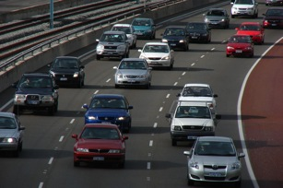

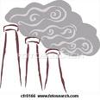

NH₃ Sources
Automobiles (catalytic converters)
Large urban centers
  50% of NH₃ in LA area
Biomass burning
Bi-directional
Flux
AGRICULTURE
Animal waste (temperature dependent)
Fertilizer application
Industry
Fertilizer
Coal Mining
Power generation

Slide 3
NH₃ in the atmosphere
NH₃ + HNO₃⬅➔NH₄NO₃
2 NH₃ + H₂SO₄➔(NH₄)₂SO₄
Long-range export
Long-range import
PM_{2.5} Particles
NH₃ forecast to increase
Health impacts
Increase number of CCN
➔Affect cloud radiative properties
➔Climate change

Slide 4
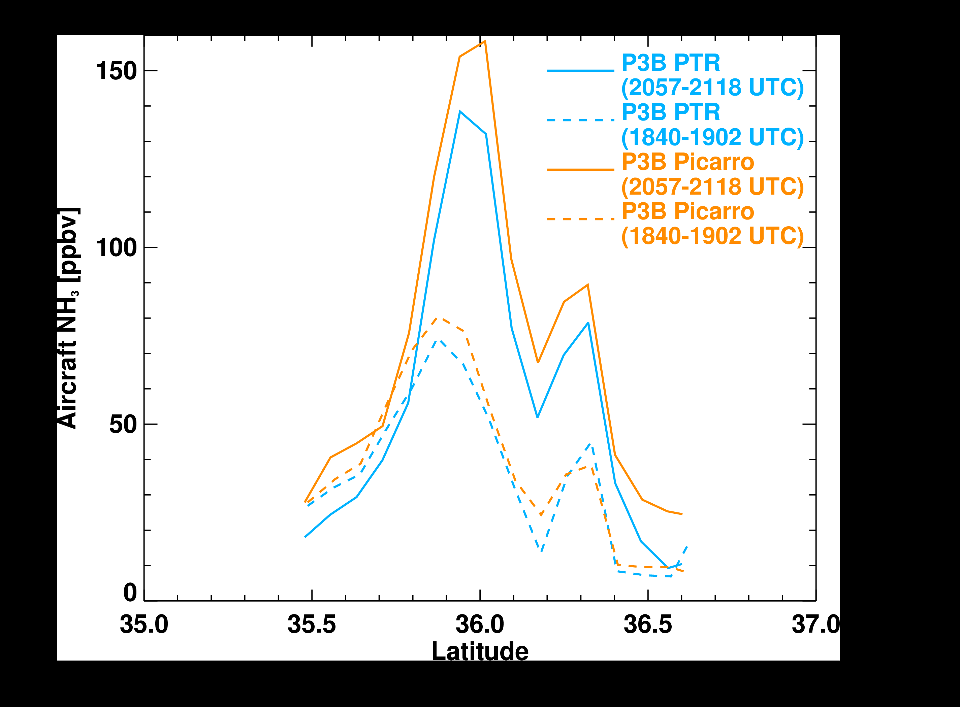
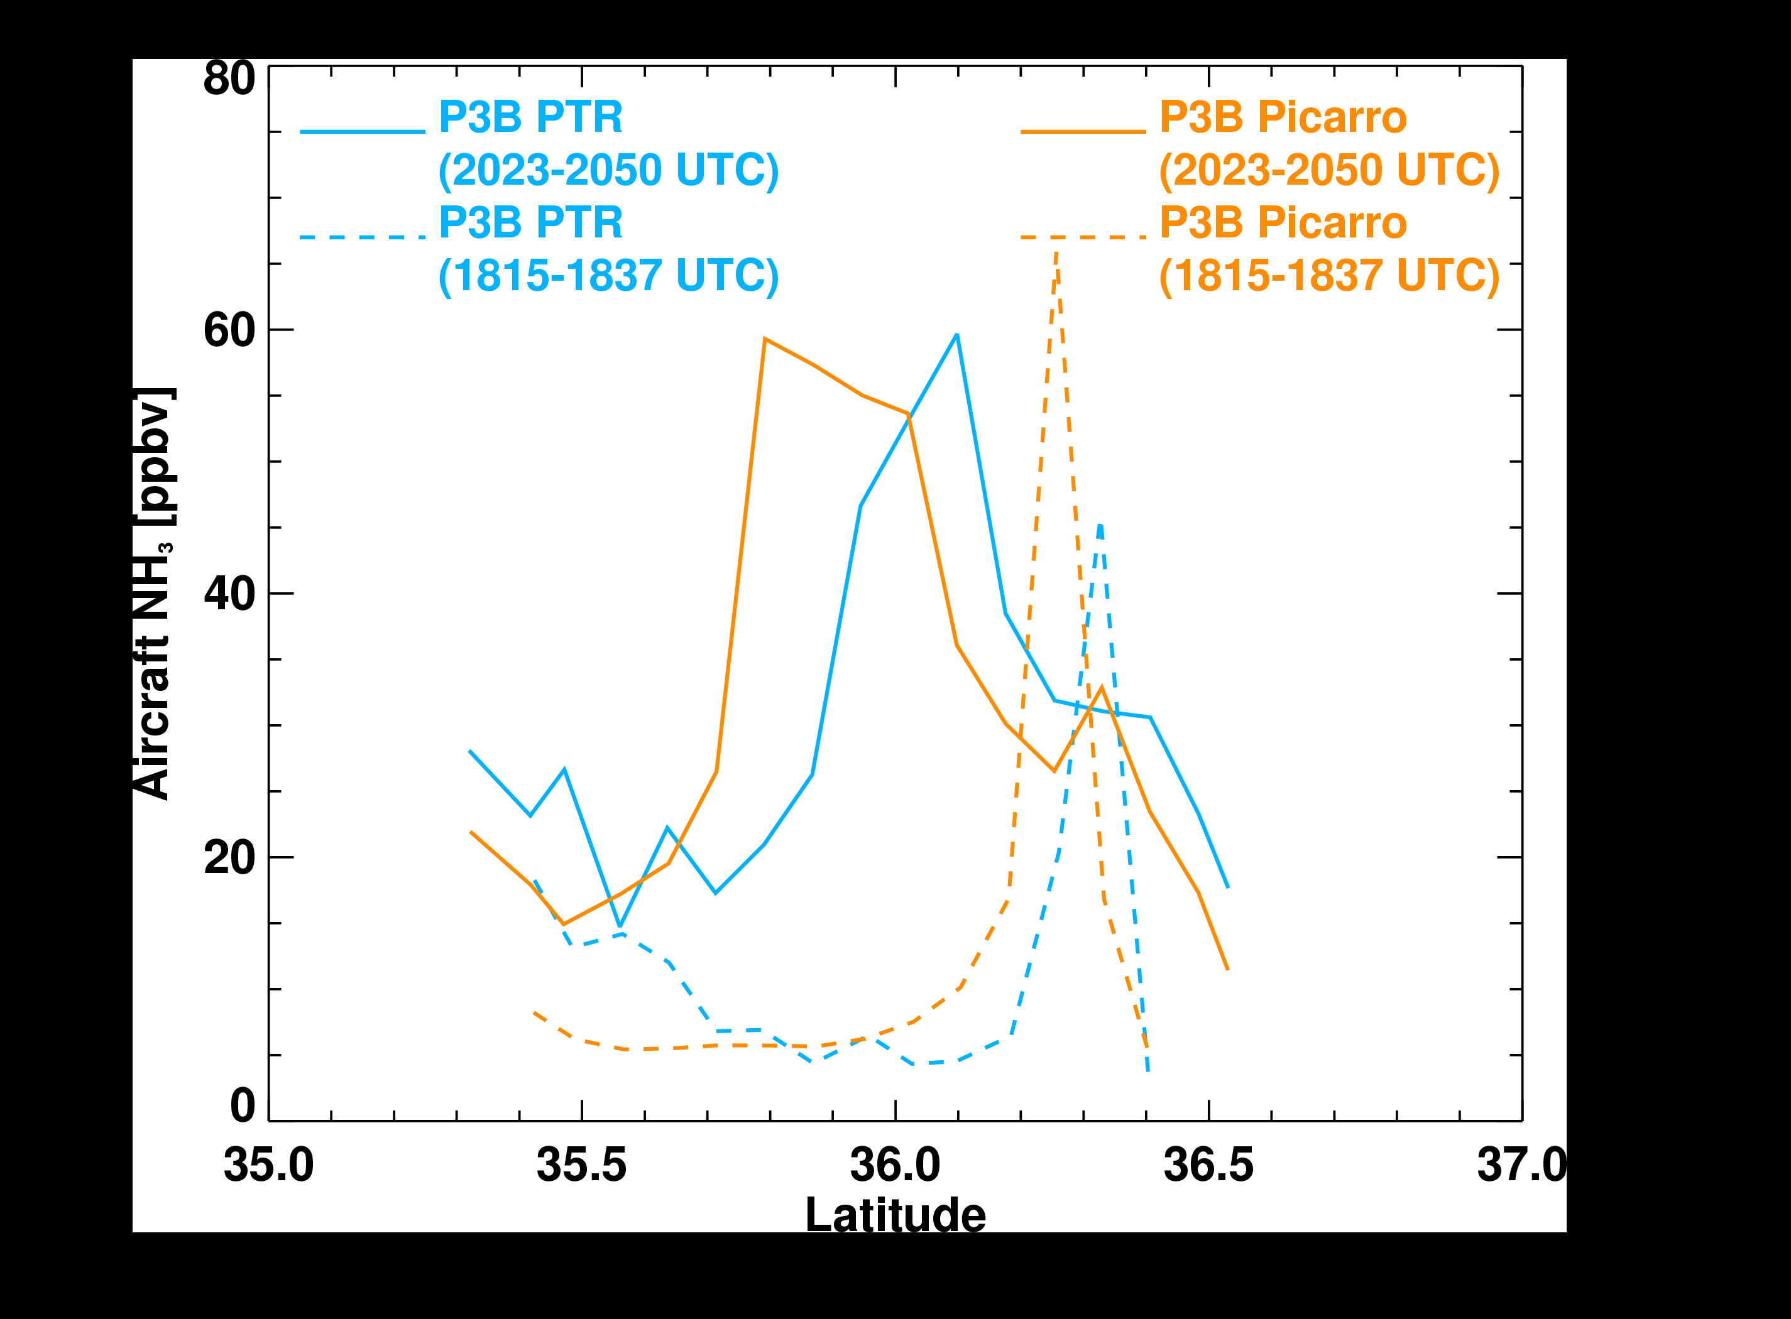
NH₃ from aircraft
NH₃ is highly reactive➔ highly variable in space and time
DISCOVER-AQ campaign in January 2013 in the San Joaquin Valley
~ 2 hours
Aircraft campaigns provide high quality data, but are not feasible for long term monitoring over large areas

Slide 5
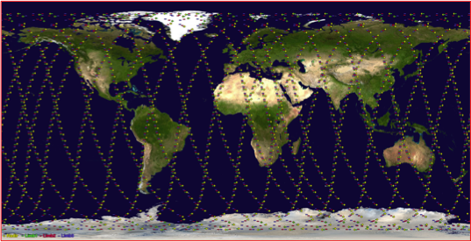
TES instrument
TES Global Survey Track
flies on NASA Aura (part of the polar orbiting “A-Train”)
launched in July 2004
well calibrated
FTS with a spectral resolution of 0.06 cm-1
5 x 8 km footprint
Two observation modes:
Global Surveys: 26 hours long, return to starting point every 16 days
Special Observations: higher sampling density over shorter tracks

Slide 6
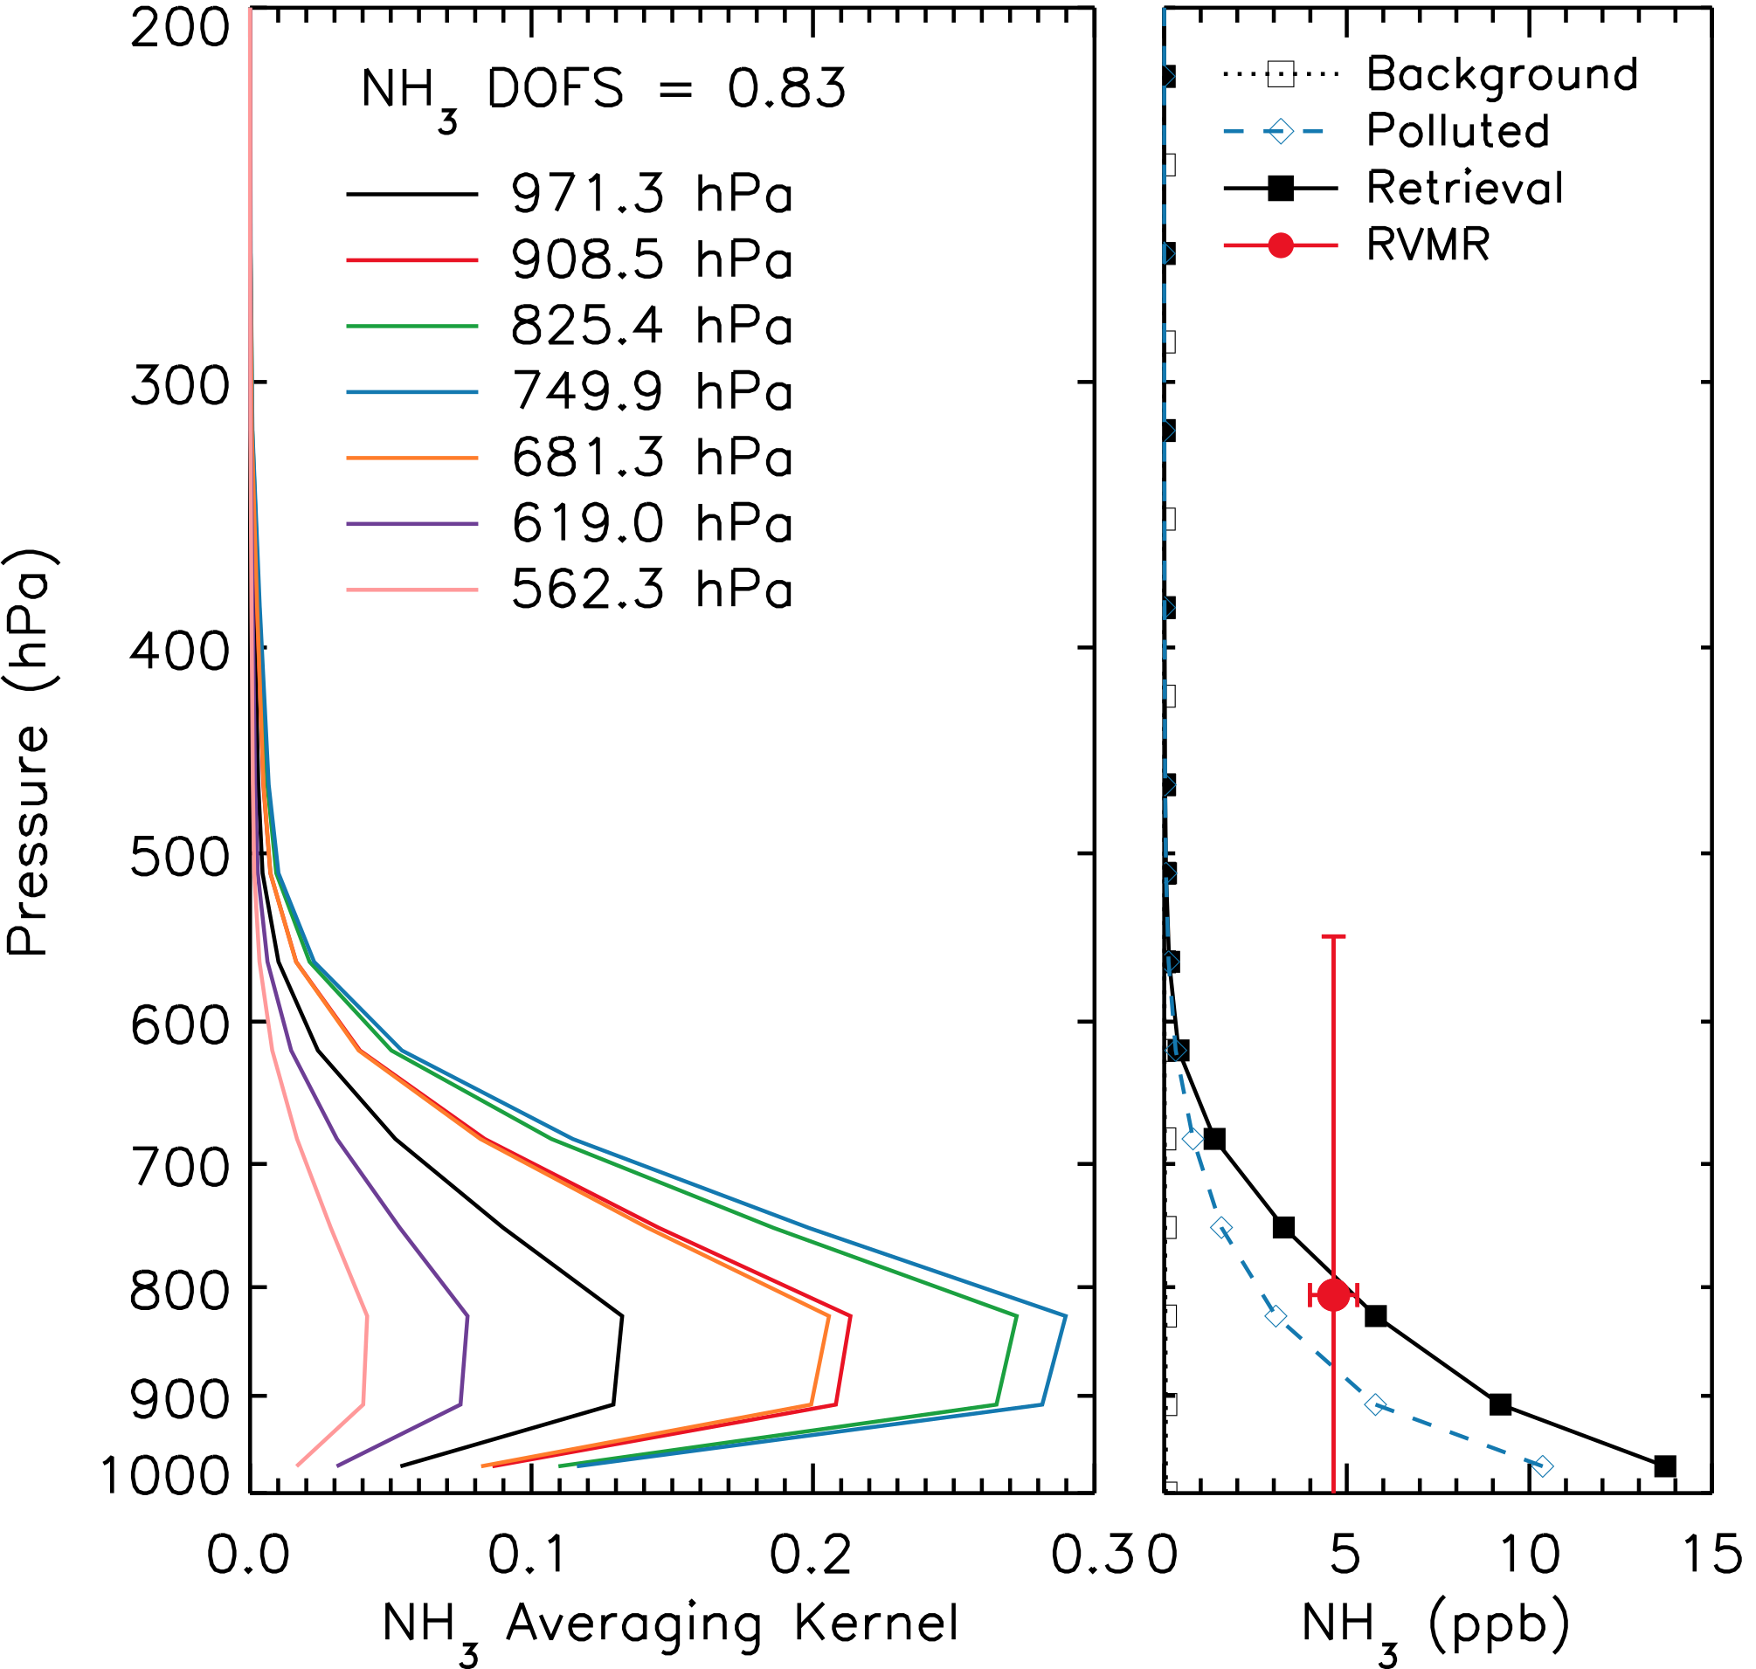
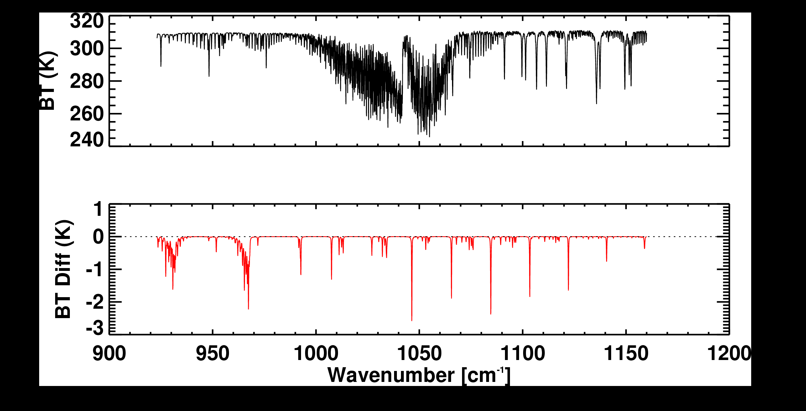
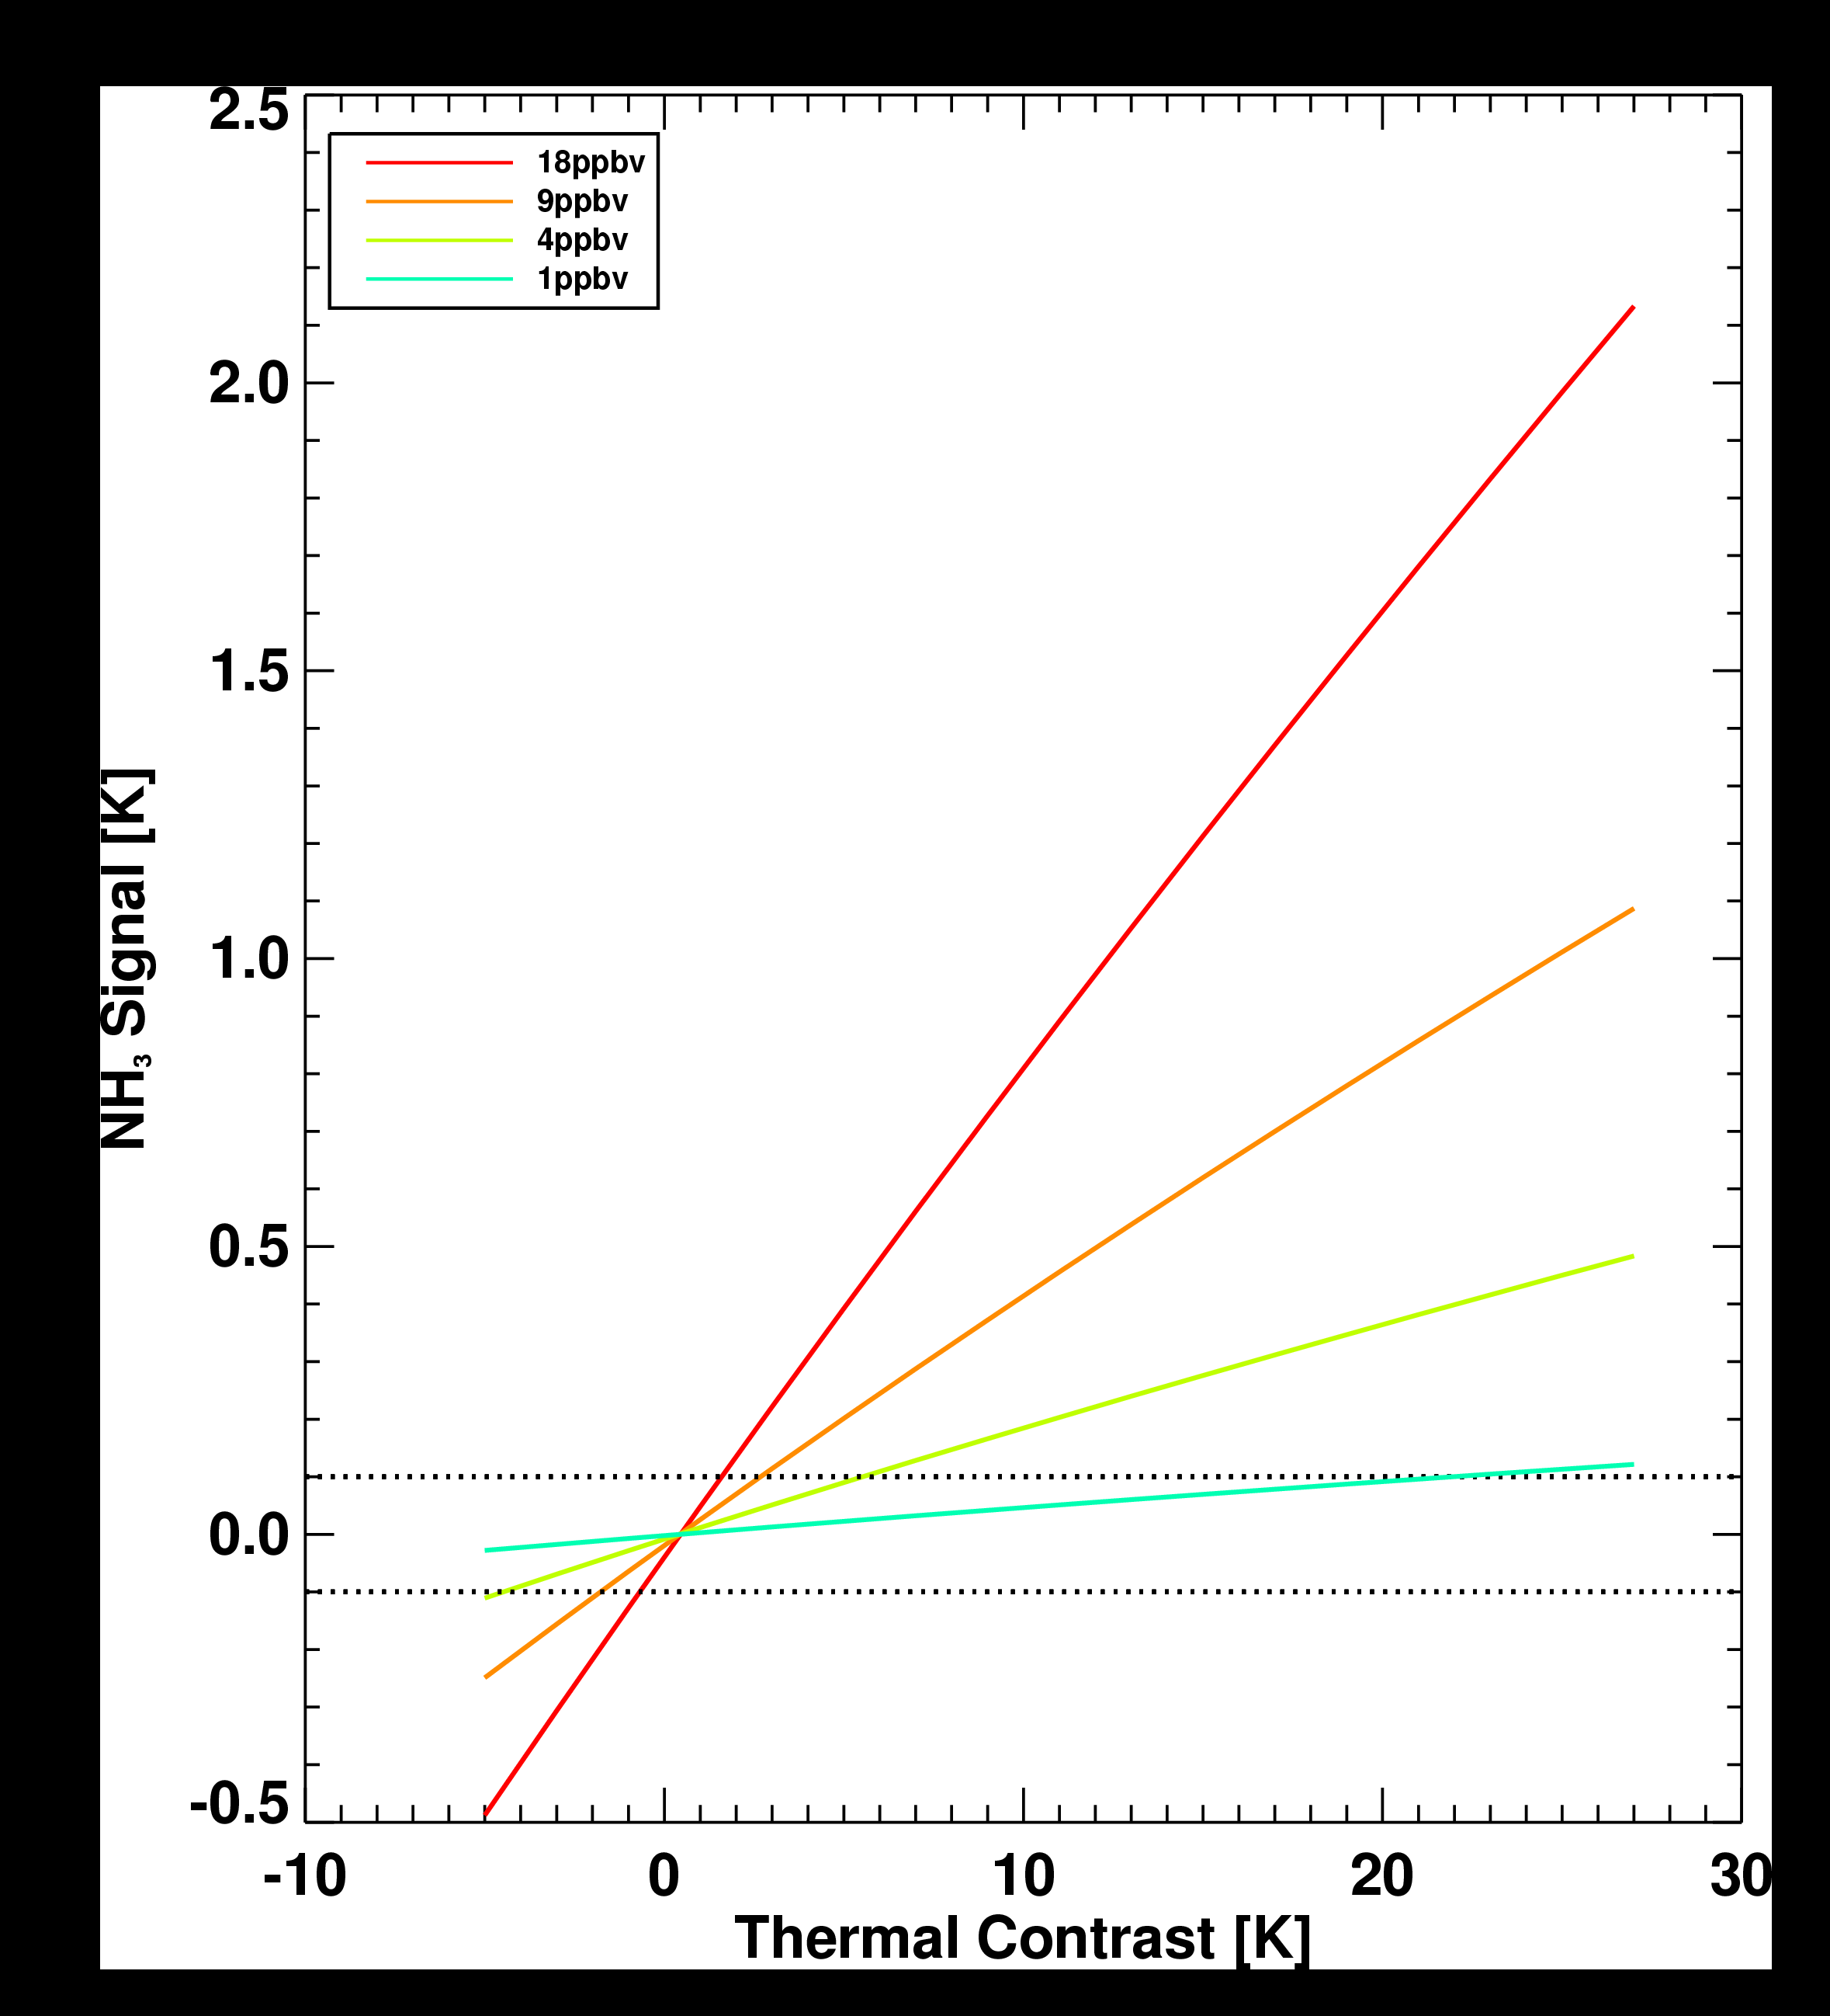
NH₃ from TES
Simulated TES spectra and NH₃ signal
18 ppbv at surface
TES is most sensitive to NH₃ between 900 and 700 mbar
1 piece of information or less: DOFS<1.0
Collapse all information to a single point: RVMR
  Easier to compare with in situ measurements
Detectability is ~ 1 ppbv under ideal conditions
But thermal contrast also plays a role

Slide 7
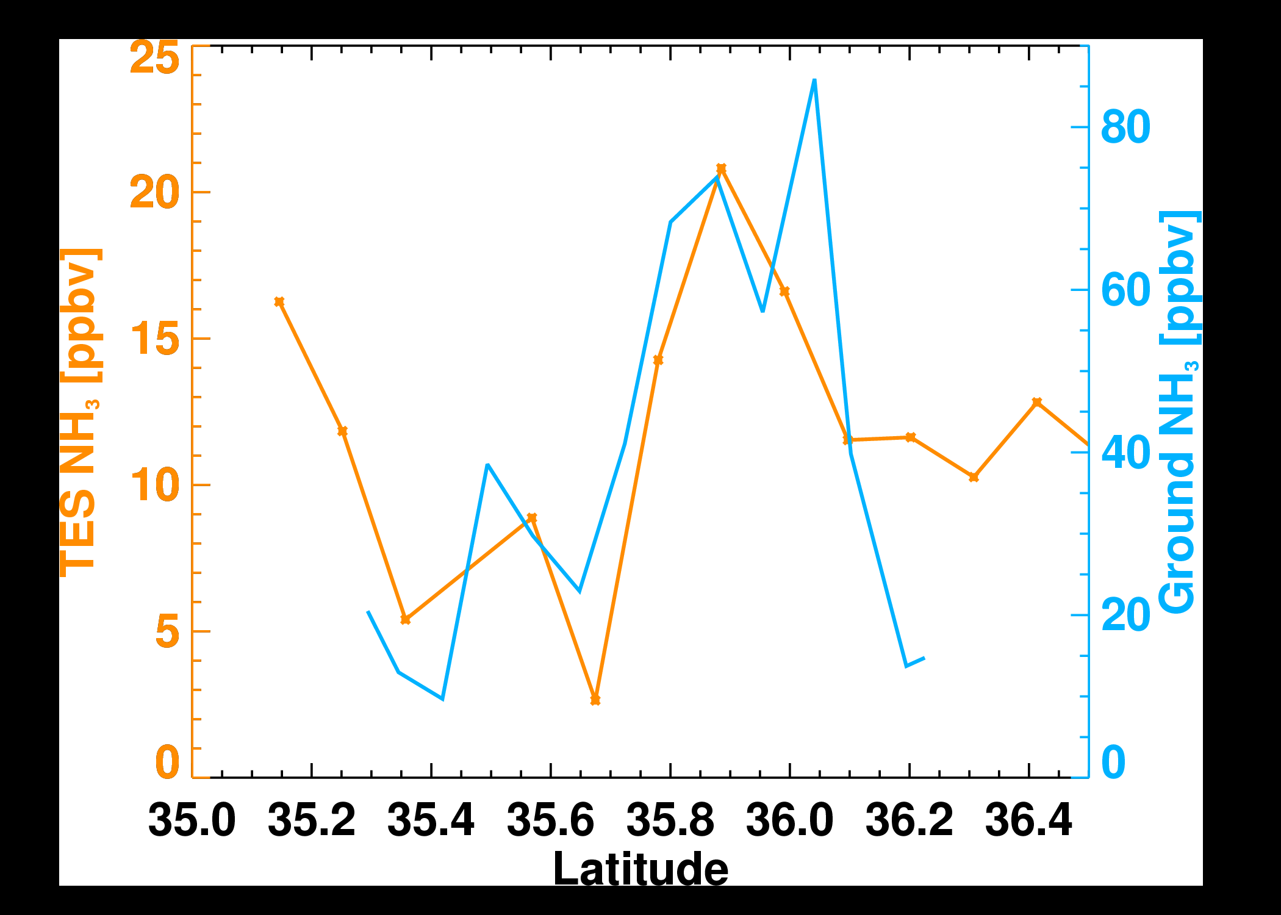
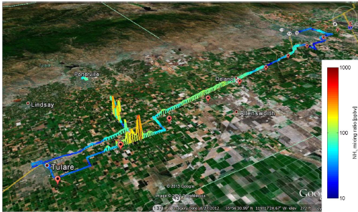
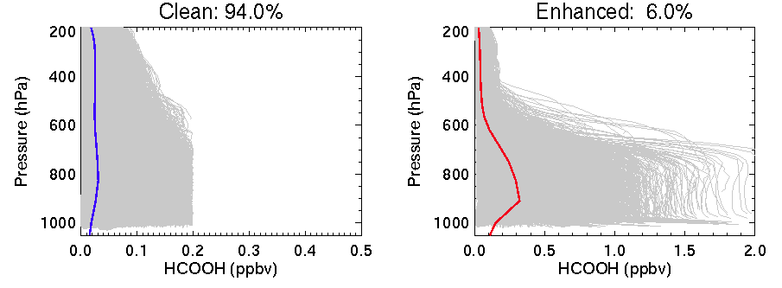
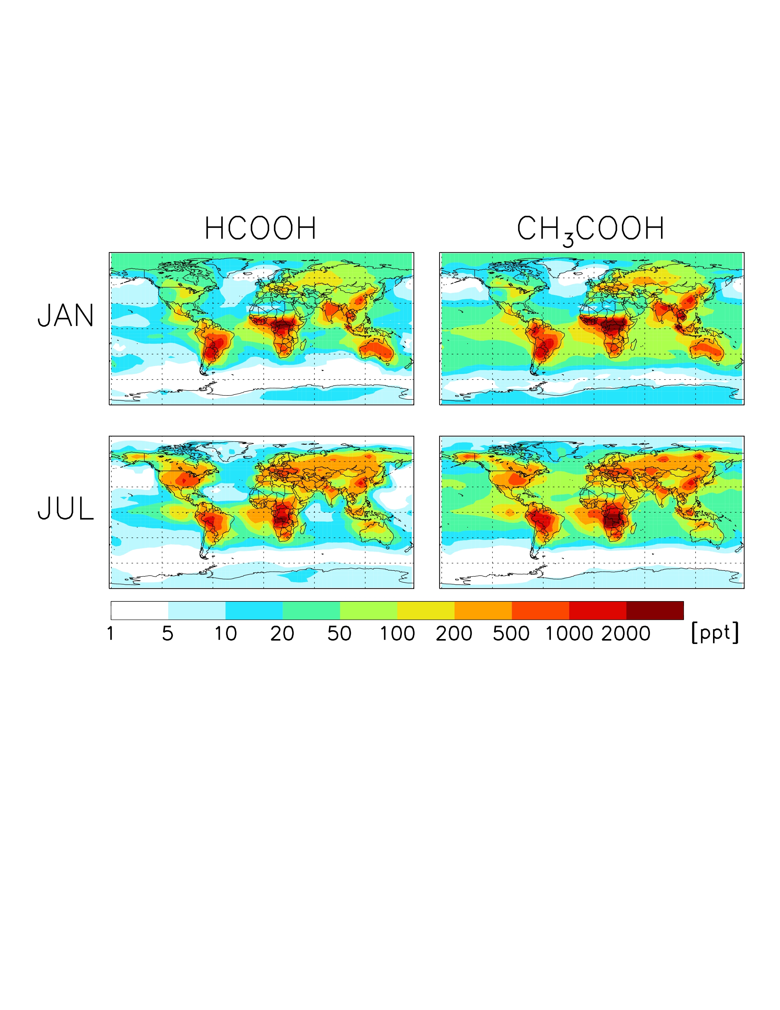
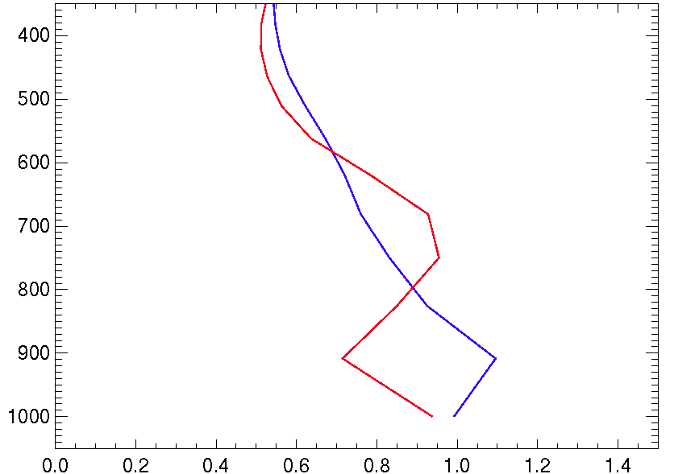
Surface and TES NH₃ in
DISCOVER-AQ 2013
Open path Quantum Cascade Laser (QCL) on a moving platform collected data almost directly under TES transect (red symbols) in the San Joaquin Valley on January 28, 2013
Hotspot measured near Tipton
TES and QCL NH₃ measured in Tipton area in January 2013 are spatially well correlated

Slide 8
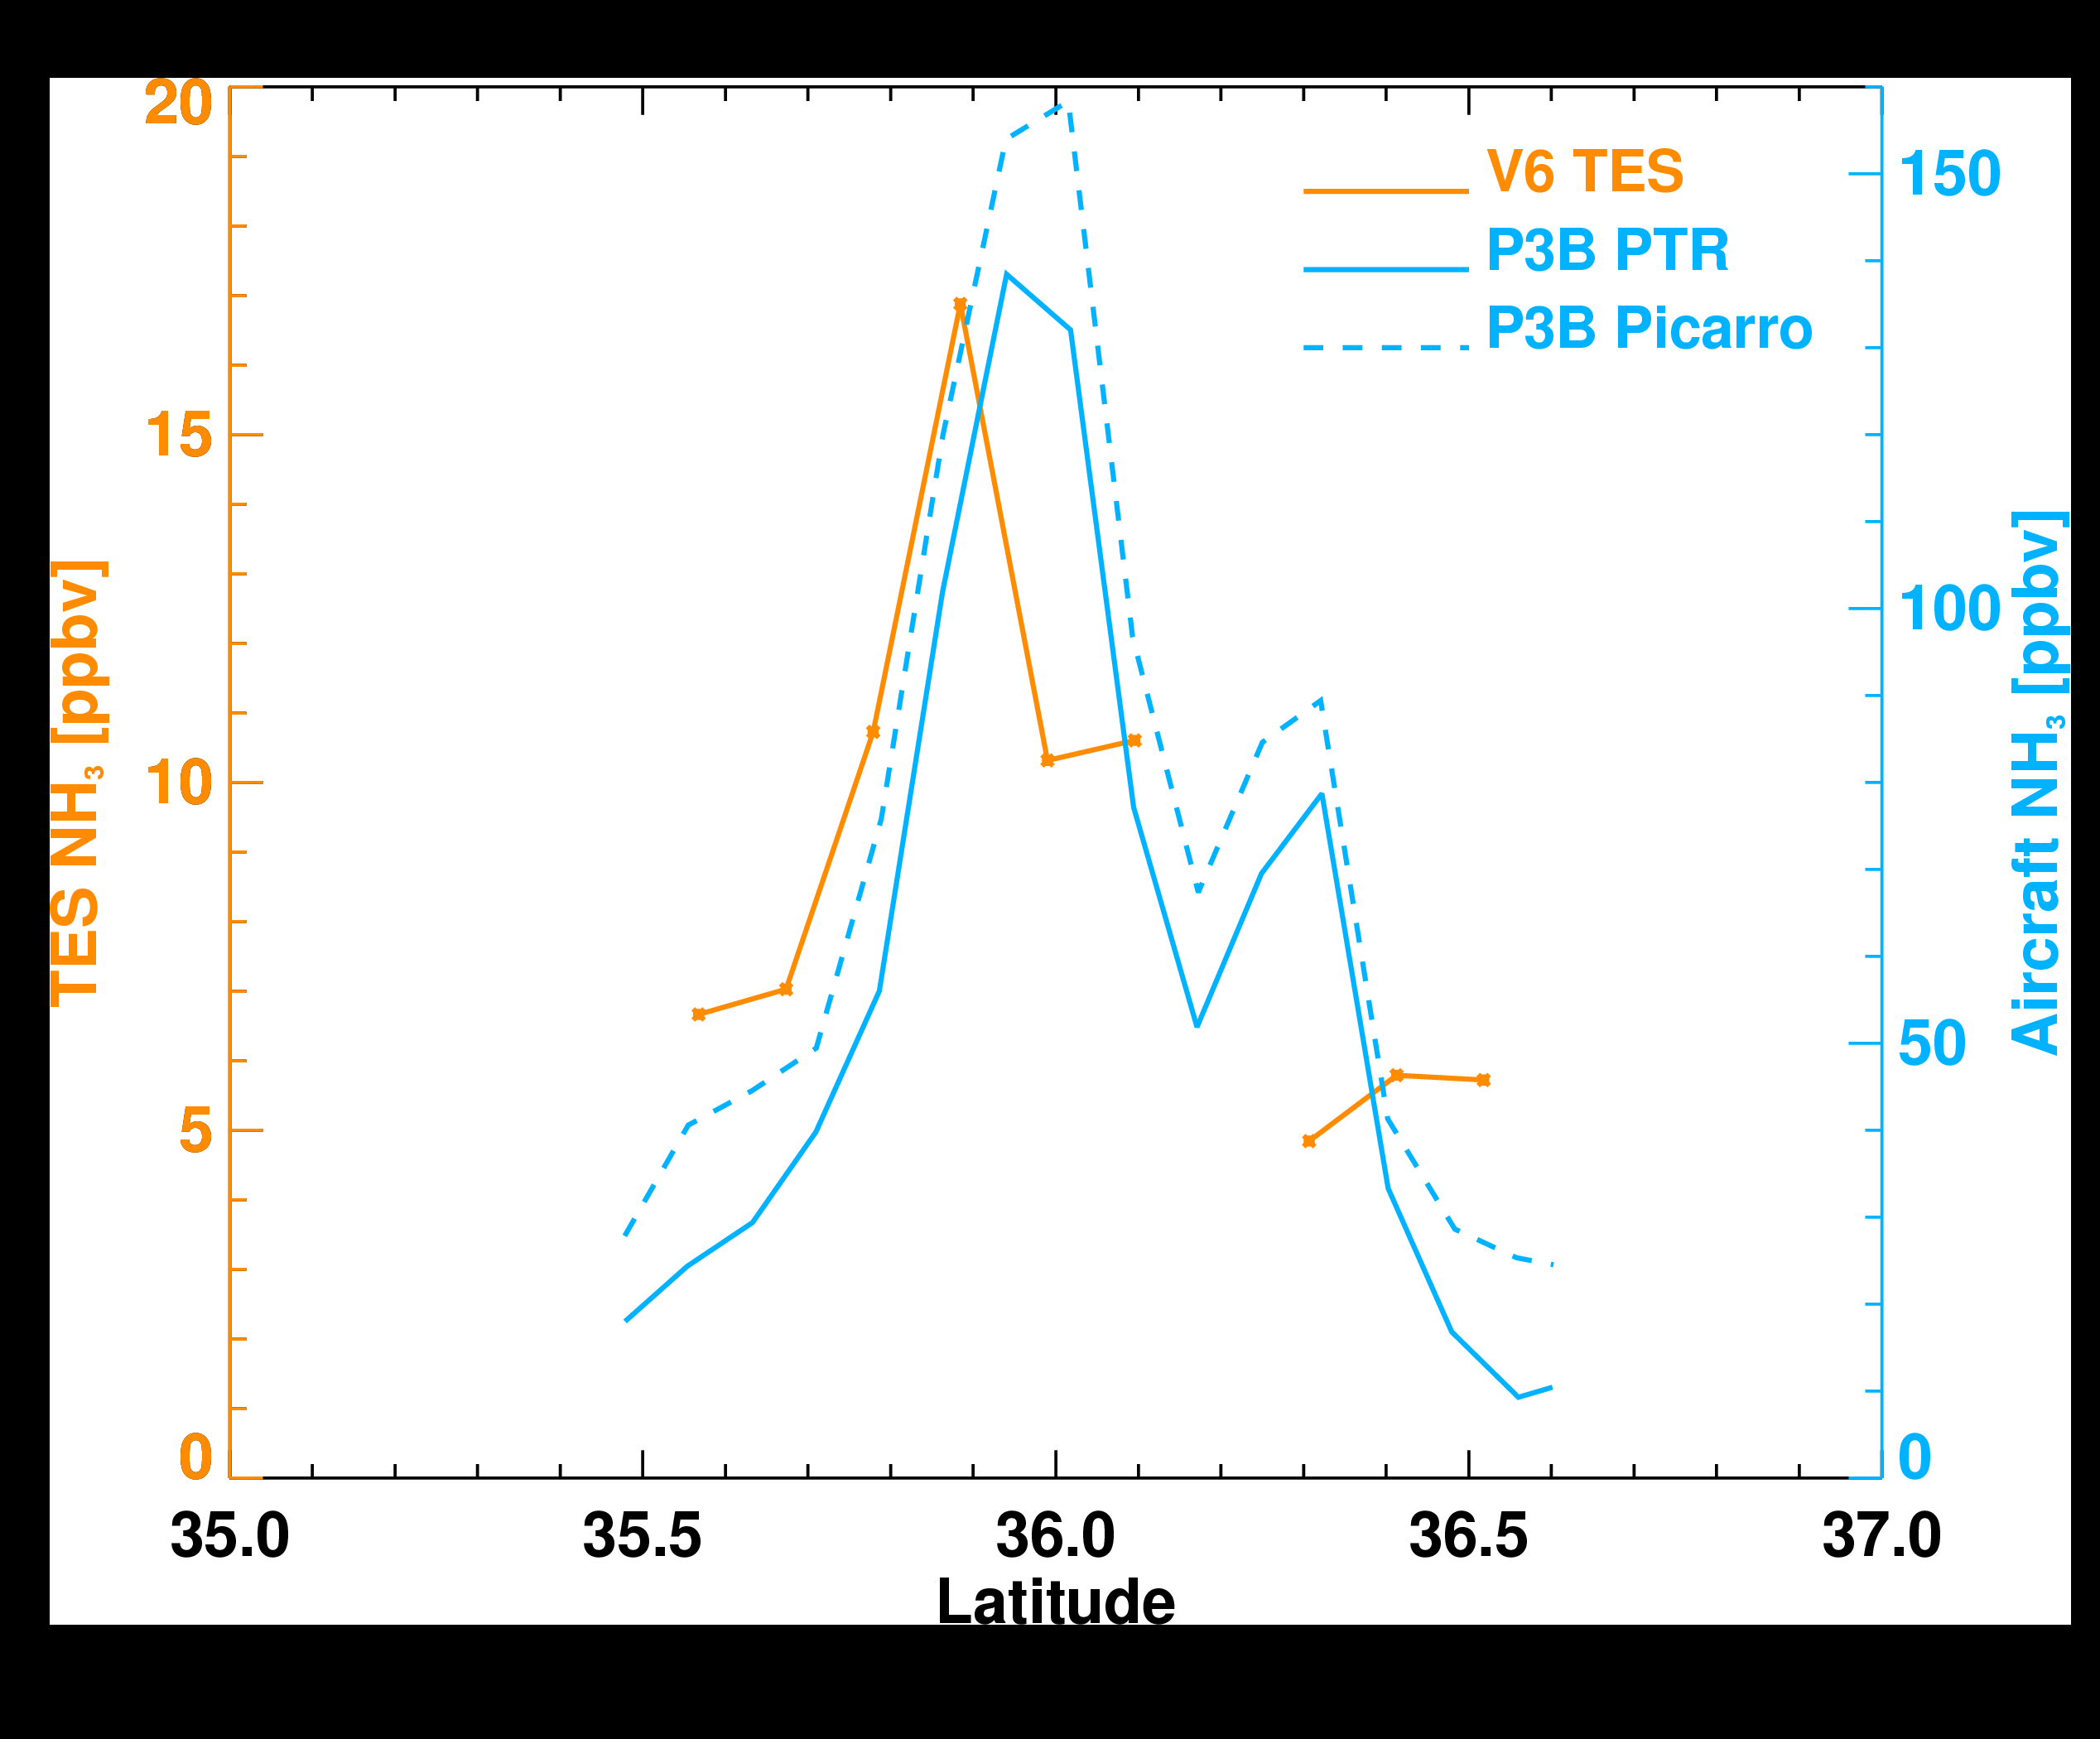
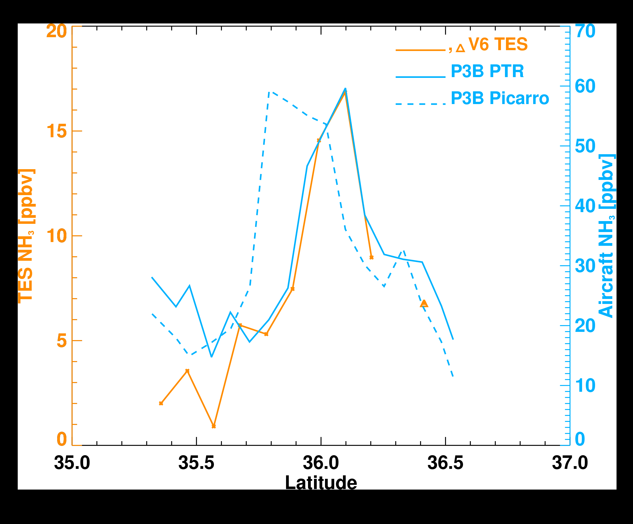
TES and aircraft NH₃ from DAQ
January 21
January 30
P3B aircraft @ 500 m
TES maximum sensitivity between 1 and 2 km

Slide 9
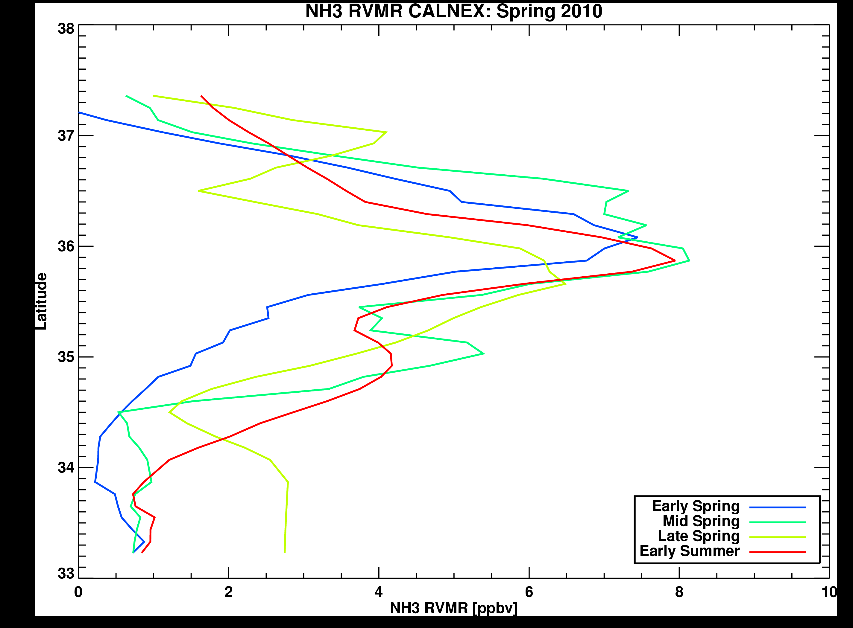
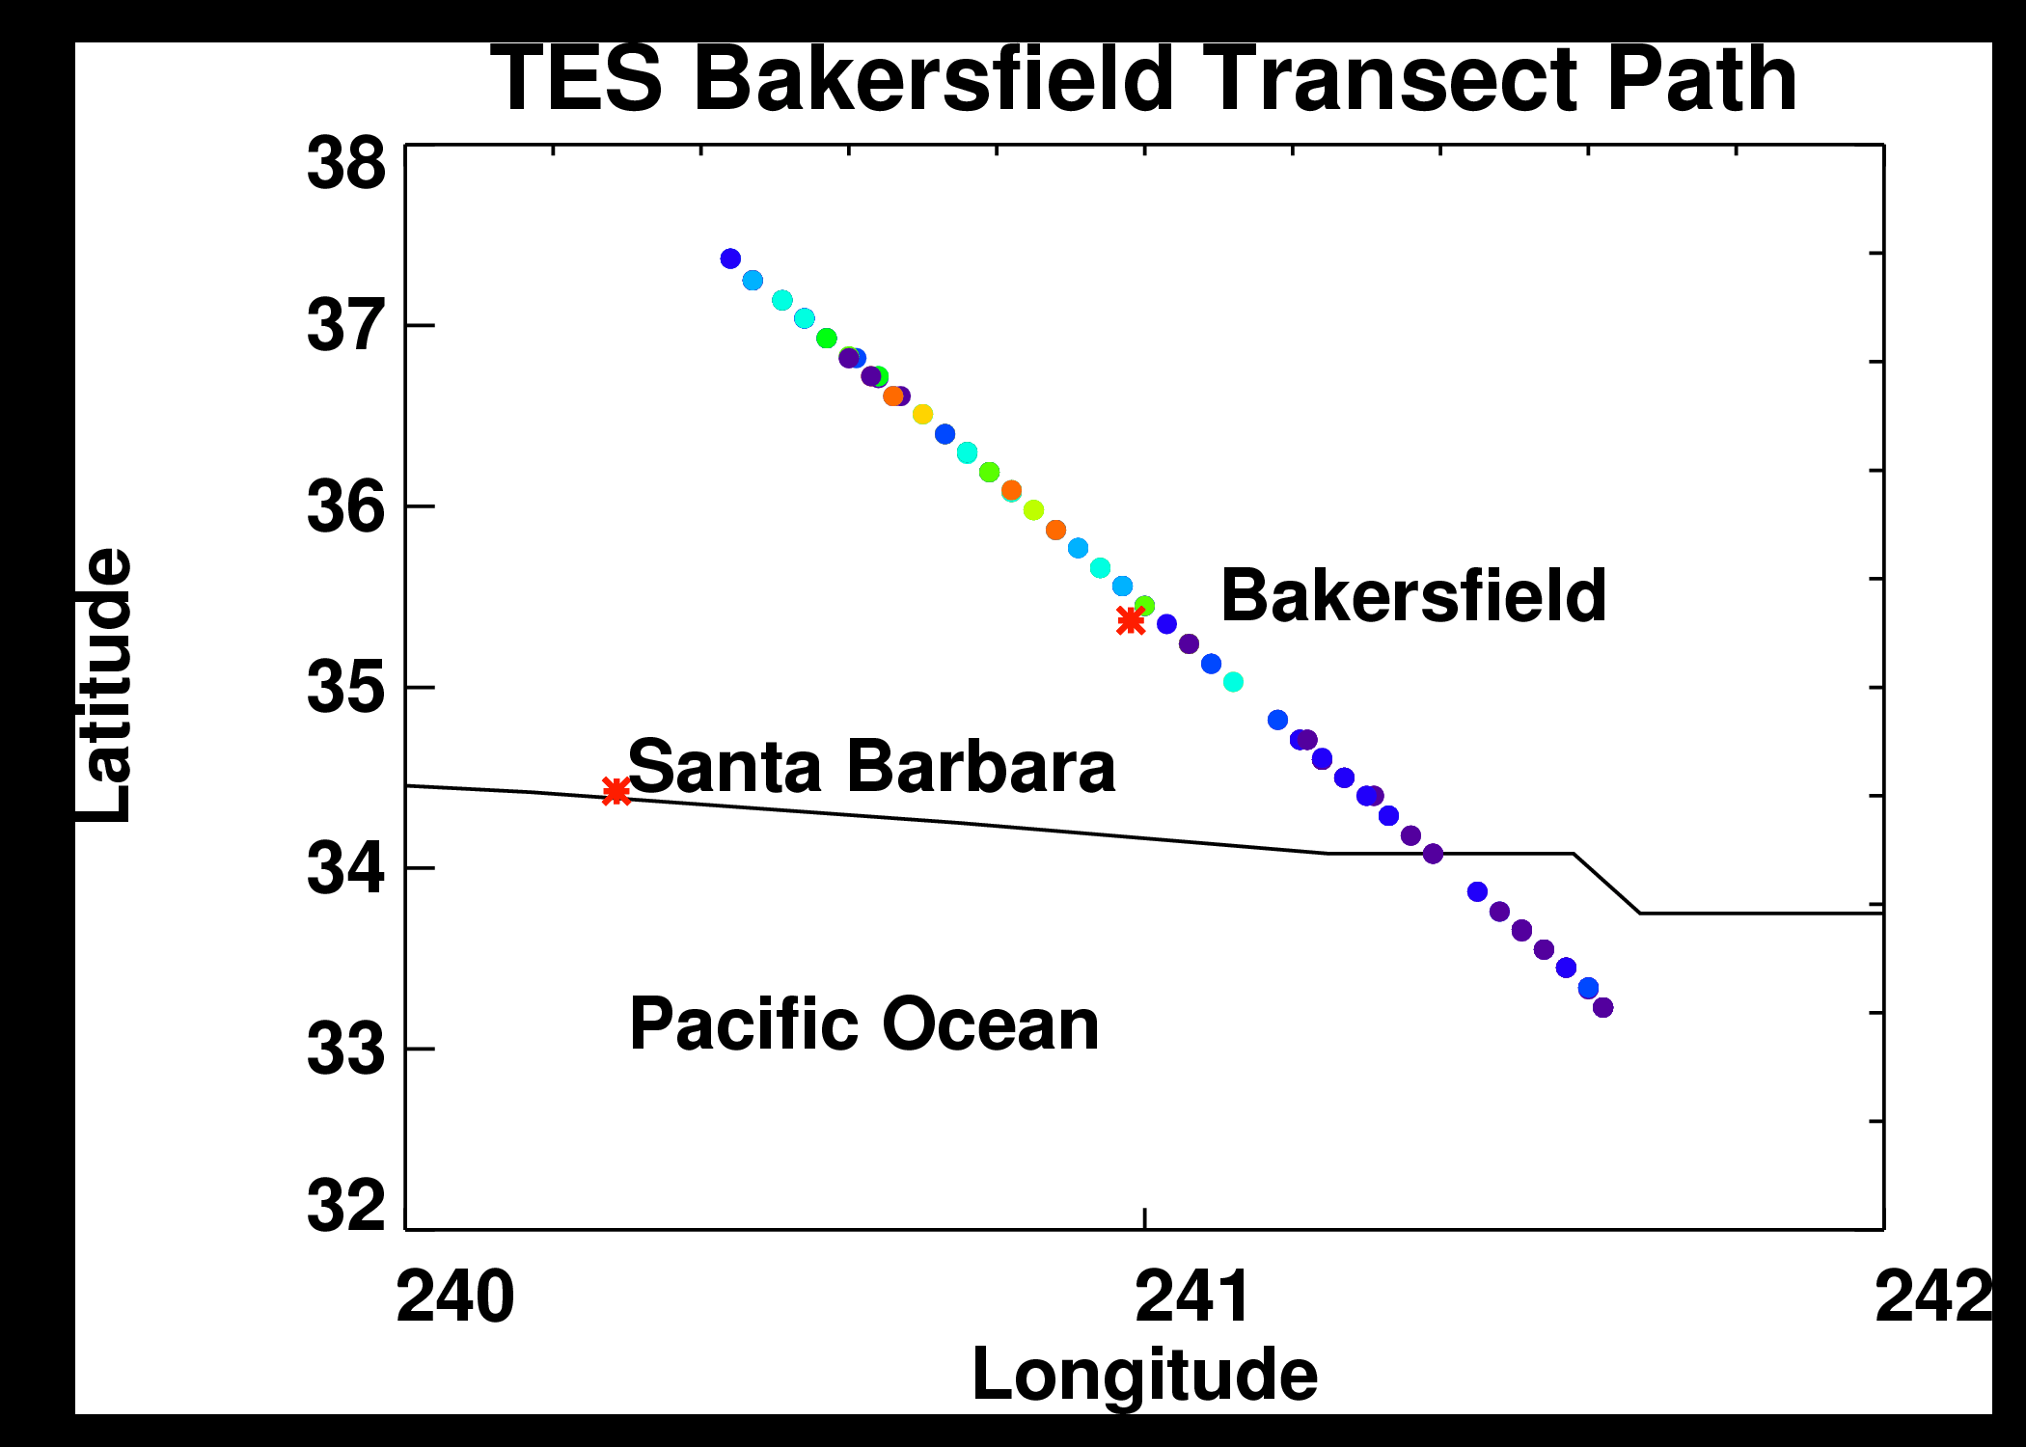
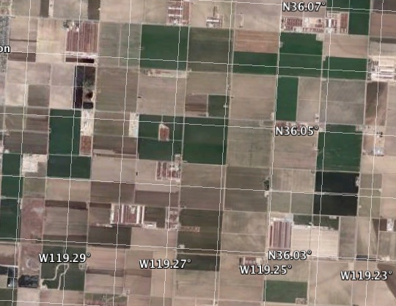
CalNex 2010: California spring
CalNex: Campaign focused on air quality and climate change
  ➔Aircraft and surface measurements and TES transects
    ➔Central Valley, southern California basin, Pacific Ocean

Slide 10
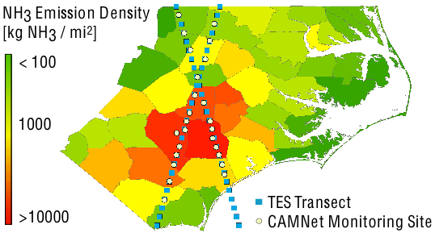
TES NH₃ Validation
North Carolina
Intense livestock farming (hogs, chickens, turkeys)
EPA CAMNet NH₃ monitoring network
TES high spatial density observations (transects)
Feb – Dec 2009
Allows detection of spatial variability and seasonal trends
CHALLENGE
  TES: instantaneous profile over 5x8 km
  CAMNet: two week average at a surface point
  Cloudy summers!

Slide 11
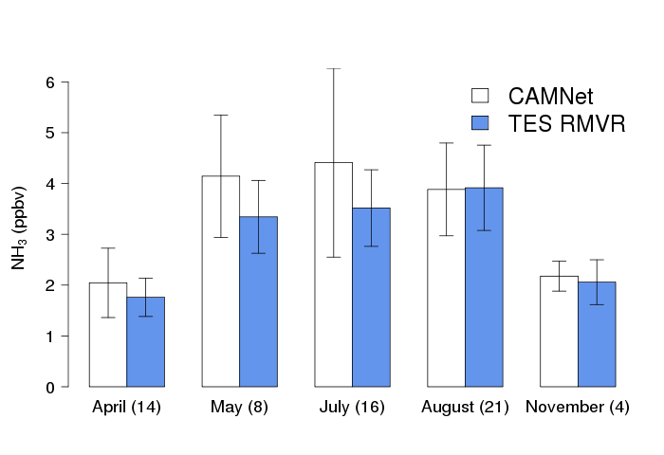
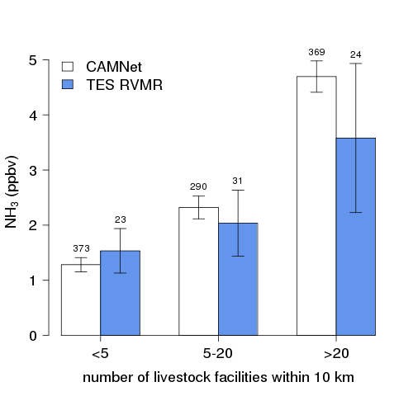
Seasonal and spatial variability
NH₃ vs time
NH₃ vs source concentration
TES and surface measurements are qualitatively well correlated
Pinder et al., GRL, 2011

Slide 12
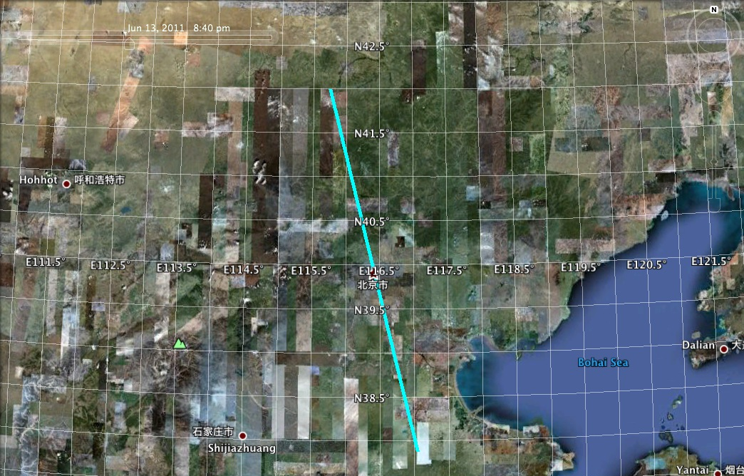
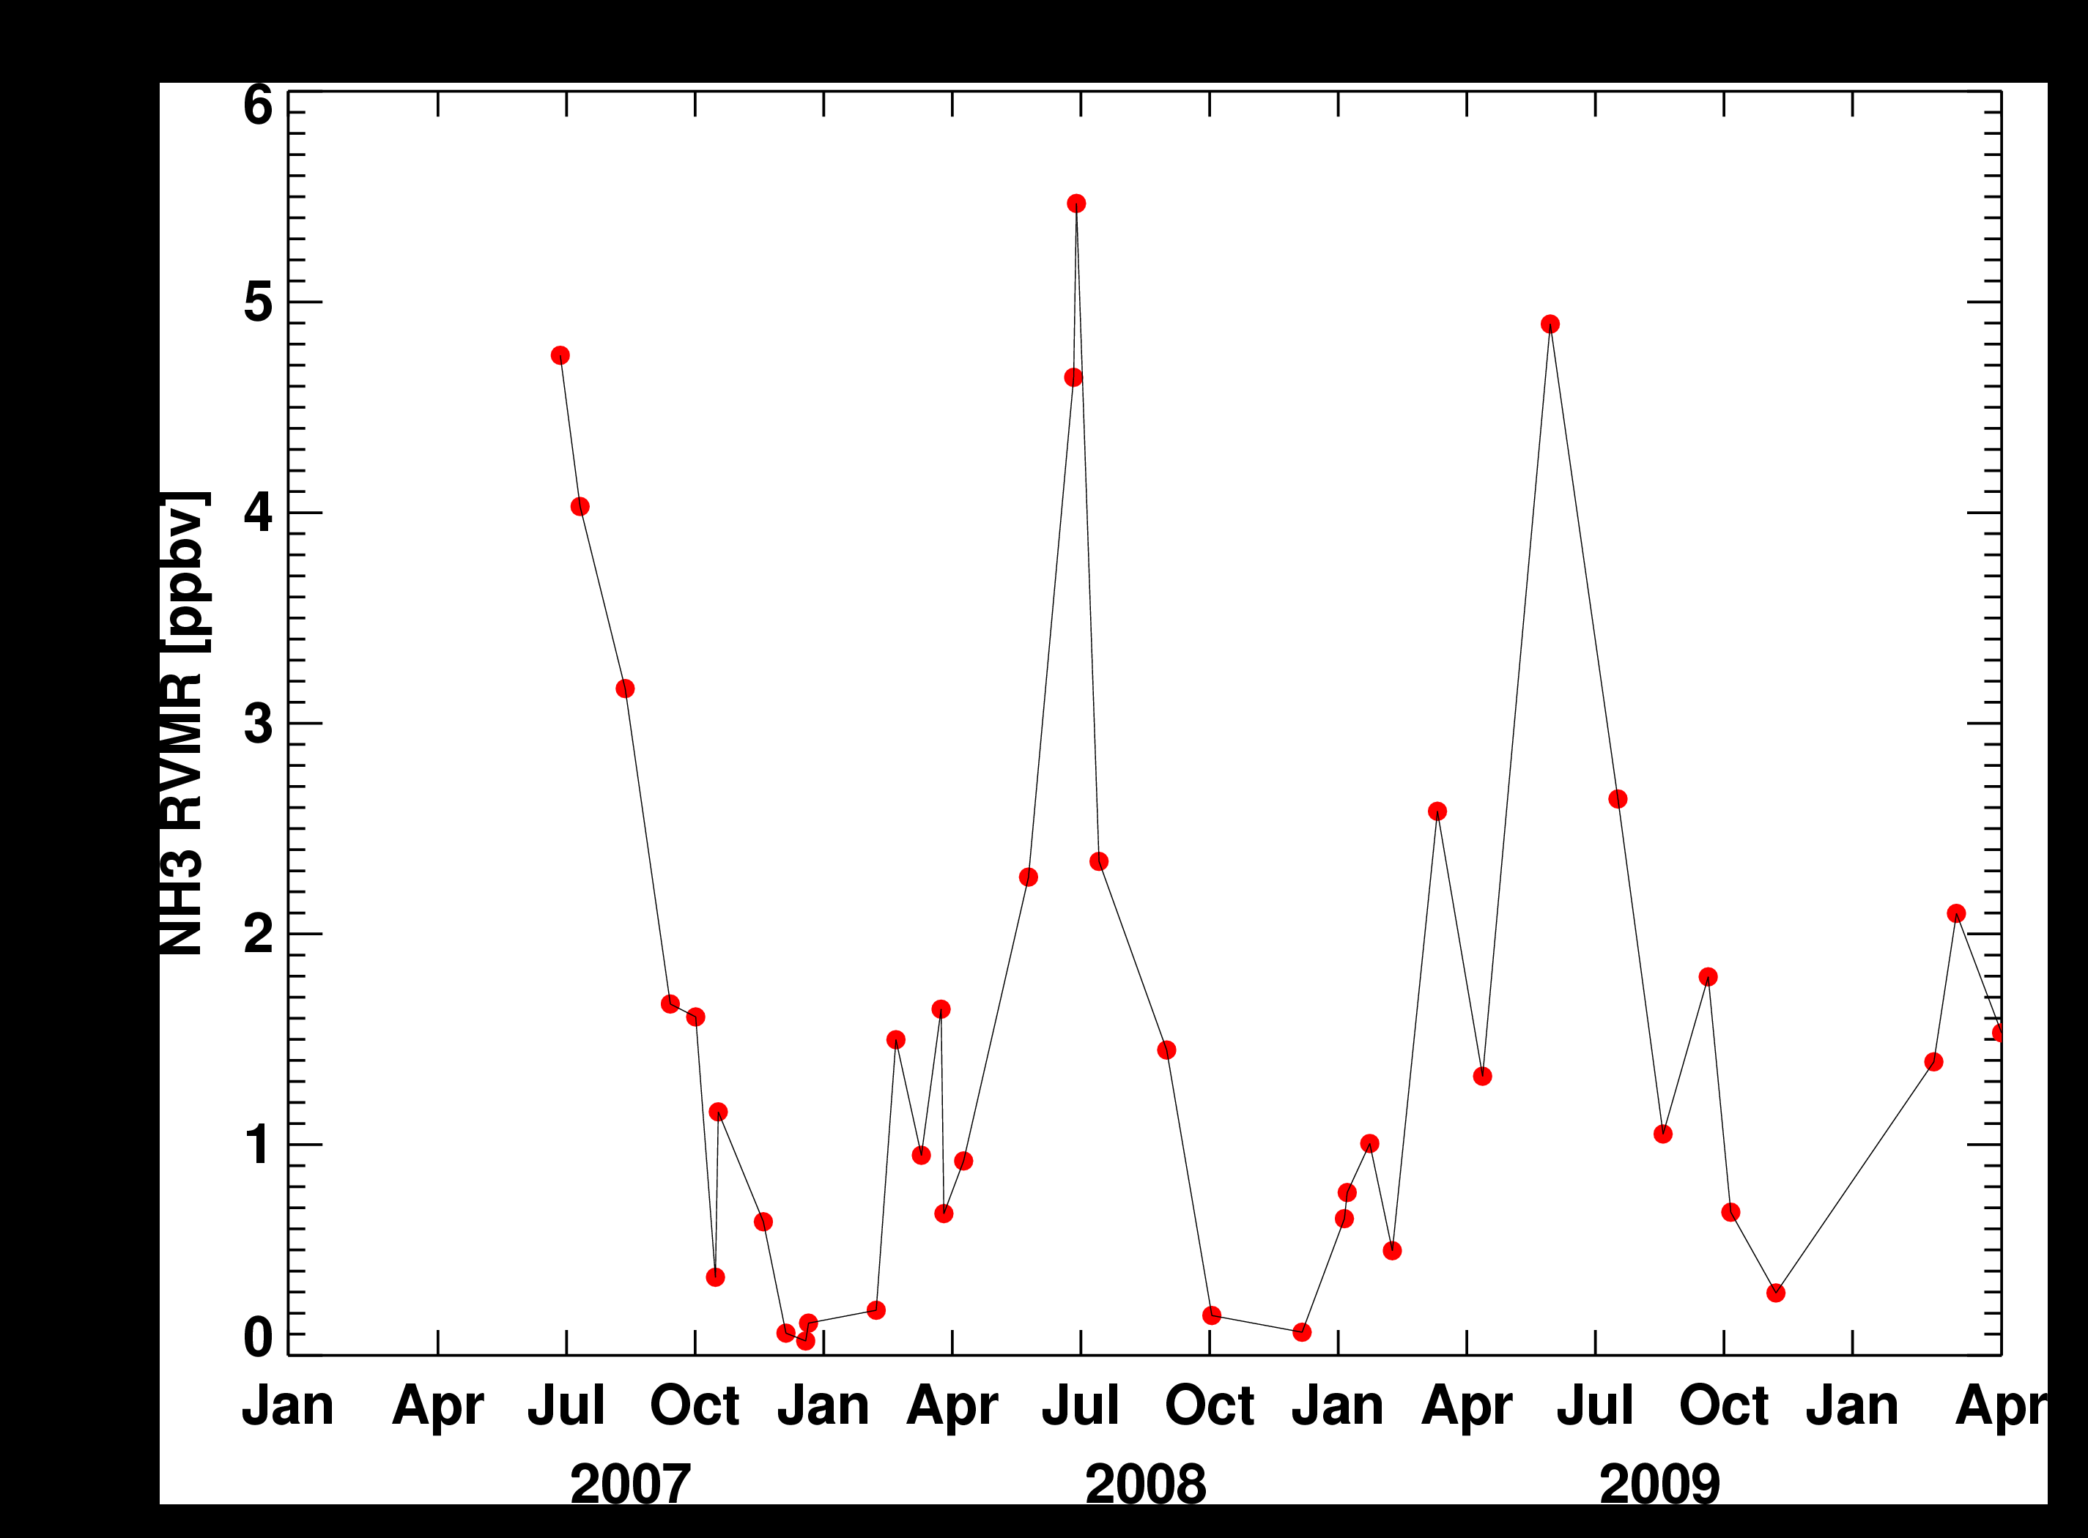
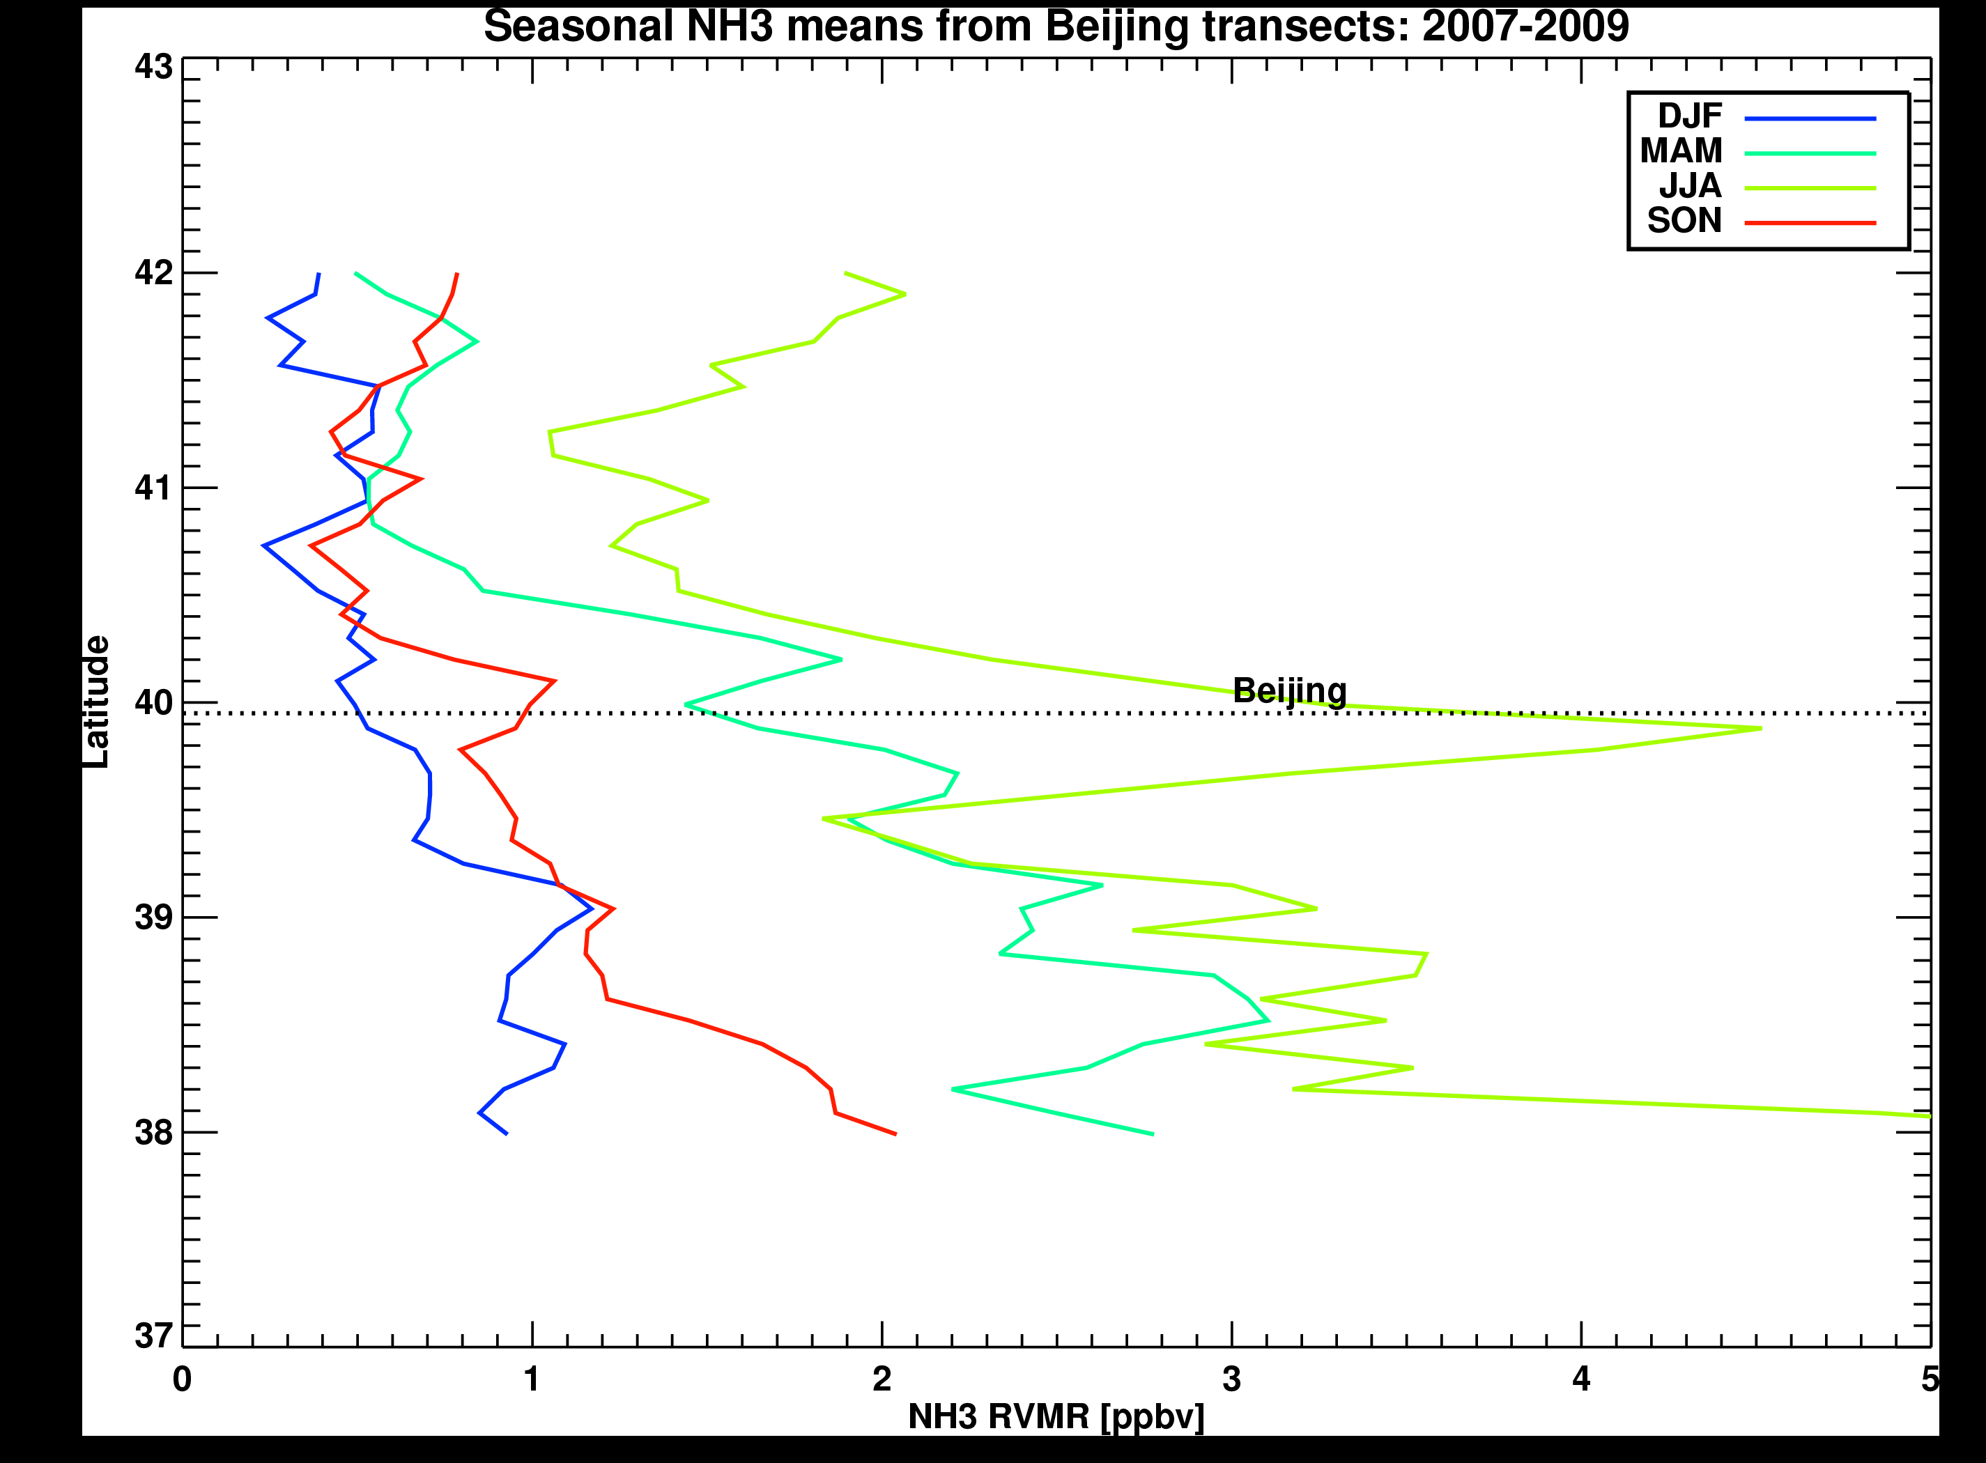
Eastern China: 2007-2009
TES transect path
TES NH₃
Shangdianzi
Beijing
Beijing
Seasonal means from TES
Beijing
Shangdianzi
Surface NH₃
Meng et al., ACP, 2011

Slide 13
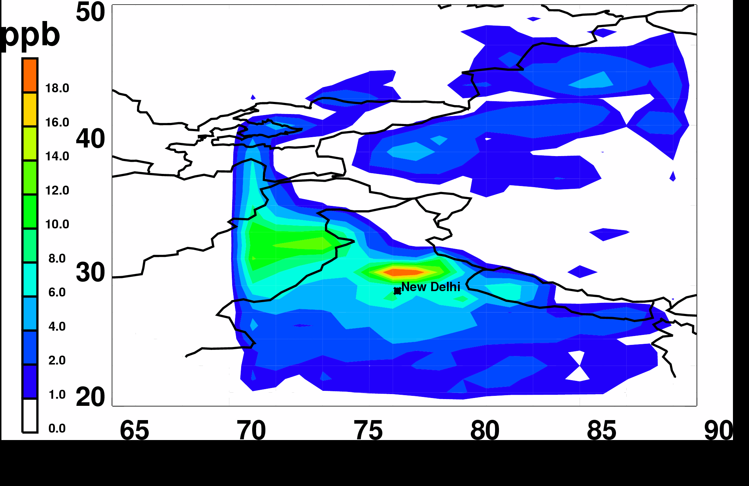
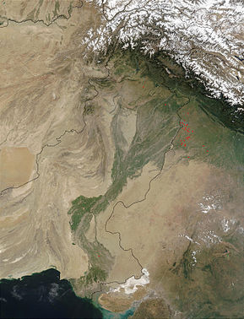
South Asia: July-August 2007
High NH₃ north of New Delhi and in the northern Indus valley
Indus River Valley

Slide 14
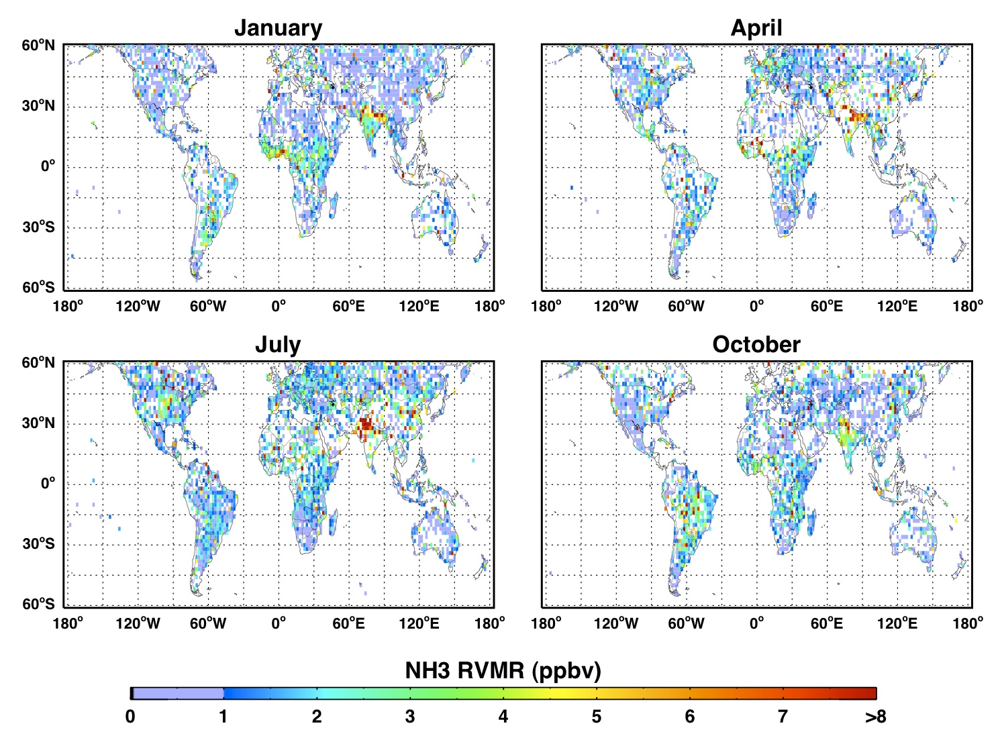
Global NH₃ results
TES NH₃ RVMR from GS: 2006-2009
Large increase between NH winter and summer
Hotspot over India
Biomass burning signal over South America and Africa
Shephard et al., ACP, 2011

Slide 15
Better emissions with TES NH₃
Largest changes western US and Mexico
Used GEOS-Chem adjoint with TES NH₃ profiles, averaging kernels and error covariances to optimize model
Optimized GC shows better agreement with AMoN network measurements
Zhu et al., 2013, JGR

Slide 16
Final comments
Limitations
  TES is sensitive to only higher amounts (> 1.0 ppbv) of NH₃
  Requires some thermal contrast to detect NH₃
  Clouds reduce amount of useful data
TES data
  Show seasonal and spatial variability consistent with in situ measurements
  Have greater temporal and spatial coverage than aircraft campaigns or surface networks
  Used in an inverse modeling framework improved agreement between GEOS-Chem output and AMoN measurements
TES NH₃ data available at:
  http://avdc.gsfc.nasa.gov/index.php?site=635564035&id=10&go=list&path=/NH3
  netcdf files with all NH₃ retrievals for each month since September 2004

Slide 17
Acknowledgements
  Markus Mueller and Tomas Mikoviny from the PTR instrument team
  PICARRO instrument team
  TES team at JPL
  Research was supported by
    the Jet Propulsion Laboratory, California Institute of Technology under contract to the National Aeronautics and Space Administration (NASA).
    CU support from NASA grant NNX10AG63G and EPA-STAR RD83455901

Slide 18
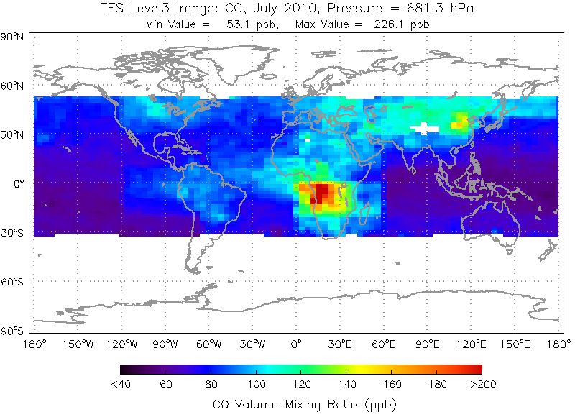
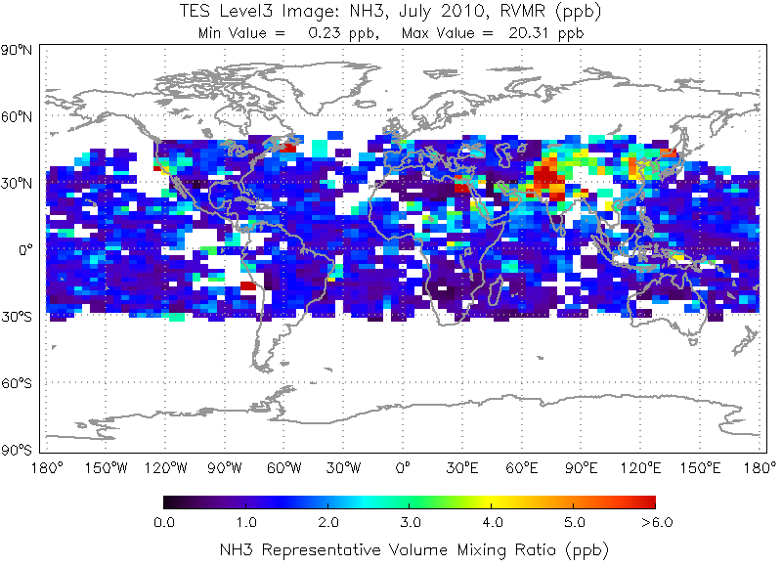
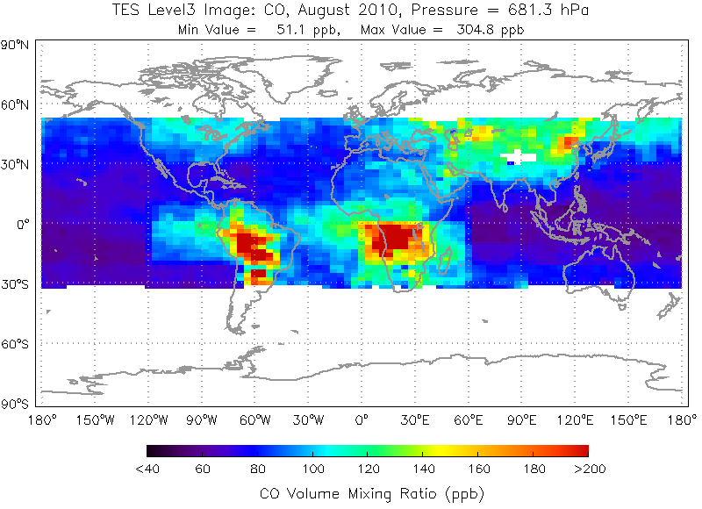
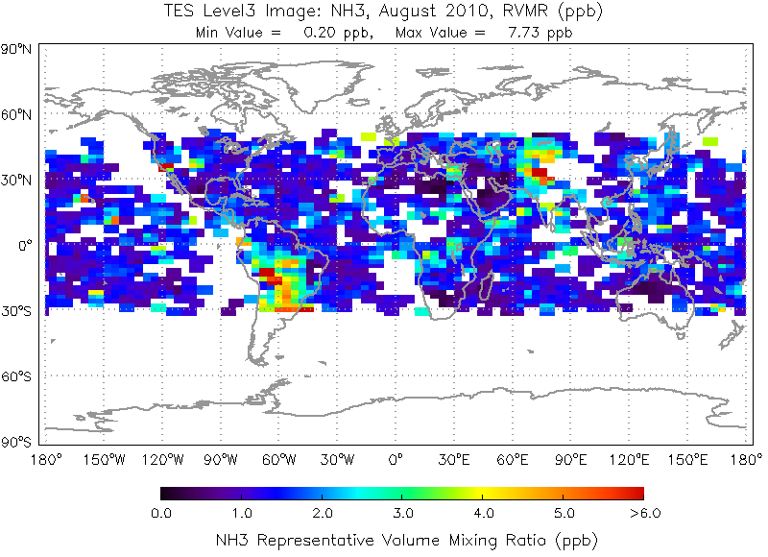
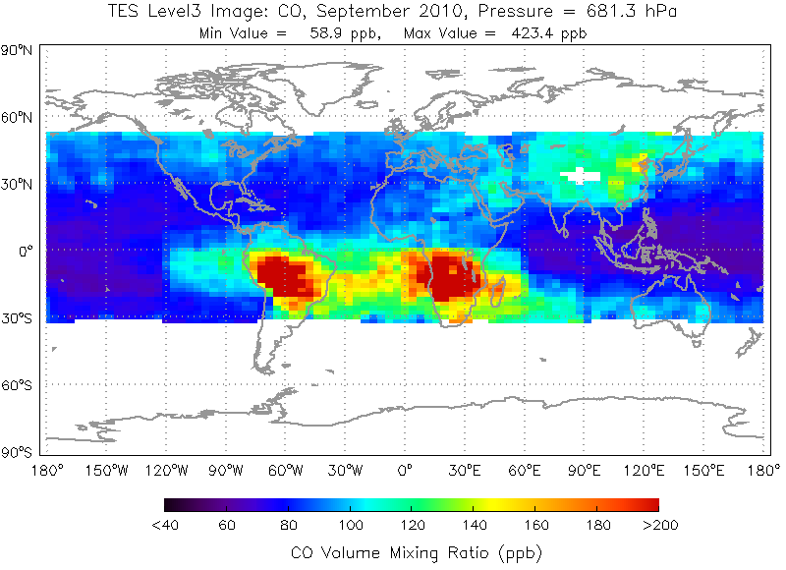
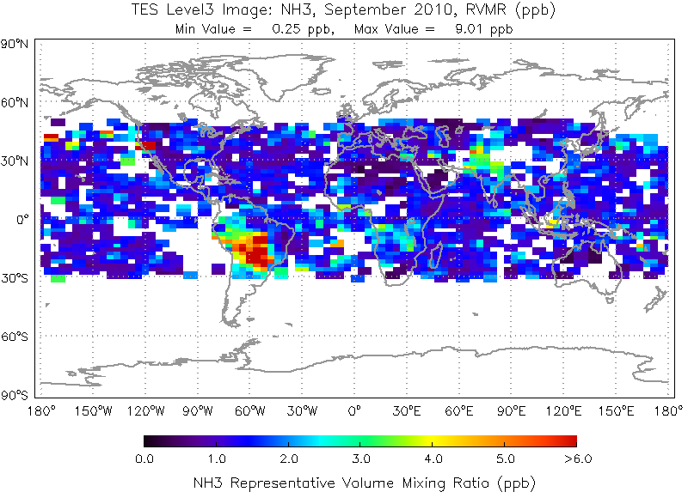
TES NH₃ and CO
Monthly CO at 681 hPa
Monthly NH₃ RVMR
NH₃ from TES V005 operational product
July 2010
High NH3 values over northern India
Aug 2010
Biomass burning in South America is evident in both CO and NH₃ maps
Sept 2010

Slide 19
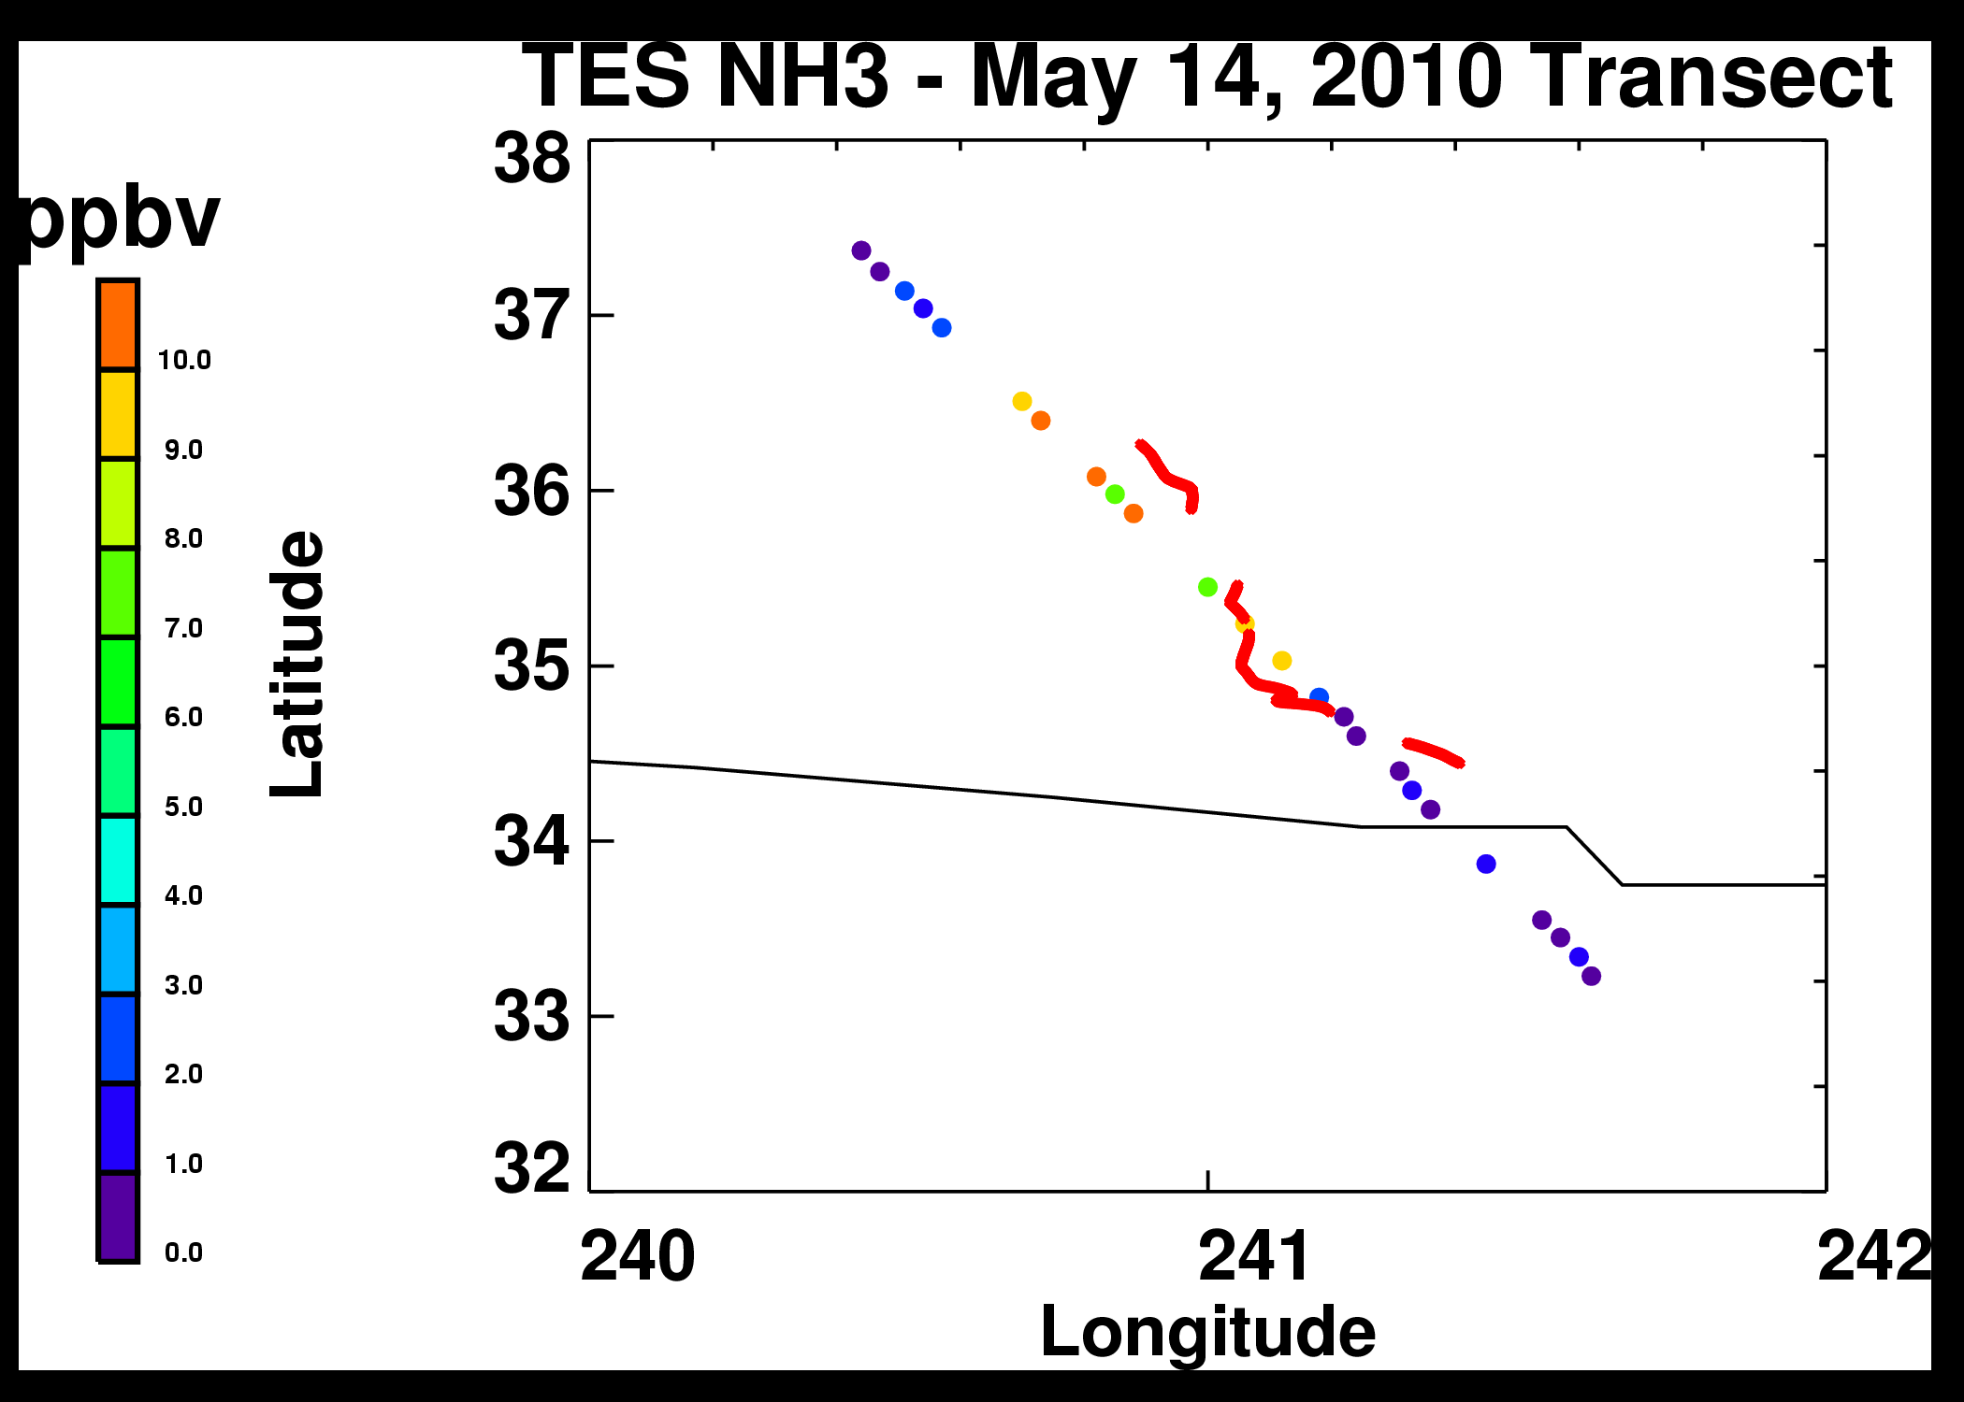
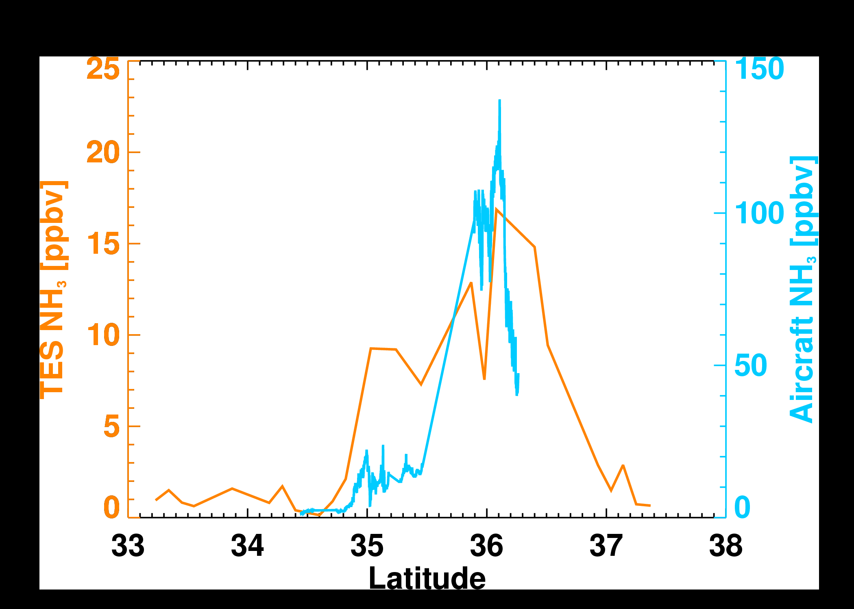
CALNEX: TES vs Aircraft
TES May 14 transect @13:15 local
Partial P3 May 12 track
(flying at ~ 300 AGL @ 17:30 local)
NH₃ measurements from TES and aircraft are well correlated

Slide 20
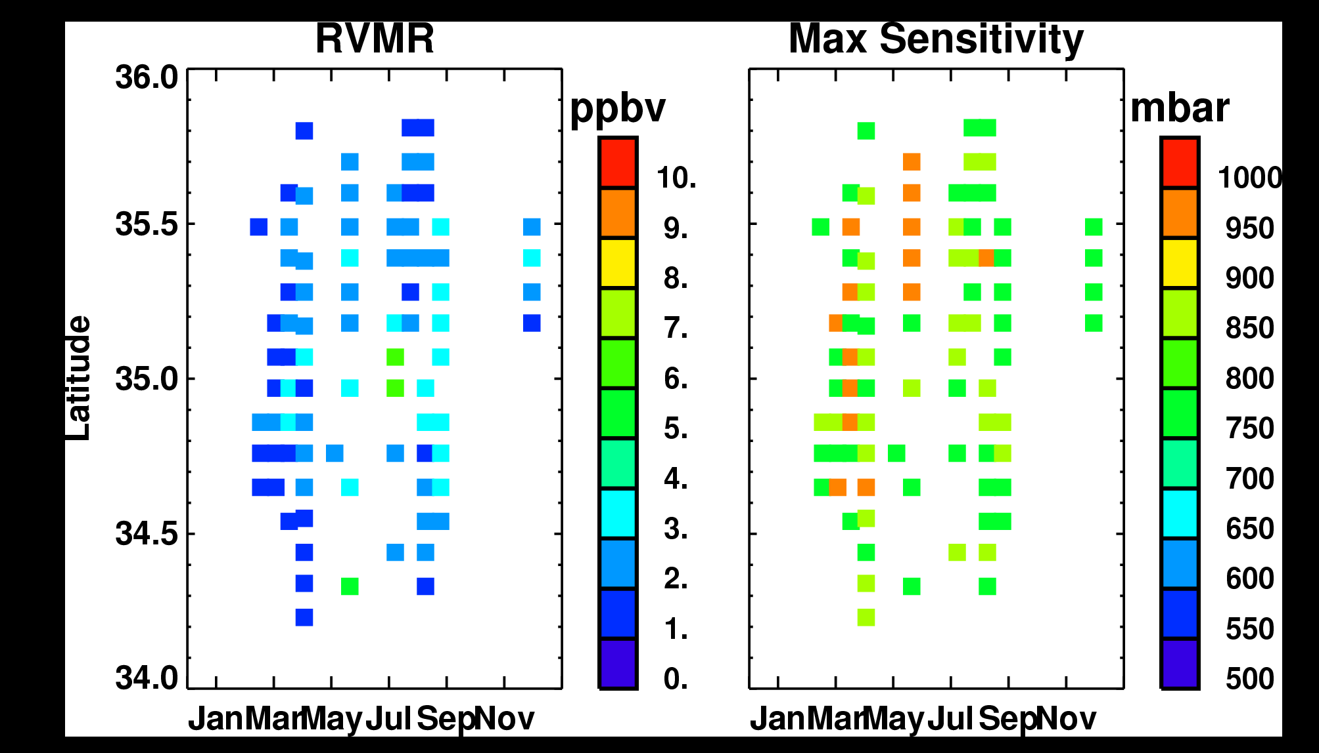
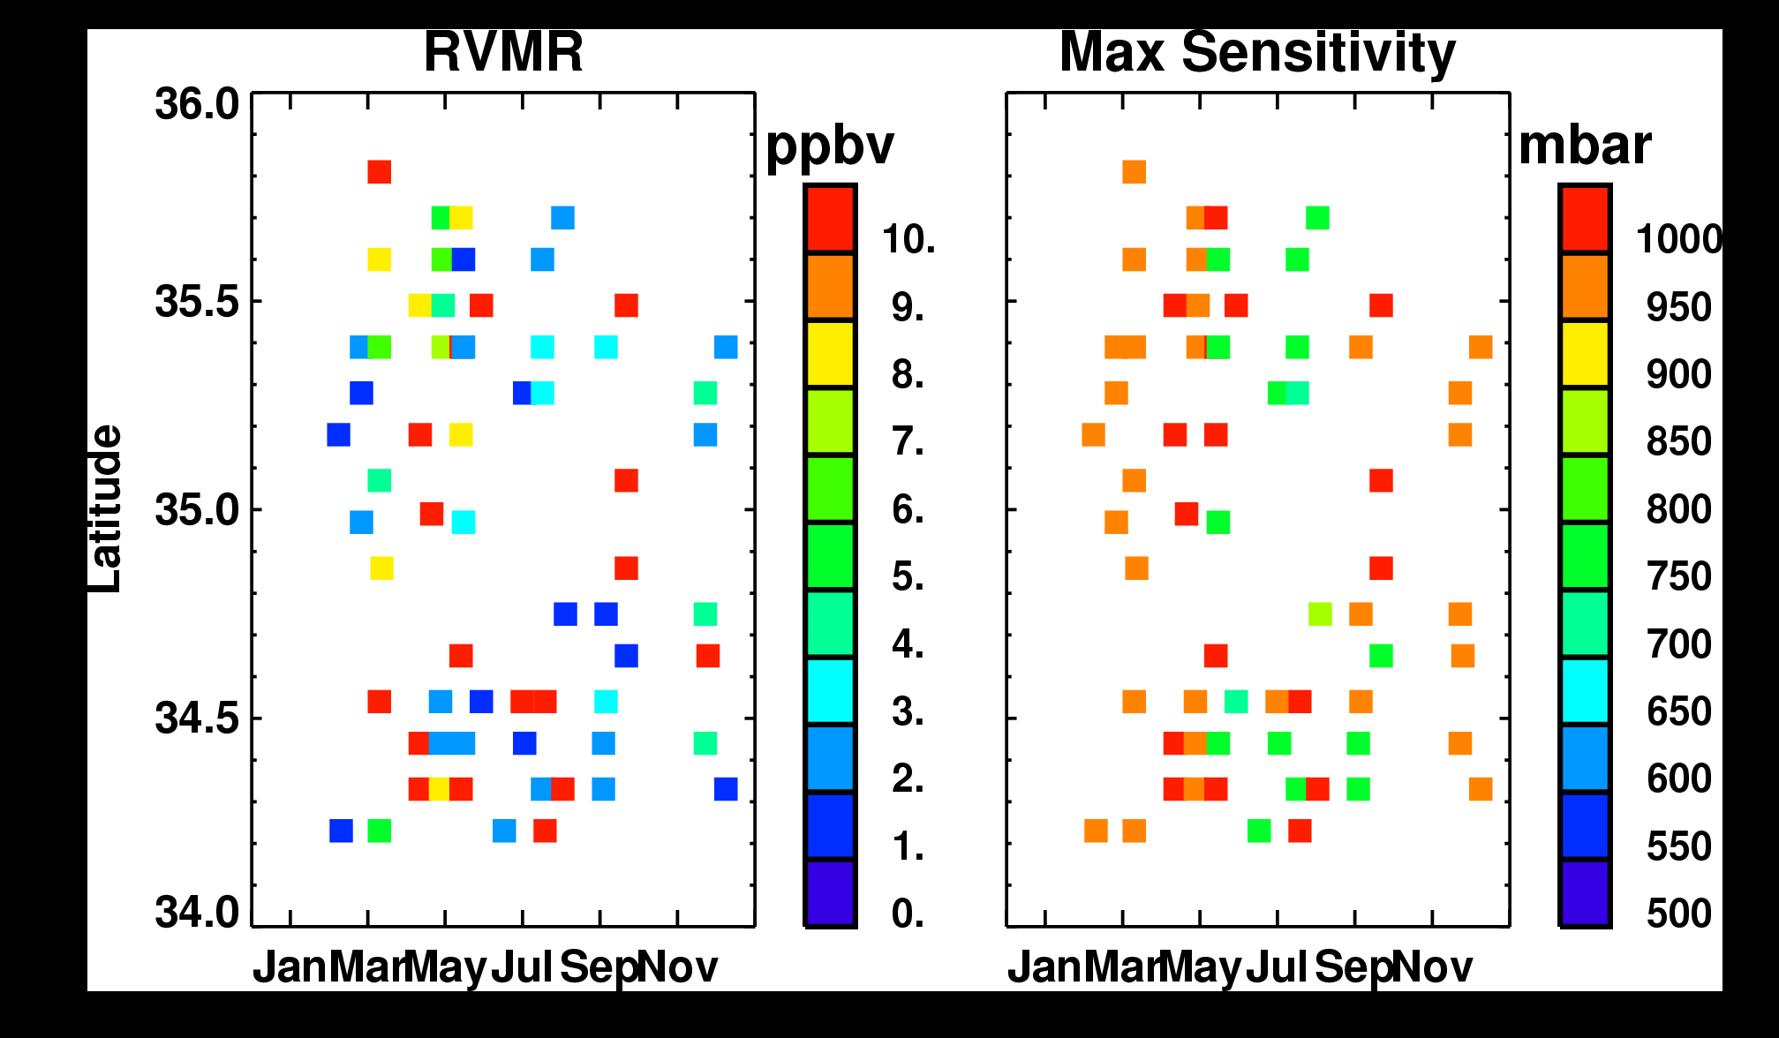
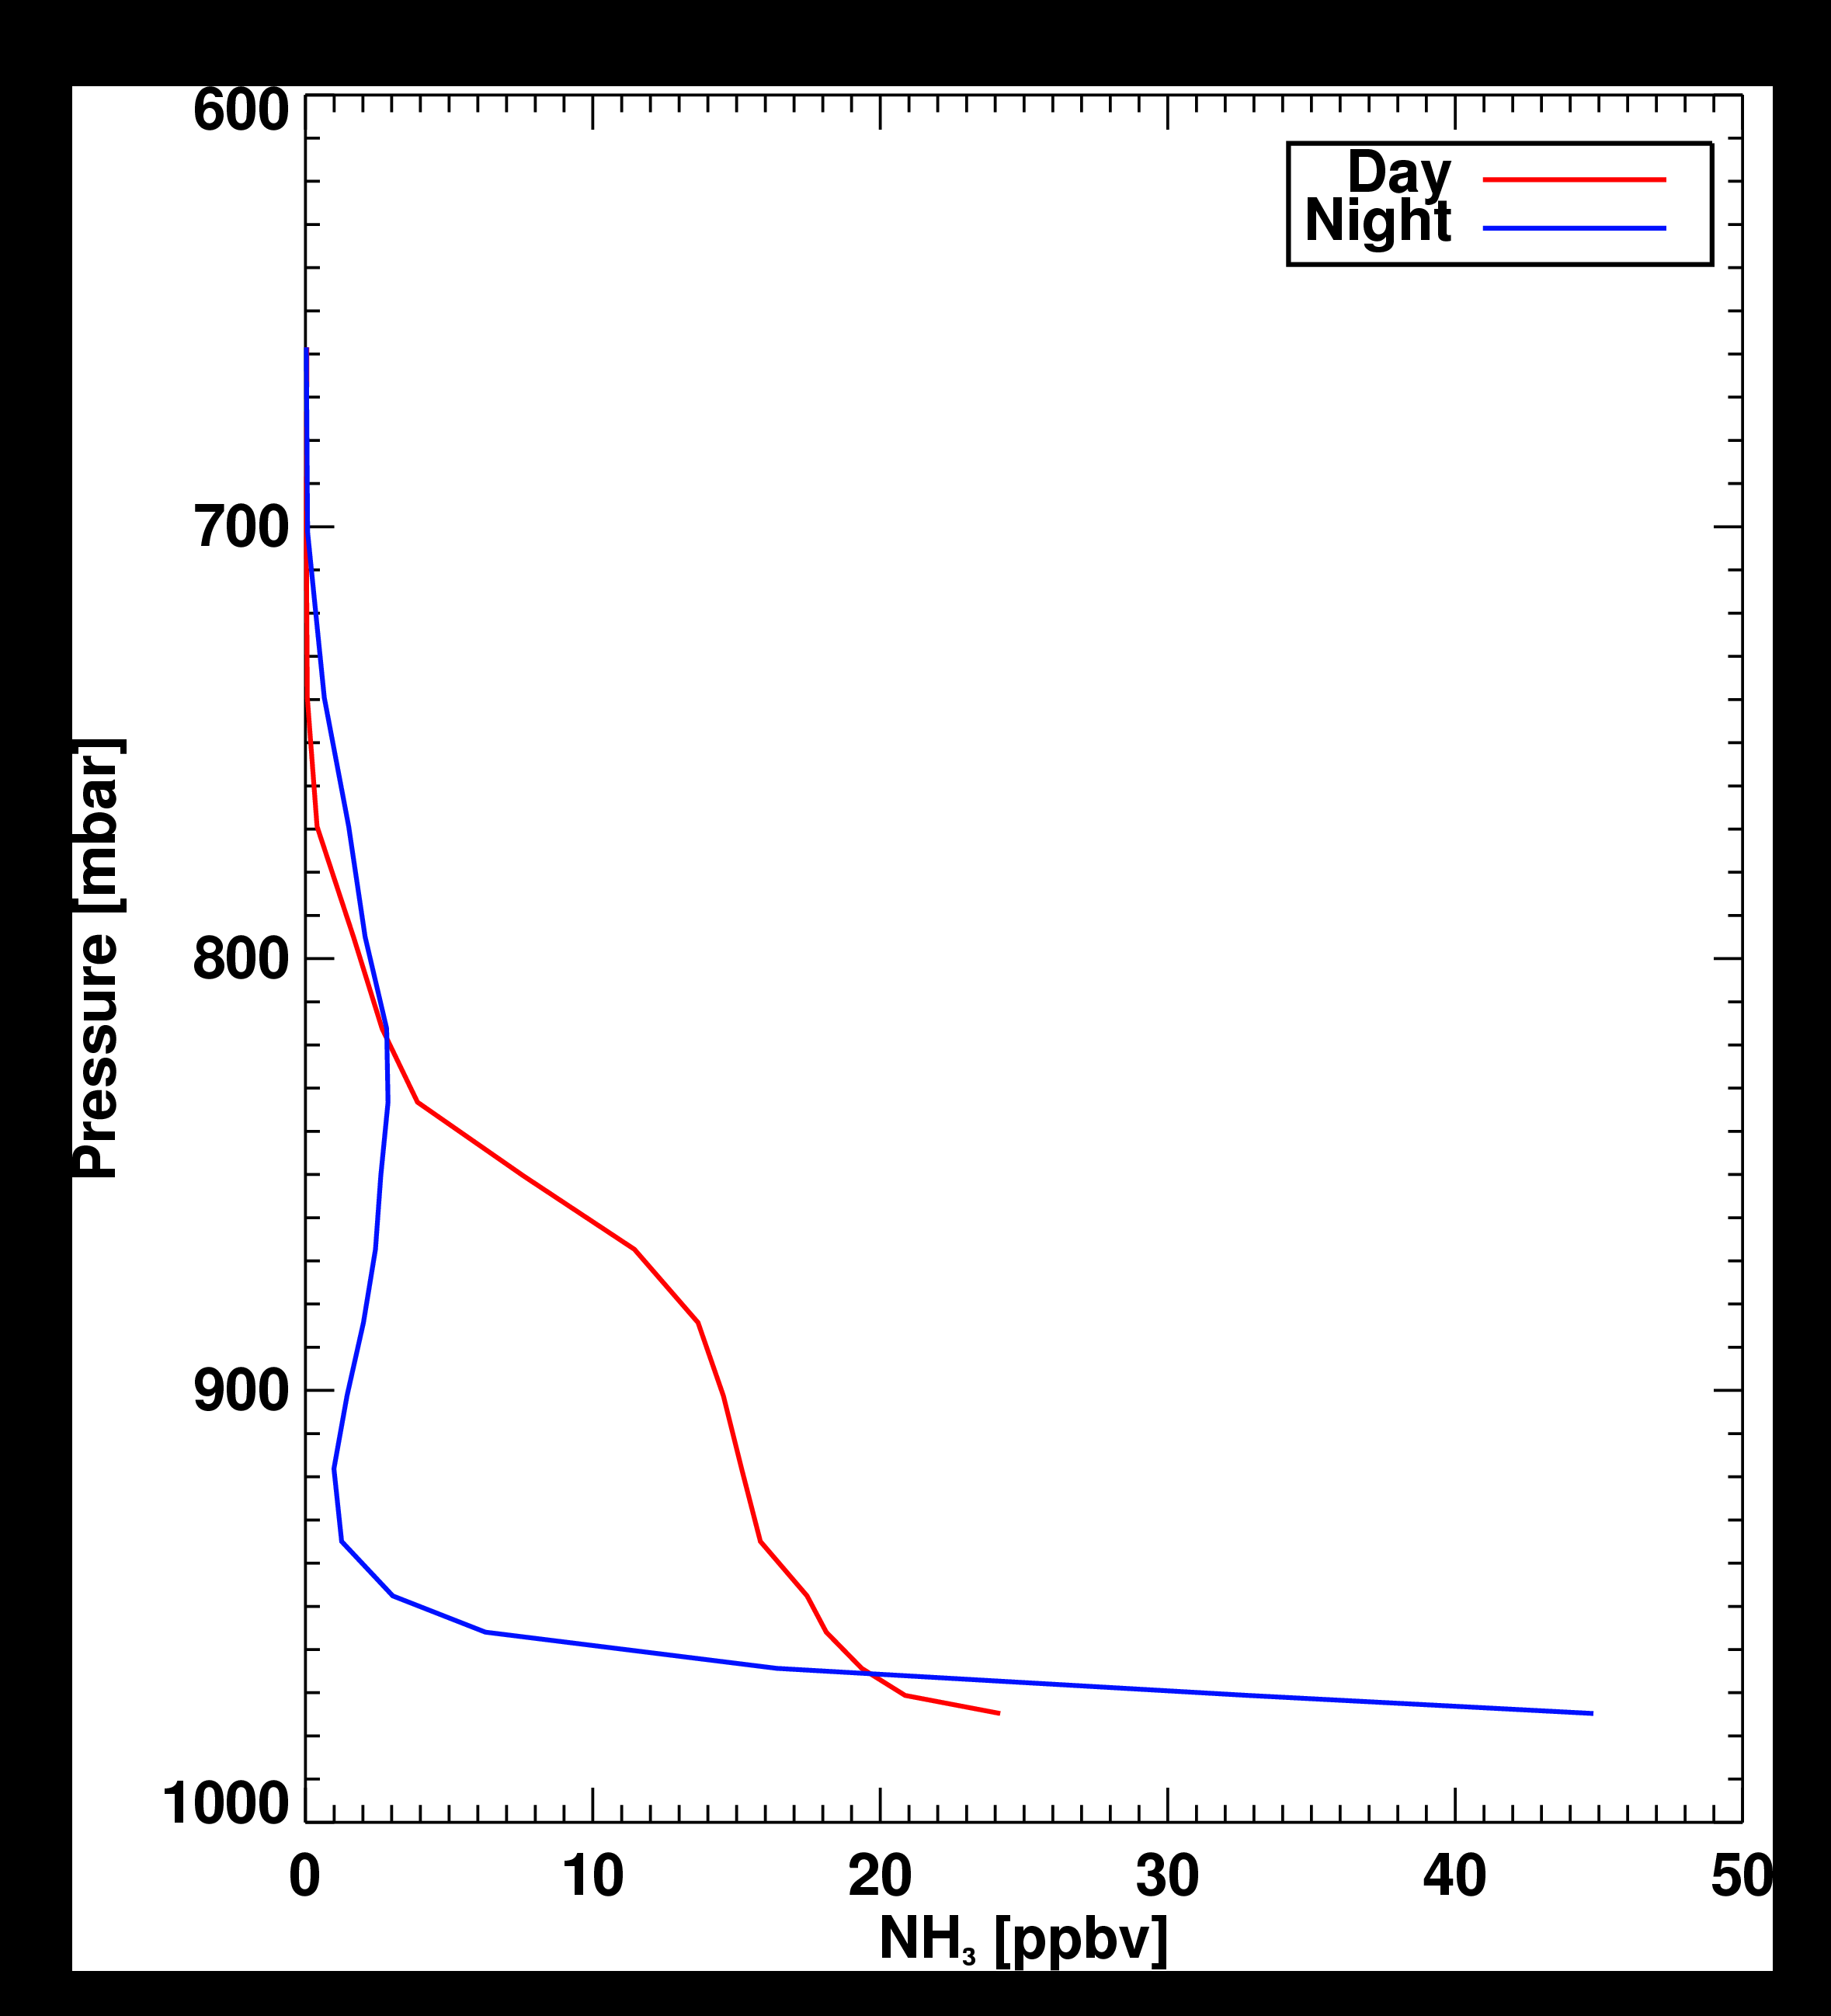
Day vs Night: TES
DAY
Lower NH₃ values
Sensitivity peaks between 900 and 750 mbar
Collapse of boundary layer
Pooling of NH₃
CMAQ simulated
NH₃ profile
NIGHT
Greater range of NH₃ values
  More high values
Sensitivity peaks between surface and 900 mbar

Slide 21
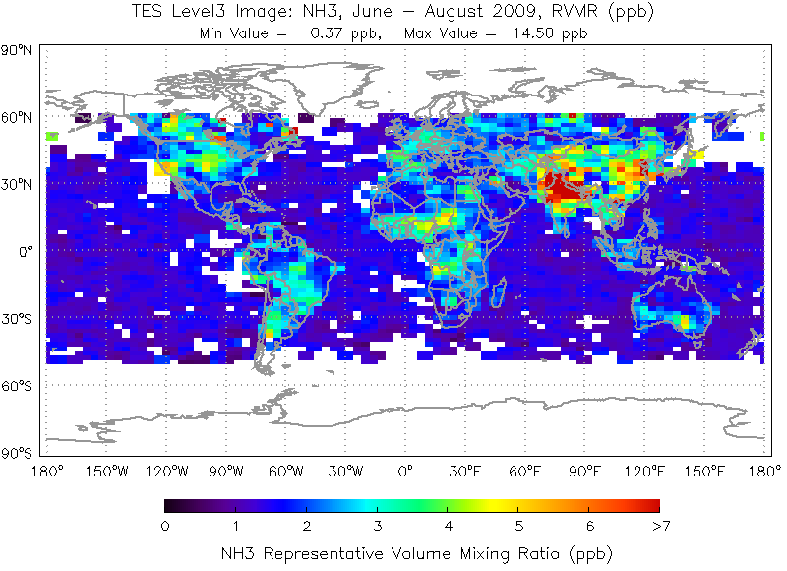
And now …
NH₃
Shephard et al.[2011]

