Slide 1
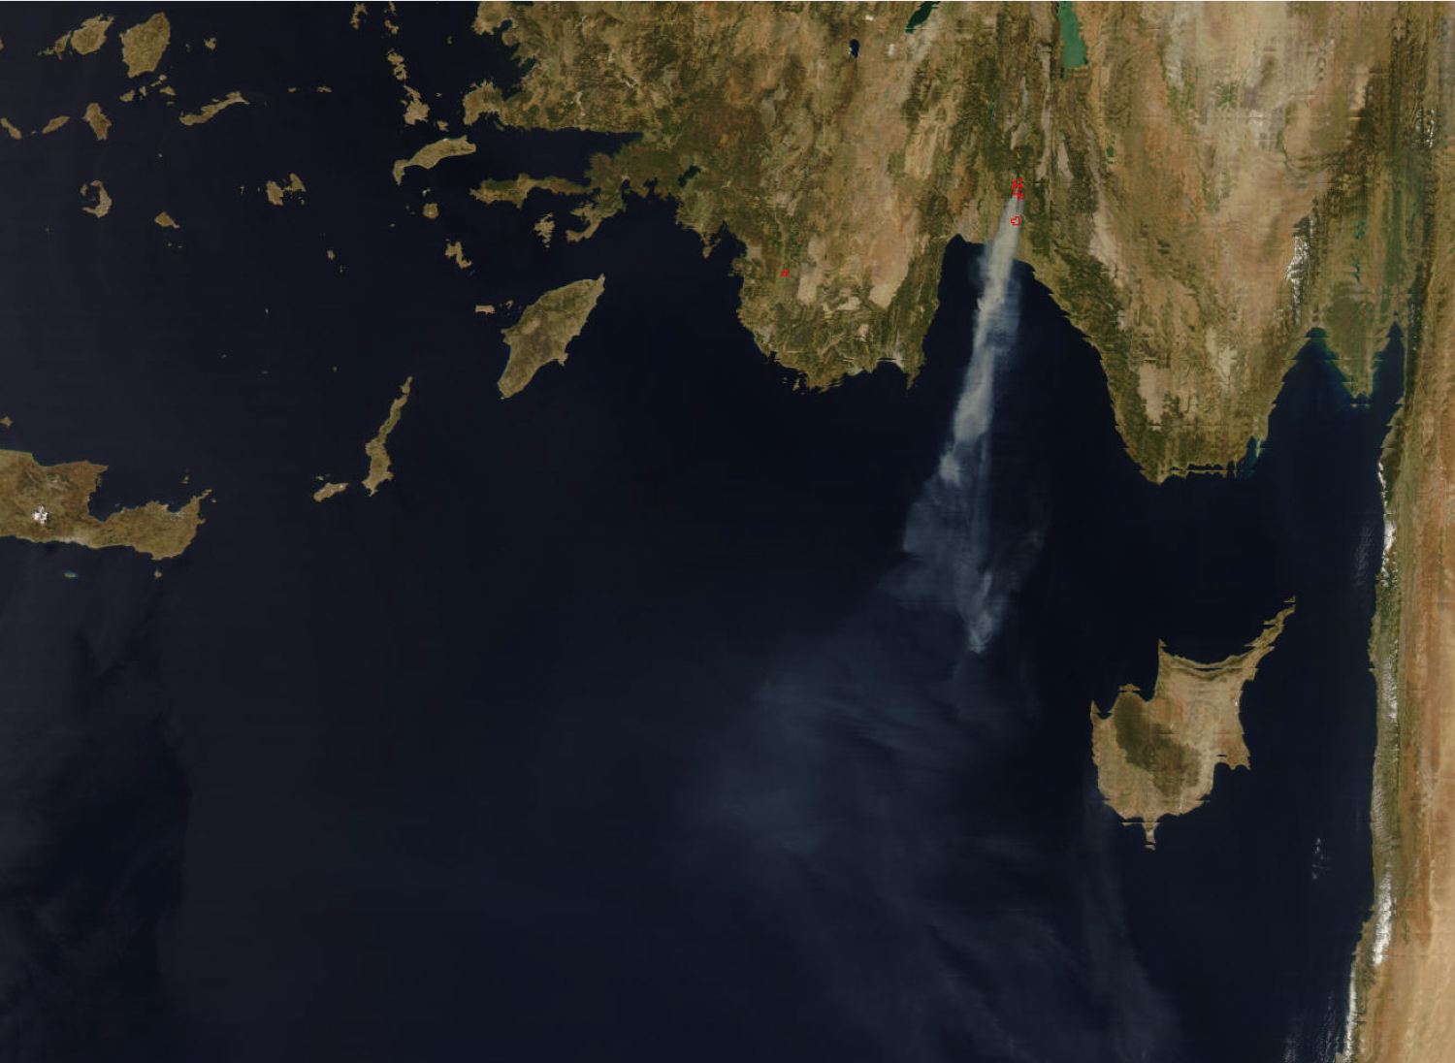
Estimation of Biomass Burning Emissions over Turkey using SEVIRI Fire Characterization data:
The Antalya fire, August 2008
Giuseppe Baldassarre, Luca Pozzoli, Johannes Kaiser, Chris Schmidt, Alper Ünal, Tayfun Kindap,
Eurasia Institute of Earth Sciences - Istanbul Technical University
KCL, London, UK; ECMWF, Reading, UK; MPI for Chemistry, Mainz, Germany
Cooperative Institute for Meteorological Satellite Studies - University of Wisconsin
Notes:
Quantify the impact of BB over Turkey during intence fire season and large fire event
Summer 2008 very intense fire seoason & Antalya fire was the strongest fire event during this season

Slide 2
Overall Project Objectives
Estimate Biomass Burning emissions over Eastern Mediterranean Basin during a large fire event (Antalya fire, August 2008)
Simulate the selected fire emission episode with the meteorological model WRF and the regional air quality model CMAQ

Slide 3
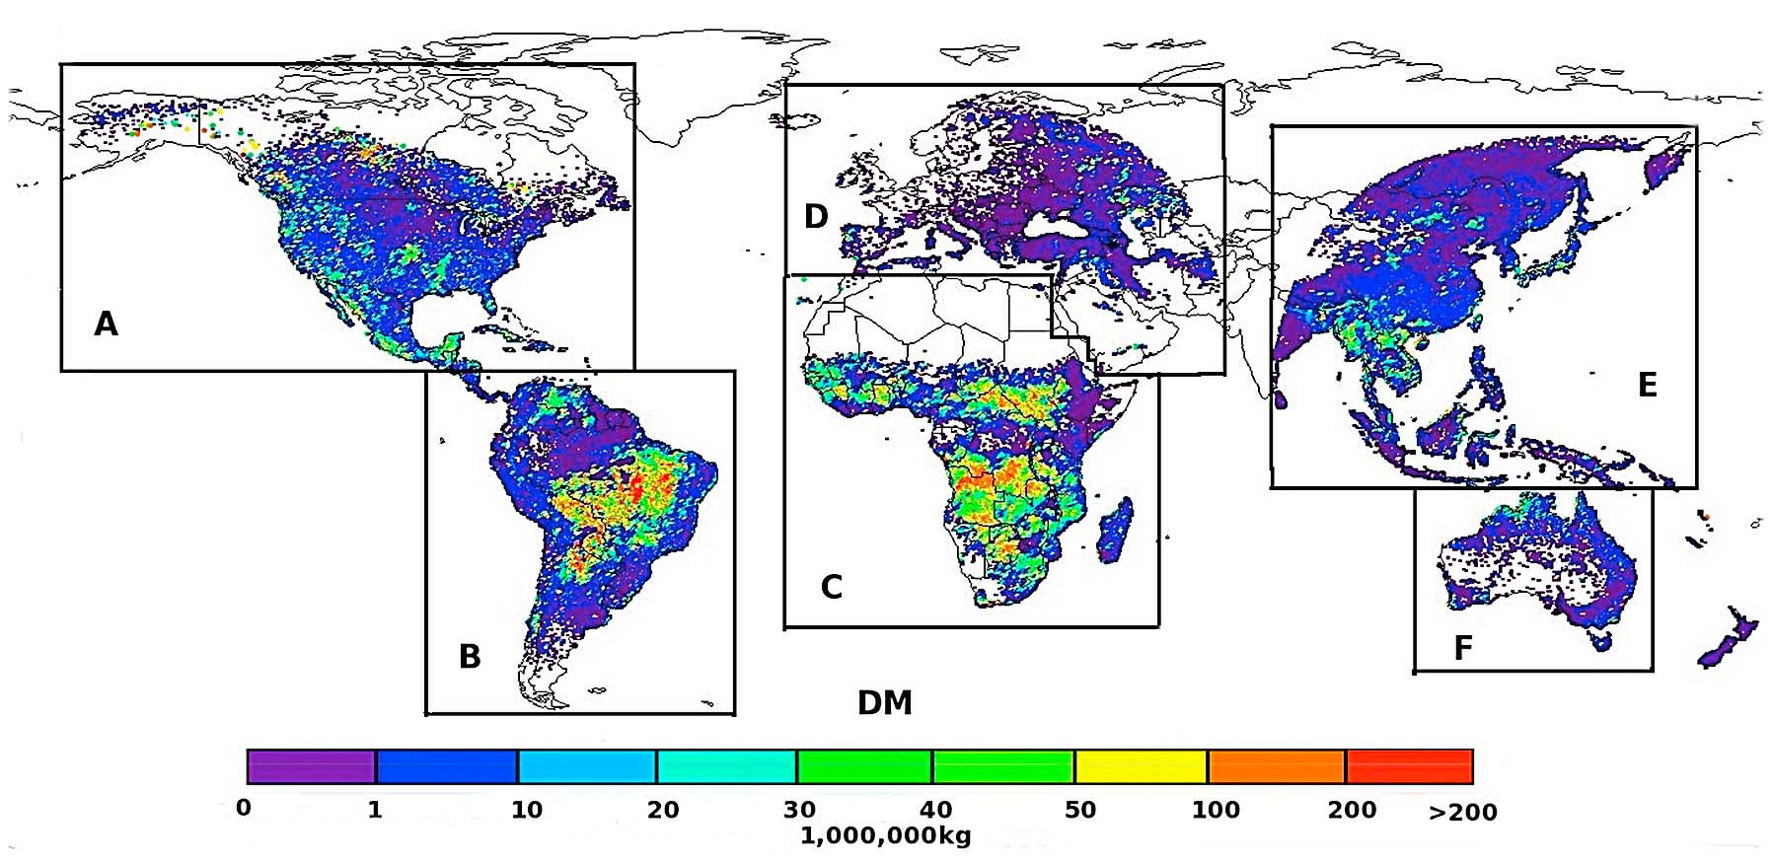
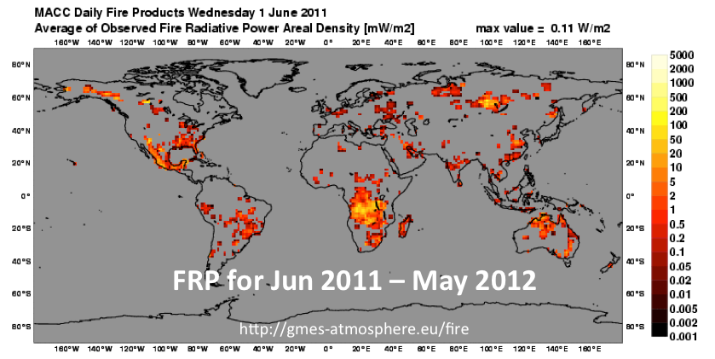
Requirements on Fire Emission Product
10 km resolution over Eastern Mediterranean Basin
Hourly time resolution
Injection height profile estimates
Newly fire emission inventories
GBBEP-Geo products:
FRE (Fire Radiative Energy)
dry mass combustion
CO, OC, BC, CO2, SO2, PM2.5 fire emissions
Hourly and at pixel resolution (≥3 km)
GFASv1.1:
40 species fire emissions
Daily and at 0.1-degree resolution
MACC: merging SEVIRI and MODIS FRP
Notes:
Requirement on fire emission product for our simulation were: 10 km spatial resolution, hourly temporal resolution, injection height
Global BB emission product ( from 2010)
GFASv1.1
Monitoring atmosphere composition and climate (not available for 2008)

Slide 4
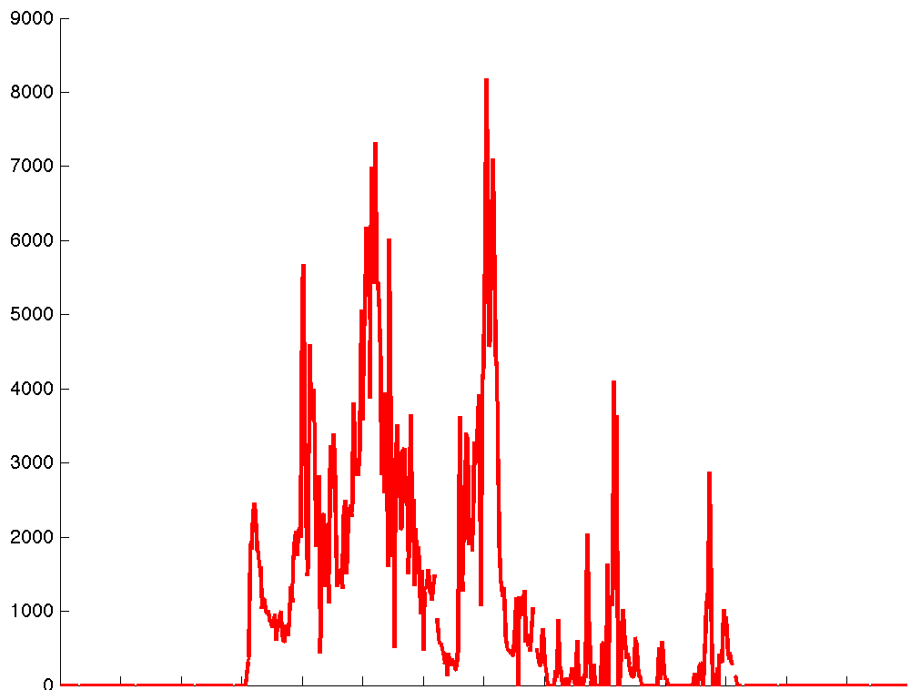
Modeling Biomass Burning Emissions
Biomass burning emission is linearly linked to fire radiative energy in a simple formula:
Rate of biomass consumption (kg/s) = ß x FRP (MW)
Antalya fire
ß : Wooster et al. determined β to be 0.368 for Miscanthus and found no evidence to suppose that β varies significantly with vegetation type.
Convert to emission rate of different species multiplying by standard emission factors (in units of g of emitted per kg of fuel burned). (Andreae and Merlet, 2001)
Alternative approach: directly relate FRP to the emission of aerosols by the application of dedicated “radiative emissions aerosols” .(Ichoku and Kaufman 2005)
Notes:
Biomass combusted is linearly linked with fire radiative energy
Directly link FRP to emission rate of a aerosol by using using coefficient of smoke aerosol proposed by Ichoku and Kaufman

Slide 5
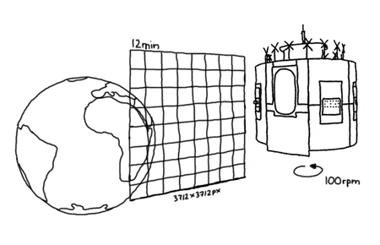
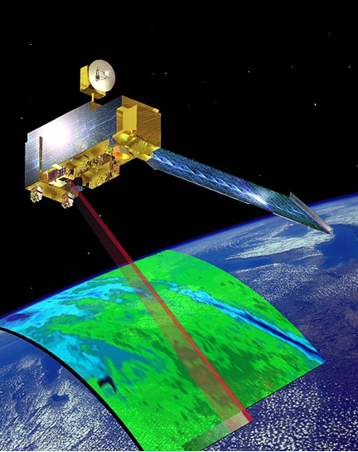
Fire Radiative Power products
WF_ABBA & Land SAF SEVIRI based FRP products
≥ 3 km spatial resolution
15 min time resolution
≈40 MW detection threshold
Limited by cloud
GFASv1.1 FRP product (MODIS based)
≥ 1 km spatial resolution
Daily time resolution
≈10 MW detection threshold
Limited by cloud
Notes:
Two main available SEVIRI FRP product are Wf_ABBA and Land SAF
MODIS based FRP product is GFASv1.1

Slide 6
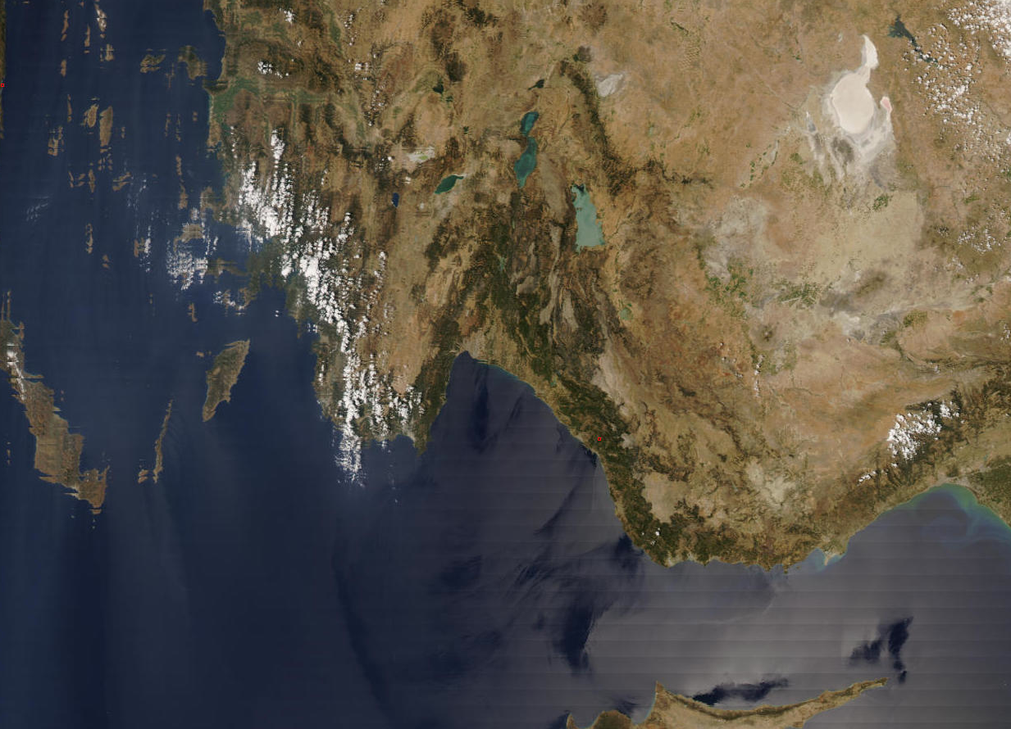
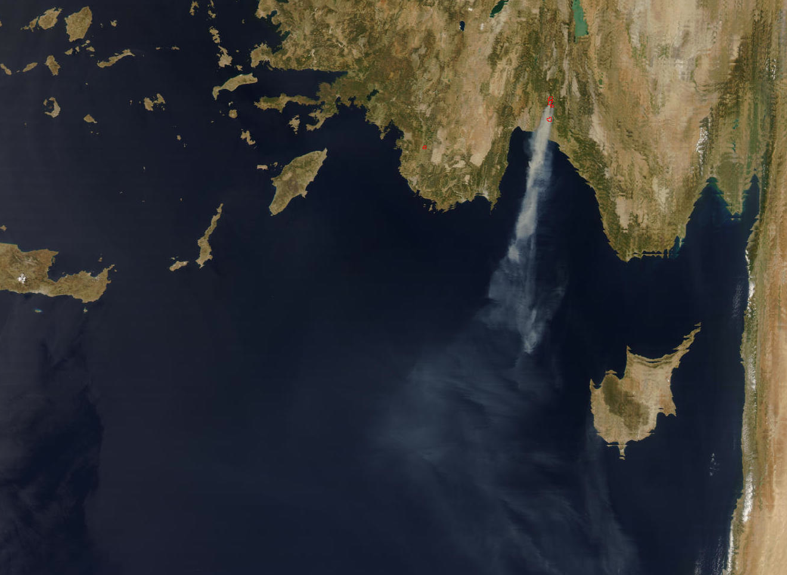
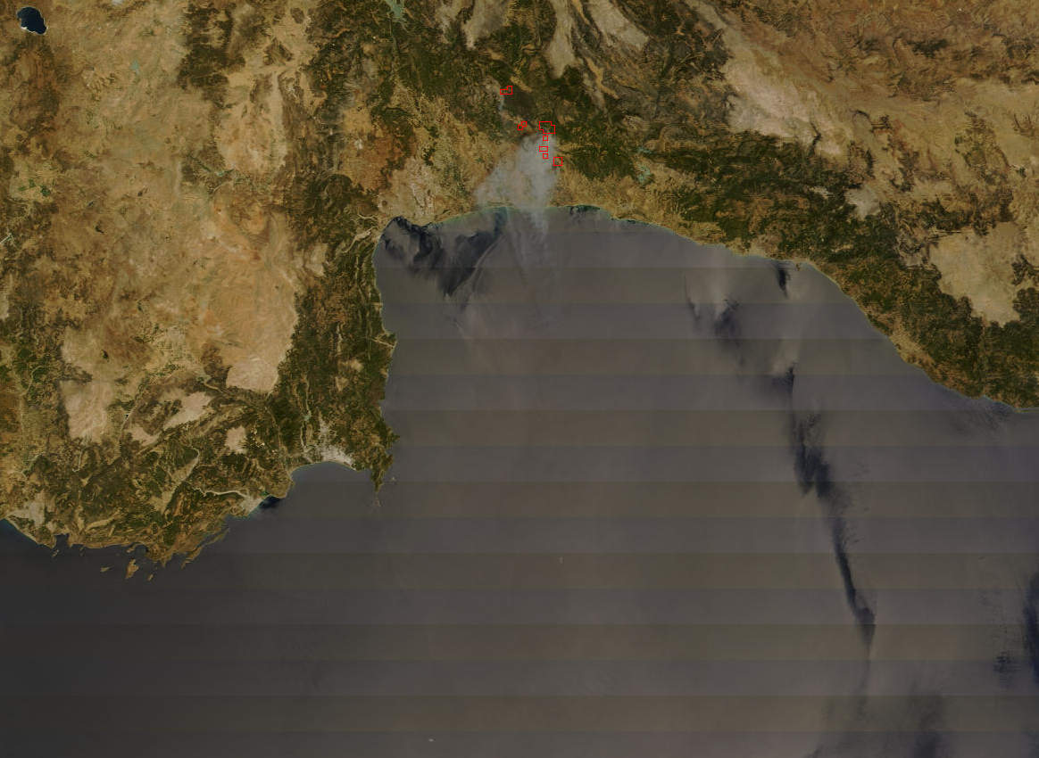
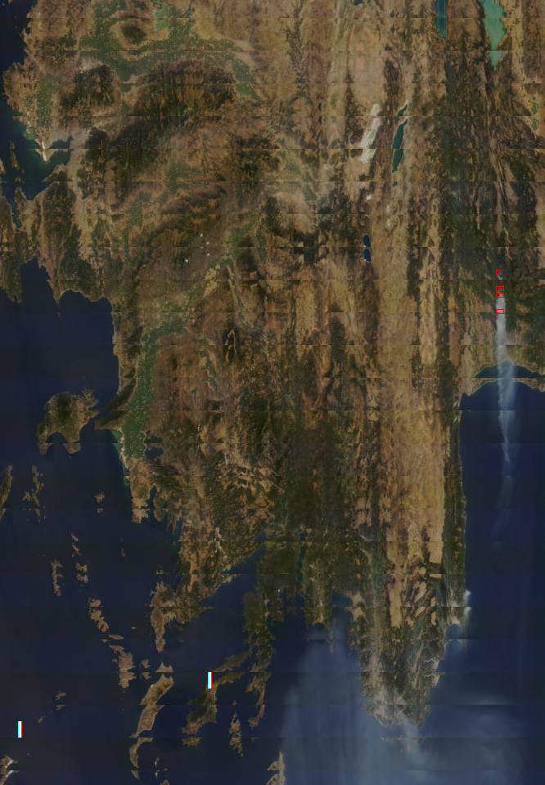
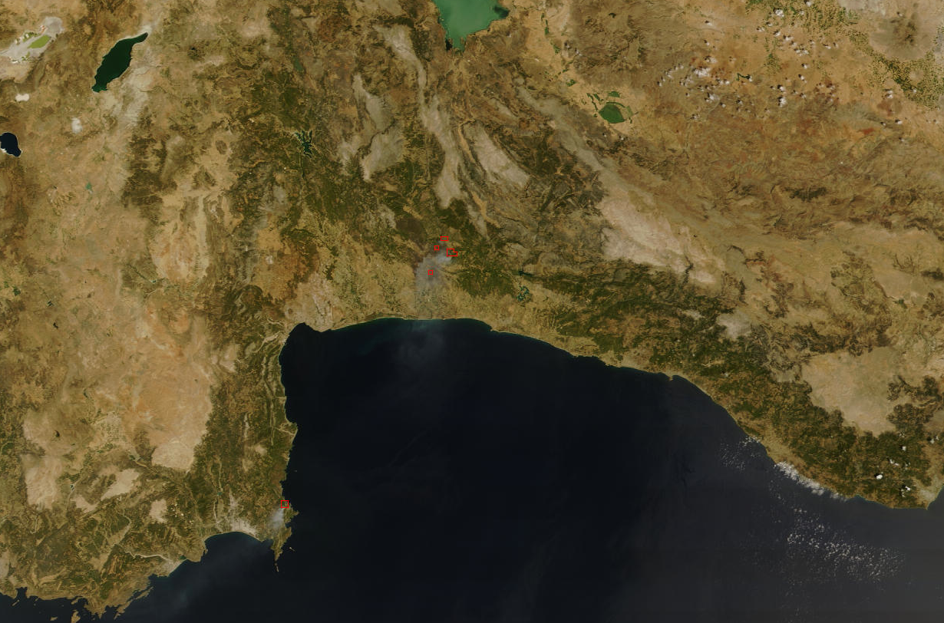
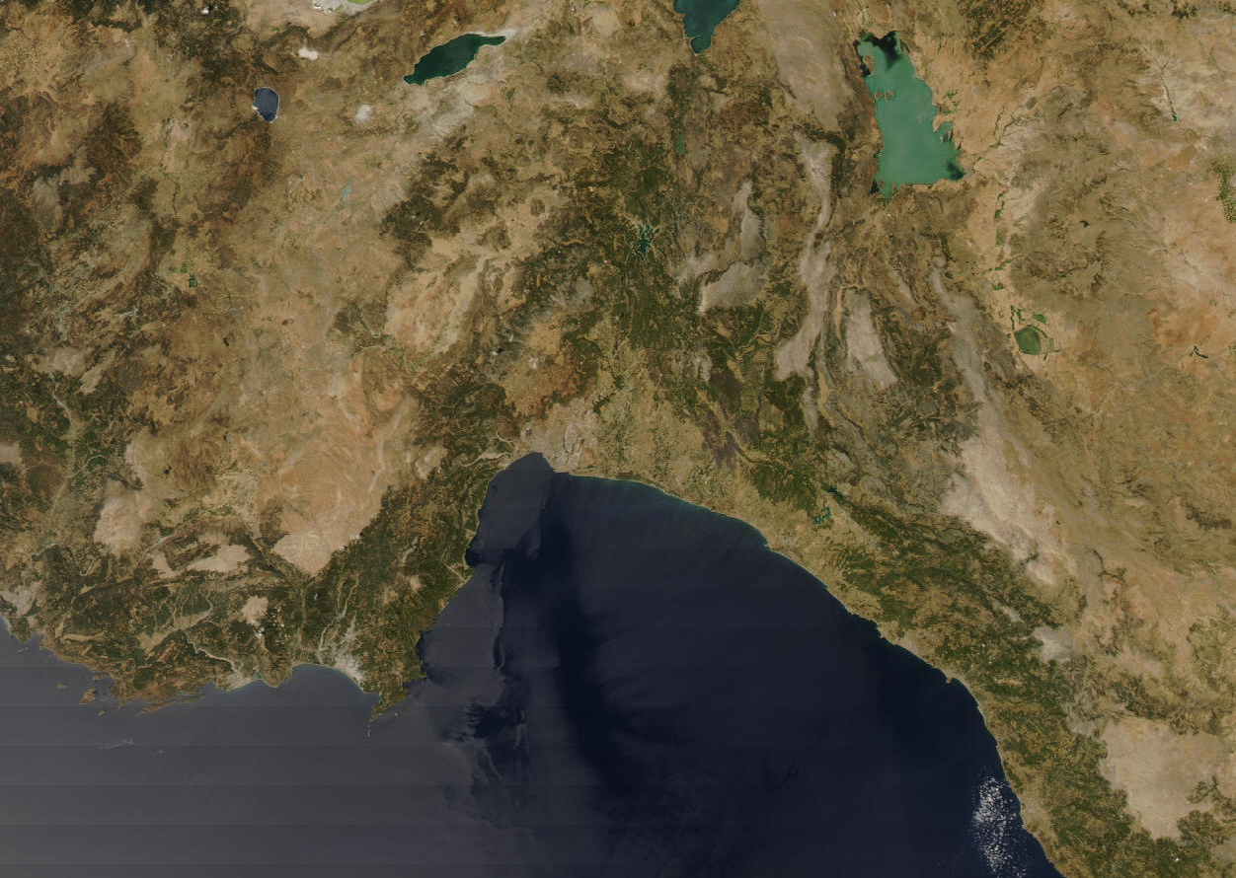
Case Study (Antalya Fire)
Aqua/MODIS 07/31/2008 10:45 UTC
Aqua/MODIS 08/01/2008 11:30 UTC
Terra/MODIS 08/02/2008 08:55 UTC
Terra/MODIS 08/03/2008 09:40 UTC
Location: province of Antalya (Manavgat and Serik towns)
Time: 31/07/2008 – 05/08/2008
Cost:
4500 hectares of forest land
60 homes
Dozens of farming buildings
2000 fire fighting personnel
Terra/MODIS 08/04/2008 08:45 UTC
Aqua/MODIS 08/05/2008 11:05 UTC
Notes:
We breafly introduce the case test

Slide 7
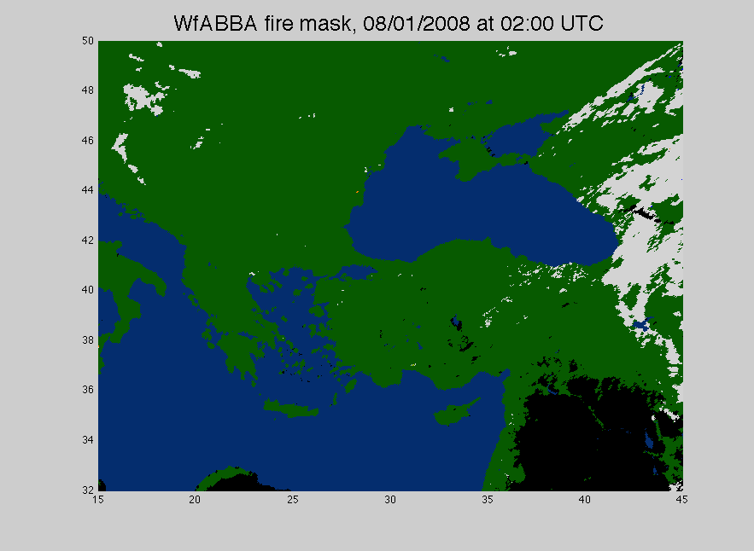
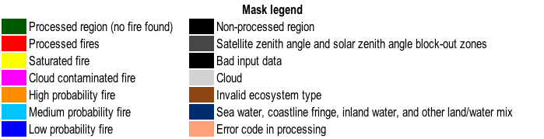
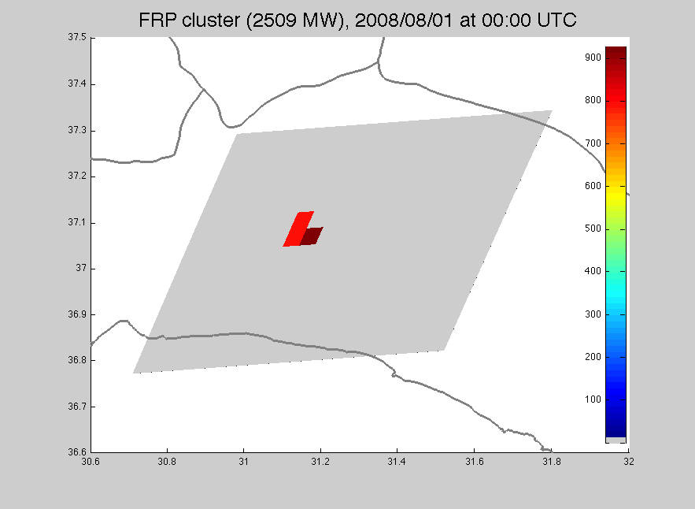
MSG-SEVIRI-based
Antalya fire
Antalya fire
Notes:
Wf_ABBA is dynamic contextual algorithm developed at UW-CIMSS mainly, firstly applied on GOES data nowadays applied on a suit of different geostationary satellite
Fire product are delivered with fire mask and ACII files listing several fir information, including location, fire size and temperature and FRP

Slide 8
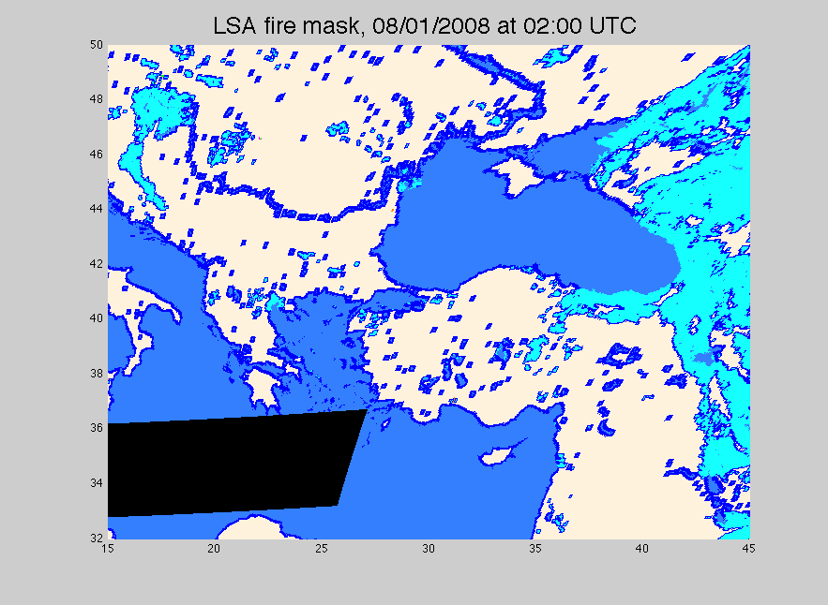
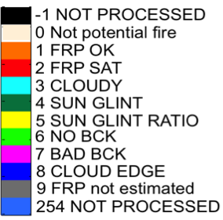
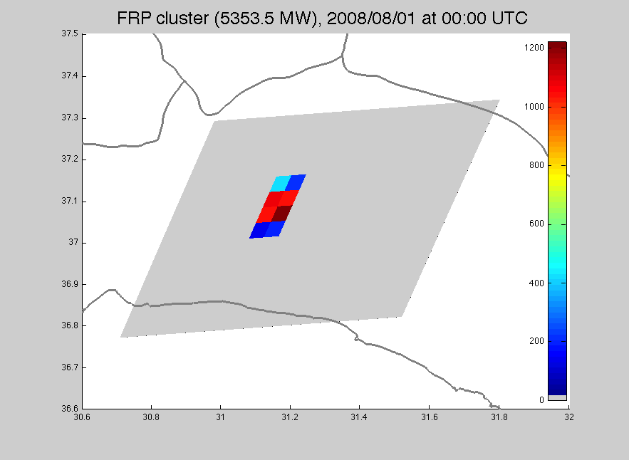
Land SAF
MSG-SEVIRI-based
Antalya fire
Antalya fire
Notes:
Labd SAF FRP product is part of Land Surface Analisis product, it is available on line

Slide 9
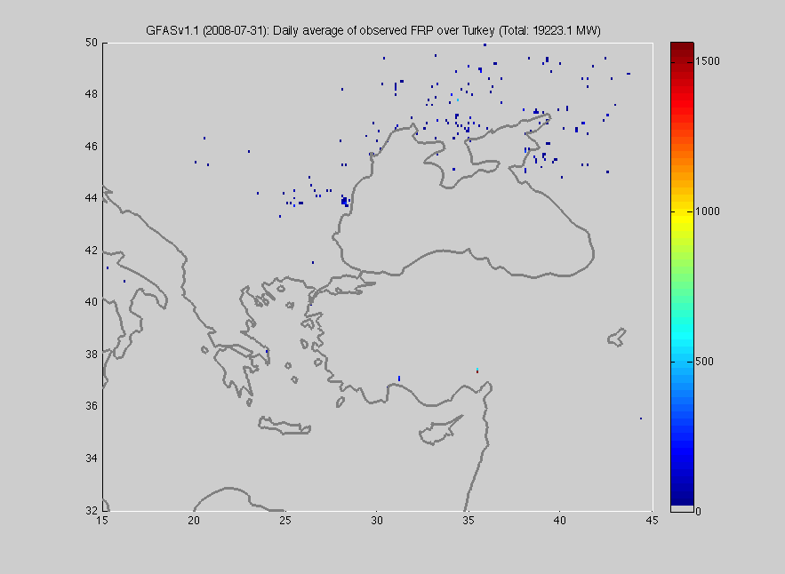
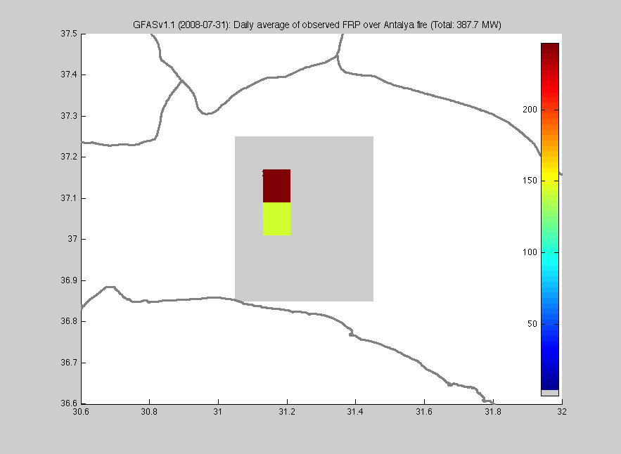
MODIS-based
The comparison of SEVIRI FRP based to GFAS emissions should be regarded as a comparison between two independent data sets rather than a validation using a reference data set
Antalya fire
Antalya fire

Slide 10
Wf_ABBA
Land Saf
GFASv1.1

Slide 11
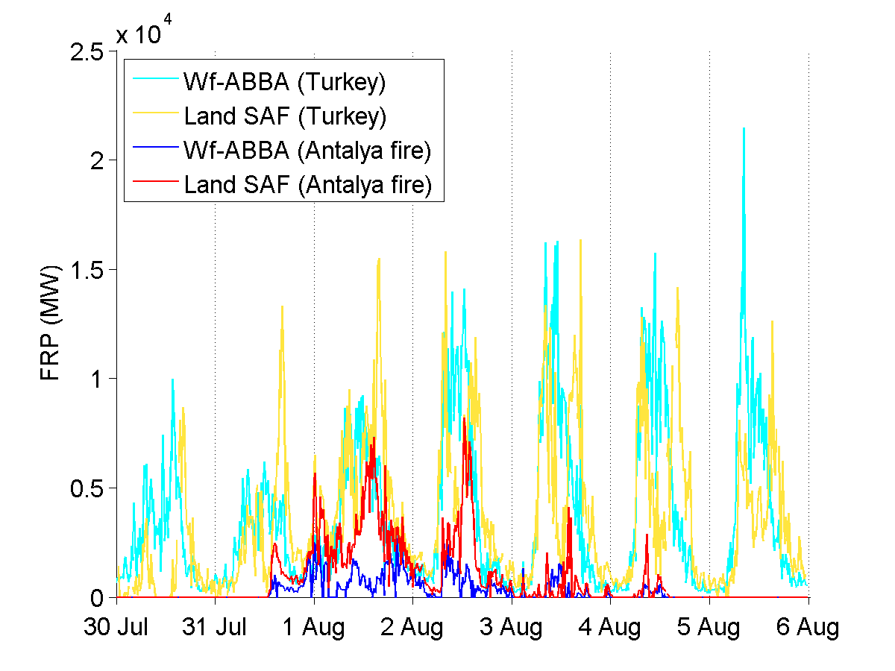
Total FRP observed over Turkey
Differences between the two algorithms, particularly in their handling of pixel oversampling, could explain why the difference is largest during peak burning.
Notes:
The two SEVIRI-based FRP products used in this work describe the same fire episode differently. The WF_ABBA data leads to lower emission estimates than those generated from Land SAF overall, but they tend to be comparable except on July 31-August

Slide 12
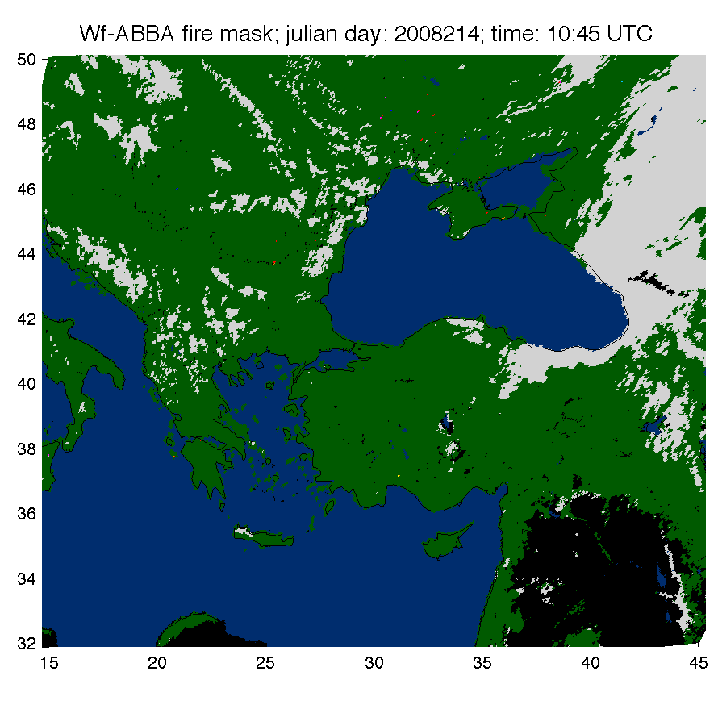
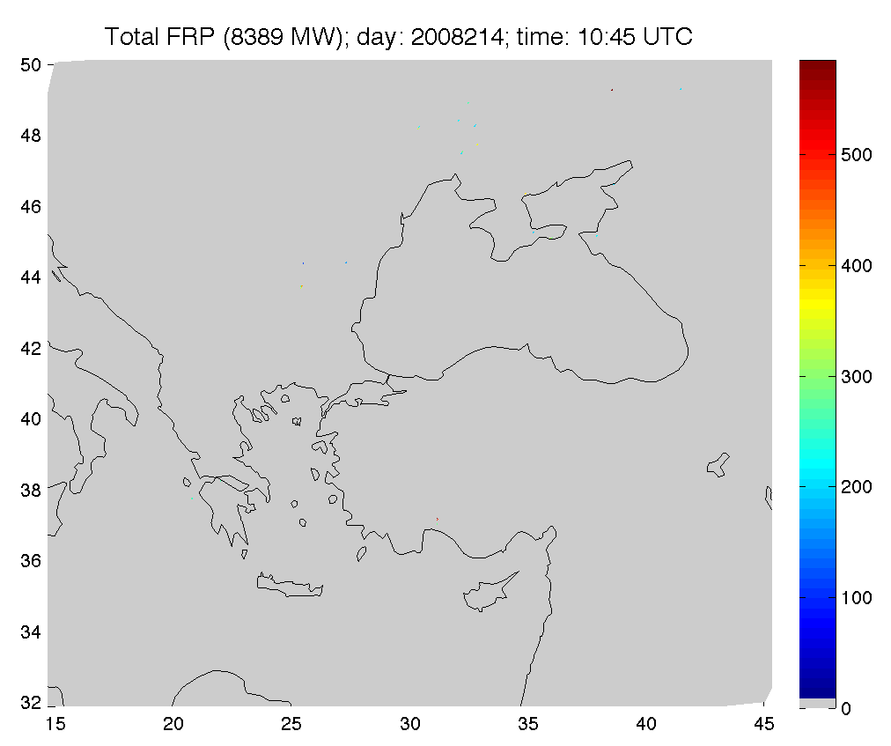
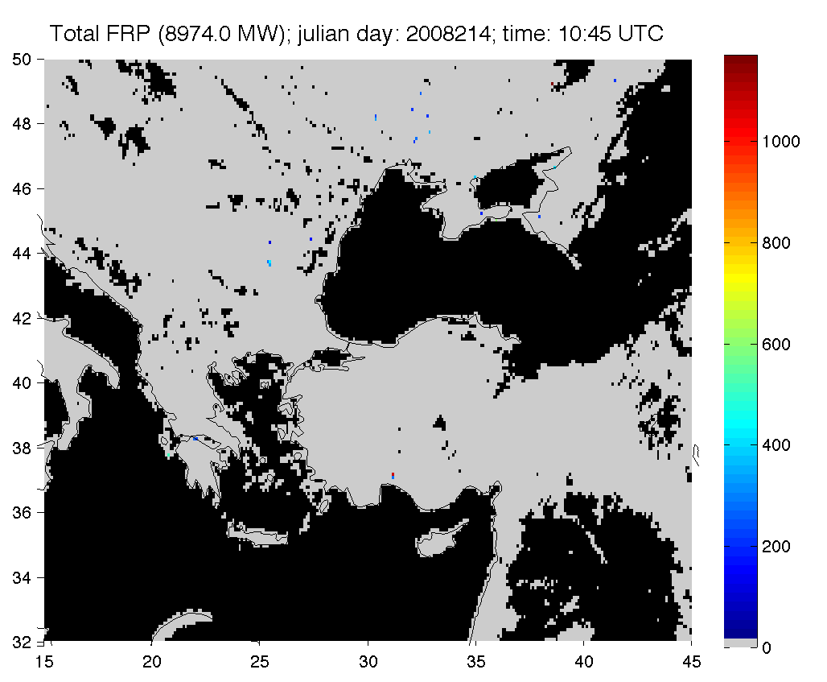

Processing steps to derive Antalya fire emissions from FRP Pixel product as input to CMAQ model
Grid FRP PIXEL product to 0.1x0.1 deg grid and correct for cloud cover
Average over 1 hour
Injection height (Sofiev et al., 2012): , Where H_{abl} is the atmospheric boundary layer height , N_{ft} is the Brunt-Vaisalia frequency for free troposphere (from WRF and MCIP model) and , α, β, γ, δ, parameters defining the dependence on stability in Free Troposphere (Sofiev et al, 2012)
Convert to trace gasses and aerosols emission rate (kg/s) with emission factors based on a combination of Andreae and Merlet (2001) and using “radiative emission ratios” proposed by Ichoku and Kaufman (2005)
Gridded FRP product at 0.1° × 0.1° resolution containing area integrated FRP totals corrected for partial cloudiness at the grid-cell scale.
Notes:
integrate FRP PIXEL ( sum of FRP(t) x time interval ) to get emitted energy

Slide 13
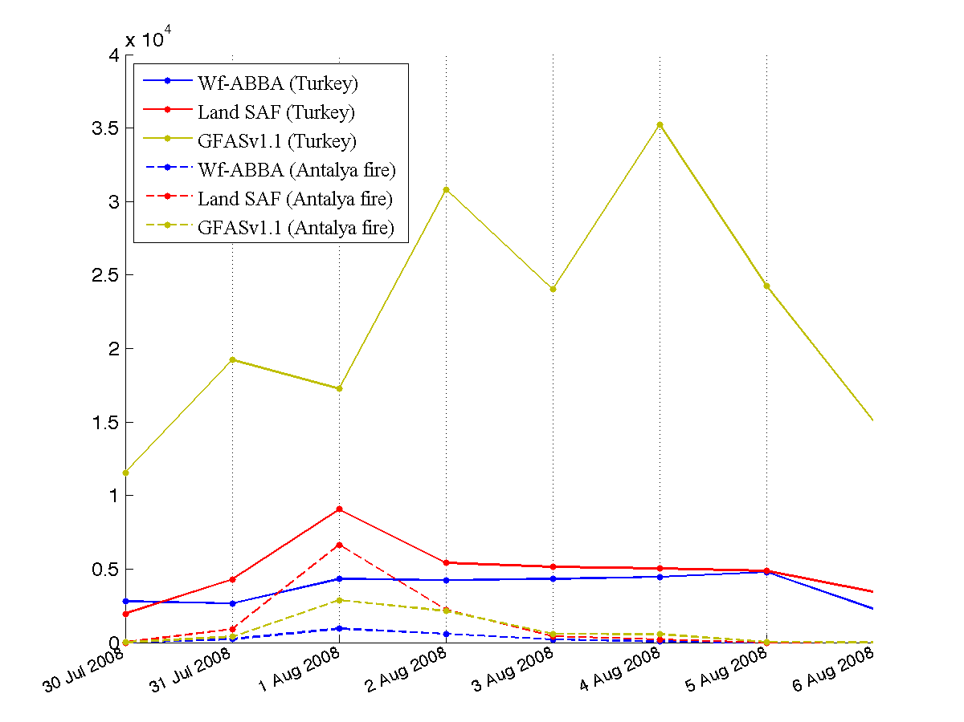
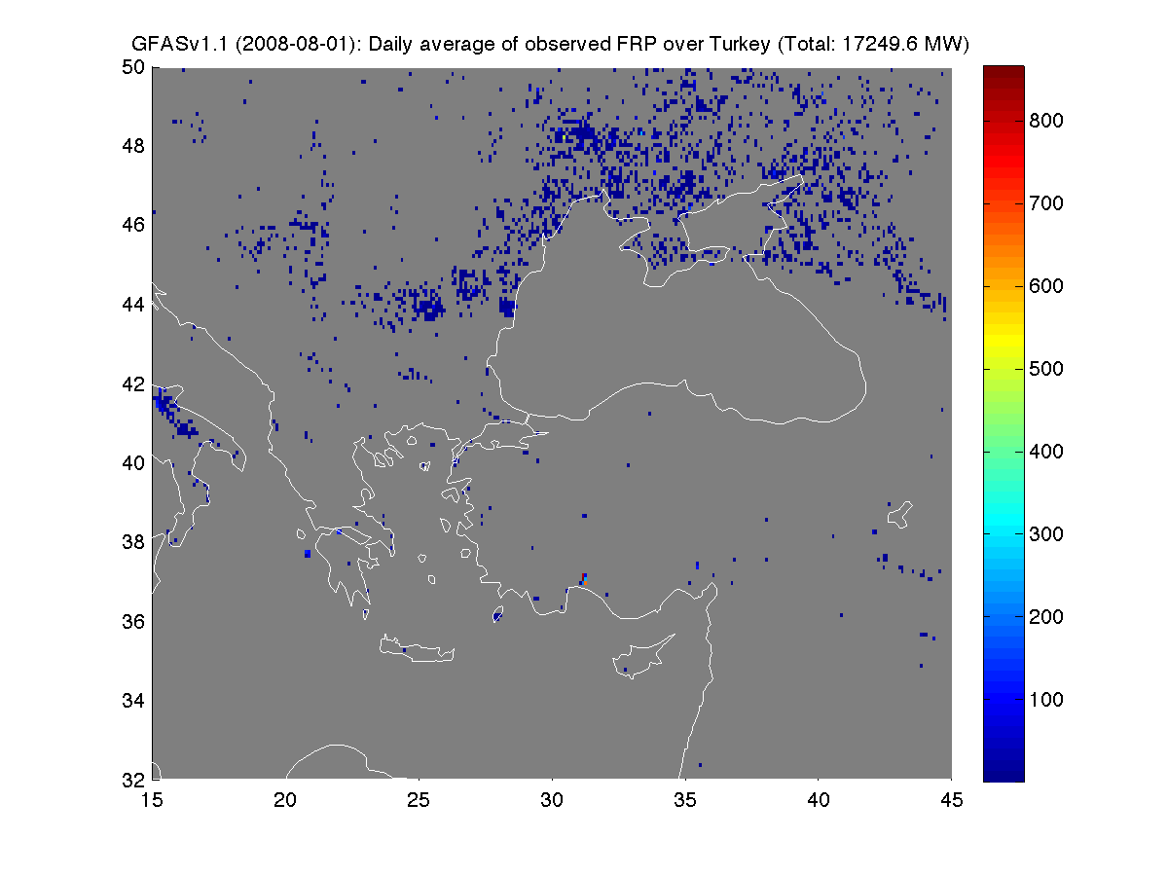
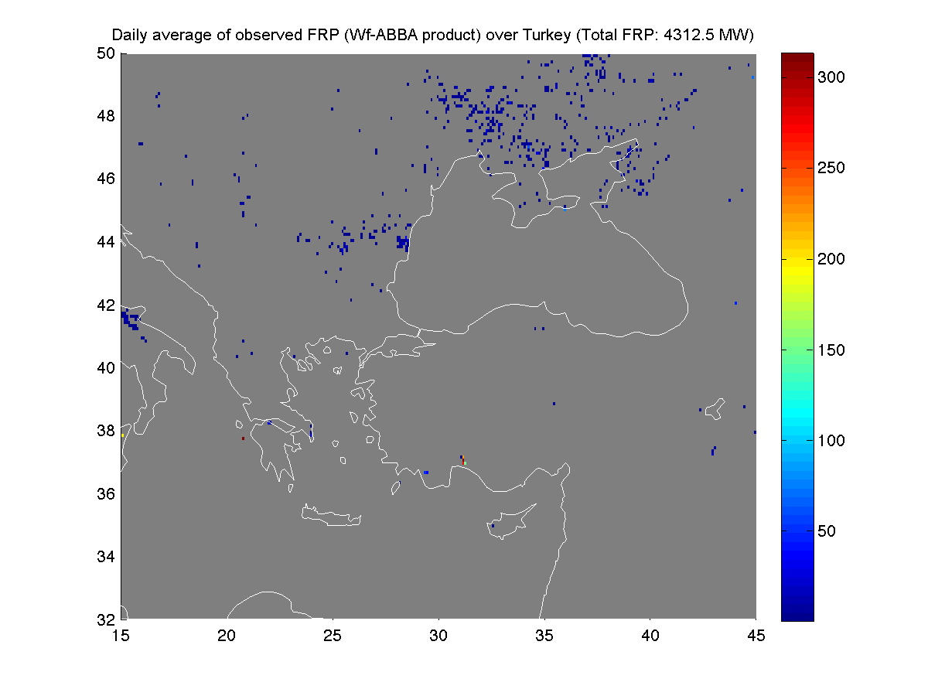
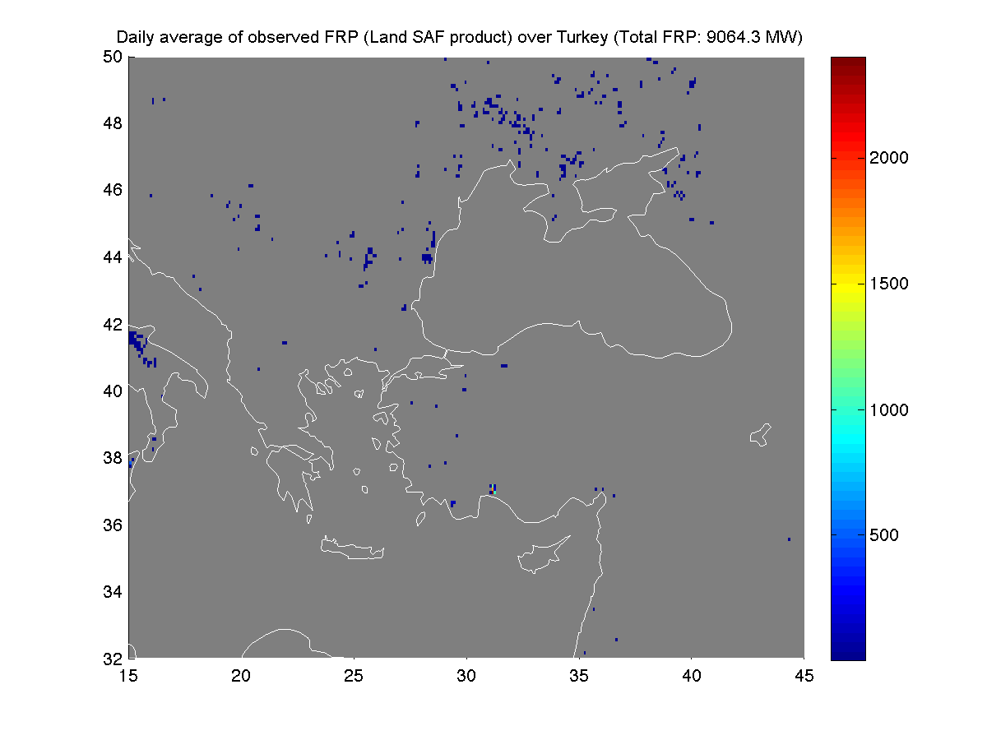
Total FRP observed over Turkey
GFASv1.1
agricultural waste burning, common this time of the year in Eastern Europe.
FRP (MW)
FRP (MW)
MODIS detection threshold ≈ 10 MW
Total FRP observed over Antalya fire
Antalya fire (FRP cluster: 2877.3 MW)
WF_ABBA
Land SAF
FRP (MW)
SEVIRI detection threshold ≈ 40 MW
Antalya fire (FRP cluster: 952.7 MW)
Antalya fire (FRP cluster: 6635.2 MW)
Notes:
MODIS and SEVIRI derived FRP over Antalya fire are comparable while the MODIS one is much higher over the east Mediterranean Basin
In fact SEVIRI could capture the complete Antalya fire life cycle that the much higher spatial resolution MODIS instruments on EOS Aqua and Terra could not describe during their four- times per day overpasses.
And capture it when it reached its pick intensity

Slide 14
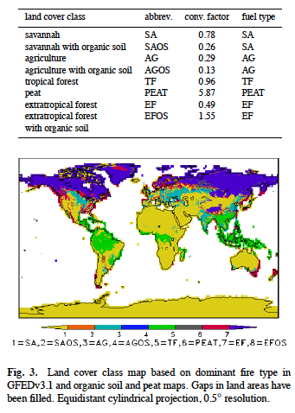
Conversion to Emission (Kaiser et al. 2012)
^{Emission rate}_{i,k} ^{(kg/s) =} ^{ß}_{k} ^{* FRP (MW)* Ef}_{i,k}^{(g/kg)}
Emission rate_{i,k} : emission rate for species i and for land cover class k
ß_{k} : conversion factor for land cover class k
FRP : Fire Radiative Power
Ef_{i,k} : emission factor for species i and for land cover class k
Emission of particulate matters have been boosted by a factor of 3.4 according to Kaiser et al. 2012
Notes:
Following Wooster approach, We convert to dry matter combustion rate using
But this time beta depends on vegetation type
We convert to emission rate of trace gasses and aerosol using Andreae and Merlet emission factors, and we boosted the aerosol emission rate of a factor of 3.4 according to Kaiser et al., 2012

Slide 15
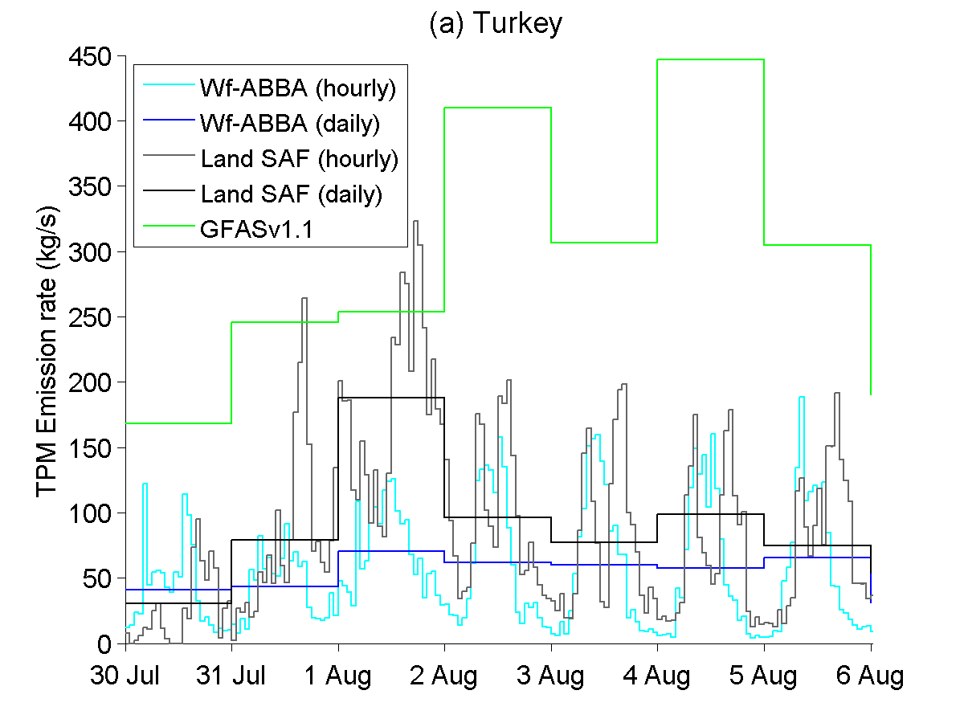
Notes:
In cyan and grey we can see the new processed (wf_abba and landsaf FRP based) TPM emission rate
The daily average has been computed to can compare it to the corresponding GFASv1.1 one
As we can see on the entire region the GFAS estimation is quite higher than the new estimated one that as we can see is strongly impacted by the presence of Antalya fire on August first

Slide 16
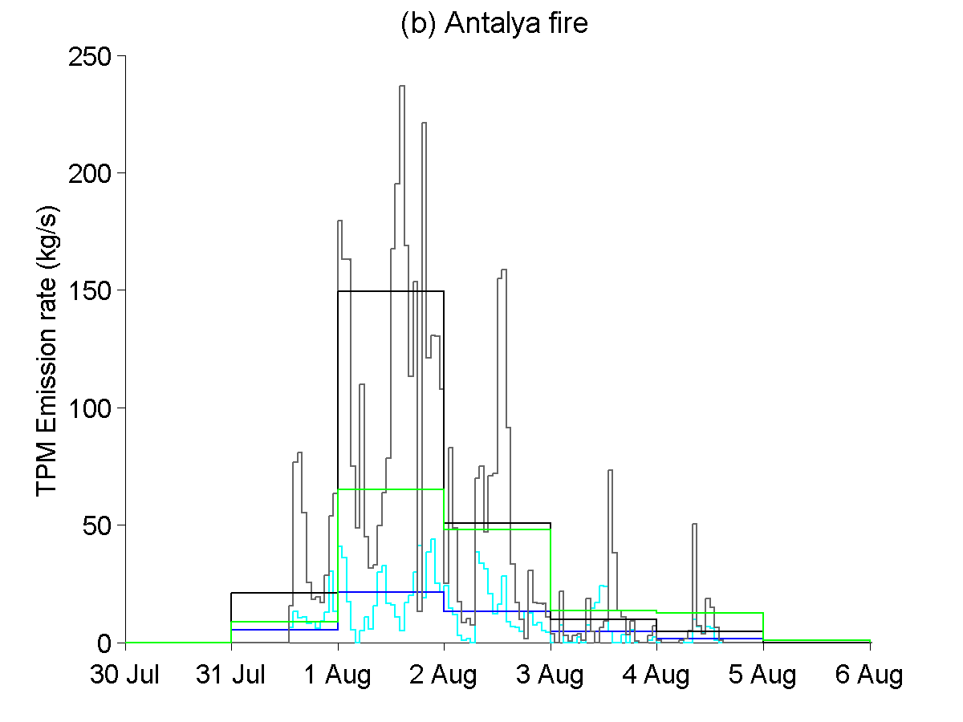
Notes:
If we focus only on a small region surrounding Antalya fire, we can see that the new emission rate are comparable with the MODIS based one and during the strongest day of Antalya fire, the LandSAF FRP based estimation is much higher than the GFAS one the hi area around Antalya fire

Slide 17
[tons]
Wf_ABBA
Land SAF
GFASv1.1
Notes:
The same we can see with the computation of main trace gases and aerosol
Here we show the total emission in tons over the EMB and over Antalya fire during the 6 days of burning of the Antalya fire

Slide 18
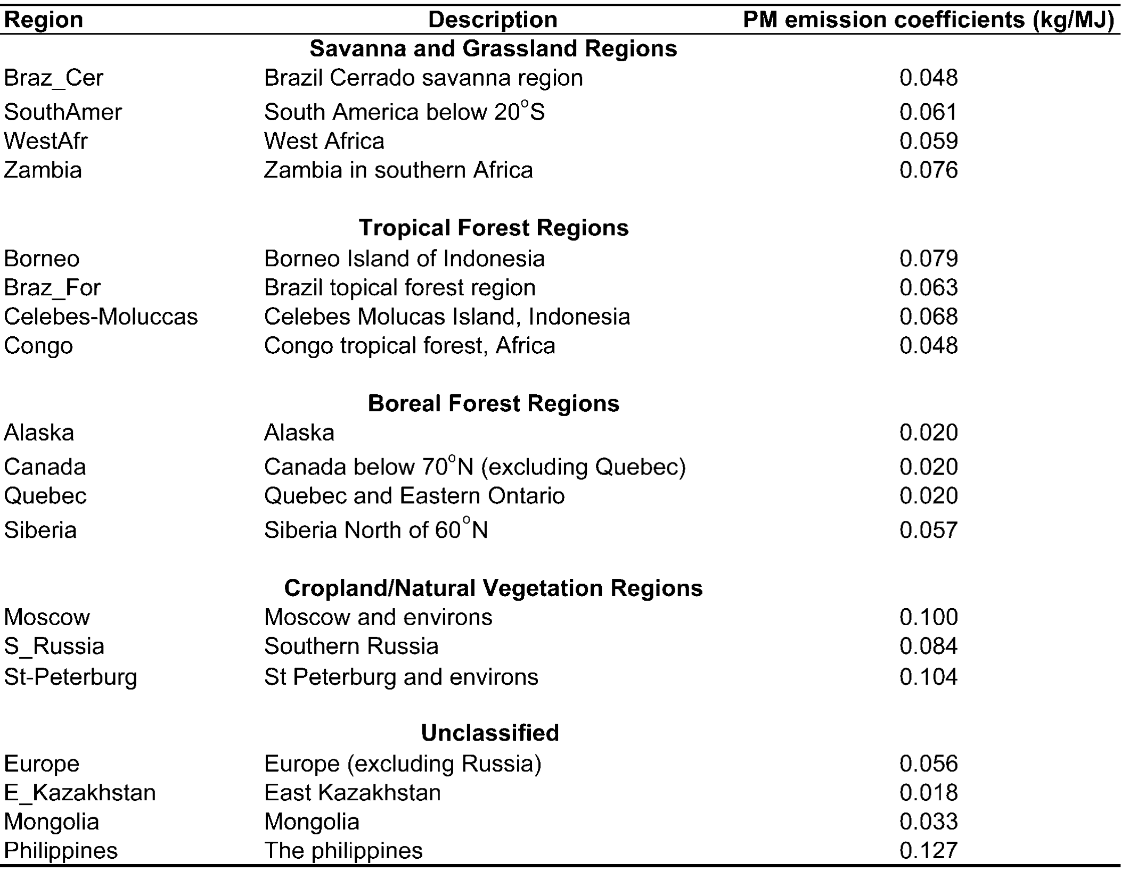
Conversion to Smoke aerosol Emission rate (Ichoku & Kaufman, 2005)
^{Emission rate}_{TPM,k}^{(kg/s) =} ^{C}_{TPM,k} ^{* FRP (MW)}
Emission rate_{i,k} : emission rate for species i and for land cover class k
FRP: Fire Radiative Power
C_{TPM,k} : Coefficient of emission of
smoke aerosol for land cover class k
0.06
0.06
0.02
0.084
Notes:
We also computed TPM emission rate in the study area during Antalya fire using coefficient of smoke emission proposed by Ichoku and Kaufman
Here there are the values for our computation

Slide 19
TPM emission [tons]
Kaiser et al., 2012
Ichoku & Kaufman, 2005
The impact of the use of different conversion factors available in literature illustrates the large uncertainties of currently available biomass burning emission estimates
Notes:
Tons emission during Antalya fire are almost one order of magnitude different this showing the large uncertainties of currently available BB estimates

Slide 20
Future work
The CMAQ air quality model will be used to estimate the impacts of the Antalya fire on air quality.
We are currently performing a set of sensitivity simulations, which will include the newly developed fire emission inventories, based on WF_ABBA and Land SAF, and the GFASv1.1.
We will be able then to quantify the impacts of different emission inventories on air quality, and differences due to total emitted amounts, their geographical location, and daily versus hourly emission temporal distribution.
Notes:
Evaluate the impact of Antalya fire to the air quality in the region by running the CMAQ model
Perform a sensitivity analysis using the new developed Wf_ABBA and Land SAF FRP based emission inventory and the MODIS based GFASv1,1 to evaluate the impact of using different fire detection algorithms

Slide 21
Acknowledgments:
I would like to thank Turkish Science Foundation for funding this effort via 111G037, “Development of Air Pollution Emissions Management System”
Thank you

Slide 23
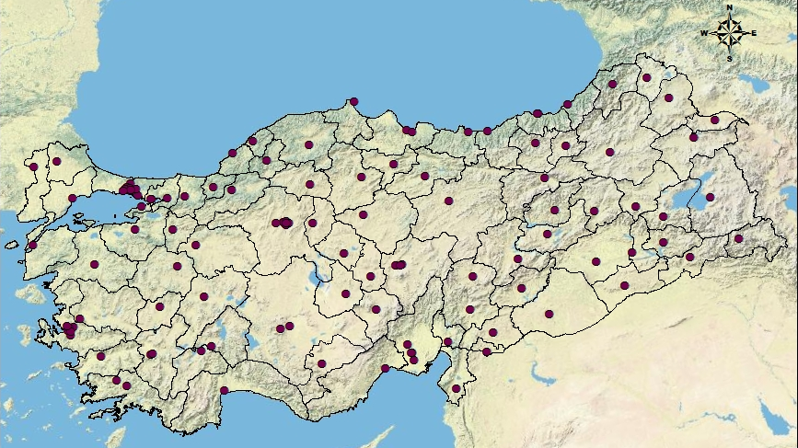
Air Quality ground station in Turkey

