Slide 1
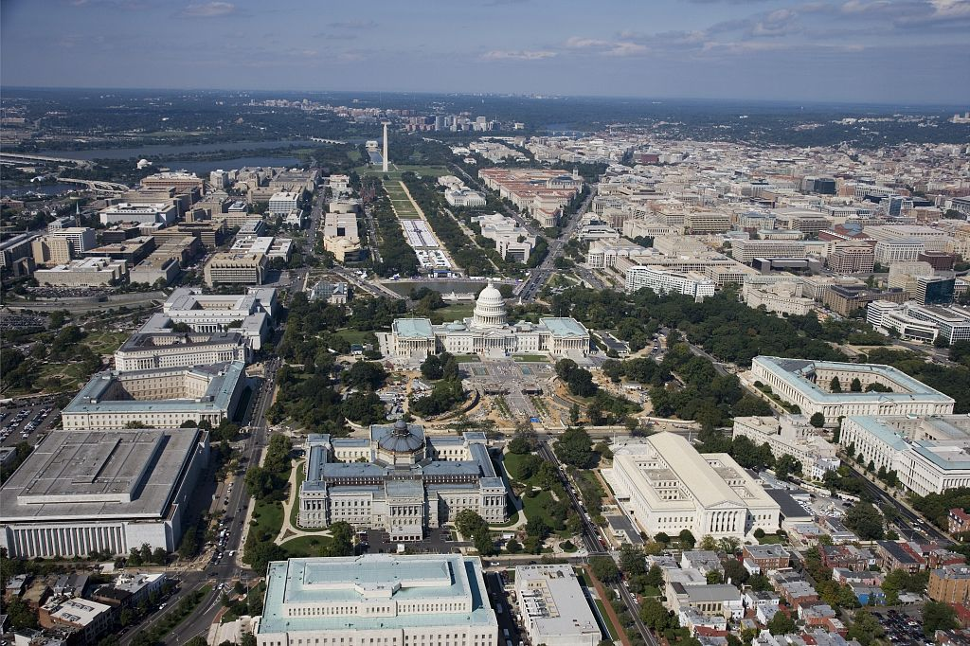
Application and evaluation of the two-way coupled WRF-CMAQ modeling system to the 2011 DISCOVER-AQ campaign in the Baltimore-Washington D.C. area
K. Wyat Appel, Jonathan Pleim, Robert Gilliam, James Godowitch, George Pouliot, David Wong, Shawn Roselle, Rohit Mathur and Daiwen Kang
12th Annual CMAS Conference
October 30, 2013

Slide 2
Reasons for High-Resolution Met/AQ Modeling
Many AQ problems have primary or near-source components
  primary particulate emissions are major contributors to PM_{2.5}
  representation of near source gradients
  exposure risk depends on proximity to sources
Complex terrain, coastlines and cities require high-resolution modeling to
  represent local wind fields, PBL structure, etc.
  represent urban effects
  Point and line source emission distributions are sub-grid at any scale
  artificial dilution of primary pollutants due to instantaneous mixing of emissions into large grid-volumes
  subsequent impacts on near-source chemistry and predictions of secondary pollutants

Slide 3
New approaches applied (in WRF)
1. High-resolution data assimilation
  Coarse grid analyses and observation data do not have sufficient resolution for high-resolution modeling
  Applied an iterative processing of the WRF output to improve high-resolution surface analysis fields
2. Improved representation of the urban environment
  Use of high-resolution impervious surface and canopy fraction data
  Adjust model parameters to better represent urban environments
3. Assimilate high-resolution sea-surface temperature data
  Improve representation of marine environment using a satellite derived high-resolution (1-km) sea-surface temperature dataset

Slide 4
1. High-Resolution Data Assimilation
Basic problem: data too sparse, especially upper air
Surface obs are more dense, including mesonets in some areas, but atmospheric nudging in PBL is not desirable
Solution: Assimilate surface and other obs data (precip, sat) into land surface parameters (e.g. soil moisture, soil temperature)
  HRLDAS (Noah LSM)
  Indirect soil nudging (PX LSM)

Slide 5
High-resolution data assimilation for soil nudging
12km Met analysis
(NAM)
The PX LSM uses T-2m and RH-2m analyses for indirect soil moisture and deep soil temperature nudging
Obs Data
Including mesonet
OBSGRID
WRF analysis
(1km)
Initial WRF output is recycled back to OBSGRID as new background
Mesonet adds high density obs data
1km WRF/CMAQ
1km WRF
WRF and CMAQ
Output (1km)
WRF output
(1km)

Slide 6
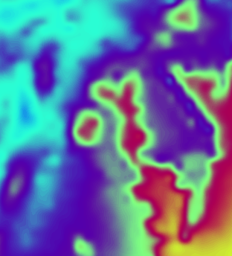
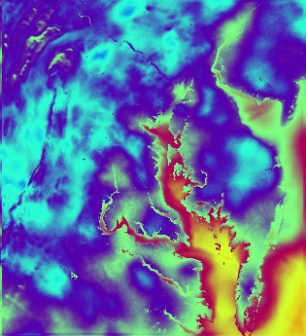
Comparison of T-2m analyses for soil nudging
Analysis with NAM 12-km Background
Analysis with Iterative 1-km WRF as Background
Without sufficient resolution data assimilation may do more harm than good

Slide 7
Temperature evaluation - July 1-31
4km base
4-km w/ iterative analysis
1-km base
1-km w/ iterative analysis
1-km w/ hi-res SST (ignore)
RMSE
Iterative analysis reduces error mostly at night and afternoon with large bias reductions at night
Before iterative technique 1-km run was much worse than 4-km run
Mean Bias

Slide 8
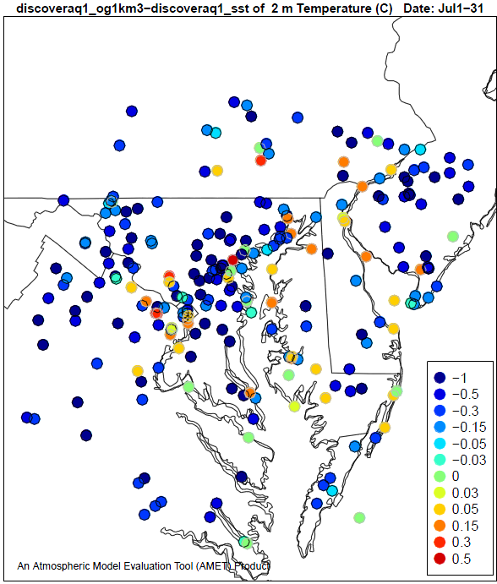
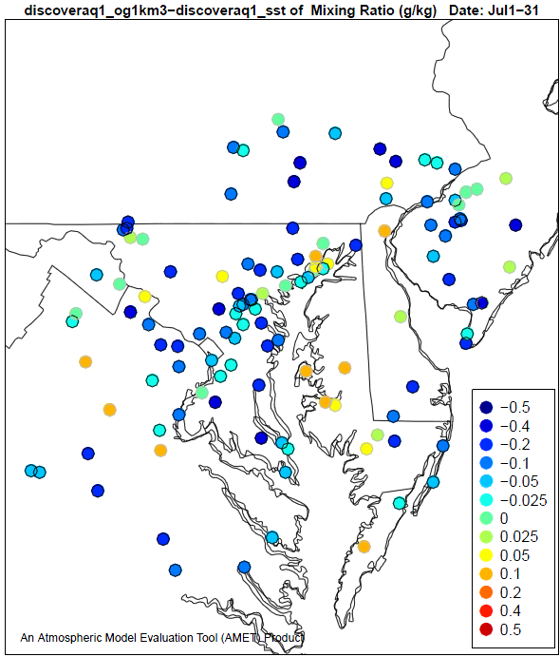
Effects of iterative analysis for soil nudging
RMSE Change = RMSE _{(Iterative analysis run)} – RMSE _{(base analysis run)}
RMSE Change
RMSE Change
T-2m
Q_{v}-2m
Reduction in
Error
Reduction in
Error
Increase in
Error
Increase in
Error
RMSE reduced at 78% sites
Bias reduced at 65% sites
RMSE reduced at 72% sites
Bias reduced at 57% sites

Slide 9
2. A Simple Bulk Urban Approach for PX LSM
Leverage very high resolution National Land Cover Database (NLCD) with multi-level urban classifications
  PX LSM considers sub-grid land use fractions
Utilize NLCD-based impervious surface data directly in LSM to scale surface heat capacity
Increase surface roughness for urban land use classes to better represent developed areas
Decrease albedo in urbanized areas to account for sky-view and radiation trapping effects
Use NLCD tree canopy coverage data in energy transfer model

Slide 10
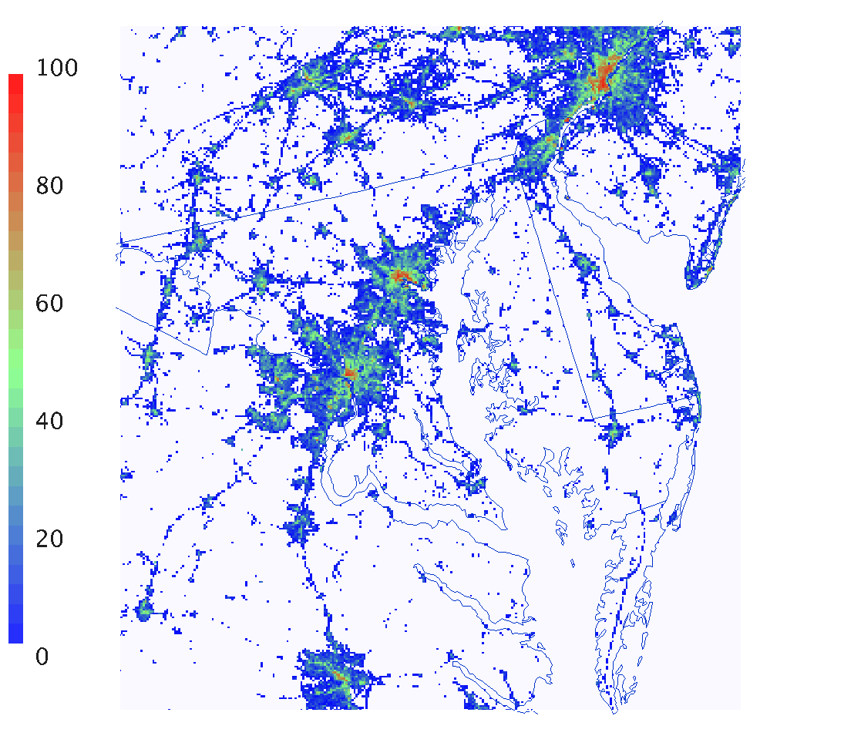
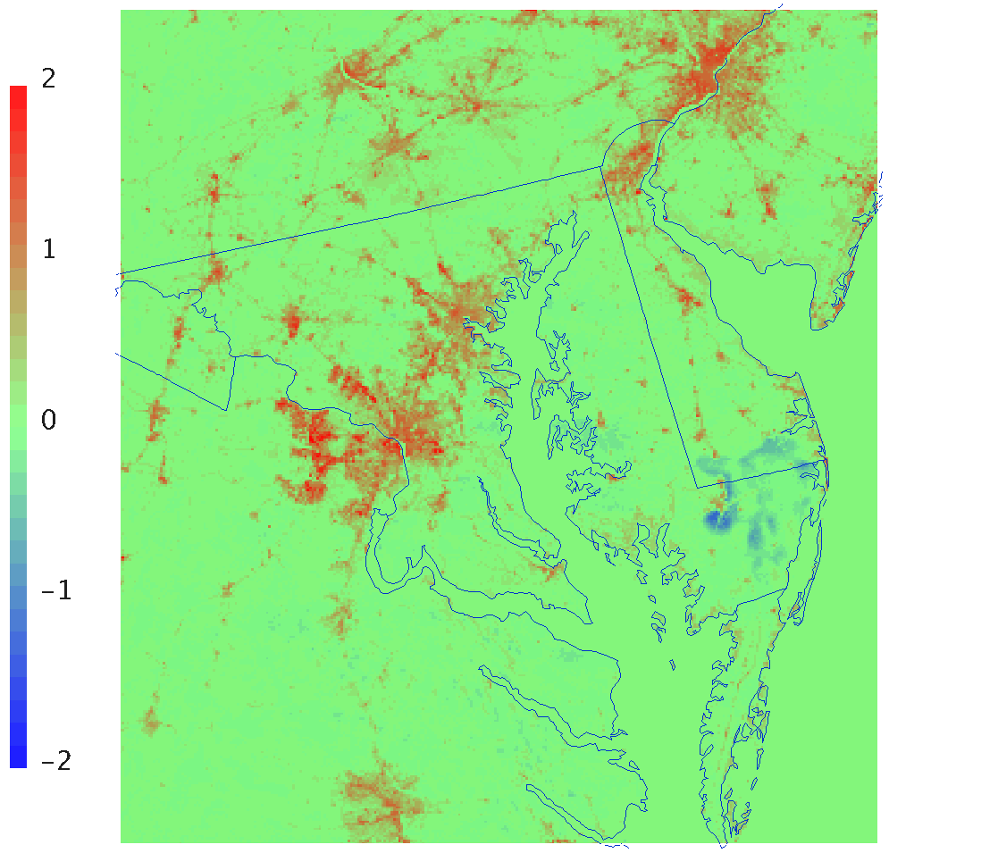
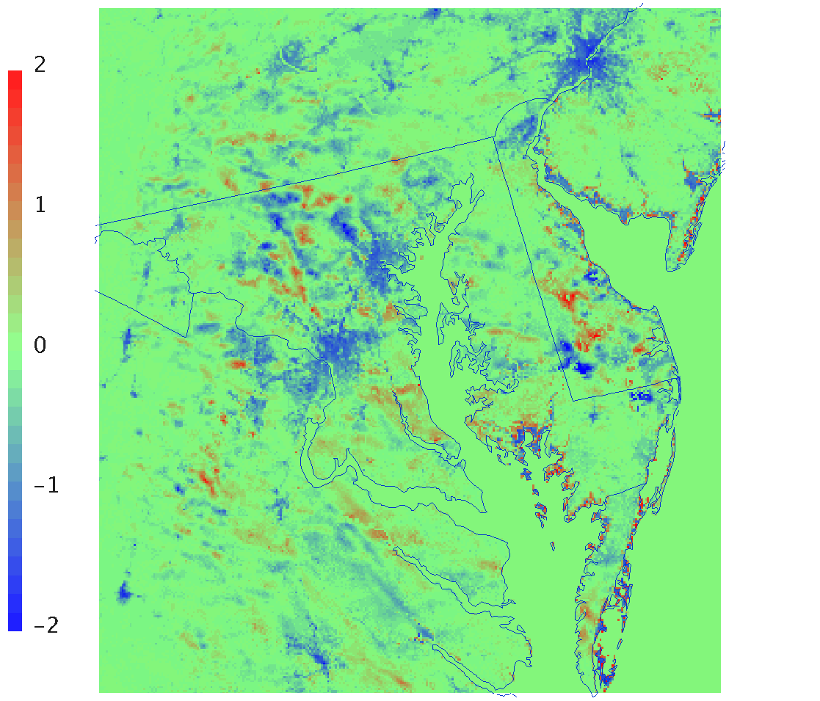
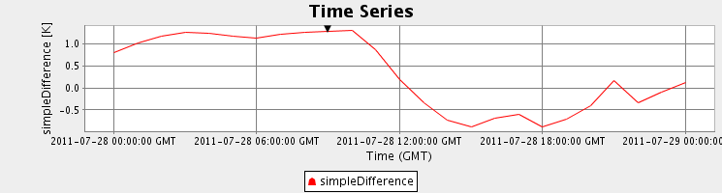
1-km WRF for DISCOVER-AQ
Urban - Base
Impervious fraction
T_{skin} - July 28, 6am LT
T_{skin} - July 28, 11am LT
Scaling heat capacity by impervious surface results in warmer T_{skin} at night but cooler T_{skin} in morning

Slide 11
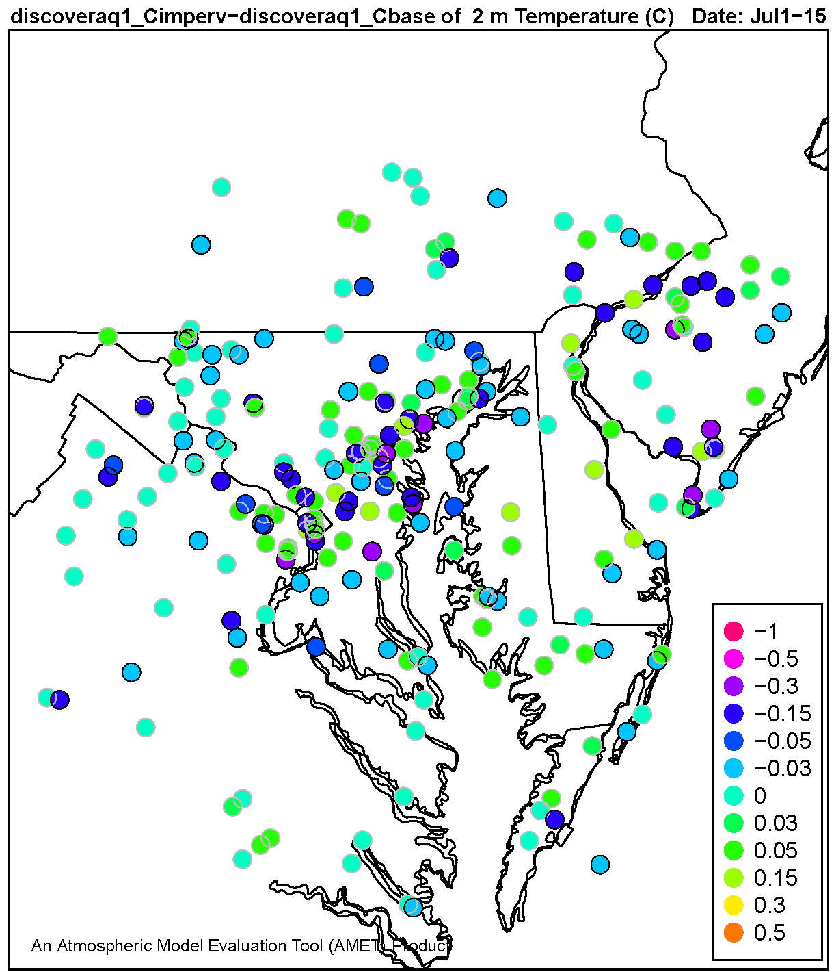
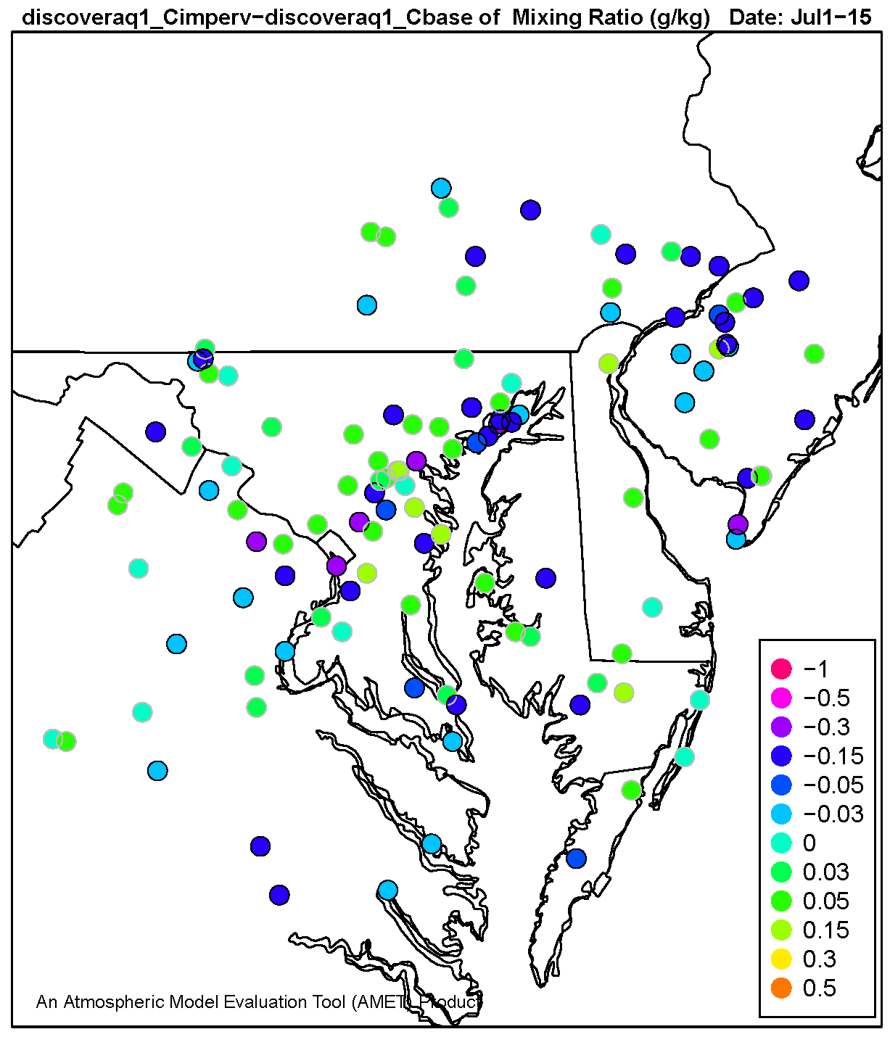
Difference in Bias, July 1-15: Urban - Base
T-2m
Qv-2m
Reduction in
Error
Reduction in
Error
Increase in
Error
Increase in
Error
T and Qv biases are smaller near urban areas in urban simulation

Slide 12
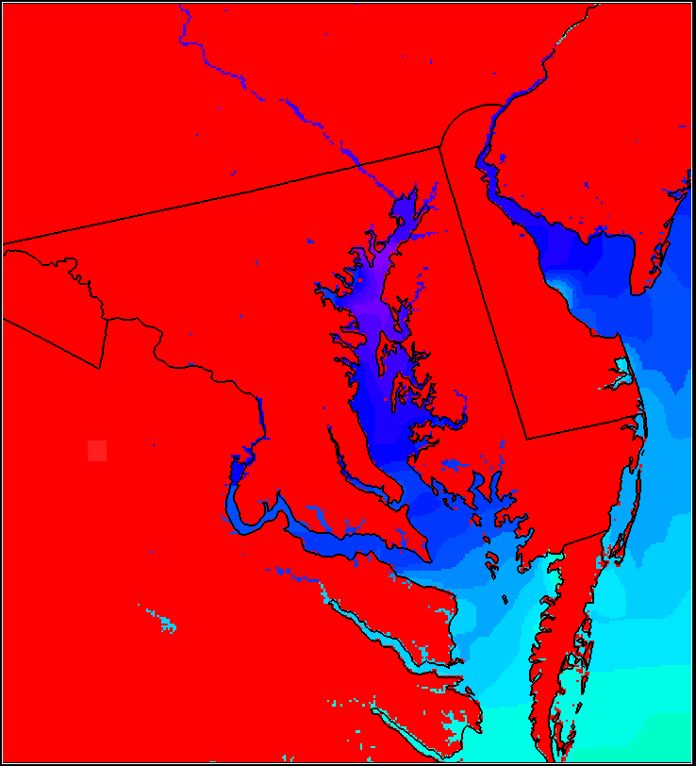
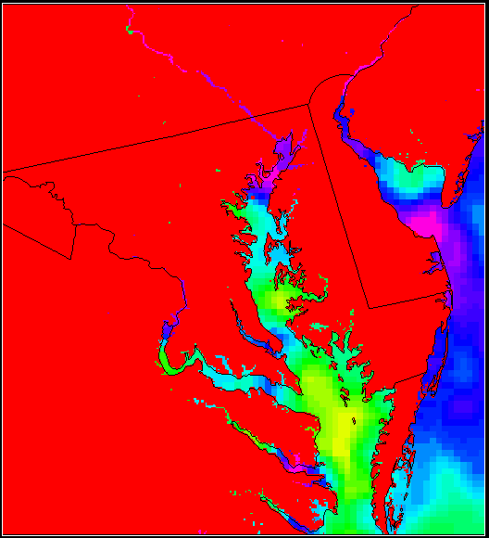
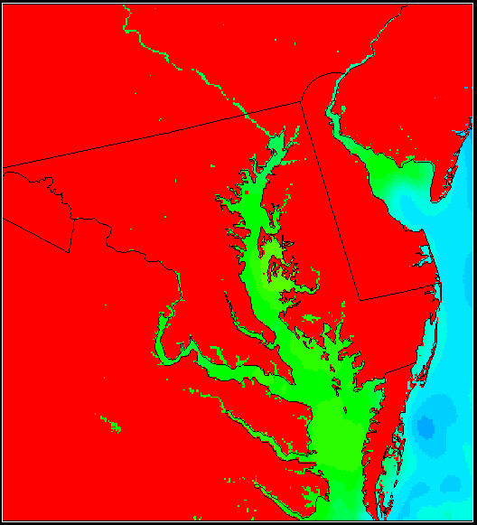

High-Resolution SST Data
NAM 12-km
PathFinder 4-km
GHRSST 1-km
NAM SST data (default)
12-km horizontal resolution
3-hourly
Used for 12-km WRF-CMAQ simulation
PathFinder SST data
4-km horizontal resolution global dataset
12-hourly
Used for 4-km and 1-km WRF-CMAQ simulation
GHRSST
1-km horizontal resolution global dataset
Daily (smoothed to prevent step change each day)
Tested with WRF, but not used for WRF-CMAQ yet
The GHRSST 1-km SST does better at capturing the smaller inlets and tributaries of the Chesapeake Bay than the NAM 12-km and even the 4-km PathFinder.

Slide 13
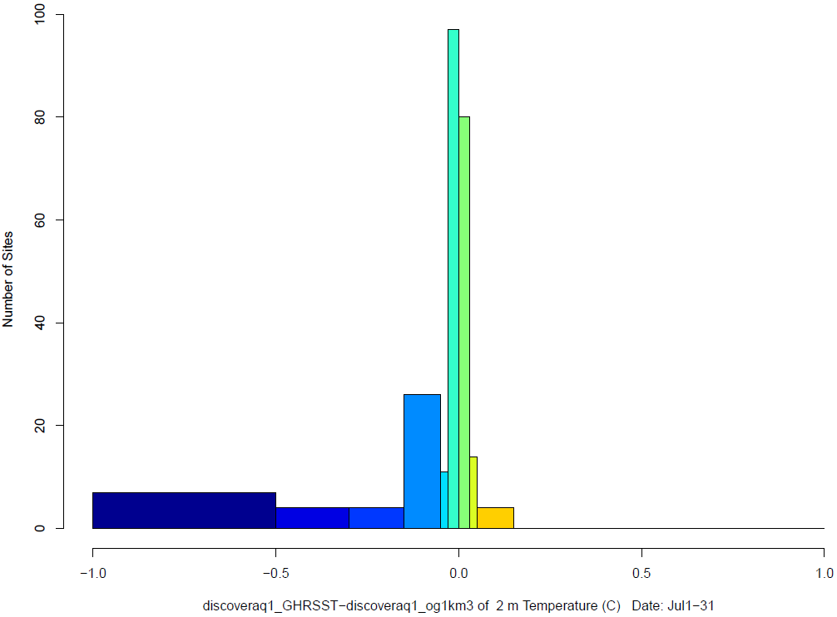
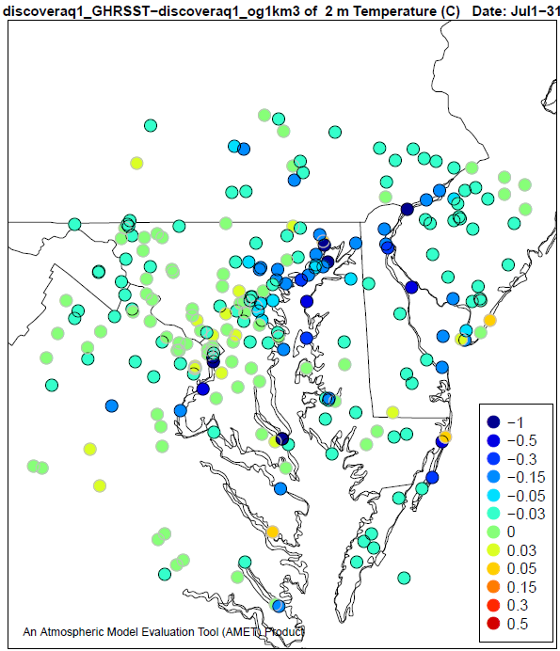
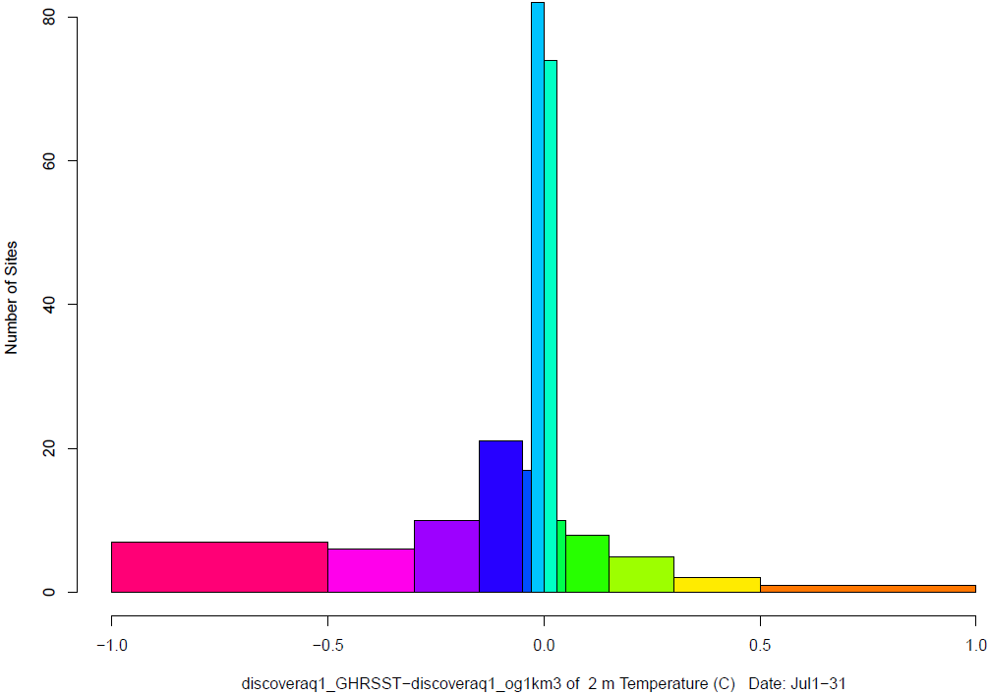
Difference in T RMSE and Bias, July 1-31: GHRSST - PathFinder
RMSE Change
RMSE Change
T-2m
63%
Reduction in
Error
Bias Change
60%
Increase in
Error
RMSE and bias are reduced with GHRSST compared to PathFinder and NAM12 (not shown).

Slide 14
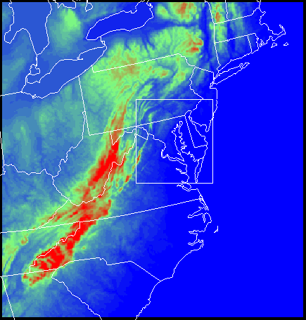
Coupled two-way WRF-CMAQ v5.0.1 with direct feedback effects applied to 12-km (CONUS), 4-km and 1-km domains
NO_{X} from lightning strikes included in 12-km simulation only
NAM SST used for 12-km simulation, PathFinder 4-km used for 4-km and 1-km simulations
Emissions based on 2010 CDC PHASE emissions with year specific updates to fires and EGU point sources (2010 mobile)
12-km boundary conditions provided by GEOS-Chem; 4-km and 1-km boundaries provided by larger WRF-CMAQ simulations
1km
4km

Slide 15
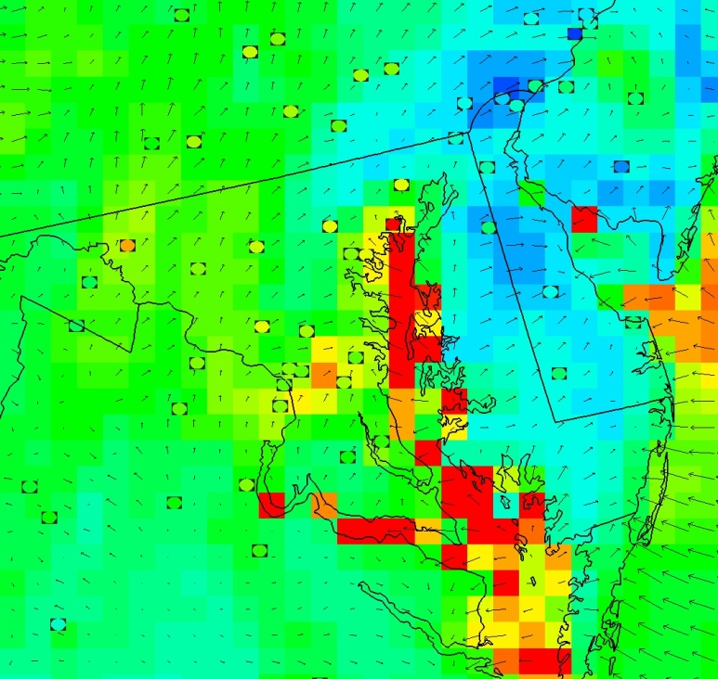
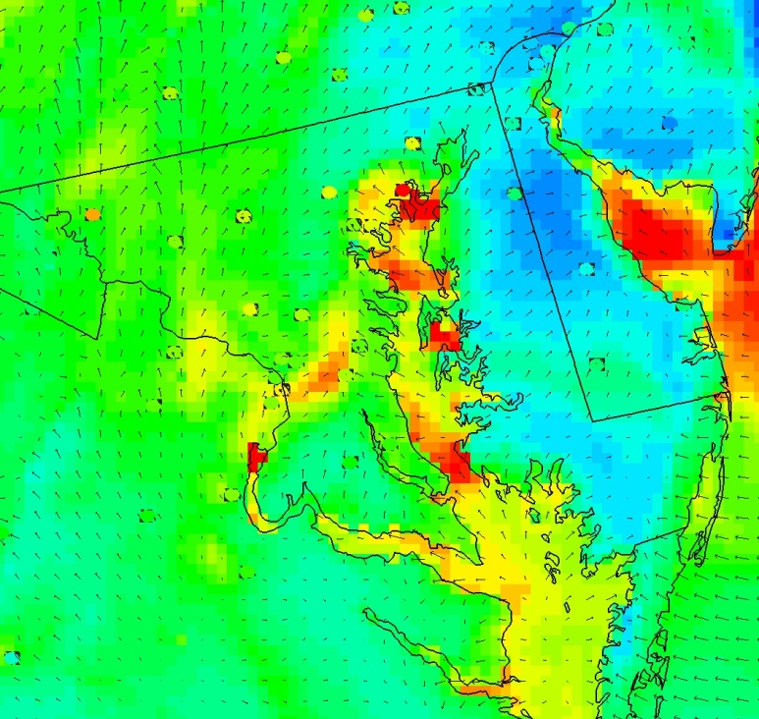
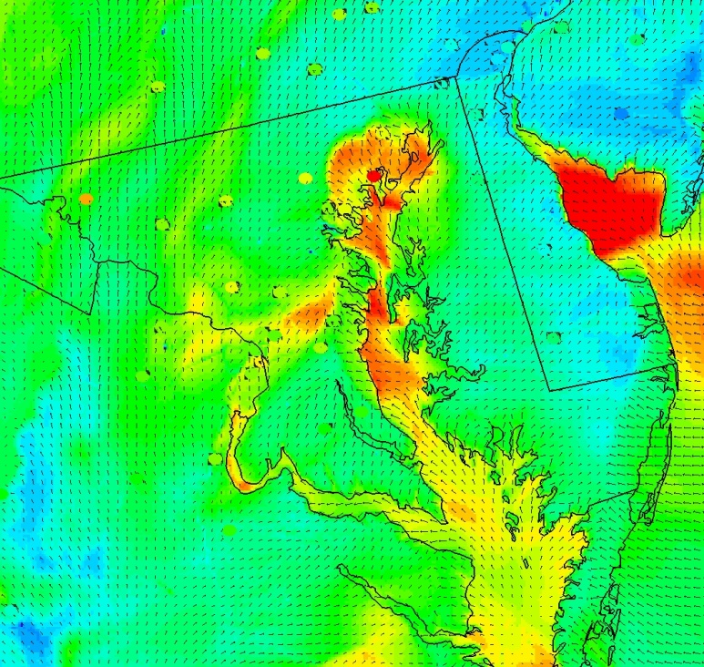

Improvements in Fine-scale simulations
12 km
4 km
1 km
Representing spatial gradients
Bay breeze impacts on inland monitors
O₃ at 3pm LT

Slide 16
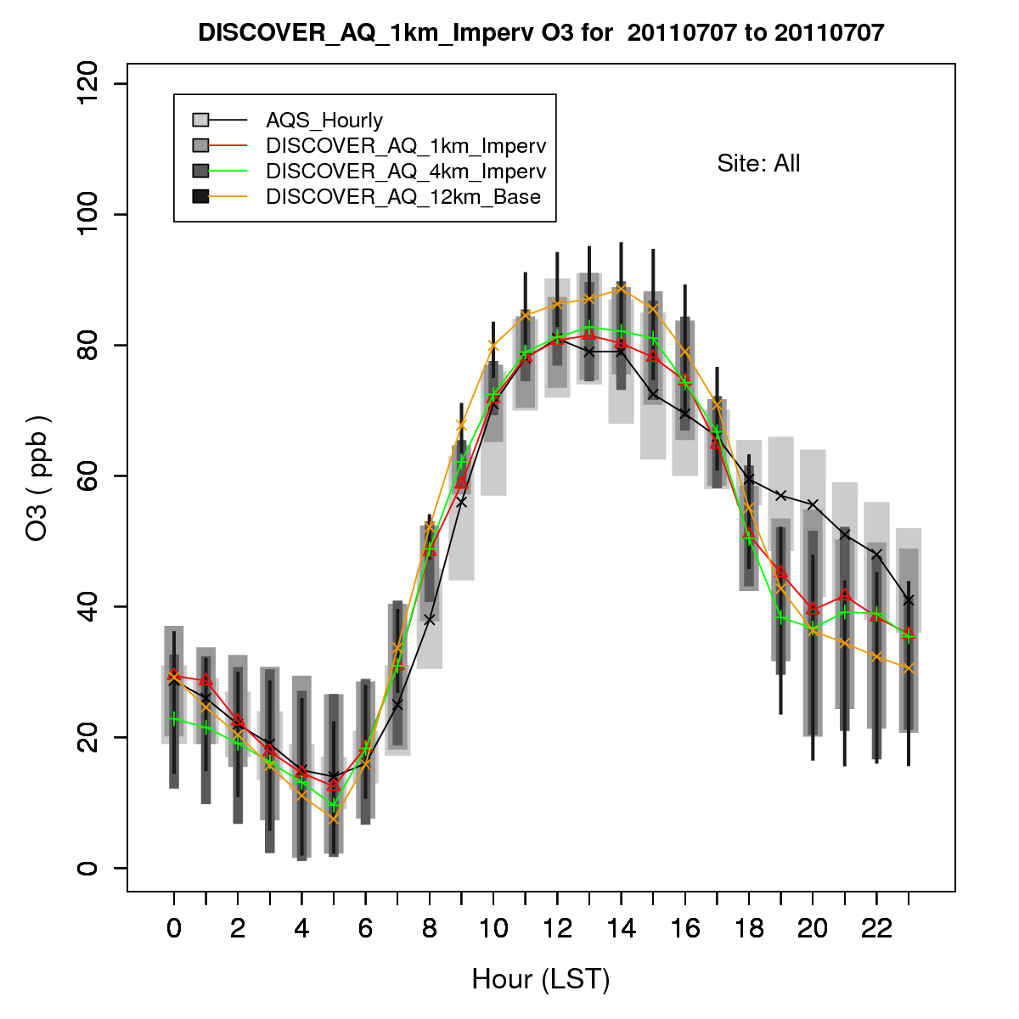
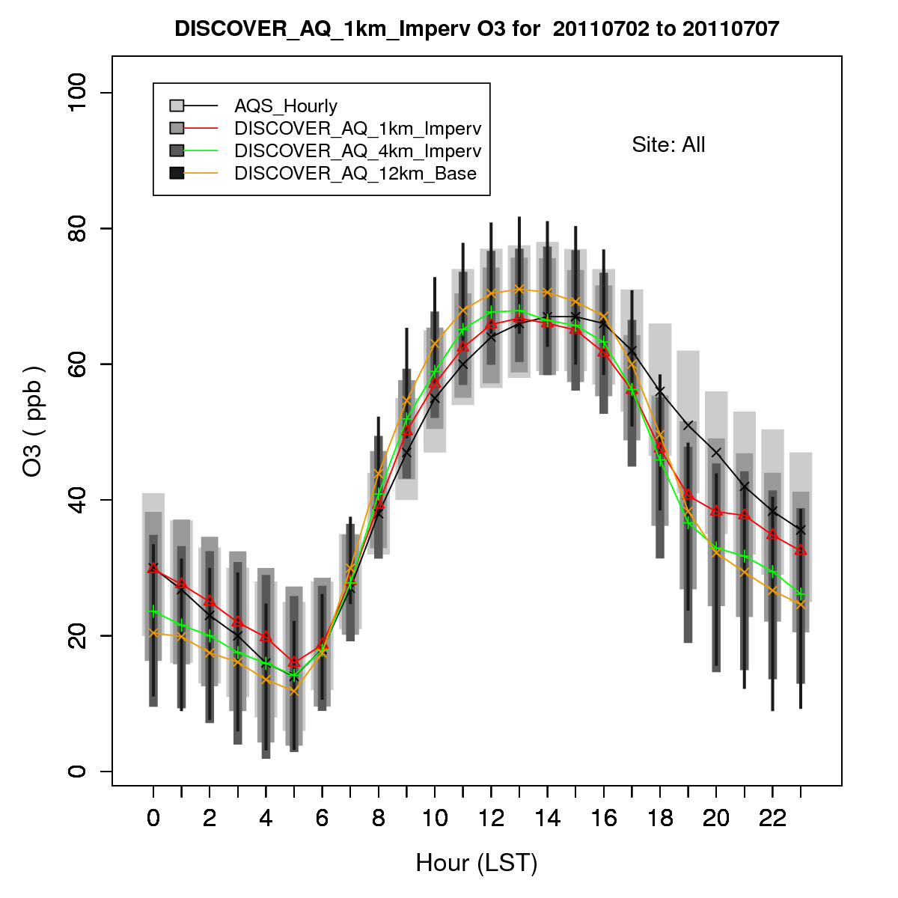
Improvements in Fine-scale simulations
Hourly O₃ for July 7 (1-km Domain)
Hourly O₃ for July 2 – 7 (1-km Domain)
Rapid collapse of evening PBL results in higher simulated primary pollutant concentrations
consequently lower O₃ compared to observations in base model
finer resolution treatments enable better representation of evening through early-morning values

Slide 17
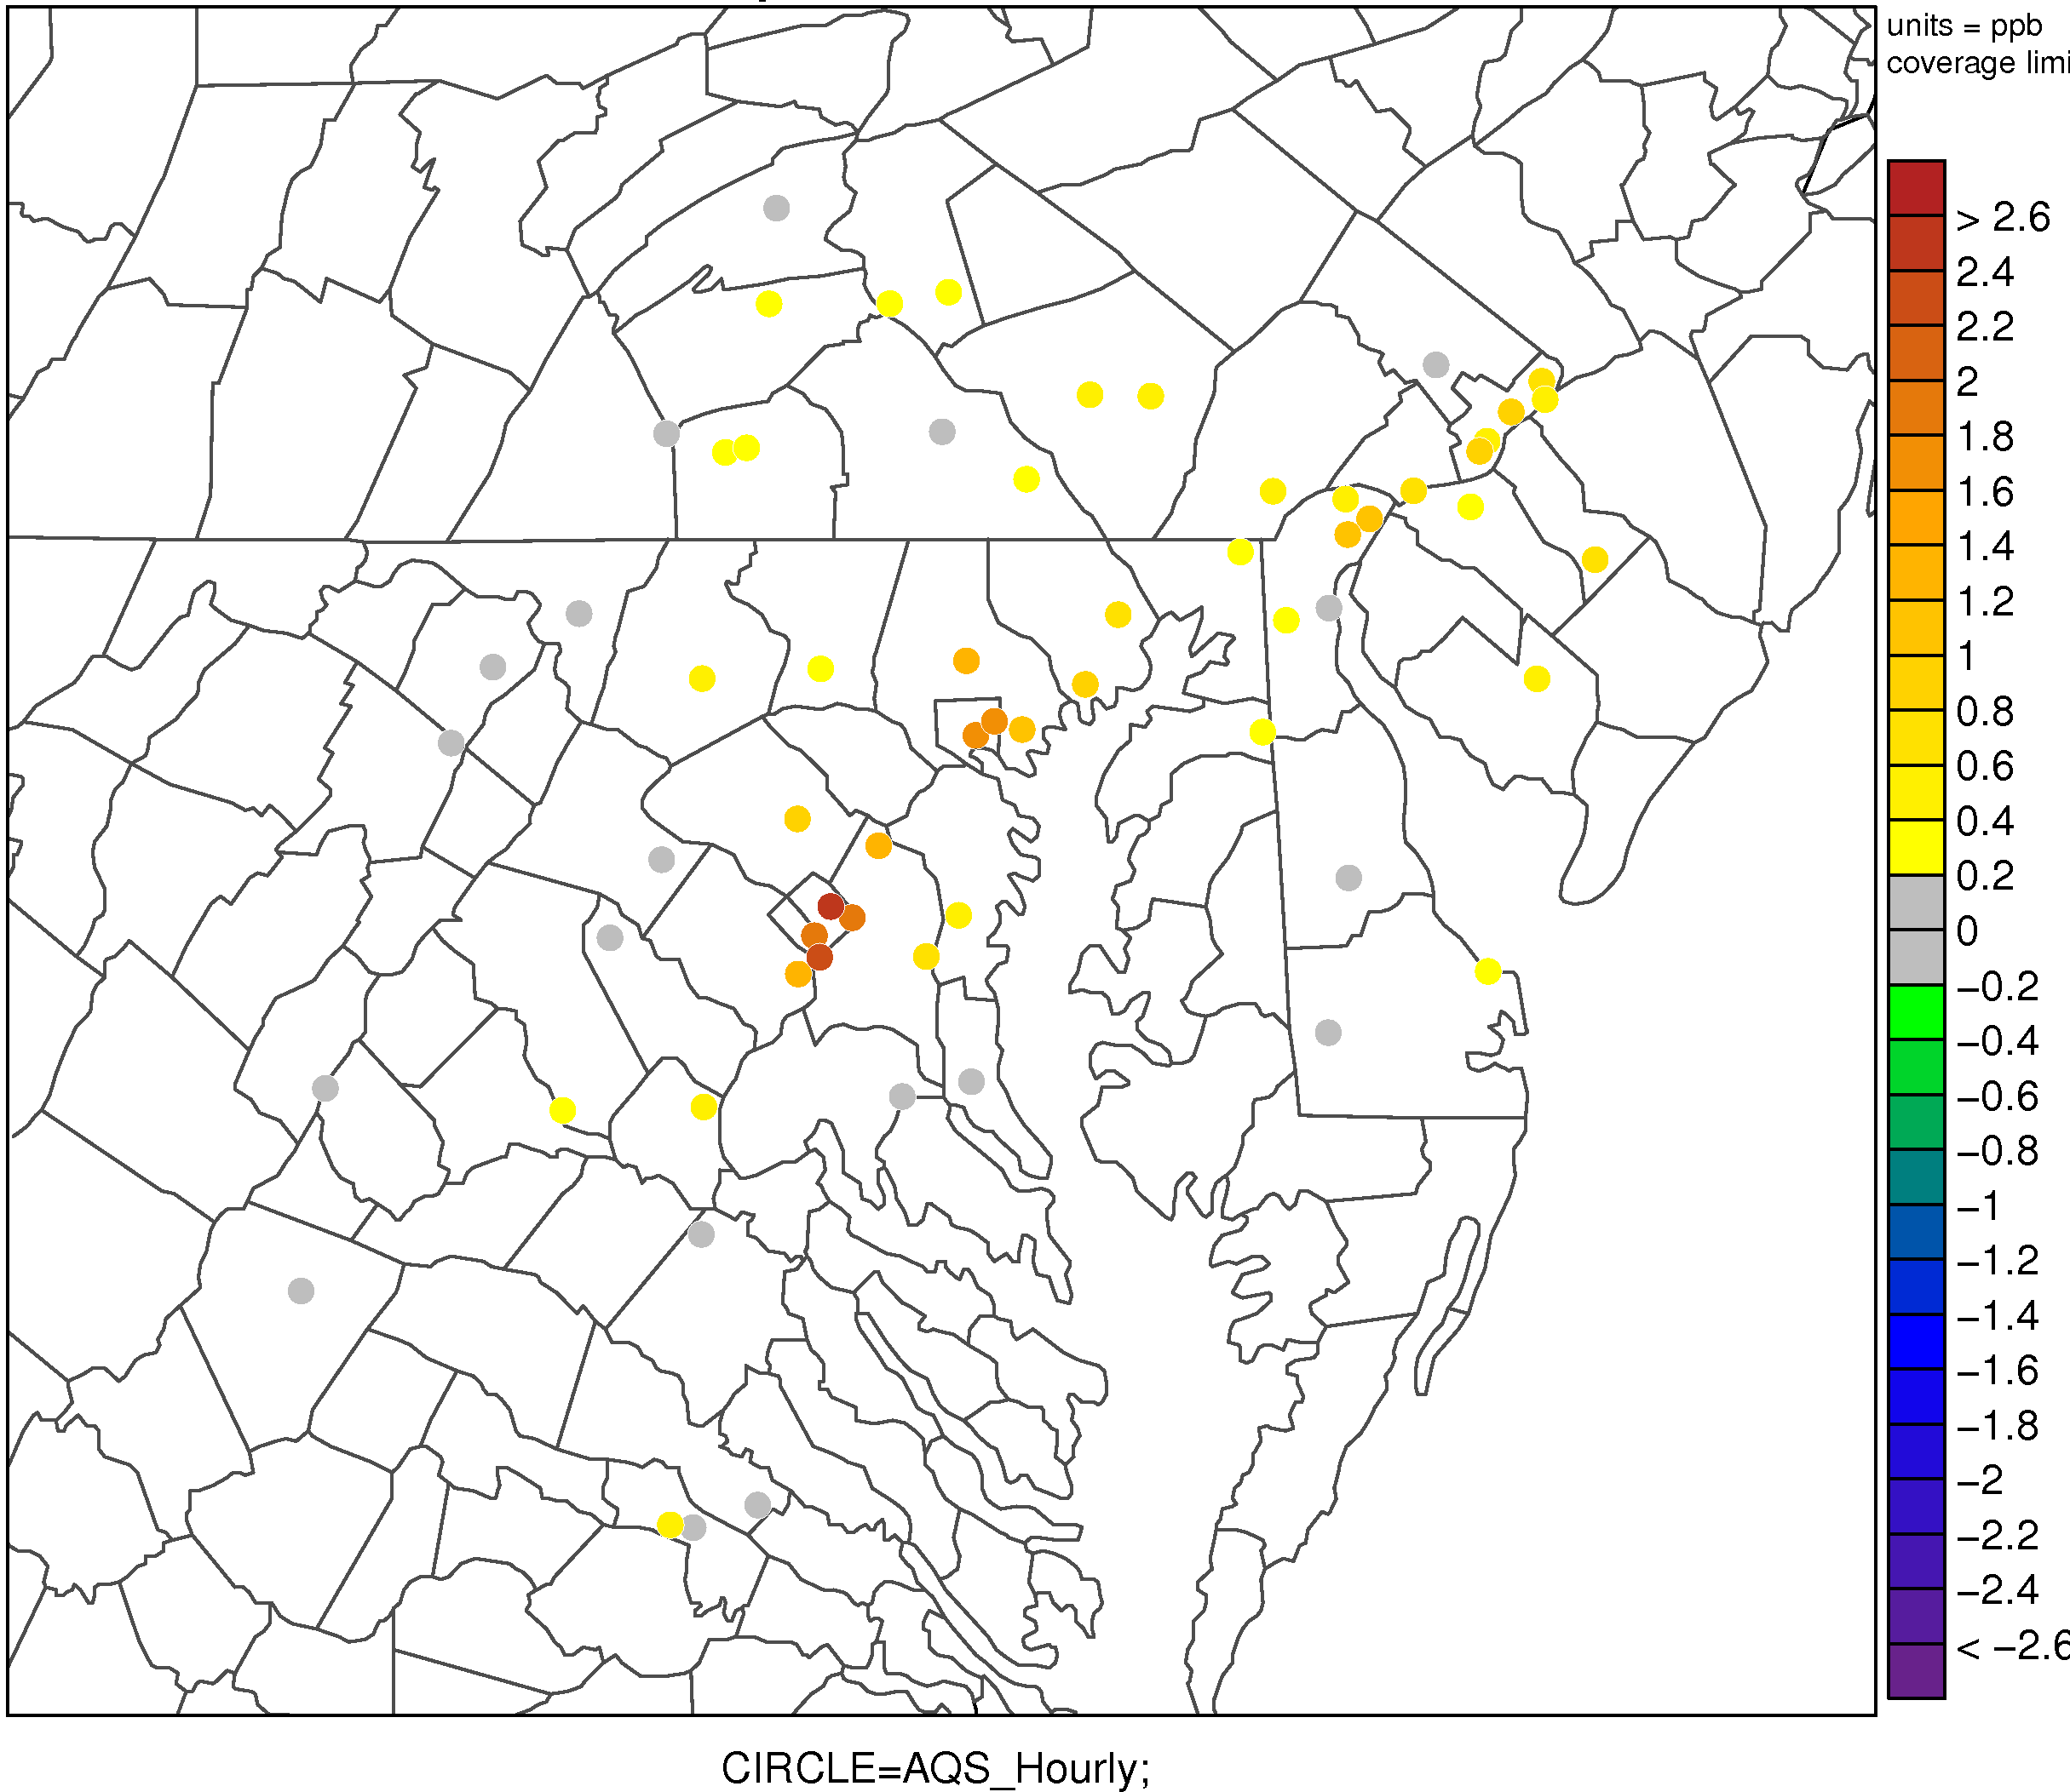
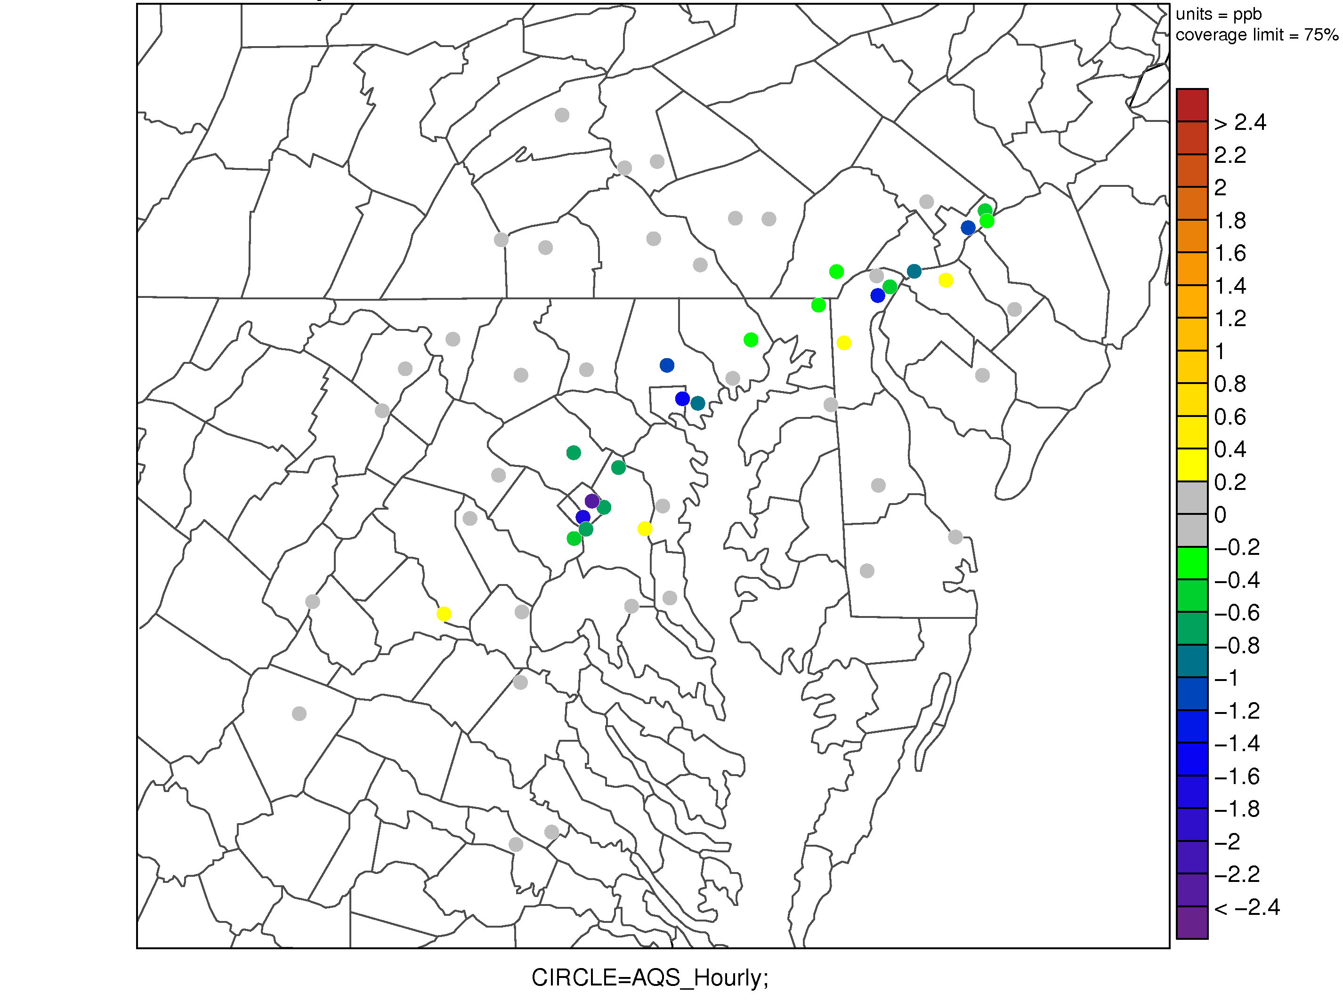
Impact of Urban Parameterization
1km Urban – Base (hourly O₃)
Absolute Difference
1km Urban – Base (hourly O₃)
Error Difference
Ozone is higher in the 1-km simulation with the urban parameterization, which results in reduced error at many sites.

Slide 18
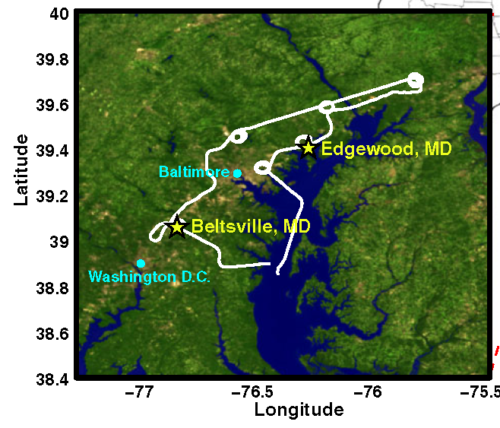
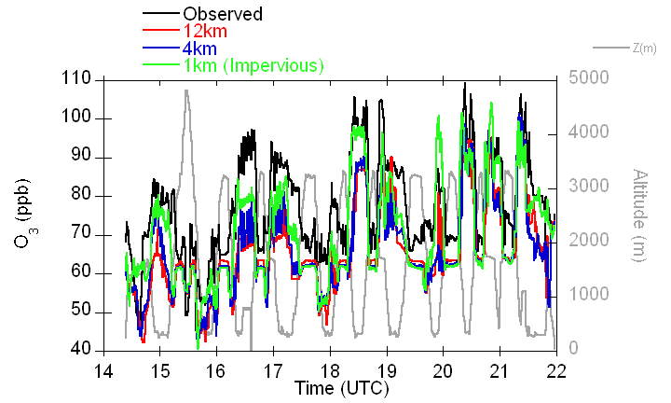
Improvements in Fine scale simulations
Comparison with aircraft measurements
DISCOVER-AQ; July 2, 2011
Aircraft ozone measurements compare better in 1-km simulation than the 4-km and 12-km simulations.

Slide 19
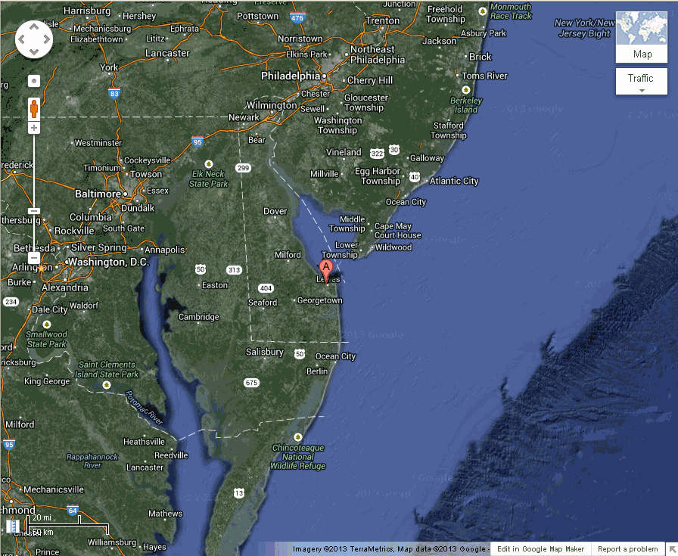

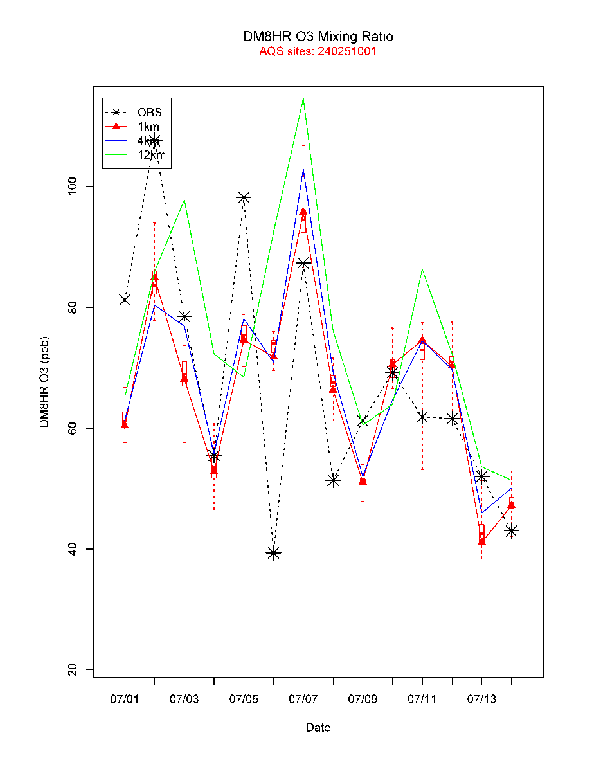
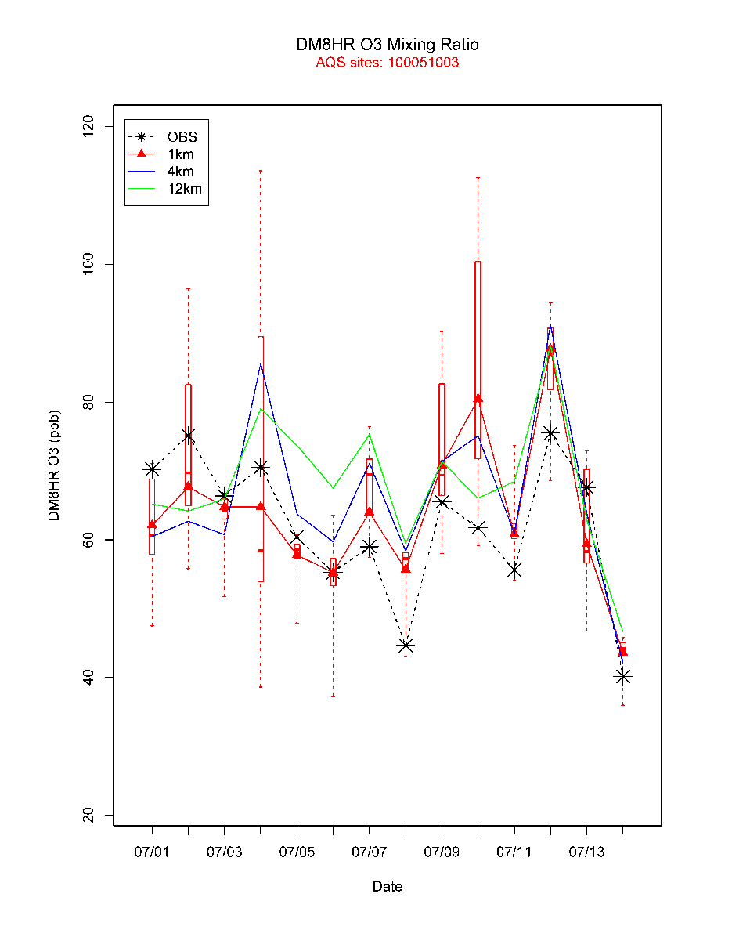
Does finer resolution enable better
representation of spatial variability?
DM8HR O₃ – Site 240251001
DM8HR O₃ – Site 100051003
The red box plots represent the distribution of 1-km values (144 total) that reside within the same 12-km grid cell.
1-km - red
4-km - blue
12-km - green

Slide 20
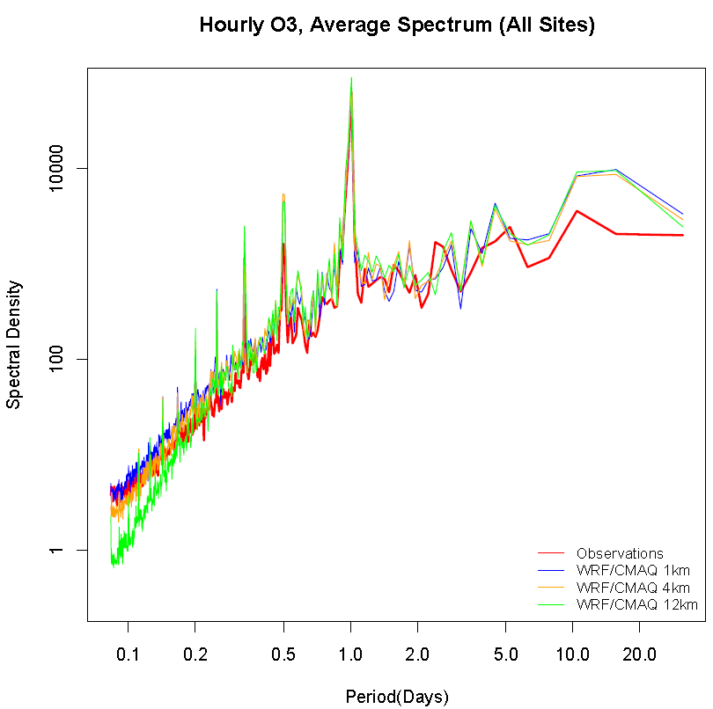
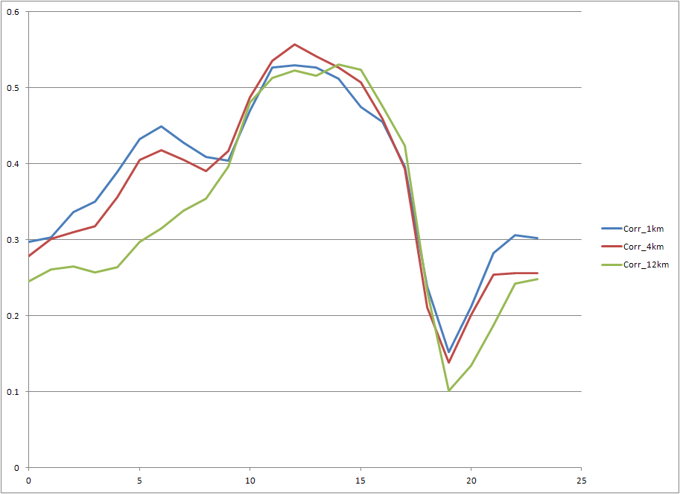
Correlation and Variability at Fine Scales
Average Diurnal Cycle of Obs/Mod Correlations (R²) Across Space for 69 AQS O3 Monitors
Correlation Coefficient
Hour of Day
Diurnal correlation of ozone and energy spectrum (variability) are better in the 1-km and 4-km simulations than the 12-km simulation.

Slide 21
Conclusions
Recycling model output as background for 2nd analysis greatly improves representation of high resolution features
  significantly improves overall model performance at fine-scales
Urban parameterization improves characterization of the boundary layer
  results in improved model performance for O₃ in the late afternoon and overnight
Use of high-resolution SST data provides a much better representation of the marine boundary layer
  improves model performance of T, q, WS and WD
Improved model performance at the 4-km and 1-km model grid resolutions versus coarser 12-km grid resolution
Coupled two-way WRF-CMAQ can accurately simulate the meteorological and air quality measurements at the urban-scale
  Combined analysis of surface ozone and wind fields demonstrates that the 1-km WRF-CMAQ model simulations can represent terrain, coastal, and urban effects that cannot be resolved by coarser grid model simulations

Slide 22
Future Work
Re-run WRF-CMAQ 12-, 4- and 1-km domains using latest inputs:
  2011 NEI
  2011 MOVES
  Use 1-km GHRSST for all three domains
  Model code fixes for lightning NO_{X} and trigger 2 option
Perform intensive operational evaluation of the new results using the unique DISCOVER-AQ data available
Likely perform other simulations to test additional model improvements
  Direct FDDA at fine-scales for example
Upcoming presentations on DISCOVER-AQ:
  AGU Conference (hopefully present results using 2011 emissions)
  2014 AMS Conference

