Slide 1
SMOKE-MOVES
Alexis Zubrow¹
BH Baek²
Harvey Michaels³
¹ Emissions Inventory Analysis Group
Office of Air Quality Planning and Standards
on detail to Region 1
U.S. Environmental Protection Agency
² Institute for the Environment
University of North Carolina – Chapel Hill
³Assesment and Standards Division
Office of Transportation and Air Quality
U.S. Environmental Protection Agency

Slide 2
Why SMOKE-MOVES?
Historically:
Run MOVES (previously MOBILE6) in inventory mode
Produce state estimates to create monthly inventories, allocate to counties via NMIM emission estimates
Process inventories through SMOKE as month-specific area/nonpoint sources
Motivation for SMOKE-MOVES:
More closely integrate MOVES into the emissions modeling process
Emission factors for multiple pollutants are sensitive to temperature
  PM, VOC, NOx, etc.
  Want to include more temporally/spatially resolved temperatures
Computational considerations
  Keep computation demands “reasonable”
  Representative counties reduce the number of MOVES runs
  Use lookup tables for emission factors
Notes:
For the integration aspect, could mention how having the activity data has been very useful. No longer a black box.
Also now get EF from MOVES and temperature is augmenting the spatial gridding and temporalization of the emissions

Slide 3
Temperature and Emission Factors (EF)
Gasoline vehicles
from OTAQ

Slide 4
SMOKE-MOVES Integration Tool
Driver Script
Meteorological
Preprocessor
(Met4Moves)
MOVES
Post-processing
Script
SMOKE
AQ model-ready files
Notes:
Met4Moves
Produces temperature ranges, diurnal temperature profiles, and relative humidity (RH) values for specific counties
MOVES
Runs series of scenarios for each of the temperature profiles and temperature bins
Produces emission factors (EF)
SMOKE
Takes EF, activity data (VMT, SPEED, VPOP) and temperature data
Produces AQ model-ready emissions

Slide 5
Emission Processes
On-roadway emissions
  Rate-per-distance (RPD)
  Exhaust, evaporative, evaporative permeation, brake and tire wear
  SMOKE uses: VMT, SPEED, speed profiles, and T (gridded, hourly)
Off-network (i.e. parked vehicles)
  Rate-per-vehicle (RPV)
    Exhaust, evaporative, evaporative permeation, extended idle
    SMOKE uses: VPOP and T (gridded, hourly)
  Rate-per-profile (RPP)
    Evaporative fuel vapor venting: hot soak (immediately after a trip) and diurnal (vehicle parked for a long period)
    SMOKE uses: VPOP and T (county based, daily diurnal profiles)

Slide 6
Reducing Number of MOVES Runs
Representative Counties
  Determine a set of counties that can represent your modeling domain.
  Key emission rates for the single representative county in MOVES can be utilized to estimate emissions for all counties in the county group through SMOKE.
  Criteria for county group: similar fuel parameters, fleet age distribution and I/M programs
Fuel Months
  using a single month to represent a set of months with similar fuel properties
  Example: Run MOVES for January, use that run to represent a series of months with similar fuel types (e.g. Oct, Nov, Dec, Jan, Feb, Mar)
Notes:
Reduces the computational burden of running MOVES on every county/month in your modeling domain

Slide 7
Met4Moves
Representative county X-ref
Output for MOVES Driver Script (Representative County)
Fuel month X-ref
Meteorological
Preprocessor
(Met4Moves)
Spatial Surrogates
Output for SMOKE (Inventory County)
Gridded/Hourly meteorology
Notes:
emphasize surrogates restrict the regions that get T from. Example, wouldn’t want to include T from mountain region if there were no cars there
for MOVES
RPD/RPV: average RH and min/max T across the county group and fuel month
RPP: Diurnal T profiles based on min/max T of county group
for SMOKE
Daily (or monthly) average RH and min/max T for RPP. County and date specific, all counties in domain

Slide 8
Running MOVES part 1
3109 counties x 12 months = 37,308 county-months
For a typical CONUS national run:
Group by IM, fuels, age distribution
146 county groups x 2 fuel months = 292 county-months
Met4Moves
Met input for
runspec generator
Runspec Generator
27,513 runspecs
27,513 ZoneMonthHour tables
Notes:
Need to run MOVES for every representative county/fuel month/process/T bin
A LOT of MOVES runs!!!

Slide 9

Running MOVES part 2
27,513 runspecs
27,513 ZoneMonthHour tables
Run MOVES in 292 batches
MOVES Rate Tables
moves2smk
SMOKE EF tables
Notes:
each batch is a representative county/fuel month

Slide 10
MOVES Post-processing Scripts
moves2smk:
Convert MOVES MySQL tables to SMOKE-ready EF tables
  Produces 3 types of EF tables RPD, RPV, RPP EF tables
  Produces separate set of tables for each representative county and fuel month
Maps MOVES PM species to SMOKE PM species
  Appropriate for CB05 with SOA
  AE5 species: PMC, POC, PEC, PNO3, PSO4, PMFINE
Maps MOVES emission processes to SMOKE emission processes
  Optionally consolidate down to aggregated SMOKE modes: EVP, EPM, EXH, BRK, TIR
Notes:
consolidation of modes: example running exhaust + crankcase running exhaust = ‘EXH’

Slide 11
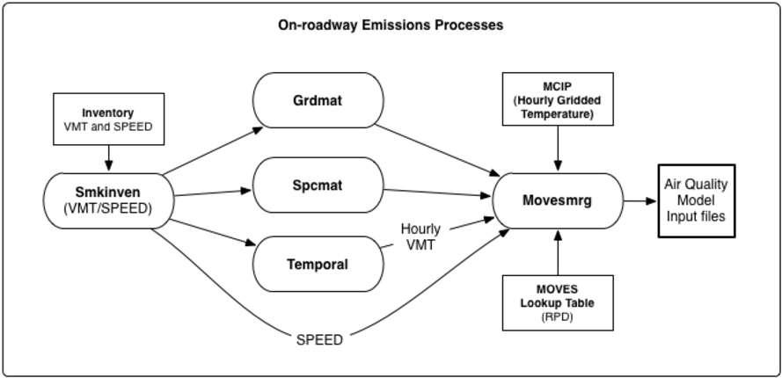
SMOKE: On-roadway Processing (RPD)
Notes:
Emphasize that have temporalized VMT and potentially hourly speed profiles. Using gridded met
RPD (grams/miles) : On-roadway Emission Process EFs
Lookup Fields: SCC, speed (optional 24-hr speed profiles), representative county, fuel month, and temperature.

Slide 12
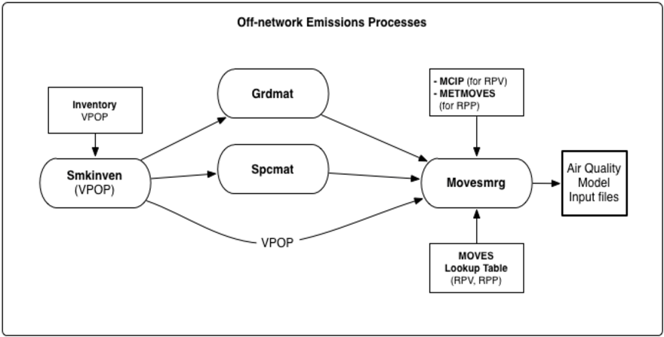
SMOKE: Off-network Processing (RPP, RPV)
Notes:
Emphasize using VPOP (not temporalized) and using gridded met for RPV and daily T min/max for RPP
RPV (grams/vehicle-hr) : Off-network Emission Process EFs
Lookup Fields: SCC, representative county, fuel month, temperature, local time (hourID).
RPP (grams/vehicle-hr) : Off-network Vapor Venting Evap. EFs
Lookup Fields: SCC, representative county, fuel month, temperature profiles, local time (hourID).

Slide 13
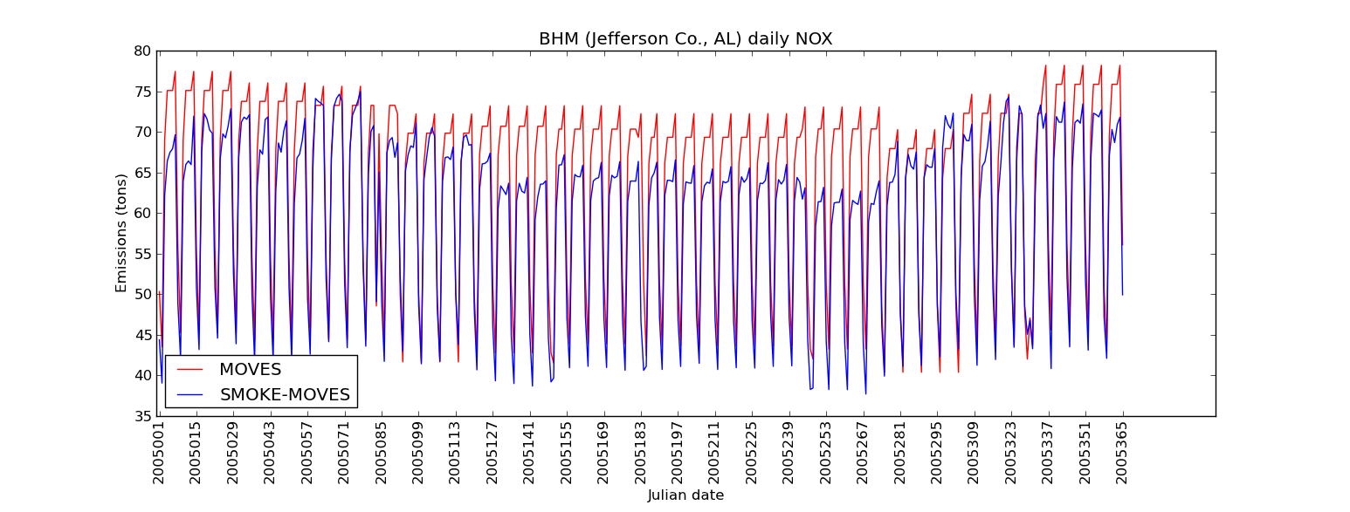
Monthly Inventory vs
SMOKE-MOVES
Emissions respond to day-specific temperature variations
Notes:
point out month transitions

Slide 14
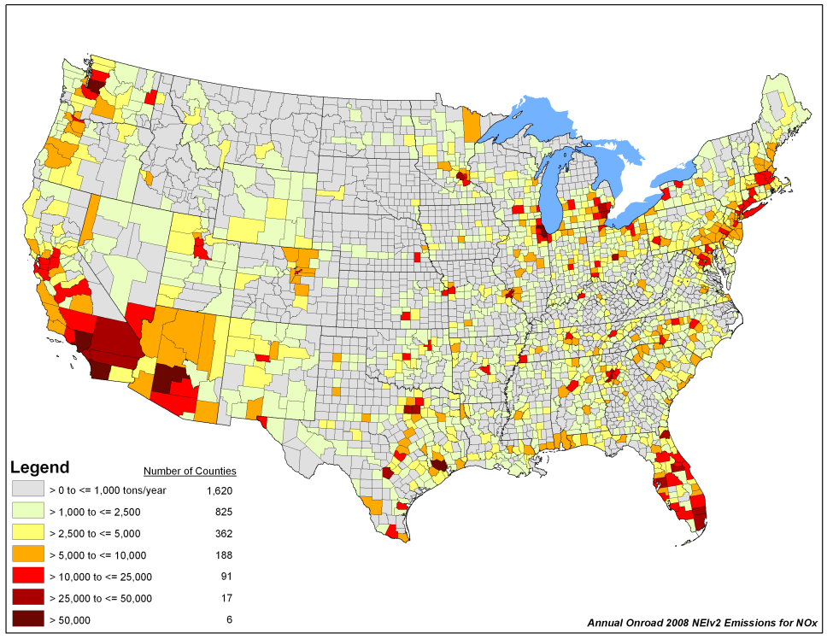
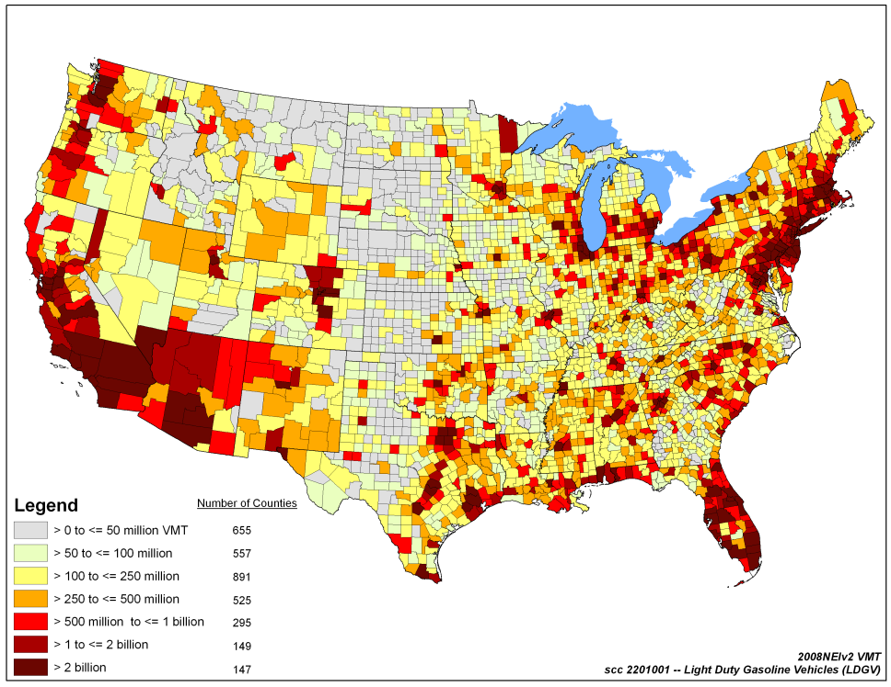
2008 NEI v2
Emissions
VMT
Ran all NEI pollutants including HAPS
Ran SMOKE-MOVES nationally
Summed up hourly emissions to create annual and monthly inventory
Notes:
emphasize no longer black box. Have greater investigation of the inputs (e.g. the activity data)

Slide 15
MOVES2010b
Support for HAPS
Explicitly model HONO
Refueling EF
Supported in SMOKE v3.1

Slide 16
Recent Developments
Improved computational efficiency of Movesmrg
low versus high memory options
Updates to post-processor script
  Easier to add or subtract pollutants
  Support for MOVES2010b (HONO, HAPS, refueling)
Met4moves averaging period
  Daily vs. Monthly ranges (SMOKE output)
Temperature out of range of EF
Adjustment factors in Movesmrg
  adjustment factor file (optional input)
  applies adjustment by FIPS, SCC, pollutant, mode, and/or month

Slide 17
Potential Future Developments
Improve treatment of RH
Modify how MOVES and SMOKE use speed to represent average speed
Speciation of VOC/TOG and PM within MOVES
Updates to SCCs
Improve how diurnal profiles are generated and used for vapor venting (RPP)
Incorporate nonroad into SMOKE-MOVES framework
Improve the computational efficiency

Slide 18
Acknowledgements
OTC, NESCAUM, MARAMA, SESARM
ENVIRON International Corporation
US EPA Office of Transportation and Air Quality (OTAQ)
Institute for the Environment – UNC Chapel Hill
CSC

Slide 19
Extra Slides

Slide 20
Met4Moves: Output
for SMOKE
  Daily (or monthly) average RH and min/max T for RPP. County and date specific, all counties in domain
for MOVES
  RPD/RPV: average RH and min/max T across the county group and fuel month
  RPP: Diurnal T profiles based on min/max T of county group

Slide 21
Overview: Representative County
Determine a set of counties that can represent your modeling domain.
Reduces the computational burden of running MOVES on every county in your modeling domain
Represent a set of similar counties (i.e., inventory counties) called a county group.
Key emission rates for the single representative county in MOVES can be utilized to estimate emissions for all counties in the county group through SMOKE.
Criteria : Similar fuel parameters, fleet age distribution and I/M programs.

Slide 22
Overview: Fuel Month
Similar to the representative county, the fuel month reduces the computational time of MOVES by using a single month to represent a set of months with similar fuels.
Represent a particular set of fuel properties over the months used in MOVES
Example: Run MOVES for January, use that run to represent a series of months with similar fuel types (e.g. Oct, Nov, Dec, Jan, Feb, Mar)
Criteria : Fuel supply data in the MOVES database for each representative county

Slide 23
MOVES Driver Script
Creates the input data tables for import
Creates run specification (runspec) XML files to run MOVES for large number of conditions
  Separate runs for each T bin or T profile and for each representative county and fuel month
Generates specific T and RH csv files based on Met4Moves output
Creates scripts to run all the importers and all the MOVES scenarios

Slide 24
Timing
For a typical CONUS domain run:
 | Fastest | Slowest | Units
MOVES batch (county/fuel month) | 13 | 44 | Hrs
SMOKE RPP (model day) | 3 | 5 | Min
SMOKE RPV (model day) | 9 | 14 | Min
SMOKE RPD (model day) | 95 | 125 | Min
MOVES total |  | 7 | Days
SMOKE total |  | 8 | Days
Notes:
for MOVES: total run approximately 1 week (includes data transfers, post-processing, restarts)
for SMOKE: total run 7-8 days including merging and some parallelization
MOVES are just the representative counties and fuel months (e.g. 292) while SMOKE is the whole domain (CONUS) and the whole year

Slide 25
Running MOVES in the Cloud
M
W
M
W
M
W
M
W
M - master
W - worker
Notes:
each batch is a representative county/fuel month
different number of runs per batch b/c of differences in number of T bins. Therefore, some batches take longer to run than others

Slide 26
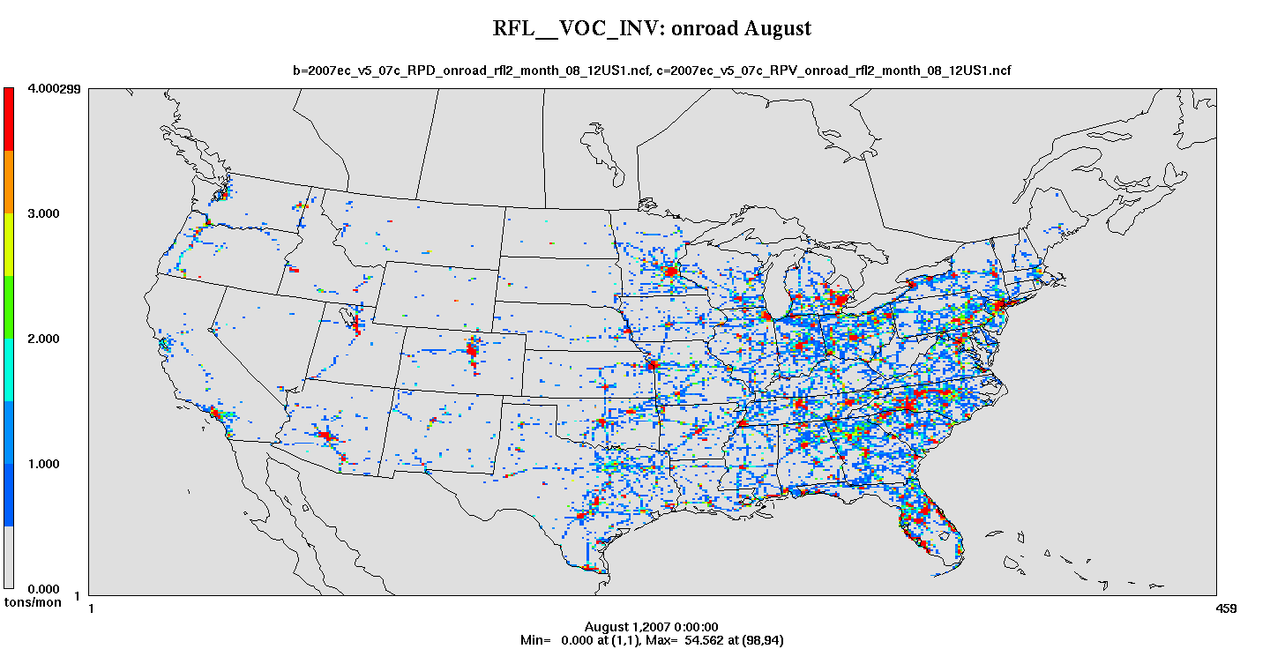
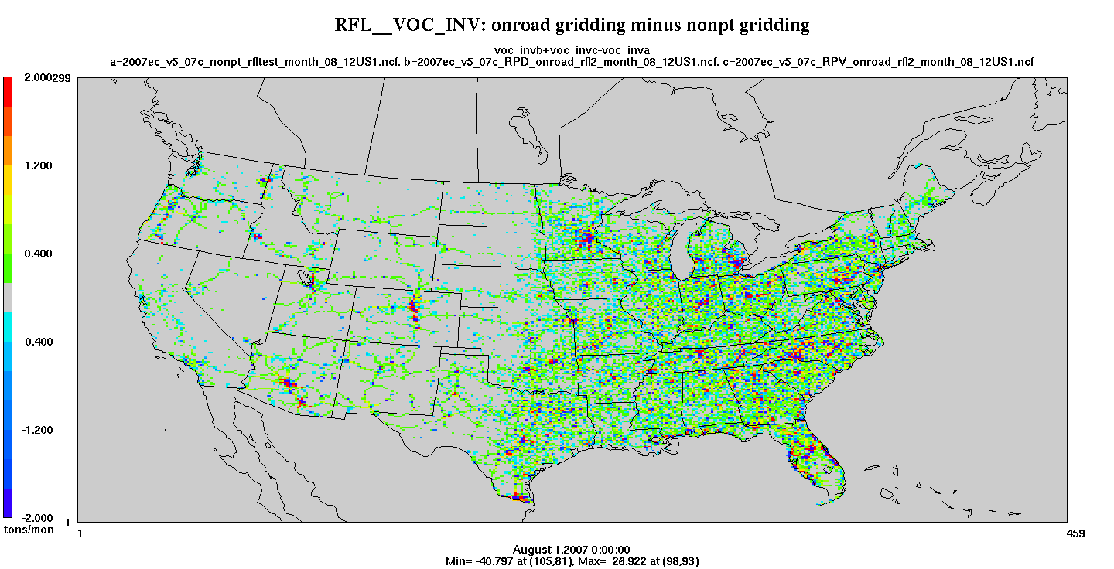
MOVES2010b: Refueling
Refueling from RPD, RPV
Same SCCs as other modes
SMOKE gridding based on SCC only
Notes:
Recommend run RFL separate bc of gridding

