Slide 1

Quantifying CMAQ Simulation Uncertainties of Particulate Matter in the Presence of Uncertain Emissions Rates
Wenxian Zhang, Marcus Trail, Alexandra Tsimpidi, Yongtao Hu, Athanasios Nenes, and Armistead Russell
CMAS Annual Conference
Oct 17, 2012

Slide 2



Acknowledgements
U.S. EPA
Southern Company/
Georgia Power
Phillips 66
RD83479901

Slide 3
Overview
Uncertainties in regional air quality models
Method for uncertainty analysis
- Monte Carlo method
- Reduced-form model based on high-order DDM sensitivity analysis
Quantification of uncertainties in simulated PM_{2.5} concentrations due to uncertain emissions
Quantification of uncertainties in model response to emissions control in the presence of uncertain emissions
Quantification of uncertainties in first-order sensitivities of PM_{2.5} due to emission uncertainties

Slide 4


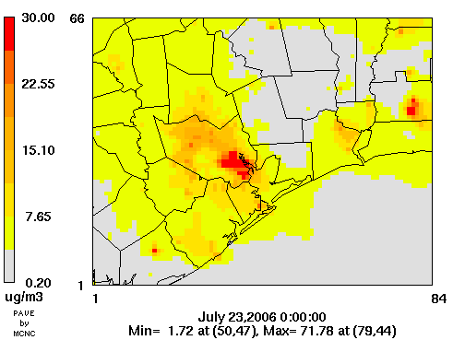



Uncertainties in Air Quality Models

Slide 5
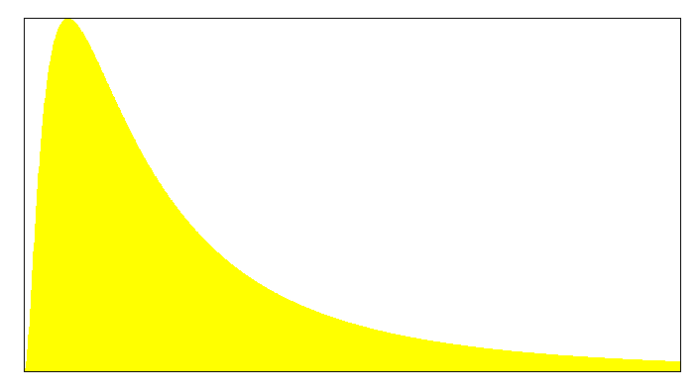
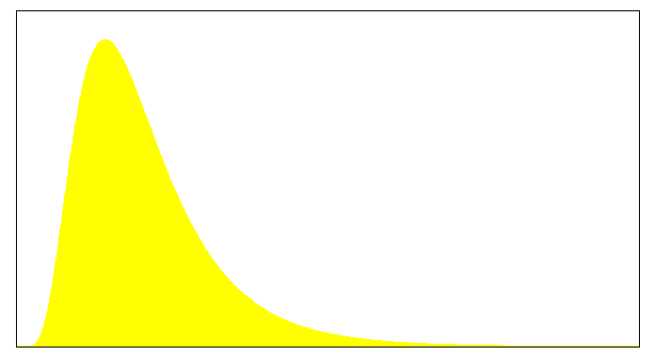
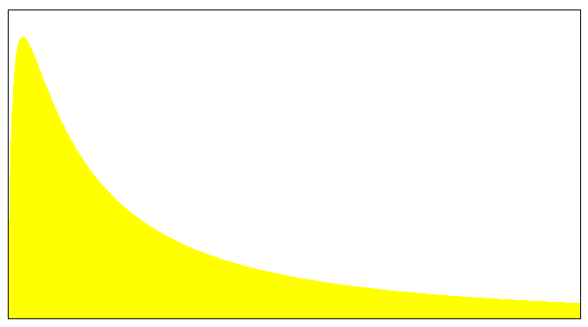
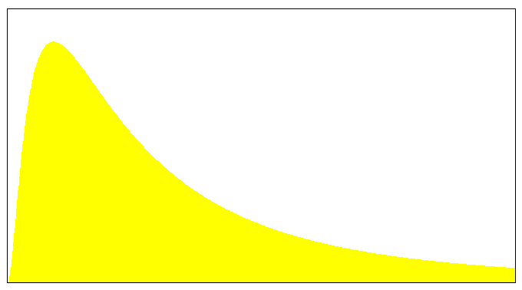
How to Quantify Uncertainties?
Mobile
Traditional: Monte Carlo Method
Nonroad
Sample 1
Sample 2
Sample 3
.
.
.
Sample N
Concentration 1
Concentration 2
Concentration 3
.
.
.
Concentration N
Original AQM
EGU
Area
Uncertainty
Biogenic
Computationally Expensive!

Slide 6
New approach: Monte Carlo Method with reduced-form model (RFM)
Mobile
Nonroad
Sample 1
Sample 2
Sample 3
.
.
.
Sample N
Concentration 1
Concentration 2
Concentration 3
.
.
.
Concentration N
RFM
EGU
Area
Uncertainty
Biogenic

Slide 7
Reduced-Form Model
CMAQ HDDM-3D
RFM
- Constructed based on sensitivity coefficients
- Directly reflects pollutant-parameter response
- Substantially reduces the computational cost
Input
Parameters
Pollutant
Concentrations
CMAQ

Slide 8
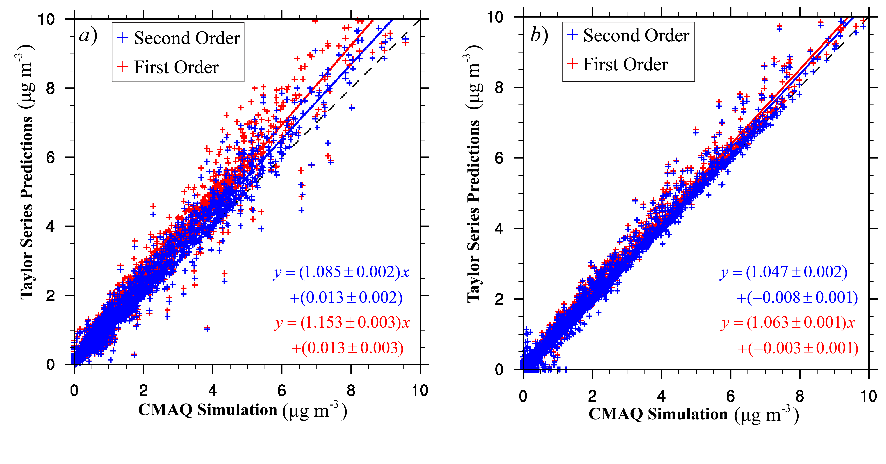
Evaluation of RFM
Nitrate concentration with
50% reductions in domain-wide NO_{x}
Nitrate concentration with
50% reductions in domain-wide SO₂
[Zhang et al., 2012 GMD]

Slide 9
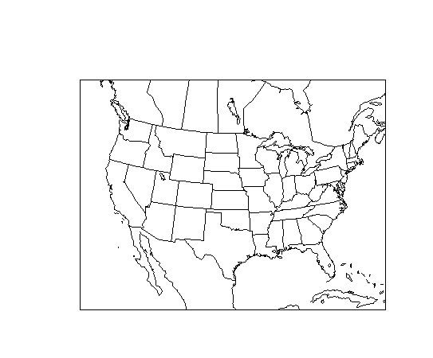
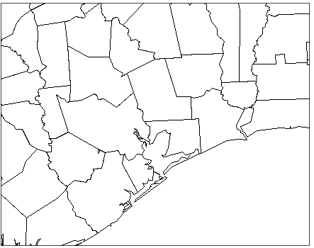
Air Quality Modeling in Houston Region
Modeling domain
- Nested 4x4km grids
- Houston region, border of
Texas and Louisiana
Episode
- July 12 – 23, 2006
Modeling system
- SMOKE v2.6
- WRF v3.0
- CMAQ v4.7.1 with HDDM
12x12 km
36x36 km
4x4 km

Slide 10
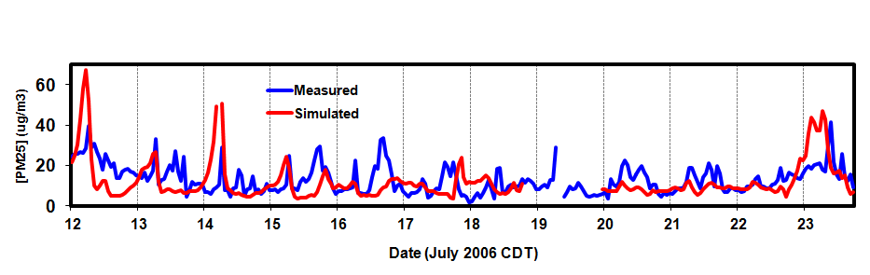
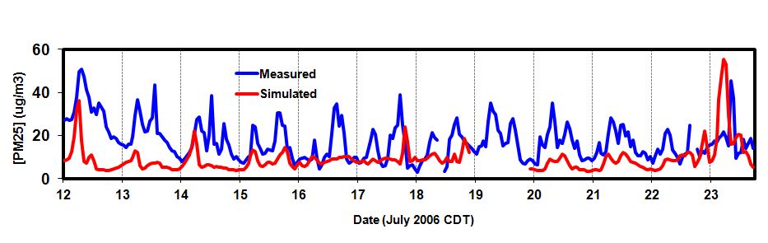
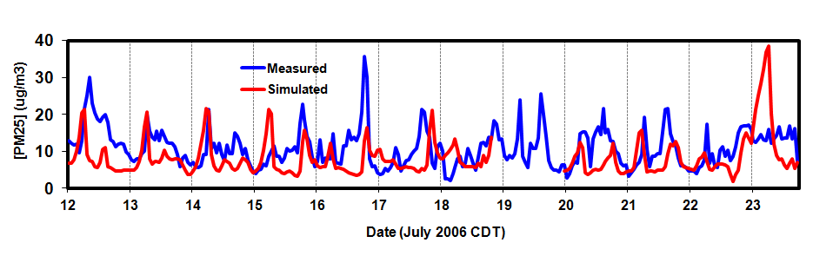
Model Performance
PM_{2.5} concentration
July 23, 2006 24-h average
Model Evaluation
July 12-23, 2006 hourly average
1262 1/2 Mae Drive
9525 1/2 Clinton Dr
PM_{2.5} Concentrations (μg m⁻³)
Performance Metrics
Pollutants | O₃ | PM_{2.5}
MOC | 54.8 ppb | 12.8 μg m⁻³
MB | 1.8 ppb | -1.8 μg m⁻³
MNB | 7.28% | 10.5%
MNE | 23% | 66.2%
FB | 3.38% | -24.4%
FE | 22.26% | 51%
4510 1/2 Aldine Mail Rd
Date (July 2006 CDT)

Slide 11
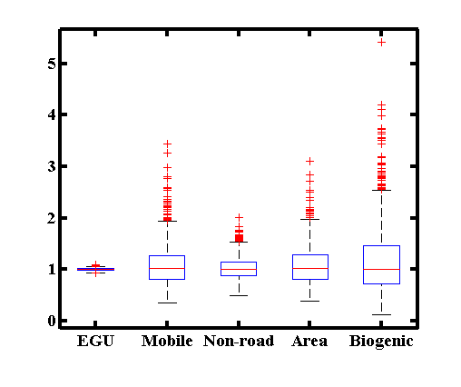
Emission Uncertainties and Sampling
Log-normal distribution
Emission uncertainty factors
[ E / f, E x f ]
Random sampling with
N = 1000
Sampling Results
Source Categories | Uncertainty Factors | References
EGU | 1.03 | Napelenok, 2011
Mobile | 2 | Hanna et al., 2001
Non-road | 1.5 | Chi et al., 2010
Area | 2 | Hanna et al., 2001
Biogenic | 3 | Hanna et al., 2005
E/E₀
Source Categories

Slide 12
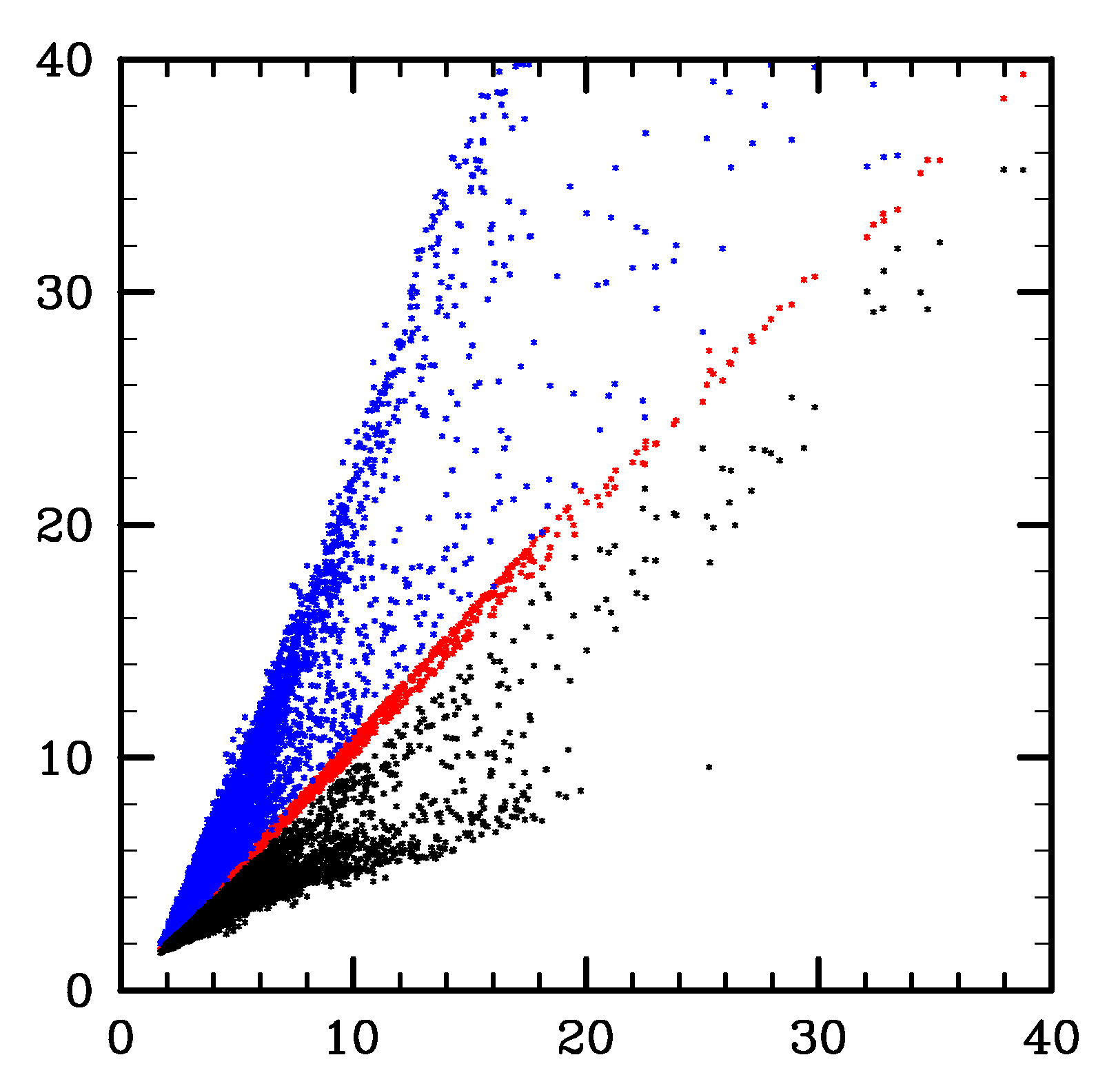
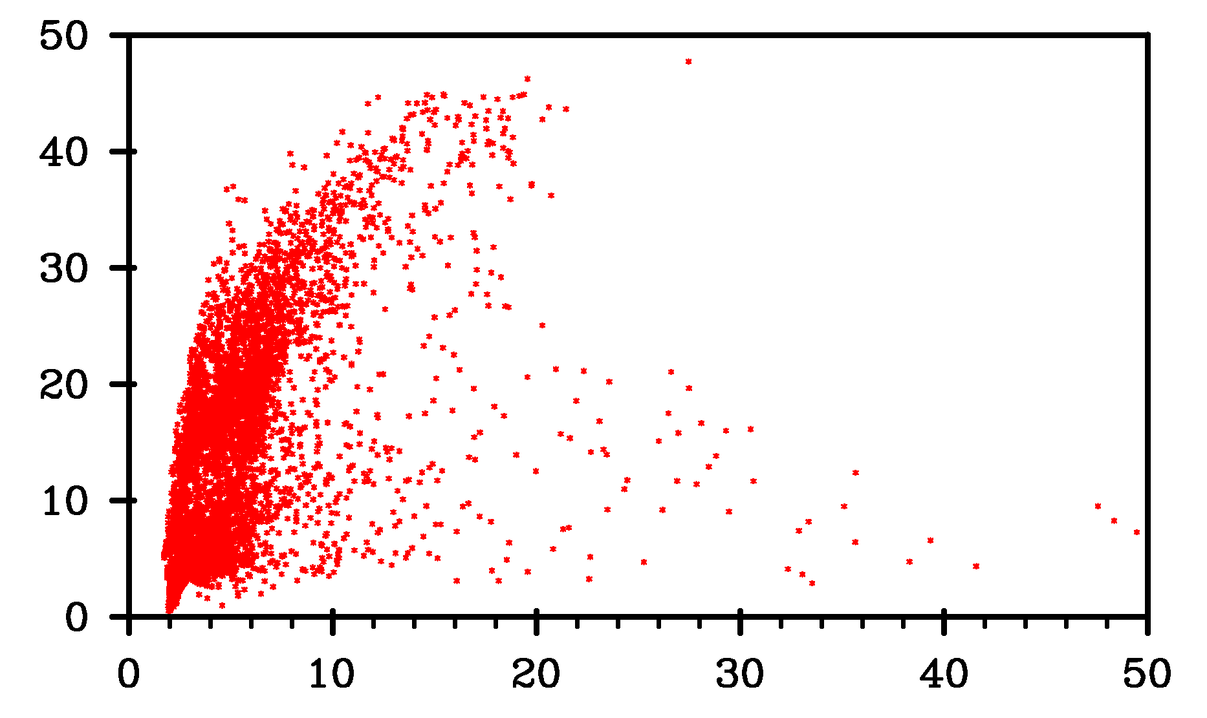
Uncertainties in PM_{2.5} Simulations
95% CI of 24-hr average PM_{2.5}
July 23, 2006
[Tian et al., 2010]
Concentration Percentiles (μg m⁻³)
Uncertainty of 24-hr average PM_{2.5}
July 23, 2006
50th
97.5th
Uncertainty (%)
2.5th
Simulated Concentrations (μg m⁻³)
PM_{2.5} Concentrations (μg m⁻³)

Slide 13
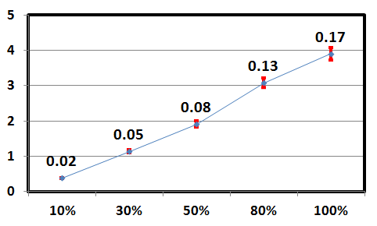
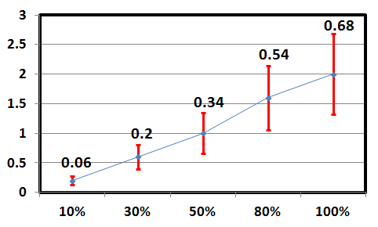
Uncertainties in PM_{2.5} Response to Emission Controls
δε_{i} - Emission uncertainties ΔE_{i} - Emission reduction
Concentration Reduction (μg m⁻³)
Emission reduction in point source
Emission reduction in mobile source
Larger uncertainty with larger emission reduction
Larger uncertainty for more uncertain sources

Slide 14
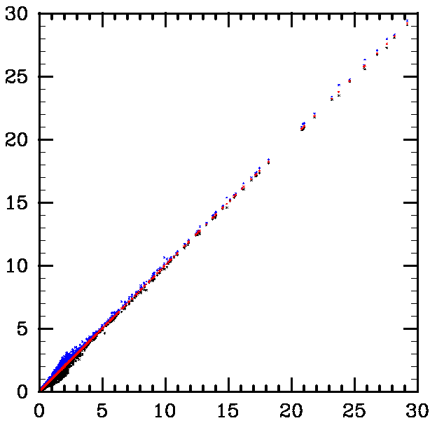
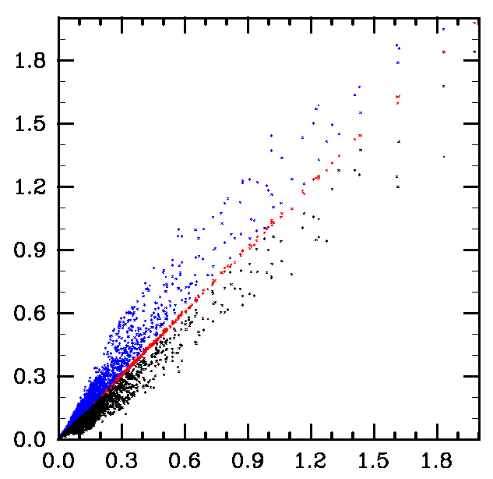
Uncertainties in First-Order Sensitivity of PM_{2.5}
95% CI of 24-hr average PM_{2.5}
sensitivity to point source emissions
July 23, 2006
95% CI of 24-hr average PM_{2.5}
sensitivity to mobile source emissions
July 23, 2006
Sensitivity Percentiles (μg m⁻³)
Sensitivity Percentiles (μg m⁻³)
97.5th
50th
2.5th
97.5th
50th
2.5th
Uncertainty ≤ 18%
Uncertainty ≤ 36%
Simulated Sensitivity (μg m⁻³)
Simulated Sensitivity (μg m⁻³)

Slide 15
Summary
Reduced-form model has been constructed using first- and second-order sensitivities obtained from CMAQ-HDDM-3D
Quantified emission-associated uncertainties of simulated 24-hr average PM_{2.5}
- Lower than 45% in the presence of assumed emission inventory uncertainties
- Does not capture upset emission biases
- Can be easily applied to different combinations of emission uncertainties
Quantified uncertainties of emission control response
- Higher uncertainties with larger emission reductions
- Higher uncertainties for more uncertain emissions
Quantified uncertainties of first-order PM_{2.5} sensitivities
- Dependent on the uncertainty of the sensitivity parameter
Future studies
- Bias analysis using observations
- Control strategy optimization

Slide 16
Questions?

