Slide 1



A novel modeling system for studying climate change effects on spatiotemporal distributions of biogenic aeroallergens
Case study using Birch and Oak Pollen
Presented at CMAS Conference
October 17, 2012 • Chapel Hill, NC
by
Yong Zhang, Leonard Bielory, Sastry Isukapalli,
Lai-yung Ruby Leung and Panos G. Georgopoulos
Environmental and Occupational Health Sciences Institute (EOHSI)
170 Frelinghuysen Road, Piscataway, NJ 08854

Slide 2
Outline
Introduction to the modeling framework of WRF-SMOKE-CMAQ-Pollen*
Pollen emission and transport models
Sptiotemporal emission profiles of birch and oak pollen
Sptiotemporal concentration profiles of birch and oak pollen
Summary and ongoing work
* WRF: Weather Research and Forecasting
SMOKE: Sparse Matrix Operator Kernel Emissions
CMAQ: Community Multiscale Air Quality

Slide 3
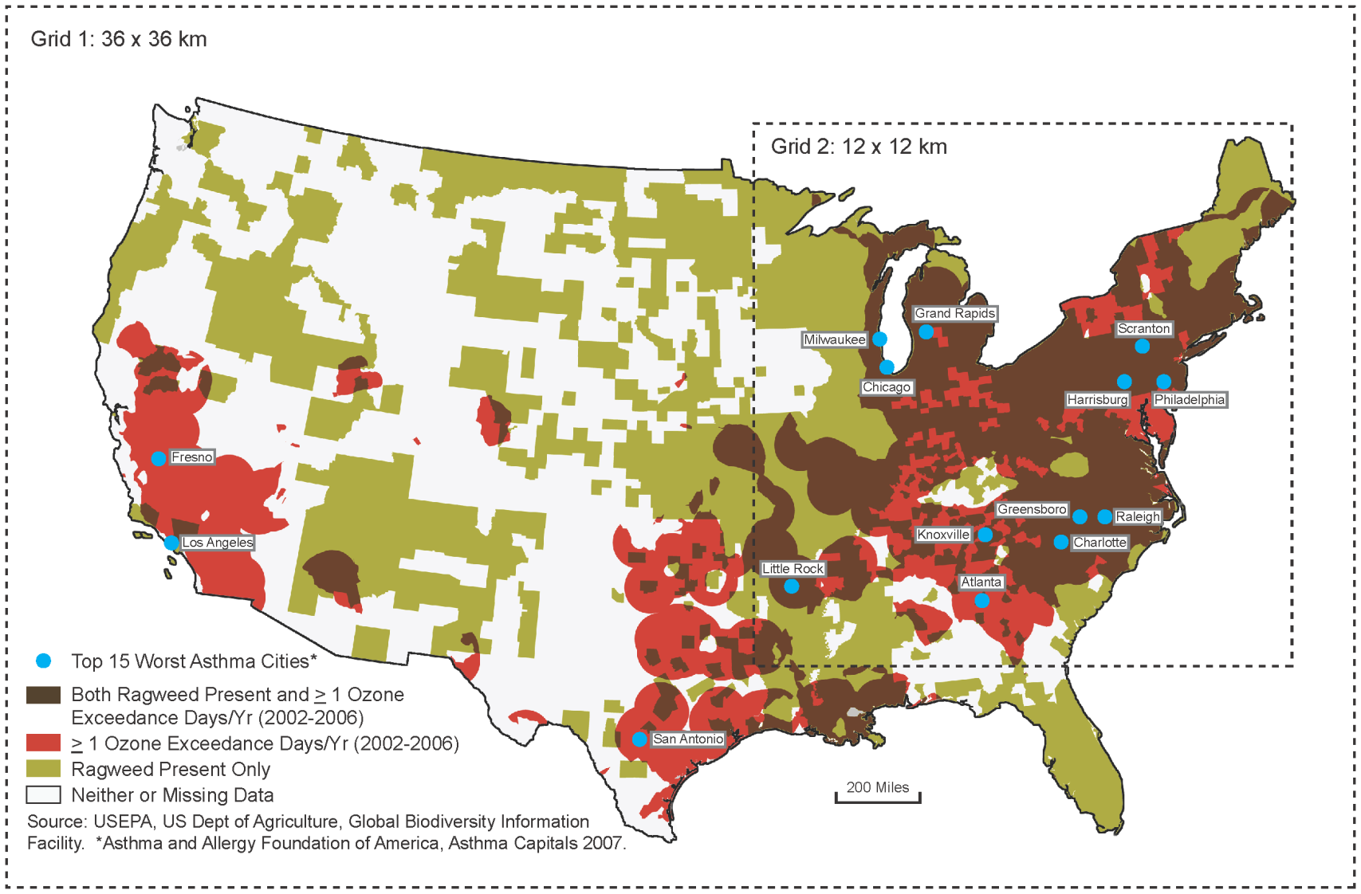
Motivation
Allergic airway disease (AAD) and related high cost of health care
  In US, 55% of employees reported experiencing allergic rhinitis symptoms for an average of 52.5 days
Lamb et al. (2006)
  In US, the total direct medical cost of allergic rhinitis was estimated at $3.4 billion in 1996 Law et al. (2003)
Cross pollination due to genetically modified plants
  Long range transport and larger quantity of pollen Slavov et al. (2004); Martin, et al. (2010).
Rapid changes in ecological systems
  Rapid shifting of flowering time
  Fitter et al. (2002)
  Dramatic changes of ecologic dynamics in Arctic region Post et al. (2009)
Ragweed and ozone co-occurrence in the continental United States (Adapted from a map published by NRDC, the Natural Resources Defense Council, www.nrdc.org)

Slide 4
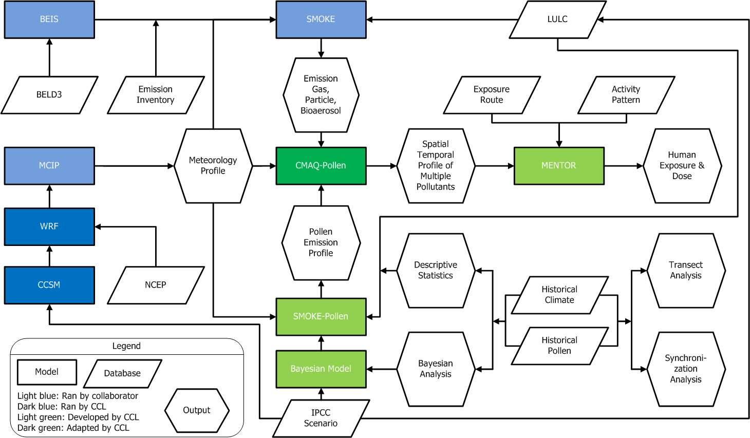
Overview of the WRF-SMOKE-CMAQ-Pollen modeling system
A modeling system linking climate change and exposure

Slide 5
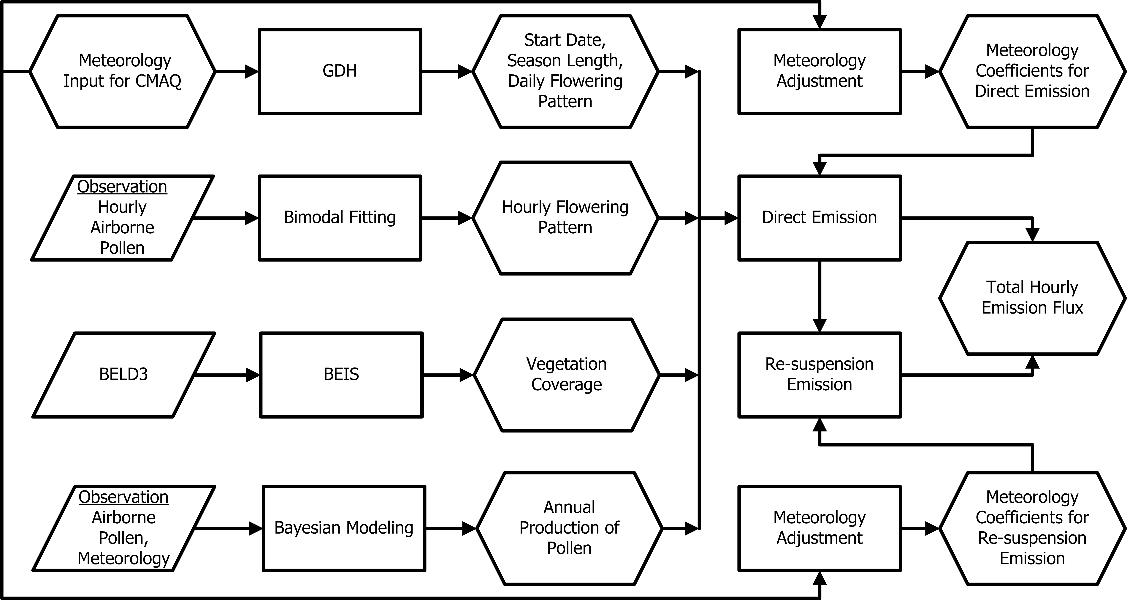
Pollen emission model

Slide 6









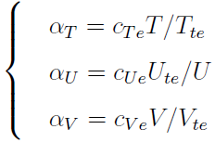
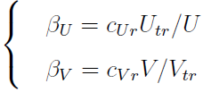





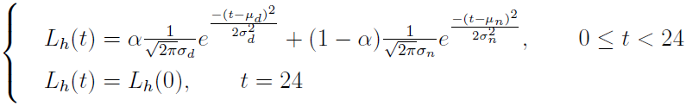
Pollen emission model
Pollen emission model was developed based on methods proposed by Helbig et al. in 2008 and Efstathiou et al. in 2010
Direct emission
Resuspension
Shao and Lu (2000)
Start and length of pollen season
Martin et al. (2010)

Slide 7
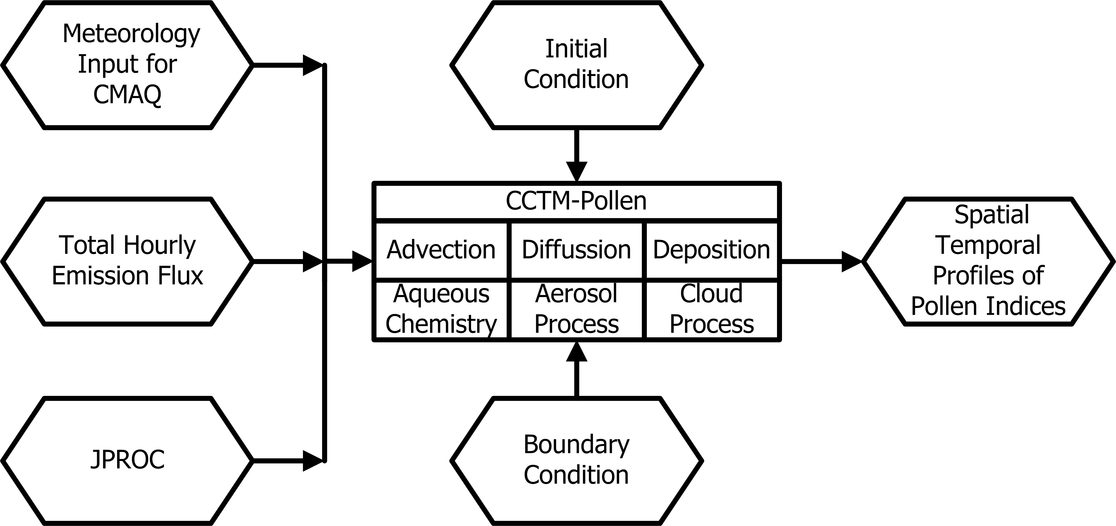
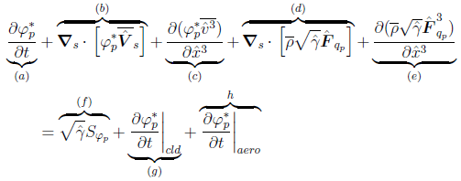
Transport model
Treat pollen grain as coarse mode particle
Adapt CMAQ4.7.1 by modifying relavant subroutines such as aero_depv.F, AERO_EMIS.F, AERO_INFO.f and aero_subs.f etc.
Compile adapted CMAQ modules to incorporate different Physicochemical process
Governing equations
(a) time rate of change of pollen concentration, (b) horizontal advection, (c) vertical advection, (d) horizontal eddy diffusion, (e) vertical eddy diffusion,
(f) emissions, (g) cloud mixing and aqueous chemistry, (h) aerosol process
Adapted from Byun and Schere (2006)

Slide 8
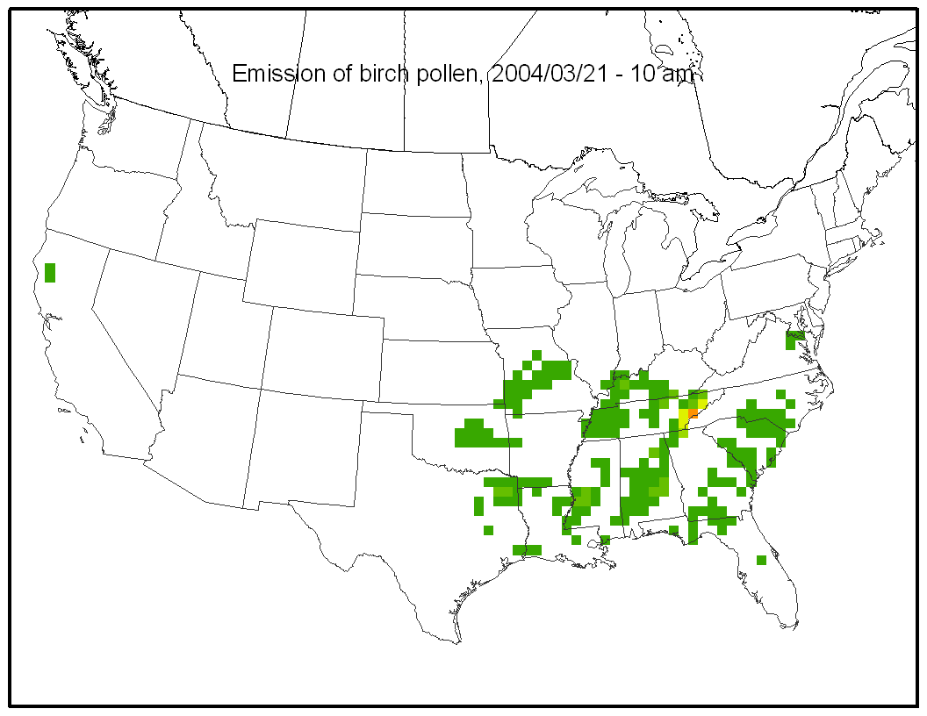
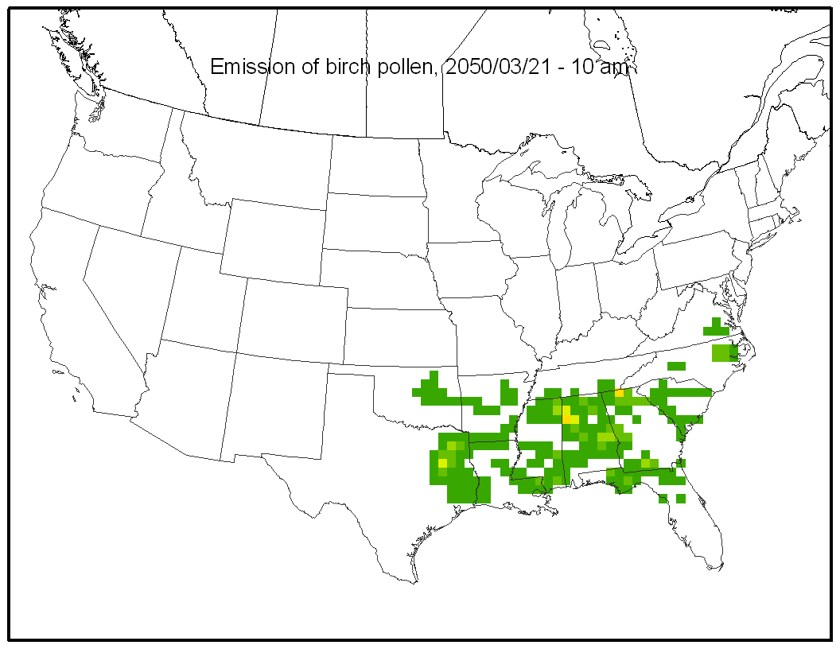
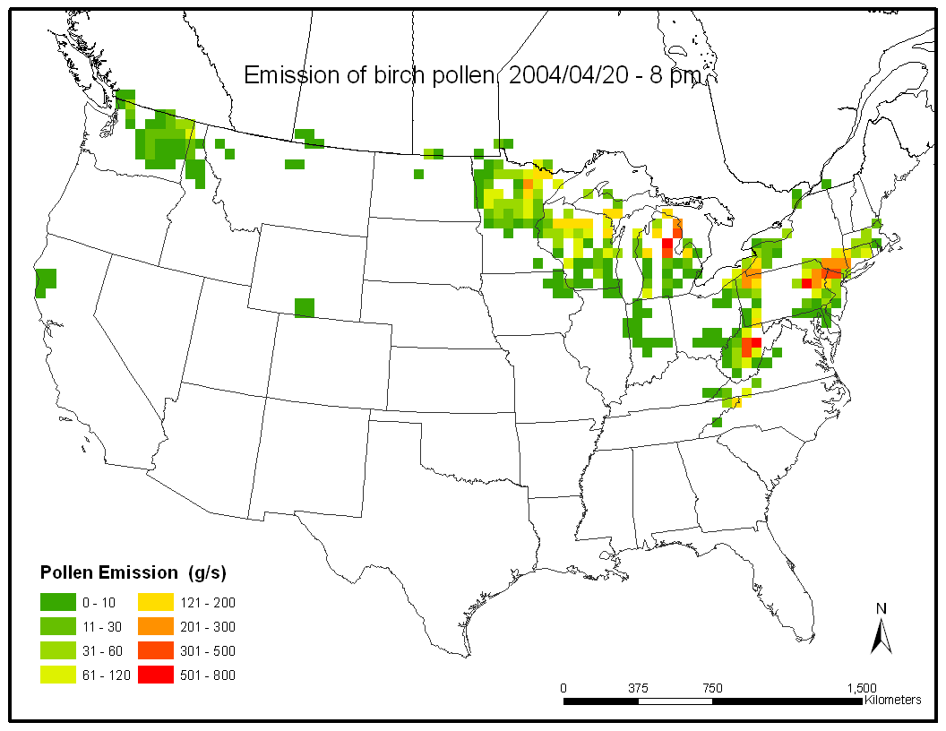
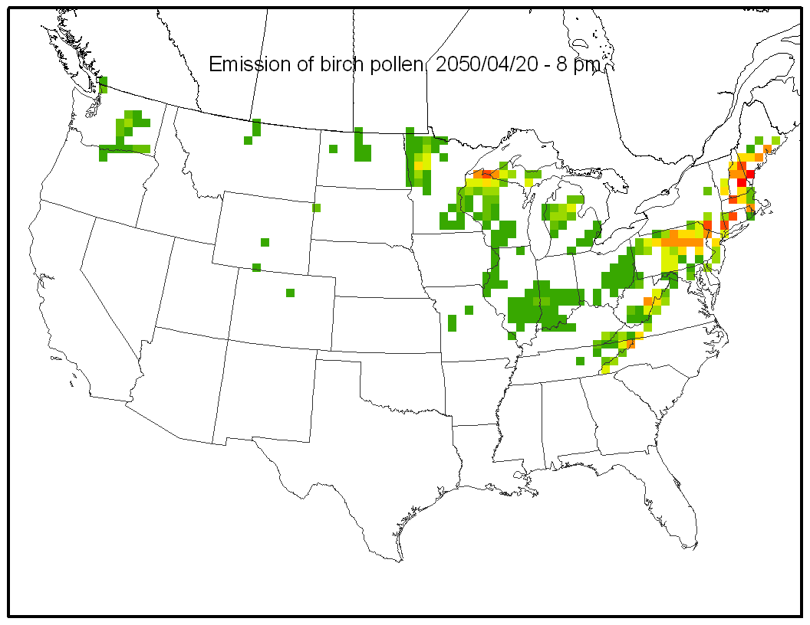
Spatiotemporal emission profiles of birch pollen
Domain: Contiguous Continental US
Resolution: 50 x 50 km; Hourly; 1 Layer

Slide 9
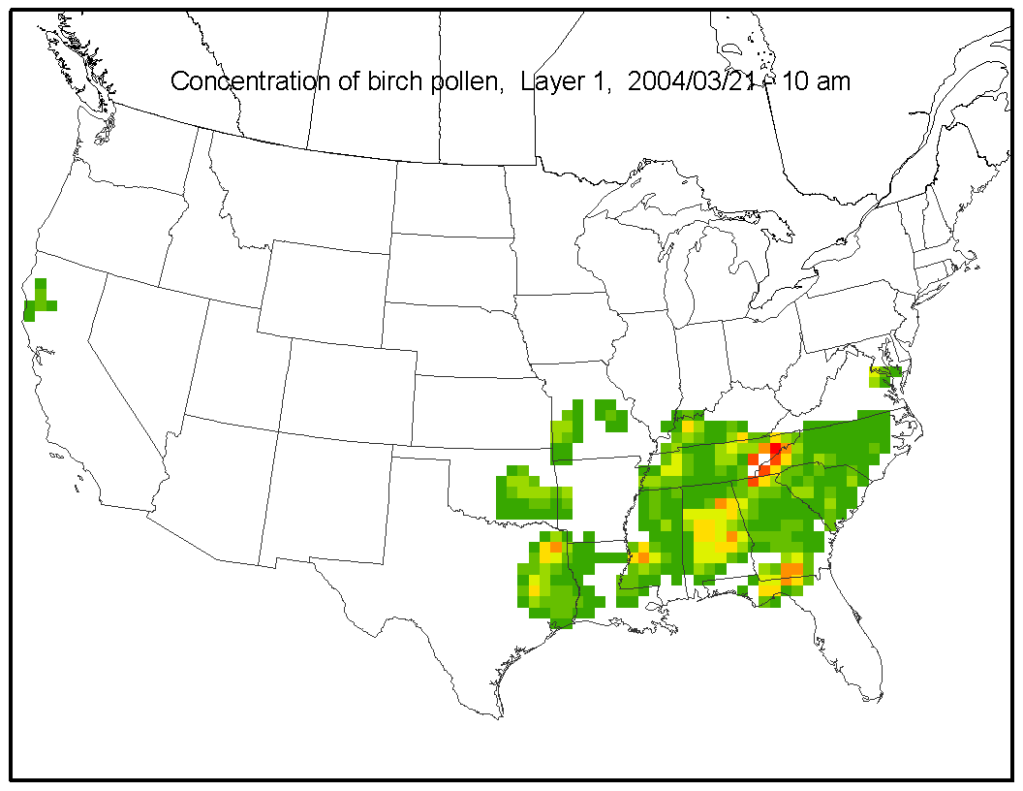
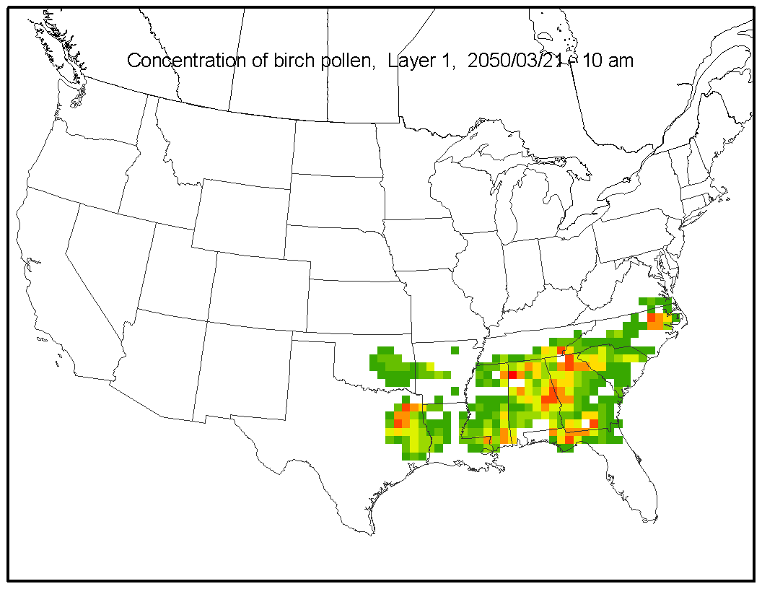
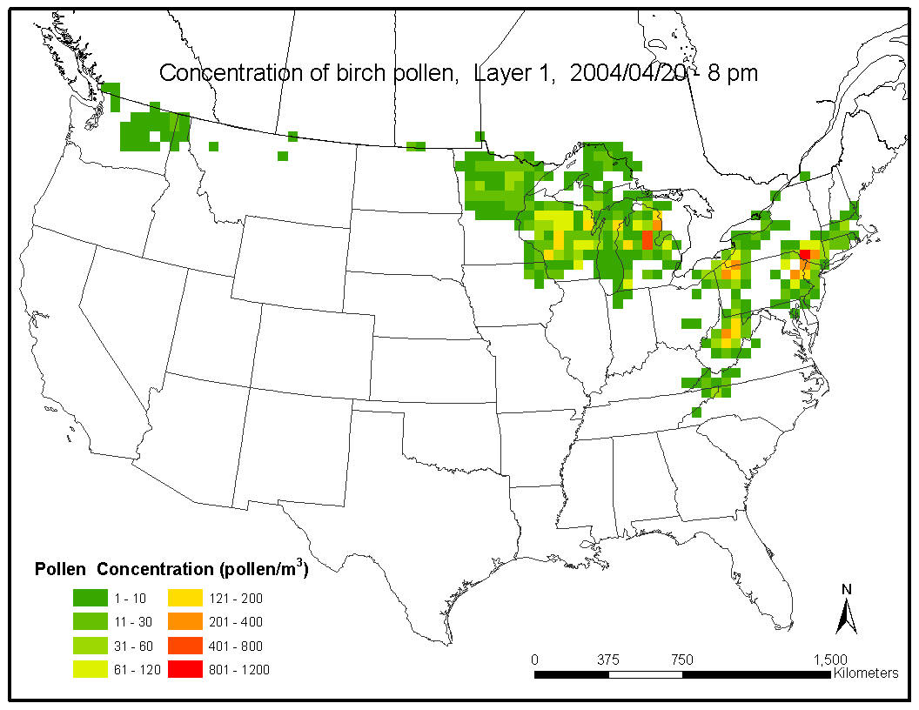
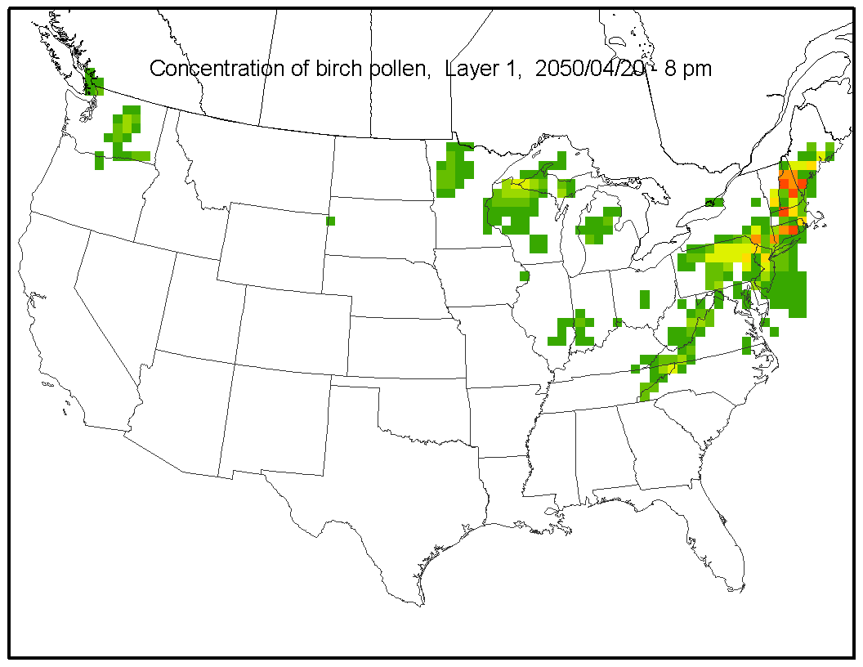
Spatiotemporal concentration profiles of birch pollen, Layer 1
Domain: Contiguous Continental US
Resolution: 50 x 50 km; Hourly; 10 Layers

Slide 10
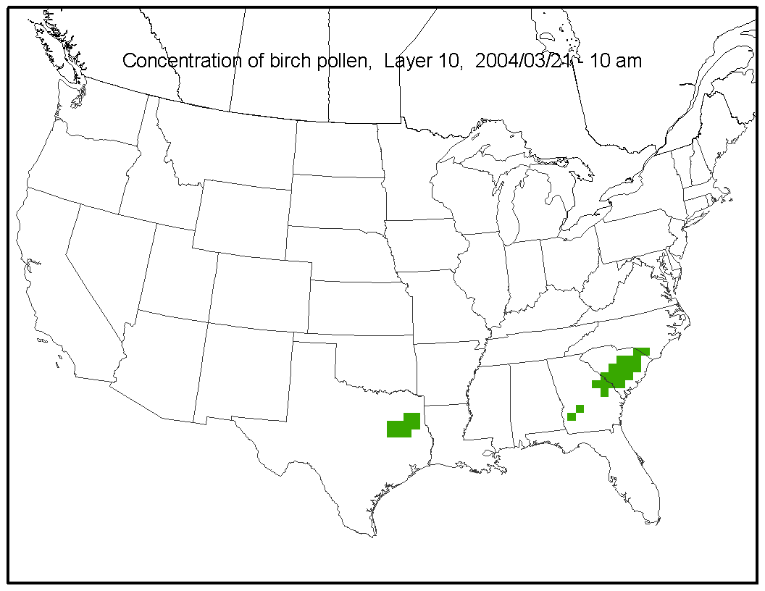
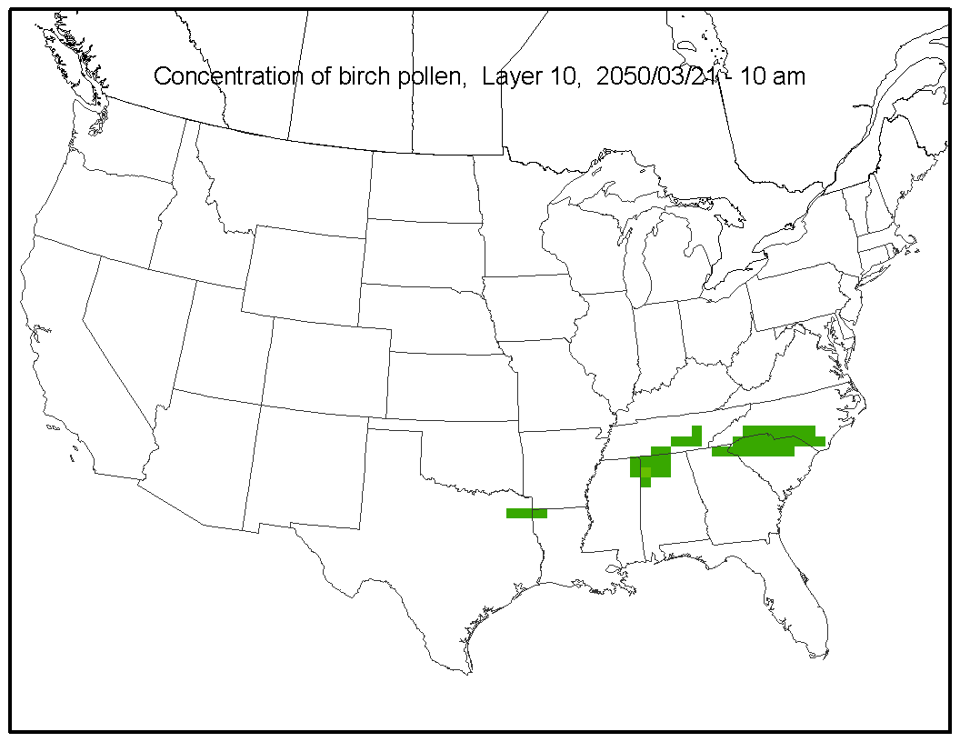
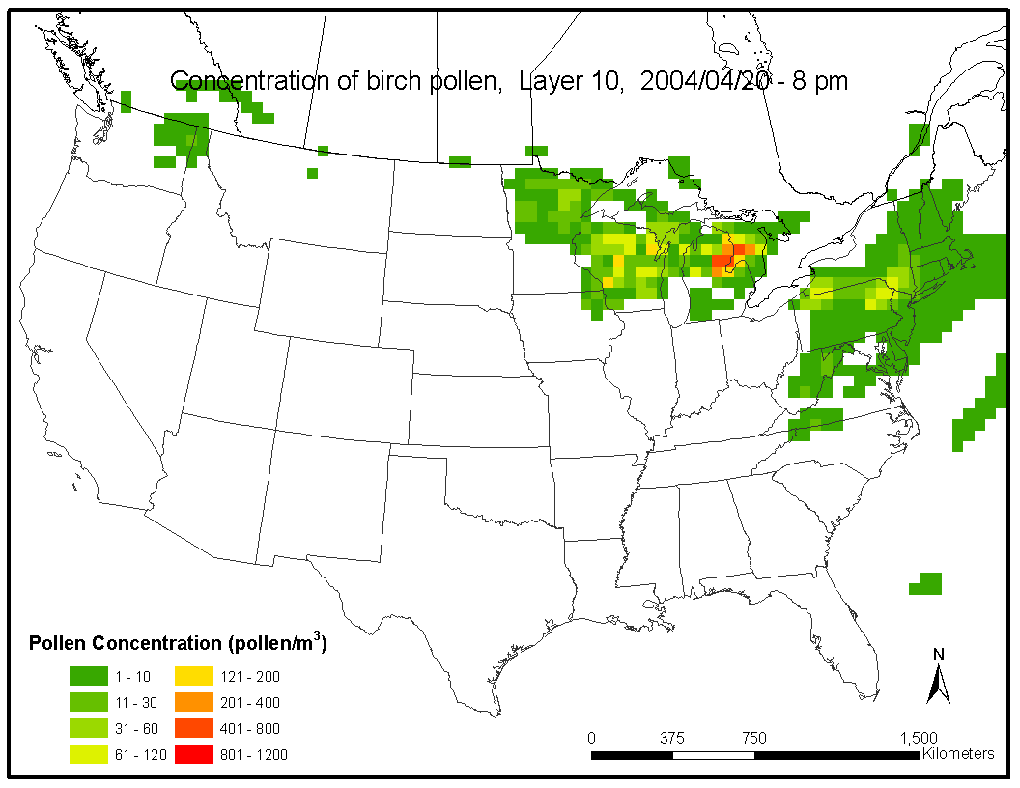
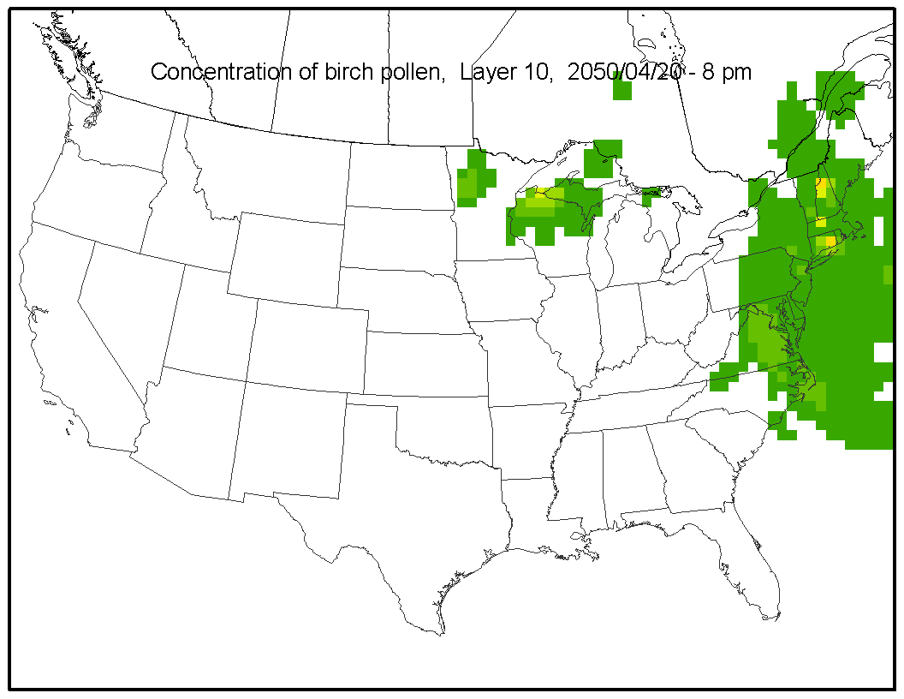
Spatiotemporal concentration profiles of birch pollen, Layer 10
Domain: Contiguous Continental US
Resolution: 50 x 50 km; Hourly; 10 Layers

Slide 11
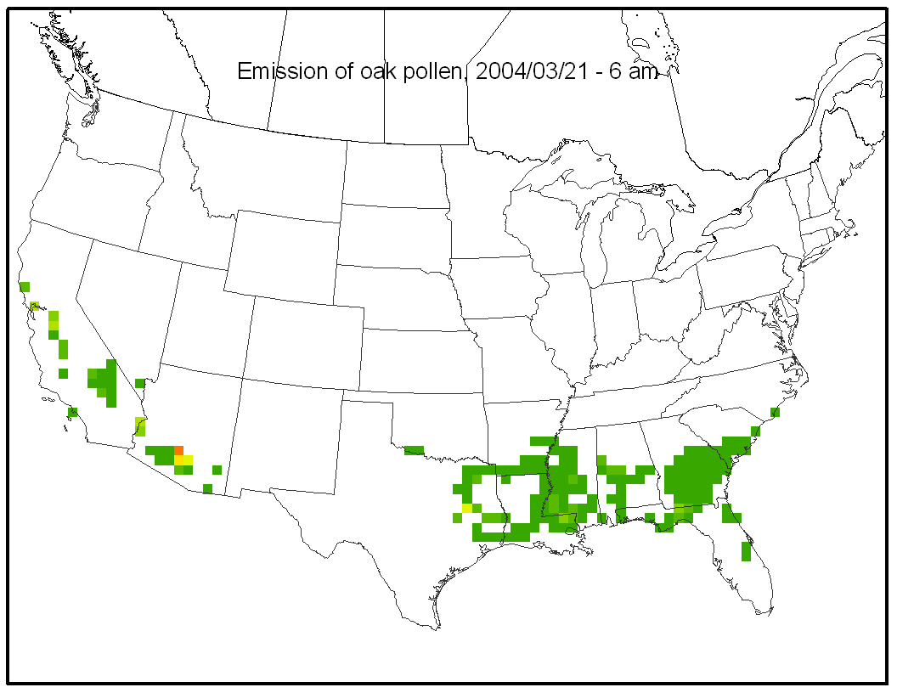
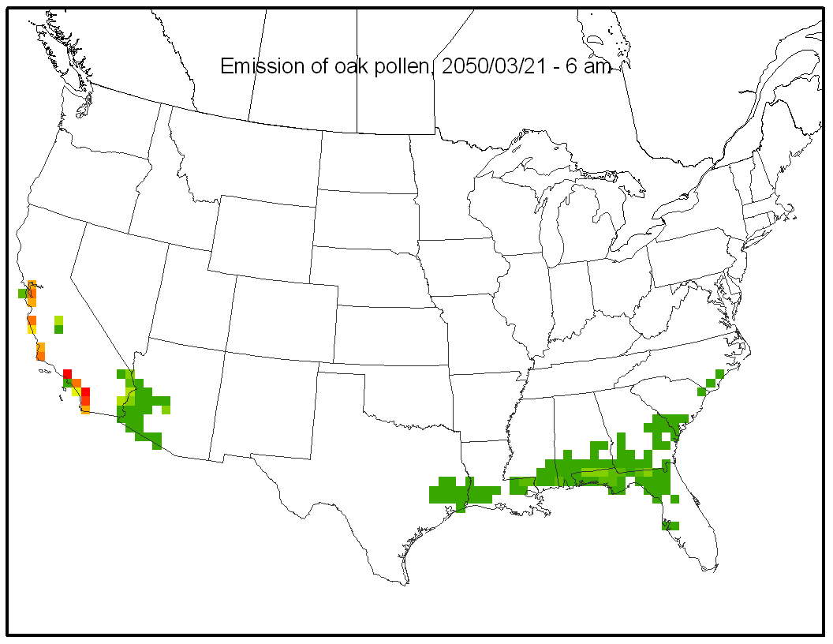
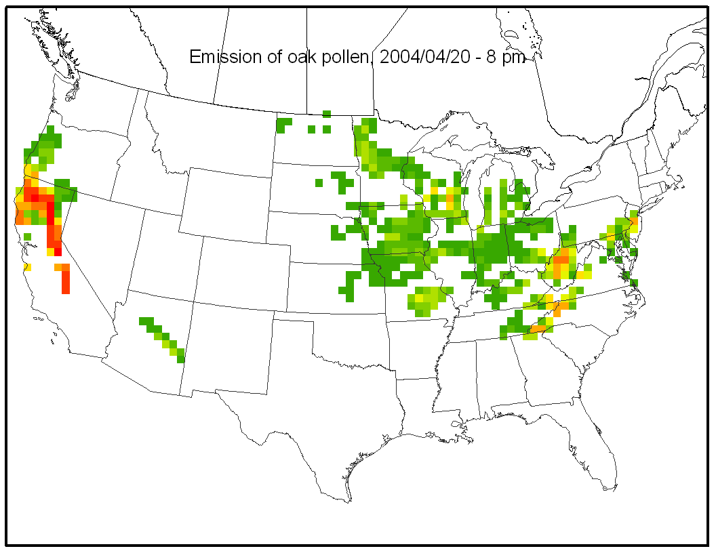
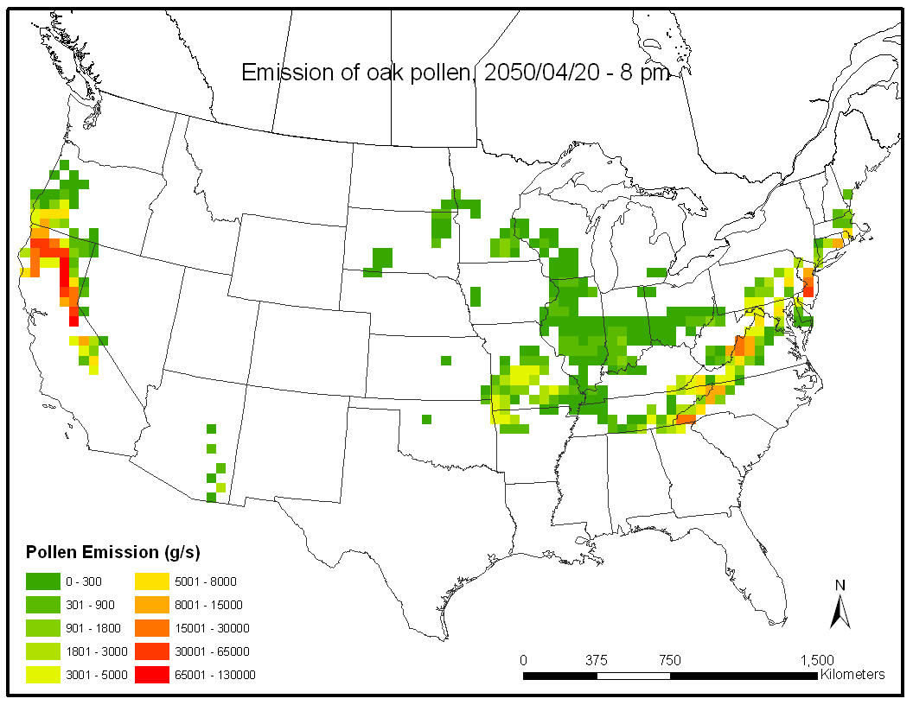
Spatiotemporal emission profiles of oak pollen
Domain: Contiguous Continental US
Resolution: 50 x 50 km; Hourly; 1 Layer

Slide 12
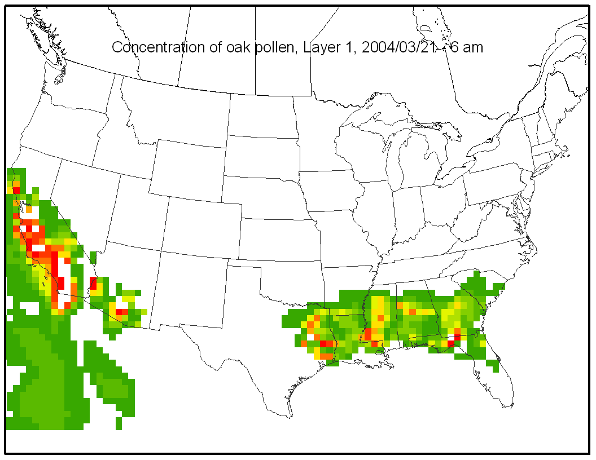
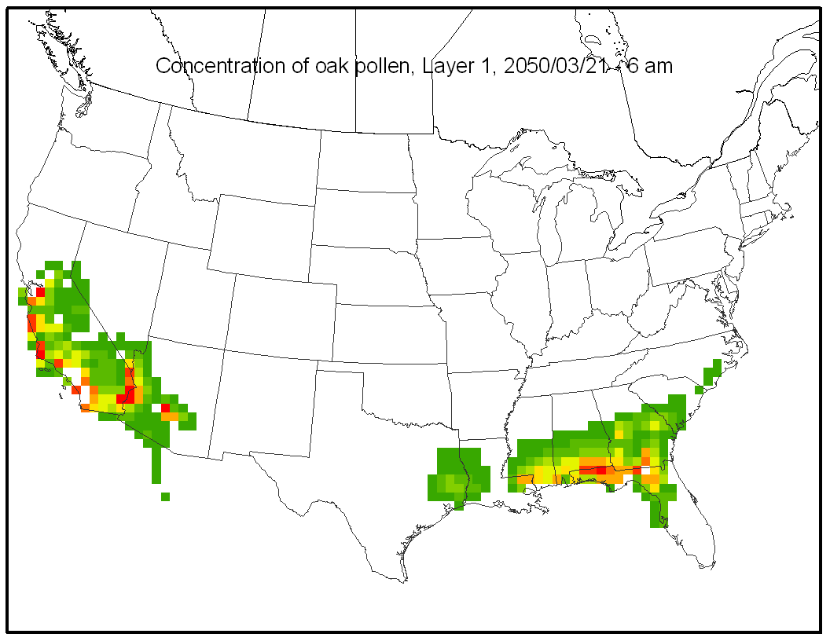
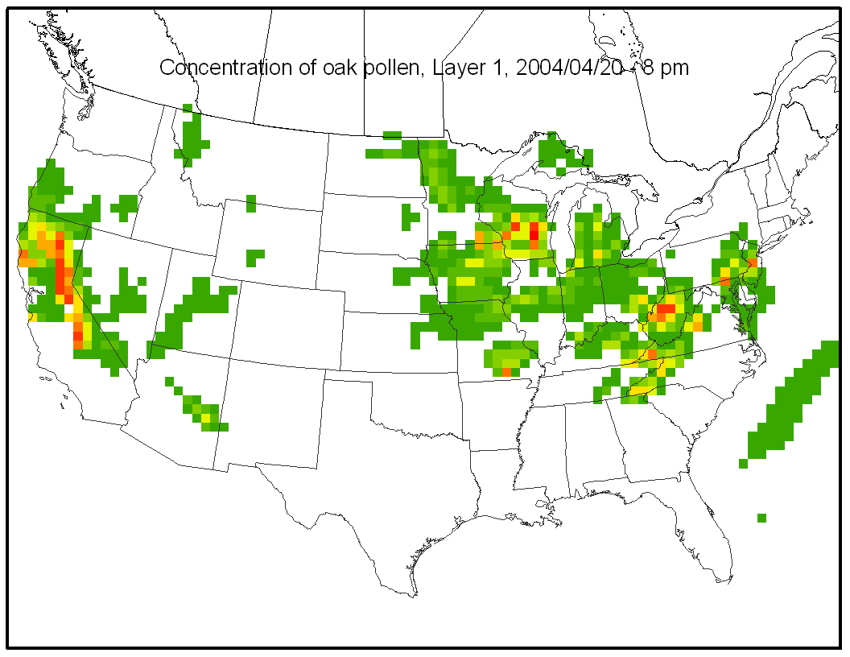
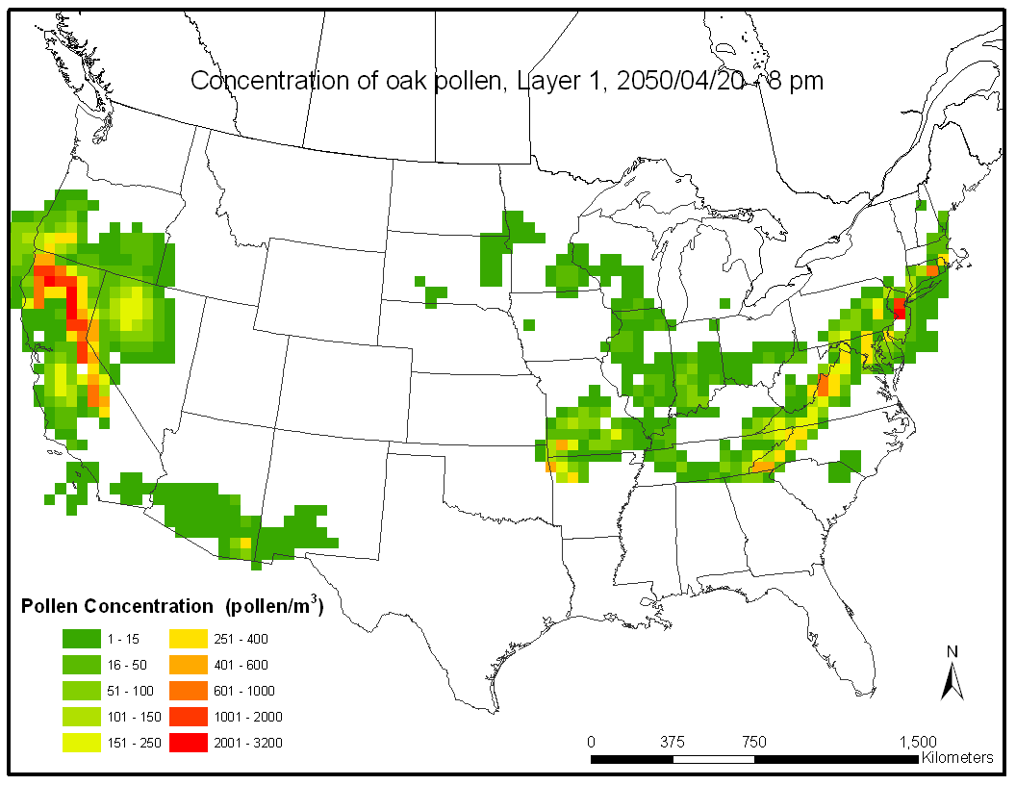
Spatiotemporal concentration profiles of oak pollen, Layer 1
Domain: Contiguous Continental US
Resolution: 50 x 50 km; Hourly; 10 Layers

Slide 13
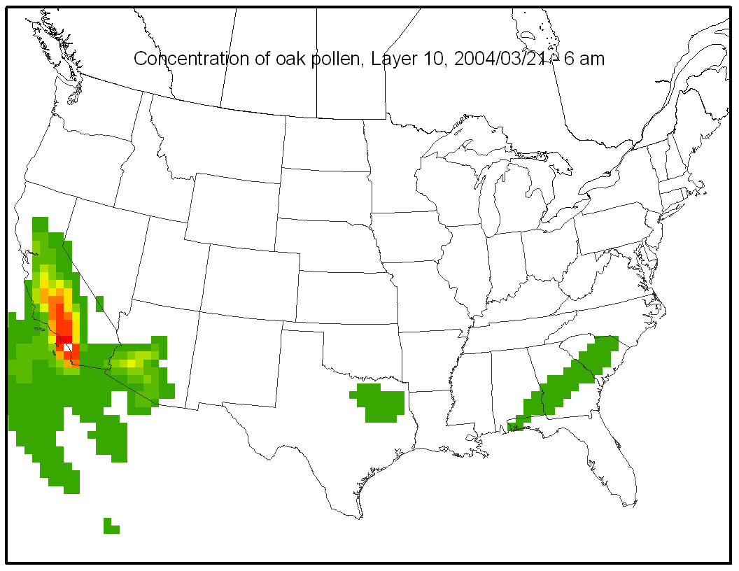
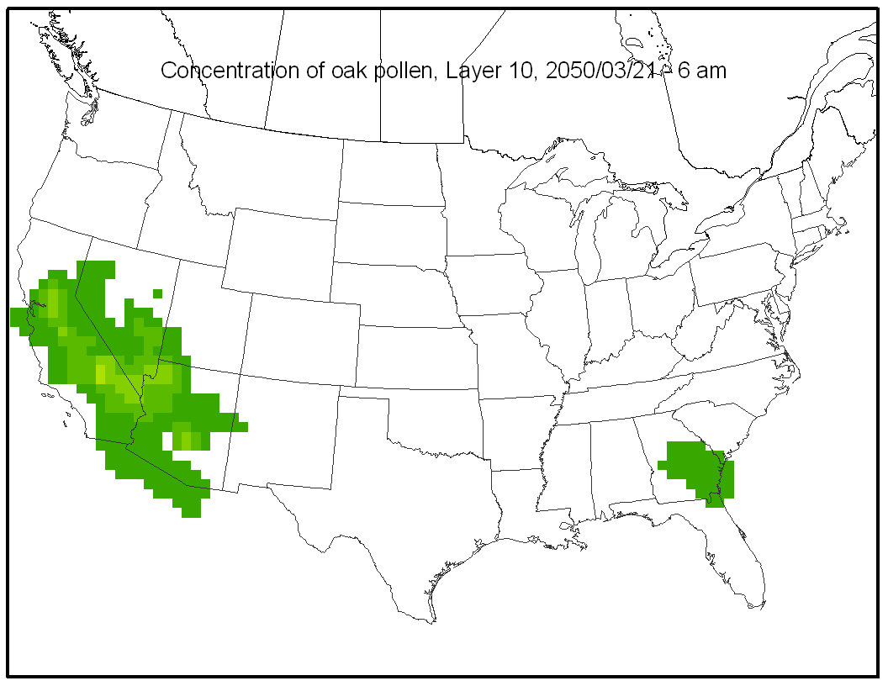
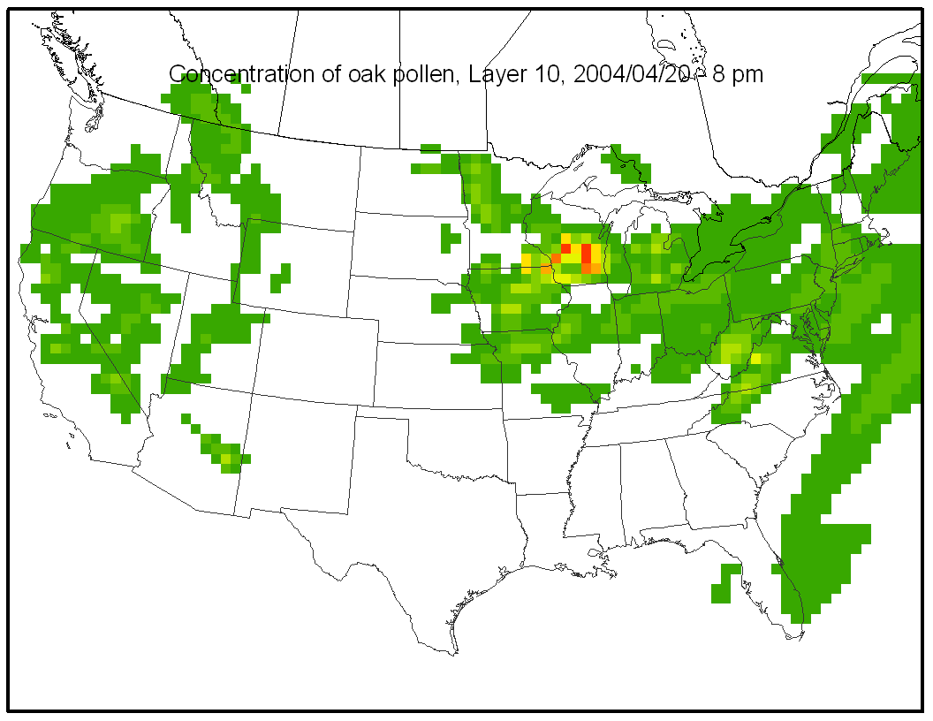
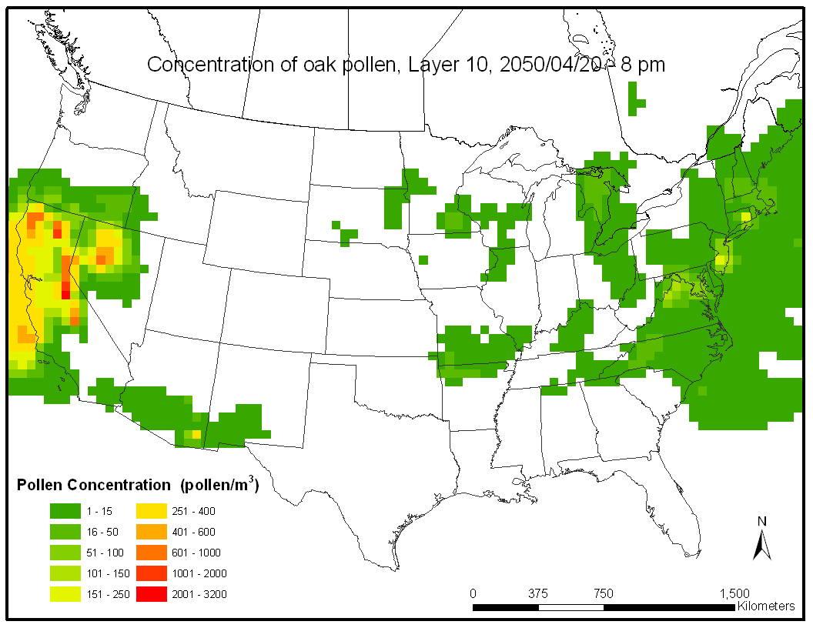
Spatiotemporal concentration profiles of oak pollen, Layer 10
Domain: Contiguous Continental US
Resolution: 50 x 50 km; Hourly; 10 Layers

Slide 14
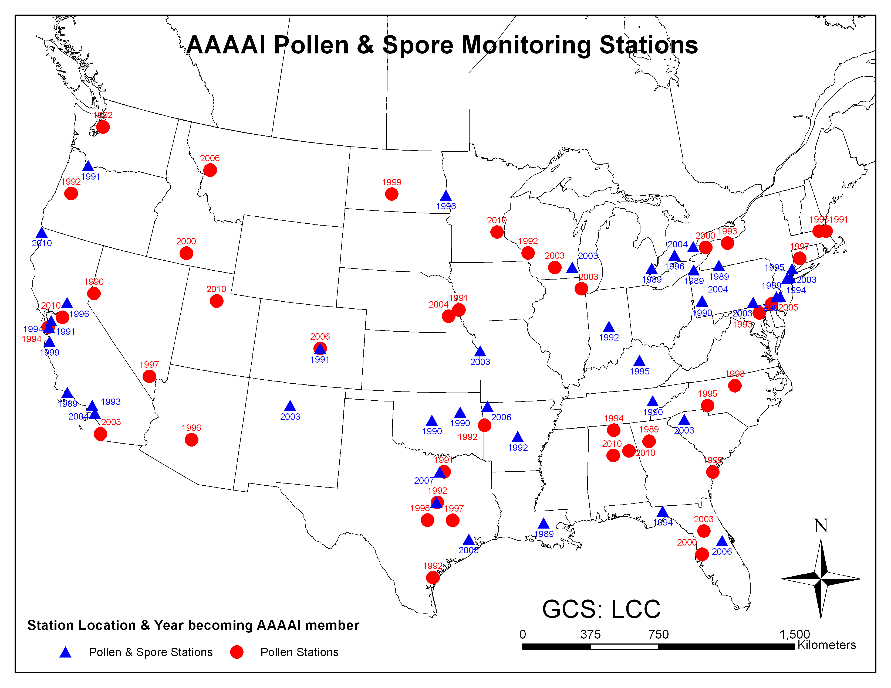

Evaluation of WRF-SMOKE-CMAQ-Pollen simulations
*
Mean Square Error (MSE) of simulation and observation
QQ plot of simulation and observation
Skill Score (SS) of simulation using climatic mean as reference forecast
Warner (2011)
*American Academy of Allergy, Asthma & Immunology

Slide 15
Evaluation of start date estimates of birch pollen
14 representative stations with valid daily birch pollen count in 2004
Observations are paired with simulation estimates in the corresponding grids
Comparison of simulated and observed start date of birch pollen at 14 monitoring stations which have available records of daily pollen count in 2004

Slide 16
Evaluation of daily birch pollen curve
Quantile-Quantile plot of simulated and observed birch pollen levels in 14 monitoring stations
Comparison of the simulated and observed daily concentrations of birch pollen at a monitoring station (Atlanta, GA); the simulated daily concentrations were obtained by averaging the simulated hourly concentrations at that station

Slide 17
Evaluation of daily birch pollen curve
Root Mean Square Errors (RMSE) and Skill Scores (SS) based on observation, simulation and climatologic mean of daily birch pollen levels
Station | RMSE | RRMSEª | RMSE_C^{b} | SS
1 | 68 | 0.11 | 72 | 0.06
2 | 22 | 0.04 | 32 | 0.33
3 | 16 | 0.10 | 19 | 0.15
4 | 62 | 0.10 | 56 | -0.11
5 | 78 | 0.11 | 87 | 0.11
6 | 54 | 0.13 | 48 | -0.14
7 | 24 | 0.17 | 27 | 0.12
8 | 256 | 0.29 | 239 | -0.07
9 | 27 | 0.14 | 30 | 0.09
10 | 223 | 0.34 | 657 | 0.66
11 | 219 | 0.59 | 423 | 0.48
12 | 11 | 0.07 | 14 | 0.22
13 | 136 | 0.20 | 120 | -0.13
14 | 27 | 0.08 | 22 | -0.21
a RRMSE: relative RMSE, percentage of RMSE to annual total pollen count;
b RMSE_C: RMSE based on climatologic mean of pollen levels (2003-2010);

Slide 18
Summary and ongoing work
Summary
A novel pollen emission model was developed and parameterized based on principles and data of physics, phenology and meteorology
The existing CMAQ4.7.1 modeling system was adapted to simulate pollen transport based on the new pollen emission module and WRF meteorology dataset established in North American Regional Climate Change Assessment Program
The WRF-SMOKE-CMAQ-Pollen modeling system was applied to model spatiotemporal profiles of birch pollen emissions and concentrations. Simulation results showed a reasonable agreement with observations.
Ongoing work
Apply the WRF-SMOKE-CMAQ-Pollen modeling system to ragweed, mugwort and grass pollen
Evaluate climate change effects on spatiotemporal distributions of biogenic aeroallergens
Estimate population exposures to biogenic aeroallergens under climate change scenarios

Slide 19
Acknowledgements
Dr. Alan Robock
Linda Everett
Zhong-Yuan Mi
Konstantina Tsintsifas
Xiaogang Tang
Steven Royce
& all other CCL colleagues
  This work is supported by USEPA under STAR Grant EPA-RD-83454701-0 (Climate Change and Allergic Airway Disease) to Rutgers University and UMDNJ
  Base Funding for the Ozone Research Center is Provided by the State of New Jersey Department of Environmental Protection.
  Additional support has been provided by the NIEHS sponsored UMDNJ Center for Environmental Exposures and Disease (CEED - Grant #: NIEHS P30E5S005022)
  This work has not been reviewed by and does not represent the opinions of the funding agencies

