Slide 1
Modeling the impacts of alternative burning strategies on local and regional air quality
Aika Yano, Yongtao Hu, M. Talat Odman, Armistead Russell
Georgia Institute of Technology
October 15, 2012
11th annual CMAS conference
Notes:
Today I will be presenting on analysis performed on different PB practices and its effect on downwind air quality

Slide 2
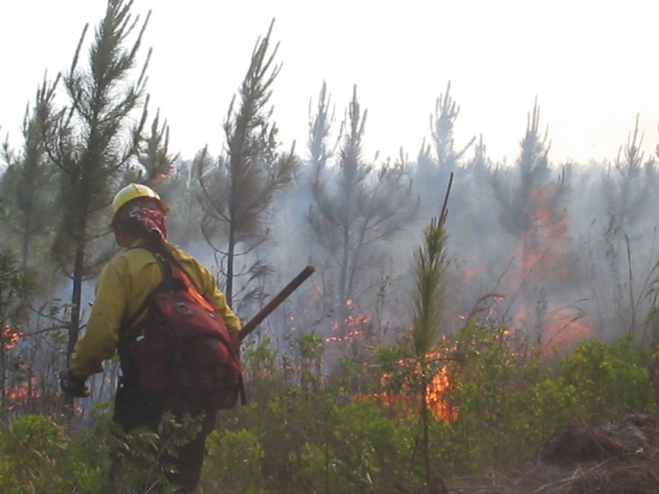
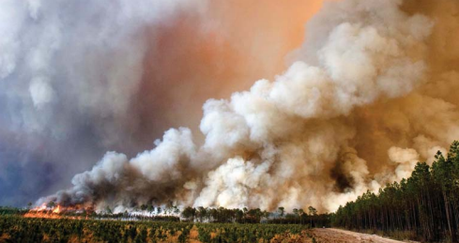
Motivation
Fires naturally occur
Prescribed burning is used to maintain/improve the ecosystem and to reduce the potential of catastrophic wildfires
Land managers must minimize smoke from reaching highly populated areas.
Burn strategies and meteorology affect dispersion, long-range transport of plumes, and ground-level concentrations of pollutants downwind.
Demand for a tool to assess/predict burn practices
Pictures: (left) http://community.fireengineering.com/photo/photo/show?id=1219672%3APhoto%3A115656,
(right) http://www.wildfirelessons.net/documents/historic_2007_ga_wildfires.pdf
Notes:
especially in southeast US.
Prescribed burning is used to maintain ecosystem , endangered species, and to reduce the potential of catastrophic wildfires
2007 GA wildfires
One of the requirements Land managers must maintain is to limit the smoke from reaching highly populated areas.
Burn strategies and meteorology can greatly shape the dispersion, long-range transport of plumes, and ground-level concentrations of pollutants downwind.
Demand for a good tool to assess burn practices
Columbus GA population: 200,000

Slide 3
Objectives
To evaluate the smoke impact prediction system
To assess different burning parameters: frequency, season, size and time of burn, and ignition type
Results of different burning strategies are analyzed based on:
Amounts of pollutants emitted
How smoke plumes are dispersed
How pollutants are transported to impact downwind air quality
Notes:
Our objective is to evaluate and apply a simulation system that can accurately predict the impacts of prescribed burns on regional air quality
To assess alternative burning strategies.

Slide 4
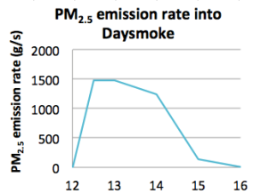
smoke impact prediction system (AGD-CMAQ)
WRF
CMAQ 4.5
Fire Emission Production Simulator
SCIPROC
Generates time-varying emissions
Daysmoke
Plume dispersion up to a certain distance (8km) from fire
Grid Adaptation
Benefit of AG-CMAQ Daysmoke coupling: has the capability to increase grid resolution for tracking biomass burning plumes at the regional scale
Notes:
1. Adaptive Grid Daysmoke-CMAQ (AGD-CMAQ), Adaptive Grid CMAQ has the capability to increase grid resolution for tracking biomass burning plumes at the regional scale.
2. Grid adaptation
3. Subgrid plume mode, Daysmoke
4. WRF
5. Fire Emission Production Simulator (FEPS) generates time-varying emissions and plume spread inputs to Daysmoke

Slide 5
April 9th, 2008 Burn of Ft. Benning Unit F5
BASE CASE
300 acres
3 year-old fuel
Location: -84.6792, 32.3515
Ignition Time: 12:30 pm EDT
Ignition Completion: 2:45 pm
Wind SE, WRF winds adjusted
Mobile 2: 5-6 km away
Columbus Airport: 31km
Notes:
1. The different PB methods will be studied using a burn that occurred at Ft Benning on 4/9/2008.
2. Hand lit ignition start at 12:30, lasts for 2:15min.
3. Wind from SE therefore plume headed towards nearby city
4. 2 monitor sites, 5kmaway and 31kn away

Slide 6
AGD-CMAQ simulation of April 9 2008 burn base case
Notes:
Base case simulation
Looking from the south of the plume
Dif scenarios compared to this base case run

Slide 7
Evaluation: at Columbus airport
Mean Fractional Error = 63% C_{max from BG}: 1.3%
Mean Fractional Bias = - 42% integral C_{abv BG}: -2.5%
Notes:
1. PM2.5 concentrations modeled and measured at the Columbus airport is compared;
2. red dots are the hourly measurements and the line in blue is from the base case simulation.
3. When looking at the concentration increase due to the fire, the Peak conc increase differed only by 1.3% ,and integral of concentration at the site differs only by -2.5%
4. Blue like will be used as the base case here on
46.3%MFE if the peak is to be shifted an hour later
INtegralC -28.75% Cmax -15.17%

Slide 8
Fire Scenarios applied to 4/9/08 burn
Scenarios identified by
Rx-burn experts:
1. Frequency of burn
2 vs 5 year-old
2. Season of burn
Winter vs spring
3. Size of burn
300 vs 600 acres
4. Ignition type
Hand-lit vs aerial
5. Time of burn
Morning vs noon vs afternoon
Notes:
1. The five scenarios that land managers wanted to be simulated are 1, 2, 3, 4, 5.
2. Top right chart shows the Variability in amount of PM2.5 emitted from the burn from differences in the studied parameters and meteorological conditions
3. Aerial ignition have different time profile (will complete the burn faster). Rest have similar distribution over time.
Lower RH higher emission
Base: 65%
Winter, summer: 42,41%
Morning, afternoon: 77,48%

Slide 9
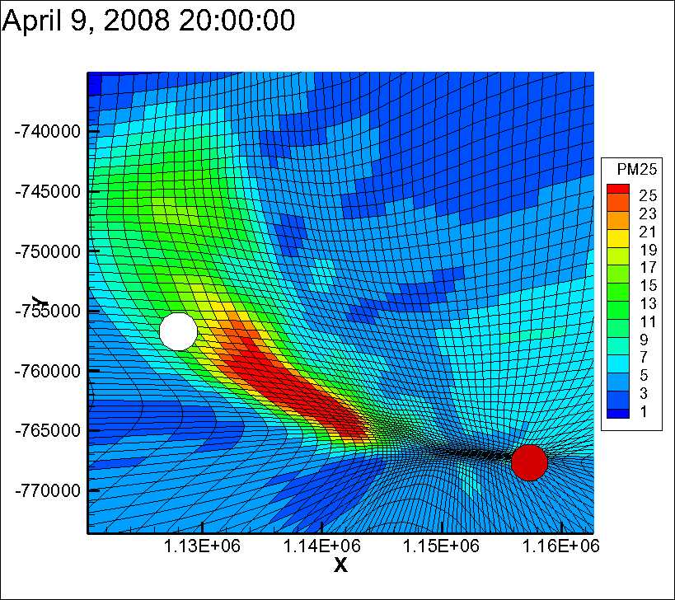
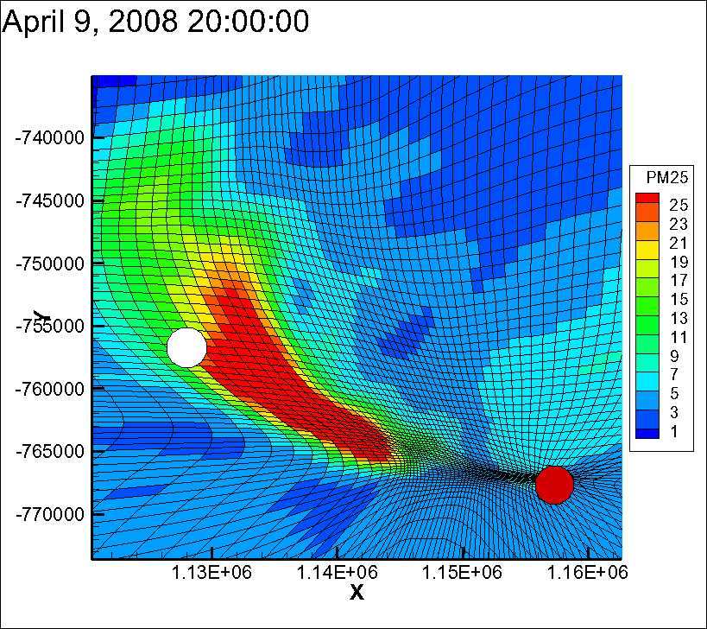
1. Frequency of burn
2 year-old fuel (base case)
5 year-old fuel (33.4% more PM_{2.5})
1430m
1700m
Notes:
Top view: ground pm2.5 conc 3.5 hours after the fire started
white circle is where the airport is, red is where the burn site is.
3. 33.4% more emissions are emitted by 5yr old fuel, therefore the plume is reaching out more to the populated area. (Click)
4. Bottom: Side view of the plume looking from the south, at the same time as above.
5. Plume is alofted slightly higher for 5yr old fuel burn case due to higher heat flux
6. The split in the plume is where Daysmoke plume (on the left) enters into CGRID, and instantaneously mixes throughout PBL.
More fuel more heat flux, same PBL, ground concentration ends up being higher, therefore mixes better, lower ground conc than expected.

Slide 10
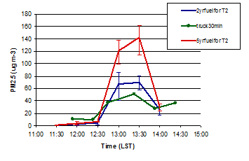
1. Frequency of burn
5 vs. 2 years
Short range PM_{2.5} (~ 5km)
Long range PM_{2.5} (~ 31km)
5 year old fuel has 40.2% more emissions
Accumulated concentration: increase by 26.0%
dC_{max}: 10 vs 15 μg/m³
Notes:
1. Top right Fuel consumption: 40% more consumption from 5 year old fuel
2. Time series PM2.5 conc at mobile 2(left) and at the airport. (right) in both 5 yr old fuel is plotted in red. 2 years old fuel burn case in blue.
3. Near fire, you can expect ground concentration to double when 5 yr old fuel (60mg/m3 vs 120 mg/m3)
4. But by 31km downwind with mixing occurring in CMAQ, peak conc does not vary much between the two, with accumulated PM2.5 conc increasing only by 26%
5. More emissions therefore more heat flux, higher plume therefore not a 1 to 1 increase in ground conc.
5 yr old fuel has higher smldering/flaming ratio total of 40.2% more consumption pm2.5 emitted more for flaming (11.5g/kg) than smoldering phase (10.5g/kg)

Slide 11
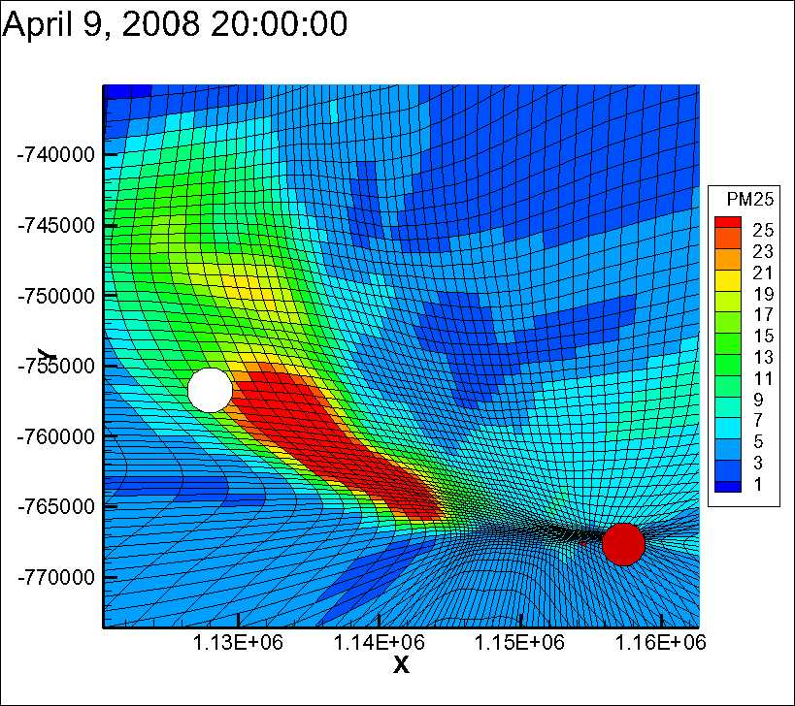
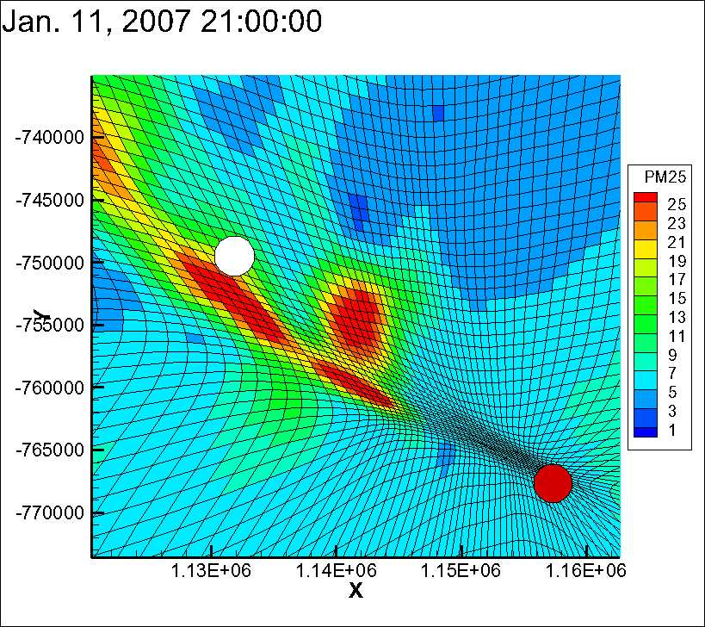
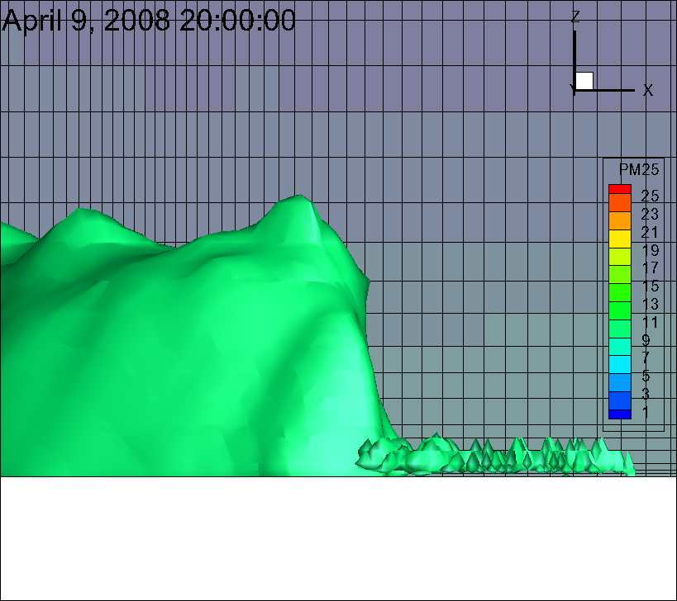
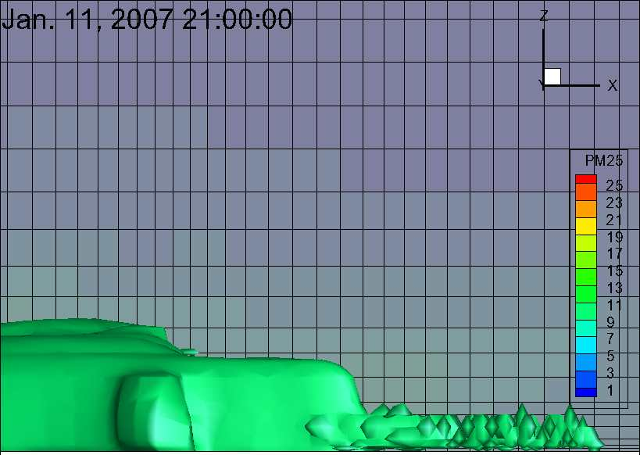
2. Season of burn
Spring
(RH: 65%)
Winter
(RH:42%, 37.3% more PM_{2.5})
1700m
800m
Notes:
Base case, spring vs winter
Winter (right) colder, drier
Top: again 3.5 hrs after ignition Whit circile are all equidistant to the fire and are the long range concs are compared
Plume mixing throughout PBL, yet Winter time having lower PBL.(click) now lets look at ground conc comparisons.

Slide 12
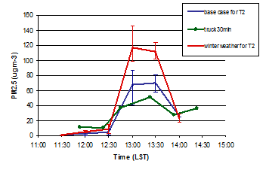
2. Season of burn
winter vs. spring
Short range PM_{2.5} (~ 5km)
Long range PM_{2.5} (~ 31km)
Lower RH leads to 37% more PM_{2.5} emission
Accumulated concentration increase by 39.7%
Notes:
Top right, plot of fuel consumption comparison between winter and spring. Lower RH lead to 3.4 times higher smoldering consumption, leading to 40% more fuel consumed in winter
smoldering consumption. (click), which also leads to 37% more emission
2 plots of time series PM conc downwind winter in red, spring the case case in blue
Higher conc near fire from winter case, probably due to lower PBL and less mixing.
Higher emis, higher heat flux but lower PBL therefore ground conc closer to 1 to 1 increase at long range, short range.
plume reaching sooner in winter case. Sun setting earlier is that why we see the second peek? Look into it (night time stable boundary layer)
Winds not identiacl, therefore difficult to make comparison but in general the winter case seems to lead to higher conc as much as 5micrograms/m3 at the airport.
Referral conc analysis rather than at a certain point to capture the whole plume at a certain distance (for season and time) population weighted conc analysis

Slide 13
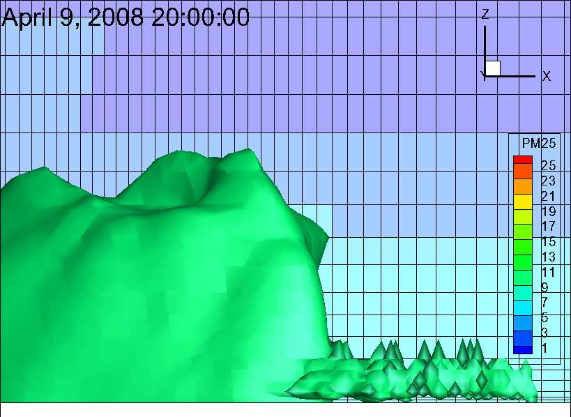
3. Size of burn
300 acres
600 acres (2 times more emission)
1850m
1700m
Notes:
Burn area doubled, emission doubled as well
Plume is spreading to the ground level much more affecting populated area more
Plume height pretty much the same, heat flux still the same, just the area that doubled
Doubling the number of core (FYI) still need to do 300 acres vs 150 X2

Slide 14
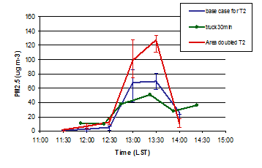
3. Size of burn
300 vs. 600 acres
Short range PM_{2.5} (~ 5km)
Long range PM_{2.5} (~ 31km)
Accumulated concentration increased by 66.1%
Emission doubled, C_{max} also doubled, over ambient AQ standard for 24hr avg. PM_{2.5}
Notes:
Doubling burn area caused Acc conc at the airport increased by 66%
Burn size can also affect Cmax to reach above the daily PM2.5 standard
3. Doubling in concentration impact due to the burn both short range and long range distance.

Slide 15
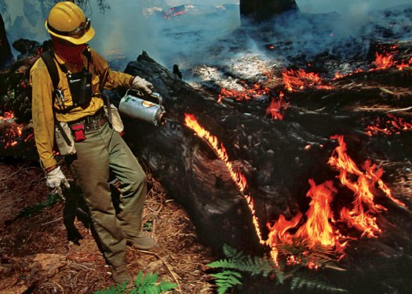
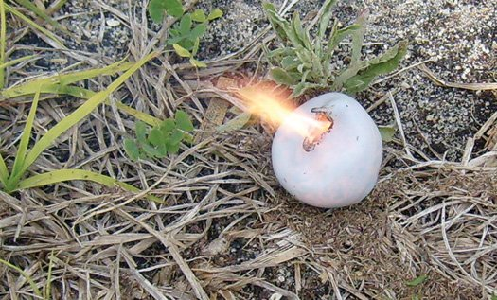
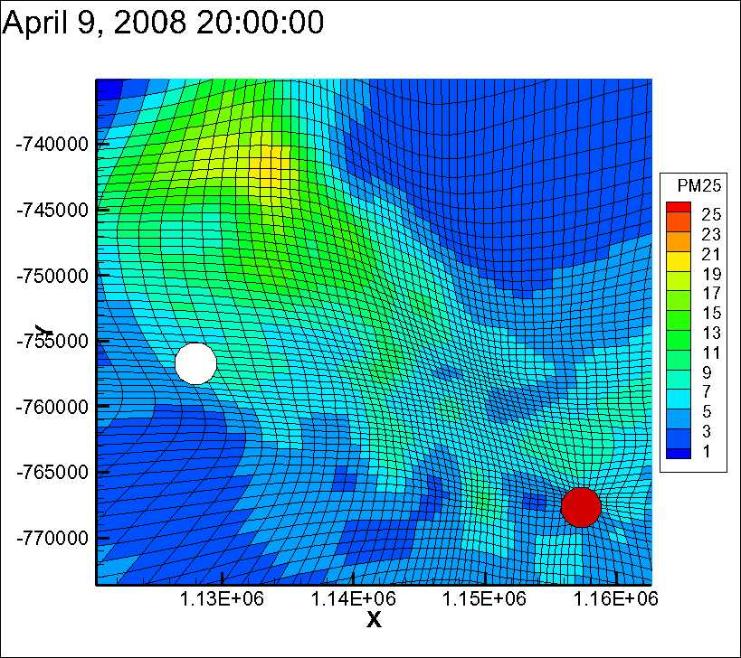
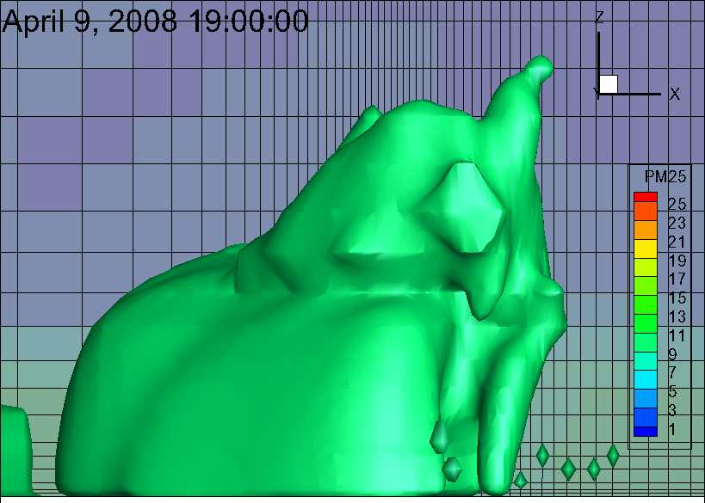
4. Ignition type
Aerial (faster, shorter helicopter ignition) 35.1% more emission
Hand-lit
2700m
1700m
http://www.popsci.com/technology/article/2011-05/firefighters-flame-throwing-toolkits-keep-wildfires-check
Notes:
1. Faster burn therefore plume disappears sooner than hand lit burn. (top)
2. Maximum plume height at different hours
3. More emissions in aerial burn due to hotter burn, faster more consumption flaming, very little in smoldering phase, increase in heat flux, therefore smoke plume penetrating through PBL, and sheer layer drafting in different direction than below PBL

Slide 16
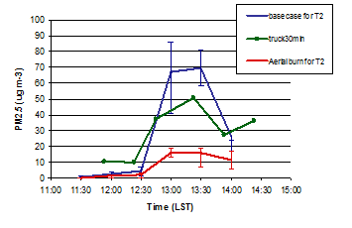
4. Ignition type
Hand lit vs. Aerial (helicopter) ignition
Short range PM_{2.5} (~ 5km)
Long range PM_{2.5} (~ 31km)
35.1% more emission by aerial ignition
Decrease in accumulated concentration by 60.8%
Notes:
Dispite higher total PM2.5 emitted, Higher alofted plume due to rapid ignition and burn, out of the mixing layer
Both regional and local ground conc decreases, long range by 61%

Slide 17
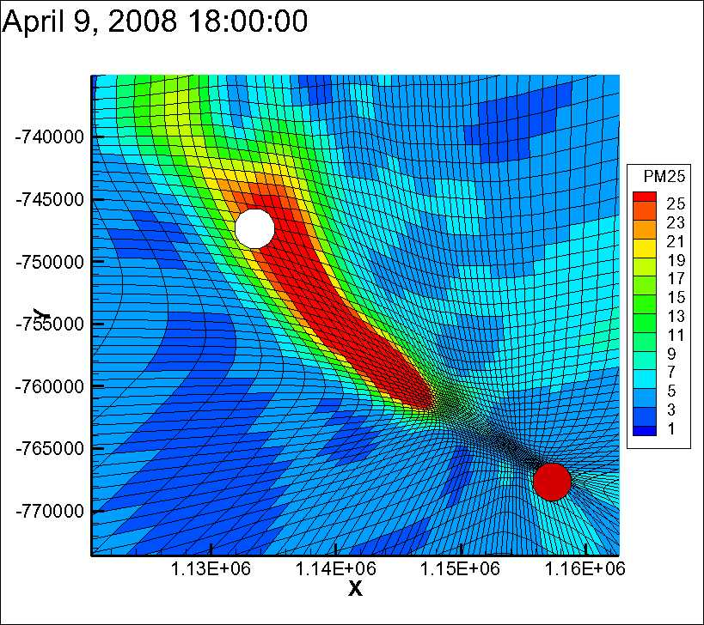
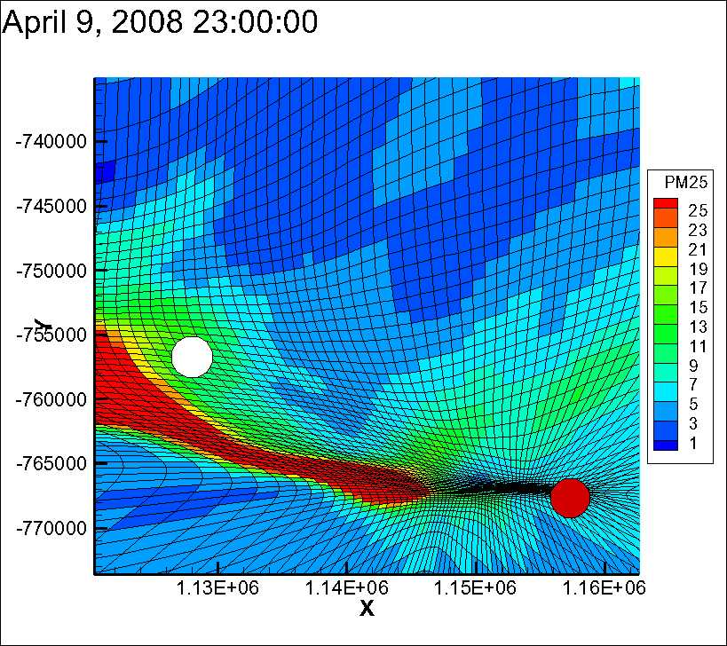
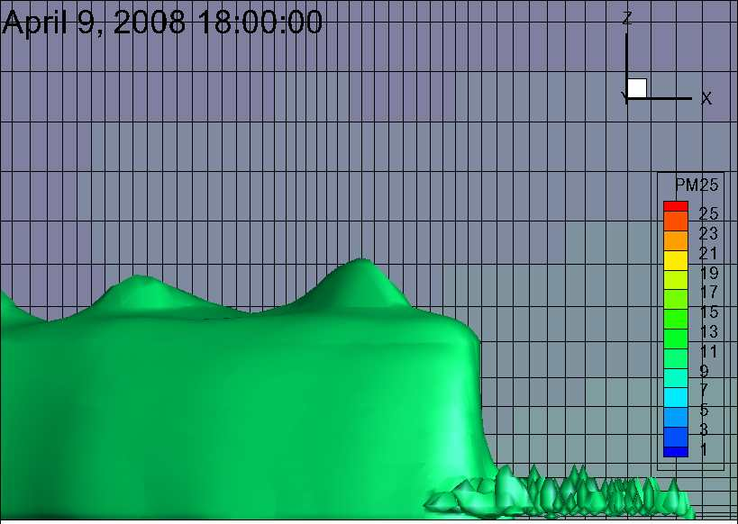
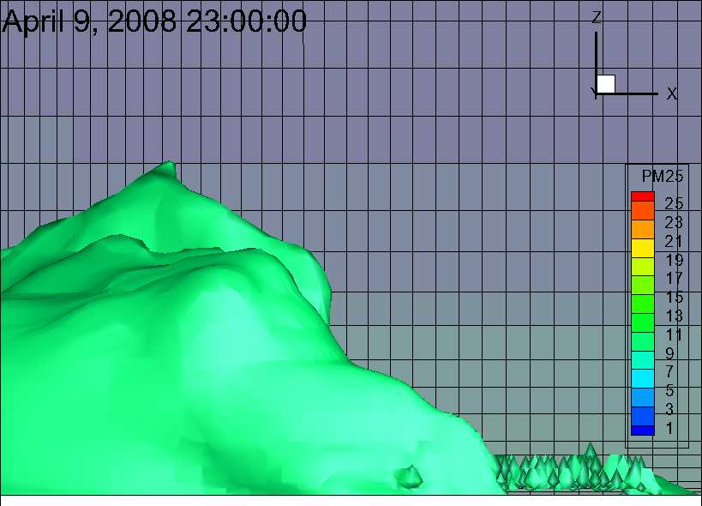
5. Time of burn
Start at 10:30am
(RH: 77%, 2.0% less PM_{2.5})
Start at 12:30pm
(RH: 65%)
Start at 3:30pm
(RH: 48%, 23.0% more PM_{2.5})
1450m
1700m
2010m
Notes:
1. RH and temp shift throughout the day. Lower RH, leading to higher emission and warmer temperature leading to higher PBL as the day passes
2. Change in PBL height as day goes on
Relationship between RH, temp, emis, PBL, heat flux, then to ground concentration.

Slide 18
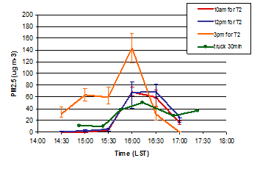
5. Time of burn
AM vs. noon vs. PM
Short range PM_{2.5} (~ 5km)
Long range PM_{2.5} (~ 31km)
2% less emission in the morning and 23% more in the afternoon burn
C_{max}: 43% &167% increase
Accumulated concentration: 13.3% & 9.2% increase
Notes:
Top right shows fuel consumption where it shows the increase in smoldering consumption throughout the day, as RH decreases
RH, temp, mostly wind direction change in a day can significantly affect the amount of emissions, plume height, and Cmax
3. Plume in the afternoon burn gets caught in collapsing boundary layer (peak operating at night time PBL), reaching over The national ambient air quality standard
4. Yet for accumulated concentration there’s a greater increase in the morning burn most likely due to having lower PBL.
RH, temp., and wind speed/direction changes during the day significantly affect the amount of emissions, plume behavior, and maximum concentration observed.

Slide 19
Summary
We used AGD-CMAQ (AG-CMAQ coupled with Daysmoke) to simulate different PB scenarios.
Frequency: 5 years vs. 2 resulted increased emissions (E) by 33% and concentrations (C) by 26%
Season: Winter vs. spring increased E by 37% and C by 40%
Size: Doubling acreage increased E by 100% and C by 66%
Ignition type: Aerial ignition increased E by 35% and decreased C by 60%
Time: RH, temp., and wind speed/direction changes during the day significantly affect the amount of emissions, plume behavior, and maximum concentration observed.
The smoke impact prediction system can be used to design burning scenarios with minimal impact to air quality.
Notes:
19

Slide 20
Acknowledgements
Strategic Environmental Research and Development Program
Joint Fire Science Program
Georgia Department of Natural Resources, Environmental Protection Division
US Forest Service, Southern Research Station
NASA AQAST
Notes:
Sponsor, supporter
20

Slide 21
Summary
AG-CMAQ coupled with Daysmoke (AGD-CMAQ) used to simulate PB scenarios
Frequency: More fuel, more heat flux, same PBL, ground concentration ends up being higher, therefore mixes better, lower ground concentration
Emissions increased by 33% increasing the fuel from 2yr old to 5 yr old fuel
Season: Fuel sensitive to RH, therefore Lower RH (by 23-24% ) leads to more PM_{2.5} emitted (37-39%)
Size: total emission increase, increase in maximum concentration
Ignition type: higher the plume, less emission at the ground level
Time: RH, temp, mostly wind direction changes in one day can significantly affect the amount of emissions, plume behavior, and maximum concentration observed
Plumes behave differently case by case and are difficult to predict, the smoke impact prediction system is able to incorporate multiple parameters providing adequate predictions
Notes:
Fix this slide according to talat’s corrections.
Least emission emitted in the morning
Ground conc related strongly related to plume height
Higher fuel moisture (less fuel burning per fuel available) yet lower ambient temp is ideal burning condition?
More emissions therefore more heat flux, higher plume therefore not a 1 to 1 increase in ground conc.
21

Slide 22
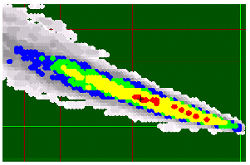
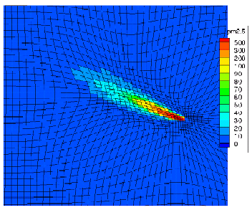
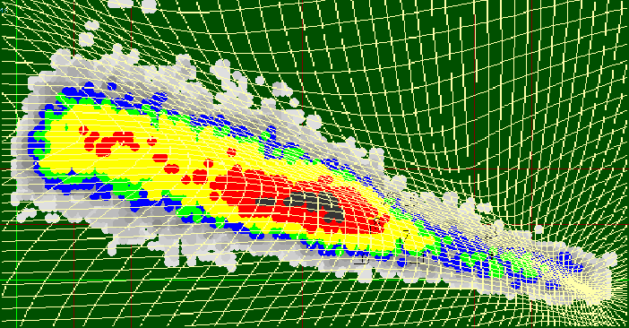
History
AGD-CMAQ presented/evaluated at:
CMAS 2011 “Coupling a subgrid-scale plume model for biomass burns with the adaptive grid CMAQ model”
CMAS 2010 “Modeling biomass burnings by coupling a sub-grid scale plume model with Adaptive Grid CMAQ”

