Slide 2
Presentation Outline
Study Motivation
Study Approach
  Previous Work: Resolution Study I
  Resolution Study II
  Model Parameters/Domain
Main Findings
Discussion
Questions

Slide 3
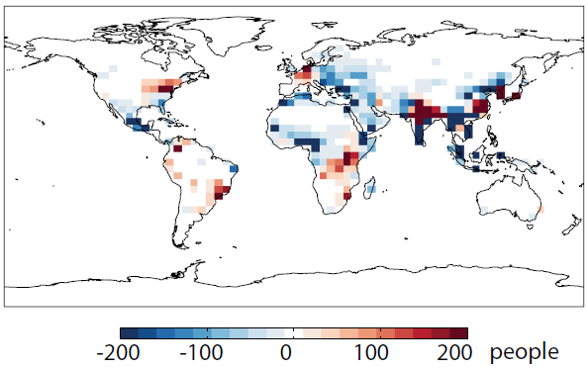
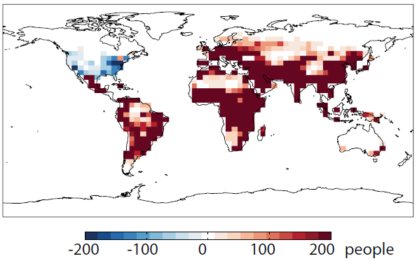
Human Health Estimates
How finely resolved do our models have to be to get meaningful estimates of human health response (relative to finer scale) given the great deal of uncertainty associated with the human health response?
Given that our ultimate goal with air quality modeling is to protect human and environmental health
There are data available that define links between pollution concentrations in the atmosphere and human health response
Example: Coarse resolution global scale modeling is commonly used to estimate health impacts from global climate or policy changes (Figures from Wu et al., 2008)
Δ Mortality with 2050 Climate
Δ Mortality with 2050 Emissions
Notes:
Fine scale modeling is necessary to capture max and min, to study chemistry, and to evaluate concentrations at a point
Uncertainty analyses also an important part of climate science

Slide 4
Need for Regional Scale Uncertainty Analyses
How finely resolved do our models have to be to get meaningful estimates of human health response (relative to finer scale) given the great deal of uncertainty associated with the human health response?
Made infeasible by resolution requirements
Coarse models often miss pollutant minimum and maximum concentrations. This is important for policy analyses.
Regulatory work is required to be done at 12 km or finer resolution
Versus the climate community who typically work with ensembles in order to capture uncertainty
Therefore, it is difficult to apply results from global scale analyses to regional scale modeling
Notes:
Fine scale modeling is necessary to capture max and min, to study chemistry, and to evaluate concentrations at a point
Uncertainty analyses also an important part of climate science

Slide 5
Study Approach
In order to evaluate the impact of Model Resolution on the Uncertainty Associated with Human Health:
Conduct air quality modeling with same inputs at multiple resolutions
Calculate changes in population-weighted concentrations of ozone and fine Particulate Matter (PM_{2.5})
Estimate avoided mortality with 95% confidence interval

Slide 6
Model Resolution Study Part I
Finding: 36 km Resolution has the potential to over-estimate human health benefits
Proof of Concept: However, this study only looked at one location, Houston, and one pollutant, Ozone, therefore limited result applicability
Thompson, T.M., N.E. Selin: Influence of air quality model resolution on uncertainty associated with health impacts, ACPD, 12, 14525–14549, 2012.
*Forthcoming in ACP
Notes:
Include acpd reference

Slide 7
Model Resolution Study part II
Expand analysis to include PM_{2.5}
Model nine regions of the US
Model a full year
Utilize BenMAP
Model Parameters:
  CAMx version 5.3
  SMOKE version 2.7
  Episode Developed by US EPA for evaluation of CSAPR
    36 km, 12 km, and 4 km Resolution
    2005 Base Case Emissions
    2014 Control Case Emissions
    MM5 developed meteorological inputs representing conditions as they occurred during the full year 2005 (4 km met data is interpolated from 12 km resolution)
Notes:
Minimize details, add methods Part II: how we improved (Start w concept)

Slide 8
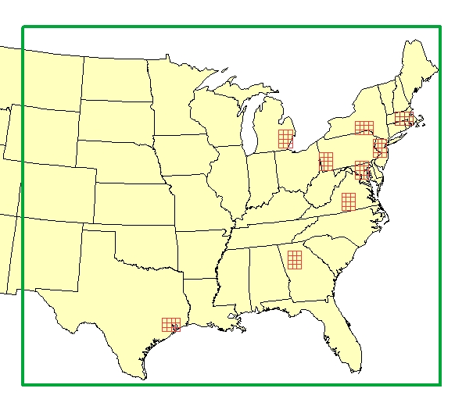
Domains Selected for Variability
4 km Regions
Varied Meteorological and Emissions Characteristics:
Coastal/Inland
Rural/Urban
Attainment/Non-Attainment
Houston
Detroit
Atlanta
Washington DC
New York City
Boston
Western Pennsylvania
Virginia
New York

Slide 9
Main Findings
With respect to Mortality Estimations:
  Ozone is more sensitive to resolution than PM_{2.5}
  Urban areas are more sensitive to resolution than rural areas
  Results are more sensitive to concentration response function selection than model resolution
Notes:
Main points introduced here

Slide 10
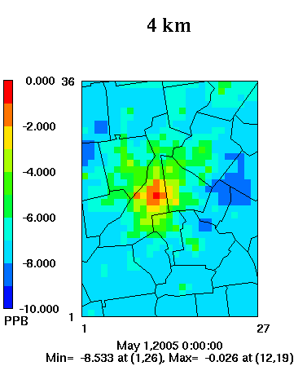
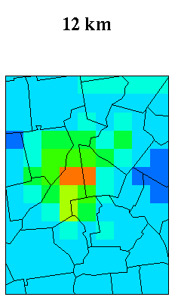
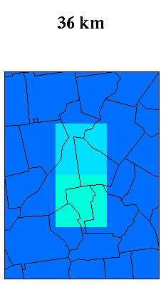
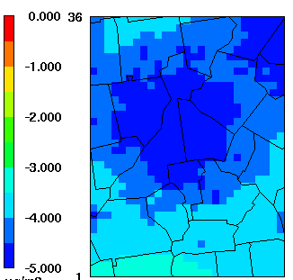
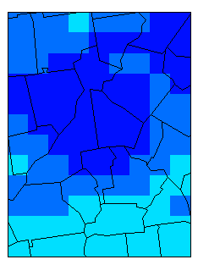
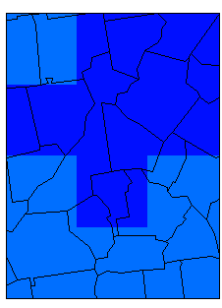
Resolution Impacts: Ozone vs PM_{2.5}
Change in Seasonal Average, Daily Max 8 Hour Ozone (ppb)
Change in Annual Average PM_{2.5} (ug/m³)

Slide 11
Urban vs Rural

Slide 12
Health Function vs Model Resolution
Ozone season avoided mortalities in Atlanta
  Single resolution, multiple health response functions (left)
  Single health response, multiple resolutions (right)

Slide 13
Health Function vs Model Resolution
Annual PM_{2.5} avoided mortalities in Atlanta
  Single resolution, multiple health response functions (left)
  Single health response, multiple resolutions (right)

Slide 14
Total Ozone Mortalities Eastern US
Ozone season avoided mortalities in the Eastern US calculated at 36 km (red) and 12 km (blue)

Slide 15
Total PM Mortalities Eastern US
Annual PM_{2.5} avoided mortalities in the Eastern US calculated at 36 km (red) and 12 km (blue)

Slide 16
Main Findings Discussion
Mortality Estimations:
Ozone is more sensitive to resolution than PM_{2.5}
  Likely due to the larger health impacts associated with PM_{2.5} (therefore larger confidence interval) as well as the mix of primary and secondary species
Urban areas are more sensitive to resolution than rural areas
  Population and emissions distributions are more homogenous
Results are more sensitive to concentration response function selection than model resolution

Slide 17
Results
Given the uncertainty ranges provided by *most* concentration response functions, modeling at scales finer than 36 km does not improve the estimations of human mortality due to changes in air quality.

Slide 18
Acknowledgements
The research described has been supported by the U.S. Environmental Protection Agency's STAR program through grant R834279 and by the MIT Joint Program on the Science and Policy of Global Change. It has not been subjected to any EPA review and therefore does not necessarily reflect the views of the Agency, and no official endorsement should be inferred.

Slide 19
Thank you!!!
(TammyT@mit.edu)
Questions??

