Slide 1
Recent performance of the National Air Quality Forecast Capability
Ivanka Stajner (1), Jeff McQueen(2), Pius Lee(3), Roland Draxler(3),
Phil Dickerson(4), Kyle Wedmark(1,5)
              (1) NOAA NWS/OST
              (2) NOAA NWS/NCEP
              (3) NOAA ARL
              (4) EPA
              (5) Noblis, Inc
CMAS meeting, Chapel Hill, NC October 16, 2012

Slide 2
Outline
Background on NAQFC
Progress in 2012
    Ozone predictions
    Smoke predictions
    Dust predictions
    Prototype PM2.5 predictions
    Outreach and feedback
Summary

Slide 3
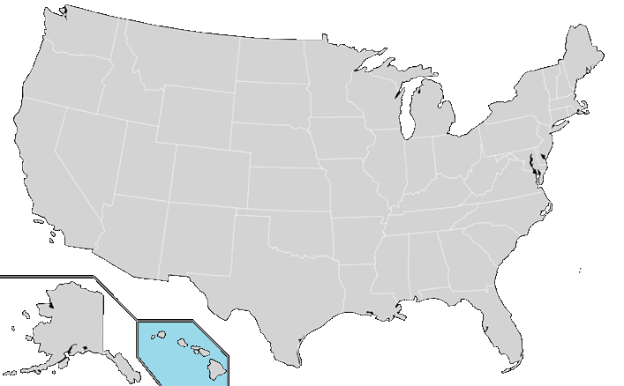
National Air Quality Forecast Capability
Capabilities as of 9/2012
Improving the basis for air quality alerts
Providing air quality information for people at risk
Prediction Capabilities:
Operations:
Ozone nationwide: expanded from EUS to CONUS (9/07), AK (9/10) and HI (9/10)
Smoke nationwide: implemented over CONUS (3/07), AK (9/09), and HI (2/10)
Dust over CONUS: (3/12)
Experimental testing:
  Ozone predictions
  Developmental testing:
Components for particulate matter (PM) forecasts
2004: ozone
2007: ozone and smoke
2012: dust
2005: ozone
2009: smoke
2010: ozone
2010: ozone and smoke

Slide 4
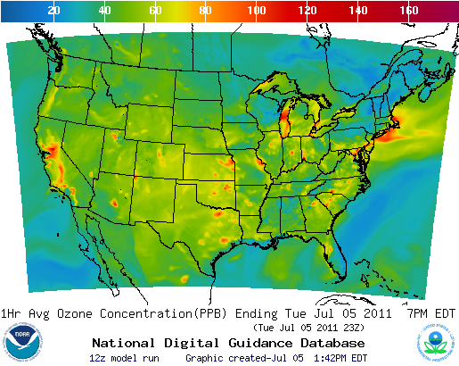
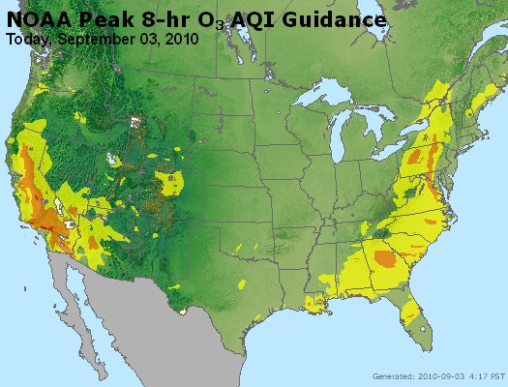
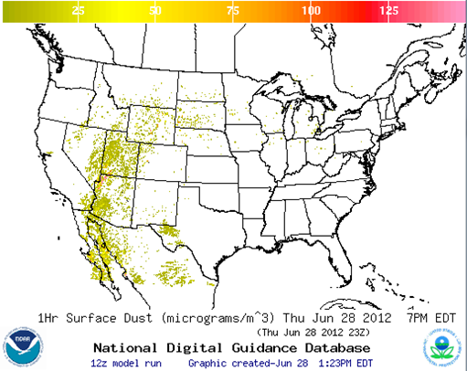
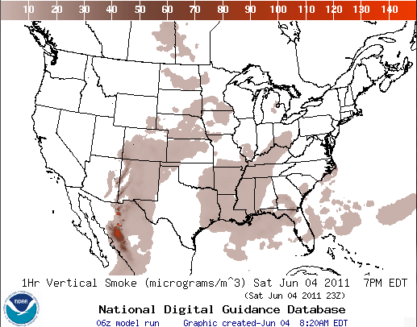
National Air Quality Forecast Capability
End-to-End Operational Capability
Model: Linked numerical prediction system
Operationally integrated on NCEP’s supercomputer
  NOAA NCEP mesoscale numerical weather prediction
  NOAA/EPA community model for air quality: CMAQ
  NOAA HYSPLIT model for smoke and dust prediction
Observational Input:
  NWS weather observations; NESDIS fire locations; climatology of regions with dust emission potential
  EPA emissions inventory
ozone
AIRNow
Gridded forecast guidance products
  On NWS servers: airquality.weather.gov and ftp-servers
  On EPA servers
  Updated 2x daily
Verification basis, near-real time:
  Ground-level AIRNow observations of surface ozone
  Satellite observations of smoke and dust
Customer outreach/feedback
  State & Local AQ forecasters coordinated with EPA
  Public and Private Sector AQ constituents
dust
smoke

Slide 5
Progress in 2012
North American Meteorological model was upgraded to Non-hydrostatic Multi-scale Model (NMMB)
  These meteorological predictions are used for all air quality predictions (October 2011)
Ozone Updates:
  Substantial emission updates:
    Mobile6 used for mobile emissions, but with emissions scaled by growth/reduction rate from 2005 to 2012
    Non-road area sources use Cross State Rule Inventory
    Canadian emissions use 2006 inventory
Dust updates:
  Dust predictions implemented operationally in March 2012
  Dust emissions are modulated by real-time soil moisture
  Testing use of a longer time step to speed up dust predictions
Smoke updates:
  Testing of updates to plume rise and deposition parameters

Slide 6
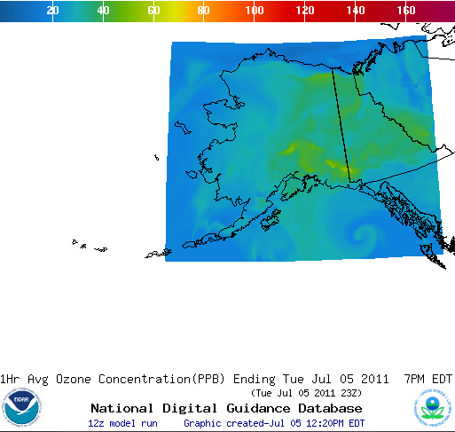
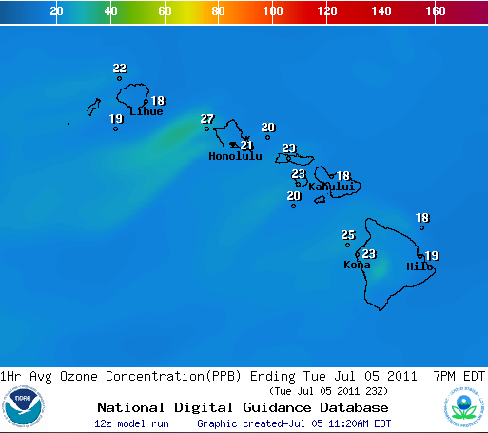
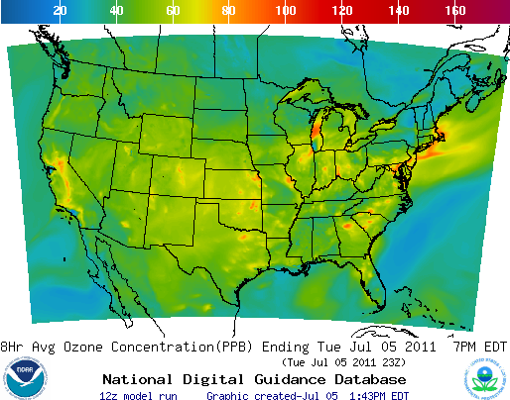

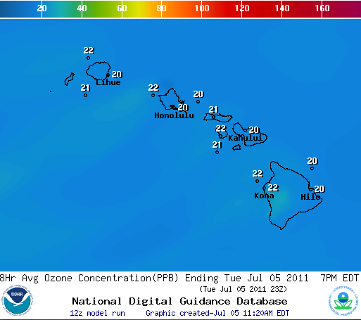
Ozone predictions
Operational predictions at http://airquality.weather.gov
1-Hr Average Ozone
1-Hr Average Ozone
1-Hr Average Ozone
8-Hr Average Ozone
8-Hr Average Ozone
8-Hr Average Ozone

Slide 7
Summary of ozone Verification over CONUS
2009
CONUS, wrt 76ppb Threshold
Operational
2010
CONUS, wrt 76ppb Threshold
Operational
0.99
0.94
0.95
2011
CONUS, wrt 76 ppb Threshold
0.98
0.96
Operational
2012
CONUS, wrt 76 ppb Threshold
Operational
Maintaining prediction accuracy as the warning threshold was lowered and emissions of pollutants are changing
7

Slide 8
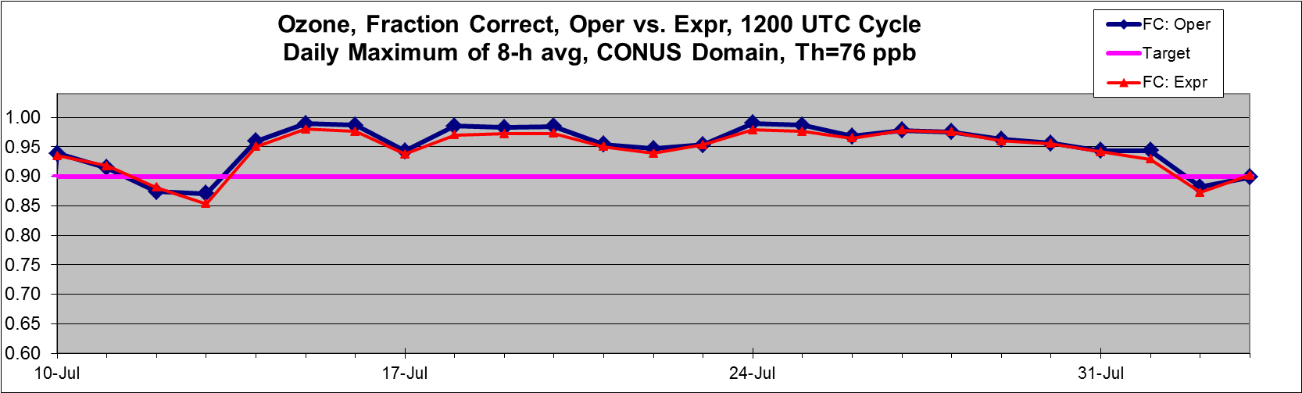
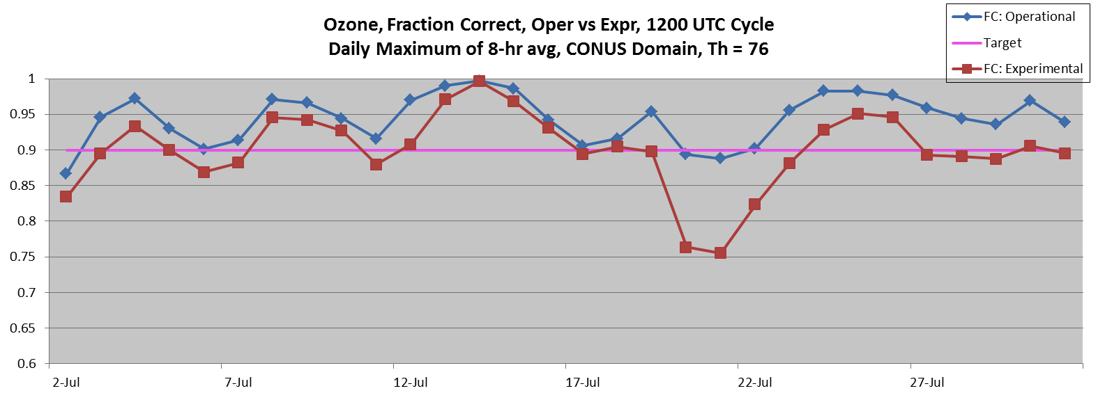
Operational and experimental predictions: fraction correct
2012
Similar performance of operational and experimental predictions
2011
Operational predictions used to be better than experimental
 | 2011 | 2012 updates
Operational CB-IV | WRF-NMM, 2005 NEI | NMM-B, 2012 emission projections
Experimental CB05 | WRF-NMM, 2005 NEI | NMM-B, 2012 emission projections | LBC, dry deposition, minimum PBL height

Slide 9
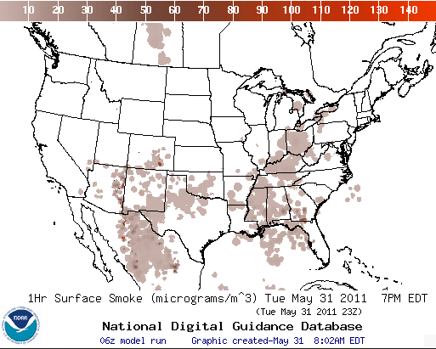
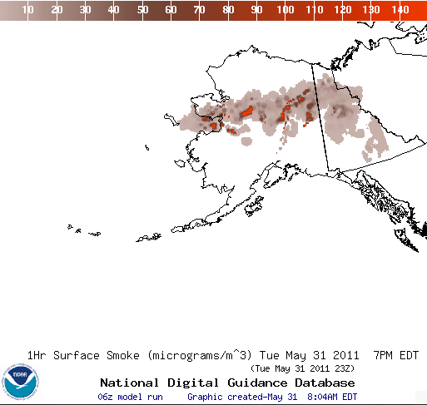
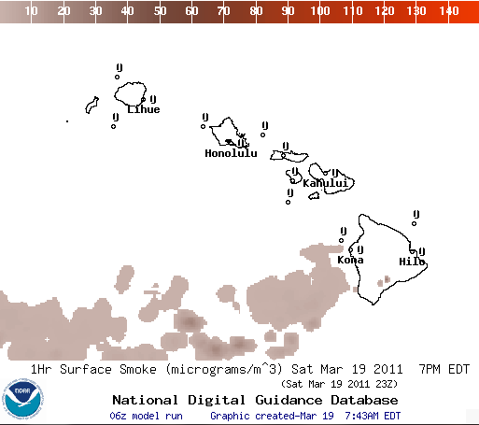
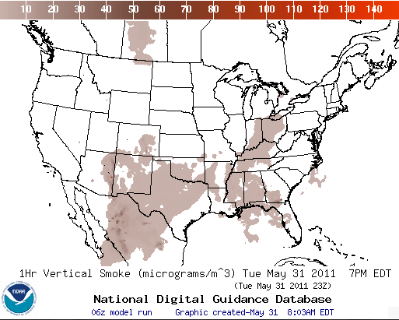
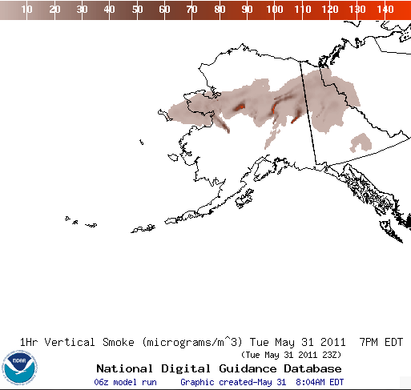
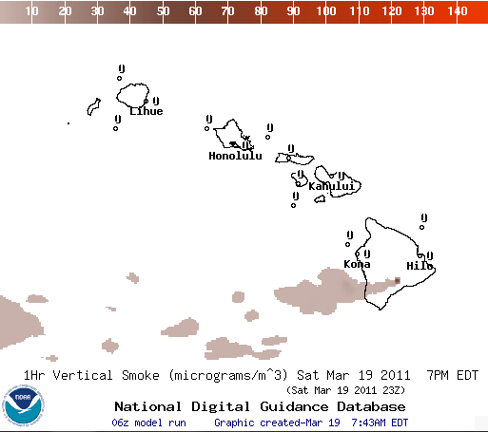
Smoke predictions
Operational predictions at http://airquality.weather.gov
Surface Smoke
Surface Smoke
Surface Smoke
Vertical Smoke
Vertical Smoke
Vertical Smoke

Slide 10
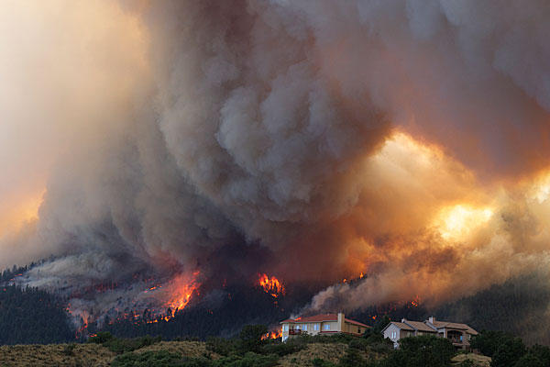
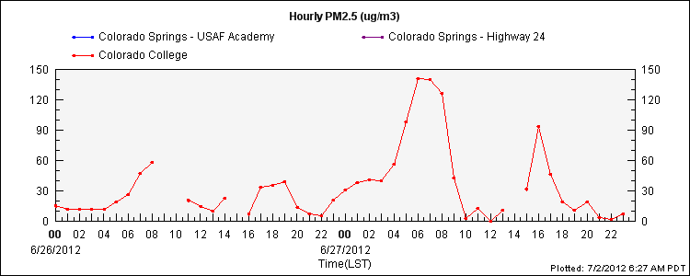
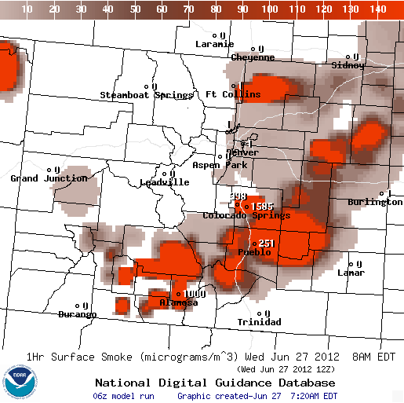
Colorado Springs – Waldo Canyon Fire
Waldo Canyon fire on June 26 in Colorado Springs²
Began on June 23, west of Colorado Springs¹
Moved eastward, burning over 18,000 acres and destroying 346 homes
Peak of fire June 26-27
Evacuations reached 32,000 on June 27
The cause is under investigation
Smoke plume reached 20,000 feet²
High winds in region have fueled rapid spread of fire; dry conditions persistent; consecutive Red Flag Warning days
Inciweb Reports, http://www.inciweb.org/incident/2929/
Waldo Canyon fire reaches 'epic proportions‘, http://www.csmonitor.com/USA/Latest-News-Wires/2012/0627/Waldo-Canyon-fire-reaches-epic-proportions-video

Slide 11
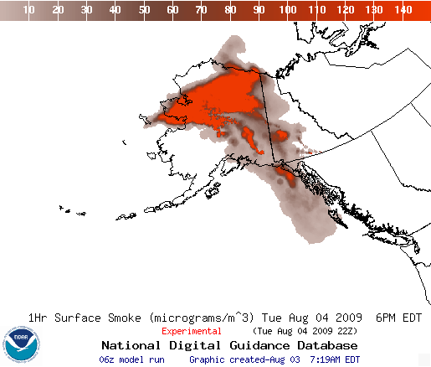
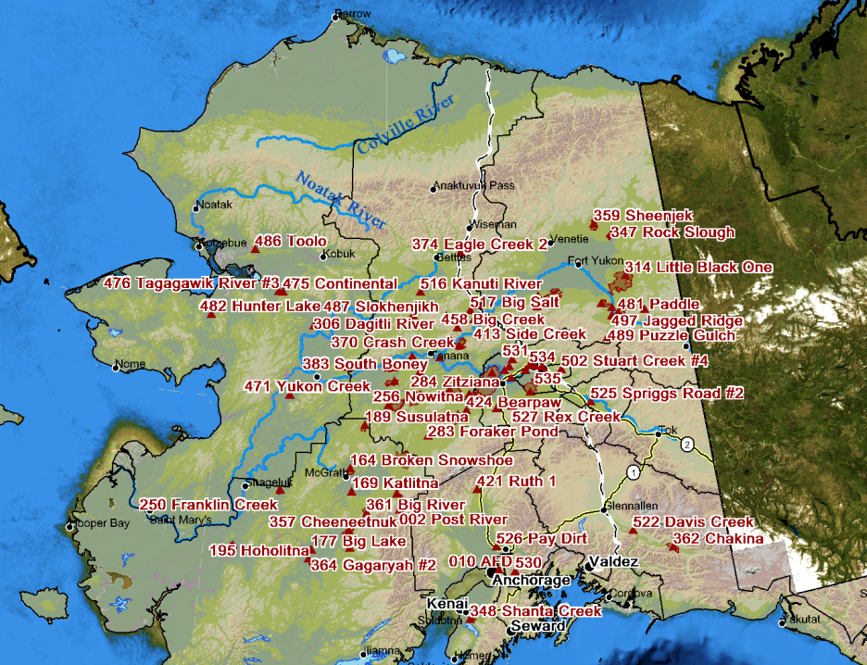
Smoke from wildfires in Alaska
86 active wildfires on August 4, 2009
4 temporary flight restrictions
~3 million acres burned in 2009
From experimental testing;
operational since September 2009
In year 2009:
Large Alaskan fires began in early July
Driest July ever recorded in Fairbanks and second warmest July ever (avg 66.5°).

Slide 12
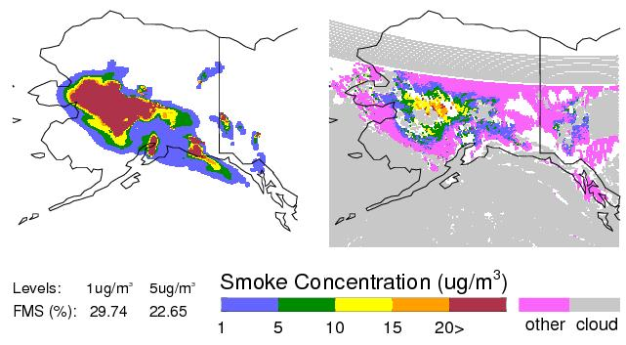
Smoke Verification:
July 13, 2009
7/13/09, 17-18Z, Prediction:
7/13/09, 17-18Z, Observation:
GOES smoke product: Confirms areal extent of peak concentrations
FMS = 30%, for column-averaged smoke > 1 ug/m³
12

Slide 13
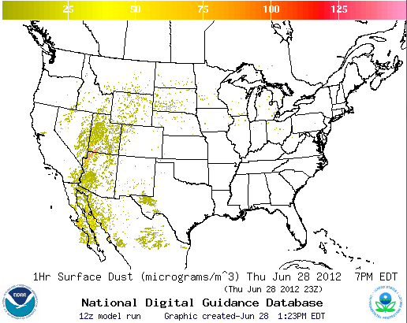
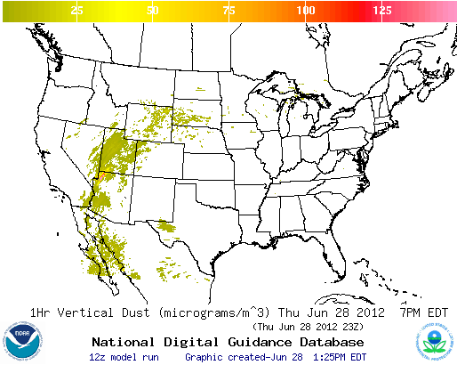
Dust Predictions
Surface Dust
Vertical Dust
Operational predictions at http://airquality.weather.gov

Slide 14
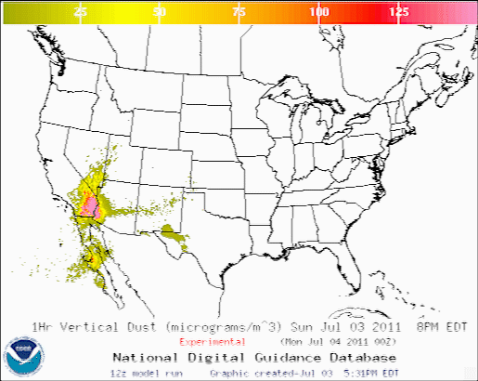
CONUS Dust Predictions
Operational Predictions at http://airquality.weather.gov/
  Standalone prediction of airborne dust from dust storms:
  Wind-driven dust emitted where surface winds exceed thresholds over source regions
Source regions with emission potential estimated from MODIS deep blue climatology (2003-2006).
  HYSPLIT model for transport, dispersion and deposition (Draxler et al., JGR, 2010)
  Emissions modulated by real-time soil moisture.
  Developed satellite product for verification (Zeng and Kondragunta)

Slide 15
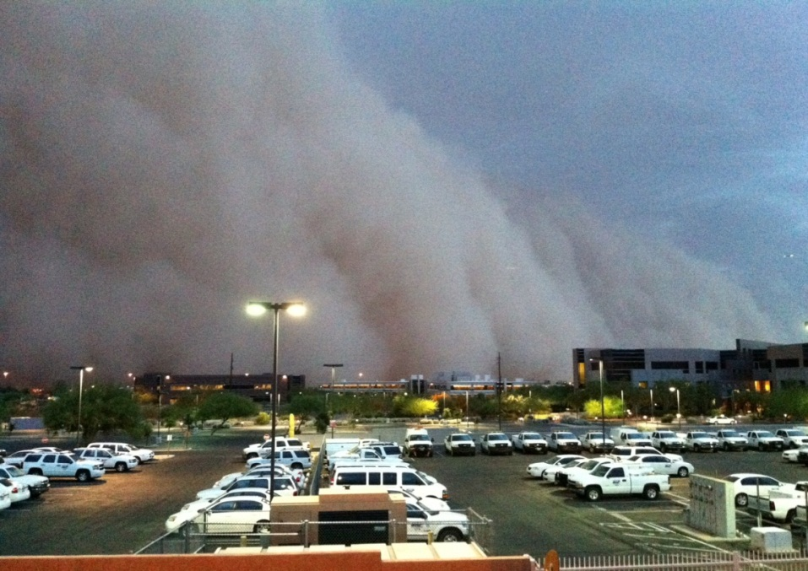
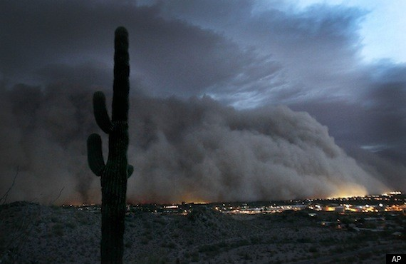
Phoenix, AZ dust event on July 5, 2011
Massive dust storm hit Phoenix, AZ in the evening on July 5, 2011
Cloud was reported to be 5,000 feet when it hit, radar shows heights from 8,000-10,000 feet tall and 50 miles wide
Source: http://www.wrh.noaa.gov/psr/pns/2011/July/DustStorm.php
Originated from convection near Tucson
Stopped air traffic for over an hour
Arizona DEQ reported a PM10 concentration of 6,348 ug/m³ during peak of storm at site in downtown Phoenix
Storm moved through Phoenix at 30-40 mph
Source: http://www.huffingtonpost.com/2011/07/06/phoenix-dust-storm-photos-video_n_891157.html
15

Slide 16
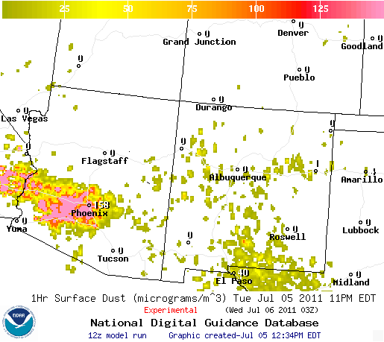
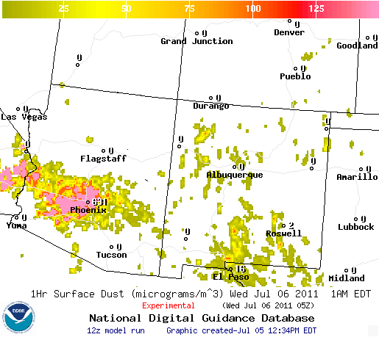
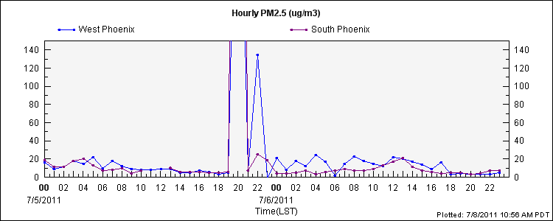
Phoenix Observed PM 2.5 Observations
Based on observations, height of impact on Phoenix was between 8 PM and 10 PM LST
Predicted surface dust concentrations:
- 8PM 158 ug/m³
- 10PM 631 ug/m³
*Note* AZ three hours behind in summer
Timing of storm based on comparing predictions to observations looks accurate (albeit perhaps early – 63 ug/m³ predicted at 7 PM for Phoenix), however, the predictions keep the high levels seen at 10 PM LST for the next four to five hours, not seen in the observations
Peak values: 996 ug/m³ at South Phoenix station at 8PM and 506 ug/m³ at West Phoenix station at 8 PM (AIRNow Tech)

Slide 17
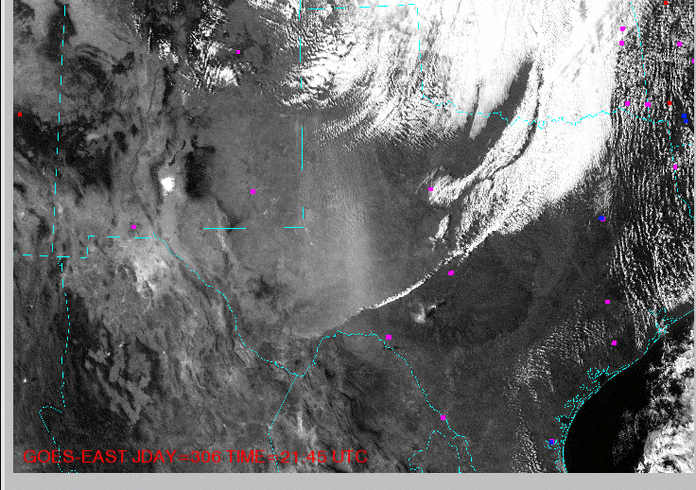
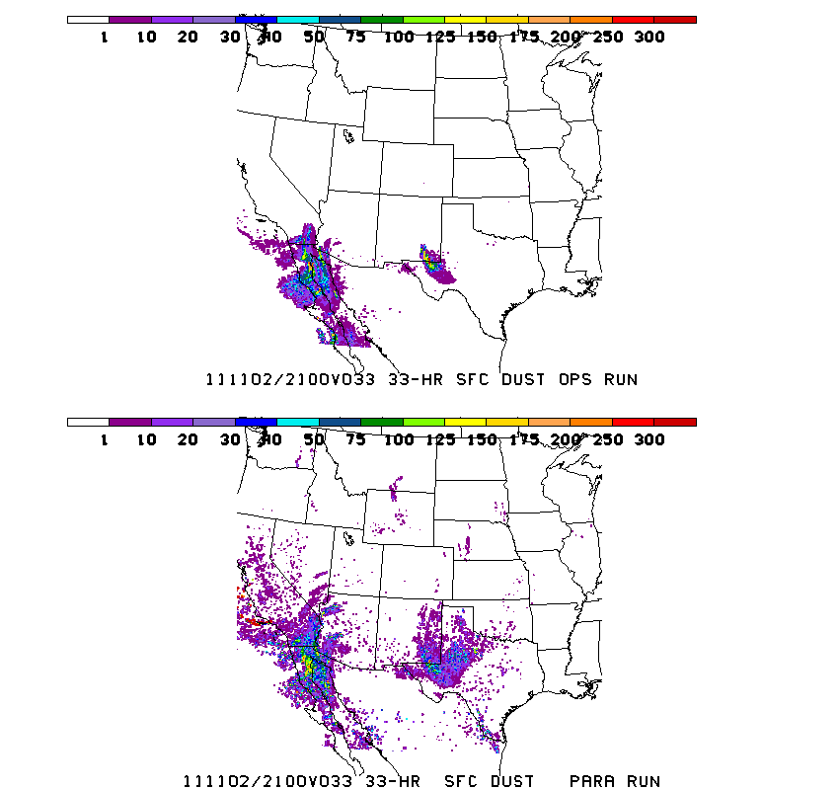
Texas dust event on November 2, 2011
Dust prediction updates
Modulating dust emissions using real-time soil moisture information (now operational)
Predicted dust concentration (ug/m3) at the surface
Current model: emissions
modulated by
soil moisture
A widespread dust event occurred on Nov 2 beginning around 18Z in west central Texas. This event was the result of ~25kt synoptic scale winds ahead of a cold front. Through 0Z (Nov 3) the dust blew south covering all of west Texas and parts of southeast New Mexico.
Previous model:
emissions
not modulated by
soil moisture
Longer time step (10 min vs. 6 min) provides comparable predictions, but reduces prediction run time by over 30% (currently in testing)

Slide 18
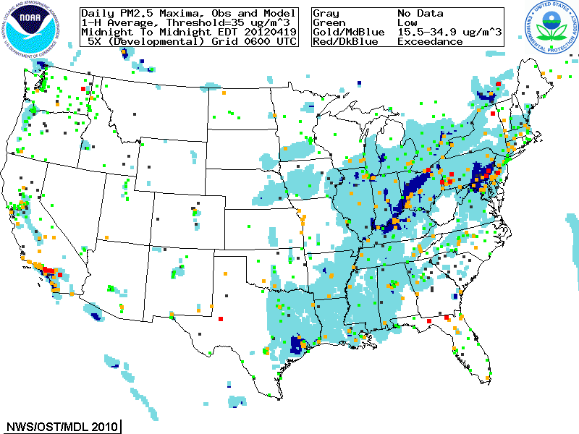
Developmental predictions, Summer 2012
  Focus group access only, real-time as resources permit
  Aerosols over CONUS
    From NEI sources only
    CMAQ:
    CB05 gases, AERO-4 aerosols
    Sea salt emissions
  Wildfire smoke emissions not included

Slide 19
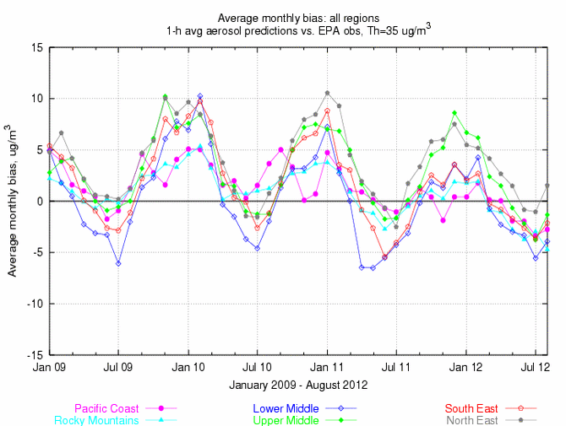
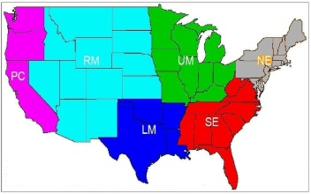
Quantitative PM performance
Forecast challenges
Aerosol simulation using emission inventories:
  Show seasonal bias-- winter, overprediction; summer, underprediction
Intermittent sources
Chemical boundary conditions/trans-boundary inputs

Slide 20
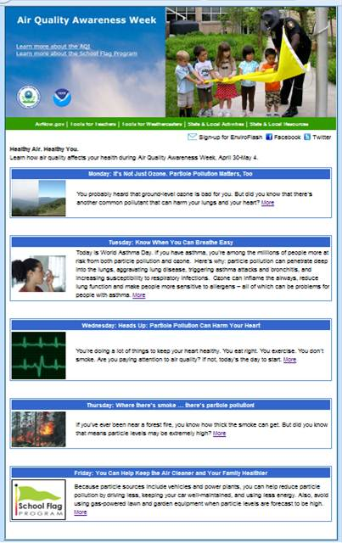
Partnering with AQ Forecasters
http://www.epa.gov/airnow/airaware/
Focus group, State/local AQ forecasters:
  Participate in real-time developmental testing of new capabilities, e.g. aerosol predictions
  Provide feedback on reliability, utility of test products
  Local episodes/case studies emphasis
  Regular meetings; working together with EPA’s AIRNow and NOAA
  Feedback is essential for refining/improving coordination

Slide 21
Feedback from state and local AQ forecasters
Examples provided in September 2012
Good performance by NAQFC ozone forecast in 2012 in the Philadelphia metropolitan area. Sunday false alarms not an issue in 2012. (William Ryan, Penn State)
In Connecticut, NOAA model outperformed [human] forecasts- 73% vs. 54%. The NOAA model past record of over-predicting during July-August didn’t occur this year. (Michael Geigert, Connecticut Dept.of Energy and Environmental Protection)
In Maryland, NOAA ozone predictions have improved since 2011: significant improvement in false alarm ratio (FAR) with some decrease in probability of detection (POD). (Laura Landry, Maryland Department of the Environment)
Bias and accuracy statistics for NAQFC ozone predictions improved in 2012 compared to 2011. (Cary Gentry, Forsyth County Office of Environmental Assistance and Protection, Winston-Salem, NC)

Slide 22
Summary
US national AQ forecasting capability:
Ozone prediction nationwide (AK and HI since September 2010)
Smoke prediction nationwide (HI since February 2010)
Dust prediction for CONUS sources (operational since March 2012)
Prototype CMAQ aerosol predictions with NEI sources

Slide 23
Acknowledgments:
AQF Implementation Team Members
Special thanks to Paula Davidson, OST chief scientist and former NAQFC Manager and to Jim Meager former NOAA AQ Matrix Manager
NOAA/NWS/OST Ivanka Stajner NAQFC Manager
NWS/OCWWS Jannie Ferrell Outreach, Feedback
NWS/OPS/TOC Cynthia Jones Data Communications
NWS/OST/MDL Jerry Gorline, Marc Saccucci, Dev. Verification, NDGD Product Development
Dave Ruth
NWS/OST Kyle Wedmark Program Support
NESDIS/NCDC Alan Hall Product Archiving
NWS/NCEP
  Jeff McQueen, Jianping Huang AQF model interface development, testing, & integration
  *Sarah Lu Global dust aerosol and feedback testing
  *Brad Ferrier, *Eric Rogers, NAM coordination
  *Hui-Ya Chuang
  Geoff Manikin Smoke and dust product testing and integration
  Dan Starosta, Chris Magee NCO transition and systems testing
  Mike Bodner, Andrew Orrison HPC coordination and AQF webdrawer
NOAA/OAR/ARL
  Pius Lee, Daniel Tong, Tianfeng Chai CMAQ development, adaptation of AQ simulations for AQF
  Hyun-Cheol Kim
  Roland Draxler, Glenn Rolph, Ariel Stein HYSPLIT adaptations
NESDIS/STAR Shobha Kondragunta, Jian Zeng Smoke and dust verification product development
NESDIS/OSDPD Liqun Ma, Mark Ruminski Production of smoke and dust verification products,
HMS product integration with smoke forecast tool
EPA/OAQPS partners:
Chet Wayland, Phil Dickerson, Brad Johns, John White AIRNow development, coordination with NAQFC
  * Guest Contributors

Slide 24
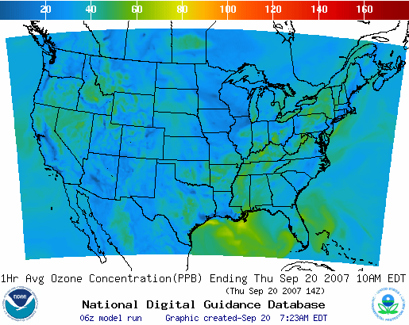
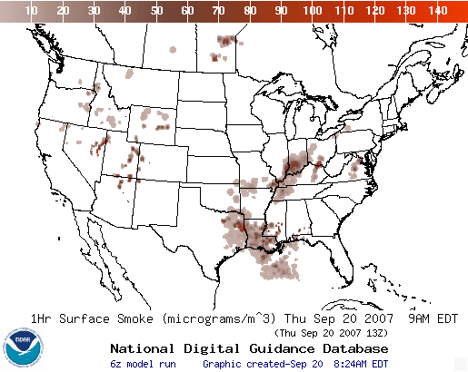
Operational AQ forecast guidance airquality.weather.gov
Ozone products
Nationwide since 2010
Smoke Products
Nationwide since 2010
Dust Products
Implemented 2012
Further information: www.nws.noaa.gov/ost/air_quality

Slide 25
Backup

Slide 26
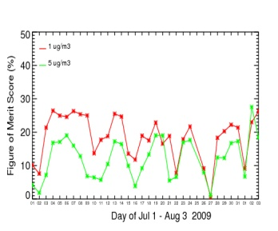

Smoke Forecast Tool
Major Components
NWP Model
NAM/NMMB
NOAA/NWS
Weather
Observations
NESDIS HMS
Fire Locations
NWP Post-processors
for AQ Modules
HYSPLIT Module:
NOAA/OAR
USFS’s BlueSky
Emissions Inventory:
USFS
Verification:
NESDIS/GASP Smoke
26
Notes:
26

Slide 27
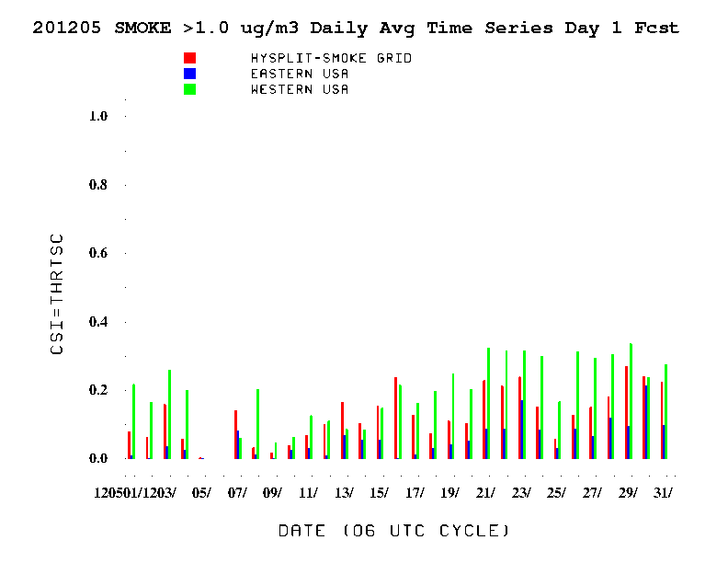
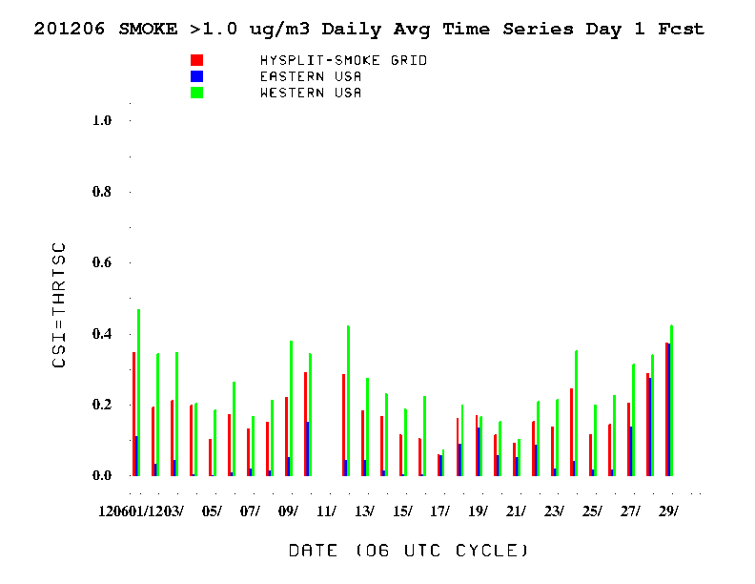
Verification of smoke predictions
for CONUS
Daily time series of FMS for smoke concentrations larger than 1um/m3
May 2012
June 2012
Figure of merit in space (FMS), which is a fraction of overlap between predicted and observed smoke plumes, threshold is 0.08 marked by green line
NESDIS GOES Aerosol/Smoke Product is used for verification

Slide 28
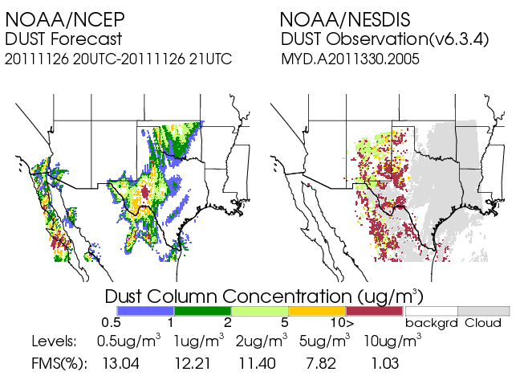
Real time verification examples
Using MODIS Dust Mask Algorithm from NOAA/NESDIS satellite imagery
“Footprint” comparison:
Threshold concentration > 1 µg/m³, for average dust in the column
Tracking threat scores, or figure-of-merit statistics:
(Area Pred ∩ Area Obs) / (Area Pred U Area Obs)
Initial skill target 0.05
28

Slide 29
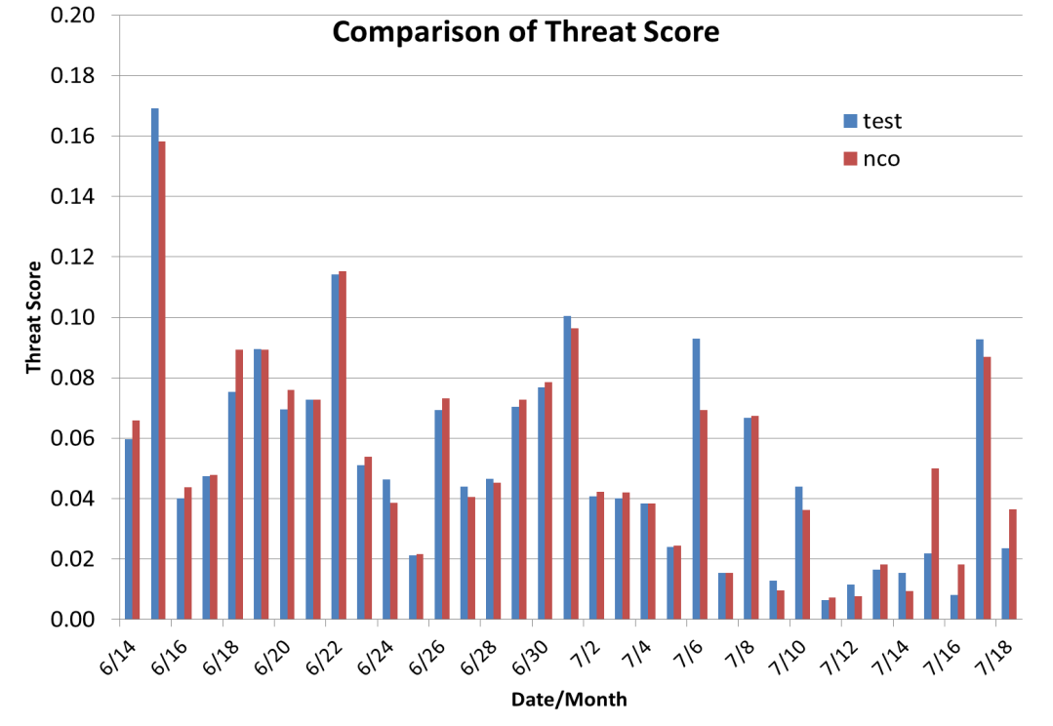
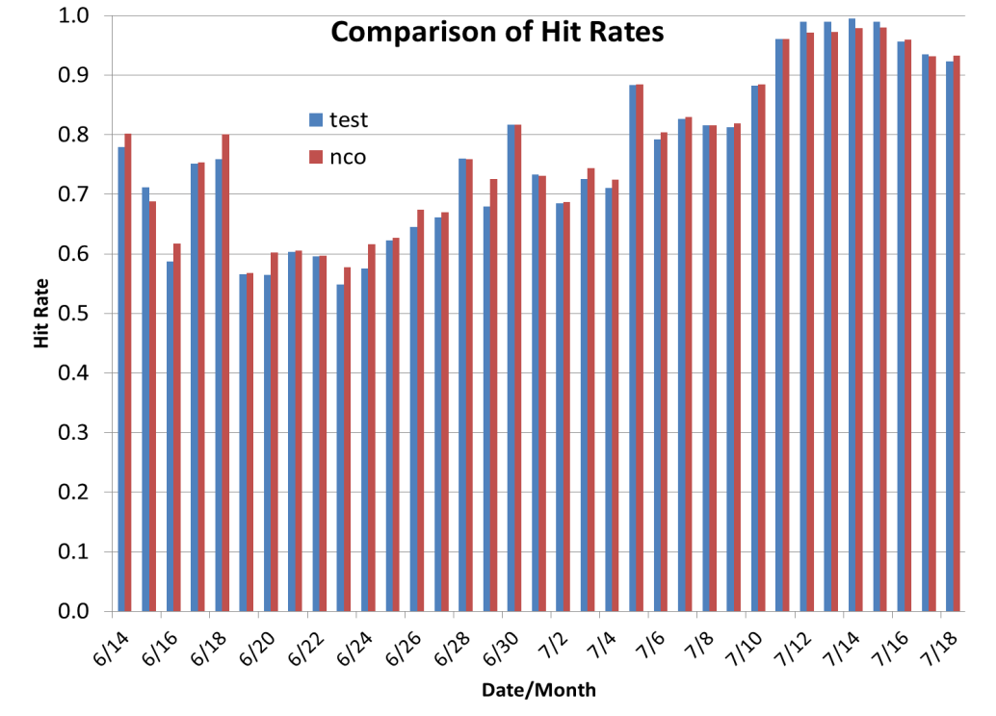
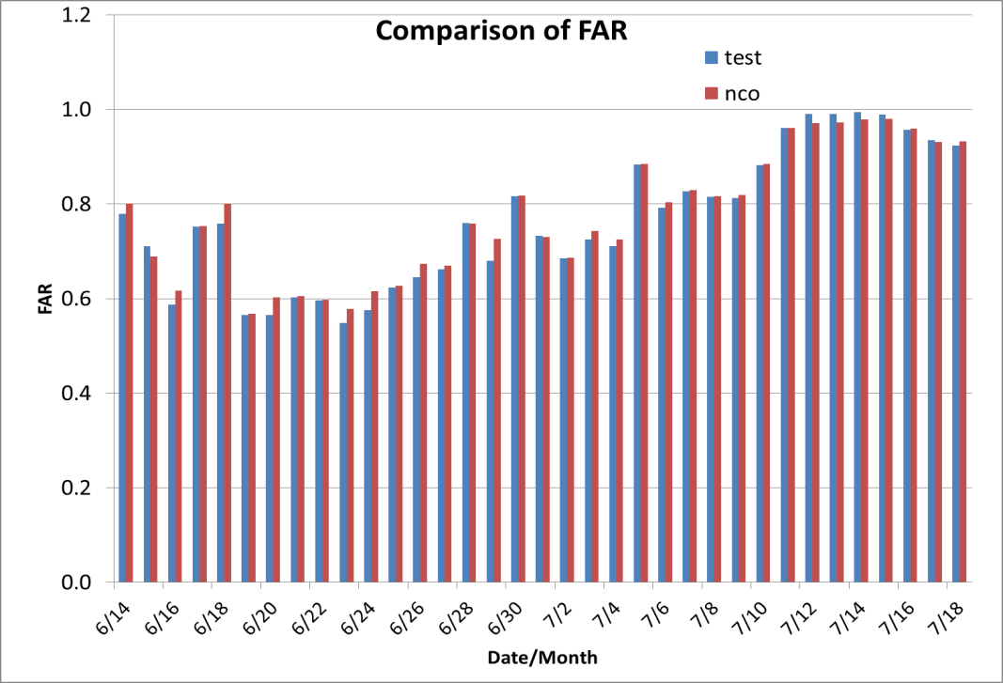
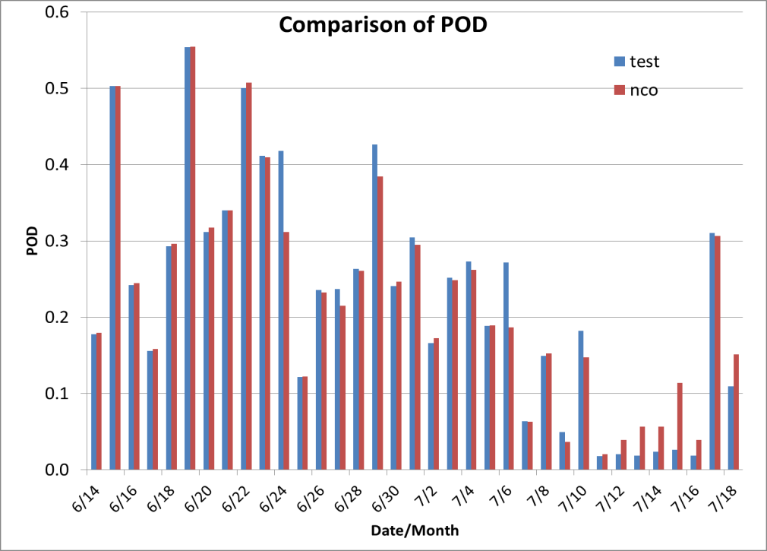
Verification of dust predictions with 10 min and 6 min time step

