Slide 1
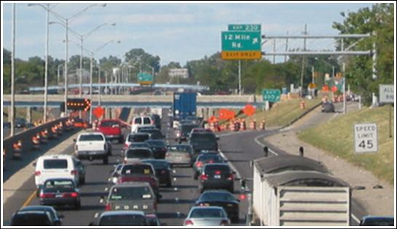
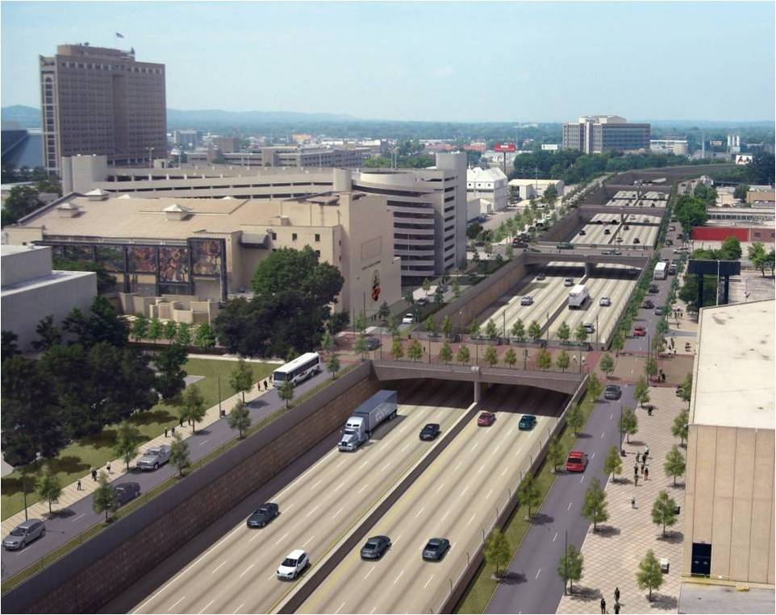
AERLINE: Air Exposure Research model for LINE sources
Michelle G. Snyder¹, Vlad Isakov¹, David K. Heist¹,
Steven G. Perry¹, Akula Venkatram², Sarav Arunachalam³
¹U.S.EPA/NERL/AMAD, ²UCR,³UNC/IE
CMAS Conference
15-17 October 2012

Slide 2
Why was AERLINE Developed?
Based on Science Advisory Board and the National Research Council recommendations, EPA-ORD initiated research on near-road air quality and health effects.
Field measurements indicated that exposures to traffic-emitted air pollutants near roads can be influenced by complexities of roadway configurations (noise walls, depressed sections, etc.).
To improve exposure metrics for future health studies, ORD initiated model development project to account for these important parameters

Slide 3
What is AERLINE?
AERLINE is EPA -ORD's research dispersion modeling tool for near roadway assessments
based on a steady-state Gaussian formulation
currently formulated for near-surface releases
contains new formulations for the vertical and lateral
dispersion rates
accounts for low wind meander
includes M-O similarity profiling of winds near the surface
uses the surface meteorology provided by AERMET
includes user-friendly input requirements for road network

Slide 4
EPA-ORD: Model Development Focus
  Account for near-road complexities and very near road concentrations (i.e. within a few meters of the road).
  Design and conduct wind tunnel and field studies for development and evaluation of improved line source algorithms.
  AERLINE is the initial modeling product of this development program.
  It is a research tool that is designed primarily to support risk assessments and health studies related to near-road pollutants.

Slide 5
What AERLINE is NOT?
AERLINE is not designed for regulatory applications (e.g. NAAQS enforcement, New Source Review, PM Hot Spot Conformity, SIP analyses, etc).
It is contained in a research platform and has not gone through the rigorous review and public comment required for inclusion in the list of recommended regulatory models

Slide 6
Model Algorithm
Steady-state, Gaussian based plume model
where
and
Concentration at a receptor is the integrated contributions from points along the line using a Romberg Iteration Scheme.
Plume
For each point source within the integration, a wind-direction following plume is simulated.
Meander
For each point source within the integration, meander is handled in the same way as
AERMOD point source meander.

Slide 7
Model Algorithm
Mean Plume Height
Concentration is a function of mean plume height (similar in nature to the effective parameter concept used in AERMOD).
Meteorological Inputs
AERLINE uses the meteorological inputs from the AERMOD met. preprocessor (u*, w*, mixing height, L_{mo}, z₀, Wspd, Wdir, heat flux, T) then corrects u* for light wind conditions.
Other surface parameters are then recalculated to be internally consistent with M-O theory.
This method was developed and evaluated by Qian and Venkatram (BLM 2011).

Slide 8
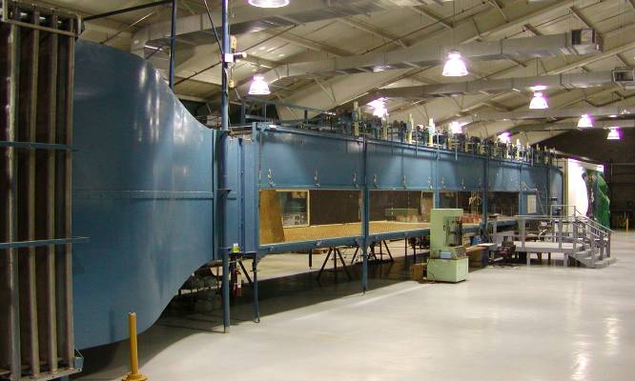
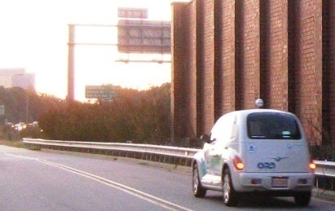
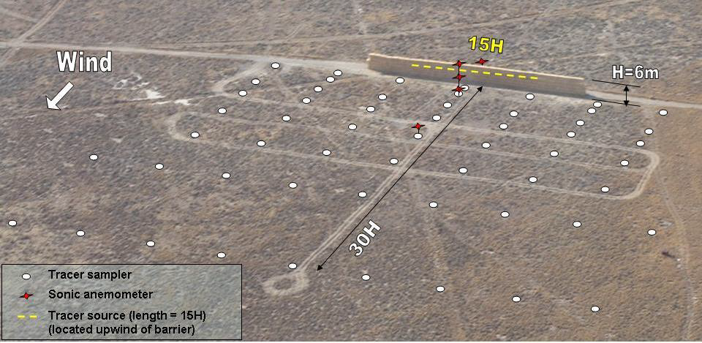
Model Development Databases
Tracer Studies
  Idaho Falls 2008
  Prairie Grass
Wind tunnel studies
Field studies

Slide 9
Model Algorithm
New Dispersion Formulations
Vertical Dispersion
Stable
Convective

Slide 10
Model Algorithm
New Dispersion Formulations
Lateral Dispersion
Stable
Convective
Prairie Grass
Prairie Grass

Slide 11
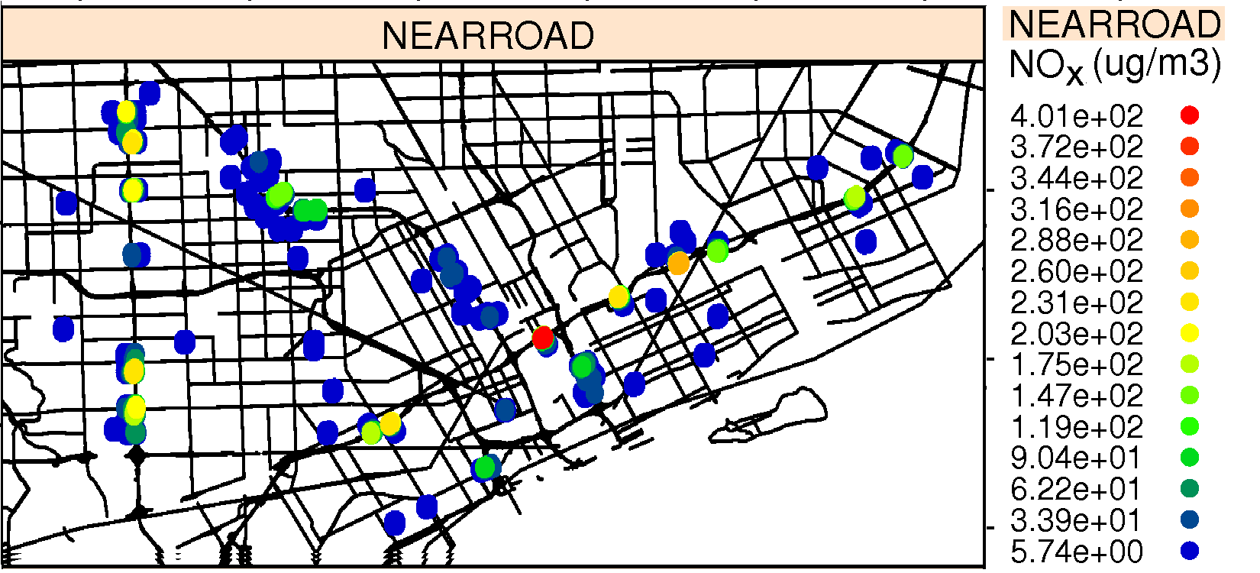
How is AERLINE being used?
The model can support health and risk assessments, epidemiology studies, and community based tools.
AERLINE is designed to handle urban situations with thousands of line sources and receptors.
AERLINE is used in “Near-Road Exposures to Urban air pollutants Study” (NEXUS) in Detroit examining the role of near-road exposures on asthmatic children who live near major roadways.
AERLINE can be used to estimate spatial variability in urban areas with many roadways.

Slide 12
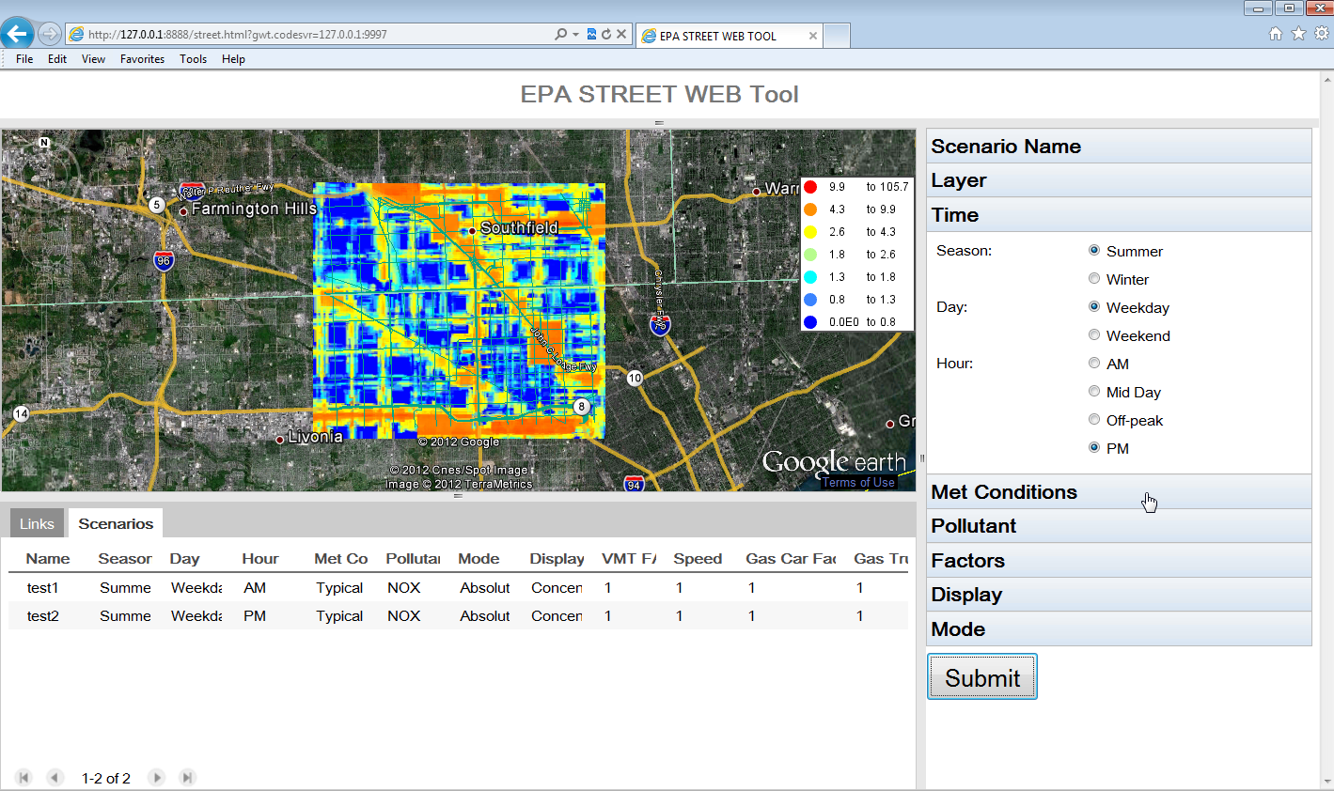
How does AERLINE support community tools?
AERLINE algorithm is used in STREET, a decision support tool for evaluating effects of alternate transportation options on community health

Slide 13
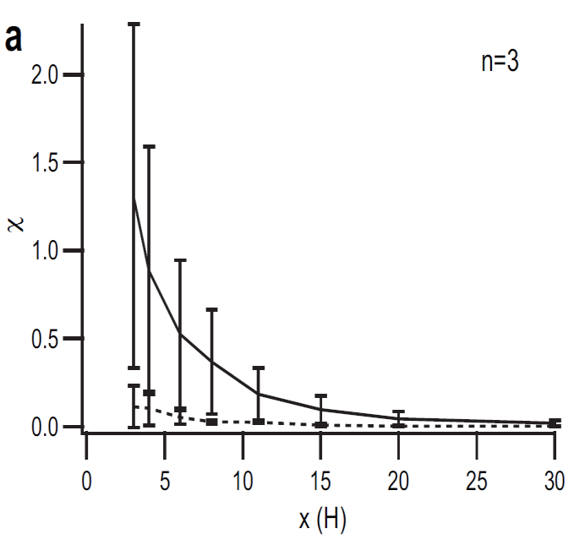
Ongoing Development Work
The model framework is designed to accommodate future algorithms for simulating the near-source effects of complex roadway configurations (noise barriers, depressed roadways, etc).
These configurations could be used in mitigation, to reduce exposure near high emission roadways.
Idaho Falls 2008 tracer study
_____ no barrier
------ barrier
Finn et al., (2010)

Slide 14
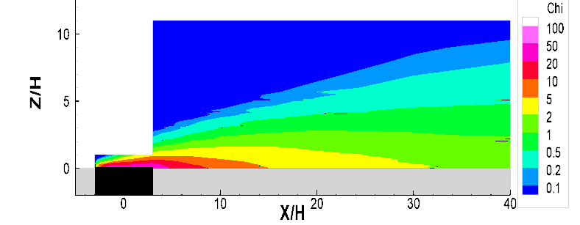
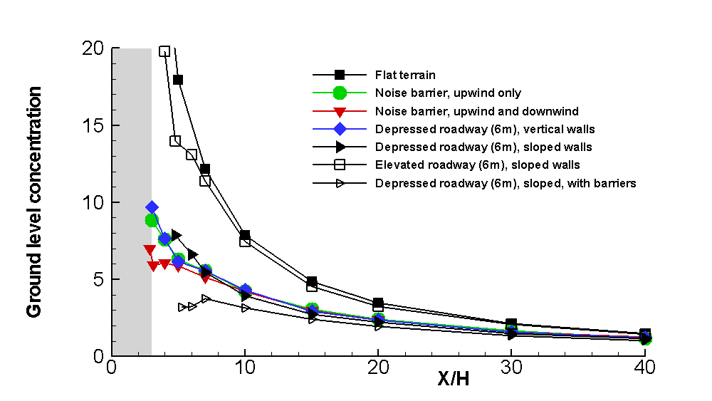
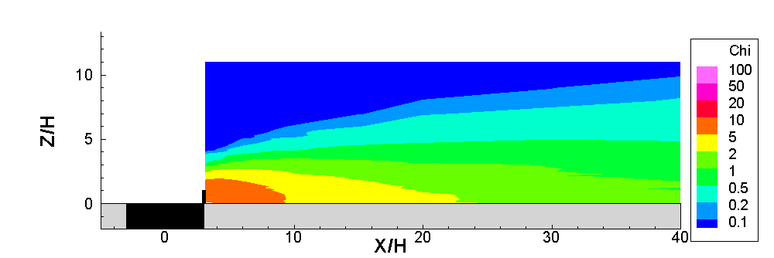
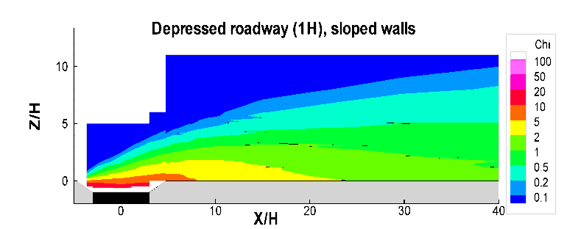
Ongoing Development Work
H = 6 m
Flat terrain
Wind tunnel studies
Downwind barrier
Depressed Roadway
Baldauf et al, (2009)
Heist et al, (2009)

Slide 15
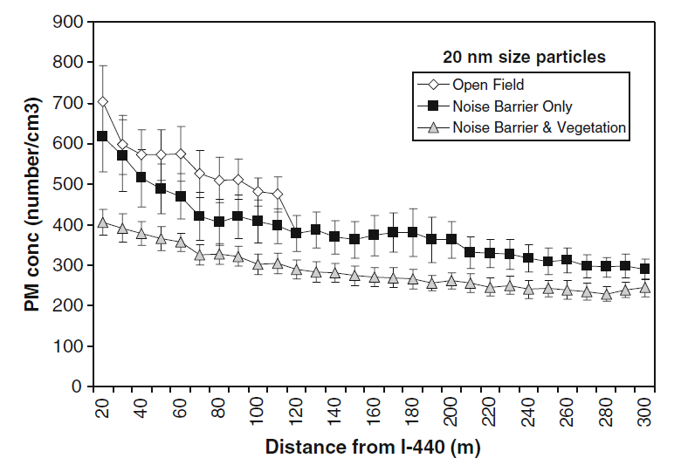
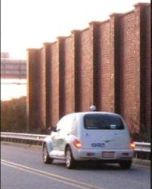
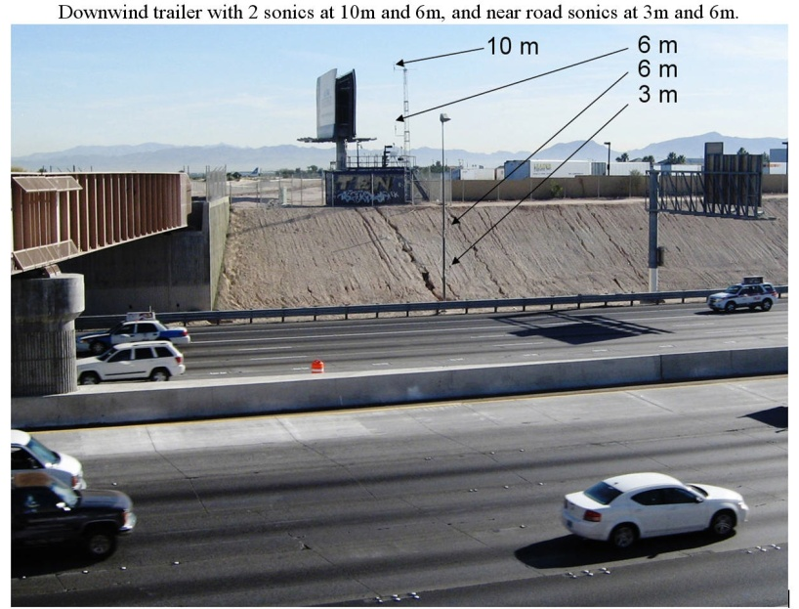
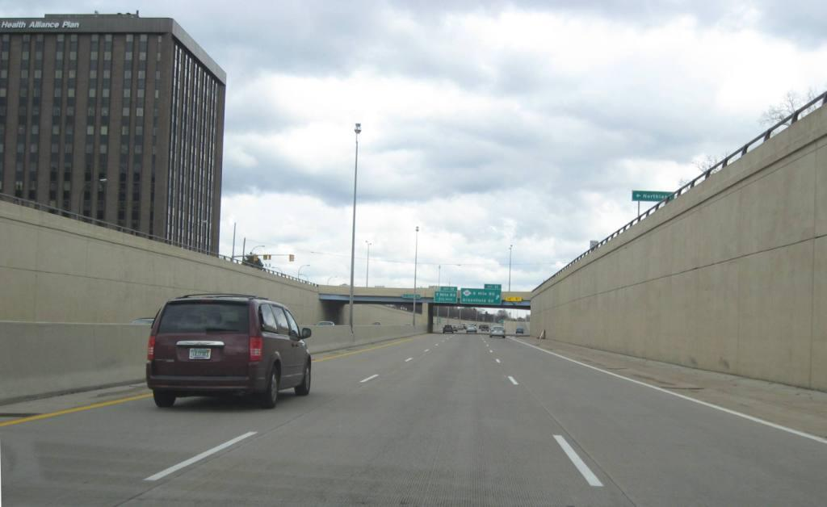
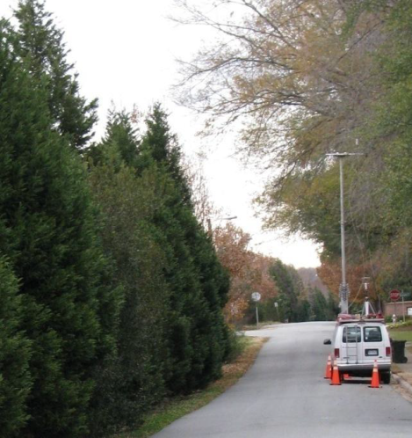
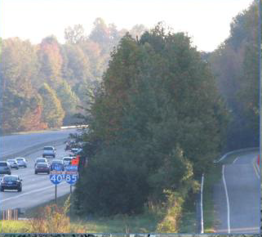
Ongoing Development Work
Field studies
Field and wind tunnel studies show noise barriers and depressions reduce downwind concentrations under multiple stability conditions. These features will be added to the flat terrain AERLINE model.

Slide 16
How will AERLINE be available?
  We plan to release the model through Community Modeling & Analysis System (CMAS) website with:
    Explanation of model code, use, and inputs required
    Documented evaluation and evaluation data
    Qualifications on appropriate use
Disclaimer: Although this work was reviewed by EPA and approved for publication, it may not necessarily reflect official Agency policy.

