Slide 1

A Comparative Analysis of MOZAIC In-Service Aircraft Profiles and use for CMAQ Evaluation
Morgan L. Silverman^{1,3}, James Szykman², James H. Crawford³, Christian Hogrefe², Brian Eder², Thomas Pierce², S.T. Rao⁴, Todd Plessel⁵, Matt Freeman⁵, Jean Pierre Cammas⁶, and Andreas Volz-Thomas⁷
¹Science Systems and Applications, Inc.
²National Exposure Research Laboratory, U.S. EPA, ORD
³NASA Langley Research Center
⁴North Carolina State University
⁵Lockheed-Martin, U.S. EPA
⁶Université de Toulouse and Centre National de la Recherche Scientifique
⁷IEK-8, Forschungszentrum Jülich
11th Annual CMAS Conference October 15-17, 2012
Chapel Hill, NC

Slide 2
Observational Needs for Four-Dimensional Air Quality Characterization
Air quality models play an important role in the decision-making process for emission controls and definition of air quality standards.
Model evaluation is essential for model development and improvement.
Routine vertical profile data are needed to assess:
  -Vertical mixing (Boundary Layer-Free Troposphere)
  -Hemispheric transport
  -Lightning generated NOx
  -Stratospheric Intrusion
(Scheffe et al., 2009)
Notes:
Air quality models play an important role in the decision of emission controls and air quality standards. To make sure these models are reliable we need to use observations such as land monitors, remotely sensed data and vertical profiles for model development and improvement. Out of these three vertical profiles are currently the scarcest piece of information available and possibly the most critical. These profiles can help asses vertical mixing, hemispheric transport, lightening NOx, and stratospheric intrusions. Because vertical profiles are such an important component we want to take advantage of existing datasets for model evaluation. One of these datasets is…

Slide 3

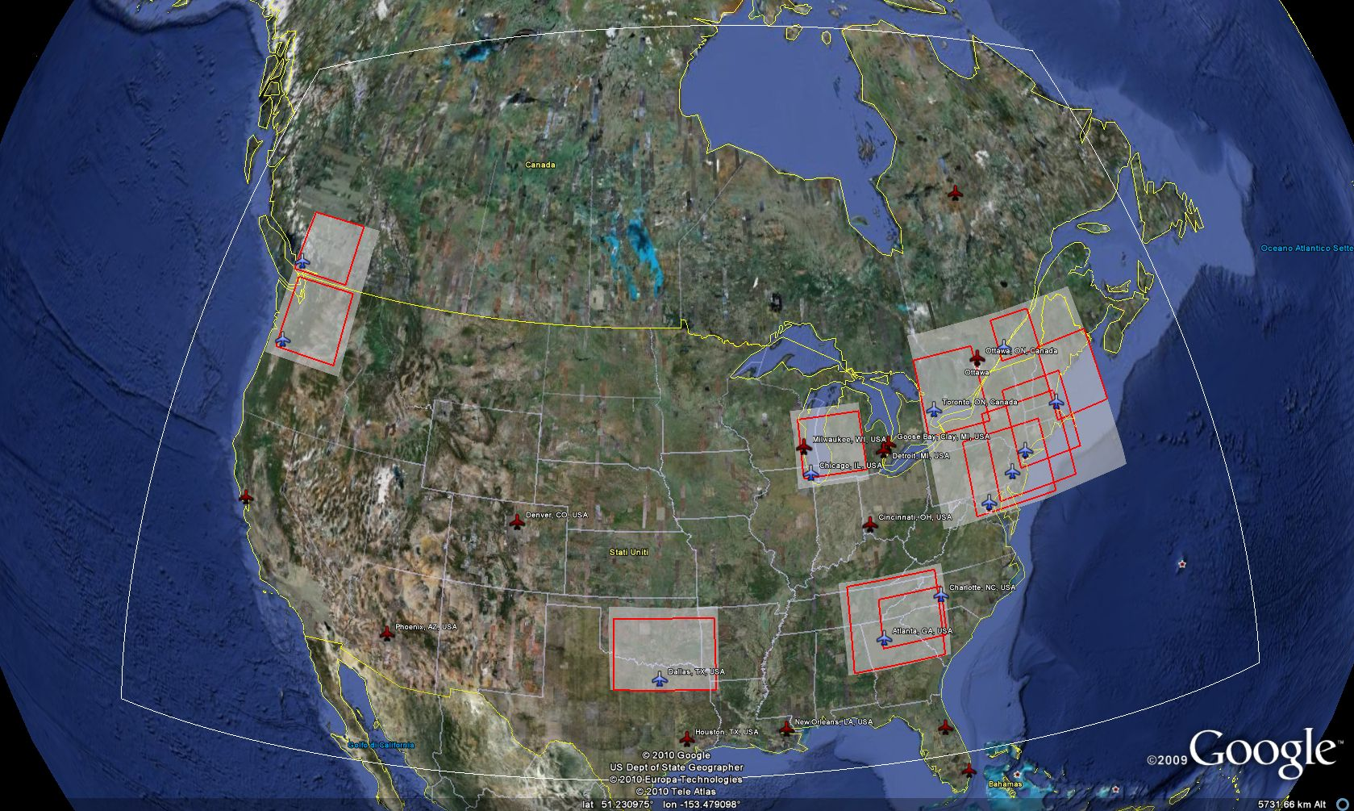
MOZAIC, a European partnership between scientists, Airbus and commercial airlines began measuring ozone and water vapor from commercial aircraft in 1994.
The MOZAIC program flew 5 long-haul aircraft with trace gas and meteorological measurements of O₃, CO, NO_{y}, T, P, RH, wind speed and direction.
MOZAIC is now part of IAGOS (In-Service Aircraft for the Global Observing System), a new European initiative to measure tropospheric and lower stratospheric air quality and greenhouse gases with instruments based on commercial aircraft.
Goal of IAGOS: Over the next decade install monitoring equipment on 10-20 commercial aircraft, based around the world.
North American Airports with available MOZAIC vertical profiles of trace gases
Notes:
The Measurement of ozone, water vapor, carbon monoxide and nitrogen oxides by airbus in service aircraft program or MOZAIC. MOZAIC began in 1994 and has since taken measurements of meteorology and trace gases on commercial aircraft. It is now part of the in-service aircraft for the global observing system (IAGOS) program which over the next decade will install a new set of monitoring equipment on aircraft around the world. The figure here just shows some of the US airports that have MOZAIC profiles.

Slide 4
Motivation
The existing literature contains an extensive use of MOZAIC in-service aircraft profiles for UT/LS model evaluation and trends, but a limited use for regional model evaluation in the lower troposphere.
The success of the MOZAIC/IAGOS program provides a data set which fills a critical data gap for routine profile data (O₃, CO, NO_{y}, RH, T, P, wind speed and direction). EPA is using the data under the AQMEII project and internally for regional model evaluation.
Concerns have been raised about the representativeness of in-service aircraft trace gas profiles for background conditions Fischer et al., (2006).
Notes:
In the literature MOZAIC profiles have been used predominantly in studies of the upper troposphere and lower stratosphere but very limited work has been done regarding the lower troposphere where we have an interest for regional model evaluation. The EPA has begun using this dataset as part of AQMEII but some concerns about the representativeness of ascents and descents at airports has come into question.

Slide 5
Approach
Find a way to help characterize the representativeness of the MOZAIC in-service aircraft lower tropospheric profiles (< 6 km) in the urban corridors.
Most MOZAIC trace gas profiles (1994-2010) over the US only measure O₃. MOZAIC added CO and NO_{y} measurements in 2002; providing a set of O₃, CO and NO_{y} profiles which span from 2002-2005.
Use data from NOAA NEAQS-ITCT (2004) and NASA DISCOVER-AQ (2011) to compare with MOZAIC profiles.
Notes:
We decided to look at MOZAIC profiles below 6 km to try and assess their representativeness in urban corridors. The majority of MOZAIC profiles over the US only measure O3 and CO but between 2002-2005 there are a limited number of NOy measurements. This gives us the opportunity to assess possible aircraft influences. We were able to compare the MOZAIC profiles to NOAA NEAQS-ITCT (2004) and NASA DISCOVER-AQ (2011) missions.

Slide 6

IAGOS aircraft measurements:
- Package I, on all aircraft, measures ozone, carbon monoxide, temperature, water vapor, cloud droplets
- Package II, optional, measures one of the following:
NO_{x} or NO_{y} or CO₂/CH₄ or aerosols
- Data will be available in near real-time for use in air quality forecast models.

Slide 7
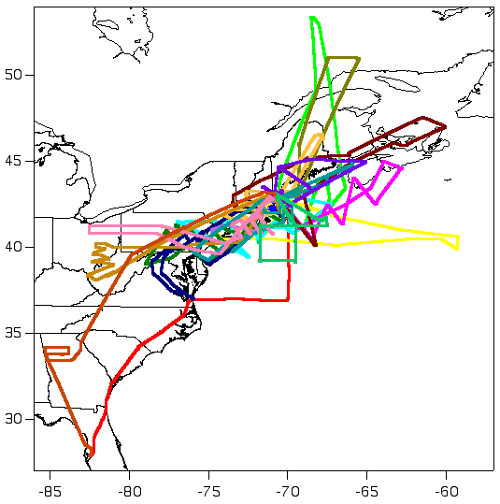
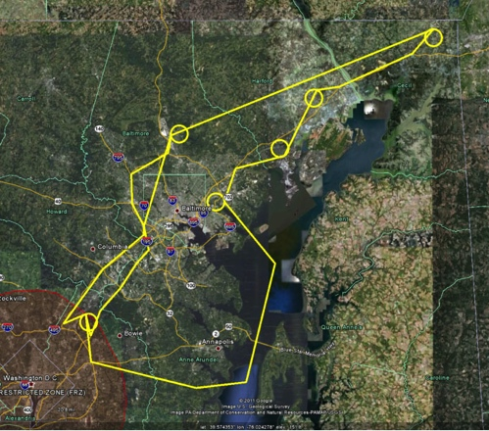
Data Used for Comparative Analysis
The NOAA New England Air Quality Study Intercontinental Transport and Chemical Transformation program (NEAQS-ITCT 2004) conducted as part of the larger trans-Atlantic ICARTT study
  July/August 2004
  O₃, NO_{y} (Ryerson) and CO (Holloway) measurements collected with the NOAA WP-3D
The NASA Deriving Information on Surface conditions from COlumn and VERtically resolved observations relevant to Air Quality (DISCOVER-AQ)
  July 2011 Baltimore-DC Metro Area
  Focused on understanding the relationship between column observation and surface pollution.
  O₃, NO_{y} (Weinheimer) and CO (Diskin) spirals collected with the NASA P-3B over 6 Maryland Department of the Environment Monitoring Sites.
Notes:
The NOAA NEAQS-ITCT program gives us a concurrent dataset from July/August 2004. We focused on the data shown in the black box here along the major northeast corridor. Trace gas measurements were taken on the NOAA P-3 aircraft. The NASA DISCOVER-AQ occurred in 2011 over the DC-Baltimore metro area. This area is much more refined and would be a tiny dot right in the bottom left corner of the black box. In this case trace gas measurements were taken on the NASA P-3. DAQ conducted spirals over 6 ground monitoring sites. Now we’re going to start looking at the distributions of descending MOZAIC flights.

Slide 8
MOZAIC O₃ (left), NO_{y} (right), and CO (bottom) Profiles Descending Flights for Eastern U.S. Airports (2003-2004 June-Sep)
Profiles from Newark JFK, Dulles, and Philadelphia combined.
Box-Whisker bars are 10th and 90th percentiles to remove extreme values.
In general, small variation between 25-to-75 percentiles, with the exception of ATL NO_{y} profiles.
Notes:
The next several slides are going to look similar. I’m showing descending flights from June to Sept 2003-2004 into Atlanta (blue), Boston (green), and Newark, JFK, Philadelphia and Dulles combined into red. The top left panel is O3, top right is NOy, and bottom is CO. We whiskers represent the 10th and 90th percentiles to remove extreme values. We see a lot of consistency between the 25th-75th % all species with the exception of Atlanta NOy. This consistency gives us the sense that precise co-location isn’t necessary. So the ITCT will be a useful comparison.

Slide 9
MOZAIC Profiles and NOAA WP-3D O₃ (left), NO_{y} (right), and CO (bottom) aircraft measurements
NOAA WP-3D measurements plotted are limited to the flight paths within a geographic domain from Boston to Washington DC.
WP-3D [O₃] distributions higher than MOZAIC, best agreement with MOAZIAC mid-Atlantic Airports.
Median [NO_{y}] distributions for WP-3D and EWR-JFK-IAD-PHL MOZAIC Flights differ by 2 ppb.
Notes:
So again the graphs are set up the same way now with the ITCT data added in gray. As I mentioned before we limited the ITCT data to a domain from Boston to DC. We see higher O3 distributions in the ITCT data than MOZAIC. This is most likely due to ITCT occurring during typical peak O3 months, July and August, while MOZAIC includes data from June and Sep. NOy distribution median values differ by 2ppb. We don’t feel that these levels are sufficiently different and that MOZAIC is likely not being influenced. CO compares reasonably well. The extreme values seen are most likely smoke from canadian fires. The goal of this was to tell ourselves that MOZAIC is suitable for model evaluation and not to explain all the differences. Now that we’ve compared to a concurrent data set we want to see how the data does against DAQ from 7 years later in a more refined area.

Slide 10
MOZAIC Profiles, NEAQS-ITCT, and DISCOVER-AQ O₃ (left), NO_{y} (right), and CO (bottom) NASA P-3B spirals (Baltimore 2011)
Difference between MOZAIC and NEAQS-ITCT and DISCOVER-AQ NO_{y} distributions appear reasonable given 30-40% percent decrease in NO_{x} point source emissions (NOx SIP Call and CAIR) and mobile source over the past decade (Gilliland et al., 2008 and Russell et at., 2012 ACPD).
Notes:
DAQ is shown here in black. We know that 2004 was a very clean O3 year which would explain why both MOZAIC and ITCT have lower than DAQ values. Since 2004 there has also been a reduction in point source emissions and mobile sources lowering NOx levels by 30-40%. CO values are very consistent though reiterating that MOZAIC is a suitable dataset for model evaluation and representative of the urban environment.

Slide 11
MOZAIC Profiles and DISCOVER-AQ O₃ (left), NO_{y} (right), and CO (bottom) NASA P-3B spirals (Baltimore 2011)
Here we show a profile from the NASA P-3B descent into BWI Airport.
Coincident increases in NO_{y} and CO concentrations below 1 km. NO₂ provides upper bound on possible O₃ titration by NO.
Notes:
During DAQ there was one descent into the Baltimore Washington international airport. We’ve added this to the graphs in light blue with NO2 levels shown in orange. The BWI approach shows coincident increases and NOy and CO concentrations below 1km. Approximately 1/3 of the NOy is NO2 giving an upper bound on possible titration impacts at the surface. Now that we’ve gained confidence that the MOZAIC data has no undue influence from the airport we can evaluate CMAQ using MOZAIC.

Slide 12
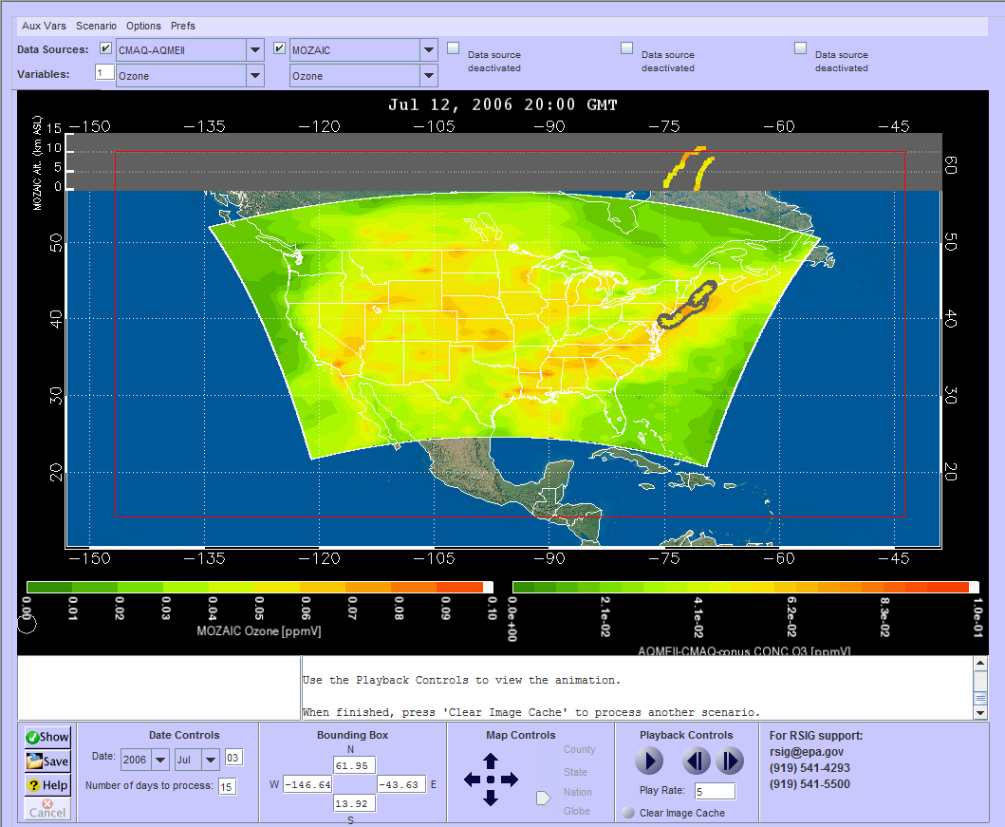
CMAQ Model Configuration
Used for AQMEII Base Run (US1-2006)
Weather Research and Forecasting (WRF) Meteorology
CMAQv4.7.1 w/ CB05 & AERO5
Modeling domain
12 km grid resolution
34-vertical layers up to 50 hPa
2005 U.S. National Emissions Inventory
Emissions: year-specific updates to EGU, mobile and fire (SmartFIRE)
Chemical boundary conditions specified by the Global and regional Earth-system Monitoring using Satellite and in-situ data (GEMS)
MOZAIC observations regridded to CMAQ layers – Implemented within the EPA Remote Sensing Information Gateway for continued use with MOZAIC data
Notes:
So the CMAQ data we used was the AQMEII base run which was run by the EPA. It used CMAQ v4.7.1 with CBO5 and AERO5. Had a 12 km grid with 34 vertical layers. Used the 2005 US national emissions inventory and GEMS chemical boundary conditions. The MOZAIC observations were regridded to the CMAQ layers. A tool for doing this has been implemented into the EPA’s remote sensing information gateway (RSIG).

Slide 13
MOZAIC and CMAQ O₃ (51) and CO (55) Profiles
Summer 2006 (J,J,A) Descending Flights Philadelphia Airport (PHL)
35% 3pm, 53% 4pm
CMAQ [O₃] distributions are low ~3-5 km as compared to MOZAIC and become higher than MOZAIC as the [CO] concentrations increase below 2 km.
CMAQ and MOZAIC [O₃] distributions in the lowest few 100 meters agree well.
[CO] overestimated in CMAQ and greater variability in the BL versus MOZAIC [CO].
Notes:
So here again we have box and whisker plots using the 10th and 90th percentiles with MOZAIC in red and CMAQ in black. These figures show afternoon inbound flights into Philadelphia airport during June, July, and Aug of 2006. I’m showing these on a log scale so that we can accentuate the fine scale resolution within the boundary layer. CMAQ O3 distributions are low compared to MOZAIC from about 3-5km and shift higher than MOZAIC as you go lower in altitude. Within the lowest 100m or so CMAQ and MOZAIC agree well. CO on the other hand is higher and has much larger variability in the boundary layer in CMAQ than MOZAIC. This my indicate there are stronger sources or a mixing issue present within the model.

Slide 14
MOZAIC and CMAQ O₃ (52) and CO (50) Profiles
Summer 2006 (J,J,A) Ascending Flights Philadelphia Airport (PHL)
38% 6pm, 43% 7pm
CMAQ [O₃] distributions low ~3-5 km compared to MOZAIC, but to a lesser degree than descending flights.
CMAQ and MOZAIC [O₃] distributions in the lowest 2 km agree well but a bit high closer to the surface.
CMAQ [CO] distributions better aligned with variability seen in MOZAIC [CO].
Notes:
Now I’m showing outbound flights from Philadelphia in the evening. Again CMAQ O3 distributions are low from 3-5km compared to MOZAIC. O3 distributions in the lowest 2km agree well but are a bit high right near the surface. The CMAQ CO distributions align better with the variability seen in MOZAIC than the inbound flights, but we still see high values in the lowest 100m.

Slide 15
MOZAIC and CMAQ O₃ (63) and CO (71) Profiles
Summer 2006 (J,J,A) Descending Flights Hartsfield-Jackson Atlanta International Airport (ATL)
77% 2pm
CMAQ [O₃] distributions are in agreement above 2 km as compared to MOZAIC but become significantly higher below this altitude.
CMAQ [CO] distributions follow the same pattern with higher variability in the model.
Notes:
Now here we have afternoon inbound flights into Atlanta international airport. Above 2km CMAQ and MOZAIC are in pretty good agreement for both O3 and CO. Below 2km it’s a whole other story. CMAQ is significantly higher than MOZAIC in both species. CMAQ exhibits much more variability in CO than we see in observations.

Slide 16
MOZAIC and CMAQ O₃ (63) and CO (67) Profiles
Summer 2006 (J,J,A) Ascending Flights Hartsfield-Jackson Atlanta International Airport (ATL)
71% 5pm
CMAQ [O₃] distributions are low ~2-5 km as compared to MOZAIC and become higher than MOZAIC below 2 km with large differences below 1km.
CMAQ [CO] distributions are low ~2-5km and become higher lower in elevation.
Notes:
And lastly here are the outbound evening flights from Atlanta. CMAQ O3 distributions trend low above 2km but again tend to shift higher below 2km with large differences in the lowest levels. CO is in much better agreement especially below 2km than in the descending flights. So from these we see that the CMAQ seems to agree better in Philadelphia than Atlanta and in the evening vs afternoon.

Slide 17
Summary and Next Steps
MOZAIC/IAGOS In-Service Trace Gas profiles provide a high quality data set for use in regional CTM evaluation such as CMAQ.
MOZAIC profiles appear to provide valuable insight into the model performance given the agreement in distributions between MOZAIC, NEASQ-ITCT, and DISCOVER-AQ aircraft data.
Extreme values should be screened out and flight times (descent and ascent) should be accounted for in analysis. Extreme values are useful for event case studies.
Investigate use of the Aircraft Communications Addressing and Reporting System (ACARS) and the Aircraft Meteorological Data Relay (AMDAR) data set to characterize boundary layer changes in conjunction with MOZAIC descents and ascents.
Notes:
So in summary, MOZAIC trace gas profiles provide a high quality data set for use in regional model evaluation given the agreement between MOZAIC, NEAQS-ITCT, and DISCOVER-AQ. They can provide valuable insight into model performance. Extreme values should be screened out or examined on a case by case basis and flight times should be accounted for. In the future we would like to investigate both AMDAR and ACARS data sets to characterize boundary layer changes better.

Slide 18
Disclaimer:
Although this work was reviewed by EPA and approved for presentation, it may not necessarily reflect official Agency policy.

Slide 19
Additional Materials

Slide 20
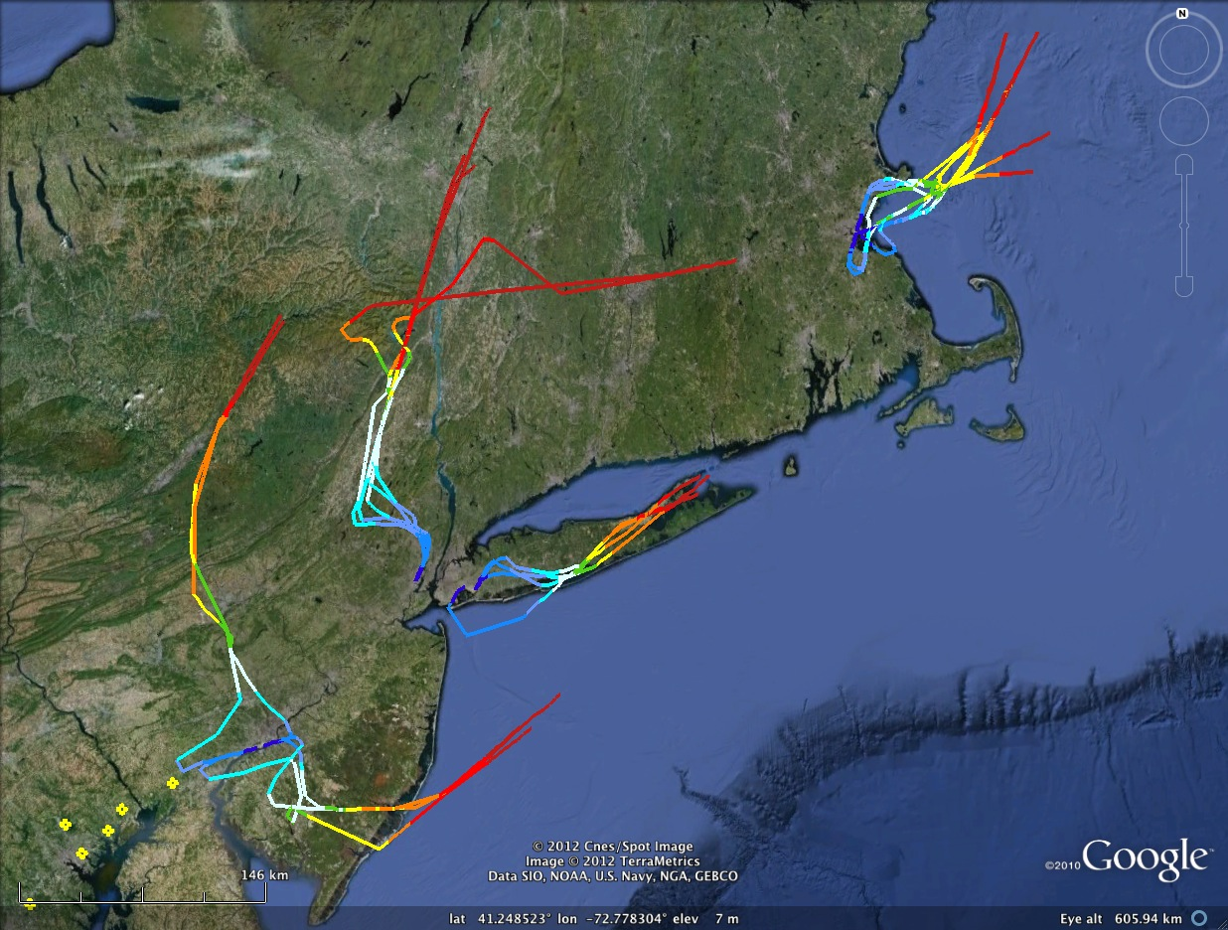
Additional Materials

Slide 21
Evaluation protocol: Remapping MOZAIC observations to CMAQ cell value
MOZAIC observation were regridded to CMAQ layers using CMAQ vertical grid description parameters NLAYS, VGTOP, VGLVLS (sigma pressures), etc. to compute the CMAQ levels in meters.
An inverse distance-weighted scheme is used for aggregating multiple MOZAIC observations within a single CMAQ grid cell.
Method implemented within the EPA Remote Sensing Information Gateway for continued use with MOZAIC data.
CMAQ cell value = ( Mozaic value1 x 1/r1² ) + ( Mozaic value2 x 1/r2² ) + ... ( Mozaic valueN x 1/rN² ) / W
where W = ( 1/r1² + 1/r2² + ... + 1/rN² )
Mozaic valuei = value of the ith projected data point that lies in the given CMAQ cell
ri = distance between Mozaic point and CMAQ grid cell center
1
2
1
Layer 14
2
3
1
Layer 13

