Slide 1
Sensitivity analysis of influencing factors on PM_{2.5} nitrate simulation
October 16, 2012
the 11th Annual CMAS Conference
○ Shimadera H.¹, Hayami H.¹, Chatani S.², Morino Y.³,
Mori Y.⁴, Morikawa T.⁵, Yamaji K.⁶, Ohara T.³
1 Central Research Institute of Electric Power Industry
2 Toyota Central R&D Labs., Inc.
3 National Institute for Environmental Studies
4 Japan Weather Association
5 Japan Automobile Research Institute
6 Japan Agency for Marine-Earth Science and Technology
This research was supported by the Environment Research and Technology Development Fund (C-1001) of the Ministry of the Environment, Japan.

Slide 2
Introduction
Fine particulate matter (PM_{2.5}) has adverse health effects
In Japan, air quality standard for PM_{2.5} is not attained in many areas*¹
Air quality models (AQMs) are essential tools to seek effective measures
Current air quality models cannot sufficiently reproduce concentrations of PM_{2.5} and its components in Japan*²
Urban air quality Model Inter-Comparison Study (UMICS) has been conducted to improve AQM
*¹Ministry of the Environment (2012) http://www.env.go.jp/press/press.php?serial=14869
*²Morino et al. (2010) J. Jpn. Soc. Atmos. Environ. 45, 212-226

Slide 3
UMICS: Urban air quality Model Inter‐Comparison Study
Phase | Target period | Target process | Target component | Influencing factor
 |  |  |  | Module | Met. | Emiss. | React.
UMICS1 (FY2010) | Summer 2007 (FAMIKA) | Transport | EC | ○ | ○ | ○ | ×
UMICS2 (FY2011) | Winter 2010 Summer 2011 | SIA production | SO₄²⁻NO₃⁻NH₄⁺ | △ | △ | ○ | ◎
UMICS3 (FY2012) | Winter 2010 Summer 2011 | SOA production | OC | △ | △ | ◎ | ◎
Focuses on PM_{2.5} components in the Kanto region of Japan
Uses common meteorological, emission and boundary data
Participants conduct sensitivity runs in their fields of expertise
– Observation vs. Baseline Simulation of UMICS2 – Sensitivity analyses to improve SIA simulation

Slide 4
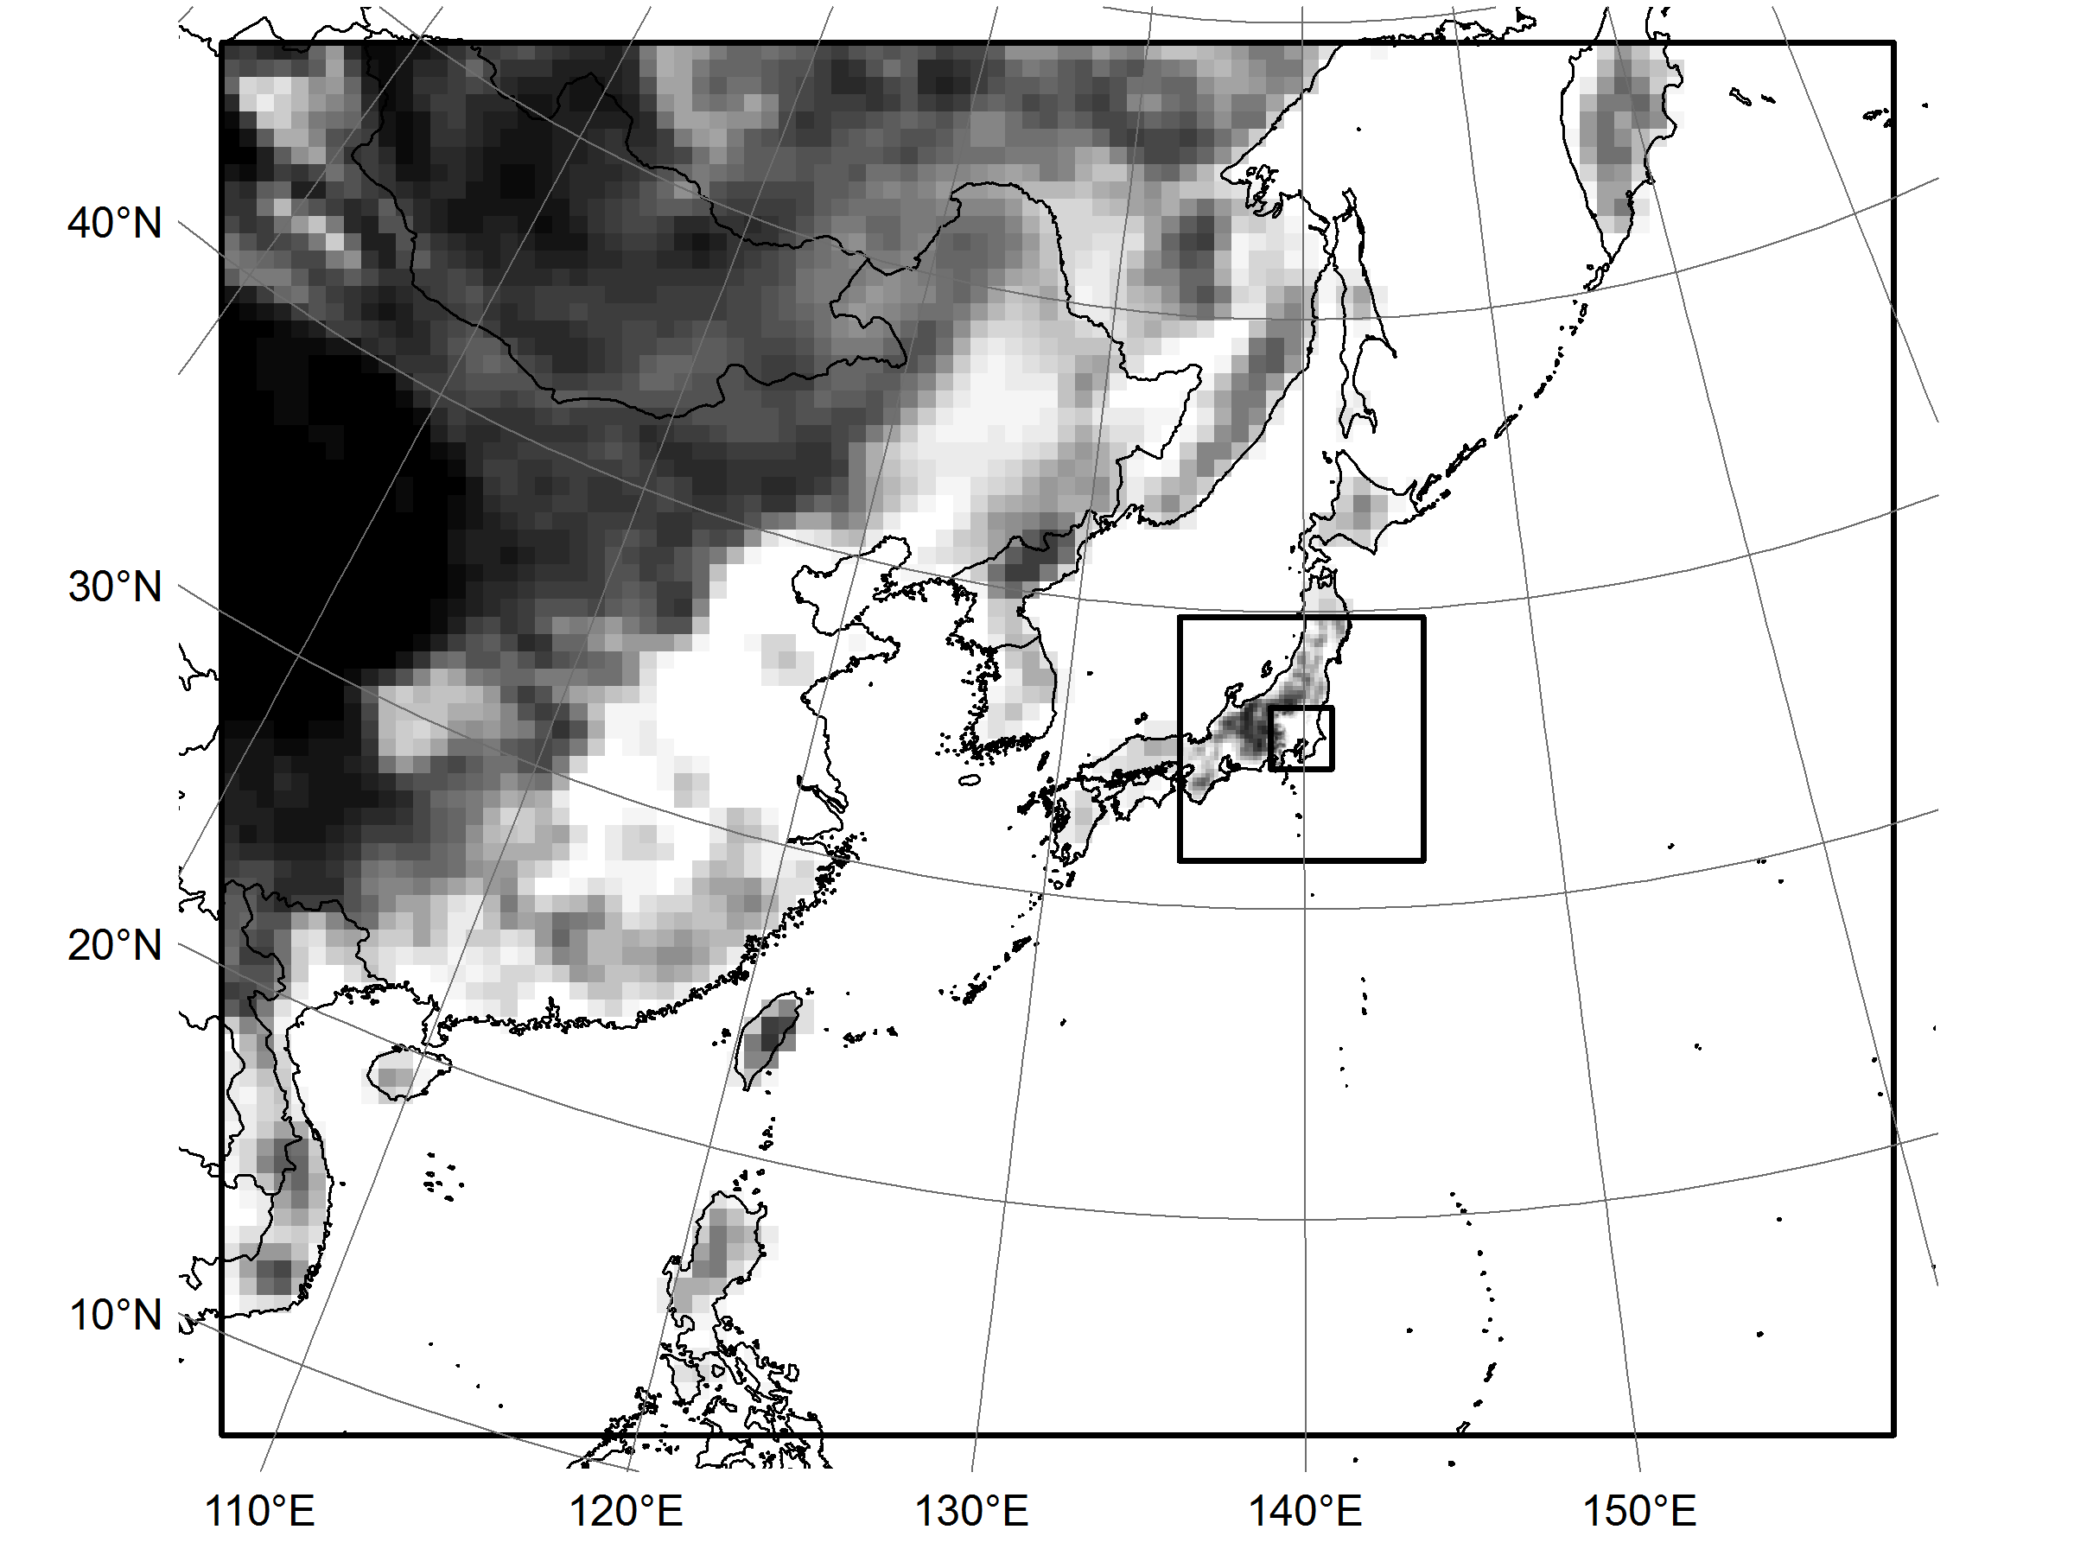
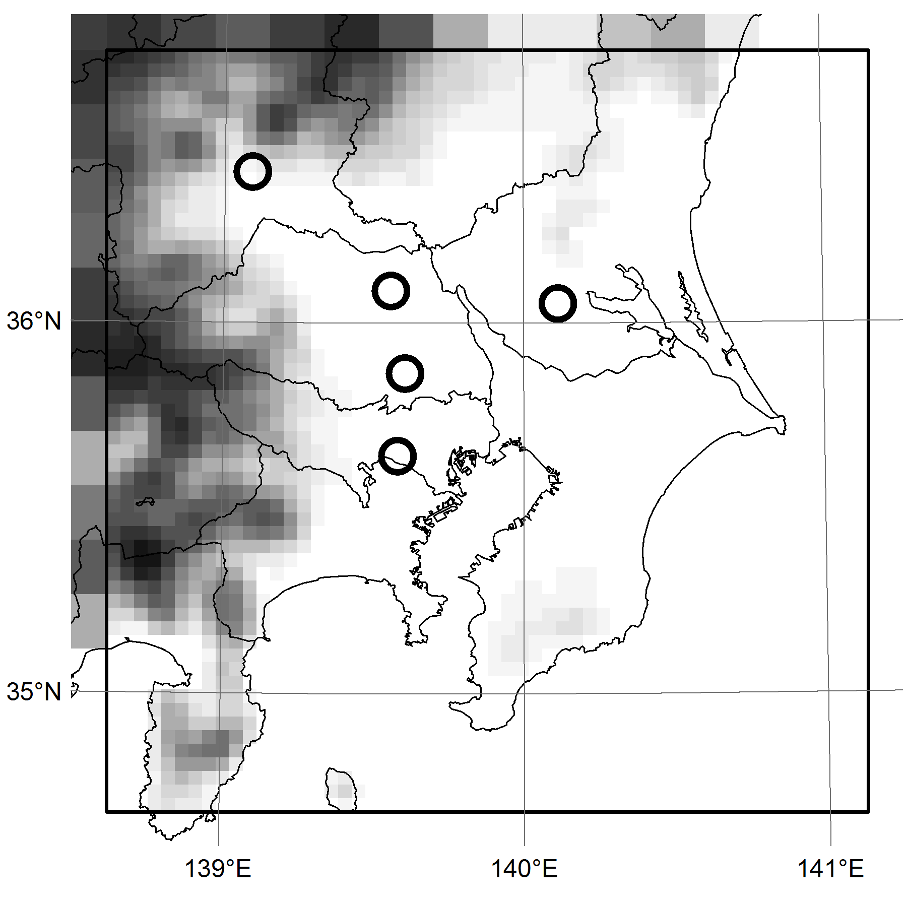
Simulation domain
Common dataset for UMICS2
Horizontal D1: East Asia (64-km grids, 96x80)
D2: East Japan (16-km grids, 56x56)
D3: Kanto region (4-km grids, 56x56)
Vertical 30 layers (surface – 100 hPa)
Elevation (m)
Maebashi
Kisai
Saitama
Tsukuba
Komae
D2
D1
D3
Observation sites for PM_{2.5} components

Slide 5
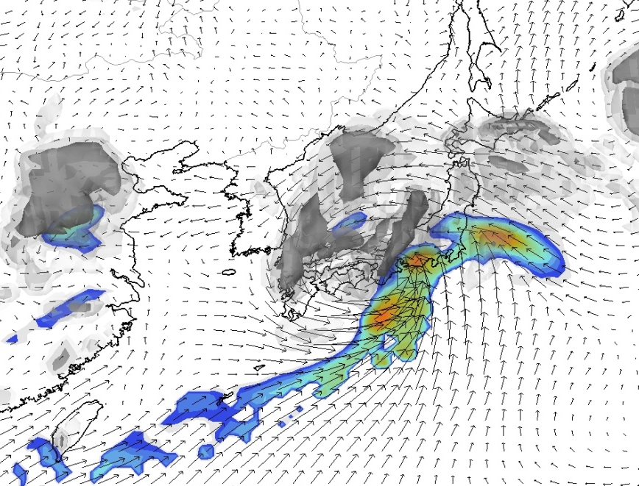
Meteorological field
Common dataset for UMICS2
Meteorological model: WRF-ARW v3.2.1
Simulation period Winter 2010: Nov. 15 – Dec. 5, 2010
Summer 2011: Jul. 11 – Jul. 31, 2011
 | Configurations
Terrain | USGS (30sec)
Initial/Boundary | NCEP FNL (1deg, 6hr) NCEP/NOAA RTG_SST_HR (1/12deg, daily)
Nesting | No feedback
Cumulus | Kain-Fritsch (D1, D2)
Microphysics | WSM5
Radiation | Dudhia/RRTM
PBL | ACM2
Land surface | Pleim-Xiu LSM
Analysis nudging | G_{t, q, uv} = 1.0x10⁻⁴ s⁻¹ (D1, D2)

Slide 6
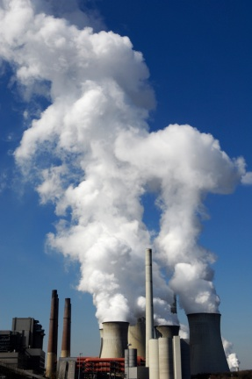


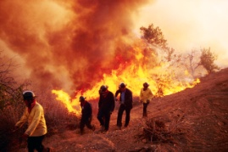
Emission data
Common dataset for UMICS2
Based on database described by Chatani et al.*
Anthropogenic
D1: INTEX-B (SO₂, NO_{X}, CO, PM, VOC), REASv1.11 (NH₃)
D2, D3: Estimate model by JATOP (Vehicle), G-BEAMS (Others)
Ship
D1: SAPA201112 by NMRI
D2, D3: Emission inventory by OPRF
Biogenic VOC
MEGAN v2.04 with common meteorological field
Volcanic SO₂
Volcanic activity reports by JMA
*Chatani et al. (2011) Atmos. Environ. 45, 1383-1393

Slide 7
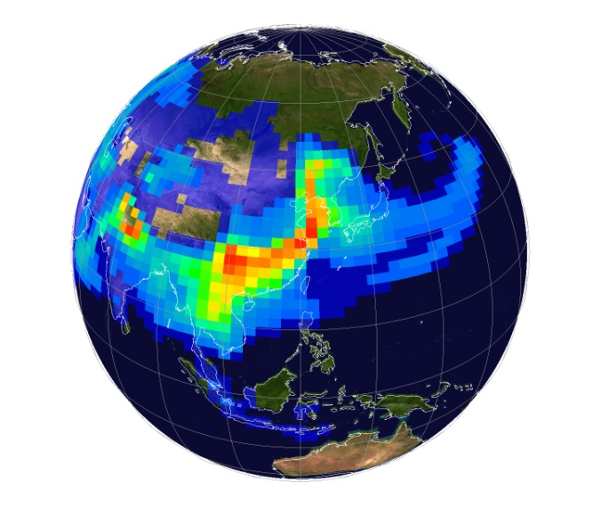
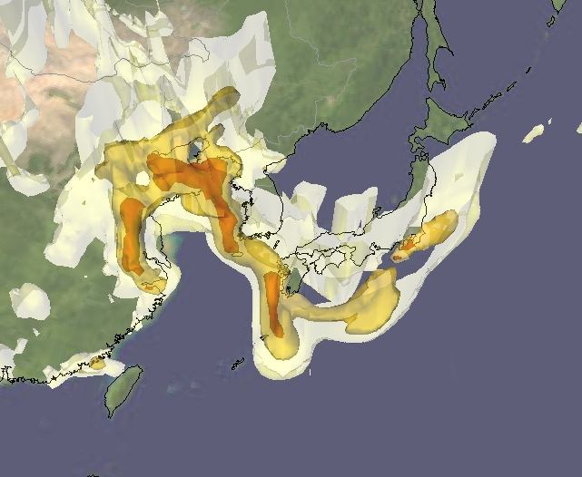
Boundary concentration
Common dataset for UMICS2
D1: MOZART-4 results
http://www.acd.ucar.edu/gctm/mozart/subset.shtml
D2, D3: CMAQ v4.7.1 with common dataset
(Baseline case for UMICS2: M0)
 | Configurations
Advection | yamo
Vertical Diffusion | acm2
Photolysis rate | table
Gas phase | saprc99 (ebi)
Aerosol phase | aero5
Cloud phase | acm

Slide 8
Time series at Kisai
Observation vs. Baseline Simulation
Winter 2010
PM_{2.5}
PM_{2.5} SO₄²⁻
(μg m⁻³)
PM_{2.5} OA
PM_{2.5} NO₃⁻
HNO₃
(μg m⁻³)
PM_{2.5} EC
PM_{2.5} NH₄⁺
NH₃
(μg m⁻³)

Slide 9
Mean concentration at observation sites
Observation vs. Baseline Simulation
Winter 2010
(μg m⁻³)
(μg m⁻³)

Slide 10
Time series at Kisai
Observation vs. Baseline Simulation
Summer 2011
PM_{2.5}
PM_{2.5} SO₄²⁻
(μg m⁻³)
PM_{2.5} OA
PM_{2.5} NO₃⁻
HNO₃
(μg m⁻³)
PM_{2.5} EC
PM_{2.5} NH₄⁺
NH₃
(μg m⁻³)

Slide 11
Mean concentration at observation sites
Observation vs. Baseline Simulation
Summer 2011
(μg m⁻³)
(μg m⁻³)

Slide 12
Summary
Observation vs. Baseline Simulation
PM_{2.5}: mean concentrations were agreed, but temporal variations were not reproduced
PM_{2.5} EC and SO₄²⁻: approximately reproduced
HNO₃: diurnal variations were reproduced
PM_{2.5} OA: clearly underestimated
  Being discussed in UMICS3
PM_{2.5} NH₄⁺: overestimated as NH₄NO₃
NH₃ and PM_{2.5} NO₃⁻: clearly overestimated
  Sensitivity analysis for influencing factors will be presented

Slide 13
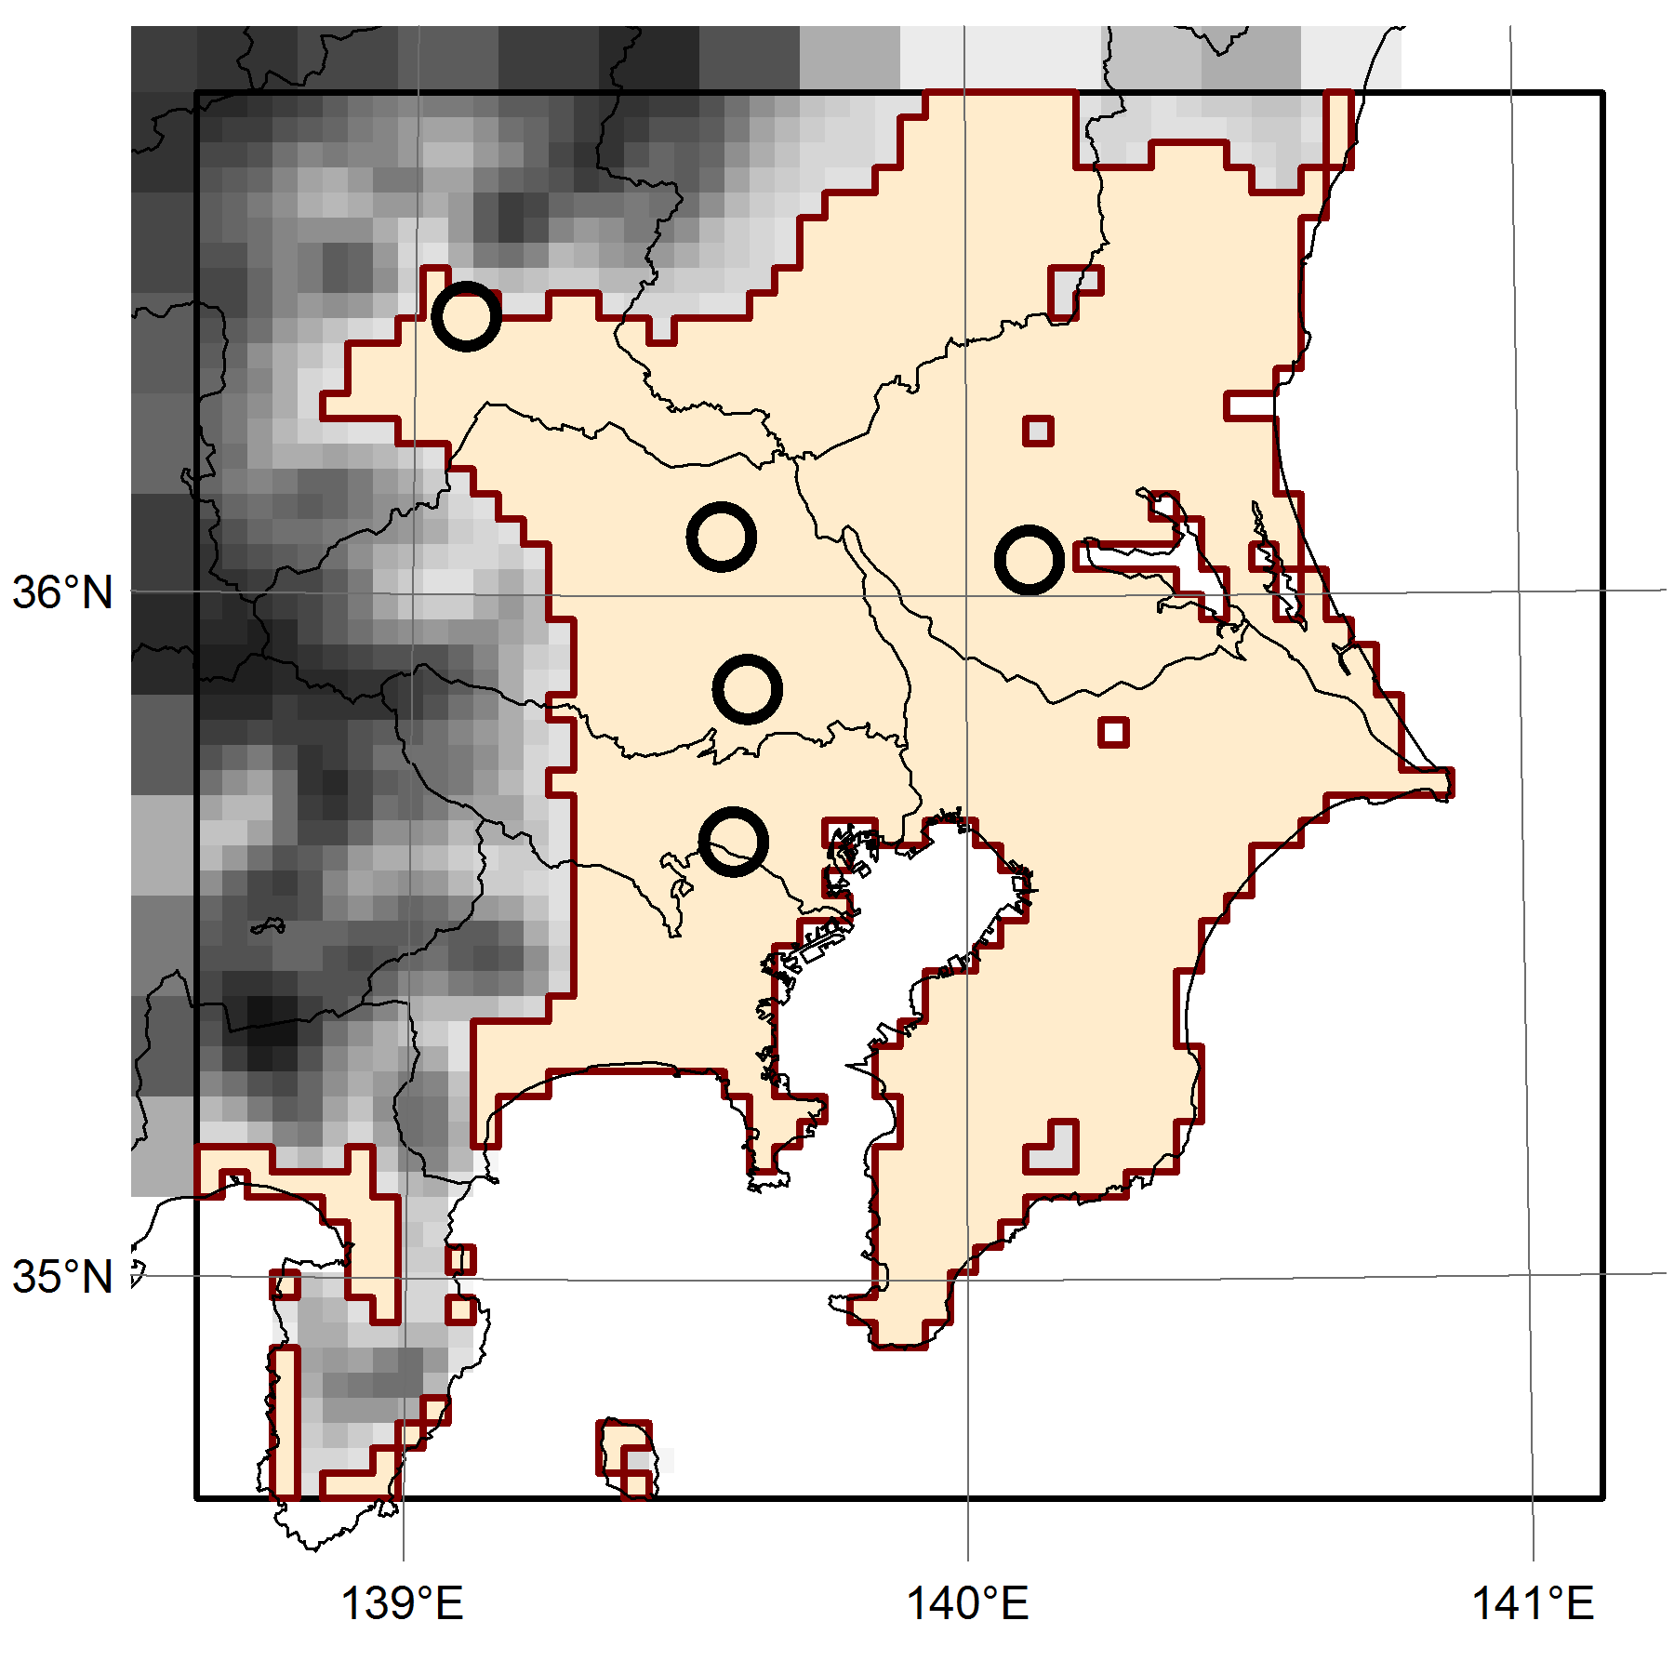
Inter-comparison of baseline Sim. cases
Target period
  Winter 2010: Nov. 22 – Dec. 5, 2010
  Summer 2011: Jul. 18 – Jul. 31, 2011
Target area
  1st layer on land area < 200m ASL in D3 ( )
D3
 | M0 | M1 | M2 | M3 | M4
AQM | CMAQ v4.7.1 | CMAQ v4.7.1 | CMAQ v4.6 | CMAQ v4.7.1 | CMAQ v5.0
Domain | D1, D2, D3 | D3* | D3* | D1, D2, D3 | D3*
H Adv. | yamo | yamo | yamo | ppm | yamo
V Adv. | yamo | yamo | yamo | ppm | wrf
H Diff. | multiscale | multiscale | multiscale | multiscale | multiscale
V Diff. | acm2 | acm2 | acm2 | acm2 | acm2
Photolysis rate | table | inline | table | inline | inline
Gas phase | saprc99 (ebi) | saprc99 (ebi) | saprc99 (ros3) | saprc99 (ebi) | saprc99 (ebi)
Aerosol phase | aero5 | aero5 | aero4 | aero5 | aero5
Cloud phase | acm | acm | radm | acm | acm
*Using D2 result of M0 for boundary concentration

Slide 14
Time series of spatial mean Conc.
Inter-comparison of baseline simulation cases
Winter 2010
Summer 2011
PM_{2.5} NO₃⁻
PM_{2.5} NO₃⁻
(μg m⁻³)
(μg m⁻³)
PM_{2.5} NH₄⁺
PM_{2.5} NH₄⁺
(μg m⁻³)
(μg m⁻³)
Using common dataset, temporal variation patterns in M0–M4 are very similar to each other

Slide 15
Difference of mean Conc. from M0
Inter-comparison of baseline simulation cases
Winter 2010
Summer 2011
Difference from M0 (%)
M1, M3: relatively small difference between CMAQ v4.7.1 runs
  phot_table→Inline reduce HNO₃ and PM_{2.5} NO₃⁻ in summer
  M3: yamo→ppm Adv. scheme increase ground-level Conc.
M2: CMAQ v4.6, ros3, aero4, radm, offline V_{D} Calc. …
M4: Smaller Min. K_{Z} in CMAQ v5.0 increase nighttime Conc.

Slide 16
Sensitivity analysis
Processes involved in PM_{2.5} NO₃⁻ production
NO_{X} Emiss.
Daytime
NO
NO₂
NH₃ Emiss.
T & RH
NO₃
HNO₃
+
NH₄NO₃
NH₃
Semi volatile
N₂O₅
Dry Dep.
Nighttime
Het. Chem.

Slide 17
T & RH (M0, D3)
Sensitivity analysis
Uniformly changed T in aerosol module by ±2 K
Uniformly changed RH in aerosol module by ±10%
  T&RH affect not only gas/aerosol partitioning
  RH is within the range of 0.5 – 99%
Winter 2010
Summer 2011
Difference from baseline case of M0
(%)

Slide 18
NO_{X} emission (M1, D3)
Sensitivity analysis
Uniformly changed NO_{X} emission by from -40 to +40%
  Uncertainty in total NO_{X} emission is probably smaller
Winter 2010
Summer 2011
Difference from baseline case of M1
(%)

Slide 19
NH₃ emission (M0, D2-D3)
Sensitivity analysis
Common data
according to EMEP/CORINAIR EF
Monthly emission ratio
Modified
according to process for N₂O emission estimate in Japan
summer
winter
Total emission changed by +52% in winter and -42% in summer in D3
Winter 2010
Summer 2011
Difference from baseline case of M0
(%)

Slide 20
HNO₃ & NH₃ dry deposition V_{D} (M2, D3)
Sensitivity analysis
Neuman et al.* estimated higher daytime
HNO₃ V_{D} (8 – 26 cm s⁻¹) from measurement
of power plant plumes
Baseline V_{D} (cm s⁻¹)
*Neuman et al. (2004) JGR 109, D23304
Uniformly multiplied HNO₃ & NH₃ V_{D} by 5 and 0.2
Winter 2010
Summer 2011
Difference from baseline case of M2
(%)

Slide 21
N₂O₅ heterogeneous reaction (M0, D3)
Sensitivity analysis
N₂O₅ reaction probability
Constant Γ_{N2O5} values: 0 (No React.) and 0.1 (Upper estimate)
Parameterization method of aero3 and aero4 (Baseline: aero5)
Winter 2010
Summer 2011
Difference from baseline case of M0
(%)

Slide 22
Mod. of multiple factors (M0, D1-D3)
Sensitivity analysis
Photolysis rate: photo_table → photo_inline
  PM_{2.5} NO₃⁻: +3% in winter, -6% in summer
Modified seasonal variation of NH₃ emission
  PM_{2.5} NO₃⁻: +11% in winter, -24% in summer
HNO₃ & NH₃ V_{D}: 5 times
  PM_{2.5} NO₃⁻: -39% in winter, -46% in summer
N₂O₅ Het. Chem.: aero5 → aero3
  PM_{2.5} NO₃⁻: -6% in winter, -4% in summer
M0_Base → ModMulti
  PM_{2.5} NO₃⁻: -39% in winter, -74% in summer
Difference from baseline case of M0 (%)
Winter
applied
simultaneously
Summer

Slide 23
Mean concentration at observation sites
Modification of multiple factors (M0)
Winter 2010
(μg m⁻³)
Summer 2011
(μg m⁻³)

Slide 24
Summary
Sensitivity analysis
UMICS2 was conducted to improve AQM performance for simulating SIA, particularly PM_{2.5} NO₃⁻
Using common dataset, results of CMAQ runs with different configurations were similar to each other
HNO₃ & NH₃ dry deposition and NH₃ emission can be key factors for improvement of PM_{2.5} NO₃⁻ simulation
  Accumulation of Obs. data of HNO₃ & NH₃ Conc.
  Development of better NH₃ emission inventory
  Drastic modification of AQM may be required

