Slide 1
Application and Evaluation of 2006 NLCD and MODIS in the WRF/CMAQ System Part I: Meteorology Simulations
Limei Ran^{1,2}, Robert Gilliam³, Jonathan Pleim³, Adel Hanna¹ , William Benjey³
¹Center for Environmental Modeling for Policy Development, Institute for the Environment
University of North Carolina at Chapel Hill, NC USA
²Ph.D. program, Curriculum for the Environment and Ecology, UNC-Chapel Hill
³Atmospheric Modeling and Analysis Division, ORD NERL/USEPA, Research Triangle Park, NC

Slide 2
Outline
Background and Objectives
NLCD/MODIS Processing Tools
WRF Simulations and Analysis with:
Four Landcover Data Sets
Two different nudging strengths
Conclusion and Future Work

Slide 3
Background
Consistent and accurate land cover data plays an important role in meteorology and air quality modeling systems such as WRF/CMAQ
Land cover data is used in:
Land surface models (LSMs) for meteorology modeling to estimate the exchanges of heat, moisture, and momentum between the land surface and the atmosphere
Bi-directional ammonia flux and dry deposition
Biogenic emission modeling
Emission spatial allocation for air quality simulations

Slide 4
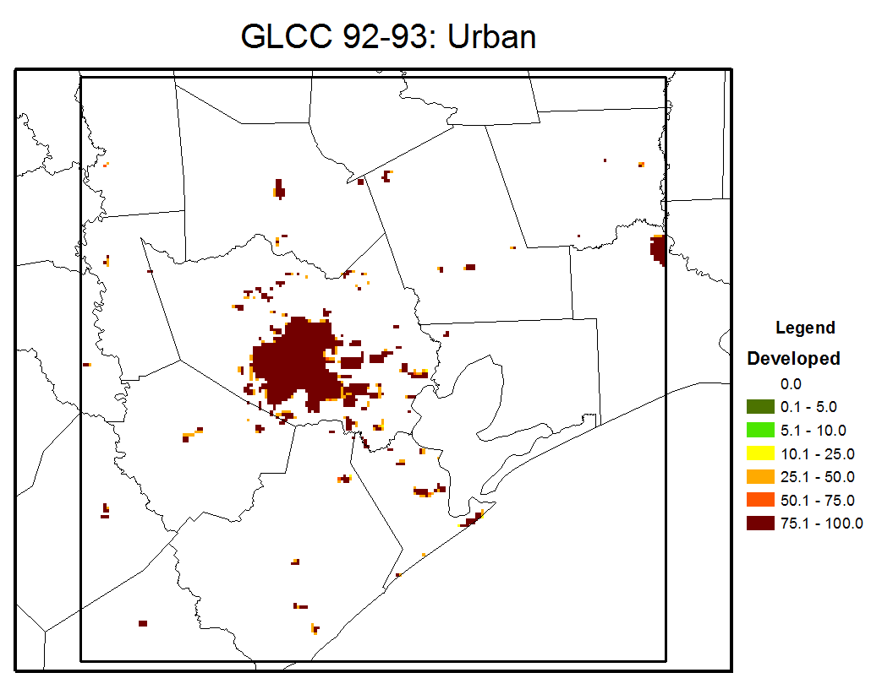
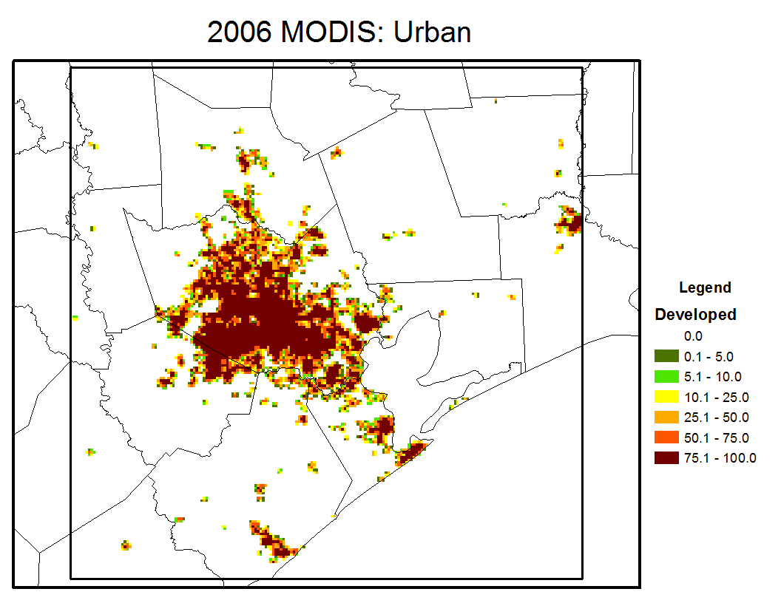
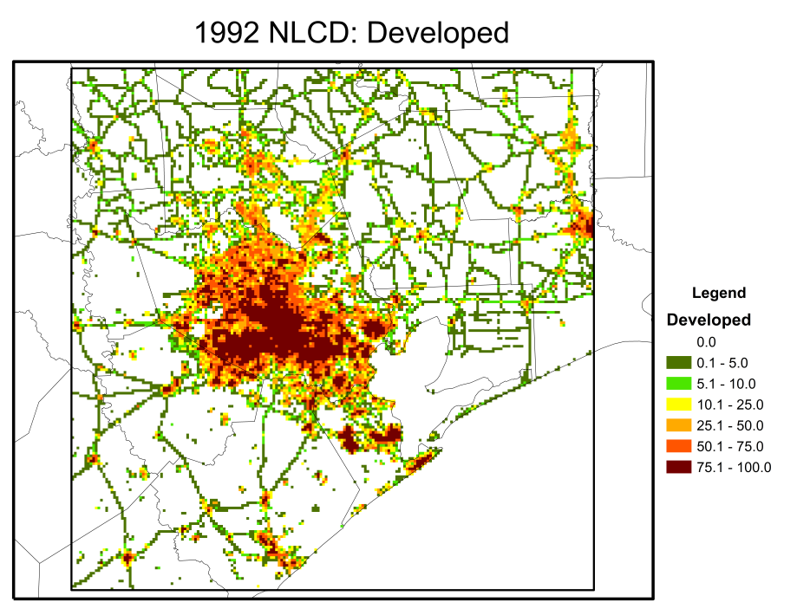
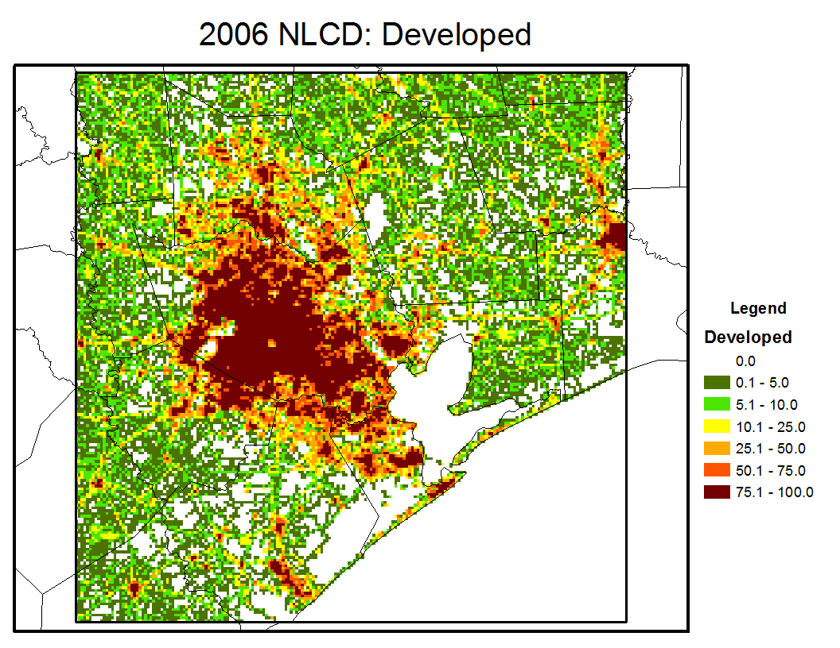
Background
Land cover data sets available to WRF/CMAQ:
USGS GLCC data (WRF, BELD3) – global, 1992-1993 AVHRR, at 30-second (~1 km), Anderson LCCS (Loveland et al. 2000)
MODIS IGBP land cover data (2001 in WRF)– global, yearly, 500m and 1km (Friedl et al. 2001)
NLCD 1992, 2001, 2006, US, 30m, modified Anderson LCCS, 30m (Vogelmann et al. 2001, Homer et al. 2004, Fry et al. 2011)
NLCD 2011 is scheduled for release in 12/2013
Houston 1km Domain Grids
Issue:
Different land cover data sets result in different LU class fractions in modeling grids

Slide 5
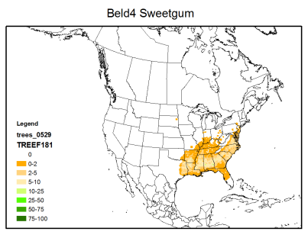
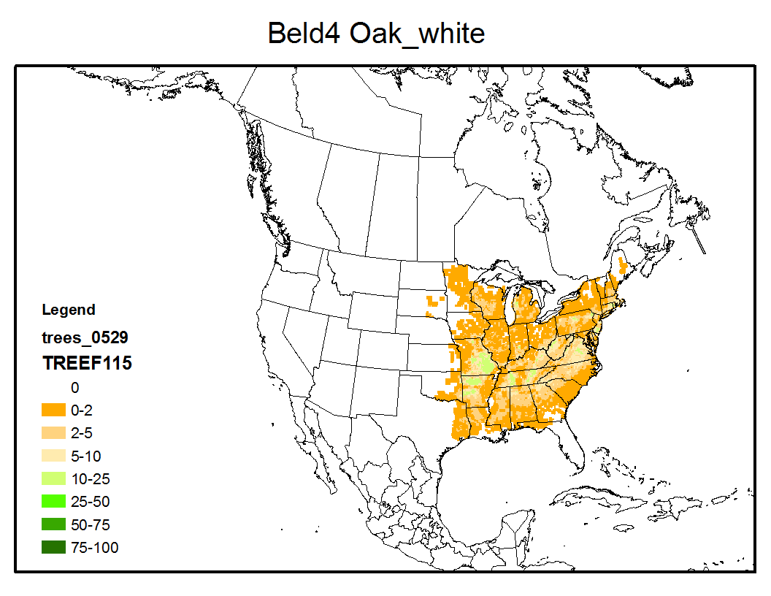
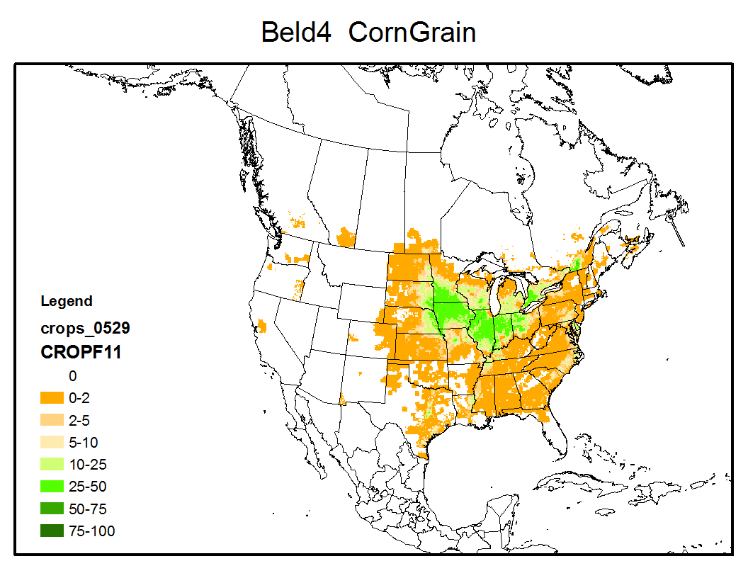
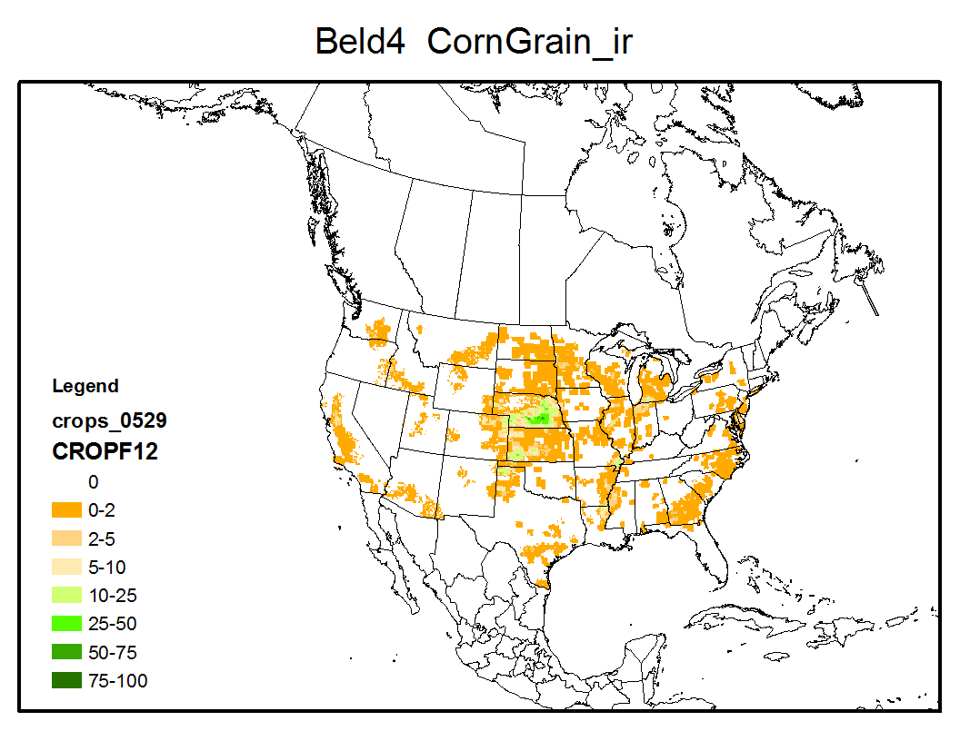
NLCD/MODIS Processing Tools
Current Spatial Allocator release
2001 USGS-NOAA NLCD/BU-MODIS tool
Land cover, canopy, and imperviousness, one MODIS file from BU
Output: 50 land cover classes
New tools developed
BELD4 Tool: 2001 USGS-NOAA NLCD/BU-MODIS, FIA, NASS, SC-CA
Land cover, canopy, and imperviousness, one MODIS
Output: 50 land cover classes, 194 Tree and 42 rainfed /irrigated crop fractions
2006 NLCD/NASA-MODIS tool
USGS NLCD and tiled NASA MODIS data in HDF format as input
Output: 40 land cover classes
Goal: one consistent land use data set
USGS NLCD, NASA tiled MODIS, FIA, NASS, SC-CA, and other spatial data (e.g. eco-regions, population for better LSM in different regions and urban areas )
40 land cover classes and tree /crop fractions
Output data to WPS GeoGrid output file – for WRF simulation

Slide 6
Objectives
Assess the impacts of different land cover data sets on the WRF/CMAQ modeling system using the PX LSM during the August 2006 TexAQS period
Key features of PX LSM
Fractional land cover within a grid cell
Soil moisture and deep soil T nudging
Connected to CMAQ dry deposition, NH₃ bi-directional models
Science questions:
How sensitive is the WRF system to:
Land cover data sets with different classification and resolution
Different nudging strength
How does CMAQ respond to changes in land cover classification

Slide 7
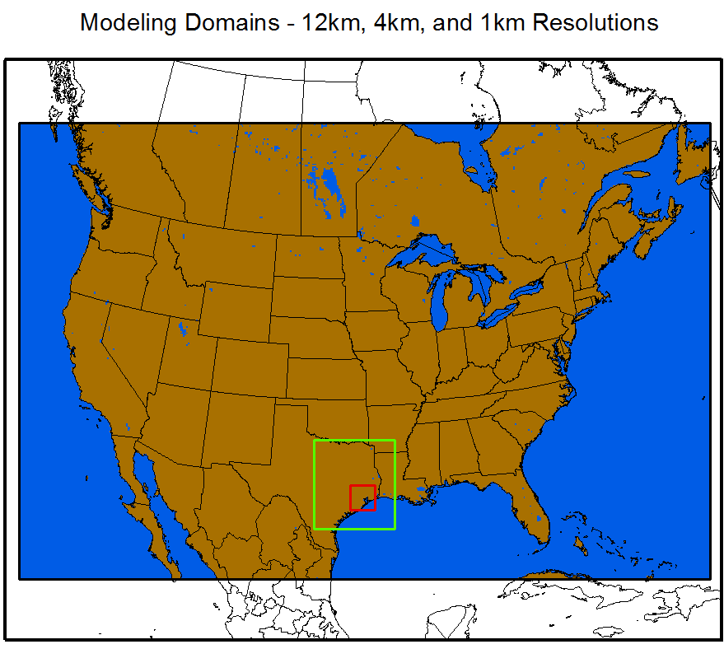
Modeling Domains and Configuration, Land Cover Data Sets
Four land cover data sets for each domain:
1992-1993 USGS GLCC land cover data within WRF
2006 NLCD and MODIS Terra and Aqua land cover 500-m (MCD12Q1) IGPB data
2006 MODIS Terra and Aqua land cover 500-m (MCD12Q1) IGPB data
1992 NLCD and 2006 MODIS Terra and Aqua land cover 500-m (MCD12Q1) IGPB data
Observation data:
NOAA’s Meteorological Assimilation Data Ingest System (MADIS) for NA
AQS air quality network data
WRF:
WRF–ARW V3.4: NCEP 12km NAM analysis and reanalyzed with OBS data using WPS OBSGRID
Regular and weaker nudging schemes for analysis nudging (W, T, Q) above the PBL and indirect soil moisture and T nudging from 2-m T and Q in the PX LSM (Pleim & Xiu 2003, Pleim & Gilliam 2009)
Modified the PX LSM for 2006 NLCD and MODIS land cover categories
Other physics options: ACM2 PBL scheme, the RRTMG radiation model for SW and LW radiation, the Morison cloud microphysics scheme, and the Kain-Fritsch cumulus scheme only on the 12 km and 4 km domains
CMAQ:
CMAQ v5.0.1 with CB05 gas-phase chemistry, AE6 modal aerosols, 2006 emissions and BELD3 data
Modified for 2006 NLCD/MODIS and 2006 MODIS land over data

Slide 8
Meteorology Results: Statistic Summary 2006 - 08/10-09/09

Slide 9
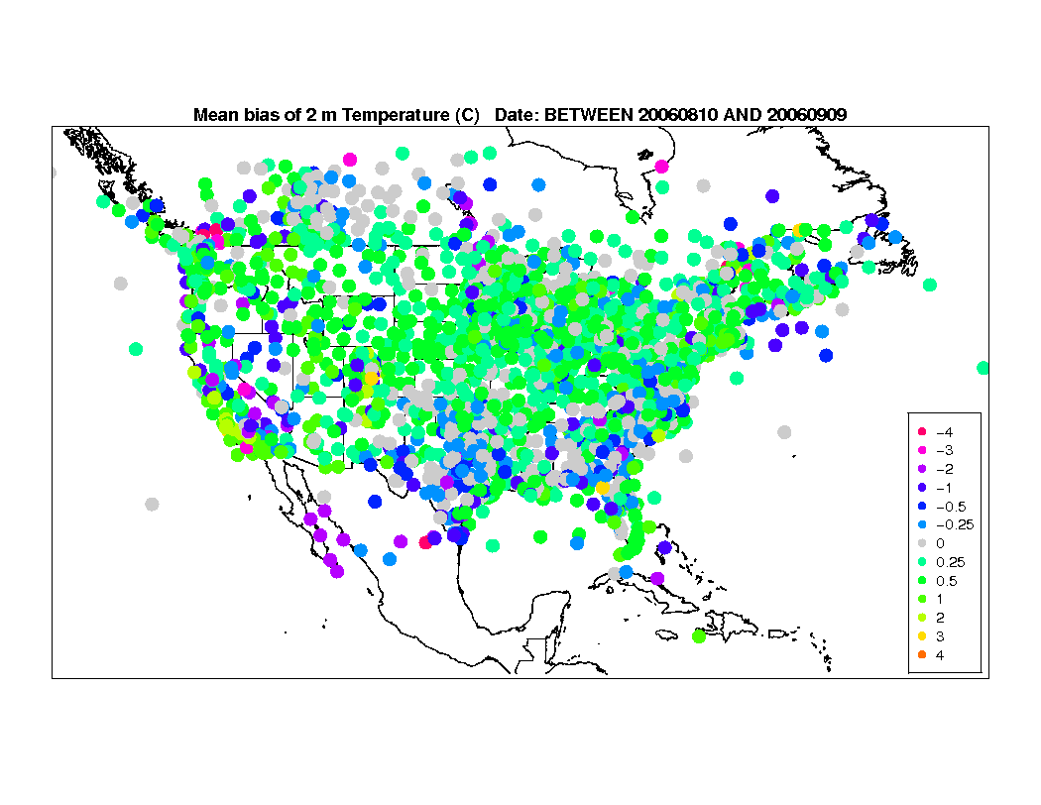
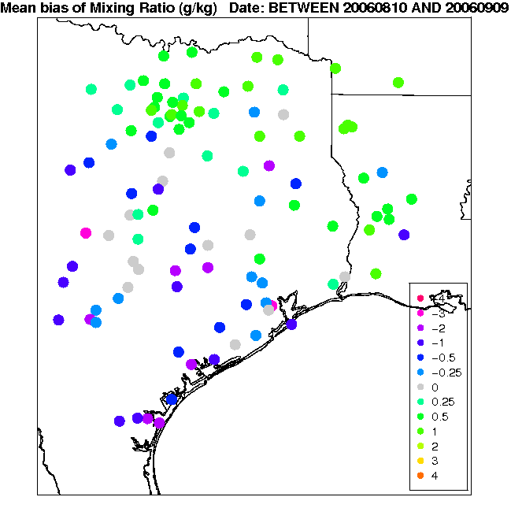
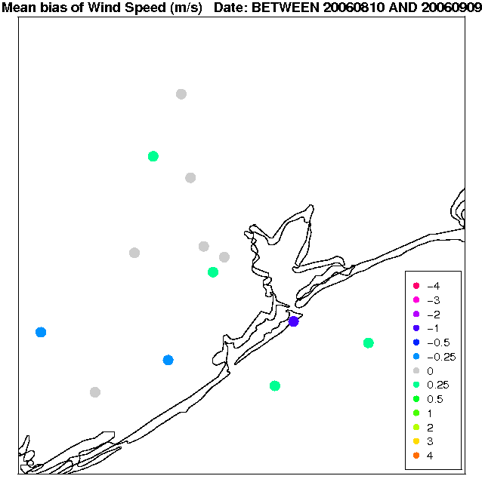
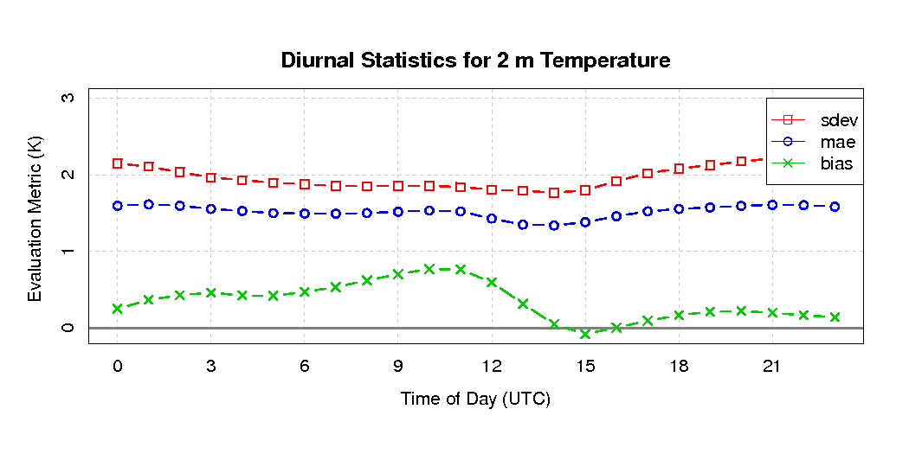
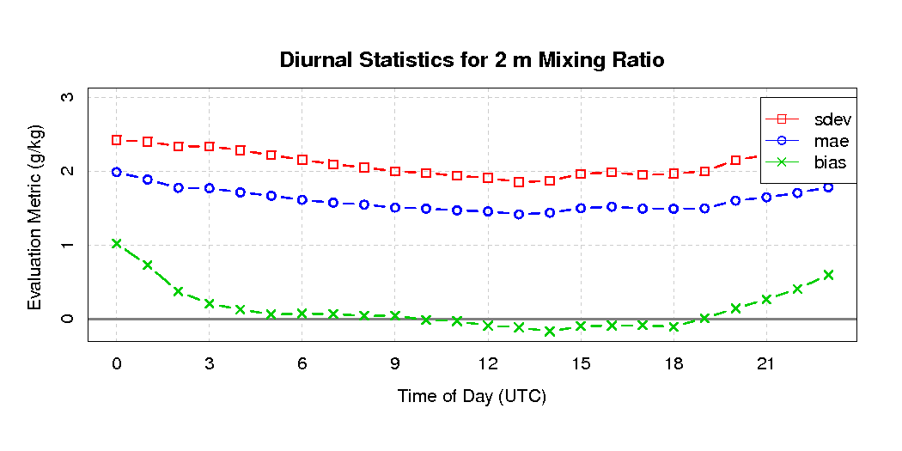
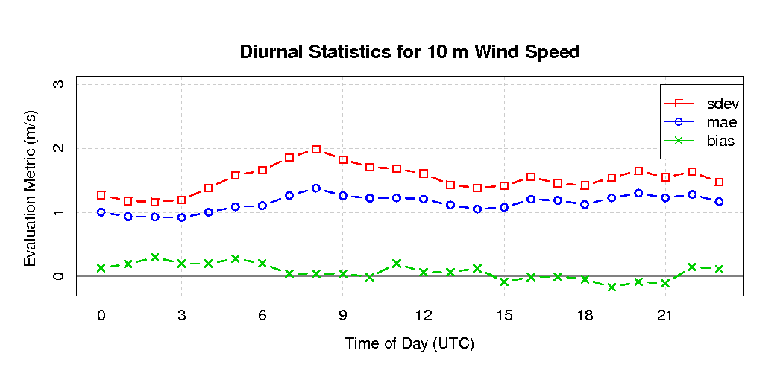
Meteorology Results: 2006 NLCD (regular nudging)
Mean Bias
2m T: 12km
2m Q: 4km
10m WS: 1km
Diurnal Statistics
2m T: 12km
2m Q: 4km
10m WS: 1km

Slide 10
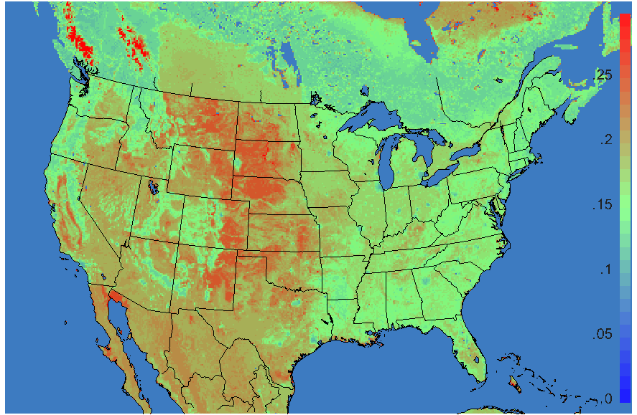
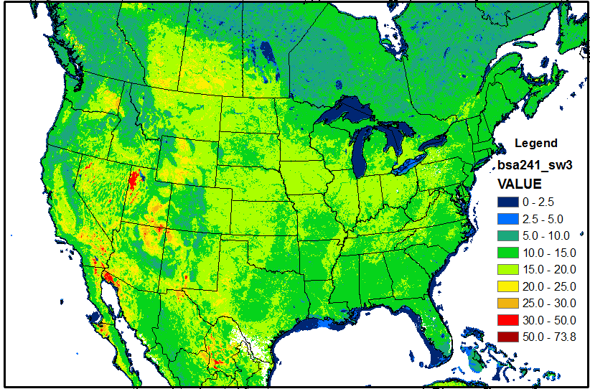
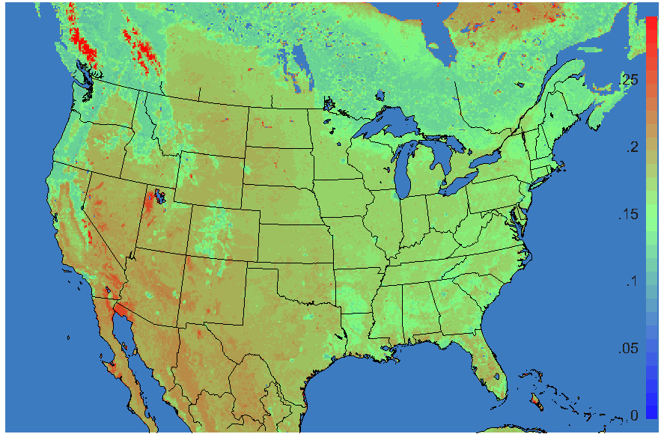
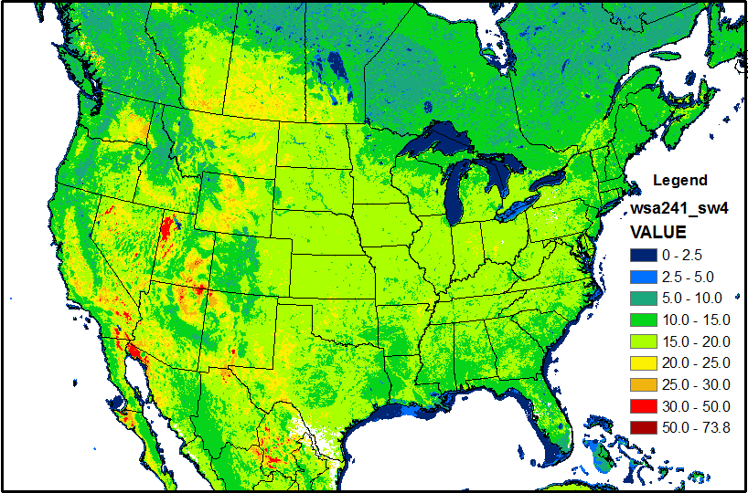
12km Albedo Comparison: 2006-08-31-18Z (2006243)
2006 NLCD
MODIS MCD43C3 Albedo, 2006241
NLCD:
Too high albedo for
Grassland and Pasture (25, 23)
Black sky (Direct) SW: 0.3-5.0 µm
2006 MODIS
NLCD shows more detailed patterns in SW, consistent with MODIS albedo
White sky (Diffuse) SW: 0.3-5.0 µm

Slide 11
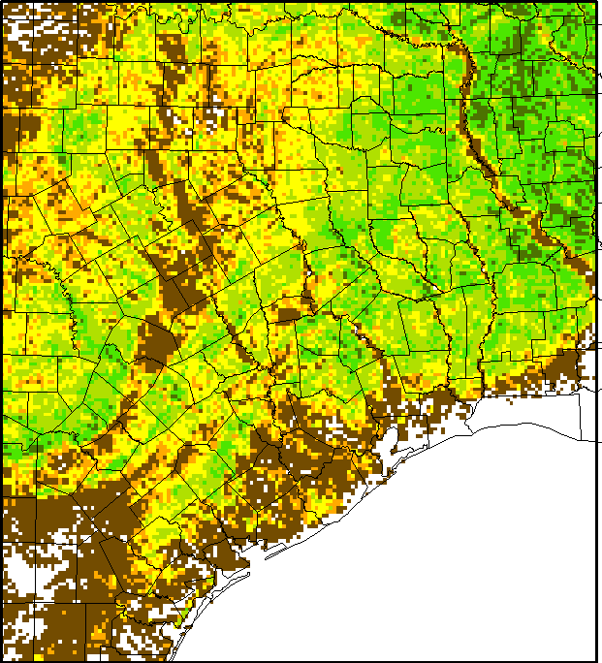
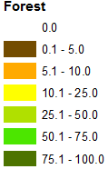
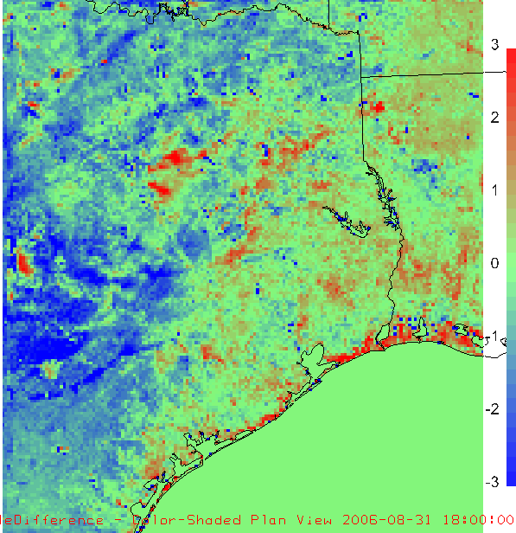
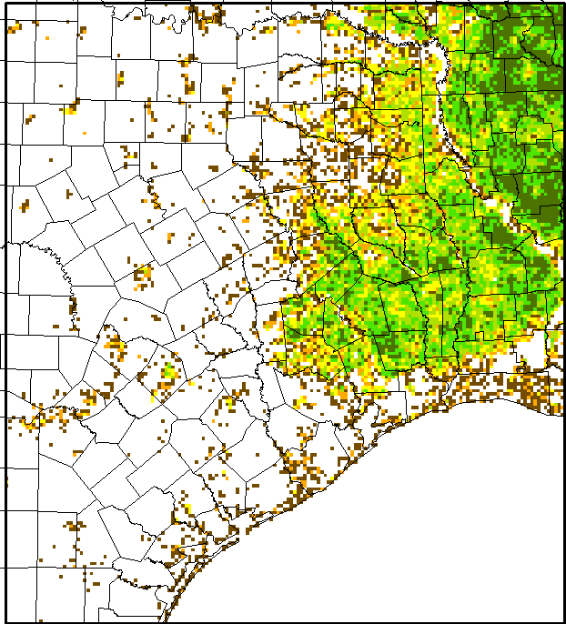
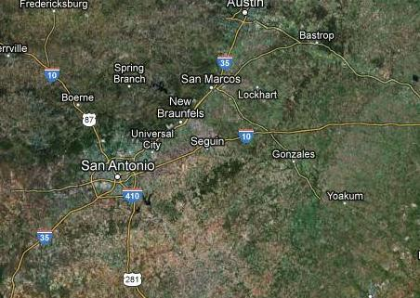
4km Meteorology Comparison: 2006-08-31-18Z Regular Nudging
ST: 2006 NLCD – 2006 MODIS
NLCD is cooler with forest cover
2006 NLCD
2006 MODIS
Google image

Slide 12
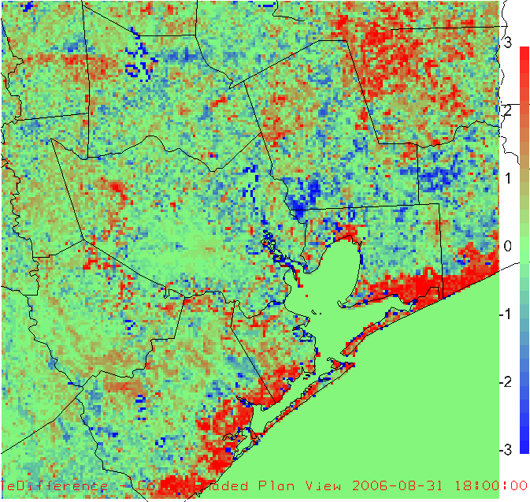
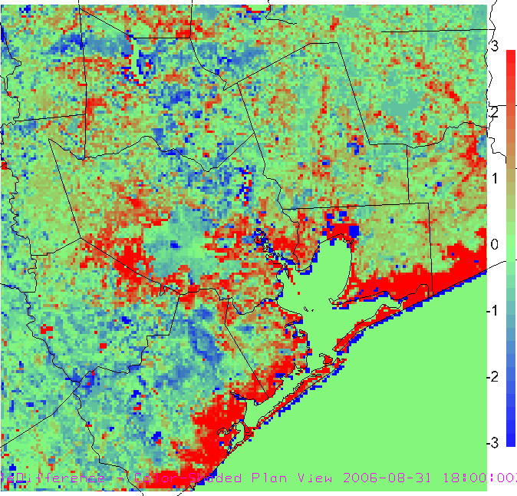
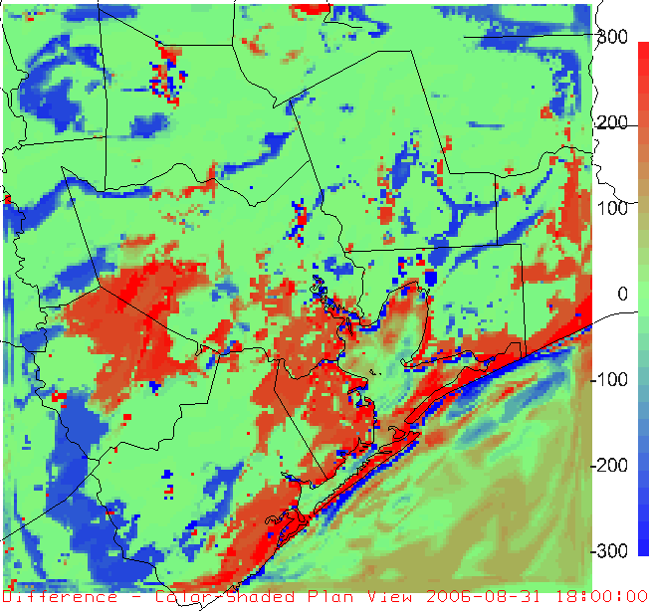
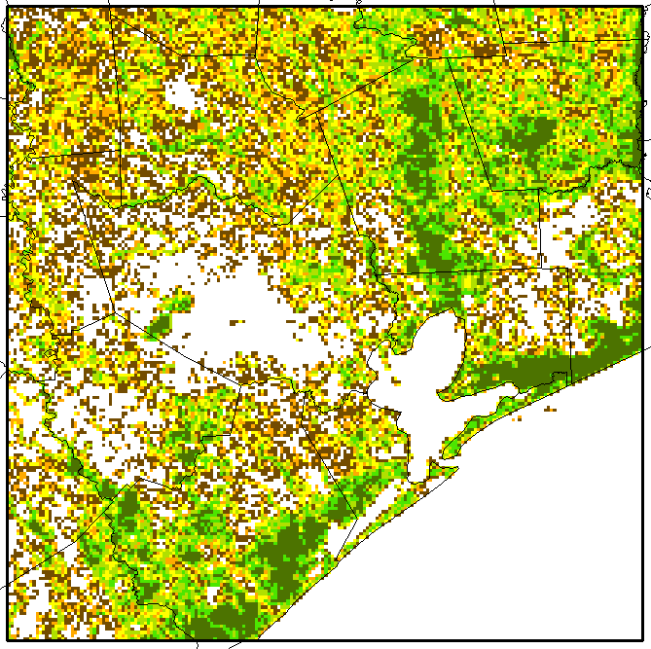
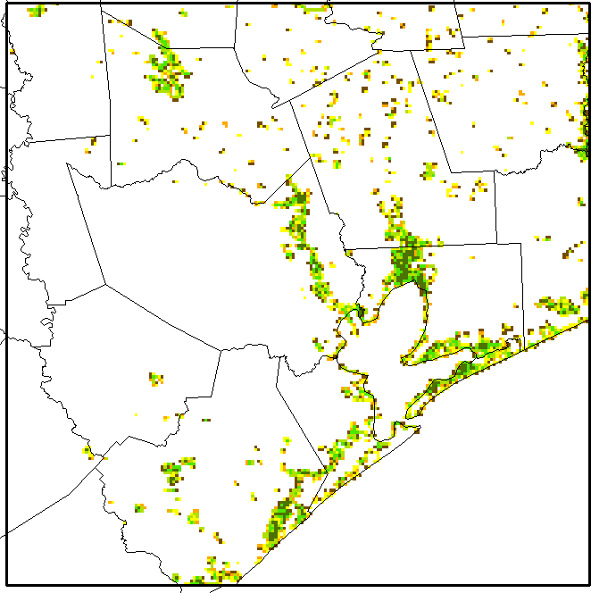
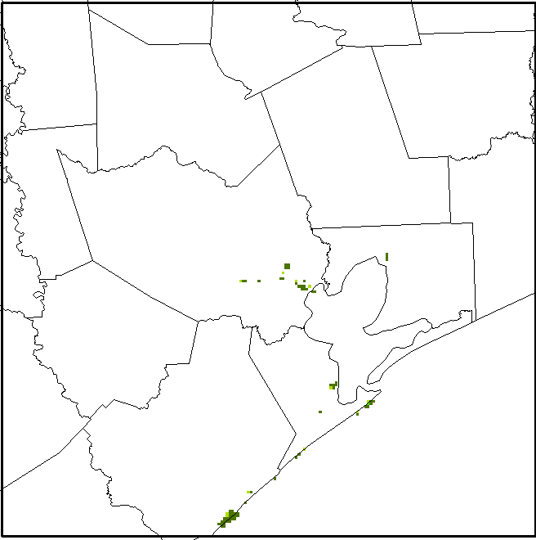
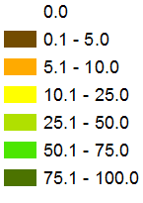
1km Meteorology Comparison: 2006-08-31-18Z Regular Nudging
ST: 2006 NLCD – 2006 MODIS
ST: 2006 NLCD – USGS GLCC
PBLH: 2006 NLCD – USGS GLCC
2006 NLCD
2006 MODIS
USGS GLCC
NLCD is much warmer along the coast:
1. Difference of wetland cover
2. Treatment of wetland in the PX LSM
Woody and Herbaceous Wetland

Slide 13
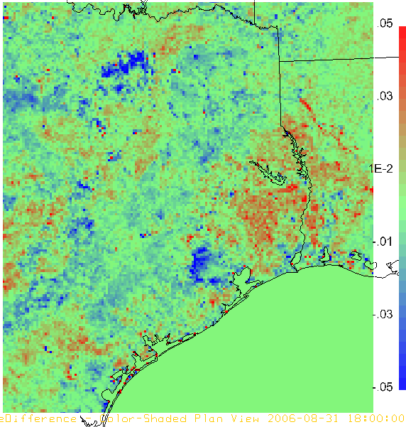
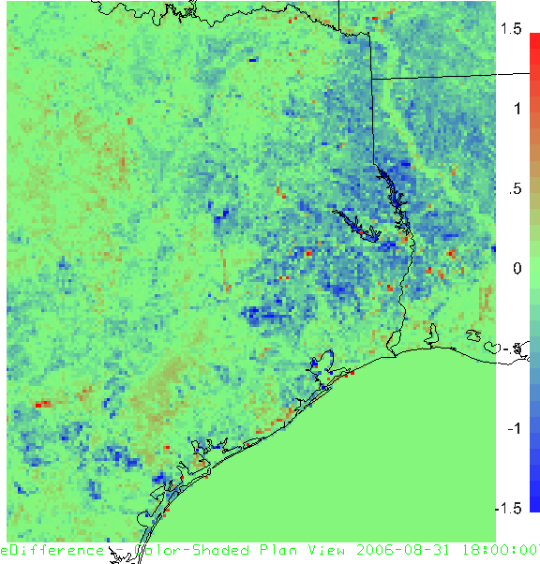
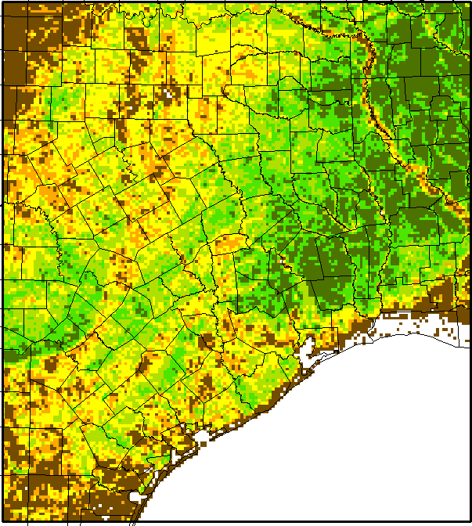
4km Meteorology Comparison, 2006-08-31-18Z Weaker Nudging
2006 NLCD: Forest
Albedo: 2006 NLCD – 1992 NLCD
LAI: 2006 NLCD – 1992 NLCD
1992 NLCD: Forest
Lower albedo for expanded urban areas
Lower LAI and higher albedo due to lower forest fractions
Changes from same land cover data, different years:
Landuse change
Different sensors and algorithms

Slide 14
Conclusions
All WRF simulation evaluation statistics well within typical model performance benchmarks
Land use data sets do matter both spatially and temporally, although nudging (particularly PX LSM soil T and moisture nudging) overpowers some differences
Future Work
Improve NLCD parameters (e.g. albedo)
Improve wetland treatments in soil moisture modeling
Re-evaluate the modified model
Complete CMAQ simulation and analysis
Release completed Raster Tools through the CMAS and modified LSM through WRF to the community
Assimilate MODIS dynamic vegetation products (e.g. fPAR, EVI, LAI) as well as albedo for better ET estimation

Slide 15
Acknowledgements
Development of the Land use processing tools are funded by:
U.S. EPA under the Contract No. EP-W-09-023, “Operation of the Center for Community Air Quality Modeling and Analysis (CMAS)”

