Slide 1
Potential role of isoprene epoxydiols in organic aerosol formation over the United States
Havala O. T. Pye¹, Rob Pinder¹, Ying Xie¹, Deborah Luecken¹, Bill Hutzell¹, Golam Sarwar¹, Jason Surratt²
¹ US Environmental Protection Agency
² University of North Carolina at Chapel Hill
Office of Research and Development
National Exposure Research Laboratory, Atmospheric Modeling and Analysis Division
15 October 2012

Slide 2
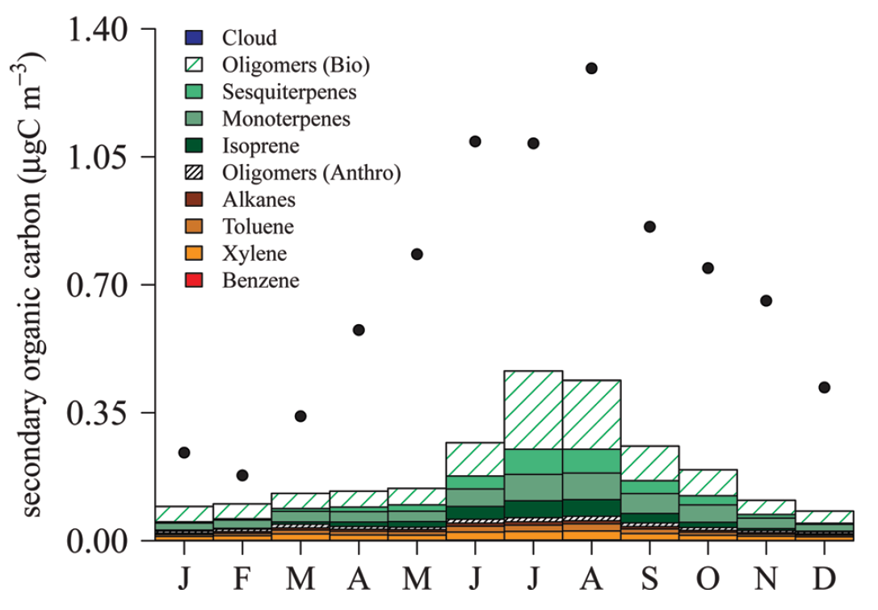
Current CMAQ Performance
CMAQ underestimates OC compared to surface networks
(especially in summer)
CMAQ 4.7 [Carlton et al. 2010]
Notes:
The SOA treatment in CMAQ v5.0 remains largely unchanged from 4.7.1 and indicates a significant underestimate in aerosol phase organic carbon.
CMAQ underestimates OC compared to surface networks in the summer, esp in southeast
tracer based evaluation (Prakash CMAS 2009?) indicates isoprene SOA in particular is underestimated
check on Carlton CalNex tracer eval (CMAS 2011)
check on Napelenok Midwest tracer eval (CMAS 2011)
modern vs fossil measurements in a variety of locations emphasize role of modern C
CMAQ underestimate is not necessarily unique: other models have very similar SOA pathways

Slide 3
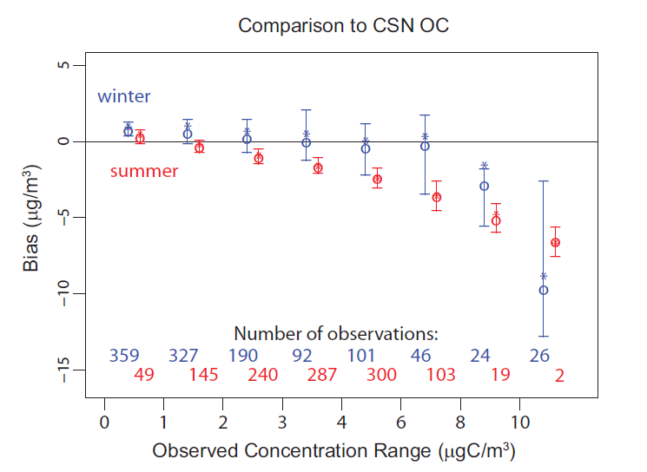
Current CMAQ Performance
CMAQ underestimates OC compared to surface networks
(especially in summer)
CMAQ 4.7 [Carlton et al. 2010]
CMAQ 5.0 [Pye and Pouliot 2012]
Notes:
CMAQ underestimates OC compared to surface networks in the summer, esp in southeast
tracer based evaluation (Prakash CMAS 2009?) indicates isoprene SOA in particular is underestimated
check on Carlton CalNex tracer eval (CMAS 2011)
check on Napelenok Midwest tracer eval (CMAS 2011)
modern vs fossil measurements in a variety of locations emphasize role of modern C
CMAQ underestimate is not necessarily unique: other models have very similar SOA pathways

Slide 4
Isoprene is a significant contributor to SOA
Isoprene is the largest non-methane VOC emission
Even a small aerosol yield makes isoprene an important SOA source
Isoprene tracers found to account for 7.9% of ambient OC in Yorkville, GA [Lin et al. 2012]
Total OC
Notes:
725 ng/m3 isoprene tracers

Slide 5
Isoprene is a significant contributor to SOA
Isoprene is the largest non-methane VOC emission
Even a small aerosol yield makes isoprene an important SOA source
Isoprene tracers found to account for 7.9% of ambient OC in Yorkville, GA [Lin et al. 2012]
Objectives
Explore a new way of modeling isoprene SOA based on recent developments
Determine how the new parameterization differs from the standard parameterization
Total OC
Notes:
725 ng/m3 isoprene tracers

Slide 6
CMAQ v5.01 Isoprene SOA (same as v4.7 Carlton et al. 2010, ES&T)
Isoprene + OH
Odum 2-product
SVISO2
SVISO1
AISO2
AISO1
Notes:
Figure showing standard pathways to isoprene SOA (same as 4.7.1)
isoprene + OH leads to initial product formation (no NOx dependence)
AISO1,2 absorptive partitioning
AISO3 acid enhancement
oligomerization

Slide 7
CMAQ v5.01 Isoprene SOA (same as v4.7 Carlton et al. 2010, ES&T)
Isoprene + OH
Odum 2-product
SVISO2
SVISO1
AISO2
AISO1
H+
AOLGB
H+
Oligomerized
AISO3
Acid Enhanced
Notes:
Figure showing standard pathways to isoprene SOA (same as 4.7.1)
isoprene + OH leads to initial product formation (no NOx dependence)
AISO1,2 absorptive partitioning
AISO3 acid enhancement
oligomerization

Slide 8
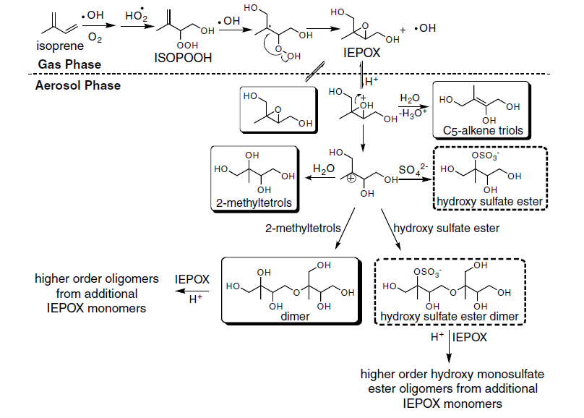
IEPOX as Precursor to SOA
[Surratt et al. 2010, PNAS]
Notes:
Recognition of new chemistry: IEPOX
produced under low-NOx conditions
Poulot Science 2009
Surratt PNAS, linkage to 2-methyl tetrols
acid catalyzes ring-opening of IEPOX (Eddingsaas 2010, McNeill 2012)
role for water and/or acidity?
Hlaw vs Kp
other things like high-NOx pathways will not be discussed

Slide 9
IEPOX as Precursor to SOA
[Surratt et al. 2010, PNAS]
Notes:
Recognition of new chemistry: IEPOX
produced under low-NOx conditions
Poulot Science 2009
Surratt PNAS, linkage to 2-methyl tetrols
acid catalyzes ring-opening of IEPOX (Eddingsaas 2010, McNeill 2012)
role for water and/or acidity?
Hlaw vs Kp
other things like high-NOx pathways will not be discussed

Slide 10
Aerosol from IEPOX Uptake
Why heterogeneous uptake?
Vapor pressure of IEPOX relatively high (C* > 10⁴ μg m⁻³)
Henry’s Law coefficient for IEPOX is large
 | Henry’s Law Coefficient [M atm⁻¹]
HNO₃ | 2.1 × 10⁵
Glyoxal | 3.6 × 10⁵
IEPOX | 1.9 × 10⁷ to 9.6 × 10⁸ [Chan et al. 2010]
Notes:
Less than a tenth of a percent of iepox partiioning to the aerosol phase under most atmospherically relevant conditions (M<22 ug/m3)
Protonation of the epoxide ring followed by ring opening is likely what leads to tracer compounds like tetrols and triols

Slide 11
Aerosol from IEPOX Uptake
Why heterogeneous uptake?
Vapor pressure of IEPOX relatively high (C* > 10⁴ μg m⁻³)
Henry’s Law coefficient for IEPOX is large
Acid catalyzed particle phase reactions can be irreversible
 | Henry’s Law Coefficient [M atm⁻¹]
HNO₃ | 2.1 × 10⁵
Glyoxal | 3.6 × 10⁵
IEPOX | 1.9 × 10⁷ to 9.6 × 10⁸ [Chan et al. 2010]
[Eddingsaas et al. 2010]
Notes:
Less than a tenth of a percent of iepox partiioning to the aerosol phase under most atmospherically relevant conditions (M<22 ug/m3)
Protonation of the epoxide ring followed by ring opening is likely what leads to tracer compounds like tetrols and triols

Slide 12
Aerosol from IEPOX Uptake
CMAQ implementation
SAPRC07TC chemistry updated to include IEPOX formation as well as greater speciation of nitrates [Xie et al. 2012, ACPD in press]
Heterogeneous uptake of IEPOX onto accumulation mode aerosol
γ = 0.0029 [Liggio et al. 2005; Lin et al. 2012]
Simulations for late July-August 2006
IEPOX
AIEPOX

Slide 13
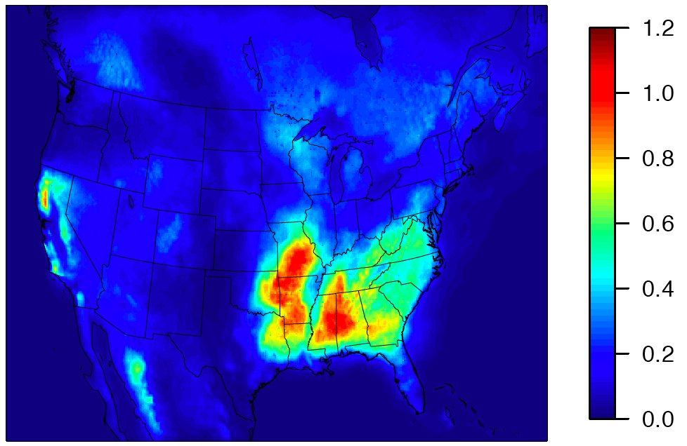
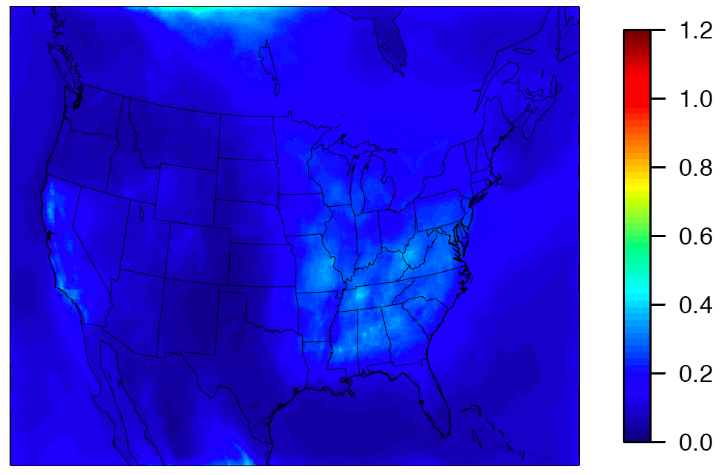
CMAQ IEPOX Predictions
Gas-Phase IEPOX
Standard Isoprene Aerosol
μgC/m³
Notes:
Figure 1: plot of gas-phase IEPOX from gas-only simulation
Figure 2: plot of standard CMAQ isoprene SOA
Same scale: ugC/m3
note the difference in spatial distribution
IEPOX forms under low NOx conditions and is higher outside urban areas
standard CMAQ SOA is driven by absorptive partitioning (generally in POA which is higher in urban areas)
If we make SOA out of IEPOX, what is it’s spatial distribution and how is it influenced by our choice of parameterization?

Slide 14
CMAQ IEPOX Predictions
Gas-Phase IEPOX
Standard Isoprene Aerosol
μgC/m³
Concentration of gas-phase IEPOX indicates significant SOA potential
IEPOX not necessarily highest in locations where we currently predict the most isoprene SOA
For example: Atlanta, Charlotte
IEPOX requires low-NO_{x} conditions to form
Notes:
Figure 1: plot of gas-phase IEPOX from gas-only simulation
Figure 2: plot of standard CMAQ isoprene SOA
Same scale: ugC/m3
note the difference in spatial distribution
IEPOX forms under low NOx conditions and is higher outside urban areas
standard CMAQ SOA is driven by absorptive partitioning (generally in POA which is higher in urban areas)
If we make SOA out of IEPOX, what is it’s spatial distribution and how is it influenced by our choice of parameterization?

Slide 15
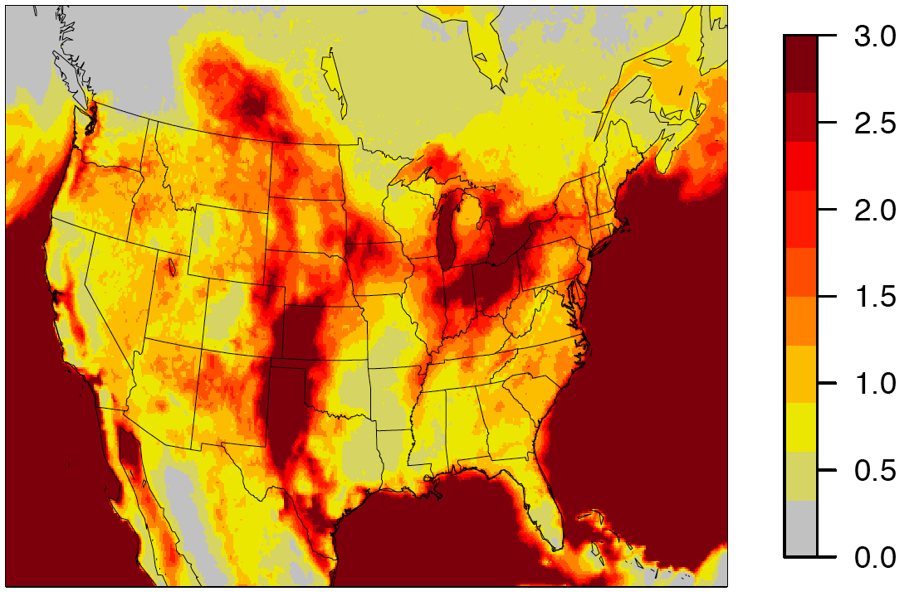
Total IEPOX Increase with Uptake
Fractional Increase (With Uptake - Without)/Without
Notes:
large fractional increases seen away from IEPOX source regions (aerosol species cannot react with OH so it lives longer)
Atlanta and Charlotte around 150% increase in total IEPOX

Slide 16
Total IEPOX Increase with Uptake
Fractional Increase (With Uptake - Without)/Without
Total IEPOX (gas+aerosol) increases due to protection against OH reaction
Lifetime of gas-phase IEPOX against OH ~ couple hours
Lifetime of gas-phase IEPOX against uptake ~ less than 30 min at peak
Notes:
large fractional increases seen away from IEPOX source regions (aerosol species cannot react with OH so it lives longer)
Atlanta and Charlotte around 150% increase in total IEPOX

Slide 17
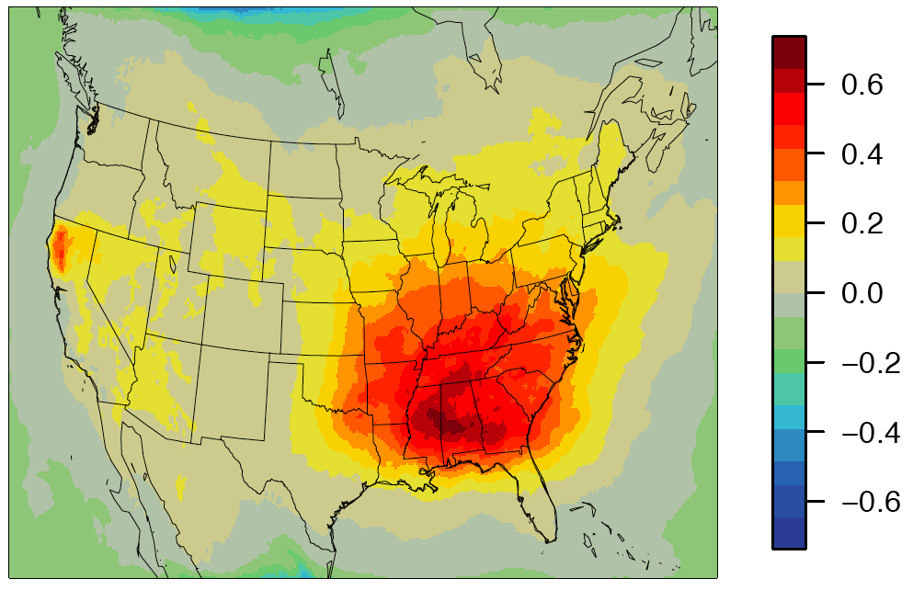
New Parameterization Increases total Aerosol OC
Change in total OC compared to standard isoprene SOA simulation
OC [μgC/m³]
Likely to result in improved model performance (reduces underestimate in OC)
Given γ uncertainty, not clear if model is improved for the right reason
Notes:
california hot spot is in location of fire—large amount of surface area for Iepox uptake

Slide 18
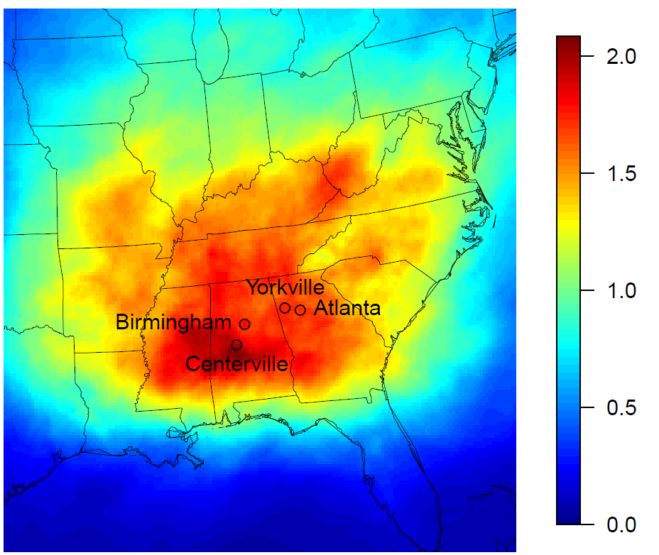
A Closer Look at the Southeast
SouthEastern Aerosol Research and Characterization (SEARCH) Network
IEPOX SOA
[μg/m³]
http://www.atmospheric-research.com/studies/SEARCH/index.html
Notes:
background is IEPOX SOA
Note that Charlotte is a local max in IEPOX SOA even though it was a min in gas-phase production

Slide 19
Diurnal Variation Different
normalized concentration
Notes:
plots normalized to median value at each location
The diurnal variation in the standard and heterogenous pathways is distinctly different
het peaks in morning and declines throughout day (sometimes a PM peak in Alabama sites)
standard generally increases throughout day and peaks around 4-7pm

Slide 20
Diurnal Variation Different
Standard SOA increases throughout day and peaks in afternoon/evening
normalized concentration
Heterogeneous SOA typically peaks in AM then decreases, sometimes with an evening peak at the AL sites
Notes:
plots normalized to median value at each location
The diurnal variation in the standard and heterogenous pathways is distinctly different
het peaks in morning and declines throughout day (sometimes a PM peak in Alabama sites)
standard generally increases throughout day and peaks around 4-7pm

Slide 21
Diurnal Variation in Standard SOA
Total semivolatile 2 (AISO2+SVISO2)
POC
normalized concentration
Standard Isoprene SOA
Notes:
peak late in the day dictated by AISO2 (the lower volatility product) when sun sets, semivolatile from the daytime is still around (more limited removal mechanisms for SV)
IEPOX is removed by OH, note that SV_ISO2 is only removed through deposition so a greater pool or SOA precursor can exist at the end of the day
both het and trad reflect competition between POC/surface area which is minimum in middle of day and photochemical production of precursors which is maximum during the middle of day/afternoon. how the patterns line up dictates where the maximum is

Slide 22
Diurnal Variation in Standard SOA
Total semivolatile 2 (AISO2+SVISO2)
POC
Standard Isoprene SOA
normalized concentration
influences: (1) production of second semivolatile product, (2) POA, (3) temperature
Notes:
peak late in the day dictated by AISO2 (the lower volatility product) when sun sets, semivolatile from the daytime is still around (more limited removal mechanisms for SV)
IEPOX is removed by OH, note that SV_ISO2 is only removed through deposition so a greater pool or SOA precursor can exist at the end of the day
both het and trad reflect competition between POC/surface area which is minimum in middle of day and photochemical production of precursors which is maximum during the middle of day/afternoon. how the patterns line up dictates where the maximum is

Slide 23
Diurnal variation in IEPOX SOA
IEPOX gas
J-mode surface area
normalized concentration/surface area
IEPOX SOA
Notes:
note: AOLGB shows a very similar pattern to AIEPXJ and surface area
AH2OJ decreases significantly throughout day
surface area and APOC show similar pattern

Slide 24
Diurnal variation in IEPOX SOA
IEPOX gas
J-mode surface area
IEPOX SOA
normalized concentration/surface area
influences: (1) aerosol surface area and (2) photochemical production of precursors
Notes:
note: AOLGB shows a very similar pattern to AIEPXJ and surface area
AH2OJ decreases significantly throughout day
surface area and APOC show similar pattern

Slide 25
Summary
Adding the heterogeneous pathway
increases total IEPOX compared to a gas-only simulation
reveals that IEPOX aerosol is important even in urban areas
leads to more isoprene derived aerosol than standard CMAQ

Slide 26
Summary
Adding the heterogeneous pathway
increases total IEPOX compared to a gas-only simulation
reveals that IEPOX aerosol is important even in urban areas
leads to more isoprene derived aerosol than standard CMAQ
Heterogeneous uptake differs from the traditional SOA parameterization in terms of
magnitude of isoprene SOA predicted
diurnal variation of isoprene SOA
Future work should refine parameters used here and capture additional dependencies

