Slide 1

Evaluation of CMAQ and WRF-Chem Simulations of Air Quality over the Baltimore-Washington Region During the July 2011 DISCOVER-AQ Field Campaign
Kenneth Pickering, NASA GSFC
Melanie Follette-Cook, GESTAR, GSFC
Christopher Loughner, ESSIC, GSFC
James Crawford, NASA LaRC
and the DISCOVER-AQ Observation Team
Jim Crawford
Principal Investigator
NASA LaRC
James.H.Crawford@nasa.gov
Ken Pickering
Project Scientist
NASA GSFC
Kenneth.E.Pickering@nasa.gov
Webpage: http://discover-aq.larc.nasa.gov/

Slide 2
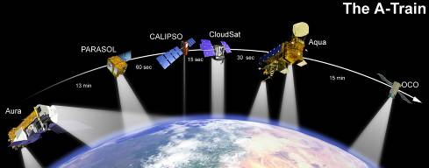
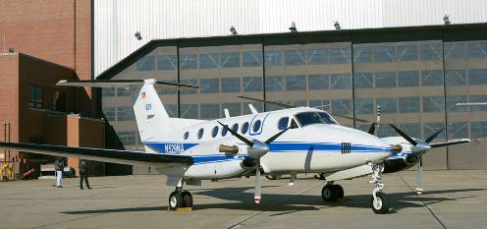
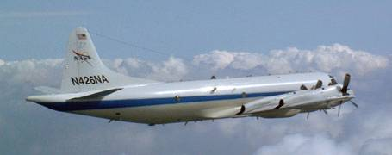
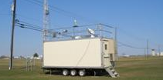
Investigation Overview
Deriving Information on Surface Conditions from Column
and VERtically Resolved Observations Relevant to Air Quality
A NASA Earth Venture campaign intended to improve the interpretation of satellite observations to diagnose near-surface conditions relating to air quality
Objectives:
1. Relate column observations to surface conditions for aerosols and key trace gases O₃, NO₂, and CH₂O
2. Characterize differences in diurnal variation of surface and column observations for key trace gases and aerosols
3. Examine horizontal scales of variability affecting satellites and model calculations
NASA UC-12
NASA P-3B
Deployments and key collaborators
Maryland, July 2011 (EPA, MDE, UMd, and Howard U.)
SJV, California, January/February 2013 (EPA and CARB)
Texas, September 2013 (EPA, TCEQ, and U. of Houston)
TBD, Summer 2014
NATIVE, EPA AQS, and associated Ground sites
Notes:
DISCOVER-AQ is a 5-year, $30M airborne field study funded under NASA’s Earth Venture 1 program. The goals of the program are intended to shed light on challenges in observing air quality from space. Results are expected to be of direct benefit to GEO-CAPE planning and development.

Slide 3
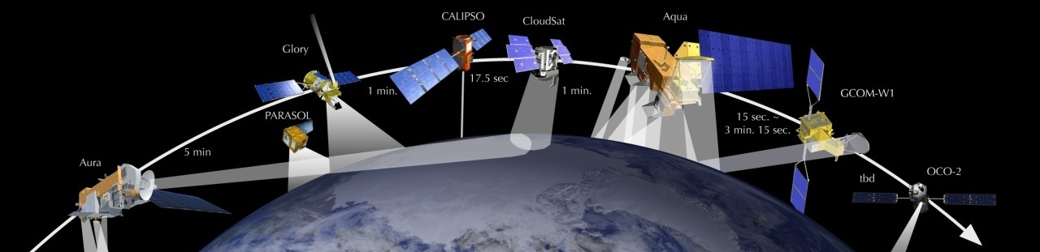
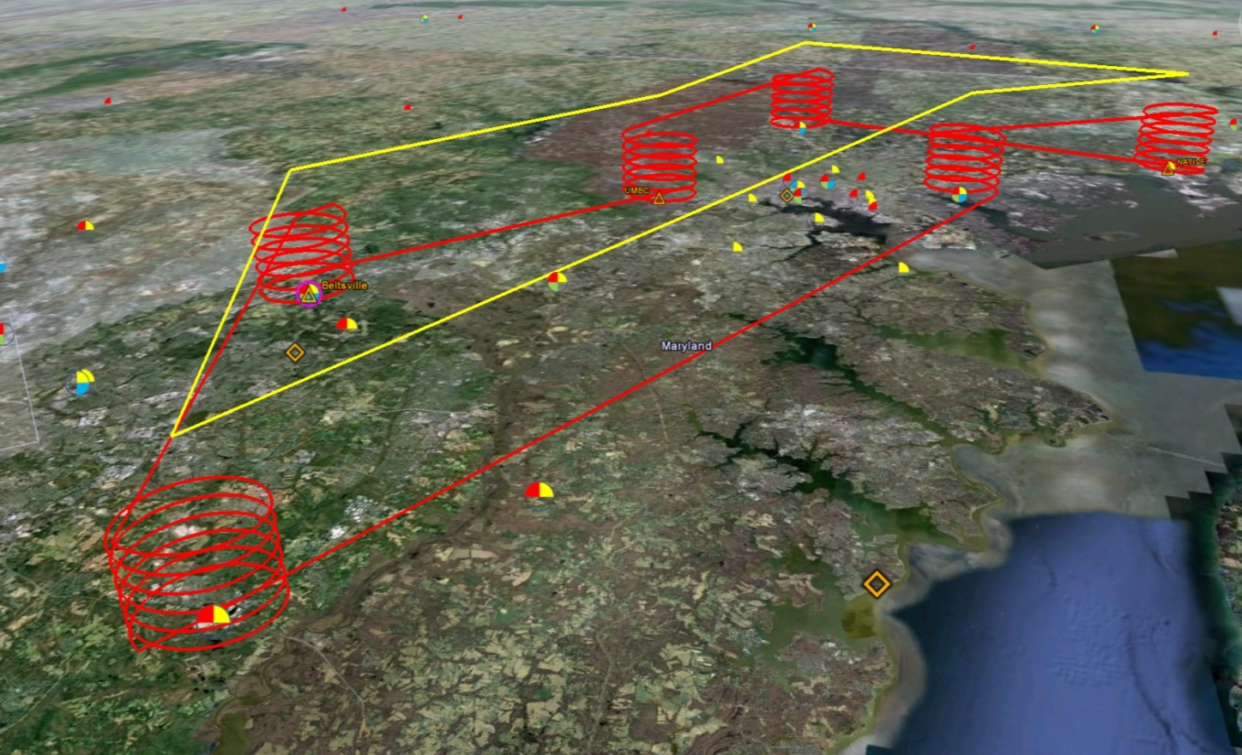
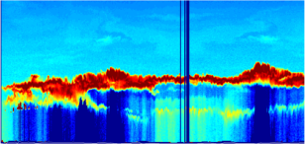

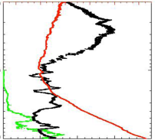
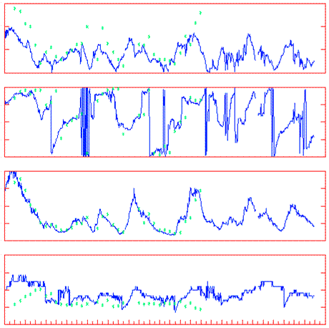
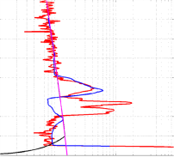
Deployment Strategy
Systematic and concurrent observation of column-integrated, surface, and vertically-resolved distributions of aerosols and trace gases relevant to air quality as they evolve throughout the day.
Three major observational components:
NASA UC-12 (Remote sensing)
Continuous mapping of aerosols with HSRL and trace gas columns with ACAM
NASA P-3B (in situ meas.)
In situ profiling of aerosols and trace gases over surface measurement sites
Ground sites
In situ trace gases and aerosols
Remote sensing of trace gas and aerosol columns
Ozonesondes
Aerosol lidar observations
Notes:
The density and simultaneity of observations from different perspectives is a key aspect of DISCOVER-AQ in creating a dataset useful for linking remote sensing and in situ observations of air quality.

Slide 4
Science Flights July 2011
Flight Statistics | WFF P-3B | LaRC UC-12
Sorties | 14 | 27
Total Hours | 112 | 106
In situ soundings over ground sites and ship | 254 (~40 per site)
Remote sensing passes over each ground site |  | 50+
Low altitude transects over I-95/BW Pkwy | 47
Remote sensing passes over the Chesapeake Bay |  | 50+
Flight Conditions | Number of Flight Days
AM/PM | 3/11
Weekday/Weekend | 11/3
Clean/Moderate/Polluted | 5/4/5
TES Special Observations/MISR overpass | 2/3
NOAA ship in Chesapeake Bay | 4
DISCOVER-AQ data allow extensive evaluation of regional air quality models.
Notes:
The initial deployment was completed over the Baltimore-DC area in July 2011. The sampling statistics describe a dataset with unprecedented temporal and vertical detail for understanding how emissions, chemistry, and transport impact daily changes in air quality.

Slide 5
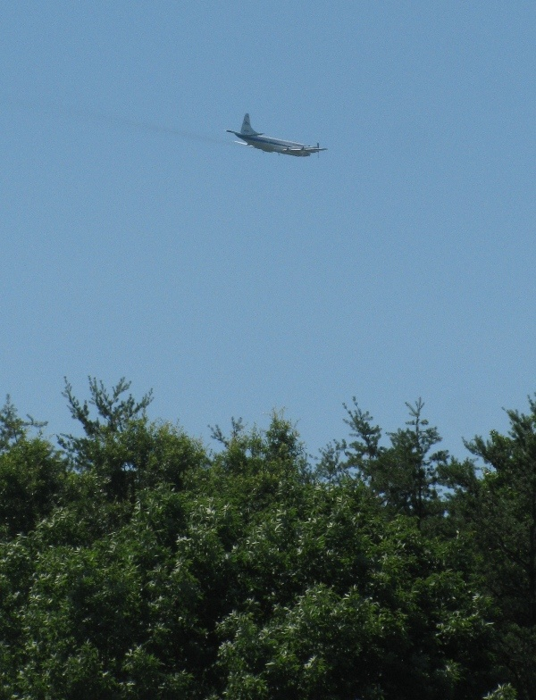
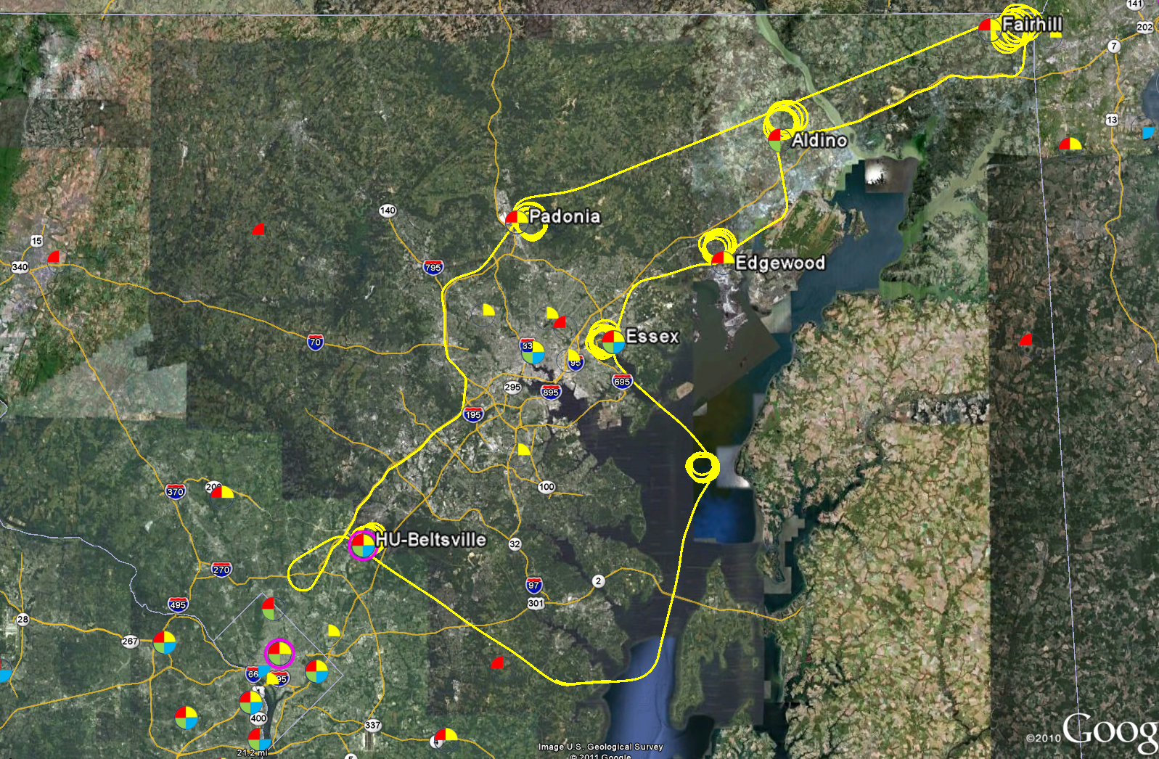
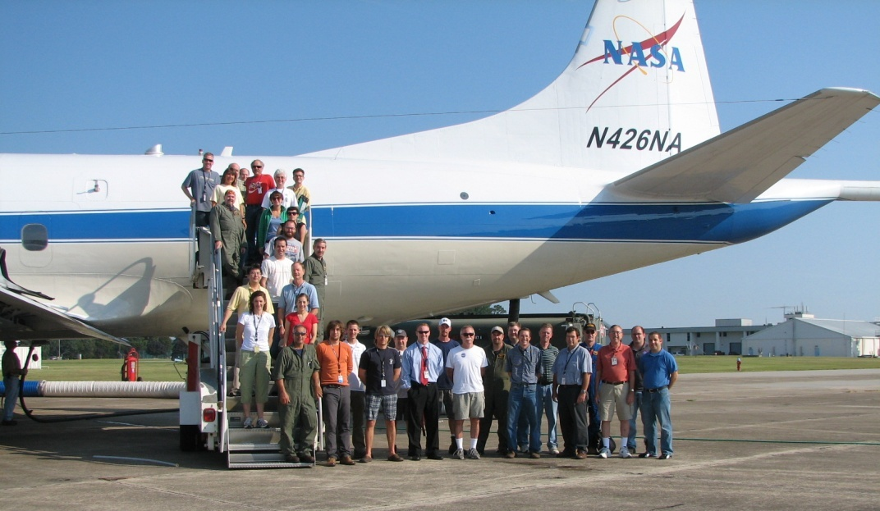
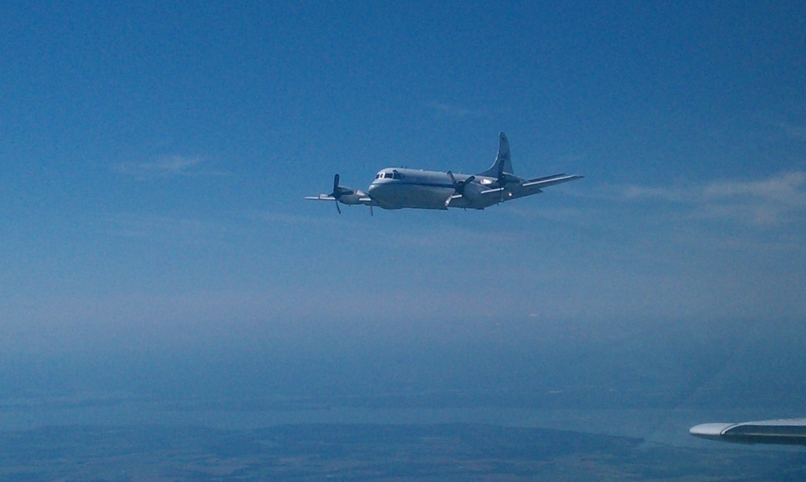
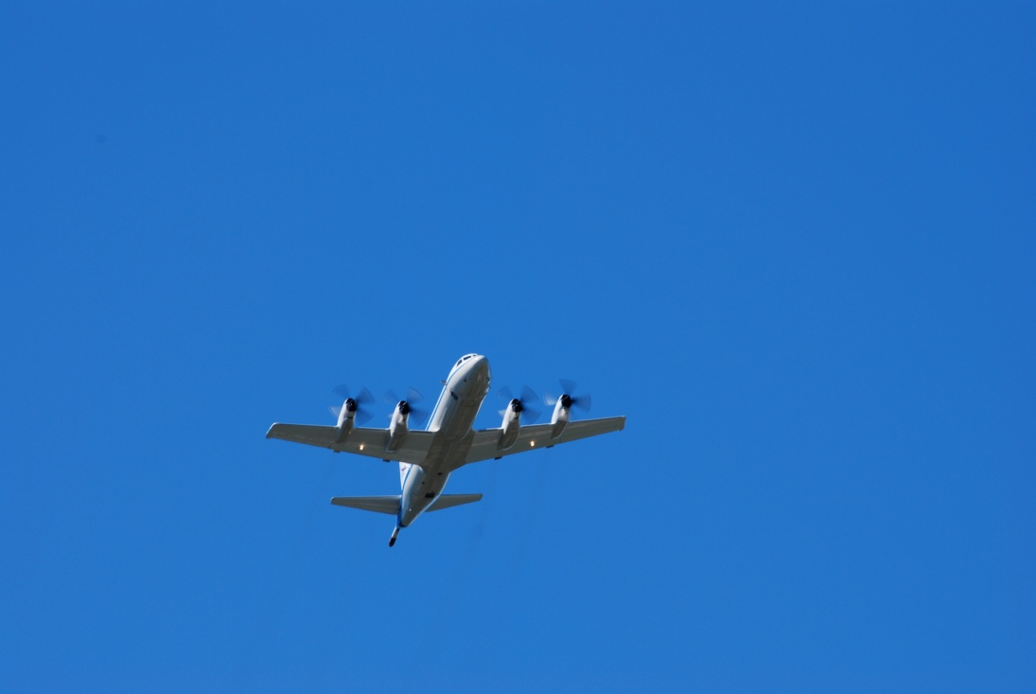
P-3B flights spiral over MDE sites
(typically 3 times per day, 2 hours apart)
P-3B In Situ Airborne Measurements
Bruce Anderson, NASA LaRC | aerosol optical, microphysical, and chemical properties
Andrew Weinheimer, NCAR | O₃, NO₂, NO, NO_{y}
Ronald Cohen, UC Berkeley | NO₂, ANs, PNs, HNO₃
Alan Fried, NCAR | HCHO
Glenn Diskin, NASA LaRC | H₂O, CO, CH₄
Stephanie Vay, NASA LaRC | CO₂
Armin Wisthaler, Innsbruck | Non-methane hydrocarbons

Slide 6
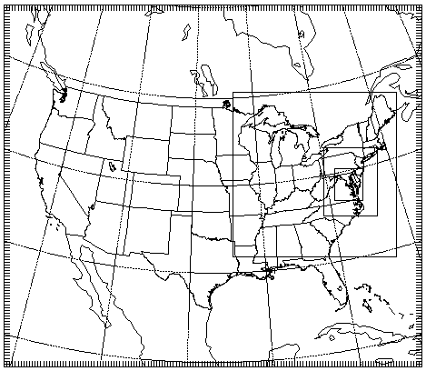
WRF and CMAQ Simulations
Time period: 24 May – 5 August
Re-initialize WRF every 3 days except for soil temperature and soil moisture
Length of each WRF run: 3.5 days (first 12 hours of each run is discarded)
Initial and Boundary Conditions: North American Regional Reanalysis and MOZART Chemical Transport Model
CMAQ run offline
36 km horizontal resolution
12 km
4 km
1.33 km

Slide 7
Weather Research and Forecasting (WRF) Version 3.3 Model Options
Radiation | LW: RRTM SW: Goddard
Surface Layer | Pleim-Xiu
Land Surface Model | Pleim-Xiu
Boundary Layer | ACM2
Cumulus | Kain-Fritsch (none for 1.3 km domain)
Microphysics | WSM-6
Nudging | Observational and analysis nudging
Damping | Vertical velocity and gravity waves damped at top of modeling domain
CMAQ Version 5.0 Model Options
Chemical Mechanism | CB05
Aerosols | AER05
Chemical initial and boundary conditions | MOZART CTM
Biogenic emissions Lightning NOx | BEIS on-line Allen et al. (2012, ACP)
Dry deposition | M3DRY

Slide 8
WRF/Chem simulation - Options
Meteorology & Physics
Initial & Boundary conditions | NARR
PBL | YSU
Microphysics | Lin
Convection | New Grell Scheme (G3)
Longwave Radiation | RRTM
Shortwave Radiation | Old Goddard scheme
Land surface | Unified NOAH LSM
Grid nudging | Coarse domain
Observational nudging | Coarse domain
Chemistry
Chemical mechanism | CBMZ
Aerosol module | MOSIAC (8 - bin)
Initial & Boundary conditions | MOZART4
Emissions | SMOKE (NEI05 projected to 2012)
Biogenic Emissions | MEGAN
Fire Emissions | The Fire INventory (FINN)
Simulation length: 6/27/2011 12Z – 8/2/2011 0Z
Meteorology was initialized every three days

Slide 9
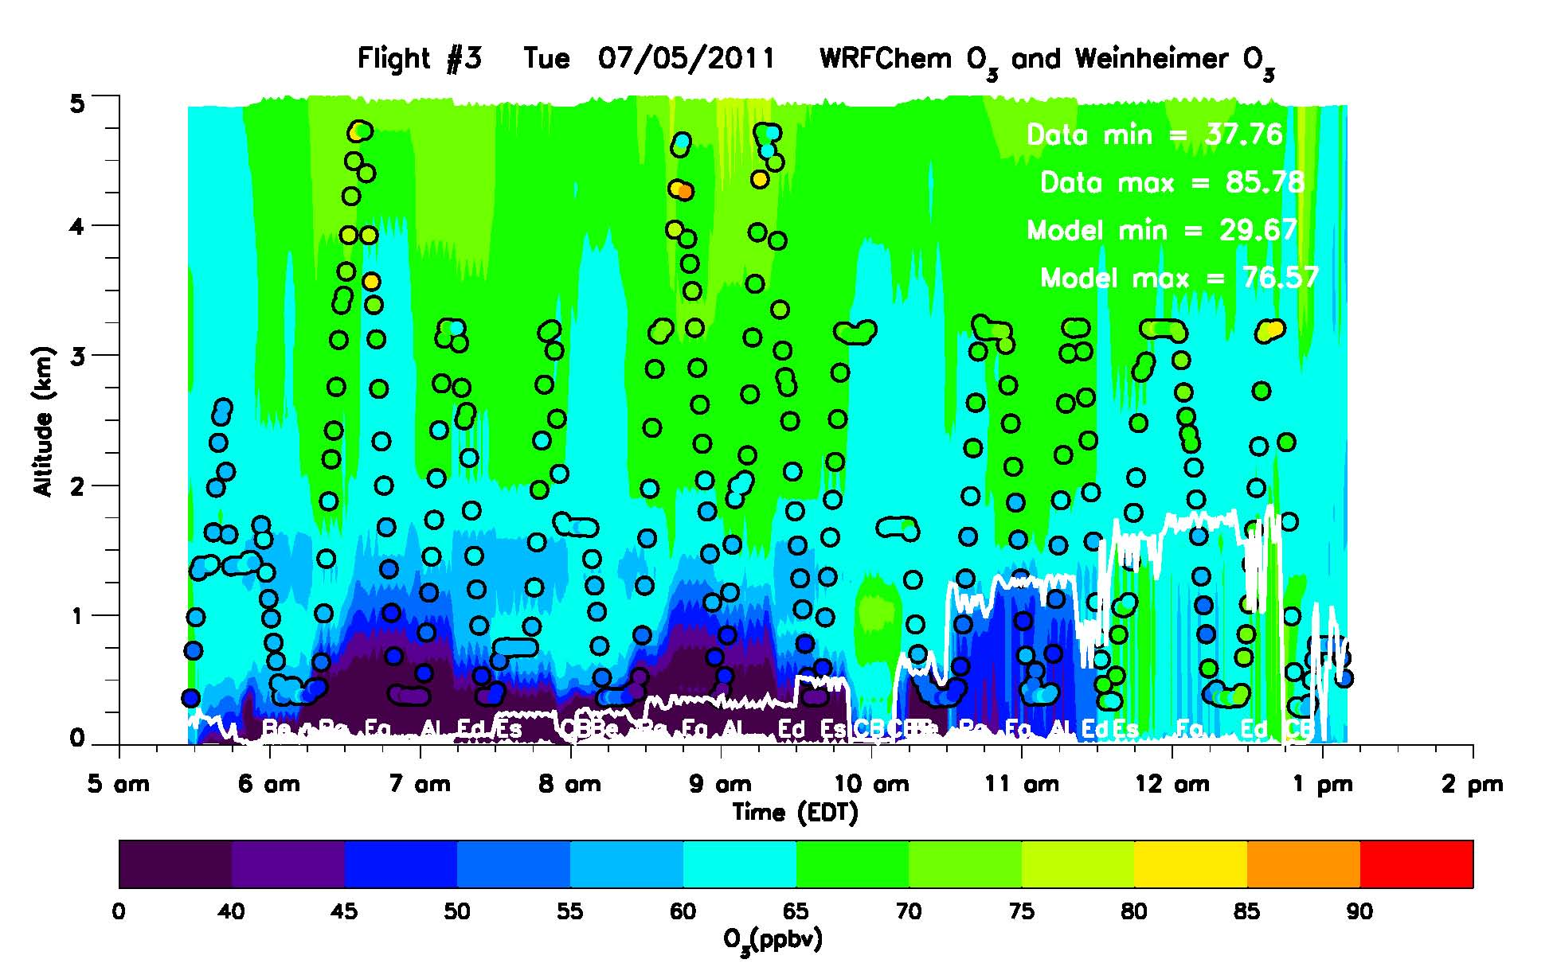
WRF/Chem O₃ curtain and Weinheimer in-situ O₃ from the P3-B
Flight #2 Tuesday 7/5/2011
Overall, WRF/Chem reproduced the O₃ observed during the campaign well
Model output profile following the flight
Data from P3-B
(60 sec average shown)
Model PBL height

Slide 10
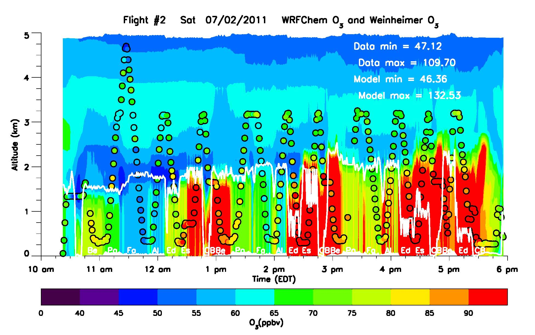
WRF/Chem O₃ curtain and Weinheimer in-situ O₃ from the P3-B
Flight #2 Saturday 7/2/2011
On several occasions, WRF/Chem underestimated O₃ above the PBL

Slide 11
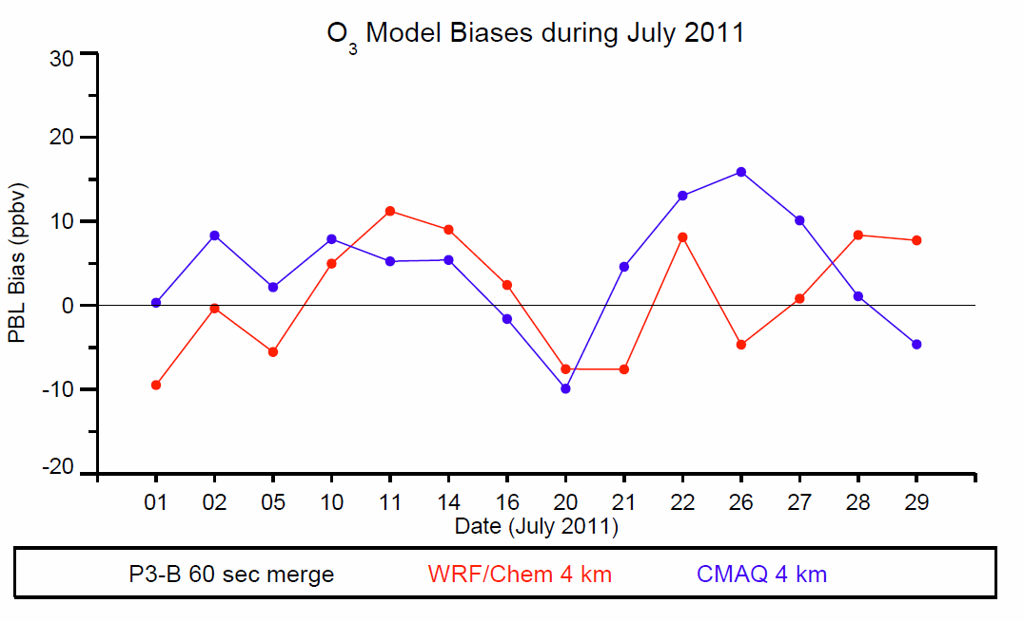
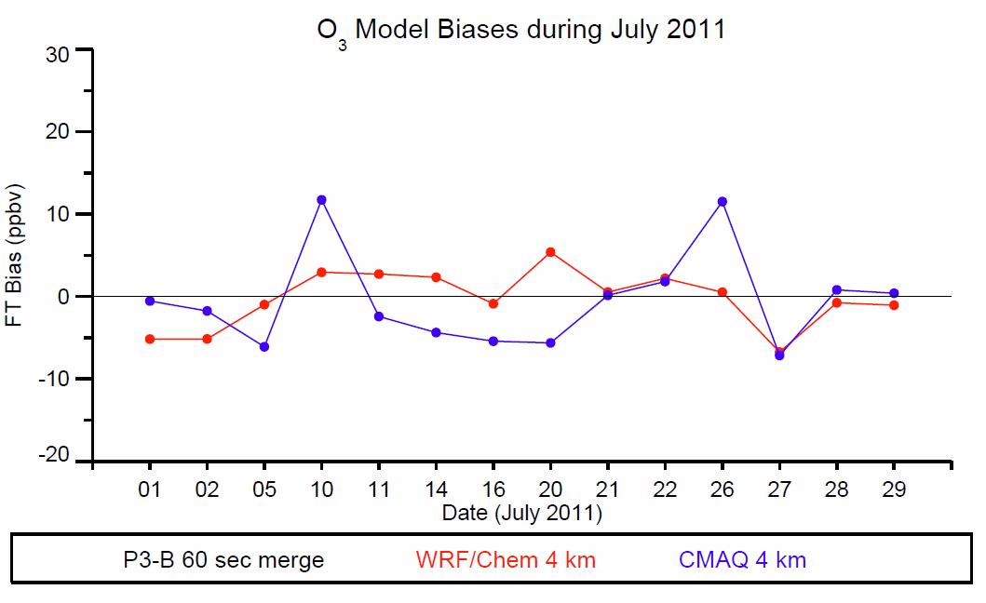
PBL mean biases:
WRF-Chem 4.5 ppbv
CMAQ 7.9 ppbv
FT mean biases:
WRF-Chem 3.0 ppbv
CMAQ 1.7 ppbv

Slide 12
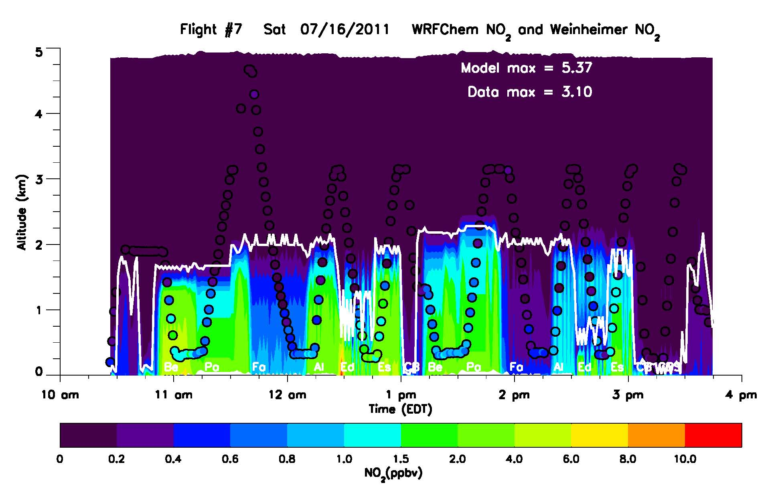
WRF/Chem NO₂ curtain and Weinheimer in-situ NO₂ from the P3-B
Flight #7 Saturday 7/16/2011
High bias in NO₂ was evident in the PBL

Slide 13
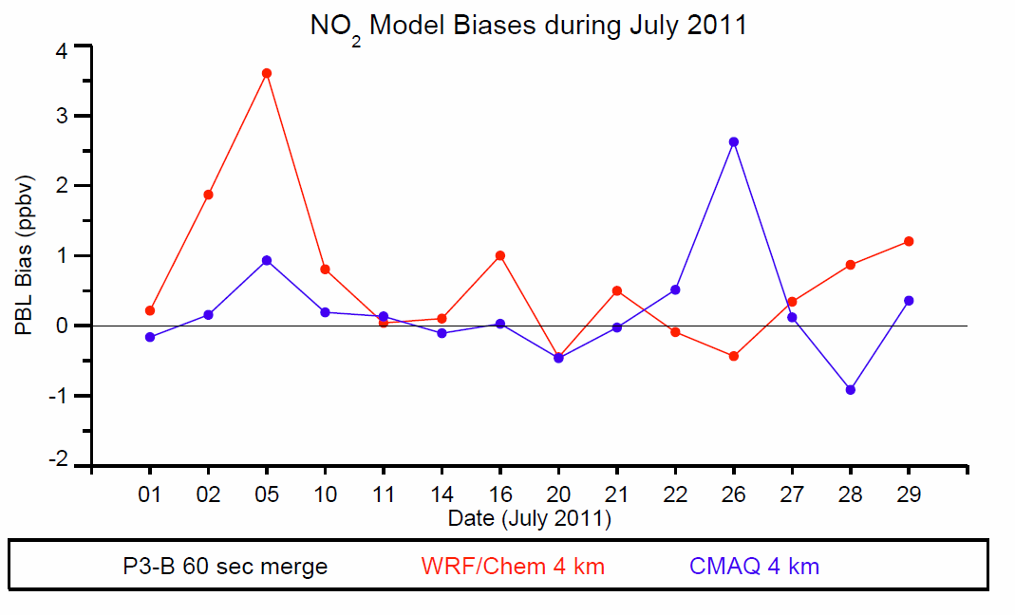
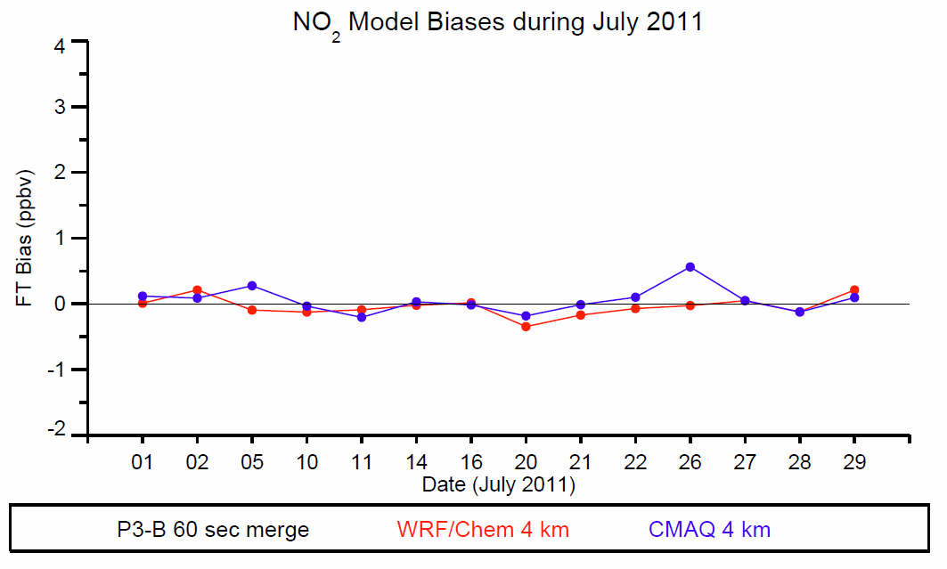
PBL mean biases:
WRF-Chem 0.81 ppbv
CMAQ 0.19 ppbv
FT mean biases:
WRF-Chem -0.13 ppbv
CMAQ -0.03 ppbv

Slide 14
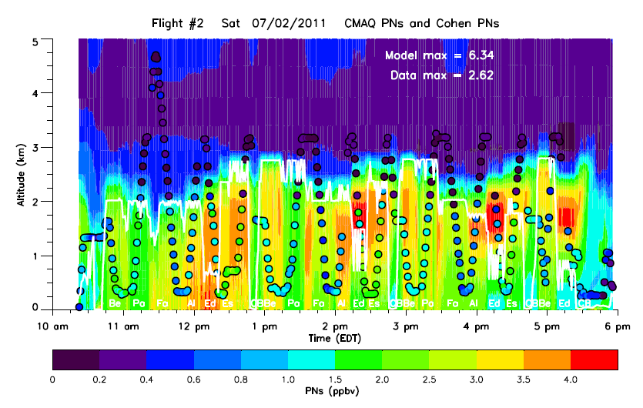

Slide 15
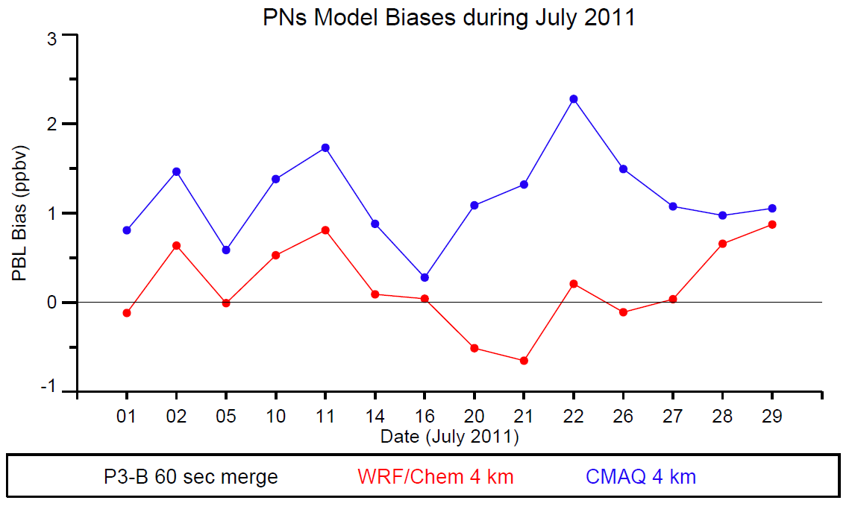
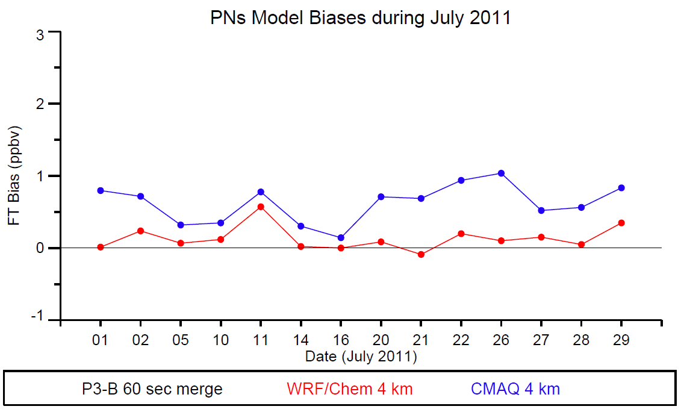
PBL mean biases:
WRF-Chem 0.53 ppbv
CMAQ 1.38 ppbv
FT mean biases:
WRF-Chem 0.12 ppbv
CMAQ 0.35 ppbv

Slide 16
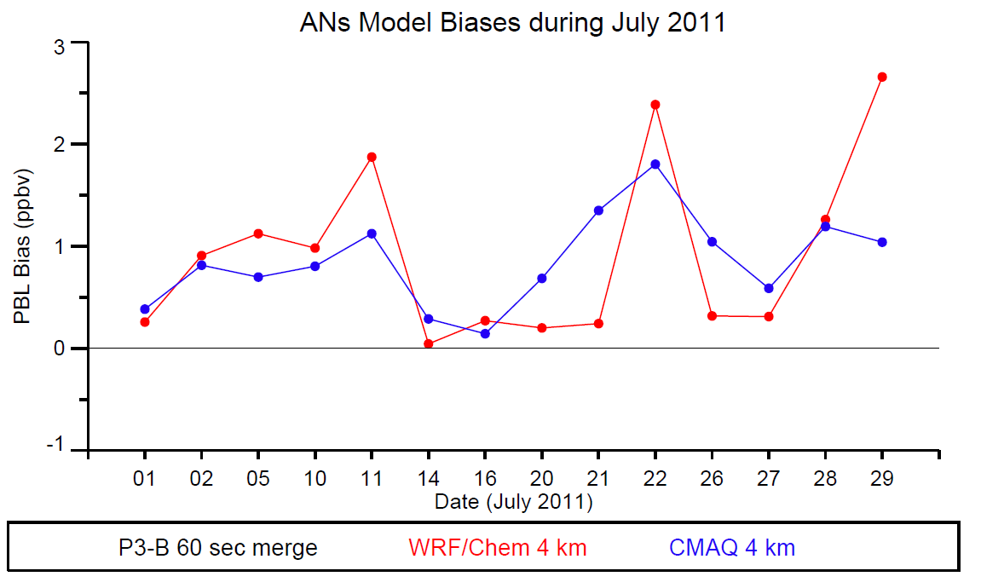
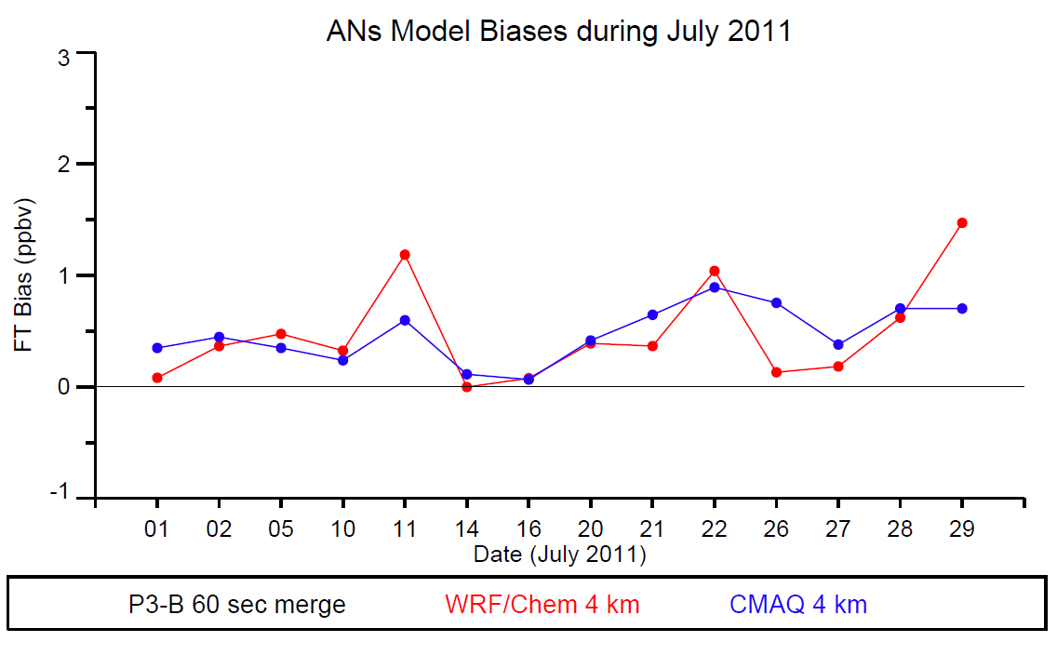
PBL mean biases:
WRF-Chem 0.98 ppbv
CMAQ 0.80 ppbv
FT mean biases:
WRF-Chem 0.32 ppbv
CMAQ 0.24 ppbv

Slide 17
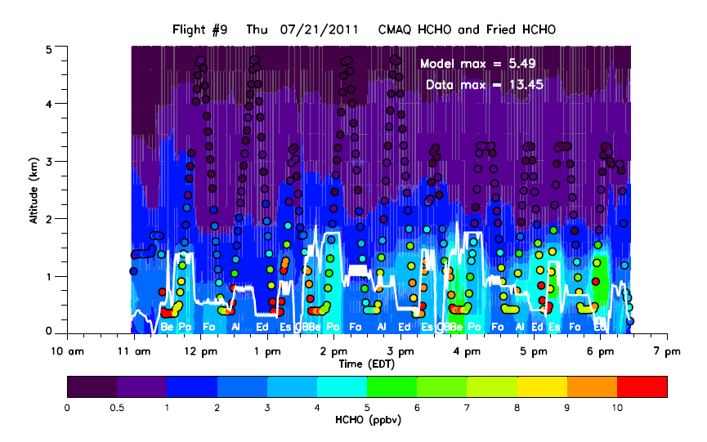

Slide 18
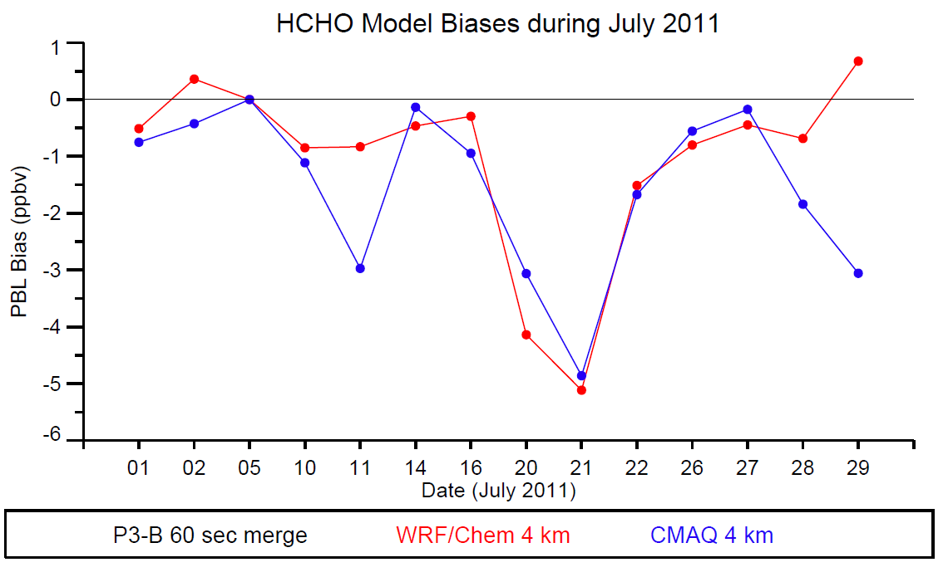
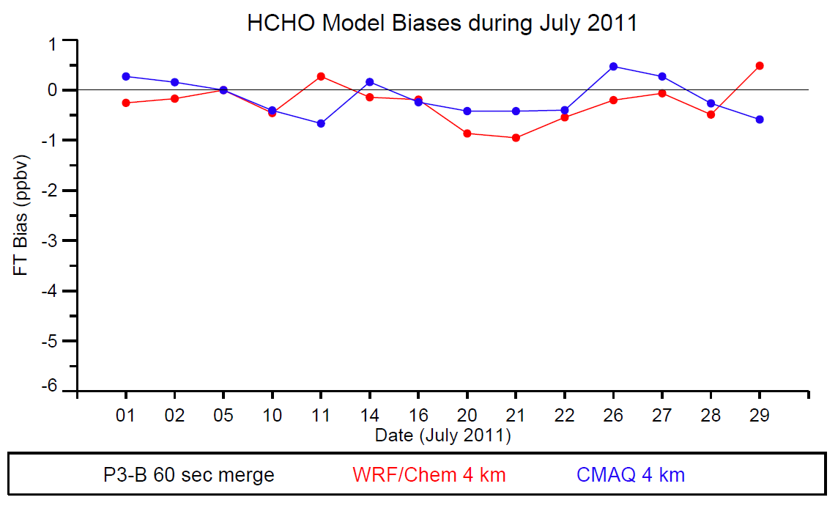
PBL mean biases:
WRF-Chem -0.85 ppbv
CMAQ -1.11 ppbv
FT mean biases:
WRF-Chem -0.46 ppbv
CMAQ -0.40 ppbv

Slide 19
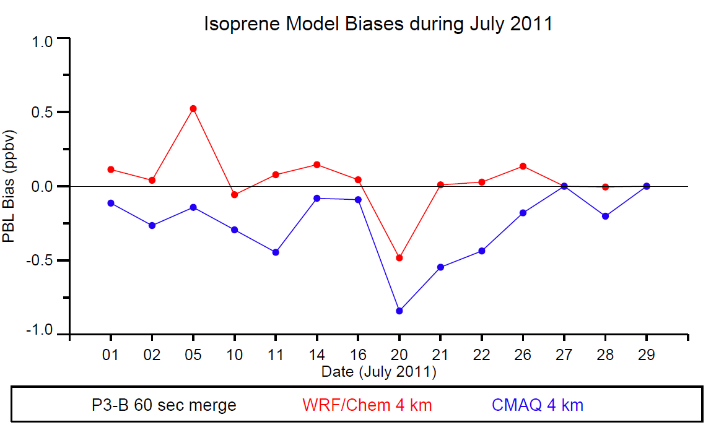
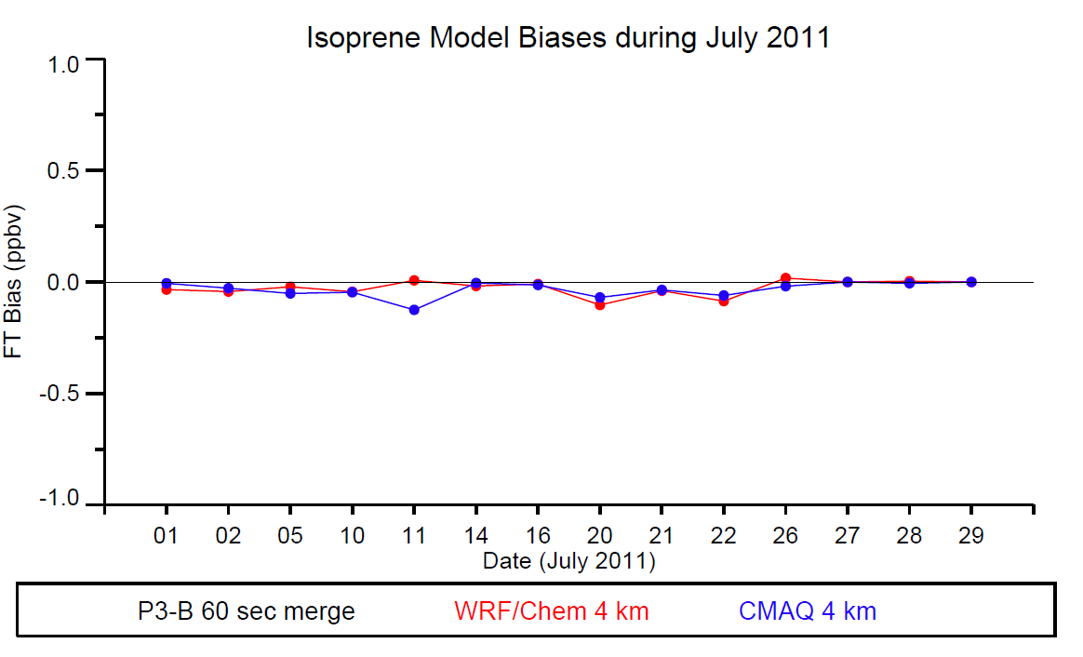
PBL mean biases:
WRF-Chem -0.06 ppbv
CMAQ -0.29 ppbv
FT mean biases:
WRF-Chem -0.04 ppbv
CMAQ -0.05 ppbv

Slide 20
Summary of Mean Biases: Green < ±10% Red > ±10%
Species WRF-Chem CMAQ
BL FT BL FT
O₃ High High High High
NO₂ High Low High Low NO2 emissions too large?
PNs High High High High Conversion to PAN too
rapid?
ANs High High High High Lifetime too long?
HCHO Low Low Low Low VOC emissions too small?
HCHO primary emissions?
Isoprene Low Low Low Low Isoprene emissions in both
BEIS3 and MEGAN low?
CO High Low High High

Slide 21
1-hour ozone biases at MDE sites
 | CMAQ 1.33 km | CMAQ 4 km | WRF-Chem 4 km
Fair Hill | 4.2 | 1.9 | 3.4
Aldino | -0.97 | -3.5 | -1.9
Padonia | 1.3 | 1.3 | 3.1
Edgewood | -0.59 | 3 | 1.6
Furley E. S. Recreation Center | 2.6 | 1.8 | 5.3
Essex | -0.32 | 1.7 | 2.8
Beltsville | 5.5 | 4.9 | 5.3
Davidsonville | 8.6 | 6.9 | 8.8
Prince George’s County Equestrian Center | 8.7 | 5.7 | 7.4
Calvert County | 10 | 8.1 | 9.4
Southern Maryland | 11.6 | 9.9 | 12.6
Millington | 4.8 | 3.3 | 5.6
All Sites (ppbv) | 4.6 | 3.8 | 5.3

Slide 22
Summary
The DISCOVER-AQ Maryland mission provided over 250 atmospheric profiles of trace gases and aerosols mostly in the 0.3 to 3 km layer
CMAQ had slightly lower mean bias at surface sites compared with WRF-Chem
Compared with P-3B aircraft observations, mean biases over all 14 flights were < ±10% for WRF-Chem O₃, CMAQ FT O₃, CMAQ NO₂, CO from both models, and WRF-Chem PBL isoprene
Problem species in both models: peroxy nitrates, alkyl nitrates, HCHO, and isoprene
Recycling more PNs and ANs back to NO_{x} will increase the existing high biases for O₃
Model evaluation using OMI tropospheric NO₂ data underway
Data from Maryland campaign publicly available; next mission in Jan/Feb 2013 in San Joaquin Valley, California.

Slide 23
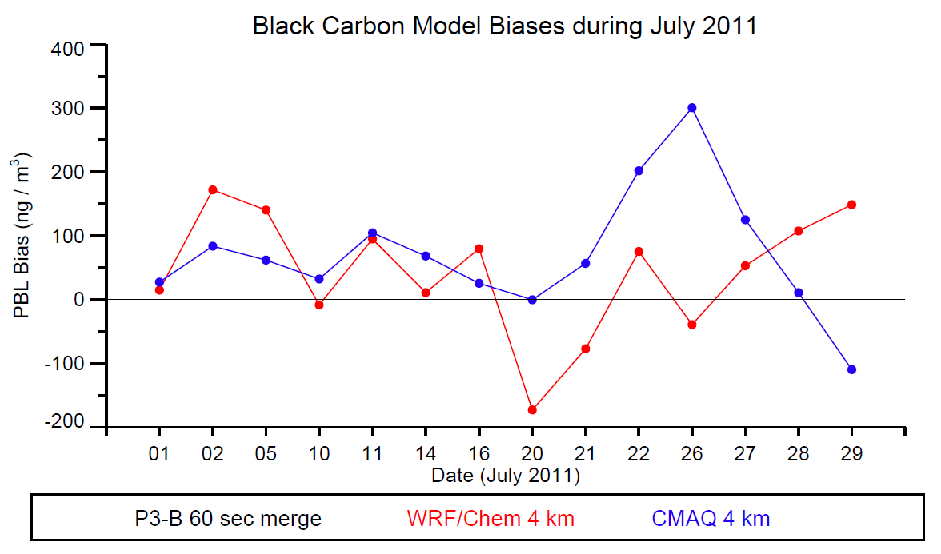
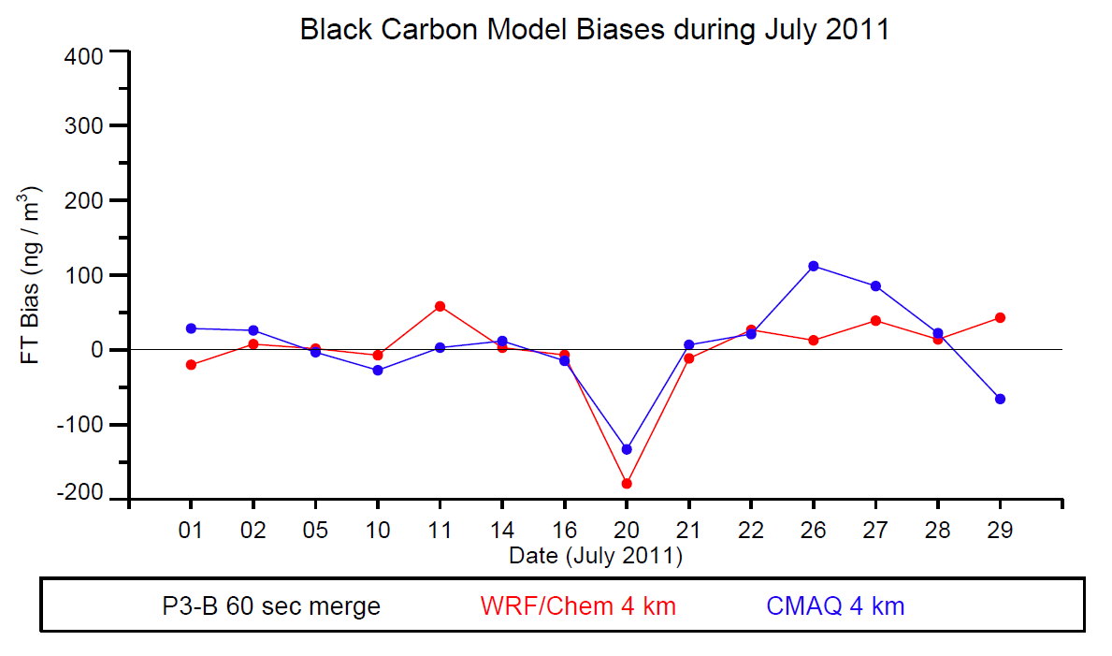
Typically BC obs
600-800 ng/m3
Typically BC obs
~50 ng/m3

