Slide 1
Sensitivities of Spectral Nudging Toward Moisture for Regional Climate Modeling
Tanya L. Otte¹, Martin J. Otte¹, Jared H. Bowden²,
and Christopher G. Nolte¹
¹U.S. Environmental Protection Agency, Research Triangle Park, NC
²University of North Carolina, Chapel Hill, NC
11th Annual CMAS Conference
Chapel Hill, North Carolina
17 October 2012

Slide 2
What is “nudging”?
Constraint toward a reference state
  Retrospective runs: reference ~ comparable spatial resolution
  Regional climate runs: reference ~ coarser spatial resolution
  Nudging strategies depend on application!
Includes non-physical term that is:
  Based on reference minus model
  Scaled relative to inverse of e-folding time of phenomena (subjective)
  Can be restricted in vertical (toward earth’s surface)
Grid nudging types:
  Differences from gridded field at each grid point (“analysis”)
    Wind, temperature, moisture*
  Differences from gridded field from spectral wave decomposition
    Wind, temperature, geopotential

Slide 3
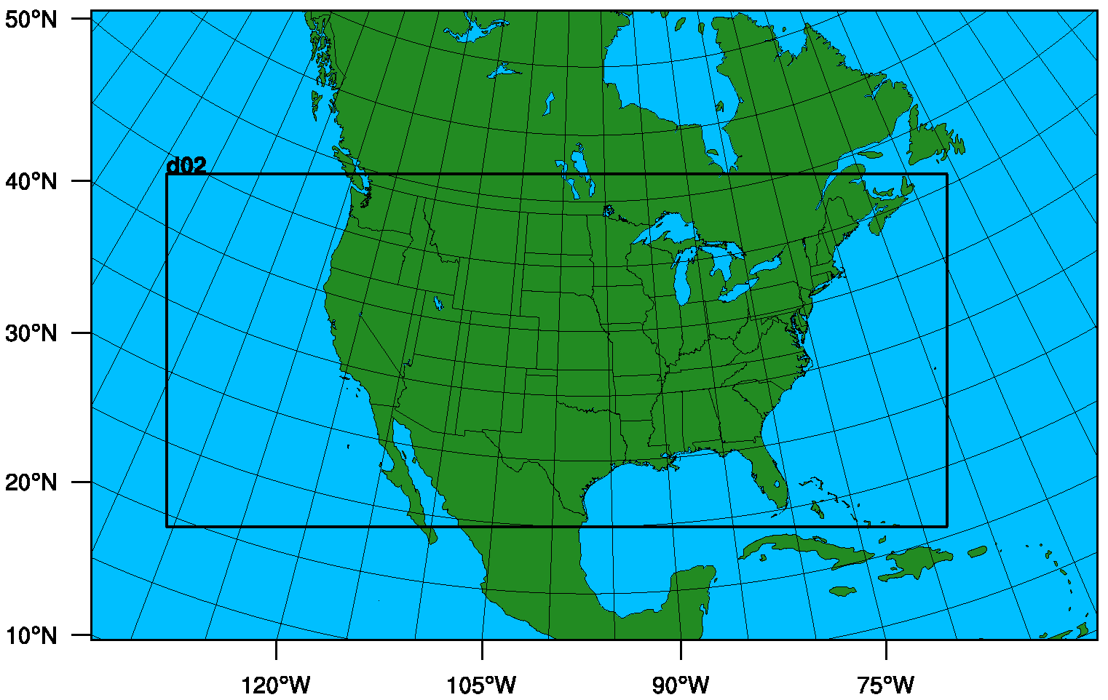
Three 20-year Historical Runs in Regional Climate Mode
  WRFv3.2.1: 2 Dec 1987 – 1 Jan 2008, continuous run
  Initialized from 2.5° × 2.5° NCEP/DOE Reanalysis II
  108-36-km, 2-way-nested
  34 layers, top at 50 hPa
  WSM6 microphysics
  Grell ensemble convection
  RRTMG radiation
  YSU PBL scheme
  NOAH LSM
Nudging: none (NN), analysis (AN), spectral (SN)
  No nudging in PBL; some changes to coefficients
Comparisons to NARR and CFSR on 36-km domain
Figure courtesy J. Herwehe

Slide 4
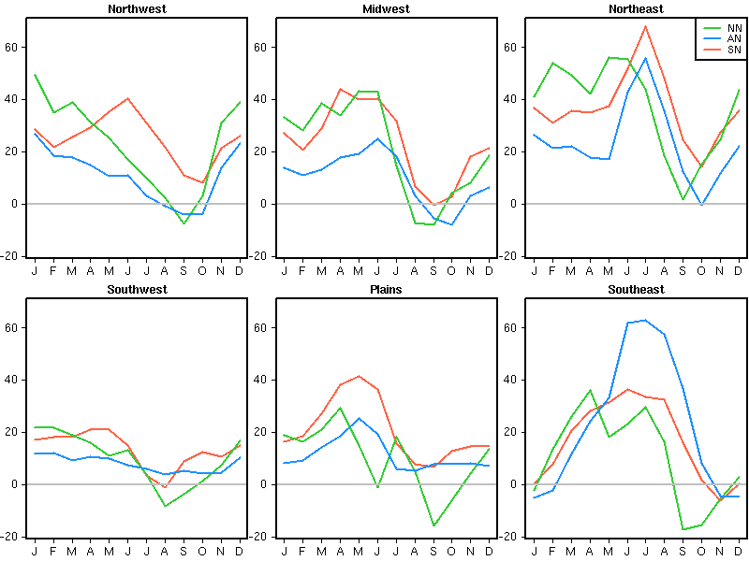
Precipitation Difference from NARR
(averaged over 20-year period)
60
40
20
0
-20
Compare to 3-h, 32-km NARR
60
40
mm
20
0
-20
Otte et al.,
J. Climate,
2012
SN is consistently wetter than AN in 5 of 6 regions.
SN wet bias is often as large as or larger than NN.

Slide 5
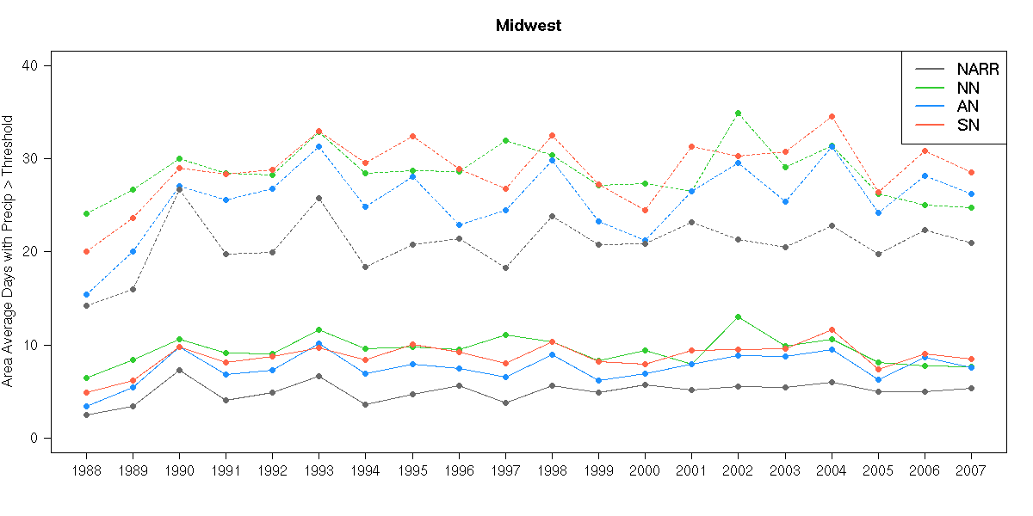
Effects of Nudging on
Precipitation Extremes
Annual Area-Average Days Exceeding Threshold Precipitation
Midwest
40
Days >0.5”
30
Compare to 3-h, 32-km NARR
20
Days >1.0”
10
0
88
89
90
91
92
93
94
95
96
97
98
99
00
01
02
03
04
05
06
07
Otte et al., J. Climate, 2012
AN closer to NARR than SN for extremes of precipitation.

Slide 6
We Prefer to use Spectral Nudging for Regional Climate Modeling
SN is spatial-scale-selective whereas AN is not.
  SN preserves spatial variability in the desirable range.
  AN produces comparable 2-m temperature to and better precipitation than SN, but dampens variability.
Motivating Science Question: Can SN precipitation be improved without compromising 2-m temperature?
Hypothesis: SN will predict precipitation better if also nudging toward moisture.

Slide 7
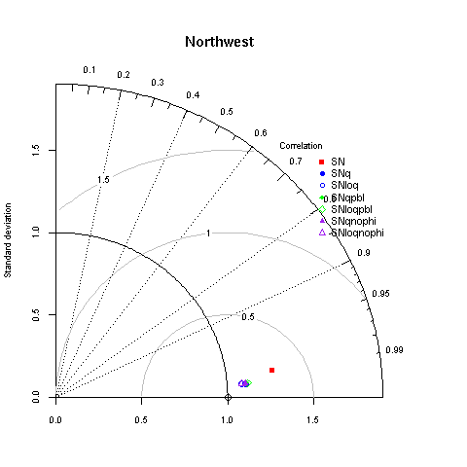
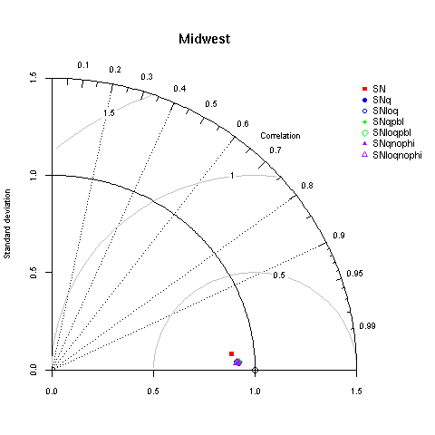
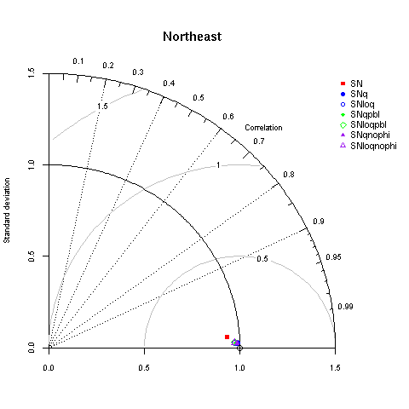

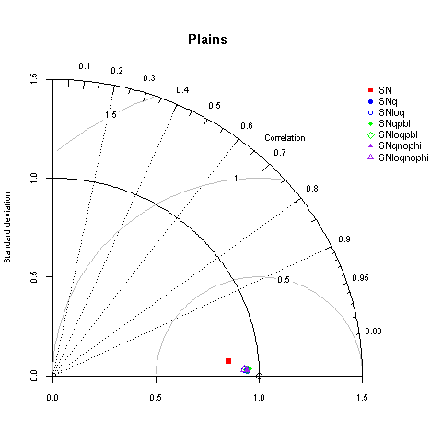
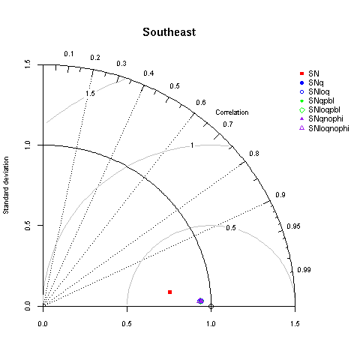
Taylor Diagrams – Precipitable Water
(“SN Sensitivities with Nudging Q” vs. NARR, 3-yr)
Northwest
Midwest
Northeast
Southwest
Plains
Southeast
Adding SN toward moisture (all except ▪) improves PWAT comparison to NARR, even in PBL, and not always in same direction (SW vs. NW).

Slide 8
We iterated on strategies to use spectral nudging of moisture.
“Default” coefficient (~1 h timescale) is too strong
  Did not improve precipitation
  Resulted in too many clouds
Conservative coefficient (~6 h timescale) works well
  Tracks consistently with AN (same coefficient)
Both had too many high clouds and too low OLR!
Implemented “reverse Zfac” to limit nudging above tropopause
Restricted nudging of θ above tropopause and lowered its coefficient to match Q
  G_{θ} = 4.5 × 10⁻⁵ s⁻¹ and G_{Q} = 4.5 × 10⁻⁵ s⁻¹ (time scale ~6 h)
  Same coefficients used on both domains

Slide 9
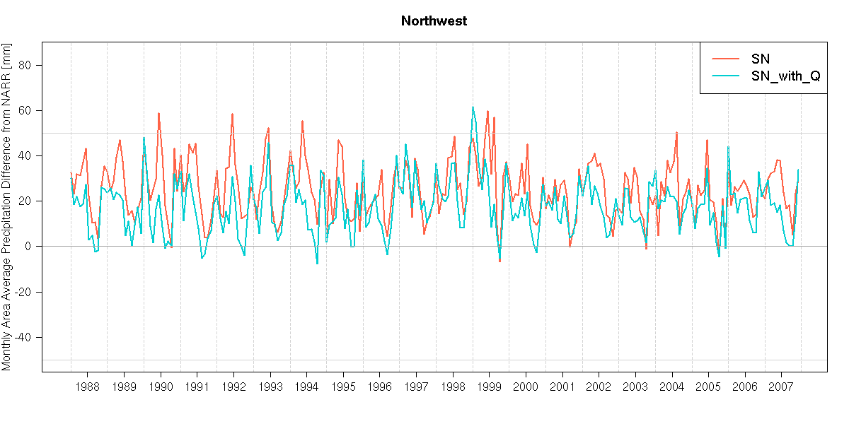
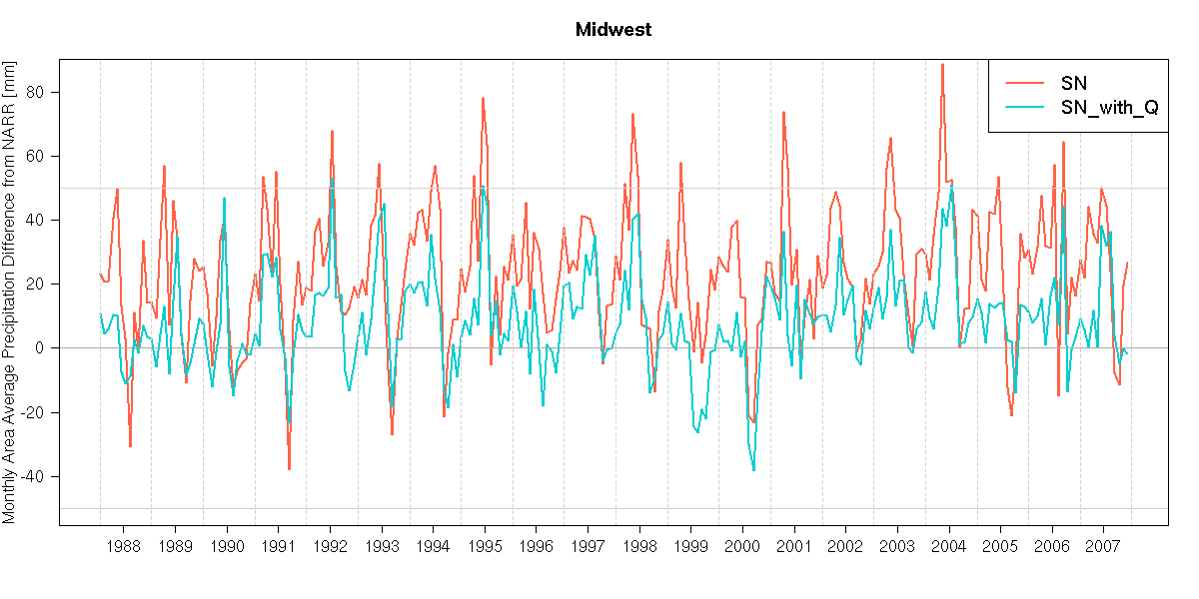
20-Year Monthly Precipitation
Difference from NARR
Northwest
50
SN_with_Q reduces overprediction of monthly precipitation in SN.
0
-50
Midwest
50
mm
0
-50

Slide 10
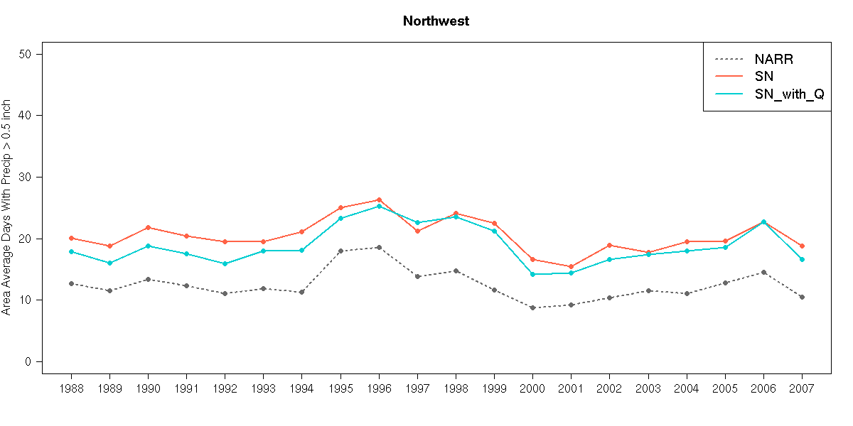
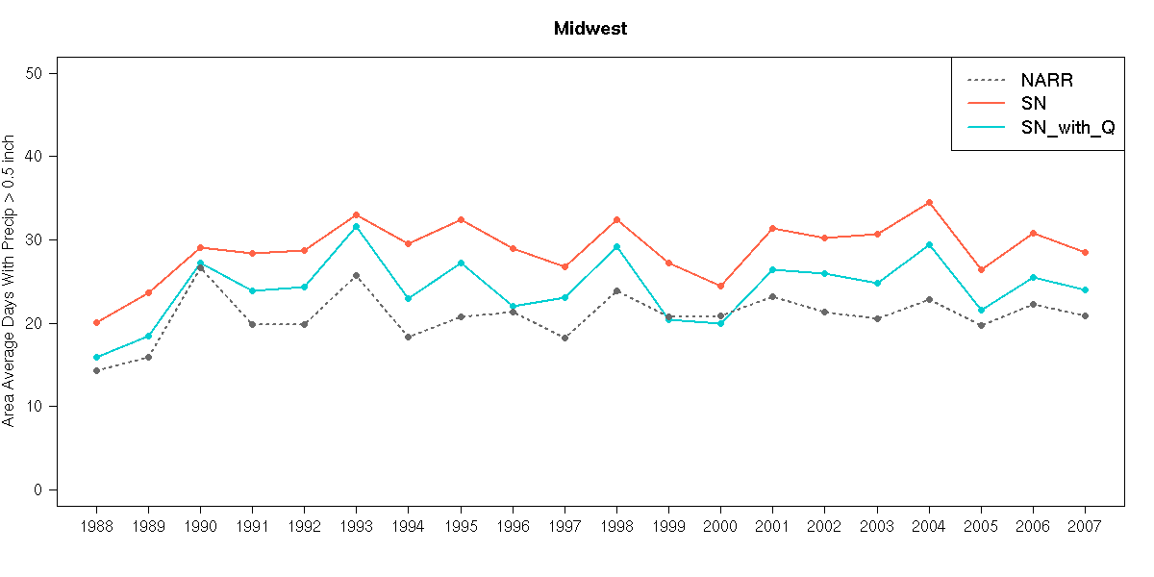
Annual Area-Average Days with Precipitation >0.5”
Northwest
40
SN_with_Q improves prediction of extreme precipitation events.
20
0
Midwest
40
days
20
0

Slide 11
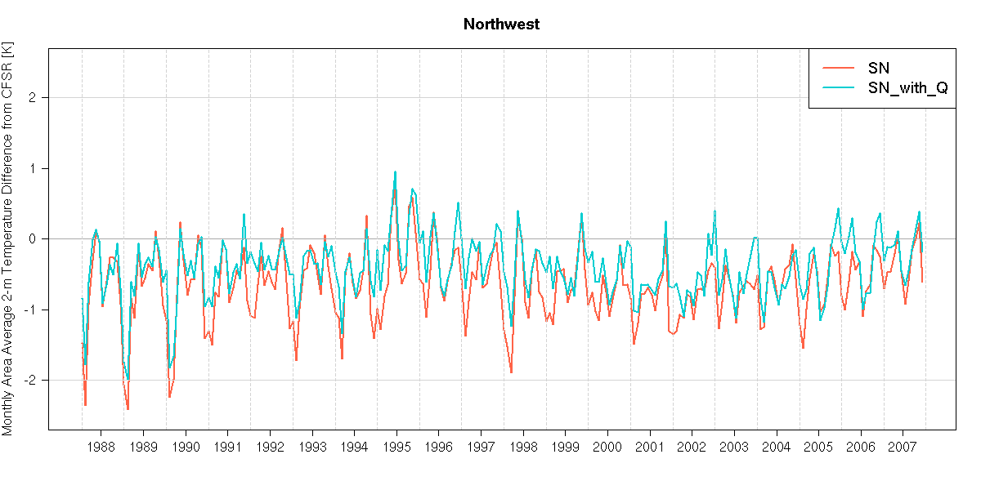
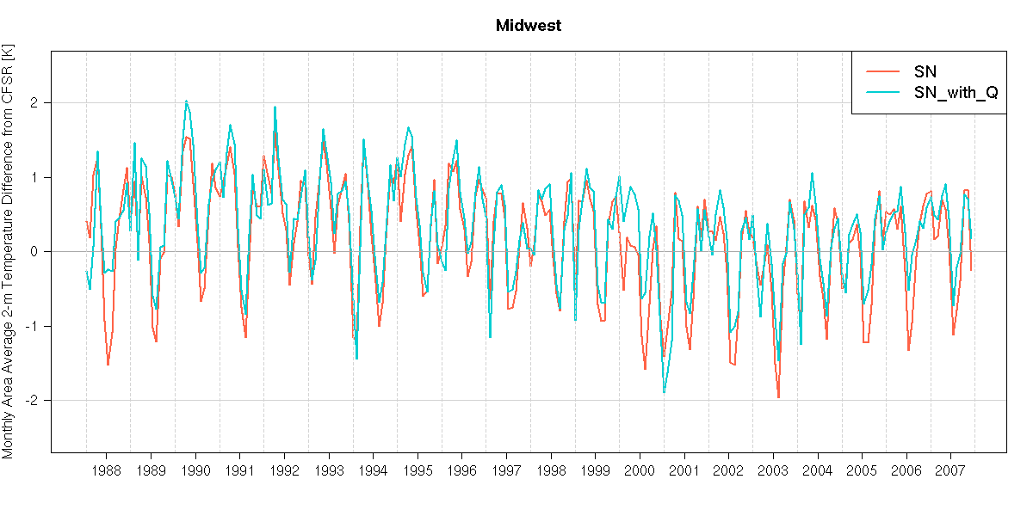
20-Year Monthly Temperature Difference from CFSR
Northwest
2
Overall, SN_with_Q improves 2-m temperatures compared with SN.
0
-2
Midwest
2
K
0
-2

Slide 12
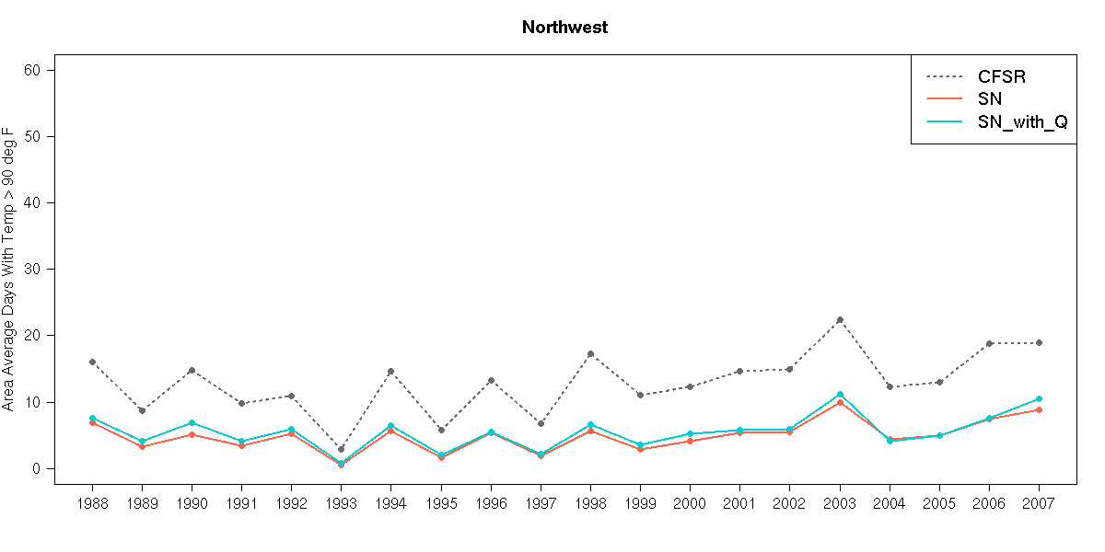
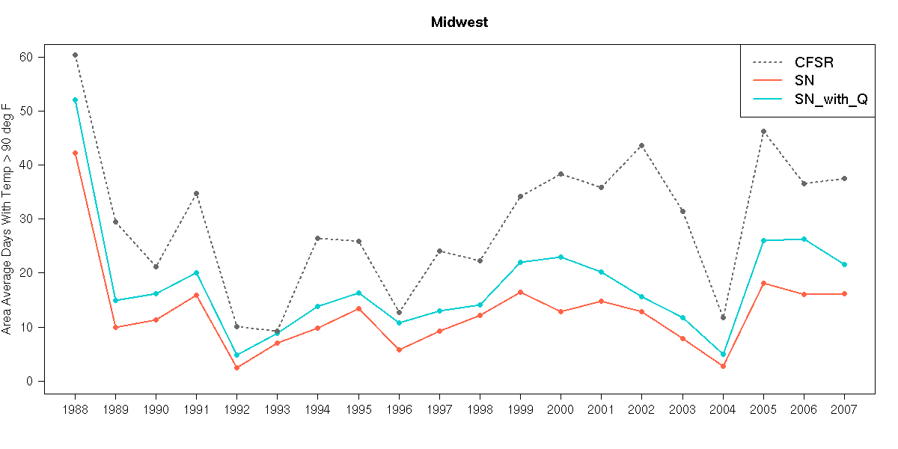
Annual Area-Average Days with Temperature >90°F
Northwest
60
40
SN_with_Q creates slight to modest improvements in prediction of extreme warm temperatures.
20
0
Midwest
60
40
days
20
0

Slide 13
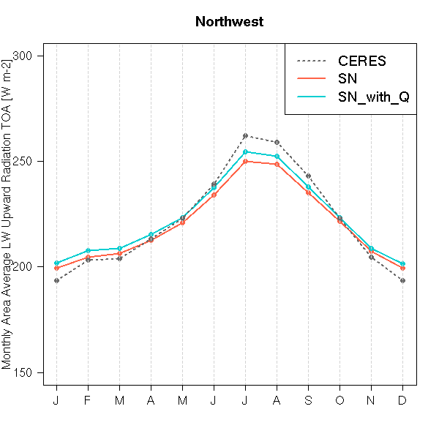
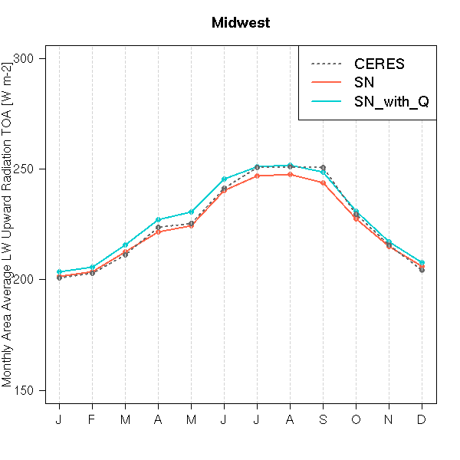
Comparison to CERES:
LW Upward Radiation at TOA
Northwest
Midwest
300
300
250
250
W m⁻²
200
200
150
150
Both agree well with CERES outgoing longwave radiation.

Slide 14
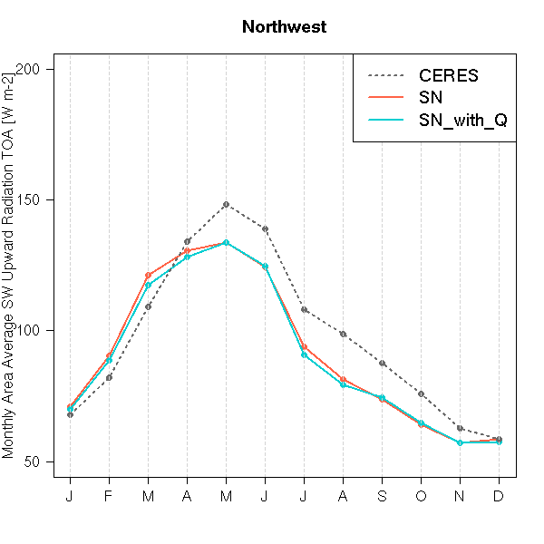
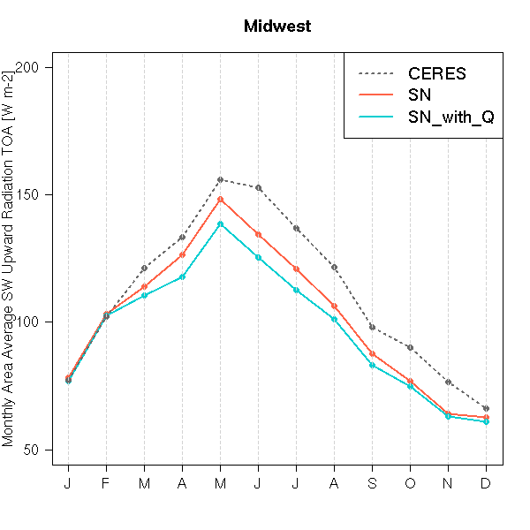
Comparison to CERES:
SW Upward Radiation at TOA
Northwest
Midwest
200
200
150
150
W m⁻²
100
100
50
50
Both agree well with CERES outgoing shortwave radiation,
although SN slightly better in Midwest.

Slide 15
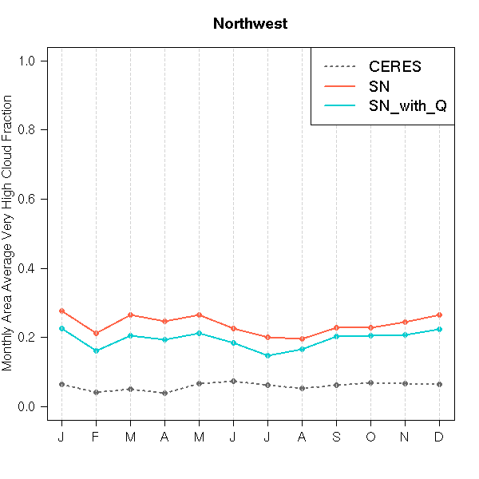
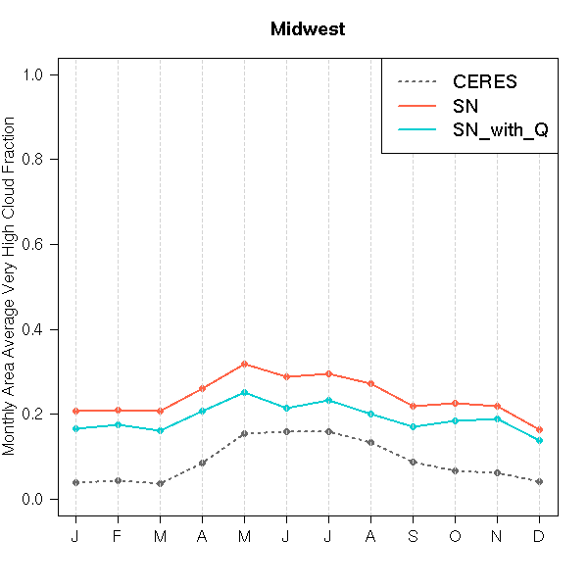
Comparison to CERES:
Cloud Fraction (above 300 hPa)
Northwest
Midwest
1.0
1.0
0.8
0.8
0.6
0.6
fraction
0.4
0.4
0.2
0.2
0.0
0.0
SN_with_Q reduces overprediction of very high clouds by 0.05.

Slide 16
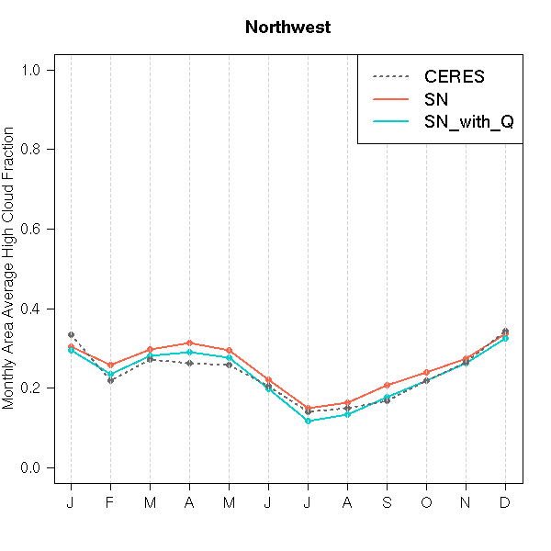
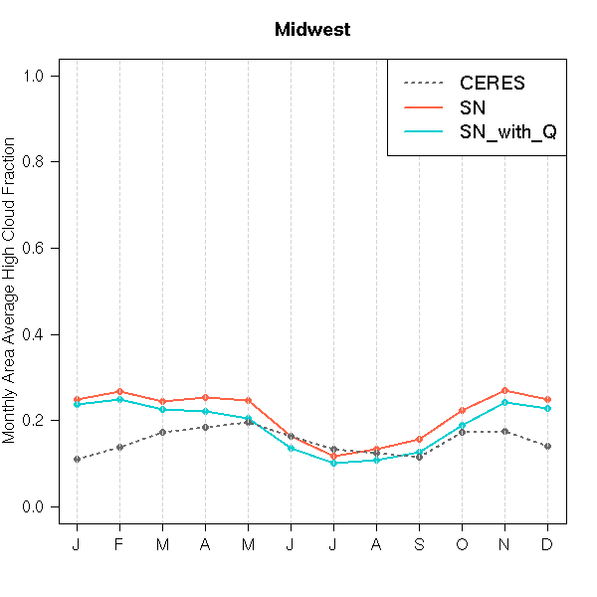
Comparison to CERES:
Cloud Fraction (300-500 hPa)
Northwest
Midwest
1.0
1.0
0.8
0.8
0.6
0.6
fraction
0.4
0.4
0.2
0.2
0.0
0.0
SN_with_Q slightly reduces high cloud fraction throughout year compared to SN.

Slide 17
Spectrally nudging moisture can improve precipitation in WRF!
Did not compromise 2-m temperature verification!
  Improved extreme heat predictions!
Must be careful and conservative!
  Default coefficient (G_{Q} = 3.0 × 10⁻⁴ s⁻¹) is too high!
  Fairly low coefficient (G_{Q} = 1.0 × 10⁻⁵ s⁻¹) is too low!
Can be limited to below tropopause
  High clouds and radiation more consistent with CERES
  Little effect on 2-m temperature or precipitation
Also restricting θ nudging above tropopause and reducing G_{θ} improves simulation
  Applying consistent nudging to thermodynamics

