Slide 1

Diagnostic Evaluation of a Modeling System for Predicting the Air Quality Impacts of Prescribed Burns
Talat Odman
Fernando Garcia-Menendez
Aika Yano
Yongtao Hu
CMAS Annual Conference
Chapel Hill, North Carolina
October 16, 2012

Slide 2
Contributors
Scott Goodrick, Yongqiang Liu, Gary Achtemeier (Forest Service)
  Emissions/Dispersion Modeling, Plume Height Measurements
Roby Greenwald (Emory University)
  Ground-based Smoke Measurements
Brian Gullett, Johanna Aurell, William Stevens (EPA)
  Aerostat-based Emissions and Wind Measurements
Roger Ottmar (Forest Service)
  Fuels/Consumption Measurements
Robert Yokelson, Sheryl Akagi (University of Montana)
  Aircraft-based Smoke/Meteorology Measurements

Slide 3
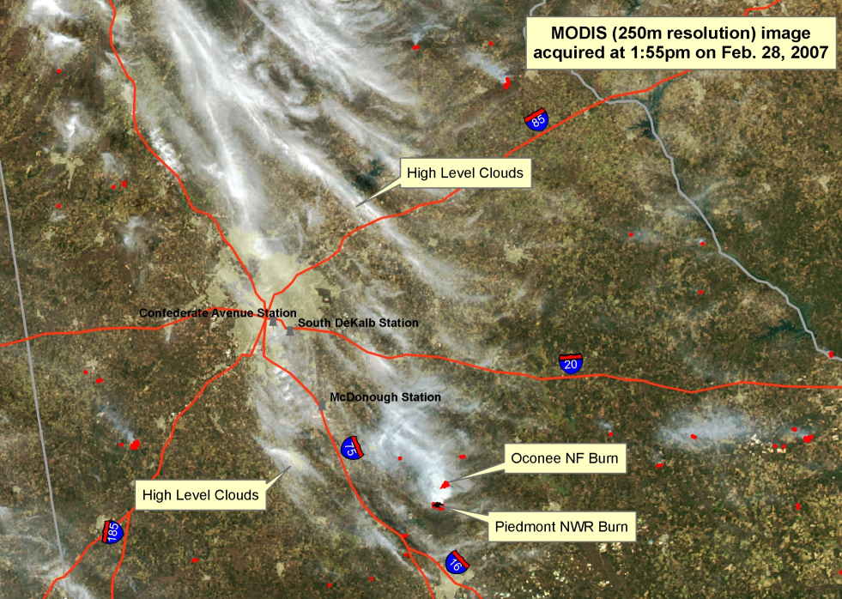
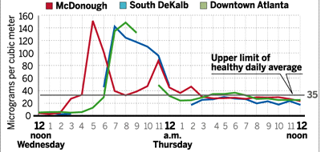
Motivation: 2007 Atlanta Smoke Incident
Two large burns (3000 acres total) were started in the morning of February 28, 2007 under easterly winds about 80 km southeast of Atlanta.
Later, the winds shifted to southeasterly and blew the smoke to Atlanta. By late afternoon, PM_{2.5} levels reached 150 μg/m³ at several Atlanta monitors.

Slide 4
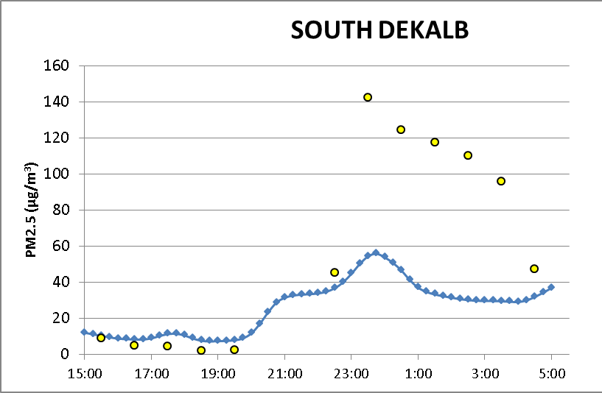
Initial Modeling Results &
Potential Sources of Improvement
Emissions
  Fuels, emission factors
Meteorology
  Wind speed/direction
Models
  Plume/PBL height
  Grid resolution

Slide 5
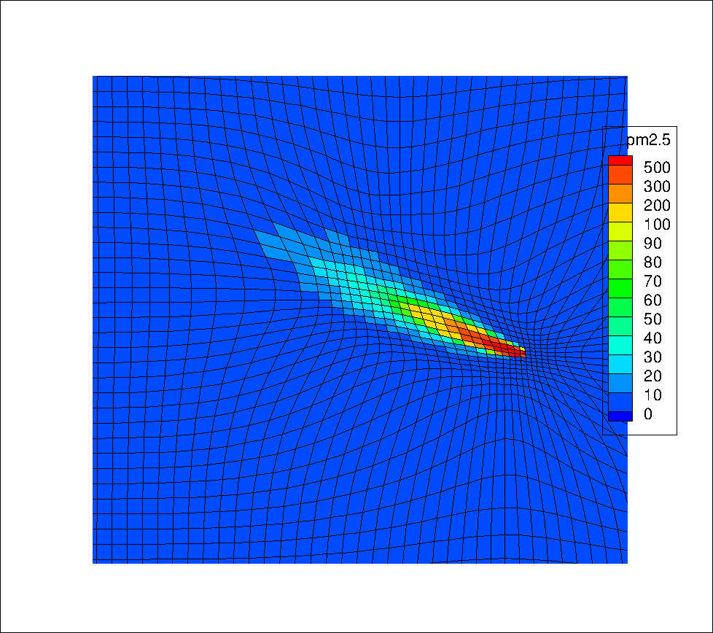
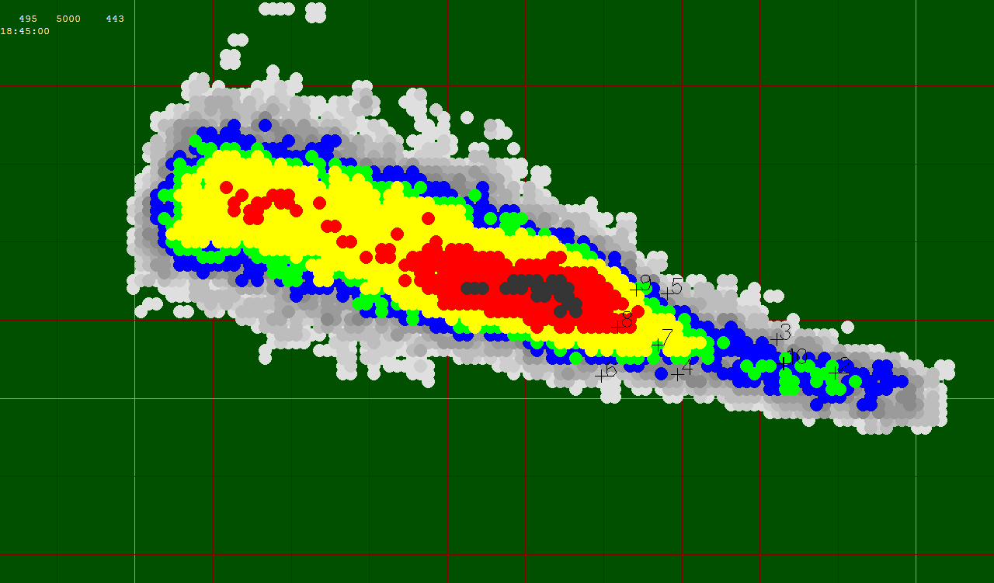
Modeling System
Emissions: CONSUME, Fire Emission Production Simulator (FEPS)
Meteorology: WRF (MM5)
Dispersion and Transport:
  Daysmoke was coupled with AG-CMAQ as a subgrid-scale plume model.
Daysmoke
(empirical stochastic dispersion model)
AG-CMAQ
(adaptive grid CMAQ)
Notes:
The models used in this research are the Community Multiscale Air Quality (CMAQ) , which is a regional scale model and Daysmoke which is a local scale plume model.
We have incorporated the Adaptive Grid methodology in CMAQ to improve its grid resolution and facilitate its coupling with sub-grid scale models.
Of course here our target model is Daysmoke but the framework can be used for other models as well.
We are also exploring the possibility of using an adaptive grid version of MM5. If this works, the meteorological inputs to CMAQ will be provided on the same grid eliminating the need for interpolations.
Because of this exciting opportunity of coupling meteorology models with air quality models we are spending more time on adaptive grid incorporation than originally planned. .

Slide 6
Effect of Grid Resolution
4 km
~100 m
Mean Fractional Error reduced by 15%

Slide 7
Emission Uncertainties
4 to 6 × Emissions gives the desired level of PM at receptors.
But, is such an increase realistic?
What are the uncertainties in emissions?
Emissions = Fuel Consumption × Emission Factors

Slide 8
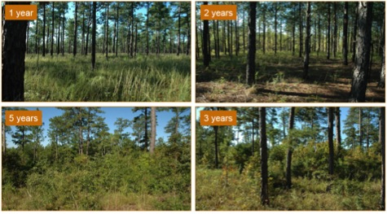
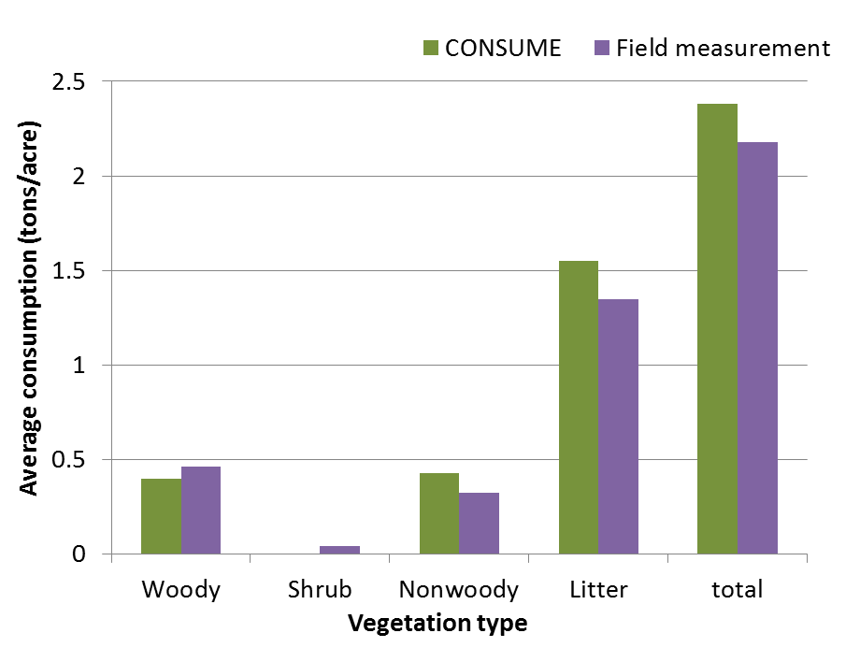
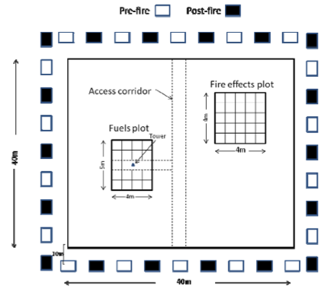
Uncertainty in Fuel Consumption
Photo Series + CONSUME 3.0 vs.
Measurements
Consumption is over-estimated by 10%
Notes:
CONSUME 3.0 calculates the amount of fuel consumption under different fire conditions.
Photo series tend to overestimate except for 100hr fuel loading. Ottmar 2.7 vs Scott 3.2 therefore 0.5 tons/acre difference or
Fuel load is 20% over-estimated by photo series

Slide 9
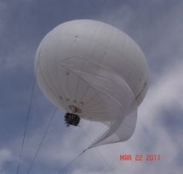
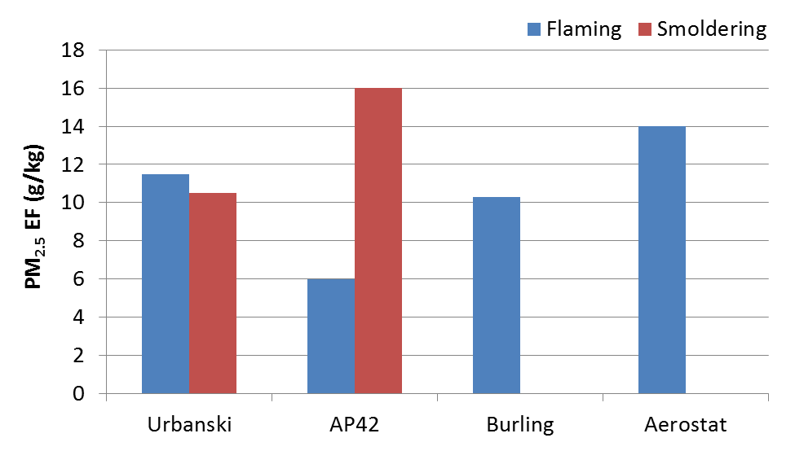
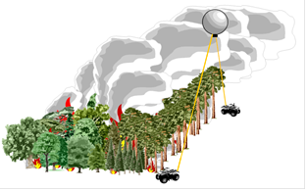
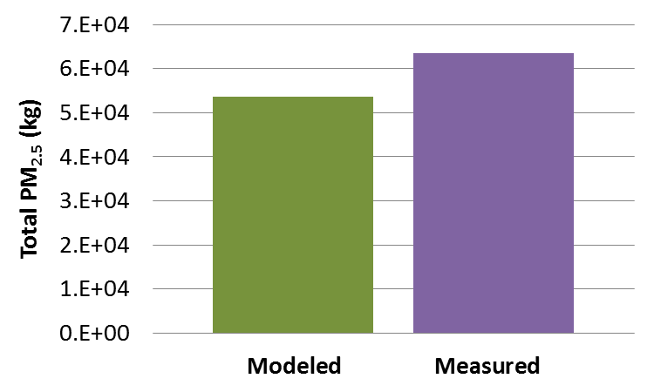
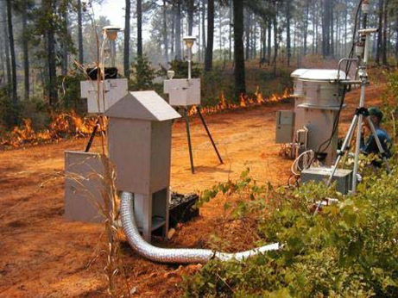
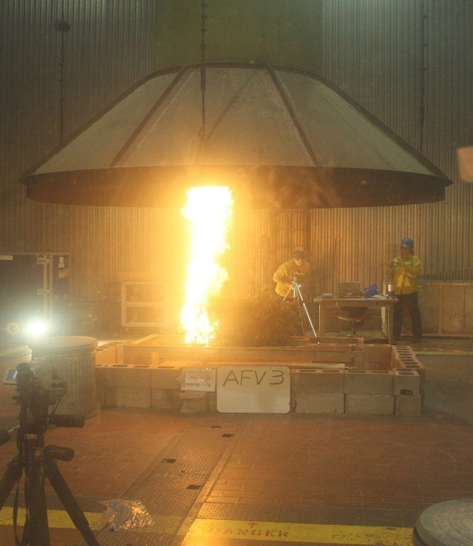
Emission Factors and Total Emission Uncertainties
PM_{2.5} emissions
under-predicted by 15%
Notes:
Emission Factors (EF) are available from field and/or laboratory studies.
Mostly on the ground
The Fire Sciences Lab in Missoula, MT is equipped to measure emissions from simulated fires. Analytical instrumentation includes GC, MS, FTIR

Slide 10
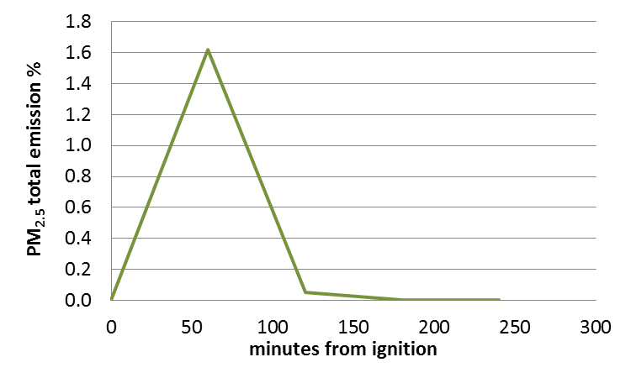
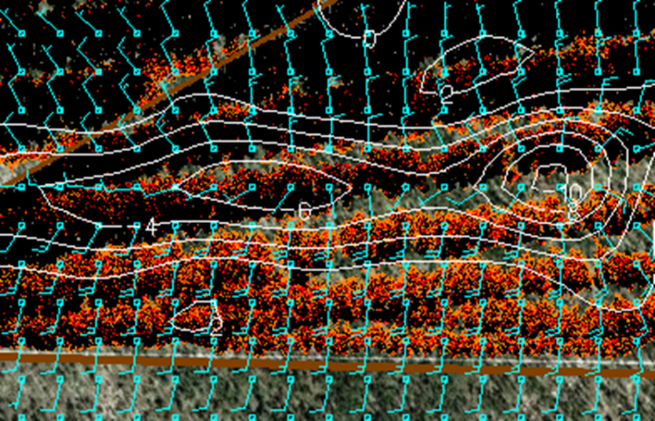
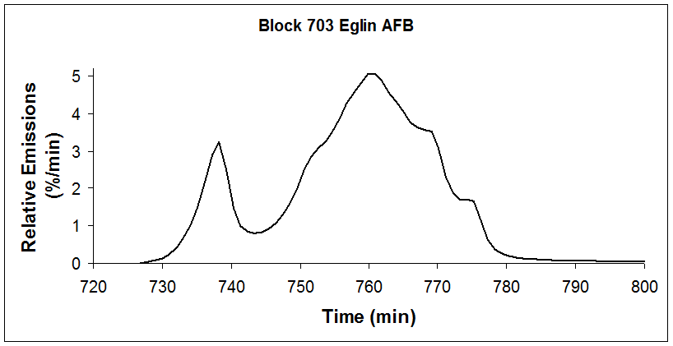
Uncertainty in Timing of Emission
Fire Emission Production Simulator (FEPS)
Rabbit Rules

Slide 11
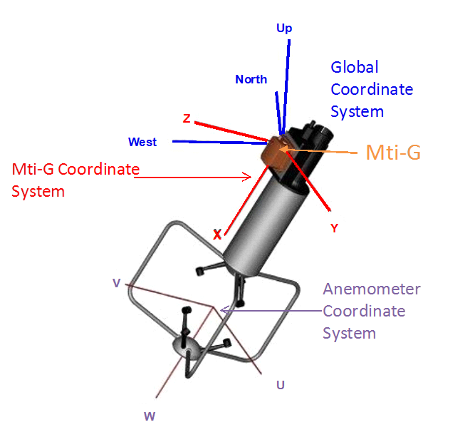
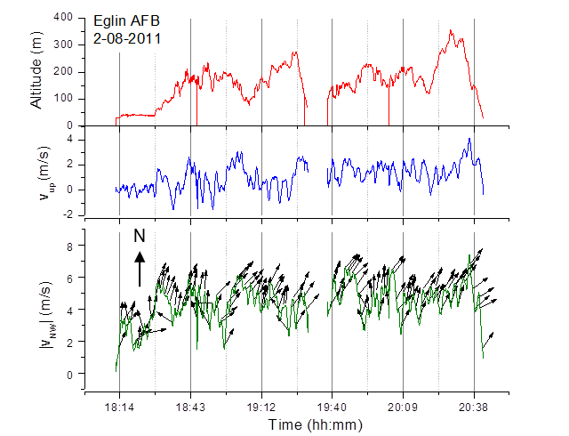
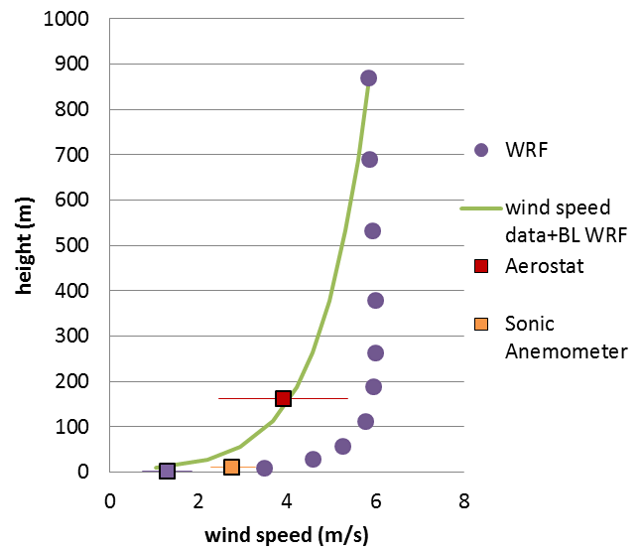
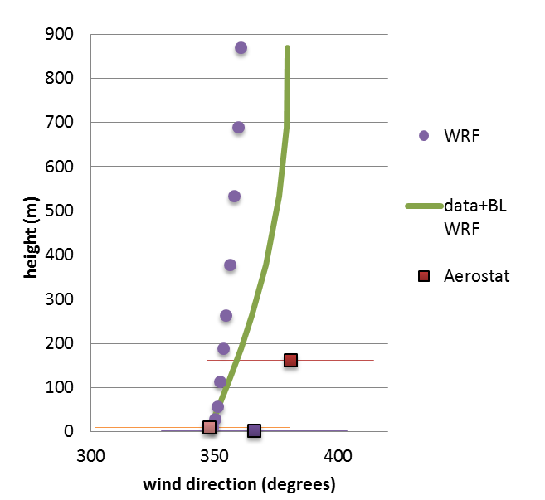
Uncertainties in Winds

Slide 12
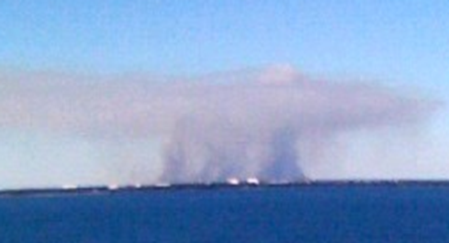
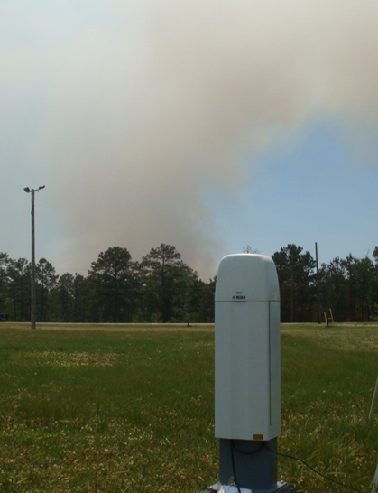
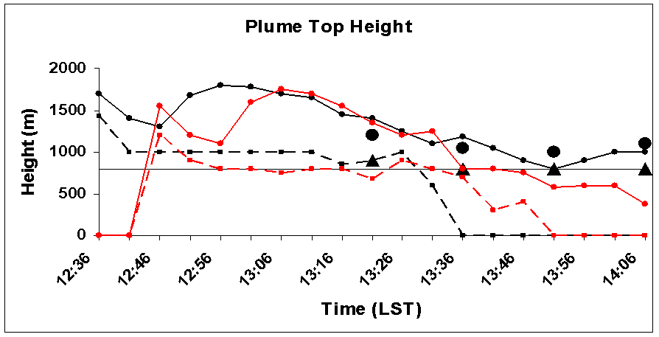
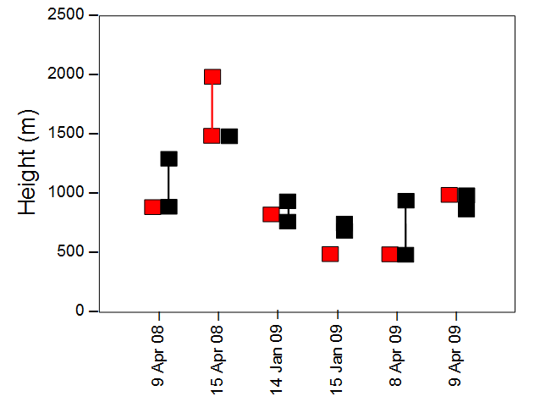
Daysmoke Plume Heights vs. Ceilometer
WRF (black), MM5 (red)
Observed top (circles) and base (triangles)

Slide 13
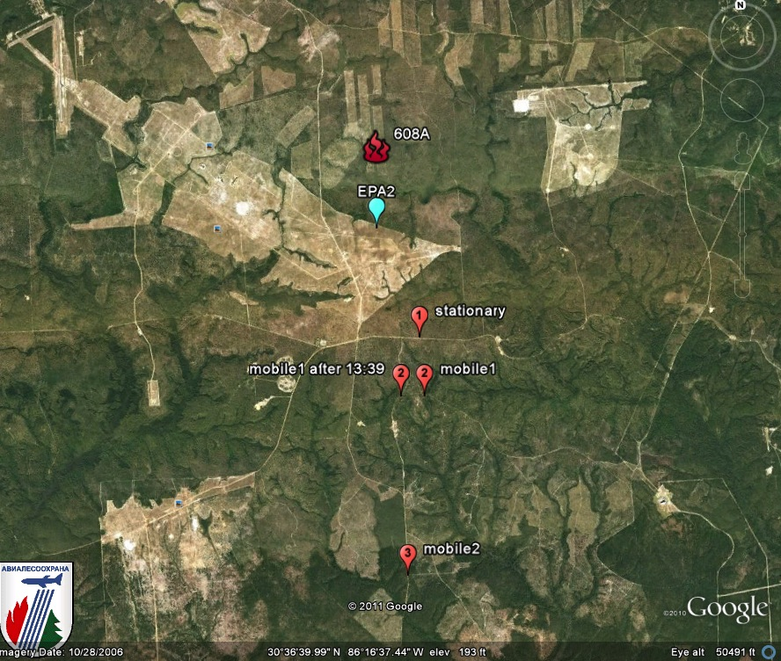
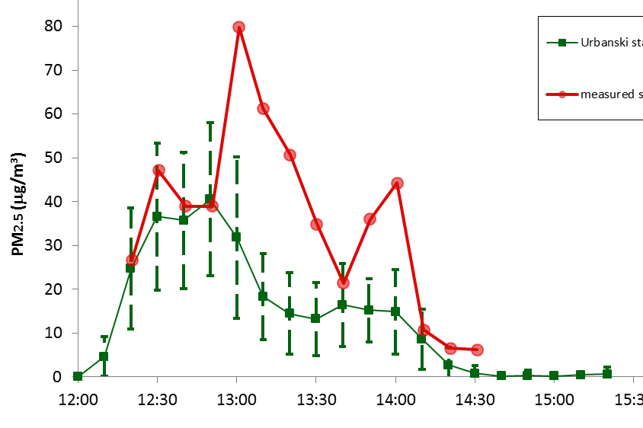
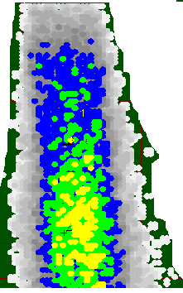
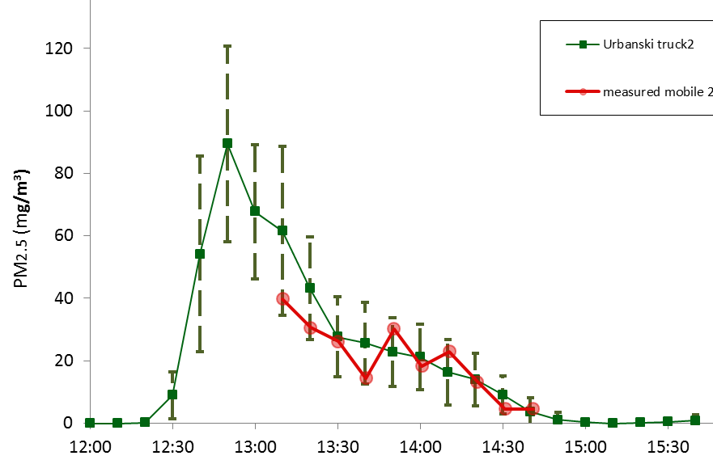
Ground Measurements
Stationary
Mobile 2
Notes:
Daysmoke: stochastic model with different output each run.
2.5 miles or 4km away from fire is stationary site
Daysmoke inputs!!!

Slide 14
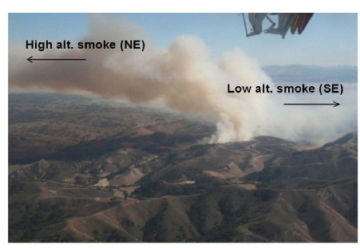
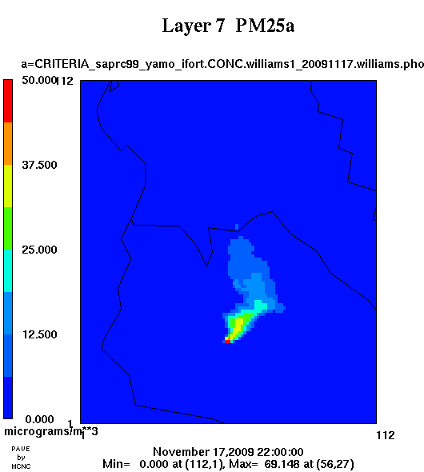

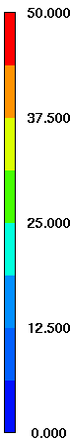
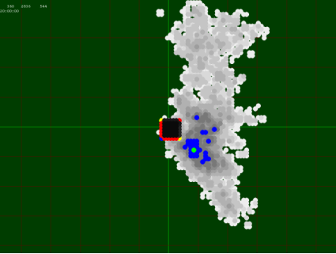
Aircraft Measurements
A suite of gases , aerosols and meteorological parameters were measured in the plume of a chaparral burn near Buelton, CA on November 17, 2009 (Akagi et al. , ACP, 2012).

Slide 15
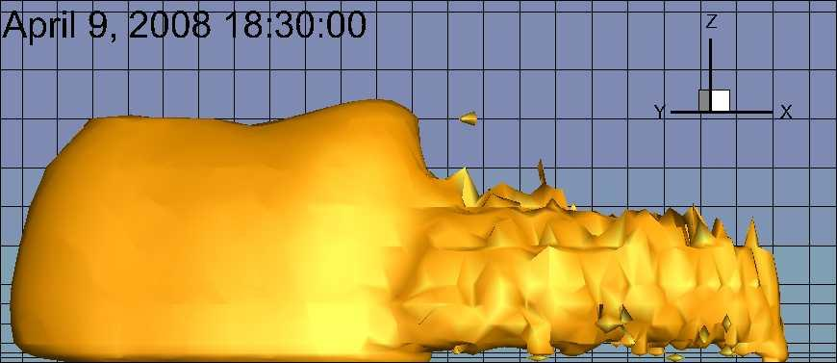
Sensitivity to Vertical Distribution of Emission (Uniform Temporal Allocation)

Slide 16
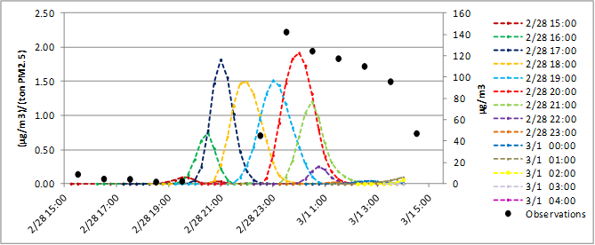
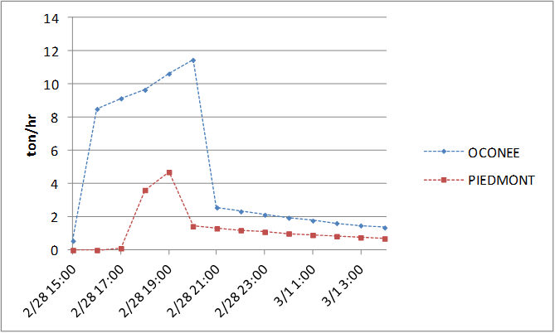
Sensitivity to Timing of Emission

Slide 17
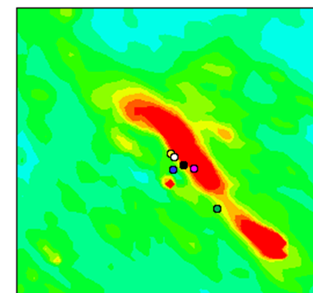
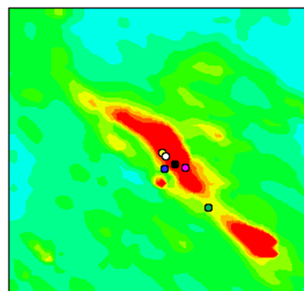
Sensitivity to Wind Direction
-5⁰

Slide 18
Sensitivity to Wind Speed
W/S: Peachtree City Sounding vs. WRF

Slide 19
Final Modeling
Emissions:
  Total increased by 15%
  Skewed towards end of burn
Injection Height:
  Plume in PBL at end of burn
Winds:
  WS reduced by 30%
  WD altered by 5⁰
Models:
  AGD-CMAQ

Slide 20
Lessons Learned
Specific:
  Uncertainties in Rx burn emissions have been reduced.
  Dispersion and transport models have been significantly improved.
  Accuracy of smoke impact prediction is limited by the accuracy of WS and WD predictions.
General:
  Using extreme events in model evaluation is beneficial.
  Uncertainties can best be determined by well designed field studies.
  Sensitivity analyses can be helpful in setting priorities for future research.

Slide 21



Acknowledgements
Strategic Environmental Research and Development Program (SERDP)
Joint Fire Science Program (JFSP)
Environmental Protection Agency (EPA)
Thank you!
Questions?

