Slide 1
Influences of Regional Climate Change on Air Quality across the Continental U.S. Projected from Downscaling IPCC AR5 Simulations
Christopher G. Nolte¹ ,Tanya L. Otte¹, Robert W. Pinder¹, Jared H. Bowden²,
Greg Faluvegi³, and Drew T. Shindell³
¹ U.S. Environmental Protection Agency, Research Triangle Park, North Carolina
² Institute for the Environment, University of North Carolina
³ NASA Goddard Institute for Space Studies
CMAS Users Conference
17 October 2012

Slide 2
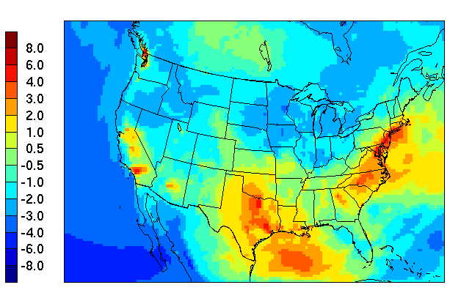
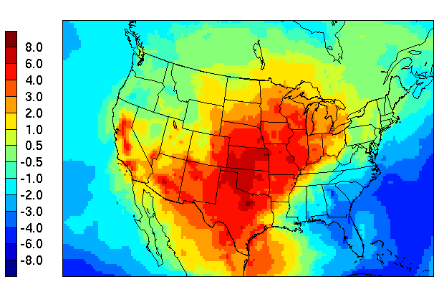
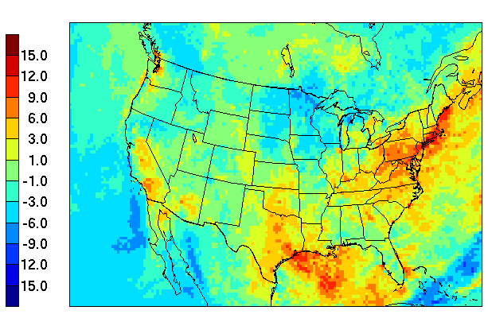
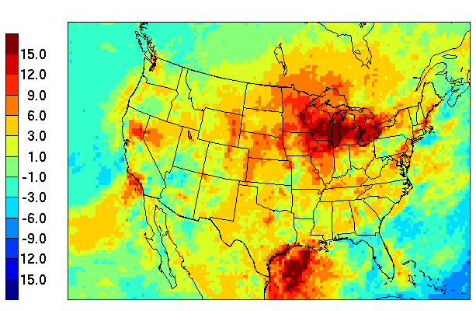
Previous Results – Change in Air Quality
Due to Future Climate Change
Δ Mean MDA8 O₃, 1 Jun – 31 Aug
Δ Mean MDA8 O₃, 1 Sep – 31 Oct
Δ 95th percentile MDA8 O₃, 1 Jun – 31 Aug
Δ 95th percentile MDA8 O₃, 1 Sep – 31 Oct
Nolte et al., J. Geophys. Res., 2008

Slide 3
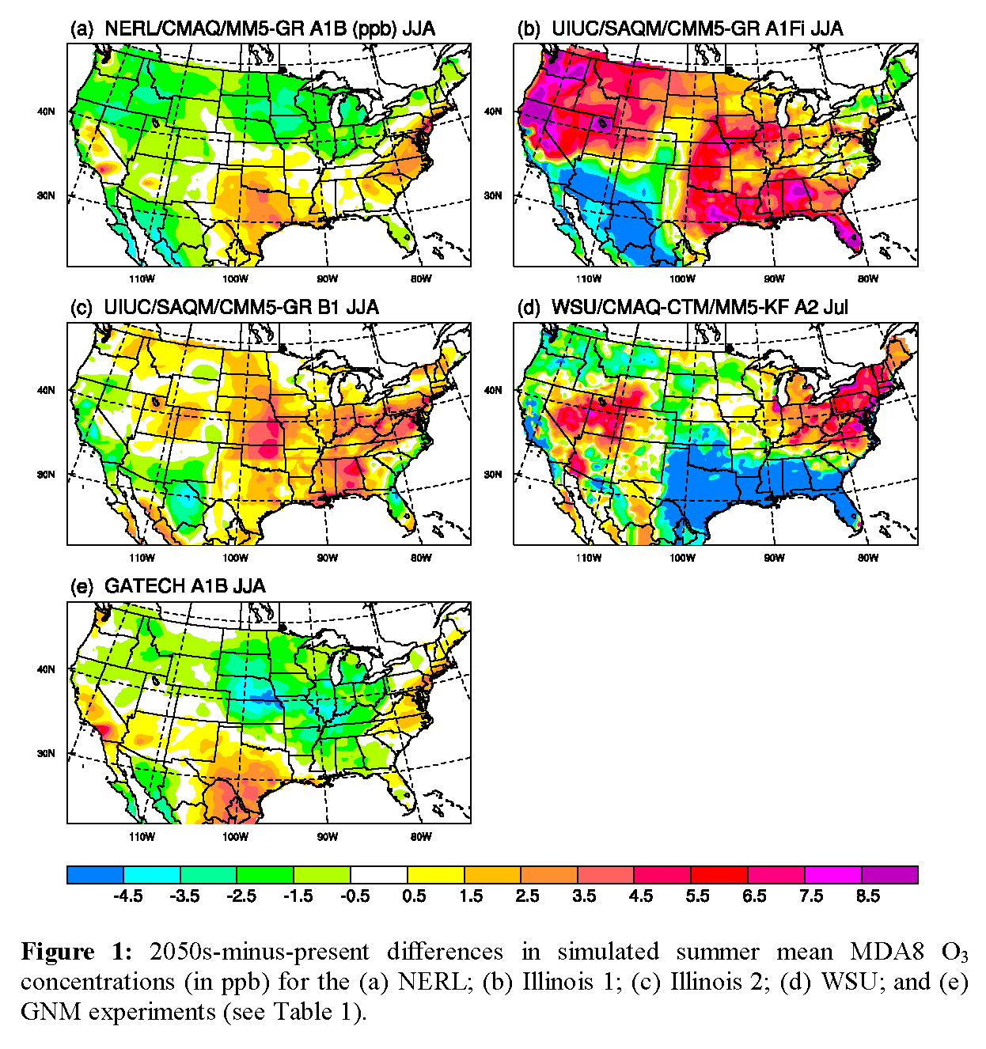
“Climate Penalty”: increase in ozone due to climate change, or the additional level of control needed to meet a given attainment level
Weaver et al., BAMS (2009)

Slide 4
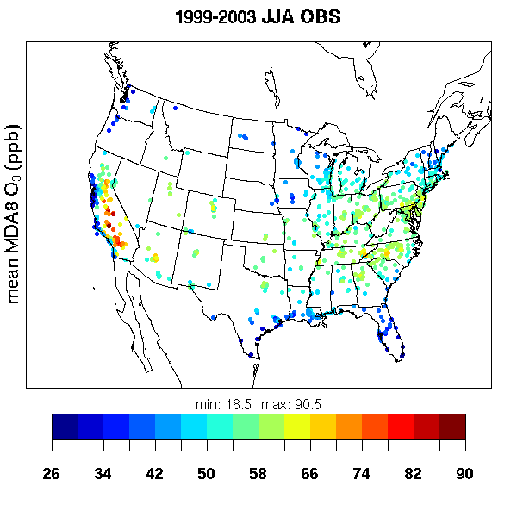
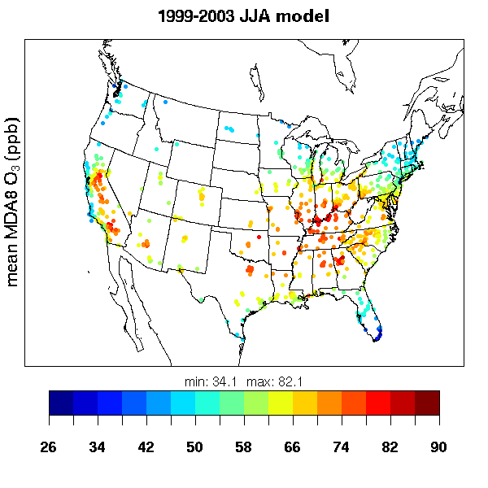
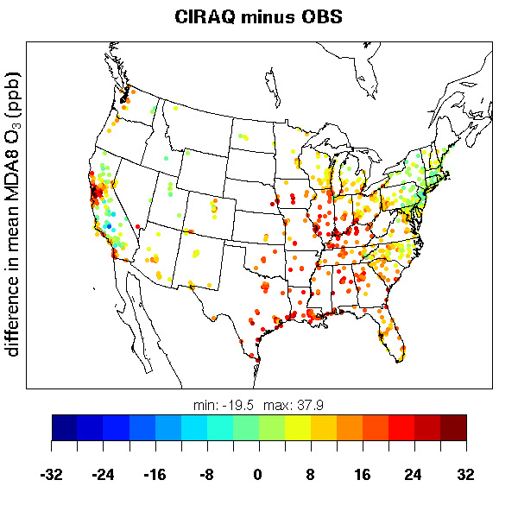
mean obs: 52.5 ppb
mean model: 63.8 ppb
mean bias: 11.3 ppb

Slide 5
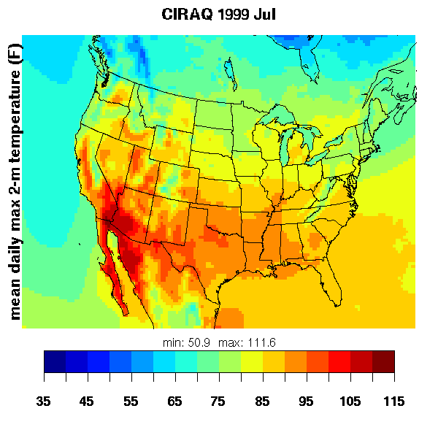
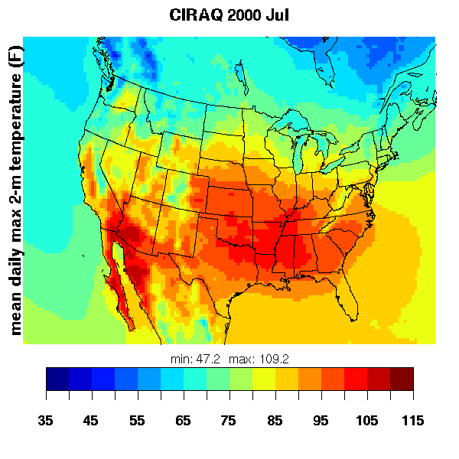
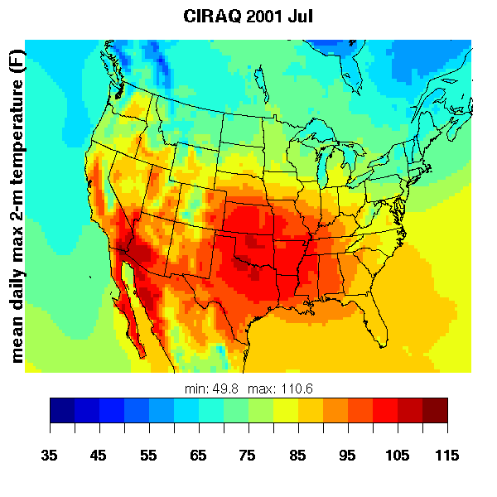
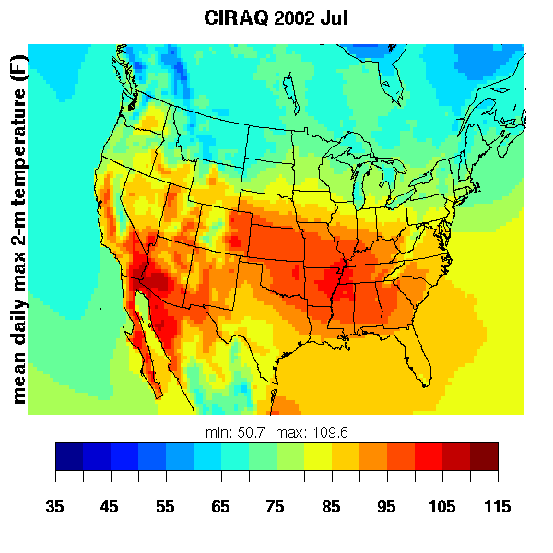
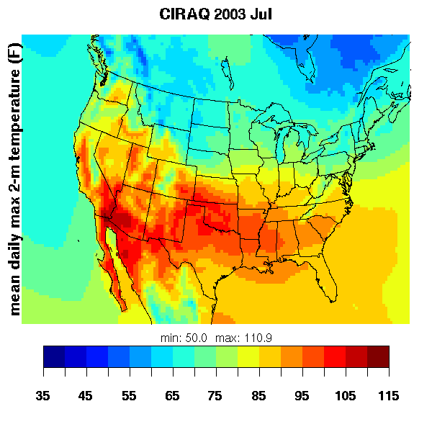
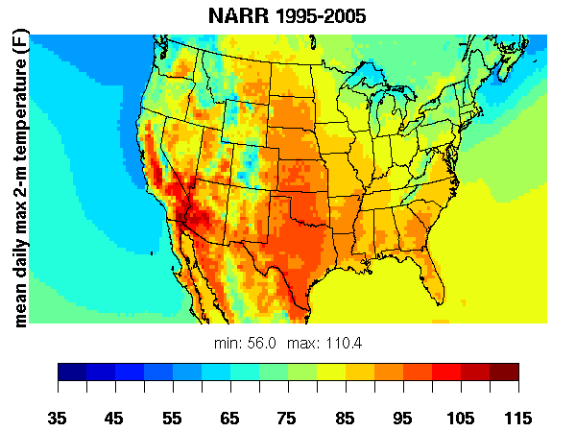
Max summer temperatures in southern U.S. much too warm for current climate
Larger biases than in GISS 2’ GCM → problematic downscaling
Typical retrospective meteorological modeling does not have biases this large!

Slide 6
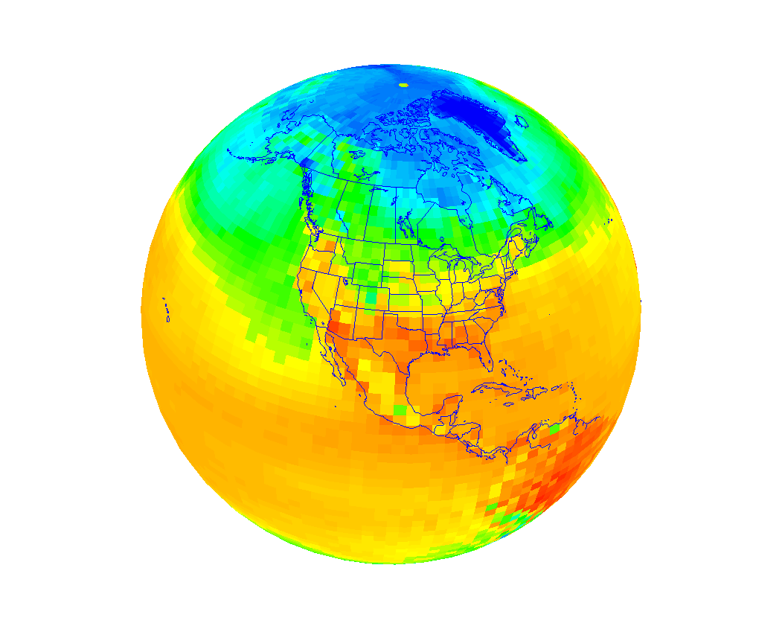
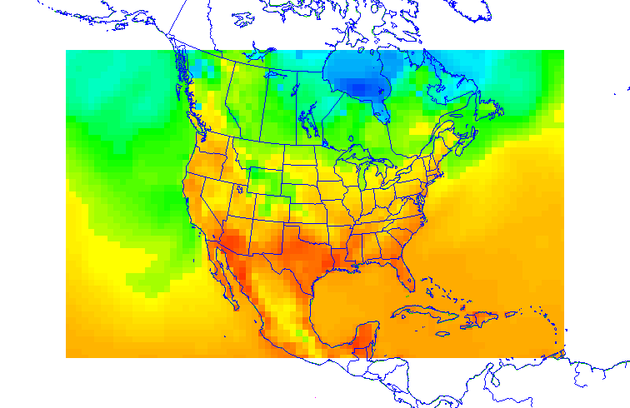
What is “dynamical downscaling”?
Global climate model (GCM) creates coarse gridded future climate with world-wide coverage.
GCM
RCM
Regional climate model (RCM) generates gridded higher-resolution climate predictions over focal area.
More detail in local effects from:
scale-appropriate physics
topography & land/water interfaces
urban areas (population centers)
precipitation patterns

Slide 7
Approach to Developing Downscaling Methodology for Air Quality Simulation
Use reanalysis data as verifiable surrogate for GCM, to develop and test downscaling methodology
  20-year runs with historical data at 2.5° grid size (comparable to GCM)
  Evaluate 36-km RCM results against higher-resolution reanalyses
  Demonstrated that FDDA (nudging) is necessary
    For further details see Bowden et al. (J. Clim. 2012),
    Otte et al. (J. Clim 2012), and Bowden et al. (Clim. Dyn., in press).
Develop downscaled fields using GCM simulations
  AR5 Ensemble: time slices, RCPs, other GCMs
    NASA GISS ModelE2, NCAR CESM 1.0, NOAA GFDL CM3, …
Examine implications for future air quality

Slide 8
Downscaling NASA/GISS ModelE2 using WRF
ModelE2: AR5 runs at 2° x 2.5°
  40 hybrid layers up to 0.1 hPa
  ca. 2000 (“1995–2005”) and RCP 6.0 ca. 2030 (“2025–2035”)
  Meteorological input data used at 6-h intervals
WRFv3.2.1
  WRF Preprocessing System adapted to ingest raw ModelE fields
  108-36-km, two-way-nested, domains (81x51 and 199x127)
  34 layers up to 50 hPa
  Continuous 11-year runs (no reinitialization)
  Spectral nudging of wavelengths >1500 km
    Analysis nudging qualitatively similar (not presented here)

Slide 9
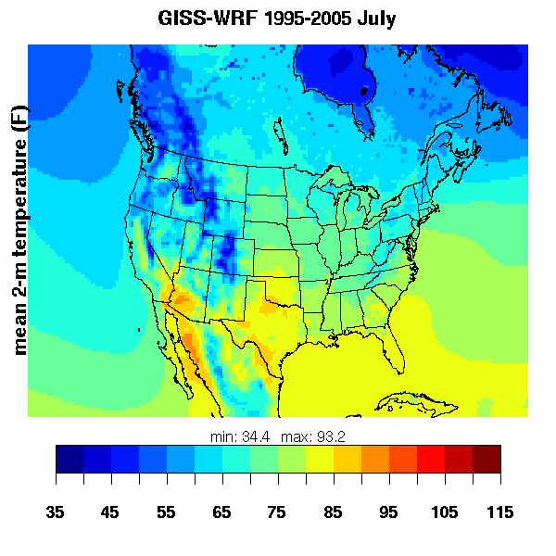
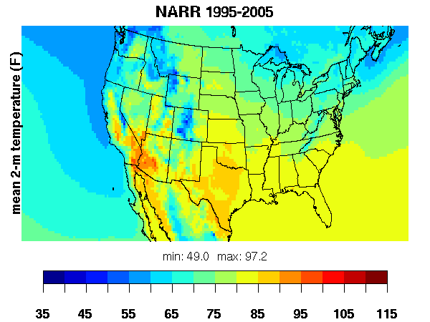
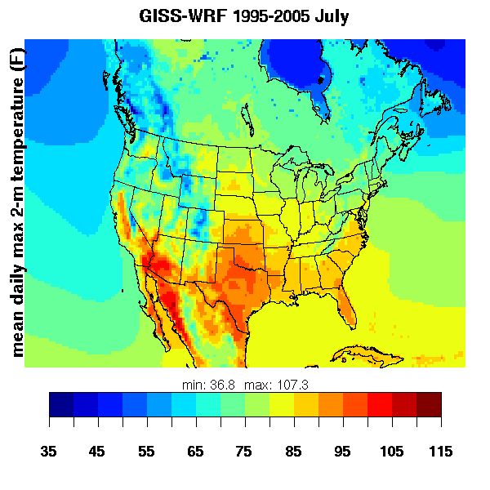

Representation of Current Climate July Temperatures
Decadal mean July 2-m temperature
(°F)
Decadal mean July daily max 2-m temperature
(°F)

Slide 10
Air Quality Simulations Using Downscaled Meteorology
Our goal is NOT to predict air quality at some future time.
  Rather, we seek to answer these questions:
  How well does meteorology downscaled from GCM capture range of conditions important for regional air pollution meteorology?
  How does the interannual meteorological variability translate into variability of air quality?
  What are the changes in future air quality for this GCM scenario, and what are the principal drivers of those changes?
  How robust are the above conclusions, when considering an ensemble of GCMs, RCPs, and future decades?
Notes:
We know from previous work that the climate signal is much smaller than that due to emissions trends. Seek to understand how climate change affects air quality to understand the climate penalty, and how to simultaneously mitigate climate change (or rate of CC) while maintaining and improving AQ.

Slide 11
Air Quality Model Configuration
Constant (for each year) anthropogenic emissions.
  2006 inventory (same as AQMEII)
  Biogenics simulated online using downscaled meteorology
Constant (clean, default) chemical boundary conditions
CMAQ v5.0 (offline), SAPRC07
  Using online photolysis and lightning NOx
  Wind-blown dust option turned off
36-km North American domain (153 x 100)
WRF and CMAQ run for 11-year time slices centered on
  2000 and 2030

Slide 12
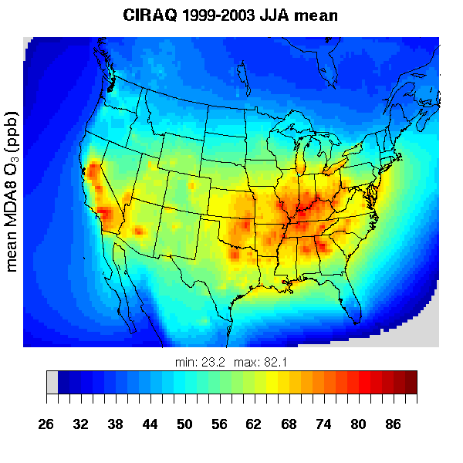
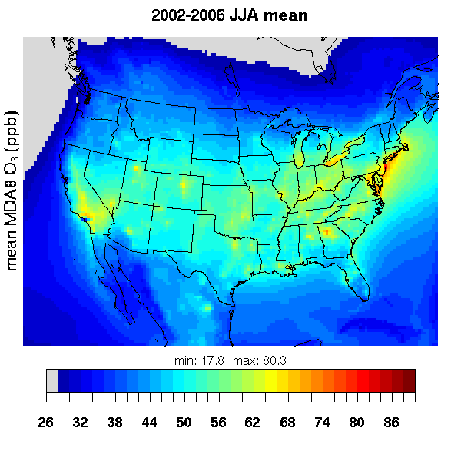
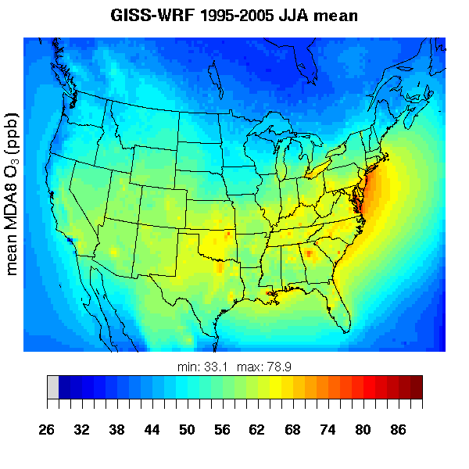
Multi-year Summer Mean MDA8 Ozone Under Current Climate
2002-2006
Retrospective CMAQ 4.7
GISS Model E2 – WRF – CMAQ 5.0.1
GISS 2′ – MM5 – CMAQ 4.5
Lots of differences between these runs impair ability to make direct comparisons … but preliminary analysis shows significant improvement over previous result.

Slide 13
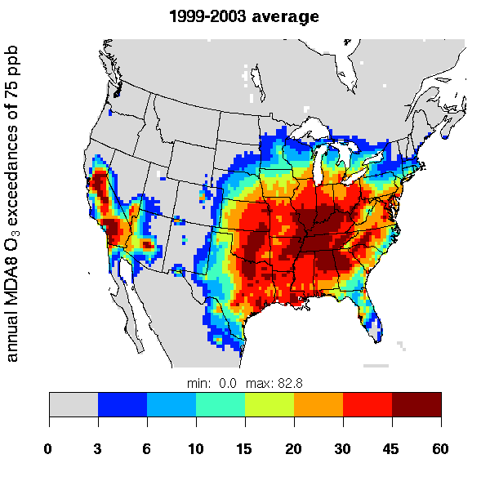
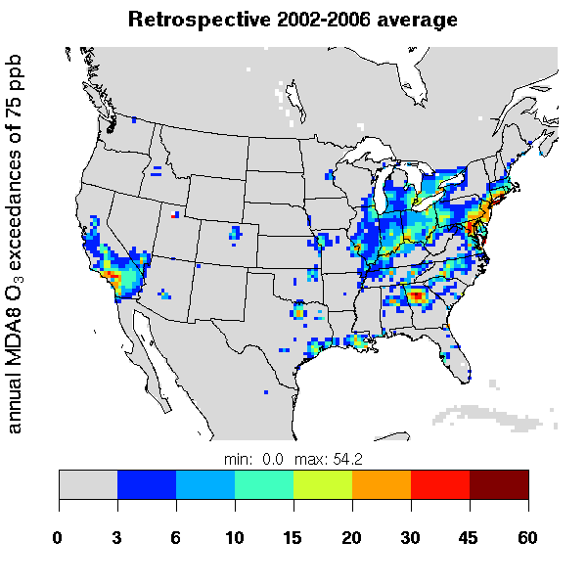
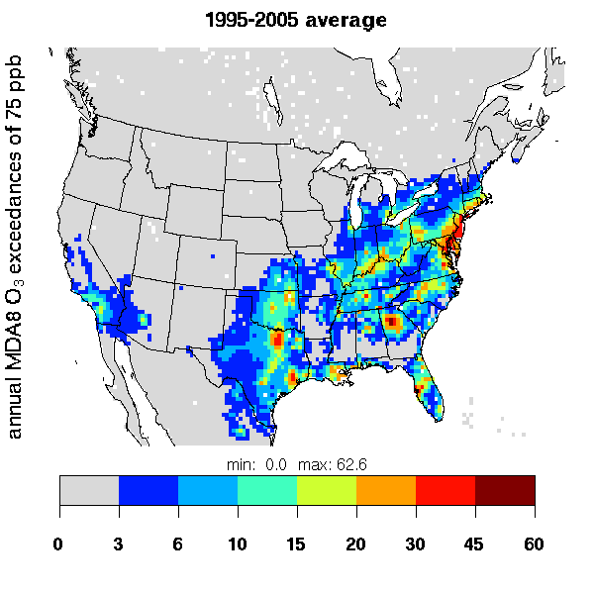
Average Annual Frequency of Exceeding 75 ppb Threshold
2002-2006
Retrospective CMAQ 4.7
GISS Model E2 – WRF – CMAQ 5.0.1
GISS 2′ – MM5 – CMAQ 4.5
Spatial pattern of exceedances well reproduced by ModelE-WRF-CMAQ.
Overall higher frequency consistent with small positive bias in MDA8 O3.

Slide 14
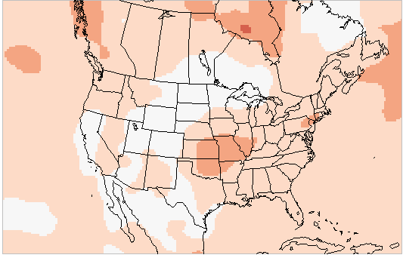
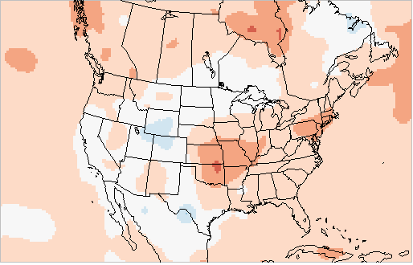
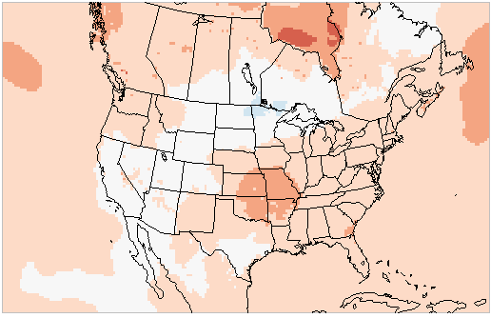
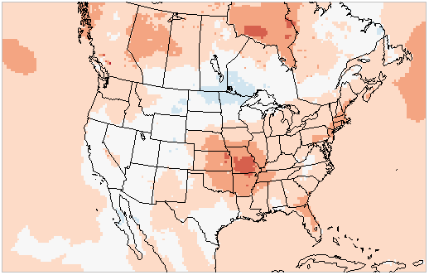
Projected Change (2030 − 2000) in July 2-m Temperatures
ModelE2 ΔT2MEAN
ModelE2 ΔT2MAXDAVG
3.6
2.8
2.0
1.2
0.4
-0.4
WRF ΔT2MEAN
WRF ΔT2MAXDAVG
-1.2
-2.0
-2.8
-3.6
K
ModelE2: Warming of up to 2 K in central US, slightly higher for daily max.
WRF generally consistent with ModelE2, with somewhat greater variability.

Slide 15
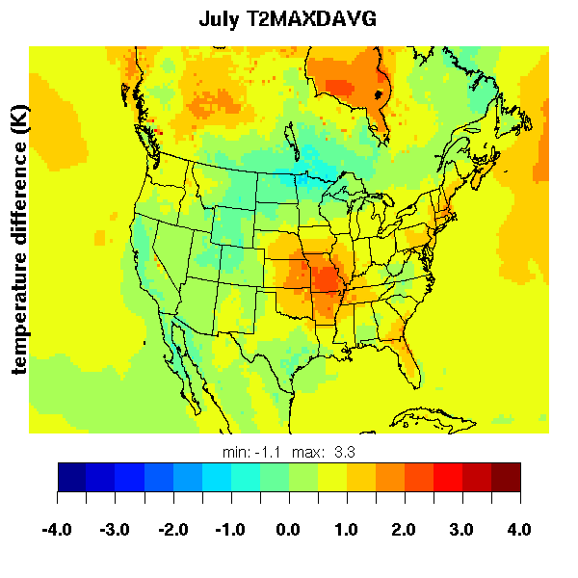
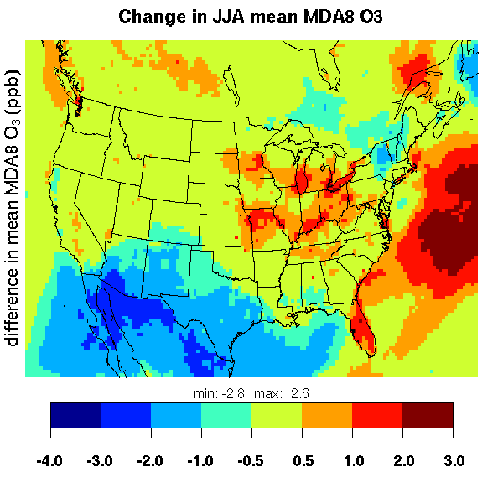
Changes in Air Quality Under Future Climate
ΔT2MAXDAVG
Δ JJA MDA8 O3
Increases of 0.5-2 ppb MDA8 O3, largely consistent with area of warming of 0.5-2 K in central/eastern US.

Slide 16
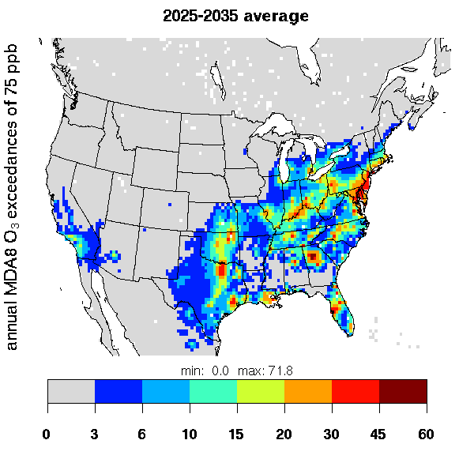
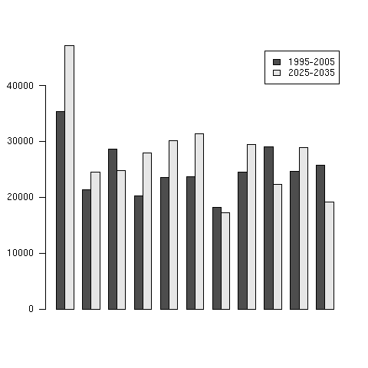
Annual Frequency of Exceeding 75 ppb MDA8
1995-2005 average
2025-2035 average
Small (statistically insignificant, p=0.4) increase in frequency of exceeding 75 ppb threshold

Slide 17
Conclusions
Substantial progress in establishing credibility of regional climate fields downscaled from global model.
  Reanalysis-driven runs verify well against NARR (though not as well as retrospective modeling runs)
  Downscaled ModelE fields seem reasonably representative
  MDA8 ozone positively biased, but greatly improved over previous efforts using linked global-to-regional modeling system.
GISS simulation of RCP 6.0 results in summertime warming of 0.5-2 K over central/eastern US around 2030 – consistent result between ModelE and WRF.
  How to demonstrate “added value” of downscaling?
Relatively modest increases of 0.5-2 ppb MDA8 O3 due to this climate change scenario (holding anthropogenic emissions constant).

Slide 18
Backup slides

Slide 19
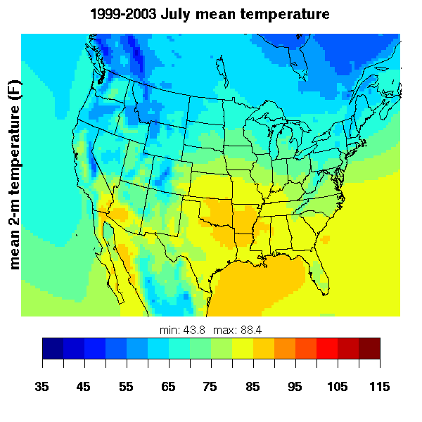
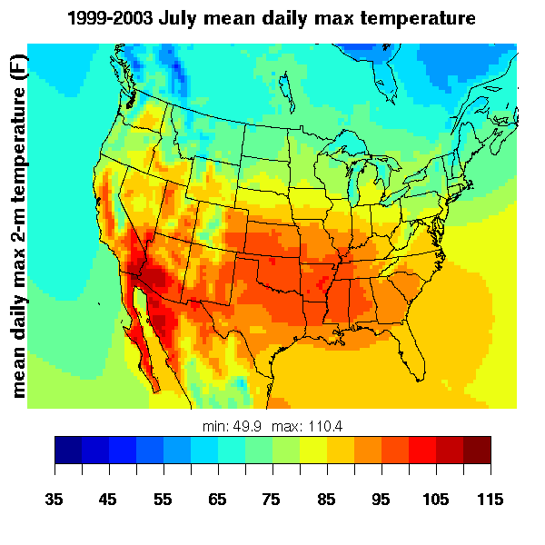
CIRAQ Representation of Current July Temperature
Model
Multi-year mean July 2-m temperature
(°F)
Model
Multi-year mean July daily max 2-m temperature
(°F)

Slide 20
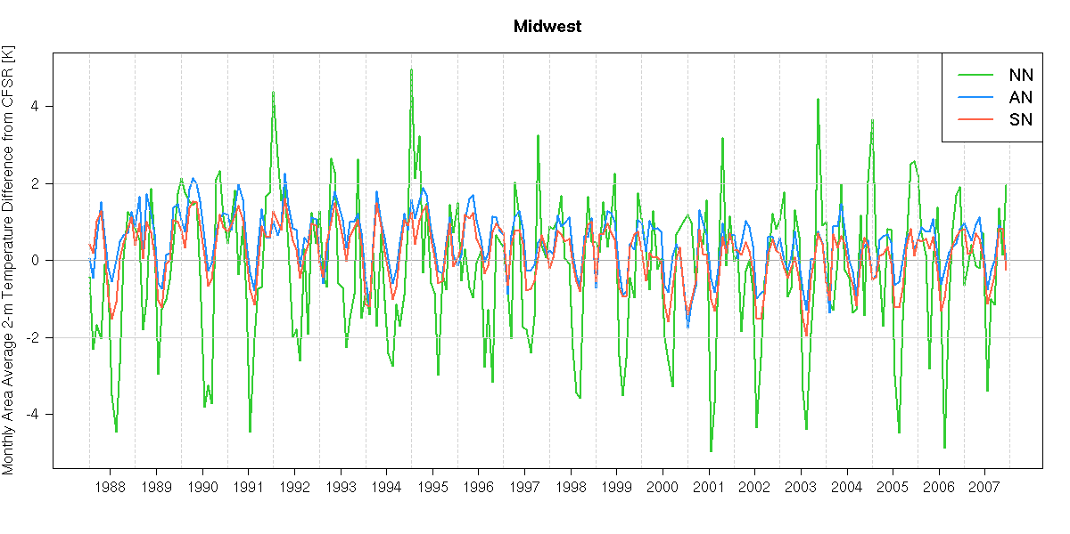
Effects of Nudging on Means:
Multi-Decadal Historical Period
Monthly Area-Average Differences in 2-m Temperature (K)
4
Winter too warm
2
Compare to hourly, 0.31° CFSR
0
-2
-4
Summer too cold
88
89
90
91
92
93
94
95
96
97
98
99
00
01
02
03
04
05
06
07
Otte et al., J. Climate (2012)
Periodic intra-annual swings in bias in WRF without nudging.
Should not examine only annual or multi-decadal means!
Systematic error in seasonality? (Also in GCM-driven WRF runs!)

Slide 21
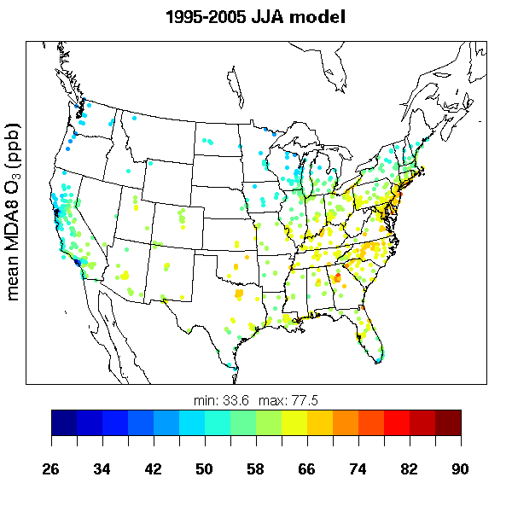
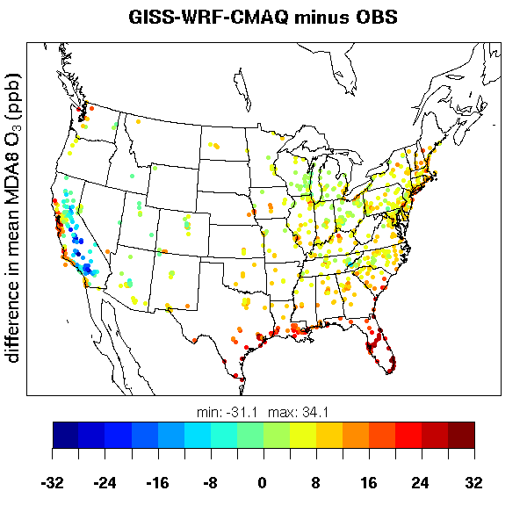
mean obs: 52.5 ppb
mean model: 63.8 ppb
mean bias: 11.3 ppb
mean obs: 52.5 ppb
mean model: 59.9 ppb
mean bias: 7.5 ppb

Slide 22
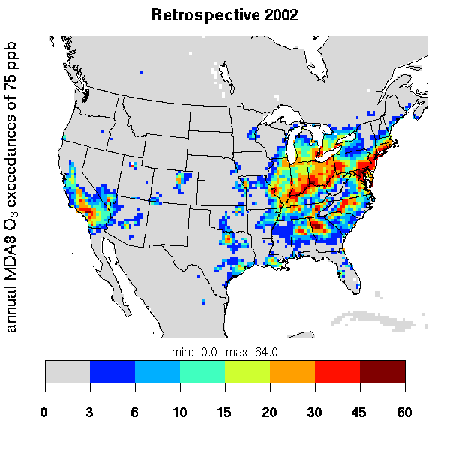
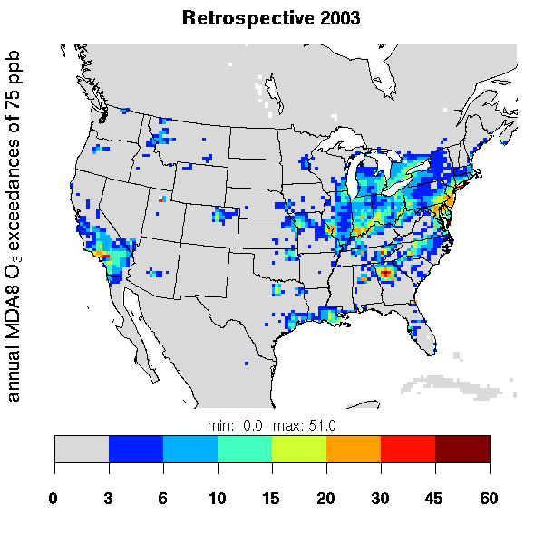
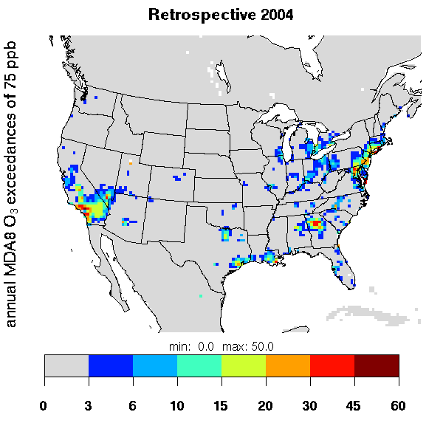
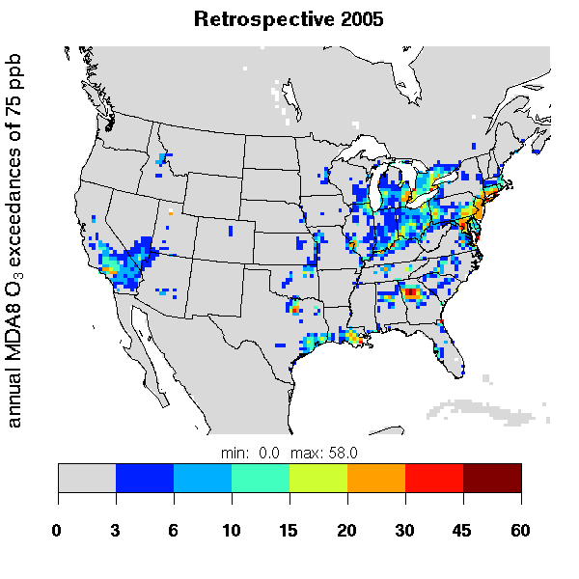
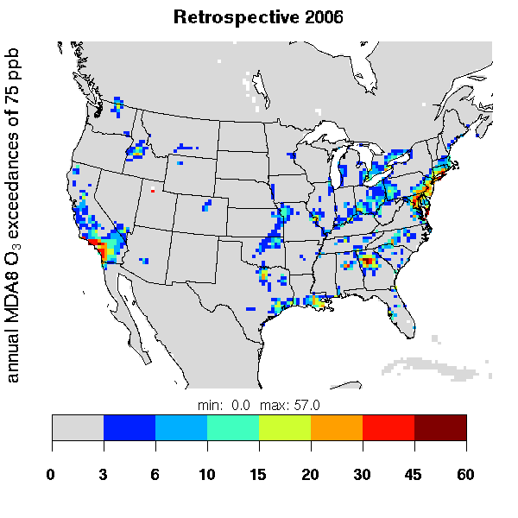
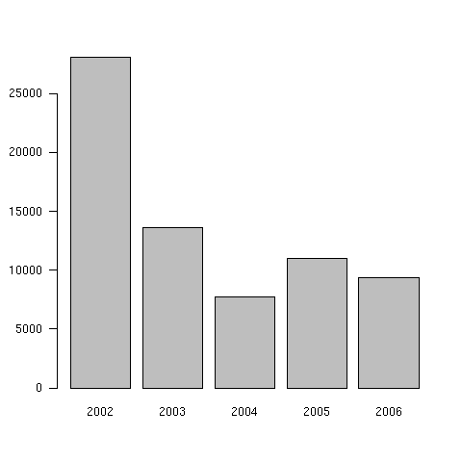
Interannual Variability – Exceedances of 75 ppb MDA8

Slide 23
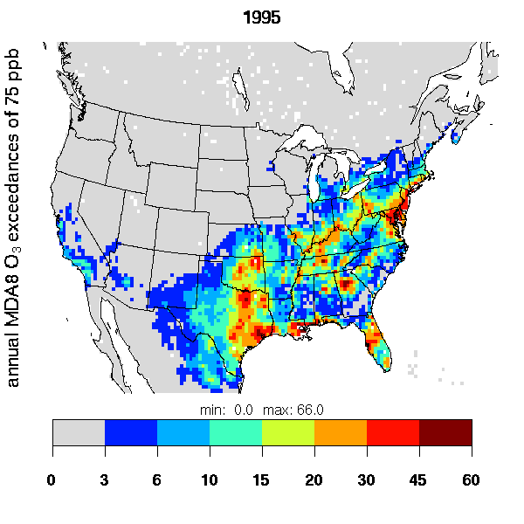
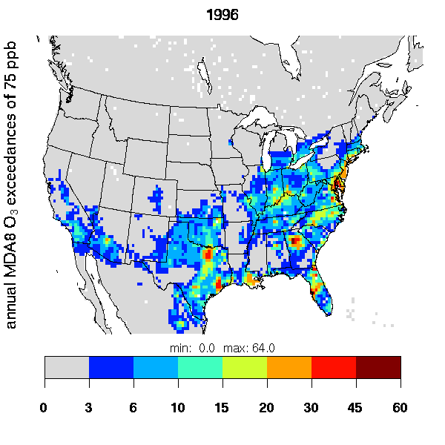
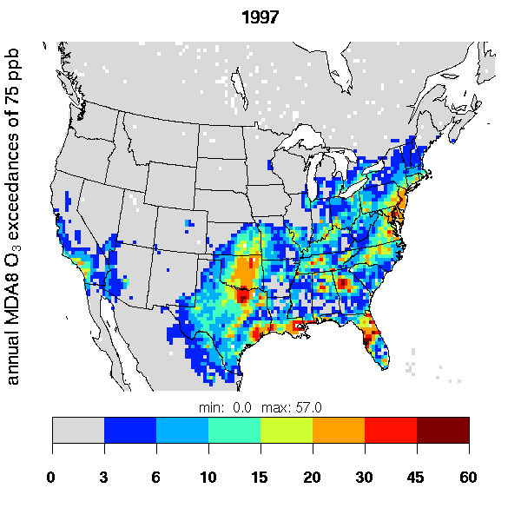
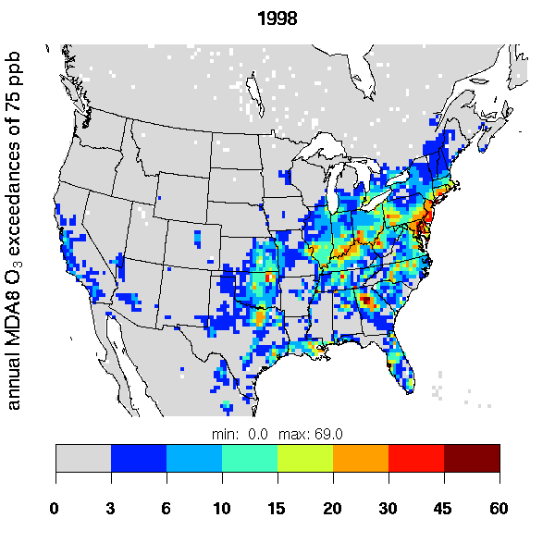
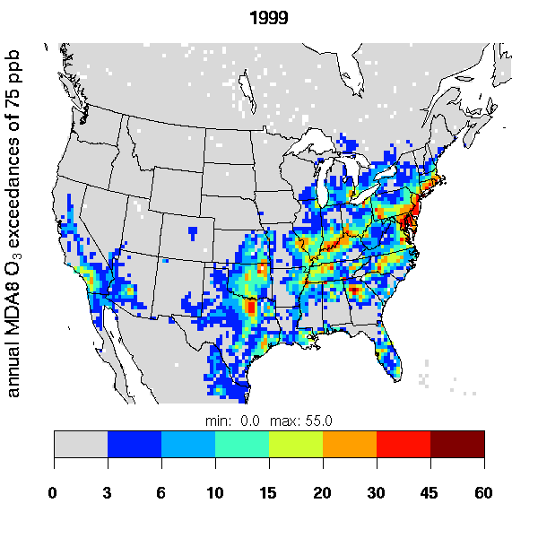
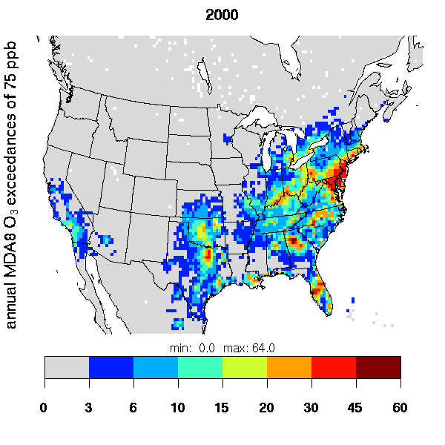







Slide 24







Initialized in Dec 1994
Initialized in Dec 2024
Initialized in Dec 1995
Initialized in Dec 2025

