Slide 1
Integrating source and receptor models for the purpose of emissions inventory improvement: Application to residential wood combustion in the Southeast.
Sergey L. Napelenok, Ram Vedantham,
George A. Pouliot, Prakash V. Bhave, Roger Kwok
U.S. Environmental Protection Agency
Research Triangle Park, NC
11th Annual CMAS Conference
Notes:
PVB: I added Michael’s first name and fixed spelling of Sheesley

Slide 2
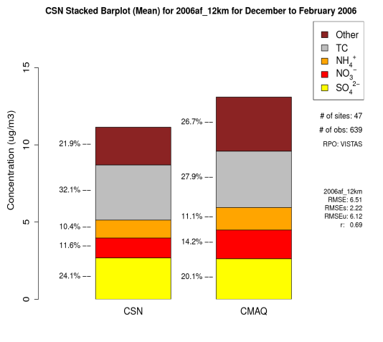
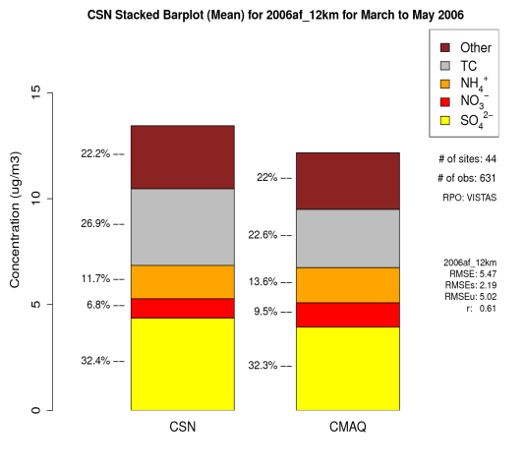
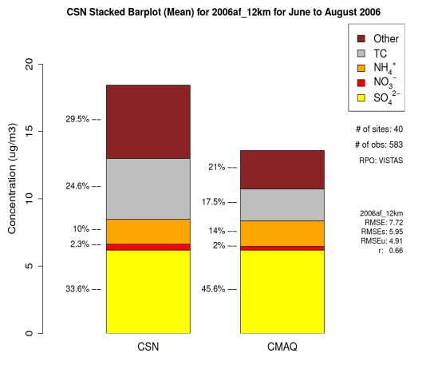
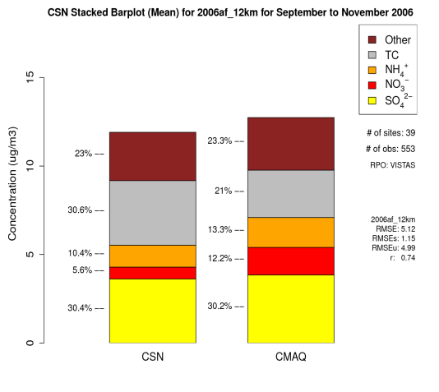
Why Residential Wood Combustion?
Primary carbon emissions from this source contribute significantly to PM_{2.5}.
This sector has been identified by NEI developers as one of their top concerns.
Our own modeling shows room for improvement in total carbon (TC) predictions.
Winter bias = 0.10
Spring bias = -0.83
Summer bias = -2.08
Autumn bias = -0.91

Slide 3
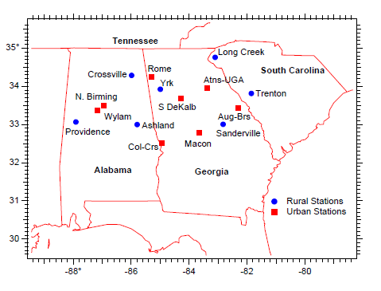
Why Southeast?
Region with highest concentration of carbonaceous PM_{2.5} in the U.S.
Extensive measurement campaign in 2007
PM, trace metals, organic tracers, etc.
15 EPA FRM sites available with a fairly complete record of observations of levoglucosan (n_{samples} = 817)
Zhang, X., Hecobian, A., Zheng, M., Frank, N. H., Weber, R. J. (2010). Biomass burning impact on PM(2.5) over the southeastern US during 2007: integrating chemically speciated FRM filter measurements, MODIS fire counts and PMF analysis. Atmos Chem Phys 10(14): 6839-6853.

Slide 4
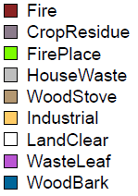
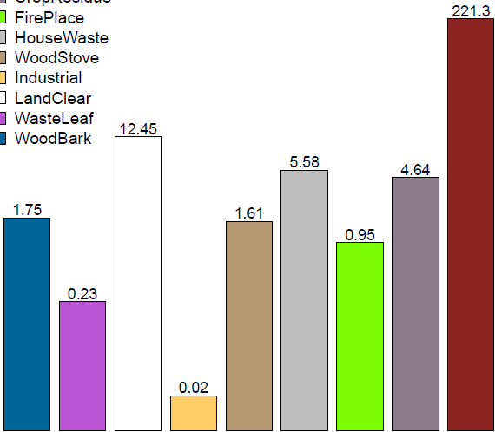
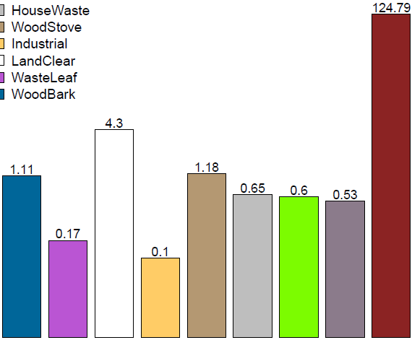
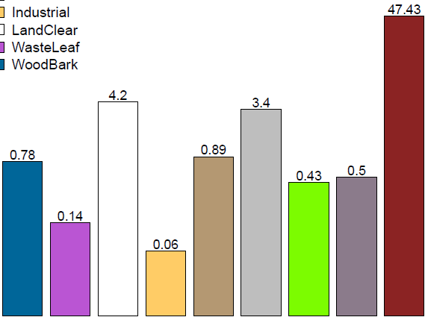
Summary of Current NEI Total Carbon Emissions
The 2008 NEI has nine distinguishable sources of biomass-combustion-produced carbon emissions.
Fires (wildland + prescribed) dominate the emissions from all 3 states of interest.
10⁵
10⁴
TC Emissions in 2007 (kg/day)
10³
10²
10
Alabama
Georgia
South Carolina

Slide 5
Air Quality Model: CMAQ-ISAM
CMAQ v4.7.1 has been equipped with Integrated Source Apportionment Method (ISAM)
Tracks primary and inorganic secondary particulate matter species by sector, geographical region, and/or chemical precursor.
Performs very well for primary sources like EC/OC
Presentation by Roger Kwok – Wednesday 11:20.
Simulation information
Episode: 1 January – 31 December 2007.
Inputs: Standard WRF, 2008 NEI, GEOS-Chem boundaries.
Track the nine carbon sources using CMAQ-ISAM.

Slide 6
Levoglucosan Source Profiles
To approximate levoglucosan concentrations from CMAQ TC, speciation profiles from emission source tests are used:
Wood Bark
Industrial 0.1134 μg levoglucosan / μg C
Wood Stove (Fine et al., 2002)
Fire Place
Waste Leaf
Land Clear 0.0658 μg levoglucosan / μg C
House Waste (Lee et al., 2005)
Fire
Crop Residue 0.0935 μg levoglucosan / μg C
(Hays et al., 2002)

Slide 7
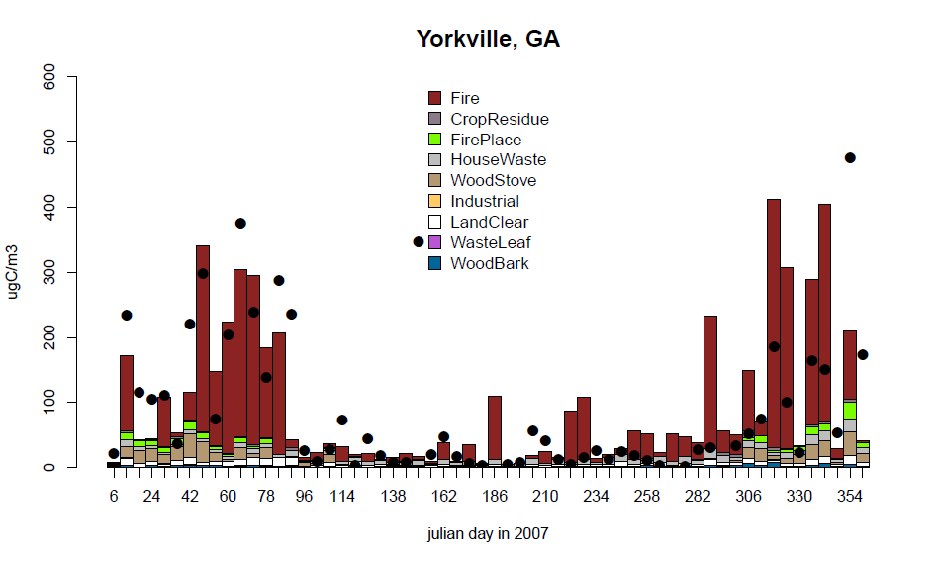
CMAQ-ISAM Apportioned Levoglucosan

Slide 8
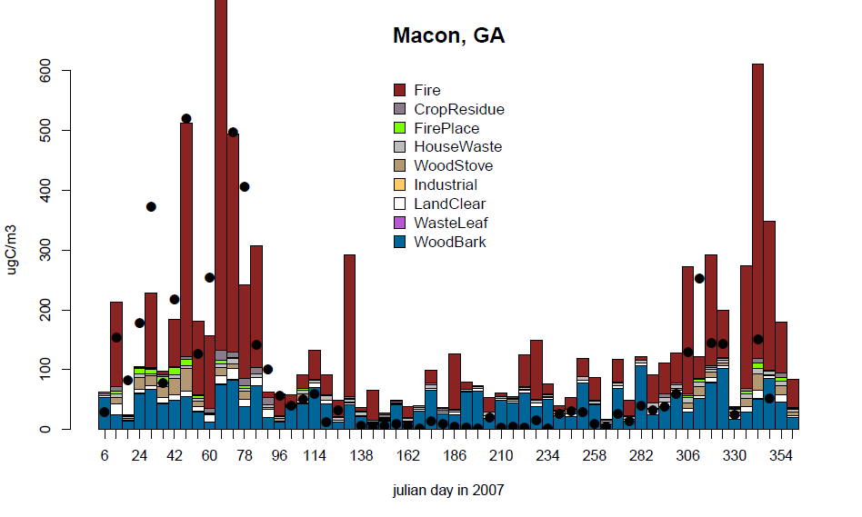
CMAQ-ISAM Apportioned Levoglucosan (2)

Slide 9
Evaluation of Model Predicted Levoglucosan
 | Mean Obs (ng/m³) | Mean CMAQ (ng/m³) | Mean Bias (ng/m³)
Winter (DJF) | 171.1 | 152.3 | -13.9
Spring (MAM) | 182.1 | 111.4 | -69.0
Summer (JJA) | 20.0 | 34.4 | 15.6
Autumn (SON) | 57.7 | 103.7 | 46.7
Model appears to consistently under predict total PM_{2.5} from biomass combustion sources at most sites
It would be helpful to split the bias among the various categories of biomass combustion – in other words to apportion the observations

Slide 10
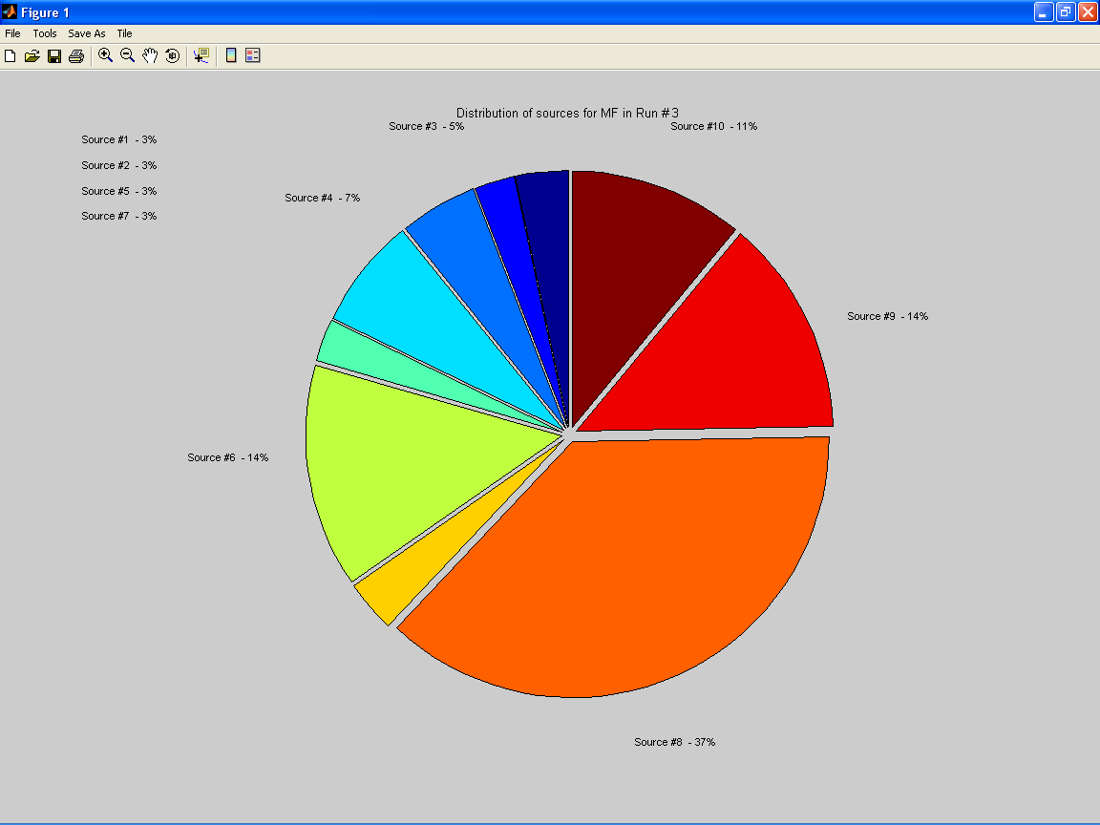
Unmix 6.0
Receptor models apportion observations to sources.
Unmix version 6.0.
Constrained multivariate receptor model.
Input: speciated concentrations.
Output: source profiles, source contributions, diagnostics, and uncertainties.
Local, urban, and regional sources.
Traditional applications of Unmix focus on identifying source types with the goal of maximally explaining total PM mass.
Inputting measured concentrations of levoglucosan and other species (mannosan, galactosan, xylose, potassium, magnesium, nitrate, sulfate, oxalate, WSOC) in a standard application results in one or two sources that can only be explained as “Biomass related.”
Not too helpful…
Need to distinguish different sources of biomass burning without source specific molecular markers.

Slide 11
Unmix Application
We can use CMAQ-ISAM apportioned levoglucosan in addition to total observed levoglucosan as independent species in Unmix to see what the distribution of sources might look like:
Unmix is able to apportion the majority of the observed levoglucosan using 7 distinct factors
Sources of WoodStove and FirePlace are indistinguishable as one factor (1)
Sources of WasteLeaf, LandClear, and HouseWaste are indistinguishable and split between two sources (5 + 7)
The other 4 sources appear to be independent of one another as resolved by Unmix
Source | Factor 1 | Factor 2 | Factor 3 | Factor 4 | Factor 5 | Factor 6 | Factor 7
WoodBark | 2 | 88 | 0 | 0 | 1 | 5 | 4
WasteLeaf | 9 | 1 | 0 | 0 | 30 | 0 | 60
LandClear | 8 | 1 | 0 | 5 | 67 | 5 | 15
Industrial | 2 | 0 | 0 | 0 | 7 | 83 | 9
WoodStove | 92 | 0 | 0 | 3 | 0 | 2 | 2
HouseWaste | 3 | 2 | 0 | 1 | 0 | 12 | 82
FirePlace | 99 | 0 | 0 | 0 | 1 | 0 | 0
CropResidue | 0 | 1 | 1 | 96 | 1 | 0 | 0
Fire | 9 | 0 | 87 | 2 | 1 | 0 | 1

Slide 12
Bias in Sector Specific Levoglucosan Predictions

Slide 13
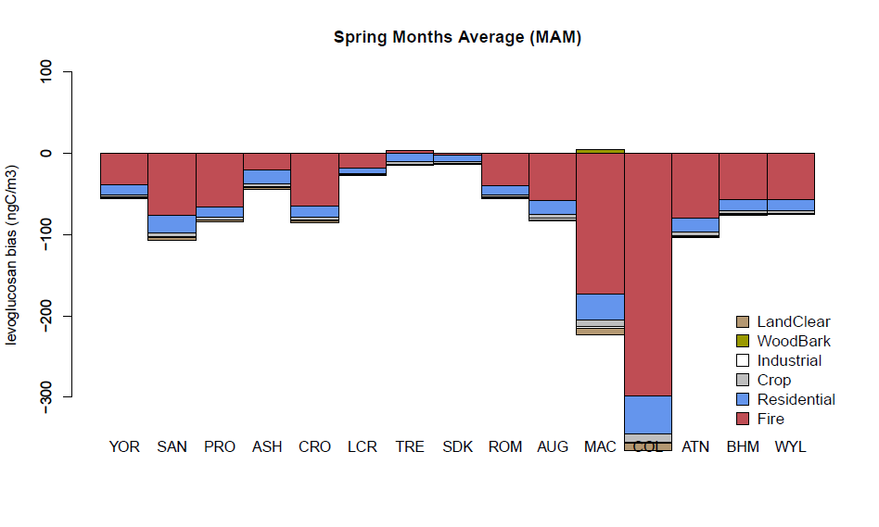
Bias in Sector Specific Levoglucosan Predictions (2)

Slide 14
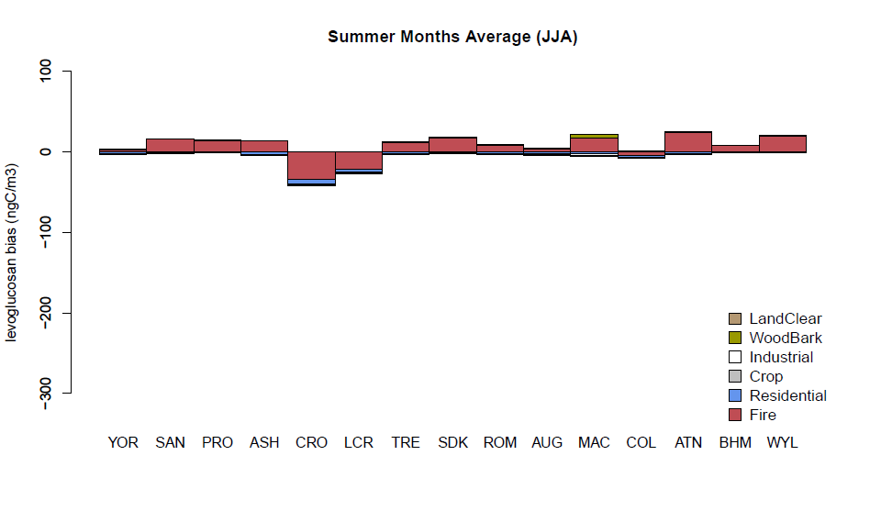
Bias in Sector Specific Levoglucosan Predictions (3)

Slide 15
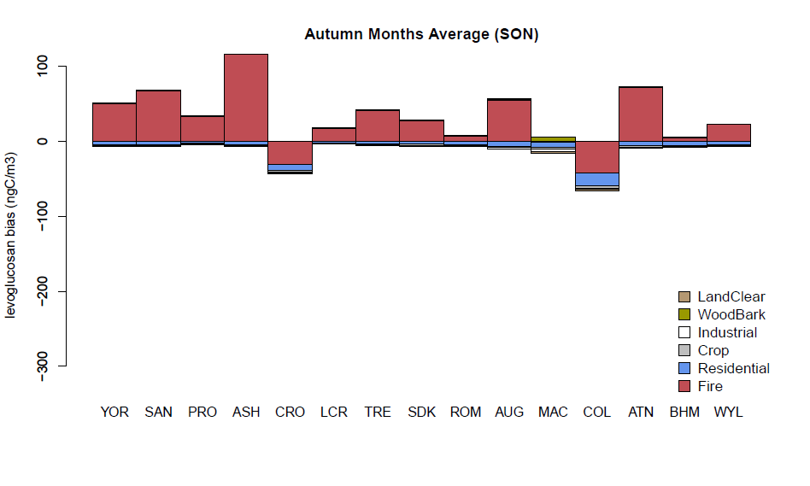
Bias in Sector Specific Levoglucosan Predictions (4)

Slide 16
Summary
A new approach for evaluating sector specific emissions
Combines AQM source apportionment and observation-based source apportionment.
Allows to further explore possible refinement to various categories of biomass burning in the NEI.
Results are very preliminary, but the method looks promising.
Too early to make recommendations
Quantify uncertainty in Unmix output
Gain confidence in the results by applying other SA models (PMF)

Slide 17
Contact information:
napelenok.sergey@epa.gov

Slide 18
Appendix: Unmix Application
samples
samples
sources
Standard
Unmix
Src
Cont
Source
Profile
obs
species
sources
species
Current
Application
Src
Cont
Source
Factors
ISAM
levo
obs

