Slide 1

2007/2008 Emissions Modeling Platform Components and New Tools
Rich Mason, Alison Eyth, Alexis Zubrow
U.S. EPA OAQPS
mason.rich@epa.gov
Zac Adelman
Institute for the Environment, UNC-CH
11th Annual CMAS Conference, Chapel Hill NC
October 16, 2012

Slide 2
Emissions Modeling Platform
“Platform” means the data and processing methods used to produce emissions inputs for AQ models
EPA has worked to improve both data and methods for its version 5 (v5) emissions modeling platform
The 2008 NEI v2 is the basis of the v5 platform
  Version 2 includes improved HAPs, lat-lon locations, control device information, and other updates such as RWC, railyards, MOVES, oil & gas
Both 2007 and 2008 versions of the platform are needed
  The choice of year is based on the purpose of the study and the ambient air quality concentrations for the issue of interest
  2008 NEI stationary nonEGUs + nonpoint are used as the “starting point” for both years for most source categories

Slide 3
2008 NEI v2
Provides “starting point” emissions used in the platform
  Earlier versions of the NEI were vetted through emissions and AQ modeling
  Emissions are less than 2005 NEI for most pollutants
  New web interface provides data access and summaries
2008 NEI first to use the Emission Inventory System (EIS)
  supports merging data from various sources (e.g. state, local, EPA)
  improves transfer of data between inventories and emissions modelers
  provides greater transparency of data sources
  has an underlying relational database
  includes a sophisticated reporting system
  exports inventories into new SMOKE inventory format “FF10”

Slide 4
Upcoming Applications of
2007/2008 Platforms
PM NAAQS Final: ongoing
  2020 Base Case w/ National Rules
  include all current rules (CSAPR, MATS, Boiler MACT reconsideration, RICE, ULSD, RFS2/LDGHG Phase 1, HDGHG)
Anti-backsliding Final Rule: this winter
NAPA 2008: possibly 2013
  Direct full HAP/CAP use of most elements of 2008v3 NEI
CDC2009 & CDC2010: ongoing
Ozone NAAQS REA: ongoing
CMAQv5.0 evaluation

Slide 5
2007 Year-Specific Data
Year-specific CEM data for EGUs
2007 meteorology and VMT
NONROAD model outputs
Onroad emission factors from MOVES
Class 3 CMV ECA-IMO projected from 2002
Biogenics
Select RPO source categories:
  some RWC and open burning
  fugitive dust
  monthly ag NH3
  c1c2 CMV and rail
CARB onroad, nonroad and c1c2 CMV and rail

Slide 6
Non-NEI Emissions Components
RPO and CARB inventories
Older versions of state-submitted data
EPA default data where appropriate
Biogenics BEIS 3.14 for 2007, 2008
Canada: 2006 Inventory
Mexico: projected 2008 from 1999
Commercial Marine Class 3
Nonroad
Area fugitive dust updated with land-use and meteorological adjustments

Slide 7
Emissions Components of the Initial 2007 Evaluation & Regulatory Platforms
Initial 2007
Platform*
2008 NEI v2
EGU
2008 NEI v2
fires
2008 SMOKE-MOVES
onroad
2008 NEI v2
nonroad
2008 NEI v2
nonEGU Point
2008 NEI v2
Nonpoint
2007 California onroad, nonroad and loco-marine
2007
EGUs/CEMS
2007 Fires/avefire
2008 NEI v2
Alternative Data
2007 RPO (MARAMA, SESARM, MWRPO) select sources (e.g., RWC, c1c2rail, ag, dust, open burning)
2007 SMOKE-
MOVES w/ refueling separate
2007 nonroad (not incl. CA)
2006 WRAP Oil & Gas Phase III
2006 CAN & 2008 MEX
*Individual modeling projects may have a different mix of data, depending on the needs of the project

Slide 8
Alternative Inventories: Oil & Gas
WRAP Phase III
  2006 base year for select basins in CO, NM, UT, WY and MT
  detailed inventories based on survey data
  includes drilling equipment, extraction and numerous other processes
  Basin-specific spatial allocation and speciation
  2008, 2012 and 2015 estimates recently received but not yet evaluated/implemented
Barnett Shale (NE TX) Phase II year 2009 via TCEQ ongoing:
  http://www.tceq.texas.gov/airquality/point‐source‐ei/psei.html#barnett
Other basins also ongoing and not currently used:
  Marcellus Shale inventories in northeast
  Permian (SE NM and west TX) year 2008 from WestJump (WRAP) project
Notes:
WRAP Phase III includes no less than 17 significant processes accounted for and many are not drilling or extraction related.

Slide 9
New Methods: SMOKE-MOVES
MOVES:
“Motor Vehicle Emissions Simulator” , replaces MOBILE6
Historically:
Run MOVES (previously MOBILE6) in inventory mode
Produce state estimates to create monthly inventories, allocate to counties via NMIM estimates
Process inventories through SMOKE as month-specific area/nonpoint sources
Motivation for SMOKE-MOVES:
More closely integrate MOVES into the emissions modeling process
  Having the activity data has been very useful, emissions no longer “black box”
Emission factors for multiple pollutants are sensitive to temperature
  PM, VOC, NO_{X}, etc.
  Want to include more temporally/spatially resolved temperatures
Computational considerations
  Keep computation demands “reasonable”
  Representative counties reduce the number of runs needed
  Use lookup tables for emission factors

Slide 10
New Methods:
Residential Wood Combustion
Developed meteorology-based temporal allocation methods for RWC
New SMOKE preprocessor (GenTPRO) creates daily temporal allocation factors
  generates a temporal cross-reference file
  uses regression equation relating ambient PM_{2.5} and temperatures
  T threshold of 50 F: if ambient T > 50, emissions = 0
  T threshold user-defined by FIPS –next version SMOKE. We changed T threshold to 60 in southern states
SMOKE applies day-specific temporal profiles to create daily emissions
Notes:
Discuss temporalization in general: temporalization uses temporal profiles to allocate annual or monthly inventories to hourly emissions.
simplest temporalization would be flat

Slide 11
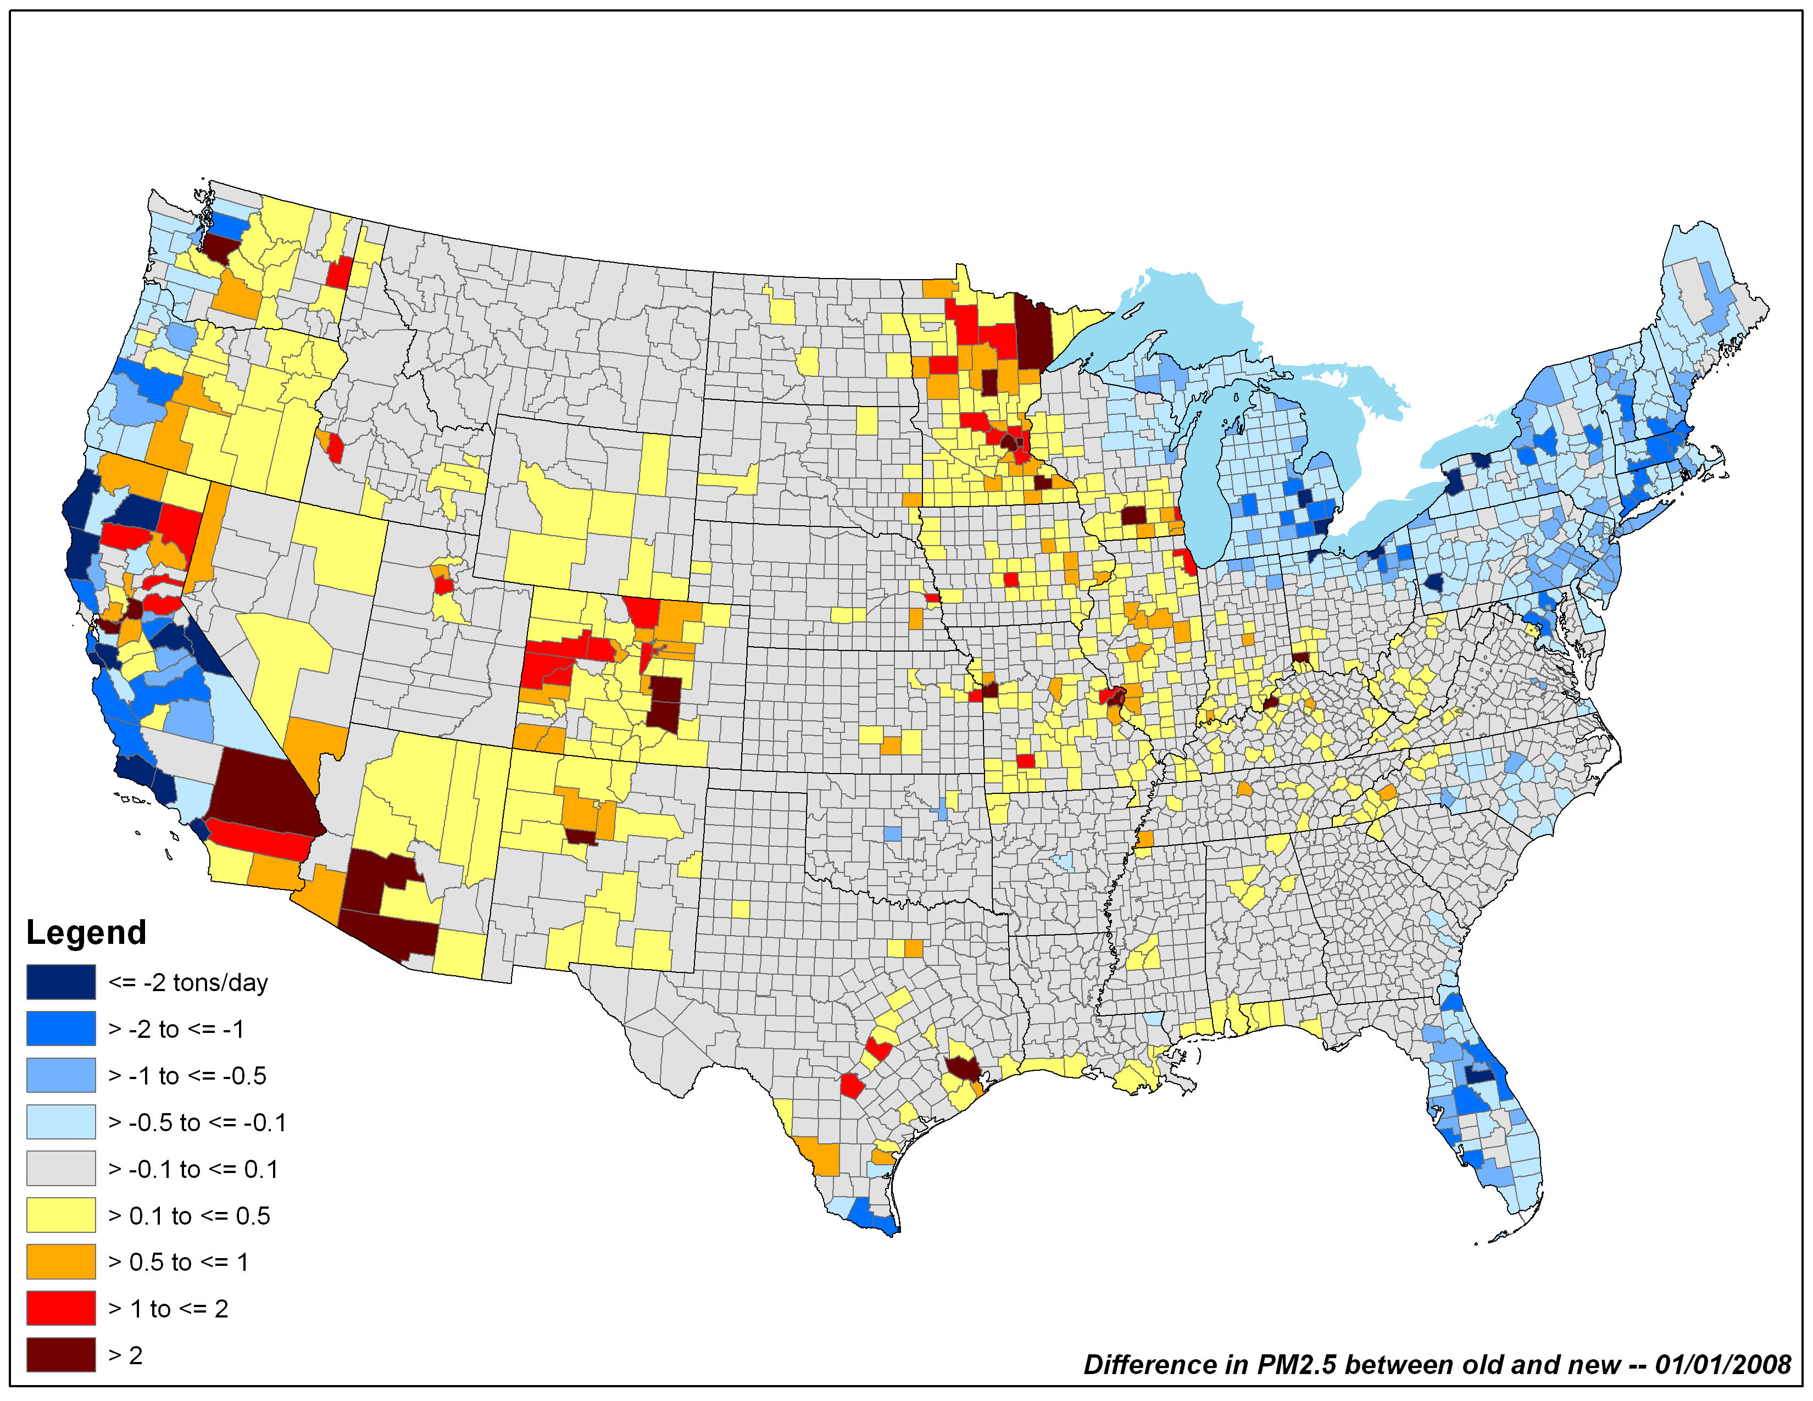
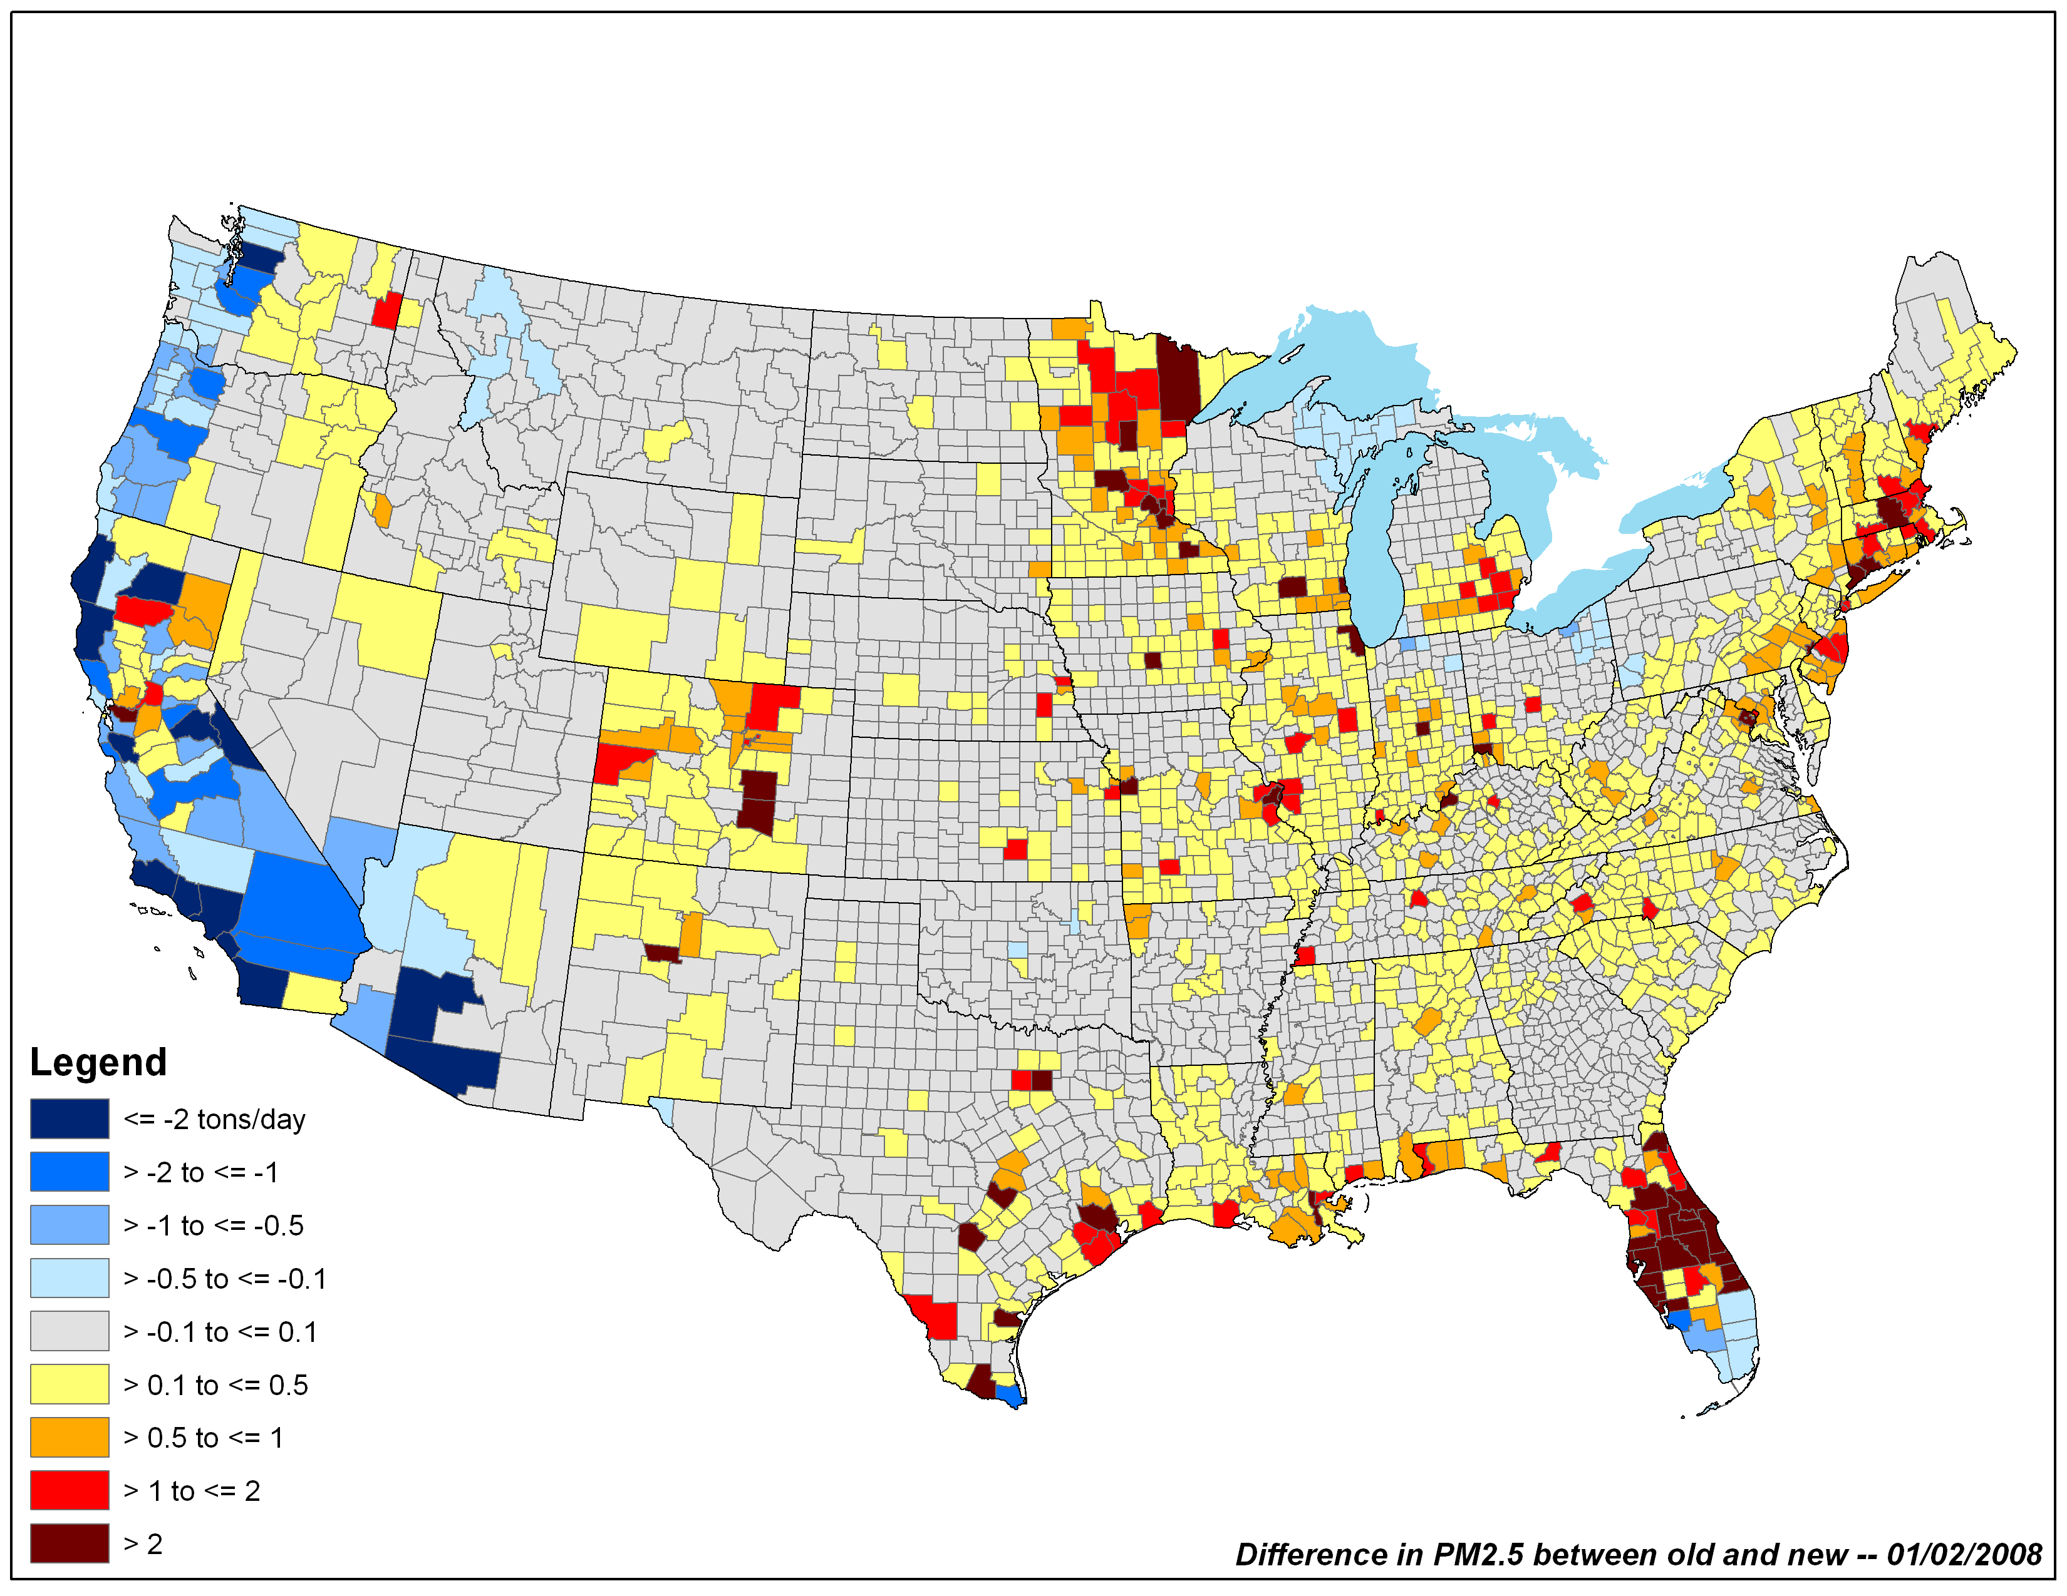
New Methods: RWC
RWC 2008 NEIv2: “old method” – “new method @50F”
Jan 1
Jan 2

Slide 12
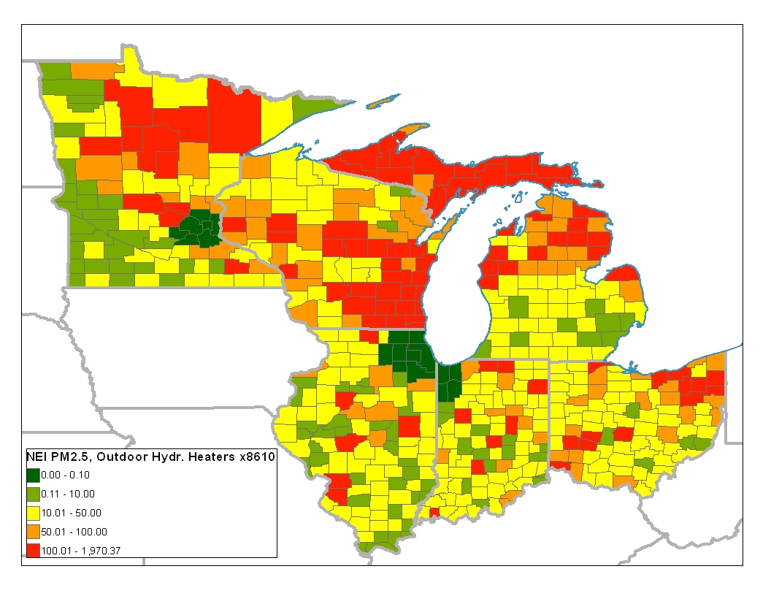
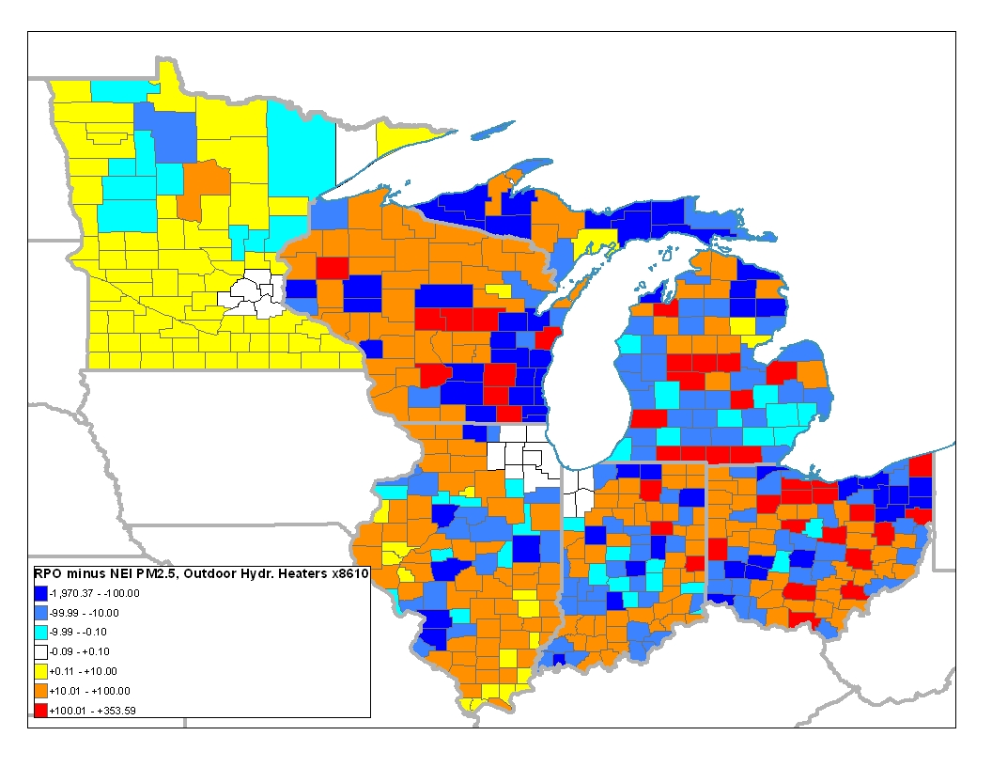
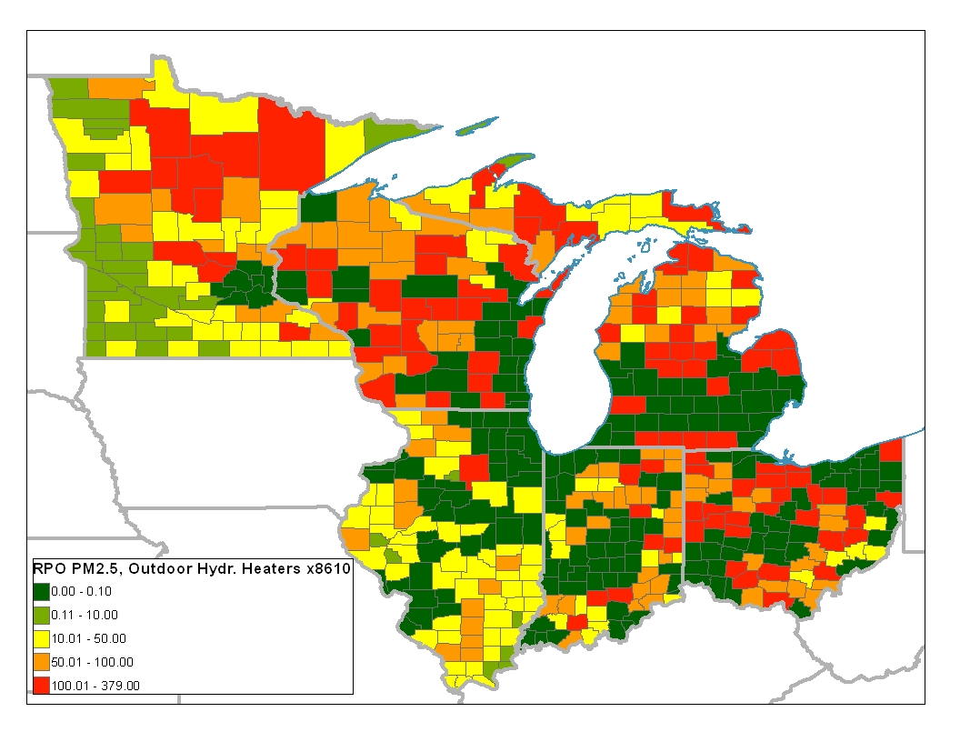
RPO vs NEI RWC Data Analysis
PM_{2.5} Outdoor Hydronic Heaters
NEI (top left)
RPO (bottom left)
Difference RPO – NEI (above)

Slide 13
Temporal Allocation
Improved RWC Diurnal Profile

Slide 14
New Methods: animal ag NH₃
ag NH₃ from animals (CAFO)
GenTPRO uses Russell and Cass equation which relates emissions to temperatures and wind speed
Create hour-of-month temporal profiles
  - previous annual to monthly allocation is retained
MN animal ag NH₃ daily temporalization

Slide 15
New Methods: fires
SMARTFIRE 2.0
Integrate satellite fire detects with ground-based databases
Classifies fires as:
  wildfires
  prescribed
  wildland fire use (WFU)
  agriculture
  unclassified
v2.0 improvements:
  fire sizing algorithms
  Classified all “unclassified” fires
  Improving evaluation of cloud-cover interference
2008 and 2009 inventories SMARTFIRE v2.0
  previous years SMARTFIRE v1.0
  NEW: developed 2007 (draft) and 2010 using v2

Slide 16
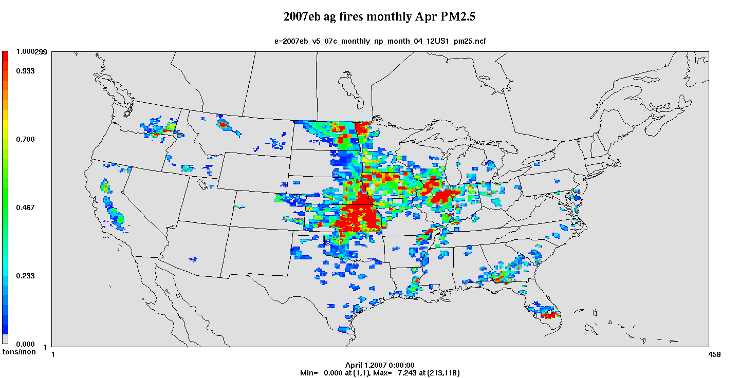
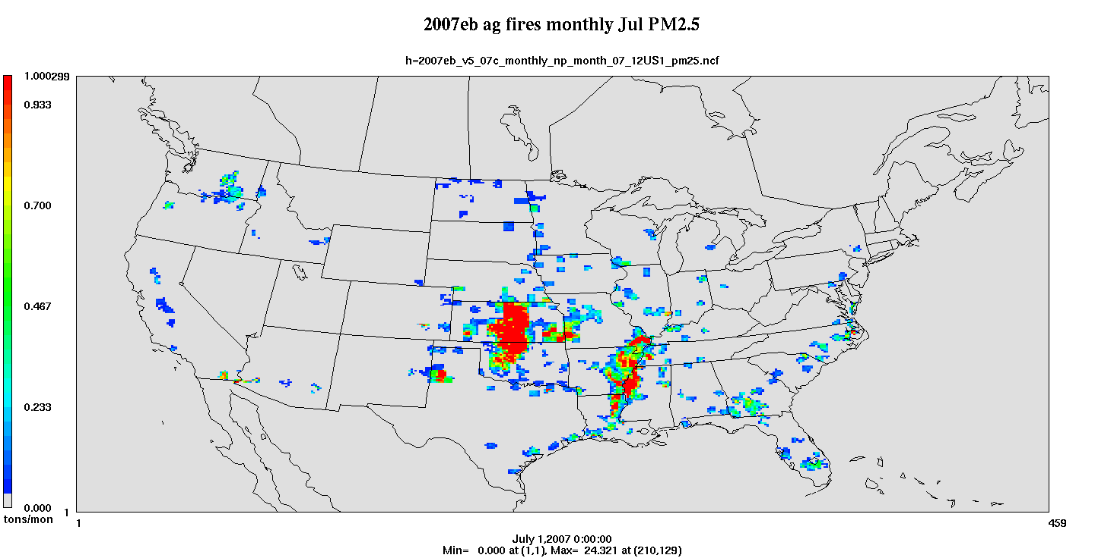
New Methods: ag fires
ag fires based on SMARTFIRE v1.0
NEI team applied EF and crop harvesting patterns
2008 daily emissions aggregated to monthly nonpoint inventory for 2007 to minimize year-specific met-dependence
April
July
PM_{2.5}

Slide 17
Temporal Allocation
Improved Ag Burning Diurnal Profile

Slide 18
New Methods: average fires
Fire Averaging Tool (FAT)
Processes point daily fires to produce emissions at daily/county resolution
Purpose is for regulatory runs for base and future year
Leverages point daily fires
User controls:
  range of years
  grouping of SCCs
  averaging period – FAT uses a rolling average (e.g., 1 week)
We currently use 2008 (SF2) for Rx burning & 2003-2009 for wildfires

Slide 19
New Methods:
Fire Averaging Tool (FAT)

Slide 20
New Methods: afdust met adjustment
Includes PM emissions from paved* and unpaved road dust, agricultural tilling, construction, etc.
New adjustments developed by EPA ORD
Transport fraction
  Reduces PM based on land use via BELD3
Meteorological adjustment
  Snow and rain suppresses PM emissions
  Snow on the ground OR top 1cm layer of soil >= 50 % saturated -> afdust emissions = 0
* paved roads inventory does not match met-adjusted NEI

Slide 21
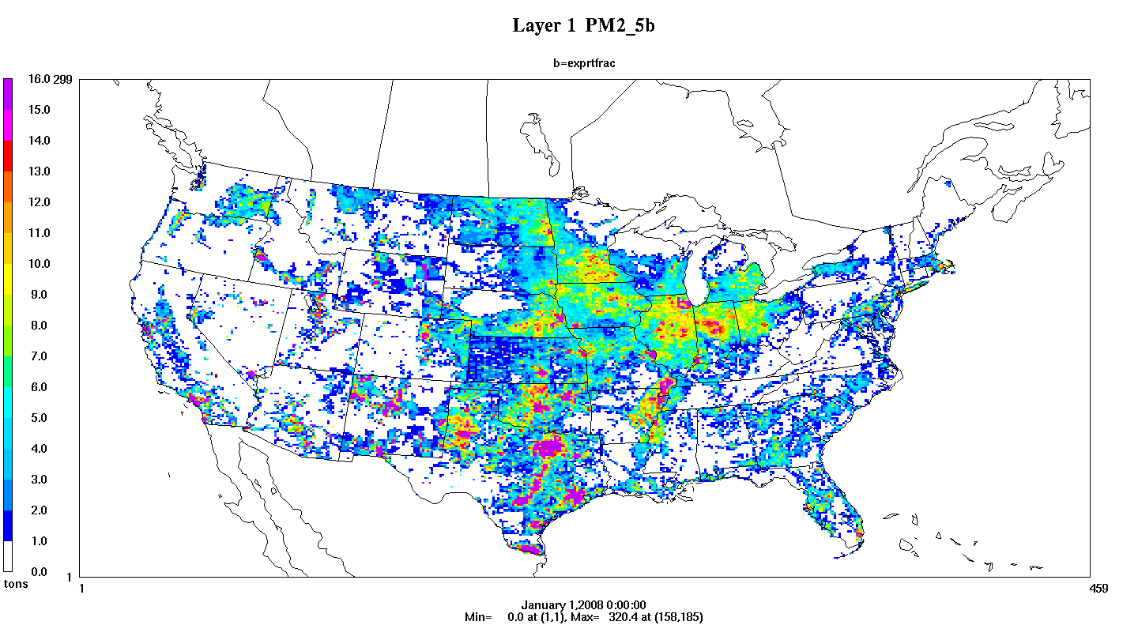
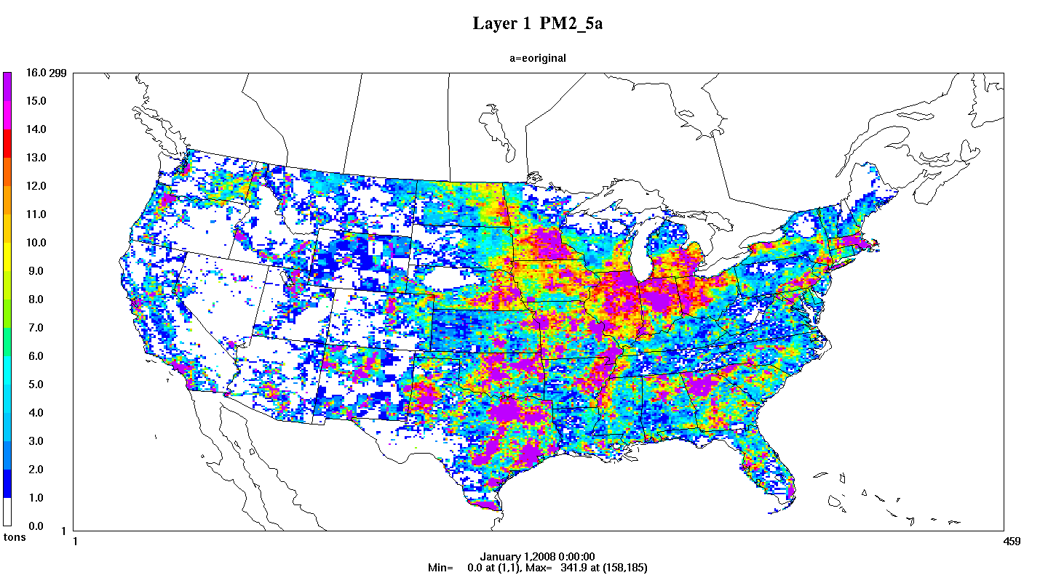
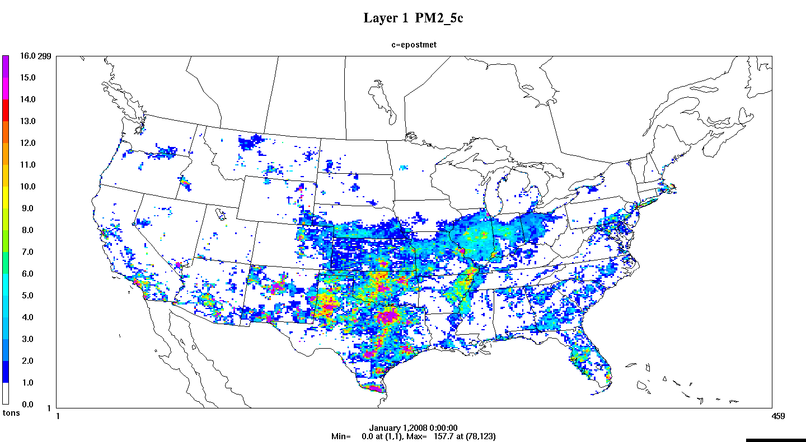
New Methods: afdust met adjustment
Jan transport fraction adj.
Jan unadjusted
PM_{2.5}
Jan transport fraction and met adj.

Slide 22
Ancillary Data:
Spatial Surrogates
Allocate nonpoint and mobile sources to grid cells
Census 2010 based surrogates
  circa-2000 for old surrogates
FEMA HAZUS (circa 2010) based surrogates
  e.g. Industrial Land, Commercial + Industrial
National Transportation Atlas Database (NTAD) 2011 based surrogates
Other updates developed but not yet implemented
  National Land Cover Database (crop and pasture land, residential density)
  Gas stations, TIGER-Line data (e.g. roads), etc.
WRAP Phase III Oil & Gas: basin specific spatial surrogates
Notes:
Mention that investigating new surrogates for things like HDDV extended-idle

Slide 23
Ancillary Data:
Speciation
Speciation profiles are used to map inventory pollutants to AQ model species
PM AE6 speciation
  support for CMAQ v5.0
  includes more specific speciation of PM (e.g. Al, Mg, etc.)
Onroad speciation
  updated profiles from OTAQ for VOC
  permeation mode specific profiles for VOC
WRAP Phase III Oil & Gas
  basin-specific VOC profiles
SPECIATE 4.3
  process underway to systematically review new profiles

Slide 24
Projections
Goal is to incorporate all “on the books” regulations
  work with RPOs and states to identify these controls
Updated non-EGU projections, controls and closures based on 2007/2008 platform
Reviewed consent decrees
Includes upstream impacts from EISA/RFS2
Updates to methodology for several sources
  RWC, ag NH₃, ULSD, RICE, Boiler MACT
Oil & Gas projections mostly unavailable outside of WRAP basins
Updated projection tools for FF10 and for monthly controls
Later: Evaluate alternative methods for projecting select non-EGU industrial source categories based on AEO data

Slide 25
SMOKE updates
SMOKE-MOVES
  improved speed & temperatures out of range of EF
  support for: MOVES2010b, refueling and for more HAPS
Support for new inventory format: Flat File 10 (FF10)
  monthly, daily, and hourly emissions and controls for point and nonpoint
  monthly activity data (e.g. VMT)
  EIS can produce the FF10 files
New temporal profiles: GenTPro
  Support for monthly profiles
  Support for daily and hourly MET-derived profiles
SMOKE v3.1 currently available, v3.1 updates include:
  movesmrg optimization/bug fixes:
    option fast/slow for high/low memory
    use correct reference month lookup table for last few local hours each month
    apply control factor by FIPS/SCC/pollutant/mode/month
  met4moves allow TEMP_BUFFER_BIN to cover wider temperature ranges in MOVES lookup tables
  fixes/enhancements of FF10 daily/hourly inventory files, allow processing w/ other PTDAY/PTHOUR inventories

Slide 26
Next Steps
Continue to include 2007 model platform improvements
  CMAQ v5 testing (lightning NO_{X}, ag NH₃ bidirectional flux)
  oil and gas Permian basin 2008 data
  CEMs clean-up
  RWC improvement via 2011 NEI project
  C3 marine reconciliation
  Latest spatial surrogates (e.g., crops, gas stations, dry cleaners)
  inventory controls QA and validation
  MEGAN v2.10 biogenics
  2007-2010 SF2 fires
Future year projections
  updated consent decrees/settlements
  available SIP control measures
  Local RWC controls/burn bans
  oil and gas WRAP basin projections to 2010, 2012 or 2015
  Begin construction of 2017/2030 base cases for ABS FRM
  RPO inventory projections

Slide 27
Acknowledgments
UNC-Institute for the Environment
ENVIRON
CSC
ERG
RPOs and EPA regions
CARB
EPA’s: OTAQ, ORD, AQM group, NEI team

Slide 28
Appendix

Slide 29
Why 2007?
Factors considered in choosing base year
  Availability of year-specific emissions data
  Ability to use recent ambient data in design value projections
  Avoid years that are not conducive/representative regarding the formation of ozone and PM2.5 concentrations
2007 was selected because…..
  We can utilize/leverage the 2008 NEI
  2007 AQ-related meteorology was more representative of average conditions than 2008 (2008 had generally “unconducive” met in most of the US)
  We can use 2005 thru 2009 ambient data as the starting point for future projections
Notes:
Minimize or drop 2007 stuff

Slide 30
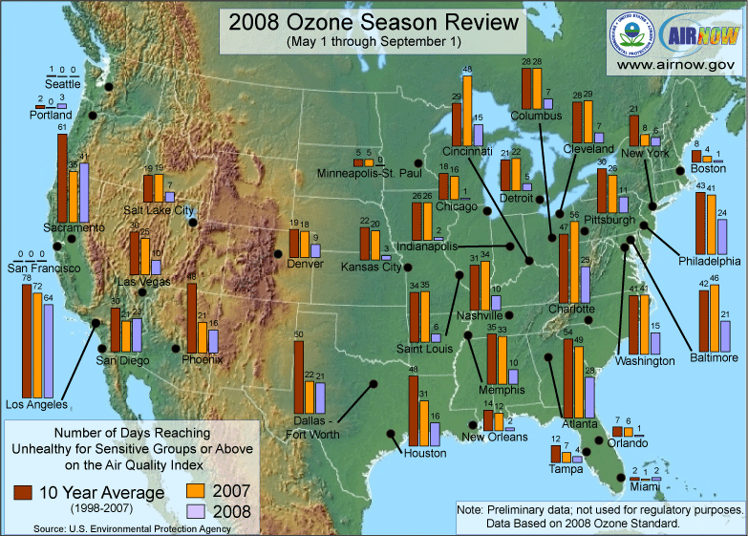
Representativeness of Air Quality in 2007 and 2008 vs Long-Term Concentrations
Number of days with AQI >100 in 2008 appears to significantly depart from the
long-term average for many cities.

Slide 31
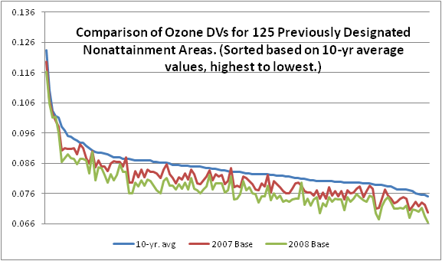
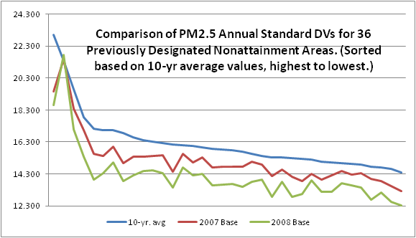
Why 2007?
Number of days with AQI >100 in 2008 appears to significantly depart from the
long-term average for many cities.

Slide 32
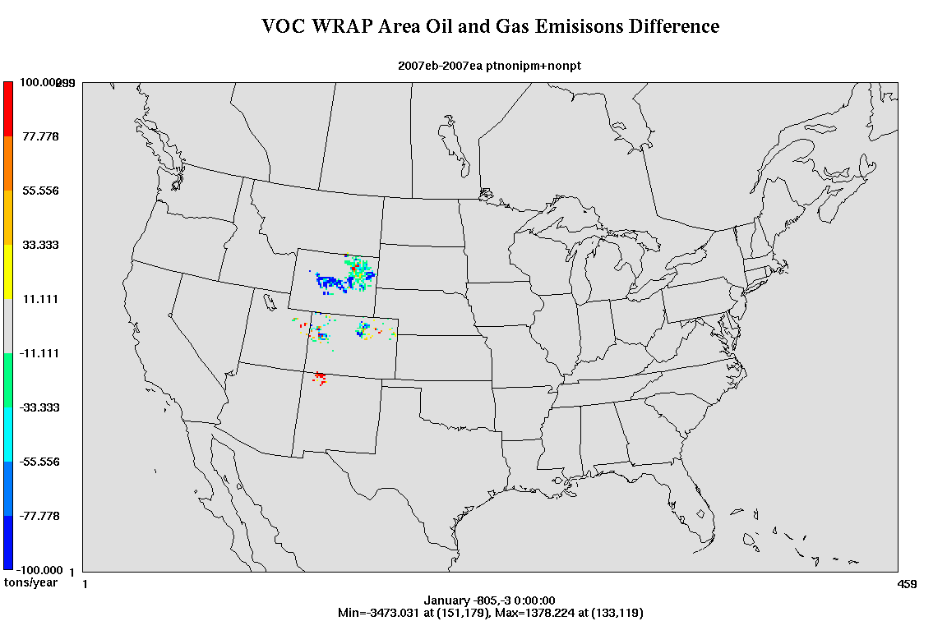
Alternative Inventories: Oil & Gas
VOC oil and gas difference
WRAP Phase III minus NEI 2008
does not reflect SW WY basin (new): double NO_{X} and 56% more VOC

Slide 33
New Methods: SMOKE-MOVES
Driver Script
Meteorological
Preprocessor
(Met4Moves)
MOVES
Post-processing
Script
SMOKE
AQ model-ready files

Slide 34
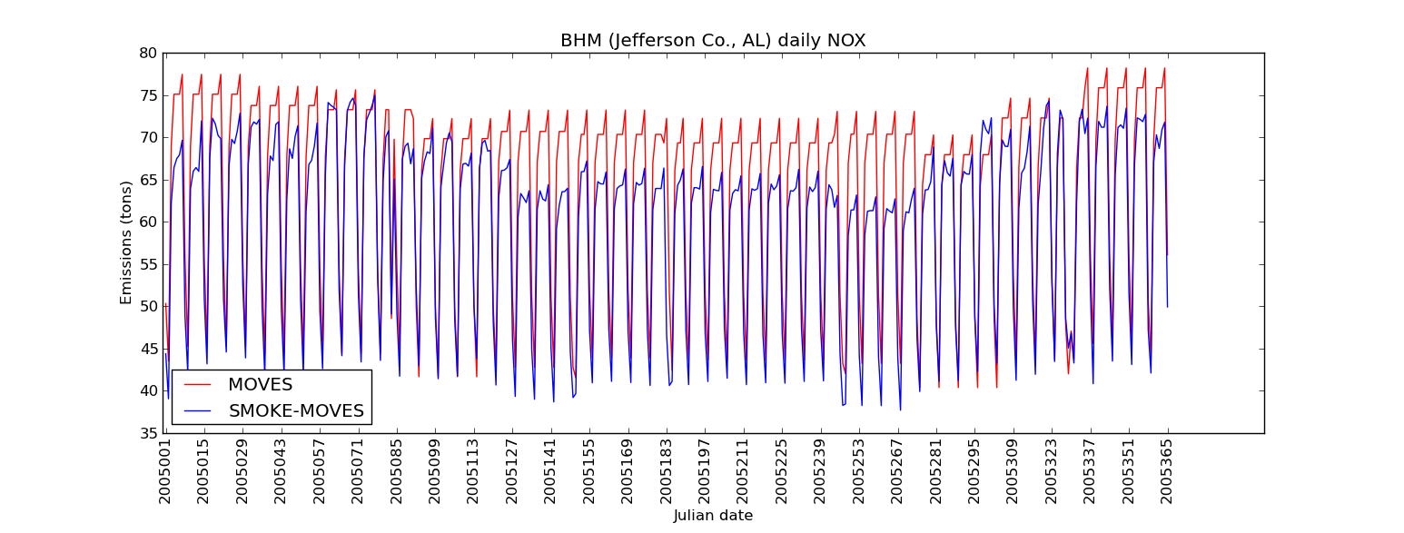
New Methods: SMOKE-MOVES
Emissions respond to day-specific temperature variations

