Slide 1
Analysis of Ultra-Fine Particle (UFP) Measurements of Urban and Rural Sites in Delaware
11th Annual CMAS Conference
October 15-17, 2012
Mohammed A Majeed¹, Golam Sarwar², Michael McDowell¹, Betsy Frey¹, Ali Mirzakhalili¹
¹Delaware Dept. of Natural Resources & Environmental Control, Division of Air Quality
²U.S. Environmental Protection Agency, Office of Research & Development

Slide 2
Outline
Trends in UFP number concentrations
At MLK and Lewes in Delaware
Descriptive statistics
Temporal and spatial variability
Diurnal variations
Weekday vs. weekend
Seasonal
Preliminary analysis of nucleation events
Summary & Future work

Slide 3
Ultrafine Particles
UFPs are particles
Diameter < 100 nm
Occur in large number, but hardly any mass
Most common source
Dominated by vehicle exhaust in urban areas
Adverse health effects may be closely related to UFPs
Long range transport
Affect particle number & mass concentrations in urban areas
Accumulation particles can transport long distances
Nucleation particles
Survive only a few hours due to coagulation and growth
Spatial scale of a max of few hundred kilometers
Meteorological conditions and seasonal changes
Can influence particle number concentrations

Slide 4
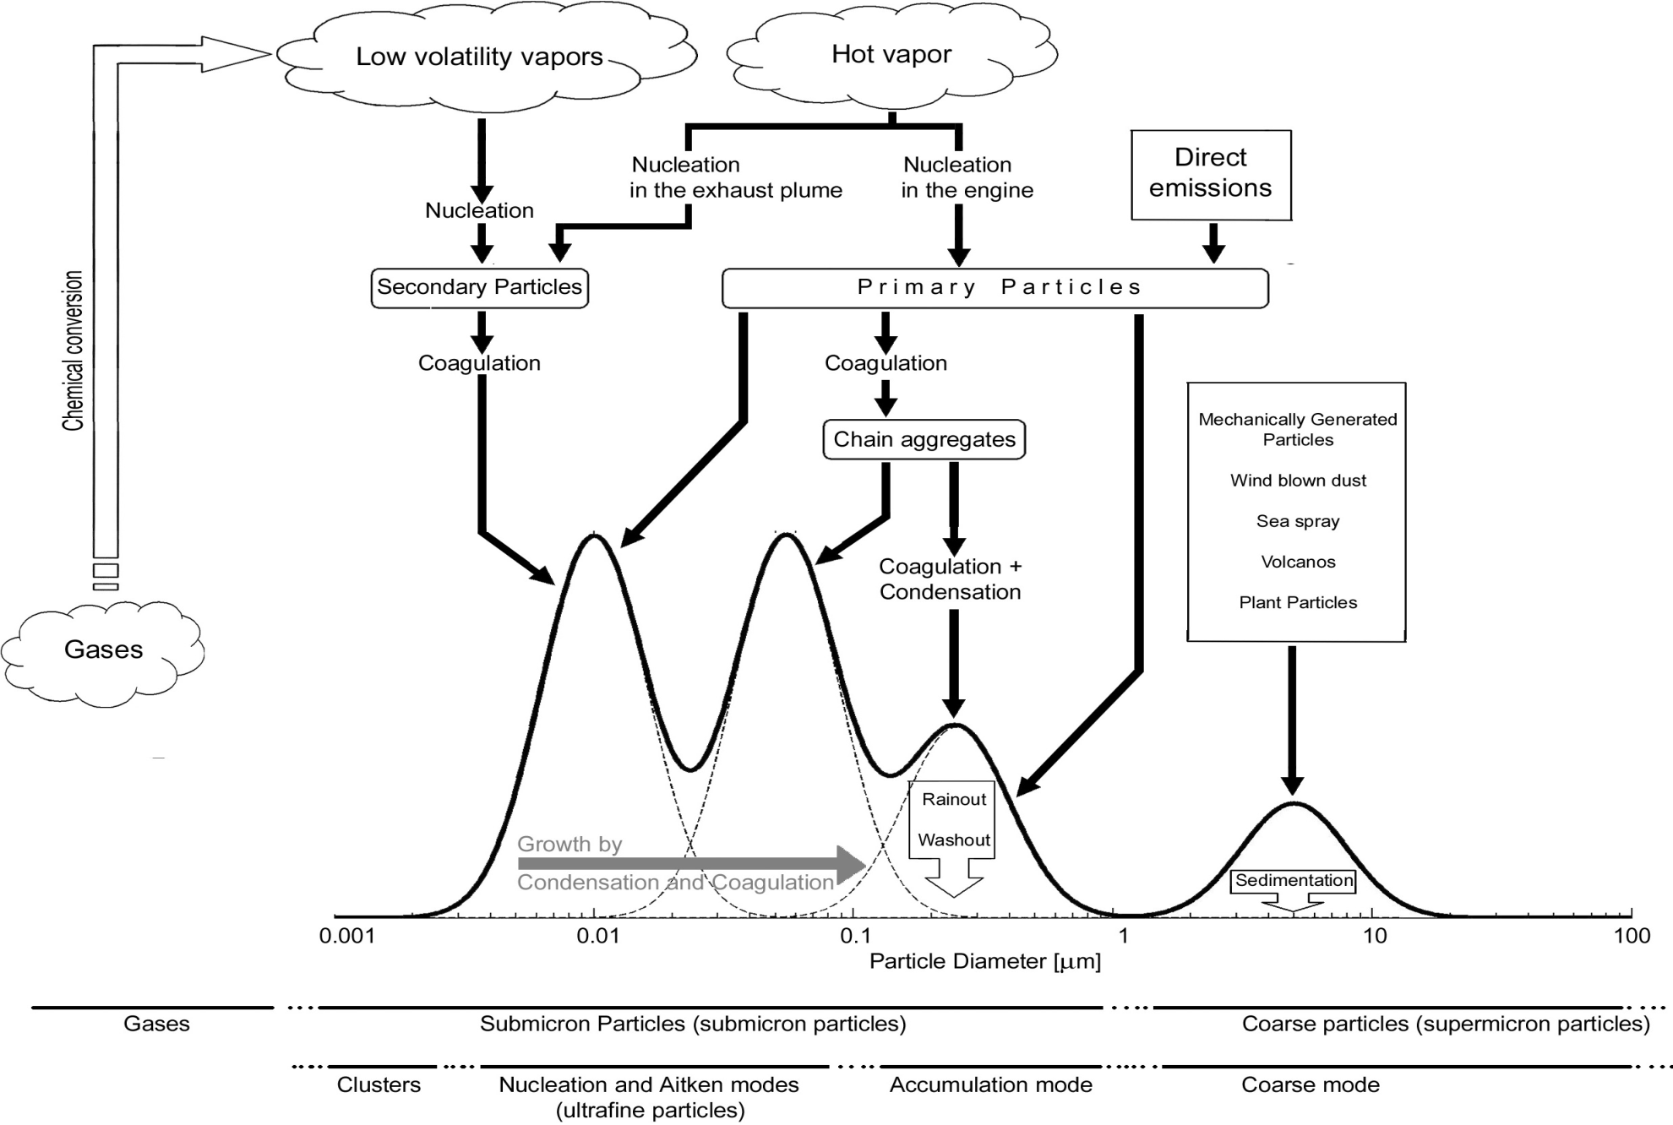
Idealized Schematic for Atmospheric Particle Number Size Distribution
(Hussein, 2005)

Slide 5
European Union UFP Standards
In 2005 the EU adopted “Clean Air for Europe” program
For light duty vehicles with diesel engines
6 x 10¹¹ particles/km
Phased in - 2010 to 2012

Slide 6
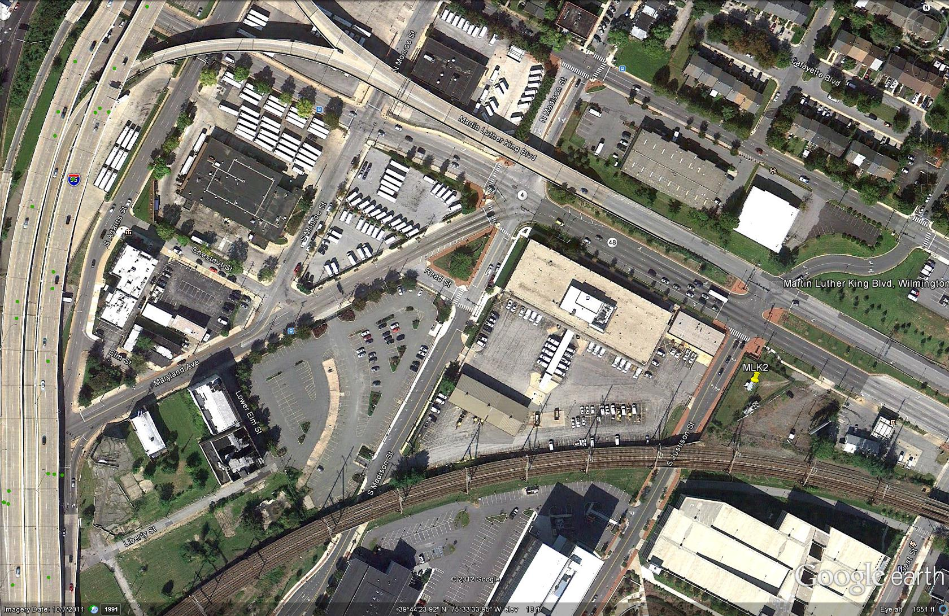
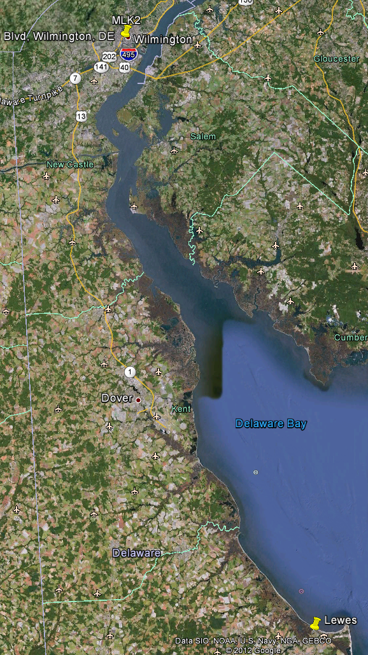
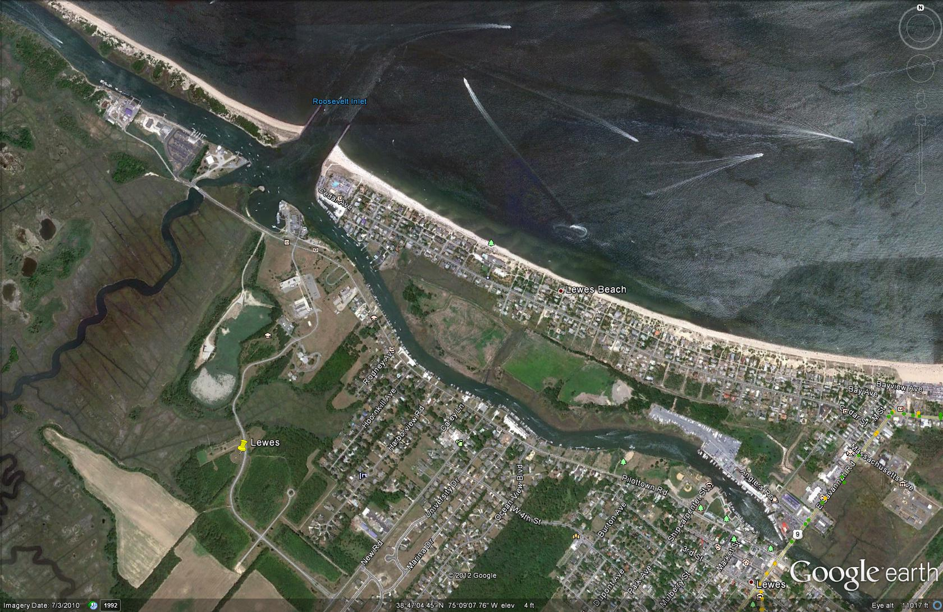
MLK
Lewes

Slide 7
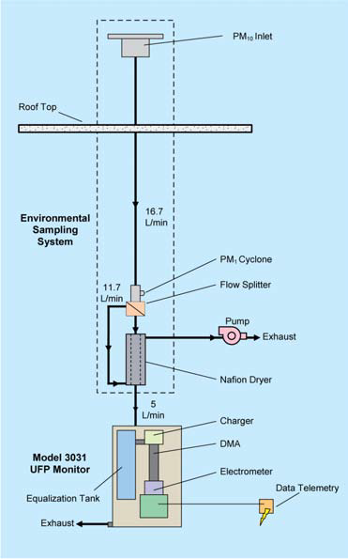
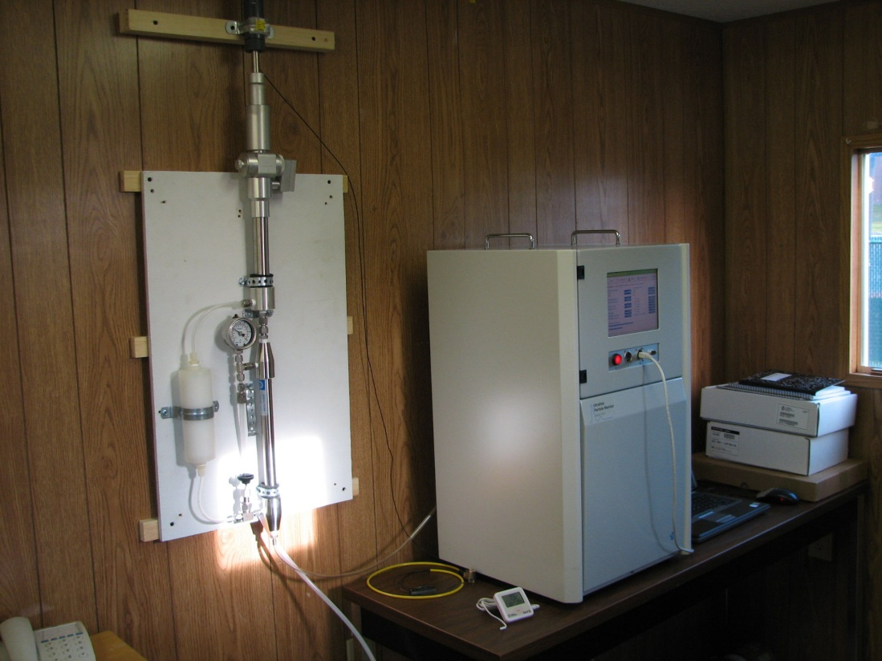
UFP Monitor (TSI Model 3031-1) & Sampling
TSI 3031-1 Ultrafine Particle Monitor and sampling system
Photo: Ted Allen

Slide 8
UFP Measurements at MLK & Lewes
Monitoring Period
MLK: 11/2009 - 07/2011
Lewes: 01/2012 - 06/2012
Measurements made in six channels at 15-min intervals
Channel 1 : 20-30 nm ➔ N₃₀
Channel 2 : 30-50 nm ➔ N₅₀
Channel 3 : 50-70 nm ➔ N₇₀
Channel 4 : 70-100 nm ➔ N₁₀₀
Channel 5 : 100-200 nm ➔ N₂₀₀
Channel 6 : 200-500 nm ➔ N₅₀₀

Slide 9
Descriptive Statistics for Similar Periods
MLK 2011 | 25th Percentile | Median | 75th Percentile | Max | Mean | SD
Jan | 26,700 | 36,500 | 54,300 | 127,900 | 41,900 | 21,000
Feb | 20.500 | 32,400 | 49,400 | 174,300 | 38,000 | 24,900
Mar | 12,200 | 19,400 | 29,700 | 187,300 | 23,000 | 15,400
Apr | 12,900 | 19,300 | 28,200 | 79,600 | 22,400 | 13,800
May | 15,200 | 23,000 | 28,300 | 75,600 | 25,400 | 13,100
Jun | 20,500 | 27,300 | 35,600 | 85,900 | 29,800 | 13,100
Lewes 2012 | 25th Percentile | Median | 75th Percentile | Max | Mean | SD
Jan | 5,900 | 9,900 | 15,700 | 47,100 | 11,200 | 6,900
Feb | 8,300 | 12,100 | 16,700 | 32,100 | 12,900 | 6,200
Mar | 6,500 | 9,600 | 15,100 | 54,500 | 11,800 | 7,300
Apr | 12,900 | 12,900 | 19,500 | 64,500 | 15,000 | 9,000
May | 5,800 | 9,100 | 19,500 | 58,300 | 11,800 | 9,000
Jun | 9,200 | 15,900 | 25,800 | 60,000 | 17,900 | 11,100
Total Number Concentration, cm⁻³.h⁻¹

Slide 10
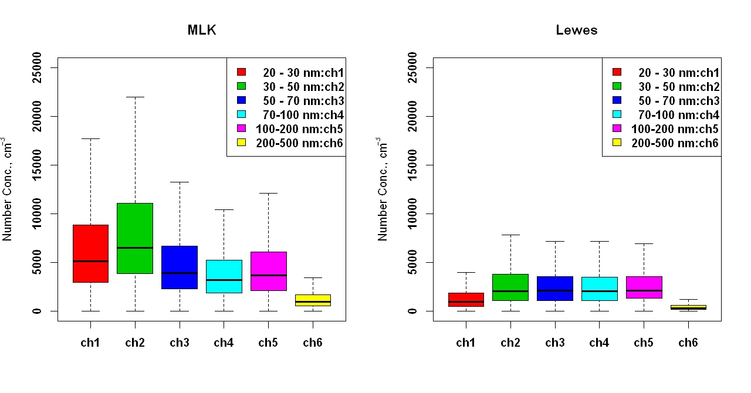
Particle Number Comparisons

Slide 11
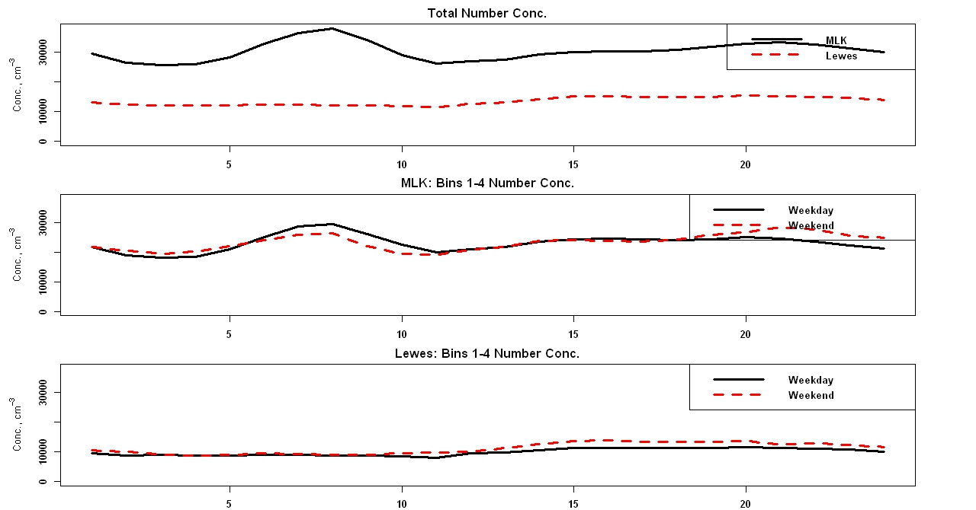
Diurnal Pattern of Particle Number Concentration
Hour of Day

Slide 12
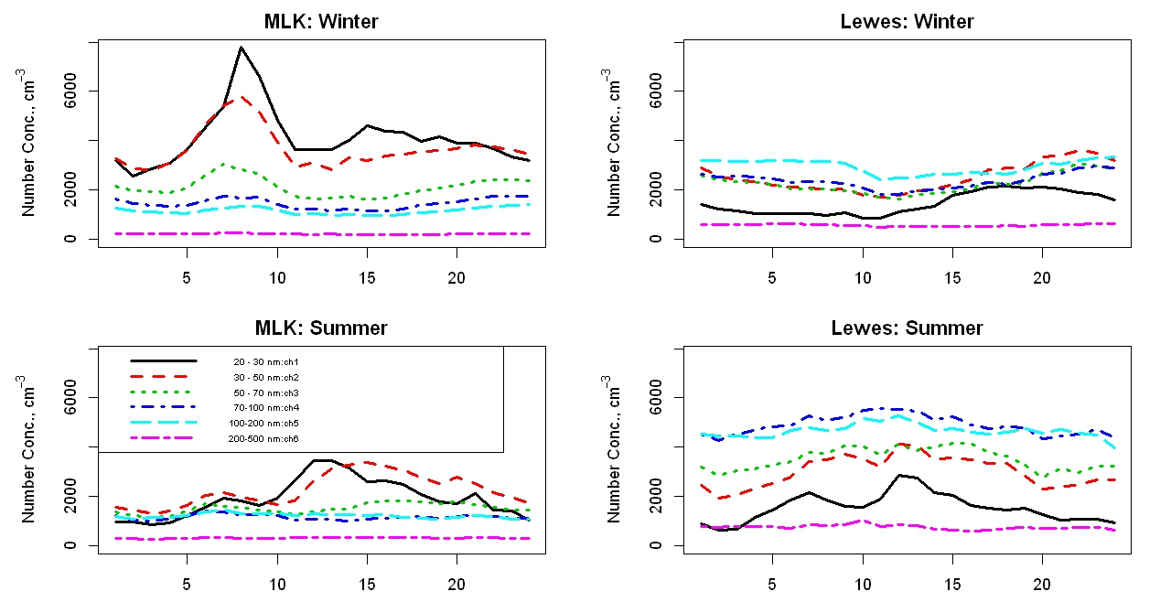
Seasonal Pattern of Particle Number Concentration for Weekdays
June 2012
June 2012
Hour of Day
Hour of Day
Hour of Day

Slide 13
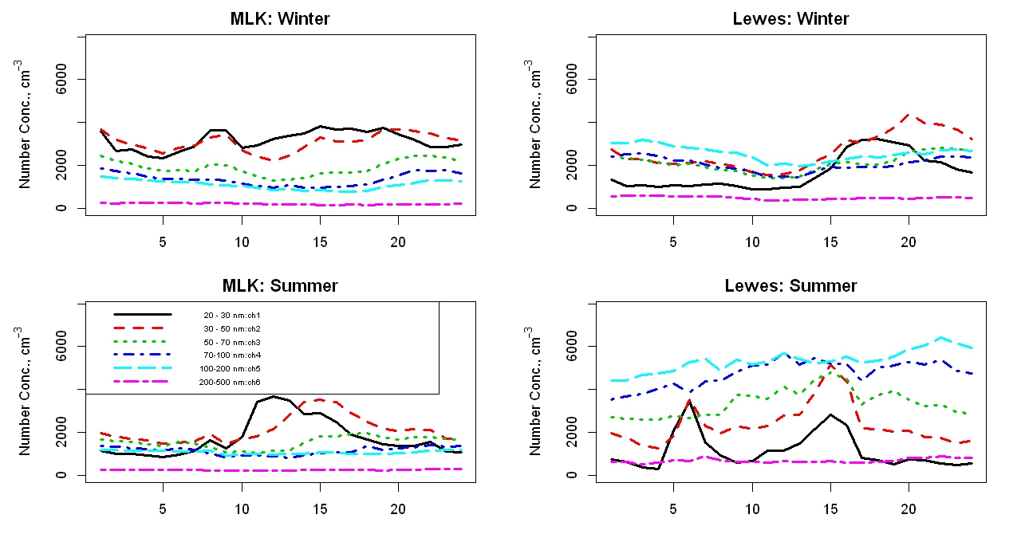
Seasonal Pattern of Particle Number Concentration for Weekends
June 2012
June 2012
Hour of Day
Hour of Day

Slide 14
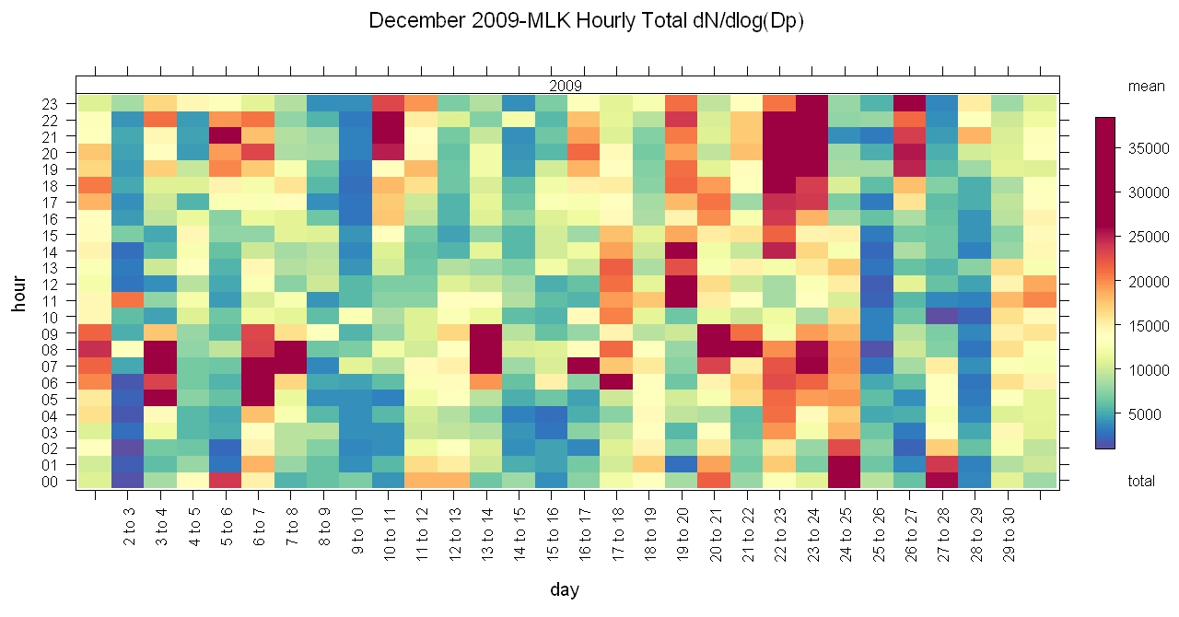

Slide 15
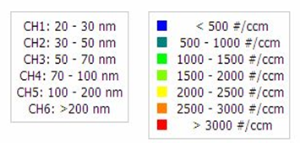
Event Types
Morning & Afternoon peaks: 1/27/2010
Three Peaks: 1/18/2010
Noon Event: 2/07/2010

Slide 16
Classification of Events
Short - lived
Weak – dN₃₀/dt: 5,000 cm⁻³ h⁻¹
Moderate – 5,000 < dN₃₀/dt < 10,000 cm⁻³ h⁻¹
Strong - dN₃₀/dt > 10,000 cm⁻³ h⁻¹
Event Days at MLK
Year | Month | Moderate | Strong
2011 | Jan | 13 | 10
 | Feb | 10 | 8
 | Mar | 11 | 5
 | Apr | 9 | 3
 | May | 7 | 3
 | Jun | 6 | 4
 | Jul | 2 | 2
Event Days at Lewes
Year | Month | Moderate | Strong
2012 | Jan | 1 | 0
 | Feb | 1 | 0
 | Mar | 1 | 1
 | Apr | 2 | 2
 | May | 1 | 1
 | Jun | 1 | 1

Slide 17
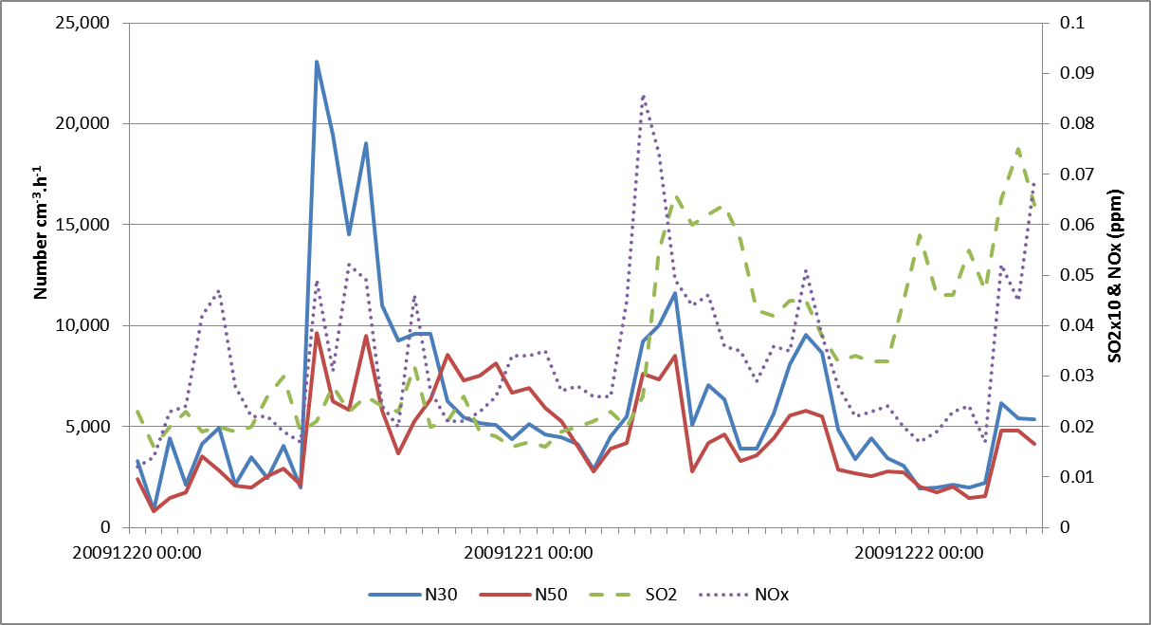
MLK: Evolution of Number Conc. on Strong Nucleation Days

Slide 18
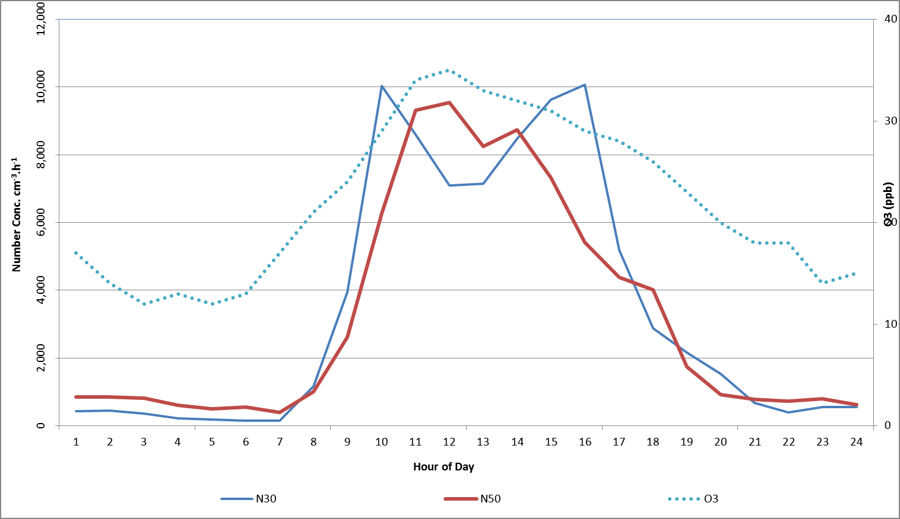
Lewes: Evolution of Number Conc. on Strong Nucleation Days
26th May 2012 (Saturday)

Slide 19
Summary & Future Work
MLK and Lewes data exhibit urban and rural differences in UFP counts
MLK number concentrations are impacted by motor vehicle emissions
Morning and afternoon peaks are evident
Weekday and weekend differences are also evident
UFP counts at urban site outnumber those at rural site
Summer UFP counts at Lewes are most likely impacted by motor vehicle emissions
Future Work
Further analysis on classification of events
Meteorological influences on nucleation
Apply the CMAQ model to simulate number concentration

