Slide 1

Verifying fossil fuel CO₂ emissions with CMAQ
Zhen Liu, Cosmin Safta, Khachik Sargsyan, Bart G. van Bloemen Waanders,
Ray P. Bambha, Hope A. Michelsen
Sandia National Laboratories, CA/NM
Tao Zeng
Georgia Department of Natural Resources, GA
CMAS 2012
15 October 2012
Notes:
I am going to talk about our recent work developing CO2 simulations with CMAQ.

Slide 2
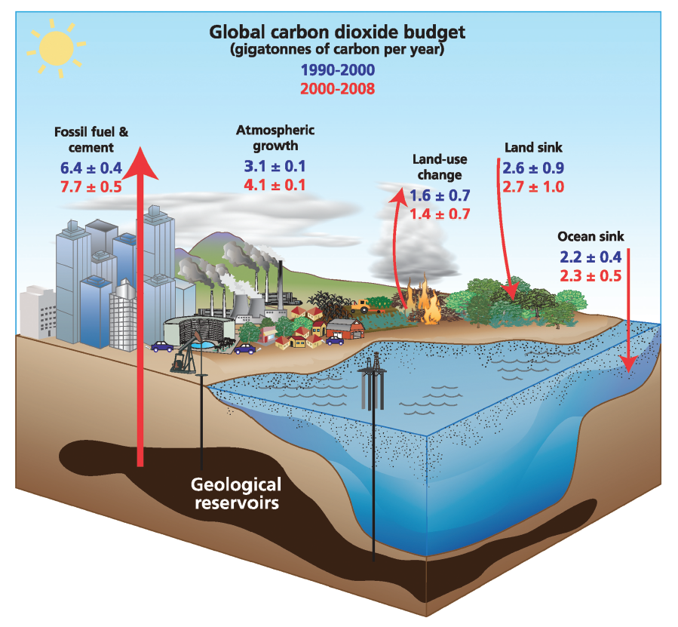
Atmospheric CO₂ trend and carbon cycle
http://www.esrl.noaa.gov/gmd/ccgg/trends/
NRC, 2010: Verifying Greenhouse Gas Emissions:
Methods to Support International Climate Agreements, pp16, Fig. 1.3
Growing fossil fuel CO₂ emission
Rising atmospheric CO₂ concentrations
Notes:
Carbon Cycle and is a chapter of atmospheric chemistry; thE increasing trend of CO2 observed at Mauna Loa Hawaii since 1950s draw great interests and attention of atmospheric chemists and ecologists because of the climate effect of CO2.
Based on mass balance and global fuel consumption statistics data, we are almost certain that the increase is mostly driven by fossil fuel combustion emissions.
However, our knowledge so far is not good enough for us to predict future trend of CO2. You can see from the figure on the right that the large uncertainties associated with these sources and sinks. Reducing these uncertainties and close the co2 budget is the goal of carbon cycle science.
However, The uncertainties at regional scale would be much larger.

Slide 3
Uncertainty of Fossil Fuel CO₂ emissions
Annual average
(higher uncertainty after temporal allocation)
?
?
gridded
Global: NRC, 2010. Country: EPA, 2012. State, county and 1-10km: Gurney et al., 2009, ES&T
Verifying fossil CO₂ emissions is
“firmly on the agenda of science, politics, and business”.
[Marland, 2008, J. Ind. Ecol., 136–139]
Notes:
Let’s next take a look at the uncertainties of fossil fuel emissions. On an annual average basis, the uncertainty of CO2 emissions increase from a few percent on a global and country scale. The uncertainty quickly increase with spatial resolution. to 16% on state scale, and when we go further to county level the uncertainty will be much larger more than 50%. If we look at monthly and daily emissions, the uncertainty could be even larger.
The reason for this is very easy to understand because we have a pretty good idea of the total amount of fuel we burn, but we don’t know for sure where and when the fuel is burned. These uncertainties need to be reduced because we need to predict the future trend of co2 and we need to come up with co2 emission control measures.
That is why verifying CO2 emissions is …

Slide 4
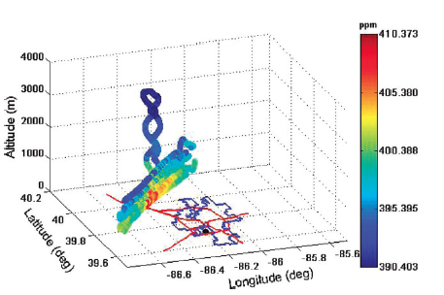
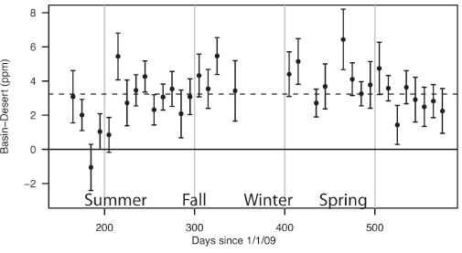
Verifying Fossil Fuel CO₂ Emissions
“A signal-to-noise problem”
Aircraft
(Indianapolis, IN)
Satellite GOSAT (Los Angeles Basin, CA)
3.2±1.5 ppm
[Mays et al., 2009, ES&T]
[Kort et al., 2012, GRL]
Model?
Model?
Can a state-of-the-art CTM help verify fossil fuel CO₂ emissions?
Notes:
The biggest challenge we face when we try to know CO2 emissions is the a signal-to-noise problem, as we have a huge background of CO2, which makes it hard to pinpoint fossil fuel emissions, even over urban areas.
So the question that those people doing observations need to answer is that can we really see the signal. The answer is it is difficult but it is possible. For example in this study, aircraft observed up to 10 ppm enhancement of CO2 in the downwind of Indianpolis. And this one is showing that the GOSAT satellite lauched in 2009 was capable of observing 3ppm of enhancement over LA basin.
As a modeler, my suggestion is that we need a model, to compare with and interpret these observations, and to link emissions to these observations. And as in these observations, the question I have to ask and answer is can we use a state-of-the-art CTM to solve the signal-to-noise problem and thus help verify the fossil fuel CO2 emissions.
And that question is the main motivation of this work, to develop the capability of CMAQ to simulate CO2.

Slide 5
3-D Eulerian Regional CO₂ Modeling using CMAQ
Add a CO₂ module in CMAQ
Widely used and well tested CTM, large user community;
Highly modularized codes makes adding species/processes easy;
Adaptable nested model domains enables high resolution modeling.
Goals:
Quantitatively examine model skills/errors on different time/spatial scales;
Develop model diagnostics and inverse modeling approach to pinpoint fossil fuel emissions;
Construct regional CO₂ budget and quantify its uncertainties.

Slide 6
Configuration of the CMAQ CO₂ module
(done/under development)
CMAQ : version 5.0
Meteorology : WRF
BC/IC : CarbonTracker (CT) (3°× 2°; 3-hourly)
Biosphere flux : (1) CarbonTracker (CASA) (1°× 1°) (2) VPRM (3) Sib3
Fossil fuel emission : (1) CDIAC (1°× 1°; monthly)
(2) VULCAN (2002; 10km; hourly)
Fire emission : GFEDv3.1 (0.5°× 0.5°; 3-hourly)
Chemistry : CB-05 → CO₂
Oceans flux : CarbonTracker
Benchmark : Oct. 2007, U.S. 36km, 22L

Slide 7
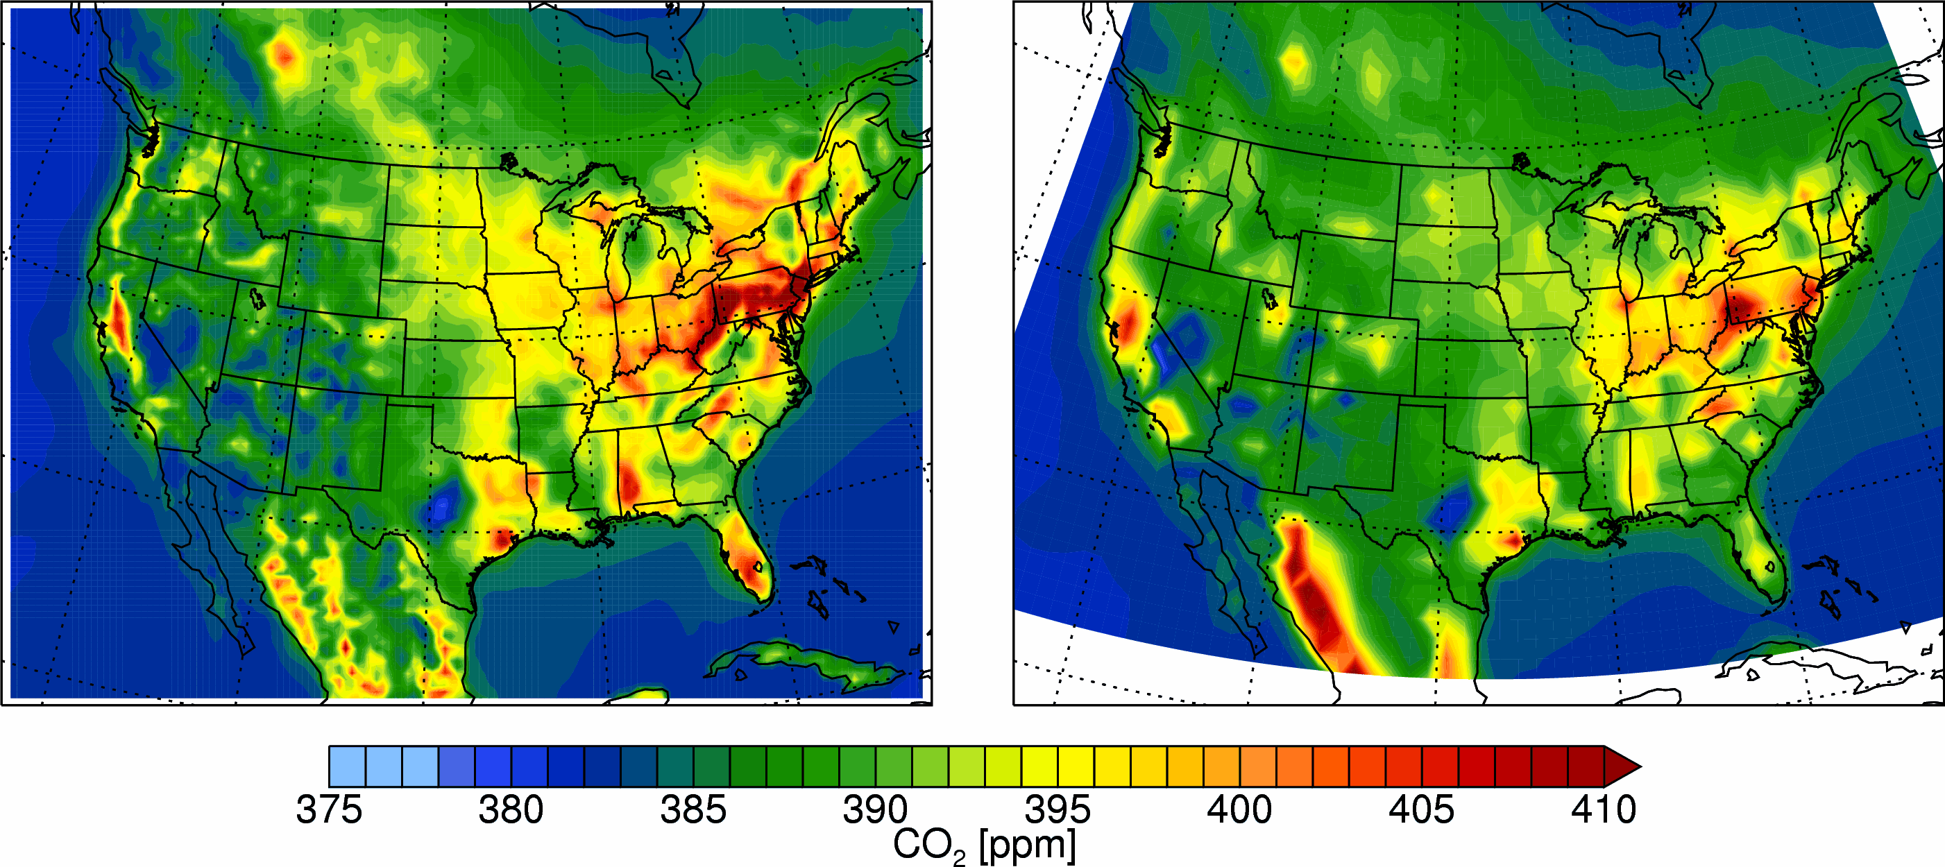
Benchmark simulation results (30m above ground) with CDIAC (1°× 1°, annual average) fossil fuel emission inventory
CMAQ-CDIAC
CarbonTracker
Root Mean Square Deviation (RMSD) = 0.47 ppm
Notes:
Here are some preliminary results for the benchmark simulation.
In the first simulation we use exactly the same fluxes as in Carbon Tracker. From the comparison between CMAQ and CarbonTracker, we will able to tell how much difference is introduced due to different model transport meteorology and model resolution.
You see on these two maps, both model give a higher flux in the east than the west because of the

Slide 8
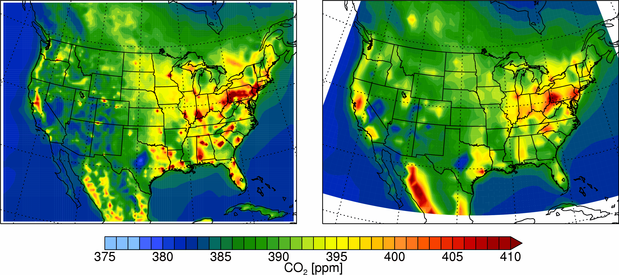
Benchmark simulation results (30m above ground) with VULCAN (10km, hourly) fossil fuel emission inventory
CMAQ-VULCAN
CarbonTracker
Root Mean Square Deviation (RMSD) = 0.48 ppm
Notes:
In a second simulation, we replace the CADIAC emission with VULCAN with has 10 times higher resolution and hourly time resolution. This time you see we start to see cities in CMAQ.

Slide 9
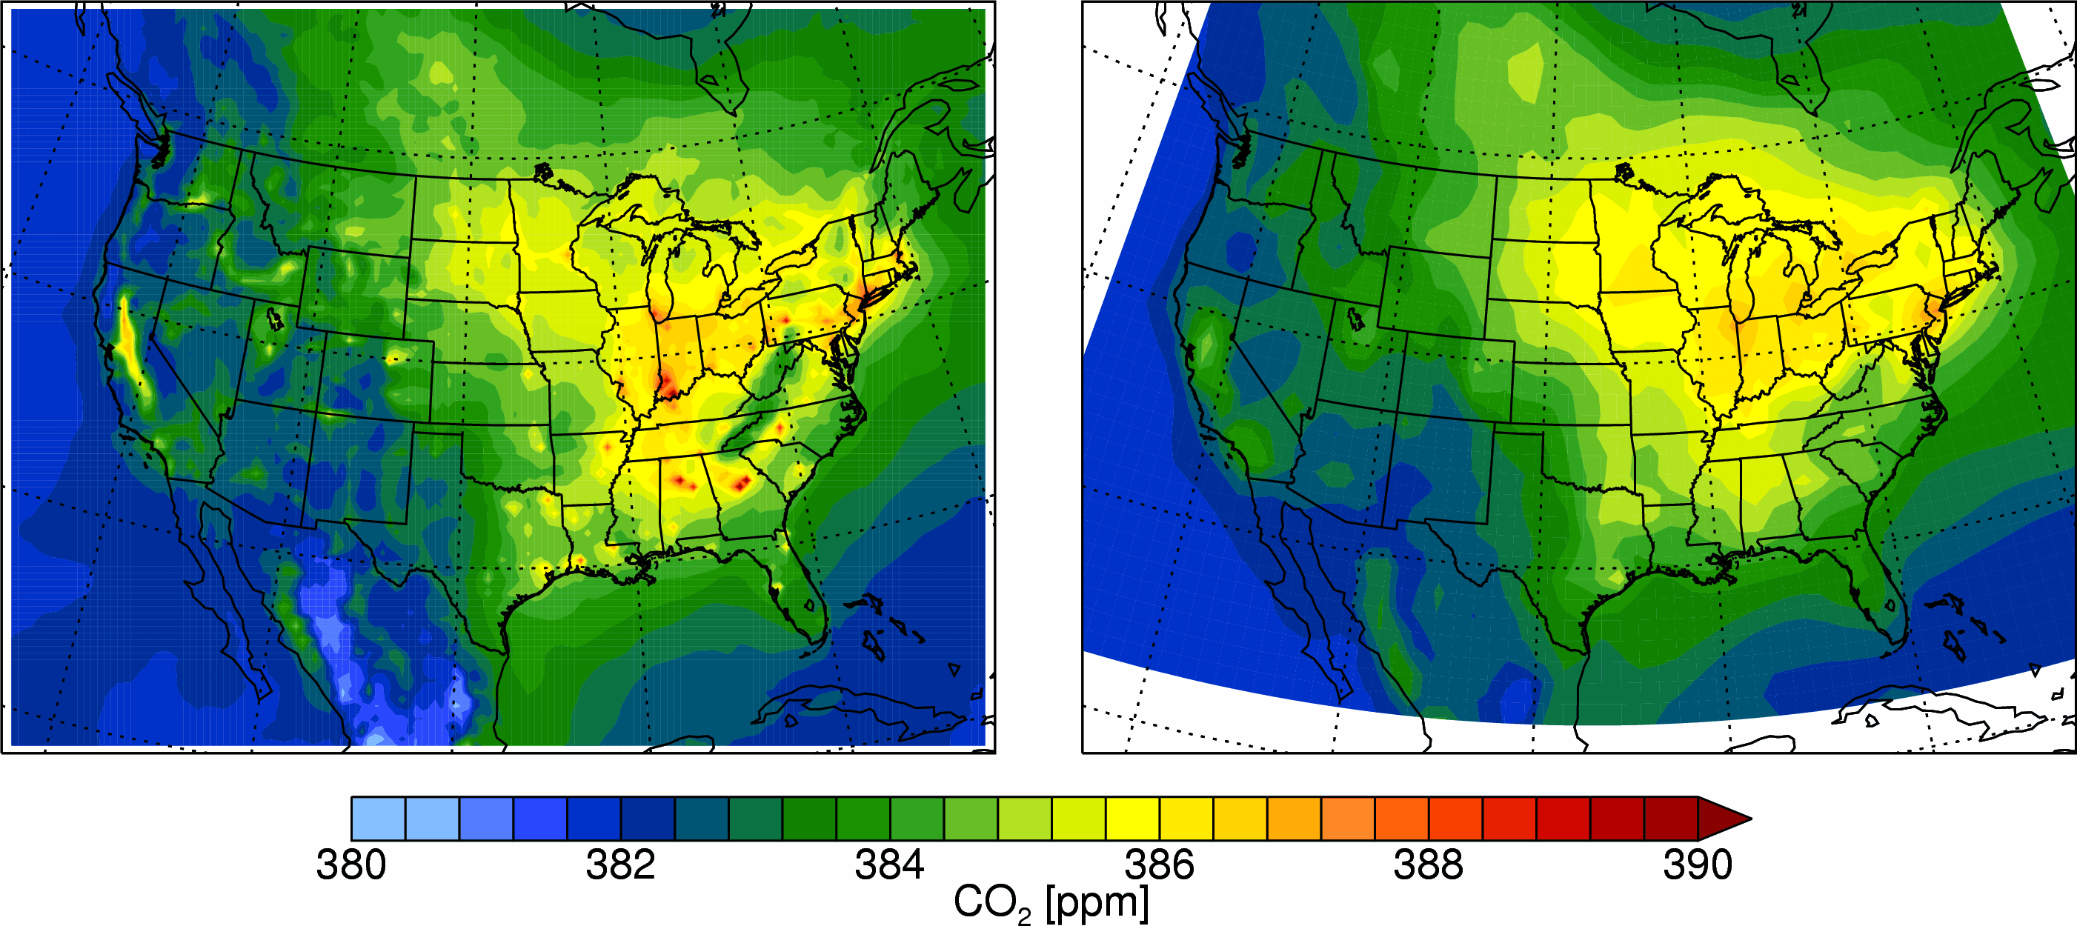
Benchmark simulation results (0-1500m average) with VULCAN (0.1°× 0.1°, hourly) fossil fuel emission inventory
CMAQ-VULCAN
CarbonTracker
Some hotspots could still be seen (> 4ppm enhancement)
Root Mean Square Deviation (RMSD) = 0.43 ppm
Notes:
Another interesting thing to look at is the average concentration over a column, which is usually the quantity a satellite would be able to measure and also a quantity that would not be affected by PBL expansion.
We see that first these two models also agree very well, and even on the left in the CMAQ simulated CO2, we can see some of the hotspots. This means that our model is able to discern some of the anthropogenic signals. As In those observational studies, this means it is promising for us to use cmaq to pinpoint fossil fuel signals.

Slide 10
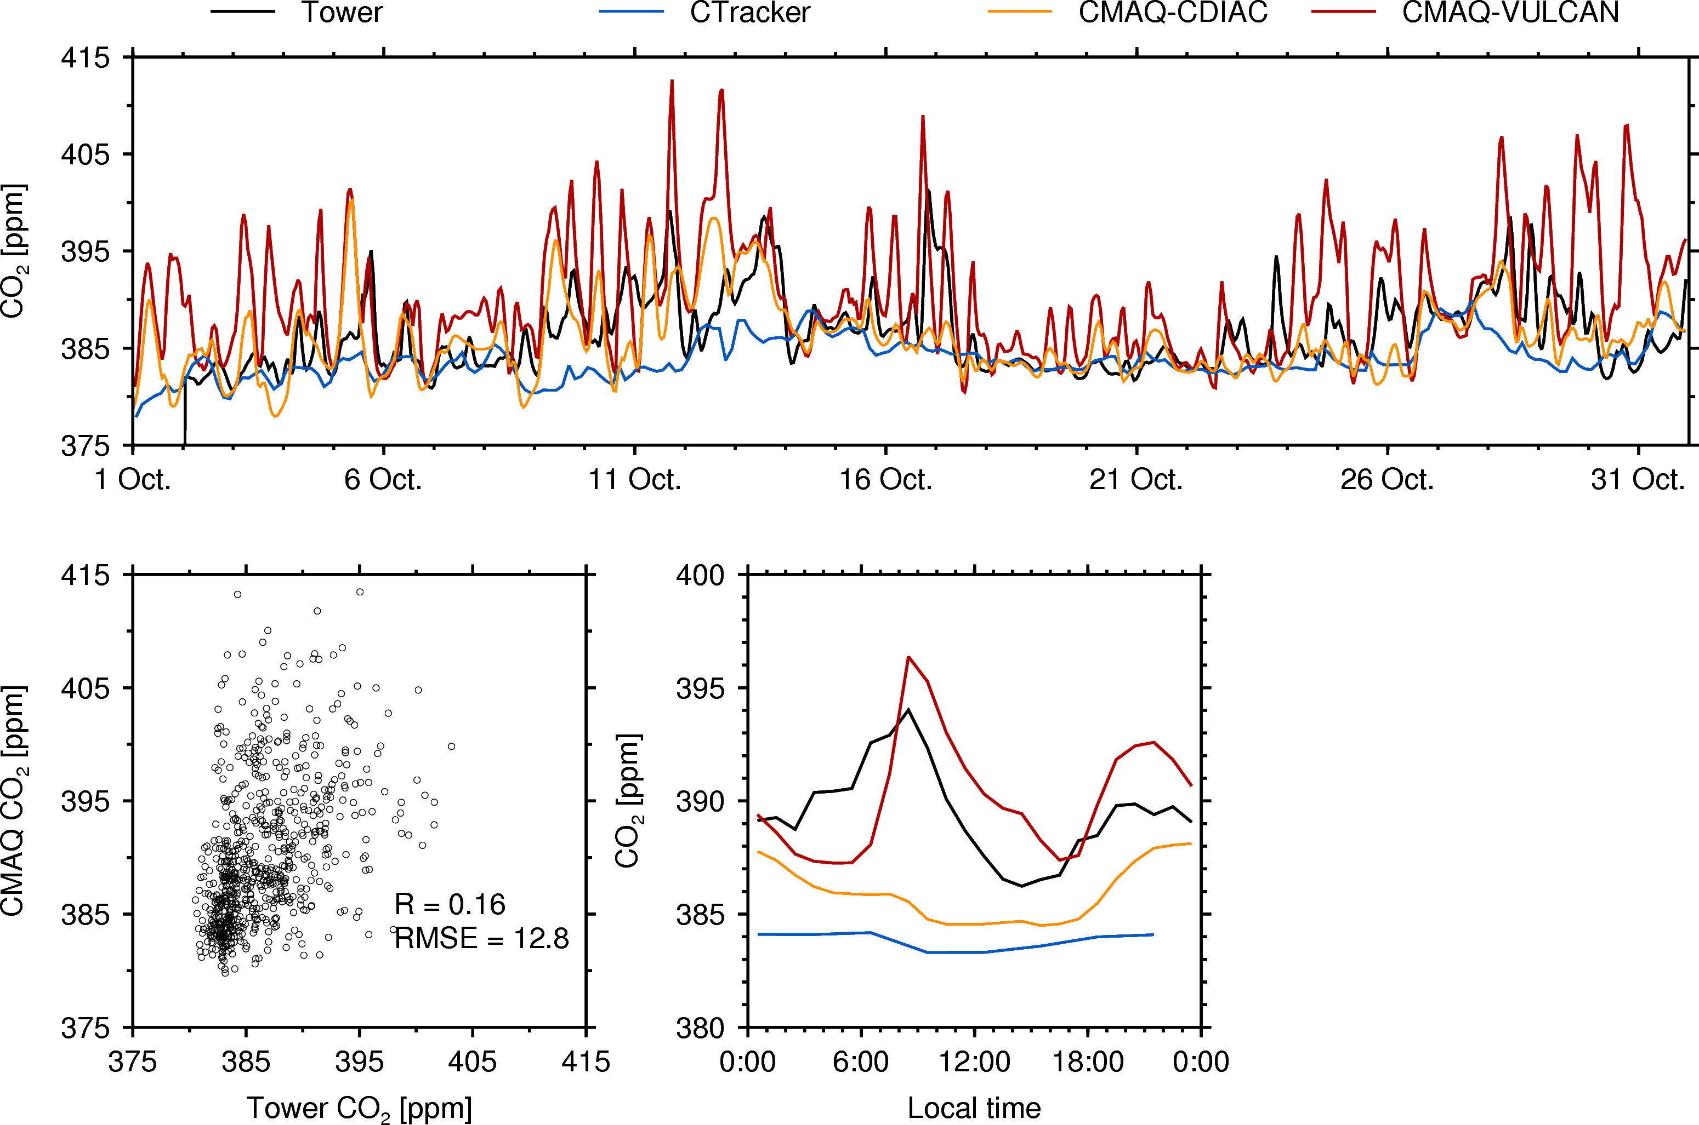
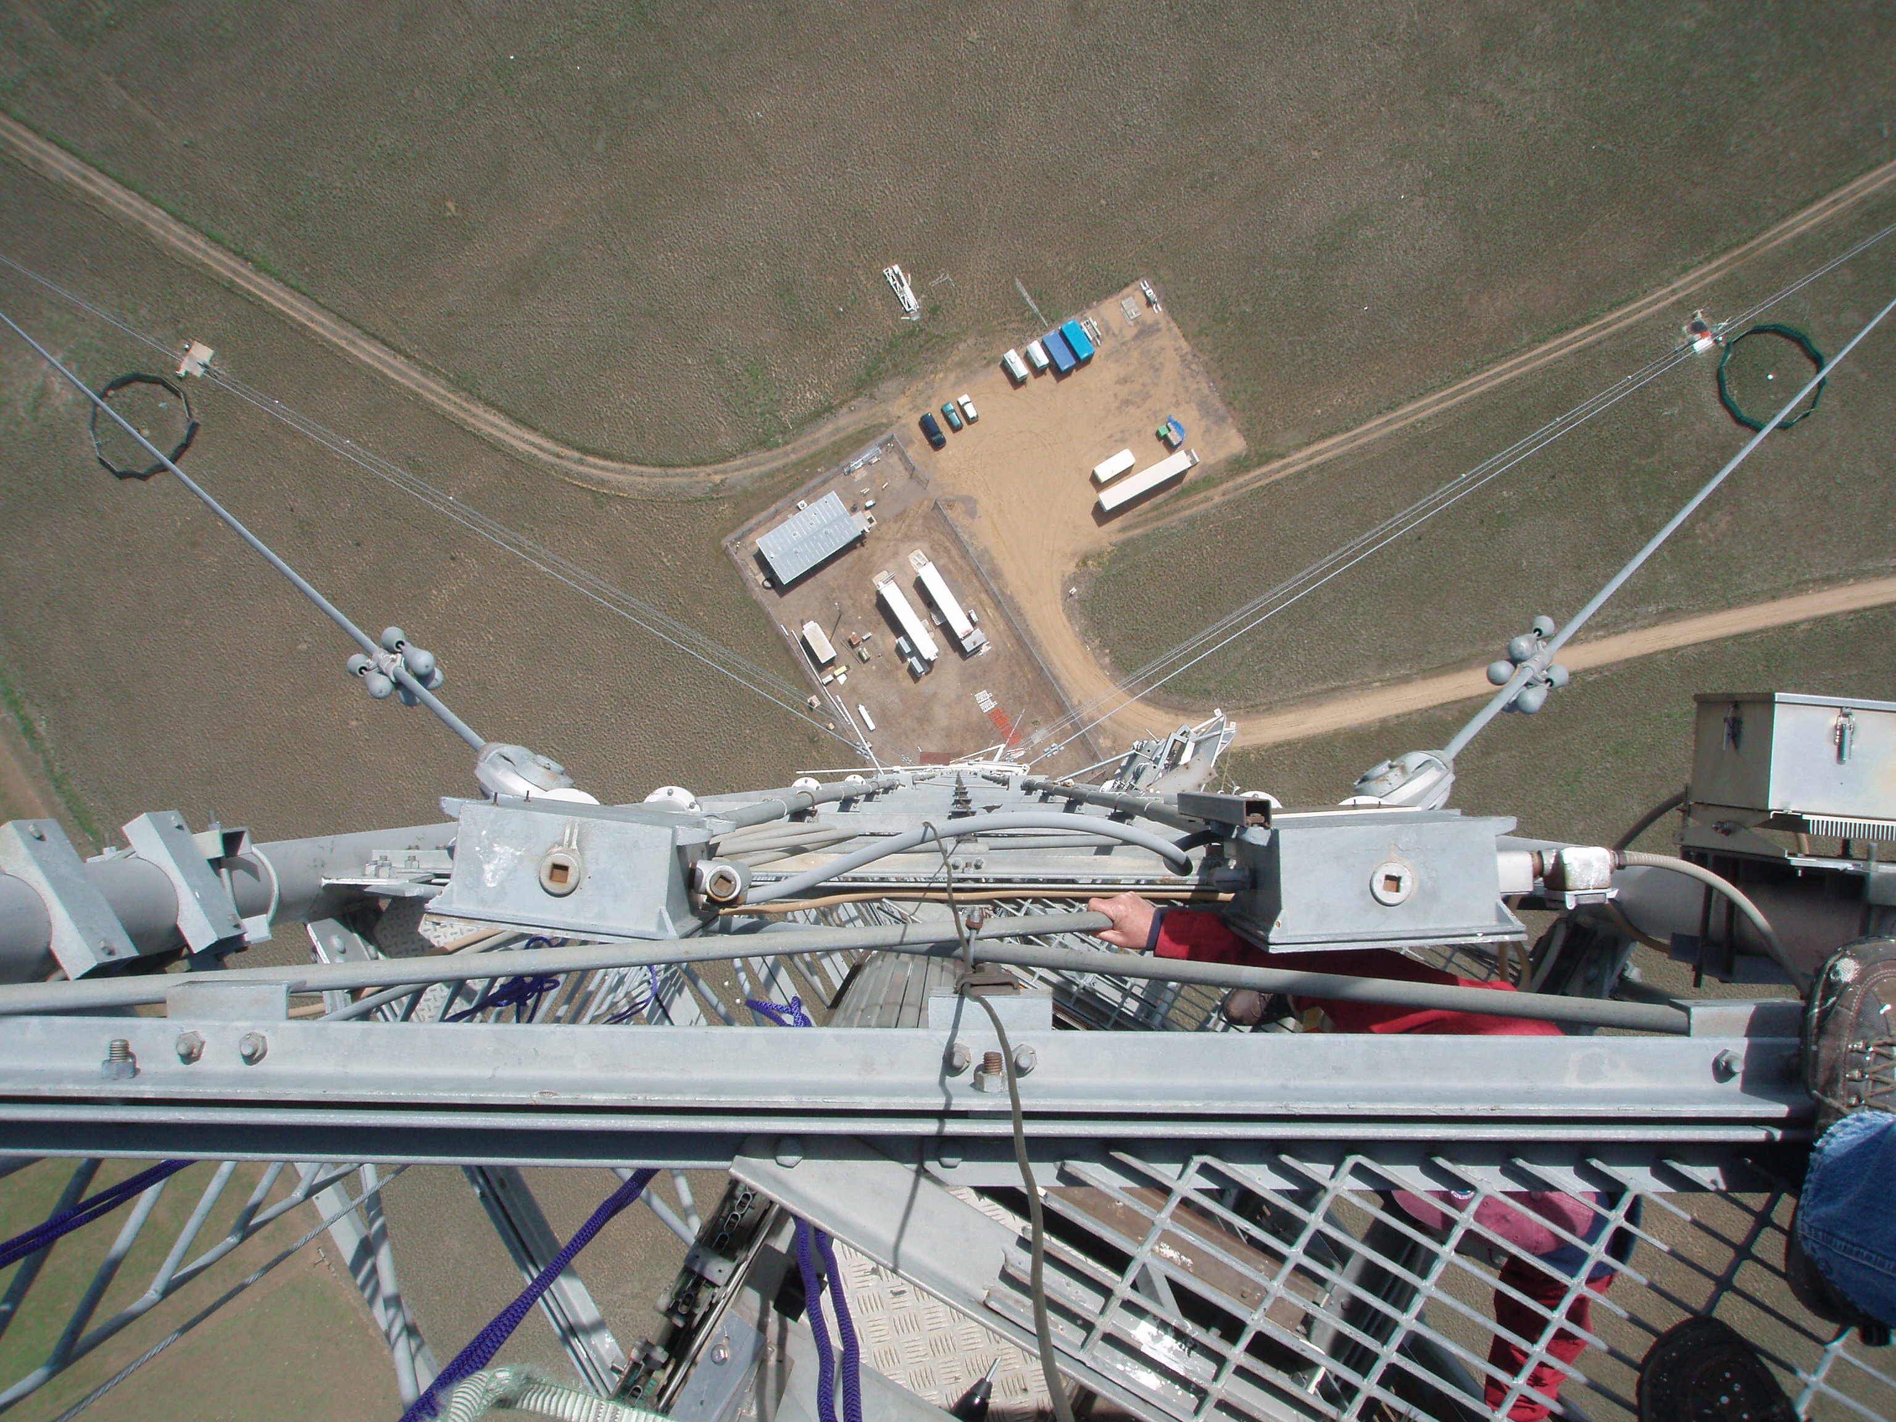
Model Evaluation: Boulder Atmospheric Observatory
40mile north of Denver; elev. 1584 masl; 300m above ground
http://www.esrl.noaa.gov/gmd/ccgg/towers/#bao
Notes:
Finally this is a comparison between CMAQ CO2 and some observational data.
The observation is from a tall tower downwind of Denver. As this site was influenced by urban emission, Carbontracker filtered a lot of data from this site before assimilation because they want natural CO2 signal. But it is a good site for us because urban emissions are what we want to study.
From this figure we see that CT is the background. With higher resolution in CMAQ but the same fluxes, you see some up and down, but on average, it is still at the bottom.
Finally if we use VULCAN, , we get bigger diurnal variation, and we get a similar shape in terms of diurnal average.

Slide 11
Summary and Future Plan
Findings
Transport difference between CMAQ (36km) and TM5 (1°× 1°) only leads to 0.47 ppm Root Mean Square Deviation (RMSD) near the surface in terms of monthly mean CO₂ distribution.
36km CMAQ with hourly VULCAN (10km) emission inventory is capable of capturing urban CO₂ hotspots in the contiguous U.S. and diurnal pattern of CO₂ downwind of urban Denver.
Some hotspots might be observed using the PBL column average metric.
To-dos
Implementing finer resolution biosphere module (VPRM) and transport;
Adding secondary CO₂ source (oxidation of CO and VOCs) in CMAQ;
Comprehensive model evaluation with tower and aircraft data.

Slide 12
Acknowledgement
CarbonTracker-2011 results are provided by NOAA ESRL (http://carbontracker.noaa.gov).
Tower CO₂ data are provided by NOAA GMD.
WRF output and non-CO₂ emission data are shared by the SESARM project (http://www.metro4-sesarm.org).
Funding for this work was provided by Sandia National Laboratories, Laboratory Directed Research And Development Program.

Slide 13
Thanks!

Slide 14
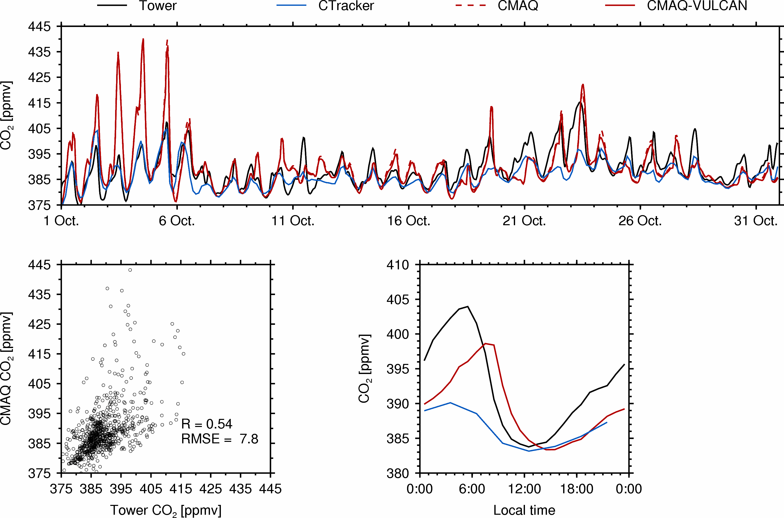
AMT

Slide 15
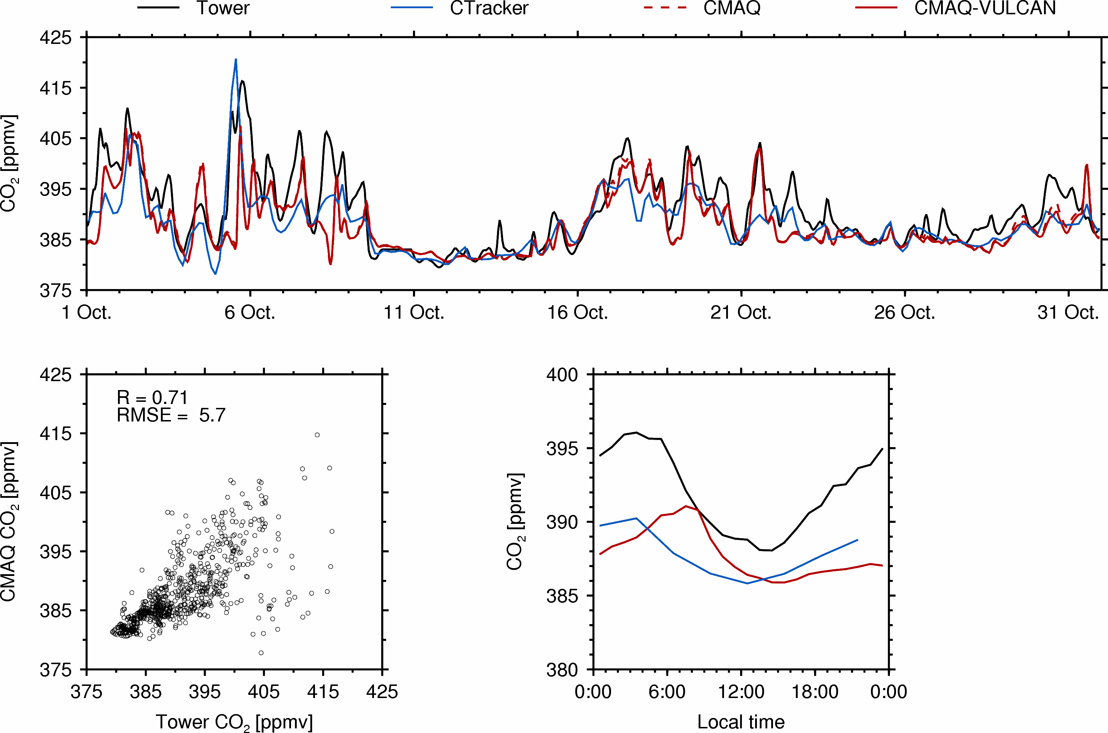
LEF

Slide 16
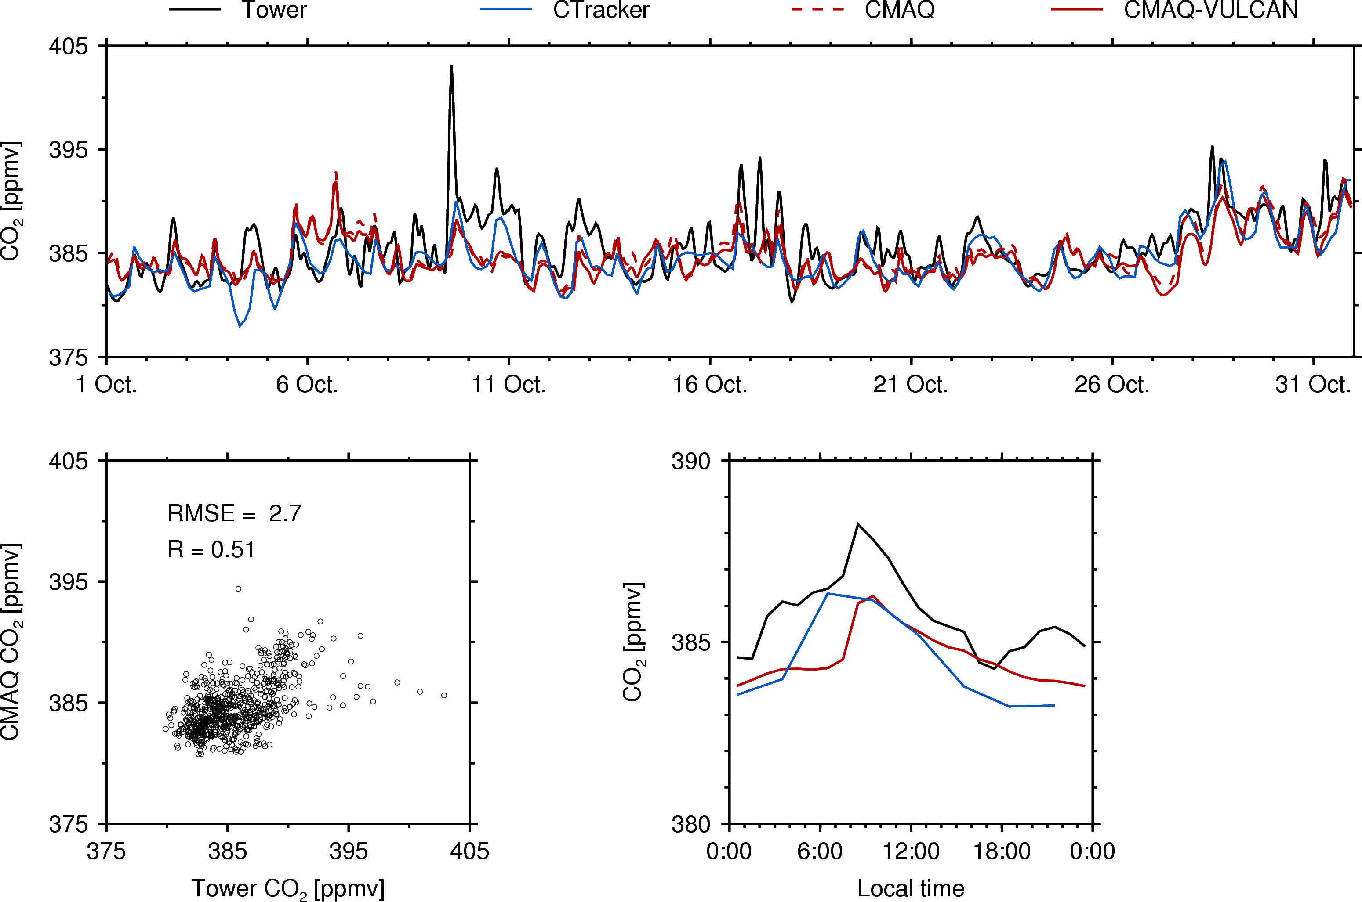
WKT

Slide 17
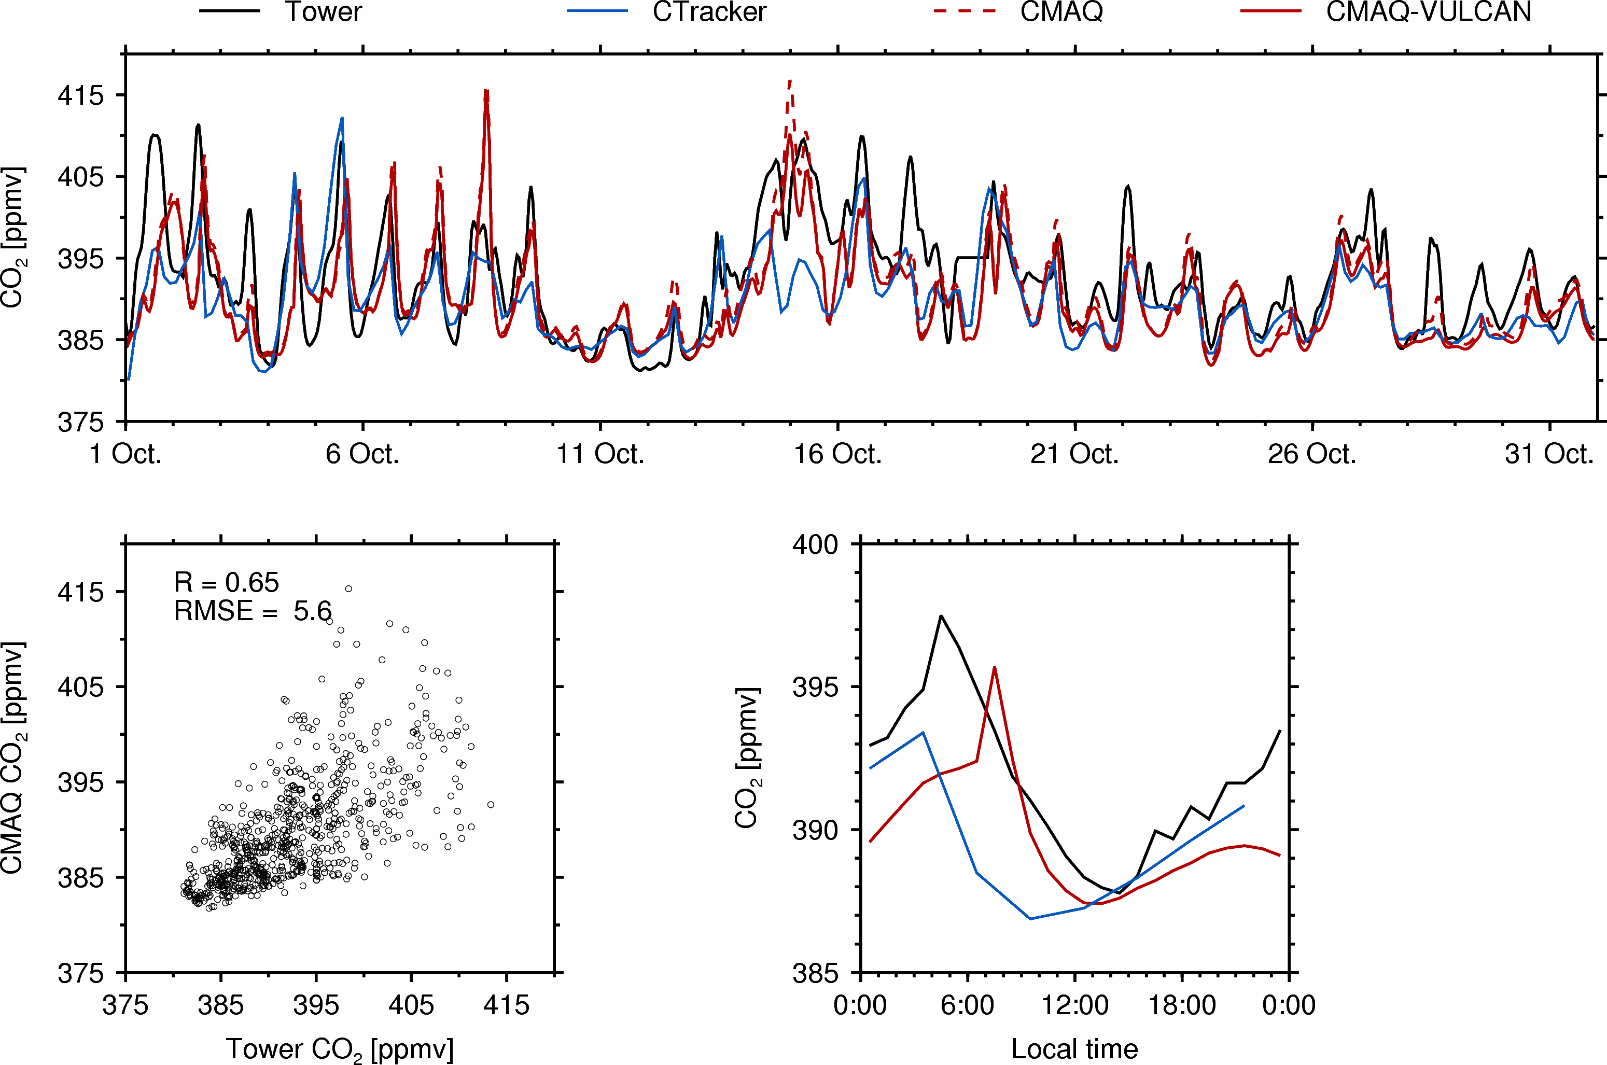
WBI

Slide 18
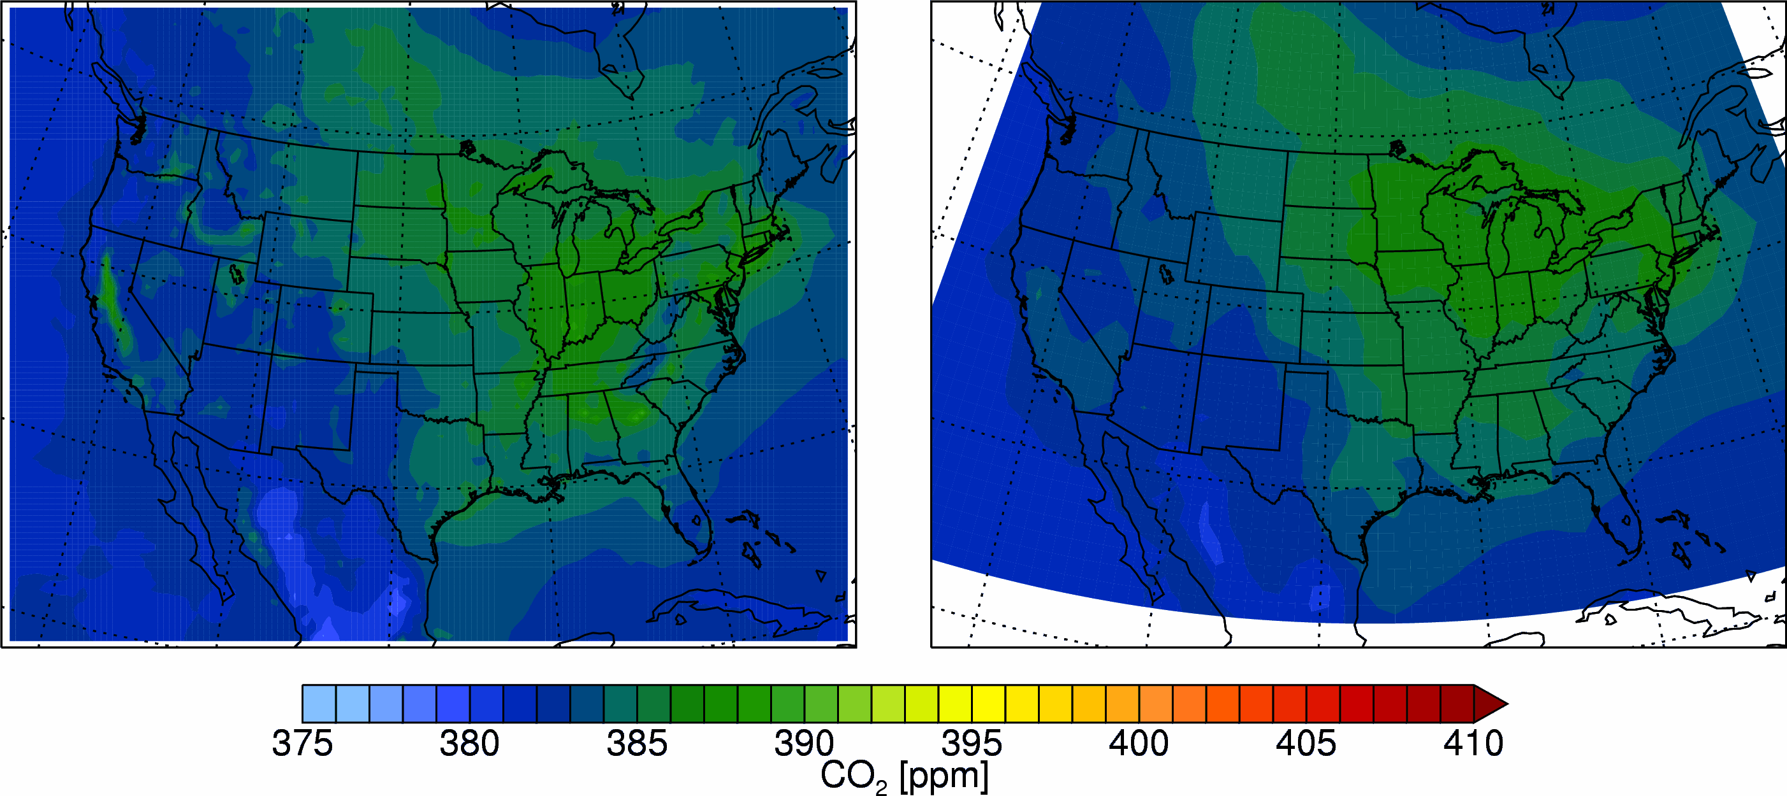
Benchmark simulation results with VULCAN (0.1°× 0.1°, hourly) fossil fuel emission inventory
CMAQ-VULCAN
(500m above ground)
CarbonTracker

Slide 19
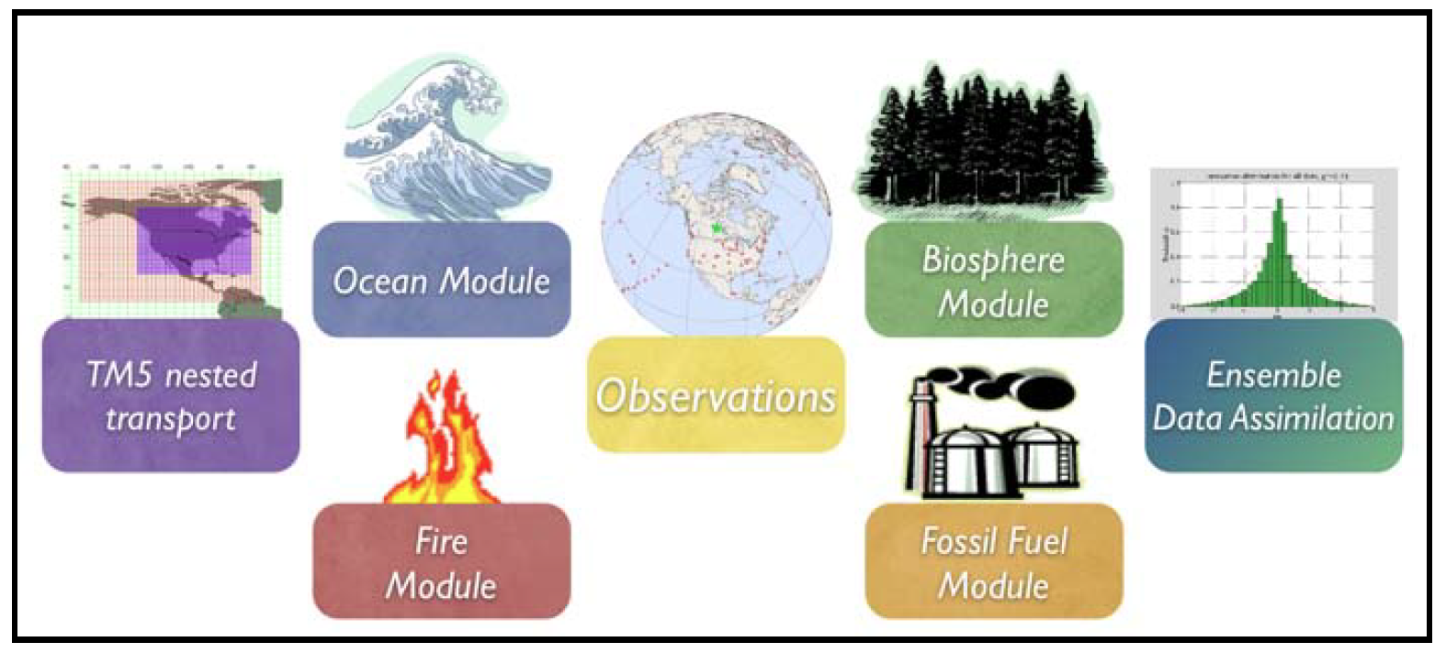
CarbonTracker (CT2011)
http://www.esrl.noaa.gov/gmd/ccgg/carbontracker/ [Peters et al., 2007, PNAS]
Meteorology : ECMWF (1°× 1° nested over NA)
Biosphere : Carnegie-Ames-Stanford-Approach (CASA)
Ocean : [Jacobson et al., 2007]
Fossil fuel : CDIAC [Oda and Maksyutov, 2011]
Fire : GFEDv3.1
Observations : NOAA ESRL, CSIRO, IPEN-CQMA

