Slide 1
Springtime Transport of Central American Fire Emissions to the United States
Hyun Cheol Kim ^{1,2}, Fantine Ngan ^{1,2}, Pius Lee ¹,
and Rick Saylor ³
¹ NOAA/ARL, Silver Spring, MD
² ERT, Inc, Laurel, MD
³ NOAA/ARL/ATDD, Oak Ridge, TN

Slide 2
Motivation & Goal
Transport of Central American fires have caused negative PM bias in southern coastal states during springtime. (e.g. May 1998)
Observations of Central American fire emission transport to US in surface and satellite measurements.
Inter-annual variation of Central American Fire emissions
For modeling efforts, please see P. Lee’s talk
Climate → Fire → Transport → US Air Quality

Slide 3
Data
Observations
  AIRNow/AQS PM surface observations (1997~)
  MODIS AOD (2000~)
  Hazard Mapping System (HMS) (2006~)
  GFED v3 burned area (1997~)
  QFED v2.2 PM emission (2000~)
Model
  NAQFC (2009~)
  UH-AQF (2006-2010)
  Hysplit trajectory
Index
  MEI(ENSO), NAO, AO, and PDSI

Slide 4
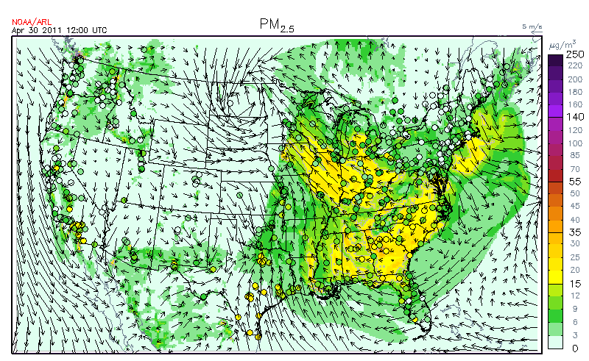
PM_{2.5} bias in southern Texas (May 1, 2011)
NAQFC

Slide 5
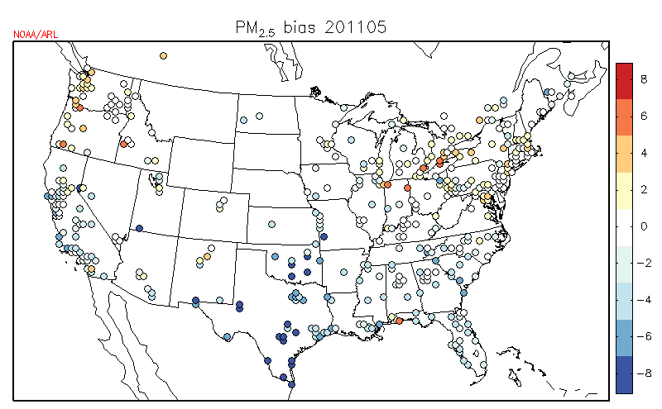
PM_{2.5} bias in Texas
Monthly averaged PM bias (May, 2011)
Up to ~10 ug/m3 bias in Texas

Slide 6
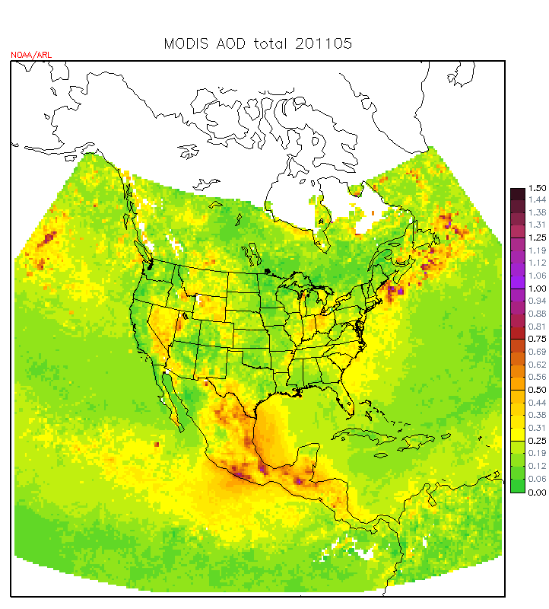
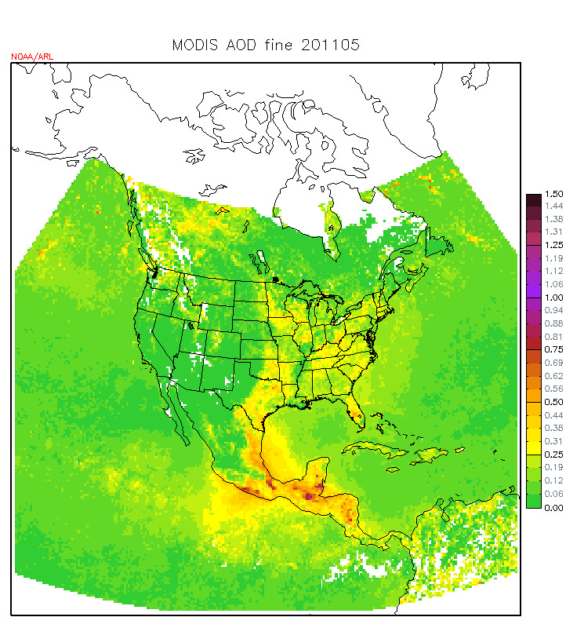
MODIS AOD
Total AOD
Fine AOD

Slide 7
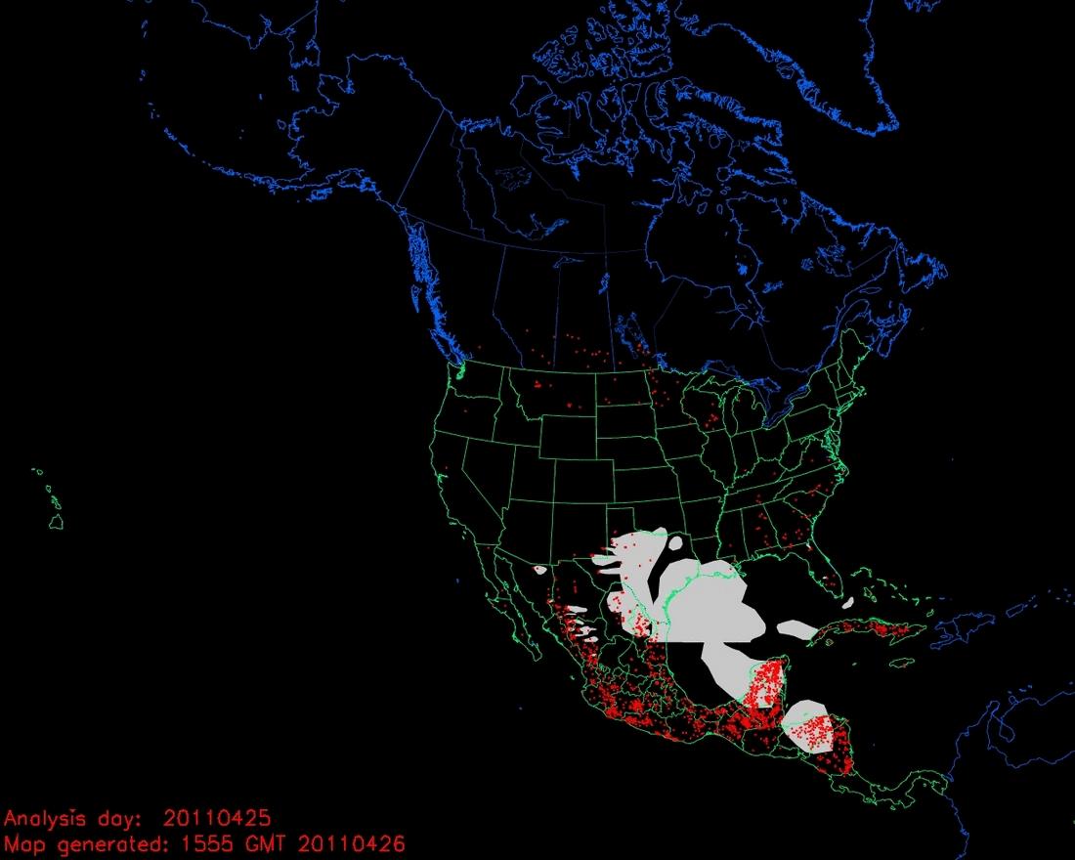
Fire detections from HMS

Slide 8
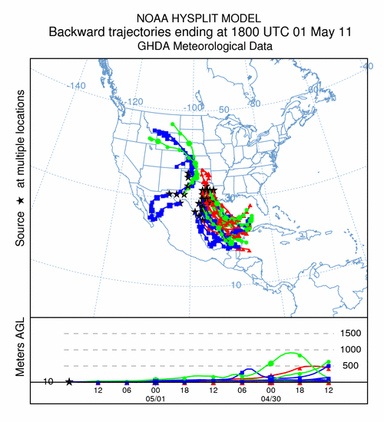
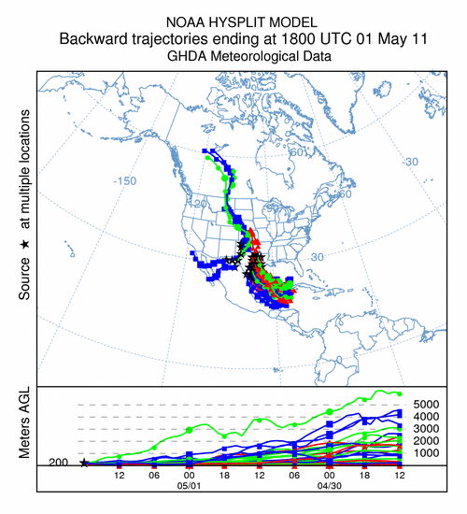
Backward trajectory (May 1, 2011)
10 m
200 m

Slide 9
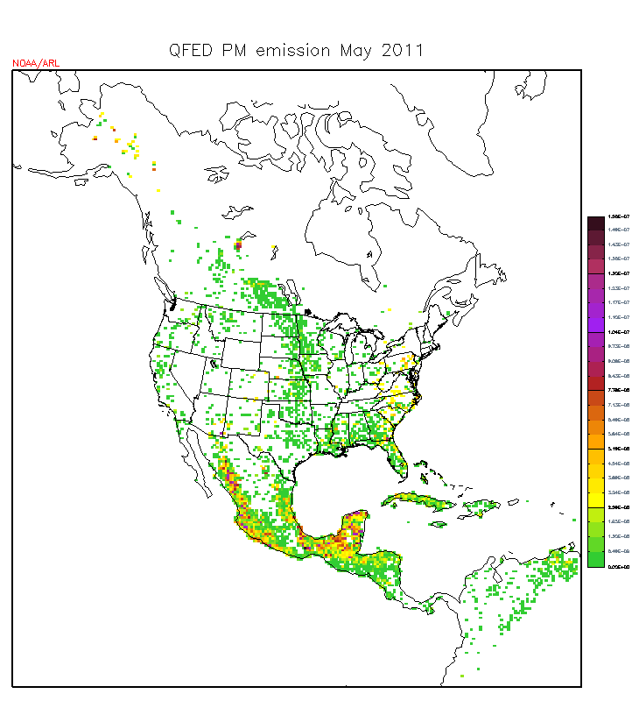
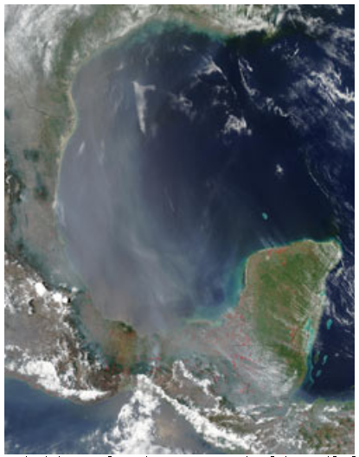
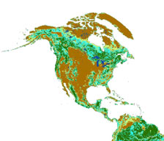
Biomass burning regions in Mesoamerica
May 9, 2003
(NASA/MODIS Rapid Response Team)
R2 (Mexico)
R1 (Central America)
Forest Cover from Global Forest Resources Assessment (FRA2000)
Mesoamerica

Slide 10
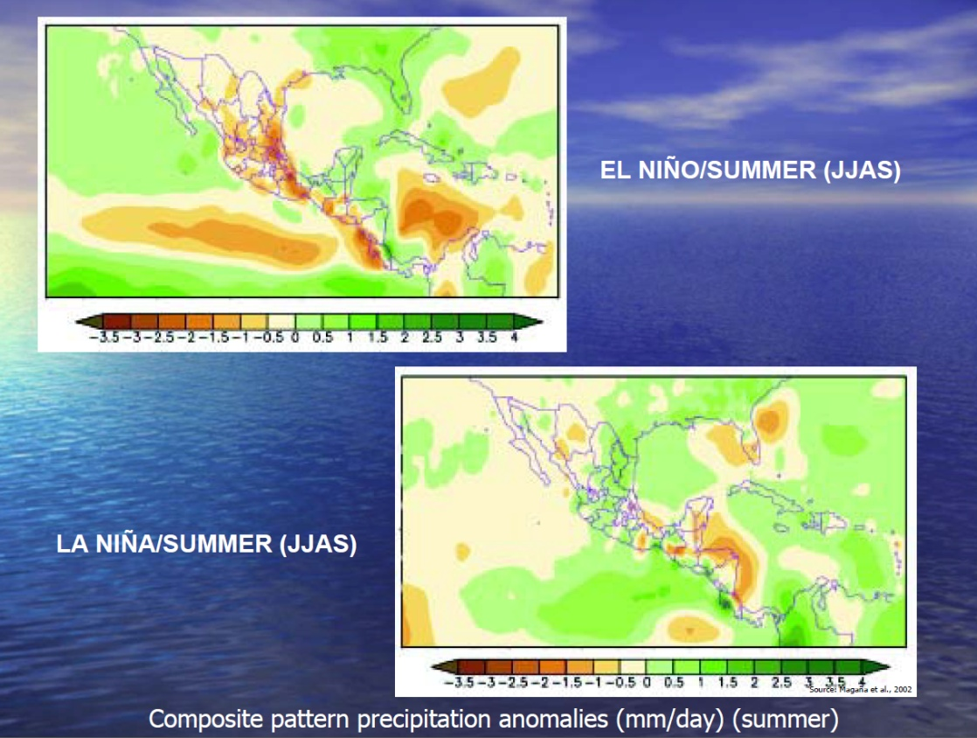
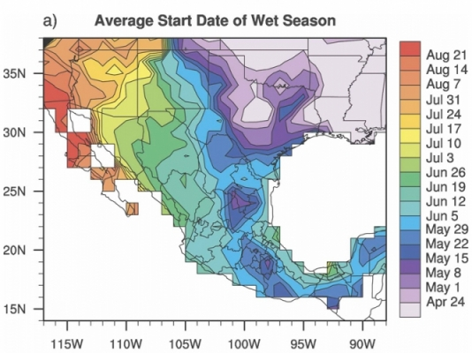
ENSO & North American Monsoon
Wet
Dry
Start of North American Monsoon
El Nino
La Nina
(Liebmann et al., 2008)
Dry
(Manso, 2005)
Wet

Slide 11
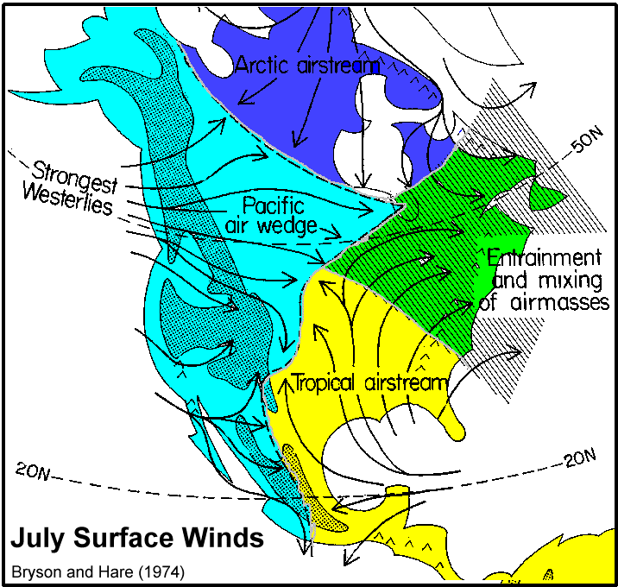
Wind pattern is also critical
H
Bermuda High
(Hursar, 2001)

Slide 12
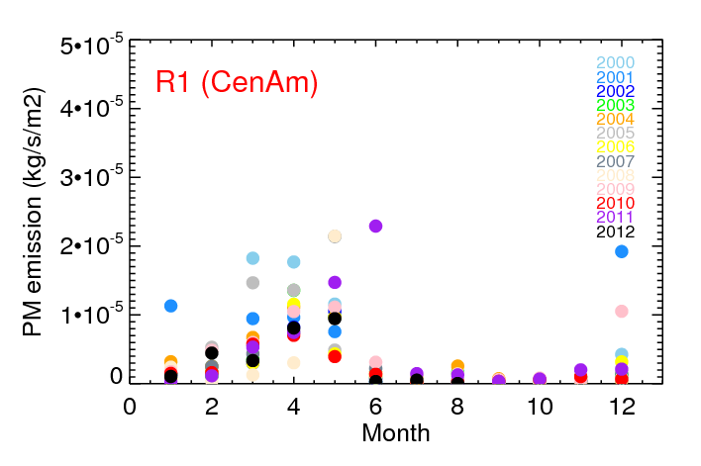
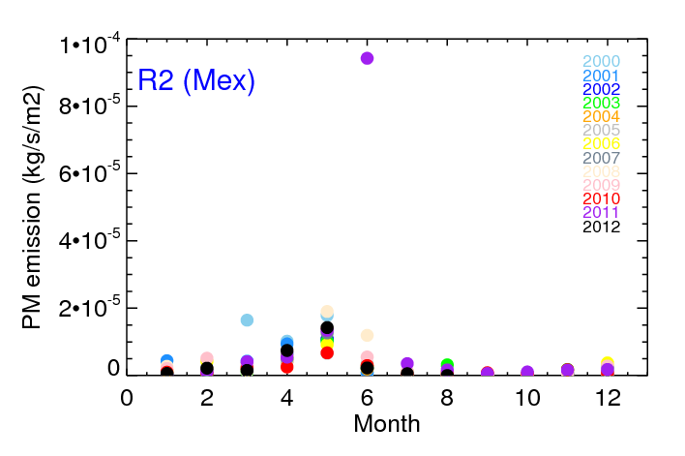
Seasonal variation of QFED PM emission
June 2011
June 2011
Meso-American fires occur most in Mar - May
Strong peak in Jun. 2011

Slide 13
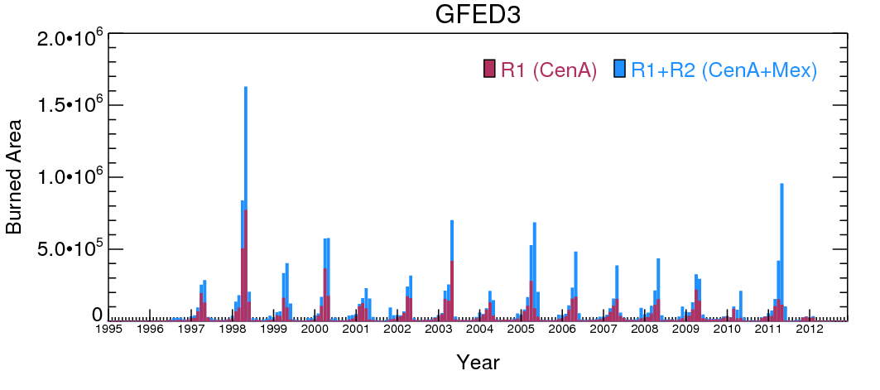
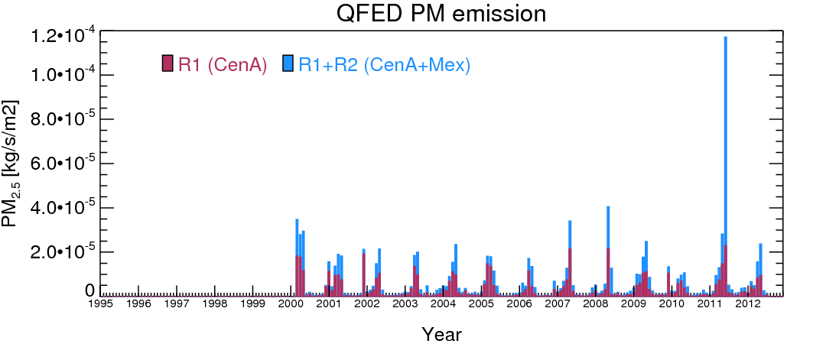
No data

Slide 14
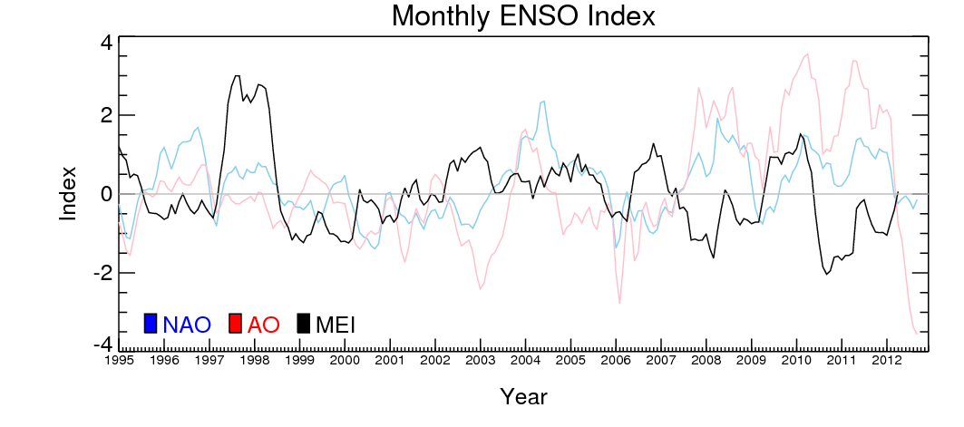
ENSO & burned area (GFED)
Strong El-Nino year
Strong La-Nina year

Slide 15
Conditions for Meso-American fire
Natural condition
 | El Nino | La Nina
Mexico | wet | dry
Central A | dry | wet
 | winter | Spring/summer
wet | More fuel | Lower burning
dry | Lower fuel | More burning
+
Human activity (Most of fires are agricultural)
+
Wind pattern (for transport to US)

Slide 16
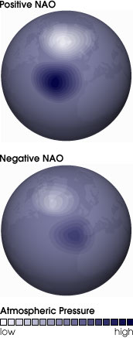
Summary & future work
Transport of wildfire emissions from Meso-America (Central + Mexican affects US PM, especially in southern coastal area
Wildfires in this region can be affected by natural condition (ENSO) and human activity (agricultural practice). Small yearly variation is not strongly tied with the variation of climatorolgical indices.
In extreme weather conditions, people likely loose control of agricultural fire. Recorded huge fire activity in 1998 (El-Nino) and 2011 (La-Nina).
Wind pattern is important to the transport. We are working on the correlation with wind pattern and North Atlantic Oscillation (NAO)
Bermuda High shifted westward during positive NAO

