Slide 1
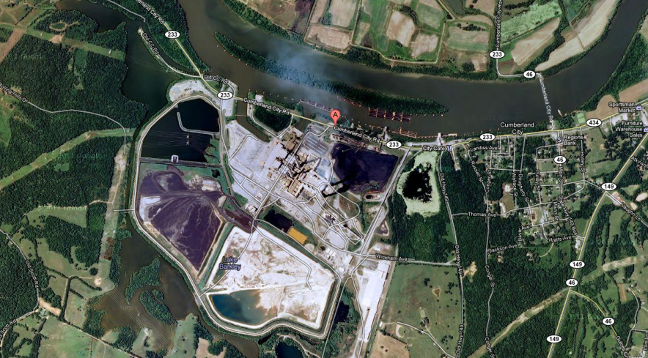
Beta Testing of the
SCICHEM-2012 Reactive Plume Model
Google earth
James T. Kelly and Kirk R. Baker
Office of Air Quality Planning & Standards
US Environmental Protection Agency
2012 Regional, State, and Local Modeler’s Workshop
Oct.15th – Oct 18th, Chapel Hill, NC

Slide 2
Motivation
A need exists in regulatory applications to accurately simulate the impacts of emissions from single sources on secondary PM_{2.5} and ozone concentrations
The SCICHEM-2012 reactive plume model could potentially be used in single-source regulatory modeling studies focused on secondary pollutants
However, before determining the applicability of SCICHEM-2012 to regulatory modeling applications
  Tools must be developed for processing model input/output
  Initial “Beta” testing of the model must be performed
  Model predictions must be evaluated for conditions relevant to regulatory applications

Slide 3
Objectives
Develop tools for processing SCICHEM-2012 inputs/outputs
Conduct “Beta” testing of SCICHEM-2012
  Compare SCICHEM-2012 predictions with predictions of the CMAQ photochemical Eulerian grid model
  Evaluate SCICHEM-2012 predictions against in-plume observations
Future work should focus on evaluating model predictions for conditions relevant to regulatory applications

Slide 4
SCICHEM-2012 Modeling
Model Configuration
  Linux build with sensor location file for extracting concentration time-histories
  Gas-phase chemistry: Carbon Bond 2005 mechanism
  Aerosol chemistry: AERO5 aerosol routine from CMAQ w/ ISORROPIA inorganic thermodynamics
  Meteorology: WRFv3.3 output converted to MEDOC format with MMIFv2.1 (Mesoscale Model Interface Program)
Simulation Episode
  TVA Cumberland Power Plant during the 1999 Nashville/Middle Tennessee Southern Oxidants Study
  6 July 1999 for hours 0-18 LST
Cases
  SCICHEM-NoAmbient
    Background concentration: Constant values from SCICHEM-2012 example “test case” files
  SCICHEM-Ambient
    Background concentration: Time-varying 3D “ambient file” based on CMAQ output

Slide 5
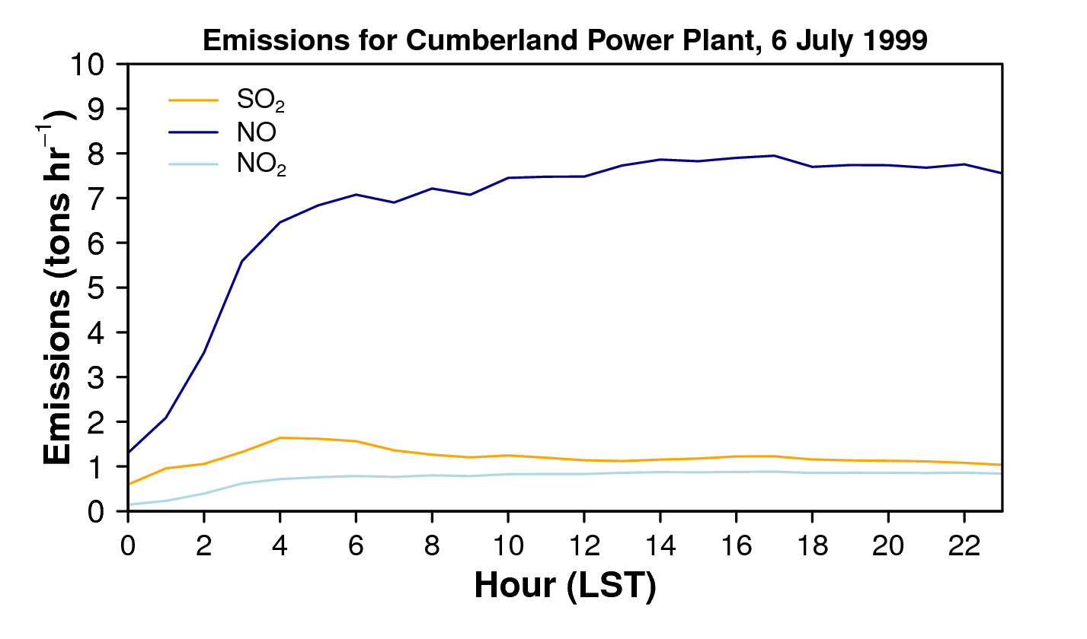
CMAQ Modeling
Community Multiscale Air Quality (CMAQ) model version 4.7.1
2001 National Emissions Inventory anthropogenic emissions
1999 hour-specific biogenic emissions estimated with BEIS model
1999 hour-specific CEM data for TVA Cumberland plant emissions
  http://camddataandmaps.epa.gov/gdm/index.cfm?fuseaction=emissions.wizard
Modeling Domains
12 km
4 km

Slide 6
I. Specifying Background Concentrations in SCICHEM-2012
SCICHEM-2012 uses either constant background concentrations or time-varying 3D concentration fields
Tools for converting CMAQ output to SCICHEM-2012 format were developed for this study
Example. Importance of Representing 3D Atmospheric Environment
Wind
NOx
HNO₃
NH₄NO₃
NH₃
Low Ammonium Nitrate
High Ammonium Nitrate

Slide 7
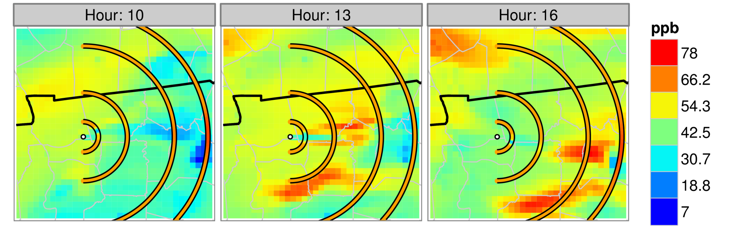
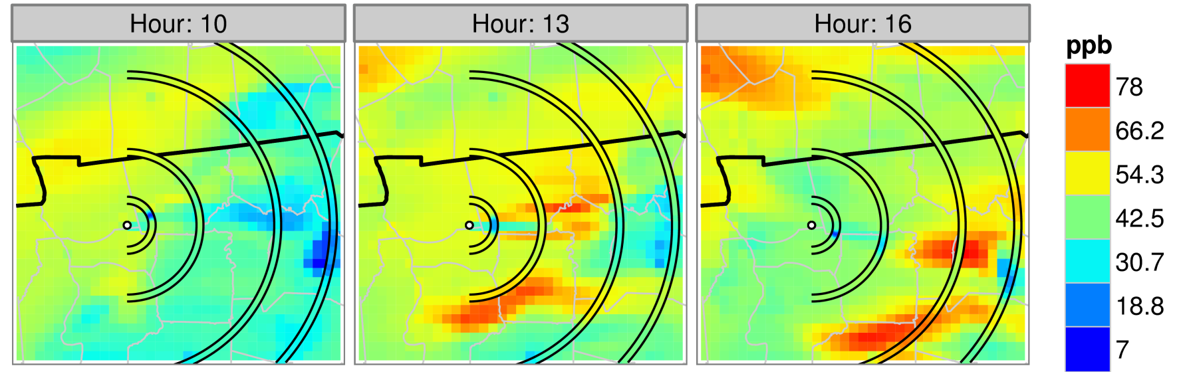
Background Concentration: Two Approaches
SCICHEM with constant background concentration and CMAQ
Ozone
SCICHEM with time-varying 3D background concentration and CMAQ
Ozone
Note: Concentrations correspond to CMAQ’s Layer 1

Slide 8
II. Plume Increment Comparisons for CMAQ and SCICHEM-2012
Conduct CMAQ and SCICHEM-2012 Simulations with TVA Power Plant emissions
Conduct CMAQ and SCICHEM-2012 Simulations without TVA Power Plant emissions (i.e., zero-out runs)
Subtract results of zero-out runs from standard runs to obtain the “plume increment” concentration

Slide 9
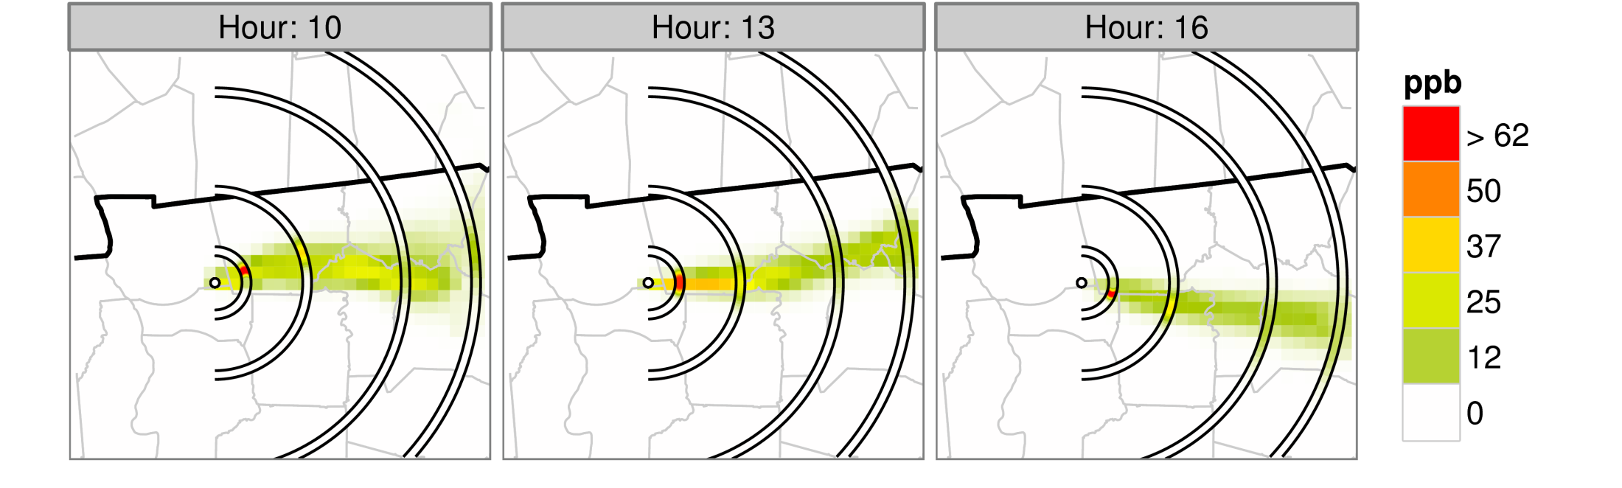
NOy Plume Increment Comparison for SCICHEM-2012 and CMAQ
Note: Concentrations correspond to CMAQ’s Layer 1

Slide 10
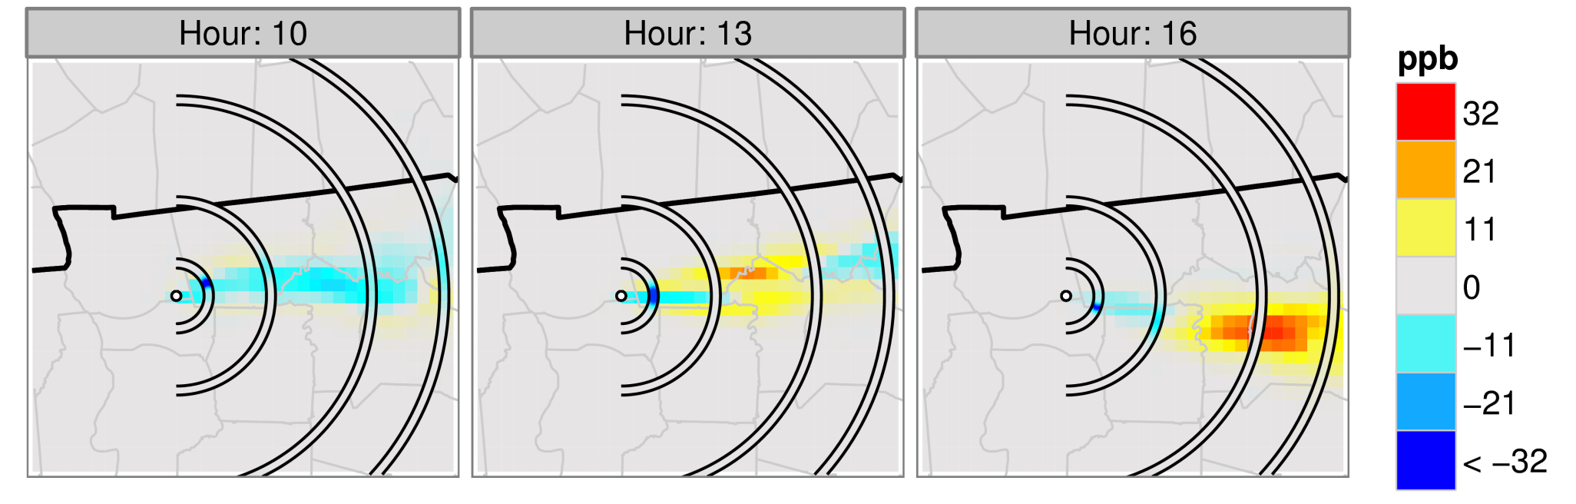
Ozone Plume Increment Comparison for SCICHEM-2012 and CMAQ
Note: Concentrations correspond to CMAQ’s Layer 1

Slide 11
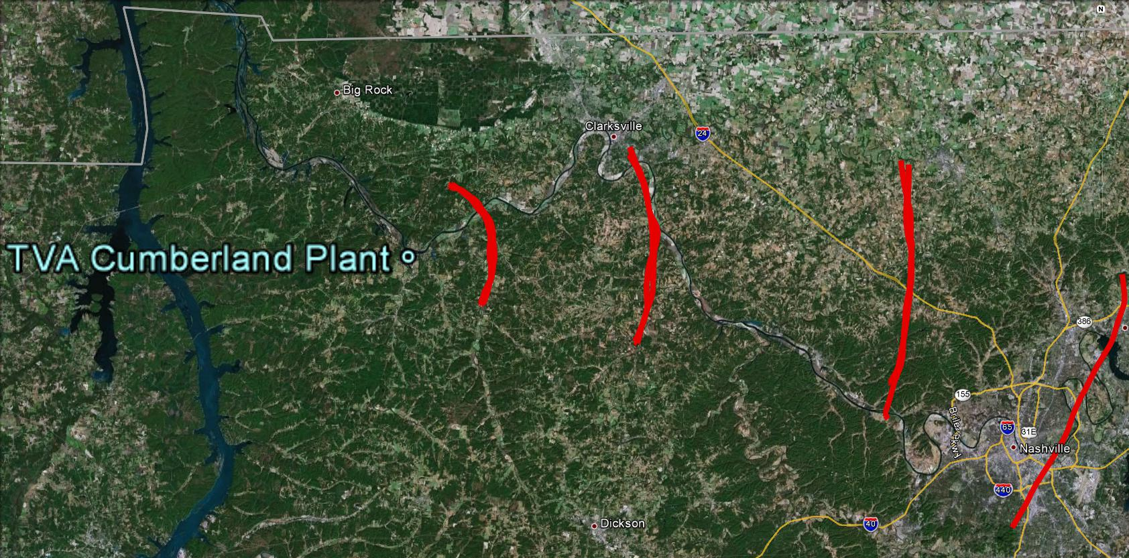
III. Evaluation Against Aircraft Observations
12 traverses of plume downwind of the TVA power plant on 6 July 1999 at an average altitude of 500 m
  Clear day with light winds from west/northwest
Observed species in include O₃, NO, NO₂, NO_{z}, and SO₂
~31 km
~65 km
~11 km
~90 km
~11 LST
~12 LST
~15 LST
Google earth
Nashville
~16 LST
Notes:
From Michael Davis flickr picture caption: This power plant is TVA's largest fossil plant in total megawatts with a total output of 2,600mw. It houses two 1,300mw units that rate among the largest Fossil Fuel units in the world. This, just like Paradise, is a monster power plant and a sight to behold. This is the view looking up stream from the outflow of Units 1 & 2 (the outflow culvert is under the Turbine Room).You can see the two massive Power Houses that house the two boilers and the Turbine Room with Switchyard behind it. The fairly new SCR (Scrubber and Wash) Stacks can be seen in the background. The two tall, main stacks are no longer in use and only serve as back-ups in case of a Scrubber issue. An interesting fact about this power plant is it sits in the bottom of an ancient (Jurassic Period) Meteor Crater along the Cumberland River in Stewart County, Tennessee. The Wells Creek Crater is roughly 7.5 miles across and between 100 & 200 million years old. This is TVA's largest coal fired power plant with Paradise running a very close second place. The two tallest chimney's are both 1,001 feet tall and the two scrubber chimney's are 600 feet tall respectively.

Slide 12
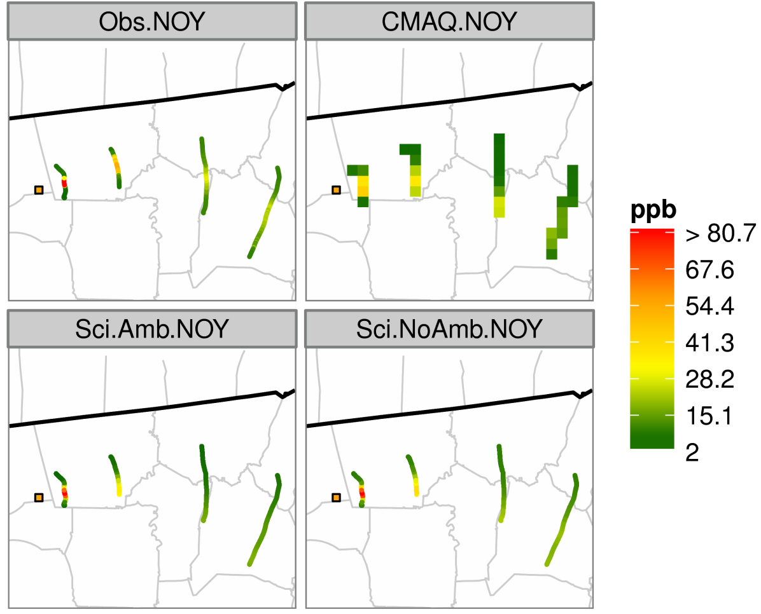
NOy Comparison with Observations
Observations
CMAQ
SCICHEM (3D Bkgrd)
SCICHEM (Const. Bkgrd)
Notes:
From Michael Davis flickr picture caption: This power plant is TVA's largest fossil plant in total megawatts with a total output of 2,600mw. It houses two 1,300mw units that rate among the largest Fossil Fuel units in the world. This, just like Paradise, is a monster power plant and a sight to behold. This is the view looking up stream from the outflow of Units 1 & 2 (the outflow culvert is under the Turbine Room).You can see the two massive Power Houses that house the two boilers and the Turbine Room with Switchyard behind it. The fairly new SCR (Scrubber and Wash) Stacks can be seen in the background. The two tall, main stacks are no longer in use and only serve as back-ups in case of a Scrubber issue. An interesting fact about this power plant is it sits in the bottom of an ancient (Jurassic Period) Meteor Crater along the Cumberland River in Stewart County, Tennessee. The Wells Creek Crater is roughly 7.5 miles across and between 100 & 200 million years old. This is TVA's largest coal fired power plant with Paradise running a very close second place. The two tallest chimney's are both 1,001 feet tall and the two scrubber chimney's are 600 feet tall respectively.

Slide 13
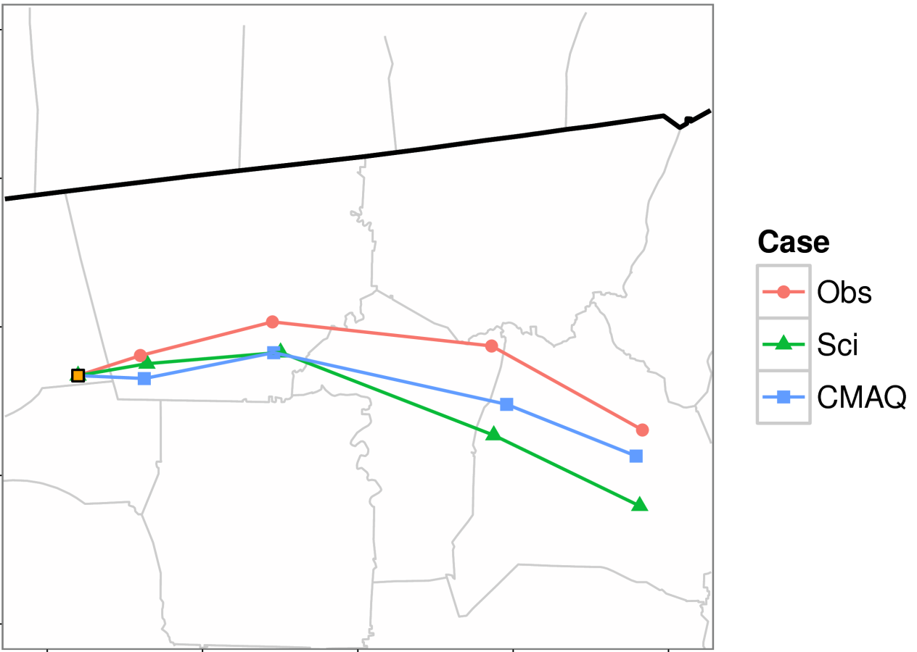
Location of Peak NOy Concentration for Flight Traverses
Observations
SCICHEM
Notes:
From Michael Davis flickr picture caption: This power plant is TVA's largest fossil plant in total megawatts with a total output of 2,600mw. It houses two 1,300mw units that rate among the largest Fossil Fuel units in the world. This, just like Paradise, is a monster power plant and a sight to behold. This is the view looking up stream from the outflow of Units 1 & 2 (the outflow culvert is under the Turbine Room).You can see the two massive Power Houses that house the two boilers and the Turbine Room with Switchyard behind it. The fairly new SCR (Scrubber and Wash) Stacks can be seen in the background. The two tall, main stacks are no longer in use and only serve as back-ups in case of a Scrubber issue. An interesting fact about this power plant is it sits in the bottom of an ancient (Jurassic Period) Meteor Crater along the Cumberland River in Stewart County, Tennessee. The Wells Creek Crater is roughly 7.5 miles across and between 100 & 200 million years old. This is TVA's largest coal fired power plant with Paradise running a very close second place. The two tallest chimney's are both 1,001 feet tall and the two scrubber chimney's are 600 feet tall respectively.

Slide 14
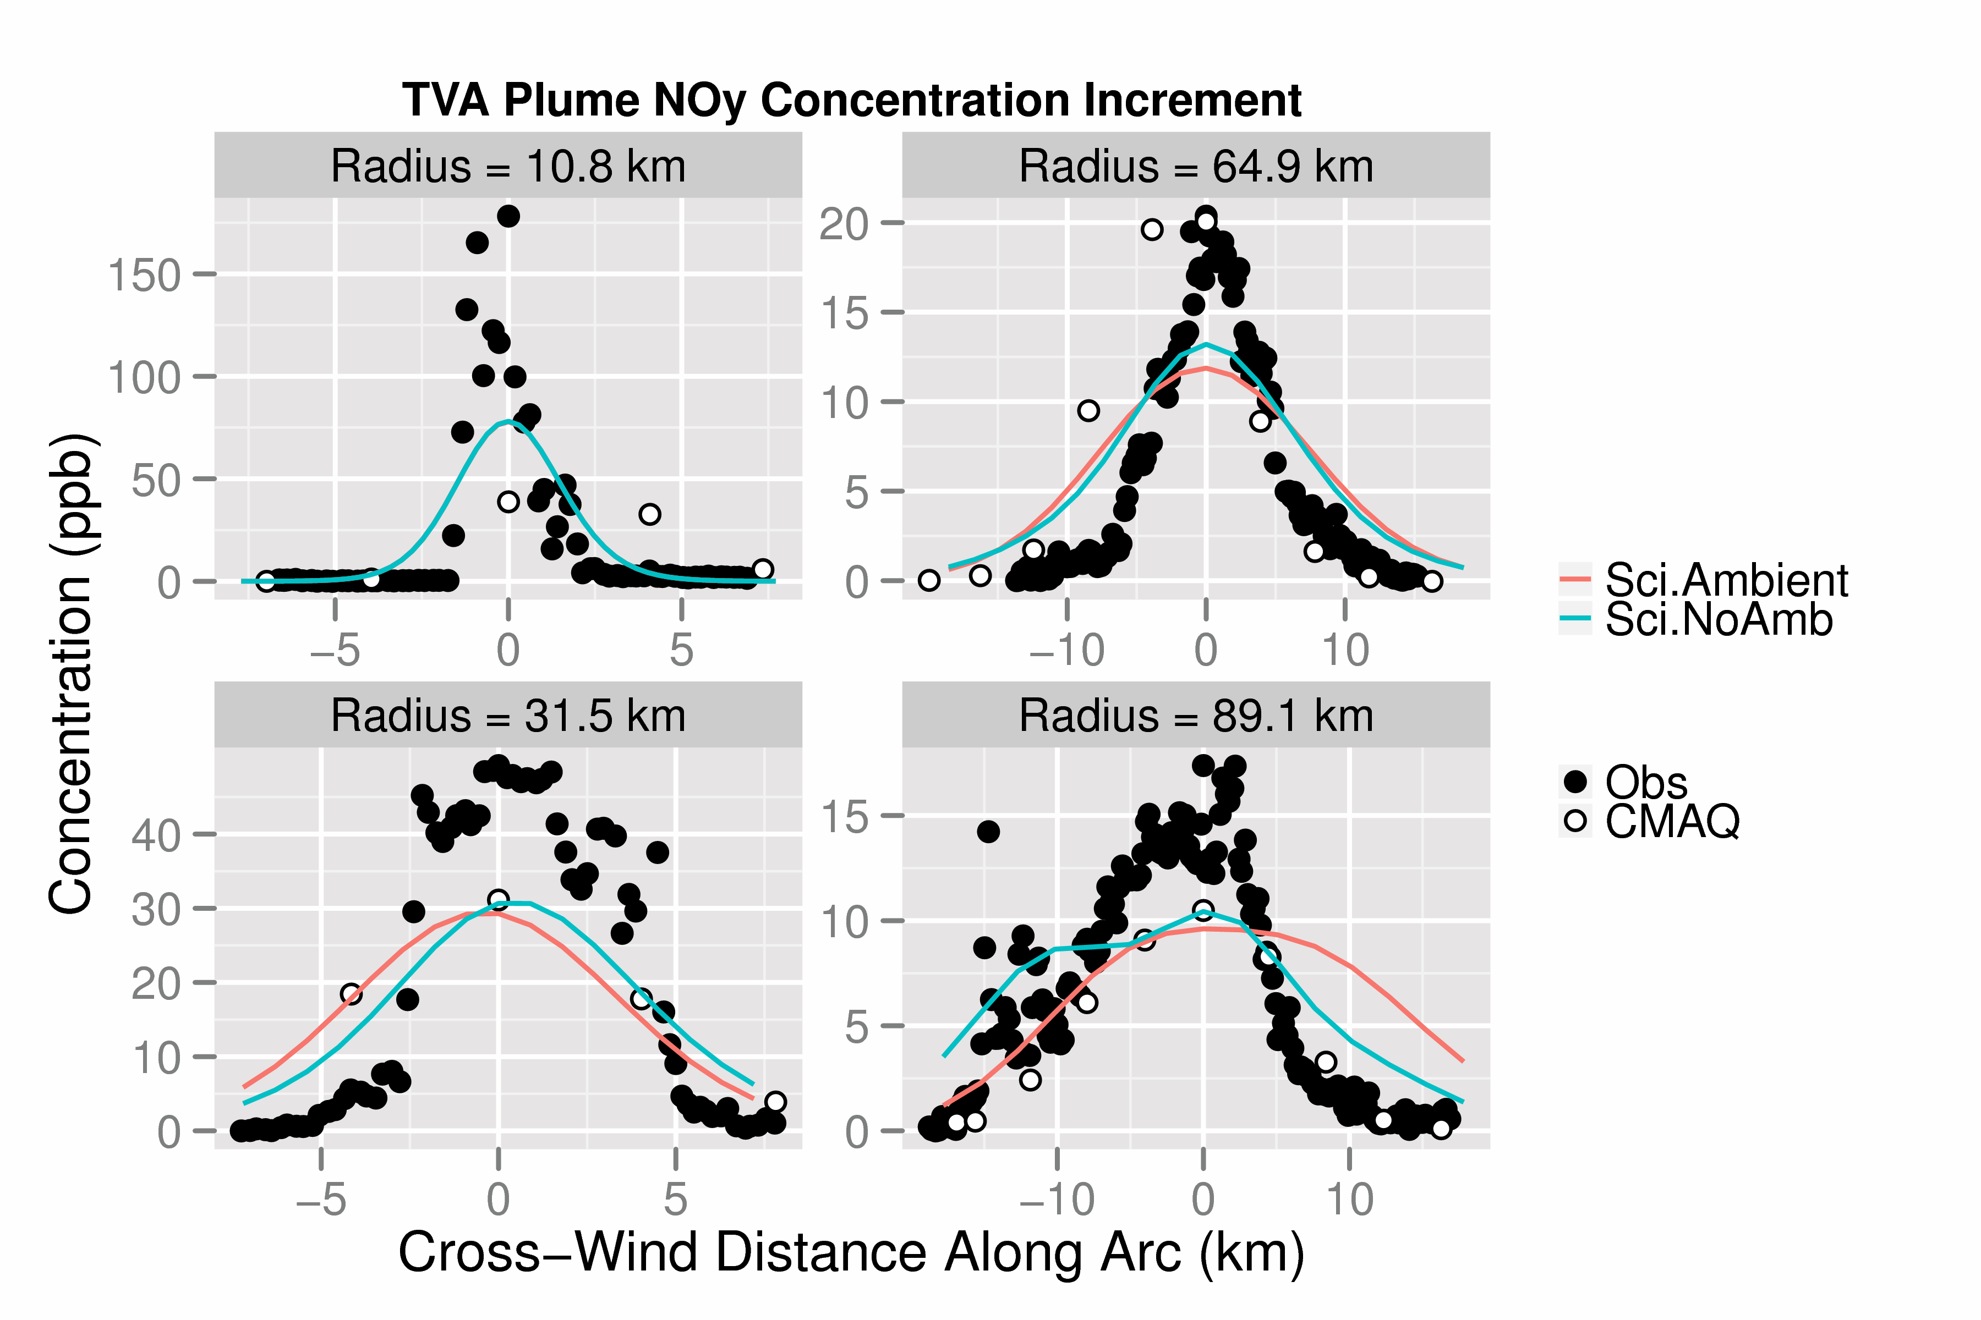
Centered Profile Evaluation:
NOy Increment
(3D Bkgrd)
(Const. Bkgrd)
Notes:
From Michael Davis flickr picture caption: This power plant is TVA's largest fossil plant in total megawatts with a total output of 2,600mw. It houses two 1,300mw units that rate among the largest Fossil Fuel units in the world. This, just like Paradise, is a monster power plant and a sight to behold. This is the view looking up stream from the outflow of Units 1 & 2 (the outflow culvert is under the Turbine Room).You can see the two massive Power Houses that house the two boilers and the Turbine Room with Switchyard behind it. The fairly new SCR (Scrubber and Wash) Stacks can be seen in the background. The two tall, main stacks are no longer in use and only serve as back-ups in case of a Scrubber issue. An interesting fact about this power plant is it sits in the bottom of an ancient (Jurassic Period) Meteor Crater along the Cumberland River in Stewart County, Tennessee. The Wells Creek Crater is roughly 7.5 miles across and between 100 & 200 million years old. This is TVA's largest coal fired power plant with Paradise running a very close second place. The two tallest chimney's are both 1,001 feet tall and the two scrubber chimney's are 600 feet tall respectively.

Slide 15
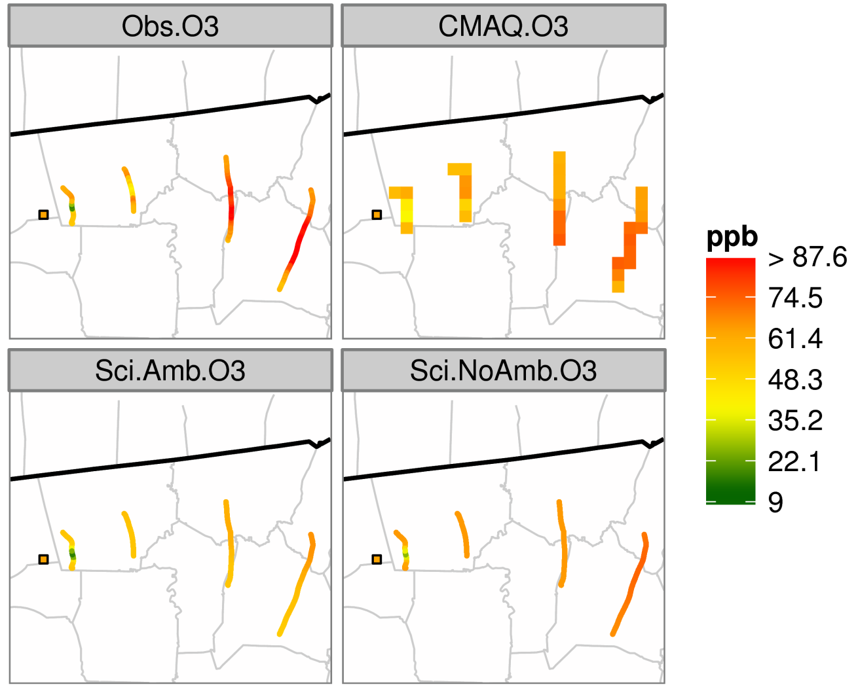
Ozone Comparison with Observations
Net Ozone production
Net Ozone destruction:
NO + O₃ → NO₂ + O
Observations
CMAQ
SCICHEM (3D Bkgrd)
SCICHEM (Const. Bkgrd)
Notes:
From Michael Davis flickr picture caption: This power plant is TVA's largest fossil plant in total megawatts with a total output of 2,600mw. It houses two 1,300mw units that rate among the largest Fossil Fuel units in the world. This, just like Paradise, is a monster power plant and a sight to behold. This is the view looking up stream from the outflow of Units 1 & 2 (the outflow culvert is under the Turbine Room).You can see the two massive Power Houses that house the two boilers and the Turbine Room with Switchyard behind it. The fairly new SCR (Scrubber and Wash) Stacks can be seen in the background. The two tall, main stacks are no longer in use and only serve as back-ups in case of a Scrubber issue. An interesting fact about this power plant is it sits in the bottom of an ancient (Jurassic Period) Meteor Crater along the Cumberland River in Stewart County, Tennessee. The Wells Creek Crater is roughly 7.5 miles across and between 100 & 200 million years old. This is TVA's largest coal fired power plant with Paradise running a very close second place. The two tallest chimney's are both 1,001 feet tall and the two scrubber chimney's are 600 feet tall respectively.

Slide 16
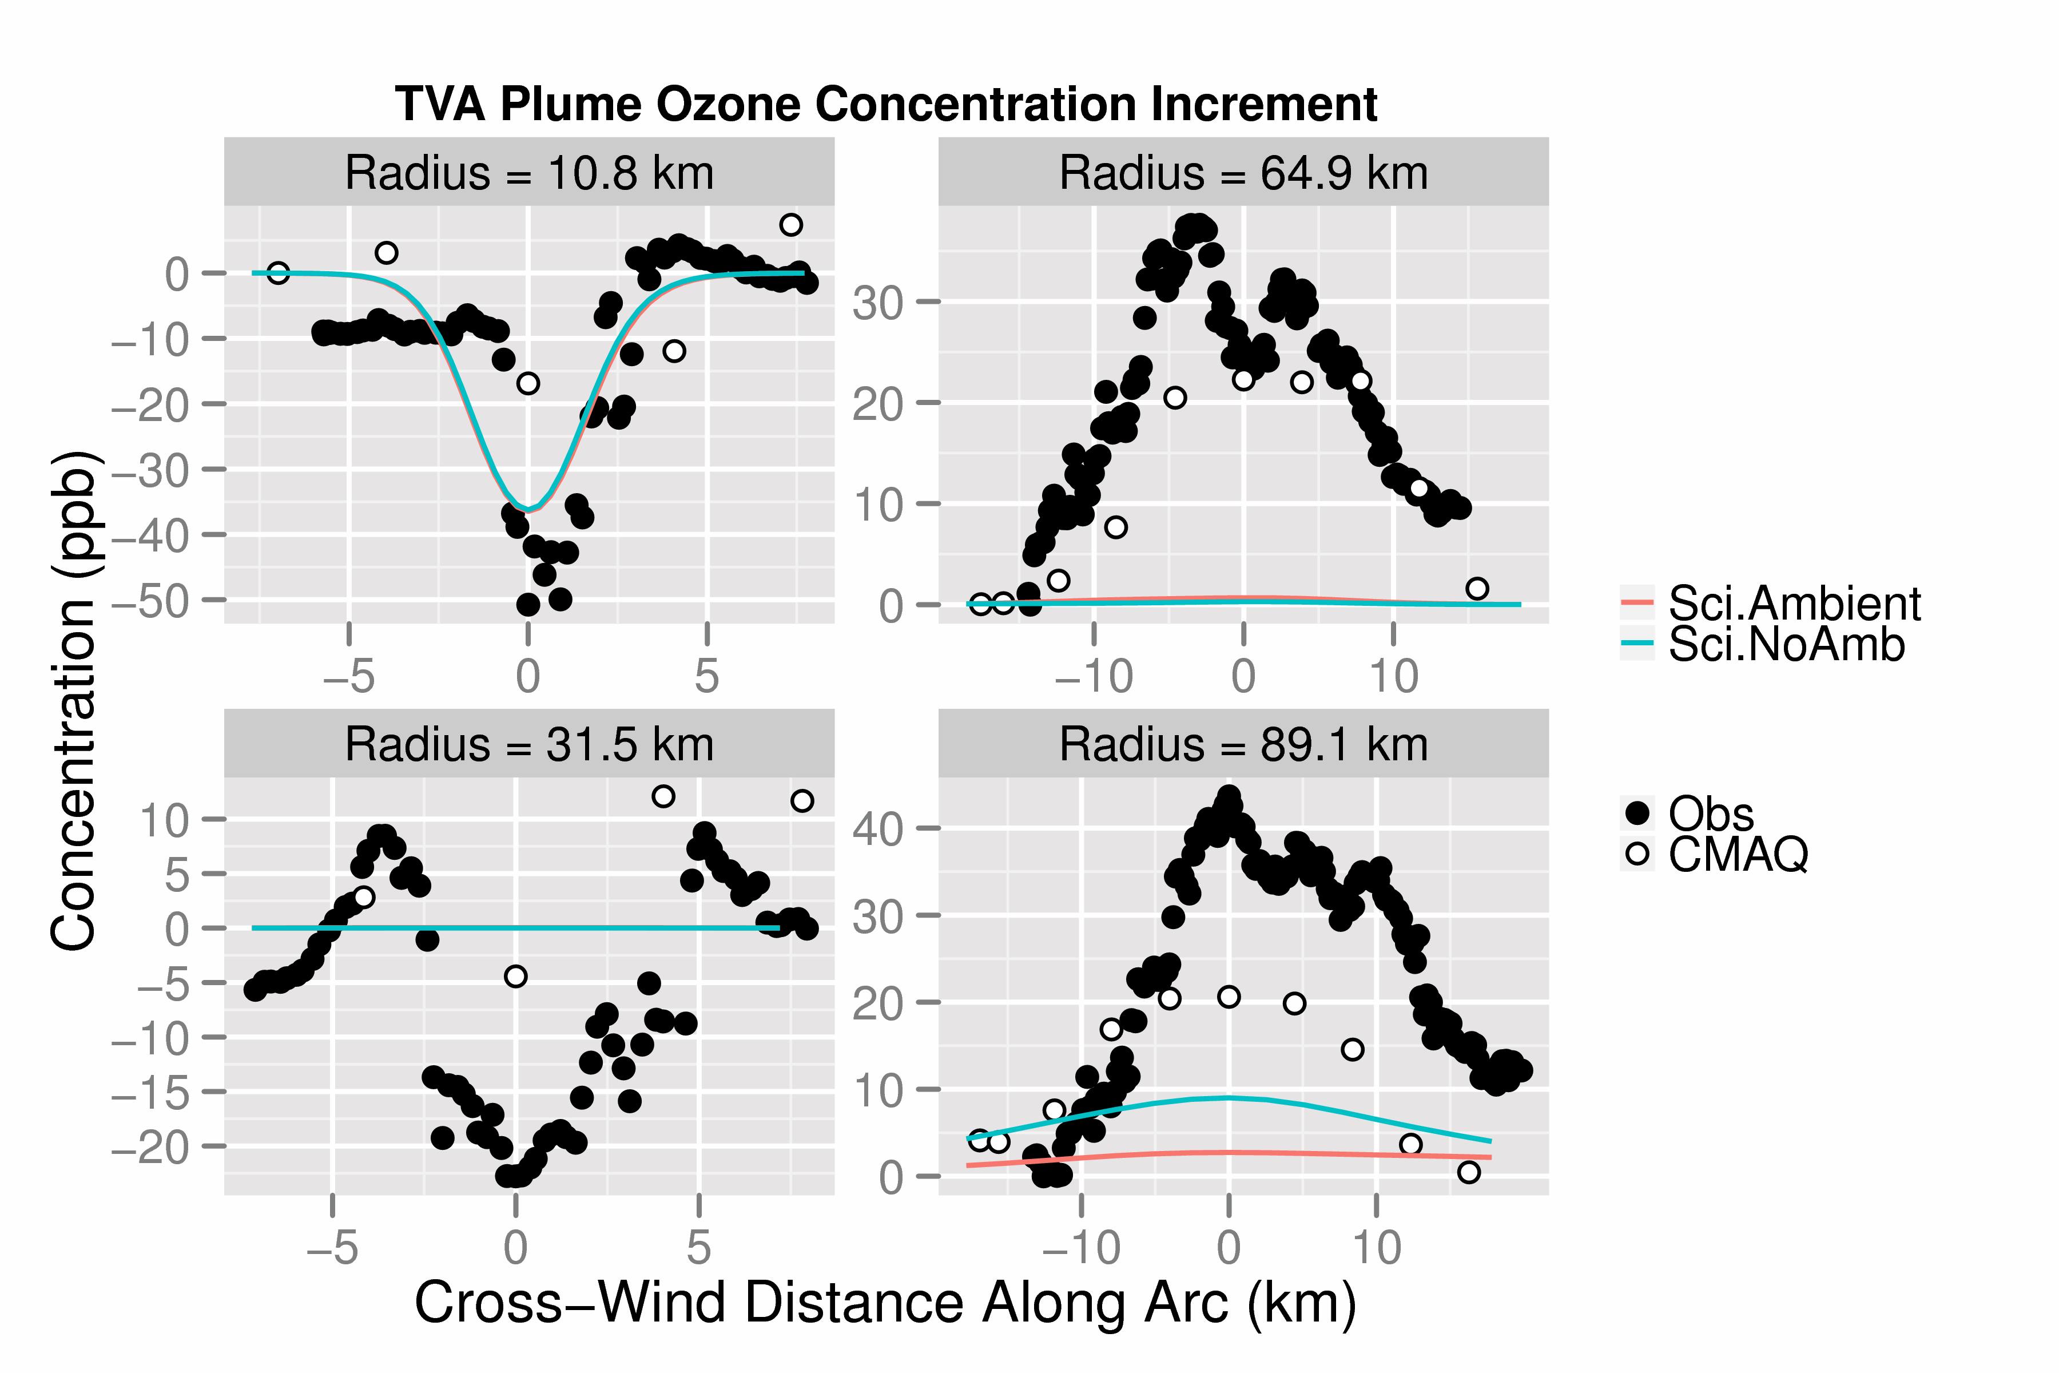
Centered Profile Comparison:
Ozone Increment
(3D Bkgrd)
(Const. Bkgrd)
Notes:
From Michael Davis flickr picture caption: This power plant is TVA's largest fossil plant in total megawatts with a total output of 2,600mw. It houses two 1,300mw units that rate among the largest Fossil Fuel units in the world. This, just like Paradise, is a monster power plant and a sight to behold. This is the view looking up stream from the outflow of Units 1 & 2 (the outflow culvert is under the Turbine Room).You can see the two massive Power Houses that house the two boilers and the Turbine Room with Switchyard behind it. The fairly new SCR (Scrubber and Wash) Stacks can be seen in the background. The two tall, main stacks are no longer in use and only serve as back-ups in case of a Scrubber issue. An interesting fact about this power plant is it sits in the bottom of an ancient (Jurassic Period) Meteor Crater along the Cumberland River in Stewart County, Tennessee. The Wells Creek Crater is roughly 7.5 miles across and between 100 & 200 million years old. This is TVA's largest coal fired power plant with Paradise running a very close second place. The two tallest chimney's are both 1,001 feet tall and the two scrubber chimney's are 600 feet tall respectively.

Slide 17
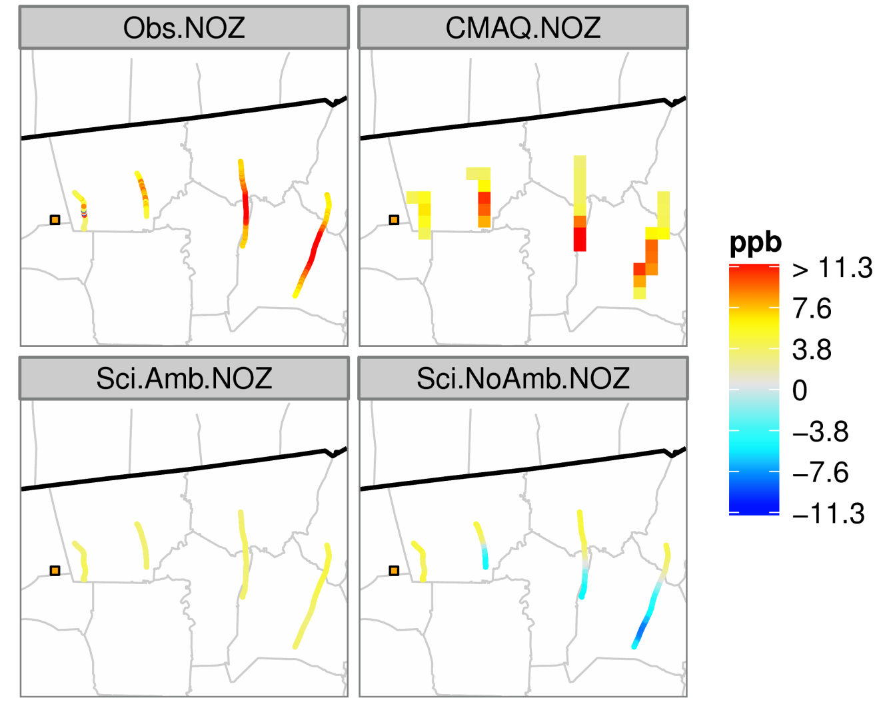
NOz Comparison with Observations
Observations
CMAQ
SCICHEM (3D Bkgrd)
SCICHEM (Const. Bkgrd)
Negative Concentrations?
NO_{Z}: Sum of NO_{X} oxidation products (e.g., HNO₃, PAN)
Notes:
From Michael Davis flickr picture caption: This power plant is TVA's largest fossil plant in total megawatts with a total output of 2,600mw. It houses two 1,300mw units that rate among the largest Fossil Fuel units in the world. This, just like Paradise, is a monster power plant and a sight to behold. This is the view looking up stream from the outflow of Units 1 & 2 (the outflow culvert is under the Turbine Room).You can see the two massive Power Houses that house the two boilers and the Turbine Room with Switchyard behind it. The fairly new SCR (Scrubber and Wash) Stacks can be seen in the background. The two tall, main stacks are no longer in use and only serve as back-ups in case of a Scrubber issue. An interesting fact about this power plant is it sits in the bottom of an ancient (Jurassic Period) Meteor Crater along the Cumberland River in Stewart County, Tennessee. The Wells Creek Crater is roughly 7.5 miles across and between 100 & 200 million years old. This is TVA's largest coal fired power plant with Paradise running a very close second place. The two tallest chimney's are both 1,001 feet tall and the two scrubber chimney's are 600 feet tall respectively.

Slide 18
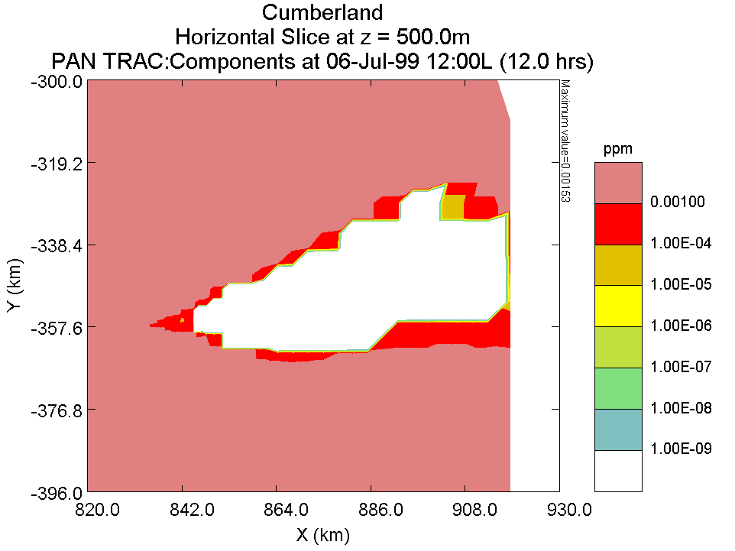
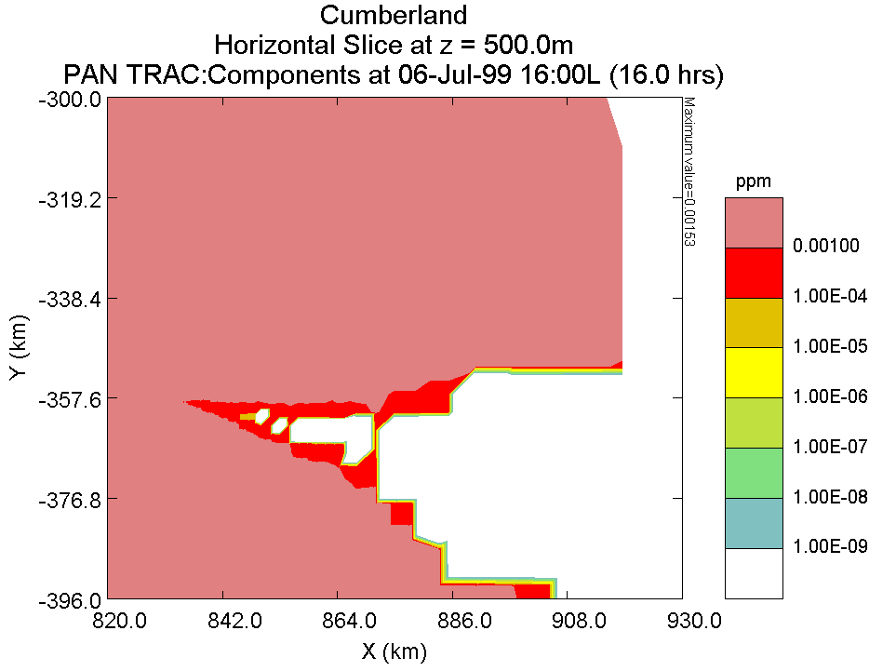
PAN Concentration Plot via SCIPUFF GUI
Notes:
From Michael Davis flickr picture caption: This power plant is TVA's largest fossil plant in total megawatts with a total output of 2,600mw. It houses two 1,300mw units that rate among the largest Fossil Fuel units in the world. This, just like Paradise, is a monster power plant and a sight to behold. This is the view looking up stream from the outflow of Units 1 & 2 (the outflow culvert is under the Turbine Room).You can see the two massive Power Houses that house the two boilers and the Turbine Room with Switchyard behind it. The fairly new SCR (Scrubber and Wash) Stacks can be seen in the background. The two tall, main stacks are no longer in use and only serve as back-ups in case of a Scrubber issue. An interesting fact about this power plant is it sits in the bottom of an ancient (Jurassic Period) Meteor Crater along the Cumberland River in Stewart County, Tennessee. The Wells Creek Crater is roughly 7.5 miles across and between 100 & 200 million years old. This is TVA's largest coal fired power plant with Paradise running a very close second place. The two tallest chimney's are both 1,001 feet tall and the two scrubber chimney's are 600 feet tall respectively.

Slide 19
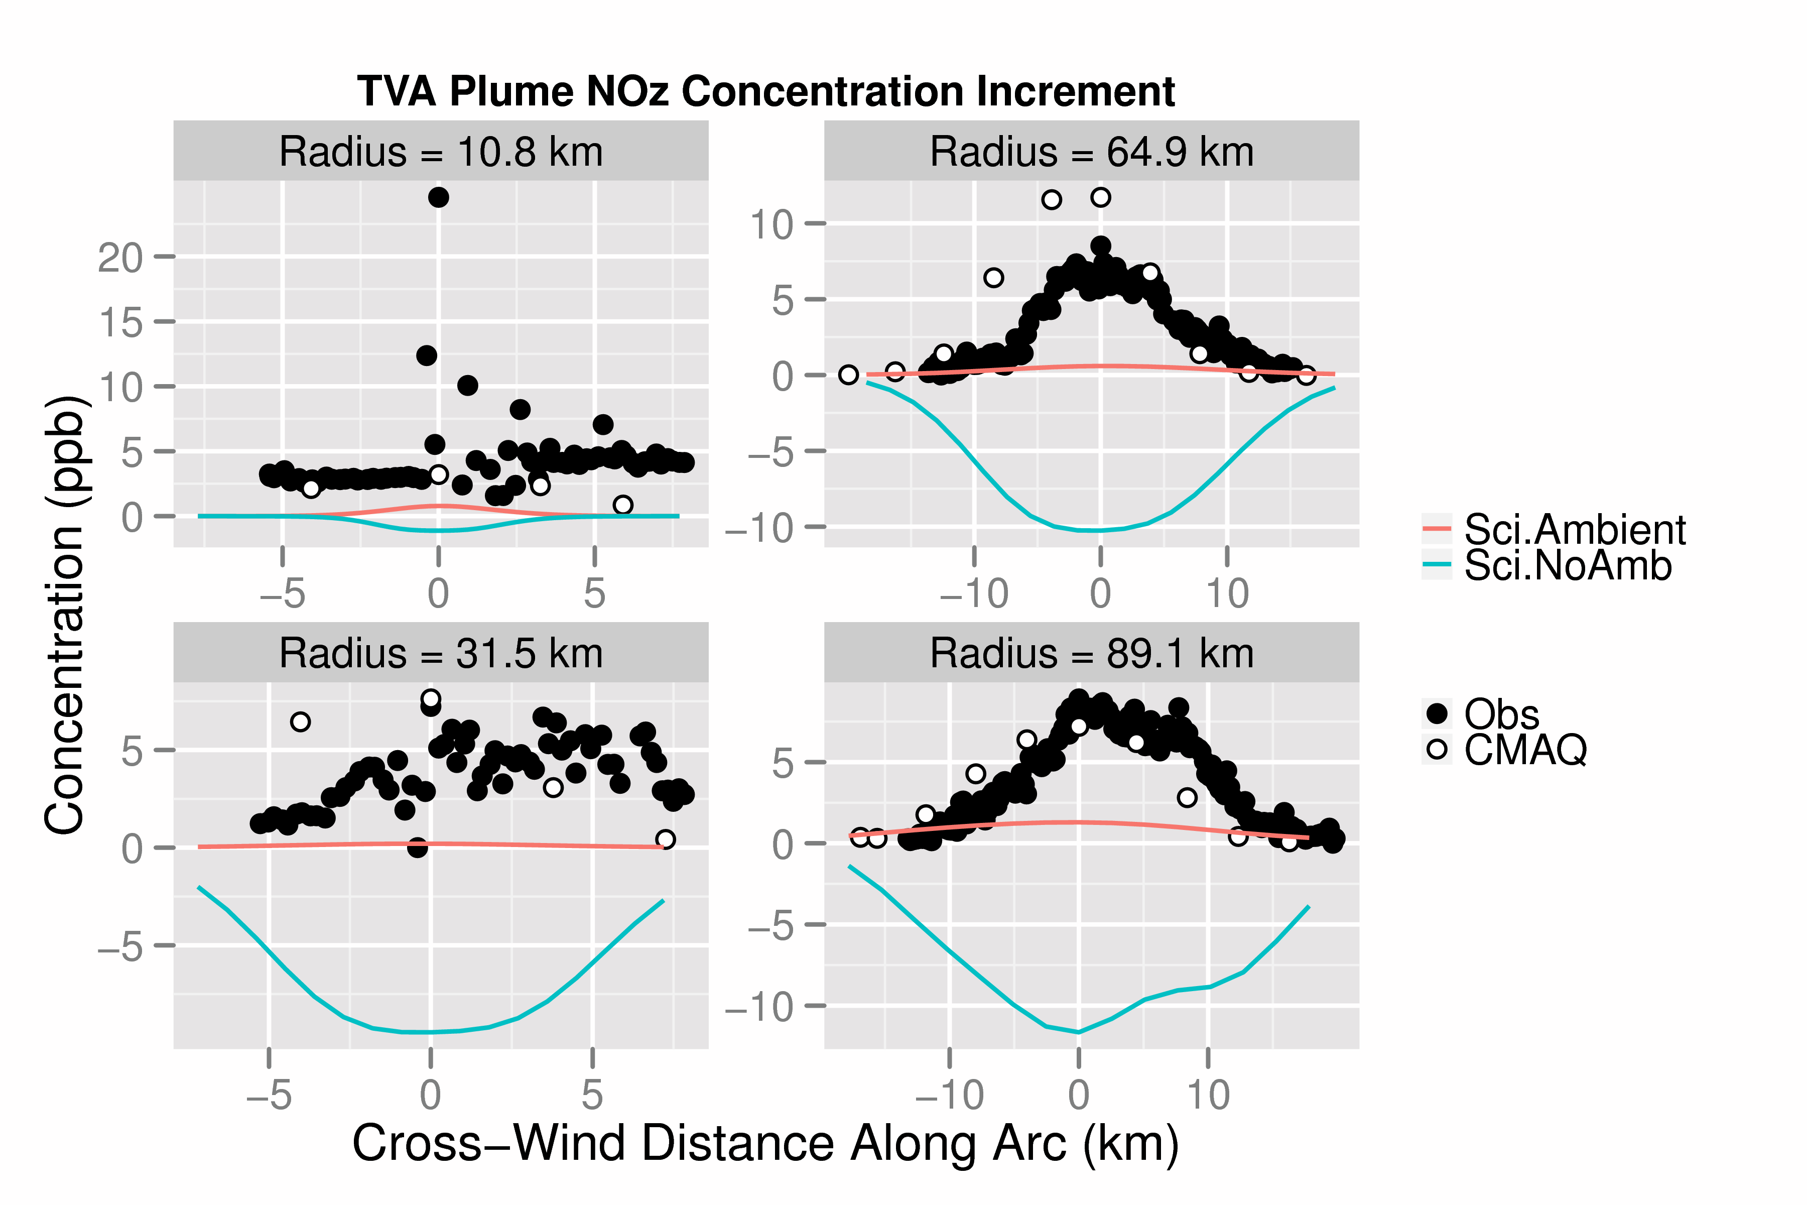
Centered Profile Comparison:
NOz Increment
(3D Bkgrd)
(Const. Bkgrd)
Notes:
From Michael Davis flickr picture caption: This power plant is TVA's largest fossil plant in total megawatts with a total output of 2,600mw. It houses two 1,300mw units that rate among the largest Fossil Fuel units in the world. This, just like Paradise, is a monster power plant and a sight to behold. This is the view looking up stream from the outflow of Units 1 & 2 (the outflow culvert is under the Turbine Room).You can see the two massive Power Houses that house the two boilers and the Turbine Room with Switchyard behind it. The fairly new SCR (Scrubber and Wash) Stacks can be seen in the background. The two tall, main stacks are no longer in use and only serve as back-ups in case of a Scrubber issue. An interesting fact about this power plant is it sits in the bottom of an ancient (Jurassic Period) Meteor Crater along the Cumberland River in Stewart County, Tennessee. The Wells Creek Crater is roughly 7.5 miles across and between 100 & 200 million years old. This is TVA's largest coal fired power plant with Paradise running a very close second place. The two tallest chimney's are both 1,001 feet tall and the two scrubber chimney's are 600 feet tall respectively.

Slide 20
Summary of Initial “Beta” Testing
SCICHEM-2012 predictions generally indicate reasonable model behavior
  Elevated NO_{y} concentration in plume; concentration profiles broaden and have lower peaks further from source due to dilution
  Ozone titration in NO_{x}-rich, VOC-poor plume; some ozone production far from source
Performance issues to examine further: negative concentrations (?) and too-little ozone production
Need for tool development to simplify processing model inputs/outputs
Future work should focus on evaluations relevant to conditions of regulatory applications

Slide 21
Acknowledgments
Biswanath Chowdhury of Sage Management
Prakash Karamchandani and Shu-Yun Chen of ENVIRON
Eladio Knipping of Electric Power Research Institute

