Slide 1
Development and Testing of PinG and VBS modules in CMAQ 5.01
Prakash Karamchandani, Bonyoung Koo, Greg Yarwood and Jeremiah Johnson
ENVIRON International Corporation
Eladio Knipping
Electric Power Research Institute
October 15, 2012
11th Annual CMAS Conference, Chapel Hill, NC

Slide 2
Acknowledgements
This work was supported by the Electric Power Research Institute (EPRI)
The U.S. EPA provided access to early alpha and beta versions of CMAQ 5.0 and pre-release versions of CMAQ 5.0 and CMAQ 5.01 to facilitate community contributions to this new release
Scientists from the U.S. EPA Atmospheric Modeling and Analysis Branch provided valuable technical advice and support during the implementation and testing of the new modules in CMAQ 5.01

Slide 3
Scope of Study
Implement Advanced Plume Treatment (APT) for sub-grid scale treatment of point source plumes in CMAQ 5.01
Implement Volatility Basis Set (VBS) approach as an alternative option for organic PM
Application of new modules using existing modeling datasets and comparison of results with those from the base (“standard”) CMAQ 5.01
Submission of new code and model results to EPA/CMAS for review (pending)
Include as new options in next interim release after submission is approved

Slide 4
VBS Implementation for CMAQ v5.0.1
Volatility basis set approach
Recognizes that both secondary and primary OA are semi-volatile
Accounts for volatility decrease with chemical aging
Aerosol formation from VOC, IVOC and SVOC emissions
Implementation distinguishes OA by major source category and between HOA and OOA (for comparison with AMS data)
Four volatility basis sets
One basis set for HOA (hydrocarbon-like OA) for emissions of fresh OA from anthropogenic sources
One basis set for BBOA (biomass-burning OA) for emissions of fresh OA from fires
Two basis sets for secondary OOA (oxygenated OA) from anthropogenic and biogenic sources
HOA converts to OOA with chemical aging
IVOC and SVOC are added internally
Current inventories lack IVOC and SVOC
Internally estimate I/SVOC from primary emissions, by major source category
Performance
Both STD and VBS schemes biased low; VBS bias has less seasonal dependence
VBS performance improves when I/SVOC emissions are estimated based on Mexico City plume analyses (Shrivastava et al., 2011)
Minor computational increase (~10%) with VBS

Slide 5
APT Implementation
Embedded plume model: SCICHEM
Updated plume model gas-phase chemistry, aerosol, and aqueous modules for consistency with CMAQ 5.01 default options (CB05TUCL, AE6)
Model interfaces rewritten to deal with structural changes to CMAQ (new modules for specification of model species, code re-engineering to increase modularity)
SCICHEM now uses CMAQ modules and derived data types to build species lists and species properties
Much tighter integration between CMAQ and SCICHEM
Updates for future CMAQ versions likely to require less coding effort as long as CMAQ is not re-engineered again
Update host and plume models for point source treatment
SCICHEM now reads CMAQ in-line point source files directly and uses the LPING flag in the stack groups file to determine point sources to simulate
CMAQ does not treat point sources that are simulated with SCICHEM
SCICHEM uses CMAQ plume-rise algorithms
5

Slide 6
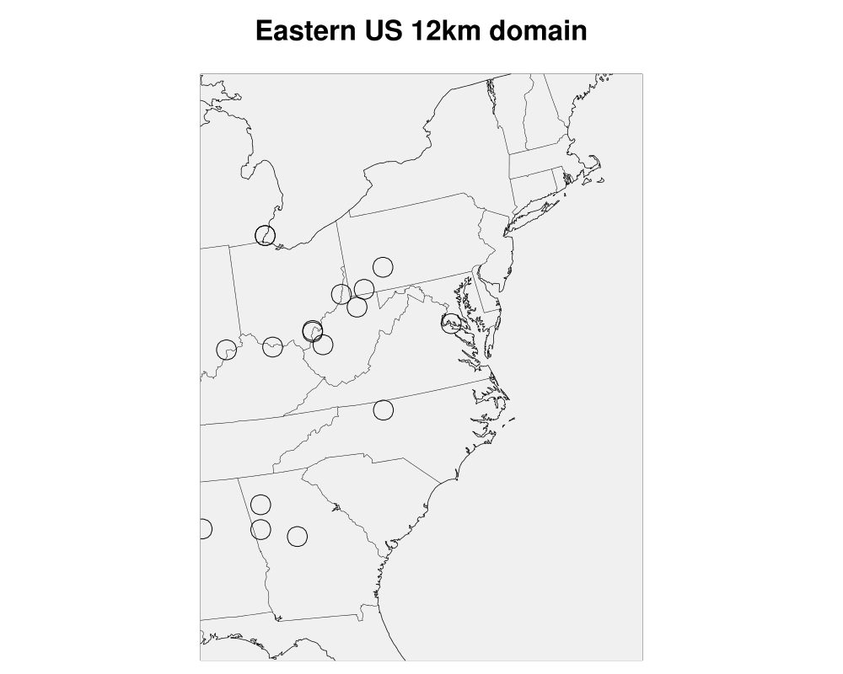
CMAQ v5 Test Case
Modeling episodes
Two-week episode for each of January and July 2005
Modeling domains
12 km modeling grid (119 X 158) centered on the Eastern U.S.
~20 point sources selected for plume-in-grid treatment in CMAQ-APT simulation
Preliminary analysis focuses on summertime differences in source attributions from the base CMAQ 5.0.1 and CMAQ-APT
Source contributions determined by conducting a “background” simulation without the point sources
6

Slide 7
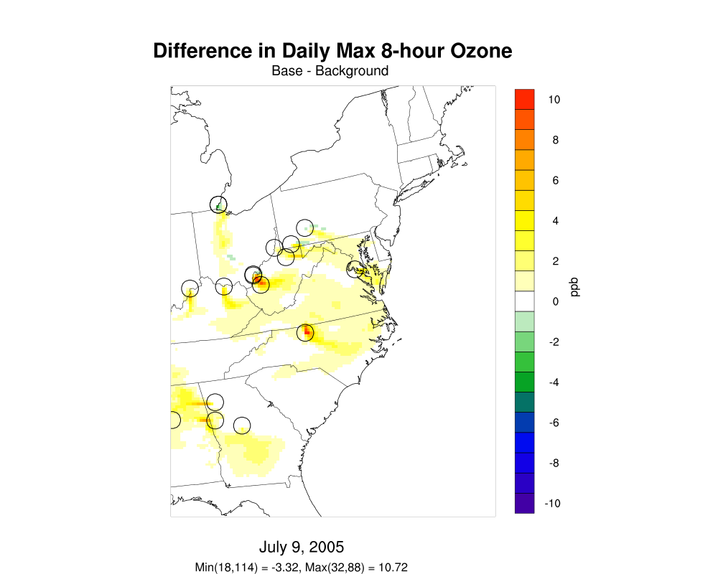
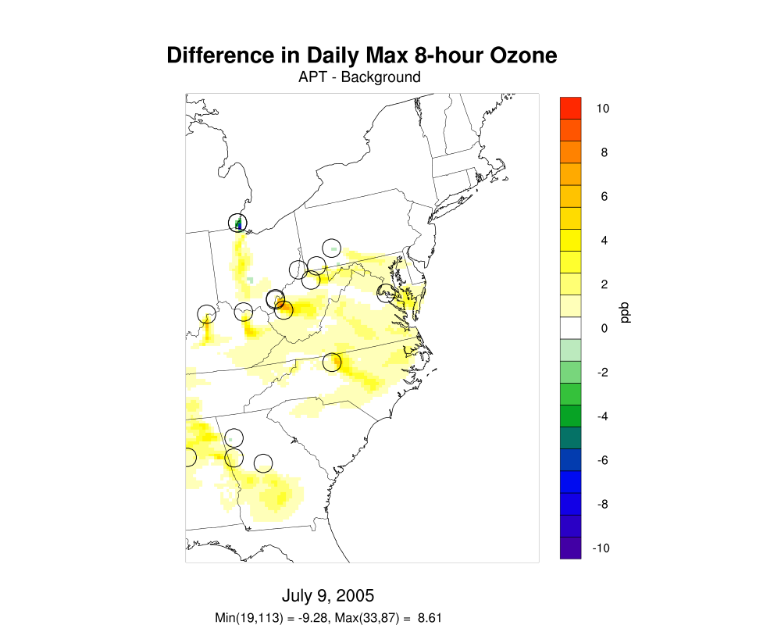
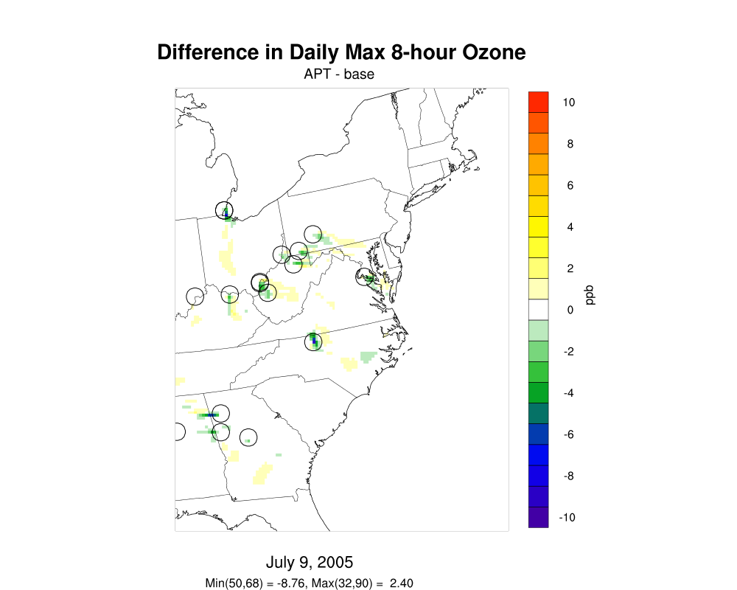
Source Contributions to Daily Max 8-hour O₃
July 9, 2005
Base CMAQ 5.01
CMAQ-APT 5.01
APT-Base

Slide 8
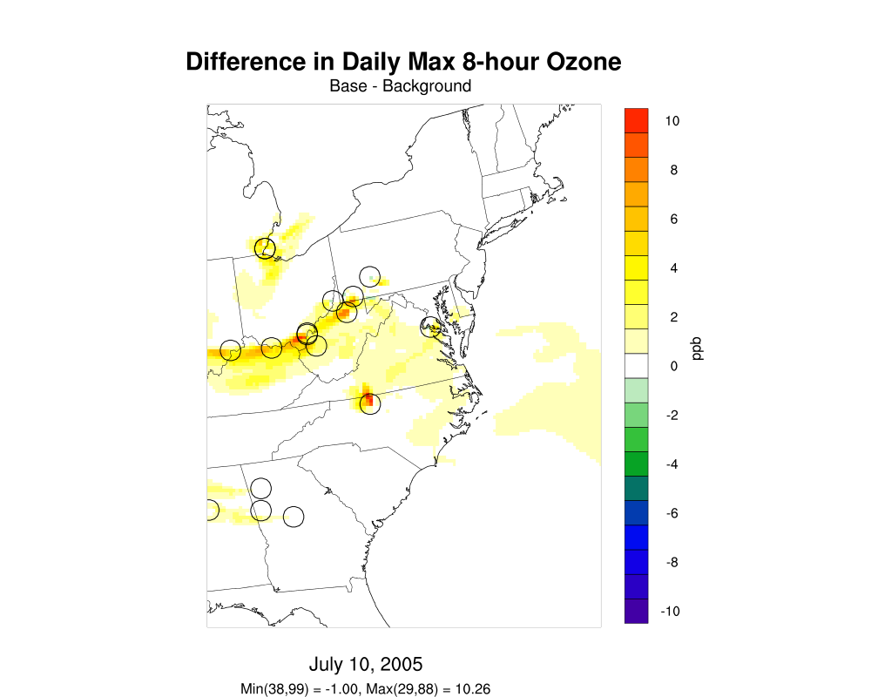
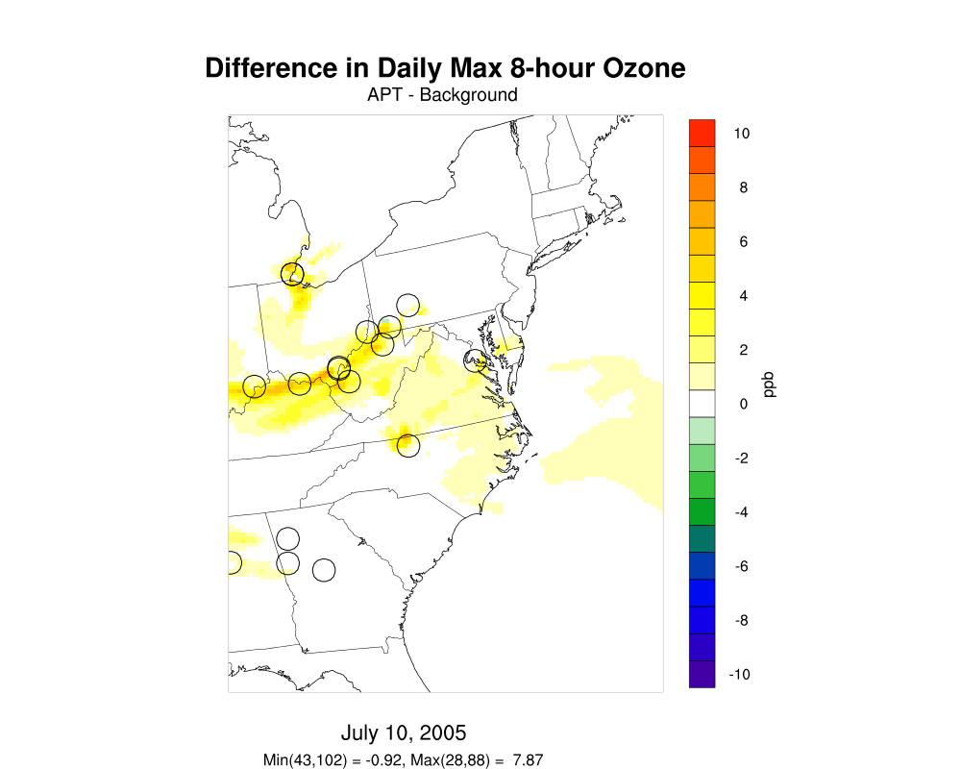
Source Contributions to Daily Max 8-hour O₃
July 10, 2005
Base CMAQ 5.01
CMAQ-APT 5.01
APT-Base

Slide 9
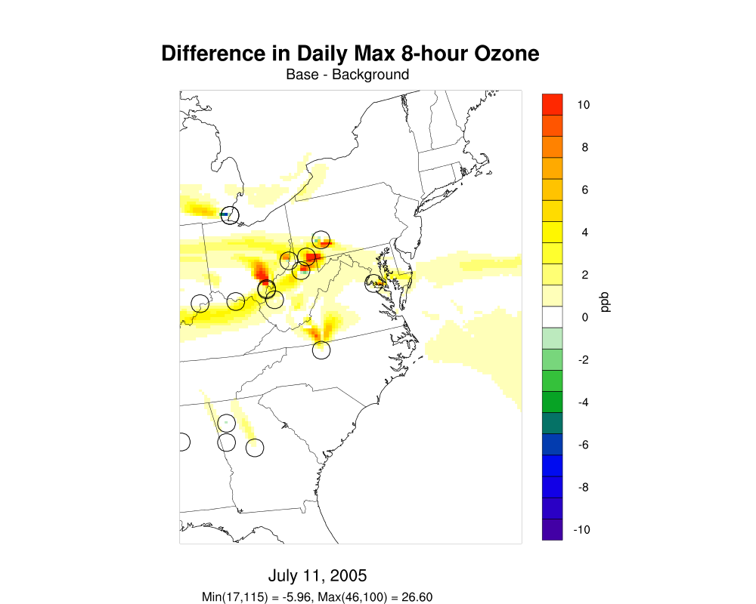
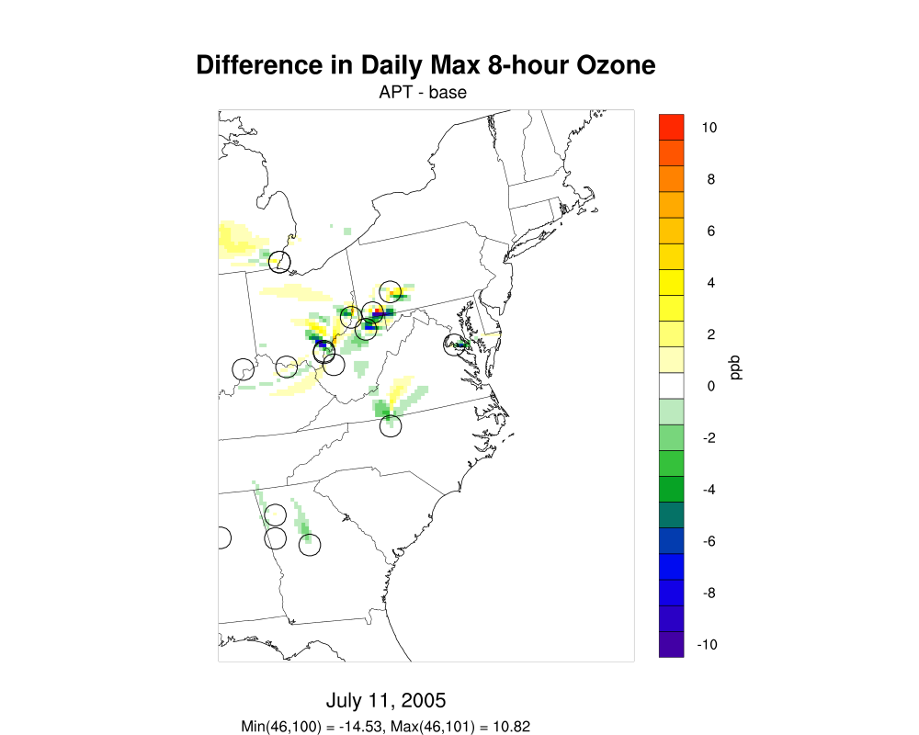
Source Contributions to Daily Max 8-hour O₃
July 11, 2005
Base CMAQ 5.01
CMAQ-APT 5.01
APT-Base

Slide 10
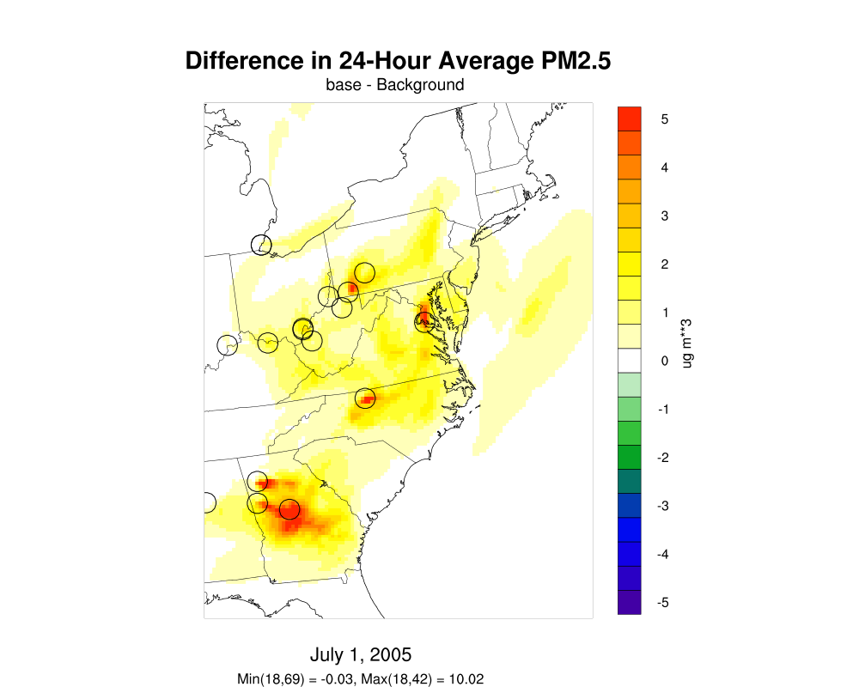
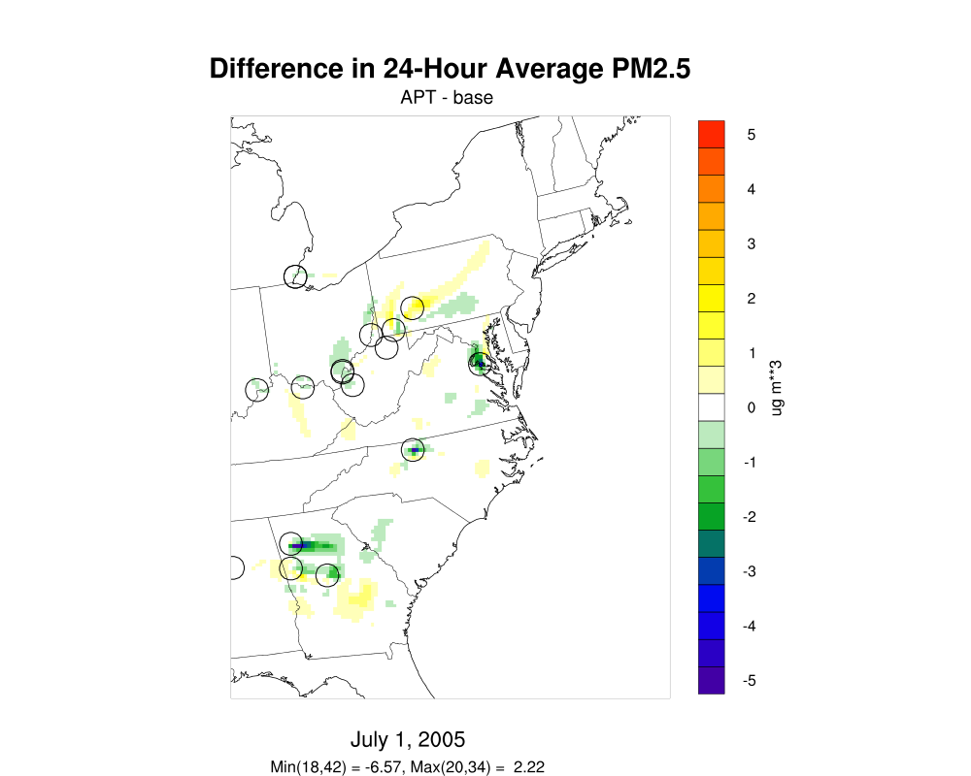
Source Contributions to 24-hour average PM_{2.5}
July 1, 2005
Base CMAQ 5.01
CMAQ-APT 5.01
APT-Base

Slide 11
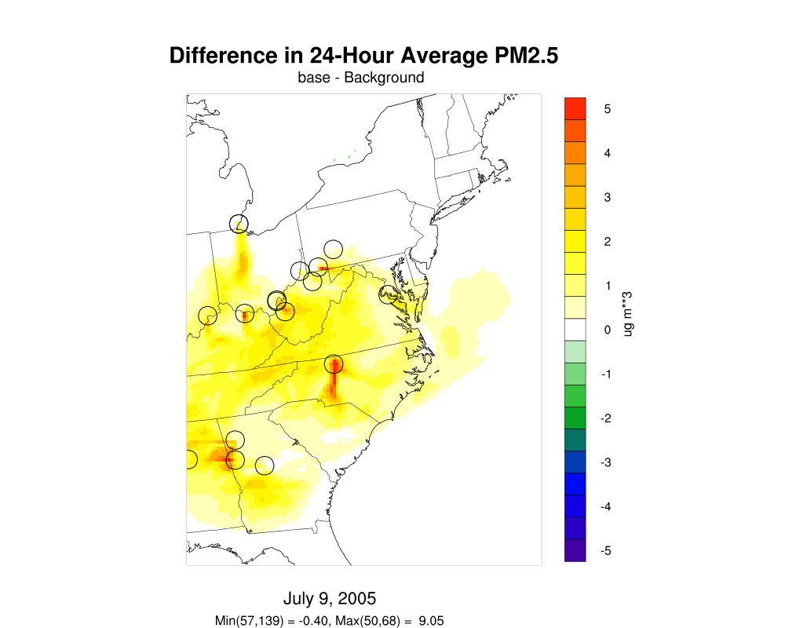
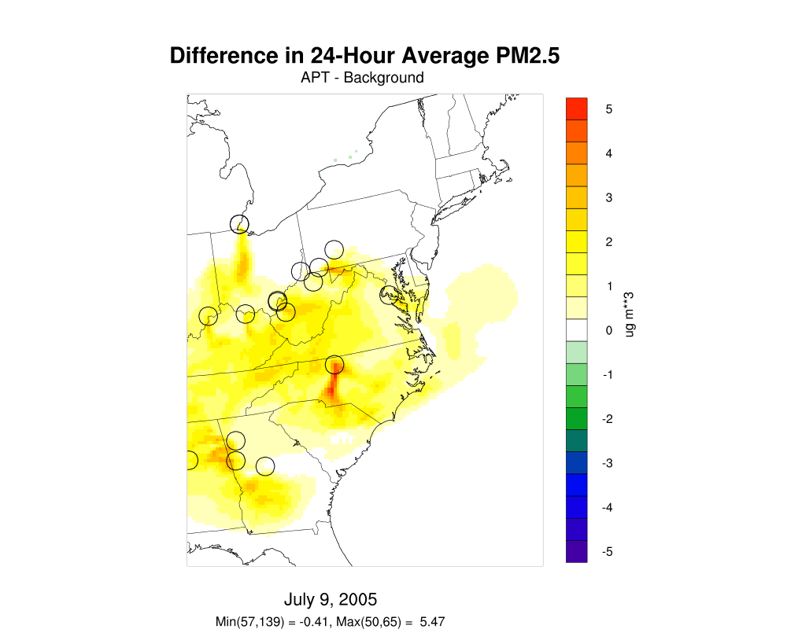
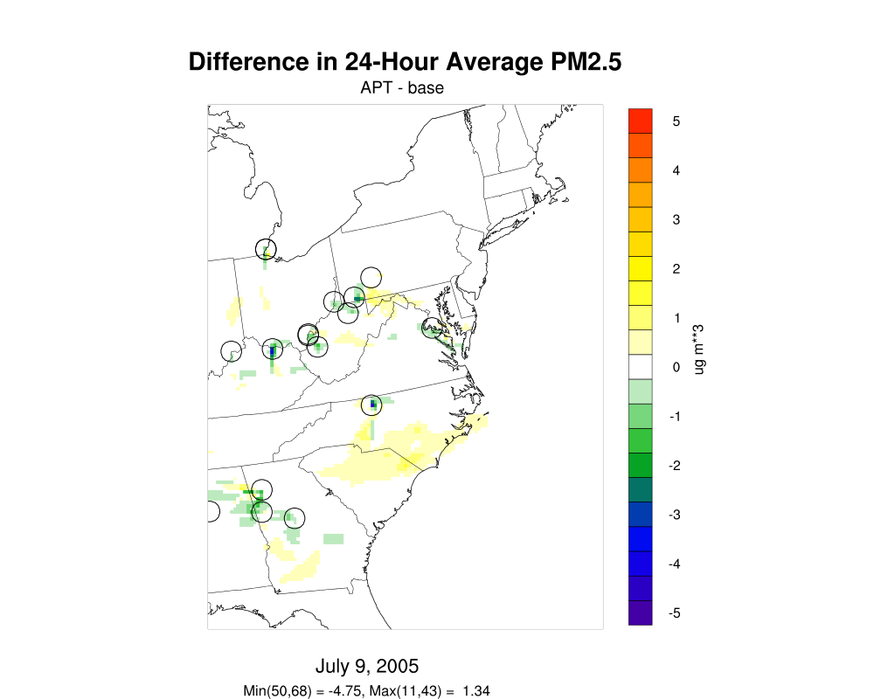
Source Contributions to 24-hour average PM_{2.5}
July 9, 2005
Base CMAQ 5.01
CMAQ-APT 5.01
APT-Base

Slide 12
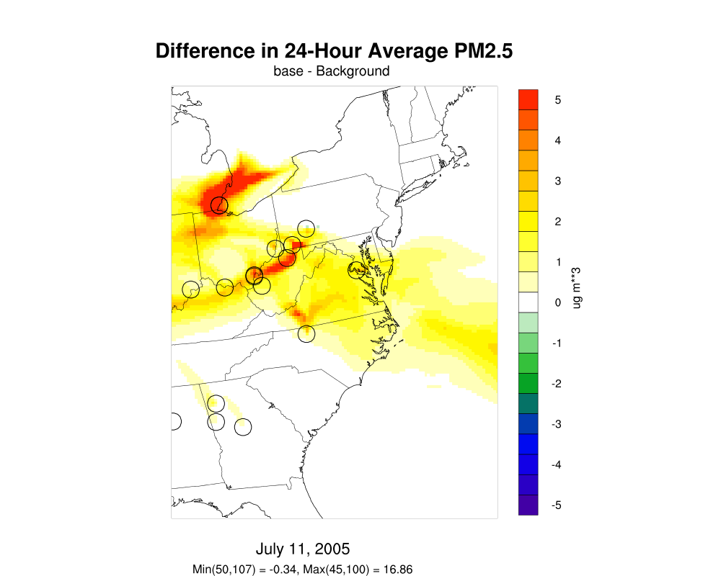
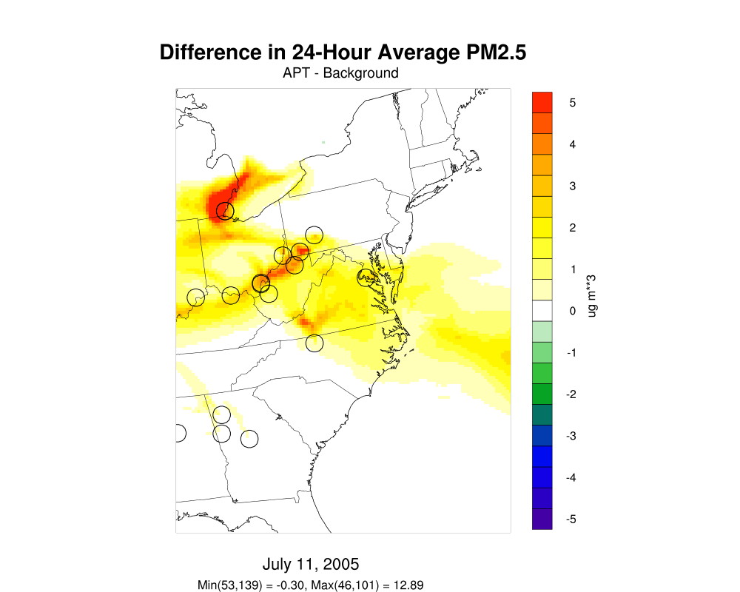
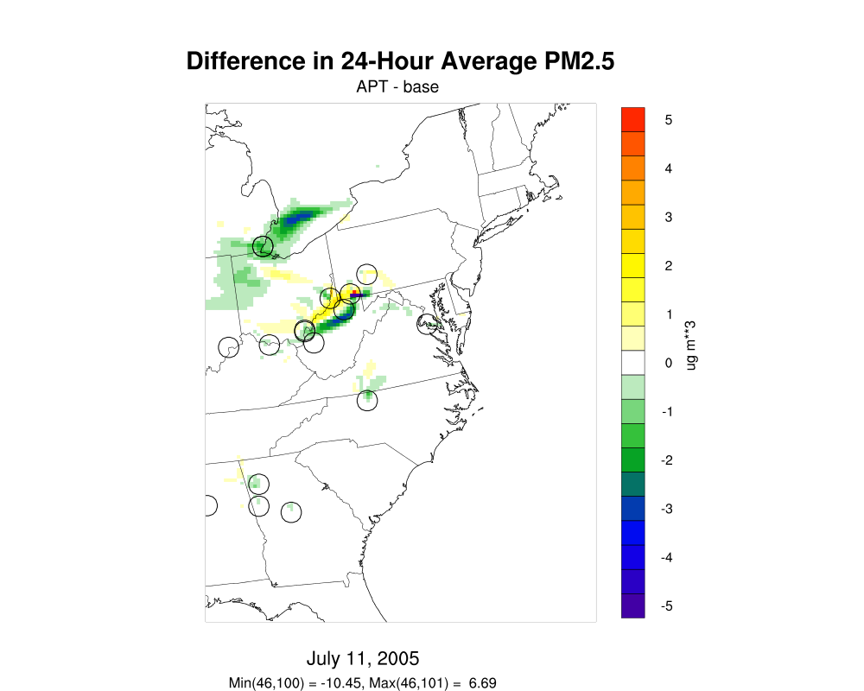
Source Contributions to 24-hour average PM_{2.5}
July 11, 2005
Base CMAQ 5.01
CMAQ-APT 5.01
APT-Base

Slide 13
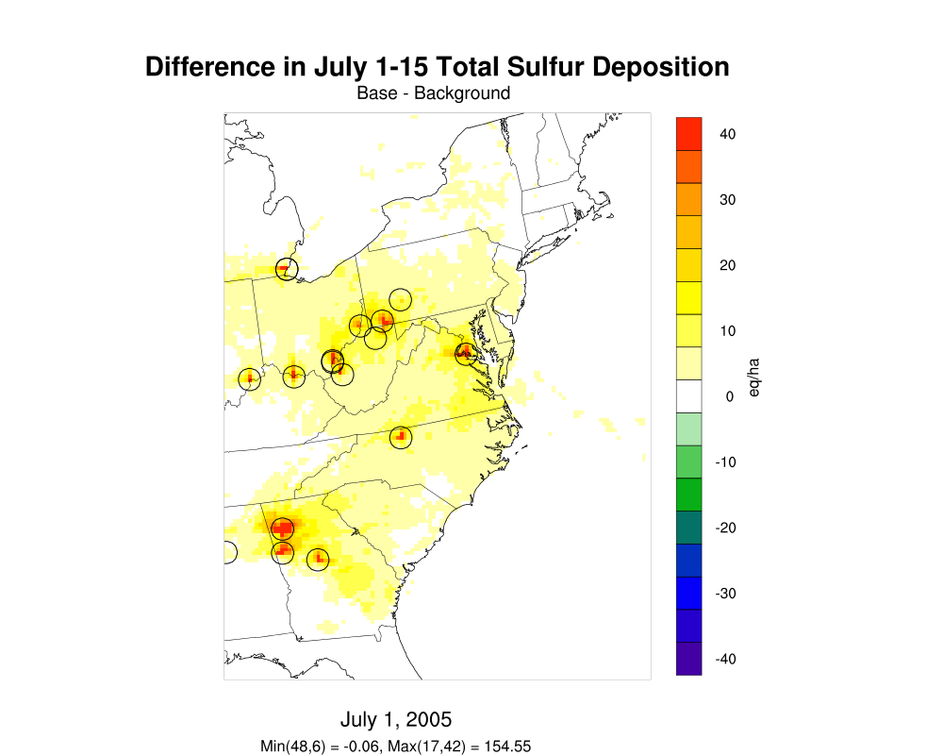
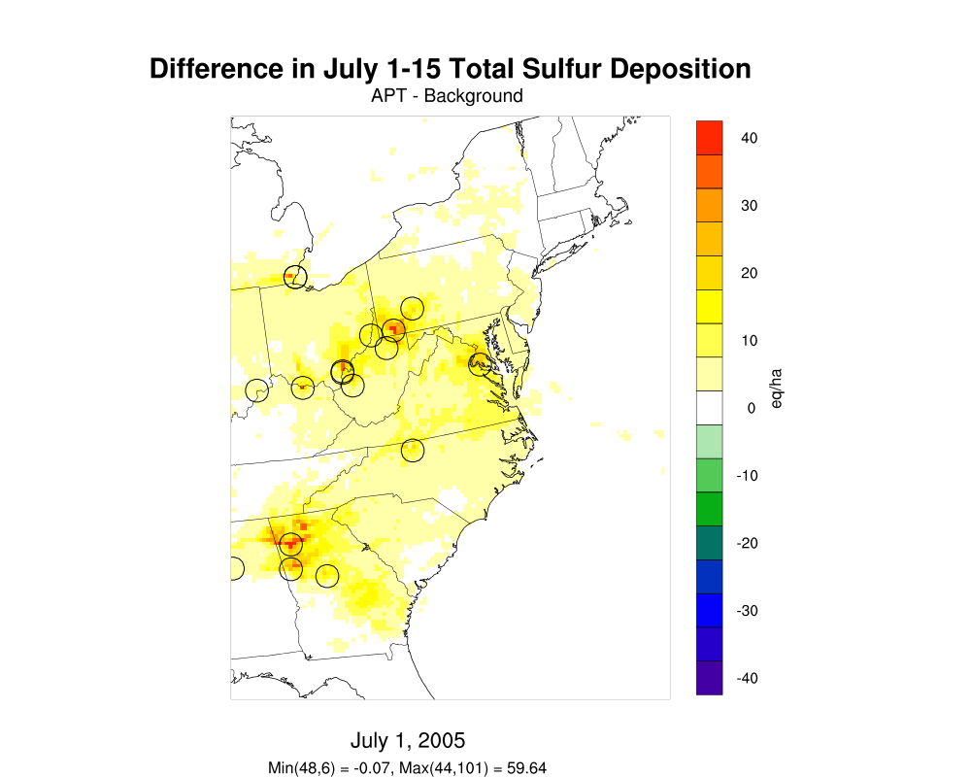
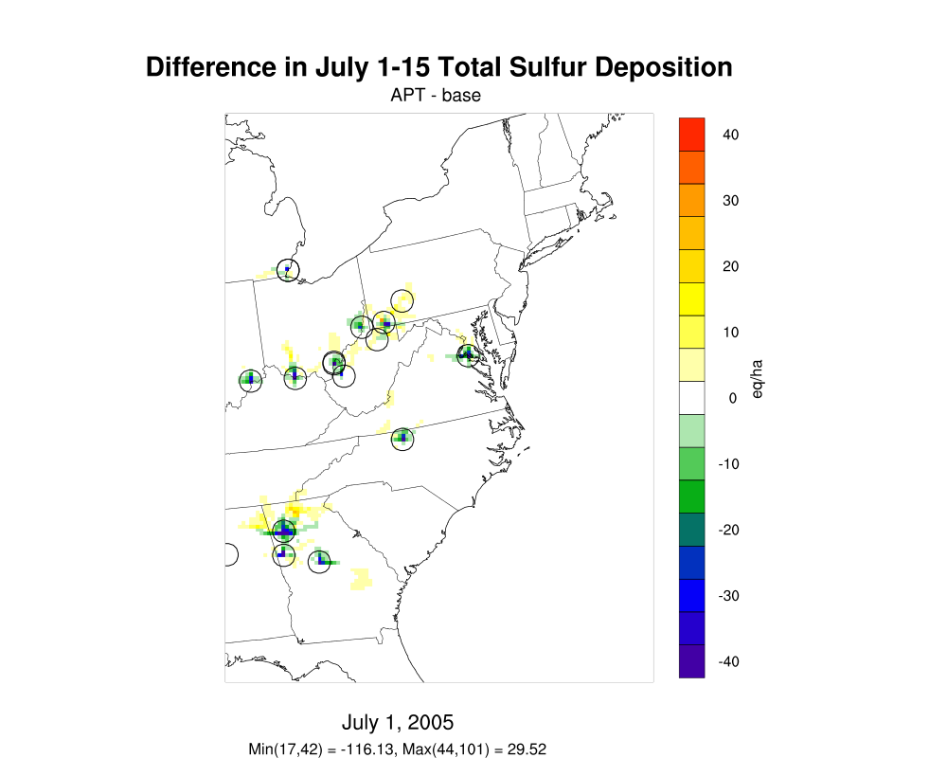
Source Contributions to 15-Day S Deposition
July 1-15, 2005
Base CMAQ 5.01
CMAQ-APT 5.01
APT-Base

Slide 14
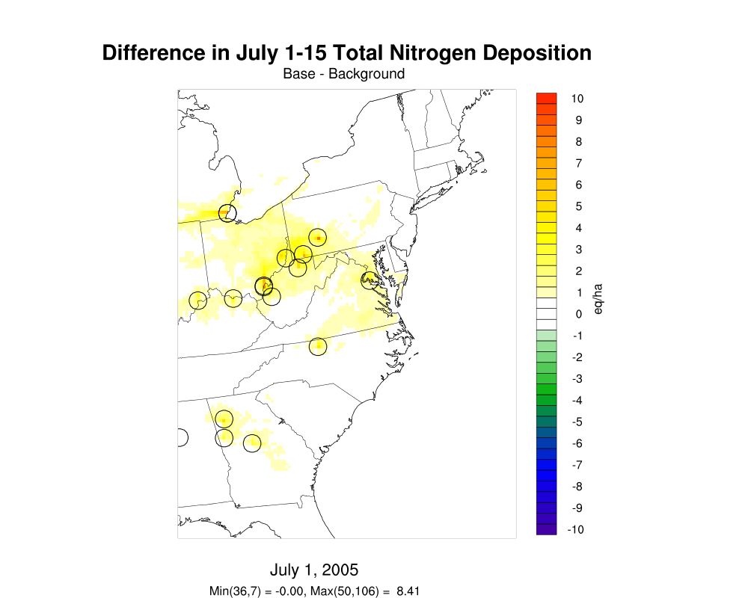
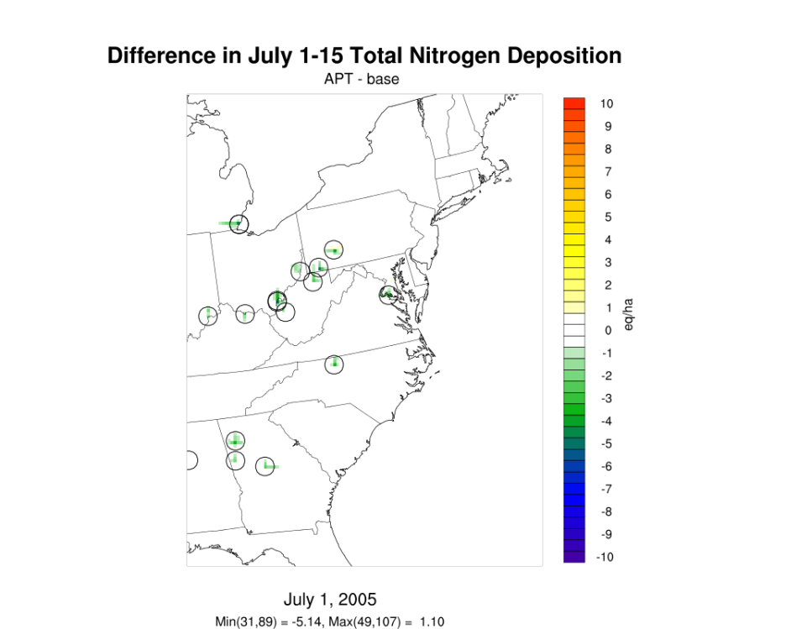
Source Contributions to 15-Day N Deposition
July 1-15, 2005
Base CMAQ 5.01
CMAQ-APT 5.01
APT-Base

Slide 15
Summary and Next Steps
Overall spatial patterns of point source contributions to ozone, PM_{2.5}, and deposition are qualitatively similar in the base and plume-in-grid simulations
Plume-in-grid treatment generally shows smaller point source contributions than standard CMAQ:
Significantly lower near the sources
Comparable or slightly higher contributions at longer downwind distances
Additional analysis of summer results ongoing
Winter episode simulations ongoing
New VBS and APT codes, inputs and model results to be submitted to EPA for review after completing the analyses

