Slide 1


Applications and Evaluations of Response Surface Model (RSM) Using CMAQ in the United States and Asia
EPA/OAQPS Team: Carey Jang, Sharon Phillips, Charles Fulcher, Bryan Hubbell, Tyler Fox, Dale Evarts
International Team: Joshua Fu (U. of TN), Yun Zhu (SCUT, China),
Shuxiao Wang, Xing Jia, Jiming Hao(Tsinghua U., China)
11th CMAS Conference, RTP, NC, Oct. 17, 2012

Slide 2
Outline
What is Response Surface Model (RSM)?
  Overview: a statistical “reduced-form” of AQ model
  Objective: real-time AQ response of emissions control
RSM Applications in USA & Asia
  RSM/CMAQ modeling in USA, China & Taiwan
RSM Validation & Evaluation
  Compare RSM w/ CMAQ brute-force results to validate RSM responses to emissions changes
    Out-of-Sample Validation : random sampling
    Cross Validation : recursive “leave-one-out”

Slide 3
Air Quality Modeling Techniques: Contribution & Control/Response Assessments
Assessment of “Contribution” of sources/pollutants
  Zero-Out (Brute Force) Modeling
  Source Apportionment Modeling
    OSAT/PSAT, OPTM/PPTM, TSSA, CMAQ Source Apportionment, etc.
  Source/Receptor Sensitivity Modeling
    Decoupled Direct Method (DDM), Adjoint, etc.
Assessment of “Response” (control efficacy) of sources/pollutants emission reductions
  Zero-Out (Brute Force) Modeling
  Response Surface Modeling (RSM)
    Provide “real-time” AQ response of emissions control
    Applied to REMSAD (PM2.5), CAMx(O3), CMAQ (multi-pollutant) for supporting regulatory modeling efforts (e.g., PM NAAQS)

Slide 4
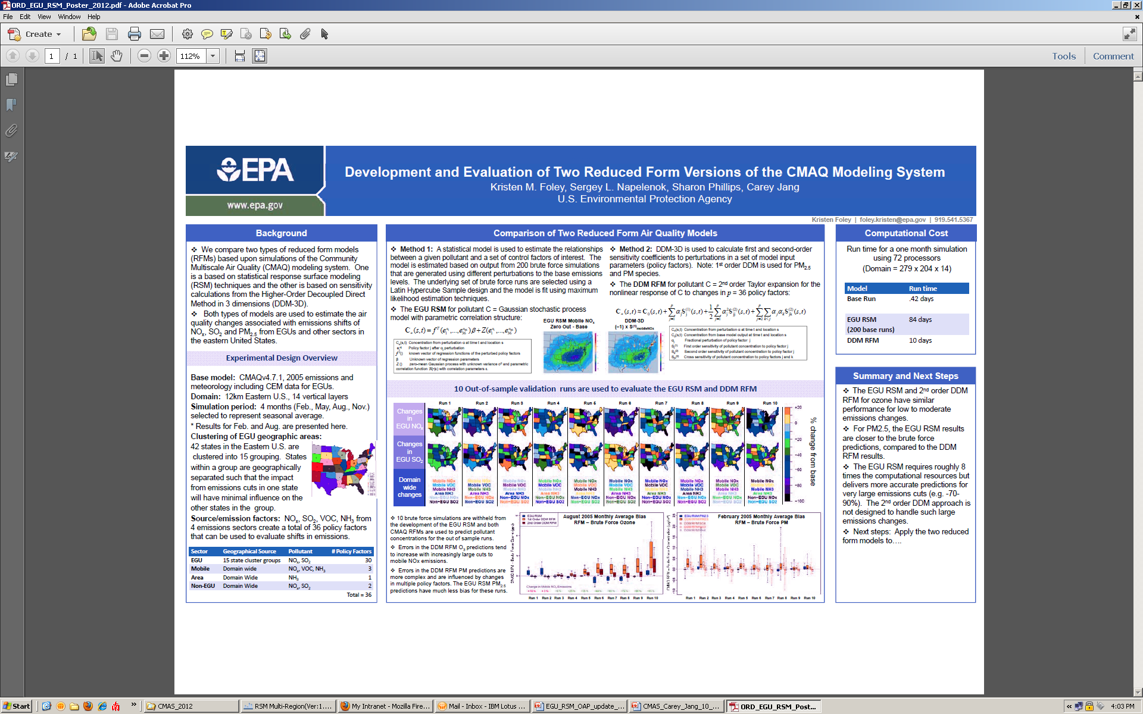
“Development and Evaluation of Two Reduced Form Versions of the CMAQ Modeling System”: Kristen Foley, Sergey Napelenok, Sharon Phillips, Carey Jang, USEPA
RSM vs. DDM using EGU RSM scenarios

Slide 5
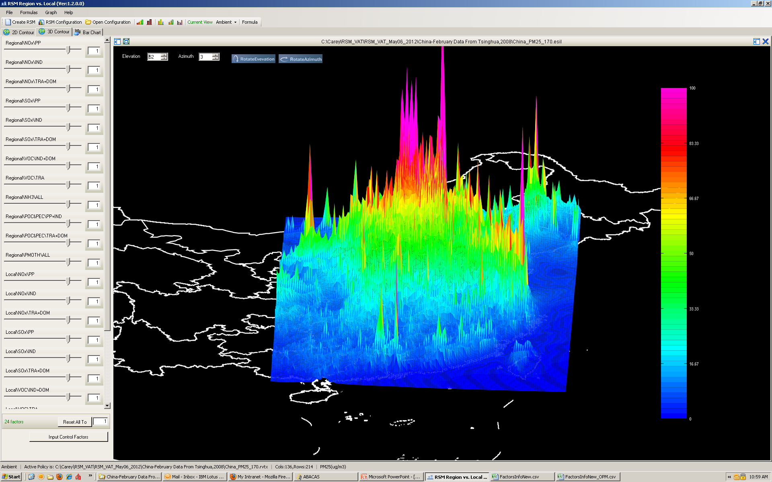
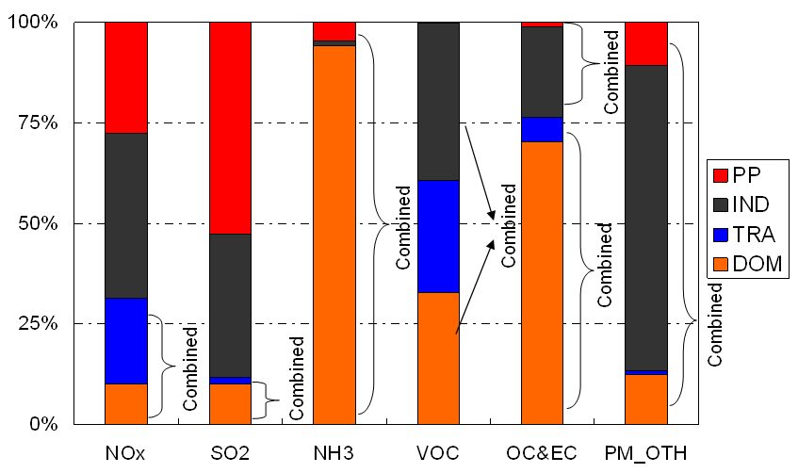
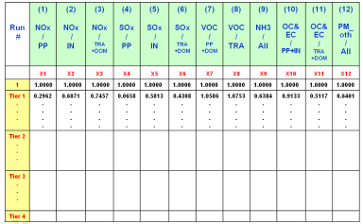
“4S” steps in RSM development
Policy Factors
(Emission Factors)
Air quality
RSM
PM2.5 Response Surface
1.Selection
Source A- Local NOx
Source B- Regional VOC
Source C- Area NOx
…
4.Statistic
Source C
2.Sampling
Empirical Best Linear Unbiased Predictors (EBLUPs)
Source A
Source B
Latin Hypercube Sample (LHS)
Hammersley quasi-random Sequence Sample (HSS)
3.Simulation
Multi-case CMAQ simulations
(Dr. Jia Xing, Tsinghua Univ., 2011)

Slide 6
RSM-VAT
Baseline
Control
Factor
(Policy
Factor)
PM_{2.5} Response Surface Modeling
Notes:
Max:196.571
Min:0.345

Slide 7
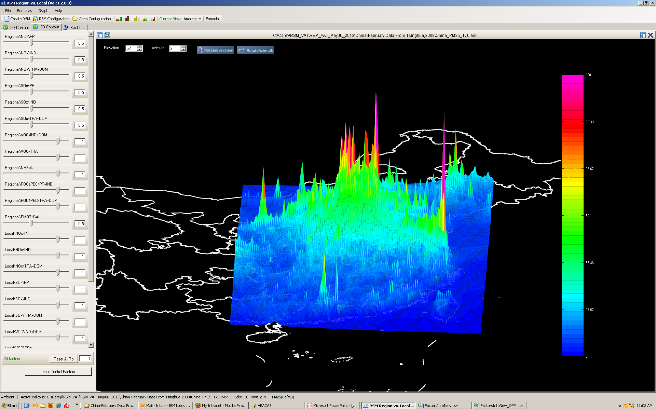
RSM-VAT
NOx/SO2/PM 50% Control
Control
Factor
(Policy
Factor)
PM_{2.5} Response Surface Modeling

Slide 8
RSM: Objectives
Control strategy assessment tool
  Provide the real-time AQ response of emissions control
Model sensitivity
  Evaluate sensitivity of model predictions to changes in emissions (precursors, source categories, etc).
Optimization of cost/benefit
  Help develop cost-effective control strategies leading to optimal AQ/health benefit
Notes:
8

Slide 9
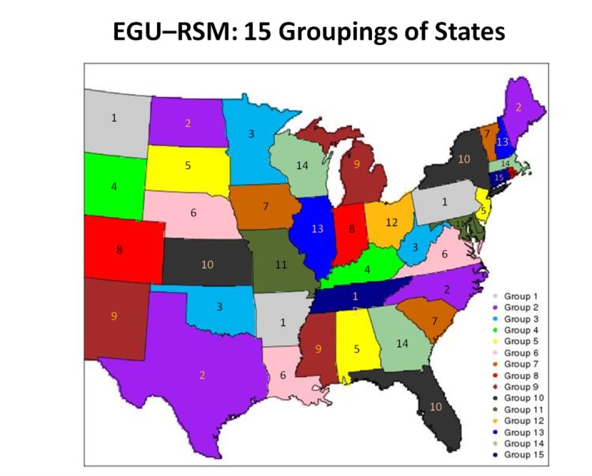
RSM Applications in USA & China
USA
  REMSAD RSM (PM2.5)
  CAMx RSM (O3)
  CMAQ Multi-pollutant RSM
  CMAQ EGU (Utility) RSM
Asia
  China PM/O3 RSM modeling
  Taiwan PM/O3 RSM modeling
Beijing
Shanghai
Guangzhou
Taiwan

Slide 10
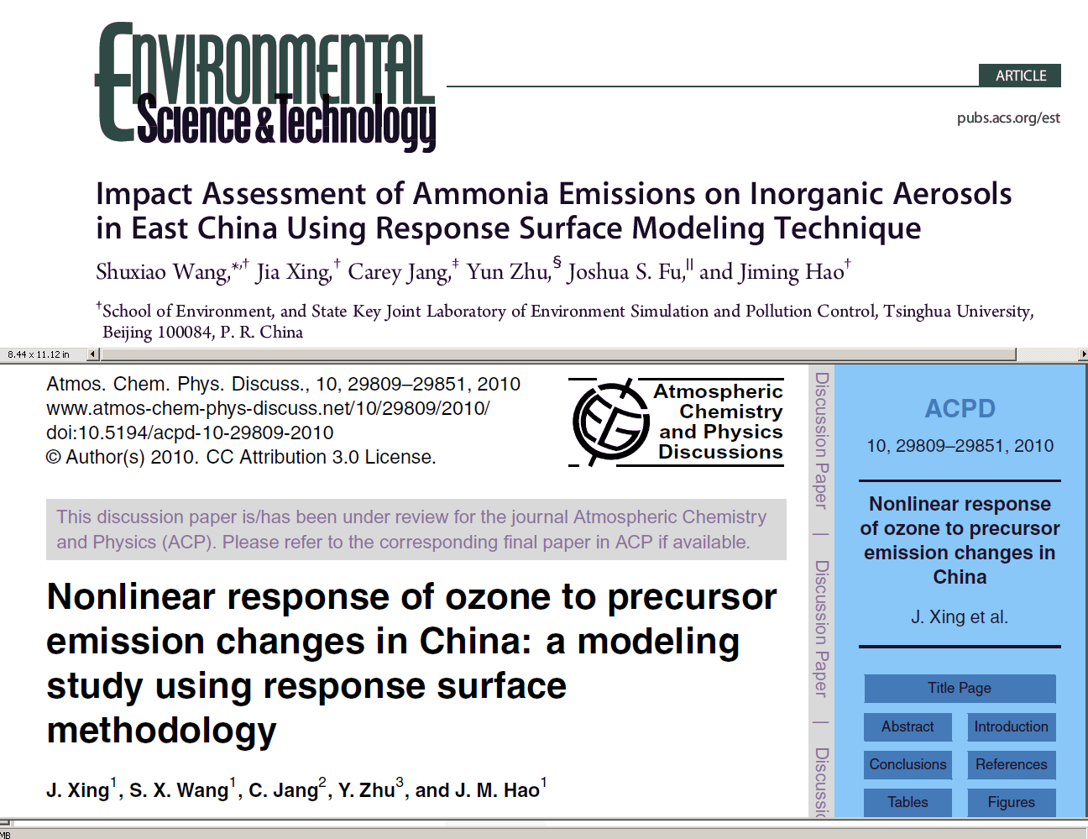
Overview of China-RSM project
Published papers:
  Wang S X, Xing J, Jang C, et al. Impact Assessment of Ammonia Emissions on Inorganic Aerosols in East China Using Response Surface Modeling Technique, Environ. Sci. Technol., 2011, 45: 9293–9300
  Xing J, Wang S X, Jang C, et al. Nonlinear Response of Ozone to Precursor Emission Changes in China: a Modeling Study using Response Surface Methodology. Atmos Chem Phys, 2011, 11: 5027-5044

Slide 11

Application of RSM-PM in China
Impacts of SO₂/NOx/NH₃ on PM
PM2.5 Control Non-linearity
NH₃ contribution to PM2.5 is comparable w/ SO₂ & NOx.
Relative contribution of NH₃ becomes larger w/ increased emissions control
NOx vs. SO2
NOx vs. NH3
PM
Sulfate
PM_{2.5}
PM
Nitrate
(Beijing, July 2005)
(Wang et al., E&ST, 2011)

Slide 12

EGU RSM: Experimental Design
Provide real-time RSM assessment of AQ impacts associated with emissions reductions of NOx, SO2, and PM2.5 from statewide EGUs (utility sources) policies
Policy Factors:
  2 EGU pollutants (NOx, SO2): 2x15 cluster groups = 30 policy factors
  1 EGU pollutant (direct PM2.5): 1x15 cluster groups = 15 policy factors
  3 non-EGU types (NOx, SO2, direct PM2.5) = 3 policy factors
  3 mobile source factors (NOx, VOC, direct PM2.5) = 3 policy factors
  2 NH3 factor (NH3 mobile, NH3 other area) = 2 policy factors
➔Total of 37 policy factors
(plus 16 linear factors)

Slide 13
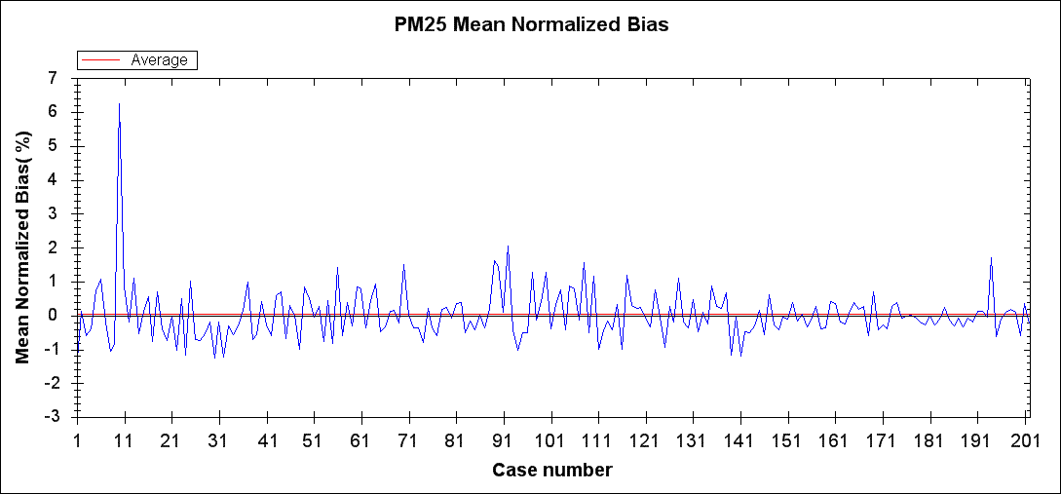
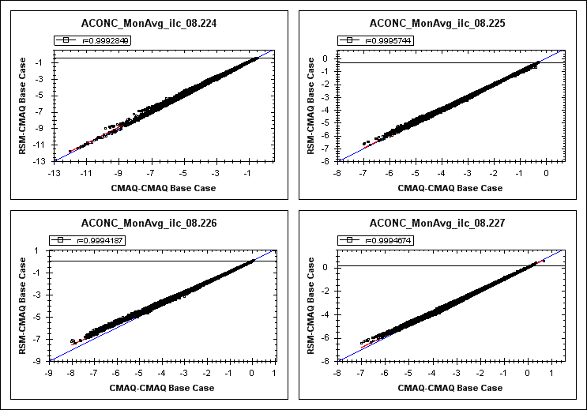
RSM Validation
“Leave-one-out” Cross Validation
  for each RSM iteration, one of the model runs was left out, the RSM is then computed and used to predict the omitted CMAQ run (e.g., under the EGU RSM effort, 202 “RSM vs. CMAQ” cross-validation are conducted)
Out-of-sample Validation
  Additional CMAQ runs are conducted (not part of the experimental design and were not used in developing RSM). RSM predictions for these out-of-sample model runs are then compared with the CMAQ predictions.
Cross Validation
Out-of-Sample Validation

Slide 14
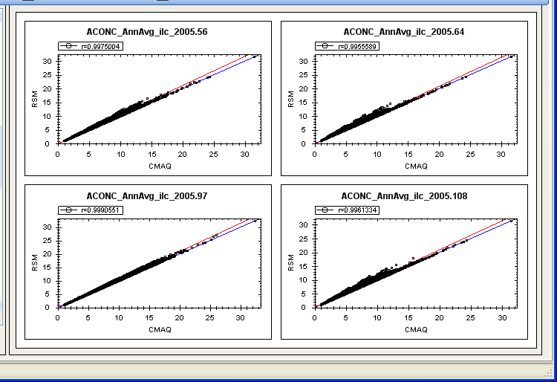
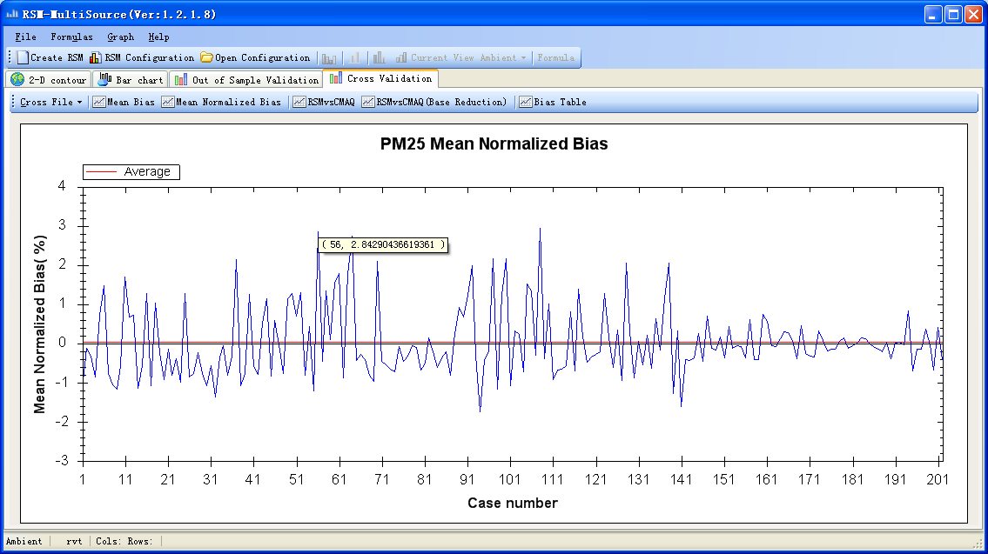
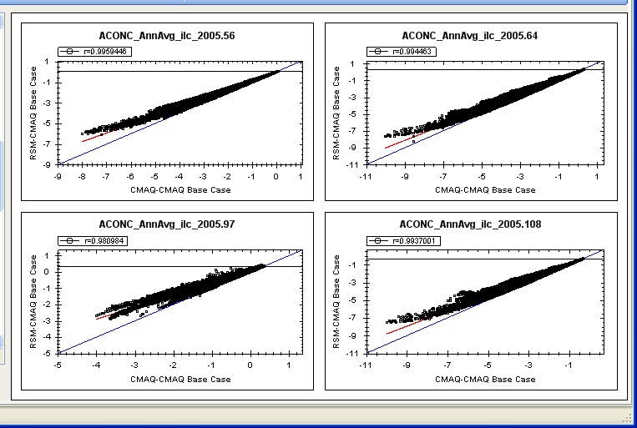
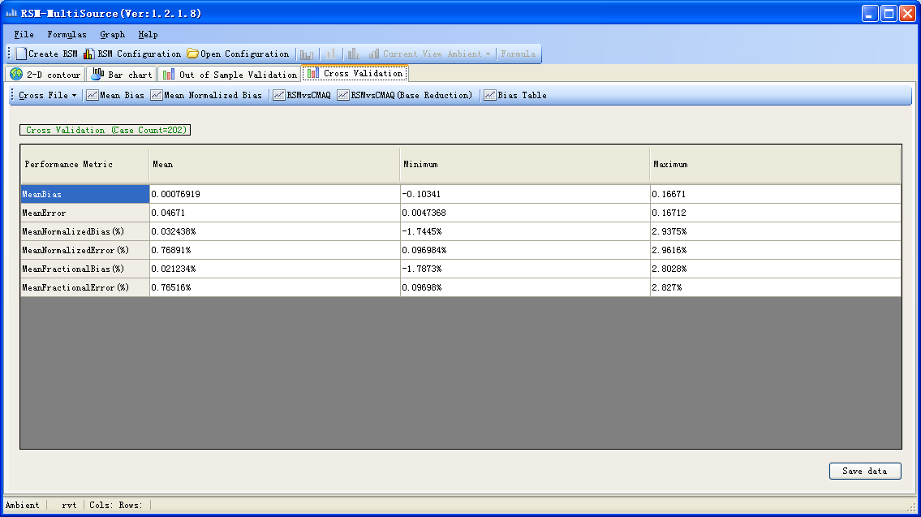
RSM vs. CMAQ (Cross Validation): Annual
PM2.5 Conc.
Selected Runs with High Bias: 56,67,94,108
RSM
Cross Validation
(202 runs)
CMAQ
PM2.5 Response (ΔPM2.5)
ΔRSM
ΔCMAQ
Notes:
14

Slide 15
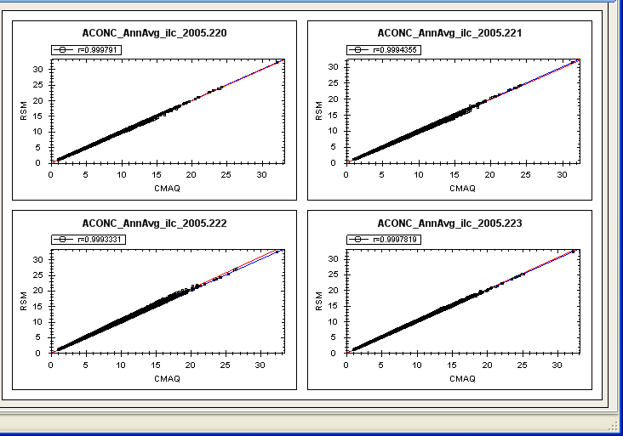
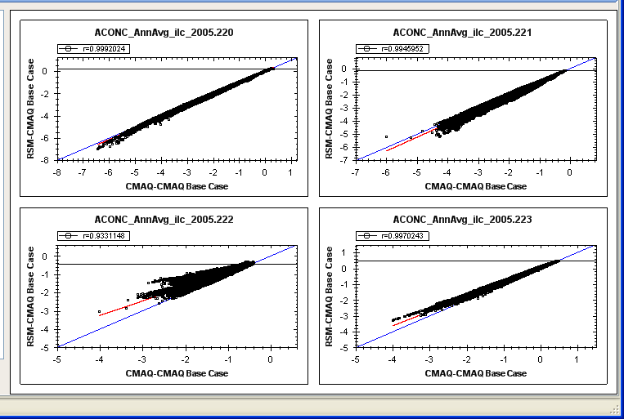
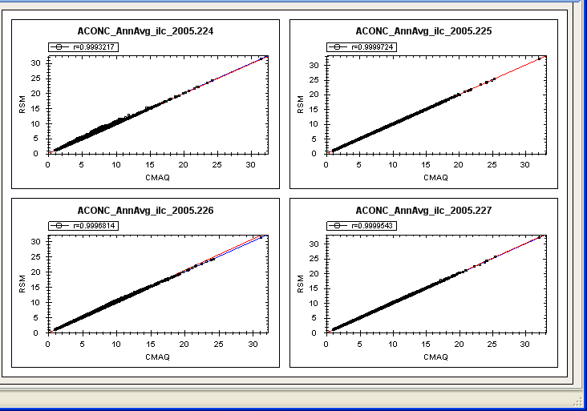
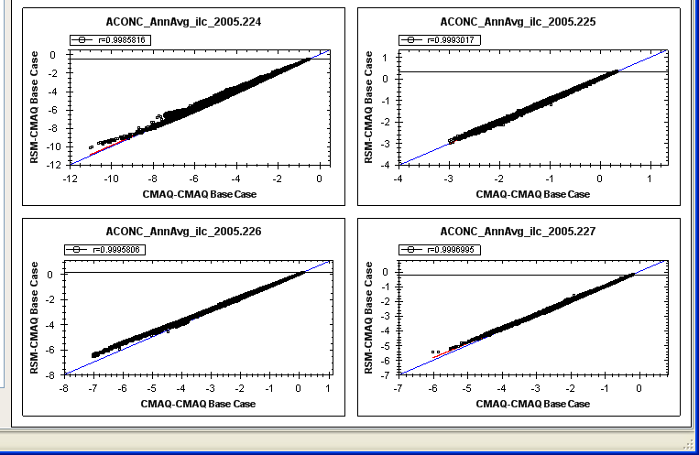
RSM vs. CMAQ (“Out-of-sample” Validation): Annual
PM2.5 Conc.
PM2.5 Response (ΔPM2.5)
RSM
ΔRSM
CMAQ
(Run #220 - #223)
ΔCMAQ
RSM
ΔRSM
CMAQ
(Run #224 - #227)
ΔCMAQ
Notes:
15

Slide 16
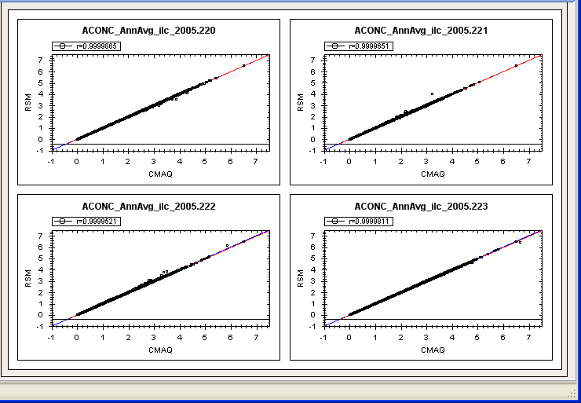
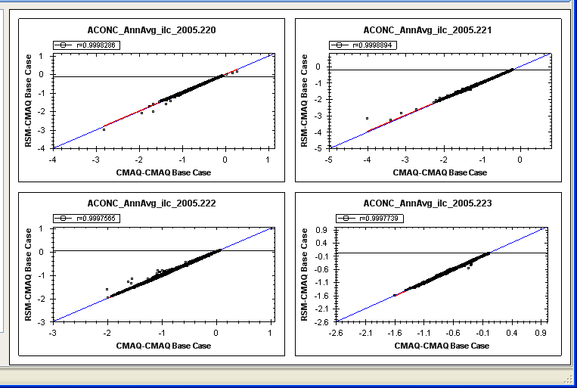
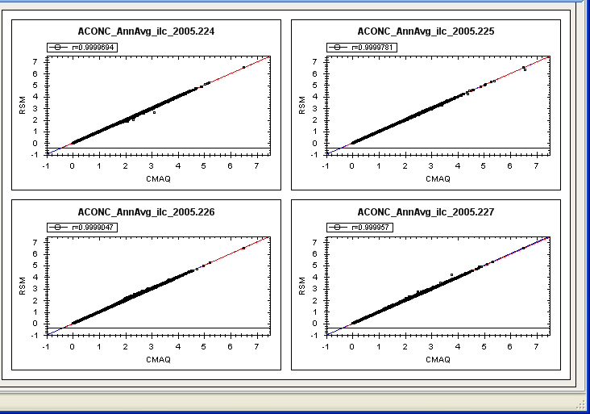
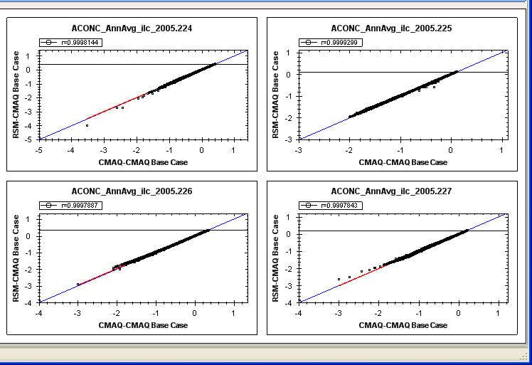
RSM vs. CMAQ (“Out-of-sample” Validation): Annual
PM-SO4 Conc.
PM-SO4 Response (ΔSO4)
RSM
ΔRSM
CMAQ
(Run #220 - #223)
ΔCMAQ
RSM
ΔRSM
CMAQ
(Run #224 - #227)
ΔCMAQ
Notes:
16

Slide 17
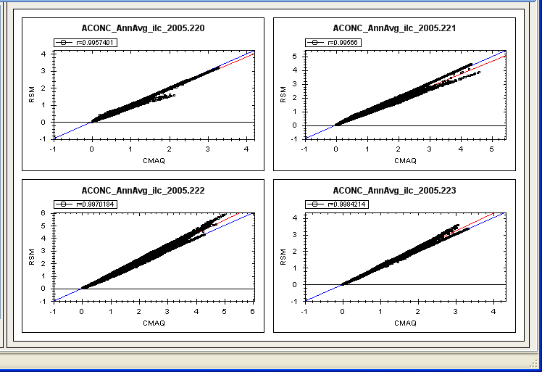
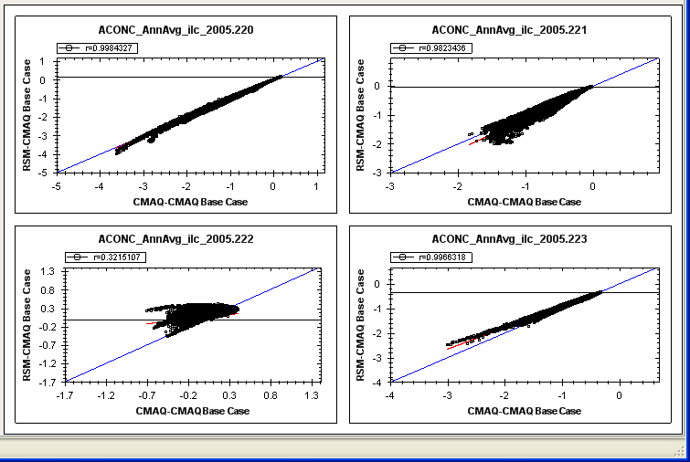
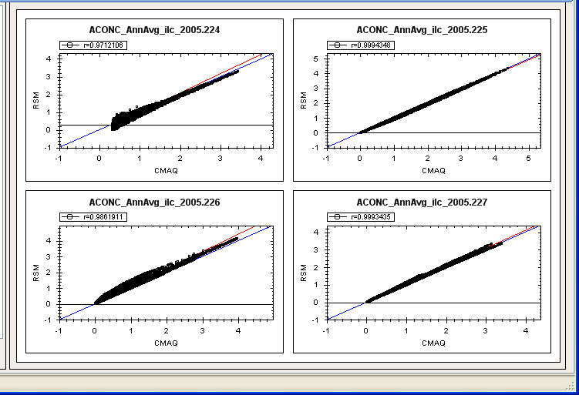
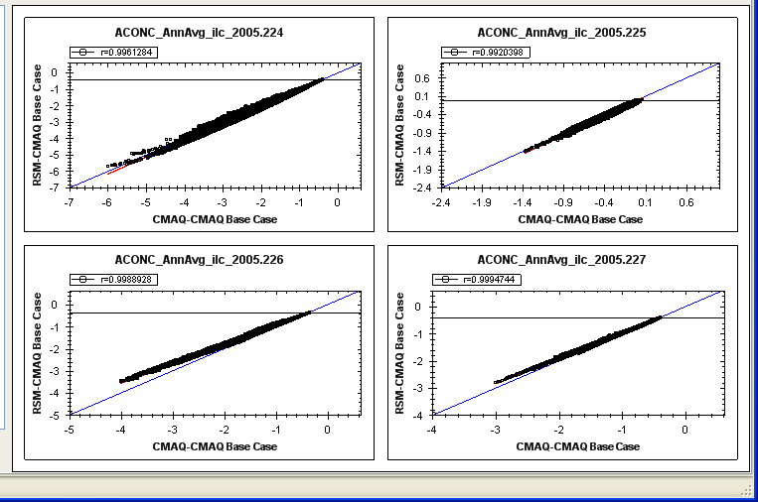
RSM vs. CMAQ (“Out-of-sample” Validation): Annual
PM-NO3 Conc.
PM-NO3 Response (ΔNO3)
RSM
ΔRSM
CMAQ
(Run #220 - #223)
ΔCMAQ
RSM
ΔRSM
CMAQ
(Run #224 - #227)
ΔCMAQ
Notes:
17

Slide 18
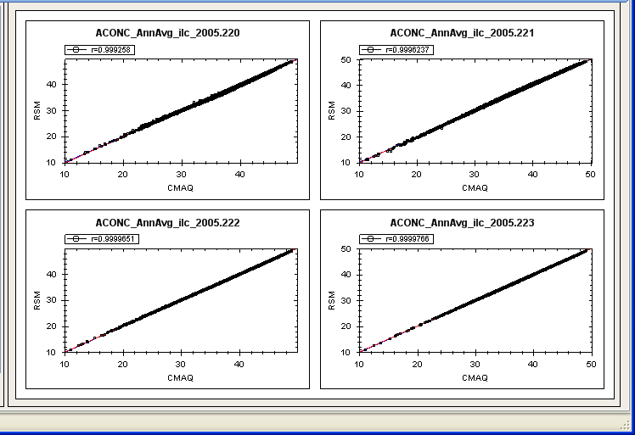
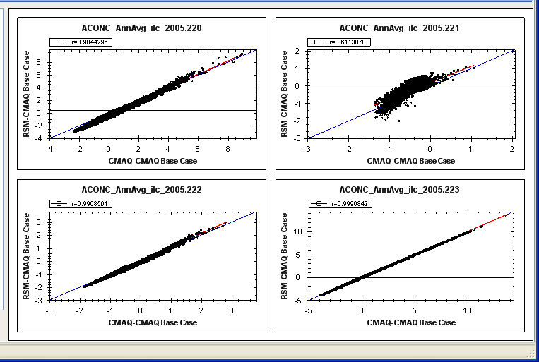
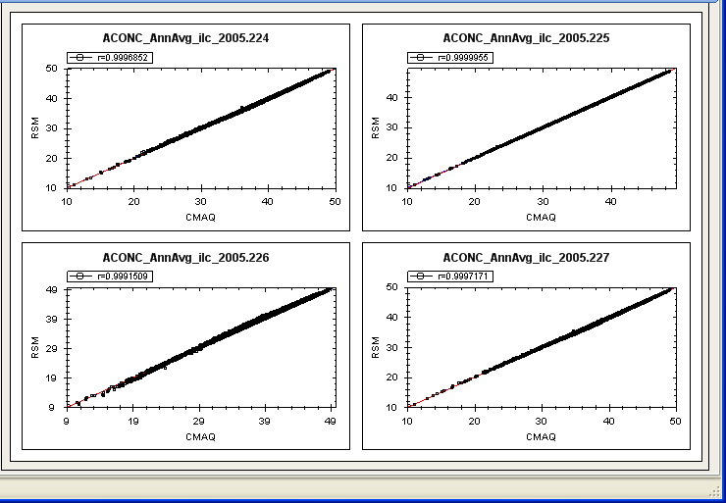
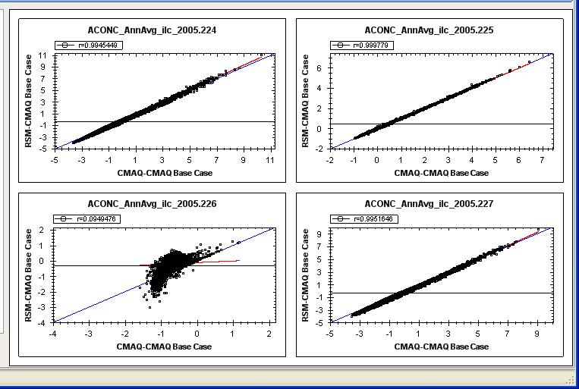
RSM vs. CMAQ (“Out-of-sample” Validation): Annual
Ozone Conc.
Ozone Response (ΔO3)
RSM
ΔRSM
CMAQ
(Run #220 - #223)
ΔCMAQ
RSM
ΔRSM
CMAQ
(Run #224 - #227)
ΔCMAQ
Notes:
18

Slide 19
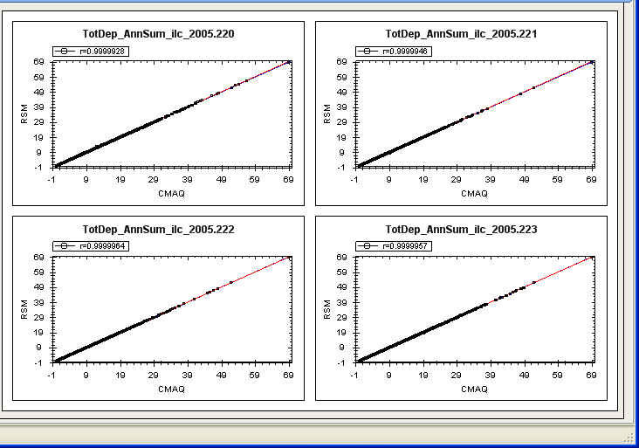
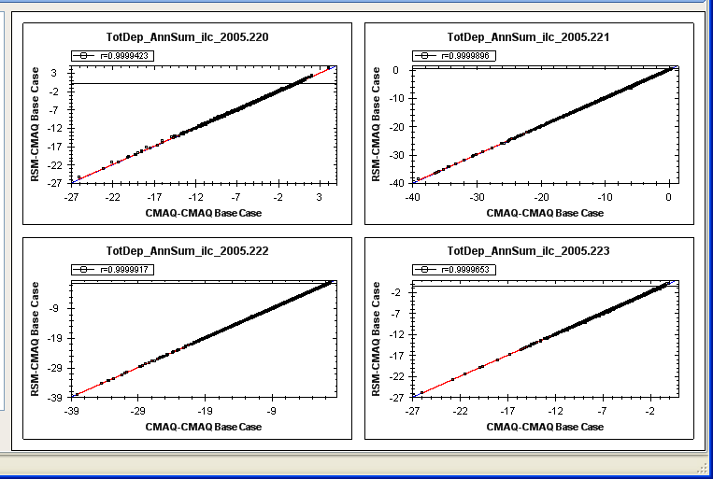

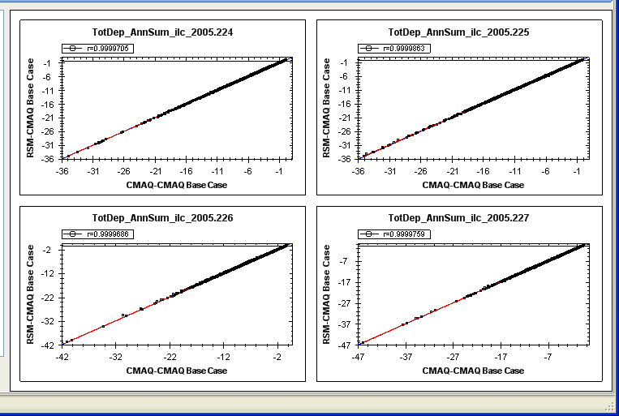
RSM vs. CMAQ (“Out-of-sample” Validation): Annual
Total Sulfur Deposition
Δ Total Sulfur Deposition
RSM
ΔRSM
CMAQ
(Run #220 - #223)
ΔCMAQ
RSM
ΔRSM
CMAQ
(Run #224 - #227)
ΔCMAQ
Notes:
19

Slide 20
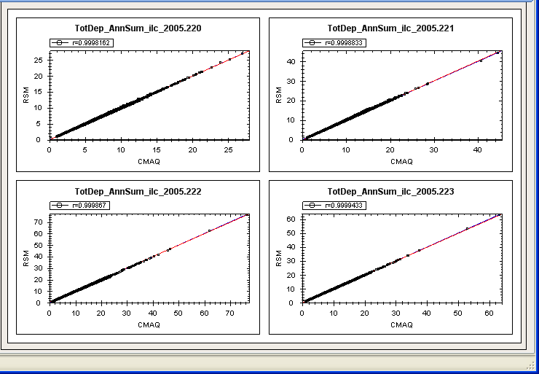
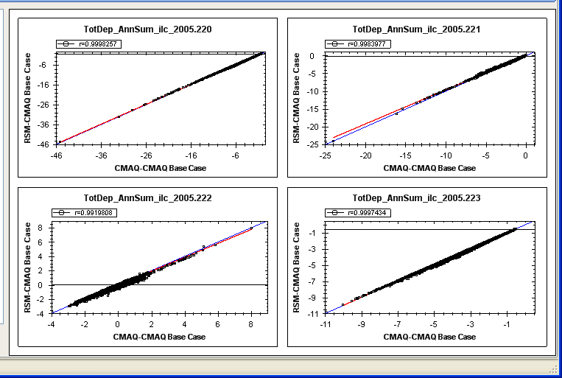
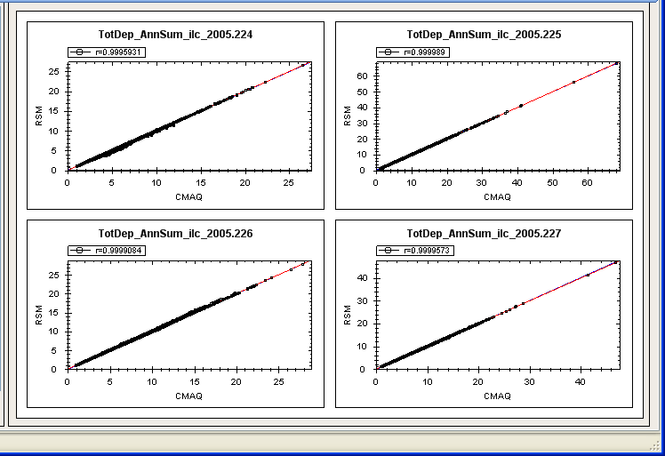
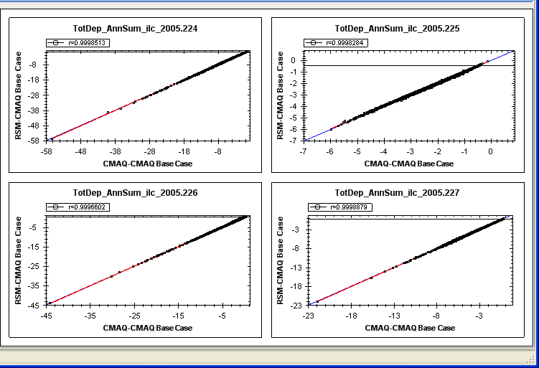
RSM vs. CMAQ (“Out-of-sample” Validation): Annual
Total Nitrogen Deposition
Δ Total Nitrogen Deposition
RSM
ΔRSM
CMAQ
(Run #220 - #223)
ΔCMAQ
RSM
ΔRSM
CMAQ
(Run #224 - #227)
ΔCMAQ
Notes:
20

Slide 21
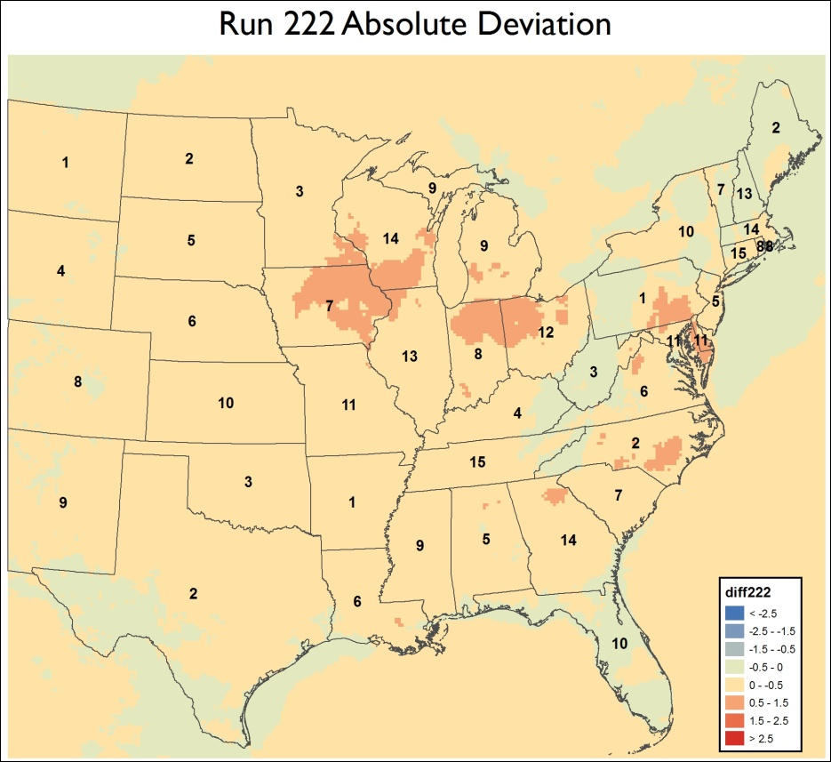
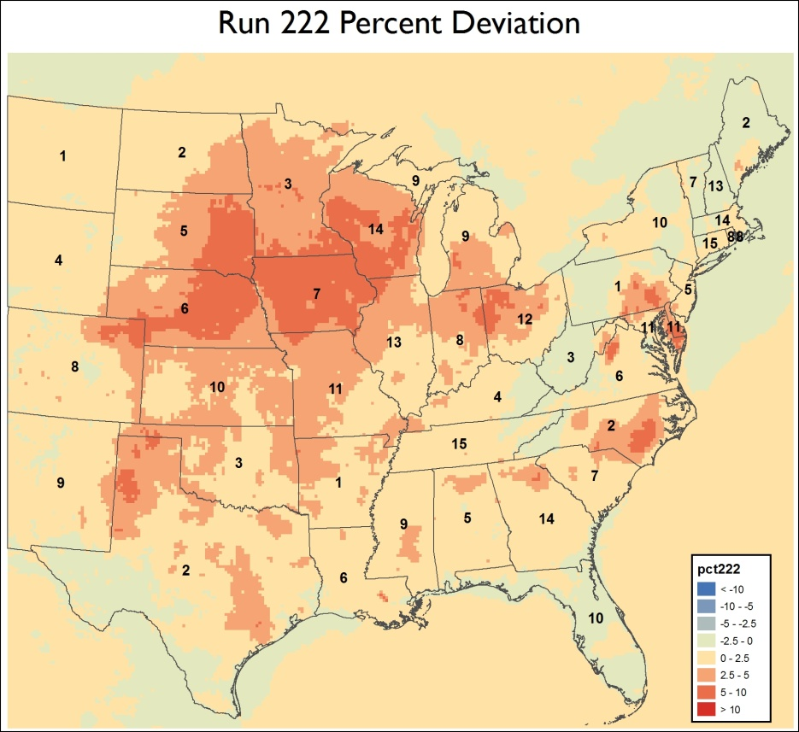
EGU RSM: Spatial Plots of RSM vs. CMAQ
Example of “Out-of-Sample” Validation (Run #222)
Δ PM (CMAQ – RSM)
Δ PM (%)
Differences possibly due to non-linearity over regions with high NH₃ and NOx

Slide 22
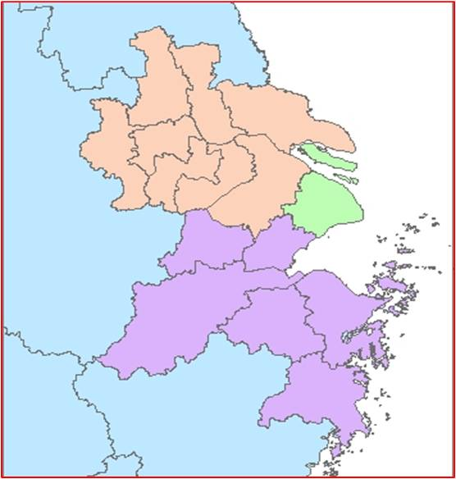
Ongoing RSM Modeling: China/ YRD
Objectives:
  Provide real-time air quality response to emissions control in YRD
  Develop cost-effective air pollution control strategies (cost/benefit optimization)
  Assess the source/receptor relationships among key economic areas in YRD (e.g., Shanghai, Zhejiang, Jiangsu, etc.)
YRD RSM/CMAQ Domain
YRD RSM/CMAQ
C
A
D
160
B
136

Slide 23
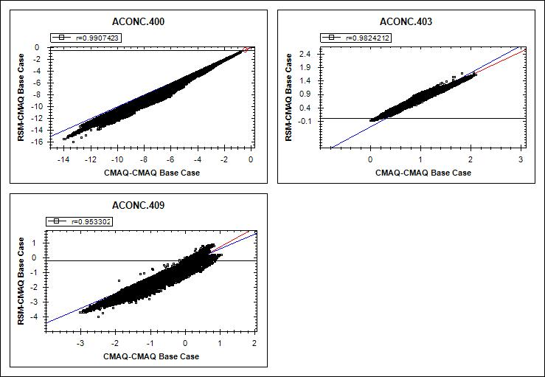
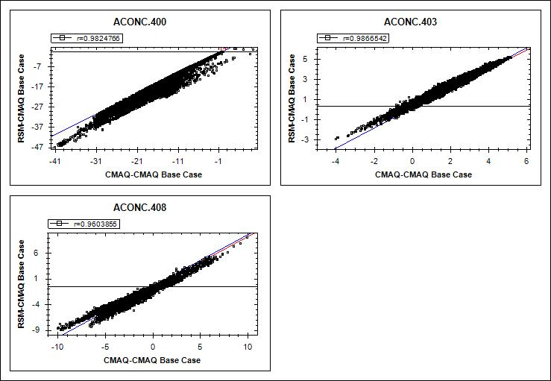
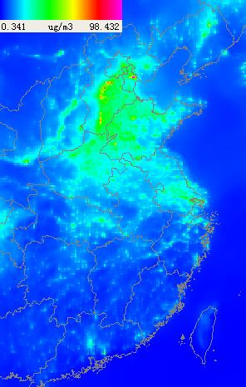

RSM vs. CMAQ (China “Out-of-Sample” Validation)
High control
Low control
Medium case
μg/m³
PM2.5
Response
ppb
O3
Response
CMAQ
China RSM
All regional factors:
50% reduction
All local factors:
50% reduction
RSM

Slide 24

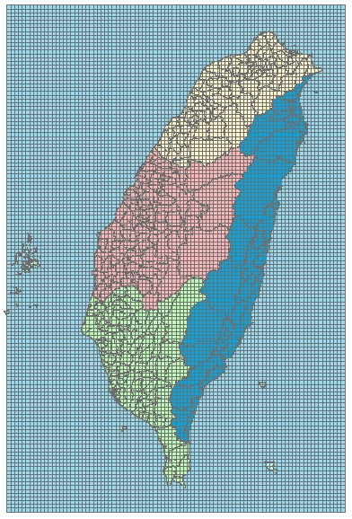
Ongoing Taiwan RSM: Experimental Design
Regions of Interests:
  4 key regions
Policy Factors (emissions Control):
  NOx-PP; NOx-Industry; NOx-Mobile;
  SO₂-PP ; SO₂-Industry ; VOC-Mobile;
  VOC-area, NH₃-area; regional transport
  (Total 33 factors)
Model Configuration:
  Modeling Domain: 3×3km, 135×90 grid cells, 24 layers
  Model Year: 2007
  Model Periods: Jan. Apr. Jul. Oct.
  Models Used: CMAQ 4.7.1/MM5
CMAQ runs for “Creating RSM”:
  Conduct 215 CMAQ model runs to develop RSM result
Taiwan RSM Domain
North
A
East
D
B
Central
C
South
CMAS Poster: Xinyi Dong - Assessment of inorganic fine particulate matter response to ammonia emissions over Taiwan using response surface modeling method

Slide 25
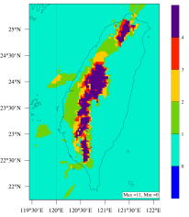
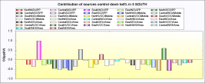
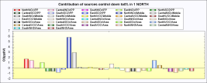
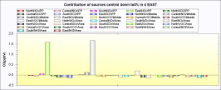
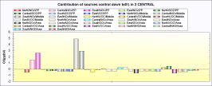

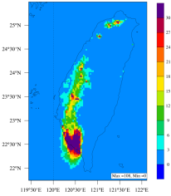
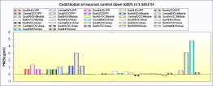














Assessment of Air Quality Response to Anthropogenic Emission Changes over Taiwan Using Response Surface Modeling Method
Xinyi Dong¹, Joshua S. Fu¹*, Carey Jang², and Hsin-Chih Lai³ , and Ciao-Kai Liang⁴
^{1.}Department of Civil and Environmental Engineering, University of Tennessee, Knoxville ^{2.}Office of Air Quality Planning and Standards, US EPA, Research Triangle Park, NC
^{3.}Environmental Research and Information Center, Chang Jung Christian University, Taipei, Taiwan ^{4.}Department of Air Pollution Control, Taiwan EPA, Taipei, Taiwan
*To whom correspondence should be addressed. E-mail: jsfu@utk.edu.
Introduction
Air quality is usually strong correlated with local anthropogenic emissions. While extensive efforts have been made to address the emission impacts on air pollution over United States, Europe, and other regions, very limited studies have been conducted with modeling method over Taiwan. In this research, the response of air quality response in terms of ozone (O₃) and particulate matter with aerodynamic diameter less than or equal to 2.5 μm (PM_{2.5}) to anthropogenic emission changes over Taiwan is studied using the MM5/CMAQ modeling system with Response Surface Model (RSM). RSM is capable of providing real-time estimation of the air quality impacts associated with emission reductions from different sectors as well as regions. It has been successfully applied in China to address the local emission impacts on inorganic aerosols (Wang et al., 2011).
In this study, the horizontal resolution of the modeling system is 3x3 km. In order to reveal the seasonal variations of air pollutants response to anthropogenic emissions, January, April, July, and October in 2007 are selected as the simulation periods, with each month represent one season.
Overlay Plots of CMAQ Model Evaluation for PM_{2.5} at TAQMN Sites
Source Contribution and Air Pollutants Response
We use 75 ppbv as the standard for daily maximum 8-hour ozone (MDA8-O₃) and 35 μm/cm³ as the standard for daily average PM_{2.5} to analyze the local air quality based on 4 month simulation results. Following plots show the total number of days exceeding the standards within the 4 months simulation period and the source contribution from each region, and also the source contributions from each sub-area and emission sectors.
Number of days exceeding the
75 ppbv MDA8-O₃ standard
O₃ Source Contribution
South-Taiwan as receptor region
North-Taiwan as receptor region
RSM Simulation Design
East-Taiwan as receptor region
Central-Taiwan as receptor region
In order to address the ambient O₃ and PM_{2.5} contributions from different emission sources and also from different sub-areas in Taiwan, totally 28 emission control variables from 3 major anthropogenic sectors and 4 sub-regions are defined to conduct 200 sampling simulations for each month with control factors generated based on Latin-hypercube method.
Base Case MM5/CMAQ Simulation
Base case simulation results are evaluated against surface observations published by Taiwan EPA* . The MM5/CMAQ modeling system is demonstrated to be capable of reproducing air quality conditions over Taiwan with an overall good agreement with local observations, as shown in the following plots.
Control Variables and Simulation Design
Definition of 4 Sub-regions in Taiwan
Number of days exceeding the
35 μm/cm³ PM_{2.5} standard
PM_{2.5} Source Contribution
Control variables design:
-NO_{x} and SO₂ emission from power plants in each sub-region
-NO_{x} and SO₂ emission from industry in each sub-region
-VOC emission from mobile source in each sub-region
-NH₃ emission from industry in each sub-region
RSM scenarios design:
-One base run
-One across-the-board run (all emission factor set to be 0.5)
-140 CMAQ runs to cover all source categories for factor of 0~1.2
-60 CMAQ runs to cover lower bounds of NO_{x} and NH₃ source categories (0~0.5)
North:
Taipei, New Taipei, Taoyuan, Hsichu , Miaoli , Keelung
South-Taiwan as receptor region
North-Taiwan as receptor region
MM5/CMAQ Model Configuration
CMAQ Evaluation: O₃
East:
Ilan, Hualien, Taitung
MM5 V3.7
Horizontal resolution | 27km/9km/3km (one-way nested)
Number of sigma level | 34
Explicit precipitation scheme | Simple ice (Dudhia) scheme
Longwave Radiation | RRTM
Shortwave Radiation | Dudhia scheme
Land-surface | 4-layer soil model (Noah)
Advection | global mass-conserving scheme
PBL scheme | MRF
Cumulus option | 27km and 9km domains : Grell 3km domain : none
CMAQ 4.7.1
Horizontal resolution | 27km/9km/3km
Vertical resolution | 24 sigma-pressure levels (with the top pressure of 100mb)
Projection | Lambert Conformal Conic
Advection | piecewise parabolic scheme
Vertical diffusion | K-theory
Gas-phase chemistry | CB05 with Euler Backward Iterative (EBI) solver
Dry deposition | Wesely
Wet deposition | Henry’s law
Aqueous chemistry | Walcek
Aerosol mechanism | AE5
Central:
Taichung, Zhanghua, Yuanlin , Nantou, Chiayi
East-Taiwan as receptor region
Central-Taiwan as receptor region
South:
Tainan, Kaohsiung, Pingtung
RSM Evaluation
Source contribution analysis indicated the different impacts from 4 sub-areas and different anthropogenic emission sectors: (1). For O₃, the largest contribution over south, north, east, and central Taiwan is 0.9, 5.8, 1.6, 4.9 ppbv respectively, which was from local power plants NOx emission for south Taiwan, and all from local mobile NO_{x} emission for all other regions; (2). For PM_{2.5}, the largest contribution over south, north, east, and central Taiwan is 4.7, 1.4, 1.0, 9.4 μm/cm³, which all come from the local industry NH₃ emission.
While both O₃ and PM_{2.5} showed linear response under the 3 cross-board emission reductions (as shown in the following plots), more detailed analysis is under process to investigate their sectoral emission reduction responses.
Two different validation methods: cross-validation and out-of-sample validation are applied to evaluate the performance of RSM. The good agreement between derived RSM and the real-CMAQ case results demonstrated the high accuracy and stability of the model, which provided the fundamental scientific base for further emission control, source contribution, and air quality response analysis.
CMAQ Evaluation: PM_{2.5}
O₃ cross validation for individual cases
O₃ out-of-sample validation for individual cases
O3 response under 3 emission control scenarios
PM2.5 response under 3 emission control scenarios
PM_{2.5} cross validation for individual cases
PM_{2.5} out-of-sample validation for individual cases
*Taiwan Air Quality Monitoring Network (TAQMN): http://taqm.epa.gov.tw/taqm/en/YearlyDataDownload.aspx
Summary
We have successfully applied MM5/CMAQ modeling system over Taiwan, and develop the response surface curve with RSM. The results showed that both O₃ and PM_{2.5} exceeded the US EPA NAAQS standard, indicating a potential serious pollution problem over Taiwan. Results from source contribution demonstrated that local anthropogenic emission is the major reason for all the 4 sub-areas, while NO_{x} and NH₃ emission from transportation is the largest source for O₃ and PM_{2.5} formation respectively, except that in south Taiwan NO_{x} emission from power plant is the largest source for local O₃.
Overlay Plots of CMAQ Model Evaluation for O₃ at TAQMN Sites
RSM Evaluation Statistics for All Cases
 | PM_{2.5} |  |  |  |  |  | O₃
 | out-of-sample validation |  |  | cross validation |  |  | out-of-sample validation |  |  | cross validation
 | Mean | Min | Max | Mean | Min | Max | Mean | Min | Max | Mean | Min | Max
Mean Bias | -0.01 | -0.03 | 0.011 | 7.69e-5 | -0.0167 | 0.023 | 0.568 | 0.054 | 1.207 | -3.05e-7 | -0.0001 | 4.65e-5
Mean Error | 0.03 | 0.014 | 0.046 | 0.005 | 3.189e-6 | 0.023 | 0.622 | 0.213 | 1.226 | 2.01e-5 | 1.23e-7 | 0.0001
Mean Normalized Bias | -0.113% | -0.563% | 0.383% | 0.003% | -0.597% | 0.862% | 1.046% | 0.077% | 2.409% | -7.83e-7% | -0.0003% | 0.0001%
Mean Normalized Error | 0.696% | 0.309% | 1.112% | 0.213% | 0.0001% | 0.862% | 1.165% | 0.395% | 2.456% | 5.19e-5% | 3.18e-7% | 0.0003%
References
Wang, S.X., Xing, J. Jang, C., Zhu, Y., Fu, J., and Hao, J.M. (2011). Impacts assessment of
ammonia emissions on inorganic aerosols in East China Using Resonse Surface Modeling
technique. ES&T, 45(21), 9293-9300.
Acknowledgements
This research is supported by both Taiwan EPA and US EPA.

Slide 26

RSM-VAT:
Key
Functions
Control Matrix & Data Processing
“Create RSM” & Validation
Visualization & Analysis
Notes:
This is the working process to build and use RSM-VAT. ///It includes experiment design, running CMAQ, ///creating RSM, validation, ///and Visualization and analysis

Slide 27





RSM-VAT: Validation
(“out-of-sample” & “cross” validation)
CMAQ (ΔPM2.5)
RSM (ΔPM2.5)
Notes:
The results of validation and QA show that predicted values of RSM are very close to the actual simulation results of CMAQ.

Slide 28









RSM-VAT: Visualization & Analysis
Notes:
RSM-VAT provides the 2D-map, many kinds of graphs, 3D-MAP and contour line to view and analyze the created RSM relationship.

Slide 29
Air Quality
Benefit
Attainment
Test
RSM/CMAQ
MATS
Control Cost
Estimate
Health & Env.
Benefit
ABaCAS
CoST
BenMAP
Cost-effective Control Strategy Development
Cost/Benefit Analysis & Optimization
Health & Air Quality Benefit Assessment
Air Quality Attainment Assessment

Slide 30

We do not inherit the earth;
We just borrow from our children.
THANK YOU!
Carey Jang
U.S. EPA
Office of Air and Radiation
Jang.carey@epa.gov

Slide 31
Appendix: EGU-RSM Validation Results
Annual and monthly avg. (Feb, May, Aug, Nov) Validation Results
  “Out-of-Sample validation” for:
    PM2.5
    PM Species
    Ozone
    Deposition
  “Cross Validation” for PM2.5

Slide 32
August Case
Validation Results
(“Out-of-sample validation” for
PM2.5, PM species, ozone & dep.;
“Cross-Validation” for PM2.5)

Slide 33




RSM vs. CMAQ (“Out-of-sample” Validation): August
PM2.5 Conc.
PM2.5 Response (ΔPM2.5)
RSM
ΔRSM
CMAQ
(Run #220 - #223)
ΔCMAQ
RSM
ΔRSM
CMAQ
(Run #224 - #227)
ΔCMAQ
Notes:
33

Slide 34




RSM vs. CMAQ (“Out-of-sample” Validation): August
PM_SO4 Conc.
PM_SO4 Response (ΔPM_SO4)
RSM
ΔRSM
CMAQ
(Run #220 - #223)
ΔCMAQ
RSM
ΔRSM
CMAQ
(Run #224 - #227)
ΔCMAQ
Notes:
34

Slide 35




RSM vs. CMAQ (“Out-of-sample” Validation): August
PM_NO3 Conc.
PM_NO3 Response (ΔPM_NO3)
RSM
ΔRSM
CMAQ
(Run #220 - #223)
ΔCMAQ
RSM
ΔRSM
CMAQ
(Run #224 - #227)
ΔCMAQ
Notes:
35

Slide 36




RSM vs. CMAQ (“Out-of-sample” Validation): August
PM_OC Conc.
PM_OC Response (ΔPM_OC)
RSM
ΔRSM
CMAQ
(Run #220 - #223)
ΔCMAQ
RSM
ΔRSM
CMAQ
(Run #224 - #227)
ΔCMAQ
Notes:
36

Slide 37




RSM vs. CMAQ (“Out-of-sample” Validation): August
O3 Conc. (monthly avg.)
O3 Response (ΔO3)
RSM
ΔRSM
CMAQ
(Run #220 - #223)
ΔCMAQ
RSM
ΔRSM
CMAQ
(Run #224 - #227)
ΔCMAQ
Notes:
37

Slide 38




RSM vs. CMAQ (“Out-of-sample” Validation): August
O3 Conc. (8HR-MDA)
O3 Response (ΔO3)
RSM
ΔRSM
CMAQ
(Run #220 - #223)
ΔCMAQ
RSM
ΔRSM
CMAQ
(Run #224 - #227)
ΔCMAQ
Notes:
38

Slide 39




RSM vs. CMAQ (“Out-of-sample” Validation): August
Total_Dep_S
ΔTotal_Dep_S
RSM
ΔRSM
CMAQ
(Run #220 - #223)
ΔCMAQ
RSM
ΔRSM
CMAQ
(Run #224 - #227)
ΔCMAQ
Notes:
39

Slide 40




RSM vs. CMAQ (“Out-of-sample” Validation): August
Total_Dep_N
ΔTotal_Dep_N
RSM
ΔRSM
CMAQ
(Run #220 - #223)
ΔCMAQ
RSM
ΔRSM
CMAQ
(Run #224 - #227)
ΔCMAQ
Notes:
40

Slide 41




RSM vs. CMAQ (Cross Validation): August
PM2.5 Conc.
Selected Runs with High Bias: 56,64,92,108
RSM
Cross Validation
(202 runs)
CMAQ
PM2.5 Response (ΔPM2.5)
ΔRSM
ΔCMAQ
Notes:
41

Slide 42
February Case
Validation Results
(“Out-of-sample validation” for
PM2.5, PM species, ozone & dep.;
“Cross-Validation” for PM2.5)

Slide 43




RSM vs. CMAQ (“Out-of-sample” Validation): February
PM2.5 Conc.
PM2.5 Response (ΔPM2.5)
RSM
ΔRSM
CMAQ
(Run #220 - #223)
ΔCMAQ
RSM
ΔRSM
CMAQ
(Run #224 - #227)
ΔCMAQ
Notes:
43

Slide 44




RSM vs. CMAQ (“Out-of-sample” Validation): February
PM_SO4 Conc.
PM_SO4 Response (ΔPM_SO4)
RSM
ΔRSM
CMAQ
(Run #220 - #223)
ΔCMAQ
RSM
ΔRSM
CMAQ
(Run #224 - #227)
ΔCMAQ
Notes:
44

Slide 45




RSM vs. CMAQ (“Out-of-sample” Validation): February
PM_NO3 Conc.
PM_NO3 Response (ΔPM_NO3)
RSM
ΔRSM
CMAQ
(Run #220 - #223)
ΔCMAQ
RSM
ΔRSM
CMAQ
(Run #224 - #227)
ΔCMAQ
Notes:
45

Slide 46




RSM vs. CMAQ (“Out-of-sample” Validation): February
Total_Dep_S
ΔTotal_Dep_S
RSM
ΔRSM
CMAQ
(Run #220 - #223)
ΔCMAQ
RSM
ΔRSM
CMAQ
(Run #224 - #227)
ΔCMAQ
Notes:
46

Slide 47




RSM vs. CMAQ (“Out-of-sample” Validation): February
Total_Dep_N
ΔTotal_Dep_N
RSM
ΔRSM
CMAQ
(Run #220 - #223)
ΔCMAQ
RSM
ΔRSM
CMAQ
(Run #224 - #227)
ΔCMAQ
Notes:
47

Slide 48




RSM vs. CMAQ (Cross Validation): February
PM2.5 Conc.
Selected Runs with High Bias: 37,56,97,130
RSM
Cross Validation
(202 runs)
CMAQ
PM2.5 Response (ΔPM2.5)
ΔRSM
ΔCMAQ
Notes:
48

Slide 49


RSM vs. CMAQ (Cross Validation)
Predicted PM2.5 Conc.
Cross Validation
(202 runs)
RSM
Predicted PM2.5 Response
(ΔPM2.5)
CMAQ
EGU RSM (August Case):
Cross Validation
(Randomly Selected Runs)
RSM
CMAQ
Notes:
49

Slide 50



RSM vs. CMAQ (“Out-of-sample” Validation)
Predicted PM2.5 Conc.
Out-of-Sample Validation
(10 runs)
RSM
Predicted PM2.5 Response
(ΔPM2.5)
CMAQ
EGU RSM (August Case):
Out-of-Sample Validation
(Run #226 - #229)
RSM
CMAQ
Notes:
50

Slide 51
Design Value RSM
Can be used to identify contributions of state groups to design values.
This example identifies the impact of a 30% cut in each factor separately on a monitor design value.

Slide 52


Slide 53


Slide 54


RSM Control Matrix Generator
Notes:
“Control Matrix” will create “control matrix” and “add-on matrix” for different experiment design purpose.

Slide 55

“Create RSM” (Build Predictive RSM)
Notes:
RSM-VAT can create/build RSM surface more reasonable than previous VPA

Slide 56
















“RSM-VAT”: Visualization & Analysis Tool
RSM-VAT Package
Available upon
Request
(PI: Prof. ZHU Yun, South China Univ. of Technology)

Slide 57
What Can ABaCAS Do?
ABaCAS will provide an integrated framework to link cost and benefit assessment effectively
  Provide efficient (or real-time) calculations of AQ or health benefit/ton (emissions), benefit/cost analysis & optimization, etc., under various control strategies/scenarios
ABaCAS will provide a user-friendly and open-source environment
  User-friendly for common users with easy-to-use visualization & analysis functions
  Open-source software for advanced users/developers
  (Leveraged from current RSM-VAT & BenMAP Next-Generation development efforts)

Slide 58




RSM Validation – Out-of-Sample
Example: O₃
Predicted O₃ Conc.
Out-of-Sample Validation (20 runs)
RSM
Predicted O₃ Response (ΔO₃)
CMAQ
Statistics
RSM
CMAQ
PI: Joshua Fu, Univ. of TN,

