Slide 1
Space-Time Analysis of AQMEII Phase 1 Air Quality Simulations
C. Hogrefe¹, S. Roselle¹, R. Mathur¹, S.T. Rao¹, and S. Galmarini²
¹Atmospheric Modeling and Analysis Division, NERL, U.S. EPA
²European Commission Joint Research Center, Ispra
Other contributors to AQMEII Phase 1:
K. Alapaty, W. Appel, J. v. Aardenne, A. Baklanov, M. Beekmann, B. Bessagnet, R. Bianconi, J. Brandt, D. Brunner, J. Christensen, C. Chemel, I. Coll, A. Colette, B. Denby, B. Eder, H. v. d. Gon, J. Ferreira, J. Flemming, G. Foley, R. Forkel, X. Francis, B. Geyer, R. Gilliam, G. Grell, P. Grossi, S. Hanna, A. Hansen, R.-M. Hu, A. Jericevic, A. Kaduwela, G. Kallos, T. Keating, L. Kraljevic, P. Makar, V. Matthias, F. Meleux, A. Miranda, M. Moran, U. Nopmongcol, T. Pierce, G. Pirovano, J. Pleim, G. Pouliot, M. Prank, A. Riccio, N. Savage, K. Sartelet, M. Schaap, K. Schere, H. Schluenzen, M. Schulz, A. Segers, J. Silver, R. Sokhi, E. Solazzo, D. Steyn, W. Stockwell, R. Vautard, J. Vira, J. Werhahn, R. Wolke, G. Yarwood, J. Zhang
CMAS Conference, October 16, 2012

Slide 2
Motivation
Utilize the rich dataset generated during AQMEII Phase 1 to explore the following questions:
  How can we use space/time information extracted from observations to stratify operational model performance analysis?
  How well do current-generation regional-scale models capture observed space/time features?

Slide 3
Dataset
AQMEII Phase 1 model simulations and observations:
  Annual regional air quality simulations over North America (NA) and Europe (EU) for 2006
    8 model simulations over NA
    11 model simulations over EU
  Observations: collected from surface monitoring networks in both continents and matched to model simulations within the ENSEMBLE database developed for AQMEII Phase 1
  Focus on May – September daily maximum 8-hr ozone concentrations
For additional information, see articles published in the July 2012 Special Issue of Atmospheric Environment

Slide 4
Temporal Stratification:
Synoptic Typing
Cluster days based on similarities in mean sea level pressure (MSLP) patterns → groups of days within a cluster tend to be influenced by similar meteorological conditions
Method: correlation-based synoptic typing following Kirchhofer (1973) and Yarnal (1993) using daily 18z MSLP fields extracted from NCEP reanalysis for May – September 2006
Analysis was performed for both NA and EU
References:
  Kirchhofer, W., 1973: Classification of European 500 mb patterns, Arbeitsbericht der Schweizerischen Meteorologischen Zentralanstalt Nr. 43, Geneva.
  Yarnal, B., 1993: Synoptic climatology in environmental analysis: a primer, Bellhaven Press, London, UK, 195 pp.

Slide 5
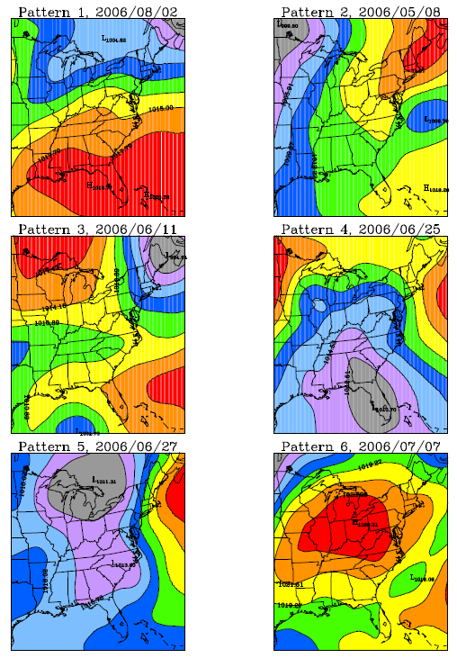
Application over North America
MSLP Pattern 1
MSLP Pattern 2
MSLP Pattern 3
Pattern 1 | 37.9% (58 days)
Pattern 2 | 16.3% (25 days)
Pattern 3 | 18.3% (28 days)
Pattern 4 | 7.8% (12 days)
Pattern 5 | 6.5% (10 days)
Pattern 6 | 3.3% (5 days)
Unassigned | 9.8% (15 days)
MSLP Pattern 4
MSLP Pattern 5
MSLP Pattern 6

Slide 6
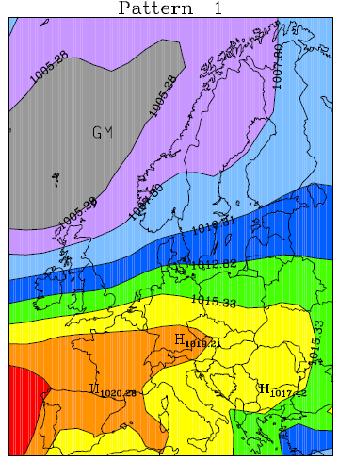
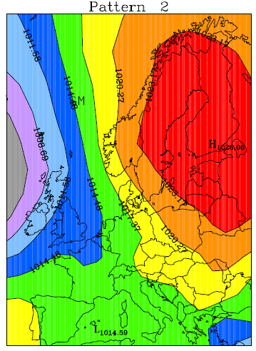
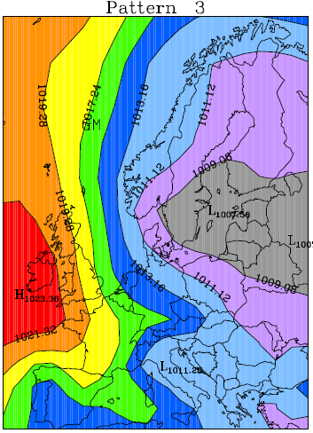
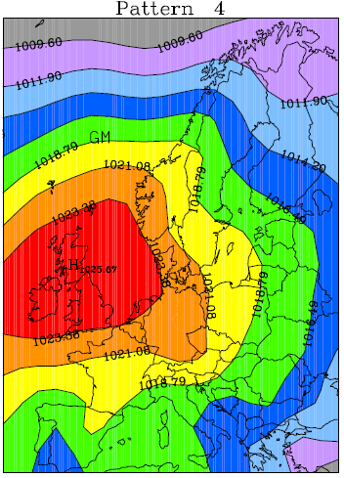
Application over Europe
MSLP Pattern 1
MSLP Pattern 2
MSLP Pattern 3
MSLP Pattern 4
Pattern 1 | 35%
Pattern 2 | 18%
Pattern 3 | 12%
Pattern 4 | 14%
Unassigned | 21%

Slide 7
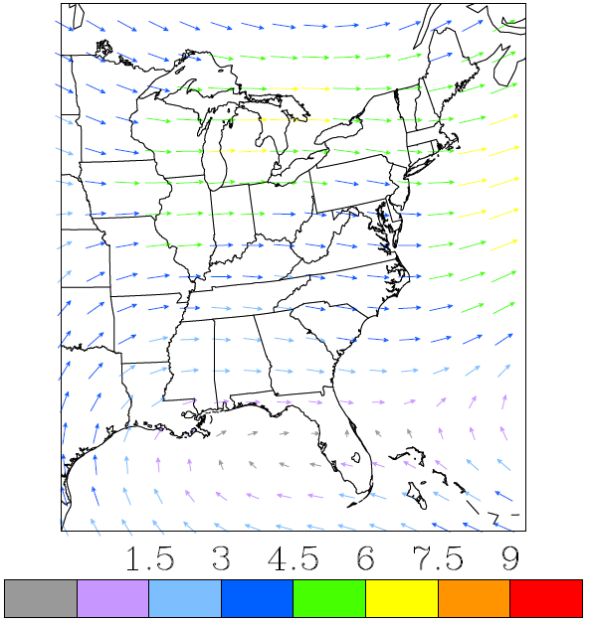
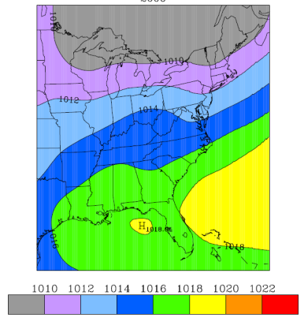
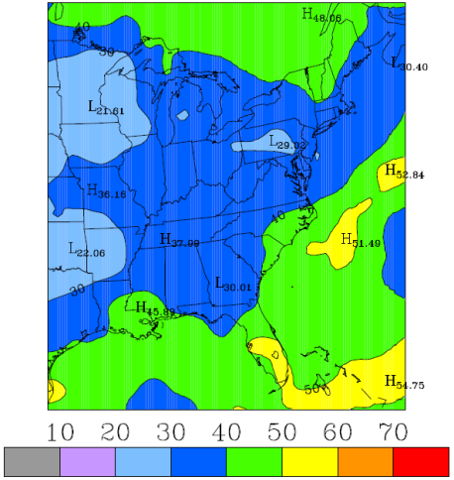
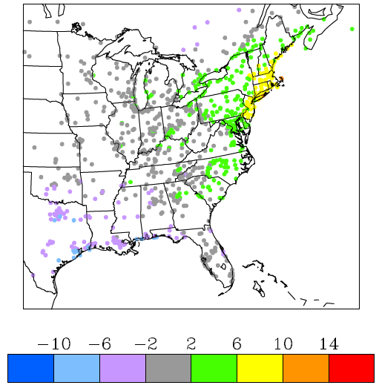
Example: Meteorological and Ozone Features for Pattern 1
Average 850 mb Winds
Average MSLP
Average Cloud Fraction
Observed Anomalies 8-hr DM O₃

Slide 8
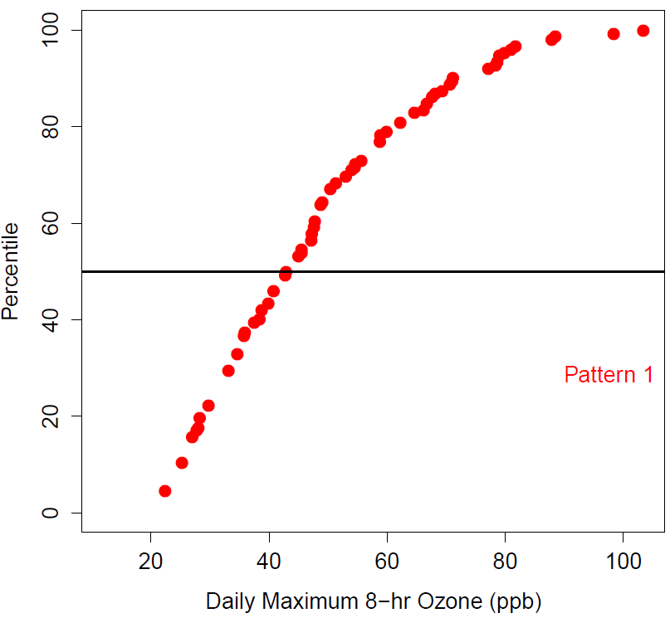
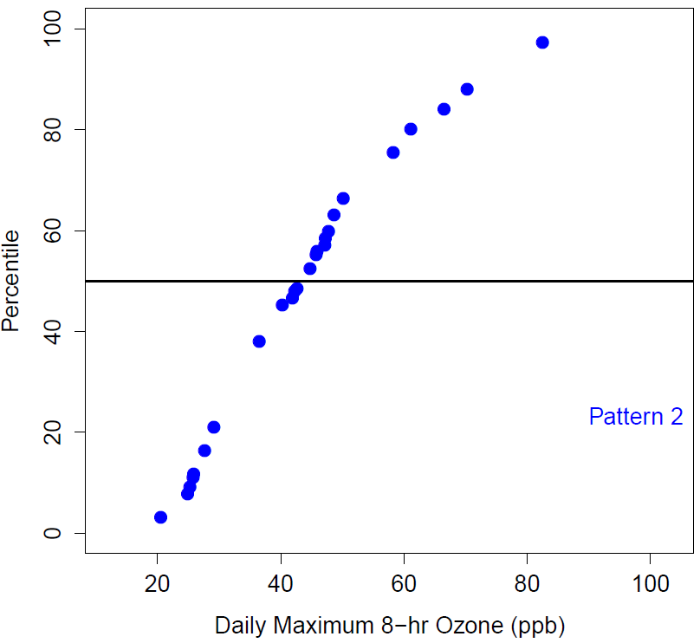
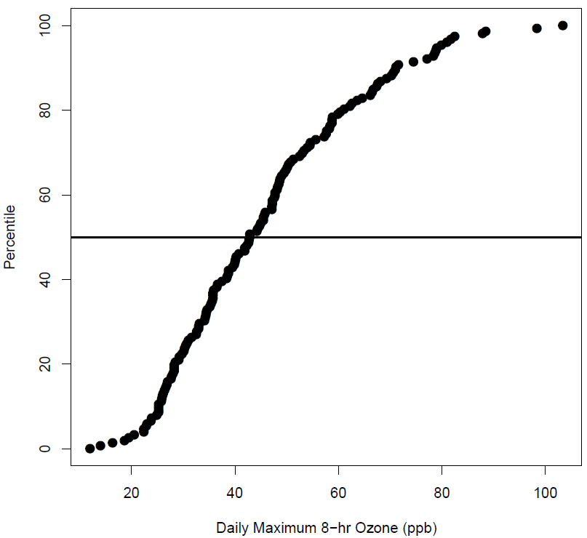
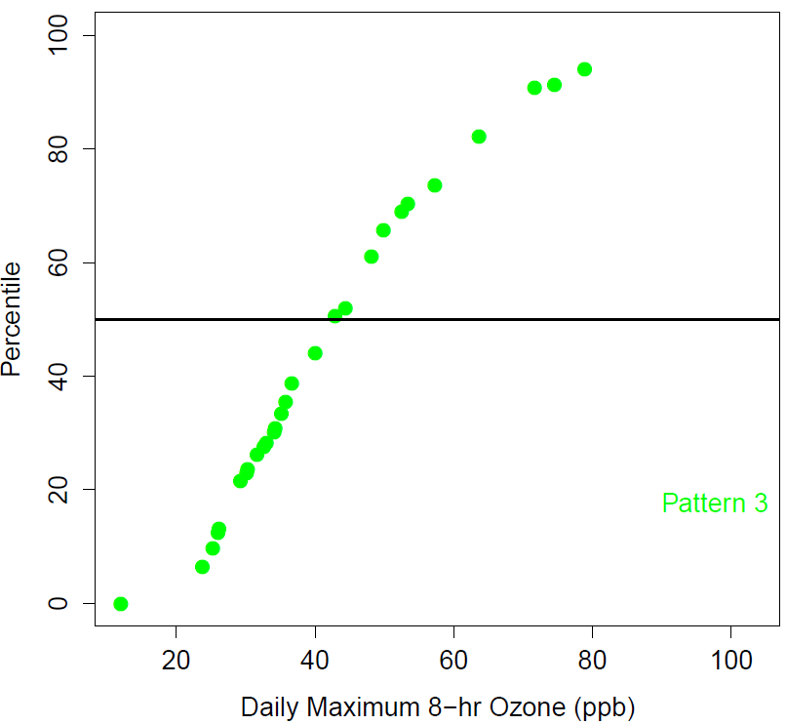
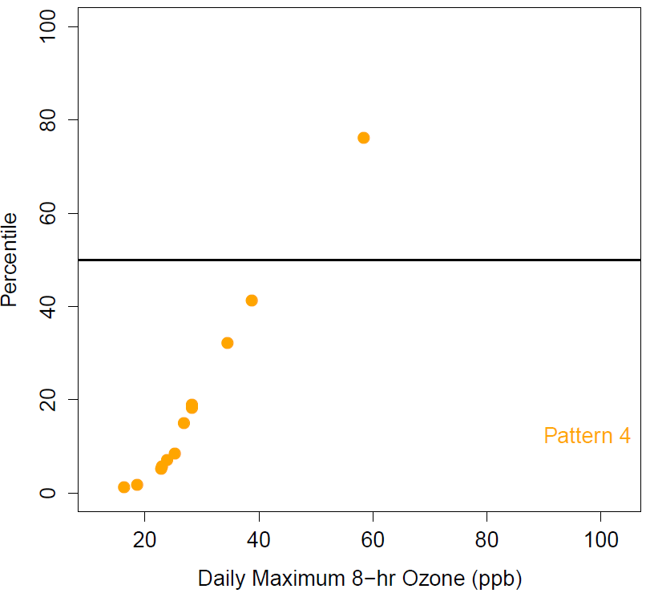
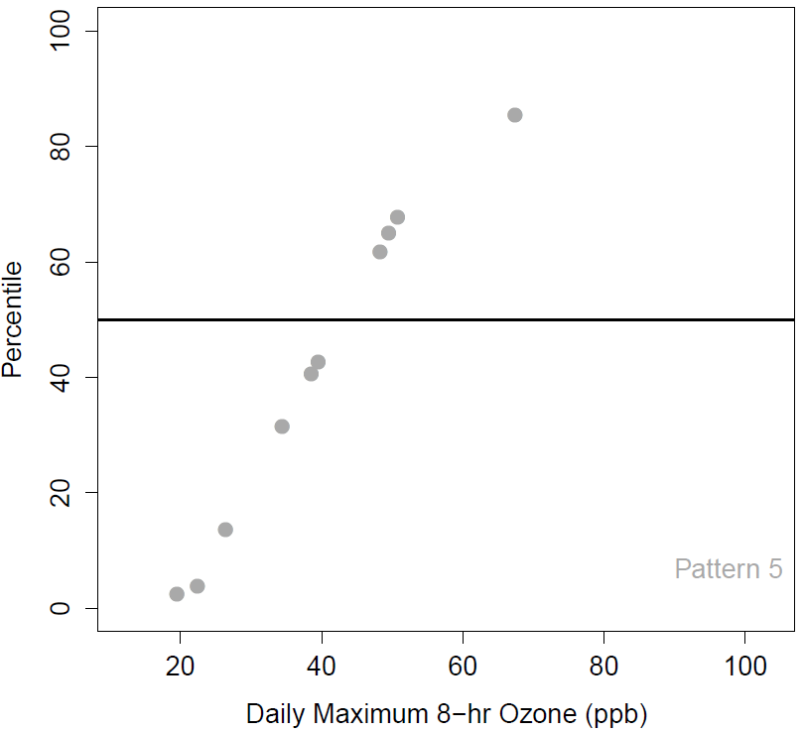
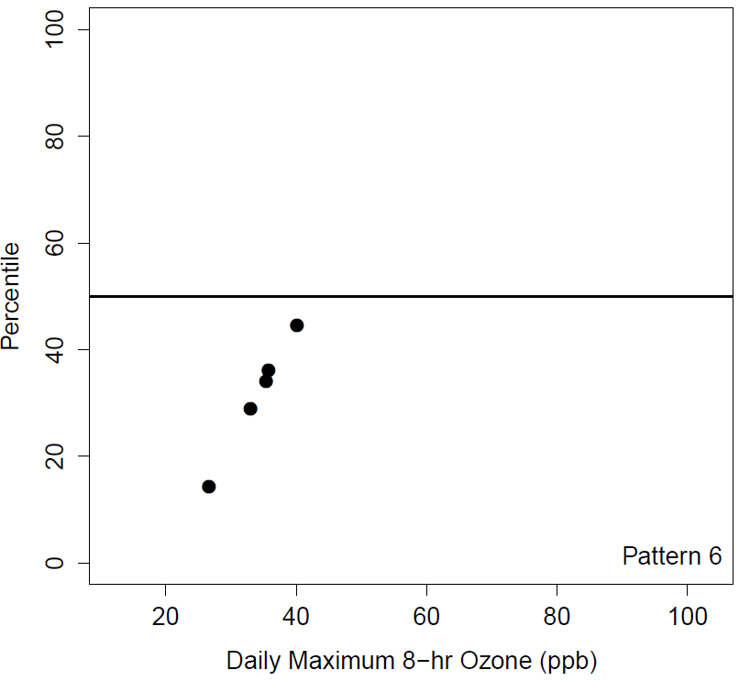
Impact of Synoptic Patterns on Cumulative Distribution Function of Daily Maximum 8-hr Ozone
Example: Danbury, CT, May – September 2006

Slide 9
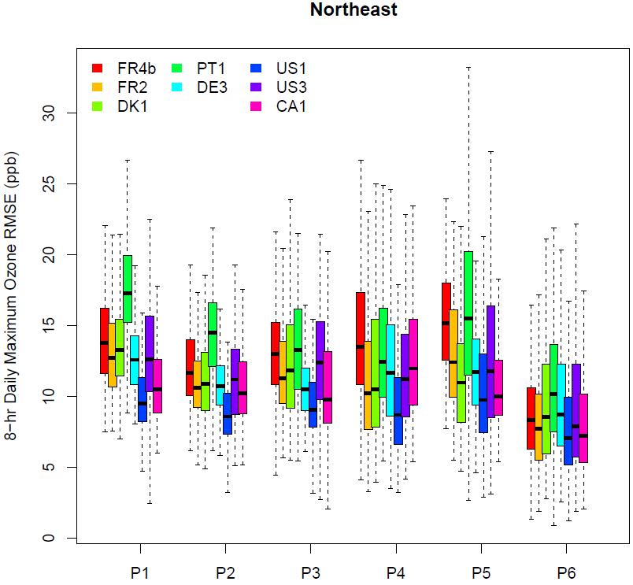
Model RMSE by Synoptic Pattern, 8-hr Daily Maximum O₃, May – September 2006, Northeastern U.S., 8 Models
EU Group
EU Model
EU Group
NA Model
NA Group
NA Model
Model RMSE and model-to-model variability vary by synoptic pattern
All models show the lowest RMSE and lowest model-to-model variability for synoptic pattern six which is characterized by close to average ozone concentrations
Simulations using models with North American heritage and performed by North American groups (US1, US3, CA1) tend to have lower RMSE than other simulations

Slide 10
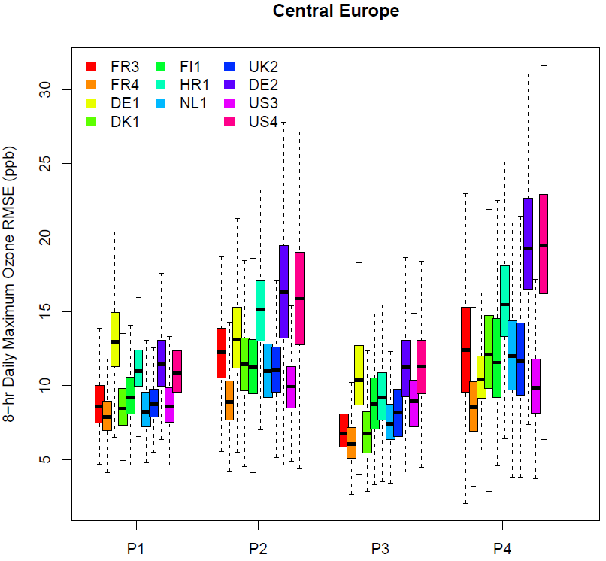
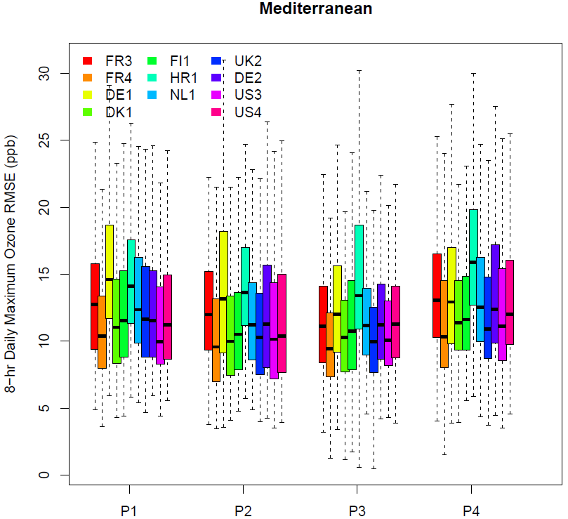
Model RMSE by Synoptic Pattern, 8-hr DM O₃, May – September 2006, Europe, 11 Models
EU Group
EU Model
EU Group
NA Model
NA Group
NA Model
For Central Europe, almost all models show the largest RMSE for synoptic pattern 4 which is characterized by positive ozone anomalies in this region
For the Mediterranean region, changes in synoptic flows lead to smaller differences in model performance for ozone compared to Central Europe
Model performance for central Europe shows more model-to-model variability than model performance for the Mediterranean region
Less evidence of “home court advantage” compared to NA simulations

Slide 11
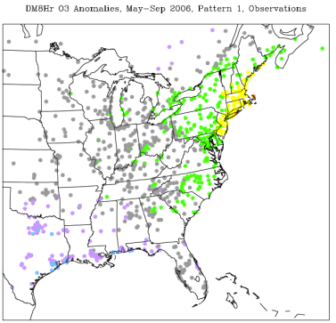
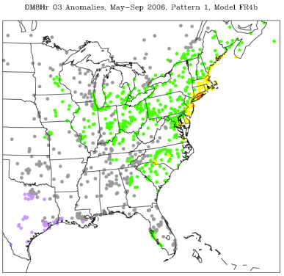
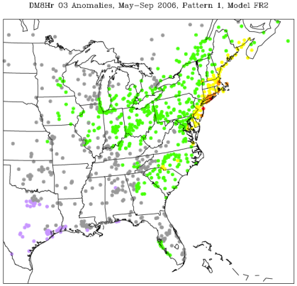
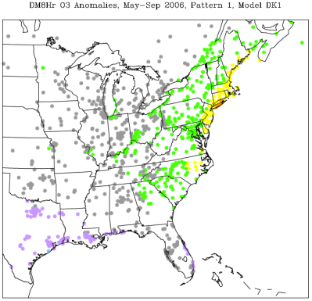
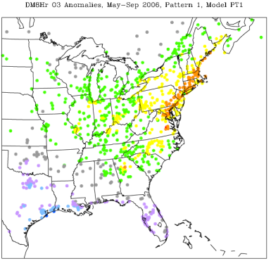
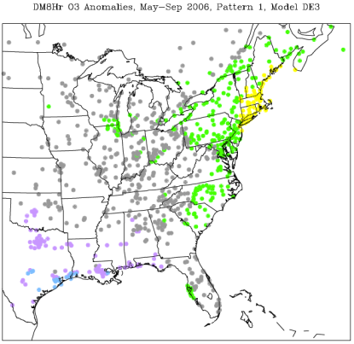
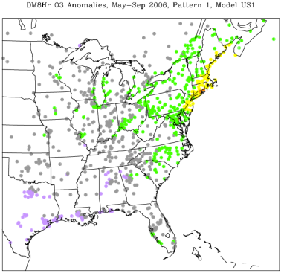
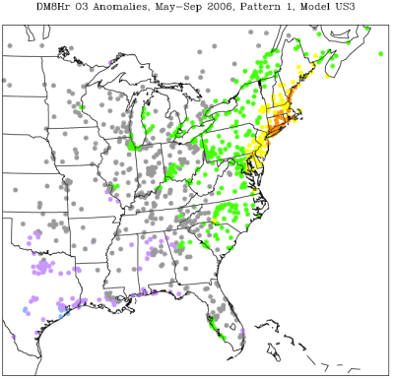
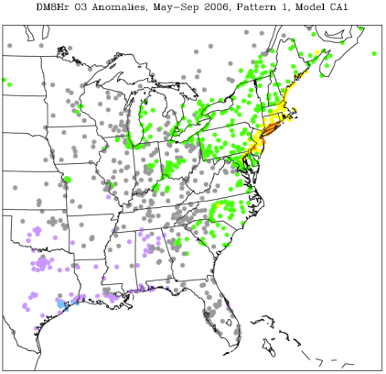
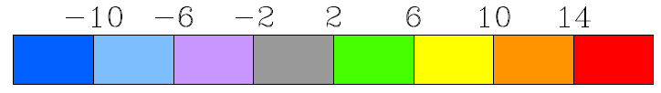
Observed and Modeled Anomalies in Daily Maximum 8-hr Ozone, Pattern 1
Obs
FR4b
FR2
All modeling systems generally capture the regions of positive and negative ozone anomalies associated with this synoptic pattern, but there are differences in the magnitude of the anomalies simulated by the various systems
DK1
PT1
DE3
US1
US3
CA1

Slide 12
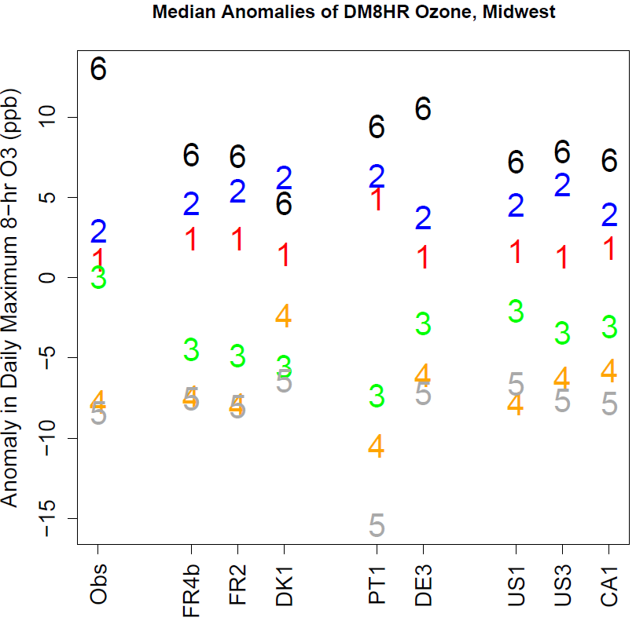
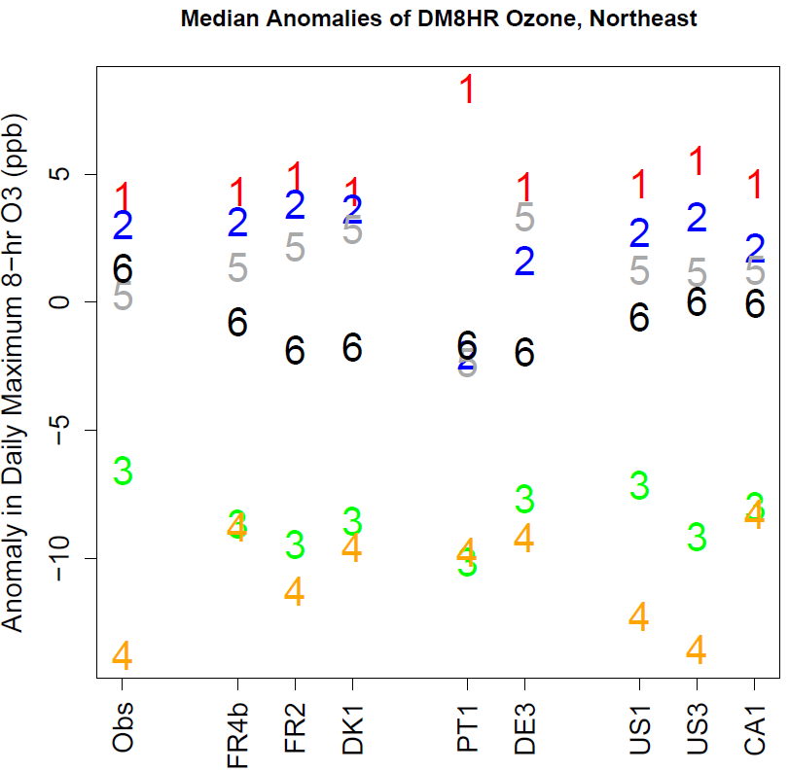
Observed and Modeled Anomalies in Daily Maximum 8-hr Ozone, All Patterns
Midwest
Northeast
All modeling systems generally capture whether a given synoptic pattern leads to positive or negative ozone anomalies, but there are differences in the magnitude of the anomalies simulated by the various systems

Slide 13
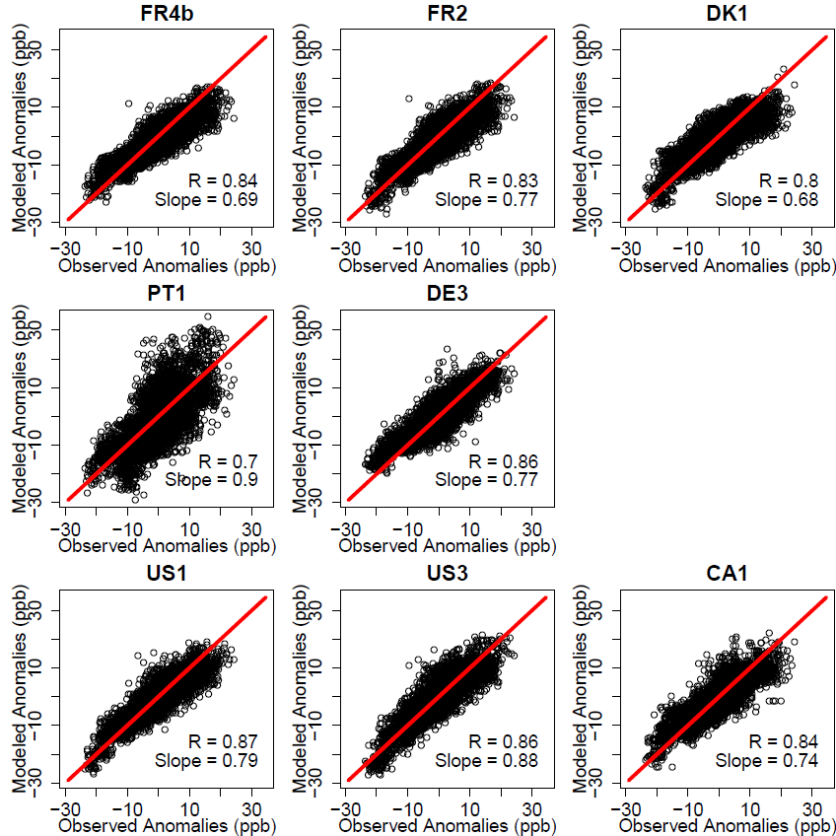
Modeled vs. Observed Anomalies in Daily Maximum 8-hr Ozone
Scatterplots show anomalies for each site for each of the six patterns
Almost all modeling systems showed correlations > 0.8 between observed and modeled anomalies → models exhibit skill in capturing the directional effects of changing weather systems
However, all slopes are less than 1, indicating that all modeling systems generally show an ozone response to changing weather systems that is lower than observed

Slide 14
Use of Observed Spatial Variability to Stratify Operational Model Evaluation
Concept: If certain sites behave very differently from surrounding sites, they may not be representative of the scales the model simulations were designed to capture and should be treated separately for operational evaluation
Dataset for analysis: Observed and simulated daily maximum 8-hr O₃, NA+EU, May - Sep, 2006

Slide 15
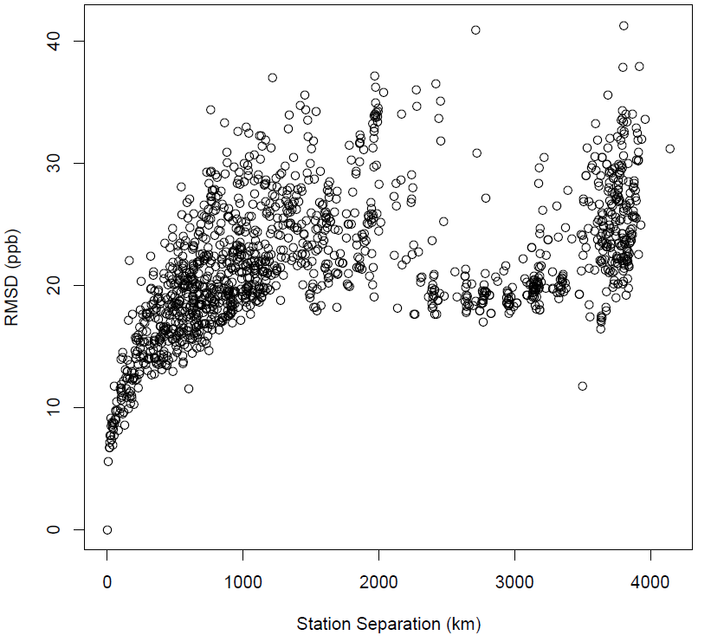
Root Mean Square Difference Between An Example Reference Site and Other Sites as Function of Distance
RMSD increases as separation between station increases
RMSD reaches plateau after ~1,000 – 2,000 km

Slide 16
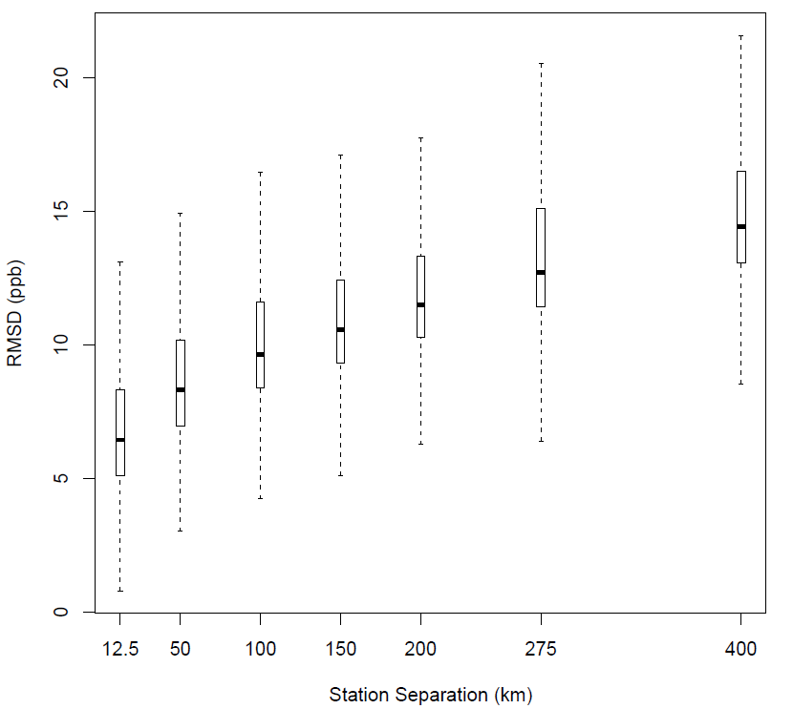
Binned Root Mean Square Difference as Function of Distance Between Stations
Example on the right is for NA, results for EU are very similar
Based on this information, we can define a criterion for sites that are “locally influenced” from “regionally representative” sites.
For the following analysis, we defined “locally influenced” as those sites for which the RMSD in the distance bin centered at 50km is > 10 ppb

Slide 17
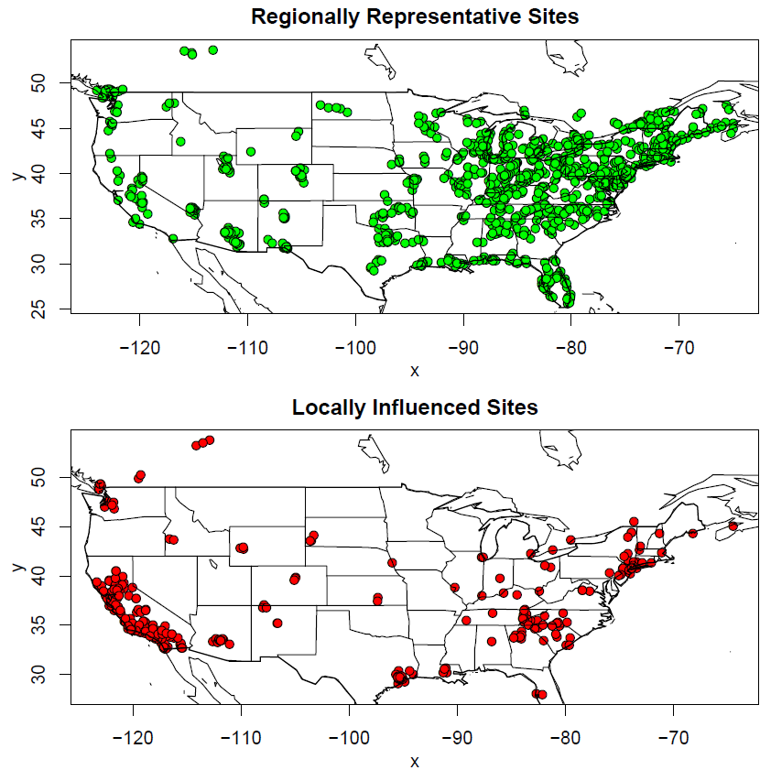
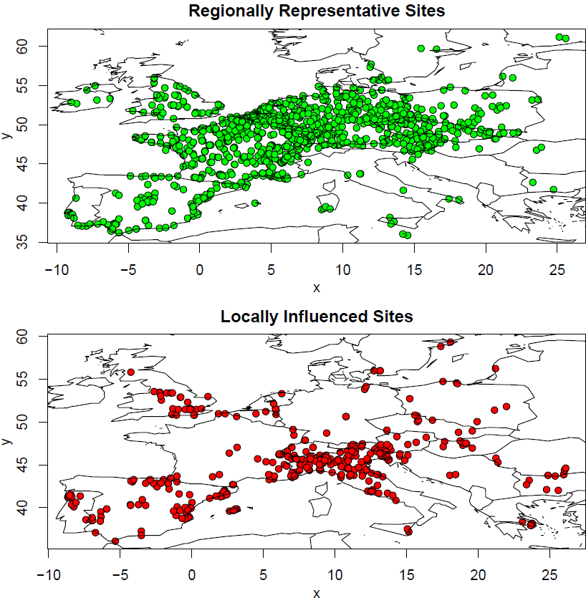
Location of “Regionally Representative” vs. “Locally Influenced” Sites for Daily Maximum 8-hr Ozone, NA and EU

Slide 18
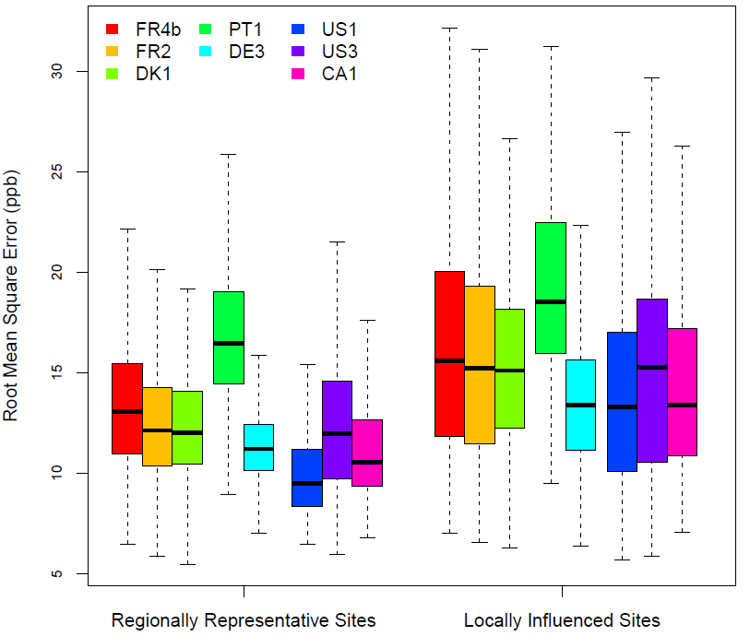
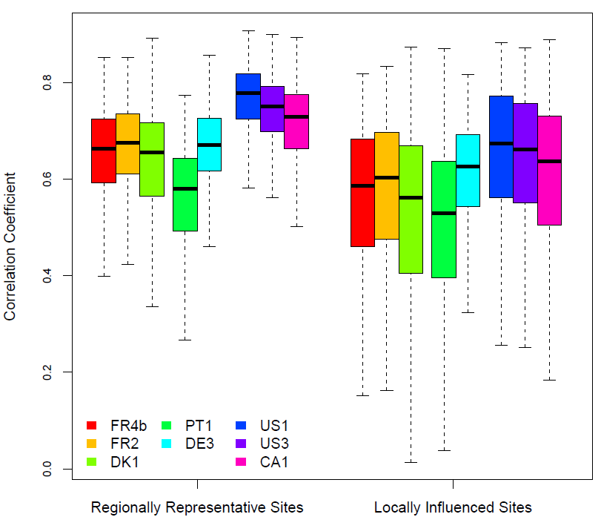
Model Performance at “Regionally Representative” vs. “Locally Influenced” Sites for Daily Maximum 8-hr Ozone, NA
RMSE
Correlation Coefficient
All models participating in AQMEII Phase 1 show lower RMSE and higher correlations at “regionally representative” sites than at “locally influenced” sites
Again, simulations using models with North American heritage and performed by North American groups (US1, US3, CA1) tend to have better performance than other simulations

Slide 19
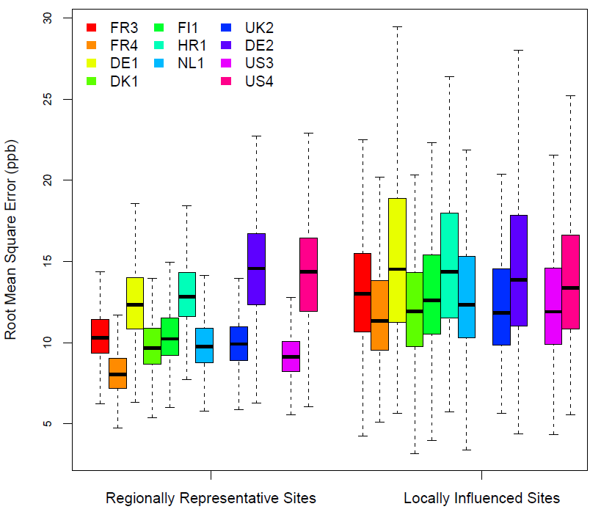
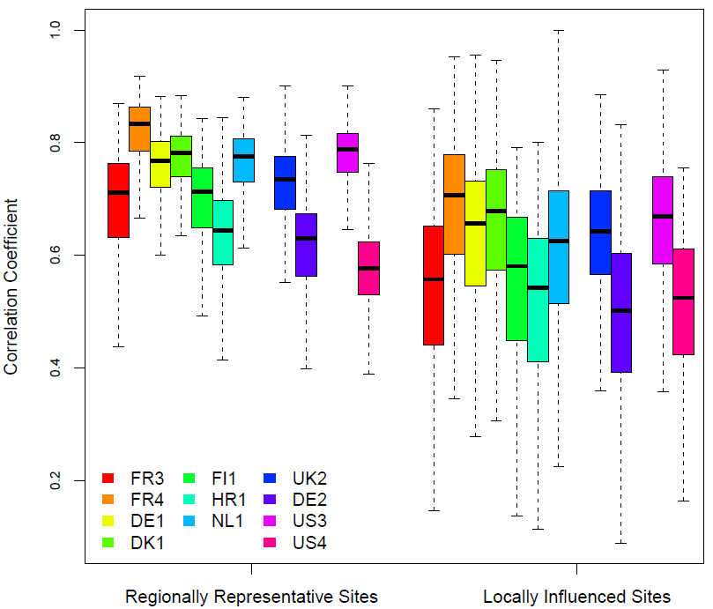
Model Performance at “Regionally Representative” vs. “Locally Influenced” Sites for Daily Maximum 8-hr Ozone, EU
RMSE
Correlation Coefficient
Almost all models show lower RMSE and higher correlations at “regionally representative” sites compared to “locally influenced” sites
Model-to-model differences tend to be more pronounced at “regionally representative” sites

Slide 20
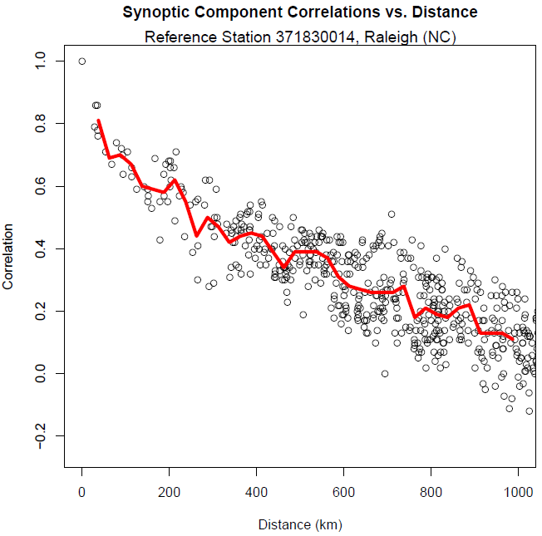
How Well Did the AQMEII Phase 1 Simulations Capture Observed Space/Time Correlation Structures?
Correlations between the KZ-estimated synoptic components of observed daily maximum 8-hr O₃ at Raleigh, NC and other sites
E-Folding distances can serve as a metric to assess the modeling systems’ ability to capture the interplay between local vs. regional effects
E-Folding Distance

Slide 21
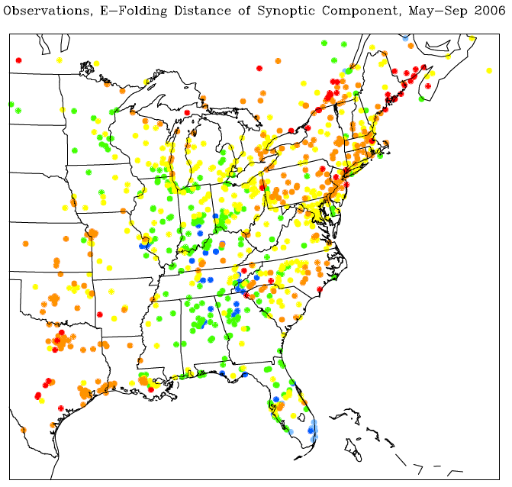
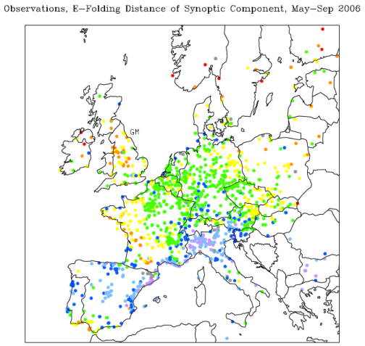

Observed E-Folding Distances, 8-hr Daily Maximum Ozone, NA and EU
North America
Europe
km
E-folding distances show distinct regional patterns over both NA and EU, highlighting the importance of different forcings in different regions

Slide 22
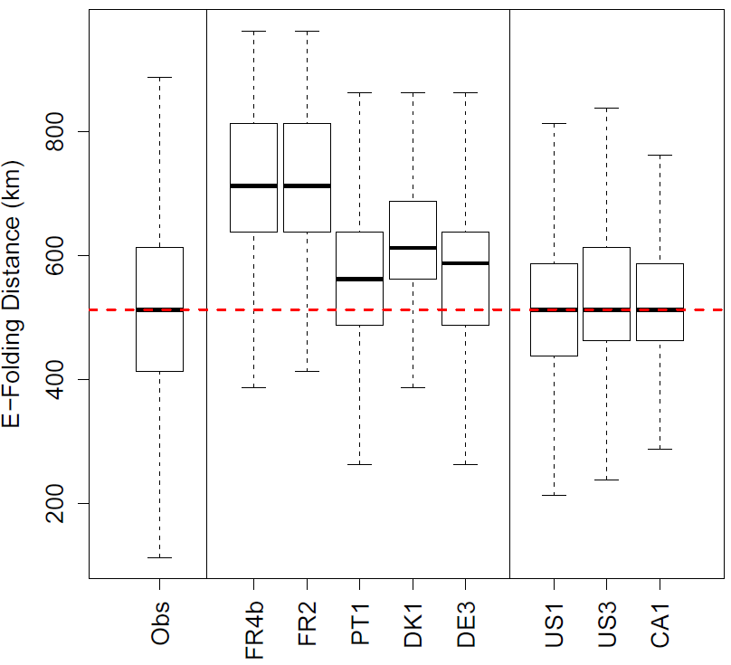
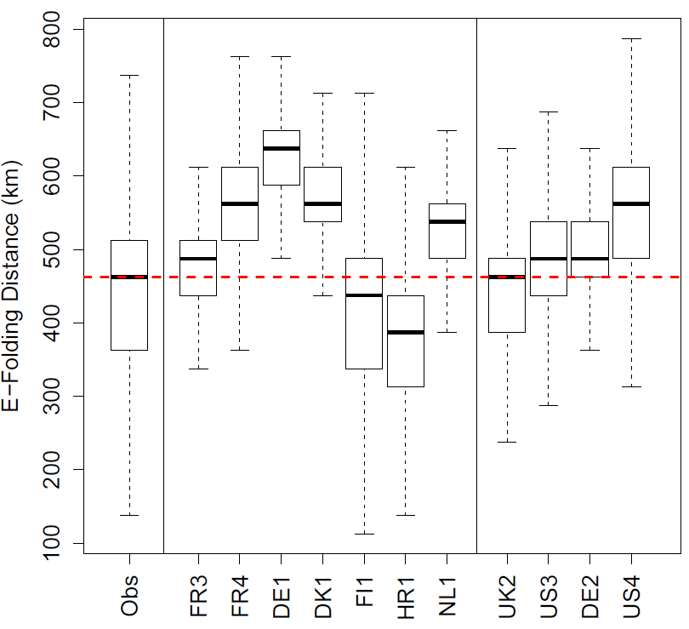
Observed and Modeled E-Folding Distances, 8-hr Daily Maximum Ozone, NA and EU
North America
Europe
Observed e-folding distances are similar in NA and EU (~450-500 km)
NA: models capture or overestimate e-folding distance
EU: mix of over- and underestimations

Slide 23
Summary
Analysis of AQMEII Phase 1 results for NA and EU showed associations between synoptic patterns, model performance and model-to-model variability
All simulations closely captured the impact of changing synoptic patterns on ozone anomalies, but the magnitude of these anomalies was generally underestimated by all modeling systems
All AQMEII Phase 1 simulations show lower RMSE and higher correlations at “regionally representative” sites compared to “locally influenced” sites
Over North America, simulations performed by North American groups using North American models tend to have better performance than other simulations

Slide 24
Acknowledgments
We gratefully acknowledge the contributions of various groups to the first Air Quality Model Evaluation International Initiative (AQMEII) activity. The following agencies have prepared the datasets used in the preparation phase of this study: U.S. EPA (North American emissions processing and gridded meteorology); U.S. EPA, Environment Canada, Mexican Secretariat of the Environment and Natural Resources (Secretaría de Medio Ambiente y Recursos Naturales-SEMARNAT), and National Institute of Ecology (Instituto Nacional de Ecología-INE) (North American national emissions inventories); TNO (European emissions processing); Laboratoire des Sciences du Climat et de l’Environnement, IPSL, CEA/CNRS/UVSQ (gridded meteorology for Europe); and ECMWF/GEMS project and Météo-France/CNRM-GAME (Chemical boundary conditions). Ambient North American concentration measurements were extracted from Environment Canada’s National Atmospheric Chemistry Database (NAtChem) PM database and provided by several U.S. and Canadian agencies (AQS, CAPMoN, CASTNet, IMPROVE, NAPS, SEARCH, and STN networks); North American precipitation-chemistry measurements were extracted from NAtChem’s precipitation-chemistry database and were provided by several U.S. and Canadian agencies (CAPMoN, NADP, NBPMN, NSPSN, and REPQ networks); the WMO World Ozone and Ultraviolet Data Centre (WOUDC) and its data contributing agencies provided North American and European ozonesonde profiles; NASA’s Aerosol Robotic Network (AeroNet) and its data-contributing agencies provided North American and European AOD measurements; the MOZAIC Data Centre and its contributing airlines provided North American and European aircraft takeoff and landing vertical profiles. For European air quality data, the EMEP European Environment Agency/European Topic Center on Air and Climate Change/AirBase provided European air- and precipitation-chemistry data. Data from meteorological station monitoring networks were provided by NOAA and Environment Canada (for the U.S. and Canadian meteorological network data) and the National Center for Atmospheric Research (NCAR) data support section. Joint Research Center Ispra/Institute for Environment and Sustainability provided its ENSEMBLE system for model-output harmonization and analyses and evaluation. Note that not all the networks listed above were used for the results presented here.

