Slide 1
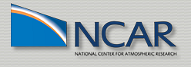
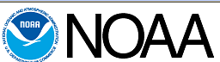
Effects of Implementing
Subgrid-Scale
Cloud-Radiation Interactions in WRF
Jerold Herwehe¹, Kiran Alapaty¹, Chris Nolte¹, Russ Bullock¹,
Tanya Otte¹, Megan Mallard¹,
Jimy Dudhia², and Jack Kain³
¹Atmospheric Modeling and Analysis Division U.S. Environmental Protection Agency
Research Triangle Park, NC
²National Center for Atmospheric Research Boulder, CO
³National Severe Storms Laboratory
National Oceanic & Atmospheric Administration
Norman, OK
Oct. 15, 2012
Office of Research and Development
National Exposure Research Laboratory, Atmospheric Modeling and Analysis Division
11th Annual CMAS Conference in Chapel Hill, NC

Slide 2
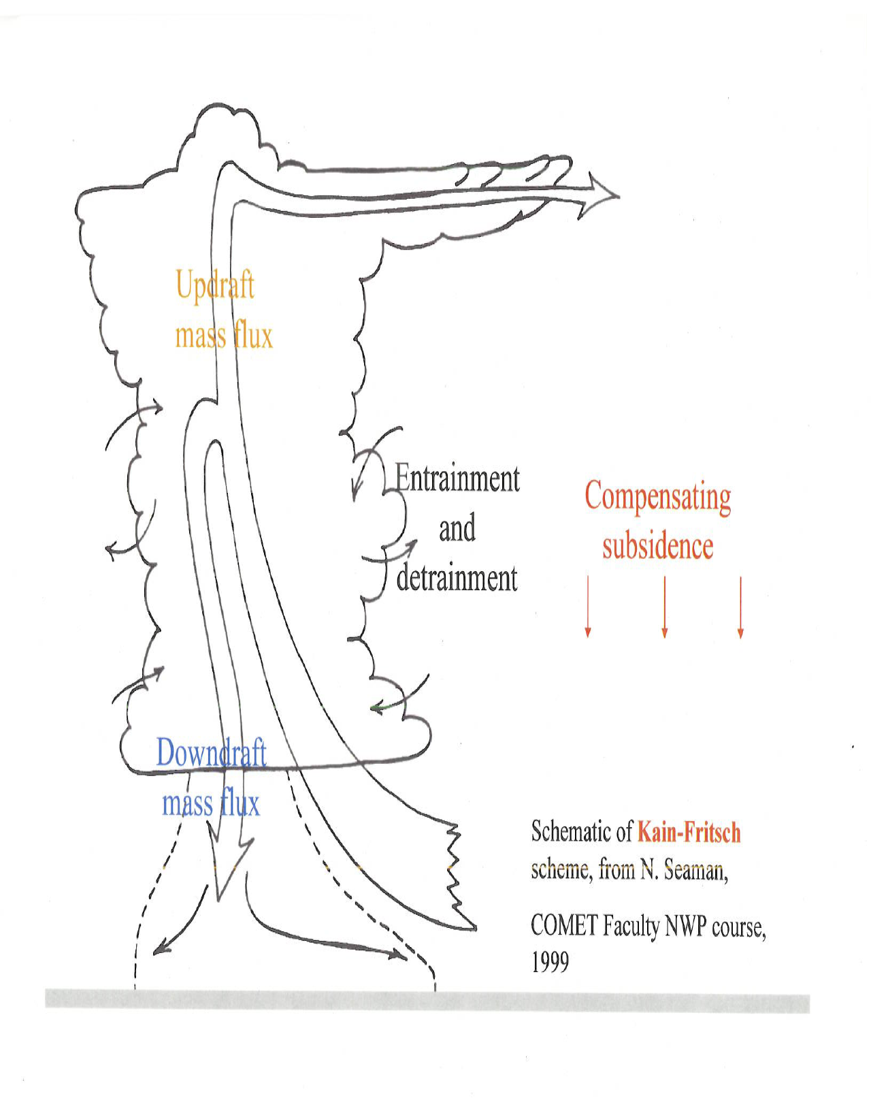
Cumulus Cloud-Radiation Interactions and the WRF Model
Background:
  Cumulus parameterizations provide:
  • Subgrid vertical exchange of heat and
  moisture
  • Convective precipitation amounts
  Climate variability and mid-latitude
  summer weather is dominated by
  cumulus cloud-radiation interactions
Problem:
  WRF is missing this cumulus cloud-radiation connection
  Causes overly energetic convection and excessive surface
  precipitation
Objective: To implement subgrid-scale convective cloud
feedbacks to the shortwave (SW) and longwave (LW)
radiation schemes in WRF.
Notes:
Why is this a problem? The radiation scheme in WRF is not aware of the subgrid cumulus clouds, thereby allowing the sun to shine through what should be cloudy sky, and then shining on the wet surface causing more instability and convection in the moist air.

Slide 3
Approach
Based on Xu and Krueger (1991) CSRM study
  Tuned & well-tested in the Community Atmosphere Model (CAM)
Use in-cloud updraft mass fluxes at each level in Kain-Fritsch
(KF) parameterization to estimate the convective cloud fraction:
• deep cumulus ≤ 60% & shallow cumulus ≤ 20% of grid cell area
Adjust resolved cloud fraction and condensates with subgrid
cloud information at each level:
• convective cloud displaces existing resolved cloud layers
Pass updated total cloud fraction and condensate at each level to
the RRTMG SW and LW radiation schemes
The result? Interactions between the subgrid cumulus clouds and radiation have now been established in the WRF model.
This application of the Xu & Krueger formulation is the first of its kind in regional climate modeling.
Notes:
In a mesoscale study, Kvamstø (1993) documented that the Xu & Krueger scheme is suitable for representing convective cloudiness and out-performs Sundqvist and RH-based schemes. To our knowledge, this is the ONLY mesoscale study that used the Xu & Krueger formulation.
CSRM = cloud system resolving model
GCM = global climate model
RRTMG = Rapid Radiative Transfer Model - Global

Slide 4
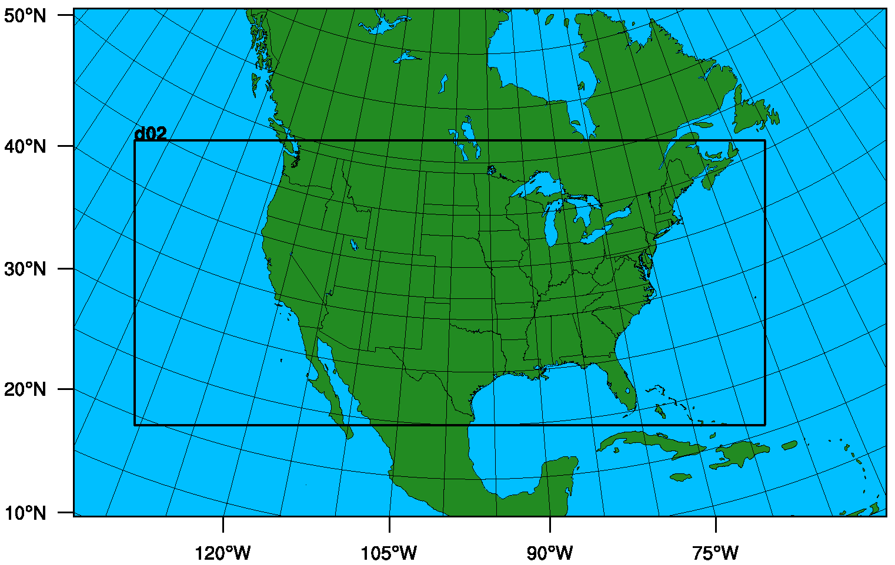
Two Modes of Testing the Implementation
Numerical Weather Prediction (NWP) tests
Regional Climate Model (RCM) application
Model Domains Used in this Study:
d01
d01: (108 km)² cells
d02: (36 km)² cells
NWP simulations
used domain d02 only
RCM simulations
used two-way nesting
of domains d01 & d02

Slide 5
Initial Testing in Numerical Weather Prediction Mode
NWP Simulation Specifications:
  One-week July 24-30, 2010 case study using WRF v3.3.1
  CONUS domain with 36 km grid and 34 layers (50 hPa top)
  Initial and boundary conditions from NWS/NCEP NAM data
  No FDDA (i.e., no nudging)
  Noah land-surface model (LSM)
  YSU planetary boundary layer (PBL) scheme
  WSM6 single-moment microphysics
  Base case = standard KF convective parameterization and
  standard RRTMG SW and LW radiation schemes
  Modified case = feedbacks from KF convective parameterization
  sent to affect RRTMG SW and LW radiation
Notes:
Title page for NWP simulation section

Slide 6
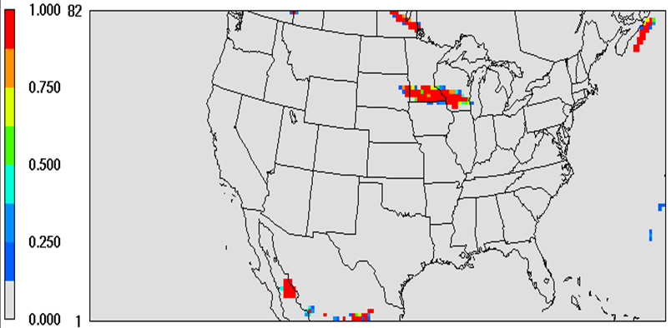
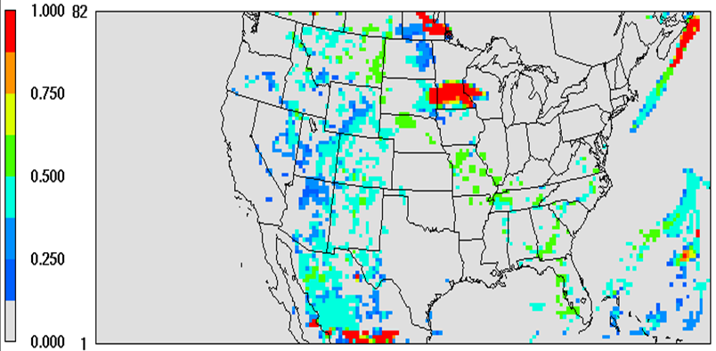
Layer 25
Cloud
Fraction
(~5 km AGL)
6 p.m. EDT
July 29, 2010
(Base)
(Modified)
Note the additional cloudiness when subgrid convection and saturation are taken into account.
Notes:
A snap shot of cloud fractions at about 500 hPa level (5 km altitude): Base case cloud fraction is ALWAYS from saturation at the grid-scale. Since convection is predominant during warmer months and the atmosphere is unsaturated, grid scale clouds are uncommon. For this reason, the Base case predicts almost clear skies, though in reality convection existed at that time. Note that sometimes, subgrid-scale convection can create grid scale saturation and for such conditions the Base case WRF predicts cloud cover. As you can see, it does not happen everywhere (top panel figure) as most of the domain is cloud free. So it can “rain cats & dogs in a clear sky.” In the Modified case, subgrid cloud cover is introduced and is a reflection on the nature of convection happening at that time. Now, it rains cats & dogs in a cloudy sky, just like in nature!

Slide 7
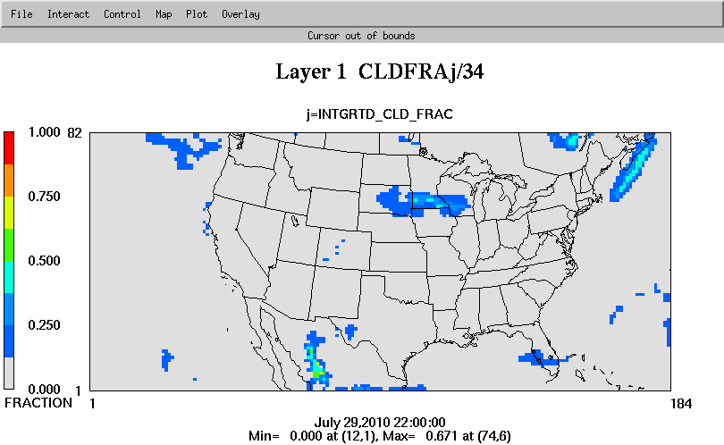
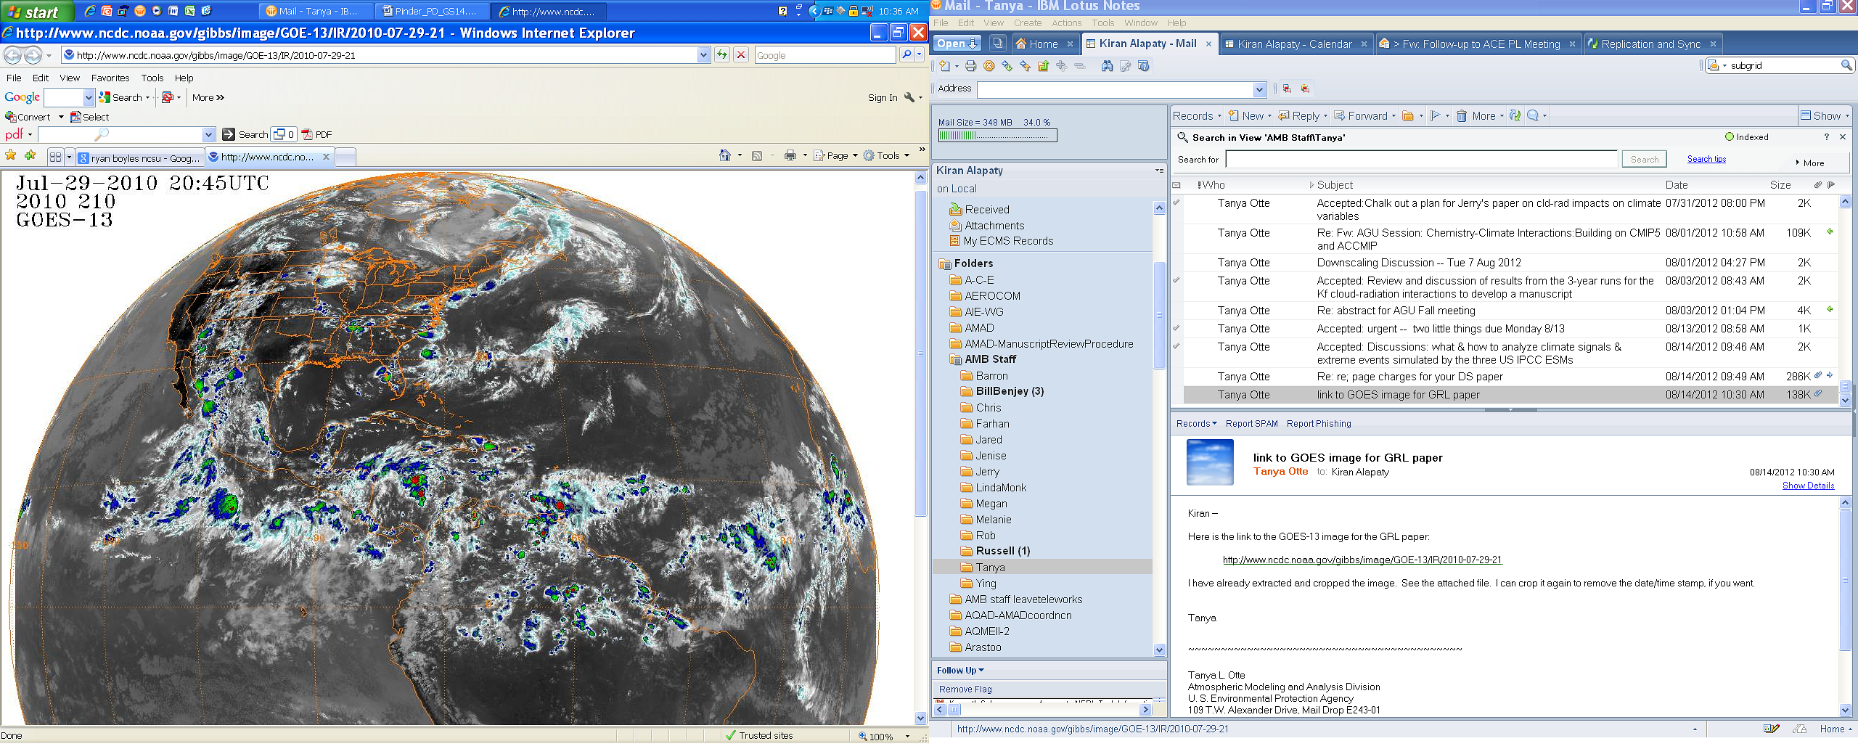
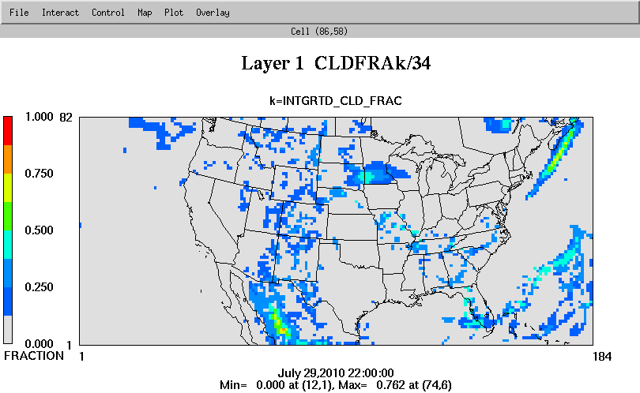
(Base)
Column
Total
Cloudiness
5 p.m. EDT
July 29, 2010
(GOES-13 Satellite)
(Modified)
(To qualitatively compare with satellite observations, column cloud fraction has been vertically integrated and normalized by the number of model layers.)
Notes:
Modified case offers some improvements in cloud cover over the Rockies, the Southeast, Mexican mountains, and the Atlantic.

Slide 8
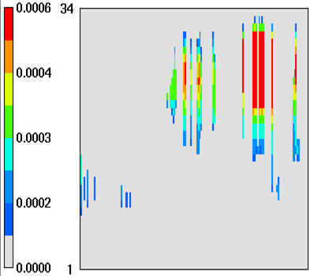
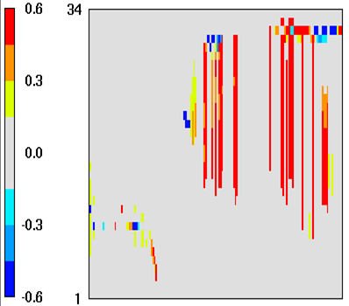
Condensate from the KF Scheme and
Cloud Fraction Differences
KF Condensate
Cloud Fraction Diffs.
(Modified − Base)
kg/kg
(W-E vertical cross sections at Row 37)
Notes:
Condensate values of 0.6 g/kg maximum is not insignificant and is being passed to the grid scale, important with up to 60% deep cumulus cloud fractions. Blue blobs high in cloud fraction difference slice indicate reduction of high cirrus decks (i.e., no Cb anvils).

Slide 9
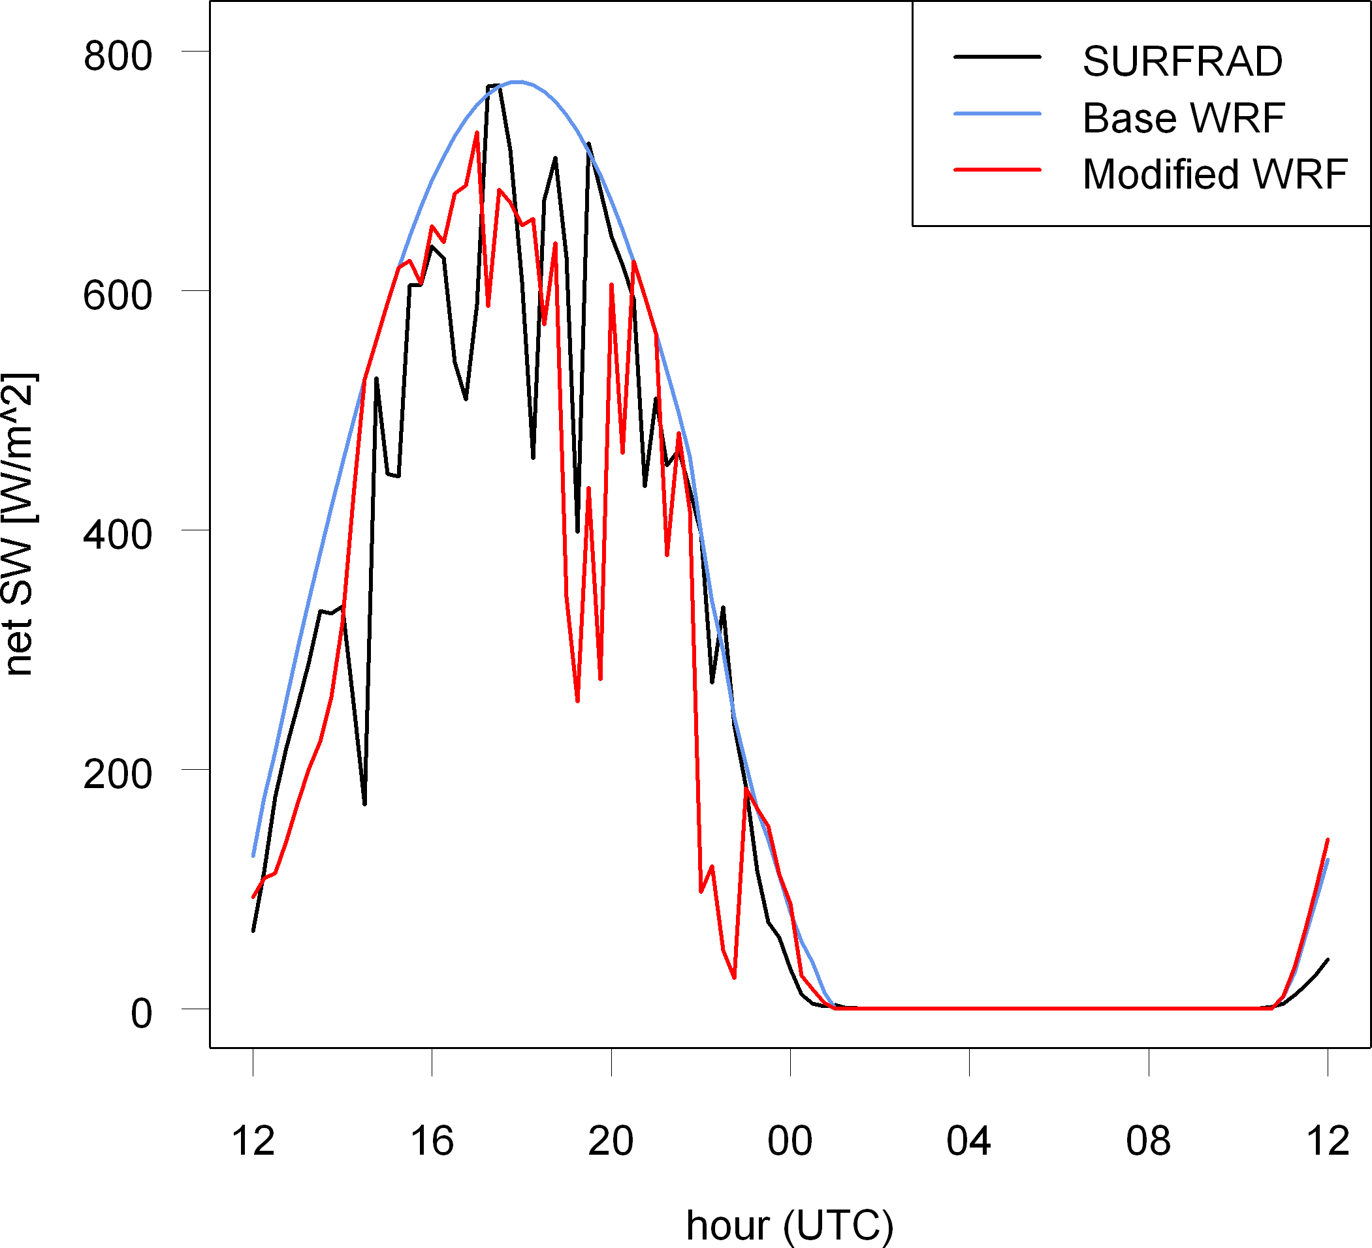
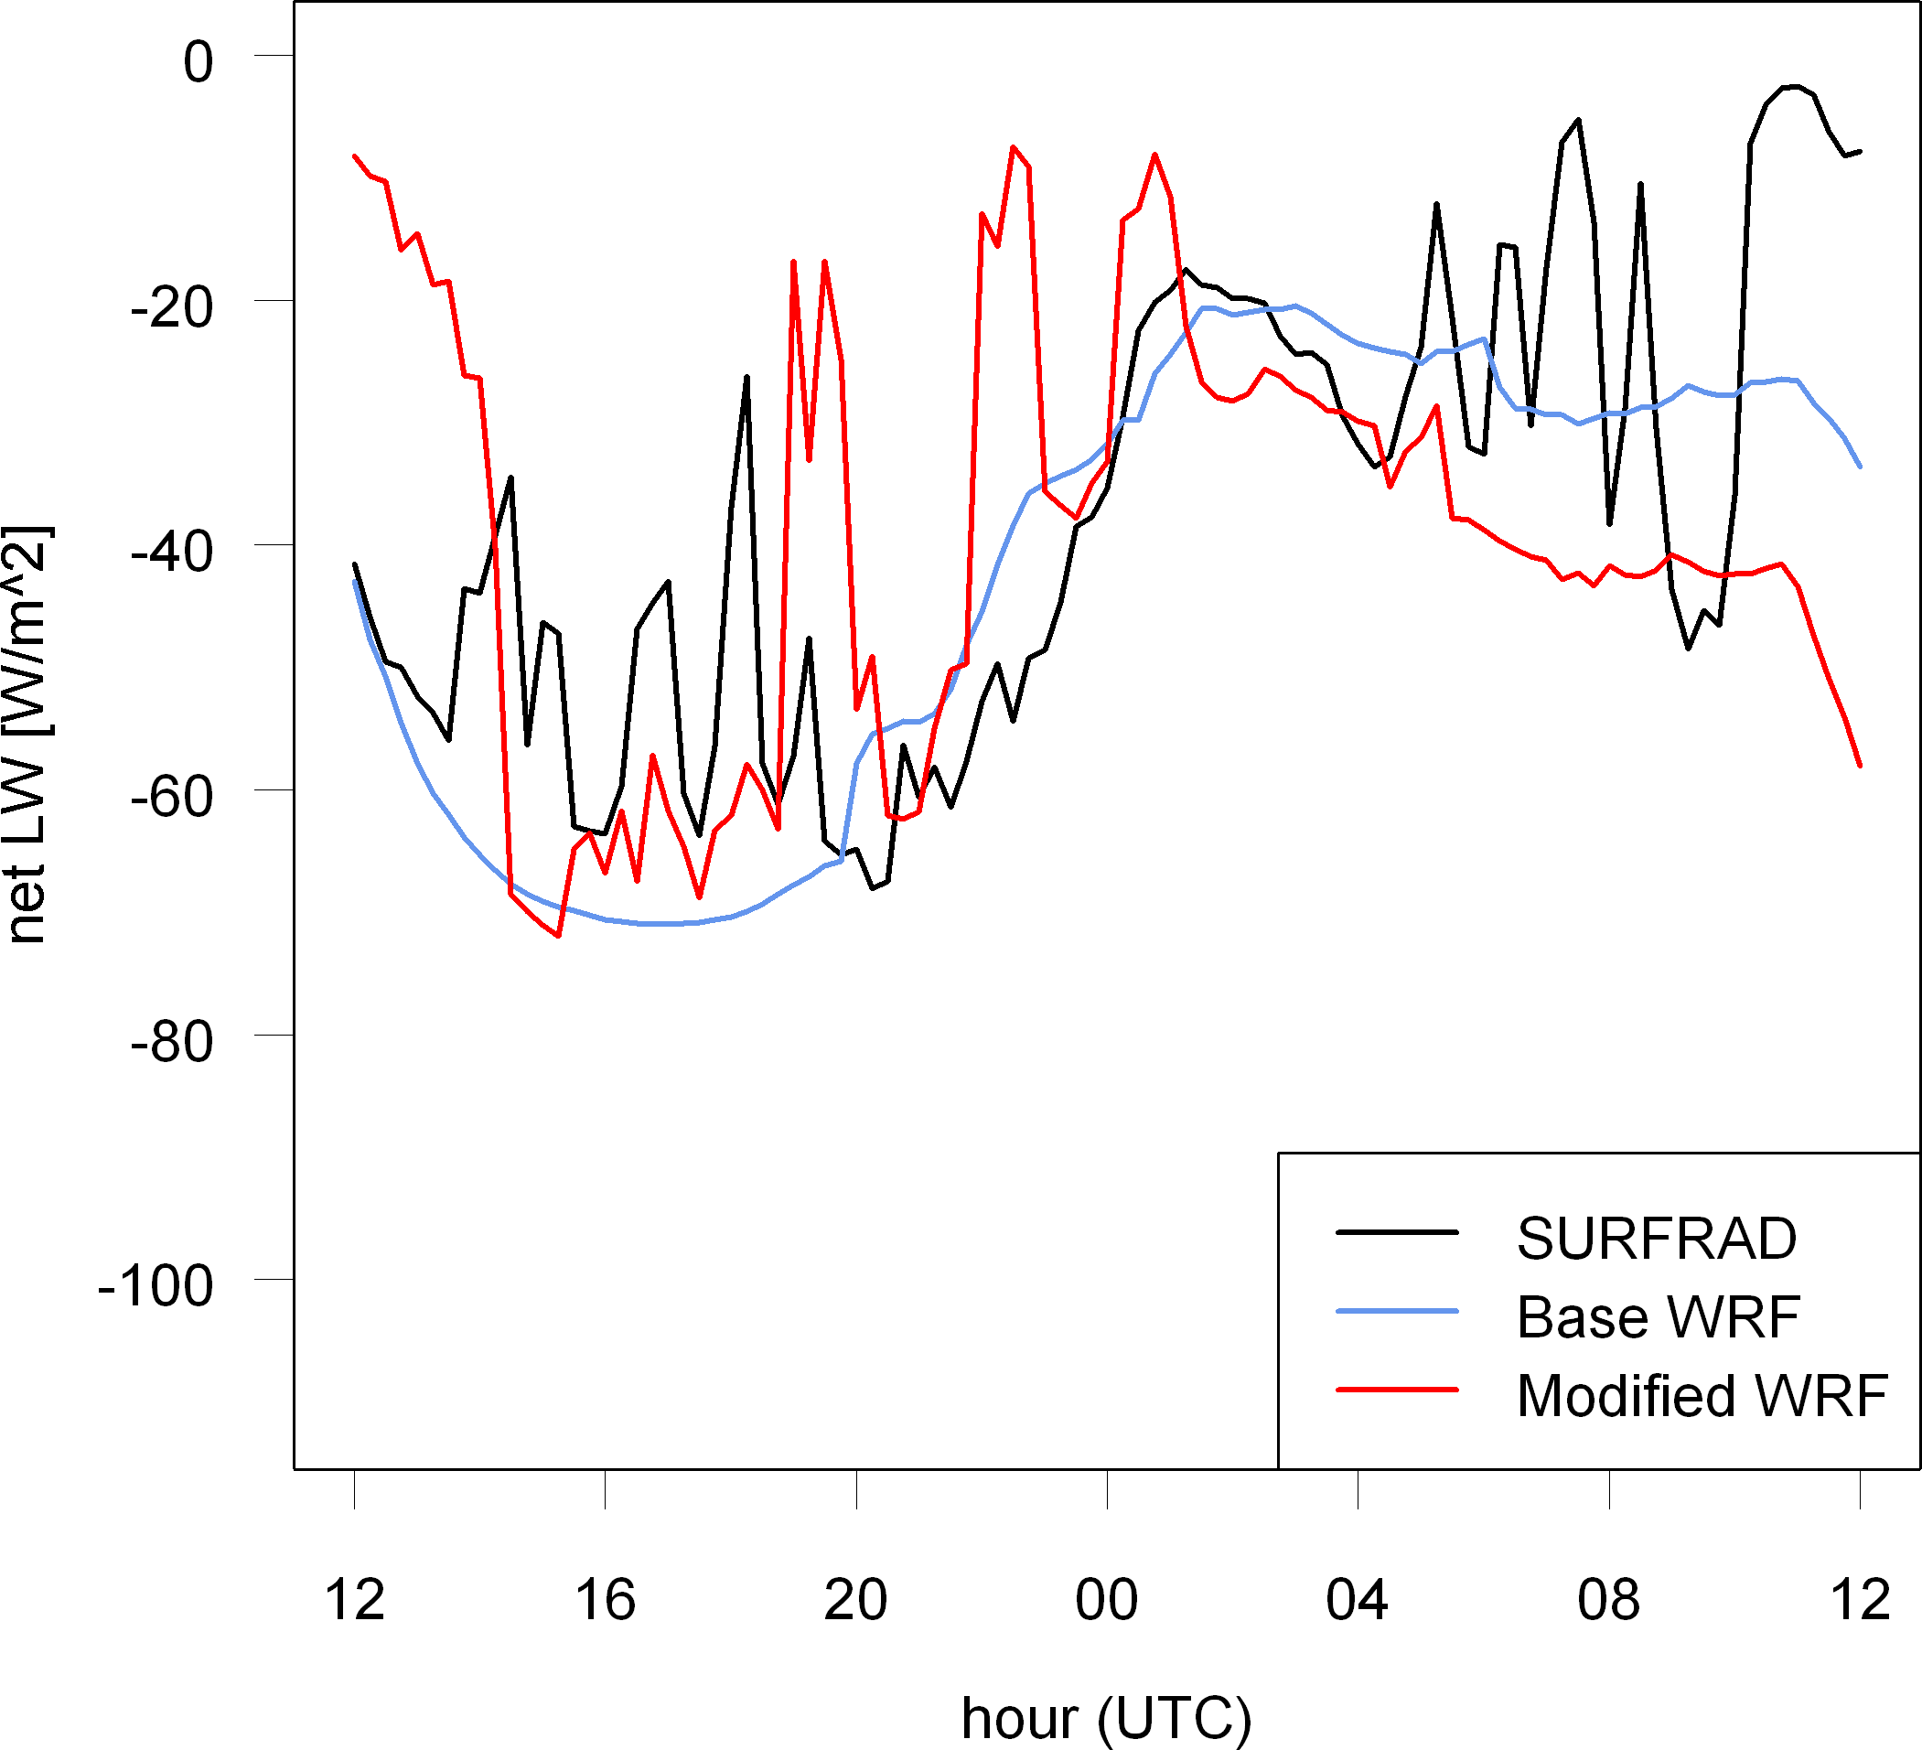
Comparison with SURFRAD Measurements
at Bondville, Illinois, July 29, 2010
Sfc. Net Shortwave Radiation
(down minus up)
Sfc. Net Longwave Radiation
(down minus up)
New total cloudiness in the Modified case attenuates the surface radiation budget by an appropriate amount, while the Base case predicts mostly clear skies.
Notes:
Modified case adds subgrid cloudiness that effects SW and LW radiation with appropriate magnitude.

Slide 10
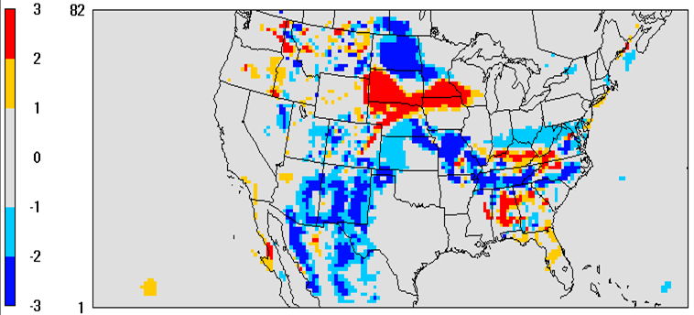
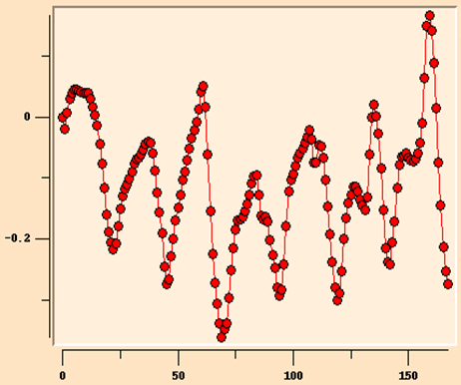
Effects on Near-Surface Temperature
Layer 1
Temperature
Differences
⇐(Modified−
Base)
6 p.m. EDT
July 29, 2010
K
(Avg. Diff. over All Land Area)
Time Series
of Layer 1
Temperature
Differences
(Modified−
Base) ⇒
(K)
Simulation Hours 24-30 July 2010
Notes:
Layer 1 is the first/bottom layer in the model domain (i.e., the “surface” layer). Both plots show general cooling of the surface in many areas, and as a land average, when including the subgrid cloudiness of the Modified case. Increased cloudiness and cooler near-surface temperatures in the simulations can have a large impact on biogenic emissions (less ozone precursors omitted, slower reaction rates, less photosynthetically active radiation (PAR) to affect the ecosystem).

Slide 11
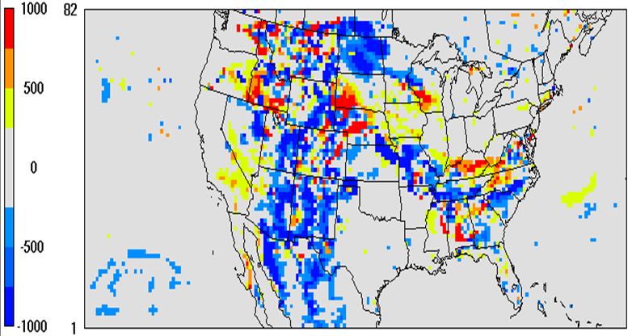
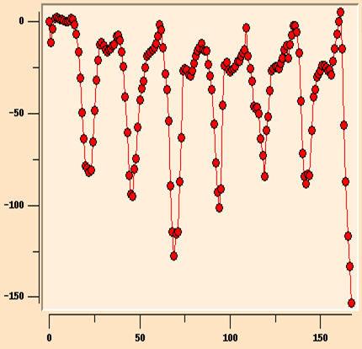
Effects on Planetary Boundary Layer Height
PBL
Height
Differences
⇐(Modified−
Base)
6 p.m. EDT
July 29, 2010
m
Time Series
of PBL Height
Differences
(Modified−
Base) ⇒
(m)
(Avg. Diff. over All Land Area)
Simulation Hours 24-30 July 2010
Notes:
Increased cloudiness in Modified case results in significantly lower PBL heights in some areas. Second plot shows one-week time series for PBL height differences averaged over all land cells.

Slide 12
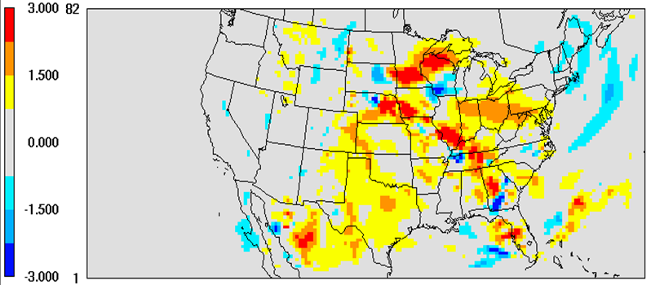
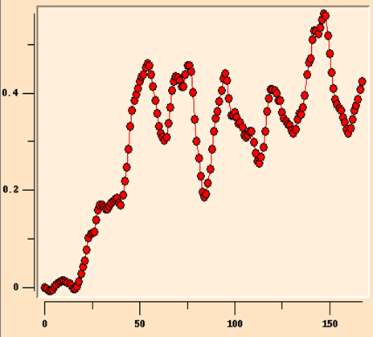
Effects on Temperature Aloft
Layer 33
(~15km AGL)
Temperature
Differences
⇐(Modified−
Base)
6 p.m. EDT
July 29, 2010
K
(Avg. Diff. over All Land Area)
Time Series
of Layer 33
Temperature
Differences
(Modified−
Base) ⇒
(K)
Simulation Hours 24-30 July 2010
Notes:
Warming near the tropopause due to 1) cloud top radiative cooling, 2) horizontal advection, and 3) differences in cloud formation (more in the Modified case). The implications are to reduce the positive bias for cirrus cloud formation high in the model domain.

Slide 13
Initial Application to
Regional Climate Modeling
RCM Multiyear Simulation Specifications:
  Three-year simulations: 1988-1990, with one-month spin-up
  Larger domain covering CONUS with two-way nested 108 km
  and 36 km grids, with 34 layers (50 hPa top)
  Initial and boundary conditions from downscaled 2.5°×2.5°
  NCEP-NCAR Reanalysis II (R2) data
  FDDA (shown here with analysis nudging of winds, temperature,
  and moisture above the boundary layer)
  Noah LSM, YSU PBL, WSM6, RRTMG SW & LW
  Used three convection parameterizations: Grell G3, original KF,
  and modified KF with feedback to RRTMG SW & LW schemes
Notes:
Title page for RCM simulation section

Slide 14
Results by Region for 1988-1990
Simulation domain is divided into 6 regions for
analysis purposes, as shown below:
Key for time series plots (land cells only) which follow:
NARR = “observations” for rainfall; CFSR = “observations” for temperature
Base_G3 = Grell 3D scheme (dashed line)
Base_KF = Standard (original) KF and RRTMG schemes
Modified_KF = Modified-KF scheme with cumulus-radiation interactions
Notes:
Our 6 traditional regions used in the statistical analyses of our RCM simulation results.

Slide 15
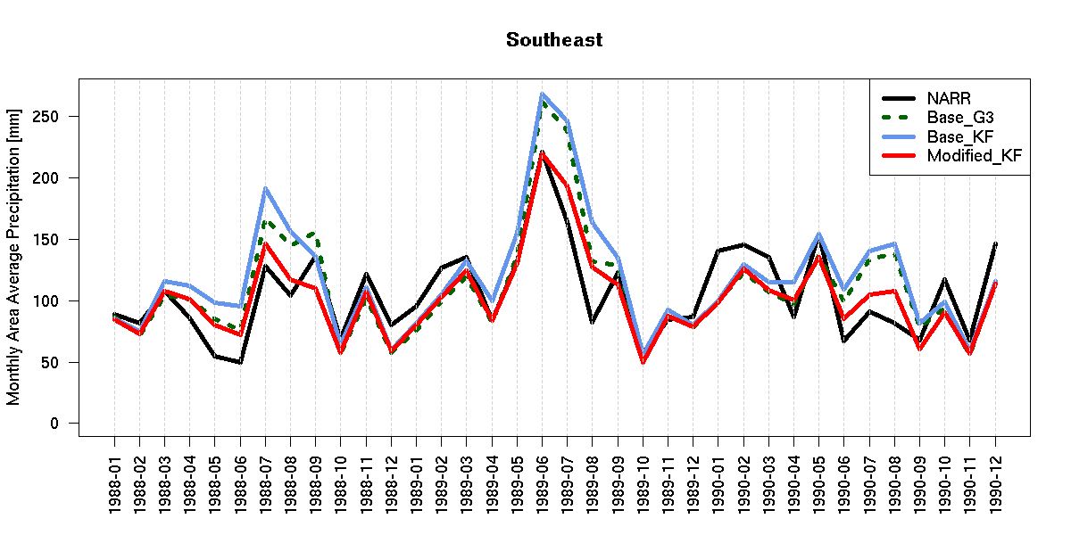
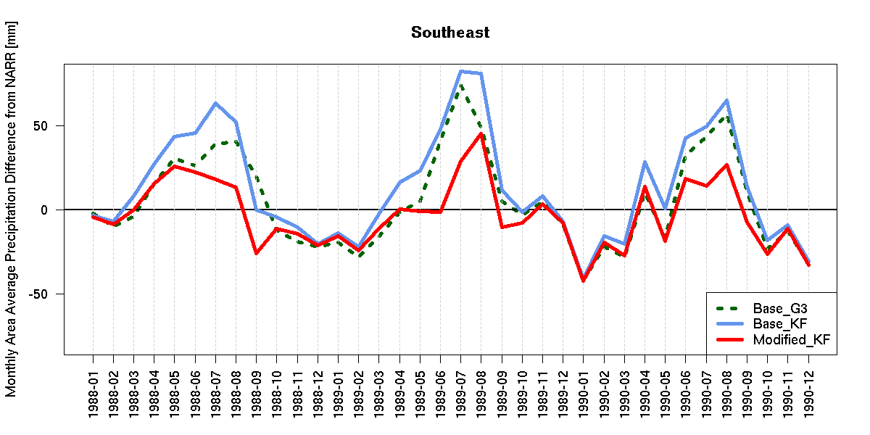
Monthly-Averaged Surface Precipitation
Southeast
Surface
⇐ Precipitation
(mm)
1988
1989
1990
Southeast
Surface
Precipitation
Differences ⇒
from Obs.
(Model −
NARR)
(mm)
1988
1989
1990
Notes:
Modified case really improves summer precipitation totals. And, as expected, has little to no effect on the cool weather precipitation.

Slide 16
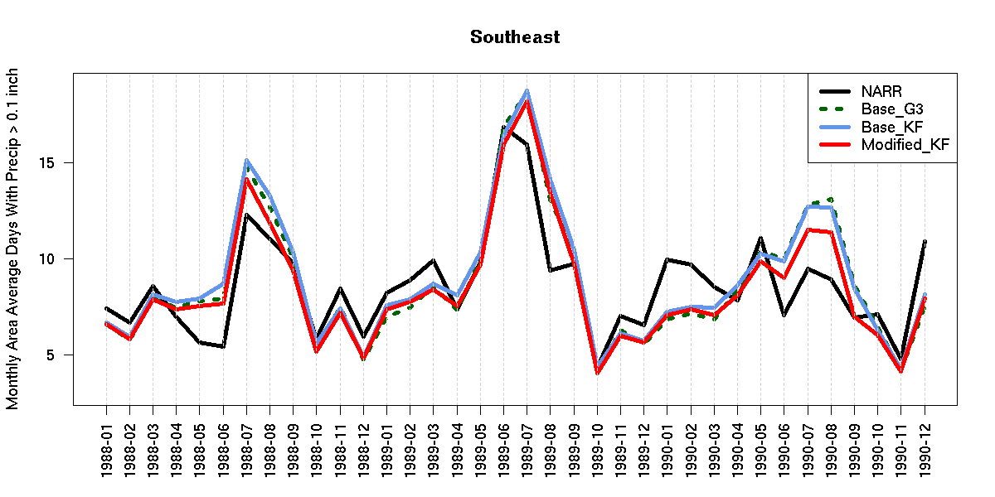
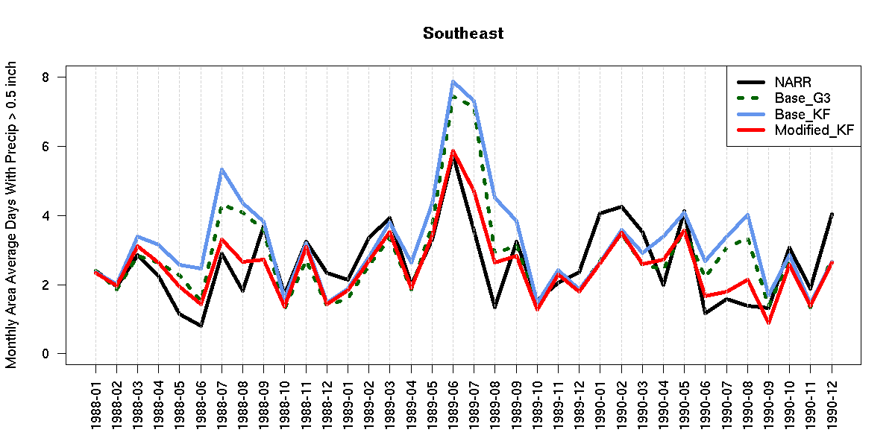
Monthly-Averaged Surface Precipitation Days per Threshold
Southeast
Avg. Days with
⇐ Precipitation
> 0.1 inch
1988
1989
1990
Southeast
Avg. Days with
Precipitation ⇒
> 0.5 inch
(note different scale)
1988
1989
1990
Notes:
Cumulus convection is usually associated with heavier rainfall, therefore, little improvement is seen using the modified-KF for light-rain events, though there is still some improvement depending on the year. More noticeable improvements are evident for the > 0.5 inch threshold, but note different scale.

Slide 17
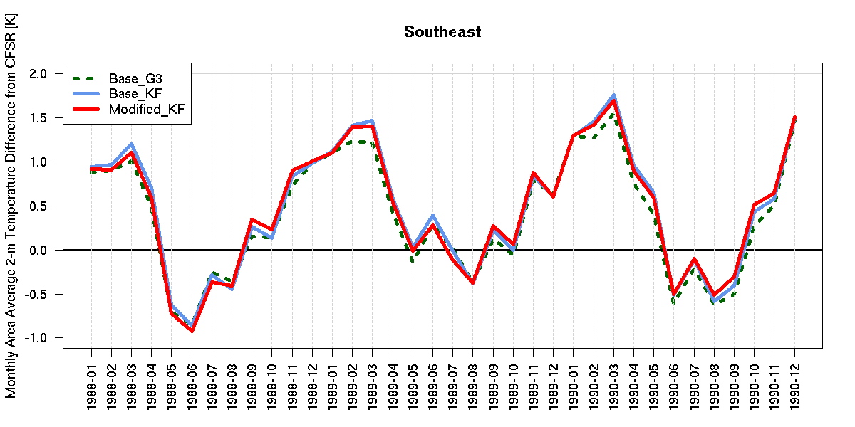
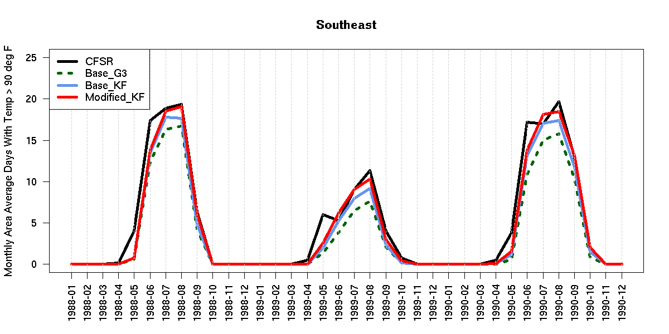
Monthly-Averaged 2-meter Temperature
Differences and Extreme Heat Days
Southeast
2-m Temperature
Differences
⇐ from Observations
for Southeast
(Model −
CFSR)
(K)
1988
1989
1990
Southeast
Avg. Days with
Temperature ⇒
> 90°F
1988
1989
1990
Notes:
All temperatures are fairly well predicted (at least always with +/- 2 K from CFSR), and the Modified_KF case reduces the bias at times compared to the Base_KF case. The additional cloudiness from accounting for the subgrid-scale cumulus clouds and their effects on the radiation schemes has not squelched the heat waves.

Slide 18
Summary and Conclusions
Essentially no computational penalty for including subgrid-scale
cumulus cloud impacts on radiation in WRF
Alleviated overprediction of summer precipitation in Southeast,
while improving prediction of extreme rainfall events
Improved prediction of heat waves in the Southeast
Caused a shift in precipitation patterns due to different dynamics
Improved temperature and moisture at the local scale, which
could have implications for biogenic emissions and reactions
Boundary layer heights are affected, which should impact
pollutant dilution and regional air quality
Will facilitate consistent treatment of clouds in the WRF and
CMAQ models to improve photolysis and aqueous chemistry
Notes:
Due to brevity, plots to support some of these findings have not been shown in this talk.

Slide 19
Deep Convective Clouds
Thank You
Questions?

