Slide 1
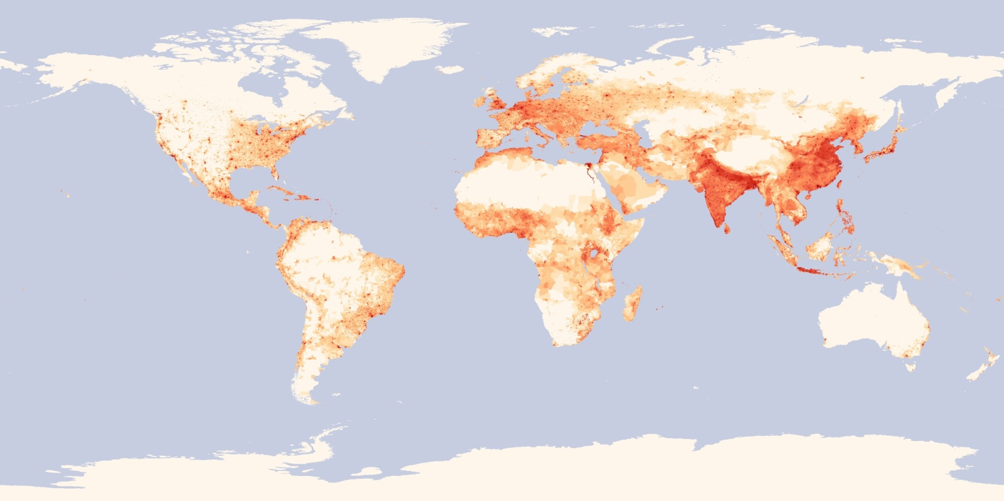
Developing chemical mechanisms that are more robust to changes in atmospheric composition
Ethene (CH₂=CH₂)
2-Butene (CH₃CH=CHCH₃)
Isobutene (CH₂=C(CH₃)₂)
Propene (CH₂=CHCH₃)
1-Butene (CH₂=CHCH₂CH₃)
1,3-Butadiene (CH₂=CHCH=CH₂)
Ozone (O₃)
Toluene (C₆H₅CH₃)
Xylenes (C₆H₄(CH₃)₂)
Trimethylbenzenes (C₆H₃(CH₃)₃)
Isoprene (CH₂=C(CH₃)CH=CH₂) … … … … … … …
SAPRC / Carbon Bond
Gookyoung Heo,ª William P. L. Carter, ª Greg Yarwood^{b}
ªCenter for Environmental Research and Technology, University of California, Riverside
ªENVIRON International Corporation
Year 2000 population density: Image by Robert Simmon, NASA's Earth Observatory (http://neo.sci.gsfc.nasa.gov)
11th CMAS conference, October 15-17, 2012, Chapel Hill, NC

Slide 2
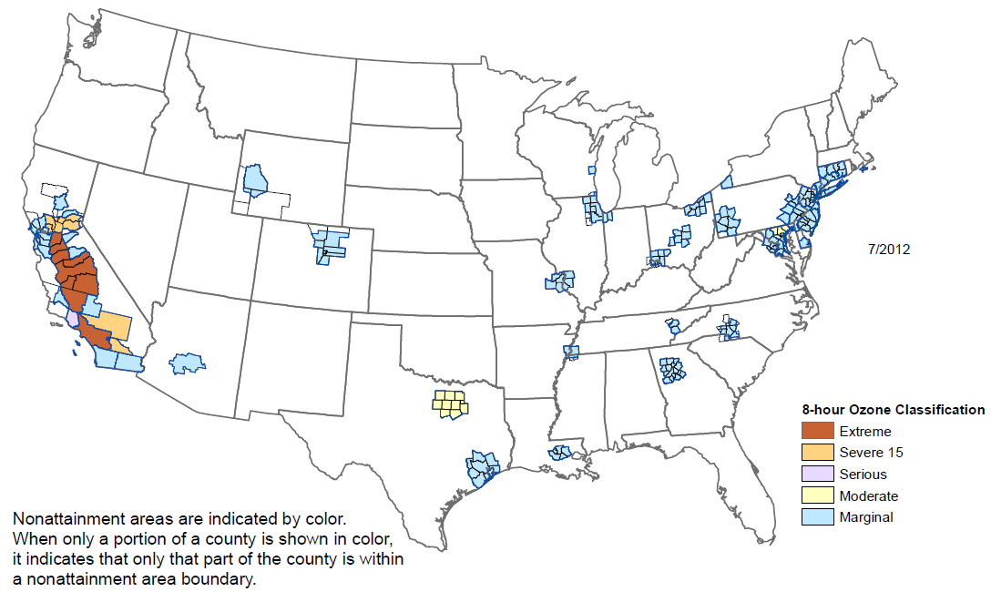
Background: ozone pollution
Many areas in the U.S. and other countries suffer ozone pollution.
123 million people live in 227 ozone nonattainment counties in the U.S. (as of July 2012, based on the 2010 census, http://www.epa.gov/oar/oaqps/greenbk/hnsum.html).
Gas-phase chemical mechanisms are important in modeling the impact of emissions on secondary pollutants such as ozone (O₃).
8-HR Ozone Nonattainment Areas (as of 7/2012)
(Source: http://www.epa.gov/airquality/greenbook/map/map8hr_2008.pdf)
Notes:
Annual fourth-highest daily maximum 8-hr concentration, averaged over 3 years > 0.075 ppm (parts per million in volume)?
(http://www.epa.gov/air/criteria.html; http://www.epa.gov/airquality/greenbook/map/map8hr_2008.pdf (7/2012))

Slide 3
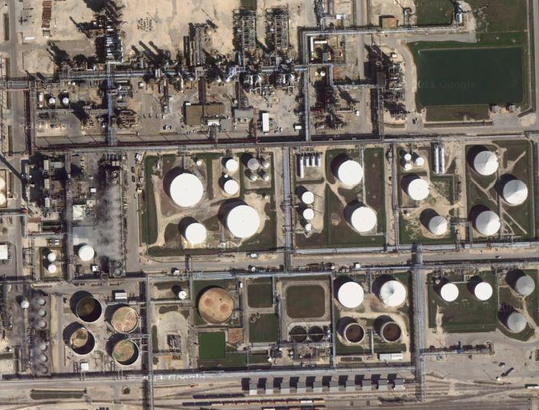
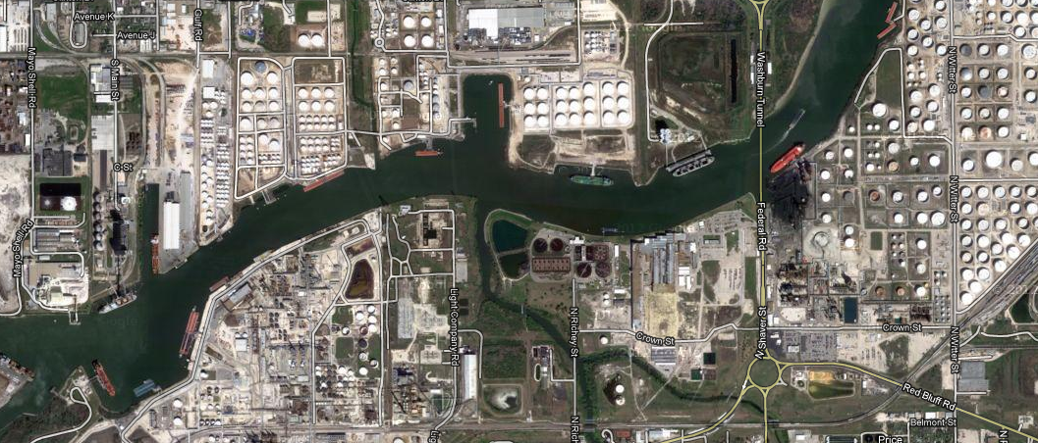
Background: Atmospheric composition changes
Condensed chemical mechanisms commonly used for air quality modeling are designed to model O₃ formation from typical urban ambient VOC mixtures.
Atmospheric composition is not constant and changes temporally and spatially.
Industrial emission sources in Houston, Texas
(Source: http://maps.google.com)
Notes:
However, atmospheric composition is not constant and temporally and spatially changes. As a result, certain compounds may warrant more attention for some areas than for other areas, and certain compounds may need more attention due to changes in emissions over time. However, using more detailed and larger chemical mechanisms does not guarantee significantly better model predictions (e.g., predicted O3 concentrations) than relatively compact chemical mechanisms while demanding more resources.
Atmospheric composition can be influenced by changes in fuels, technologies and emission standards over time. Therefore, chemical mechanisms need to address changes in emissions that will be translated into changes in atmospheric composition. Atmospheric composition can be non-negligibly different at different locations due to differences in emission activities.
For example, the air composition in the greater Houston area in southeast Texas is influenced by emissions from petrochemical facilities and is often markedly different from that of the typical composition in most urban areas (e.g., see Table 3 of Heo et al (2010)). Industrial emissions can influence air quality in areas where industrial sources such as refineries, chemical plants and oil and gas production facilities are concentrated.

Slide 4
Background: Atmospheric composition changes
Atmospheric emissions can be influenced by changes in fuels, technologies and emission standards over time.
Changes in emissions lead to changes in atmospheric composition:
  Changes in the total amount of emissions
    For example, different reductions for total NOx and total VOC will change the VOC/NOx ratio (e.g., 50% NOx reduction and 20% VOC reduction => increase in VOC/NOx).
  Changes in the composition of emissions
    Changes in splitting factors of total NOx into NO, NO₂ and HONO.
    Changes in splitting factors of total VOC into specific compounds such as propane, ethene and toluene.

Slide 5
Background: Atmospheric composition changes
Atmospheric emissions and compositions can be spatially different due to differences in emission activities at different locations.
Industrial emissions from chemical plants and refineries: Houston in TX.
Oil and gas fields: Western Kern County in CA, Upper Green River Basin in WY.
8-HR Ozone Nonattainment Areas (as of 7/2012)
St. Louis
Chicago
Columbus
Cleveland
Pittsburgh
New York
San Francisco
Wyoming
Philadelphia
Washington, DC
Kern County
Cincinnati
Denver
Charlotte
Los Angeles
Knoxville
Memphis
Phoenix
Dallas
Atlanta
Houston
Baton Rouge
(Source: http://www.epa.gov/airquality/greenbook/map/map8hr_2008.pdf)

Slide 6
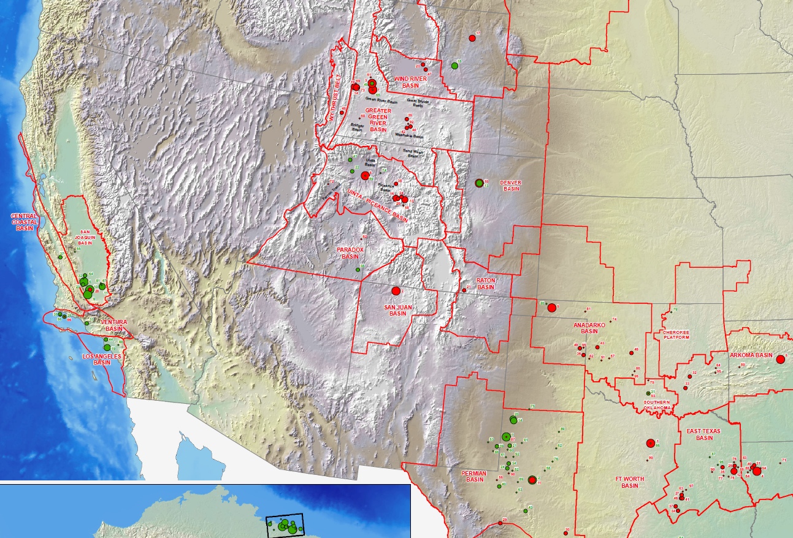
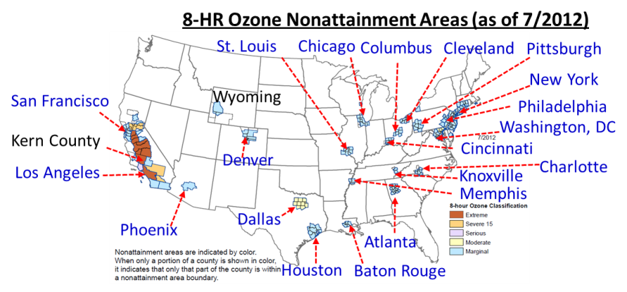
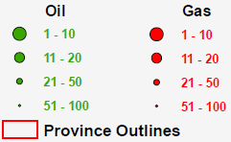
Background: Atmospheric composition changes
Emissions from oil/gas production can influence atmospheric composition.
Locations in Western U.S. of 100 U.S. Oil & Gas Fields by 2009 Proved Reserves
Oil
Gas
Upper Green River
Basin, Wyoming
Kern County,
California
(Source: http://www.eia.gov/oil_gas/rpd/topfields.pdf)

Slide 7
Background: Chemical composition matters
Different compounds react differently and have different impact on ozone formation (Carter, 1994, 2010a).
Atmospheric composition data are useful for judging which compounds need more attention.
Temporal and spatial differences in atmospheric composition need to be considered during development of chemical mechanisms.
St. Louis
Chicago
Columbus
Cleveland
Pittsburgh
New York
San Francisco
Wyoming
Philadelphia
Washington, DC
Kern County
Cincinnati
Denver
Charlotte
Los Angeles
Knoxville
Memphis
Phoenix
Dallas
Atlanta
Houston
Baton Rouge
(Source: http://www.epa.gov/airquality/greenbook/map/map8hr_2008.pdf)
Notes:
Annual fourth-highest daily maximum 8-hr concentration, averaged over 3 years > 0.075 ppm (parts per million in volume)?
(http://www.epa.gov/air/criteria.html; http://www.epa.gov/airquality/greenbook/map/map8hr_2008.pdf (7/2012))

Slide 8
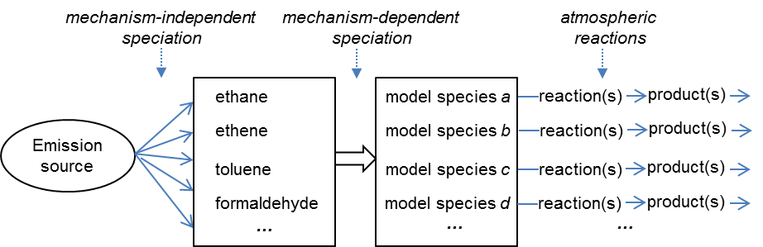
Speciation of emissions for air quality modeling
Mapping of emissions into model-ready emissions:
  Step 1: Representing emissions in terms of specific compounds (e.g., emissions into 40% propane, 30% ethene, and 30% toluene)
  Step 2: Representing compounds in terms of model species (e.g., toluene by “TOL” for CB05” or by “ARO1” for SAPRC-07)
For Step 1, chemical composition data (speciation profiles) are needed (i.e., SPECIATE (U.S. EPA, 2011, http://www.epa.gov/ttnchie1/software/speciate)).
For Step 2, mechanism-dependent mapping rules are needed (e.g., see Carter, 2011, http://www.cert.ucr.edu/~carter/emitdb).

Slide 9
Accuracy of speciation profiles in SPECIATE4.3
Profiles 8750 and 8751 for gasoline exhaust emissions of pre-Tier 2* light-duty vehicles: weight fractions for 3-methyl-1-butene (~6%) and isopentane (~0.2%) are not consistent with previous tunnel and ambient measurements.
Note that maximum incremental reactivity (MIR, Carter, 2010a) values for 3-methyl-1-butene and isopentane are 6.99 and 1.45 gO₃/gVOC, respectively.
*Tier 2 standards had been phased in from 2004 to 2009 (http://www.epa.gov/otaq/standards/light-duty/tier2stds.htm). The average age of light-duty vehicles in operation in the U.S. in 2011 was 10.8 years (Polk, 2012, https://www.polk.com/company/news/average_age_of_vehicles_reaches_record_high_according_to_polk).
8750 (for reformulated gasoline)
8751 (for E10 ethanol gasoline)
Notes:
Federal (National) "Tier 1" regulations went into effect starting in 1994, and "Tier 2" standards are being phased in from 2004 to 2009.
http://www.epa.gov/otaq/standards.htm: The Tier 2 Program sets the standards for tailpipe emissions for all passenger vehicles, including sport utility vehicles (SUVs, minivans, vans, and pick-up trucks, beginning in 2004. The Tier 2 Program also requires reduced levels of sulfur in gasoline.
The average age of cars and light trucks currently in operation in the U.S. has increased to 10.8 years, according to Polk, a leading global automotive market intelligence firm. (Polk, 2012, https://www.polk.com/company/news/average_age_of_vehicles_reaches_record_high_according_to_polk, accessed on 10/9/2012)

Slide 10
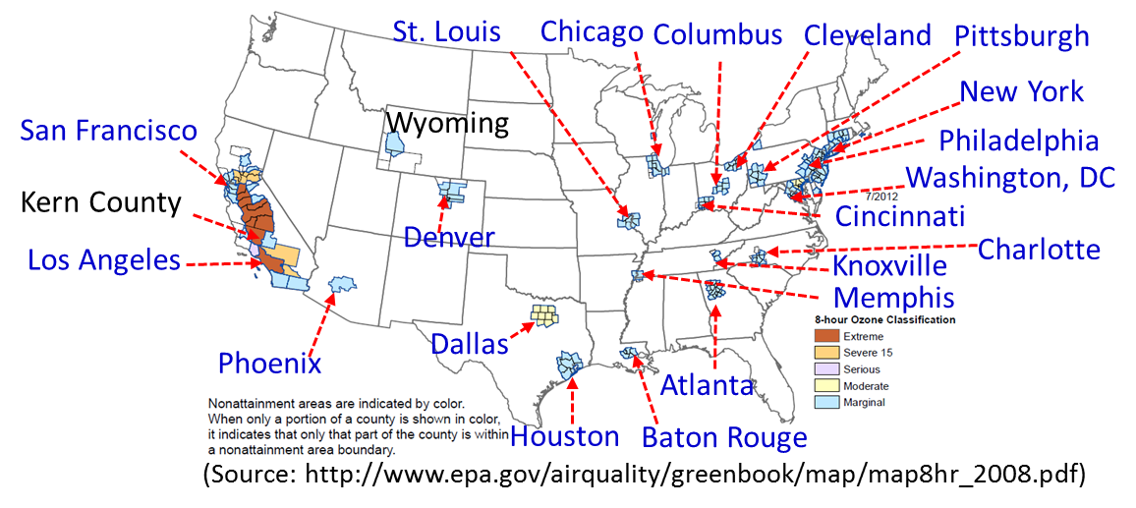
Implications on developing chemical mechanisms
Lumping strategies: Use a broader range of atmospheric chemical composition in constructing lumping rules.
Explicit species: Selectively increase the number of explicitly represented compounds (e.g., ethene in SAPRC and CB) to limit the inaccuracy in model results due to lumping with other compounds.
Optimum size for use in 3-D models
Data for mechanism evaluation: Additional mechanism evaluation data are needed to evaluate reaction parameters (e.g., for low-NOx chemistry).
Notes:
The fact that atmospheric composition can be non-negligibly changed over time and can be much different at different locations has multiple implications on developing chemical mechanisms for air quality applications.
First, mechanisms that determine lumping by assuming a typical average atmospheric composition (e.g., SAPRC) could use a broader range of atmospheric chemical composition.
Second, the number of separately represented compounds (e.g., ethene and isoprene in SAPRC and CB) can be selectively increased to limit the inaccuracy in model results due to lumping with other compounds. For example, when the reactivity is dominated by a few reactive compounds, the reactions of those compounds can be much better represented by using their own model species than by using lumped model species (Heo et al, 2010 and 2012).
Third, information on optimum size of chemical mechanisms for use in 3-D modeling needs to be obtained because using a larger chemical mechanism does not guarantee more accurate model predictions but results in extra burdens such as requiring more computational resources for preparing emissions data and model simulations.
Fourth, additional mechanism evaluation data are needed to develop chemical mechanisms that are more robust to changes in atmospheric composition caused by changes in emissions. More detailed chemical mechanisms use a larger number of reaction parameters that need to be based on well-established basic laboratory data, reliable theoretical data or environmental chamber data produced under well-controlled and atmospherically-relevant experimental conditions.

Slide 11

Proposed approach to developing chemical mechanisms
Examining the relative importance of different compounds
Representing relatively important compounds
Representing less important compounds
Evaluating mechanisms with experimental data
Year 2000 population density:
Image by Robert Simmon, NASA's Earth Observatory
(http://neo.sci.gsfc.nasa.gov)
Notes:
In this section, we will propose an approach to developing chemical mechanisms whose ozone predictions are relatively more robust to changes in atmospheric composition.
“Which compounds deserve relatively more detailed representation in a chemical mechanism?” is a complicated question because atmospheric composition temporally and spatially changes and the relative importance of different compounds is also variable. However, atmospheric abundance and reactivity can be used in ranking compounds.
-Speciated ambient VOC measurements are useful for this, and
-emission inventories evaluated against ambient measurements and speciation profiles such as those of SPECIATE (U.S. EPA, 2011) are also valuable to judging which compounds need more attention.
-Kinetic and mechanistic information (e.g., IUPAC, 2012; NASA/JPL, 2012) should be useful in ranking the relative importance of different compounds as well;
-relevant reactivity scales such as the MIR scale (Carter, 1994, 2010a) can be also useful.
In assessing the relative importance of compounds emitted from emission sources, the variability of emissions needs to be considered.
For example, industrial alkene emissions in southeast Texas tend to be highly variable in emission strength and timing (Webster et al, 2007).
For regions with emission sources that are highly variable enough to significantly increase atmospheric reactivity, major components of such emissions may need to be treated as relatively important compounds.
==
The reactions of relatively important compounds can be best described by representing those compounds explicitly by their own model species.
The reaction products can be represented by explicit model species (e.g., HCHO in SAPRC-07 for formaldehyde) or lumped model species (e.g., RCHO in SAPRC-07 for C3+ aldehydes).
For example, adding just one additional species to explicitly represent propene and using the reactions of that explicit model species resulted in ozone predictions that were more robust to changes in the propene concentration (Heo et al., 2010, 2012).
Note that the toxics version of SAPRC-07, SAPRC-07T (Hutzell et al, 2012), uses model species to explicitly represent propene, 1,3-butadiene, alpha-pinene, toluene, o/p/m-xylene, 1,2,4-trimethylbenzene and ethanol as well as ethene, isoprene, benzene and acetylene that are explicitly represented in the standard condensed version of SAPRC-07 (Carter, 2010c).
-
Lumped model species can be used to represent multiple compounds whose atmospheric reactions are kinetically and mechanistically similar to each other. Lumped model species can be used to represent numerous compounds (i.e., various alkanes) that are emitted in a relatively small amount and/or have low reactivity.
The reactions of relatively less important compounds can be represented by using these lumped model species so that the size of the chemical mechanism can be constrained and suitable for use in 3-D models.
-
Chemical mechanisms developed for use in 3-D air quality models need to perform well under targeted atmospheric conditions. However, evaluating chemical mechanisms under ambient conditions by carrying out 3-D air quality modeling is confounded by other factors such as emissions and meteorology. Uncertainties and errors in emissions and meteorology data can mislead modelers in evaluating the performance of a chemical mechanism.
Therefore, evaluating chemical mechanisms with experimental data before incorporation into 3-D models is a useful approach to evaluating chemical mechanisms while focusing on chemistry and minimizing the impact of uncertainties in emissions and meteorology.
Environmental chamber data produced under well-characterized and well-controlled conditions can be useful in evaluating mechanisms (Dodge, 2000; Carter et al, 2005). Chamber experiments for mechanism evaluation should be carried out by using atmospherically relevant experimental conditions whenever possible. Emission controls have lowered NOx (NO and NO2) concentrations in most areas in the U.S. Therefore, as noted by Carter et al (2005), chamber experimental data produced by using lower initial NOx concentrations than previously used need to be expanded, particularly for evaluating mechanisms for aromatics such as toluene and ethylbenzene (Carter et al, 2005; Carter, 2010a, Whitten et al, 2010).
Detailed field measurement data can be useful to evaluate mechanisms with constrained box modeling, and can also be used to challenge assumptions that are used during mechanism development but are not fully tested by evaluation using environmental chamber data. Rigorous mechanism evaluation using experimental data will contribute to producing evidence of the credibility of chemical mechanisms used in air quality models.

Slide 12
Proposed approach to developing chemical mechanisms
Examining the relative importance of different compounds:
  Atmospheric abundance and reactivity can be used in ranking compounds.
  Available useful data:
    Speciated ambient VOC measurements
    Emission inventories evaluated against ambient measurements
    Speciation profiles such as those of SPECIATE (U.S. EPA, 2011)
    Kinetic and mechanistic information (e.g., IUPAC and NASA/JPL evaluations)
    Relevant reactivity scales such as the MIR scale (Carter, 1994, 2010a).
  For emission sources that are highly variable enough to significantly increase atmospheric reactivity (e.g, Webster et al, 2007, Atmos. Environ., 41, 9580-9593), major components of such emissions may need to be treated as relatively important compounds.
    Industrial upset emissions (e.g., from refineries and chemical plants)
    Industrial fugitive emissions (e.g., emissions due to leaks)

Slide 13
Proposed approach to developing chemical mechanisms
Representing relatively important compounds:
  The reactions of relatively important compounds can be best described by representing those compounds explicitly by their own model species (e.g., Heo et al, 2010, 2012).
  The reaction products can be represented by explicit model species (e.g., HCHO in SAPRC-07 for formaldehyde) or lumped model species (e.g., RCHO in SAPRC-07 for C3+ aldehydes).
  Note that SAPRC-07T (the toxics version of SAPRC-07, Hutzell et al, 2012) and CB6 (Yarwood et al, 2010) use more explicit species compared to SAPRC-07 and CB05, respectively.

Slide 14
Proposed approach to developing chemical mechanisms
Representing less important compounds:
How the size of the chemical mechanism can be constrained to be suitable for use in 3-D models?
The reactions of relatively less important compounds can be represented by using lumped model species.
Lumped model species can be used to represent multiple compounds whose atmospheric reactions are kinetically and mechanistically similar to each other.
Lumped model species can be used to represent numerous compounds (i.e., various alkanes) that are emitted in relatively small amounts and/or have low reactivity.

Slide 15
Proposed approach to developing chemical mechanisms
Evaluating mechanisms with experimental data:
Evaluating chemical mechanisms with experimental data before incorporation into 3-D models is a useful approach to evaluating the predictive capability of chemical mechanisms while focusing on chemistry and minimizing the impact of uncertainties in emissions and meteorology.
Environmental chamber data produced under well-characterized and well-controlled conditions can be useful in evaluating mechanisms (Dodge, 2000; Carter et al, 2005).
Chamber experimental data produced by using low initial NOx concentrations (e.g., < 100 ppb) need to be expanded, particularly for evaluating mechanisms for aromatics (Carter et al, 2005; Carter, 2010a, Whitten et al, 2010).
Detailed field measurement data can also be useful to evaluate mechanisms with constrained box modeling.

Slide 16
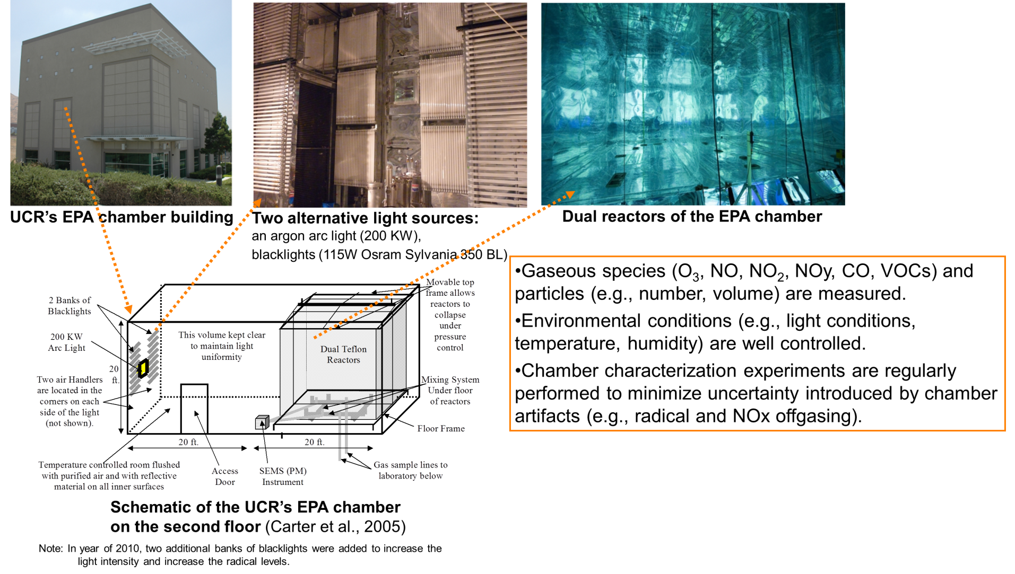
UCR EPA chamber
The UCR EPA chamber was designed to carry out chamber experiments for studying ozone and secondary organic aerosol formation at lower pollutant levels (Carter et al, 2005, Atmos. Environ., 39, 7768-7788).

Slide 17
Summary
Atmospheric composition is not constant and changes temporally and spatially.
Proposed approach to developing chemical mechanisms:
  Examine the relative importance of different compounds.
  More explicitly represent relatively important compounds.
  Represent less important compounds with lumped species to constrain the size of the chemical mechanism.
  Evaluate mechanisms with experimental data.
Notes:
In this section, we will propose an approach to developing chemical mechanisms whose ozone predictions are relatively more robust to changes in atmospheric composition.
“Which compounds deserve relatively more detailed representation in a chemical mechanism?” is a complicated question because atmospheric composition temporally and spatially changes and the relative importance of different compounds is also variable. However, atmospheric abundance and reactivity can be used in ranking compounds.
-Speciated ambient VOC measurements are useful for this, and
-emission inventories evaluated against ambient measurements and speciation profiles such as those of SPECIATE (U.S. EPA, 2011) are also valuable to judging which compounds need more attention.
-Kinetic and mechanistic information (e.g., IUPAC, 2012; NASA/JPL, 2012) should be useful in ranking the relative importance of different compounds as well;
-relevant reactivity scales such as the MIR scale (Carter, 1994, 2010a) can be also useful.
In assessing the relative importance of compounds emitted from emission sources, the variability of emissions needs to be considered.
For example, industrial alkene emissions in southeast Texas tend to be highly variable in emission strength and timing (Webster et al, 2007).
For regions with emission sources that are highly variable enough to significantly increase atmospheric reactivity, major components of such emissions may need to be treated as relatively important compounds.
==
The reactions of relatively important compounds can be best described by representing those compounds explicitly by their own model species.
The reaction products can be represented by explicit model species (e.g., HCHO in SAPRC-07 for formaldehyde) or lumped model species (e.g., RCHO in SAPRC-07 for C3+ aldehydes).
For example, adding just one additional species to explicitly represent propene and using the reactions of that explicit model species resulted in ozone predictions that were more robust to changes in the propene concentration (Heo et al., 2010, 2012).
Note that the toxics version of SAPRC-07, SAPRC-07T (Hutzell et al, 2012), uses model species to explicitly represent propene, 1,3-butadiene, alpha-pinene, toluene, o/p/m-xylene, 1,2,4-trimethylbenzene and ethanol as well as ethene, isoprene, benzene and acetylene that are explicitly represented in the standard condensed version of SAPRC-07 (Carter, 2010c).
-
Lumped model species can be used to represent multiple compounds whose atmospheric reactions are kinetically and mechanistically similar to each other. Lumped model species can be used to represent numerous compounds (i.e., various alkanes) that are emitted in a relatively small amount and/or have low reactivity.
The reactions of relatively less important compounds can be represented by using these lumped model species so that the size of the chemical mechanism can be constrained and suitable for use in 3-D models.
-
Chemical mechanisms developed for use in 3-D air quality models need to perform well under targeted atmospheric conditions. However, evaluating chemical mechanisms under ambient conditions by carrying out 3-D air quality modeling is confounded by other factors such as emissions and meteorology. Uncertainties and errors in emissions and meteorology data can mislead modelers in evaluating the performance of a chemical mechanism.
Therefore, evaluating chemical mechanisms with experimental data before incorporation into 3-D models is a useful approach to evaluating chemical mechanisms while focusing on chemistry and minimizing the impact of uncertainties in emissions and meteorology.
Environmental chamber data produced under well-characterized and well-controlled conditions can be useful in evaluating mechanisms (Dodge, 2000; Carter et al, 2005). Chamber experiments for mechanism evaluation should be carried out by using atmospherically relevant experimental conditions whenever possible. Emission controls have lowered NOx (NO and NO2) concentrations in most areas in the U.S. Therefore, as noted by Carter et al (2005), chamber experimental data produced by using lower initial NOx concentrations than previously used need to be expanded, particularly for evaluating mechanisms for aromatics such as toluene and ethylbenzene (Carter et al, 2005; Carter, 2010a, Whitten et al, 2010).
Detailed field measurement data can be useful to evaluate mechanisms with constrained box modeling, and can also be used to challenge assumptions that are used during mechanism development but are not fully tested by evaluation using environmental chamber data. Rigorous mechanism evaluation using experimental data will contribute to producing evidence of the credibility of chemical mechanisms used in air quality models.

Slide 18
Acknowledgements
Previous and current funding and collaboration for developing and evaluating the SAPRC and Carbon Bond chemical mechanisms.
Lee Beck, Ying Hsu and Catherine Yanca for discussions on SPECIATE4.3 profiles.
Heather Simon for providing further information related to a paper on SPECIATE, Simon et al (2010; Atmospheric Pollution Research 1, 196‐206, http://www.atmospolres.com/articles/Volume1/issue4/APR-10-026.pdf).
Center for Environmental Research and Technology, University of California, Riverside (http://www.cert.ucr.edu/) for support for travel of G. Heo.

Slide 19
Extra slides

Slide 20
2008 8-Hour Ozone Classifications
Extreme: Area has a design value of 0.175 ppm and above.
Severe 17: Area has a design value of 0.119 up to but not including 0.175 ppm
Severe 15: Area has a design value of 0.113 up to but not including 0.119 ppm
Serious: Area has a design value of 0.100 up to but not including 0.113 ppm.
Moderate: Area has a design value of 0.086 up to but not including 0.100 ppm.
Marginal: Area has a design value of 0.076 up to but not including 0.086 ppm.
*Note: The ozone design value is the annual fourth-highest daily maximum 8-hour ozone concentration, expressed in parts per million, averaged over three years
Sources: http://www.epa.gov/airquality/greenbook/define.html#Ozone2008Classifications;
http://www.epa.gov/airtrends/pdfs/Clarification_on_ozone_dvs.pdf

Slide 21
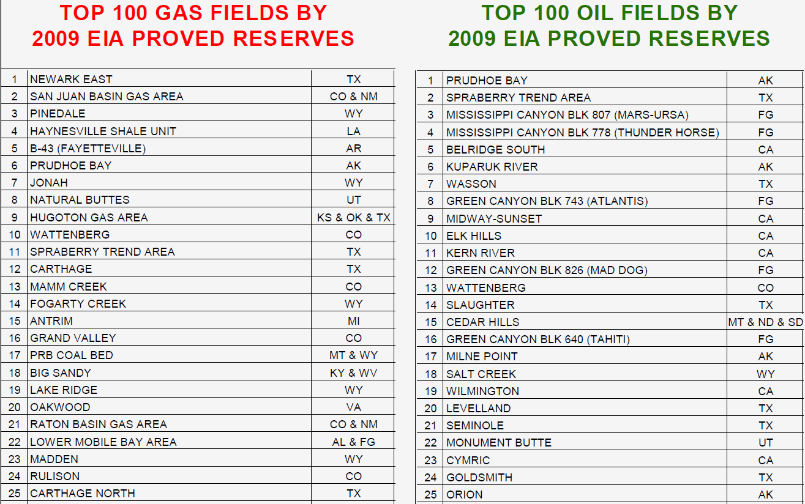
Top 25 gas and oil fields
(Source: http://www.eia.gov/oil_gas/rpd/topfields.pdf)

Slide 22
Average age of light-duty vehicles in operation in the U.S.
Source: Polk, 2012, note that figures are from July 1 each year;
https://www.polk.com/company/news/average_age_of_vehicles_reaches_record_high_according_to_polk, accessed on 10/9/2012.

